Slide 1
Programming by a Sample: Rapidly Creating Web Applications with d.mix
Björn Hartmann, Leslie Wu
Kevin Collins, Scott R. Klemmer
UIST · 10 October 2007
Notes:
Good morning, my name is Bjoern Hartmann and this is Leslie Wu. Today we are presenting our work on authoring tools for the web at the Stanford HCI group.
This work is advised by Prof. Scott Klemmer and jointly carried out with Kevin Collins.

Slide 2
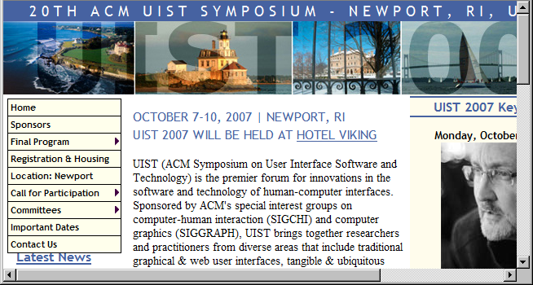
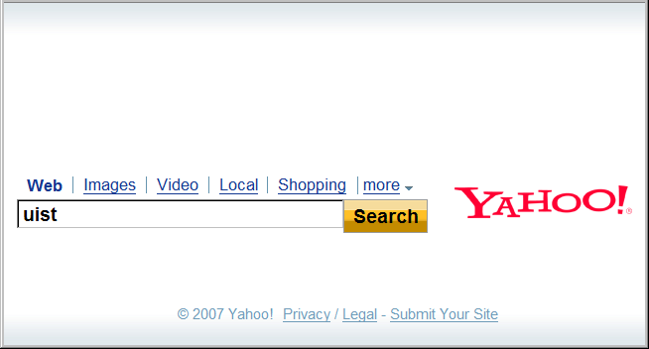
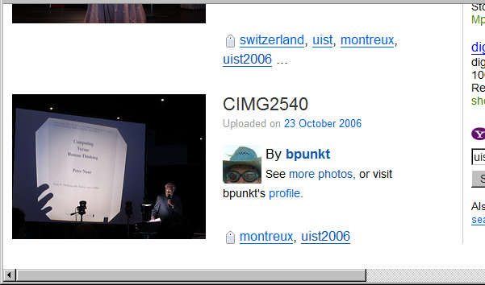
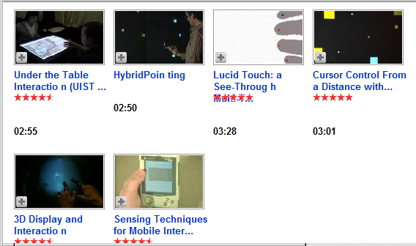
How would you share UIST highlights with colleagues back home?
Notes:
Let me start with a question: how would you share this year’s UIST highlights with colleagues back home who could not attend?
At your next meeting you may first open the conference web page to project the conference program. Then maybe search for authors’ home pages to get more information. You may then go to a photo site to find other attendee’s images they tagged with uist.
And then show some videos people took at the demo reception two days ago.
In short, you may do it by browsing the web.

Slide 3
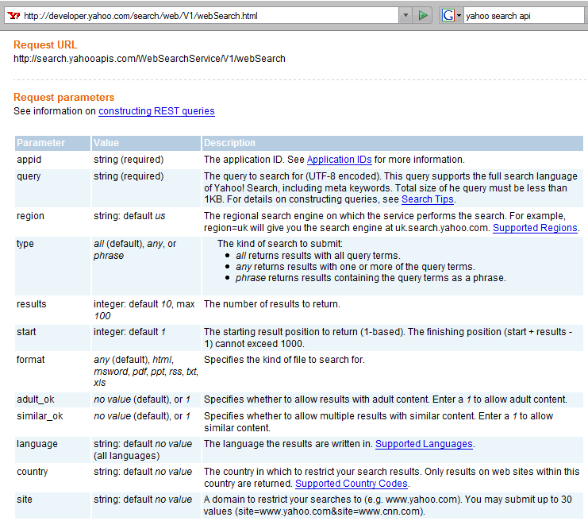
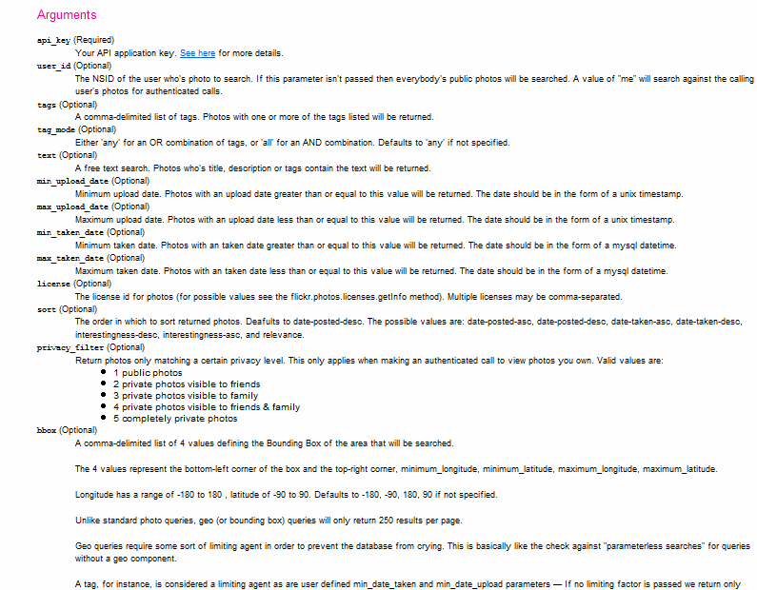
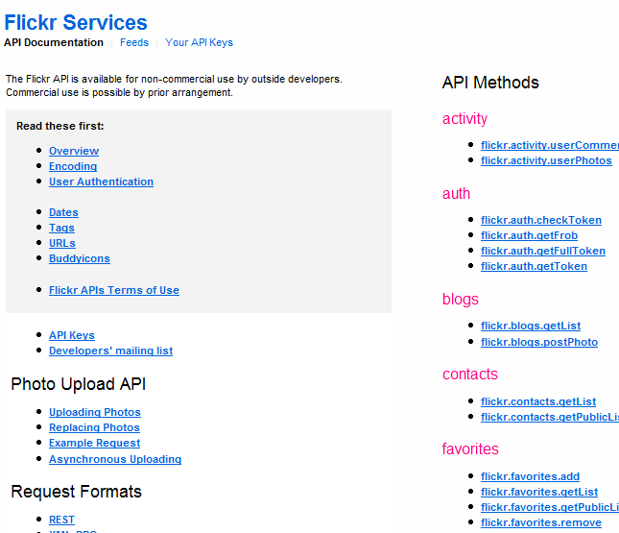
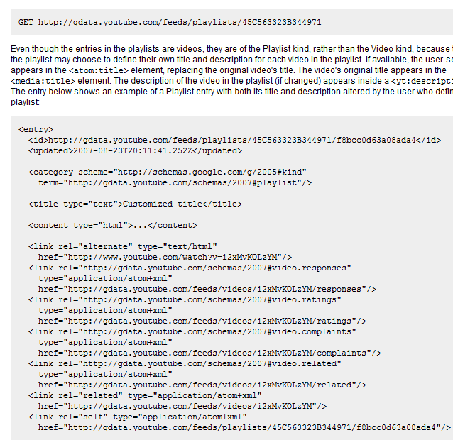
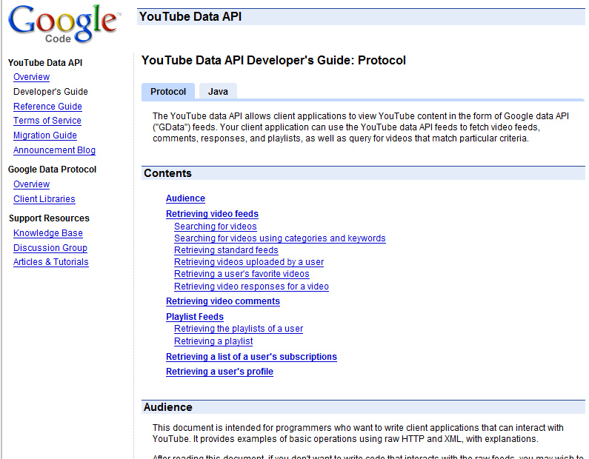
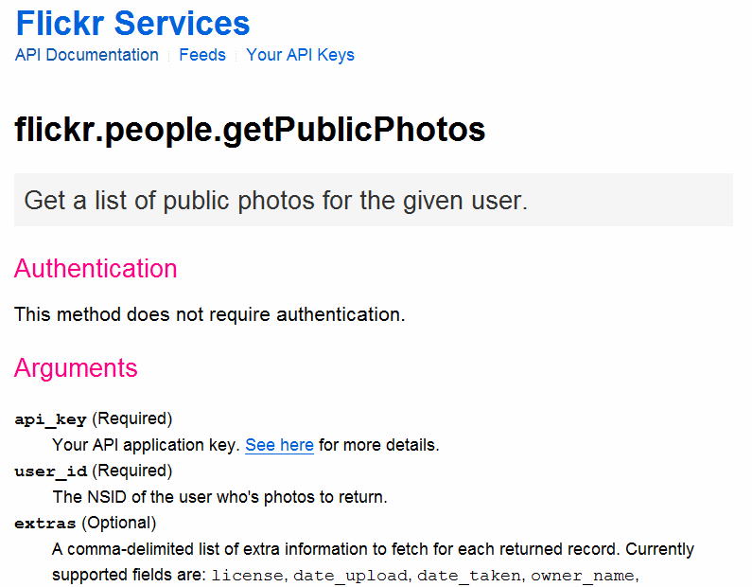
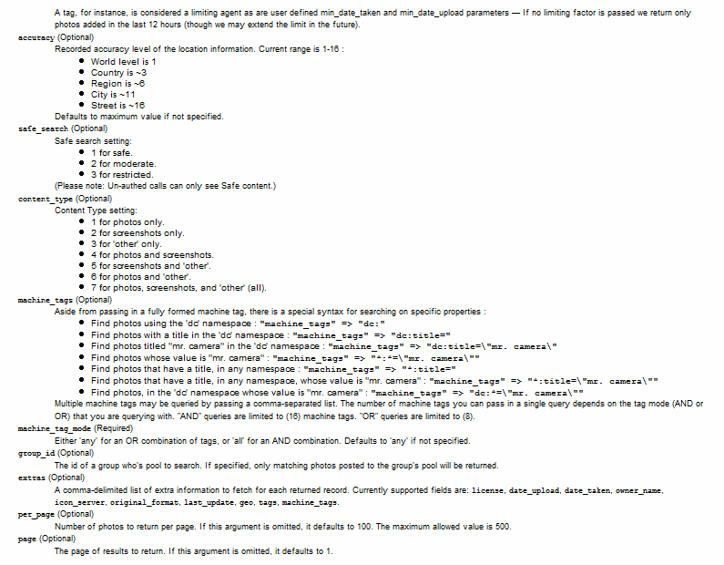
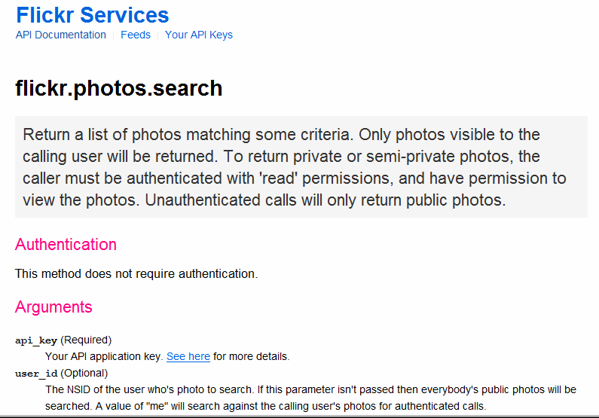
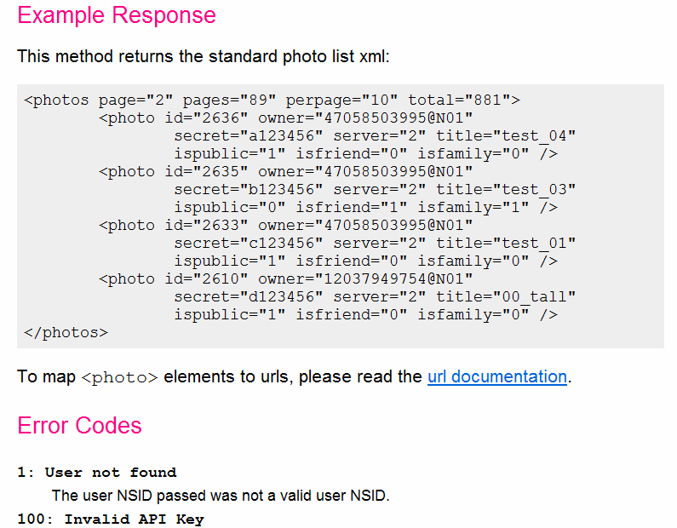
How would you retrieve the same data programmatically?
It’s easy to understand the sites, but not the services.
Notes:
What would you do if you wanted to write a web application that queries the same data? This is possible, all of the sites offer web service APIs.
You would probably have to get some information on the web search api first.
And the photo site’s API, and hmm, those look nothing alike.
You’ll probably go down some blind alleys before finding the right function; but what’s the right set of arguments?
And then you’d repeat those steps for the video search site.
One frustrating problem of programming the web today is that programming models and documentation conventions vary widely – there is no global type hierarchy to rely on, and there is no javadoc for web services.
So while it’s easy to understand the web sites, it is much harder to understand their services.

Slide 4
Notes:
PAUSE
Understanding API structure is only half the task. Most existing tools implicitly assume that developers start with a clean slate, and then type their program.
However, this is not how casual programming happens in practice.
“Programming by Example modification" is a successful alternative because examples situate code snippets in a functioning system. However, since search for examples happens in the domain of source code – api packages, function names, etc. users are faced with a large gulf of execution to translate their goals into system steps.

Slide 5
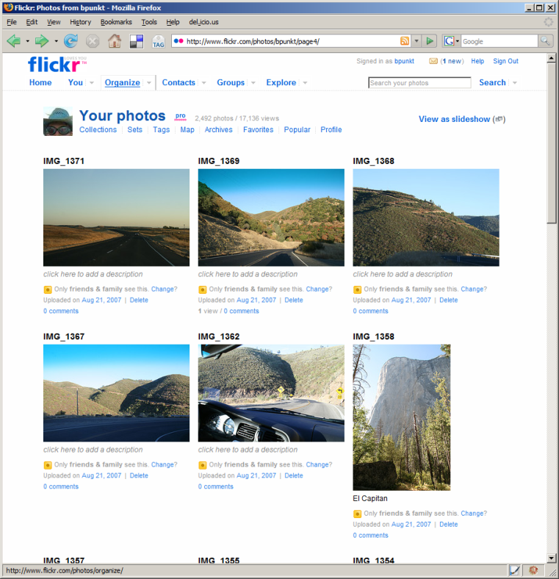
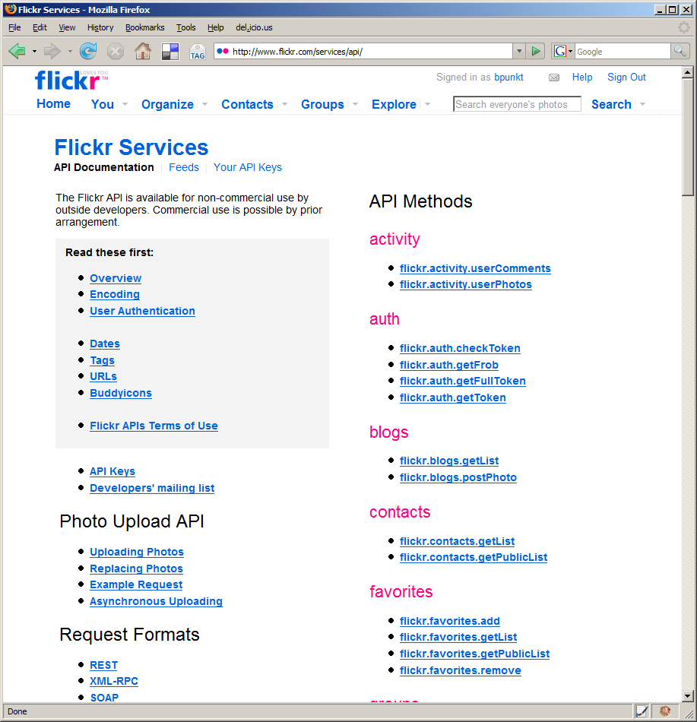
Web sites and their APIs are correlated…
≈
…let’s leverage that fact!
[flickr.com]
Notes:
To bridge this chasm, we note that web sites and their APIs are correlated.
For example, I can both look at the set of images taken on my last trip to Yosemite on the flickr website, AND I can retrieve the same set of images by calling an appropriate method in the flickr API.
The site and its API offer complementary views of the same underlying functionality.
In essence, the web site is the largest functional example of what can be accomplished with an API.
Our present work seeks to leverage the value that can be achieved by coordinating these representations.

Slide 6
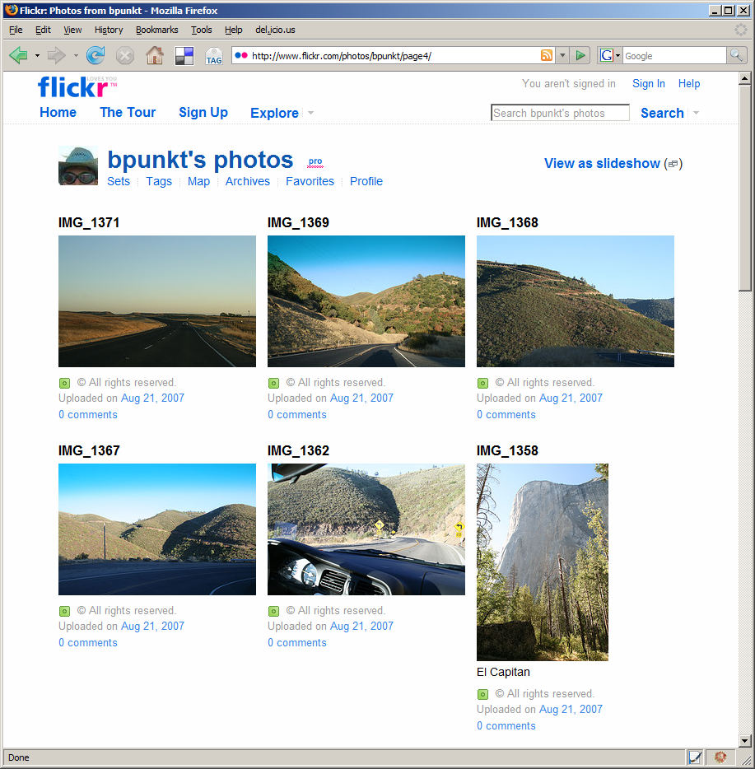
Give me the code for this!
Notes:
d.mix models the correspondence between html pages and api calls to let users create program code by sampling content from a web page. (space)
It co-locates two different kinds of information on one page: examples of what functionality a web
site offers,

Slide 7
To retrieve this image, use:
flickr.photos.getInfo( user_id = '73866493@N00', photo_id= ‘3208312’)
Notes:
together with information how one would obtain this information programmatically.
With d.mix. users can generate working code examples by selecting the information on the web site itself.
This selection technique allows users to remain in the domain of their task goal, in this case retrieving images.

Slide 8
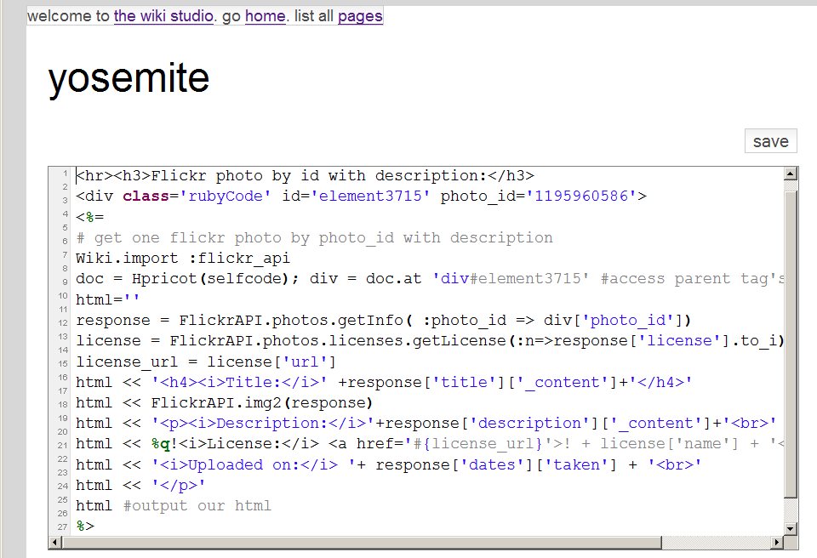
d.mix active wiki
Source code generated by d.mix
Rendered Page
is executed in the active wiki
Notes:
The source code generated through sampling with d.mix
Can then be copied to an active wiki, a server-side code environment, where it can be edited and safely executed. (click) The
active wiki provides a configuration-free environment for
rapid experimentation.

Slide 9
Scenario
Notes:
This scenario will clarify the main interaction techniques of d.mix:
A group of rock climbers would like to create a photo page for the group,

Slide 10
Notes:
Which should always show the latest iamges from the groups’ trips without requiring manual updates.

Slide 11
Notes:
Drew keeps his images on Flikckr where he aggregates them in an image set.
Jane begins by navigating to drew’s flickr page and clicks on the “sample this” button in her browser.
The page now shows dashed borders around items she can retrieve through the site’s API.
By right-clicking she can copy drew’s climbing image set into her sampling bin.
From the sampling bin, she sends selected items to the d.mix active wiki.
Because d.mix performed a deep copy of the images by generating web API calls,
Jane can edit parameters of those calls through a property sheet.
Here she sets that only the two most recent images for one of the image sets should be returned.
Jane can also change the source code that d.mix generated for her.
In the source view, she can add static HTML to the page or edit the web API calls made to retrieve images from flickr.

Slide 12
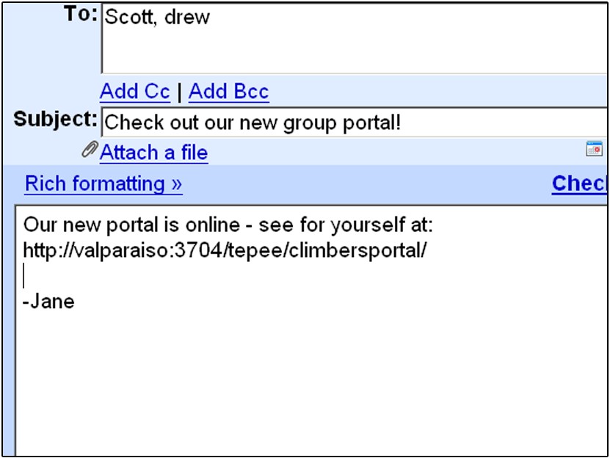
Notes:
When Jane is satisfied with the rendered view of her page, she can share the URL of the page she created with her group members.

Slide 13
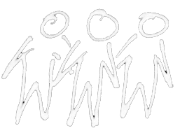
d.mix users
Site owners or lead users define mappings between sites and services (once).
Lead Users
Web Developers
End Users
Notes:
There are several classes of users that work with d.mix.
First, lead users manually establish the correlation between sites and their services.
Alternatively, webmasters at sites such as Flickr, Yahoo, or Amazon.com could easily provide such mappings.

Slide 14
Web developers create d.mix applications
Lead Users
Web Developers
End Users
Notes:
After a small number of lead users author these mappings, many more web developers can create applications in d.mix and quickly prototype web-based mashups.

Slide 15
End-users run (and tailor) applications
in the d.mix wiki.
Lead Users
Web Developers
End Users
Notes:
Finally, end-users can run applications written in d.mix, by visiting them from any browser.
End-users can also tailor applications created in d.mix, by copy and pasting code from one d.mix wiki page to another.

Slide 16
d.mix Proxy Architecture
Rewritten page
with API annotations
Original Page
Proxy Server
Site-to-Service Map
(hosted on d.mix wiki)
Notes:
This diagram describes the d.mix architecture for sampling content from web pages.
d.mix uses a programmable HTTP proxy that rewrites the original web site, adding API annotations. Each API annotation contains an associated snippet of code that generates a working web service call in the Ruby programming language.
The programmable proxy knows how to annotate web pages by using the site-to-service map. (space) This map defines the correspondence between web sites and their associated web services.

Slide 17
Authoring the Site-to-Service Map …Without Help From the Site Owner
1 Map URL to Page Type
2 Identify visual elements in page to annotate (using XPath/CSS selectors)
3 Extract arguments for service calls from page source
Bind arguments to web service code snippet
Notes:
How does a 3rd party developer author a site-to-service map? (space)
First, a developer maps web page URLs to web “page types”. (space)
For any given “page type”, a developer defines a combination of XPath and CSS selectors that identify the visual elements to be annotated (space)
They then define selectors that infer web service arguments given the markup on a page. (space)
Finally, these arguments are bound to a web service code snippet
Note that it is easier for site owners to provide this mapping, as they do not need to infer these relationships programmatically through scraping. We hope that in the future, site owners will provide such site-to-service mappings for the larger web developer community.

Slide 18
Why Not Just Scrape?
Scraping at design-time rather than at run-time minimizes brittleness
Web service calls can be parameterized
Scraping at run-time can lead to lock-out
Notes:
So why not rely solely on scraping, without trying to generate web service code?
(space) Web site content and markup change quickly. Thus, programs based on scraped content can be brittle.
In contrast, web service APIs are often frozen. Since applications are authored once, but executed many more times, scraping once at “application design time” is preferable to scraping at execution time.
(space)
Furthermore, web service calls can be meaningfully parameterized by changing the arguments used to call them. This is not possible with scraped content.
(space)
Finally, scraping may not scale. Many sites monitor their traffic and actively lock out clients that request a large number of pages in a short amount of time.

Slide 19
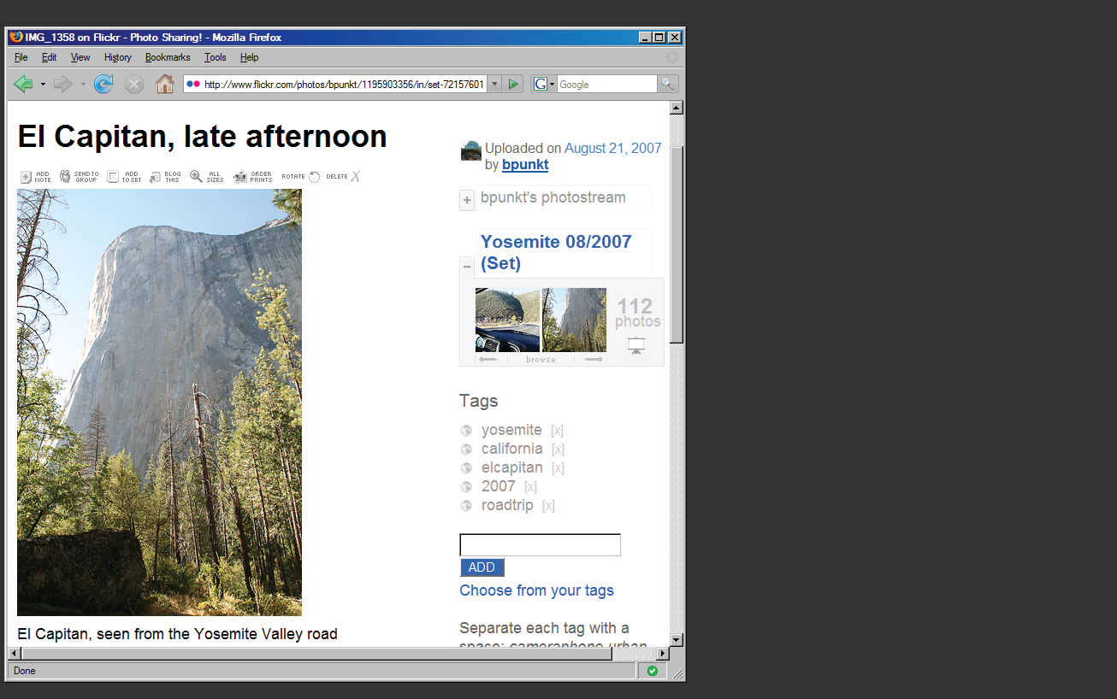
Notes:
Let me illustrate the process of creating a site-to-service map with a concrete example.
Here is a single photo page from flickr.com.

Slide 20
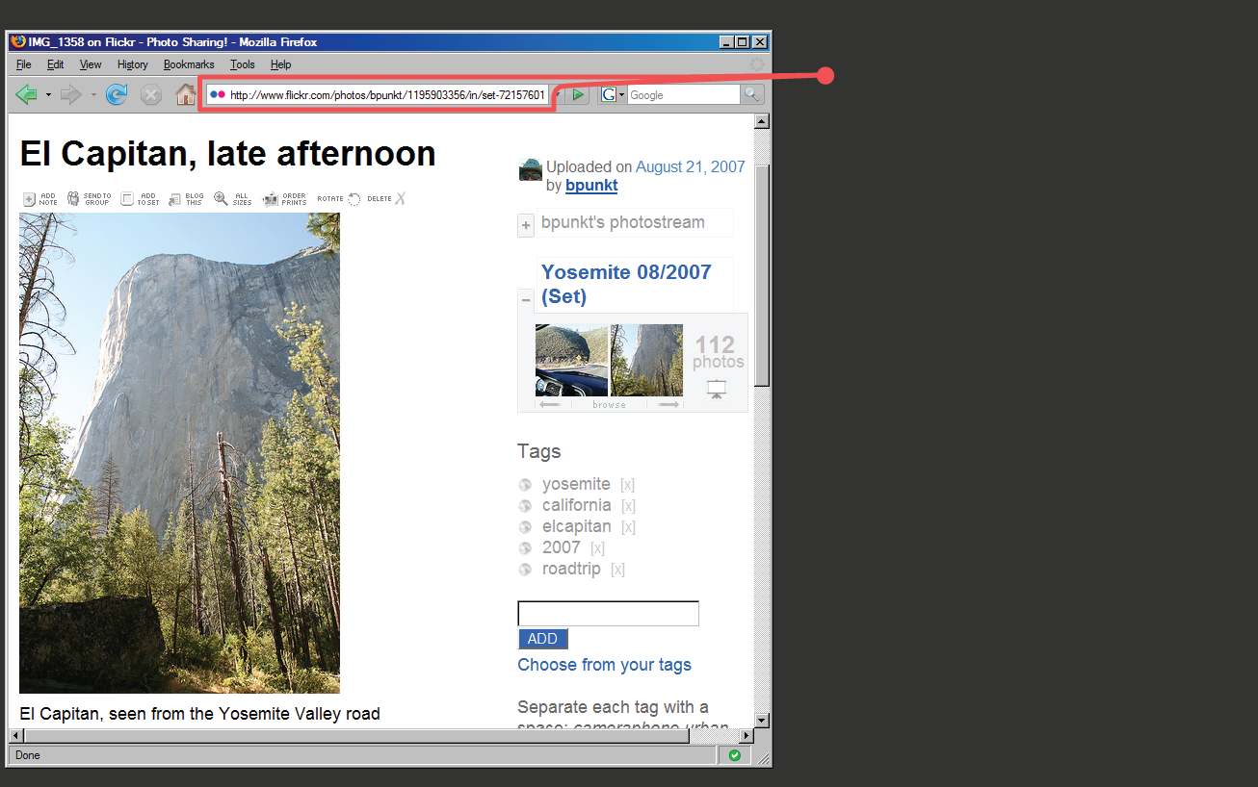
Page URL:
flickr.com/ photos/ <username>/
<photoid>/…
Regular Expression:
%r{flickr.com//?photos/ [^/]+/\d+/?&script}
Notes:
First, we note that photo pages have a consistent URL structure.
Thus, we can define a regular expression that detects similar photo pages,
And a set of expressions that furthermore classify pages into distinct page “types”.

Slide 21
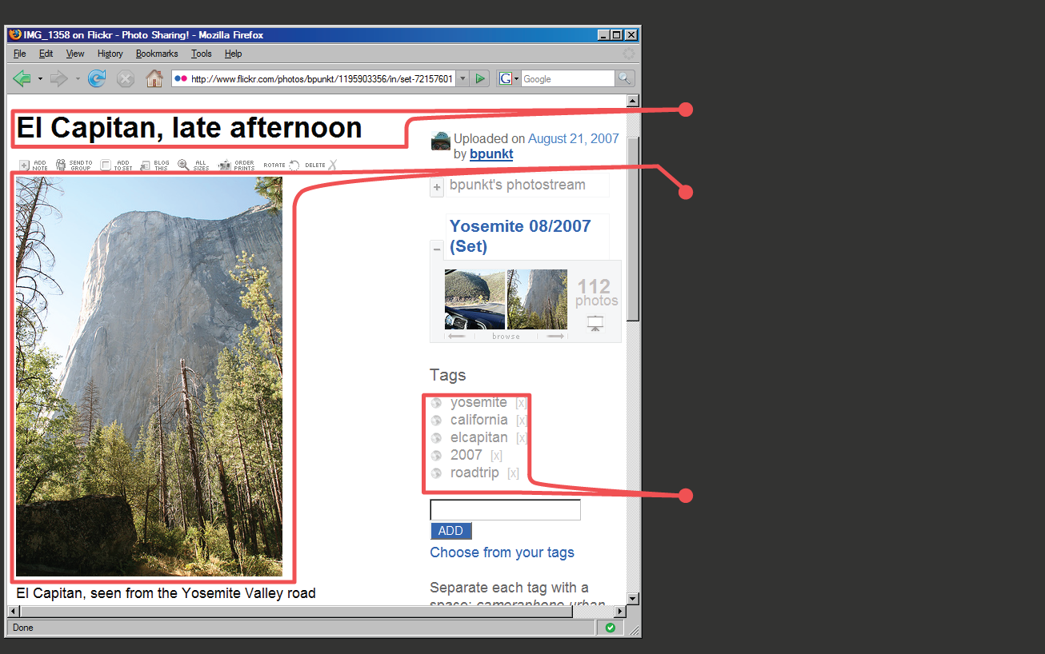
Photo Title
Image URL
Tag Search
Notes:
Here are three items of interest: a photo’s title, the URL for an image, and a way to run a tag search (SPACE, SPACE)

Slide 22
Photo Title
(doc/"#title_div")
Image URL
(doc/"div.photoImgDiv")
Tag Search
(doc/"div.TagList")
Notes:
Each of these items can be accessed by searching the DOM, the document object model.
d.mix uses a combination of CSS and XPath selectors to identify elements, highlight them, and add a context-menu handler to each element.
For any given item on the page, there may be multiple matching web service calls that return that element. For example (SPACE), one can either sample “the first image in a photo set” or “this particular image”. d.mix generates multiple entries in the context menu to let the user guide the generalization process.

Slide 23
flickr.photos.getInfo(
photo_id = “298655528”).title
info = flickr.photos.getInfo(
photo_id = “298655528”)
URL = “http://farm”+ info.farm-id + “.static.flickr.com/”
+ info.server-id
+ “/” + info.attributes[”id”]
+ “_”
+ info.secret
+ “.jpg”
Extracted from page source:
Within <div> for all tags:
tag=div.at("a.Plain").inner_html
flickr.photos.search(
tags = “yosemite ...”)
Notes:
The site-to-service map then specifies how to connect each of these items to a source code snippet.
For example (SPACE) to perform a tag search, one needs to pass in the appropriate tag to a specific method. These arguments are also extracted using CSS and XPath selectors.

Slide 24
Putting it all together…
def self.annotate_photopage_tags(doc)
(doc/"div").reject{…}.each do |div|
tag = div.at("a.Plain").inner_html
src = generate_tag_search_source (...)
doc.at("body").inner_html +=
make_context_menu(div.at("a.Plain"),
["Images matching tag #{tag}"],[src])
end
Notes:
Continuing this example, here is an abbreviated form of the Ruby code that defines part of the site-to-service map for Flickr.com.
To summarize, it…

Slide 25
Putting it all together…
def self.annotate_photopage_tags(doc)
(doc/"div").reject{…}.each do |div|
tag = div.at("a.Plain").inner_html
src = generate_tag_search_source (...)
doc.at("body").inner_html +=
make_context_menu(div.at("a.Plain"),
["Images matching tag #{tag}"],[src])
end
Extract tag name
Notes:
…extracts tag names

Slide 26
Putting it all together…
def self.annotate_photopage_tags(doc)
(doc/"div").reject{…}.each do |div|
tag = div.at("a.Plain").inner_html
src = generate_tag_search_source (...)
doc.at("body").inner_html +=
make_context_menu(div.at("a.Plain"),
["Images matching tag #{tag}"],[src])
end
Instantiate Source Example
Notes:
…instantiates working examples for each different tag

Slide 27
Putting it all together…
def self.annotate_photopage_tags(doc)
(doc/"div").reject{…}.each do |div|
tag = div.at("a.Plain").inner_html
src = generate_tag_search_source (...)
doc.at("body").inner_html +=
make_context_menu(div.at("a.Plain"),
["Images matching tag #{tag}"],[src])
end
Add annotation to original page
Notes:
…and adds code examples as annotations on the original page

Slide 28
Dataflow Summary
d.mix design time
sends
code to
d.mix run time
adds annotation
invokes
Web site
Web service
Notes:
After adding annotations, working code examples can be sent to the d.mix active wiki. (SPACE)
The active wiki enables quick testing and modification of generated code. (SPACE)
The code then queries the original web site programmatically.

Slide 29
Active Wiki
Wiki editor provides syntax-highlighting for Ruby script
Sandboxed execution runs script with limited capabilities
Libraries facilitate invoking web services and manipulating results
Notes:
After code is copied or appended to wiki pages, programs can be modified directly in the active wiki
(SPACE)
Programs are then run in a sandboxed execution model. For example, a program may make a web service call, but it does not have read/write access to the wiki server’s file system.
(SPACE)
The active wiki also provides libraries that faciliate calling web services and transforming the results.

Slide 30
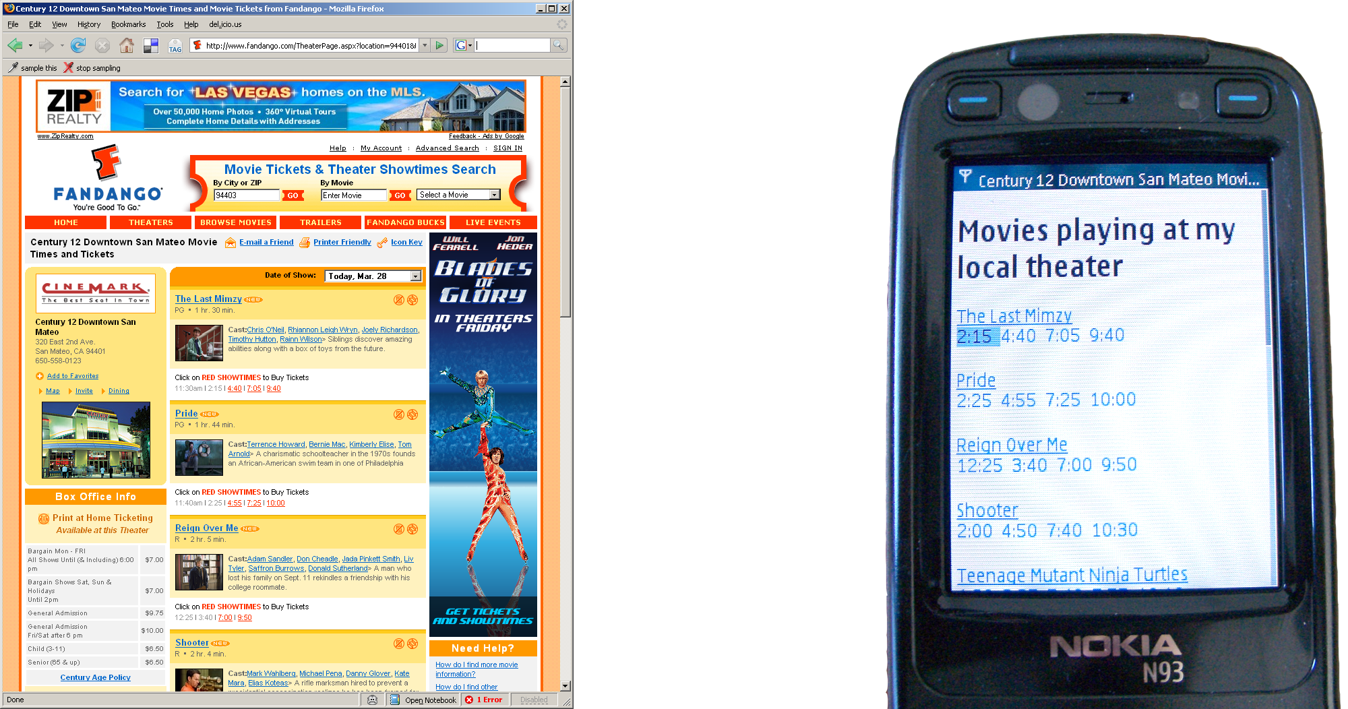
Beyond the Desktop Browser
Notes:
A proxy that can be programmed with code hosted on wiki pages is a flexible, general tool for prototyping web applications. For example, we have used the d.mix architecture to create an application that reformats web content to better fit mobile devices. It extracts only essential information — here, movie names and show times — from
a cluttered web page. This application took half an hour to build using the d.mix system.

Slide 31
What we borrowed and what we wrote
Front end
Yahoo! UI (annotation UI)
JQuery (selectors)
Back end
MouseHole (proxy)
Tepee (wiki)
Freakyfreakysandbox (safe execution)
Hpricot (selectors)
Bookmarklet
Annotation code
d.mix library
Site-to-service map
API wrappers
UI logic
Notes:
(PAUSE)
d.Mix builds on a number of freely available open source toolkits which facilitate front-end and back-end development on the web. In particular, d.mix takes an existing programmable HTTP proxy, the mouseHole, among other software, and adds logic to annotate pages and author site-to-service mappings.

Slide 32
Prototype Site-to-Service Library
API | Supported Actions | Site-to-Service map code size
 | Get images from a user’s photo stream, with or without meta data Get images from an image set Get images from individual photo pages Get images matching tags, global or per user, from tag clouds and photo pages Get images by global image id Get images from full-text search | 355 lines
 | Single web search result Web search result set | 54 lines
 | Retrieve a user’s videos Retrieve most recent videos Single search result Search result set | 115 lines
Notes:
(Switch to Bjoern here)
To evaluate the authoring approach embodied in d.mix, we wrote a prototype site-to-service library that supports three web sites and their services:
Flickr, Yahoo! web search, and the YouTube video site.
For each site, our library supports a subset of the API.
For example, the library provides methods to perform full-text and tag searches
and copy images from Flickr, but it does not support extraction of user profile information.

Slide 33
First-use Lab Study (n=8)
All participants had some programming experience, knew HTML
Four had no experience with web APIs
75 minute sessions: Demonstration, warm-up, two design tasks
Notes:
With this library, we then conducted a first-use evaluation study with eight participants, aged 25 to 46. (SPACE)
We recruited participants with some programming and web development experience,
but only half had programmed in Ruby before. (SPACE)Also, only half worked with web APIs before.
(SPACE) We first demonstrated d.mix’s interface to participants. Next, we gave them three tasks to perform.
The first task tested the overall usability of our approach:
participants were asked to find media files, send
content to the wiki, and change simple parameters of there, e.g., how many images to show from a
photo stream.

Slide 34
Total lines of code | 54
Written by participant | 13
Generated by d.mix | 41
Generated lines modified by participant | 4
Notes:
The second design task was similar to our scenario — it asked participants to create an information
dashboard for a magazine’s photography editor to track image submissions by photographers. This required
combining data from multiple users on the Flickr site and formatting the results.
This image is a solution one of our participants created. The exciting result here is that everyone successfully built web applications in a very short amount of time. (SPACE)

Slide 35
Notes:
The third task asked participants to create a meta-search engine by querying at least two different web
services and combining search results from both on a single page. This image also shows a page created in the study.
While participants were generally not familiar with the particular APIs involved in this task,
they did successfully modify the code generated by d.mix.
In addition, many leveraged their existing web design experience to add formatting commands such as CSS styles to the generated code.

Slide 36
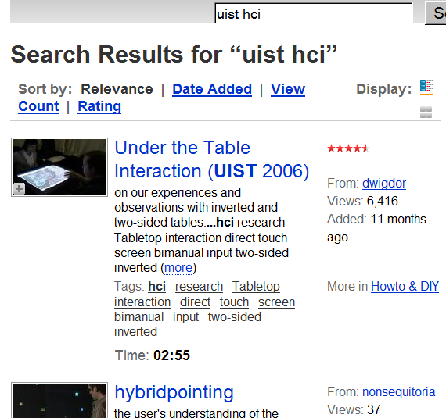
Lessons Learned
How do I know what I can sample?
?
Notes:
The user study also uncovered some important design suggestions for the future. d.mix users would first navigate to a page, then turn on annotation thorugh the sample this button.

Slide 37
Lessons Learned
How do I know what I can sample?
Notes:
However, because only some page items were supported by our limited library, participants would then discover that the desired data were not retrievable by d.mix.
A straightforward solution would be to proxy every single page request. Since annotating pages currently introduces a delay of a second or more, engineering for better performance is required to make this tractable.

Slide 38
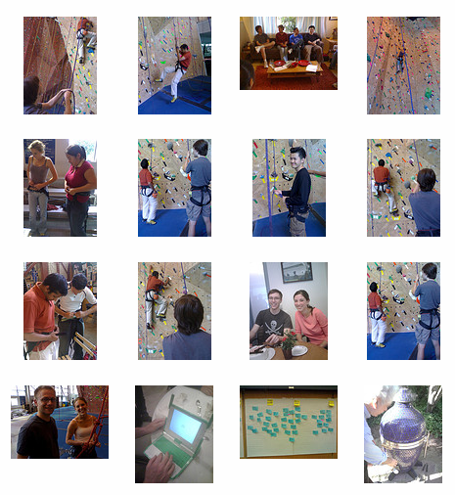
Lessons Learned
Offer multiple ways to sample information.
Sample from link to content
Sample content directly
Notes:
Some participants were also confused by two different approaches to sampling employed inconsistently:
For example, to specify a query for a set of Flickr images matching a specific tag, in d.mix, the user currently
must sample from the link to the image set, not the results.
However, to select images from a photo stream, the user must sample from the set of images itself, not the link. (SPACE)
This suggests that example-based programming tools for the web should consistently enable sampling from both the source and from the target page to support both interaction styles.

Slide 39
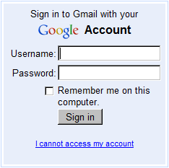
Limitations
Proxying the logged-in web is challenging
Notes:
There are also some architectural limitations of d.mix that we would like to acknowledge.
The logged-in web –, web-based email, online banking, -- relies on state maintained in the browser.
the current d.mix HTTP proxy does not handle cookies of remote sites as a client browser would.
So d.mix cannot currently sample content from the pages that require authentication beyond basic API keys.

Slide 40
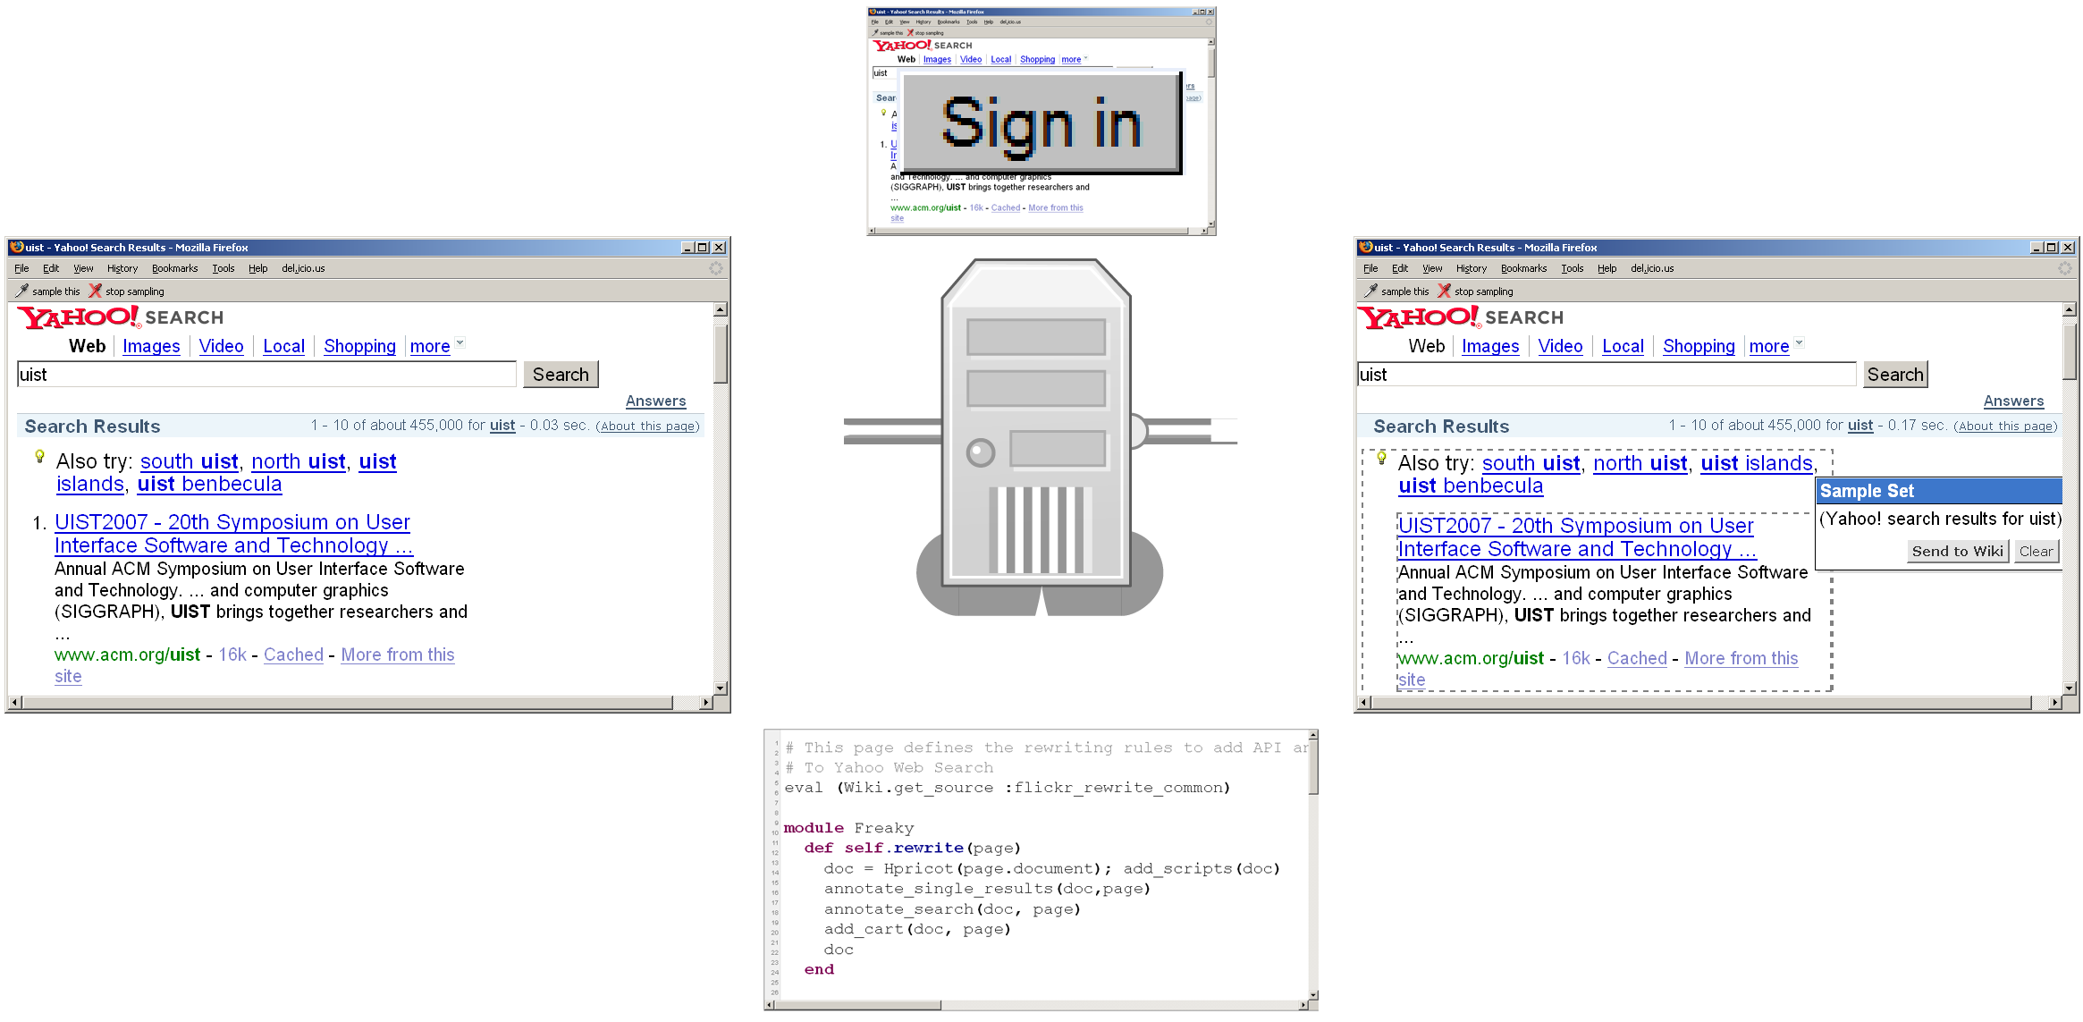
Limitations
Proxying the logged-in web is challenging
Notes:
The most promising solution to this problem is to co-locate a server-side “headless” browser (space) that can handle cookies with our proxy. We have some preliminary results that suggest this is a possible way forward.

Slide 41
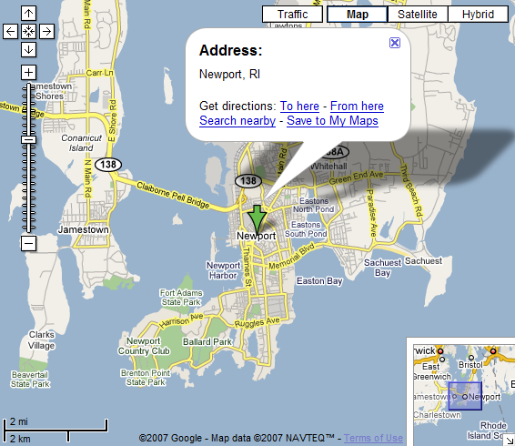
Limitations
How can one sample APIs that provide interactive widgets intead of data?
Notes:
Third, the examples we have shown focused on sampling content: photos, text, videos. Other web services offer rich interaction widgets, for example for building user interface components and for map navigation. We have not yet addressed how the principal action of selecting annotated items would extend to such services.

Slide 42
Related Work
End-user Page
Modification &
Automation
End-user PAGE
Creation
Deep
Copy & paste
Greasemonkey
Chickenfoot [Bolin, UIST2005]
Koala [Little, CHI2007]
Yahoo! Pipes
Open Kapow
Marmite [Wong, CHI2007]
IBM QEDWiki
Intel MashMaker [Ennals, SIGMOD2007]
Relations, Cards, and Search Templates [Dontcheva, UIST2007]
Citrine [Stylos, UIST2004]
WinCuts [Tan, CHI2004]
Clip, connect, clone [Fujima, UIST2004]
Hunter Gatherer [schraefel, WWW2002]
Facades [Stuerzlinger, UIST2006]
Finding API
Examples
Mica [Stylos, VL/HCC2006]
Assieme [Hoffmann, UIST2007]
Notes:
Let’s take a brief look at four areas of related work: systems for end-user modification and automation of pages within the browser;
systems that help developers find API examples on the web;
systems that allow users to create new pages or information collections;
And systems for enhanced copy and paste of structured information or higher level widgets;
In the interest of time, I will just pick three.

Slide 43
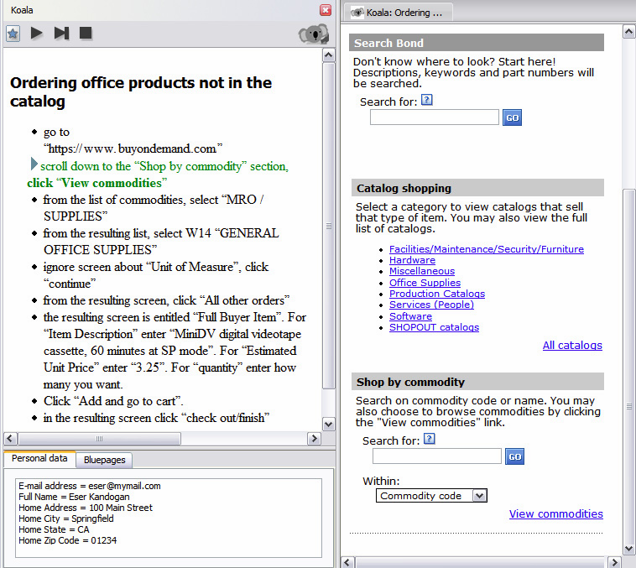
End-user Page
Modification &
Automation
Greasemonkey
Chickenfoot [Bolin, UIST2005]
Koala [Little, CHI2007]
Notes:
A good example of research concerned with browser automation is Koala.
In Koala, users compose scripts that automate browser sessions by demonstration, e.g. following links or entering form information.
d.mix shares with Koala the use of programming-
by-demonstration techniques to generate working examples.
Both systems also use the social-
software mechanism of sharing scripts server-side on a
wiki page.
d.mix distinguishes itself in two important
ways. First, Koala shields users from the underlying representation.
d.mix uses visual representations when they are expedient, yet also provides
access to source code.
Second, Koala and similar systems focus on automating web
browsing and changing web pages solely through the DOM — they do not interact with web service APIs
directly.

Slide 44
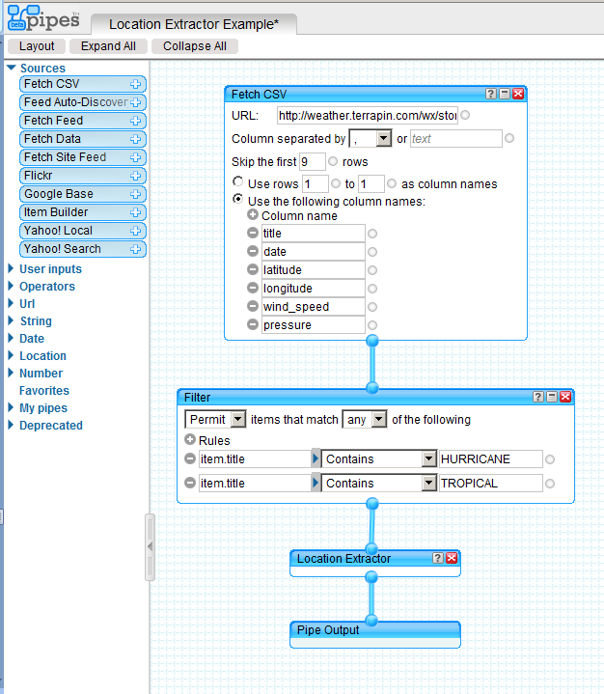
End-user
AuTHORING TOOLS
Yahoo! Pipes
Open Kapow
Marmite [Wong, CHI2007]
IBM QEDWiki
Intel MashMaker [Ennals, SIGMOD2007]
Relations, Cards, and Search Templates [Dontcheva, UIST2007]
Notes:
There are several end-user autoring tools that lower the expertise threshold required to create applications that
synthesize data from multiple pre-existing sources.
Yahoo pipes for instance introduces a visual node-and-link editor for
manipulating web data sources.
Pipes and similar systems like Kapow are used to themselves create web
services meant for programmatic consumption. The output is an RSS feed, not a user-facing application.
The main advantage of d.mix over such work is the integration of site and service in a single page that d.mix offers.

Slide 45
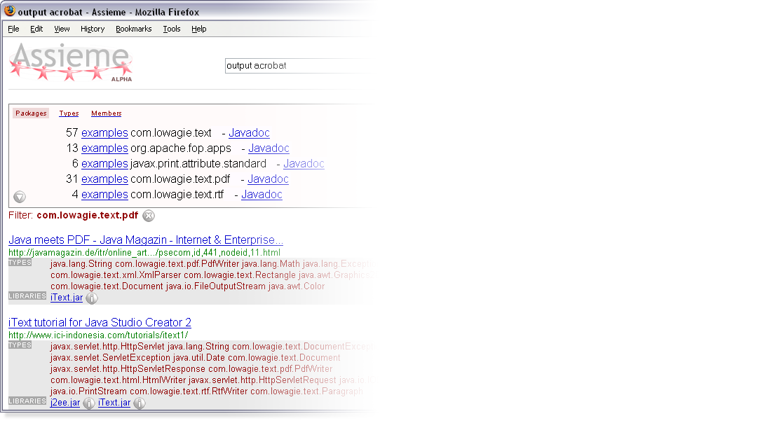
API SEARCH
TOOLS
Assieme [Hoffmann, UIST2007]
Mica [Stylos, VL/HCC2006]
Notes:
Programmers often create new functionality by finding examples online.
Assieme is one example of an augmented search interface to support search for example-based programming.
In particular, Assieme integrates information from Web-accessible (JAR) files, API documentation, and pages that include
explanatory text and sample code.
d.Mix differs form this work by searching in solution the solution domain, rather than the code domain:
Users find examples of the kind of output they would like to create and generate matching code from those examples.
d.Mix additionally offers a lightweight execution environment to test the code it generated.

Slide 46
Contributions
Search for programming examples in the solution domain, not the code domain.
d.mix instantiates this idea for web service APIs through a site-to-service map.
Integration of page annotation and script hosting enables rapid experimentation.
Notes:
In summary, the underlying research idea of our work is to search for programming examples in solution space, instead of code space, and then map back from application output to code that can generate that output.
(SPACE)
d.Mix is an instance of this idea for programming with data-centric web service APIs.
Conceptually, d.mix is enabled by a mapping from HTML pages to the API calls in a site-to-service map.
(SPACE)
On a technical level, we introduced a prototyping environment for web service code through the integration of
a programmable proxy to annotate pages and a wiki to safely execute scripts.

Slide 47
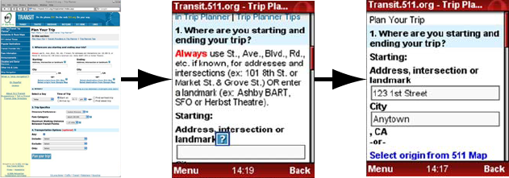
Current Work
Re:Mix
Reformatting existing web applications for
mobile device use
Juxtapose Exploring design alternatives in parallel
Notes:
We have plans to extend the research ideas investigated by d.mix in two areas.
First, we have done preliminary work in using server-side programmable proxies for retargeting existing web applications to mobile devices.
Second, design of interactive applications is often about generating different alternative designs and then choosing among them. Beyond enabling rapid experimentation, we are interested in explicitly supporting work with multiple alternative interface designs through better authoring environments.

Slide 48
Acknowledgments
Funding
NSF grant IIS-0534662
SAP Stanford Graduate Fellowship
Microsoft New Faculty Fellowship
Intel (equipment donation)
Help Wendy Ju, Leith Abdulla, Michel Krieger,
whytheluckystiff
Images
morguefile.com
Notes:
finally, I’d like to thank our sponsors and additional collaborators.

Slide 49
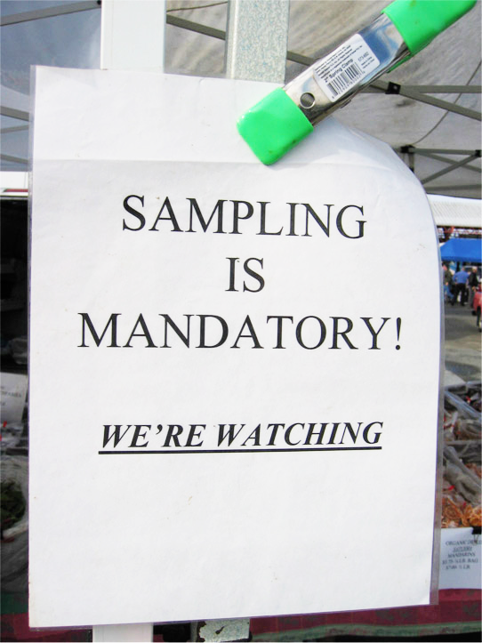
hci.stanford.edu/dmix
Notes:
And I invite you to visit our web page.
Thank you.

