Slide 1

designing solutions to global grand challenges: the refugee crisis
刘哲明
James A. Landay
Professor
Computer Science
@landay
Julie Stanford
Sliced Bread Design
@jstanford1000
CS377E
Spring 2016
March 28, 2016

Slide 2
outline
Quick introductions
Course Overview
Detailed introductions
DP0 - New City Experience

Slide 3


Who are We?

Slide 4
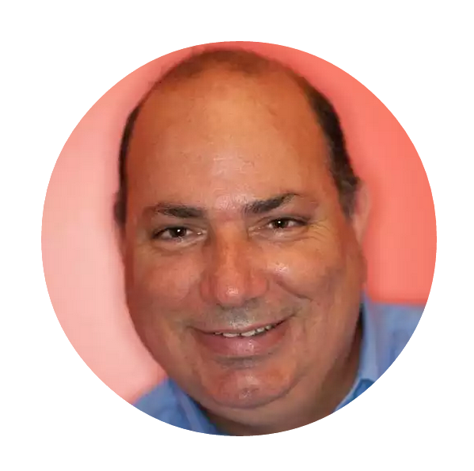
james
landay
Professor in Computer Science at Stanford
  formerly professor in Information Science at Cornell NYC Tech,
  CSE at the University of Washington & EECS at UC Berkeley
  spent 3 years as Director of Intel Labs Seattle
PhD in CS from Carnegie Mellon ’96
Human Computer Interaction w/ focus on informal input (pens & speech), crowdwork, web design (tools & patterns) & Ubiquitous Computing
Office Hours: Mon. 2-3 PM & Wed. 10-11 AM in 390 Gates
Email: landay@[insert usual stanford email domain]

Slide 5
julie stanford
BS/MA Stanford in Symbolic Systems & Communications w/ focus on Interaction Design
Founder & Principal of Sliced Bread Design using design thinking to create compelling user experience for tech products
Office hours: By appt julie@slicedbreaddesign.com

Slide 6

sarah nader
BS & MS in CS (HCI)
Visual design, ethnography, rapid ideation, user testing
I hiked up Mount Fuji and slept on top.
Office hours TBD
Email: snader2@[insert usual stanford email domain]

Slide 7
jenny mailhot
BS Stanford in Computer Science w/ focus on Interaction Design
Design Director at Sliced Bread Design
Office hours: By appt jenny@slicedbreaddesign.com

Slide 8

b a l a n c e
design
technology
Notes:
You need to find a balance between:
design & technology, human-centered approaches & CS approaches
Especially now HCI needs to find a balance between careful controlled experiments of existing technologies or minor tweaks on technology and building major new systems that can solve important world problems.
East: more family centric… west; individualistic… balance

Slide 9
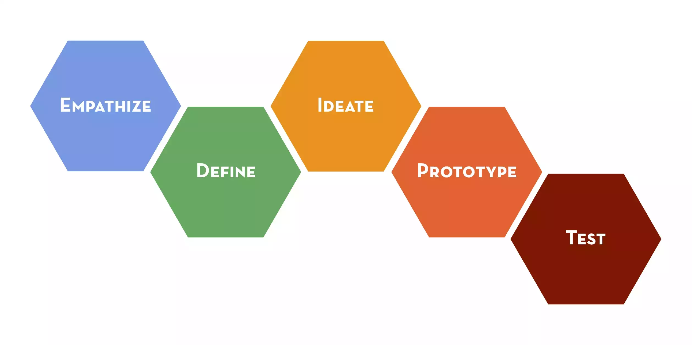
design thinking

Slide 10
design doing timeline
Experience Prototypes
Point of View
HMWs
Low-fi
Prototyping &
Testing
Prototype
Evaluation
Project Fair
Hi-fi Prototype
#2
Usability Testing
Needfinding
Project
Solution
Brainstorms
Medium-fi
Prototypes
Hi-fi Prototype
#1
Unpack &
Present
Needfinding
Results
Week 1
Week 2
Week 3
Week 4
Week 5
Week 6
Week 7
Week 8
Week 9
Week 10

Slide 11
Project partners

Slide 12
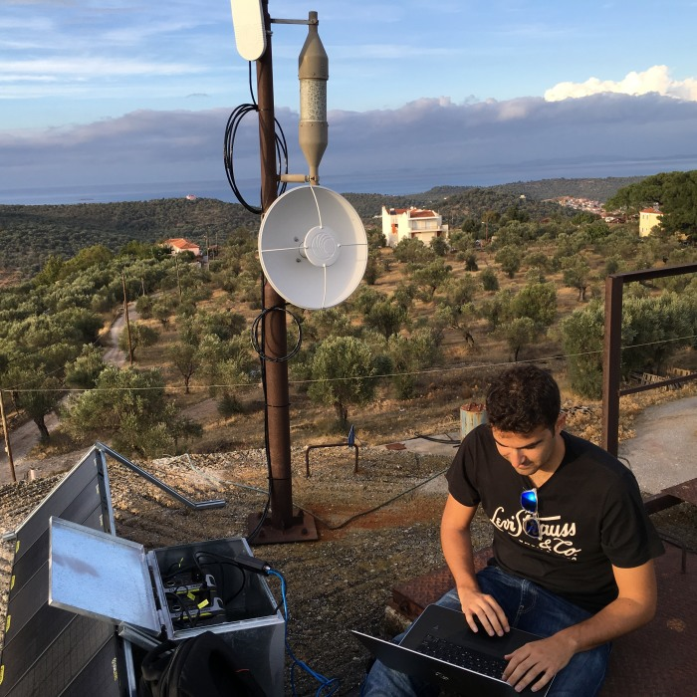
Connecting volunteers
with information
Disaster Tech Lab

Slide 13

Education for resettled young adult refugees
Sea of Solidarity

Slide 14
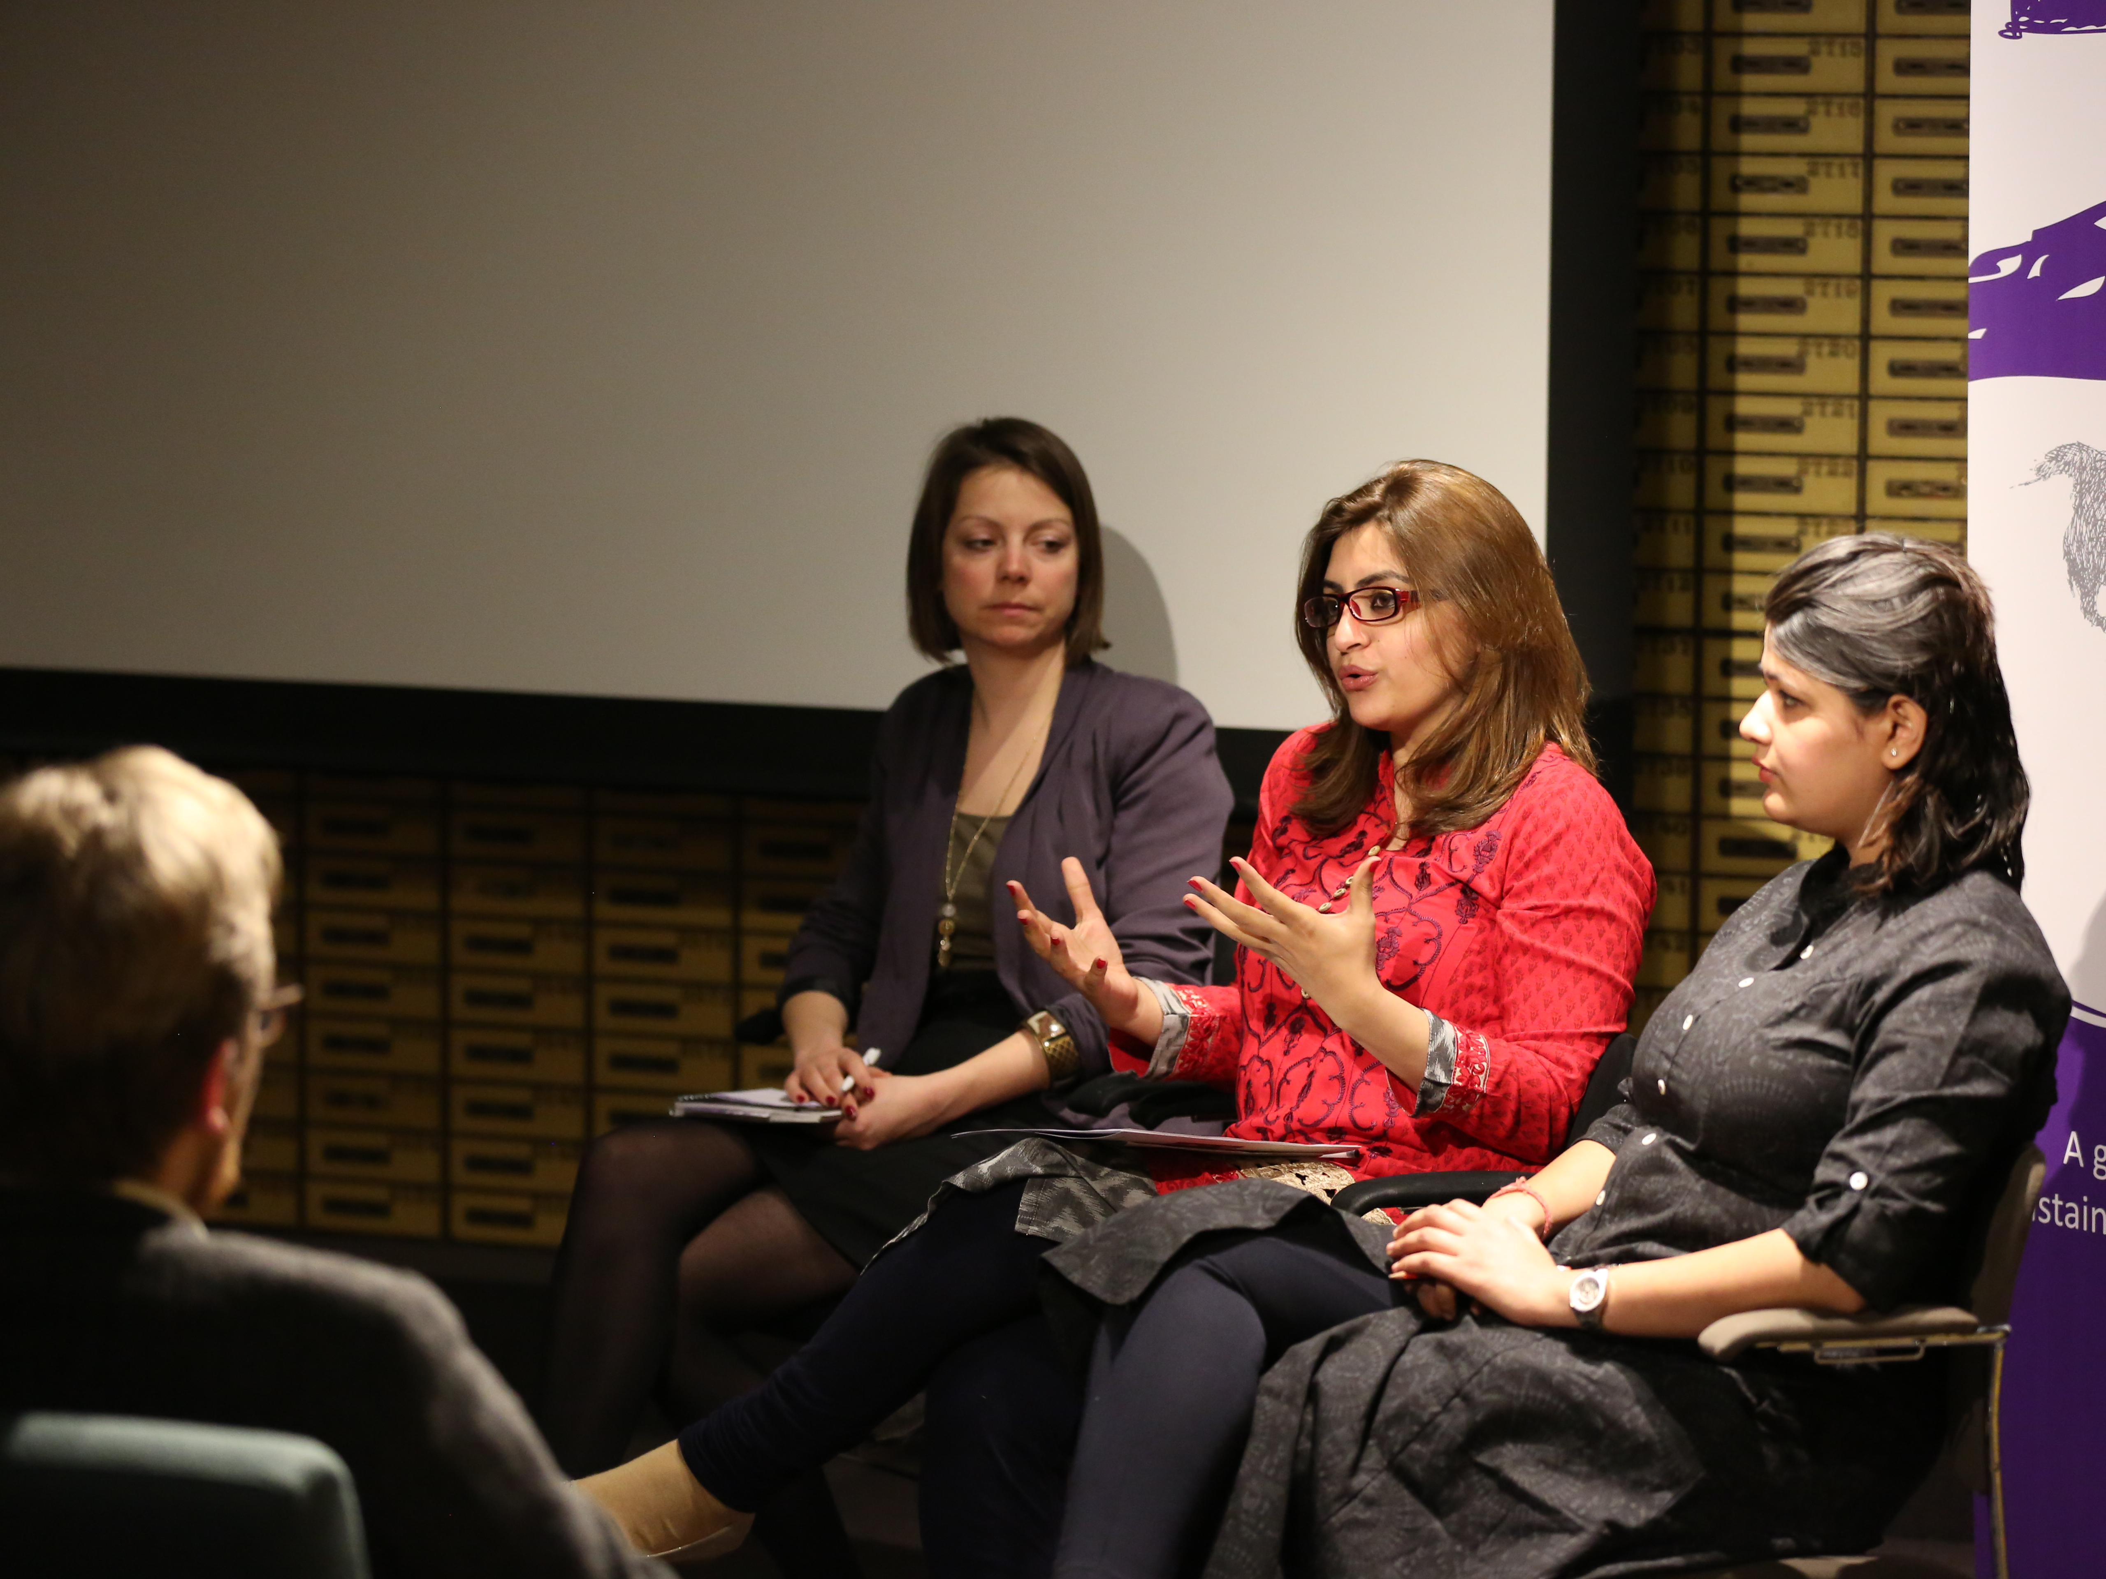
Increasing collaboration
between refugee tech
efforts in the US
Hive, UNHCR

Slide 15
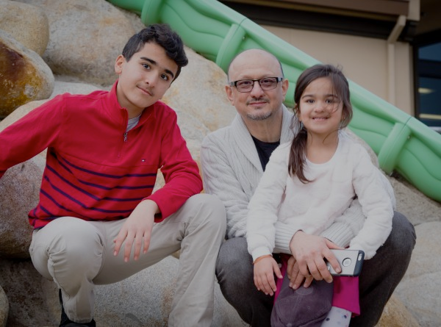
Helping the local
refugee community
International Refugee Committee

Slide 16

Coordinating East Bay refugee social work
East Bay Refugee Forum

Slide 17
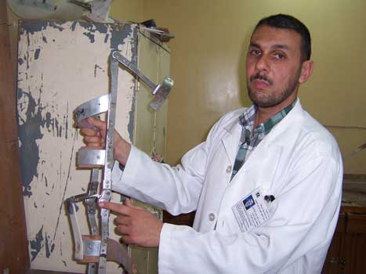
Refugee clinics
in Iraq
Iraqi Ministry of Health

Slide 18
homework
Fill out the project selection form
You can start doing online research on the project(s) you are interested in – work on this topic has probably been done already
  Google
  Facebook

Slide 19
homework
Watch 2 needfinding videos (Piazza)
  Take notes on stickies with a sharpie
  Note what you notice about interviewing technique
  Note interesting things in the interview that stick out to you such as contradictions, issues, concerns, things that the subject feels strongly about

Slide 20
grading
A combination of
  individual assignments & presentation (10%)
  class/studio participation (30%)
  group project (60%)
    demos/presentations/poster (group component)
    project write-ups, exercises & other deliverables
No Exams
  must present at project fair at end of quarter

Slide 21
tidbits
Web site online tomorrow
Sign up for the piazza site if you haven’t already
  http://piazza.com/stanford/spring2016/cs377e

Slide 22
next time
Fill out this survey by Tuesday at noon (letting us know your project preferences)
  http://bit.ly/377E-teams
  we will create project teams by Wed.
Lecture
  Guest lecture (Mary Tran, Sea of Solidarity / Facebook)
  Sarah Nader initial needfinding
  In class needfinding exercise
Watch example needfinding videos
  https://vimeo.com/user38238387/review/121817191/7605f2b138
  https://vimeo.com/user38238387/review/121817185/b2c4480e49
  take notes ON STICKIES of what you notice the interviewer does as they are conducting the interviewees
  take notes ON STICKIES of interesting things that the subject says, stories you hear, contradictions, etc.

