Slide 1
ask.in
Med-fi Prototype
Team Larry the Porcupine
Sean Chang, Grace Zhao, Melinda Wang,
Ari Qayumi & Vrinda Vasavada

Slide 2
Our Team
Sean C
Melinda W
Vrinda V
Grace Z
Ari Q

Slide 3
Problem Overview
Young adults need higher quality and better access to healthcare and health insurance education

Slide 4
Mission Statement
Value Proposition
Increase health insurance literacy of young adults who are navigating healthcare for the first time, and to foster a culture of preventative care.
A community to help you navigate your lifelong healthcare journey.

Slide 5
Solution Overview
A Reddit for health insurance, with hassle-free plan attachment/info extraction and optimal organization of feedback from peers and experts

Slide 6
Outline
1
2
3
Task Overview
Revised Interface Design
Prototype Overview

Slide 7
Task Overview

Slide 8
Simple Task
Can you navigate to your questions and can you define a term that someone responded with that you don’t understand?
Can you navigate to your questions and can you view its comments/feedback?
Notes:
(we made defining a term a subtask)

Slide 9
Medium Task
Can you upload the two insurance plans you’re choosing between and post a question about them
Can you upload an insurance plan and post a question about it?

Slide 10
Complex Task
Can you go to another user’s post, comment on it and vote on it?

Slide 11
Revised Interface Design

Slide 12
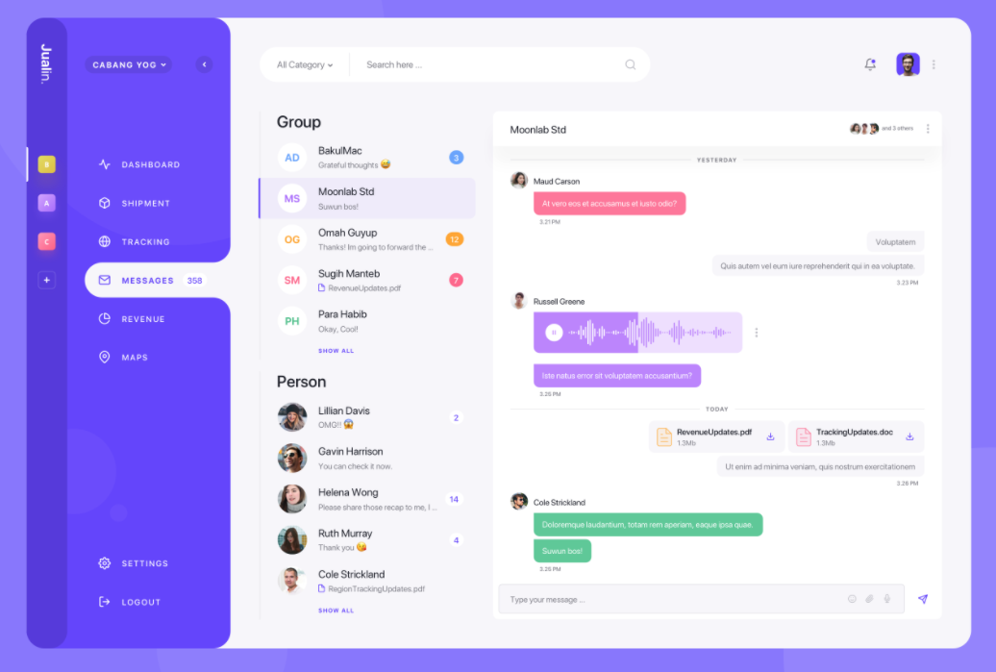
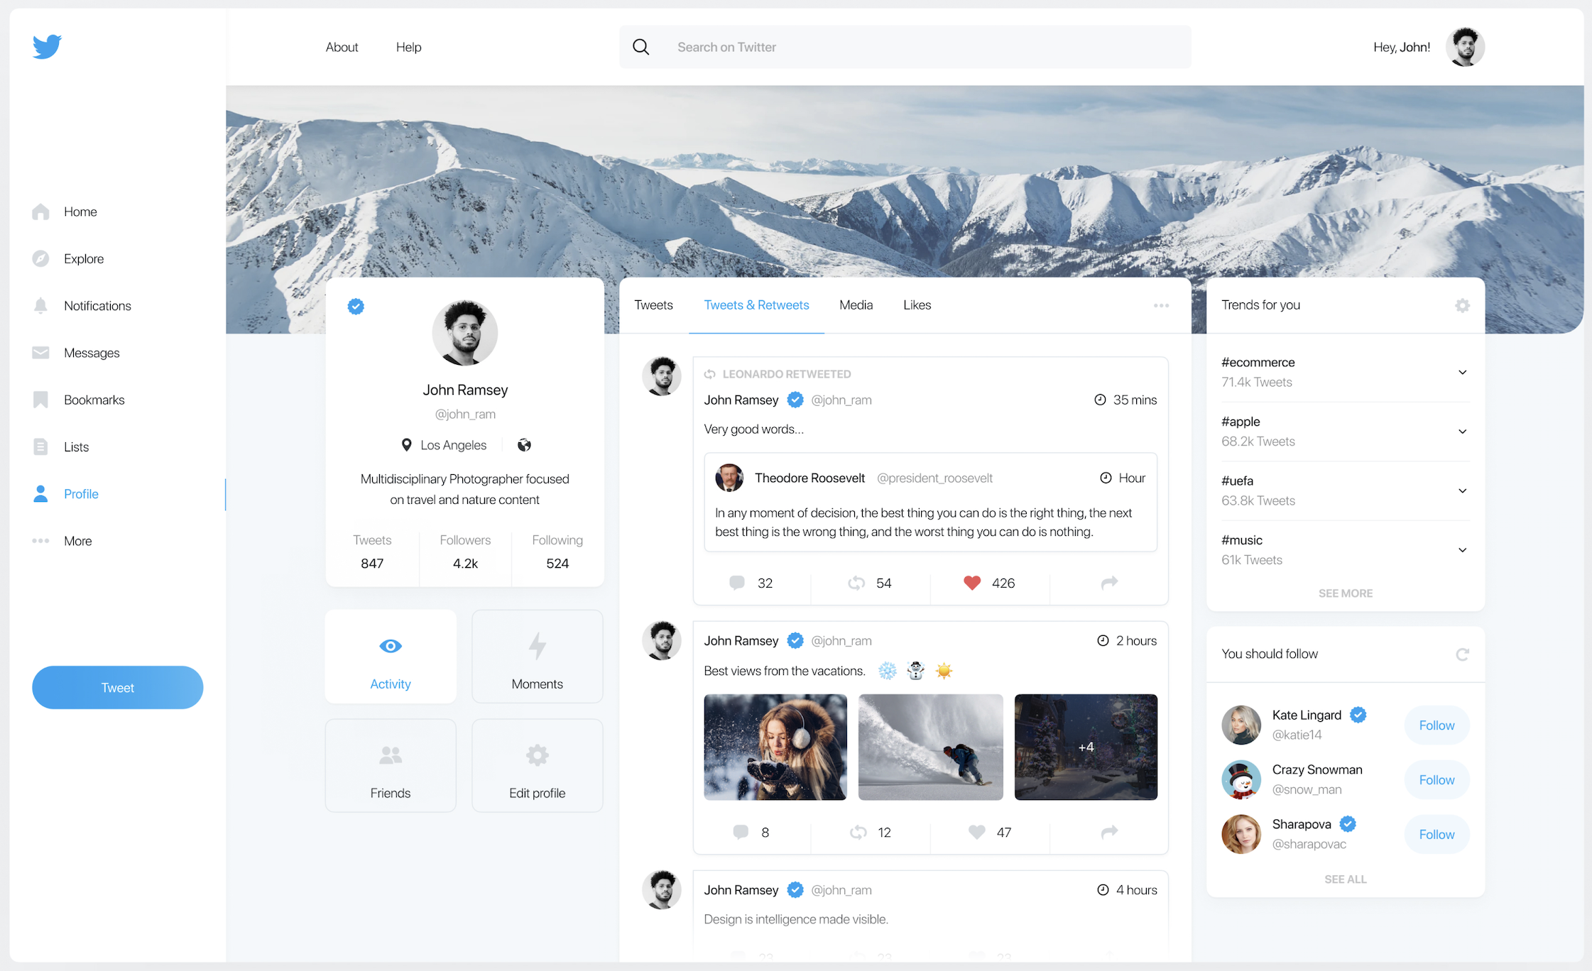
Design System Inspiration

Slide 13
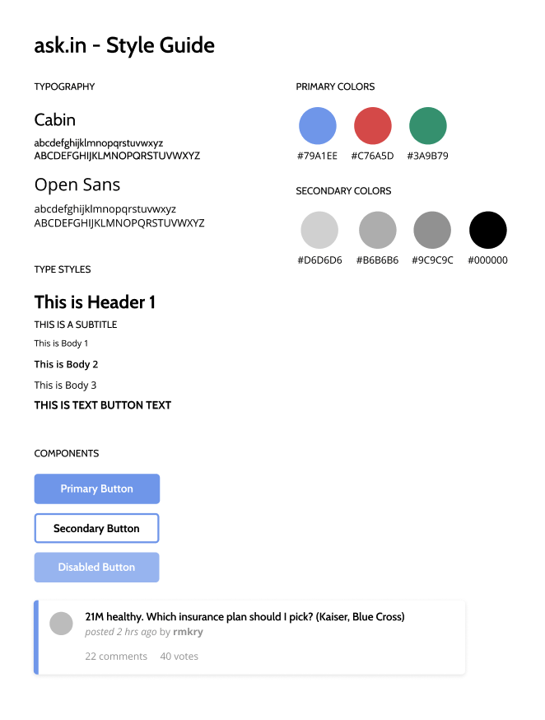
Design System
clean
trustworthy
compassionate
comfortable
organized

Slide 14
Major Design Changes
2) Grouping Comments
1) Attaching Insurance Flow
3) Post, Comment & Vote Filtering
What if there are so many comments that I can’t see the screen?
What do I do if I don’t have a file of my insurance plan on my computer?
What if I only want to see comments from people like me?

Slide 15
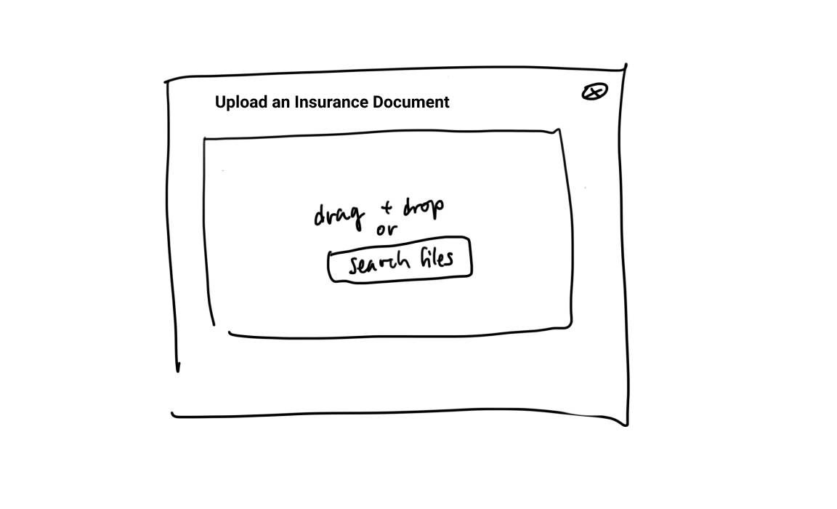
Design Change 1: Attaching Insurance Flow
Notes:
keywords/rationale

Slide 16
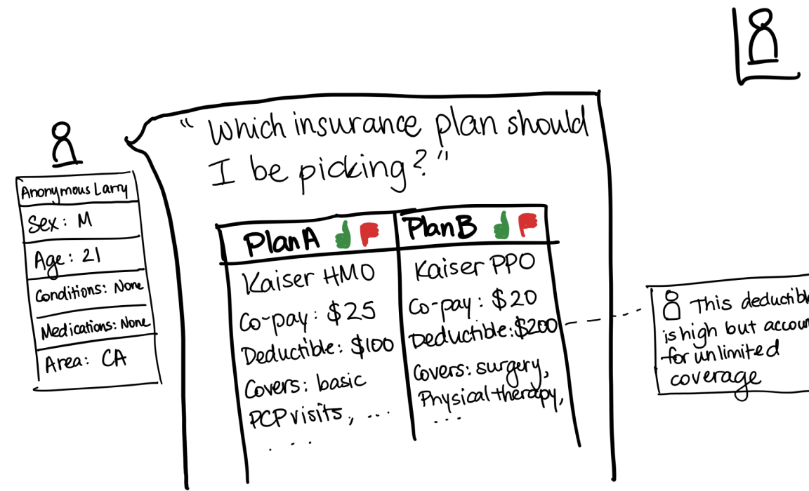
Design Change 2: Grouping Comments

Slide 17
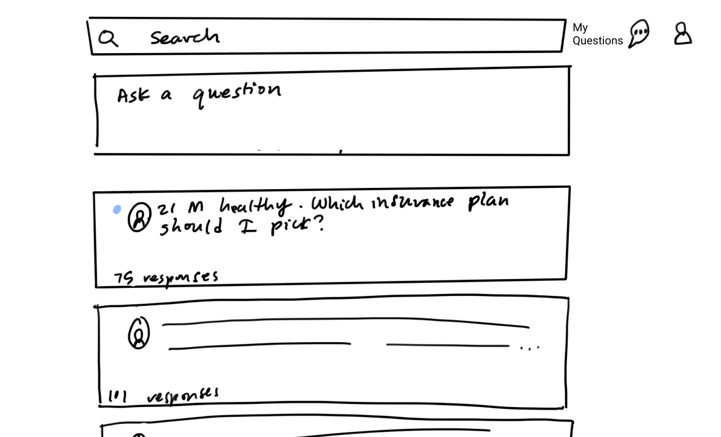
Design Change 3: Post, Comment & Vote Filtering

Slide 18
Med-fi Simple Task Flow

Slide 19
Simple Task Flow: View Your Questions’ Commentary
1
2
3
4
5*
Task Progress
*subtask

Slide 20
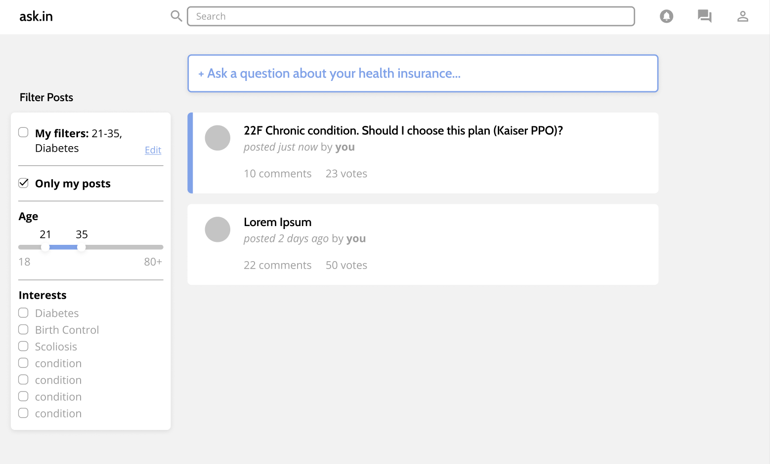
Simple Task Flow: View Your Questions’ Commentary
1
2
3
4
5*
Task Progress
*subtask

Slide 21
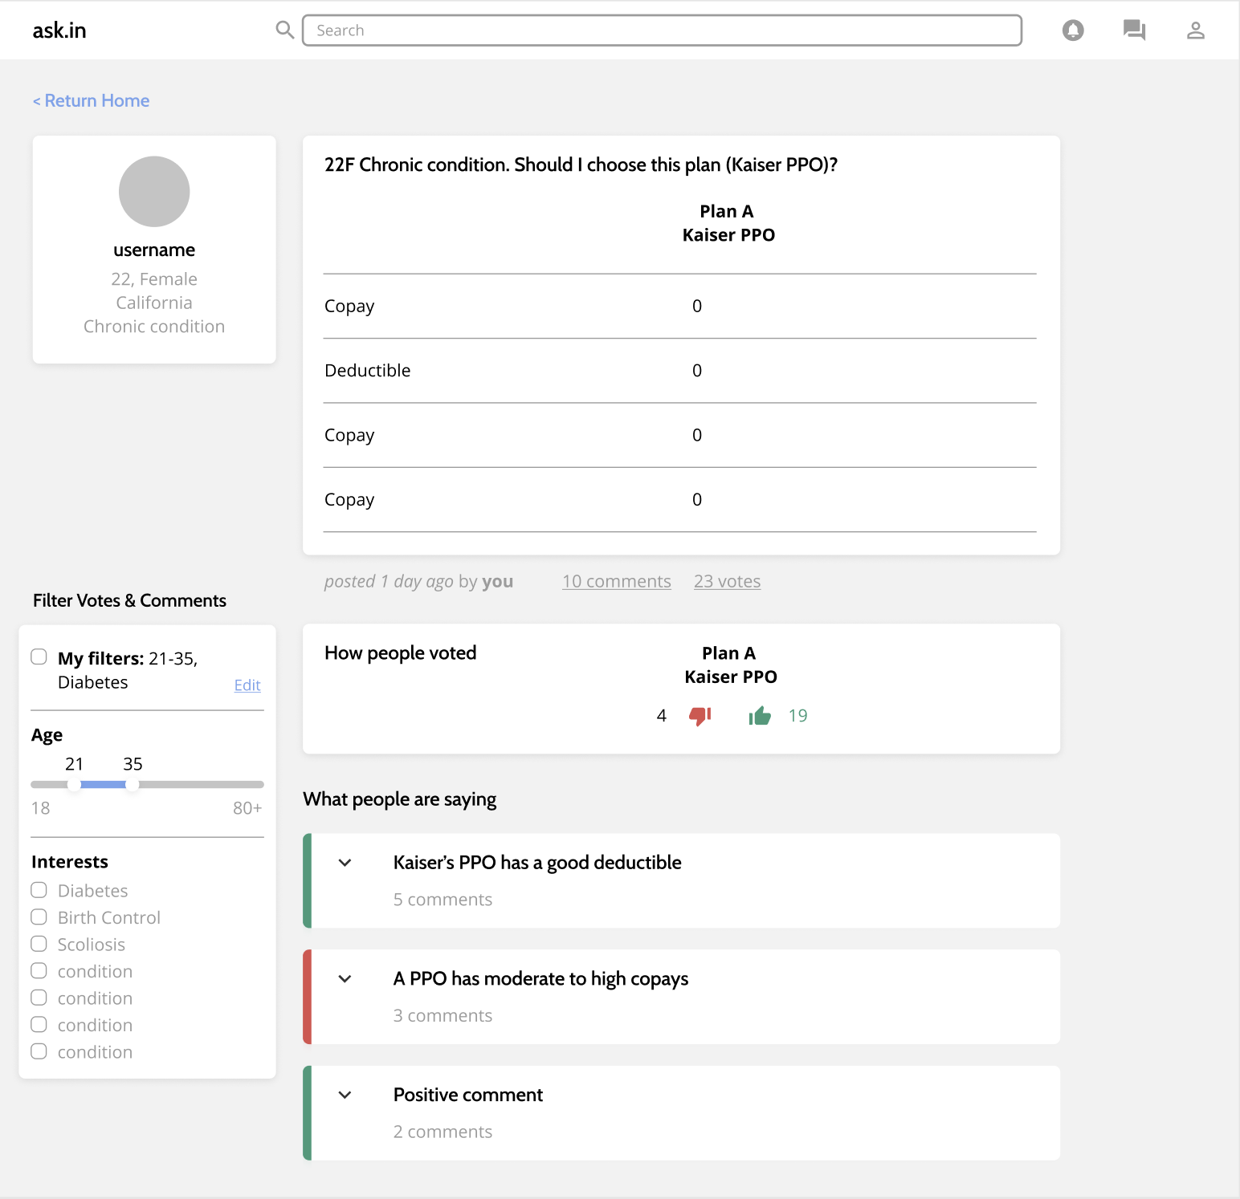
Simple Task Flow: View Your Questions’ Commentary
1
2
3
4
5*
Task Progress
*subtask

Slide 22
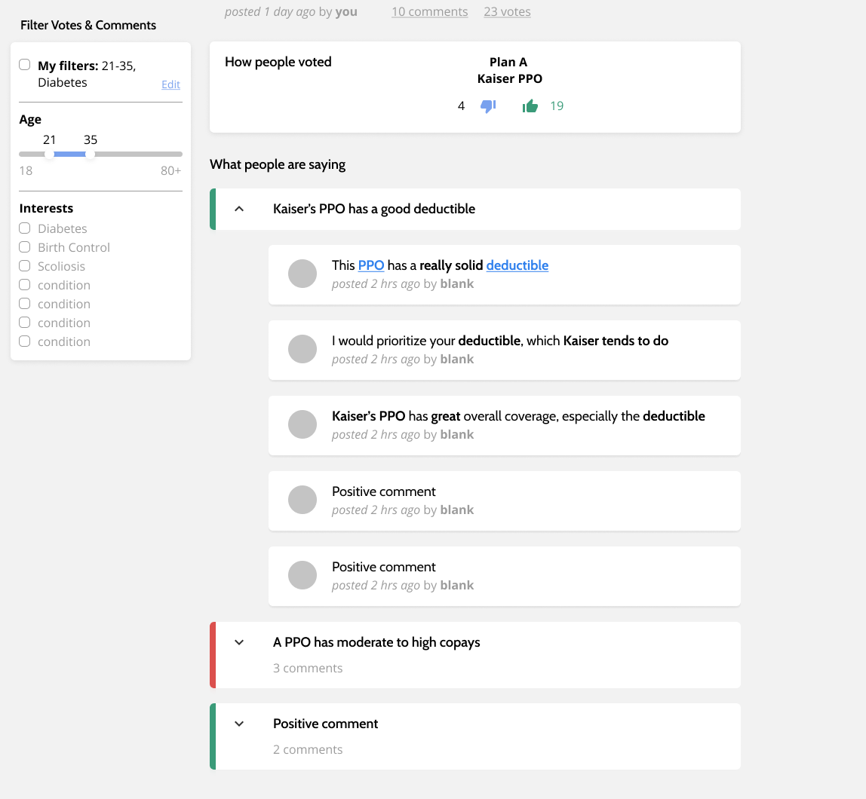
Simple Task Flow: View Your Questions’ Commentary
1
2
3
4
5*
Task Progress
*subtask

Slide 23
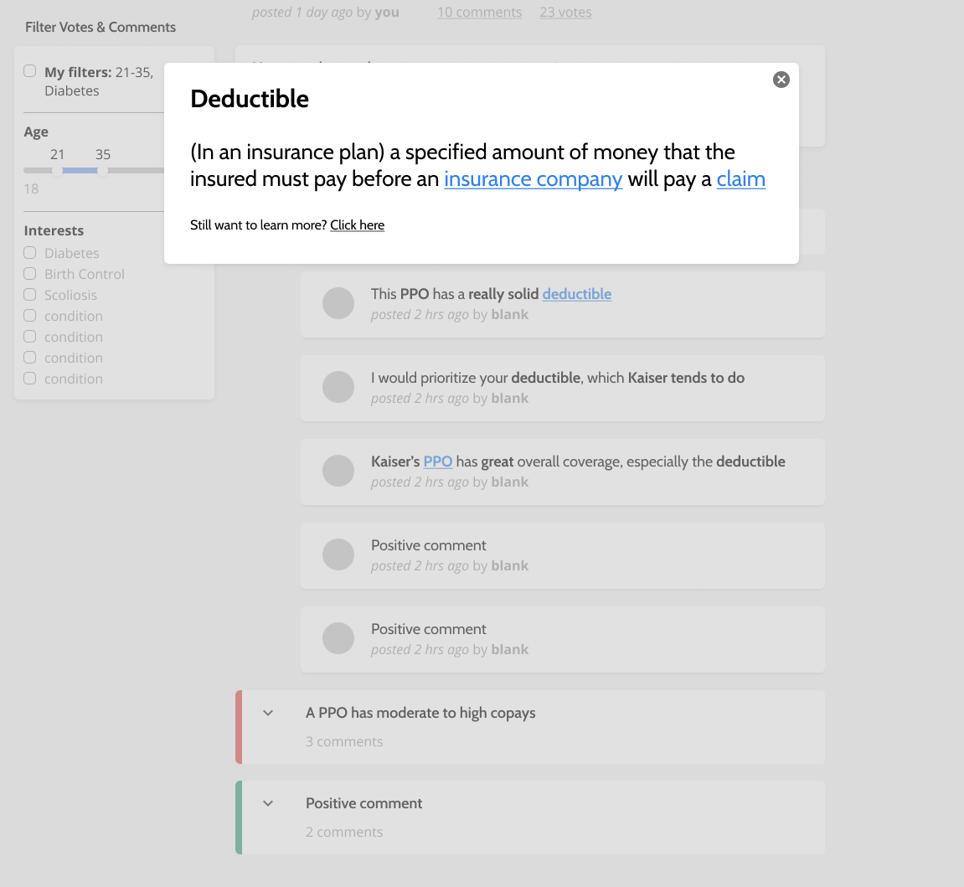
Simple Task Flow: View Your Questions’ Commentary
1
2
3
4
5*
Task Progress
*subtask

Slide 24
Med-fi Medium Task Flow

Slide 25
Medium Task Flow: Upload a Plan and Question
1
2
3
4
5
Task Progress

Slide 26
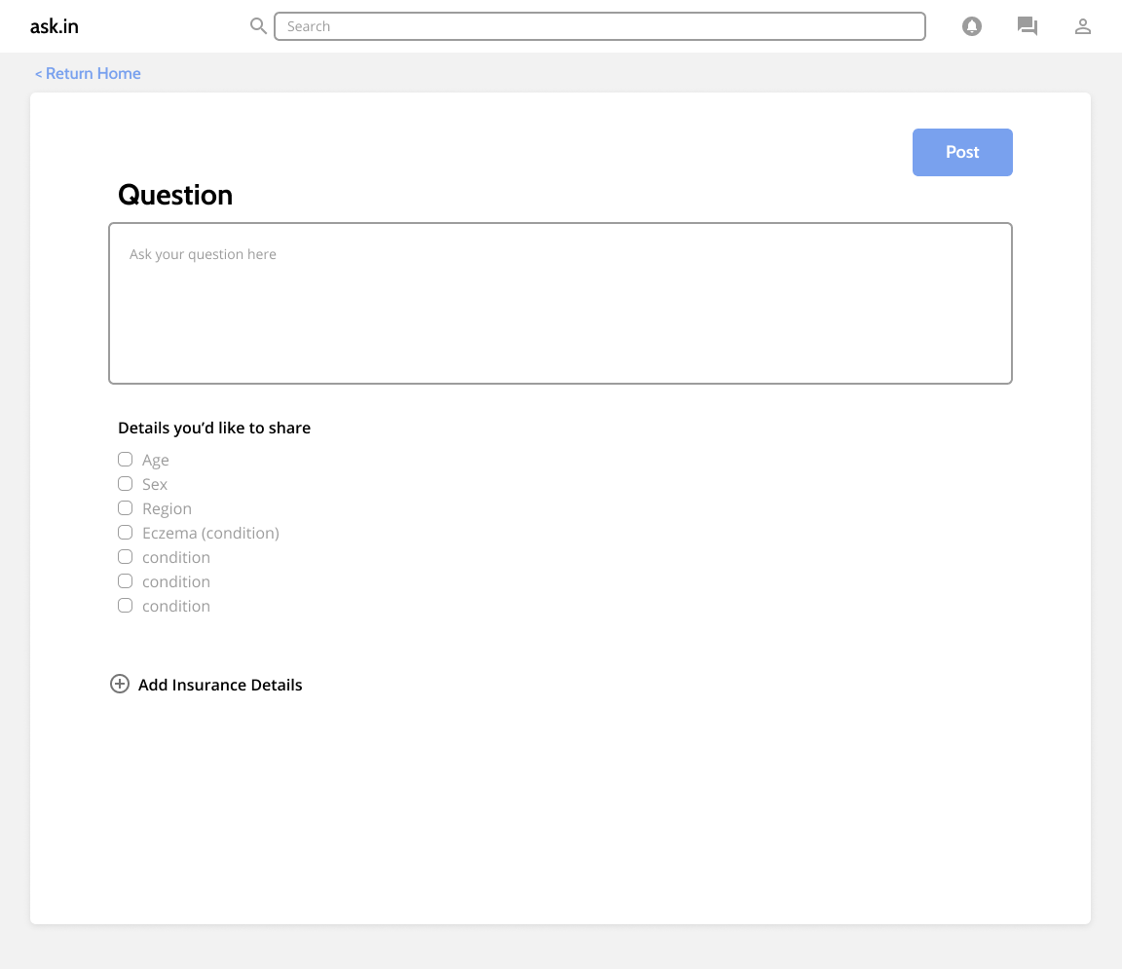
Medium Task Flow: Upload a Plan and Question
1
2
3
4
5
Task Progress

Slide 27
Medium Task Flow: Upload a Plan and Question
1
2
3
4
5
Task Progress
Notes:
Alternatively, they can choose to upload the insurance and have info automatically extracted...

Slide 28
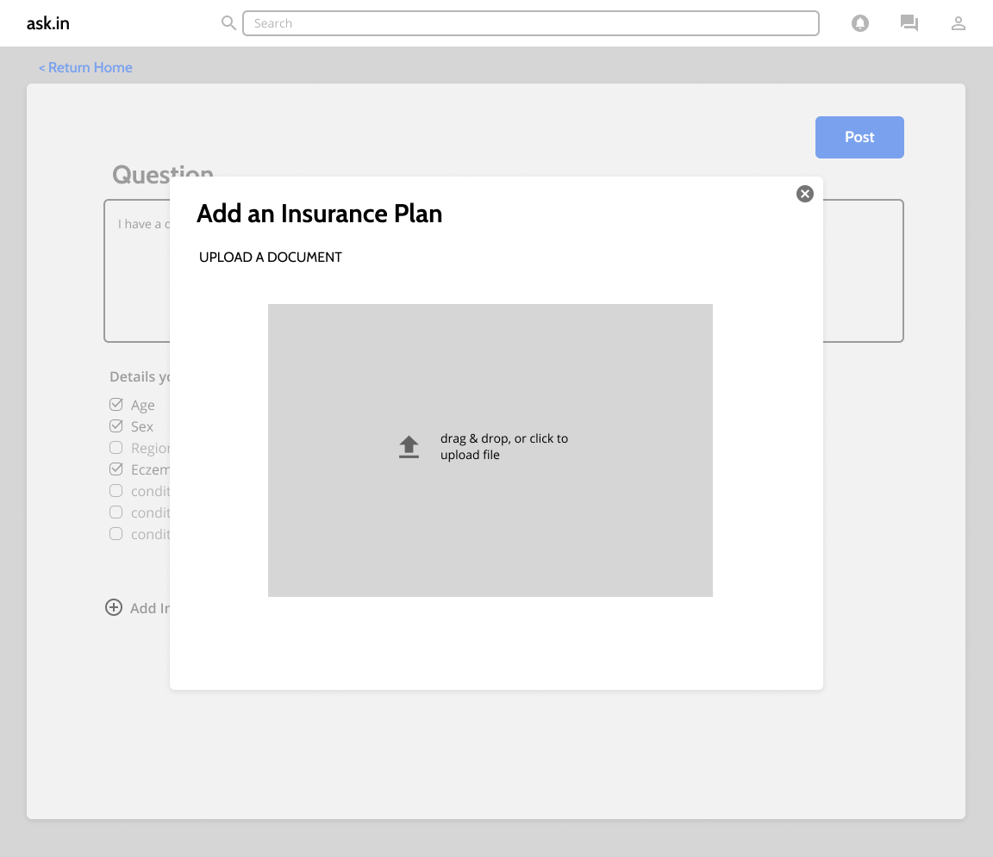
Medium Task Flow: Upload a Plan and Question
1
2
3
4
5
Task Progress

Slide 29
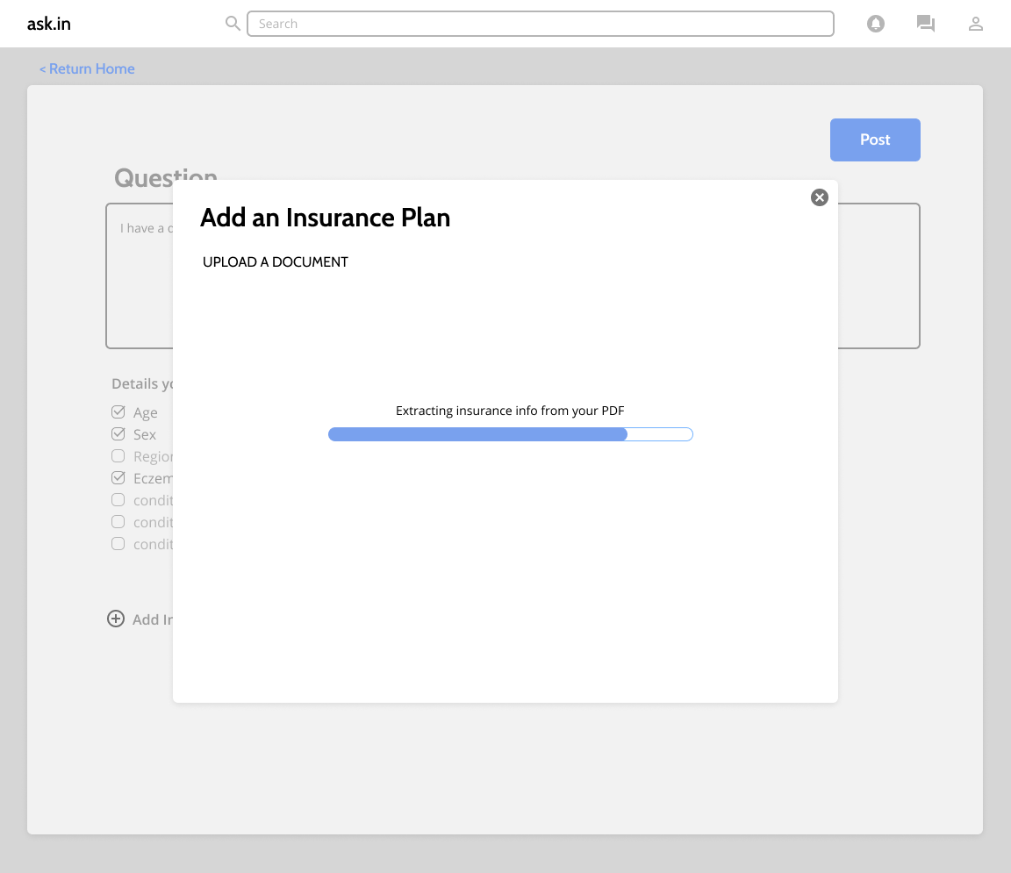
Medium Task Flow: Upload a Plan and Question
1
2
3
4
5
Task Progress

Slide 30
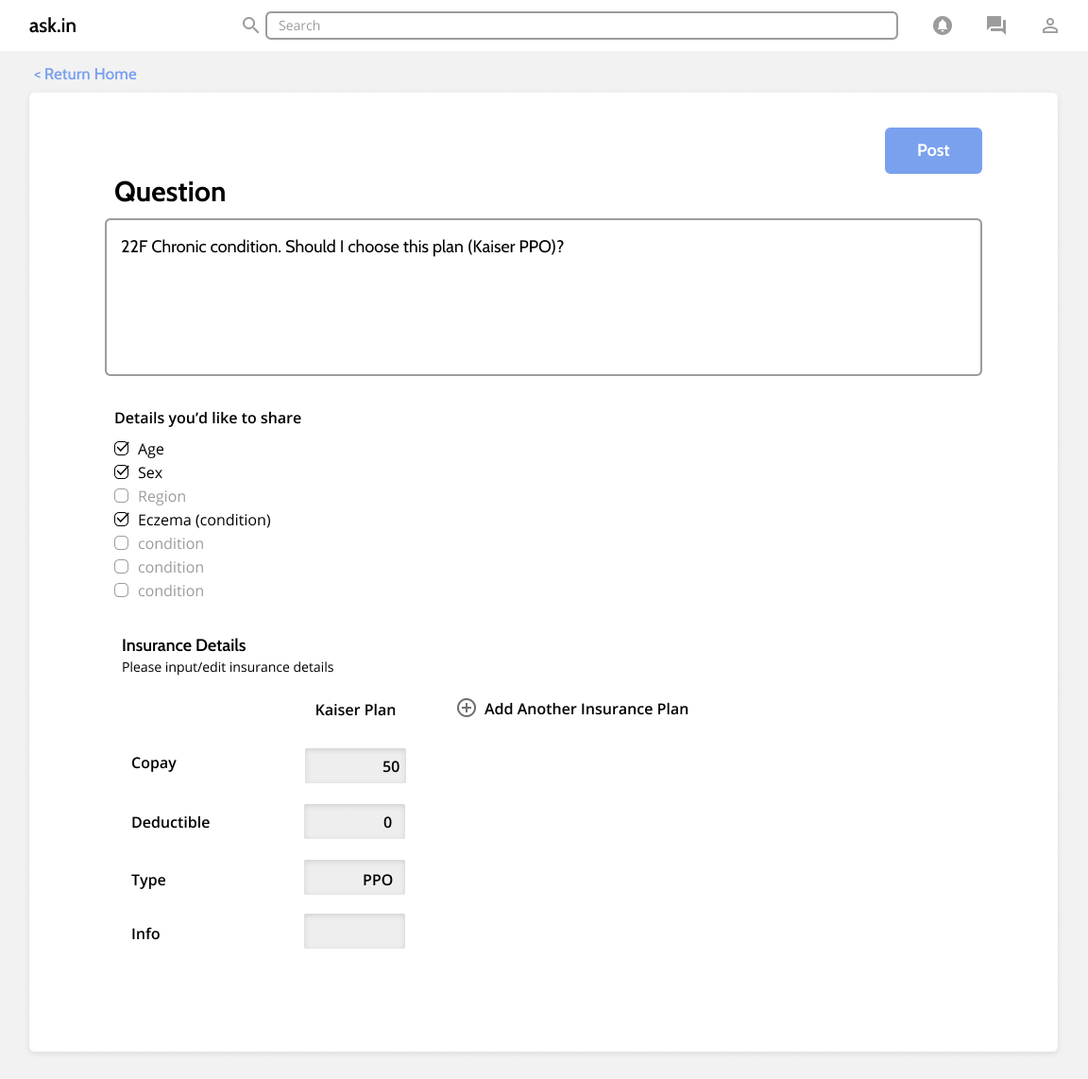
Medium Task Flow: Upload a Plan and Question
1
2
3
4
5
Task Progress
Notes:
Can still edit info

Slide 31
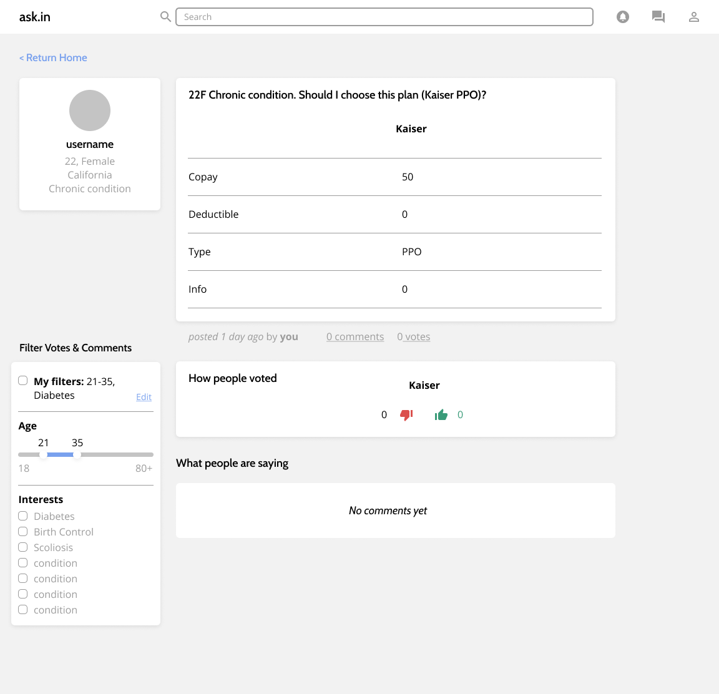
Medium Task Flow: Upload a Plan and Question
1
2
3
4
5
Task Progress

Slide 32
Med-fi Complex Task Flow

Slide 33
Complex Task Flow: View a Post & Vote/Comment
1
2
3
4
5
Task Progress

Slide 34
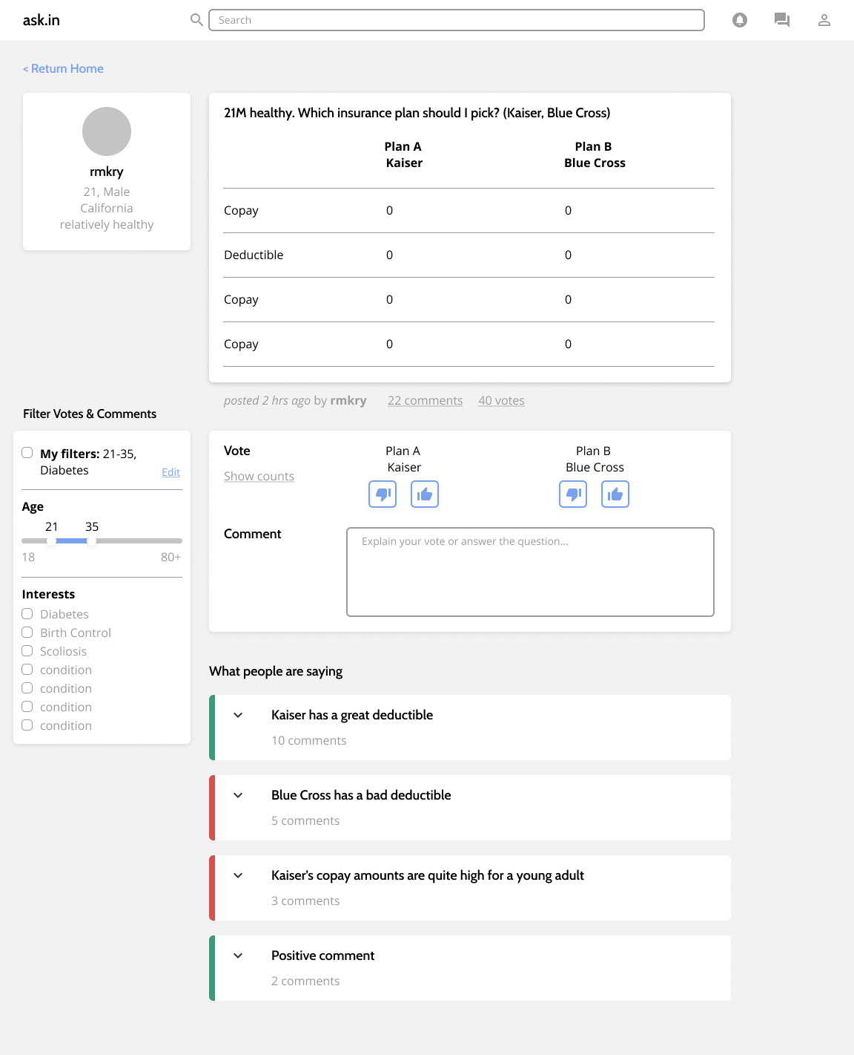
Complex Task Flow: View a Post & Vote/Comment
1
2
3
4
5
Task Progress

Slide 35
Complex Task Flow: View a Post & Vote/Comment
1
2
3
4
5
Task Progress

Slide 36
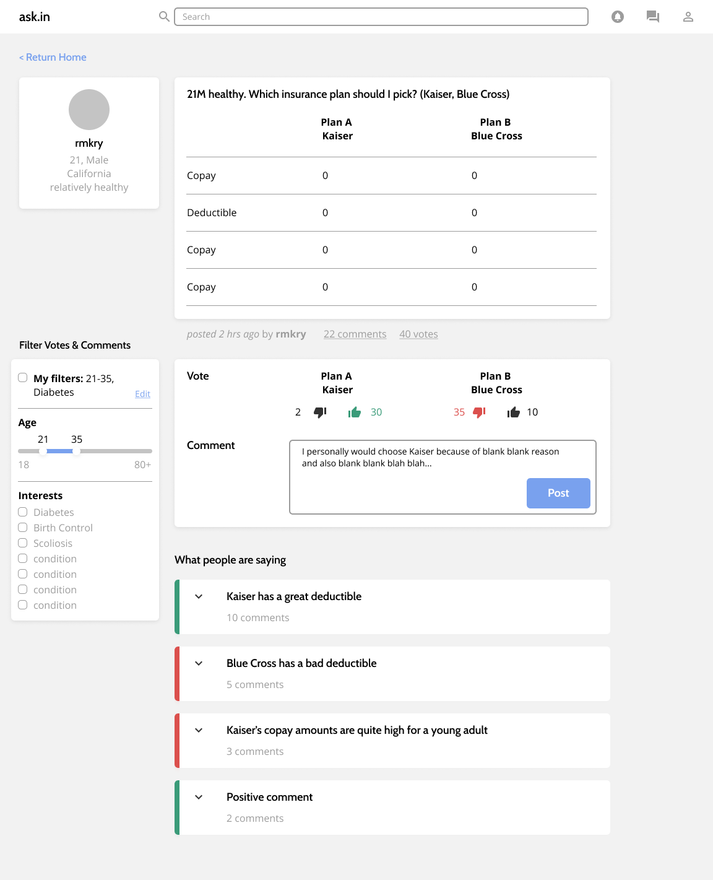
Complex Task Flow: View a Post & Vote/Comment
1
2
3
4
5
Task Progress

Slide 37
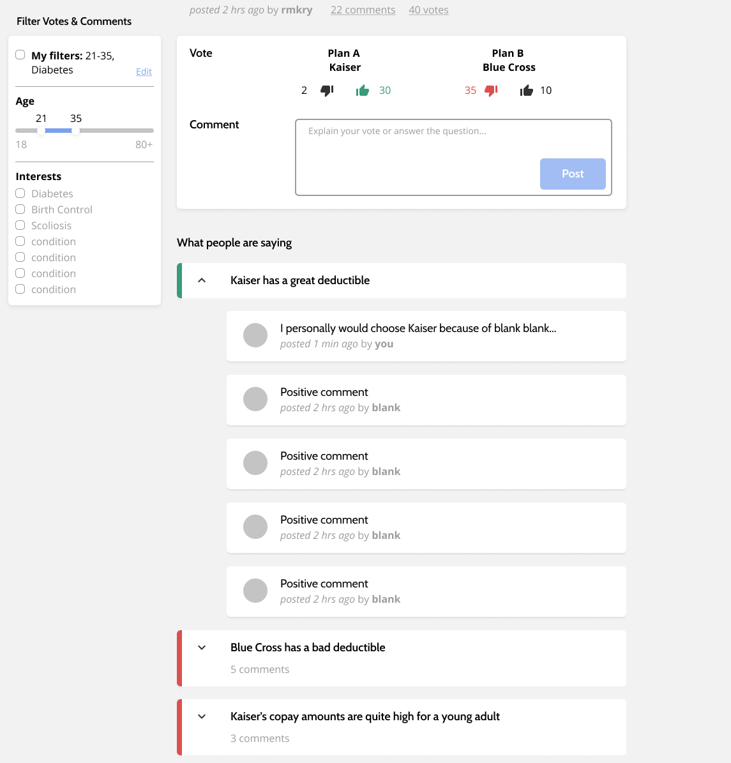
Complex Task Flow: View a Post & Vote/Comment
1
2
3
4
5
Task Progress

Slide 38
Prototype Overview

Slide 39
Prototyping Tools
What did we use?
How did the tool help?
How did the tool not help?
Figma
Flexible Style, Components, Collaboration
Majority of us aren’t figma pros (yet!)

Slide 40
Limitations
Trade-offs
No moderator or “trust”-qualification due to med-fi quality assumptions
Small subset of filters for initial concept testing
Comments being grouped together removes inline comments
Balance between filtering for your personal needs and learning about health insurance holistically
Notes:
(tradeoff) less overwhelming location-specific comments
We have filtering but no moderator / “trust” qualification (could be solved using a profile or a tag) partly because we’re wondering if med-fi prototype resolves some of those
Design limited due to current legislation

Slide 41
Wizard of Oz
Automatic Insurance Detail Extraction
Clustering Comments
Automatic Term Selection & Definition

Slide 42
Thank you!
Any Questions?

Slide 43
Appendix

Slide 44
Relevant Links
Figma Prototype URL: https://www.figma.com/file/DSgazxvGULbbsE81VnX8qs/377E-Health-Insurance-Education?node-id=155%3A3
Figma Visual Design URL: https://www.figma.com/file/DSgazxvGULbbsE81VnX8qs/377E-Health-Insurance-Education?node-id=143%3A2
Med-Fi Annotated Task Flows: https://docs.google.com/document/d/1evPStB_9upsaL_5Ply4dmWxDfHdwxzI2-sUePaP5uU4/edit
Med-FI Prototype PDF: https://drive.google.com/drive/u/0/folders/1cXK72WAHmsnOTJbV0dYBxC4iKFTezFft
Med-FI Prototype Screen PNGs: https://drive.google.com/drive/u/0/folders/1F96K76AZ056K9S6QR-cJLUM2STHwMKD6

Slide 45
Design Changes Explained
Design Change 1: Attaching Insurance Flow: We opted to update the process of attaching an insurance plan to a question to provide users with more options and to reduce confusion. We allow for three possible methods (instead of assuming they have a document to upload) that allow for more flexibility when attaching an insurance plan.
Design Change 2: Grouping Comments: We decided to update how comments are displayed and organized for a question a user posted. Although our users generally liked seeing where in an insurance plan a comment was specifically made, many expressed concerns over feeling overwhelmed if there were too many comments and feared that this would feel like a Google doc that can easily be sloppy once enough comments are made. Likewise, users weren’t certain what this would look like for a question that didn’t post physical pictures of an insurance plan. As a result, we now group the comments based on their content and organize them below the question and optional plan details.
Design Change 3: Post, Comment, and Vote Filtering: We chose to update the questions, comments, and votes that a user can see based on filters that they choose to apply. Users expressed how although they do like seeing general questions and responses from a variety of people, they would like to be able to see content specifically from people that they share similar backgrounds and/or health considerations with. We are looking forward to exploring what types of filters users would want most through user testing, and flushing out this design change further.

