Slide 1

thanks to our sponsors
www.vituity.com
Notes:
Thanks to for sponsoring the fair (our food and helping to defray the cost of the poster printing)

Slide 2

刘哲明
James A. Landay
Professor
Computer Science
@landay
Chloe Thai
Mechanical Engineering
CS377E
Project Fair
Autumn 2020
November 18, 2020
designing solutions to
global grand challenges:
smart education

Slide 3
outline
Course overview
Team presentations (4 x 12 min. + 3 min questions)
More questions for any team
Award presentations

Slide 4

balance
design
technology
Notes:
You need to find a balance between:
design & technology, human-centered approaches & CS approaches
Especially now HCI needs to find a balance between careful controlled experiments of existing technologies or minor tweaks on technology and building major new systems that can solve important world problems.

Slide 5
How will AI technology affect humans & society?
What is the next generation of AI technology?
Pressing questions about AI
How should
AI technology be designed & deployed?
Notes:
At Stanford we’ve identified 3 big unanswered questions about the future of AI.

Slide 6

The development of AI must be guided by its human impact
AI technology should be
inspired by human intelligence
Applications of AI should enhance and augment humans, not replace them
Notes:
We have recently started a new institute to Study what we call Human-Centered AI, and it consists of three simple but powerful ideas.

Slide 7
The development of AI must be guided by its human impact
AI technology should be
inspired by human intelligence
Applications of AI should enhance and augment humans, not replace them
Notes:
My work is focused in this last focus area. How do we use AI to augment and enhance what people can do.
User Experience Design is the human-centered methodology that we apply in our work
What will this mean in AI applications?

Slide 8
ai needs user experience (ux) design
Tesla Model S “Autopilot”
Future of autonomous cars
How do we design the UX?
Notes:
Lots in algorithms of AI, especially computer vision.
But what should the user see on the dash board?
How should they control it from the large display screen?
What happens when things go wrong? Which they will (and already have)?

Slide 9
ai needs user experience (ux) design
Amazon Echo, Google Home & other Smart Speakers use Voice UI
How do we design them to deal with natural human conversation?
How do we design to support multimodal input? (e.g., + screen or vision)
Notes:
These let us easily speak to our devices.
But as of now the conversations are unnatural. How do we make them more natural?
As they fit in with more of our computing ecosystem (e.g, the echo show with a screen and touch input or even computer vision), how do we design this multimodal input and output?

Slide 10
ai needs user experience (ux) design
Computer vision-based skin cancer detection getting better and better
What is appropriate to show a patient?
What should be the interface for the doctor?
Is there a set of design patterns for these Smart UIs?
Notes:
These are the types of AI and UX questions I’m interested in moving forward
Image from https://www.zwivel.com/blog/wp-content/uploads/2017/03/skinvision2.jpg
Studies are starting to show AI-based skin cancer detection is close to that of an expert. Take these results with a grain of salt, but it may happen.
What is appropriate to show the patient?

Slide 11
course format
Project brief: human-centered AI applications for education
Quarter long, team project
Project presentations
Critiques of project work
Small number of lectures
All material is online
  slides, assignments, readings, schedule
  http://hci.stanford.edu/cs377e

Slide 12
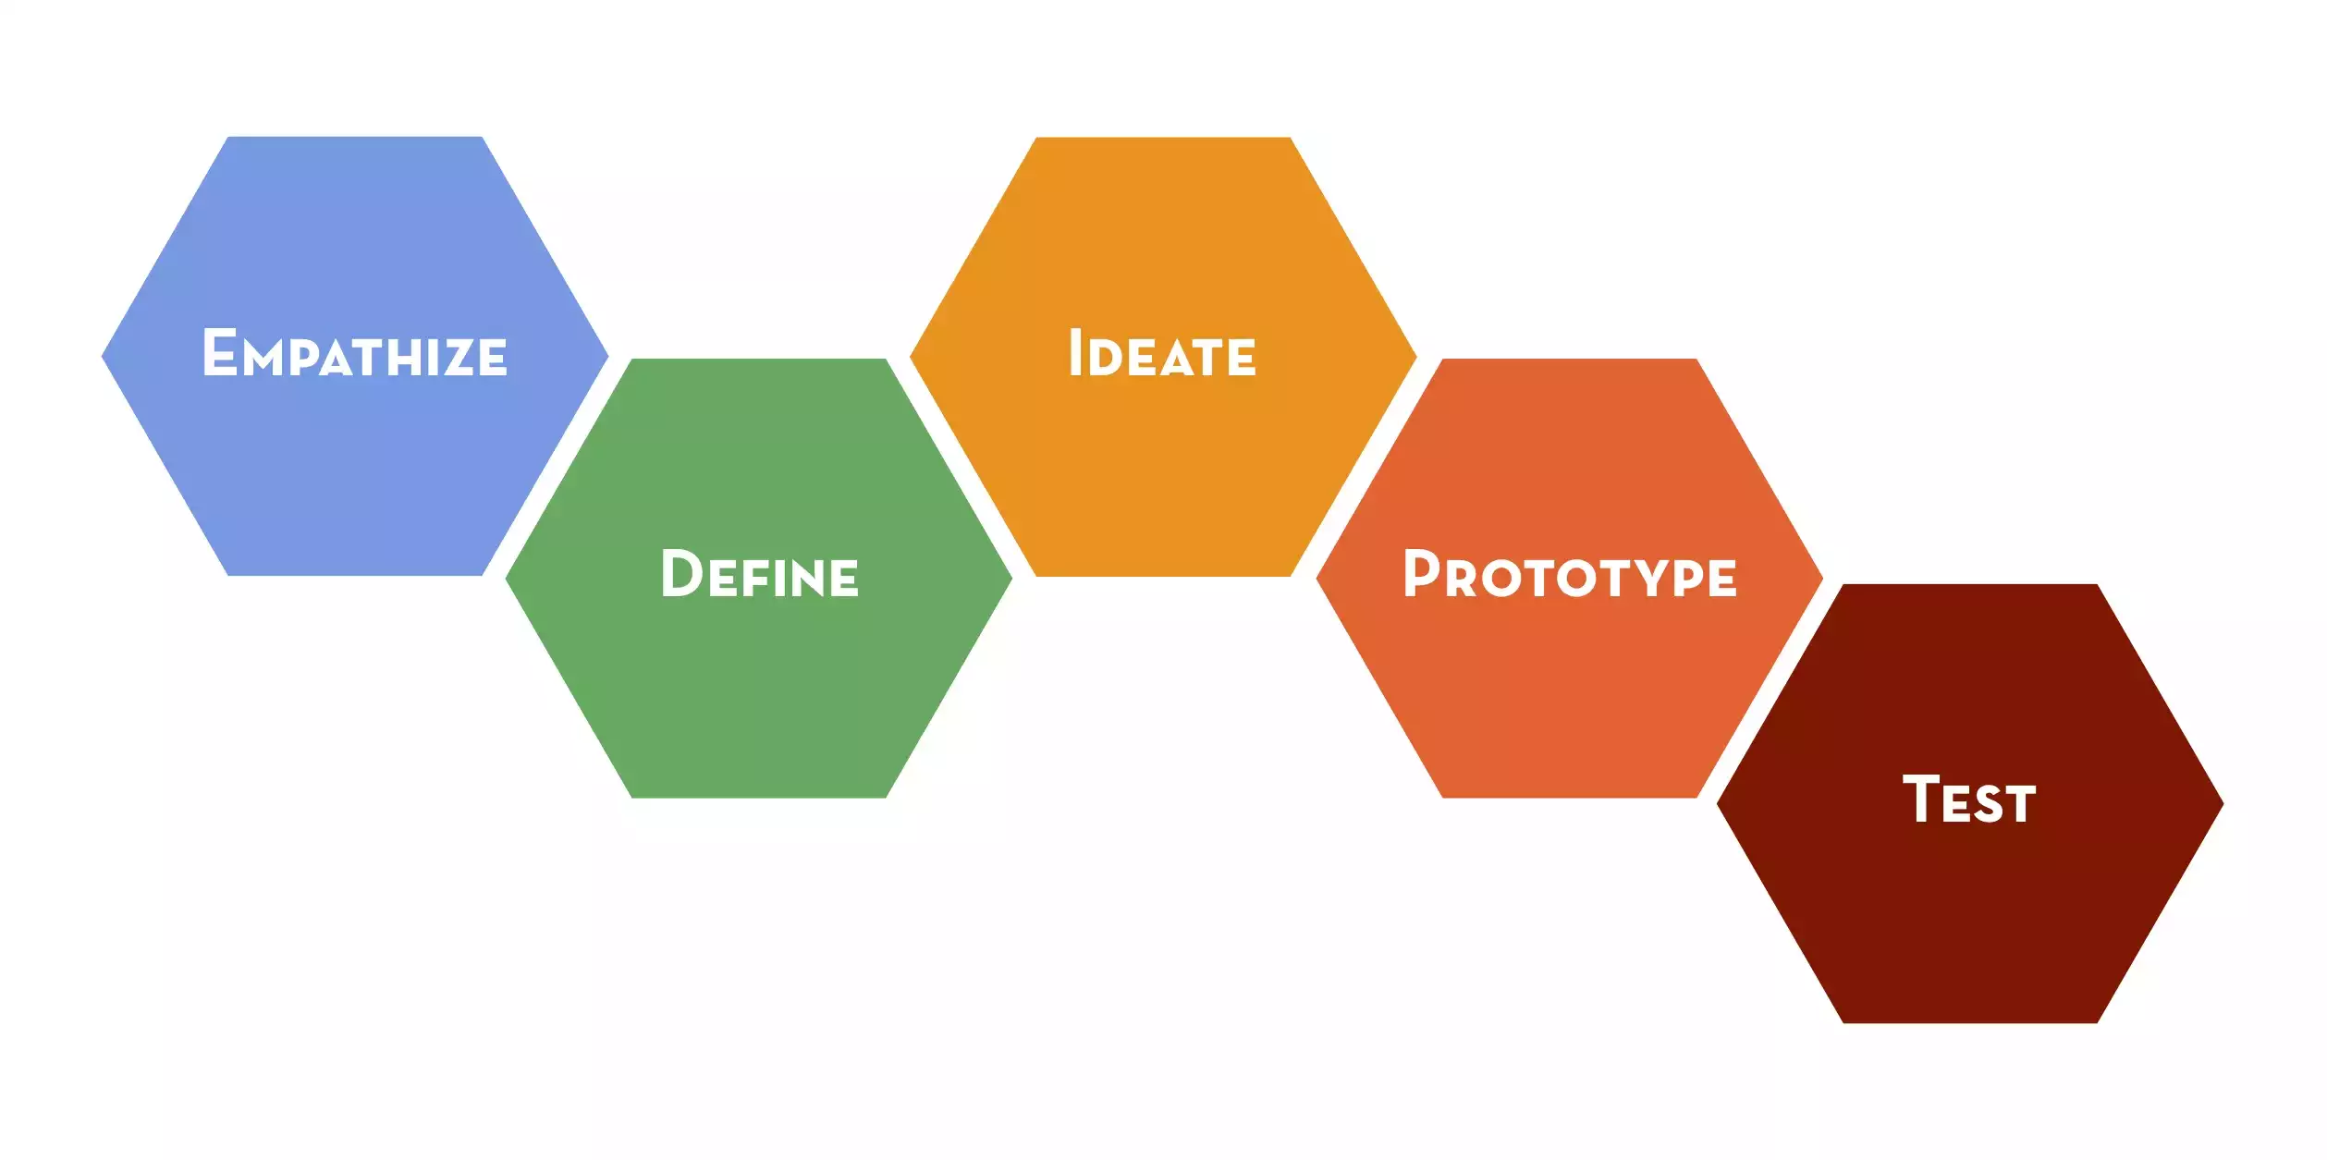
design thinking

Slide 13
design doing timeline
Needfinding
Results
Experience
Prototype
Experiments
Medium-fi
Prototype #1
& Evaluation
Project Fair
Final Medium-fi
Prototype
Medium-fi #3
Needfinding Plan
& Lit Review
Point of View
HMWs
Solutions
Experience Prototypes
Low-fi
Prototypes
& Testing
Medium-fi
Prototype #2
& Heuristic
Evaluation
Week 1
Week 2
Week 3
Week 4
Week 5
Week 6
Week 7
Week 8
Week 9
Week 10
Notes:
6 four person teams

Slide 14
thanks to our sponsors
www.vituity.com
Notes:
Thanks to for sponsoring the fair (our food and helping to defray the cost of the poster printing)

Slide 15
the judges
Siamak Ashrafi, ZoeWave
Francesca Barrientos, Cisco
Raju Goteti, Tata Consultancy Services
Karim Guessous, Tradepal
Piyush Gupta, Sounding Board
Suyash Joshi, SF Bay Area Interaction Design Meetup
Vince Kohli, Design Innovation
Chok Fung Lai, NASA
Grace Lam, IDEO CoLab
Katya Lavrenova, Facebook
Brandon Lee, Intuit
Aikaterini Liakopoulou, EIT Ventures
Edmond Macaluso, nguage Ventures
Michael Murphy, Kloa
Daniel Russell, Google
Suril Shah, Google
Abhijit Thosar, Vmware
Yifei Wang, Cisco
Nina Wei, Qokka

Slide 16
agenda
12 Minute Talks + 3 Minutes Q&A
  eduCulture
  ask.in
  wello
  lecturely
More Q&A
Awards
Notes:
Remind the judges to have your judging form open so you can take notes/make comments for the teams on the form.

Slide 17
awards
Best Presentation
  eduCulture
Best Visual Design
  wello
Best Potential Impact
  Lecturely
Best Interaction Design (the most impressive project)
  ask.in

