Slide 1
Advanced Interaction Design
CS377E Spring 2019
James Landay
*based on slides by Julie Stanford

Slide 2
what is interaction design?
the practice of designing interactive digital products, environments, systems, and services

Slide 3
interaction design vs. visual design
interaction design
visual design
How much overlap?
Notes:
“interaction design includes any aspects of the design that impact usability”????

Slide 4
where does it fit in the process?
Empathize
Ideate
Define
Prototype
Test

Slide 5
what to think about when you are designing

Slide 6
timeline of use

Slide 7
People will use your UI over time
First use
Sign up
Explore
Taste
Excitement
2nd use
Repeat something
Try new area
Accomplish specific goal
Confirm assumptions
Getting comfortable
5th use
Habits/Ruts
Ignore updates
Effect of lack of novelty
Time period between use
Requirement for user engagement

Slide 8
timeline how to
Think about not just first use but 2nd use, and 10th use…how do things change?
What stays fresh? What becomes tedious?

Slide 9
implicit interactions

Slide 10


Slide 11

“Sensing and computation need to be augmented with an understanding of the unstated expectations people have from our interactive counterparts.”
- Wendy Ju
The Design of Implicit Interactions

Slide 12
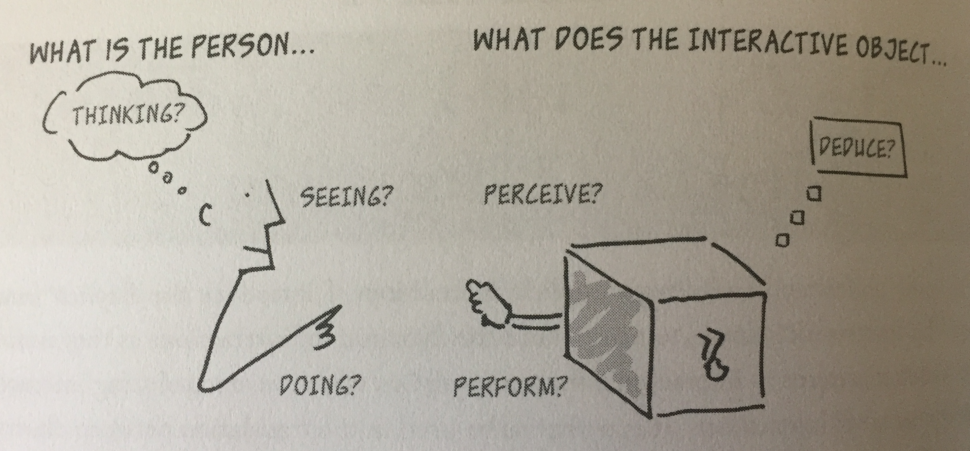
Wendy Ju, Design of Implicit Interactions

Slide 13
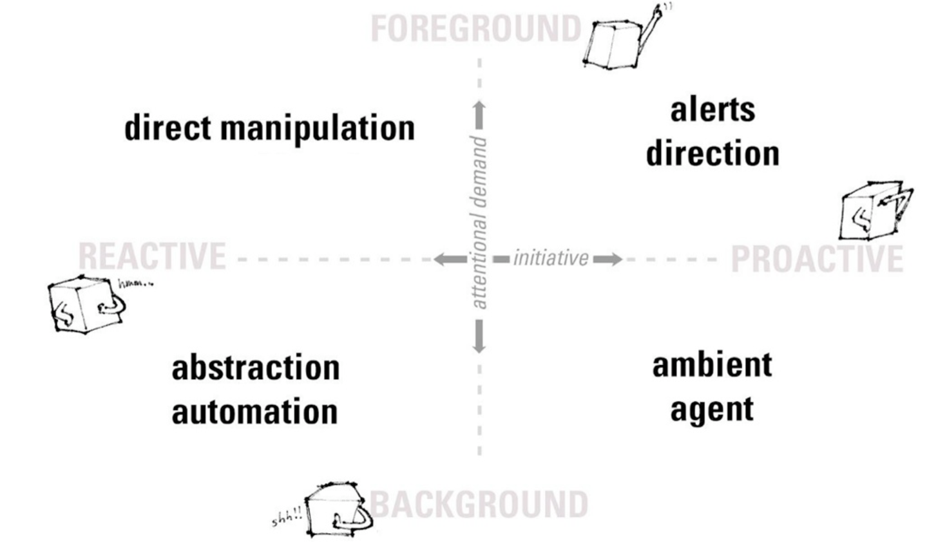
Wendy Ju, Design of Implicit Interactions

Slide 14
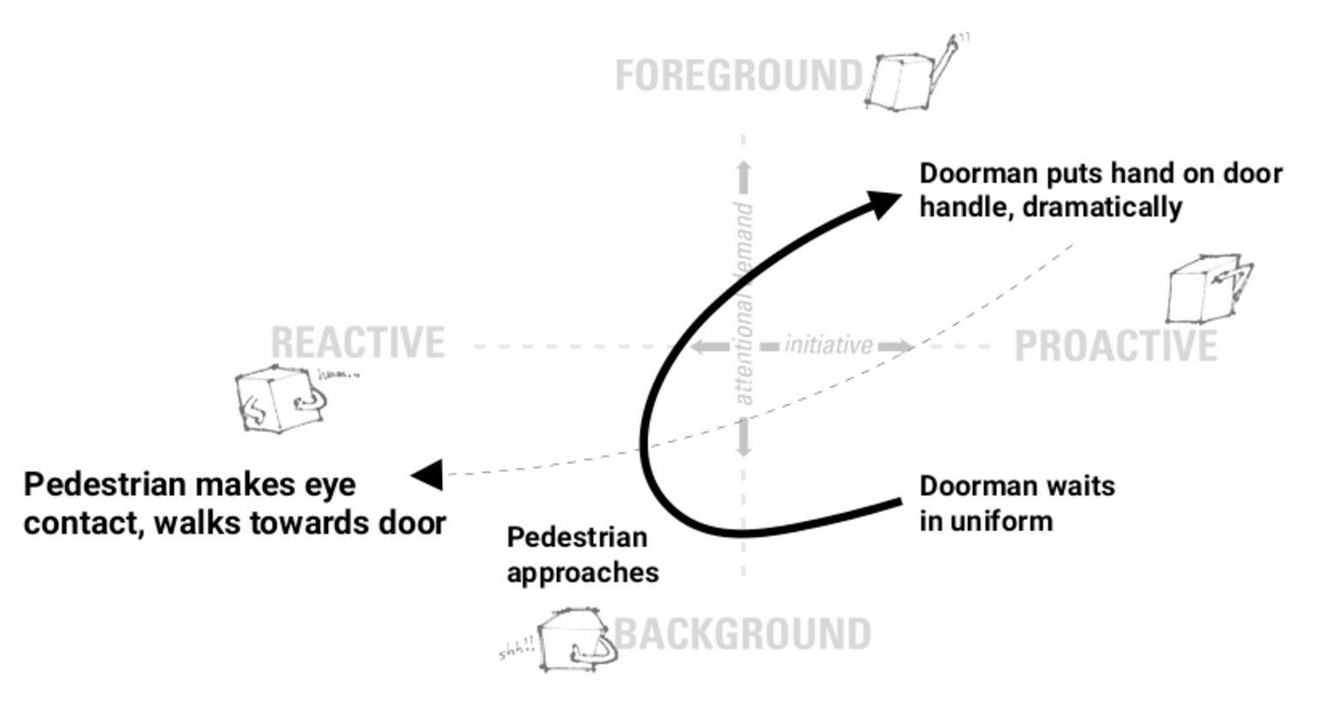
Wendy Ju, Design of Implicit Interactions

Slide 15
Wendy Ju, Design of Implicit Interactions

Slide 16
You use a DVR to
record a show
DVR suggests
a show you might like
DVR records a pre-set
weekly show
DVR pre-records shows you
might like on its own
Wendy Ju, Design of Implicit Interactions

Slide 17
What does this mean for your UIs?
Think about all the potential ways the user is implicitly interacting with your experience.
Example: Light switch state: On/Off
User’s State:
Can see the light is on
Sees the light is on but thinks it should be off
Doesn’t notice the light is on but would want it off
Might want to turn it off if it were clear how to
Doesn’t know if he is responsible for the light or not

Slide 18
implicit interactions how to
Consider ALL the mental states that the user might have when they are engaging with your interface (make a list!)
How will the interface react? What social cues will it use?

Slide 19
and don’t forget the basics…

Slide 20
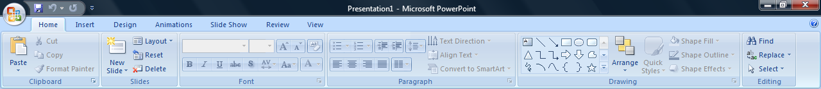
80/20 rule
Ribbon in Microsoft Office 2007
A high percentage of effects in any large system are caused by a low percentage of variables. Also know as Pareto’s Principle. – Universal Principles of Design
“Users use 20% of the features 80% of the time.”
Notes:
Pareto – economist who discovered Pareto’s principle in the early 20th century looking at wealth distribution in Italy
Focus, simplification

Slide 21


Slide 22
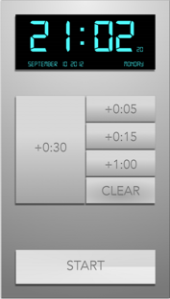
80/20 rule: CS247 microwave redesign
removed unnecessary buttons
only functionality to increase time
most important buttons larger
Notes:
Pareto – economist who discovered Pareto’s principle in the early 20th century looking at wealth distribution in Italy

Slide 23
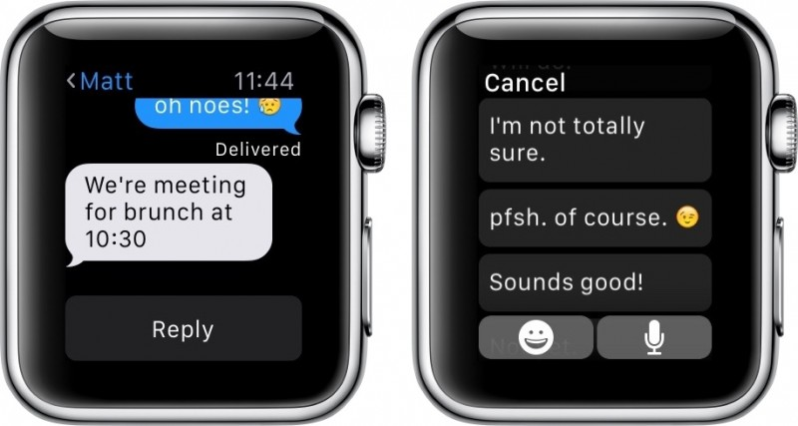
80/20 rule: cross-platform design
Notes:
Pareto – economist who discovered Pareto’s principle in the early 20th century looking at wealth distribution in Italy

Slide 24
80/20 rule how to
List all the things your user may want to do
Select 20% of them as the key things
Ensure those 20% of things are easy & fast
Question your need for the other 80%

Slide 25
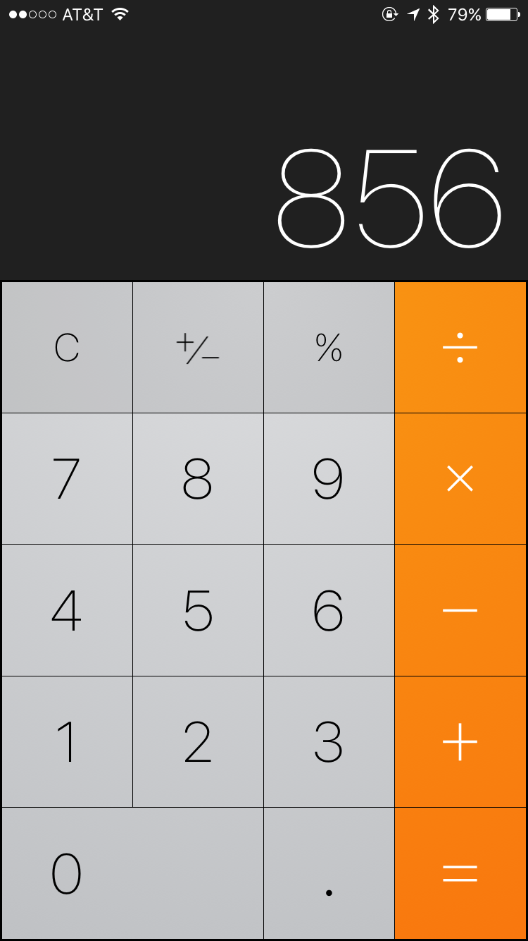
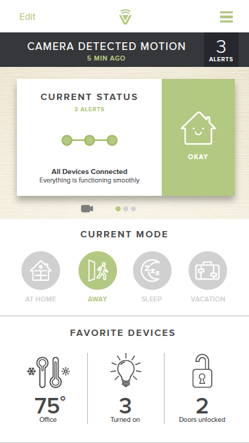
affordances

Slide 26
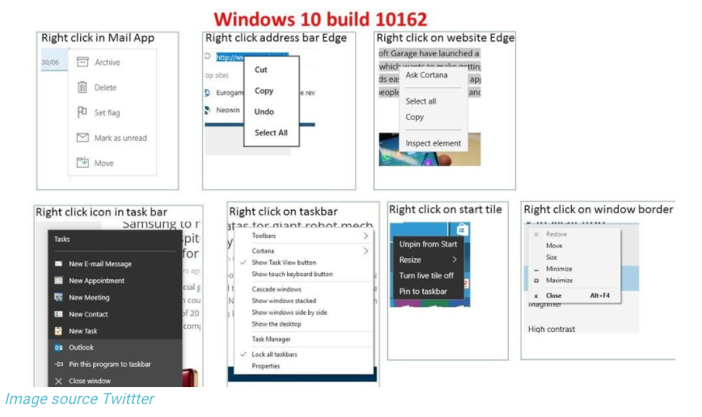
consistency

Slide 27
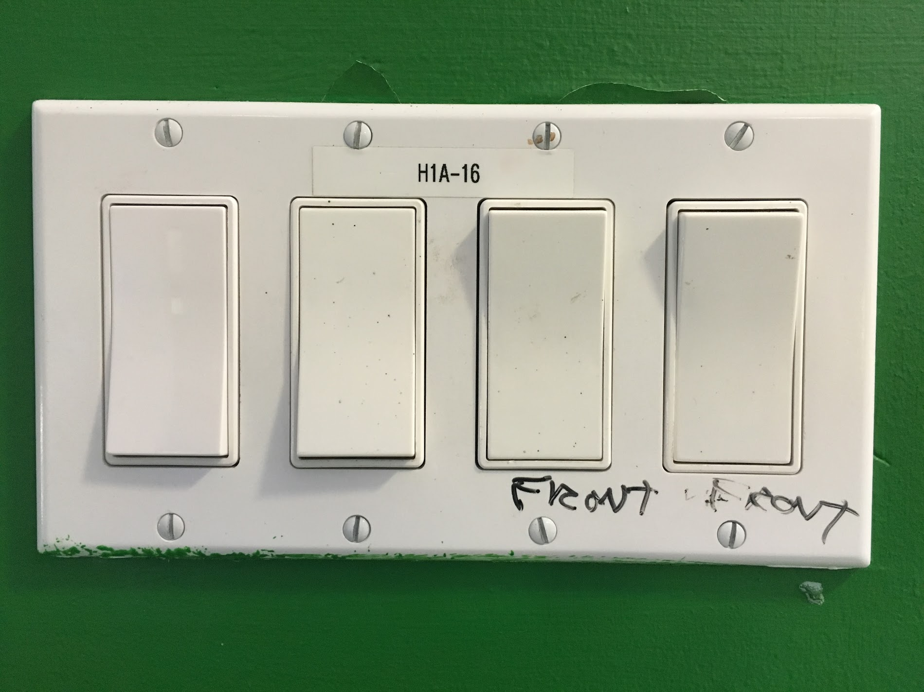
mapping
A relationship between controls and their movements or effects. Good mapping between controls and their effects results in greater ease of use. – Universal Principles of Design
Notes:
proximity and spacing

Slide 28
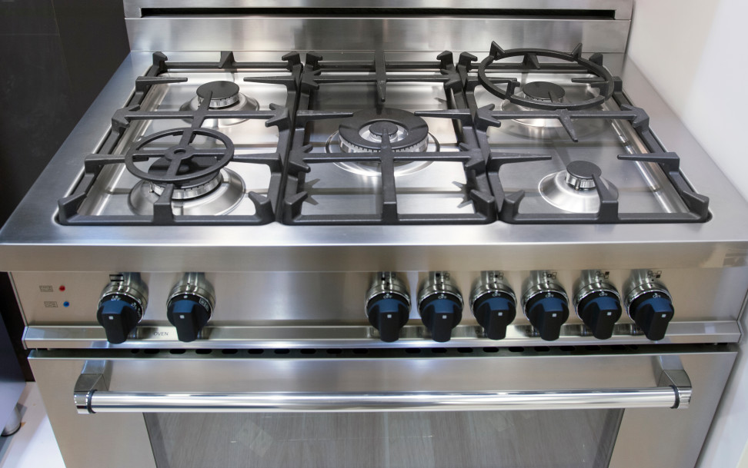
mapping – which knob goes to each burner?

Slide 29
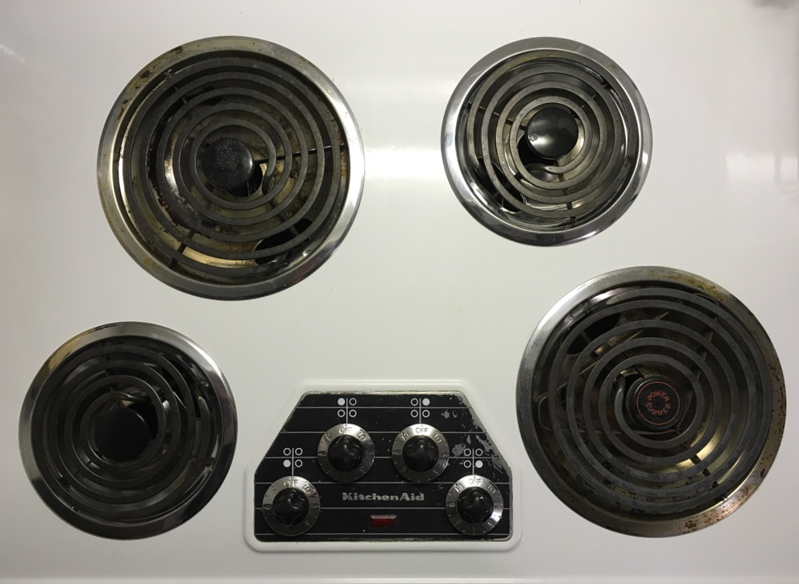
mapping – better knob & burner mapping

Slide 30
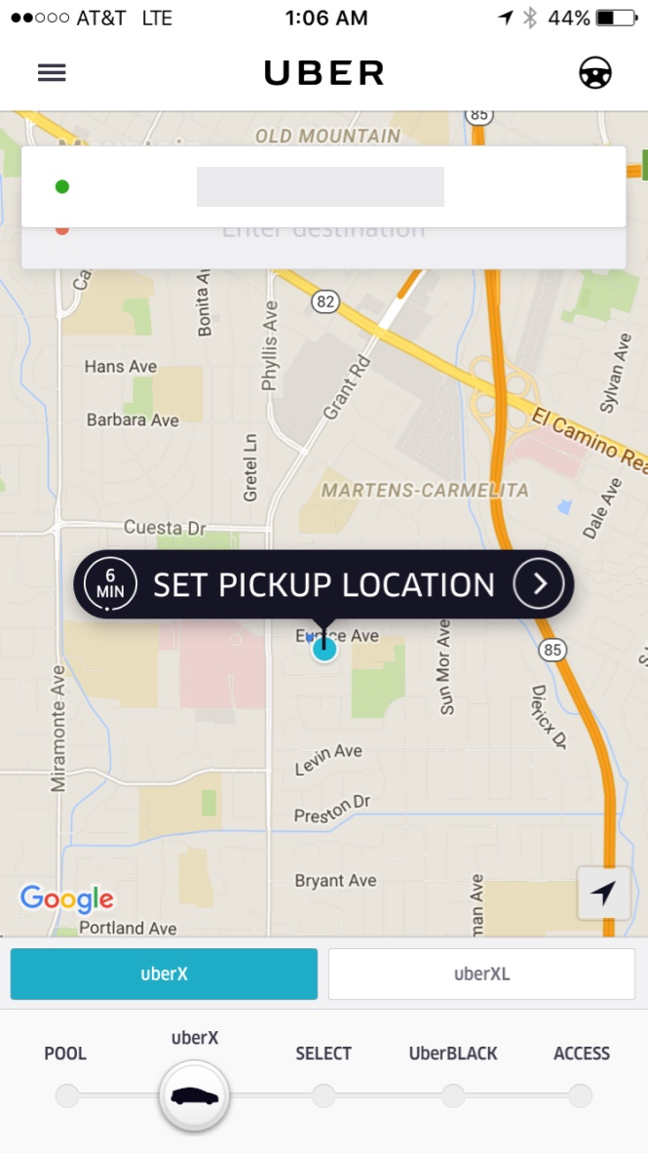
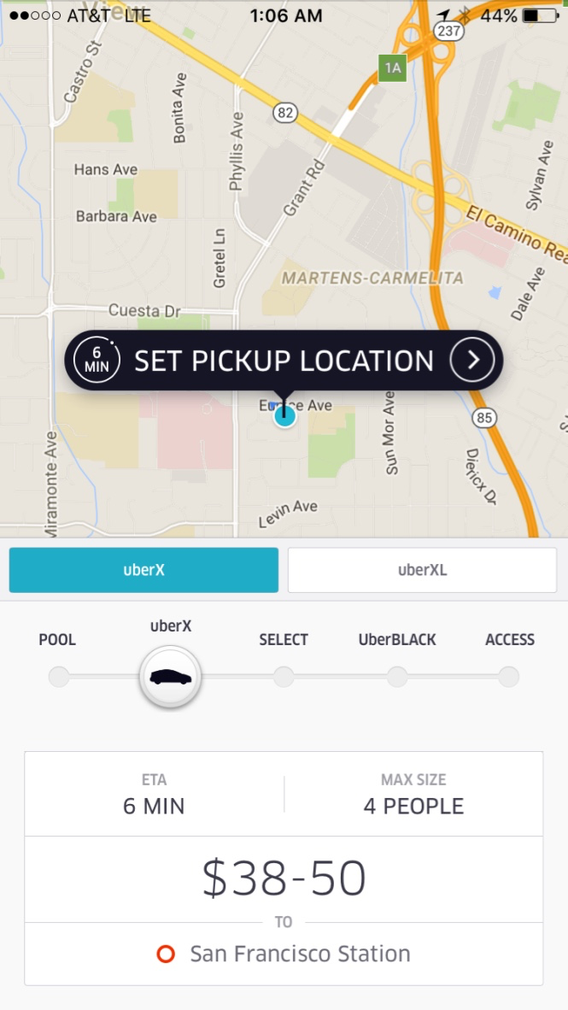
progressive disclosure
Notes:
help maintain the focus of a user’s attention by reducing clutter, confusion, and cognitive load. minimum data for the task at hand

Slide 31
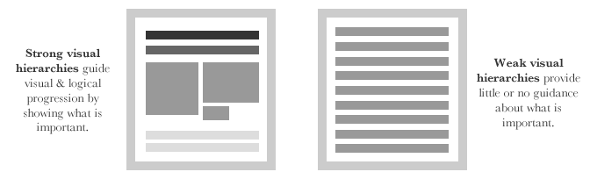
visual hierarchy and reading order
source: http://52weeksofux.com/post/443828775/visual-hierarchy
Notes:
http://52weeksofux.com/post/443828775/visual-hierarchy

Slide 32
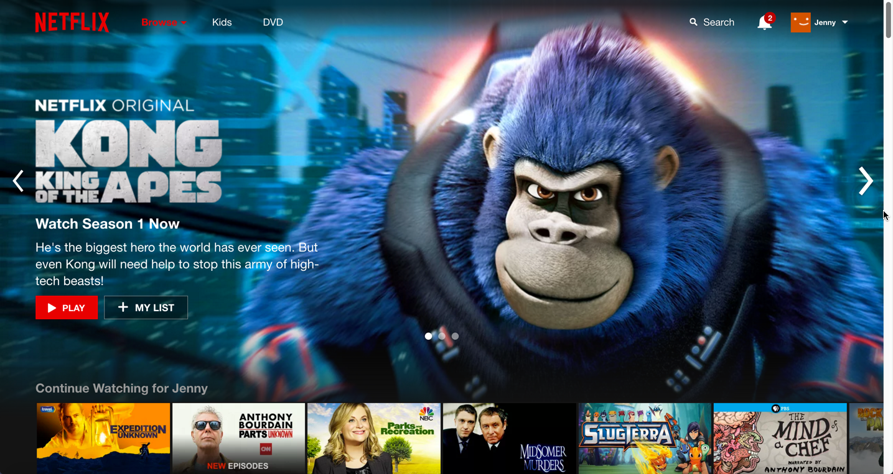
Notes:
what’s the reading order? how is it achieved?

Slide 33
reading order pillars
size
color
layout
spacing
style
source: http://thenextweb.com/dd/2015/04/30/the-5-pillars-of-visual-hierarchy-in-web-design/#gref
Notes:
what’s the reading order? how is it achieved?

Slide 34
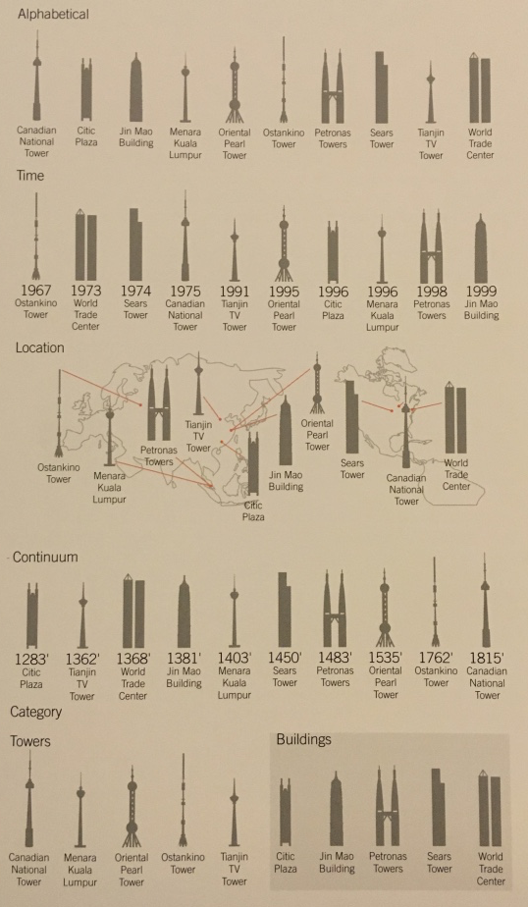
5 ways to organize information (five hat racks)
category
time
location
continuum
alphabet
The fallback order is alphabetical order
Source: Universal Principles of Design
Notes:
analogy
Richard Saul Wurman – Information Anxiety
discuss example of each?

Slide 35
combining it all

Slide 36
What to consider
Timeline of use
Implicit interactions
Basics
  80/20
  consistency
  mapping
  progressive disclosure
  order
  hierarchy

Slide 37
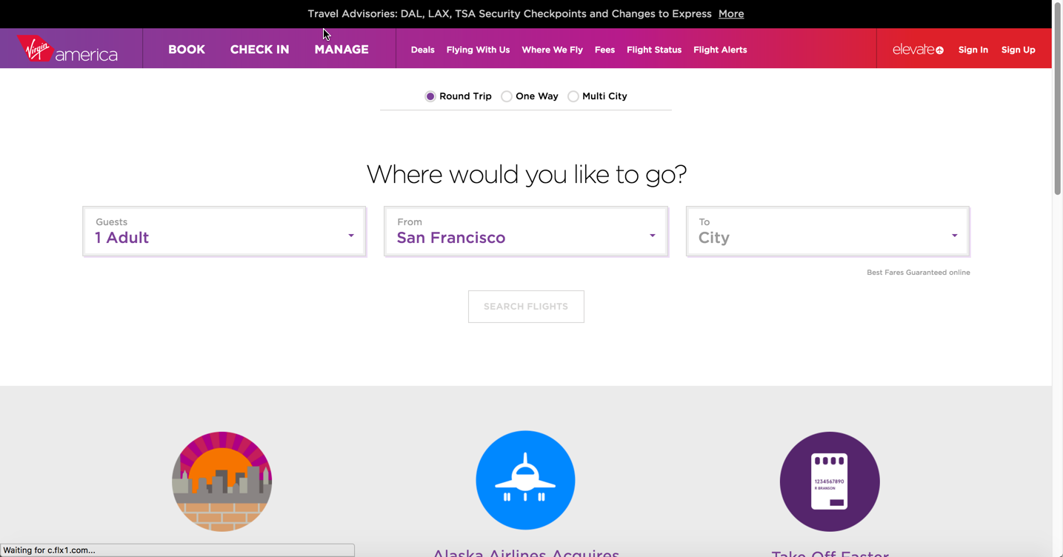
Virgin America
Notes:
reduce cognitive load
specific use case: repeated travel for specific date and time, business traveler, not shopping around
once vs. repetitive
volume of information

Slide 38

Edward Tufte on visualizing information
How should I design a bar chart?
Notes:
p.126-128

Slide 39
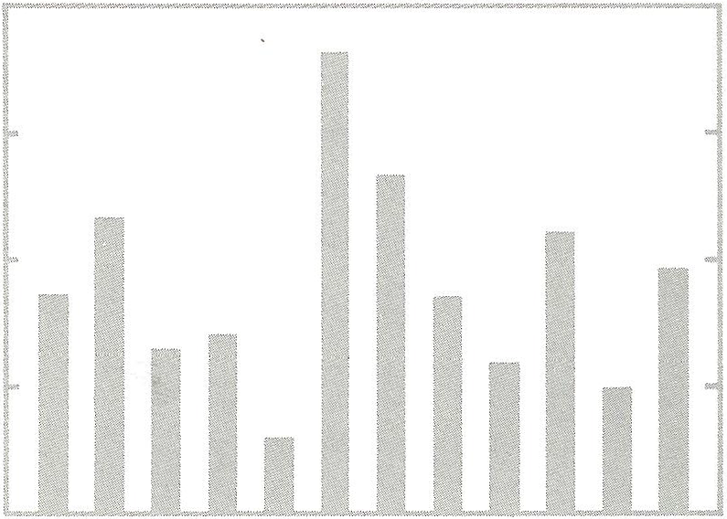
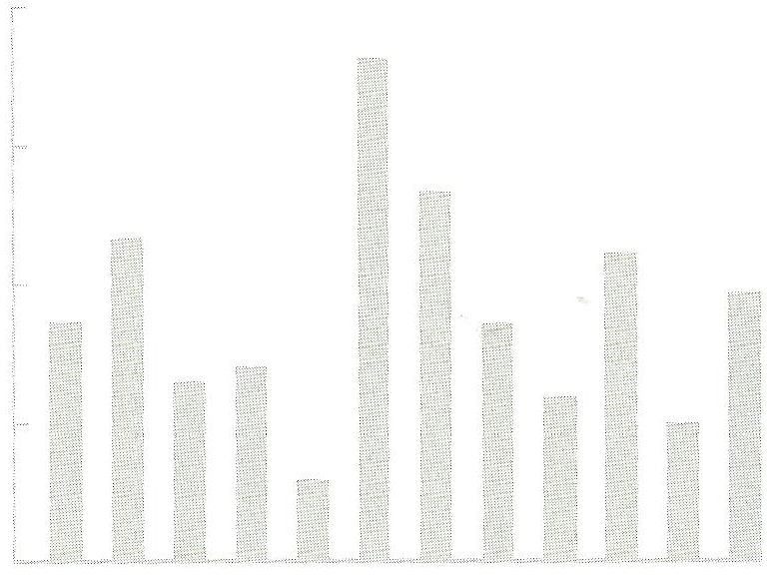
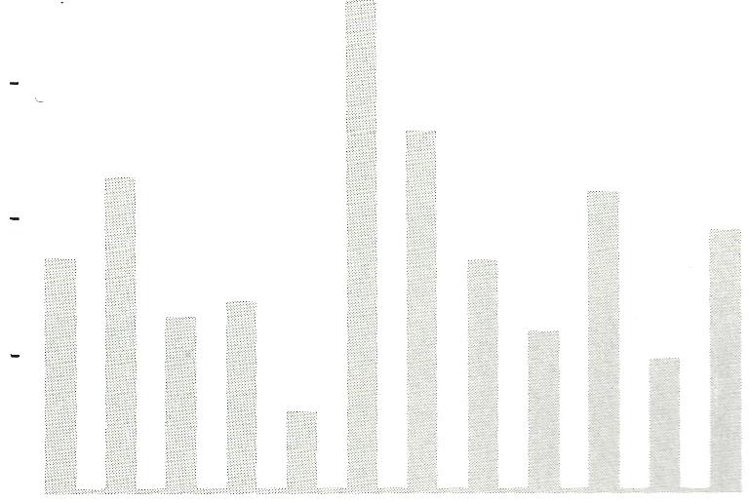
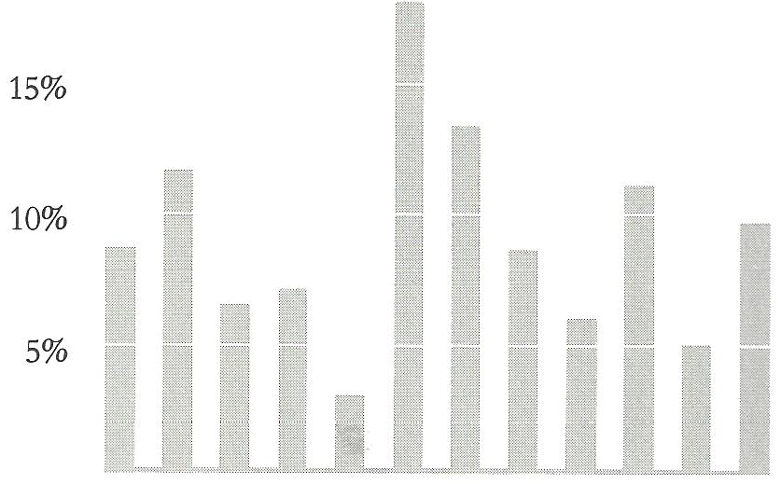
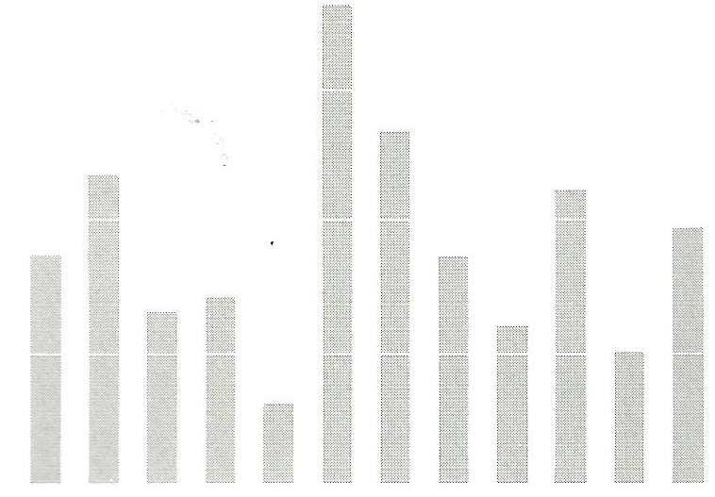
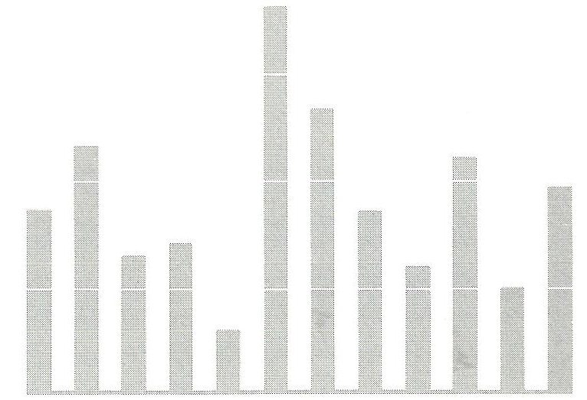
Edward Tufte on visualizing information
typical bar chart
erase box
erase vertical axis, except ticks
add white grid to replace
tick marks
erase baseline, bottom
of bars define endpoint
still, a thin baseline looks good
Source: The Visual Display of Quantitative Information by Edward R. Tufte
Notes:
p.126-128, [example of bar charts from Tufte book]

Slide 40
other reference books
Universal Principles of Design by Lidwell, Holden, and Butler
Designing for Interaction by Dan Saffer
The Non-Designer’s Design Book by Robin Williams
Don’t Make Me Think by Steve Krug

Slide 41
inspiration and resources
inspiration
  https://www.pinterest.com/timoa
  http://pttrns.com/
icon resources
  Noun Project
  FontAwesome

