Slide 1
Early Stage (lo-fi & med-fi) Prototyping
April 29, 2019
Notes:
Goal 45 min plus 35 min to check in on teams (did it in 30 min)

Slide 2
Outline
Selecting tasks
Storyboarding
Low-fi prototyping
Conducting a low-fi test
Medium-fi prototyping

Slide 3
Task. The structured set of activities or high-level actions required to achieve a high level user goal.
what a user wants to do

Slide 4
Task-based Design & Evaluation
Real tasks customers have faced / will face
collect any necessary materials
Do your tasks support the problem you are solving?
Mixture of simple & complex tasks
simple task (common or introductory)
moderate task
complex task (infrequent or for power customers)

Slide 5
What Should Tasks Look Like?
Say what customer wants to do, but not how
allows comparing different design alternatives
Good (Task)
Tony is visiting London and wants to find the pub that his friend told him about. He is walking down the street using his phone to navigate to the place that he has previously looked up.
Notes:
Tony is visiting London and wants to find the pub that his friend told him about. He is walking down the street using his phone to navigate to the place that he has previously looked up (good) TASK
This is good. Now compare this task to this:
[ADVANCE]

Slide 6
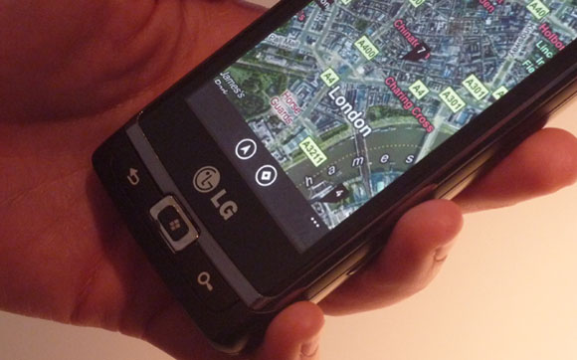
What Should Tasks Look Like?
Say what customer wants to do, but not how
allows comparing different design alternatives
Bad (this is a Taskflow)
Tony clicks on the Charing Cross Pub icon and selects “directions to” as he walks down the street.
Notes:
Tony clicks on the Charing Cross Pub icon and selects “directions to” as he walks down the street (bad) TASK FLOW (used to call Scenario)

Slide 7
What Should Tasks Look Like?
Say what customer wants to do, but not how
allows comparing different design alternatives
Be specific – stories based on facts!
say who customers are (use personas or profiles)
design can really differ depending on who
name names (allows getting more info later)
characteristics of customers (job, expertise, etc.)
forces us to fill out description w/ relevant details
Some should describe a complete goal
forces us to consider how features work together
example: phone-in bank functions
Notes:
“Wixon and colleagues were developing an interface for a file management system. It passed lab tests with flying colors, but bombed as soon as customers got it. The problem was that it had a scrolling file list that was (say) twenty characters wide, but the file names customers used were very long, and in fact often identical for more than twenty characters (the names were made up by concatenating various qualifiers, and for many names the first several qualifiers would be the same.) Customers were not amused by needing to select from a scrolling list of umpty-ump identical entries that stood for different files. And this wasn't an oddball case, it was in fact typical. How had it been missed in the lab tests? Nobody thought it would matter what specific file names you used for the test, so of course they were all short.” – from Chapter 2 of TASK-CENTERED USER INTERFACE DESIGN A Practical Introduction by Clayton Lewis and John Rieman.

Slide 8
Using Tasks in Design
Write up a description of tasks
formally or informally
run by customers and rest of the design team
get more information where needed
Let my friends know where I am Manny is in the city at a club that he wasn’t planning to go to and would like to let his girlfriend, Sherry, know where he is and be notified when she is about to get to the club.

Slide 9
Using Tasks in Design (cont.)
Rough out an interface design
discard features that don’t support your tasks
or add a real task that exercises that feature
major screens & functions (not too detailed)
hand sketched
Produce task flows for each task
what customer has to do & what they would see
step-by-step performance of task
illustrate using storyboards
sequences of sketches showing screens & transitions

Slide 10
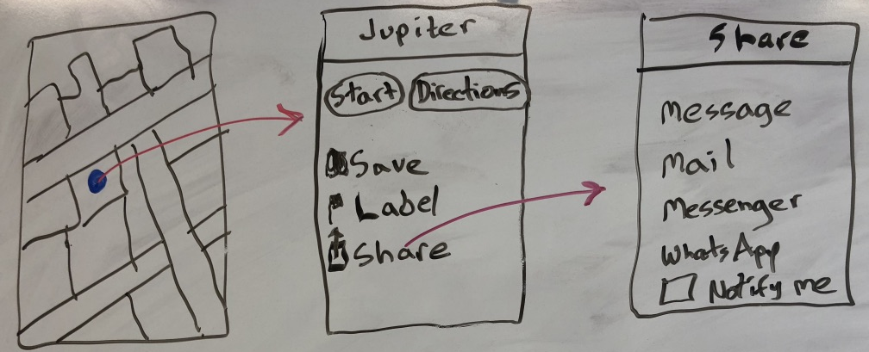
Task Flows Show How to Do the Task
Task Flows are design specific, tasks aren’t
Task Flows force us to
show how various features will work together
settle design arguments by seeing examples
Show users taskflows to get feedback

Slide 11
What
How
Task
Task Flow
Notes:
We have this continuum between saying “What” and “how” to achieve it for Tasks to Task Flows.

Slide 12
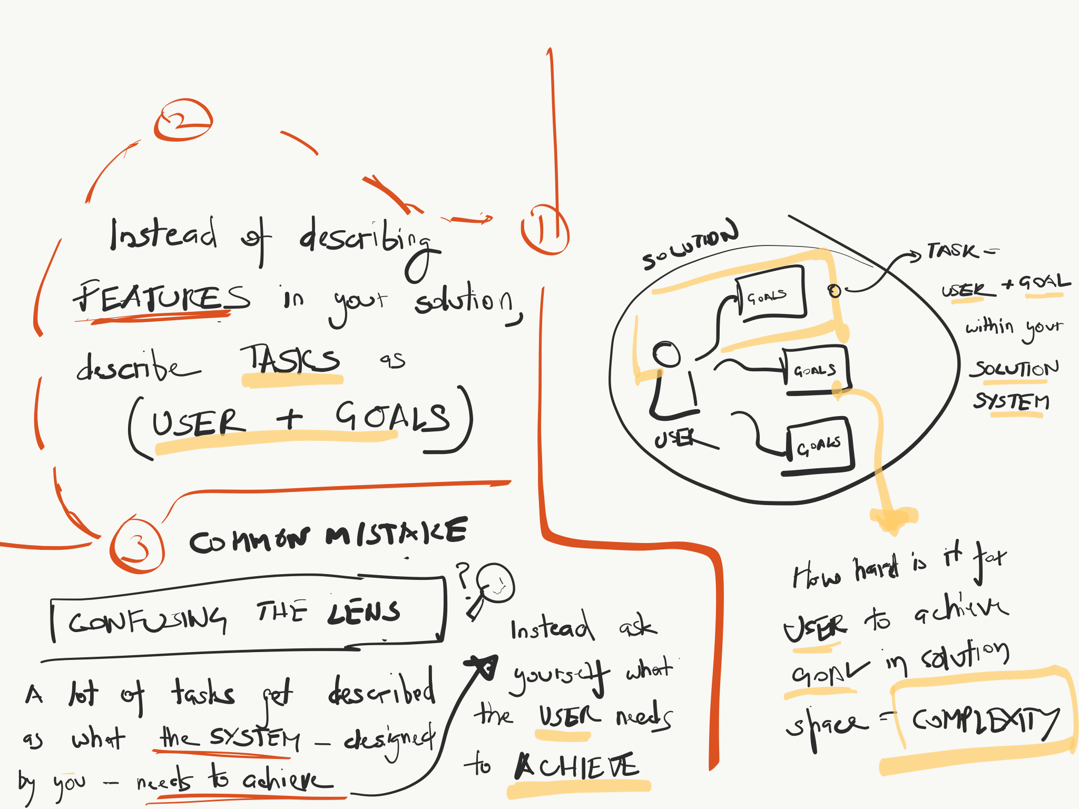
Tasks
Sketch by Trijeet Mukhopadhyay

Slide 13
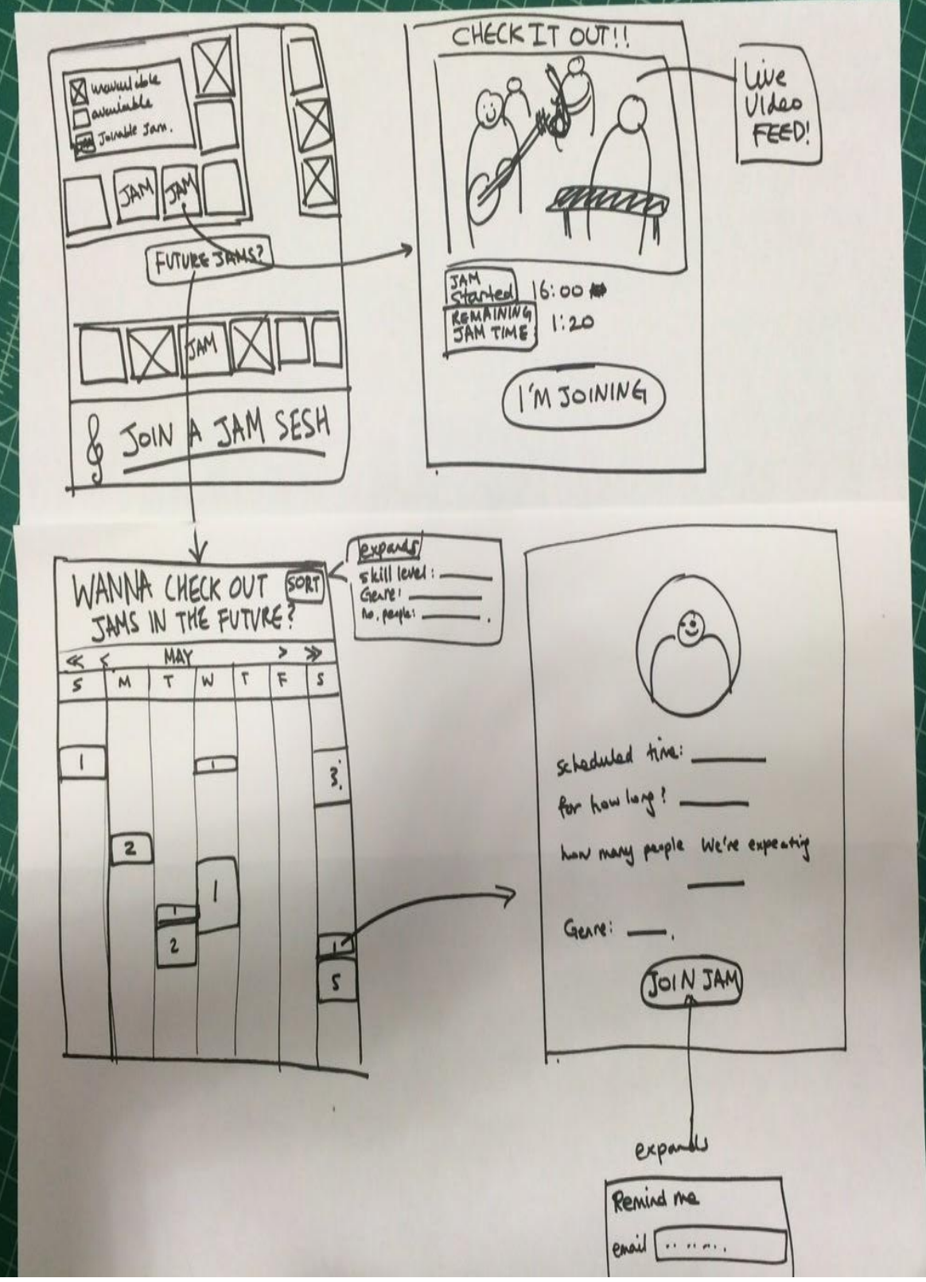
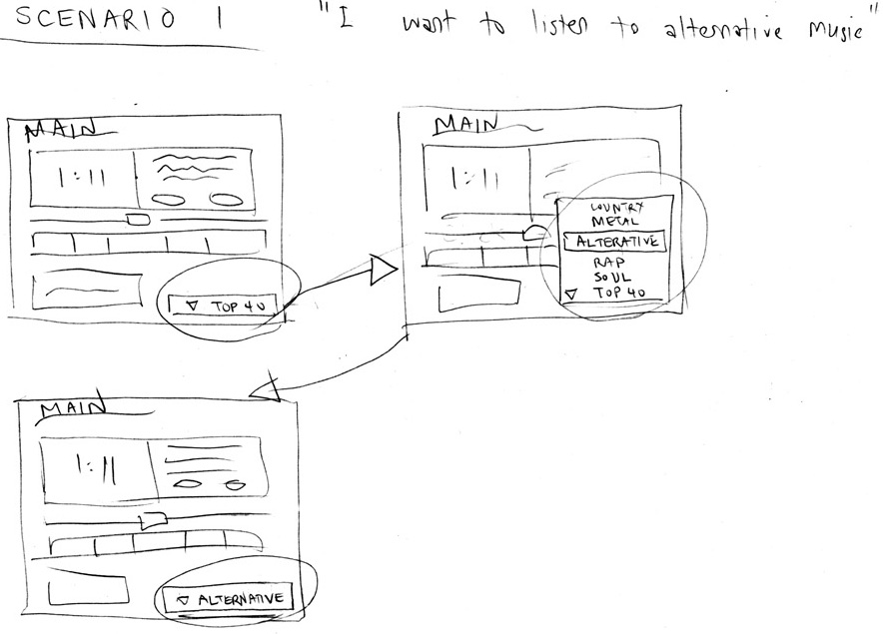
Storyboards in UX Design
Task:
Task Flow #1
Notes:
Storyboards allow us to show interaction and time
Task vs. task flow
is this a form of prototype? Let’s define it more carefully

Slide 14
Fidelity in Prototyping
Fidelity refers to the level of detail
High fidelity?
prototypes look like the final product
Low fidelity?
artists renditions with many details missing

Slide 15
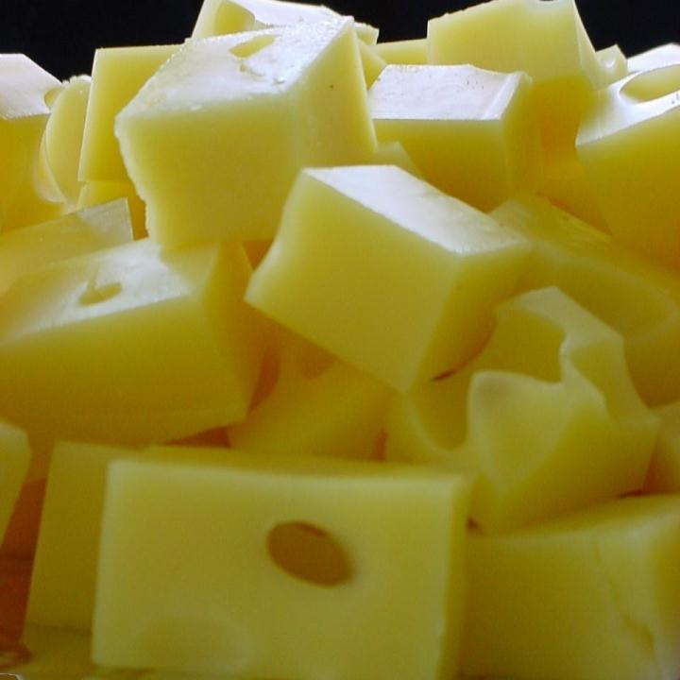
Hi-fi Prototypes Warp
Perceptions of the tester/reviewer
representation communicates “finished”
comments focus on color, fonts, & alignment
Time
encourage precision
specifying details takes more time
Creativity
lose track of the big picture

Slide 16
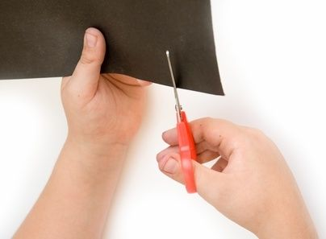
Why Use Low-fi Prototypes?
Traditional methods take too long
sketches → prototype → evaluate → iterate
Can instead simulate the prototype
sketches → evaluate → iterate
sketches act as prototypes
designer “plays computer”; others observe & record
Kindergarten building skills
allows non-programmers to participate

Slide 17
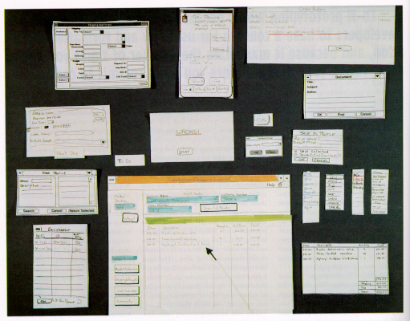
“Prototyping for Tiny Fingers” by Rettig

Slide 18
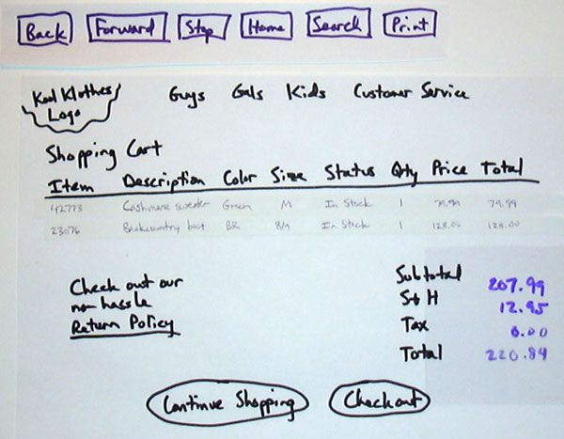

Slide 19
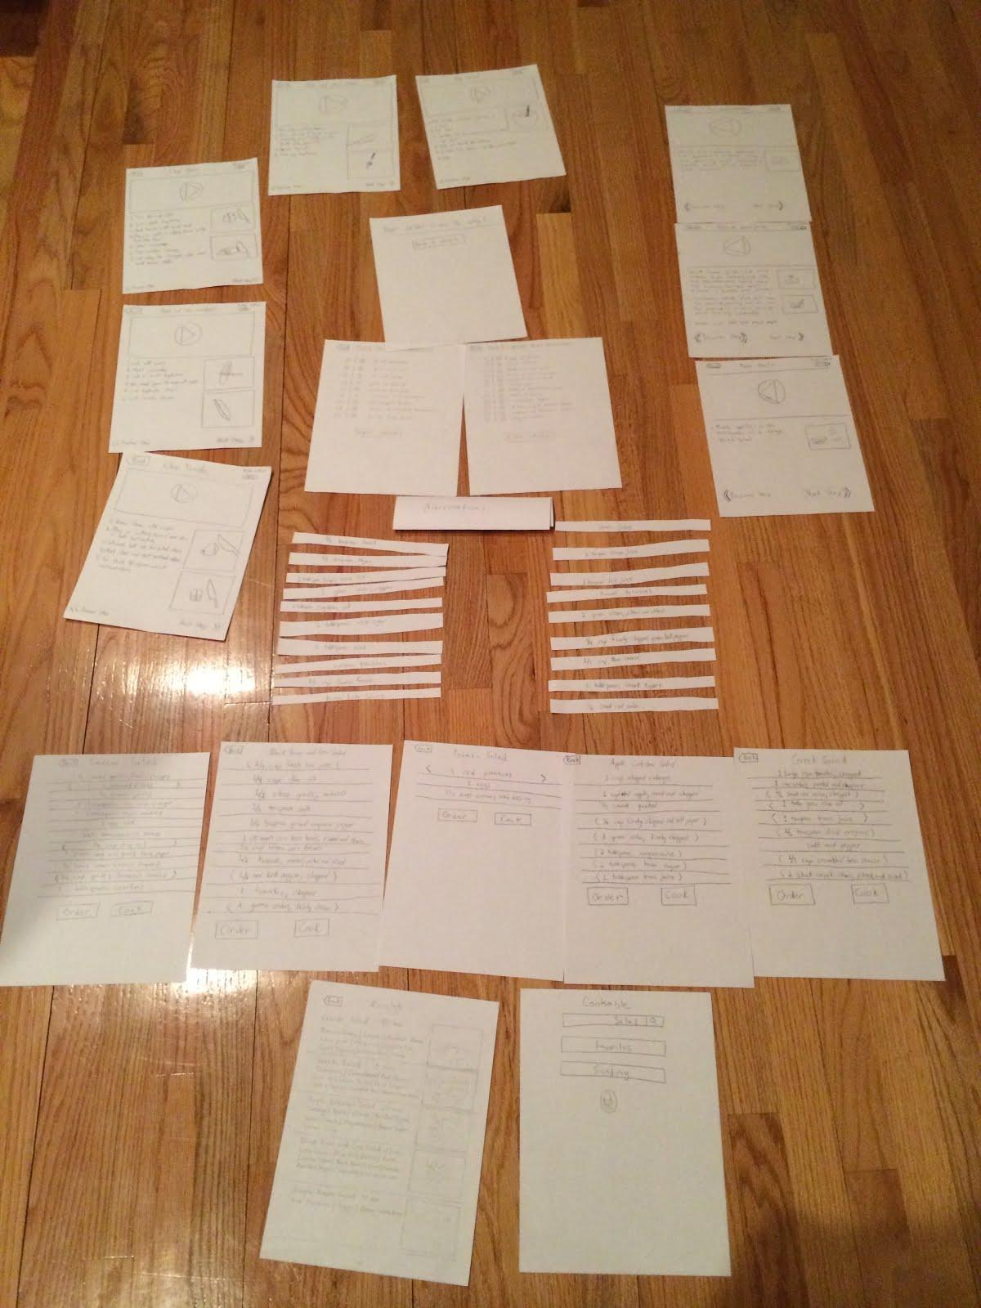
Cookable

Slide 20
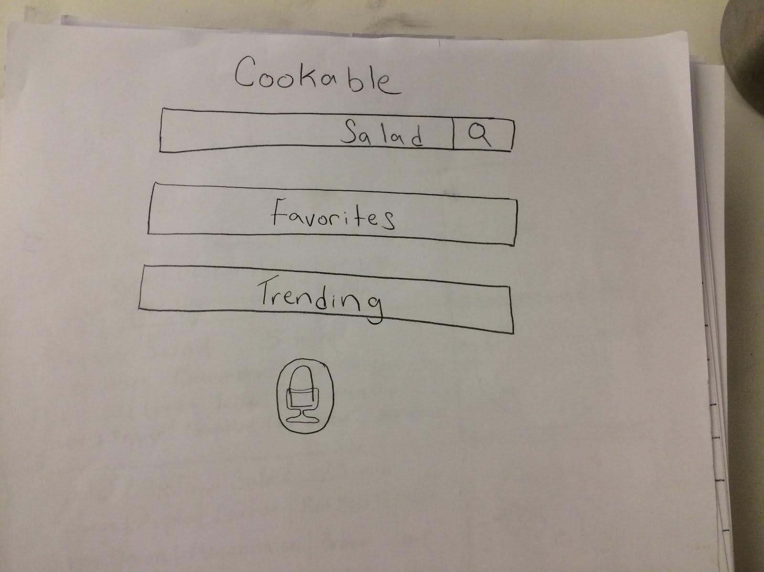
Cookable

Slide 21
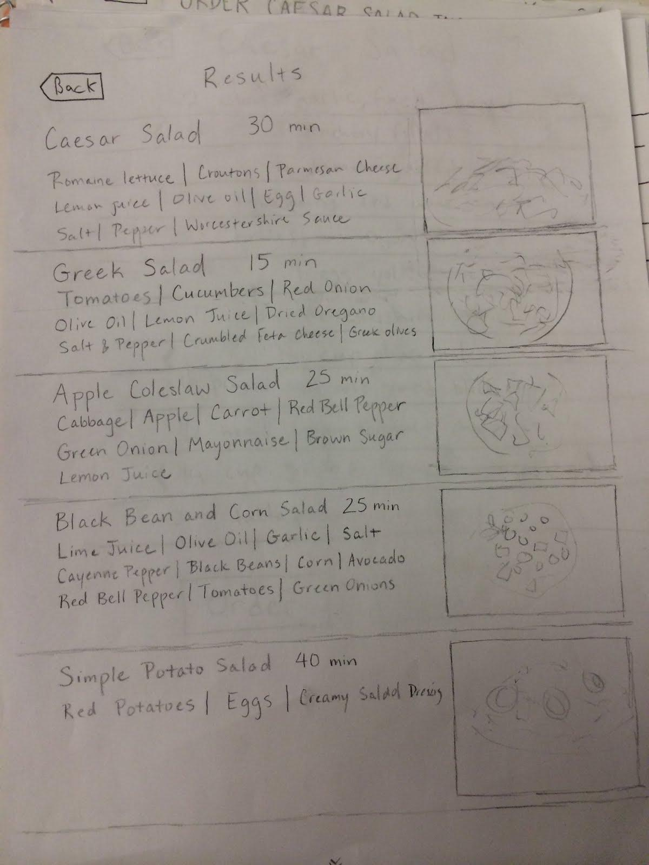
Cookable

Slide 22
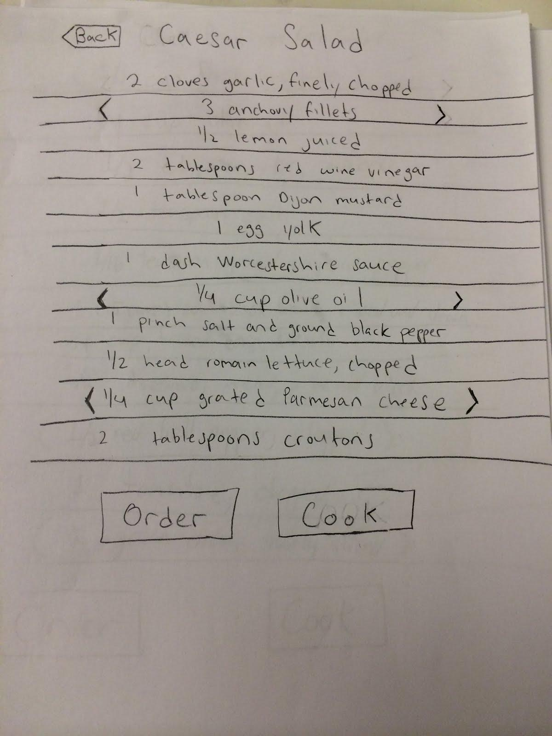
Cookable

Slide 23
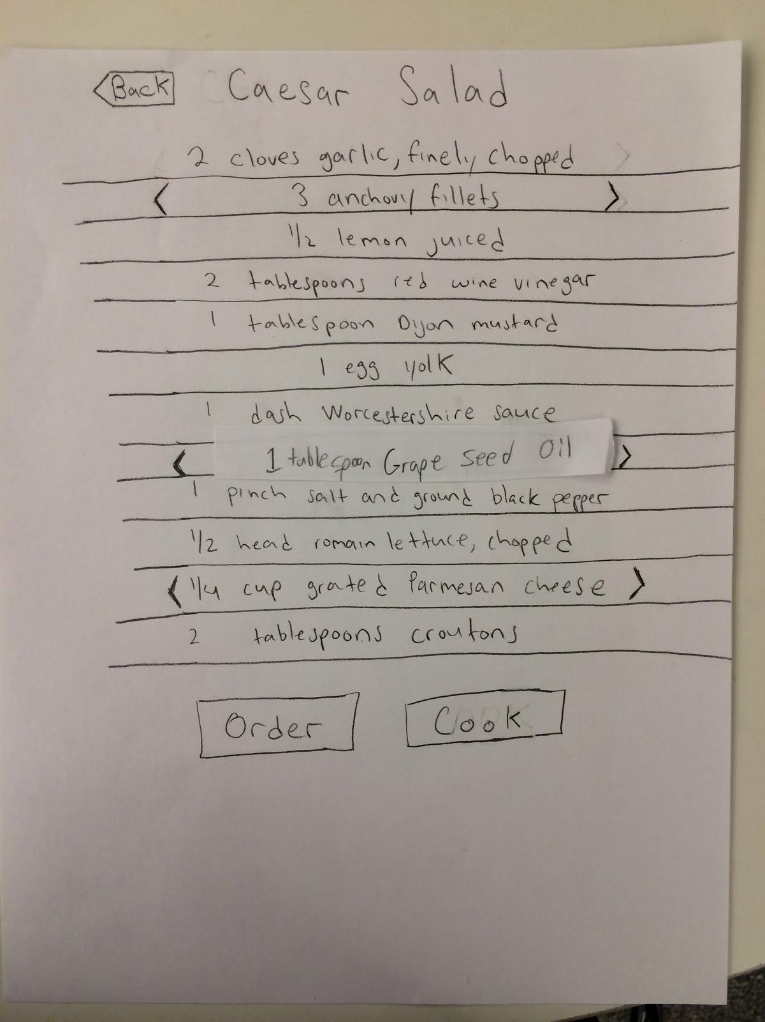
Cookable

Slide 24
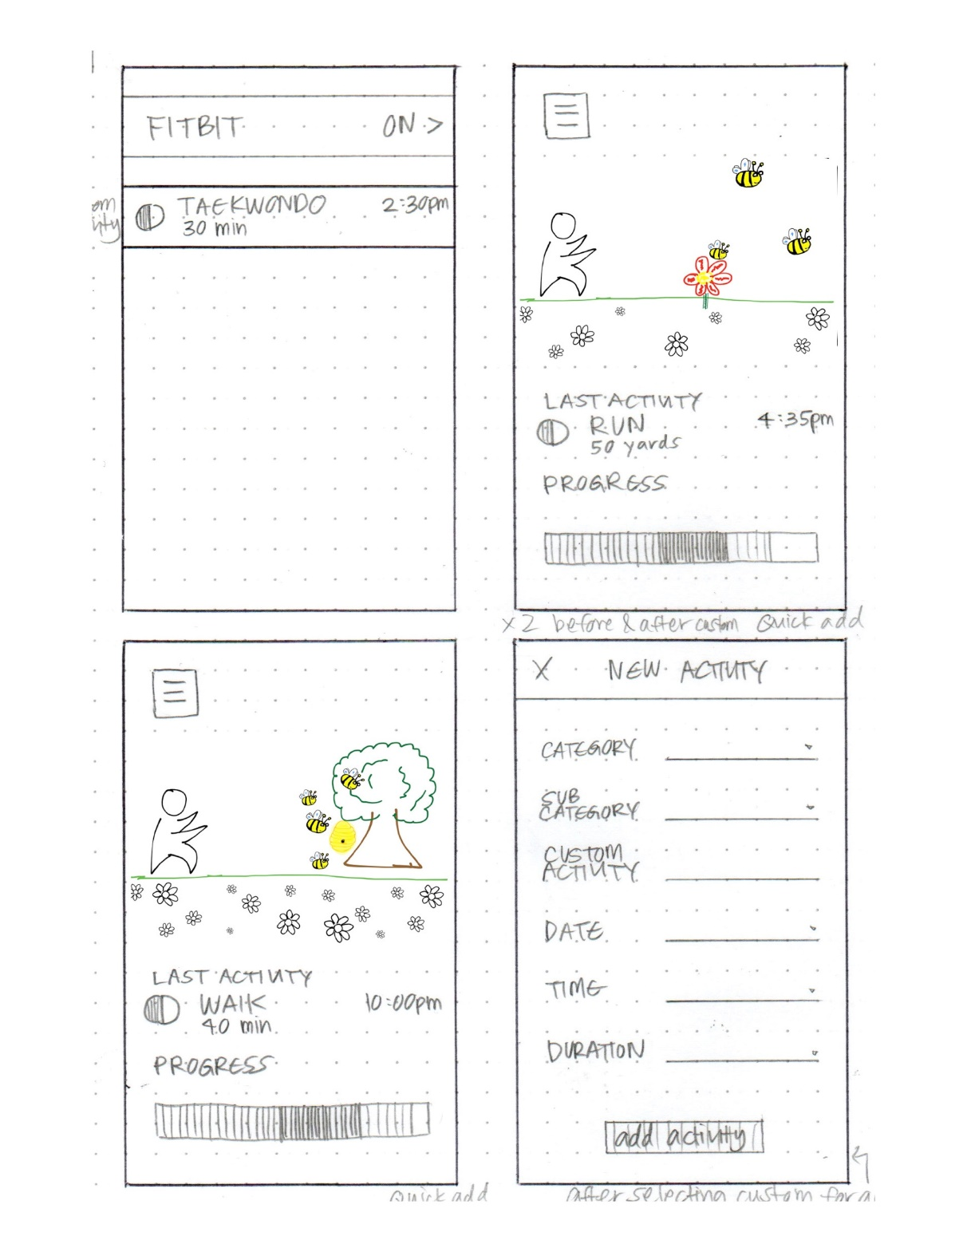
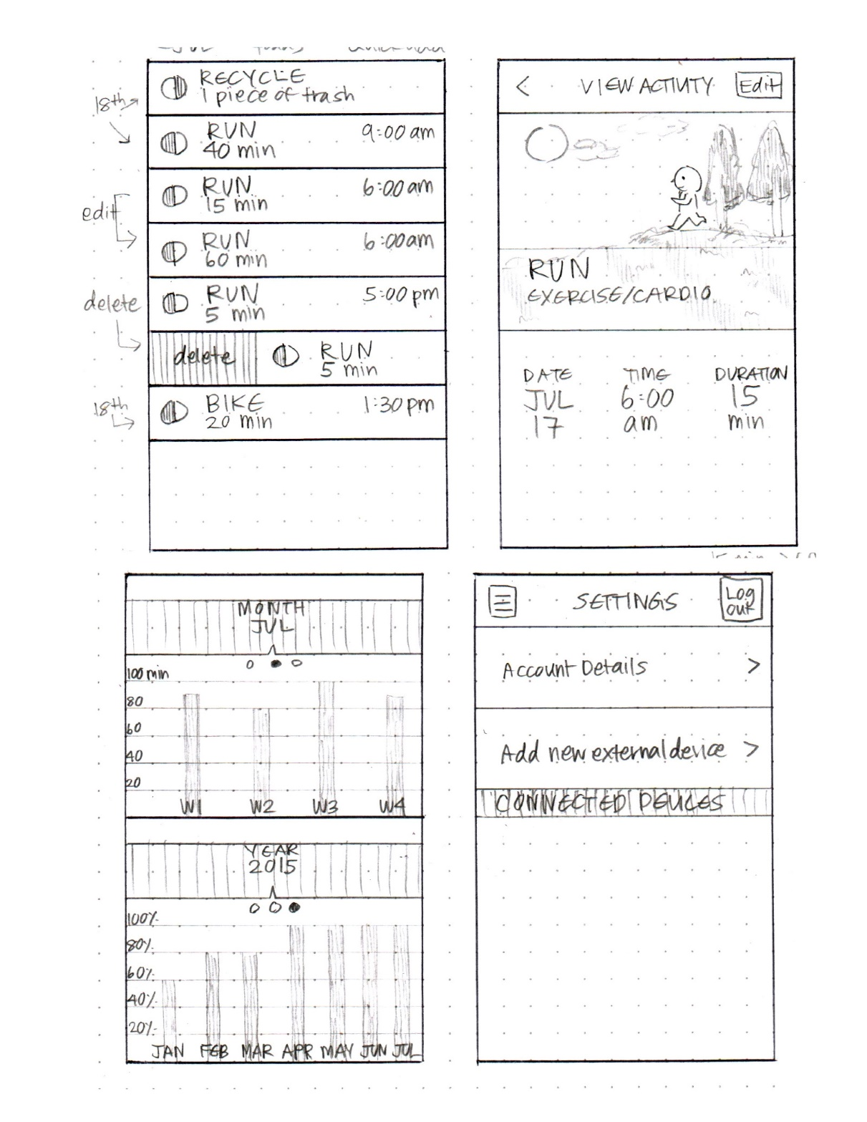
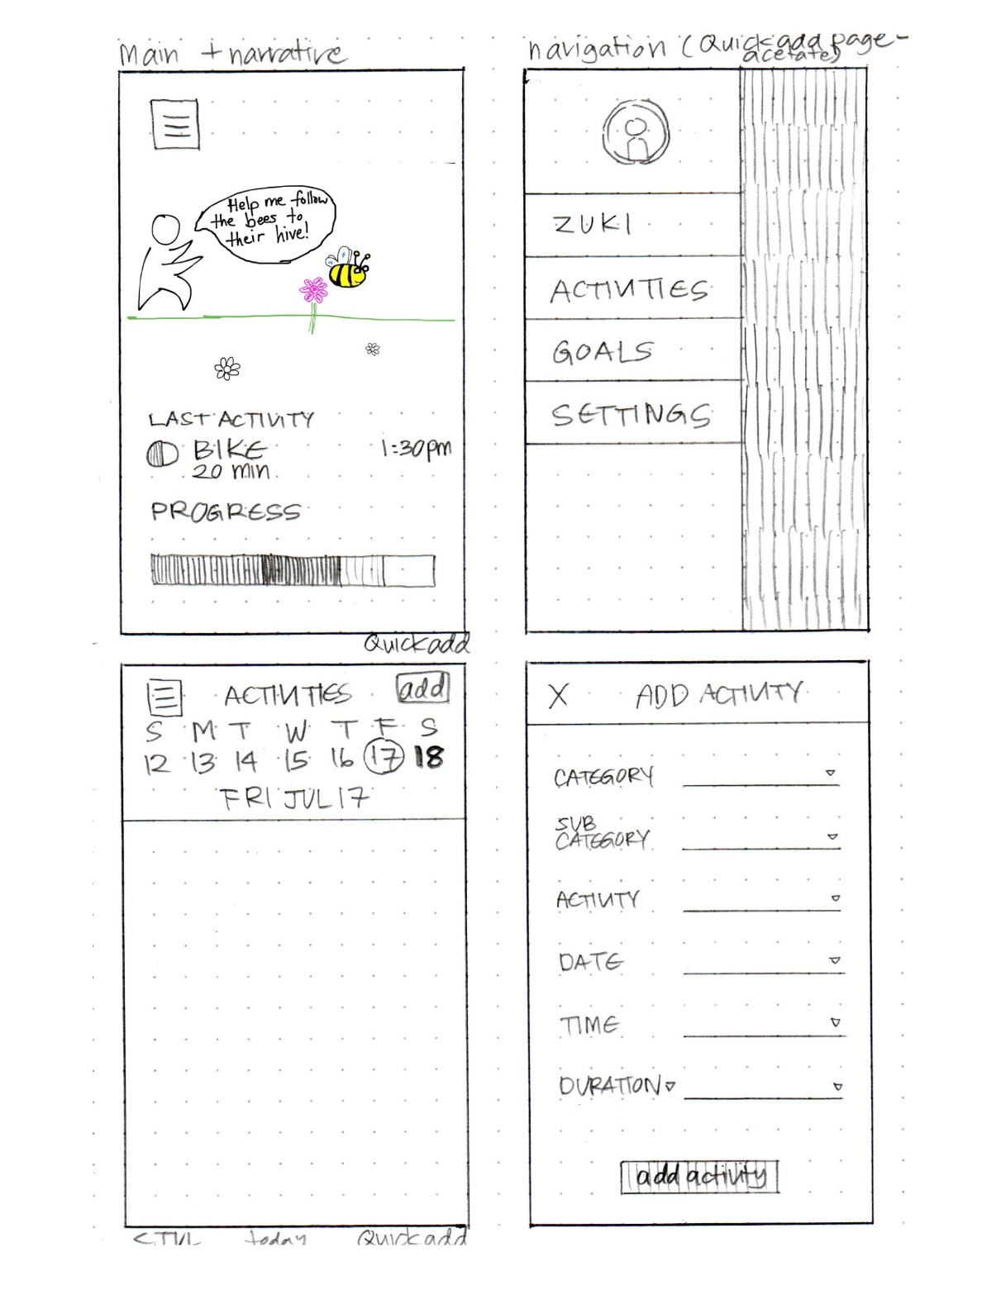
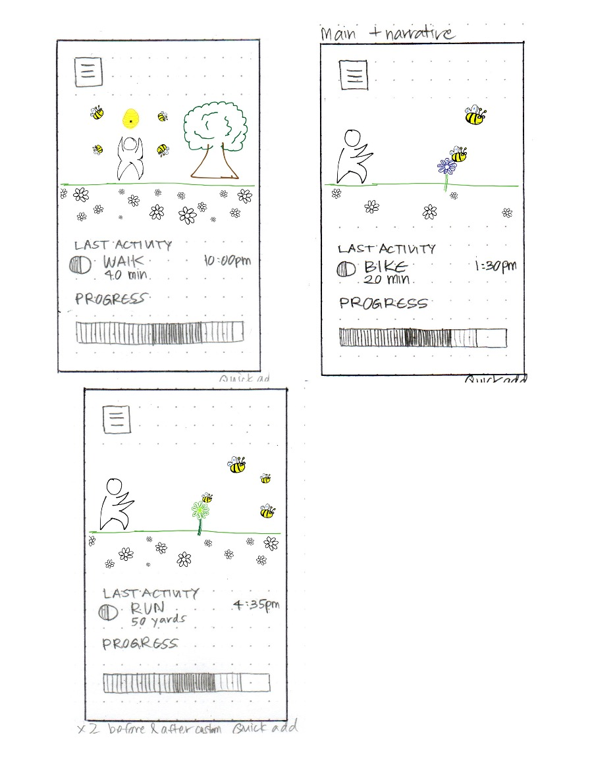
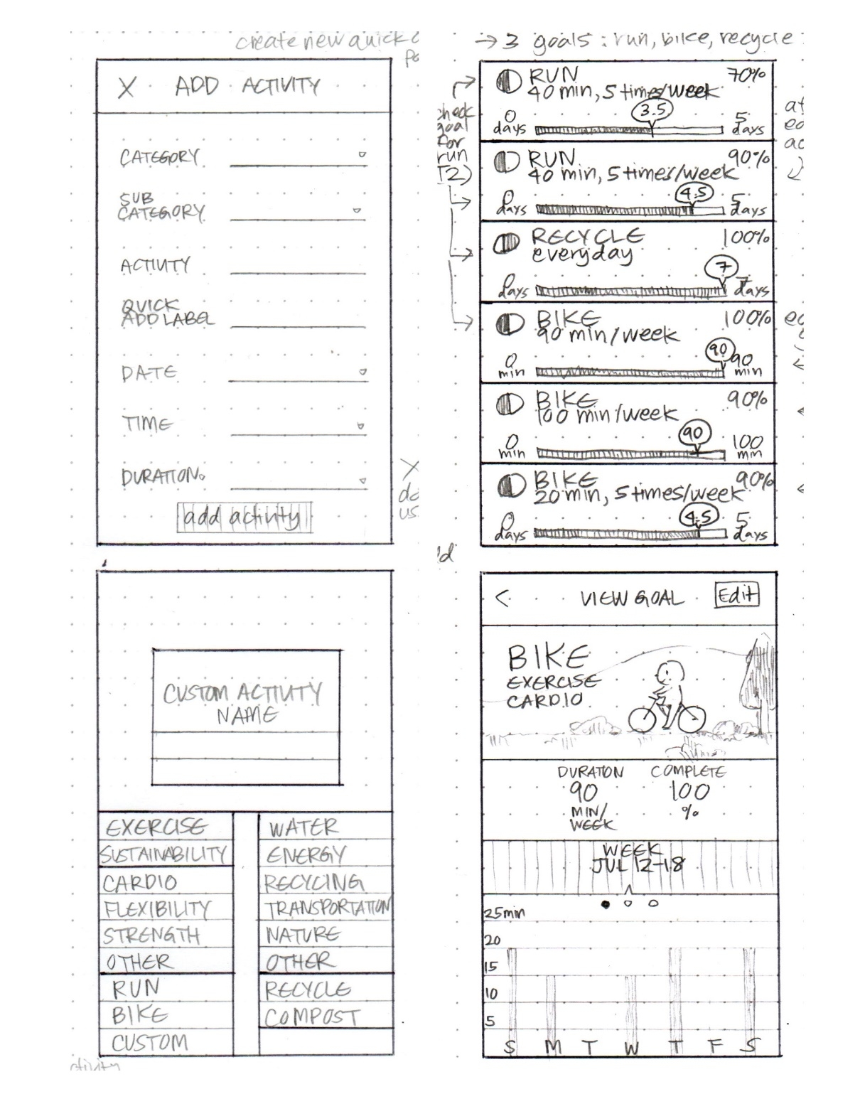
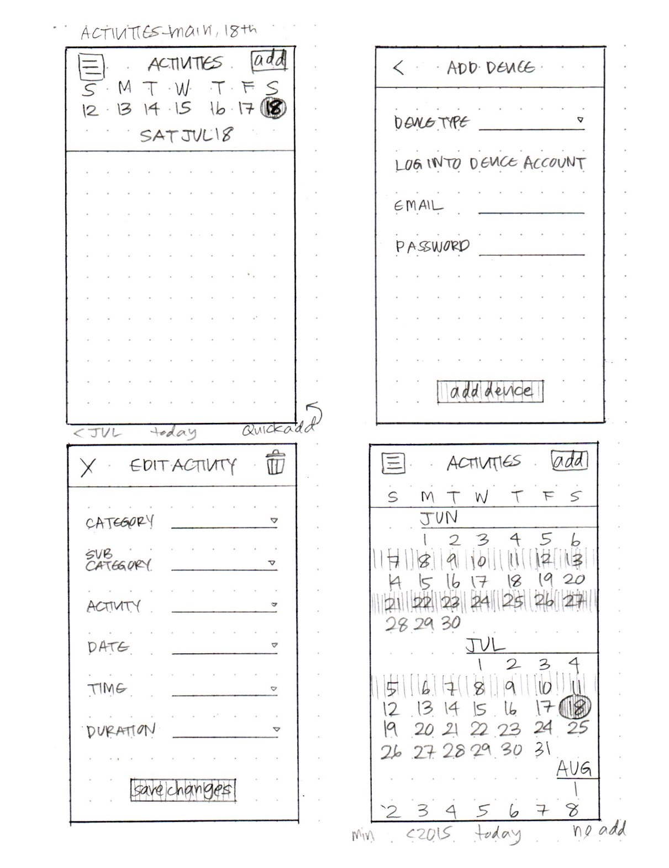
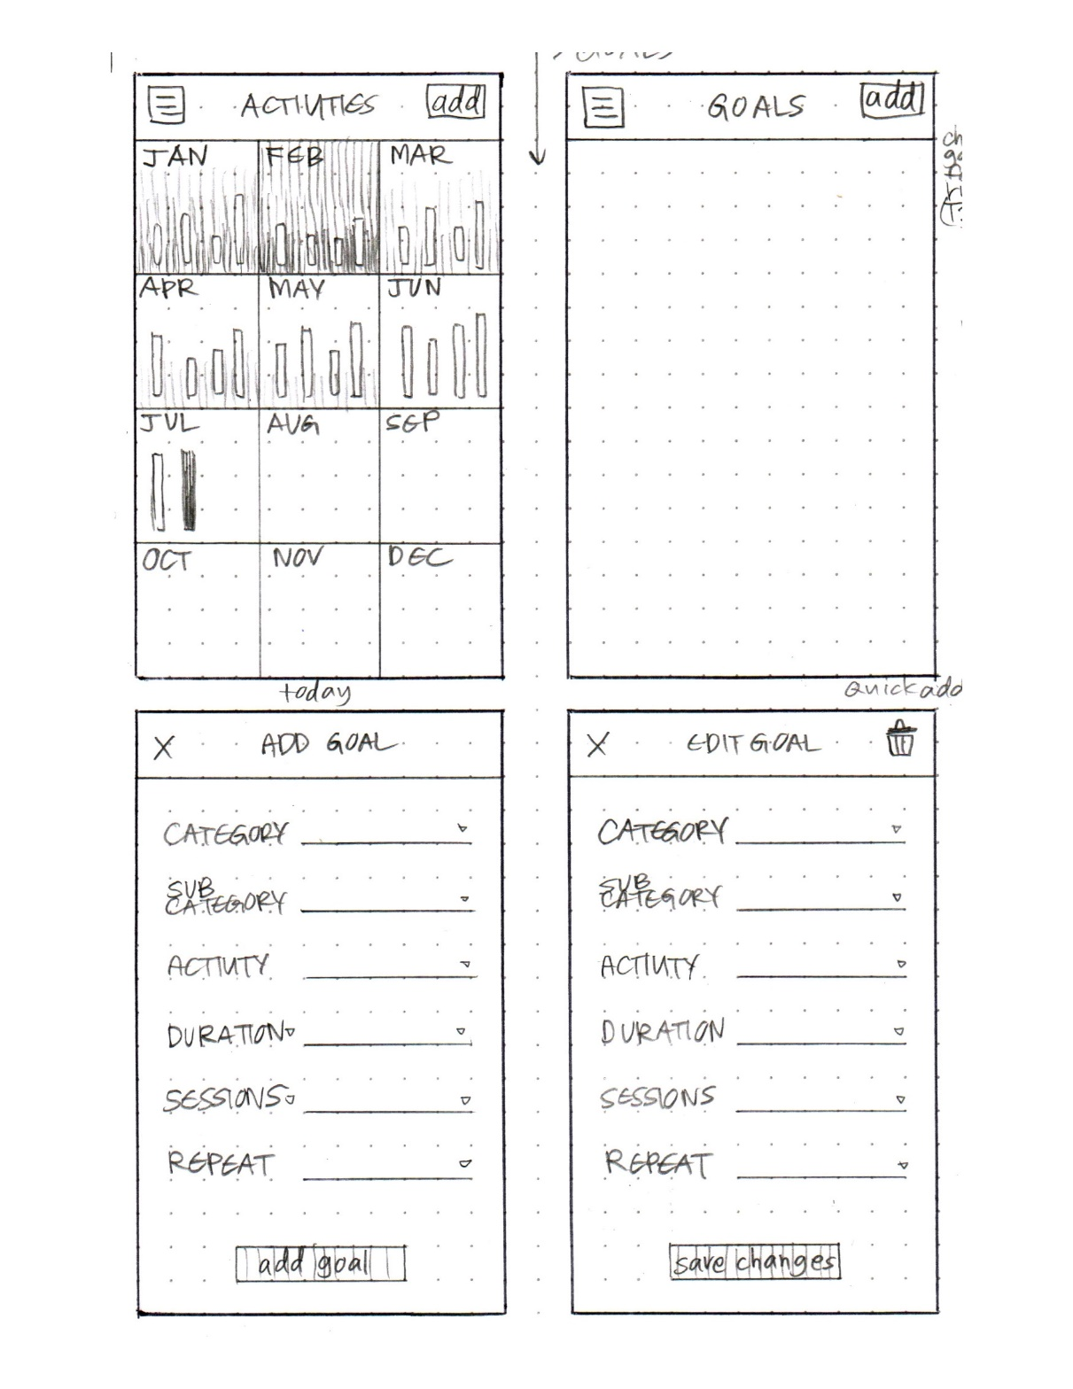
Who is Zuki?

Slide 25
Constructing the Model
Set a deadline
don’t think too long - build it!
Draw a window frame on large paper
Put different screen regions on cards
anything that moves, changes, appears/disappears
Ready response for any user action
e.g., have those pop-up dialogs, etc. already made
Use photocopier/printer to make many versions

Slide 26
Preparing for a Test
Select your “customers”
understand background of intended users
use a questionnaire to get the people you need
don’t use friends or family
Prepare scenarios that are
typical of the product during actual use
make prototype support these (small, yet broad)
Practice to avoid “bugs”
Notes:
At most 1 stanford student

Slide 27
Conducting a Test Four Roles
Greeter – puts users at ease & gets data
Facilitator – only team member who speaks
gives instructions & encourages thoughts, opinions
Computer – knows application logic & controls it
always simulates the response, w/o explanation
Observers – take notes & recommendations

Slide 28
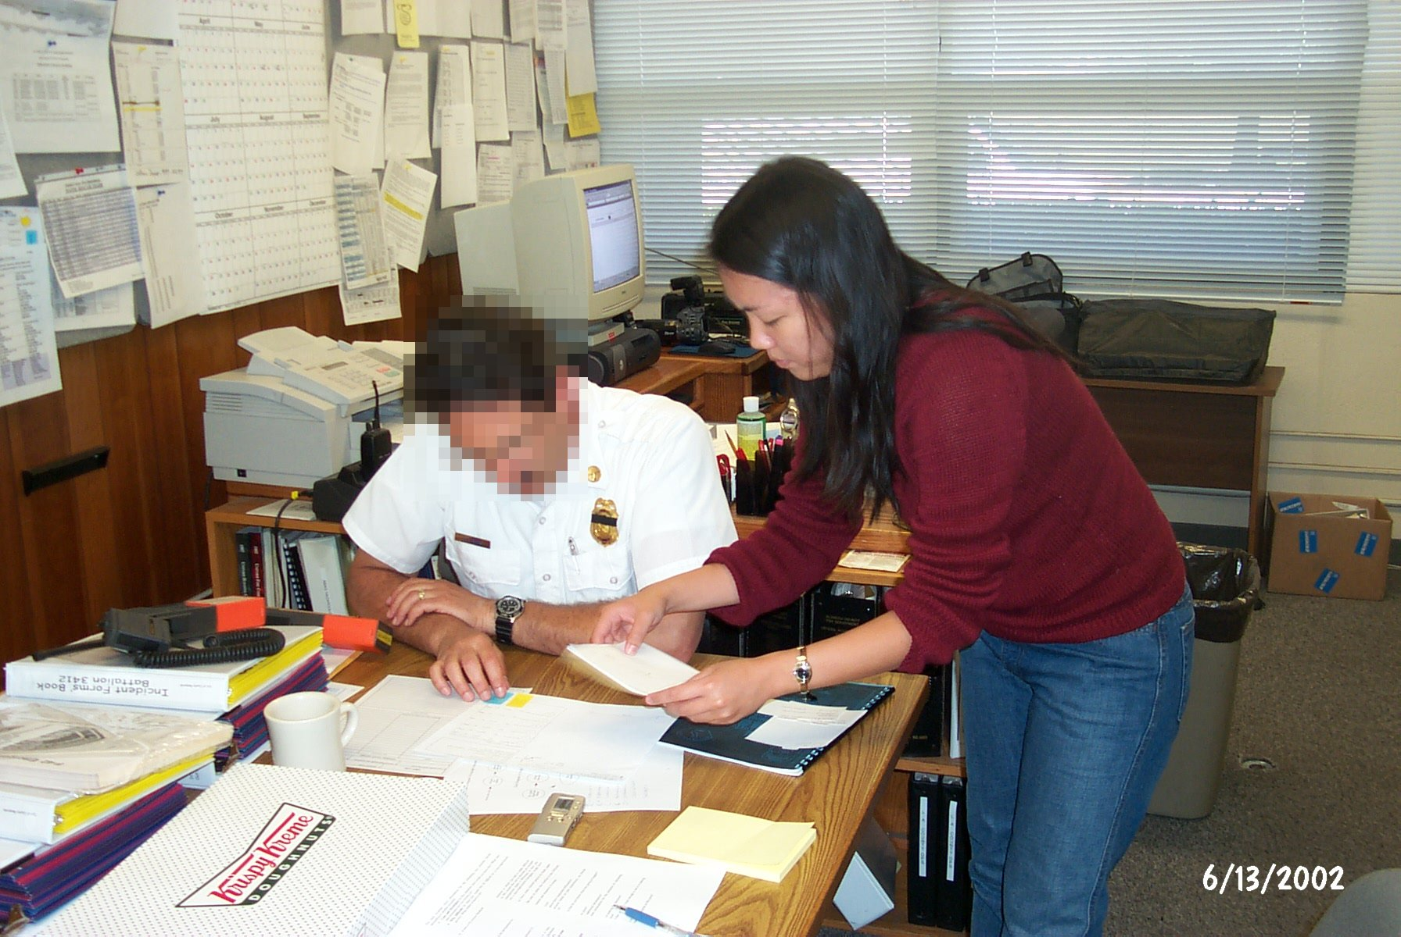
Conducting a Test
Notes:
Note USE REAL IMAGES in your reports (blur faces if you need to)

Slide 29
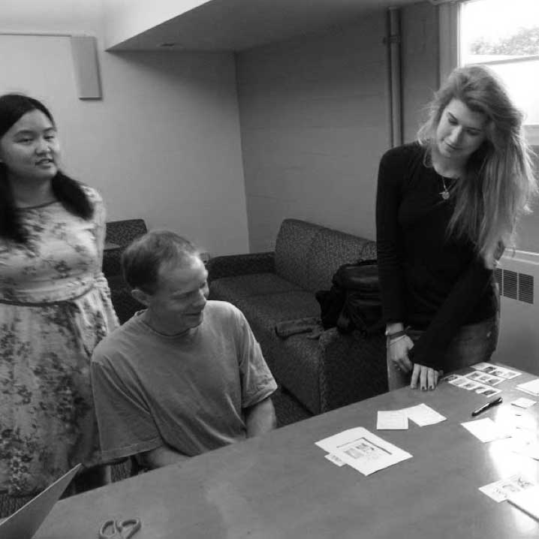
Wonderlust
Notes:
Wonderlust, CS147, 2014au

Slide 30
Who is Zuki?
Notes:
1:46 video

Slide 31
Evaluating Results
High level questions about your design
does it address the problem you want to solve?
is this the right realization of your solution?
Sort & prioritize observations
what was important?
lots of problems in the same area?
Make changes & iterate
even iterate between tests

Slide 32
Fidelity in Prototyping: Instagator

Slide 33
Fidelity in Prototyping Task 1: Take a Destination Poll
Low-fi
Medium-fi
Notes:
Medium-fi start to give us more realism. Most often tested on the target device and fonts, colors, and interactive elements (widgets) look real to people.
Often harder to change as rapidly and can cause tunnel vision. So do NOT start with these.
This is where we start to use tools like Sketch

Slide 34
Summary
Prototypes are a concrete representation of a design or final product
Low-fi testing allows us to quickly iterate
get feedback from users & change right away

