Slide 1
Define
This work is licensed under the Creative Commons Attribution-Noncommercial-Share Alike 3.0 Unported License. To view a copy of this license, visit http://creativecommons.org/licenses/by-nc-sa/3.0/
2019/04/17
Slides adapted from d.leadership Define + Ideate slides (https://dschool.stanford.edu/groups/dleadership/wiki/59f08/dleadership_2015.html)
Additional resources from bootcamp bootleg (http://dschool.stanford.edu/wp-content/uploads/2011/03/BootcampBootleg2010v2SLIM.pdf)
Notes:
Spoke fast but got through entire deck in class period including two 5-minute exercises

Slide 2
Outline
Inferring insights
Point of views

Slide 3
Design Thinking
Empathize
Ideate
Define
Prototype
Test
Notes:
You have now gone in the field and done some great initial needfinding. This allows you to Empathize with your target customers and to see things from their perspective.

Slide 4
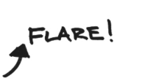
Notes:
So remember, the design process has areas where we flare and then we focus. This is often repeated. We flare by doing needfinding but then we try to use it to focus.

Slide 5
Design Thinking
Define
Notes:
Now we want to use that information to focus in on a problem.

Slide 6
REALIZE
Define
FOCUS
Notes:
We want to realize what is happening from our needfinding with potential customers and use that to find a focus

Slide 7
REALIZE
NEW
INSIGHTS
REFRAME THE PROBLEM.
UNCOVER OPPORTUNITIES.
Notes:
It’s about making meaning. Make sense of your empathy work to get to useful and actionable insights. Insights uncover opportunities and help you think about the problem in a different way.
This leads to more exciting, novel and relevant solutions (once you get into ideation).

Slide 8
OBSERVATION INSIGHT
INFER
NOTICE
SOMETHING
“I WONDER IF THIS MEANS . . .”
ACTIONABLE
LEARNING
ABOUT
PEOPLE
Notes:
This inference is a LEAP

Slide 9
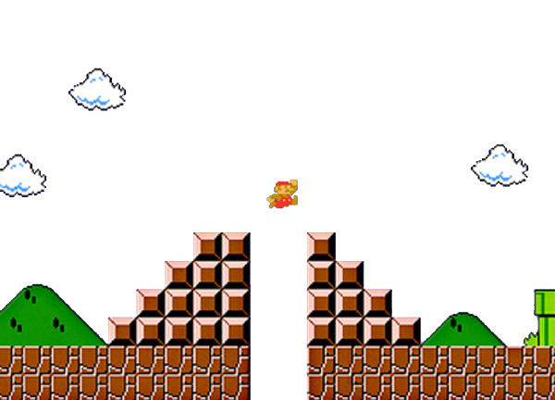
OBSERVATION + INFERENCE = INSIGHT
INFER
Notes:
Take a LEAP of inference

Slide 10
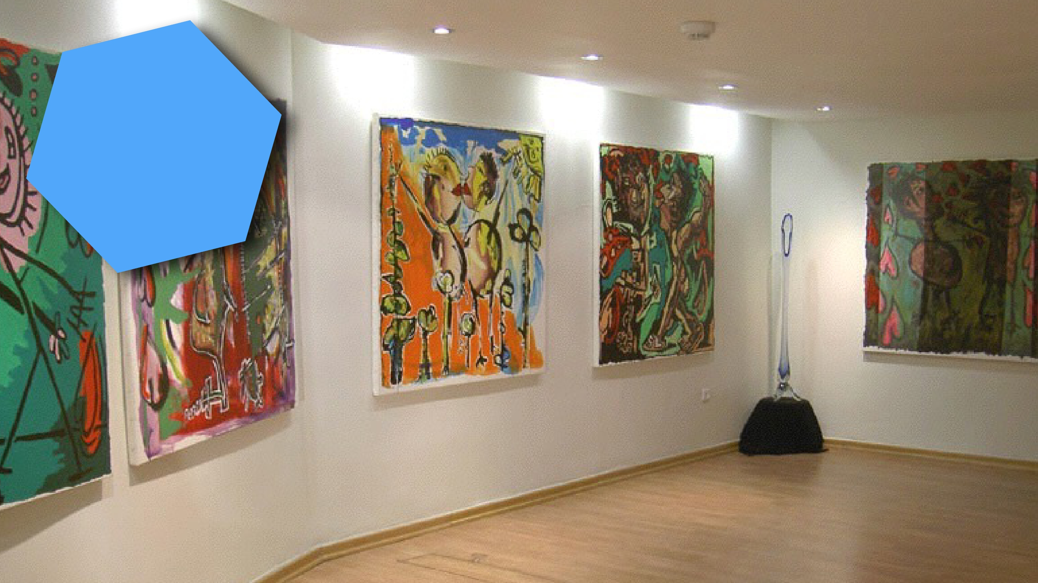
AL
UM
IO
N
CT
A
Notes:
Another example
Ethan Appleby (graduate DTBC in March 2013)

Slide 11
Making Art Accessible to Young Professionals
Notes:
He was interested in figuring how to make art accessible to his generation of young professionals.
People who now had some money, but didn’t know how to buy art.

Slide 12
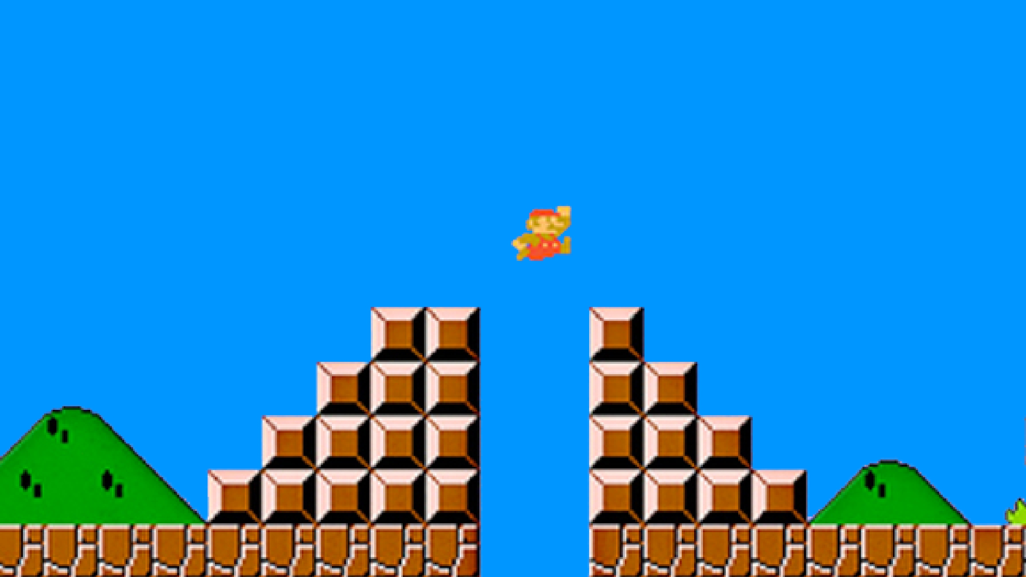
We heard:
“I don’t understand.
Why is this $50 and this $5000. I actually like the $50 one more, but maybe it sucks.”
“What do my
friends like?”
We think of
collecting art as
deeply personal,
but in fact for
them art is about
what others are
going to think.
Notes:
The leap here was…

Slide 13
The presumed mindset:
ART IS DEEPLY PERSONAL.
The realization:
ART IS FASHION ON THE WALL.

Slide 14
REALIZE
Define
FOCUS
Notes:
The definition phase is about making realizations and then creating a focus for your work

Slide 15
FOCUS
ON ONE MEANINGFUL CHALLENGE
Notes:
We do this by…

Slide 16
Focus by Writing a “Point of View”
A unique, concise reframing of the problem that is grounded in user needs & insights.

Slide 17
Focus by Writing a “Point of View”
WE MET . . .
(user you are inspired by)
WE WERE AMAZED TO REALIZE. . .
(insight—verb reflecting user needs)
IT WOULD BE GAME-CHANGING TO. . .
(Synthesized statement to leverage in designing solution.
NOT just a reason for the need! )
Notes:
3 straight-forward sentences.
(We met): “What specific person did you meet that inspires your work?”
(We were amazed to realize:) “This is your insight. Tell us something we didn’t know or wouldn’t have thought about before we started this project. What unique new perspective do you have now?”
(It would be game-changing to:) “This is your call to action. Build on your insight and take an aspirational stance on what you can do as a team. This isn’t your solution -- it is the problem to be solved. A problem with a more informed perspective.”

Slide 18
WE MET . . .
a guy in his twenties with a good new job and a
new apartment
WE WERE AMAZED TO REALIZE . . .
art is fashion on the wall: it’s about what other
people are going to think of you
IT WOULD BE GAME-CHANGING TO . . .
help buyers cut through the paralysis of doubt

Slide 19
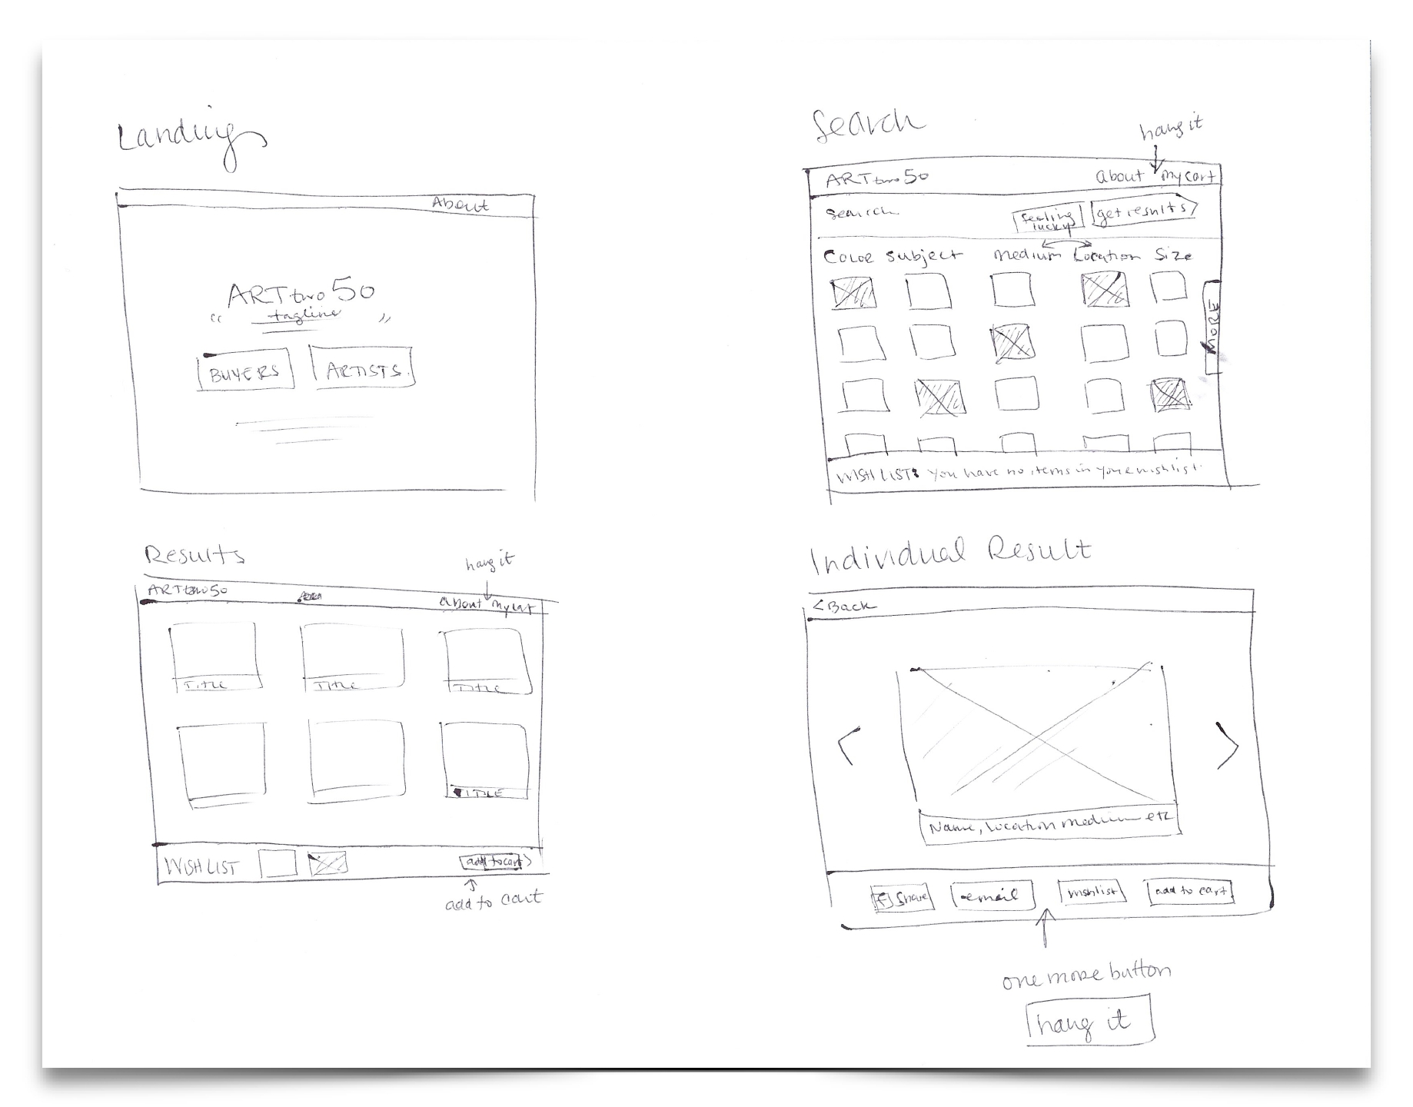
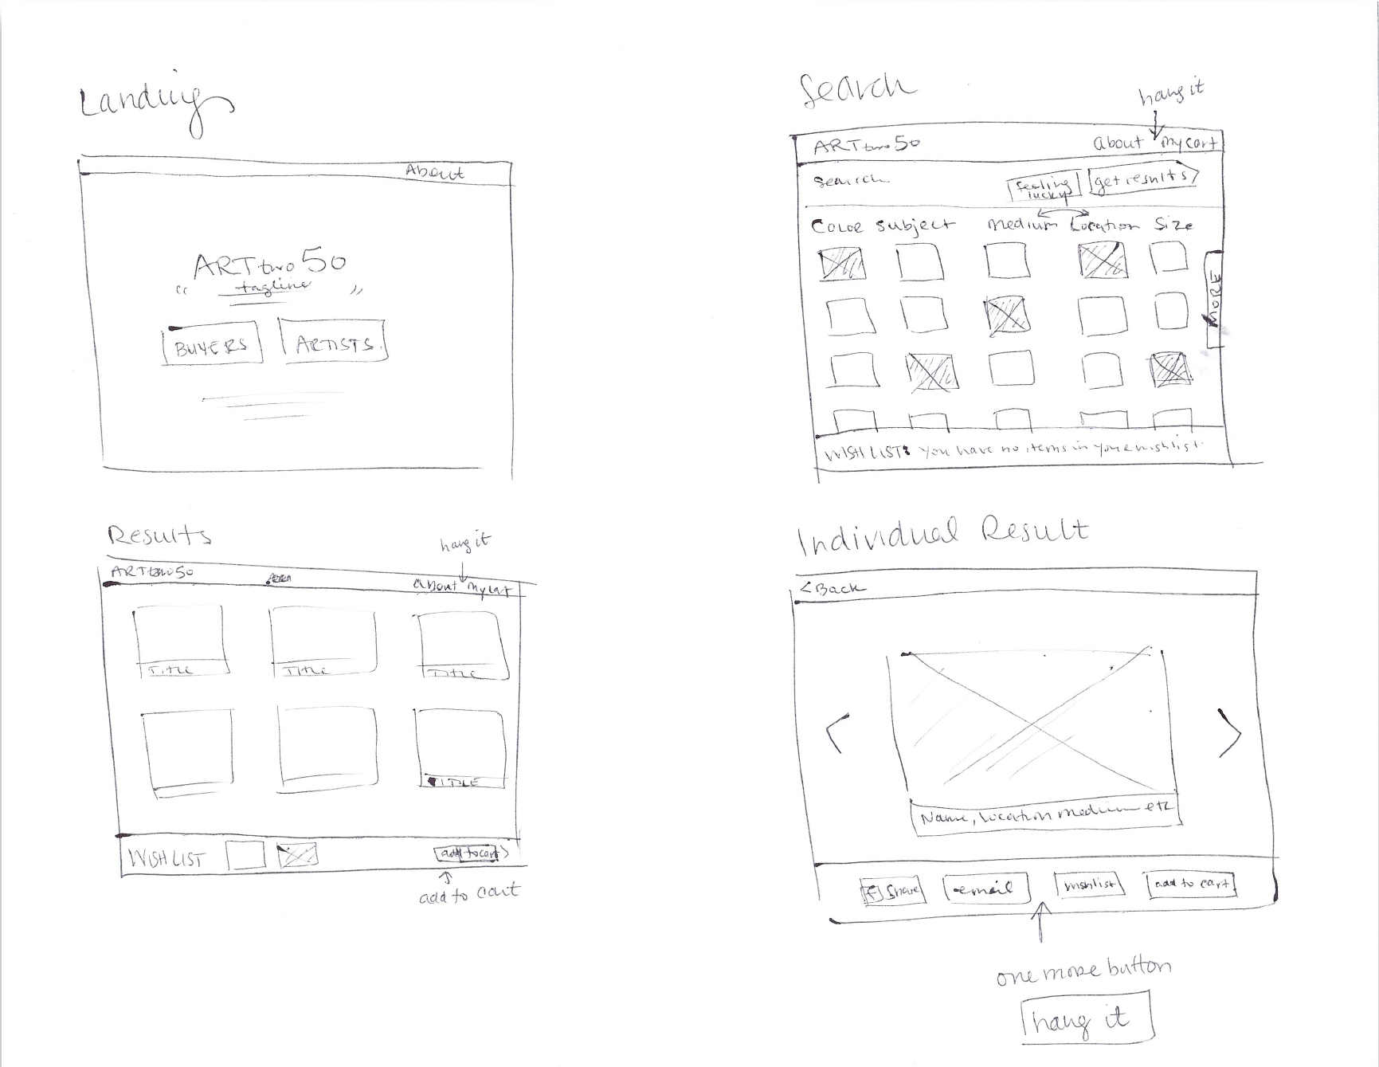
Notes:
Initial sketches for “Art Two Fifty”
“hang it” shows up on 3 of these 4 screens as a key feature he added in

Slide 20
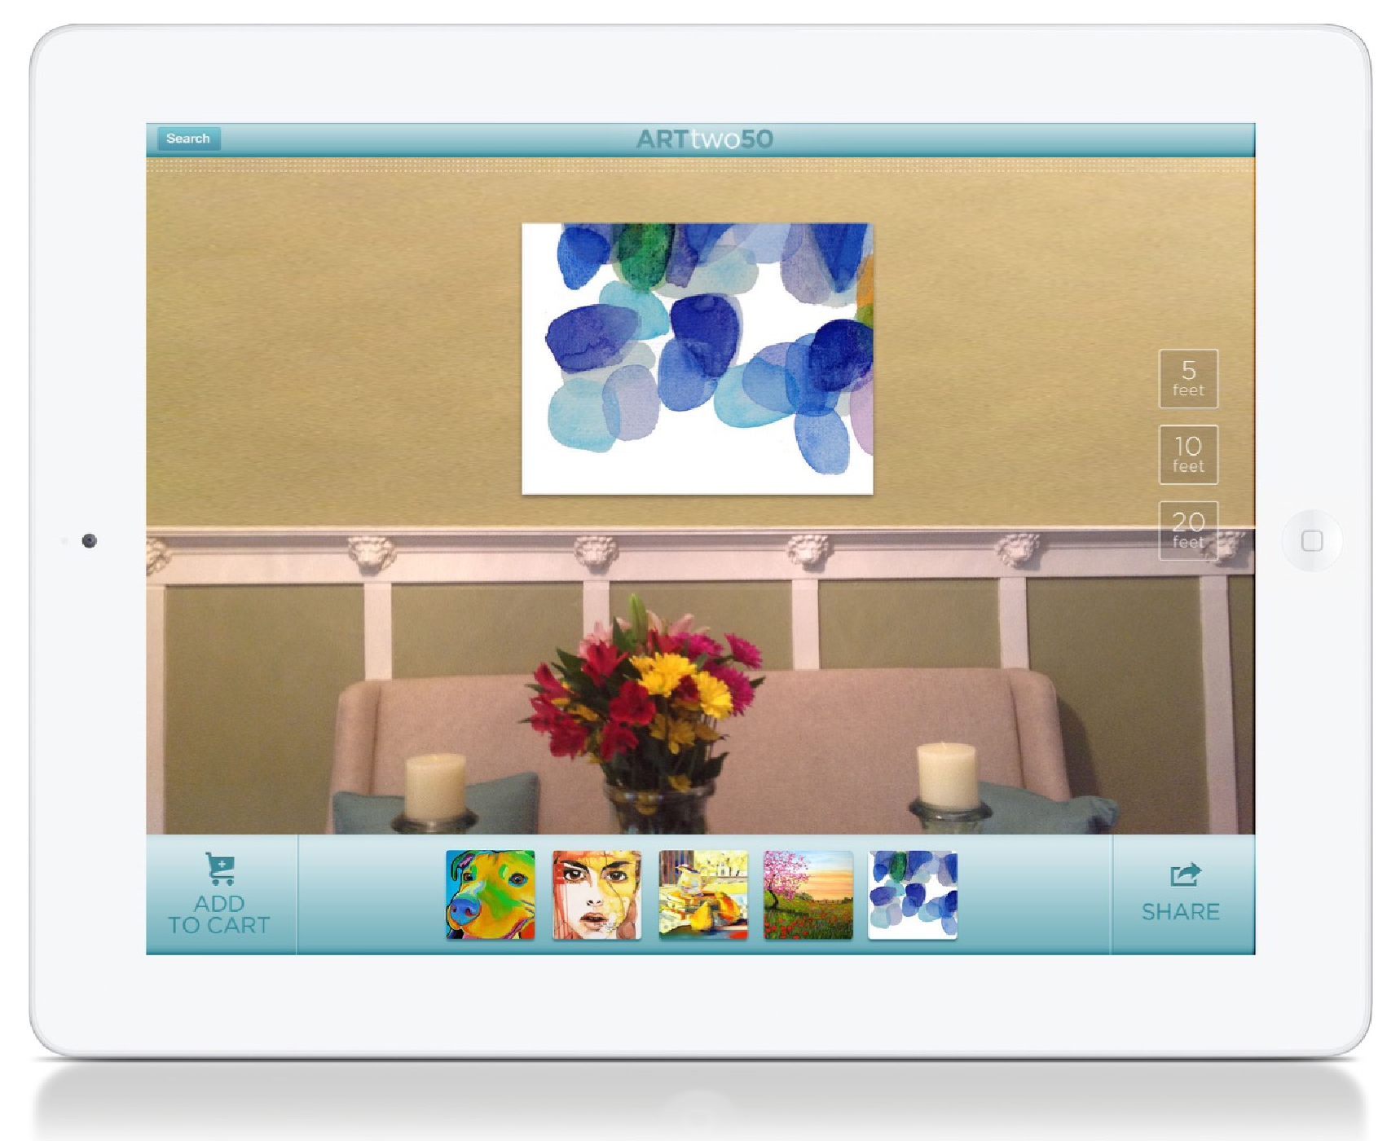
Notes:
What it turned into

Slide 21
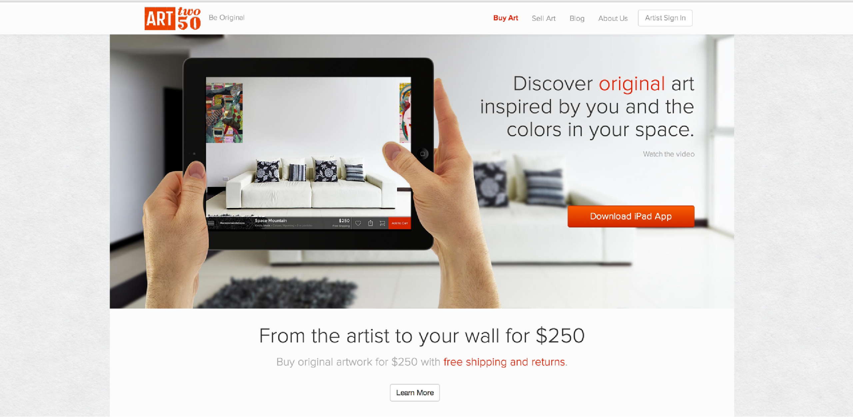
Notes:
All of it costs $250 (removes price consideration)
See what it looks like in your space
Free RETURNS

Slide 22
Point of View: How?
Unpack your empathy work
Leap from observations to identifying user, needs, & insights
Reframe the problem as a POV
Notes:
restarted at 1:15 in (12:45)

Slide 23
UNPACK
INSIGHTS
POINT OF VIEW

Slide 24
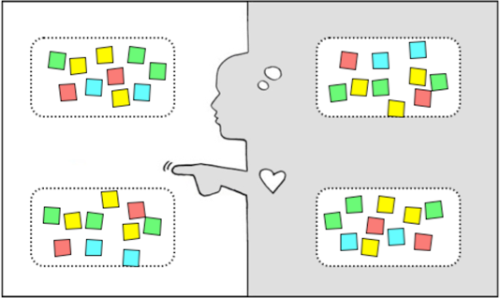
Empathy Map to Help Synthesize
say
think
Observations
Inferences
do
feel
Notes:
An Empathy Map is one tool to help you synthesize your observations and draw out unexpected insights.
On The Left are observations and on the right on inferences
Use your notes, audio, & video from your fieldwork to fill out the 4 quadrants
SAY: What are some quotes and defining words your user said?
DO: What actions and behaviors did you notice?
THINK: What might your user be thinking? What does this tell you about his or her beliefs?
FEEL: What emotions might your subject be feeling?

Slide 25
Empathy Map to Help Synthesize
say
think
KEEP A LIST OF
TENSIONS, CONTRADICTIONS, SURPRISES
USE TO FIND NEEDS & INSIGHTS
do
feel
Notes:
As we unpack we look for Tensions, Contractions, and Surprises – put them to the side!
We use these to help identify Needs and Insights
Needs are human emotional or physical necessities -- verbs (activities and desires with which your user could use help)
An “Insight” is a remarkable realization that you could leverage to better respond to a design challenge

Slide 26
Identifying Needs
WHAT DOES SHE NEED?
A ladder, more books, …
NO, these are solutions
Acknowledgement from her peers that she is a hard worker?
A strong voice driven by knowledge & education?
More social time with her father through reading together?
These needs are more powerful & inspiring for design
Notes:
Now, a lot of peoples initial reactions would be things like a ladder, more books, or even an elastic arm so she can reach the top shelves
In those suggested “needs” is already the solution and no innovation is required.
Where I would challenge you is to dig deeper to find out why she is reaching for those books in the first place.
[ADVANCE]
Maybe her need is “acknowledgement from her student peers that she is a hard worker”, maybe her need is “a strong voice in this world driven by knowledge and education” or maybe its even “more social time with her father through reading books together”. You can feel how much more powerful that inspires you as a designer. Pull these types of needs out of your empathy.

Slide 27
UNPACK
INSIGHTS
POINT OF VIEW
Notes:
So, how do we use the tensions, contradictions, and surprises to make insights?

Slide 28
I wonder if this means . . .
TENSIONS,
CONTRADICTIONS,
SURPRISES
INSIGHTS
think
feel
Notes:
Ask yourself… I wonder if this means?

Slide 29
identify user, needs, and insights
user
need
insight
Notes:
Categorize (and rephrase) your discoveries as USER ATTRIBUTES, NEEDS, and INSIGHTS.
"Look back to your User Empathy Map and the Tensions, Contradictions, and Surprises you captured -- and now list User Attributes (what's important about your user when you design for her?), Needs (remember, use verbs), and insights (synthesize and intepret what's on the board to get to novel, useful assertions.”

Slide 30
combine to create point of view
user
need
insight

Slide 31
combine to create point of view
user
need
insight
…SURPISED TO DISCOVER...
…GAME-CHANGING TO…
Notes:
“Select and combine elements to create your point-of-view. Often the easiest way to start is to select your most compelling user. You could also start with a compelling insight or need you want to work with.”

Slide 32
UNPACK
INSIGHTS
POINT OF VIEW

Slide 33
Point of View
WE MET . . .
(extreme user you are inspired by)
WE WERE AMAZED TO REALIZE . . .
(what did you learn that’s new? What is their need?)
IT WOULD BE GAME-CHANGING TO . . .
(frame up an inspired challenge for yourself – the insight.)
(don’t dictate the solution.)
Notes:
Focus your work by writing a Point of View. Three straight-forward sentences.
We use the user, their need, and the insight to write the Point of View.
(We met): “What specific person did you meet that inspires your work?”
(We were amazed to realize:) “This is your insight. Tell us something we didn’t know or wouldn’t have thought about before we started this project. What unique new perspective do you have now?”
(A game-changer would be to:) “This is your call to action. Build on your insight and take an aspirational stance on what you can do as a team. This isn’t your solution -- it is the problem to be solved. A problem with a more informed perspective.”
As a test, a good point of view (POV) is one that: • Provides focus and frames the problem • Inspires your team • Provides a reference for evaluating competing ideas • Empowers your team to make decisions independently in parallel • Fuels brainstorms by suggesting “how might we” statements • Captures the hearts and minds of people you meet • Saves you from the impossible task of developing concepts that are all things to all people • Is something you revisit and reformulate as you learn by doing • Guides your innovation efforts

Slide 34
DO IT NOW:
UNPACK: done – use this to get to needs
INSIGHTS: infer challenge from your needs
POINT OF VIEW: 1 written sentence
We met X
We were amazed to realize…
It would be game-changing to…
Notes:
spend 5 minutes with your team trying to develop at POV
Share out at the end

Slide 35
Point of View
WE MET . . .
(extreme user you are inspired by)
WE WERE AMAZED TO REALIZE . . .
(what did you learn that’s new? What is their need?)
IT WOULD BE GAME-CHANGING TO . . .
(frame up an inspired challenge for yourself – the insight.)
(don’t dictate the solution.)
Notes:
We use the user, their need, and the insight to write the Point of View.
(We met): “What specific person did you meet that inspires your work?”
(We were amazed to realize:) “This is your insight. Tell us something we didn’t know or wouldn’t have thought about before we started this project. What unique new perspective do you have now?”
(A game-changer would be to:) “This is your call to action. Build on your insight and take an aspirational stance on what you can do as a team. This isn’t your solution -- it is the problem to be solved. A problem with a more informed perspective

Slide 36
Ideate
This work is licensed under the Creative Commons Attribution-Noncommercial-Share Alike 3.0 Unported License. To view a copy of this license, visit http://creativecommons.org/licenses/by-nc-sa/3.0/
2019/04/17
Slides adapted from d.leadership Define + Ideate slides (https://dschool.stanford.edu/groups/dleadership/wiki/59f08/dleadership_2015.html)
Additional resources from bootcamp bootleg (http://dschool.stanford.edu/wp-content/uploads/2011/03/BootcampBootleg2010v2SLIM.pdf)

Slide 37
Design Thinking
Empathize
Ideate
Define
Prototype
Test

Slide 38
Design Thinking
Ideate

Slide 39
innovation
potential
separate generation & evaluation
Notes:
Ideate is about building innovation potential – not necessarily about finding that one great idea.
Brainstorming gets you the seed of what can become innovative solutions (through prototyping and iteration).
We will use brainstorming for ideation.
(Regardless of what ideation technique you use), the core principle is to separate idea generation and evaluation.
Let yourself and your team explore, and turn off the critical part of your brain for just this period of time.

Slide 40
How do we start?

Slide 41
How do we start?
Notes:
The words “How might we” are important
As soon as you start using words like can and should, you’re implying judgment: Can we really do it? And should we?”
These still aren’t solutions, but are more specific problems that are directions for solutions

Slide 42
“Might” lets you defer judgment
helps people to create options freely
opens up more possibilities
Notes:
“you’re able to defer judgment, which helps people to create options more freely, and opens up more possibilities.”

Slide 43
POV: We met Janice, a harried mother of 3, rushing through the airport only to wait hours at the gate. We were surprised at the many games she makes up to to entertain her children so they don’t irritate frustrated fellow passengers. It would be game changing to bring the other passengers and the airport facilities into helping families have a better travel experience.
Notes:
How do we take that POV and find “How Might We” statements that are directions for solutions
We have some tools that help you turn a POV into HMWs
MODIFY this POV to be in the standard format

Slide 44
POV: We met Janice, a harried mother of 3, rushing through the airport only to wait hours at the gate. We were surprised at the many games she makes up to to entertain her children so they don’t irritate frustrated fellow passengers. It would be game changing to bring the other passengers and the airport facilities into helping families have a better travel experience.
Break POV into pieces
HMW entertain kids? HMW slow a mom down?
Amp up the good/Remove the bad
HMW separate kids from fellow passengers?
Explore the opposite
HMW make the wait the most exciting part of the trip?
Question an assumption
HMW entirely remove the wait time at the airport?
http://dschool.stanford.edu/wp-content/uploads/2012/05/HMW-METHODCARD.pdf
Notes:
How do we take that POV and find “How Might We” statements that are directions for solutions
8 How Might We Generators!

Slide 45
POV: We met Janice, a harried mother of 3, rushing through the airport only to wait hours at the gate. We were surprised at the many games she makes up to to entertain her children so they don’t irritate frustrated fellow passengers. It would be game changing to bring the other passengers and the airport facilities into helping families have a better travel experience.
Go after adjectives
HMW we make the rush refreshing instead of harrying?
Identify unexpected resources
HMW leverage free time of fellow passengers to share the load?
Create an analogy from need or context
HMW make the airport like a spa?
Change a status quo
HMW make playful, loud kids less annoying?
http://dschool.stanford.edu/wp-content/uploads/2012/05/HMW-METHODCARD.pdf
Notes:
Some of these generators might overlap, but that is OK. You are just trying to find new solution spaces.
Again, these are NOT the solutions themselves, but more specific problems that if you solve, might make the breakthrough for your customer.

Slide 46
Anatomy of a Strong HMW Question
Who
What
When
Where
Why
Best to have at least 3 W’s in a good HMW question

Slide 47
one conversation at a time
go for quantity
headline!
build on the ideas of others
encourage wild ideas
be visual
stay on topic
defer judgment
Notes:
“ . . . This is one of the few times in a design process when we have rules laid out. It may seem counter-intuitive to have rules for a mind-blowing-free-for-all-idea-fest. But these rules are actually to help be your best as a brainstorming team.”

Slide 48
DO IT NOW:
Generate some HMW statements for your project!
Notes:
5 minutes

Slide 49
POV: We met X. We were surprised to find Y. It would be game changing if Z.
Break POV into pieces
Amp up the good/Remove the bad
Explore the opposite
Question an assumption
Go after adjectives
ID unexpected resources
Create an analogy from need or context
Change a status quo
http://dschool.stanford.edu/wp-content/uploads/2012/05/HMW-METHODCARD.pdf
Notes:
Use these to generate HMW
10 minutes and report out

Slide 50
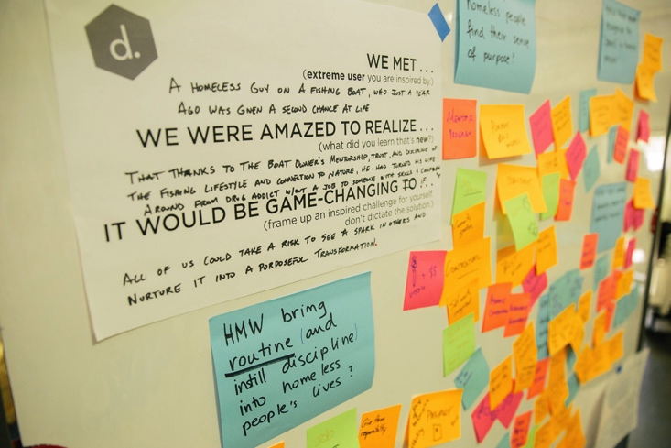
Brainstorm “How Might We’s” Solutions
Notes:
We met a homeless guy on a fishing boat, who just a year ago was given a second chance at life
We were amazed to realize that thanks to the boat owner’s mentorship, trust, and display of the fishing lifestyle and connection to nature, he has turned around his life from drug addict without a job to someone with success and compassion
It would be game-changing if all of us could take a risk to see a spark in others and nurture it into a purposeful transformation.

Slide 51
Constraints Can Energize
“How would you design it with the technology of 100 years ago?”
“What if we had to spend at least a million dollars?”
“Only ideas that would get you fired”
“All ideas must use magic.”
http://dschool.stanford.edu/wp-content/themes/dschool/method-cards/facilitate-a-brainstorm.pdf
Notes:
Demo it!

Slide 52
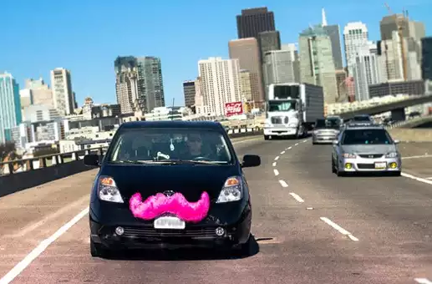
Selecting a Good Problem or Solution Idea
Frequency
want something that occurs often
Density
lots of people experience it
Pain
more than a small annoyance
Interested
your team is motivated to work on this problem
* see Manu Kumar’s blog post on this topic: http://www.k9ventures.com/blog/2015/02/10/finding-problem-worth-solving/
Notes:
I like this framework (maybe combined with the last one)

Slide 53
Downselecting Ideas
Celebrate the success of the brainstorm, take a break, vote!
Option 1: Heat map voting
Everyone starts with an unlimited number of votes (small dots)
Then everyone gets 3 final votes on their absolute favorites (large dots) and 1 bonus dark horse vote
Option 2: Category voting
Each person gets a specific number of votes (i.e., 5)
Specific categories (Most feasible idea, Craziest idea, Best long shot, my favorite but improbable, short term solution, etc.)

Slide 54
Experience Prototyping
This work is licensed under the Creative Commons Attribution-
Noncommercial-Share Alike 3.0 Unported License. To view a copy of
this license, visit http://creativecommons.org/licenses/by-nc-sa/3.0/
2019/04/17
* slides marked Buxton are courtesy of Bill Buxton, from his talk “Why I Love the iPod, iPhone, Wii and Google”, remix uk, 18-19 Sept. 2008, Brighton

Slide 55
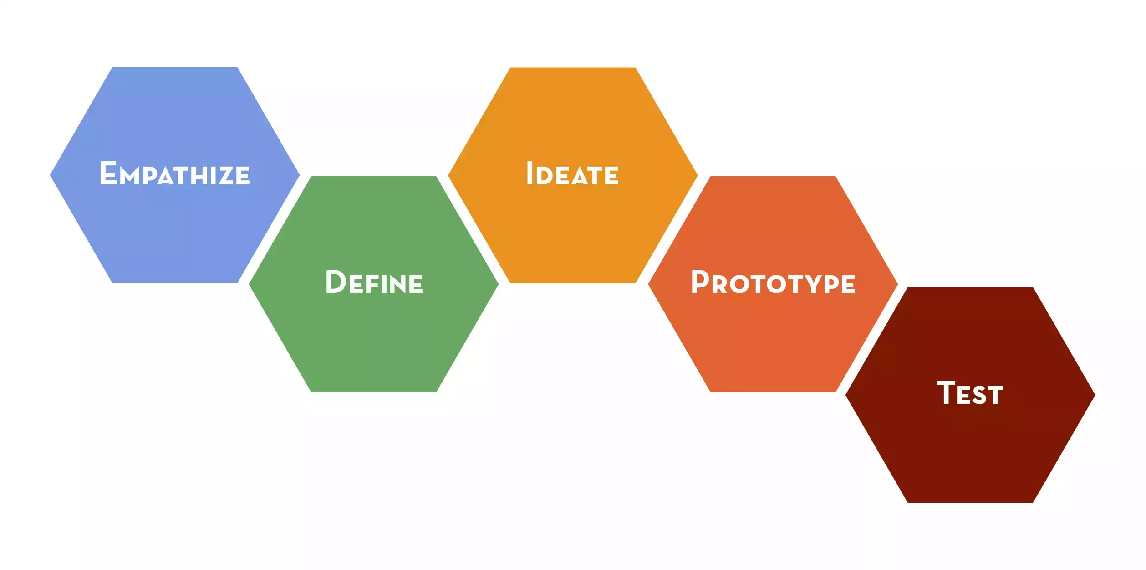
Design Thinking

Slide 56
Design Thinking

Slide 57
to think
prototype
to learn

Slide 58
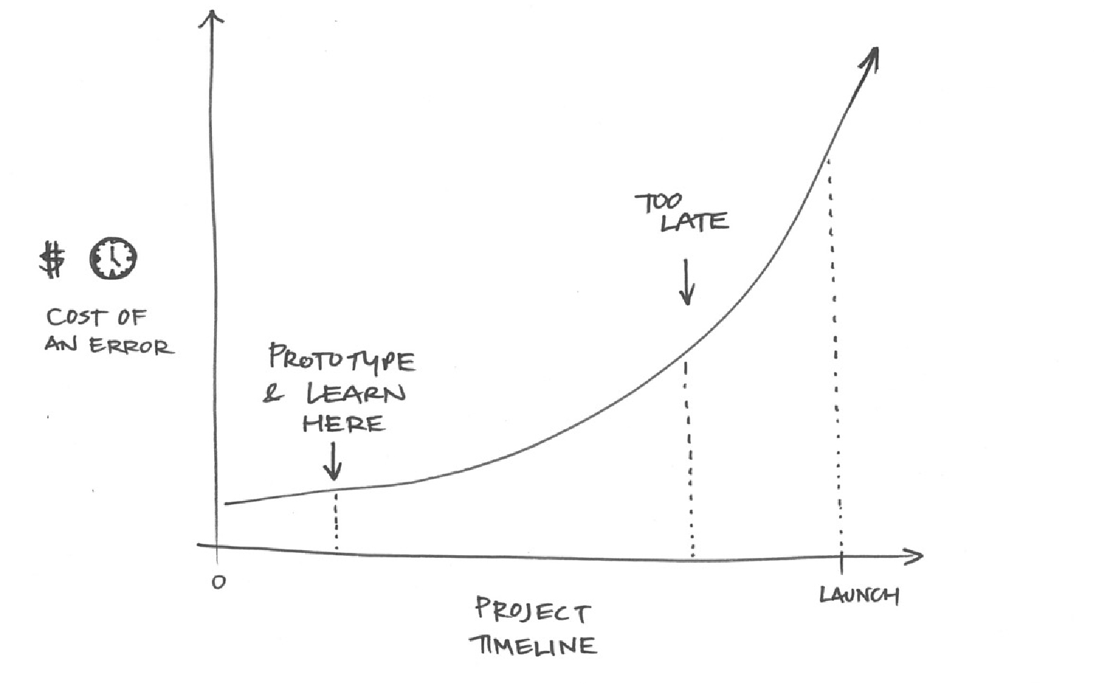
TRY THE MARSHMALLOW
TEST YOUR ASSUMPTIONS
From a resources and project management point of view: Prototyping reduces risk! Early failures are much cheaper (time and $) than late failures!
Notes:
From a resources and project management point of view: Prototyping reduces risk! Early failures are much cheaper (time and $) than late failures!

Slide 59
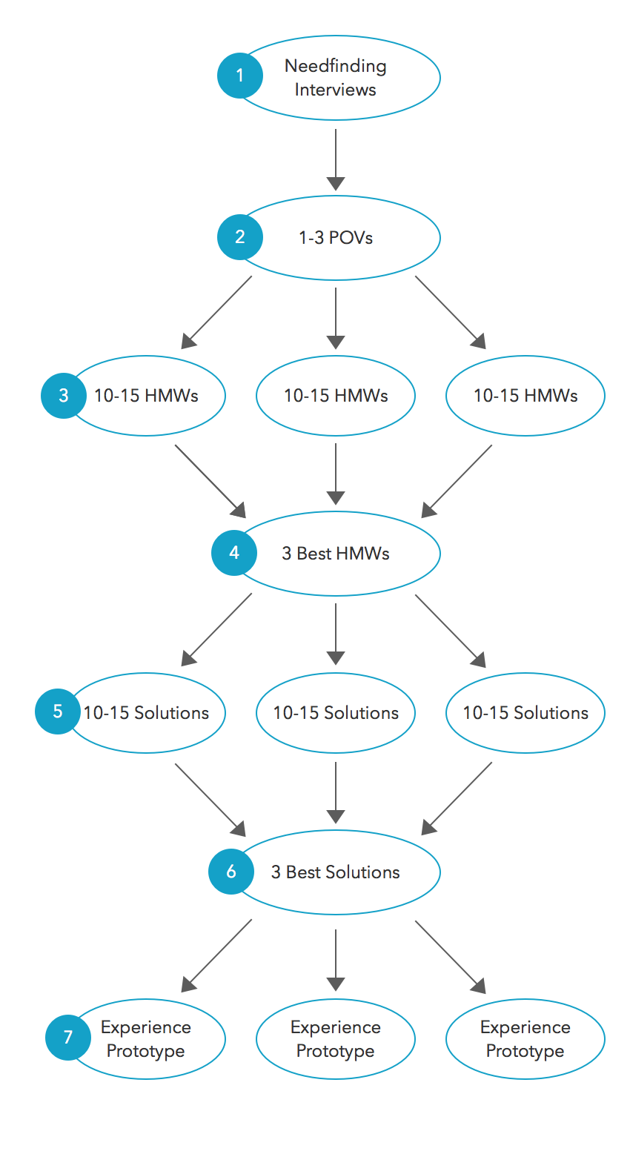
Next Assignment (due at Monday’s class)
Strive for diversity of solutions

Slide 60
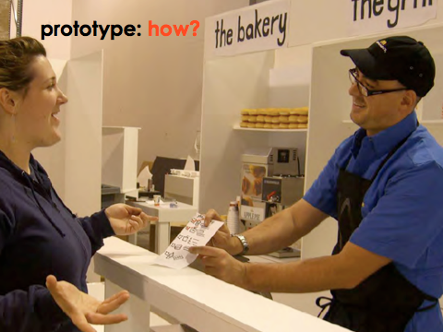
EXPERIENCE PROTOTYPE
INTERACTS LIKE
Notes:
Interacts like
So how can we get from all the ideas we generated in our brainstorm to making a prototype that helps us learn from users
You can also prototype what something INTERACTS like. We also call these EXPERIENCE prototypes. In these, we test how users interact with our ideas– what they think and how they feel during that experience.
This is a picture of a team testing a new fast food counter concept. They are actually letting the users experience the process the team has developed.
Don’t just tell users about an idea that you have—a prototype is an opportunity for you to create an experience for your user.
You get to observe how the user acts, and also ask them about the experience they had.
Let the user react to something they are doing, rather than just intellectually judging something you describe.

Slide 61
Notes:
Interacts like
So how can we get from all the ideas we generated in our brainstorm to making a prototype that helps us learn from users

Slide 62
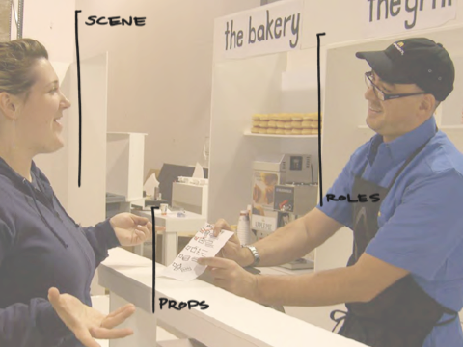
Notes:
We need to think about the various components of the interacts-like prototype. Think about it like a developing a play.
You’ve got the props – i.e. the physical objects. These could be the things you are actually testing (the prototype itself) – or they could be objects in the larger prototype.
Then, you have the scene or scenario surrounding the objects – you’re not just giving things to people in a vacuum. You are helping people imagine and experience the possible situation they are in.
And finally, you may have roles that you play within the prototype – you become part of the prototype.

Slide 63
what new information do you
have about the
user’s need?
test
what new information do you
have about how your
solution addresses
the need?
Notes:
Focus on both of these aspects. Especially the “need” at this point of our projects
What assumptions do we have a bout need that we are basing our solution on?

Slide 64
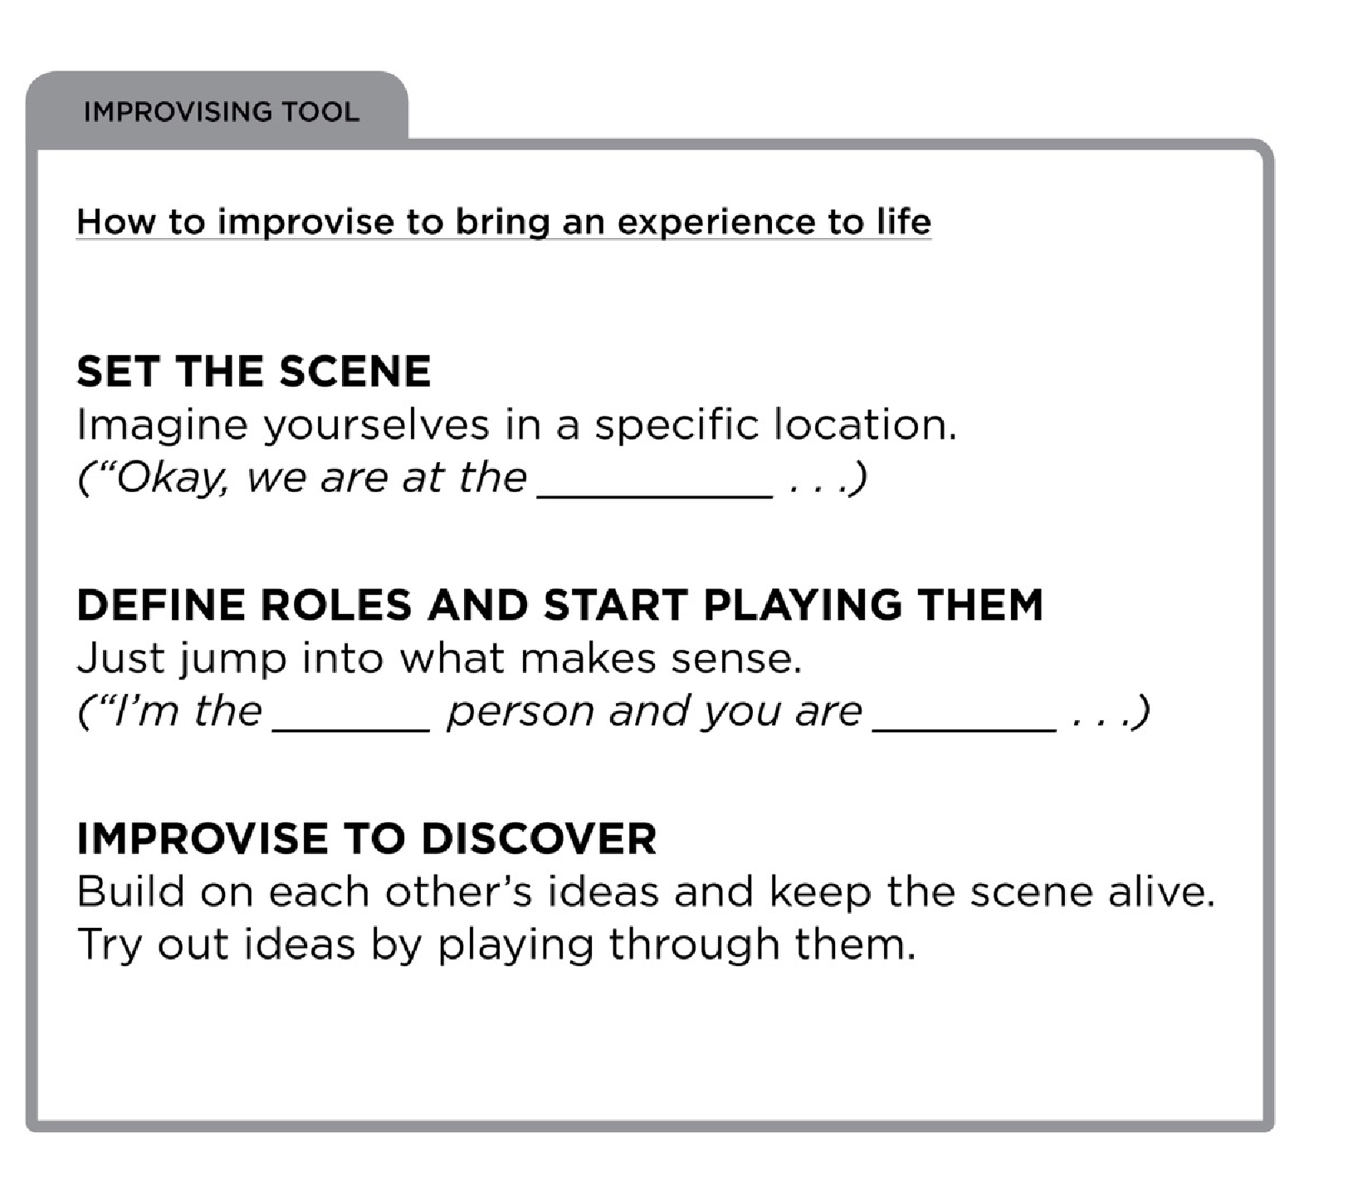
Notes:
This is how you do this.

Slide 66
Parallel Experience Prototyping Goal
Prototype to test an assumption
Prototype can be a piece of idea rather than a complete solution
Think of it as a needfinding technique

Slide 67
Summary
Experience prototyping allows us to try many ideas quickly & learn more about the problem & solution space (prototype to learn)

Slide 68
Next Time
Project (due Monday at start of class)
Flesh out POVs
Create HMWs
Brainstorm solutions & select the best
Create/test experience prototypes for top 3 solutions
Test each prototype with at least 1 target users
In presentation, get across what you learned!
Class will be used to select the idea to move forward

