Slide 1

Define
This work is licensed under the Creative Commons Attribution-Noncommercial-Share Alike 3.0 Unported License. To view a copy of this license, visit http://creativecommons.org/licenses/by-nc-sa/3.0/
2017/04/17
Slides adapted from d.leadership Define + Ideate slides (https://dschool.stanford.edu/groups/dleadership/wiki/59f08/dleadership_2015.html)
Additional resources from bootcamp bootleg (http://dschool.stanford.edu/wp-content/uploads/2011/03/BootcampBootleg2010v2SLIM.pdf)

Slide 2
Outline
Ethical considerations in needfinding
Inferring insights
Point of views

Slide 3
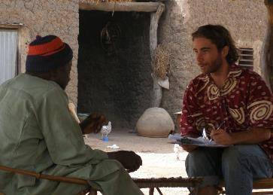
Ethical Considerations in Needfinding
Testing/fieldwork can be coercive if there is a power imbalance (e.g., in under resourced communities)
http://centread.ucsc.edu/CenTREAD%20photos/BrianDowd2.JPG
People may feel no option but to speak to you or give you their time even though they may not get anything of value in return.
Notes:
Doing fieldwork in under resourced communities has a number of pitfalls for researchers coming from an empowered group (whether by race, education, or other institutional privilege).
You cannot just drop in to some rural village wearing your African shirt. It just isn’t ethical.
Even paying money can be coercive because they may NOT be able to turn you down

Slide 4

Ethical Considerations in Needfinding
Testing/fieldwork can be coercive if there is a power imbalance (e.g., in under resourced communities)
http://www.sunypress.edu/
“the ‘at-risk’ label is highly problematic and often implicitly racist and classist… [it] locates problems in individuals, families, and communities, rather than in institutional structures that create and maintain inequality.”
Notes:
There has been a lot written about this in terms of education and social welfare
Even the terminology we use in these situations (like “at risk”) might be holding people back.
http://www.sunypress.edu/p-2029-children-and-families-at-promis.aspx
This book shows how the labeling of children as "at-risk" actually perpetuates the inequities, racism, and discrimination facing many families in America.
This book critiques the currently popular "at-risk" construct, drawing from historical, contextual, critical, and personal perspectives. It provides an alternative context for viewing children and their families as "at-promise." A basic premise of the book is that the generalized use of the "at-risk" label is highly problematic and often implicitly racist and classist--a 1990s version of the cultural deficit model that locates problems in individuals, families, and communities, rather than in institutional structures that create and maintain inequality. This book provides a needed interrogation and alternative context for viewing children and families caught in the extreme conditions facing many families in the United States.

Slide 5
Ethical Considerations in Needfinding
Testing/fieldwork can be coercive if there is a power imbalance (e.g., in under resourced communities)
http://research.microsoft.com/pubs/163718/CHI2012-Dell-ResponseBias-proc.pdf
“When the interviewer is a foreign researcher requiring a translator, the bias towards the interviewer’s artifact increases to 5x.”
Notes:
Finally, the results you get might simply be wrong.
Nicki Dell on Participant Response Bias.
Although HCI researchers and practitioners frequently work with groups of people that differ significantly from themselves, little attention has been paid to the effects these differences have on the evaluation of technological systems. Via 450 interviews in Bangalore, India, we measure participant response bias due to interviewer demand characteristics and the role of social and demographic factors in influencing that bias. We find that respondents are about 2.5x more likely to prefer a technological artifact they believe to be developed by the interviewer, even when the alternative is identical. When the interviewer is a foreign researcher requiring a translator, the bias towards the interviewer’s artifact increases to 5x. In fact, the interviewer’s artifact is preferred even when it is degraded to be obviously inferior to the alternative. We conclude that participant response bias should receive more attention within the CHI community, especially when designing for underprivileged populations.

Slide 6
Design Thinking
Empathize
Ideate
Define
Prototype
Test
Notes:
Last time we talked about Needfinding and Contextual Inquiry. This allows you to Empathize with your target customers and to see things from their perspective.

Slide 7
Design Thinking
Define
Notes:
Now we want to use that information to focus in on a problem.

Slide 8

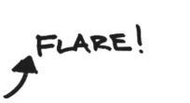

Notes:
So remember, the design process has areas where we flare and then we focus. This is often repeated. We flare by doing needfinding but then we try to use it to focus.

Slide 9
REALIZE
Define
FOCUS
Notes:
We want to realize what is happening from our needfinding with potential customers and use that to find a focus

Slide 10

REALIZE
NEW
INSIGHTS
REFRAME THE PROBLEM.
UNCOVER OPPORTUNITIES.
Notes:
It’s about making meaning. Make sense of your empathy work to get to useful and actionable insights. Insights uncover opportunities and help you think about the problem in a different way.
This leads to more exciting, novel and relevant solutions (once you get into ideation).

Slide 11
OBSERVATION INSIGHT
INFER
NOTICE
SOMETHING
“I WONDER IF THIS MEANS . . .”
ACTIONABLE
LEARNING
ABOUT
PEOPLE
Notes:
This inference is a LEAP

Slide 12
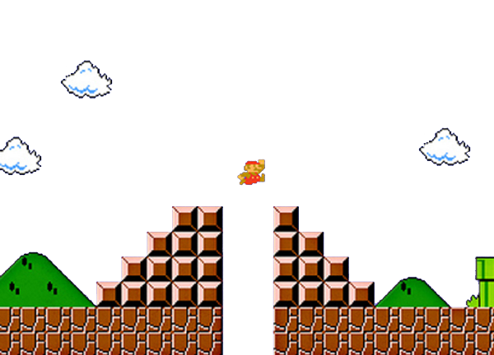
OBSERVATION + INFERENCE = INSIGHT
INFER
Notes:
Take a LEAP of inference

Slide 13
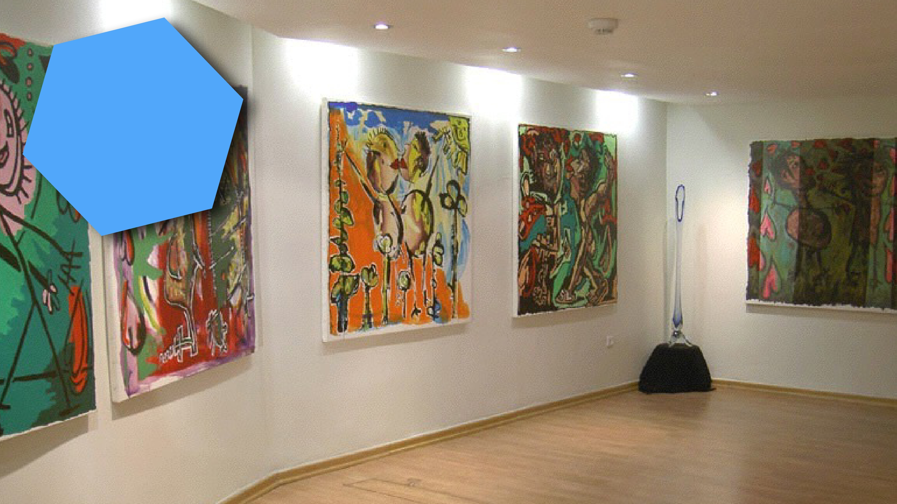
AL
UM
IO
N
CT
A
Notes:
Another example
Ethan Appleby (graduate DTBC in March 2013)

Slide 14
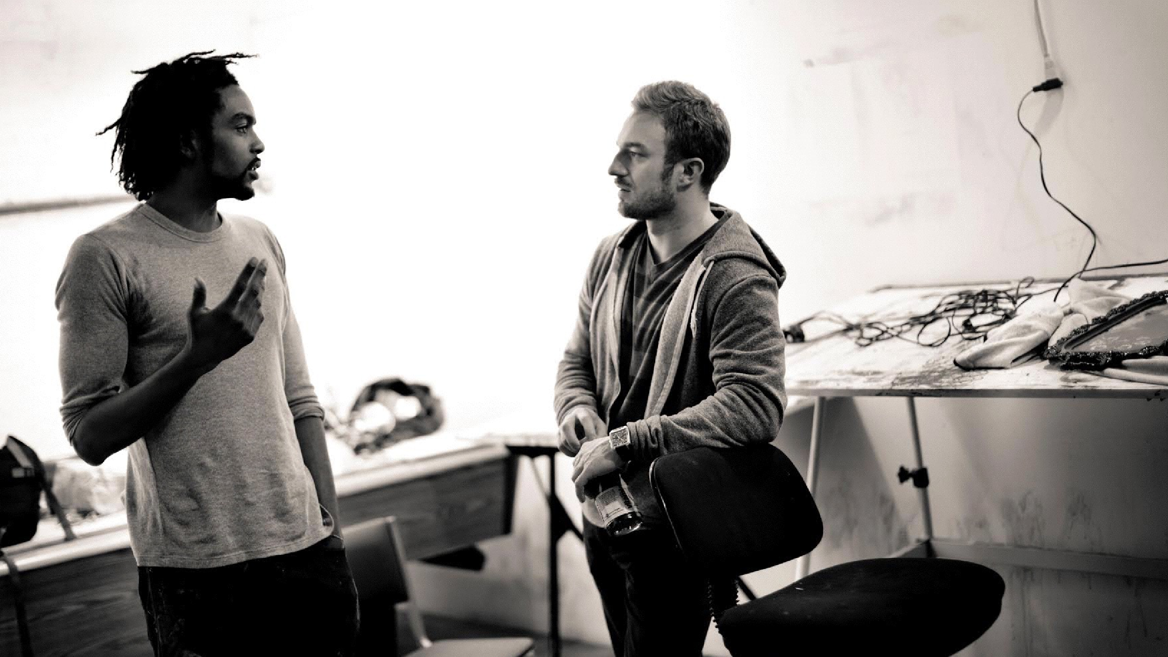
Making Art Accessible to Young Professionals
Notes:
He was interested in figuring how to make art accessible to his generation of young professionals.
People who now had some money, but didn’t know how to buy art.

Slide 15
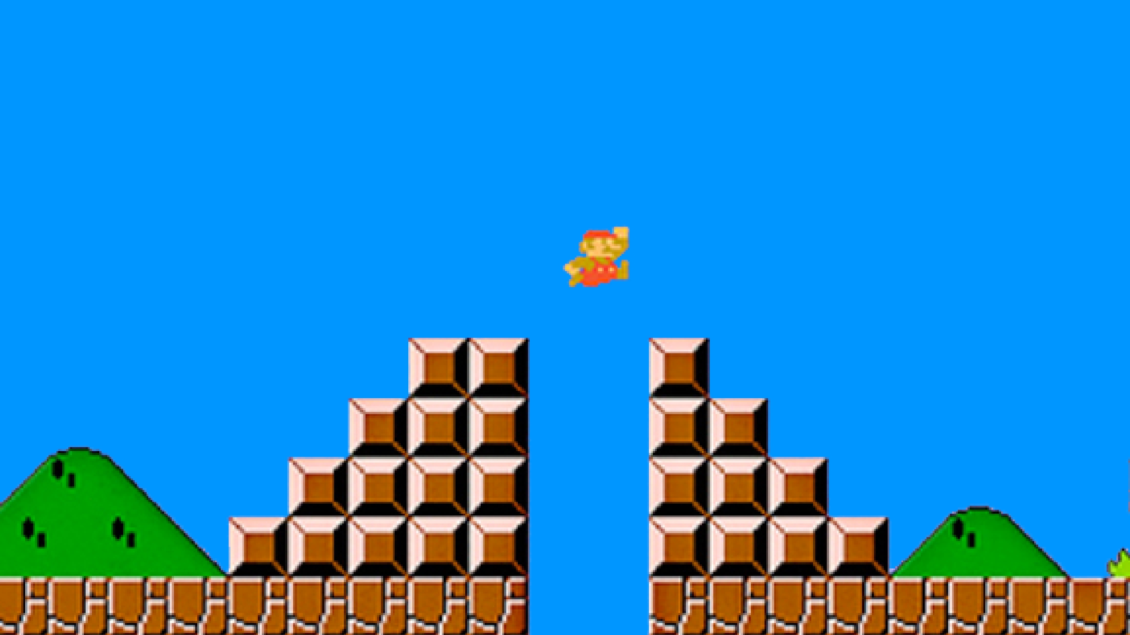
We heard:
“I don’t understand.
Why is this $50 and this $5000.
I actually like the $50 one more, but maybe it sucks.”
“What do my
friends like?”
We think of
collecting art as
deeply personal,
but in fact for
them art is about
what others are
going to think.
Notes:
The leap here was…

Slide 16
The presumed mindset:
ART IS DEEPLY PERSONAL.
The realization:
ART IS FASHION ON THE WALL.

Slide 17
REALIZE
Define
FOCUS
Notes:
The definition phase is about making realizations and then creating a focus for your work

Slide 18
FOCUS
ON ONE MEANINGFUL CHALLENGE
Notes:
We do this by…

Slide 19
Focus by Writing a “Point of View”
A unique, concise reframing of the problem that is grounded in user needs & insights.

Slide 20
Focus by Writing a “Point of View”
WE MET . . .
(user you are inspired by)
WE WERE AMAZED TO REALIZE. . .
(insight—verb reflecting user needs)
IT WOULD BE GAME-CHANGING TO. . .
(Synthesized statement to leverage in designing solution.
NOT just a reason for the need! )
Notes:
3 straight-forward sentences.
(We met): “What specific person did you meet that inspires your work?”
(We were amazed to realize:) “This is your insight. Tell us something we didn’t know or wouldn’t have thought about before we started this project. What unique new perspective do you have now?”
(It would be game-changing to:) “This is your call to action. Build on your insight and take an aspirational stance on what you can do as a team. This isn’t your solution -- it is the problem to be solved. A problem with a more informed perspective.”

Slide 21
WE MET . . .
a guy in his twenties with a good new job and a
new apartment
WE WERE AMAZED TO REALIZE . . .
art is fashion on the wall: it’s about what other
people are going to think of you
IT WOULD BE GAME-CHANGING TO . . .
help buyers cut through the paralysis of doubt

Slide 22
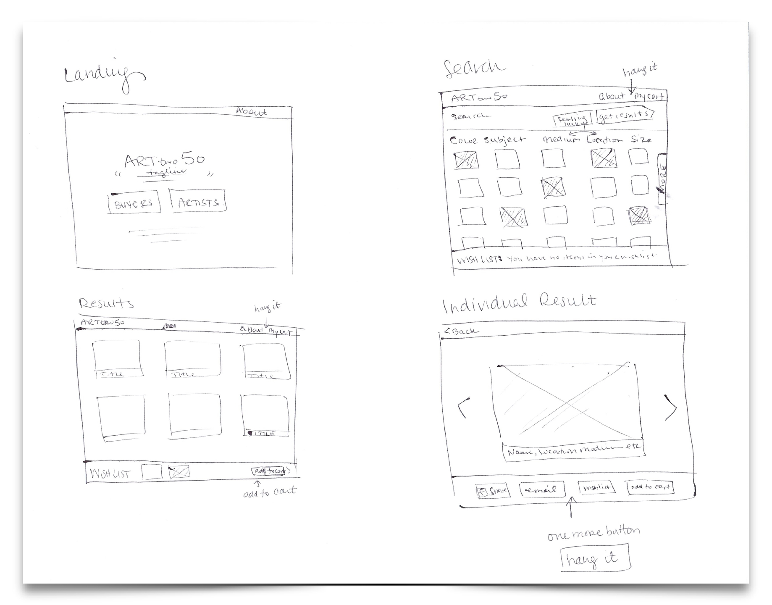
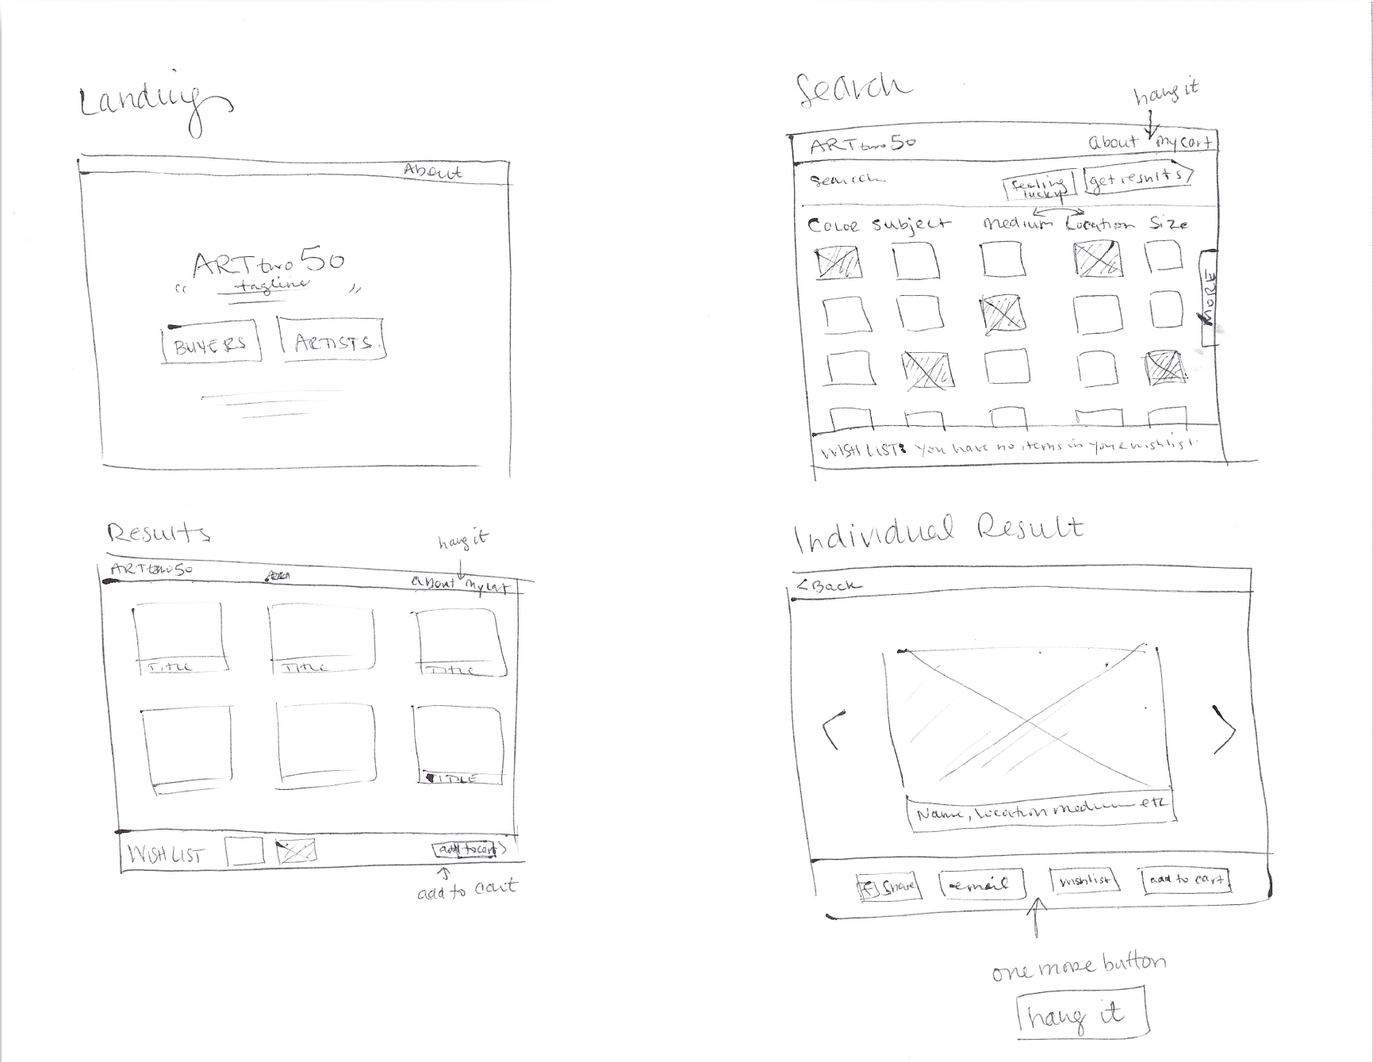
Notes:
Initial sketches for “Art Two Fifty”
“hang it” shows up on 3 of these 4 screens as a key feature he added in

Slide 23
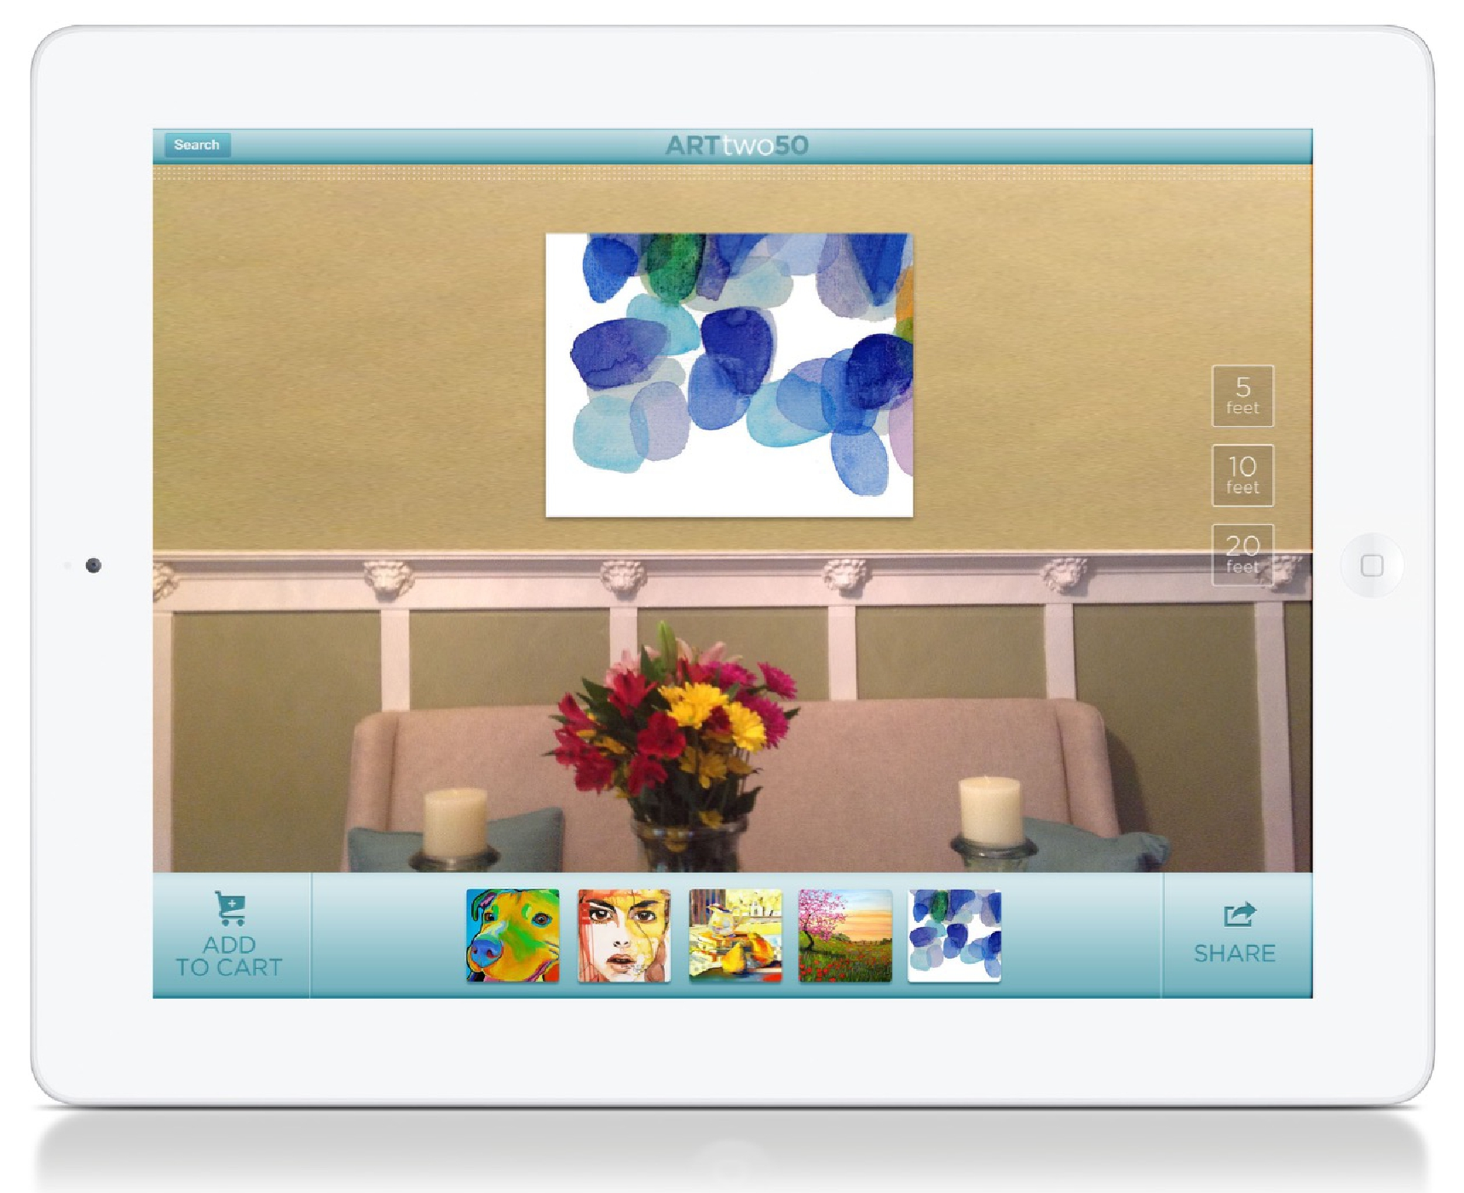
Notes:
What it turned into

Slide 24
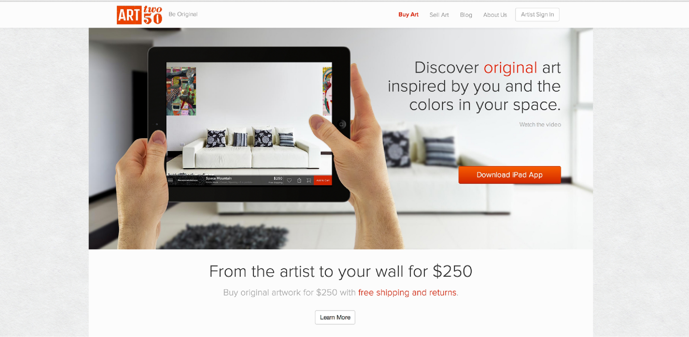
Notes:
All of it costs $250 (removes price consideration)
See what it looks like in your space
Free RETURNS

Slide 25
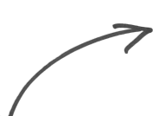
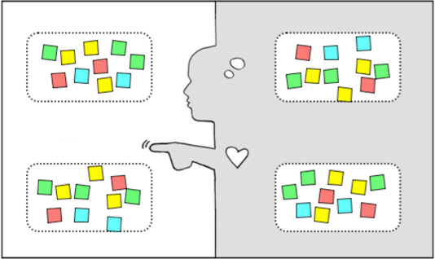

I wonder if this means . . .
TENSIONS,
CONTRADICTIONS,
SURPRISES
INSIGHTS
think
feel
Notes:
We use the tensions, contradictions and surprises to find insights
The identified user, needs, and insights are key to establishing our Point of View

Slide 26
Characteristics of A Good Point of View
Provides focus & frames the problem
Inspires your team & people you meet
Fuels brainstorms
Gives a reference to evaluate competing ideas
Saves you from the impossible task of creating concepts that are all things to all people
Revisit/reformulate as you learn by doing

Slide 27
Point of View
WE MET . . .
(extreme user you are inspired by)
WE WERE AMAZED TO REALIZE . . .
(what did you learn that’s new? What is their need?)
IT WOULD BE GAME-CHANGING TO . . .
(frame up an inspired challenge for yourself – the insight.)
(don’t dictate the solution.)
Notes:
We use the user, their need, and the insight to write the Point of View.
(We met): “What specific person did you meet that inspires your work?”
(We were amazed to realize:) “This is your insight. Tell us something we didn’t know or wouldn’t have thought about before we started this project. What unique new perspective do you have now?”
(A game-changer would be to:) “This is your call to action. Build on your insight and take an aspirational stance on what you can do as a team. This isn’t your solution -- it is the problem to be solved. A problem with a more informed perspective

Slide 28
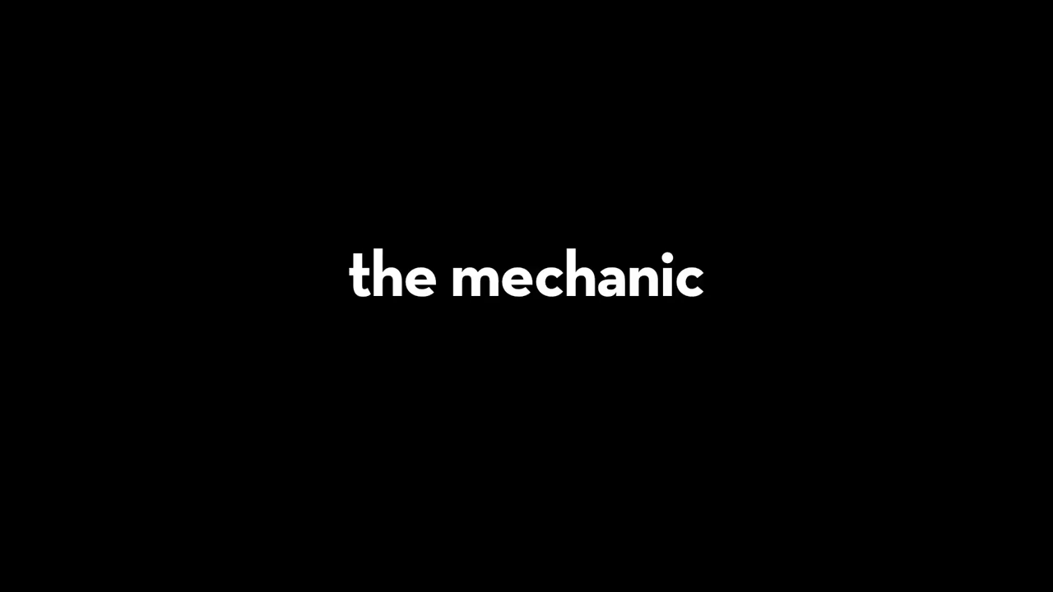
Mechanic’s POV
https://vimeo.com/9121675
Notes:
This is a 3:51 piece of an interview.
Pay careful attention to this video
Take notes
Afterwards you are going to analyze it your teams
Let’s call him Chuck.

Slide 29
DO IT NOW:
UNPACK: note the say, do, think, & feel
INSIGHTS: infer from observations
POINT OF VIEW: 1 written sentence
We met X
We were amazed to realize…
It would be game-changing to…
Notes:
Improve the car maintenance experience
What did you notice?
spend 5 minutes with a partner trying to develop at POV
Share out at the end

Slide 30
DO IT NOW FOR YOUR PROJECT:
UNPACK: done already
INSIGHTS: infer from observations
POINT OF VIEW: 1 written sentence
We met X
We were amazed to realize…
It would be game-changing to…
Notes:
spend 10 minutes with your team trying to develop at POV
Share out at the end

Slide 31
Ideate
This work is licensed under the Creative Commons Attribution-Noncommercial-Share Alike 3.0 Unported License. To view a copy of this license, visit http://creativecommons.org/licenses/by-nc-sa/3.0/
2017/04/17
Slides adapted from d.leadership Define + Ideate slides (https://dschool.stanford.edu/groups/dleadership/wiki/59f08/dleadership_2015.html)
Additional resources from bootcamp bootleg (http://dschool.stanford.edu/wp-content/uploads/2011/03/BootcampBootleg2010v2SLIM.pdf)
Notes:
Didn’t have time for brainstorming example
Went 5 mintues over
Move some of the examples from my DTBC project to here from next lecture
Change HMW exercise to be in the same format of POV as we taught in class

Slide 32
Outline
Ideate
Exercise
How Might We…?
Selecting good problems & solutions
Brainstorming solutions

Slide 33
Design Thinking
Empathize
Ideate
Define
Prototype
Test

Slide 34
Design Thinking
Ideate

Slide 35

innovation
potential
separate
generation & evaluation
Notes:
Ideate is about building innovation potential – not necessarily about finding that one great idea.
Brainstorming gets you the seed of what can become innovative solutions (through prototyping and iteration).
We will use brainstorming for ideation.
(Regardless of what ideation technique you use), the core principle is to separate idea generation and evaluation.
Let yourself and your team explore, and turn off the critical part of your brain for just this period of time.

Slide 36

How do we start?

Slide 37
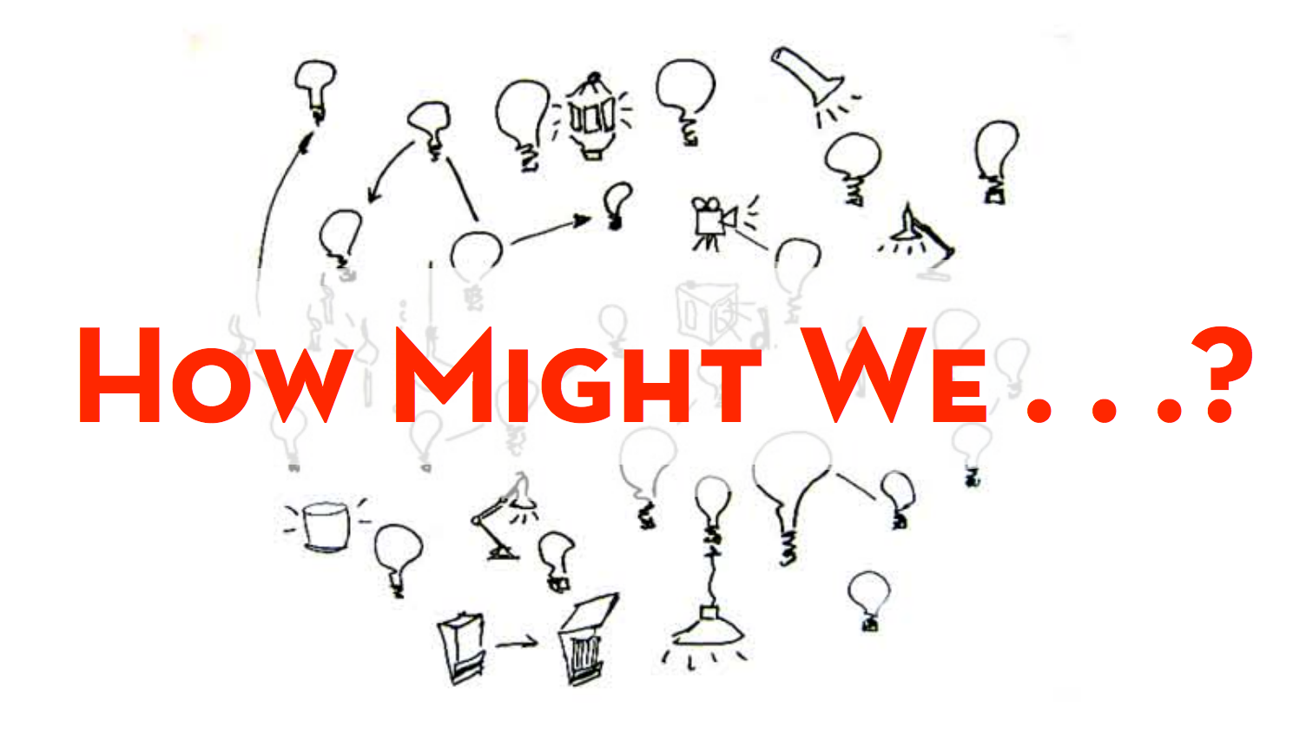
How do we start?
Notes:
The words “How might we” are important
As soon as you start using words like can and should, you’re implying judgment: Can we really do it? And should we?”
These still aren’t solutions, but are more specific problems that are directions for solutions

Slide 38
“Might” lets you defer judgment
helps people to create options freely
opens up more possibilities
Notes:
“you’re able to defer judgment, which helps people to create options more freely, and opens up more possibilities.”

Slide 39
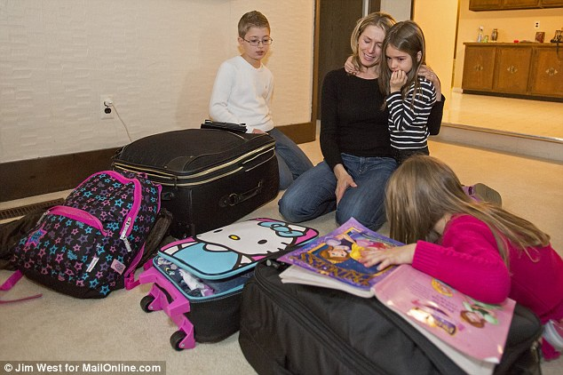
POV: We met Janice, a harried mother of 3, rushing through the airport only to wait hours at the gate. We were surprised at the many games she makes up to to entertain her children so they don’t irritate frustrated fellow passengers. It would be game changing to bring the other passengers and the airport facilities into helping families have a better travel experience.
Notes:
How do we take that POV and find “How Might We” statements that are directions for solutions
We have some tools that help you turn a POV into HMWs
MODIFY this POV to be in the standard format

Slide 40
POV: We met Janice, a harried mother of 3, rushing through the airport only to wait hours at the gate. We were surprised at the many games she makes up to to entertain her children so they don’t irritate frustrated fellow passengers. It would be game changing to bring the other passengers and the airport facilities into helping families have a better travel experience.
Break POV into pieces
HMW entertain kids? HMW slow a mom down?
Amp up the good/Remove the bad
HMW separate kids from fellow passengers?
Explore the opposite
HMW make the wait the most exciting part of the trip?
Question an assumption
HMW entirely remove the wait time at the airport?
http://dschool.stanford.edu/wp-content/uploads/2012/05/HMW-METHODCARD.pdf
Notes:
How do we take that POV and find “How Might We” statements that are directions for solutions
8 How Might We Generators!

Slide 41
POV: We met Janice, a harried mother of 3, rushing through the airport only to wait hours at the gate. We were surprised at the many games she makes up to to entertain her children so they don’t irritate frustrated fellow passengers. It would be game changing to bring the other passengers and the airport facilities into helping families have a better travel experience.
Go after adjectives
HMW we make the rush refreshing instead of harrying?
Identify unexpected resources
HMW leverage free time of fellow passengers to share the load?
Create an analogy from need or context
HMW make the airport like a spa?
Change a status quo
HMW make playful, loud kids less annoying?
http://dschool.stanford.edu/wp-content/uploads/2012/05/HMW-METHODCARD.pdf
Notes:
Some of these generators might overlap, but that is OK. You are just trying to find new solution spaces.
Again, these are NOT the solutions themselves, but more specific problems that if you solve, might make the breakthrough for your customer.

Slide 42
Anatomy of a Strong HMW Question
Who
What
When
Where
Why
Best to have at least 3 W’s in a good HMW question

Slide 43



connection
How might we…
offer long term connection in a sustainable way?
keep former clients connected with each other?
encourage clients to be resources for each other during and after their stay?
connect people who have a history of interpersonal issues with a reliable support network?
connect people without an established network to word of mouth resources?
help people get connections in a new place where they’ve moved?
help clients reconnect with their family?
connect clients with an existing community such as…
  faith baed organization?
  tech/affluent community?
  retired community?

Slide 44


clarity
How might we…
make people feel confident that they understand all the relevant information?
give people clarity about their current reality?
insure that people
understand how Connect
works?

Slide 45

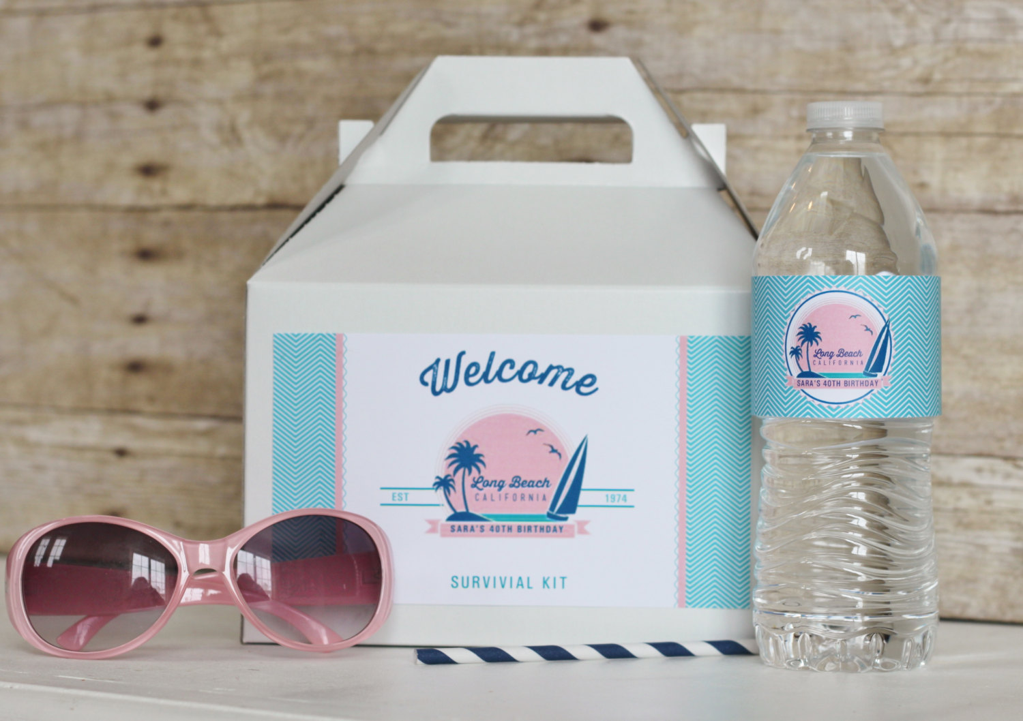
new beginning
How might we…
make people feel like LifeMoves is the start of something great not scary?
help launch people into their new housing feeling confident that they won’t fall in a hole?
help clients remain capable
as they face the same challenges?

Slide 46

competence
How might we…
make people feel confident that they will be able to engage with Connect?
make people who are effective at solving small problems expand their abilities to long term competence?
give people small wins that result in a feeling of confidence and hope in the face of large problems?

Slide 47

long term plan
How might we…
insure that we remain connected over the long term as phones and technologies change?
help people create a long term plan?
help people move from a low paid job to a career plan?
help people assess the riskiness of their situation?
balance long and short term thinking?

Slide 48
DO IT NOW:
Generate some HMW statements for your project!
Notes:
10 minutes

Slide 49
POV: We met X. We were surprised to find Y. It would be game changing if Z.
Break POV into pieces
Amp up the good/Remove the bad
Explore the opposite
Question an assumption
Go after adjectives
ID unexpected resources
Create an analogy from need or context
Change a status quo
http://dschool.stanford.edu/wp-content/uploads/2012/05/HMW-METHODCARD.pdf
Notes:
Use these to generate HMW
10 minutes and report out

Slide 50
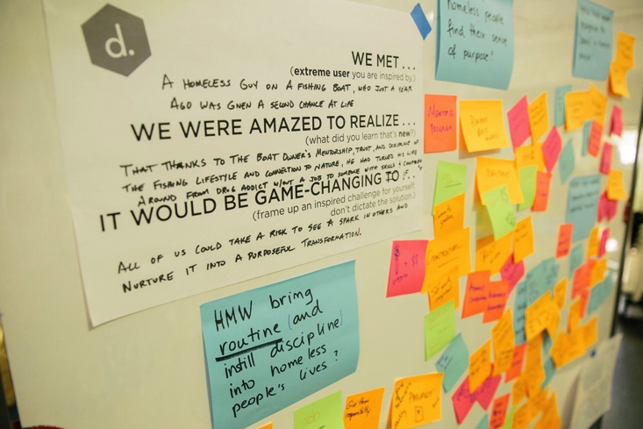
Brainstorm “How Might We’s” Solutions
Notes:
We met a homeless guy on a fishing boat, who just a year ago was given a second chance at life
We were amazed to realize that thanks to the boat owner’s mentorship, trust, and display of the fishing lifestyle and connection to nature, he has turned around his life from drug addict without a job to someone with success and compassion
It would be game-changing if all of us could take a risk to see a spark in others and nurture it into a purposeful transformation.

Slide 51
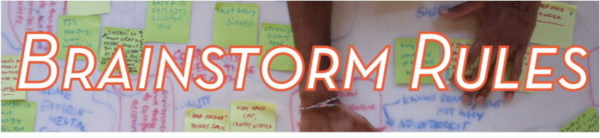
one conversation at a time
go for quantity
headline!
build on the ideas of others
encourage wild ideas
be visual
stay on topic
defer judgment
Notes:
“ . . . This is one of the few times in a design process when we have rules laid out. It may seem counter-intuitive to have rules for a mind-blowing-free-for-all-idea-fest. But these rules are actually to help be your best as a brainstorming team.”

Slide 52
Constraints Can Energize
“How would you design it with the technology of 100 years ago?”
“What if we had to spend at least a million dollars?”
“Only ideas that would get you fired”
“All ideas must use magic.”
http://dschool.stanford.edu/wp-content/themes/dschool/method-cards/facilitate-a-brainstorm.pdf
Notes:
Demo it!

Slide 53

Selecting a Good Problem or Solution Idea
3 Favorites!
OR
Rational, Delightful, Long shot
http://dschool.stanford.edu/wp-content/uploads/2011/03/BootcampBootleg2010v2SLIM.pdf
Notes:
Some people do something as simple as this…

Slide 54
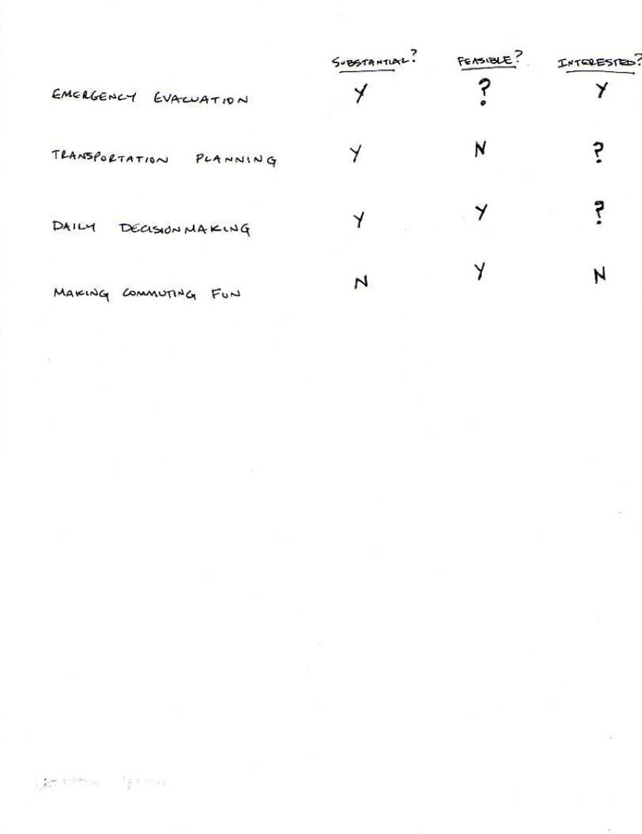
Substantial?
Feasible?
Interested?
Prioritizing Problems / Solution Ideas
Notes:
Sometimes a more quantitative approach is better

Slide 55
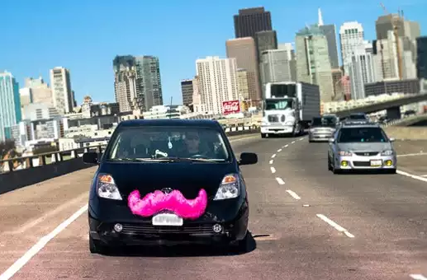
Selecting a Good Problem or Solution Idea
Frequency
  want something that occurs often
Density
  lots of people experience it
Pain
  more than a small annoyance
Interested
  your team is motivated
  to work on this problem
* see Manu Kumar’s blog post on this topic: http://www.k9ventures.com/blog/2015/02/10/finding-problem-worth-solving/
Notes:
I like this framework (maybe combined with the last one)

Slide 56
Research/Analysis
How big a problem is it? (market)
Whose problem is it? (stakeholders)
What’s already out there? (competition)
How are things done currently? (status quo)
How can they be improved? (innovation)
Notes:
You can put more meat on your analysis by thinking through/researching these questions

Slide 57

Dark Horse Idea
Notes:
prevents premature convergence
forces teams to take a fresh look at the problem space

Slide 58
Dark Horse Idea
Dark: explores a space that is risky, radical or orthogonal
Brainstormed after more traditional HMW/ideas
Possible to prototype & test (can’t be infeasible)

Slide 59
Downselecting Ideas
Celebrate the success of the brainstorm, take a break, vote!
Option 1: Heat map voting
  Everyone starts with an unlimited number of votes (small dots)
  Then everyone gets 3 final votes on their absolute favorites (large dots) and 1 bonus dark horse vote
Option 2: Category voting
  Each person gets a specific number of votes (i.e., 5)
  Specific categories (Most feasible idea, Craziest idea, Best long shot, my favorite but improbable, short term solution, etc.)

Slide 60

Experience Prototyping
This work is licensed under the Creative Commons Attribution-
Noncommercial-Share Alike 3.0 Unported License. To view a copy of
this license, visit http://creativecommons.org/licenses/by-nc-sa/3.0/
2017/04/17
* slides marked Buxton are courtesy of Bill Buxton, from his talk “Why I Love the iPod, iPhone, Wii and Google”, remix uk, 18-19 Sept. 2008, Brighton
Notes:
50 minutes until the team break (at 2:20)
Finished at 3:18 (2 minutes early)
Perfect on time. Maybe MORE info on how to create experience prototypes (example).
Also move some of the Experience Prototype content to the previous lecture on Ideation so that is has been seen before that assignment is given out.

Slide 61
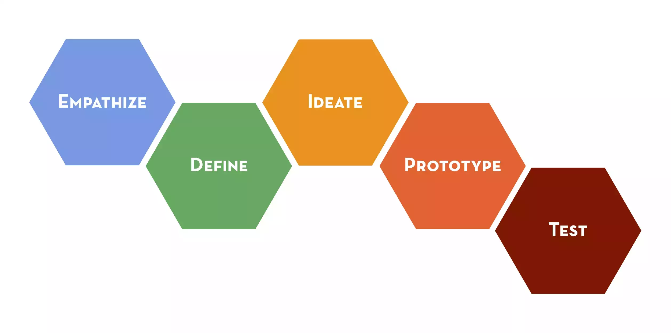
Design Thinking

Slide 62
Design Thinking

Slide 63
to think
prototype
to learn

Slide 64
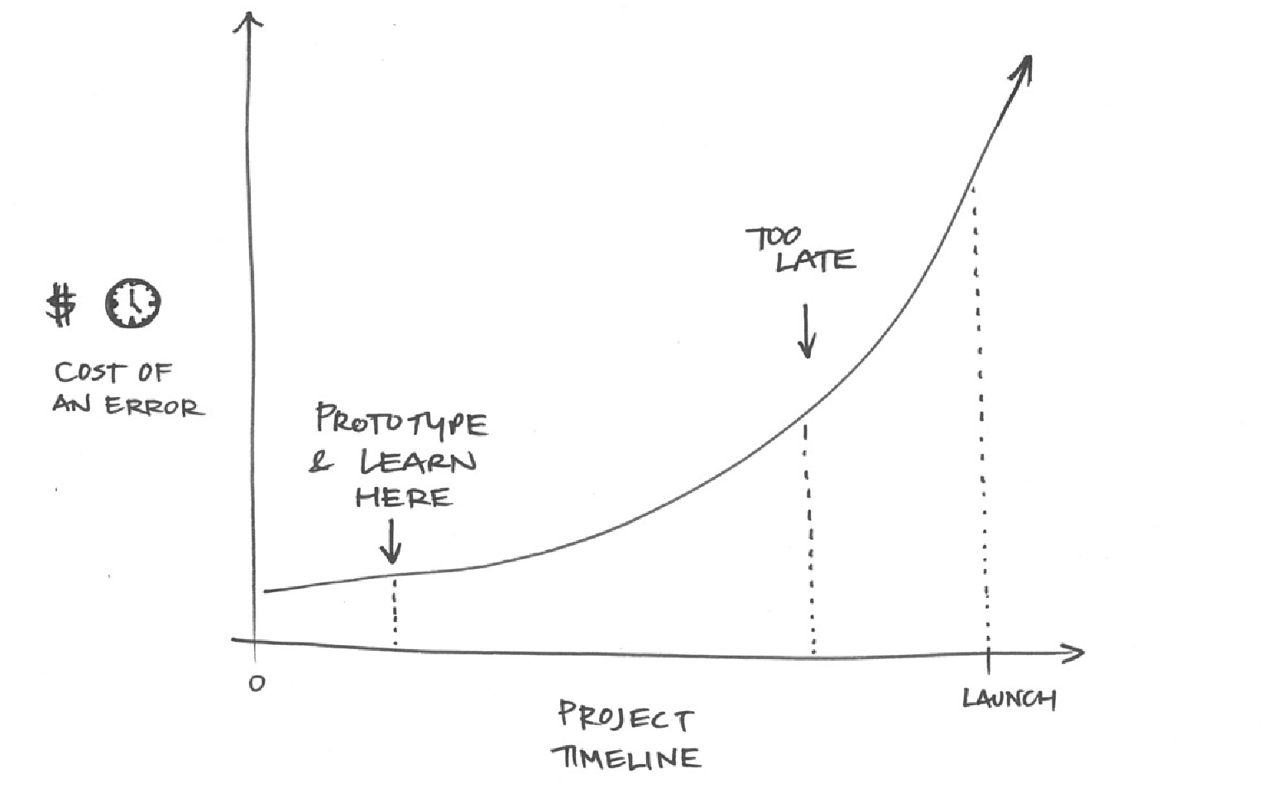
TRY THE MARSHMALLOW
TEST YOUR ASSUMPTIONS
From a resources and project management point of view: Prototyping reduces risk! Early failures are much cheaper (time and $) than late failures!
Notes:
From a resources and project management point of view: Prototyping reduces risk! Early failures are much cheaper (time and $) than late failures!

Slide 65
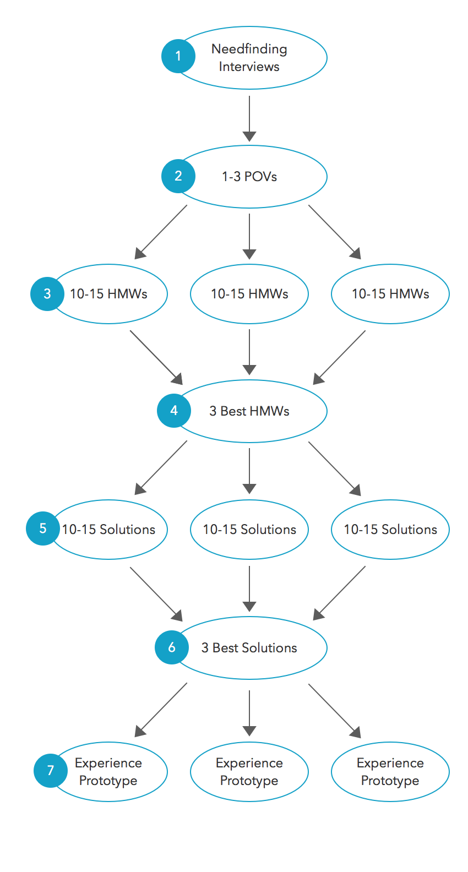
Next Assignment (due at Monday’s class)
Strive for diversity of solutions

Slide 66
You can use an eraser
on the drafting table or
a sledgehammer on the construction site.
Frank Lloyd Wright

Slide 67
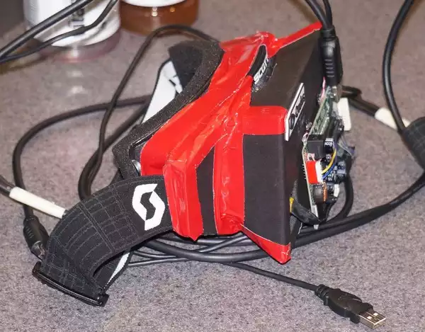
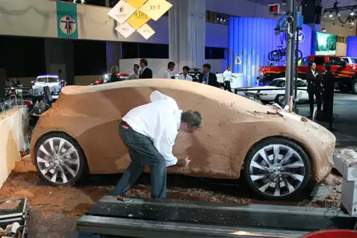
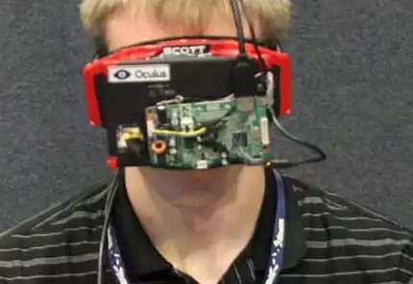
Types of Prototypes
looks like
works like

Slide 68
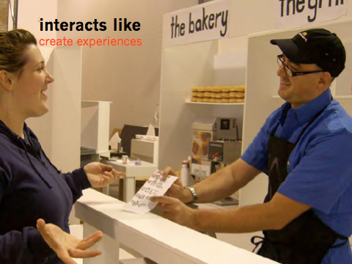
Notes:
You can also prototype what something INTERACTS like. We also call these EXPERIENCE prototypes. In these, we test how users interact with our ideas– what they think and how they feel during that experience.
This is a picture of a team testing a new fast food counter concept. They are actually letting the users experience the process the team has developed.
Don’t just tell users about an idea that you have—a prototype is an opportunity for you to create an experience for your user.
You get to observe how the user acts, and also ask them about the experience they had.
Let the user react to something they are doing, rather than just intellectually judging something you describe.

Slide 69
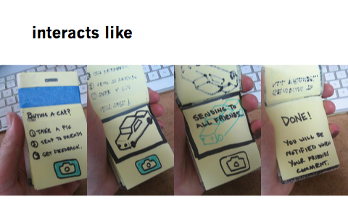
Interacts Like = Experience Prototype
Notes:
This is another experience prototype – an early concept to explore buying a car with a smartphone. Notice that even though this is low-res, it is still developed. It is not just something that looks like an iPhone – it takes a shot at a possible sequence that the user can actually try out. The idea in testing this isn’t whether the user likes it or not – instead by going through the process (with some realism) it can bring up issues you hadn’t thought of, or feelings from the user, or stark memories of stories . . .

Slide 70

Notes:
So how can we get from all the ideas we generated in our brainstorm to making a prototype that helps us learn from users

Slide 71
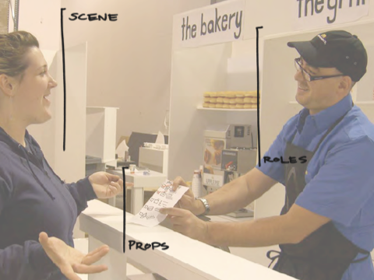
Notes:
We need to think about the various components of the experience prototype. Think about it like a developing a play.
You’ve got the props – i.e. the physical objects. These could be the things you are actually testing (the prototype itself) – or they could be objects in the larger prototype.
Then, you have the scene or scenario surrounding the objects – you’re not just giving things to people in a vacuum. You are helping people imagine and experience the possible situation they are in.
And finally, you may have roles that you play within the prototype – you become part of the prototype.

Slide 72
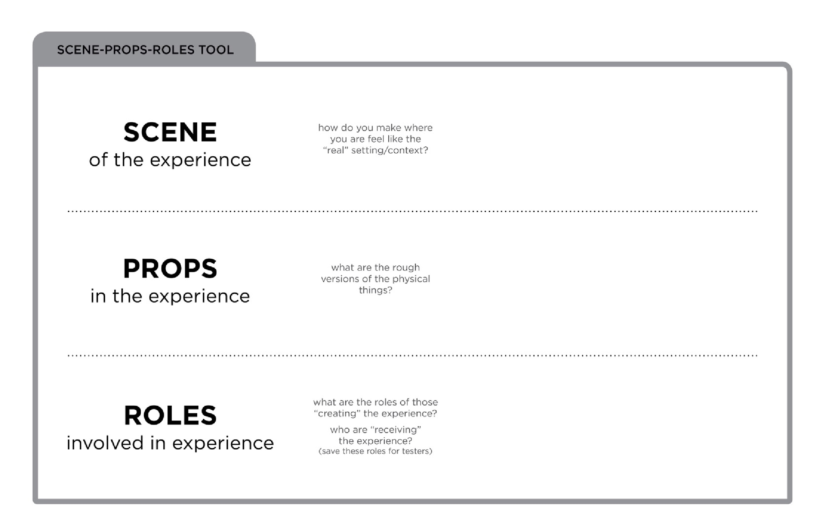

Slide 73
what new
information do you
have about the
user’s need?
test
what new
information do you
have about how your
solution addresses
the need?
Notes:
Focus on both of these aspects. Especially the “need” at this point of our projects
What assumptions do we have a bout need that we are basing our solution on?

Slide 74
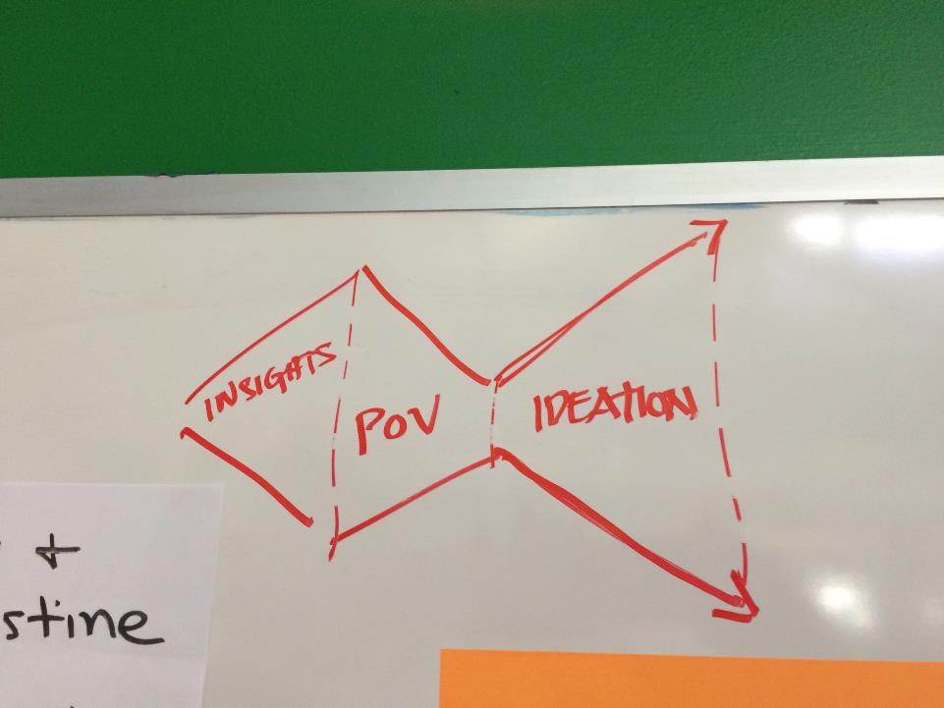
Notes:
Let me give you an example that I worked on with my team.
Now that you have a refined point of view, we can continue with ideation

Slide 75
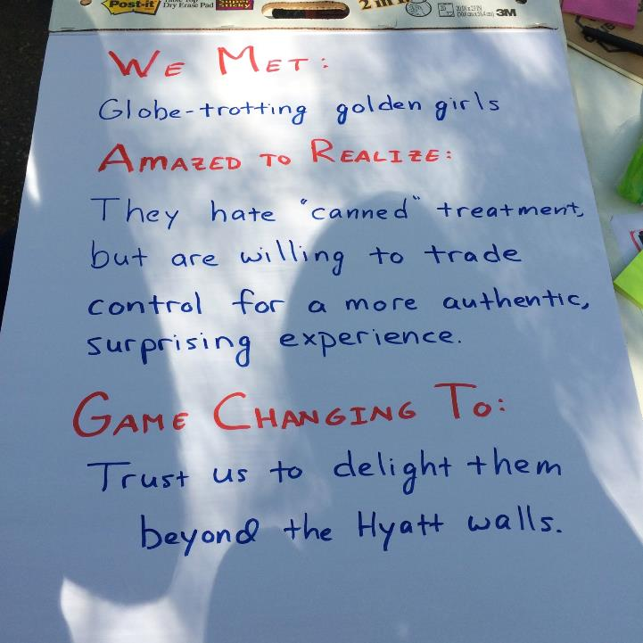
Notes:
I worked on a team over Spring Break at the d.School that was exploring how to improve the customer experience outside of the hotel for Hyatt Hotels
We interviewed a number of people in downtown San Francisco around the Hyatt (mainly in Union Square).
We met two interesting older ladies who gave us a lot of insight in to the travel experience.
This led to the following Point of View (POV)
Your teams are at the point of needing to create such opportunity statements.

Slide 76
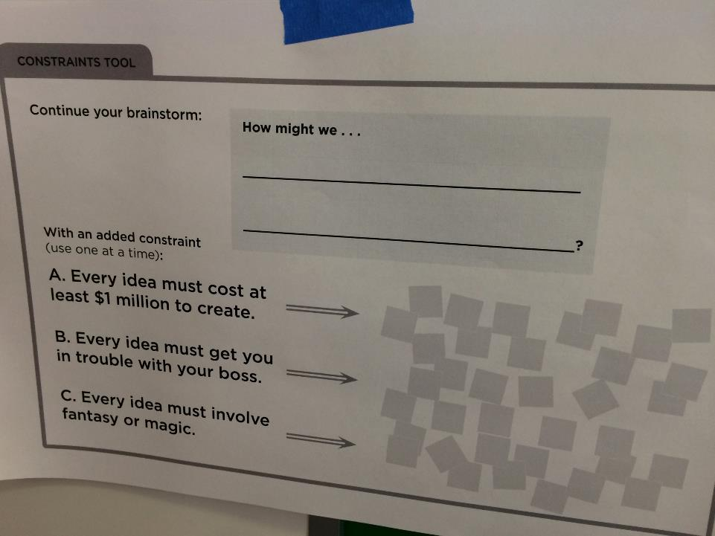
Notes:
We used this to then brainstorm on some possible opportunities (4-6).
“How might we statements”

Slide 77
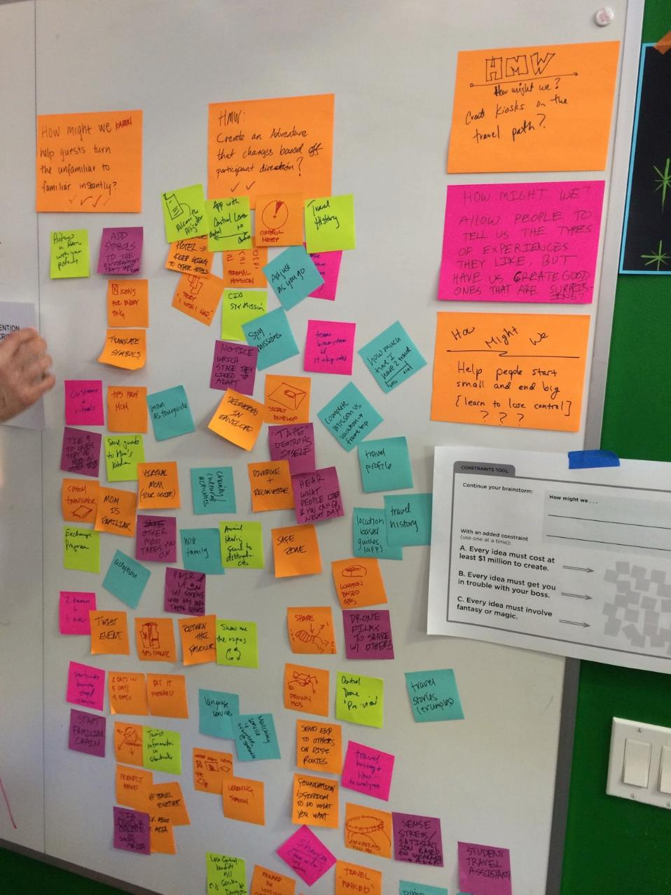
Notes:
Here are 5 of them
How might we help guests turn the unfamiliar to the familiar instantly?
How might we create an adventure that changes based off participant direction?
How might we create kiosks on the travel path? (solution)
How might we allow people to tell us the types of experiences they like, but have us create good ones that are surprising?
How might we help people start small and end big [learn to lose control]?

Slide 78
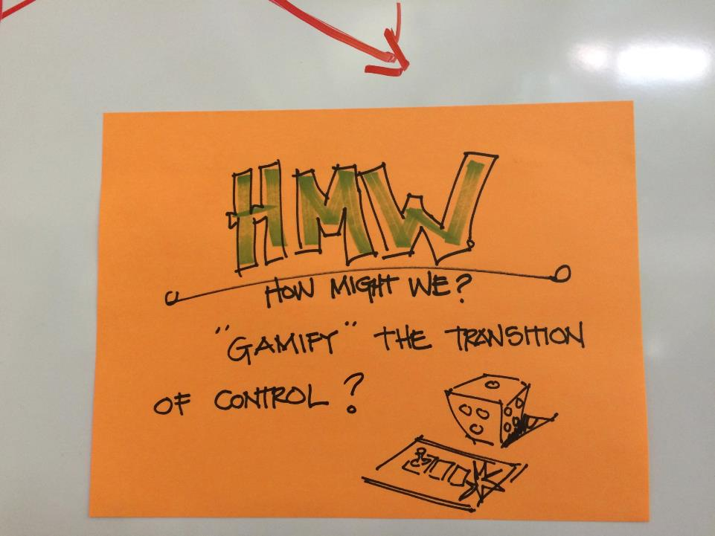
Notes:
Here is the 6th that we decided to push on further

Slide 79
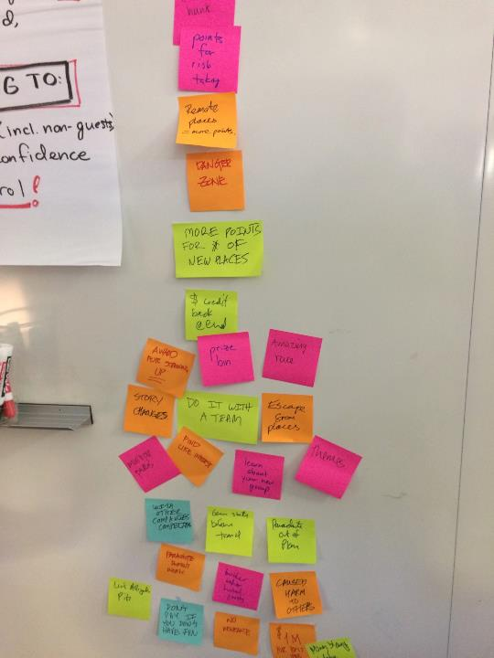
Notes:
We brainstormed on how we might do this [advance]

Slide 80
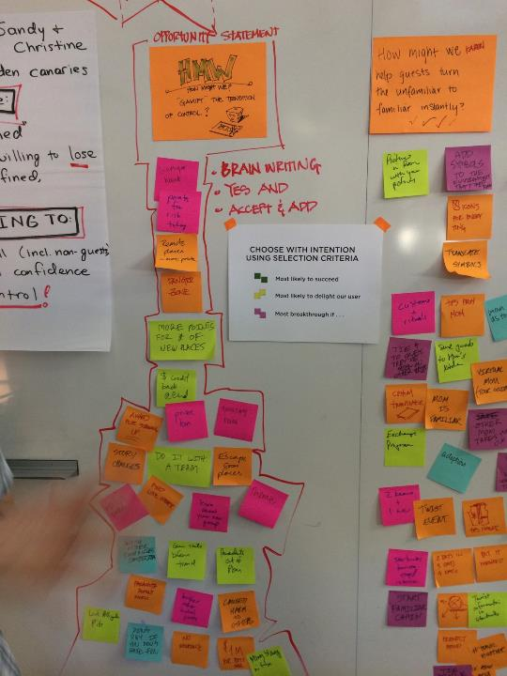
Notes:
generating 27 ideas in only 10 minutes or so… and then trying to decide on how to select among the two “How Might We” statements we brainstormed on

Slide 81
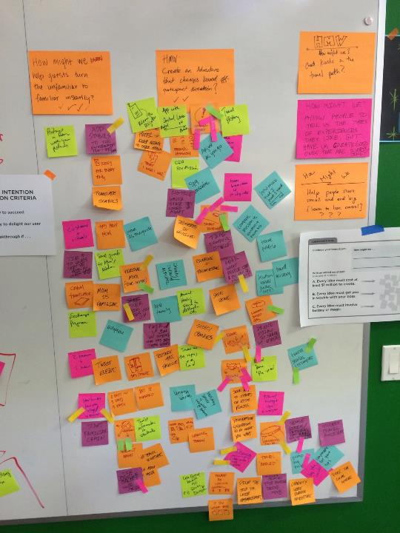
Notes:
everyone got 3 votes

Slide 82
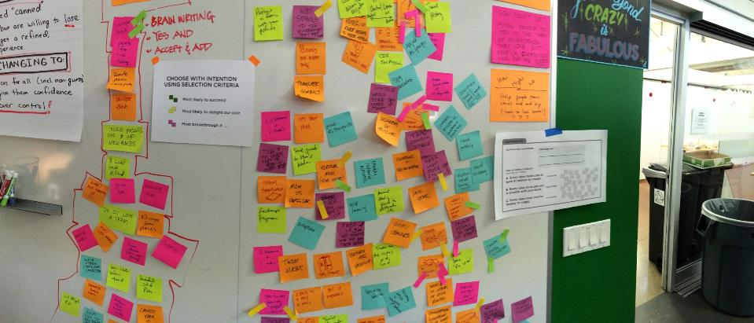
Notes:
we then selected an idea to go further with and create a rapid prototype to learn more

Slide 83
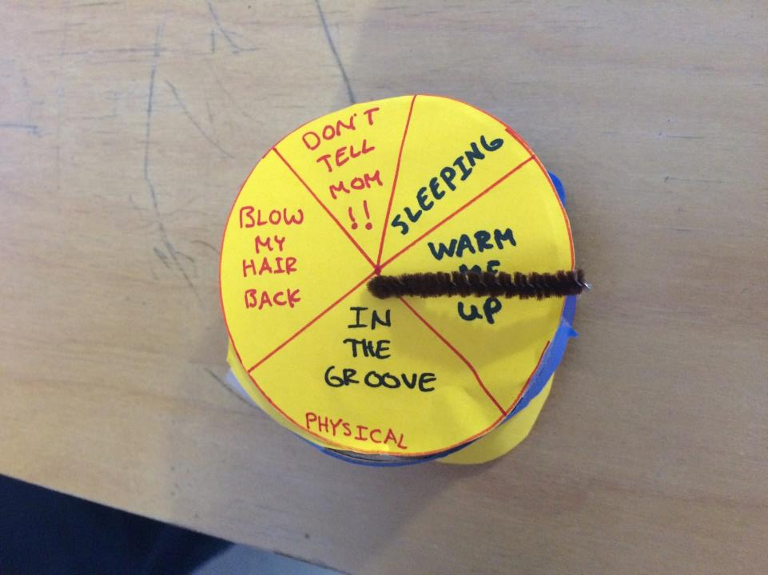
Notes:
This is what we ended up with. A special Activity Watch.
We did NOT think this would be a product. It was purely to let us explore the assumption of letting go of control, but somehow giving feedback on how the experience was going.

Slide 84
Next Assignment (due at Monday’s class)
Strive for diversity of solutions

Slide 85
Parallel Experience Prototyping Goal
Prototype to test an assumption
Prototype can be a piece of idea rather than a complete solution
Think of it as a needfinding technique

Slide 86
Summary
Experience prototyping allows us to try many ideas quickly & learn more about the problem & solution space (prototype to learn)

Slide 87
Next Time
Lecture
  Rapid Experimentation
Project (due Monday at start of class)
  Flesh out POVs
  Create HMWs
  Brainstorm solutions & select the best
  Create/test experience prototypes for top 3 solutions
  Test each prototype with at least 1 target users
  In presentation, get across what you learned!
  Class will be used to select the idea to move forward

