Slide 1
Unpacking and Journey Maps
Julie Stanford
Sliced Bread Design
@jstanford1000
CS377E
Spring 2017
April 10, 2017

Slide 2

unpacking
analyzing an interview

Slide 3
analysis
long, thorough method

Slide 4
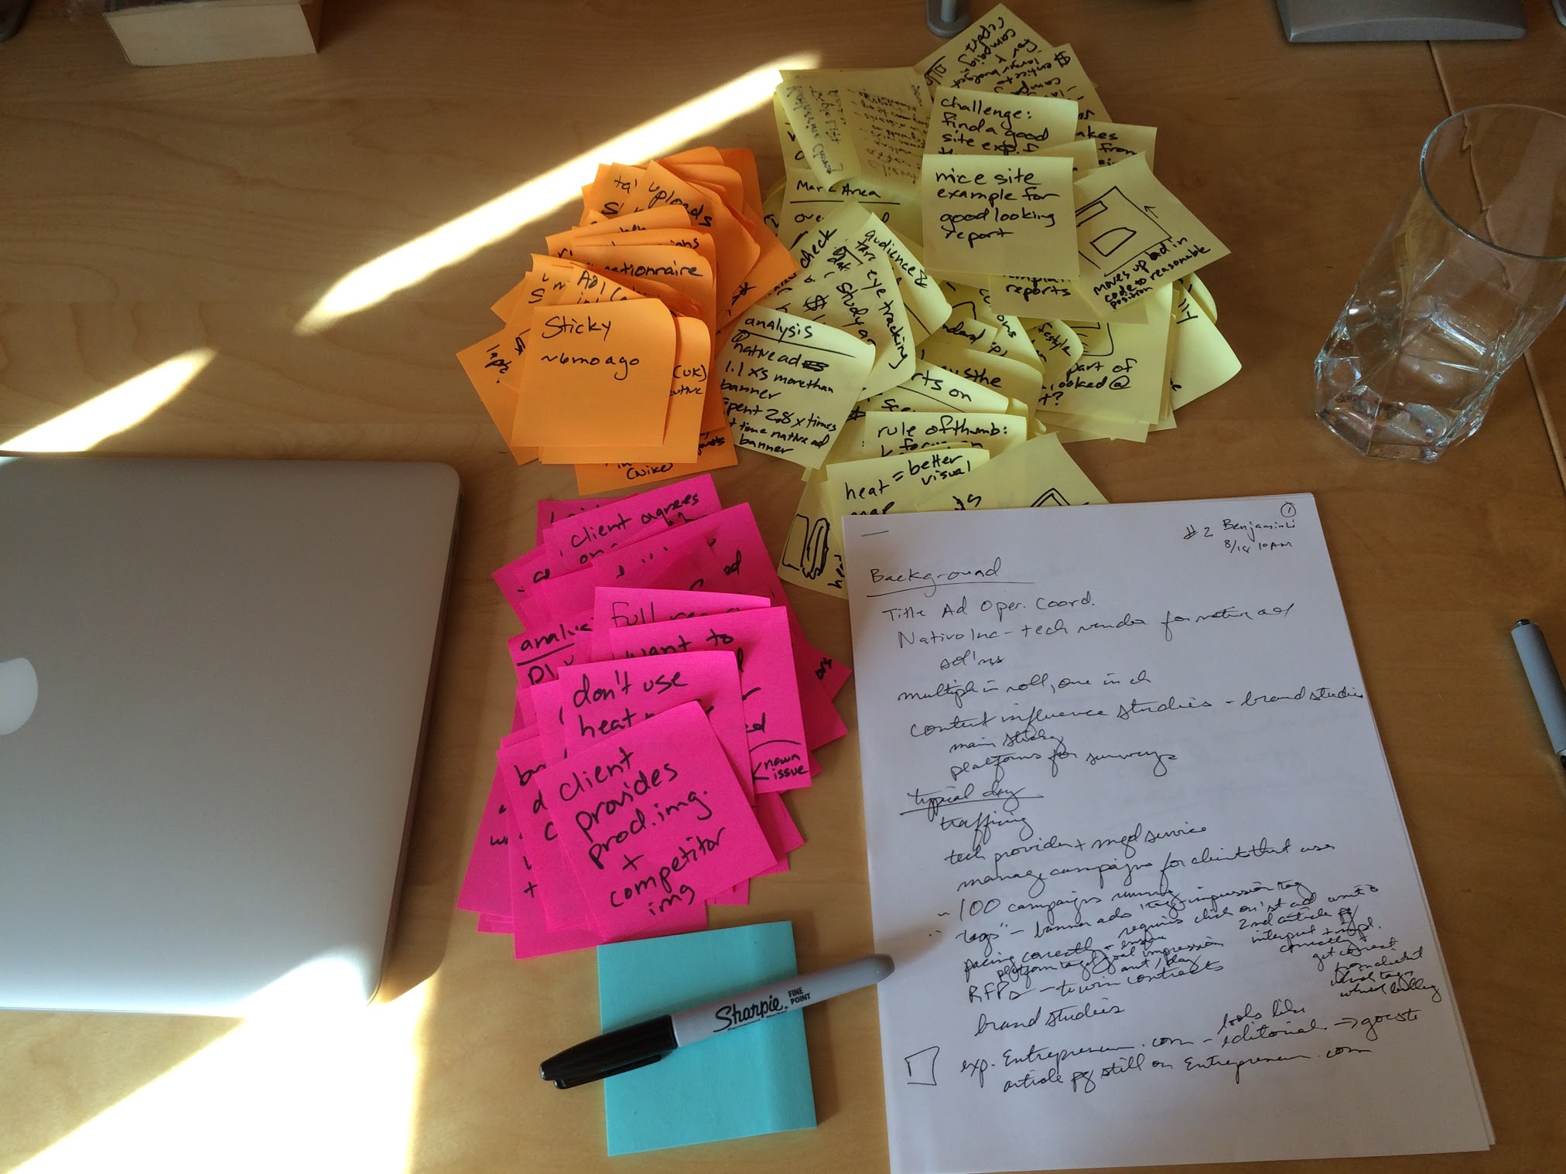
one color per participant, take notes with a sharpie
write down snippets of everything

Slide 5
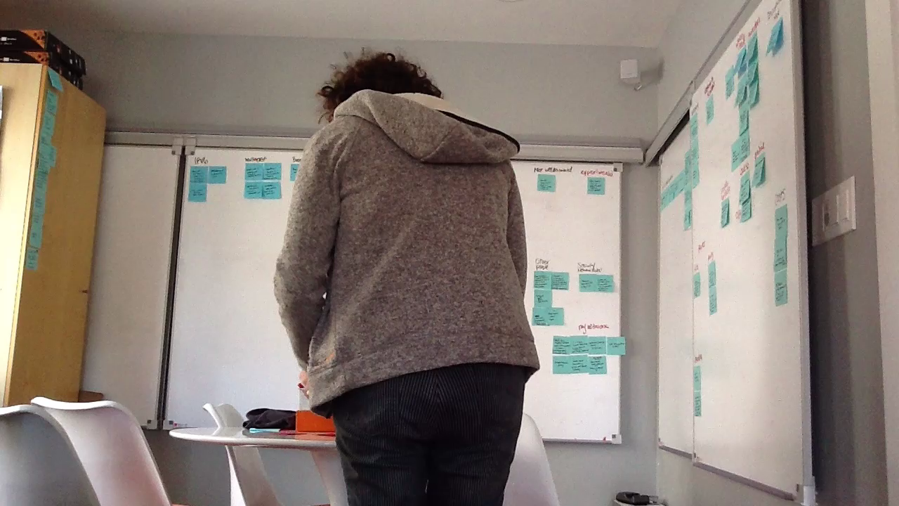

Slide 6
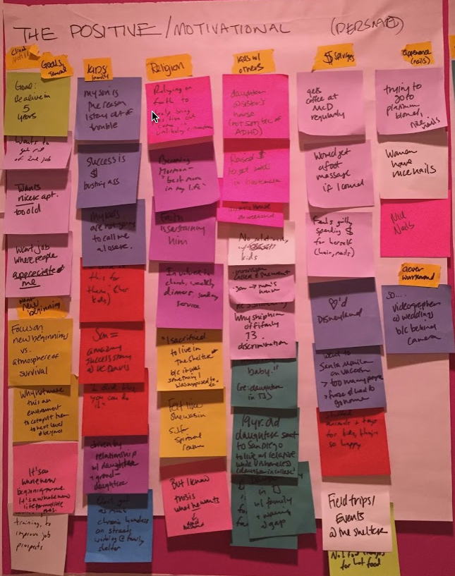
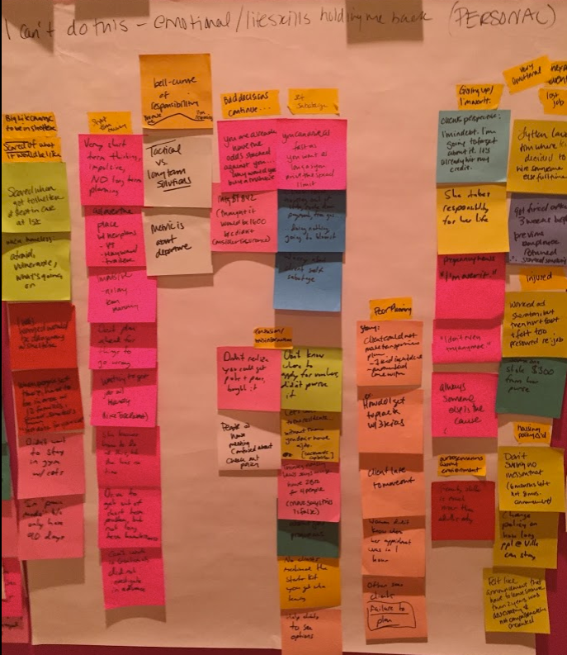

Slide 7
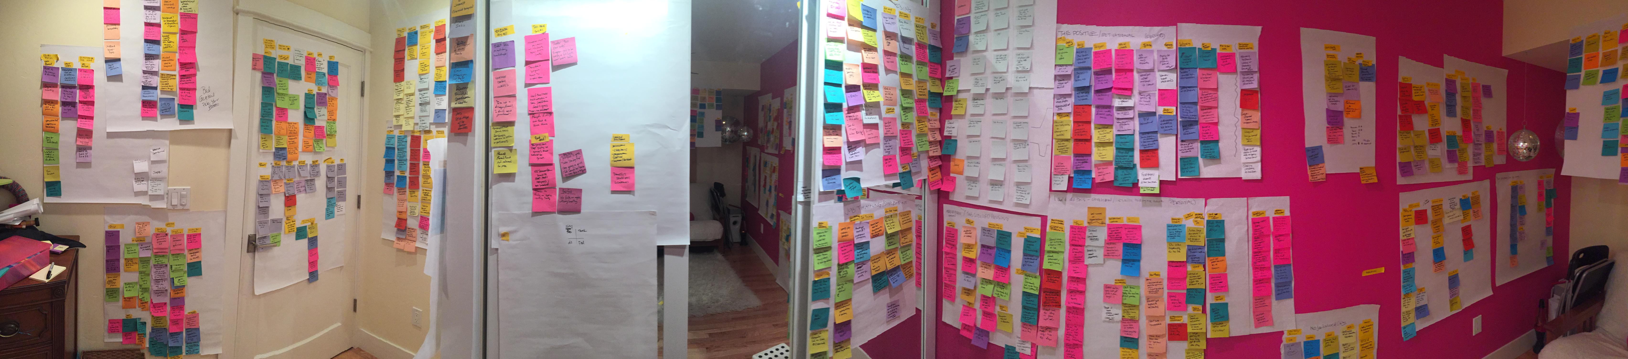

Slide 8


Slide 9
analysis short-cut
journey map method

Slide 10
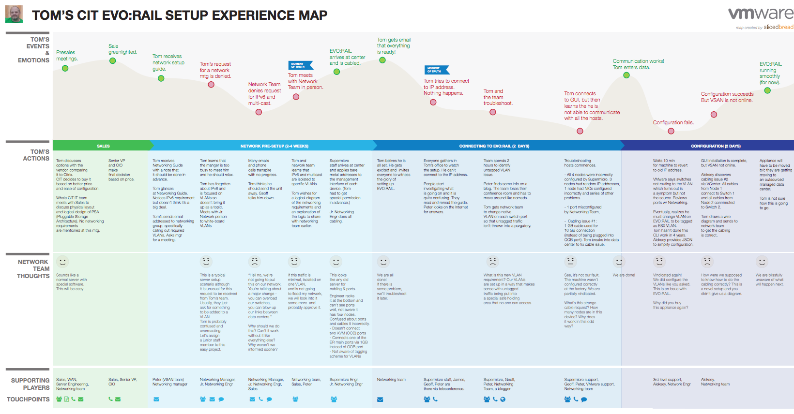

Slide 11
visual interpretation of the full story of an experience from an individual’s perspective

Slide 12
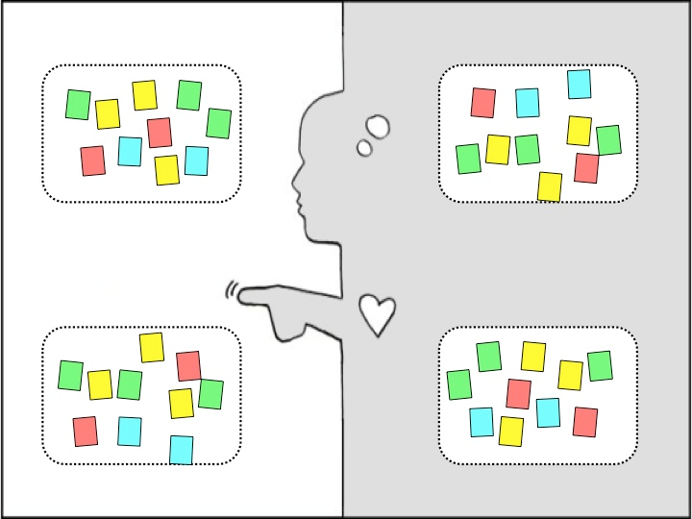
classic empathy map
say
think
do
feel

Slide 13

journey empathy map
say
think
do
feel

Slide 14
journey empathy map
say
think
do
feel
time

Slide 15
journey empathy map
say
additional elements
person background
phases:
divisions of time
touch points:
where, using what
moments of truth:
turning points
supporting characters
pain points:
questions & issues
think
do
feel
time

Slide 16
Person
Do/Feel
Phases
Think/Say/Do
Supporting Characters
Touchpoints /Characters

Slide 17
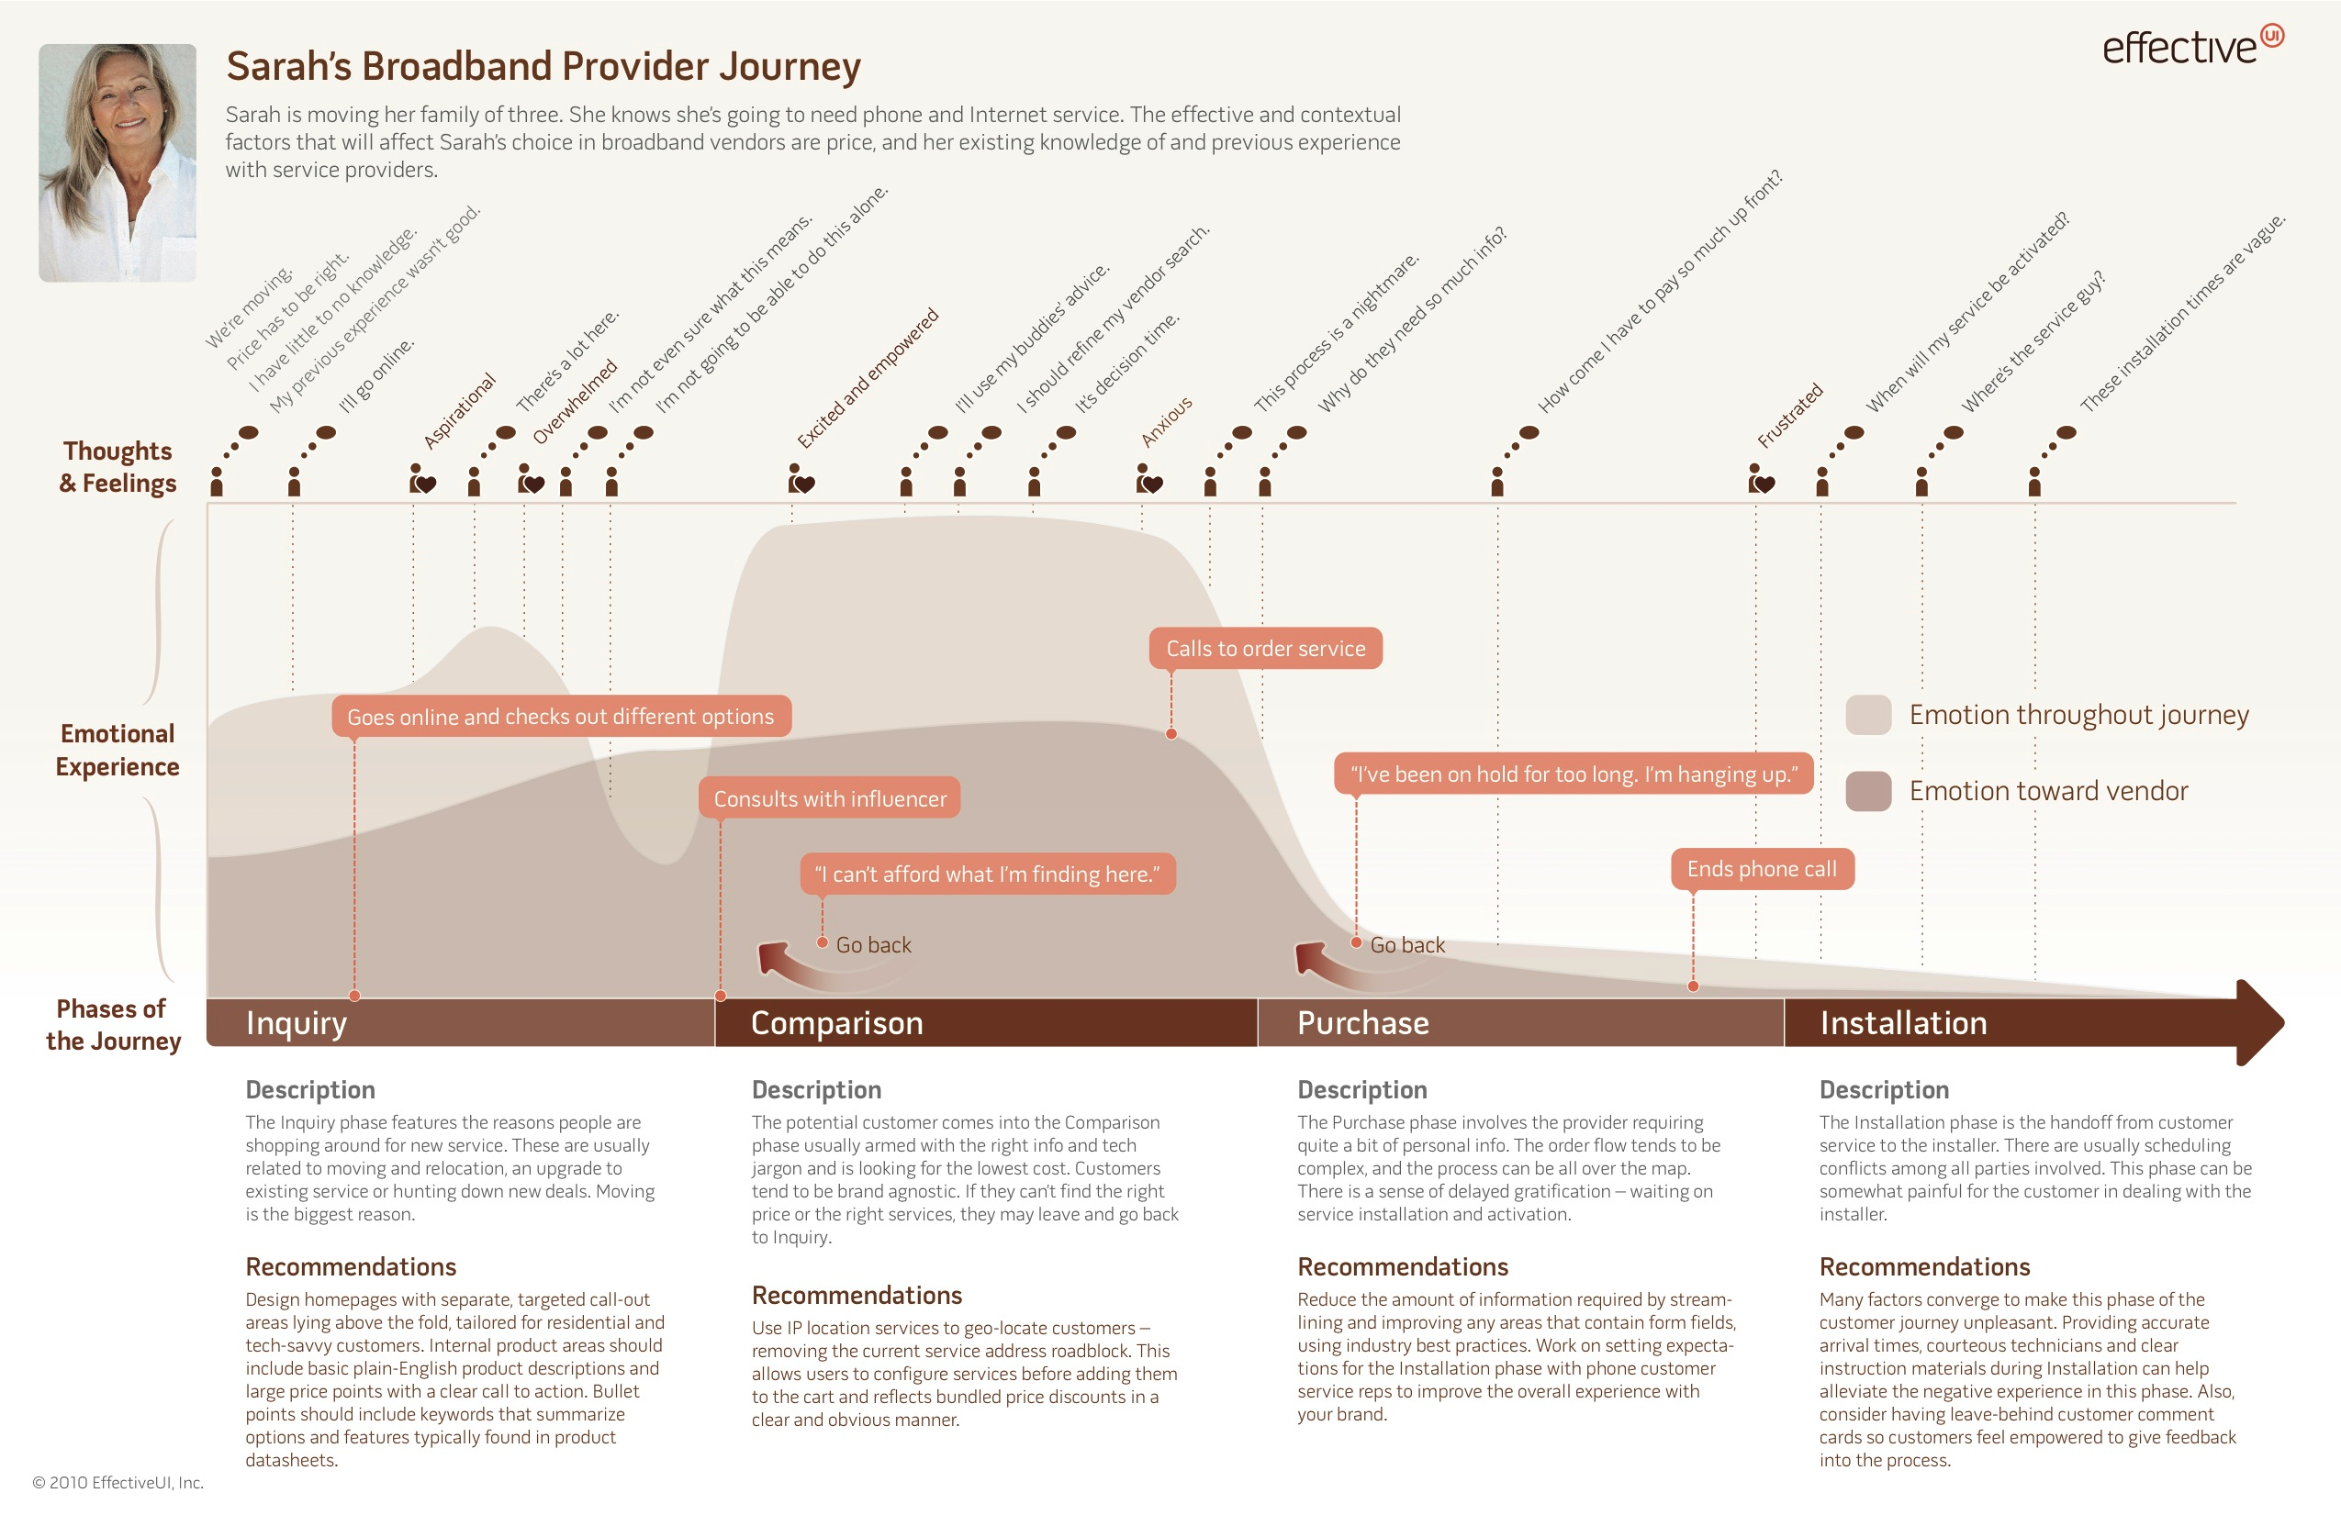
Person
Think
Feel
Do
Phases
Pain points & Do
No Say or Touchpoints!

Slide 18
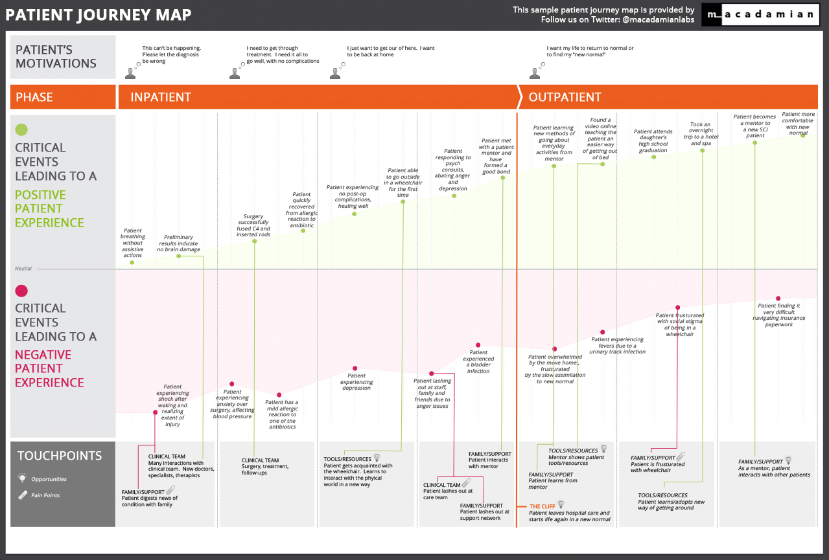
General Person
Think
Phases
Do
Feel
No Say
Touchpoints, supporting characters

Slide 19
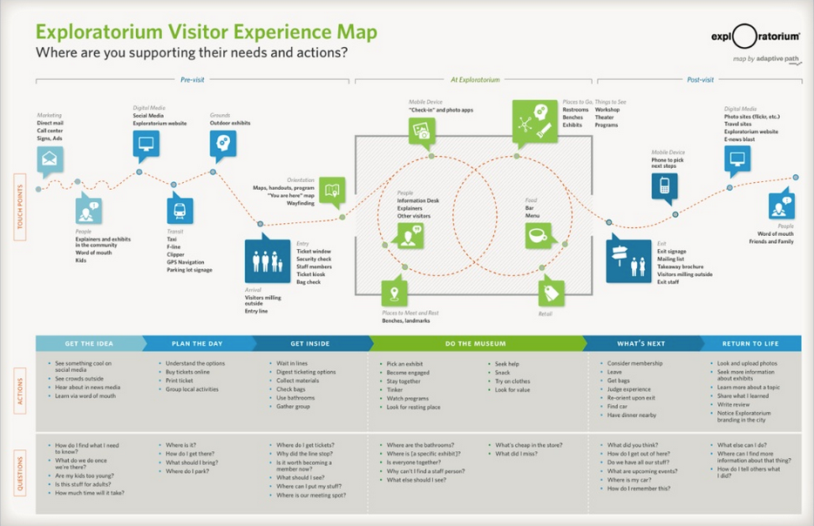
General Person
Workflow
Touchpoints
Phases
Do
Think
No Feel/Say

Slide 20
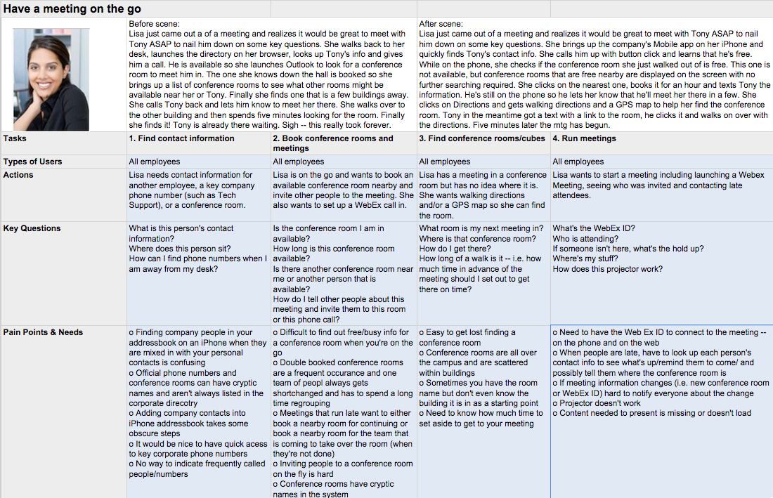
Phases
Do
Think
Pain
points
can you see the opportunity?

Slide 21
Student examples

Slide 22
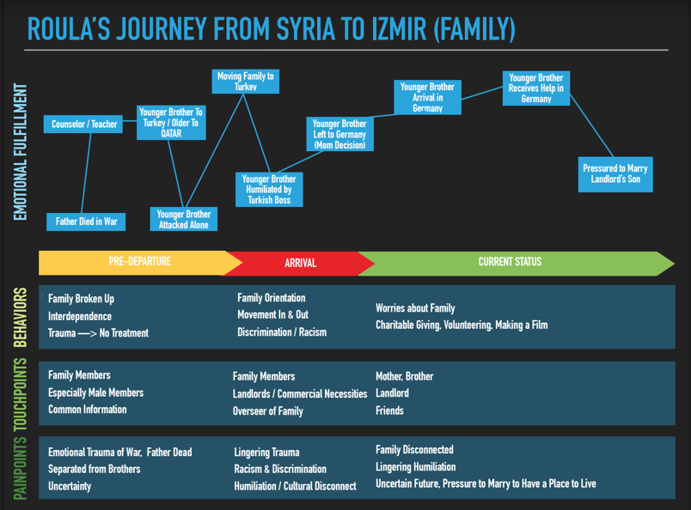

Slide 23
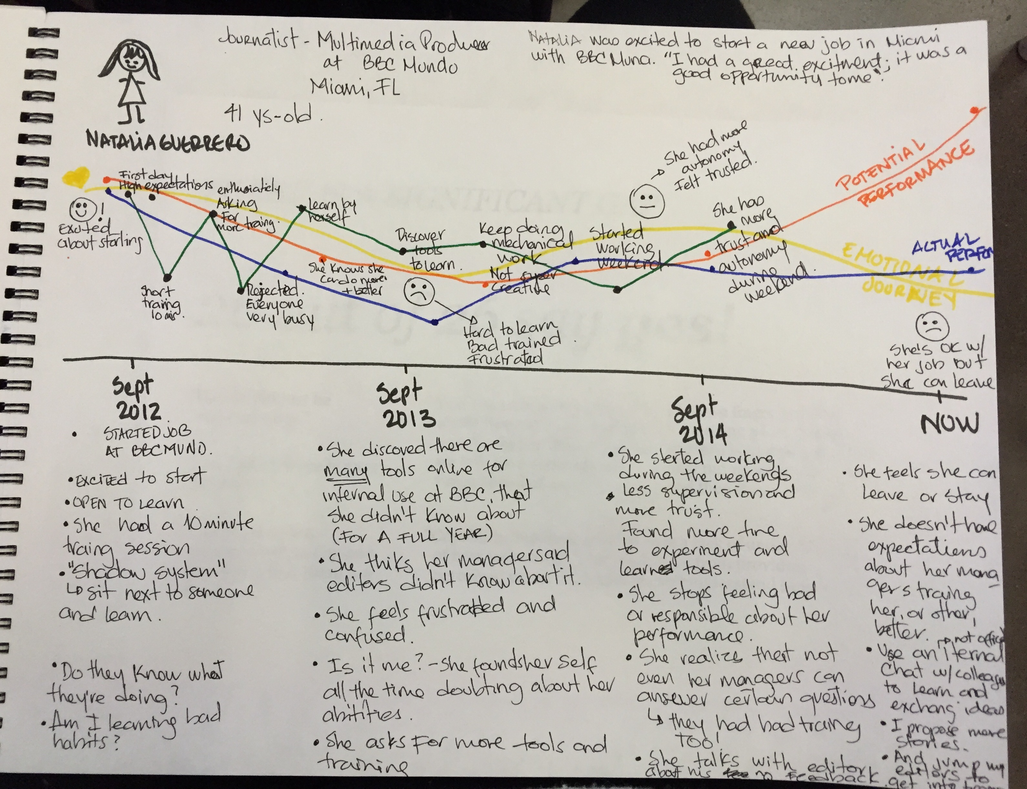

Slide 24
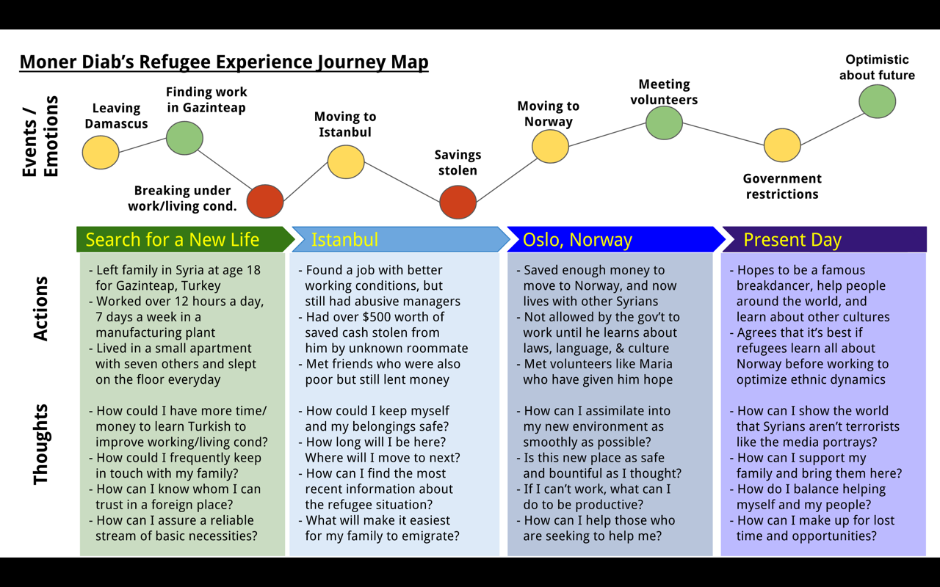

Slide 25
how do you do it?

Slide 26
understand the timeline of the story from many angles

Slide 27
Person
Feel &
High-Level Do
Key Point
Yay!
Opportunity
Uh-oh!
Phases of timeline
Behaviors & Quotes (Do/Say)
Painpoints (Think)
Touchpoints (optional: supporting characters)

Slide 28


Slide 29
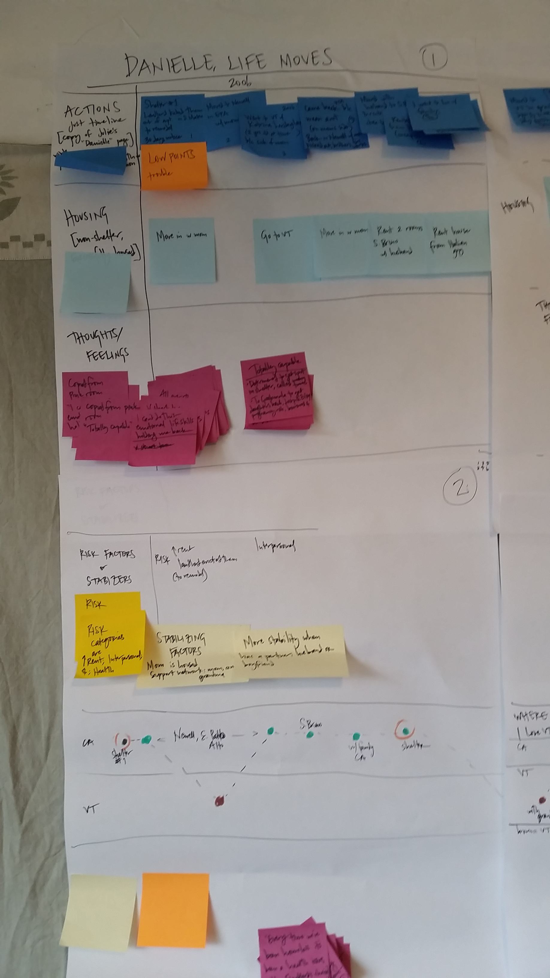

Slide 30
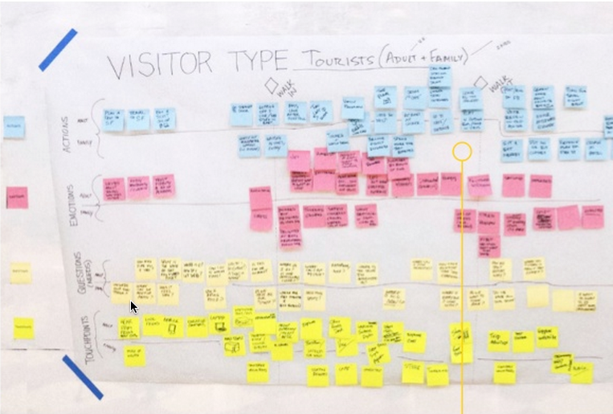

Slide 31
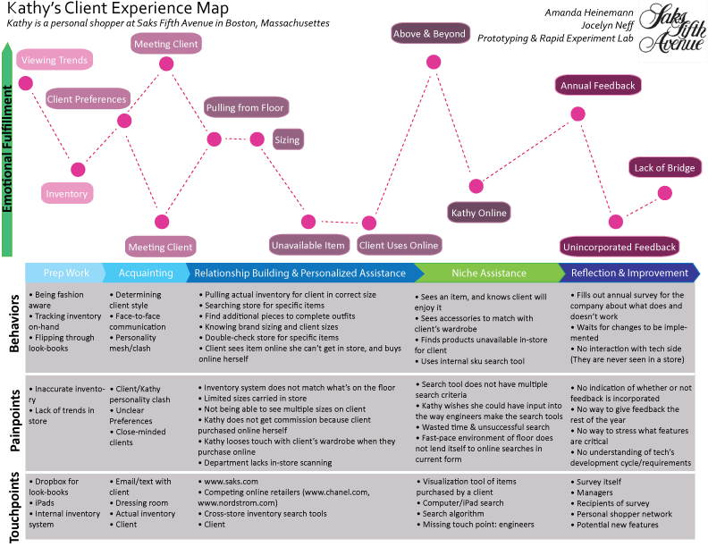
repeat and then discuss

Slide 32
some final tips
Don’t just capture the facts of DO…think about why this happening from the user’s perspectives and capture that in the THINK area
Don’t just capture high level issues...capture story details to build empathy
Discuss the journey map with your group. Use this as a tool for digging deeply into the needs that this journey represents.
Compare multiple journey maps and look for patterns and contradictions. Why was one successful and another not?

Slide 33
you do it
Get together with your group and start using the journey map process to analyze one of your interviews.
You can grab large white boards from the d.school to keep your work. (We have also brought large white post-it sheets).
Create Journey Maps by next Monday for your interviews
Next Monday, we will discuss Needs and How Might We Questions in more detail

