Slide 1
Early Stage Prototyping
May 7, 2015
Notes:
[35 minutes – goal 30 and was going fast]

Slide 2
Outline
Storyboarding
Types of Prototypes
Low-fi prototyping

Slide 3
Design Process: Exploration
Expand Design Space
Brainstorming
Sketching
Storyboarding
Prototyping
Discovery
Design Exploration
Design Refinement
Production
Notes:
We are STILL in the exploration phase (especially on your projects). DO NOT narrow down too early.

Slide 4
Sketches & Storyboards
Where do storyboards come from?
film & animation
Give you a “script” of important events
leave out the details
concentrate on the important interactions

Slide 5
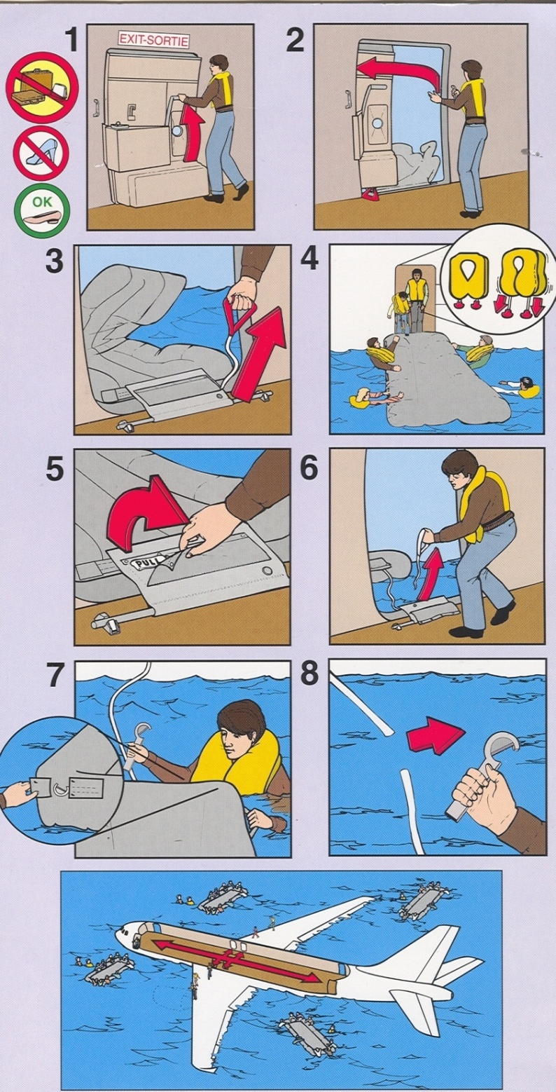
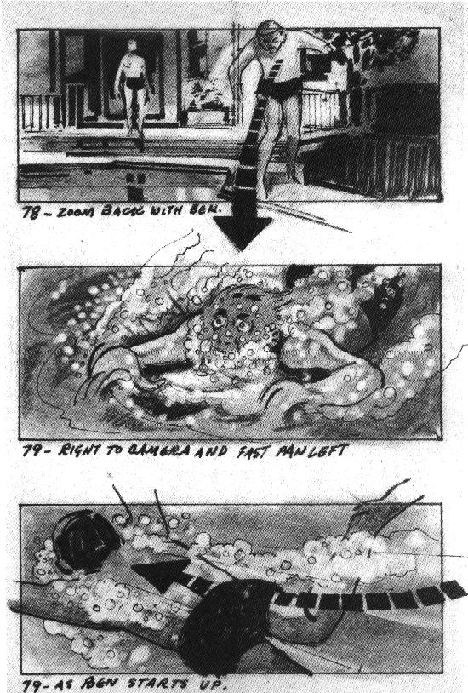

Slide 6
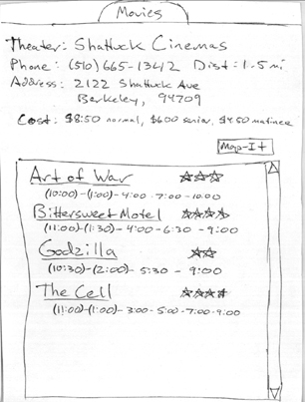
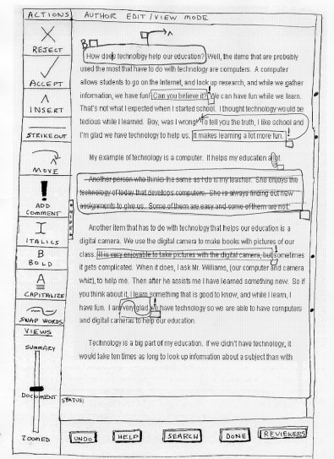
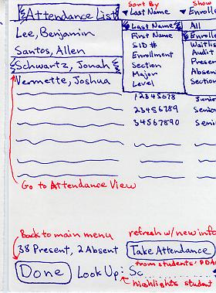
Sketches & Storyboards

Slide 7
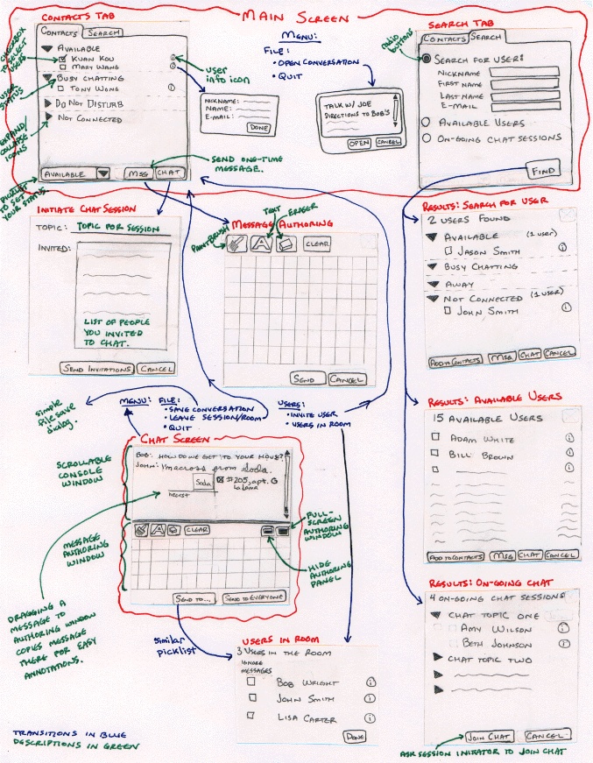
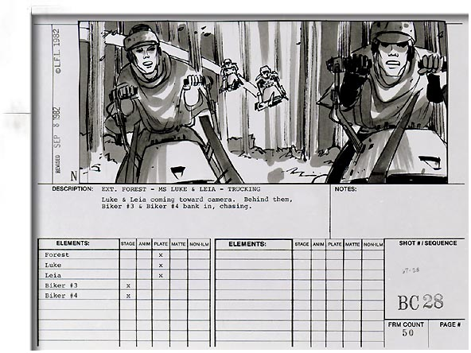
Ink Chat
Starts to tell a story, but still describes the design
Notes:
combination of the two

Slide 8
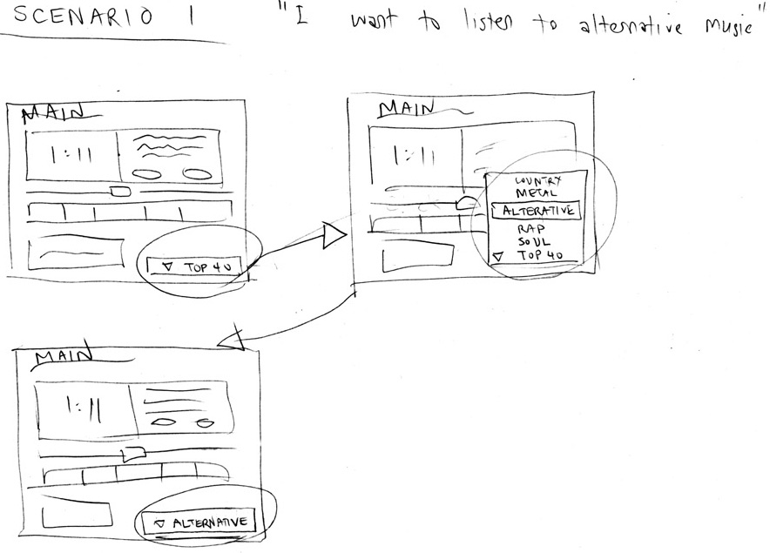
Sketches & Storyboards

Slide 9
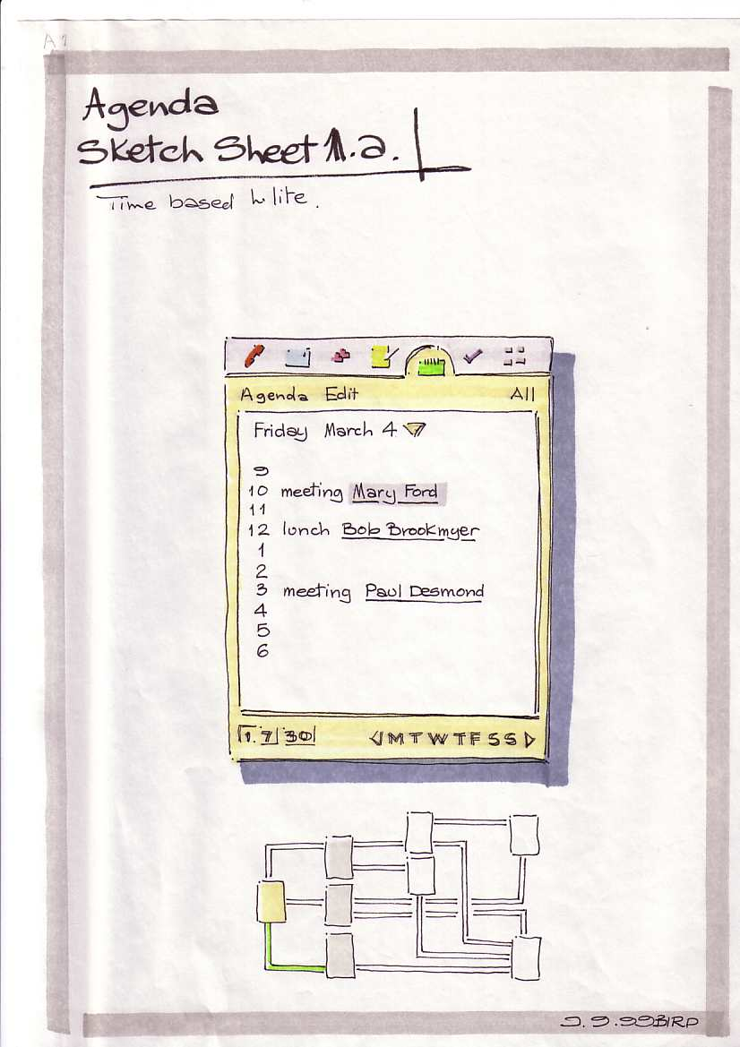
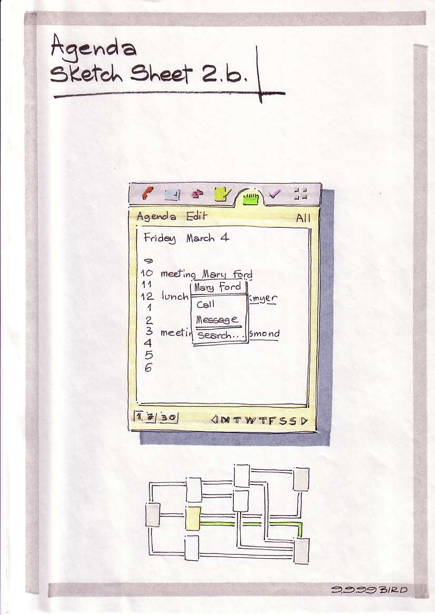
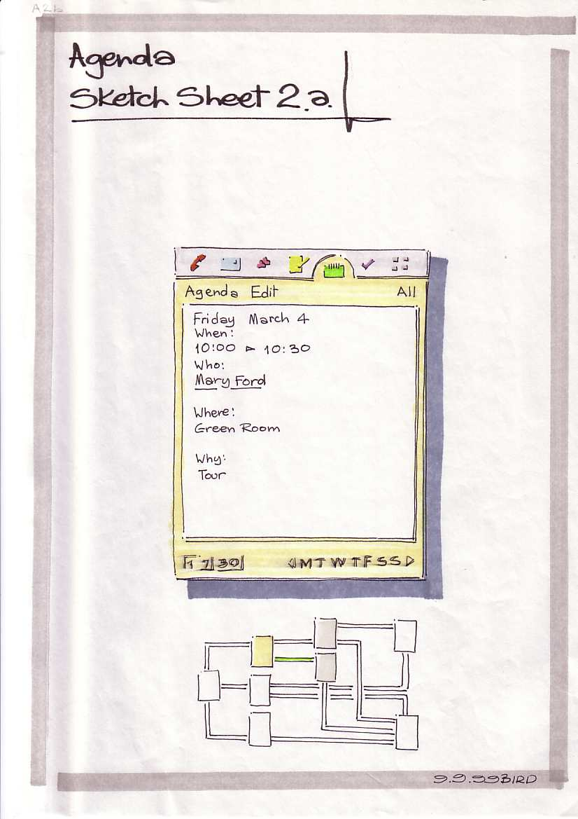
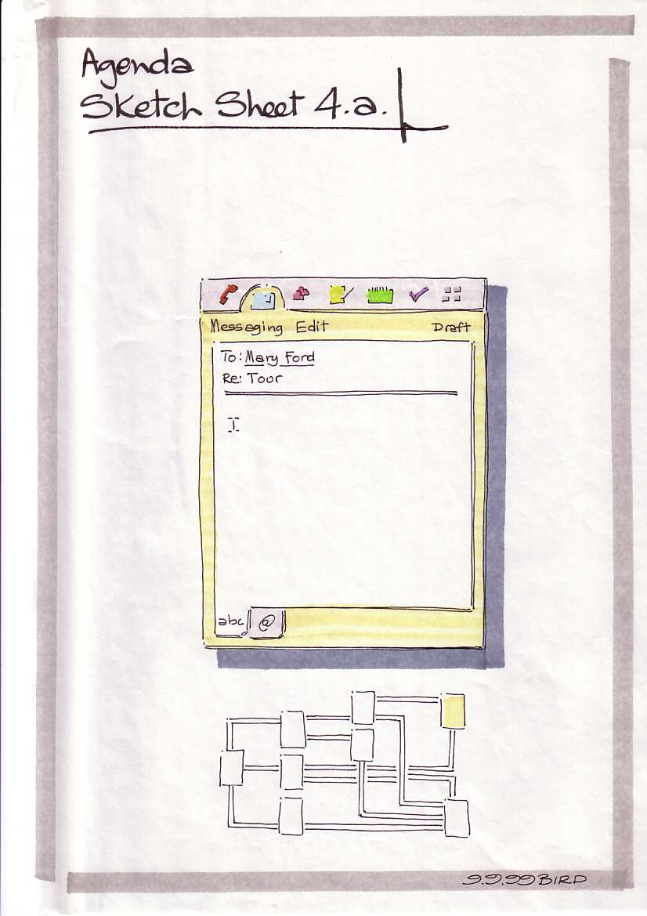
Picturing Time
Ron Bird

Slide 10
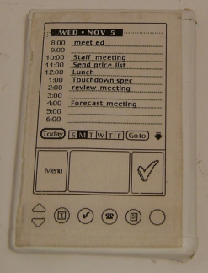
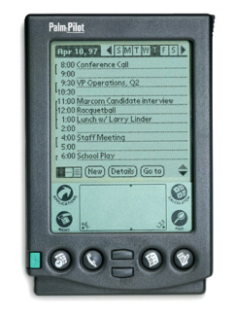
What is a Prototype?
“A prototype is an early sample or model built to test a concept or process or to act as a thing to be replicated or learned from.” – Wikipedia
a working representation of a final artifact
http://www.computerhistory.org/collections/accession/102716262
Notes:
Jeff Hawkins carried around a block of wood like this in his pocket & pulled it out when meeting people and used a pen to act like he was adding things to his device
This led to the prototype in the middle and
The final product: The PalmPilot (right)

Slide 11
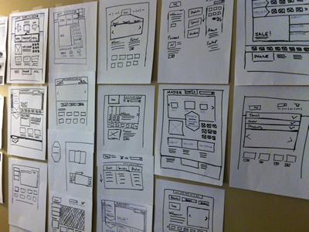
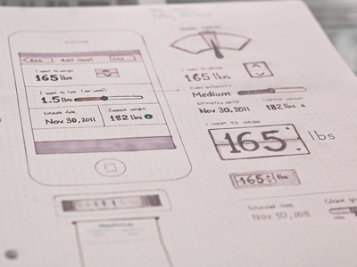
Types of Prototypes
Prototypes are concrete representations of a design
Prototype dimensions
representation: form of the prototype
off-line (paper) or on-line (software)
precision: level of detail (e.g., informal or polished)
interactivity: watch-only vs. fully interactive
fixed prototype (video clips)
fixed-path prototype (each step triggered by specified actions)
at extreme could be 1 path or possibly more open (e.g., Denim)
open prototype (real, but limited error handling or performance)
evolution: expected life cycle of prototype
e.g., throw away or iterative
PJ McCormick
Karem Suer
Notes:
PJ McCormick (left)
Kerem Suer (right)

Slide 12
Types of Prototypes
Prototypes are concrete representations of a design
Prototype dimensions
representation: form of the prototype
off-line (paper) or on-line (software)
precision: level of detail (e.g., informal or polished)
interactivity: watch-only vs. fully interactive
fixed prototype (video clips)
fixed-path prototype (each step triggered by specified actions)
at extreme could be 1 path or possibly more open (e.g., Denim)
open prototype (real, but limited error handling or performance)
evolution: expected life cycle of prototype
e.g., throw away or iterative

Slide 13
Fidelity in Prototyping
Fidelity refers to the level of detail
High fidelity?
prototypes look like the final product
Low fidelity?
artists renditions with many details missing

Slide 14
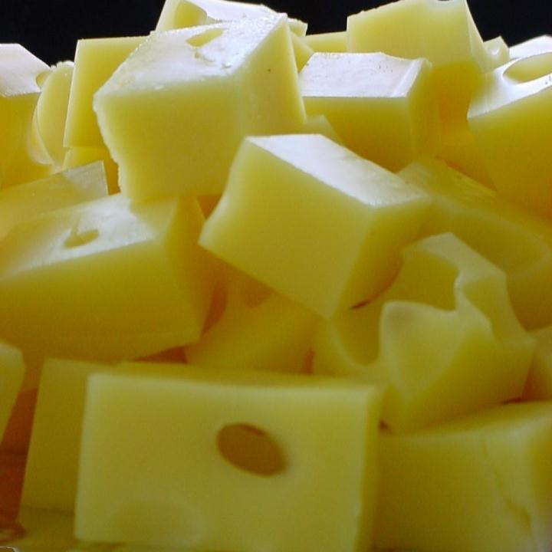
Hi-fi Prototypes Warp
Perceptions of the tester/reviewer
representation communicates “finished”
comments focus on color, fonts, & alignment
Time
encourage precision
specifying details takes more time
Creativity
lose track of the big picture

Slide 15
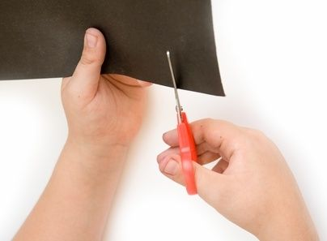
Why Use Low-fi Prototypes?
Traditional methods take too long
sketches → prototype → evaluate → iterate
Can instead simulate the prototype
sketches → evaluate → iterate
sketches act as prototypes
designer “plays computer”; others observe & record
Kindergarten implementation skills
allows non-programmers to participate

Slide 16
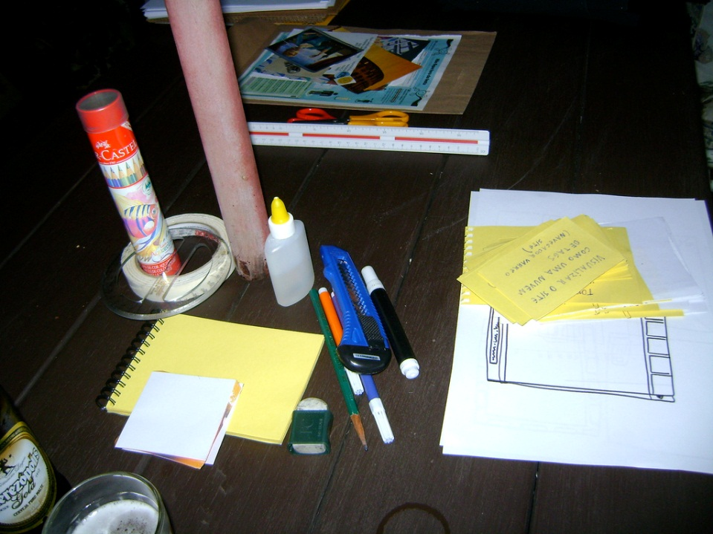
The Basic Materials
Large, heavy, white paper (A3 or 11x17)
5x8 in./A5/A6 index cards
Tape, stick glue, correction tape
Pens & markers (many colors & sizes)
Post-its
Overhead transparencies
Scissors
X-acto knives, etc.
http://www.flickr.com/photos/latitude14/3651034642/sizes/l/in/photostream/

Slide 17
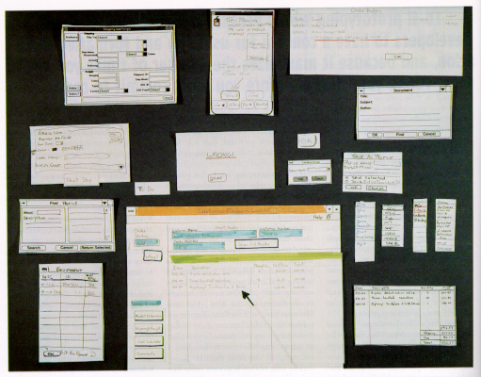
from “Prototyping for Tiny Fingers” by Rettig

Slide 18
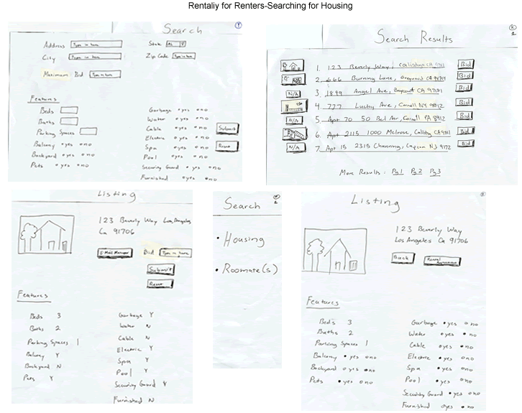

Slide 19
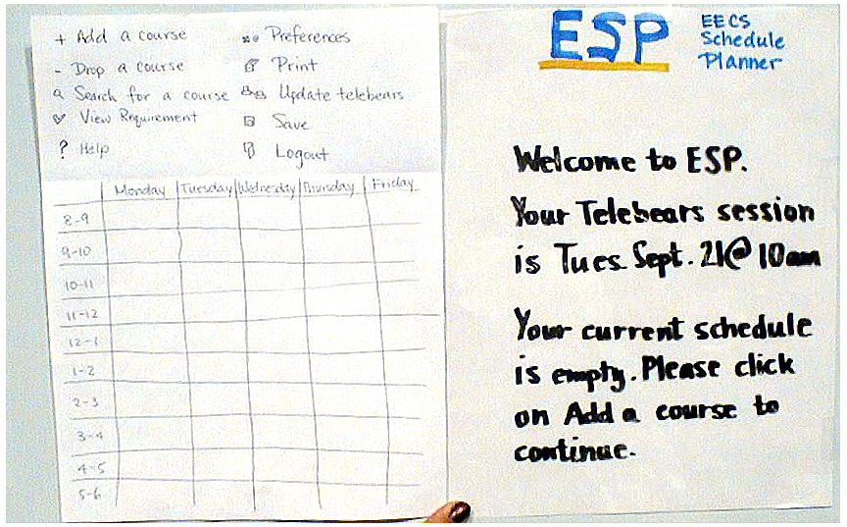
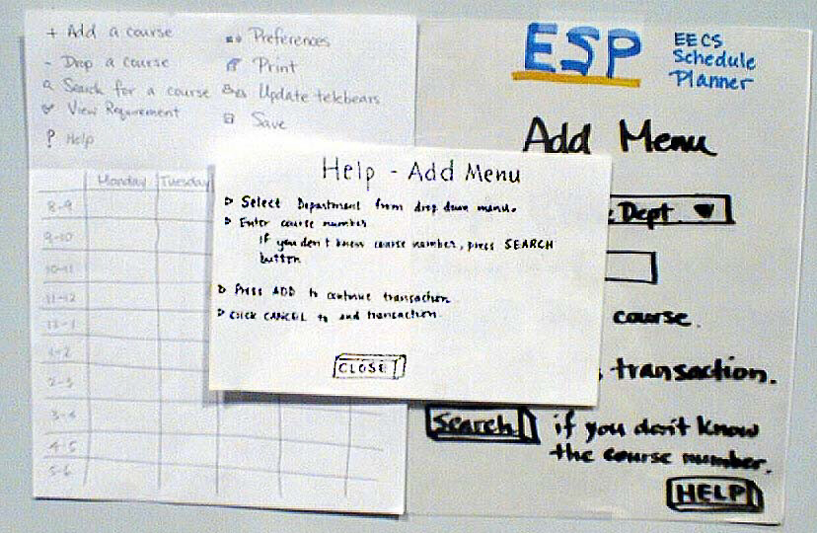
ESP

Slide 20
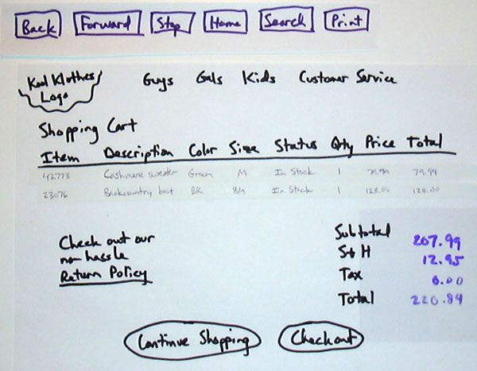

Slide 21
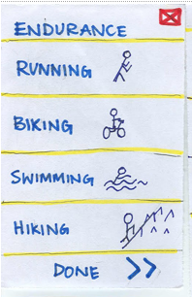
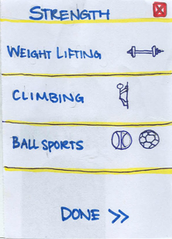
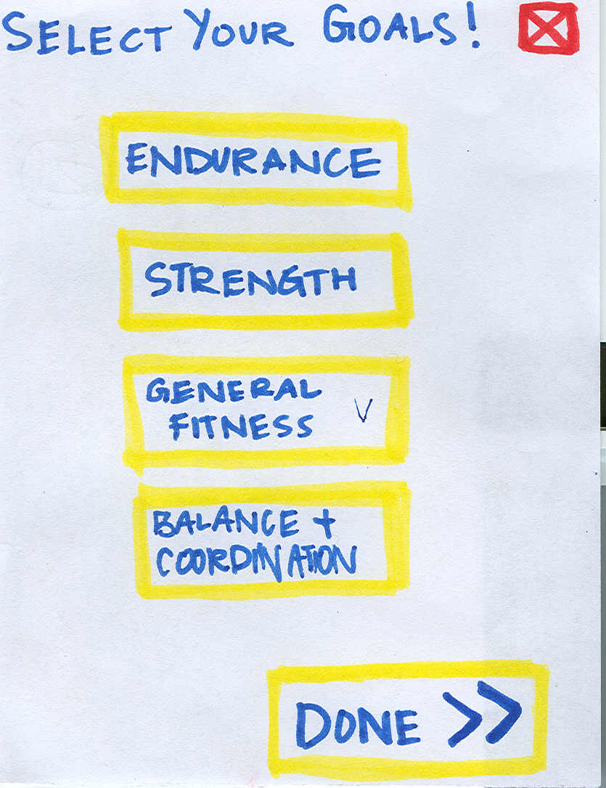
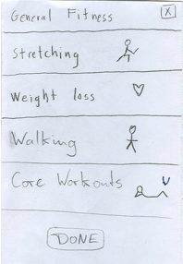
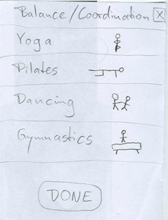
➔
ZAPT

Slide 22
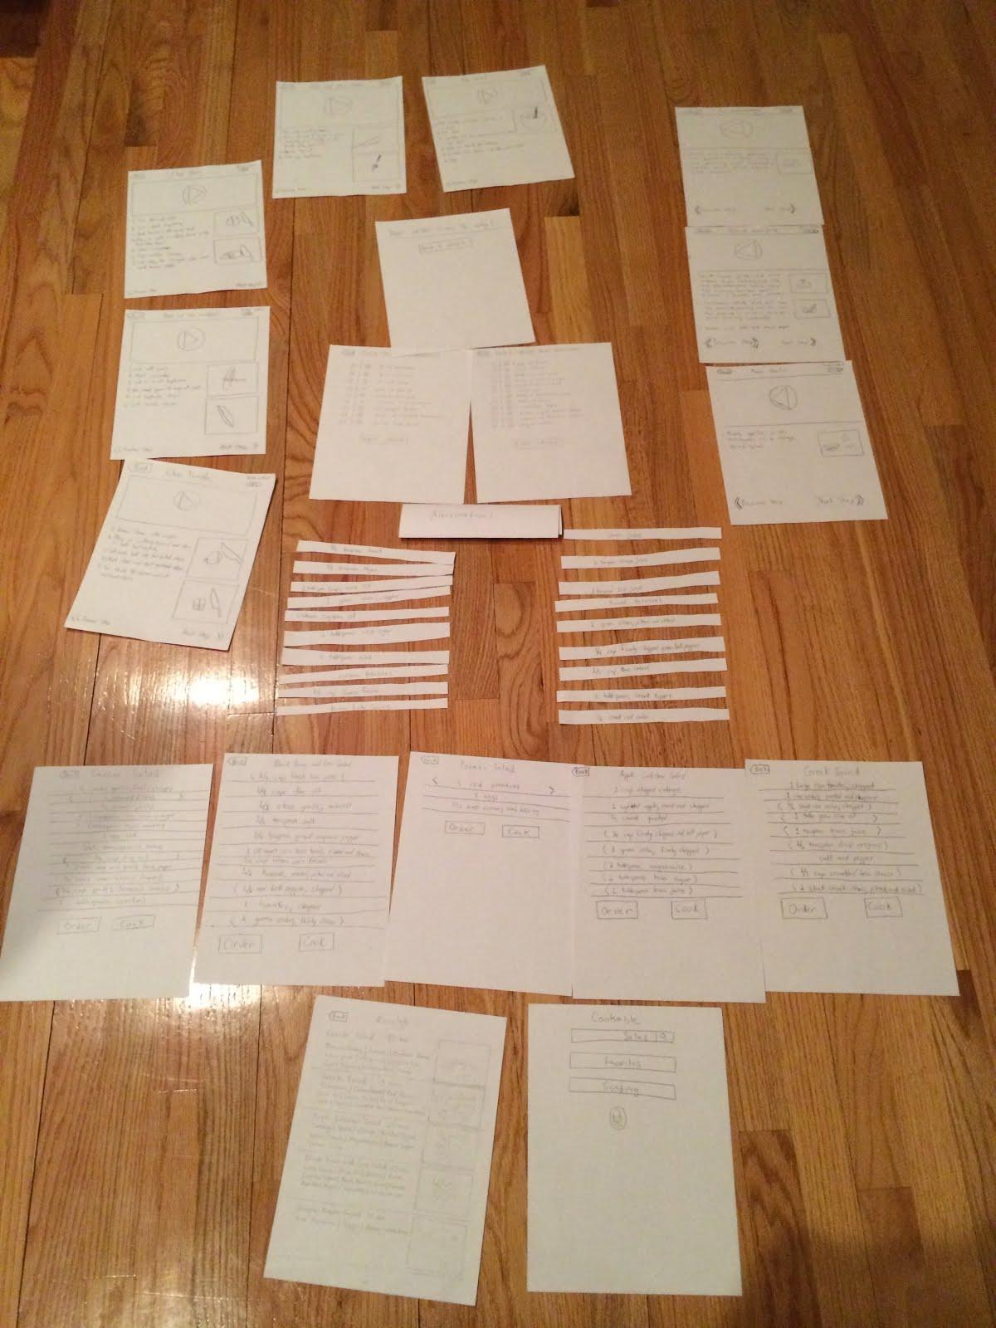
Cookable

Slide 23
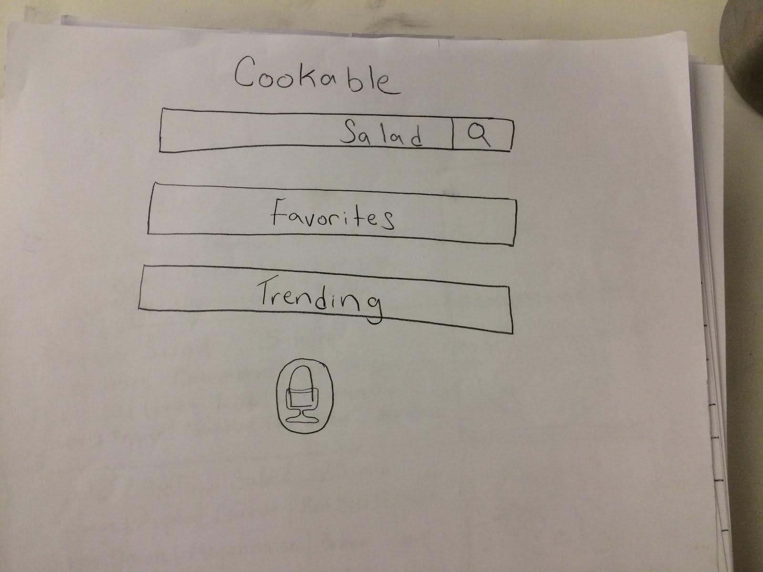
Cookable

Slide 24
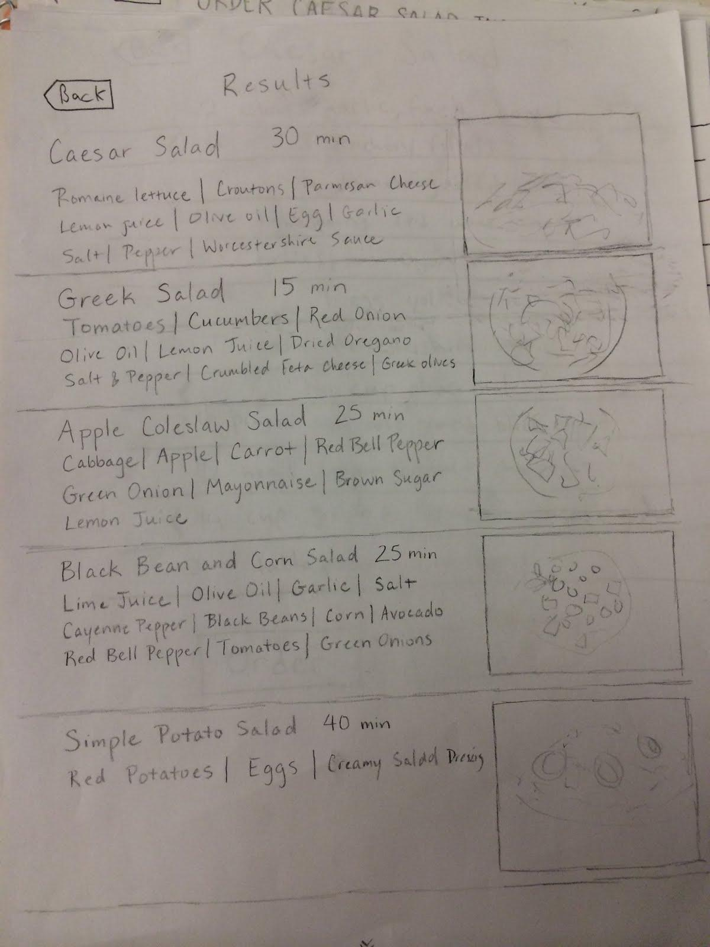
Cookable

Slide 25
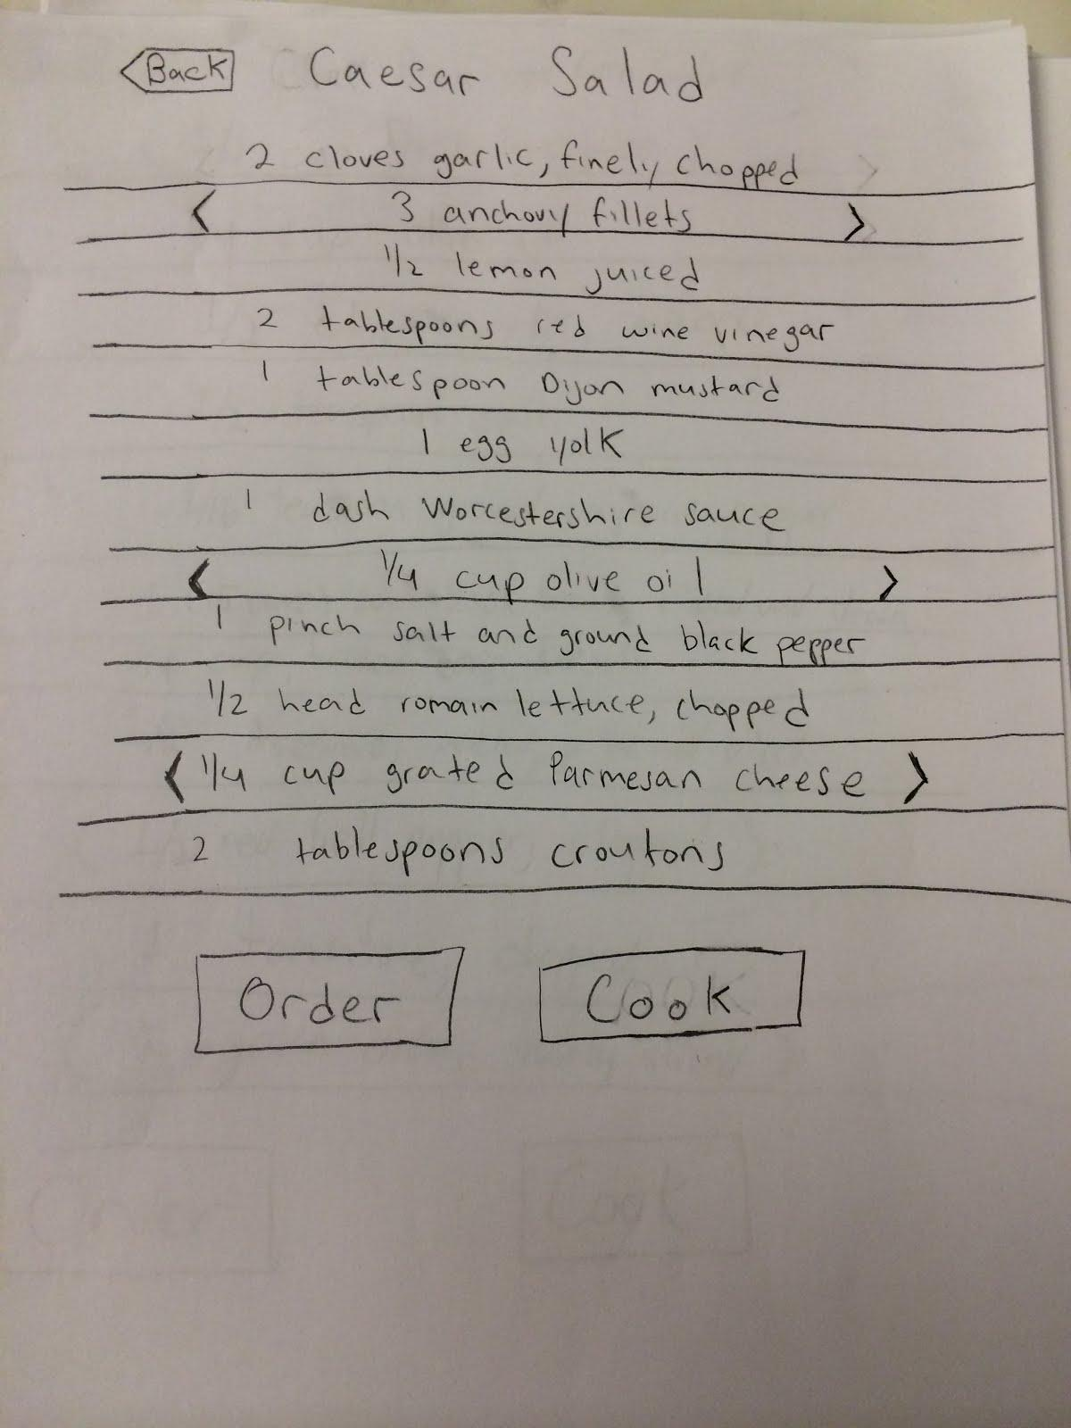
Cookable

Slide 26
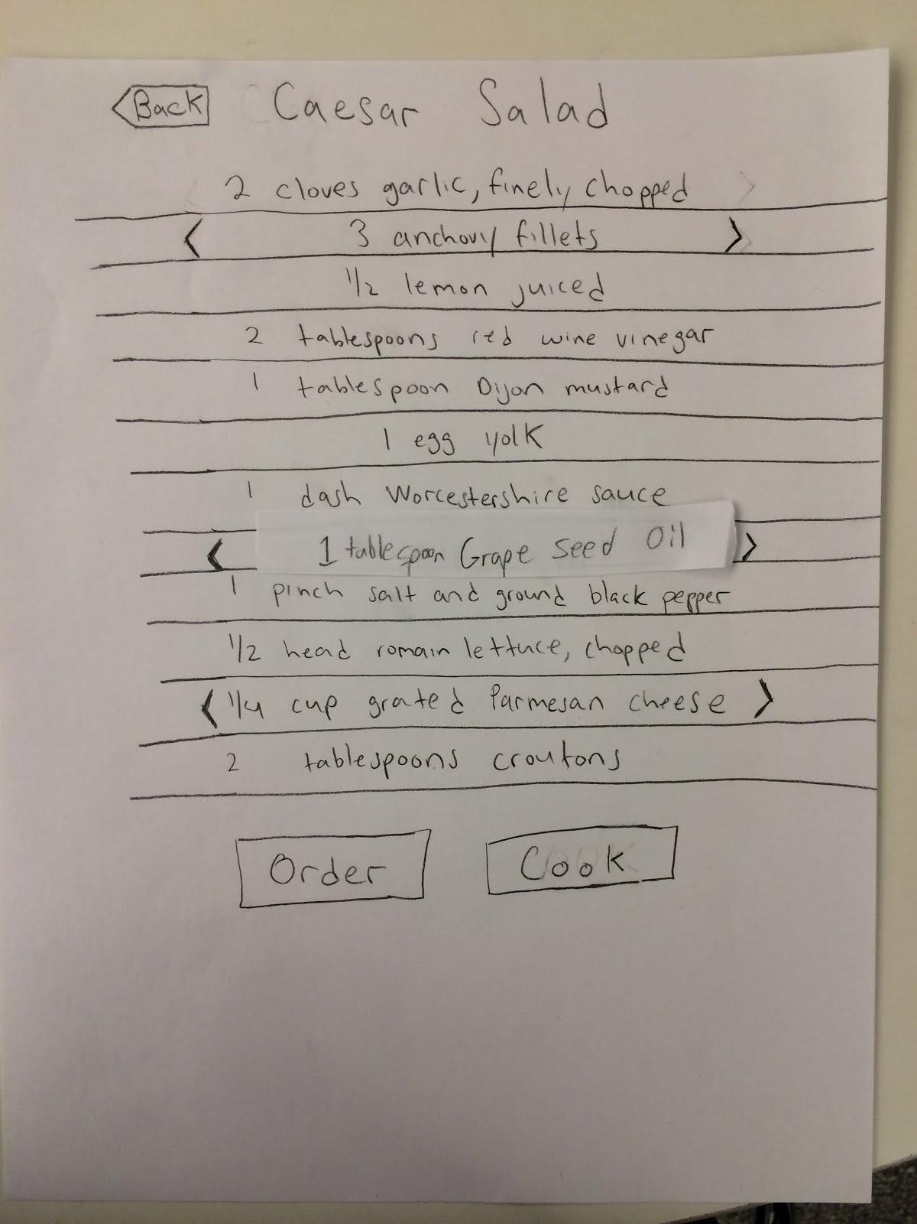
Cookable

Slide 27
Constructing the Model
Set a deadline
don’t think too long - build it!
Draw a window frame on large paper
Put different screen regions on cards
anything that moves, changes, appears/disappears
Ready response for any user action
e.g., have those pull-down menus already made
Use photocopier/printer to make many versions

Slide 28
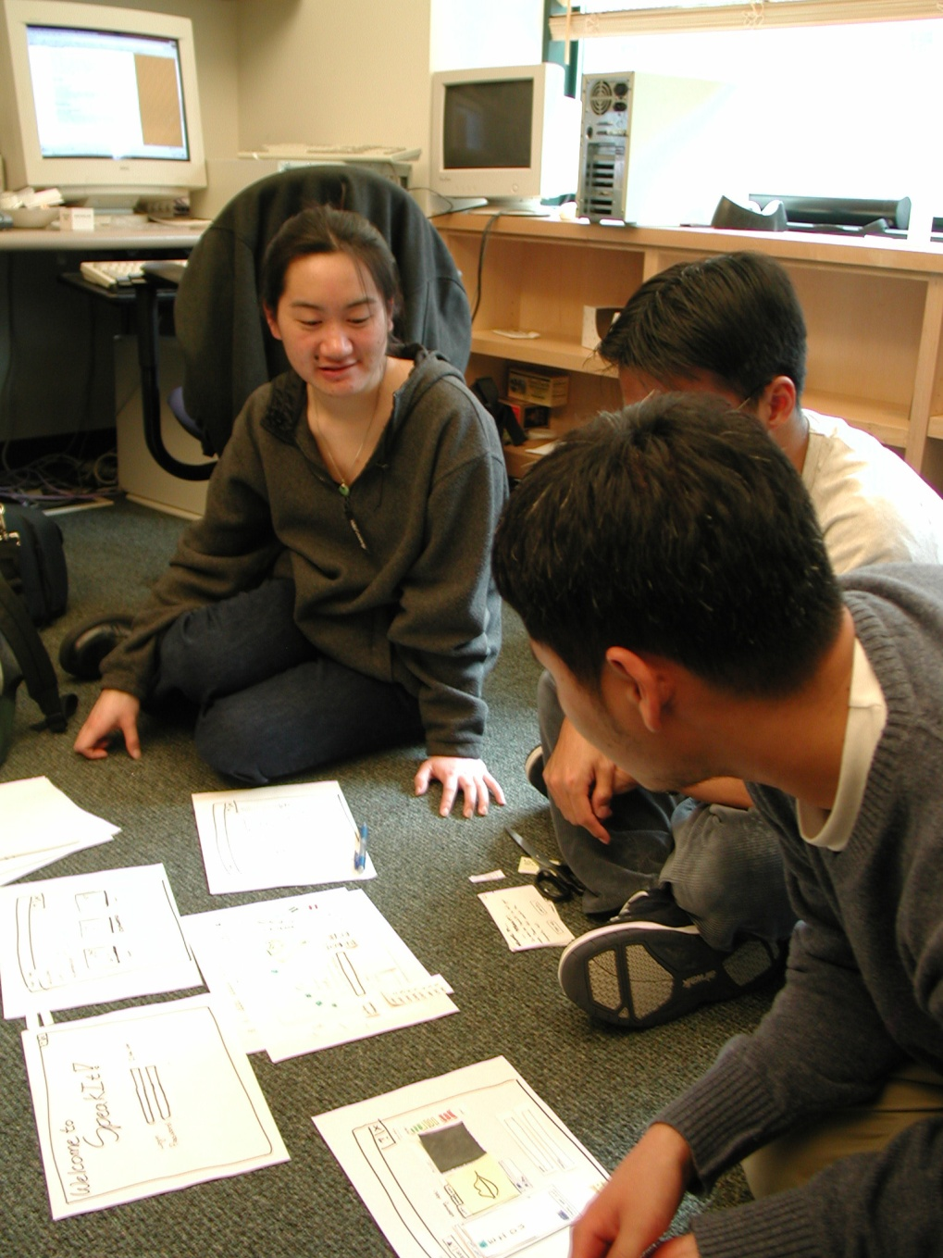
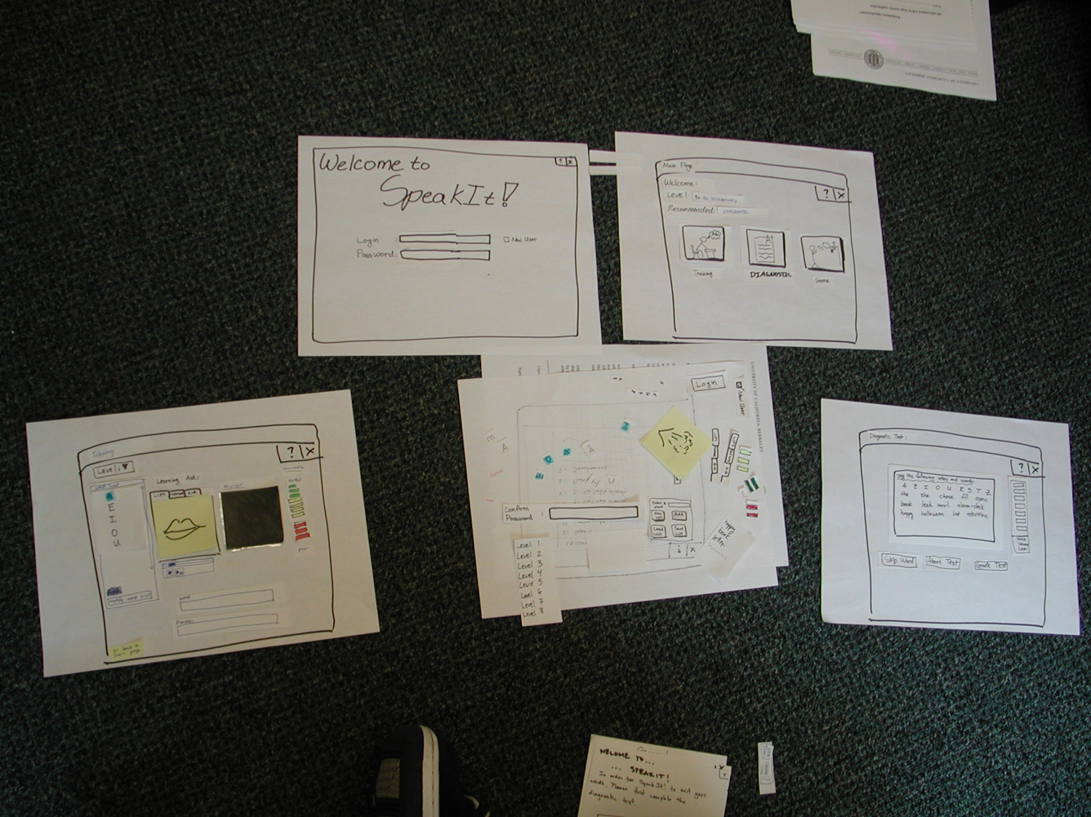
Constructing the Model

Slide 29
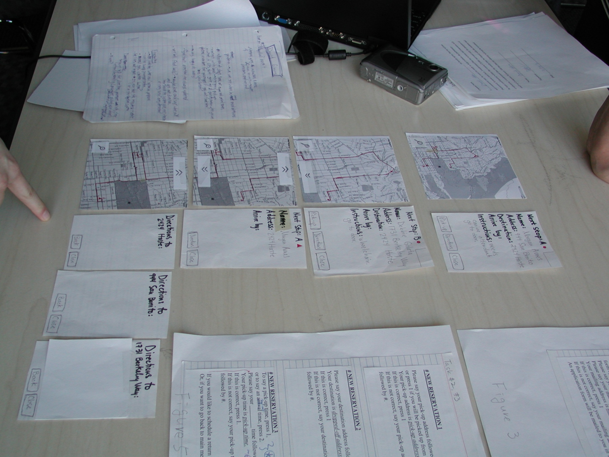
Constructing the Model

Slide 30
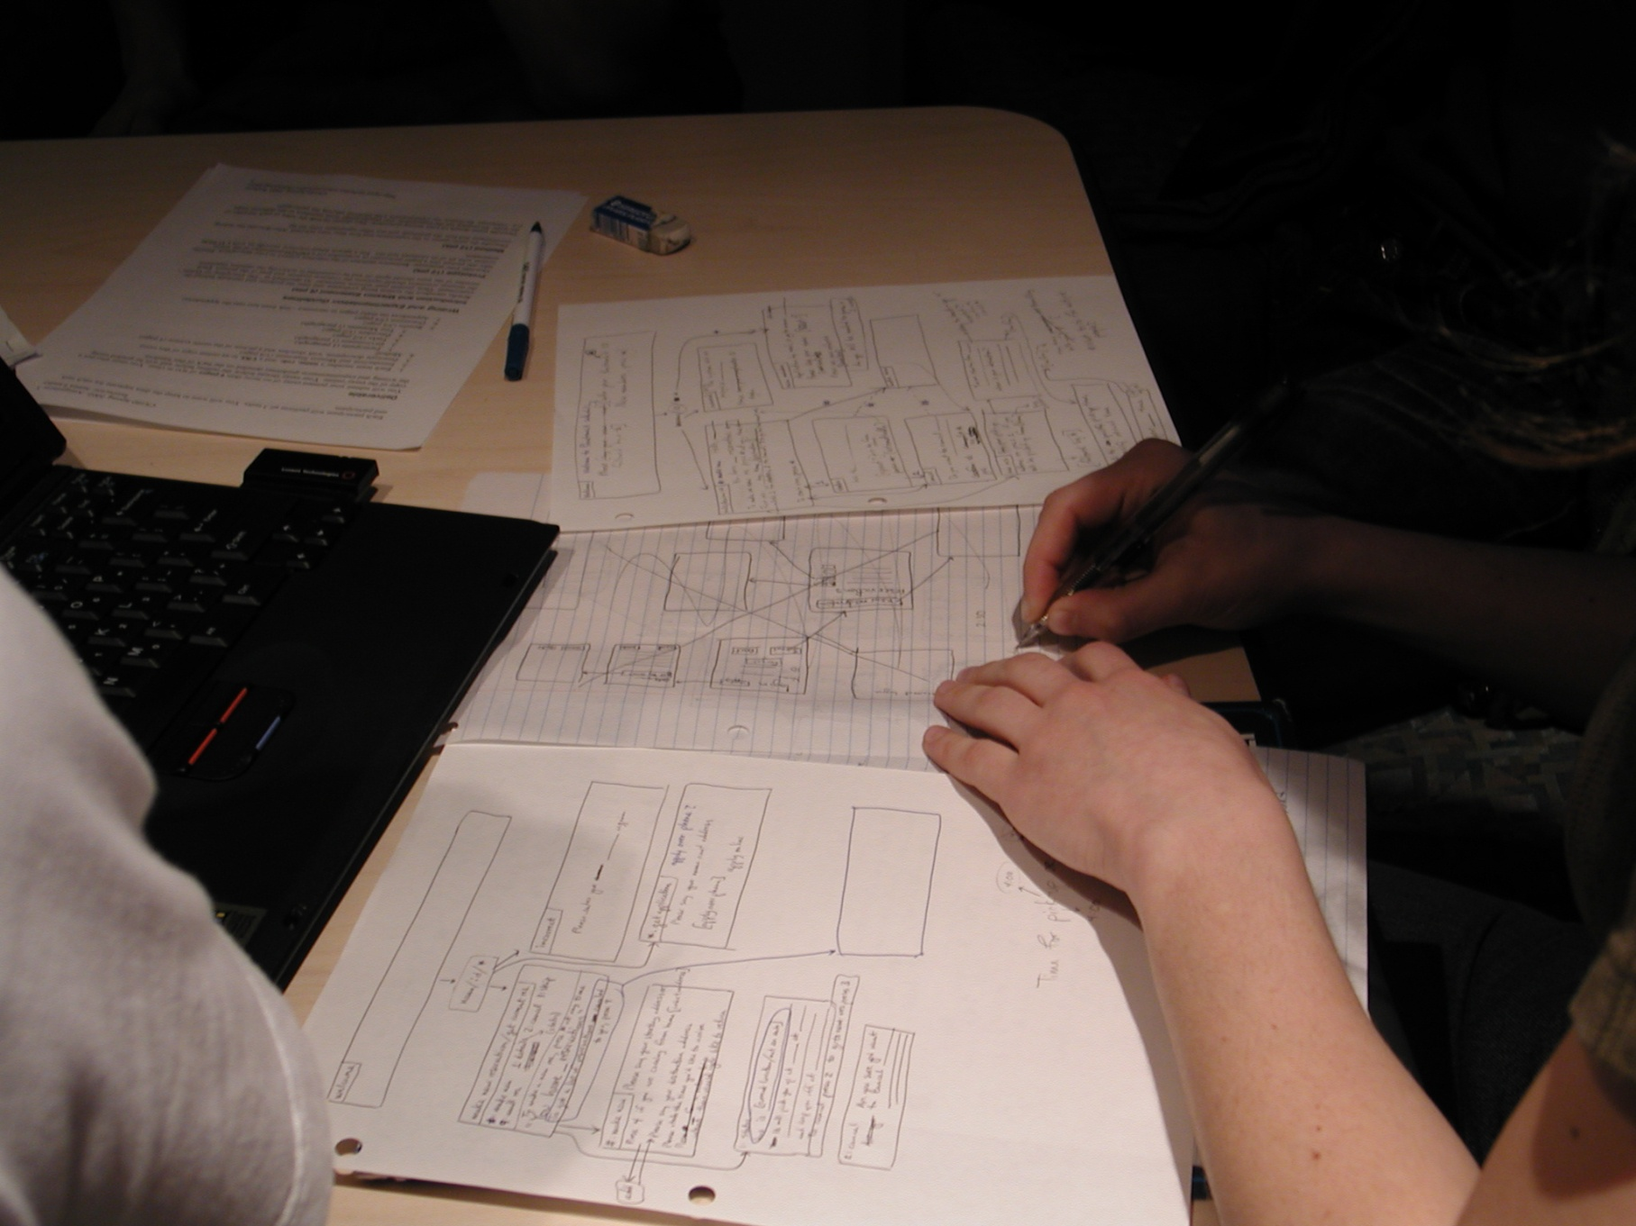
Constructing the Model

Slide 31
Constructing the Model

Slide 32
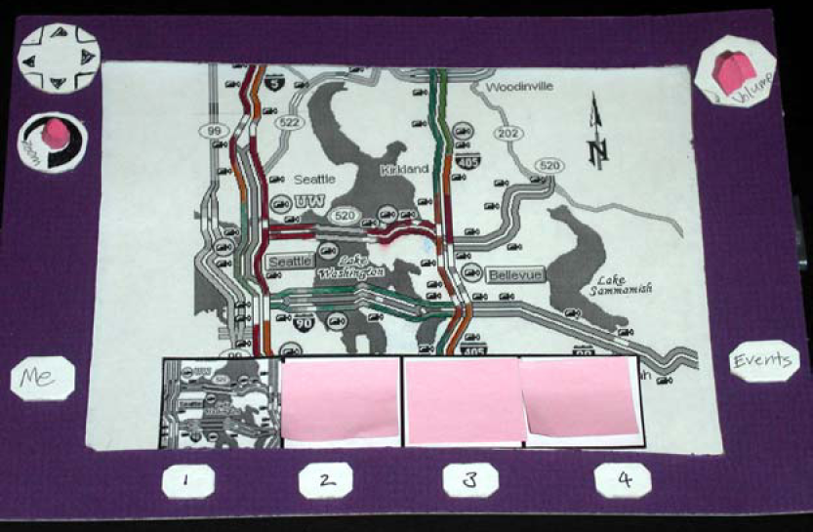
Constructing the Model

Slide 33
Preparing for a Test
Select your “customers”
understand background of intended users
use a questionnaire to get the people you need
don’t use friends or family
I think existing “customers” are OK (Rettig disagrees)
Prepare scenarios that are
typical of the product during actual use
make prototype support these (small, yet broad)
Practice to avoid “bugs”

Slide 34
Conducting a Test
Four roles
greeter – puts users at ease & gets data
facilitator – only team member who speaks
gives instructions & encourages thoughts, opinions
computer – knows application logic & controls it
always simulates the response, w/o explanation
observers – take notes & recommendations

Slide 35
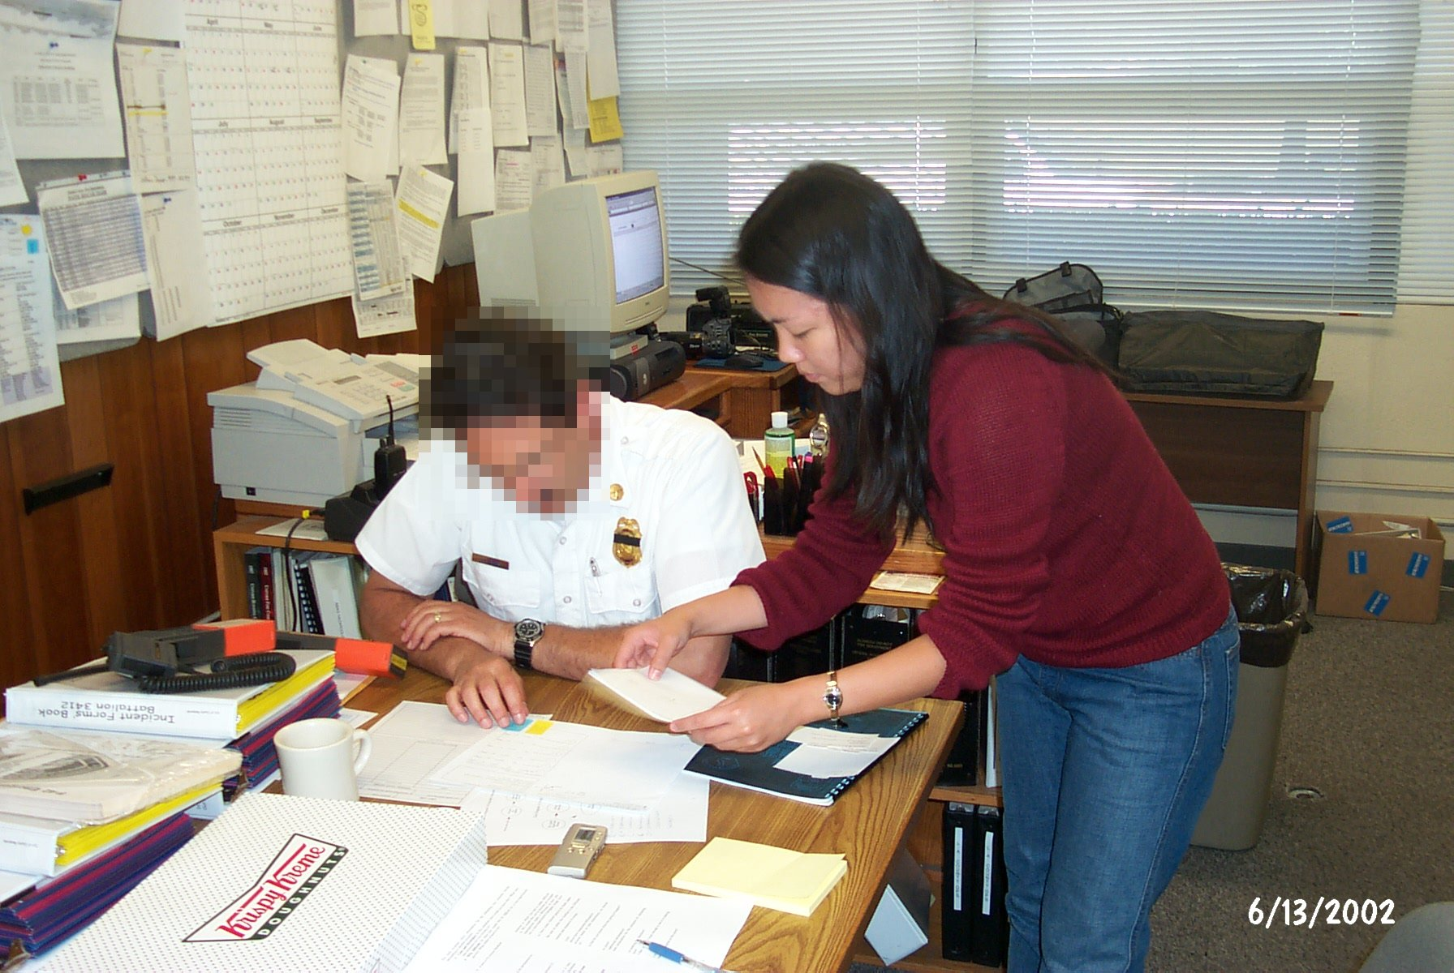
Conducting a Test

Slide 36
Conducting a Test
Four roles
greeter – puts users at ease & gets data
facilitator – only team member who speaks
gives instructions & encourages thoughts, opinions
computer – knows application logic & controls it
always simulates the response, w/o explanation
observers – take notes & recommendations
Typical session is 1 hour
preparation, the test, debriefing
Read the Gommol paper (1 page) for details on conducting a test

Slide 37
Evaluating Results
Sort & prioritize observations
what was important?
lots of problems in the same area?
Create a written report on findings
gives agenda for meeting on design changes
Make changes & iterate

Slide 38
Advantages of Low-fi Prototyping
Takes only a few hours
no expensive equipment needed
Can test multiple alternatives
fast iterations
number of iterations is tied to final quality
Almost all interaction can be faked

Slide 39
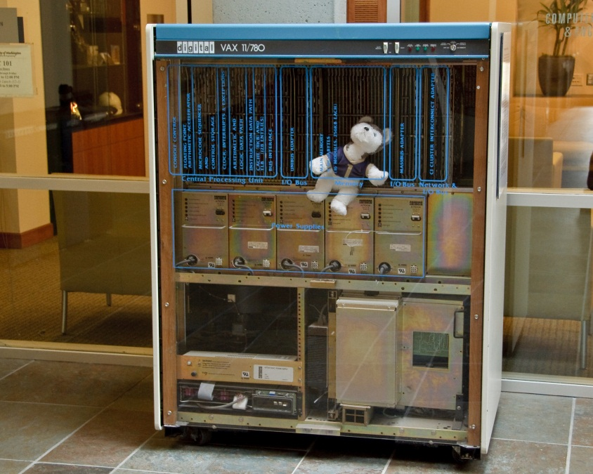
Wizard of Oz Technique
Faking the interaction. Comes from?
the film “The Wizard of OZ”
“the man behind the curtain”
Long tradition in computer industry
e.g., prototype of a PC w/ a DEC VAX behind the curtain

Slide 40
Wizard of Oz Technique
Faking the interaction. Comes from?
the film “The Wizard of OZ”
“the man behind the curtain”
Long tradition in computer industry
e.g., prototype of a PC w/ a DEC VAX behind the curtain
Much more important for hard to implement features
speech & handwriting recognition

Slide 41
Problems with Low-fi Prototypes
“Computer” inherently buggy
Slow compared to real app
timings not accurate
Hard to implement some functionality
pulldowns, feedback, drag, viz …
Won’t look like final product
sometimes hard to recognize widgets
End-users can’t use by themselves
not in context of user’s work environment

Slide 42
Summary
Prototypes are a concrete representation of a design or final product
Low-fi testing allows us to quickly iterate
get feedback from users & change right away

Slide 43
Further Reading Prototyping
Books
Paper Prototyping: The Fast and Easy Way to Design and Refine User Interfaces, by Carolyn Snyder, Morgan Kaufmann, 2003
Articles
“Prototyping for Tiny Fingers” by Marc Rettig, in Communications of the ACM, 1994
“Using Paper Prototypes to Manage Risk” by Carolyn Snyder, http://world.std.com/~uieweb/paper.htm
“The Perils of Prototyping” by Alan Cooper,
http://www.chi-sa.org.za/Documents/articles/perils.htm

Slide 44
Next Time
Project
work on defining project idea, tasks, and low-fi prototype in class
build & test low-fi prototypes for next Tuesday’s class

