Slide 1

designing solutions to global grand challenges: or, doug engelbart’s unfinished legacy
刘哲明
James A. Landay
Professor
Computer Science
@landay
Tanja Aitamurto, PhD
Deputy Director
Brown Institute for Media Innovation
@TanjaAita
CS377E
Spring 2015
March 31, 2015

Slide 2
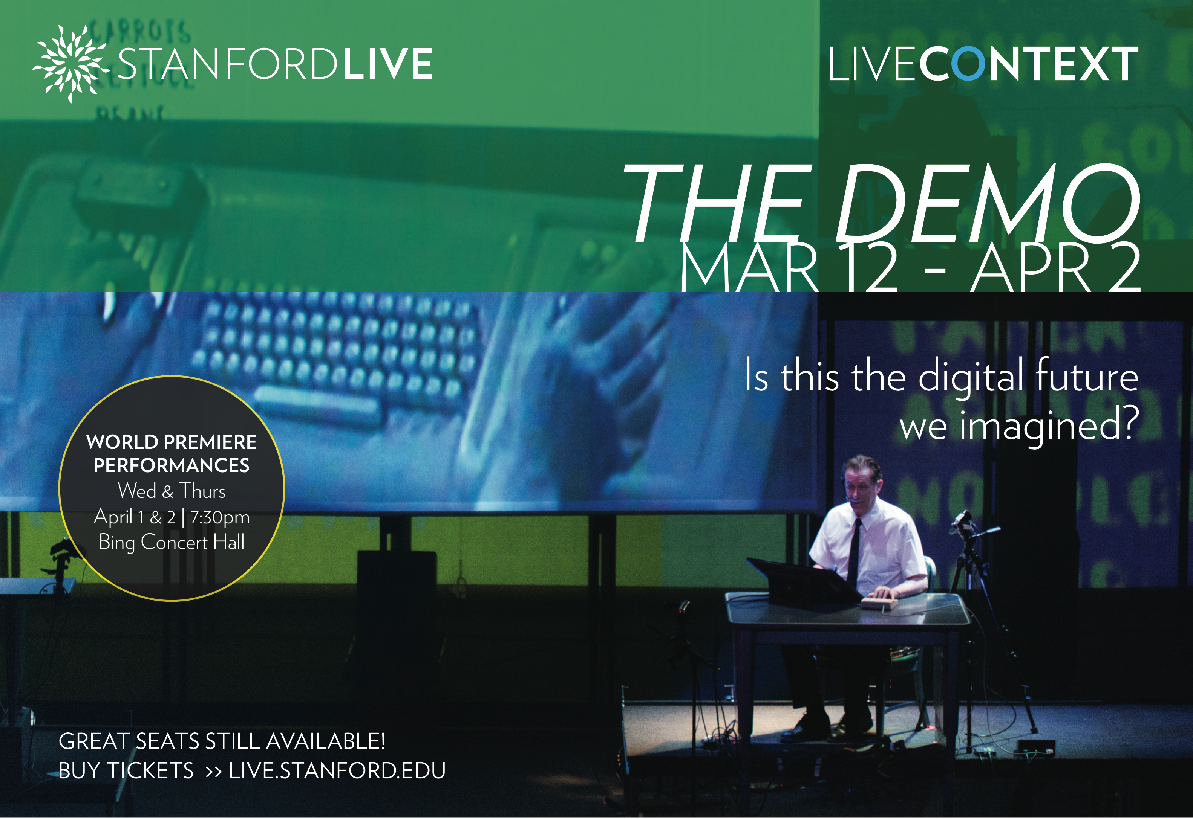
the show: the demo

Slide 3
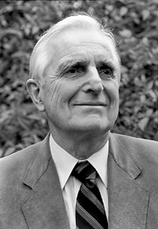
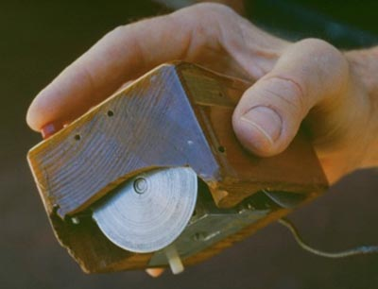
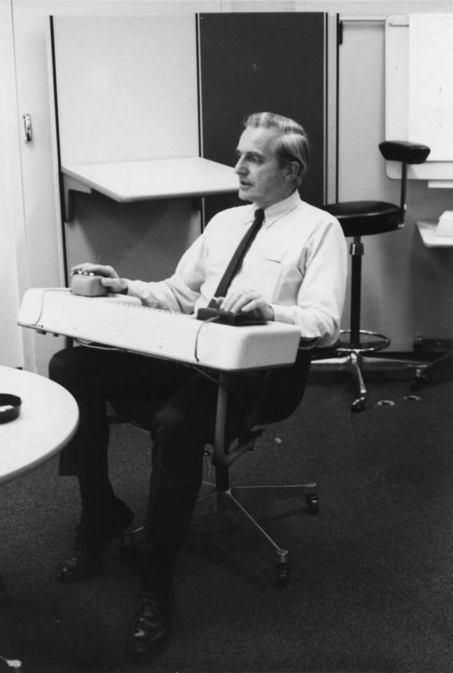
douglas engelbart augmenting human intellect
Stanford Research Institute (SRI) in the 1960s
1962 Paper “Conceptual Model for Augmenting Human Intellect”
  complexity of problems increasing → need new tools to solve
Known for?
  mouse
  did so much more…
Notes:
At the same time there was a small group led by Douglas Engelbart working on the future of computing at SRI from 1958 to the early 1970s.
Stanford Research Institute (SRI)
Augmentation Research Center
1962 Paper “Conceptual Model for Augmenting Human Intellect”
complexity of problems increasing
need better ways of solving problems

Slide 4
engelbart’s crusade
“The complexity of a lot of the problems [in the world] and the means for solving them are just getting to be too much. The time available for solving a lot of the problems is getting shorter and shorter. So the urgency goes up… The complexity/urgency factor had transcended what humans can cope with. I suddenly flashed that if you could do something to improve human capability to cope with that, then you’d really contribute something basic.”
– Douglas Engelbart (1996)
Notes:
Engelbart repeatedly referred to what he was doing as a crusade, which expresses the religious fervor of his beliefs
Within an hour of Engelbart’s insight on what his crusade should be, he had an an idea of what it was he should create

Slide 5
engelbart’s unfinished legacy: the class
Co-teaching a small class this Spring at the Stanford d.School
Expose students to Engelbart’s long-term agenda
Lead students on design of information technology to have impact on problems in
  environment
  health
  education

Slide 6

environment环境
las vegas water district has paid residents nearly $200 million to remove grass
[NY Times, Aug 11, 2013]
Notes:
As a society, we have to look for balance with our surroundings (that is, the environment)
36 US states will face serious water shortages in the next three to five years

Slide 7

environment环境
“china melting snow to meet
freshwater demand”
[Guardian, Dec 2010]
Notes:
Surprised to find this was true in China also.
Melting snow in the winter!
South-to-North Water Diversion Project one of the largest engineering projects ever attempted
100 years from conception to completion (construction started 2002, expected to end 2050)
Huge impact on people and environment – millions forced to move
IF WE ARE TO LOOK AT THESE PROBLEMS FURTHER OUT (5-10 YEARS),
What would an AUDACIOUS GOAL be?

Slide 8
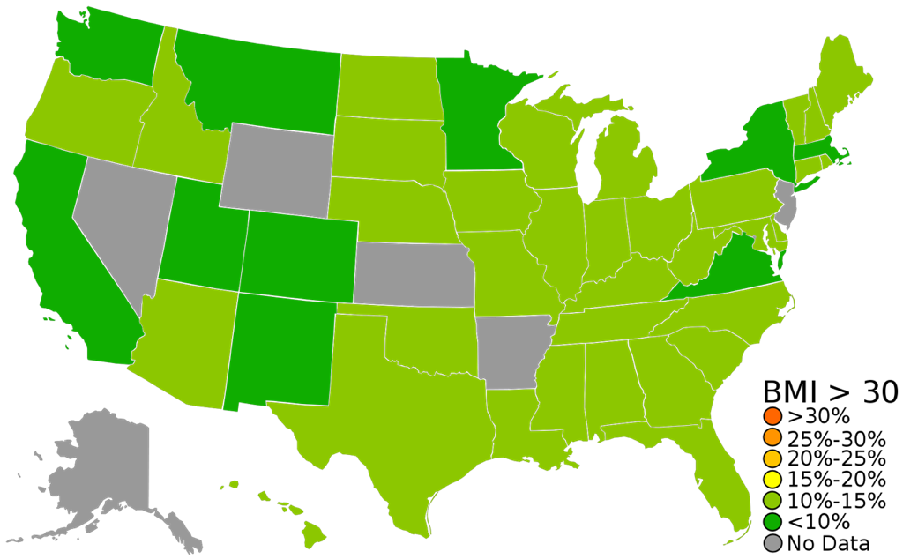
体重指数
1990
Notes:
BEHAVIOR is at the root of many of our biggest problems
For example balance between eating and exercise
Data from the US Center for Disease Control (CDC)
Slides courtesy of Erika Poole at Penn State
See this very RECENT trend in obesity rates (BMI > 30 = “obese”)

Slide 9
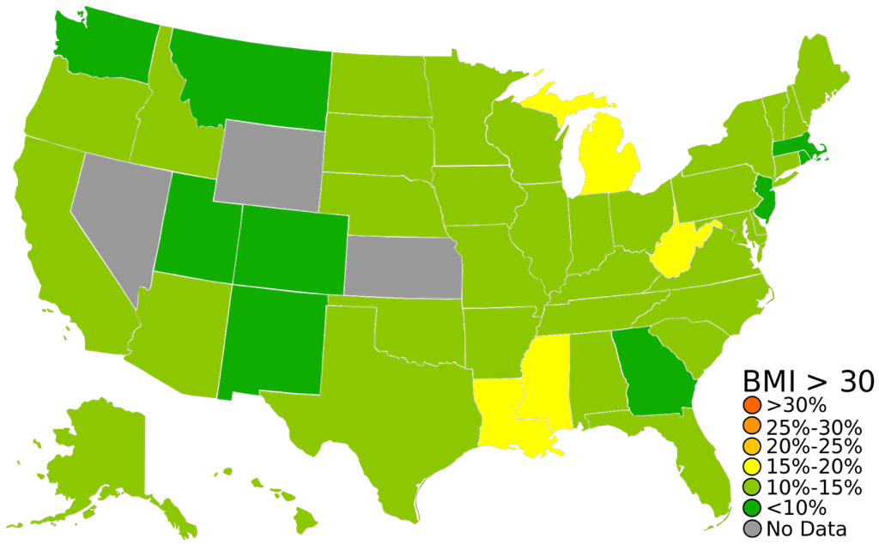
体重指数
1991

Slide 10
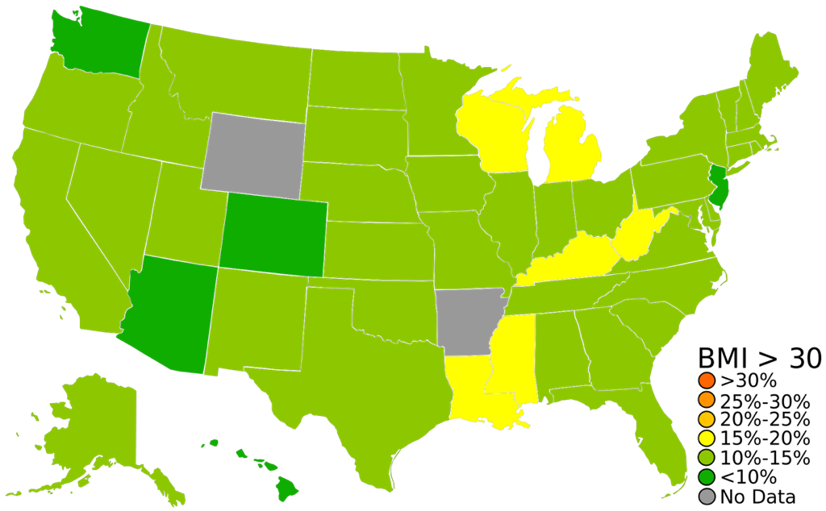
体重指数
1992

Slide 11
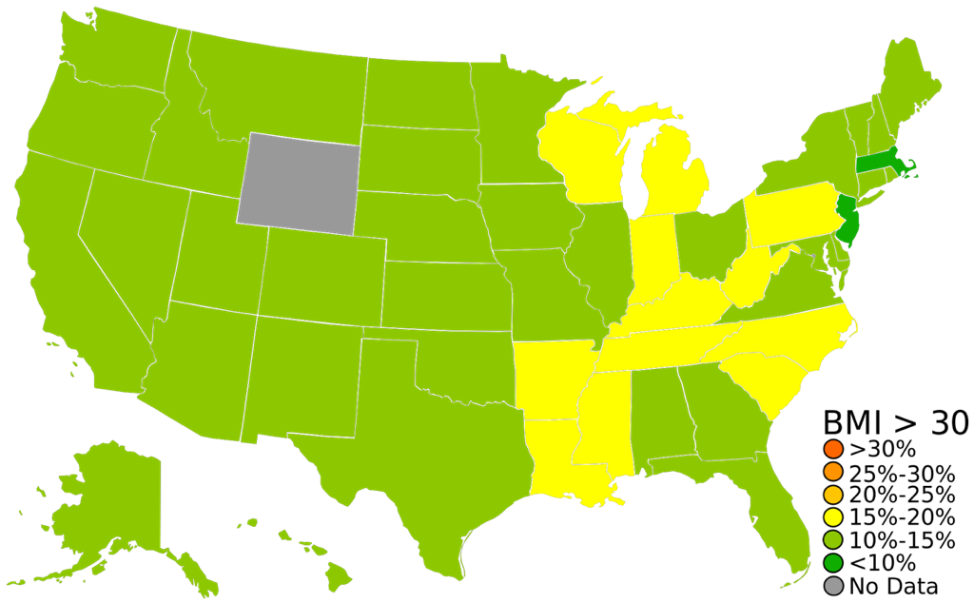
体重指数
1993

Slide 12
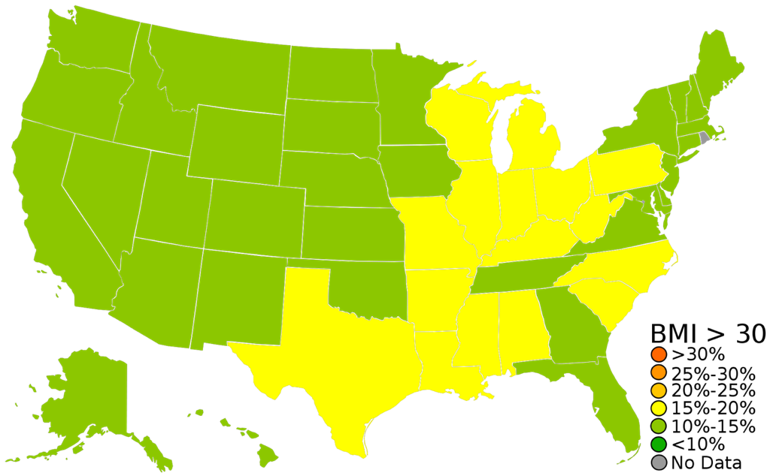
体重指数
1994

Slide 13
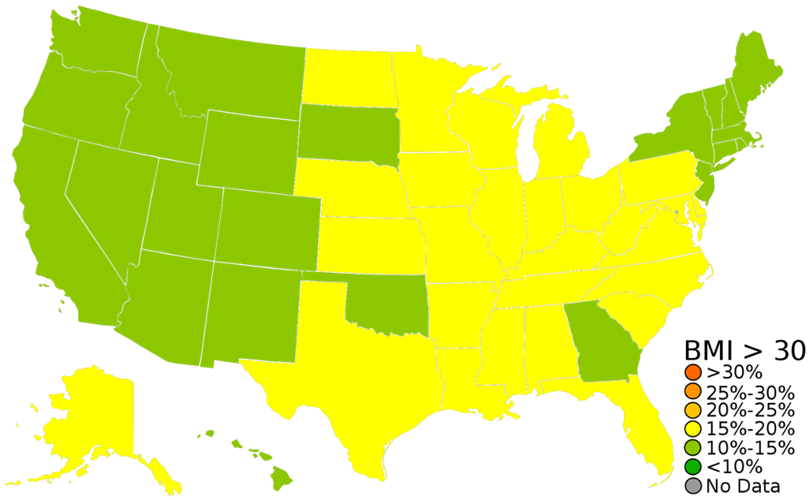
体重指数
1995

Slide 14
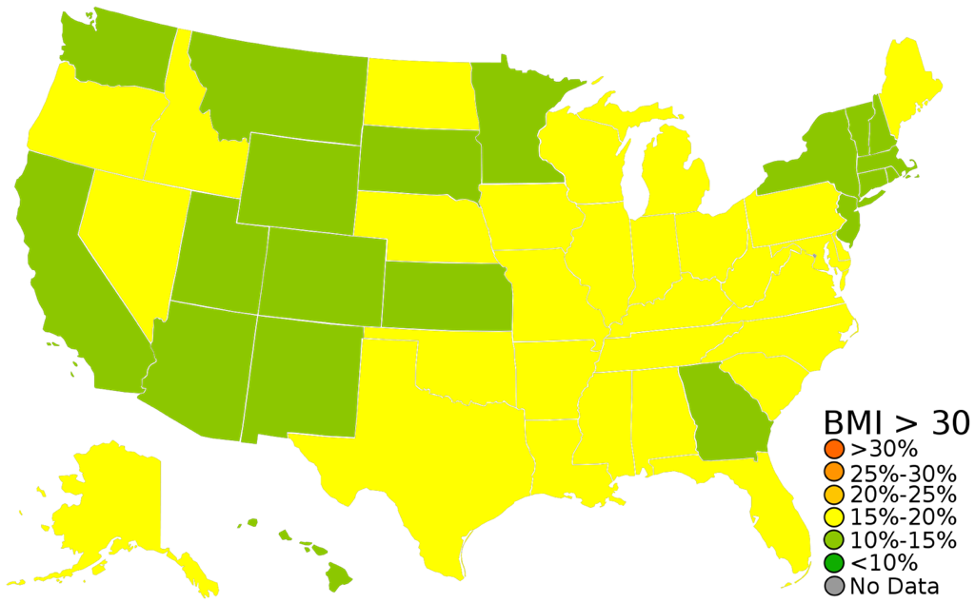
体重指数
1996

Slide 15
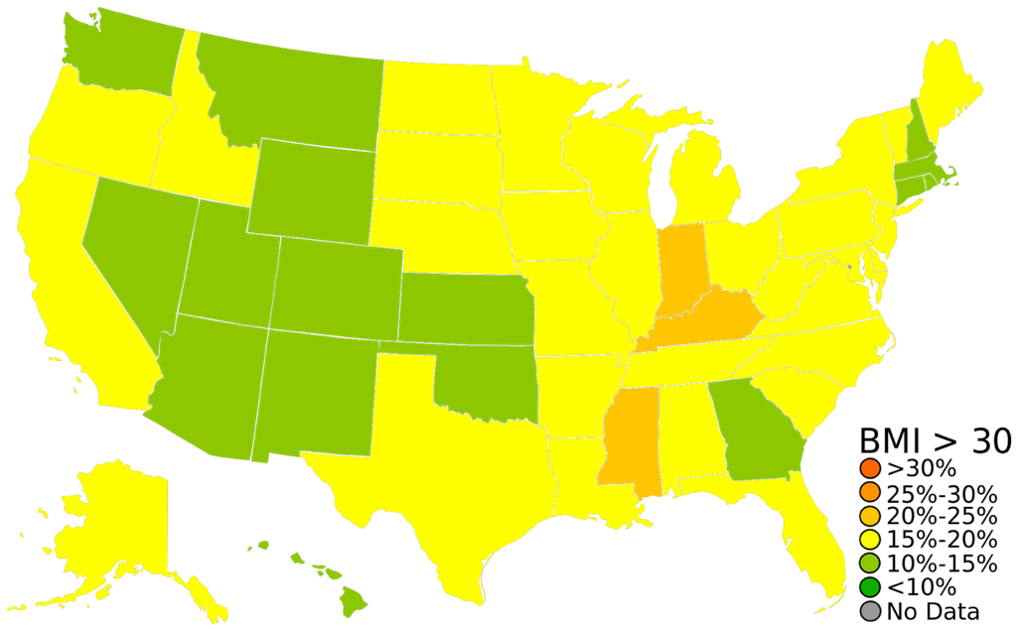
体重指数
1997

Slide 16
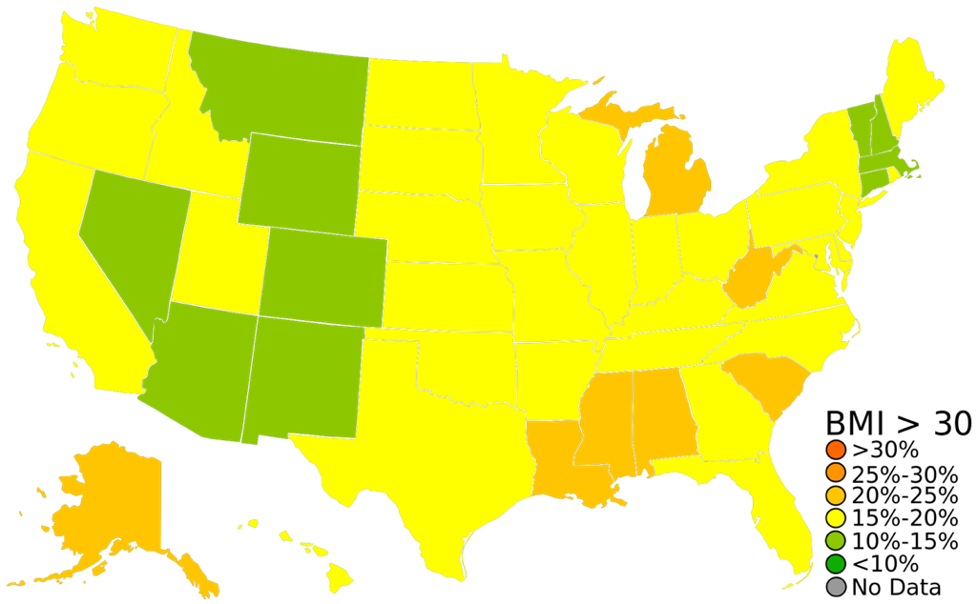
体重指数
1998

Slide 17
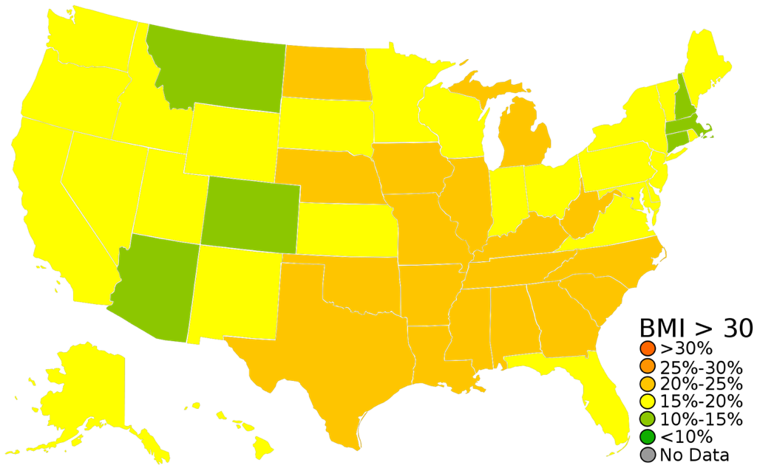
体重指数
1999

Slide 18
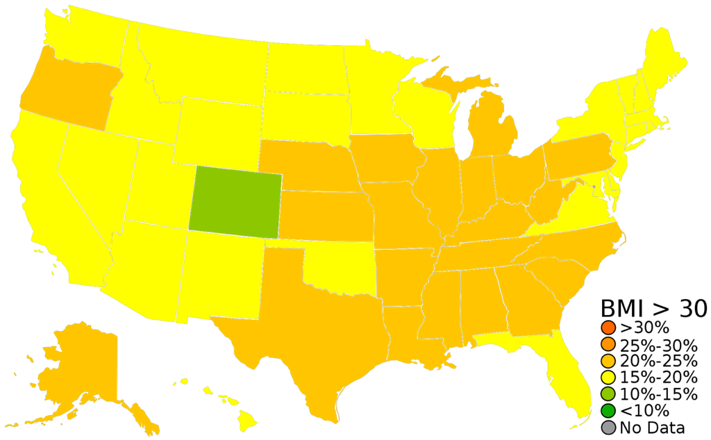
体重指数
2000

Slide 19
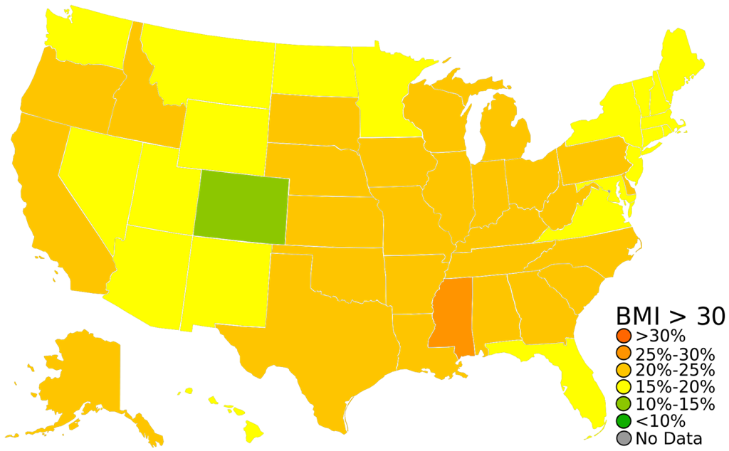
体重指数
2001

Slide 20
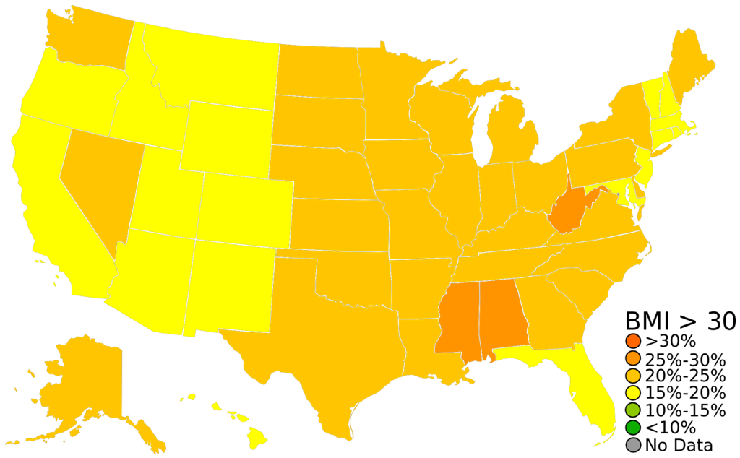
体重指数
2002

Slide 21
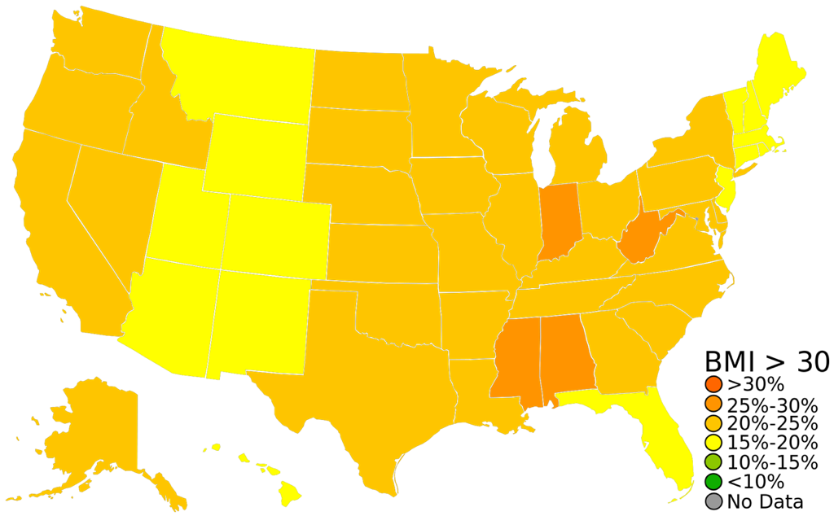
体重指数
2003

Slide 22
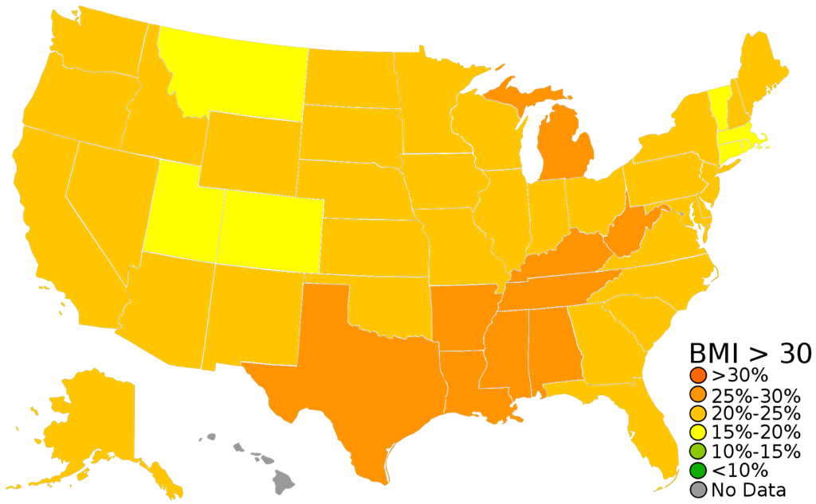
体重指数
2004

Slide 23
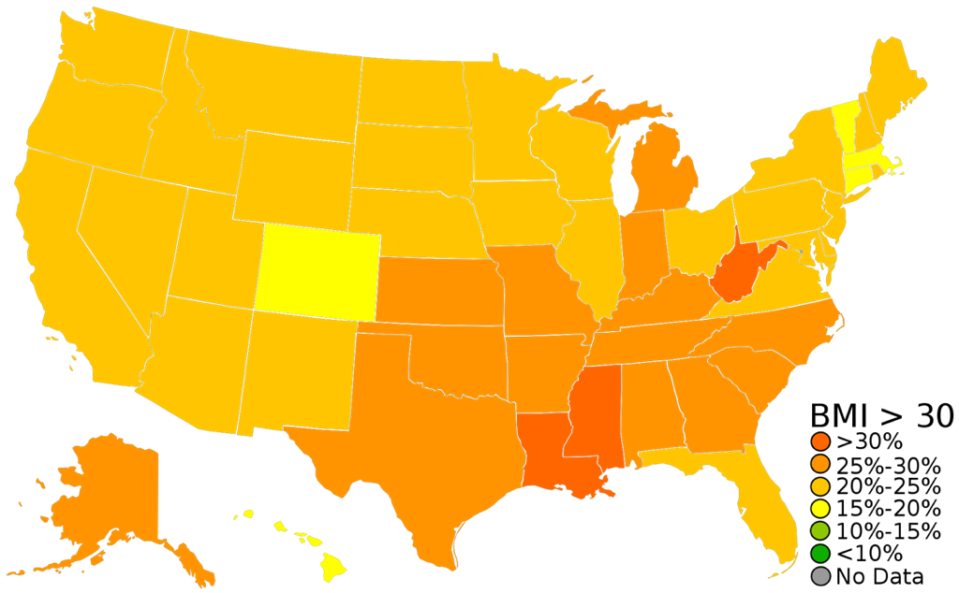
体重指数
2005

Slide 24
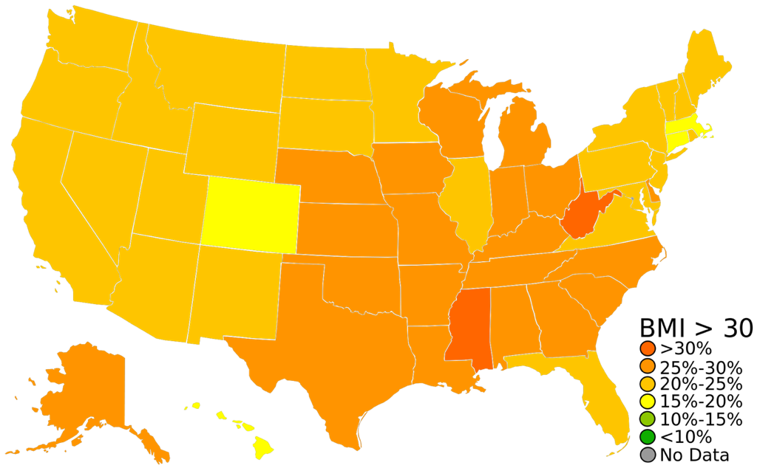
体重指数
2006

Slide 25
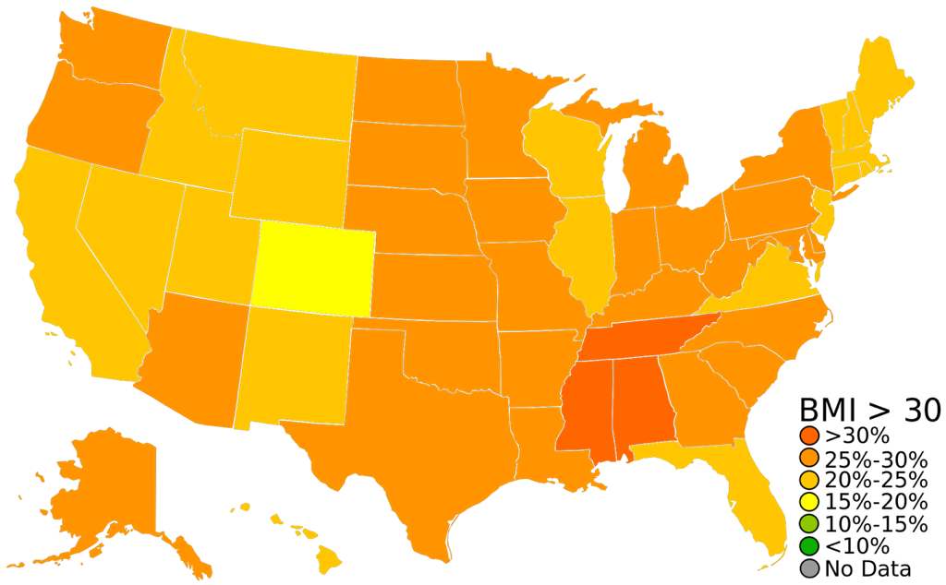
体重指数
2007

Slide 26
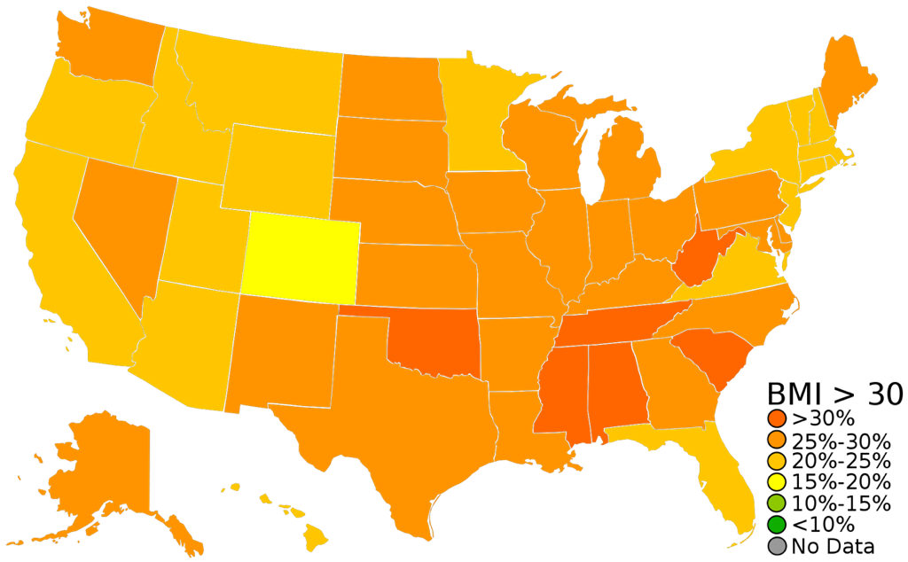
体重指数
2008

Slide 27
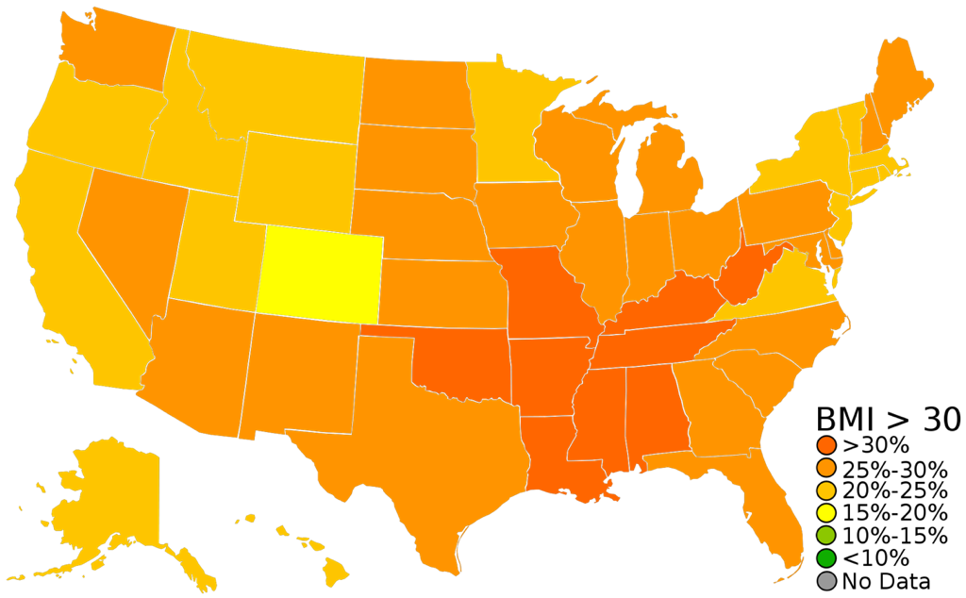
体重指数
2009

Slide 28
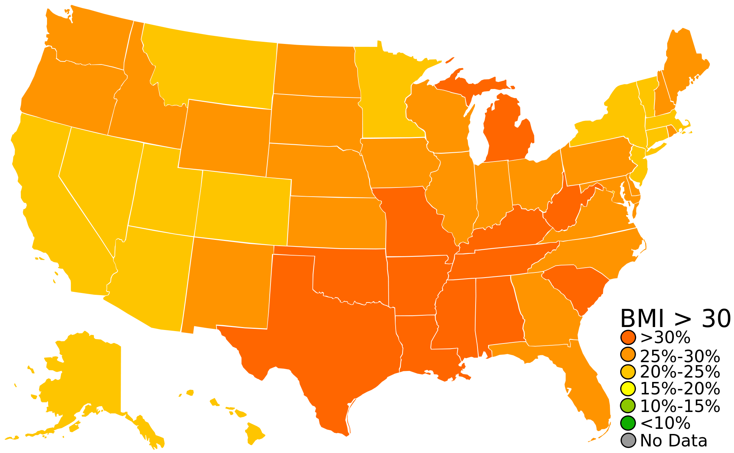
体重指数
2010
Notes:
12 states with 30% of the population clinically obese
24 states with 25-30% of the population clinically obese
And the other 14 states have 20-25% of their population with this condition
[ADVANCE SLIDE}

Slide 29
obesity epidemic
肥胖流行症
体重指数
2010
Notes:
It’s now over 33% of the overall population
This is an obesity epidemic
It isn’t just the baby boomers getting fat:
“The percentage of children aged 6–11 years in the United States who were obese increased from 7% in 1980 to nearly 20% in 2008. Similarly, the percentage of adolescents aged 12–19 years who were obese increased from 5% to 18% over the same period.”-center for disease control
Obesity leads to many other big problems in HEALTH, and HEALTH is the 2nd key area we need to focus

Slide 30
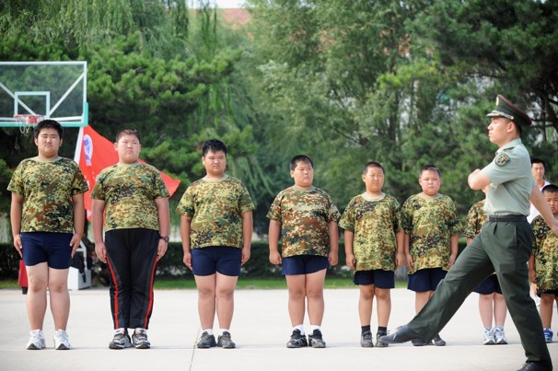
health
健康
More than 7% of Chinese children are obese,
2nd only to the US
[China National Task Force on Childhood Obesity, 2008]
Notes:
Many health problems are also global problems
For example the American obesity epidemic seems to be getting exported to the rest of the world
Even to China
These problems are also about balance: between exercise and eating right
Solutions require balance of technologies as well as psychological models of behavior change

Slide 31
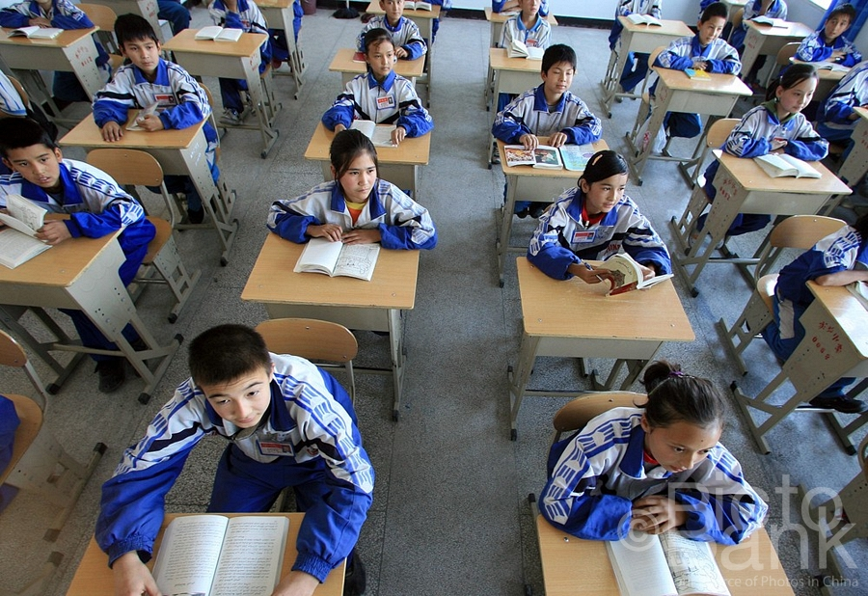
education
教育
Conformity and efficiency rather than innovation?
填鸭式教育，还是创新？
Notes:
The 3rd key area of importance is EDUCATION
China has shown the world it can produce anything, including highly educated kids
ADVANCE SLIDE
Although the kids in Shanghai beat the world on standardized tests (PISA), many believe
The COMFORMITY & EFFICIENCY that is characteristic of the Chinese educational system
Is NOT producing the INNOVATORS & CREATORS of the products of tomorrow
This shows a LACK of BALANCE…

Slide 32

education 教育
68% of US 8th graders can’t read at grade level, & most will never catch up [the broad foundation]
68%的美国8年级学生不能达到——且他们之中大部分未来也难以达到——
教学期望水平
Notes:
The United States’ educational system is OUT OF BALANCE but in the opposite direction.
Creativity & innovation are encouraged, but the BASICS ARE POOR.
So we see people feel education is in crisis on both sides of the world & it is crucial to our future

Slide 33


Who are We?

Slide 34

james
landay
Professor in Computer Science at Stanford
  formerly professor in Information Science at Cornell NYC Tech,
  CSE at the University of Washington & EECS at UC Berkeley
  spent 3 years as Director of Intel Labs Seattle
PhD in CS from Carnegie Mellon ’96
HCI w/ focus on informal input (pens, speech, etc.), crowdwork,
web design (tools, patterns, etc.), & Ubiquitous Computing (Ubicomp)
Office Hours: Mon. 2-3 PM & Wed. 10-11 AM in 390 Gates
Email: landay@[insert usual stanford email domain]

Slide 35

tanja aitamurto
PhD in Communication 2014
Collective intelligence in journalism & democratic processes: crowdsourcing &co-creation
Award-winning journalist
Office hours: By appt tanjaa@stanford.edu

Slide 36

makiko fujimoto
BS in SymSys, MS in CS (HCI)
Needfinding, rapid ideation and prototyping, user testing, ed-tech
I went to school in 3 different countries!
Office hours
  TBD in TBD

Slide 37

b a l a n c e
design
technology
Notes:
You need to find a balance between:
design & technology, human-centered approaches & CS approaches
Especially now HCI needs to find a balance between careful controlled experiments of existing technologies or minor tweaks on technology and building major new systems that can solve important world problems.
East: more family centric… west; individualistic… balance

Slide 38
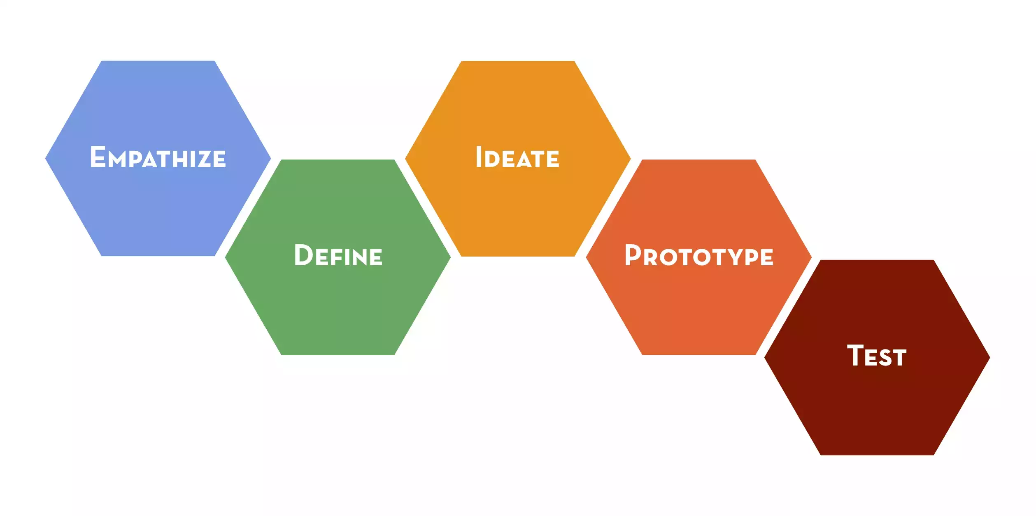
design thinking

Slide 39
design doing timeline
Brainstorming &
Needfinding in
Project Domain
Parallel
Prototypes &
User Testing
Low-fi
Prototyping
Project Fair
Video Prototype
Needfinding @
The Demo
Present
Results
Present
Results
Medium-fi
Prototype
Present
Results
Week 1
Week 2
Week 3
Week 4
Week 5
Week 6
Week 7
Week 8
Week 9
Week 10

Slide 40
grading
A combination of
  individual assignments & presentation (10%)
  class/studio participation (30%)
  group project (60%)
    demos/presentations/poster (group component)
    project write-ups, exercises, videos & other deliverables
No Exams
  must present at project fair at end of quarter

Slide 41
tidbits
Late Policy
  no lates on group assignments
  individual assignments lose one letter grade/day
Web site online tomorrow

Slide 42
next time
Fill out this survey by tonight (letting us know whether you want in the class still)
  http://goo.gl/forms/CrOrry41vr
Lecture
  Doug Engelbart and the Mother of All Demos
Read
  Tools For Thought Ch 9 (Engelbart Demo)
  (http://www.rheingold.com/texts/tft/9.html)

