Slide 1
Vivek Choksi, Natasha Berk, Anne Evered
Notes:
Vivek: Replace with higher-resolution image
Hi we are team scraps and we are focused on reducing cafeteria food waste.
just say we are approaching issue as students
Vivek presentation notes:
Start with insights for prototyping
Motivation → idea → why it worked / didn’t work
Explain what row houses are
Dara POV is weak
Natasha too much upspeak
Too wordy on parallel prototypes and too fast
Maybe don’t highlight compost bin feedback parallel prototype in much detail since we talk about it for the rest of the presentation
Final UI-- kind of repetitive. Maybe read the info on one particular screen. Insert image of iPad...
Ideas on how to start: …
Show revisions in “how might we”s and/or POVs
Get rid of most of “Final UI” screens -- let the video show that
Create an outline slide we can keep revisiting to show audience where we are in the presentation
Problem → needfinding → ideation → parallel prototypes →
revised problem statement → prototypes → video → summary
OR: Empathize, Define, Ideate, Prototype, Test → Redefine, ideate, prototype, test → video

Slide 2
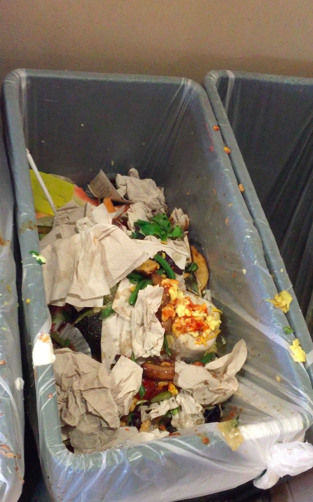
Each student...
wastes a ~0.4 lbs of food per meal
Each dining hall...
wastes ~240 pounds of food per meal
Stanford...
throws out ~3,900 tons of food each year
Statistics courtesy of Hannah Mensing and Sonia Baltodano
Notes:
so take a look at this, this is a picture of a compost bin at one of our dining hall, we’ve noticed. So did you know…. stats,

Slide 3
Outline
Problem
Needfinding
Prototyping/Testing
Solution
Design evolution
Final Design

Slide 4
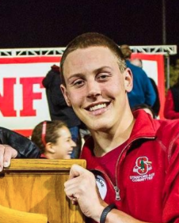
Needfinding - Initial POV’s
Dara
needs students to waste less food on their plates
Sloane
needs more variety in late-night food options
Maria
needs to reduce wasted leftovers
Notes:
→ make these one story per page, do three slides, point of view and the prototype that came out of it

Slide 5
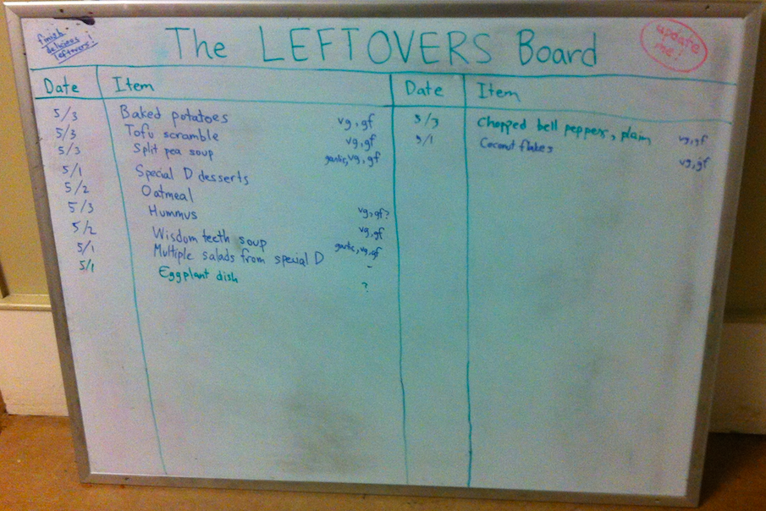
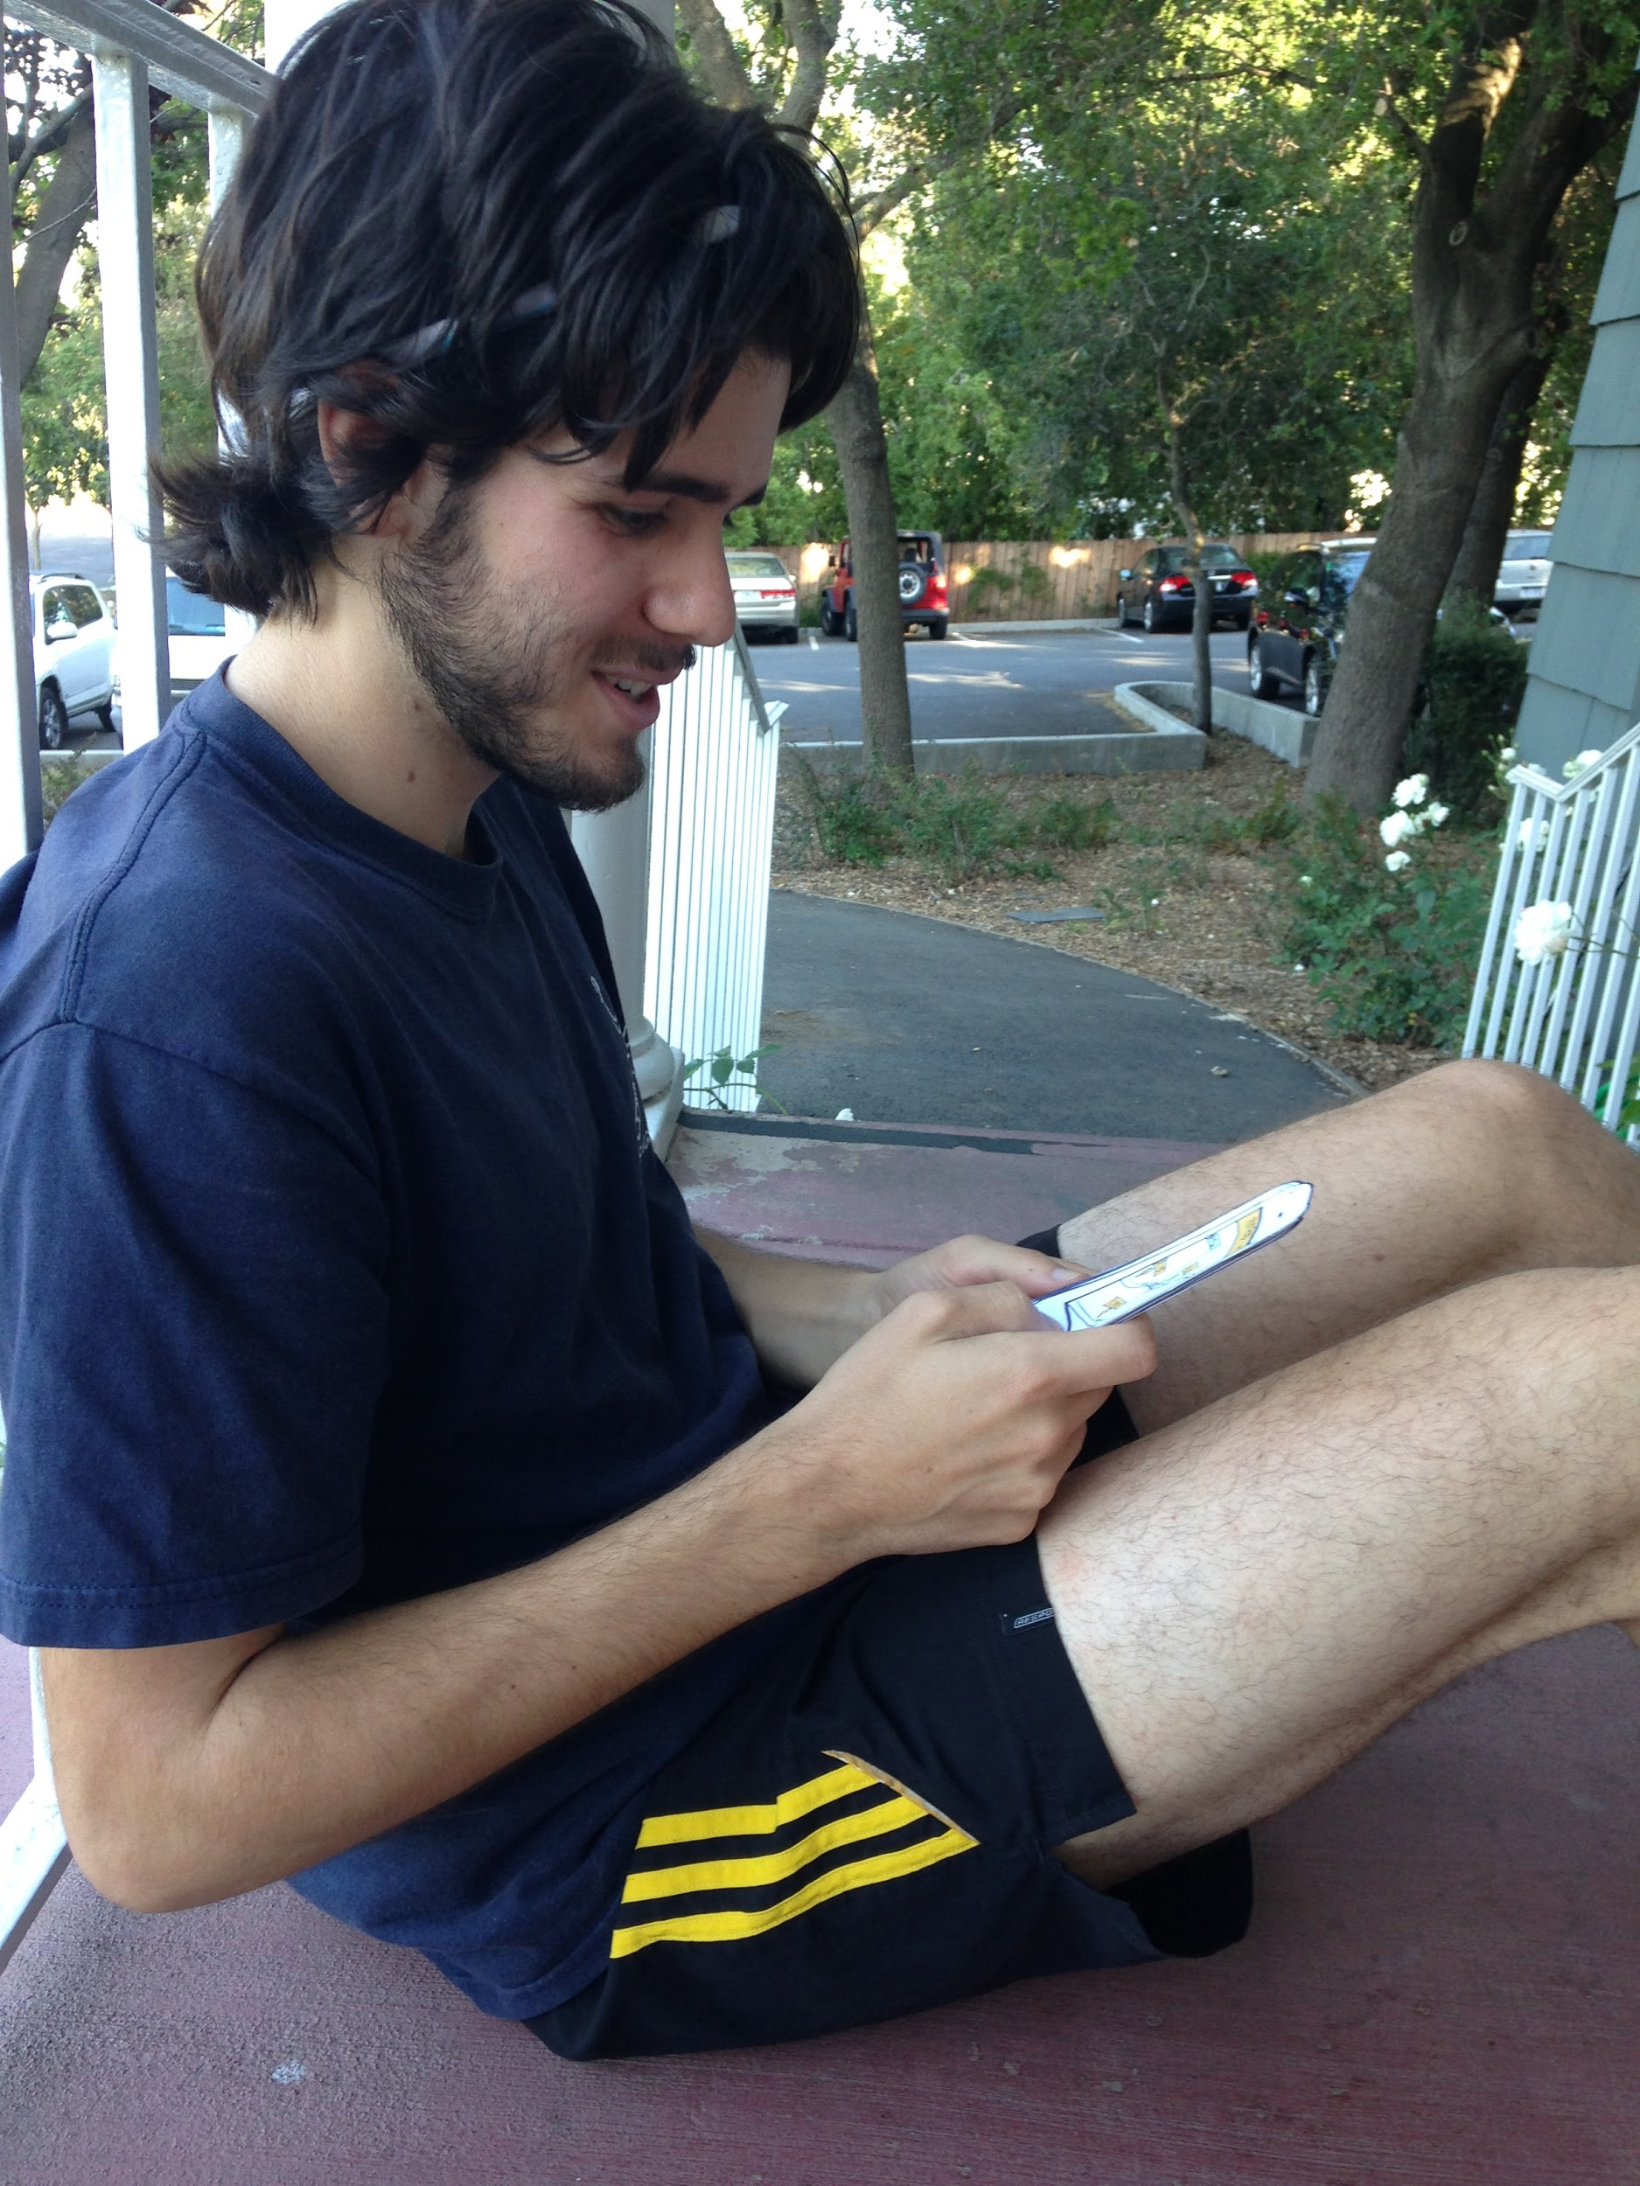
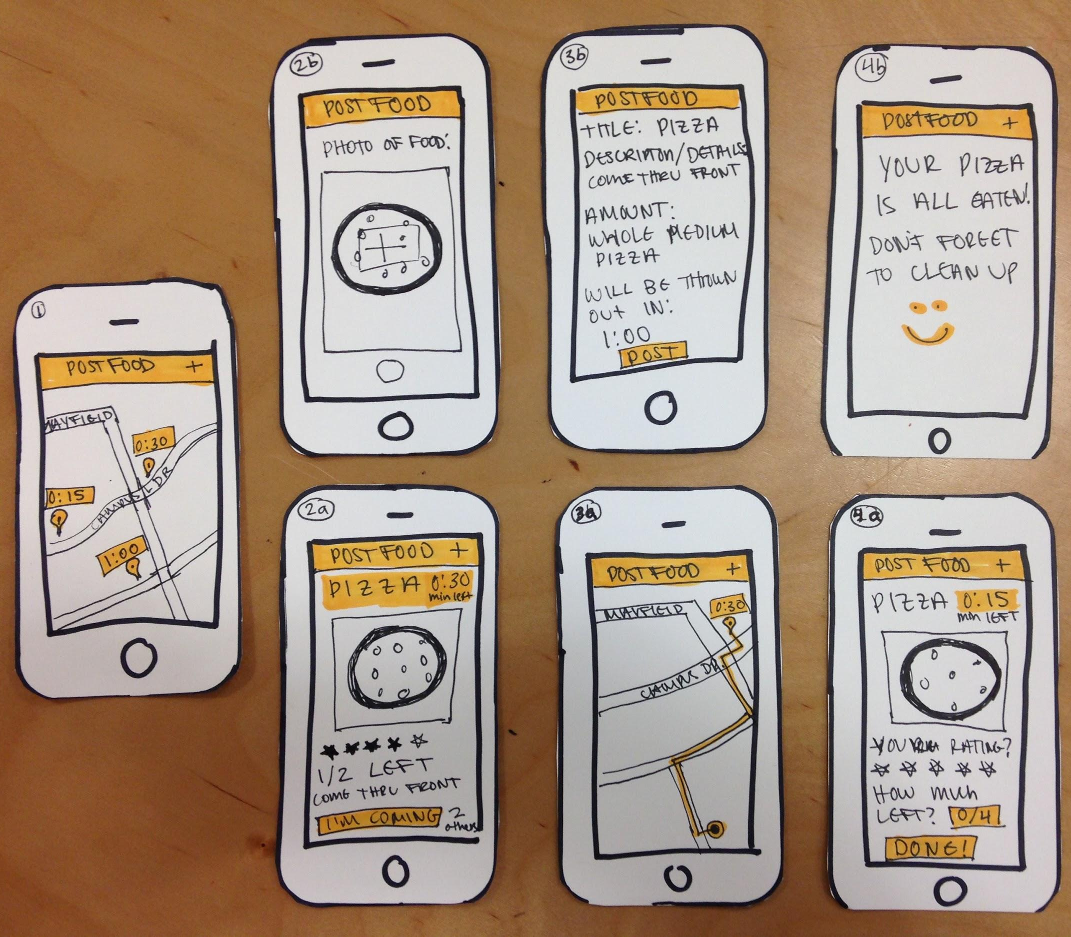
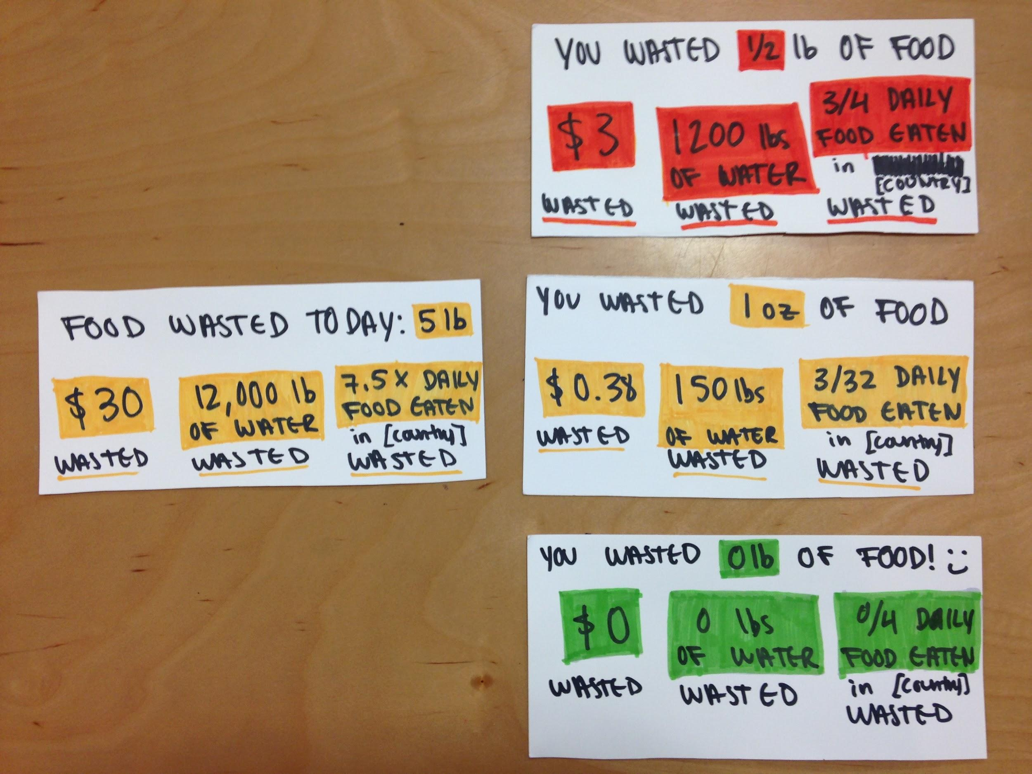
Parallel Prototypes
Leftovers Board ↑
Keep track of available leftovers so people eat them more
Leftovers Tracker App ↑
post leftovers so people nearby can come eat them
Compost Bin Feedback App →
prominently display amount of food each person throws out
Notes:
Parallel prototypes
→ make sure talk about what learned from each

Slide 6
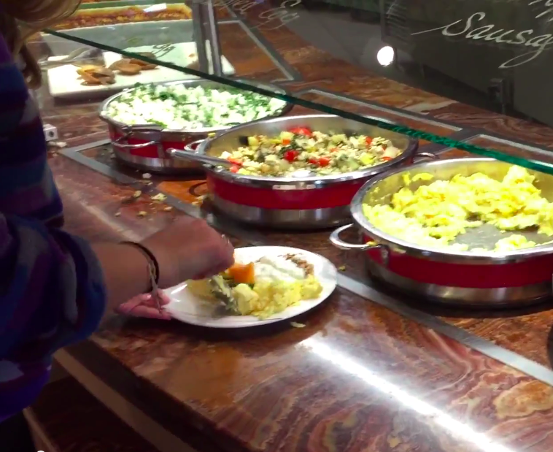
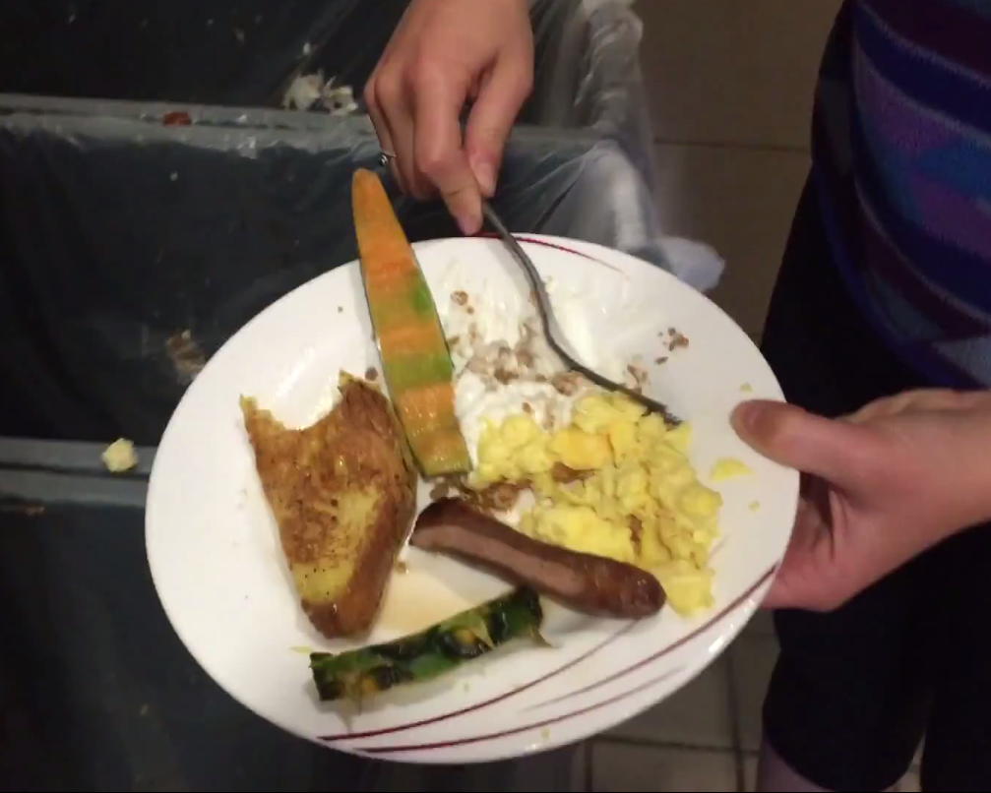
Serving food at dining hall
Composting uneaten leftovers
Each student wastes ~0.4 lbs of food per meal!
Notes:
Vivek (script shown in blue):
Anyone who has eaten at a cafeteria -- has witnessed this: many diners serve themselves more food than they eat and throw out the rest into compost bins.
This is the food waste problem we decided to address.
And it’s no small problem-- each student wastes an average of 0.4 pounds of food per meal.

Slide 7
Why?
Maybe diners just need...
Diners on autopilot; not thinking about waste
Belief that composting isn’t wasteful
To realize if they’re systematically wasting food
To understand food waste’s impact tangibly
Notes:
Vivek:
That’s a staggering amount of food waste. The next question is: why? We interviewed a number of diners to understand what causes this waste to happen, so that we could more thoughtfully work to reduce it. Here’s what people said.
People on autopilot in dining halls; eyes bigger than stomach; don’t recognize that waste is a pattern
People did not think of composting uneaten food as a wasteful activity; possibly because composting is presented as the more sustainable alternative to throwing food into trash cans, diners don’t
Reflecting on these insights, we thought, maybe diners just need:
A gentle reminder about food waste, and how much food they are personally wasting
Make composted food waste tangible; we thought we could do this by relating composted food waste to environmental and economic impact, making it clear that composting large quantities of leftovers is wasteful

Slide 8
Final POV
We met “Fred”, a student who serves himself more food than he eats because he is not very waste-conscious. It would be game-changing if we could make him aware of his pattern of wasting food to motivate him to change his serving habits.
Notes:
Talk more about our insight here: people on autopilot at dining halls; don’t know that composting is wasteful
Talk about people needs to be aware of (1) compost amount and (2) serving amount. This informs our two-display final solution.
We met “Fred”, a student who serves himself more food than he eats because he is not very waste-conscious. It would be game-changing if we could make him aware of his pattern of wasting food to motivate him to change his serving habits.
Serves food onto plate
Eats food at cafeteria table
Throws out food (either in trash or compost bins)

Slide 9
Final Solution
Screen showing individual waste as person throws food into compost bin
Screen showing total waste at stations where people serve themselves food
Notes:
Vivek:
In our solution, we envisioned two components: a screen next to the compost bins showing people’s personal amount of food waste; and screens at the cafeteria food counters showing the cafeteria’s collective amount of food waste.

Slide 10
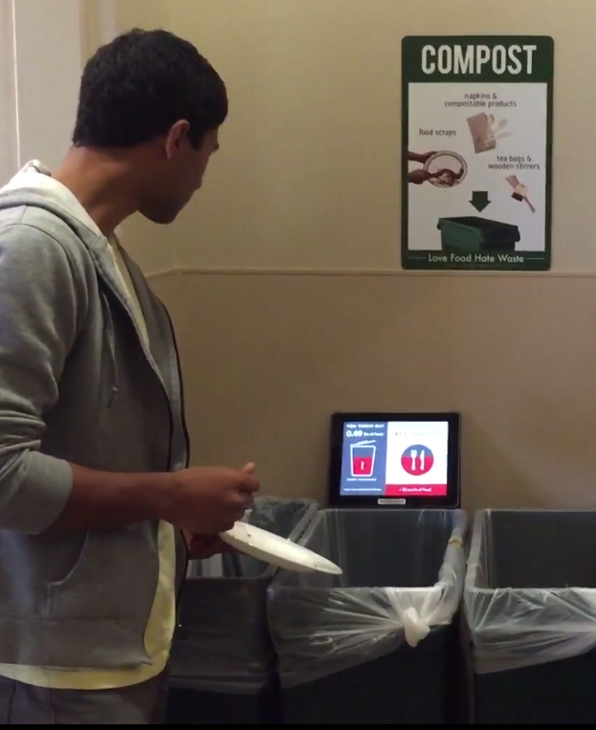
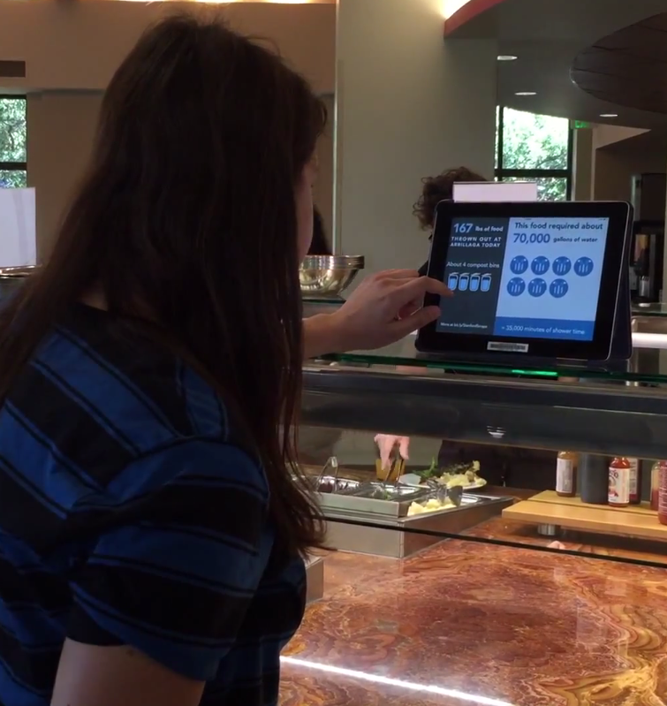
Individual waste display
Total waste display
Notes:
Vivek:
As shown in the left image, we would display individual waste at compost stations so that people know how much they’re individually throwing out. As a person throws food out, a wifi-enabled scale underneath the compost bin measures the weight of food thrown out and updates a display.
As shown in the right image, we would display total waste in the dining hall so that people are reminded of food waste as they’re serving themselves food.

Slide 11
Design Evolution
Notes:
Vivek:
At this point, we had a clear problem and solution frame. We next prototyped and tested a few iterations of our solution design.
→ in these slides, add one line of key finding, ex. “messaging was unclear
→ make sure explain why made the changes

Slide 12
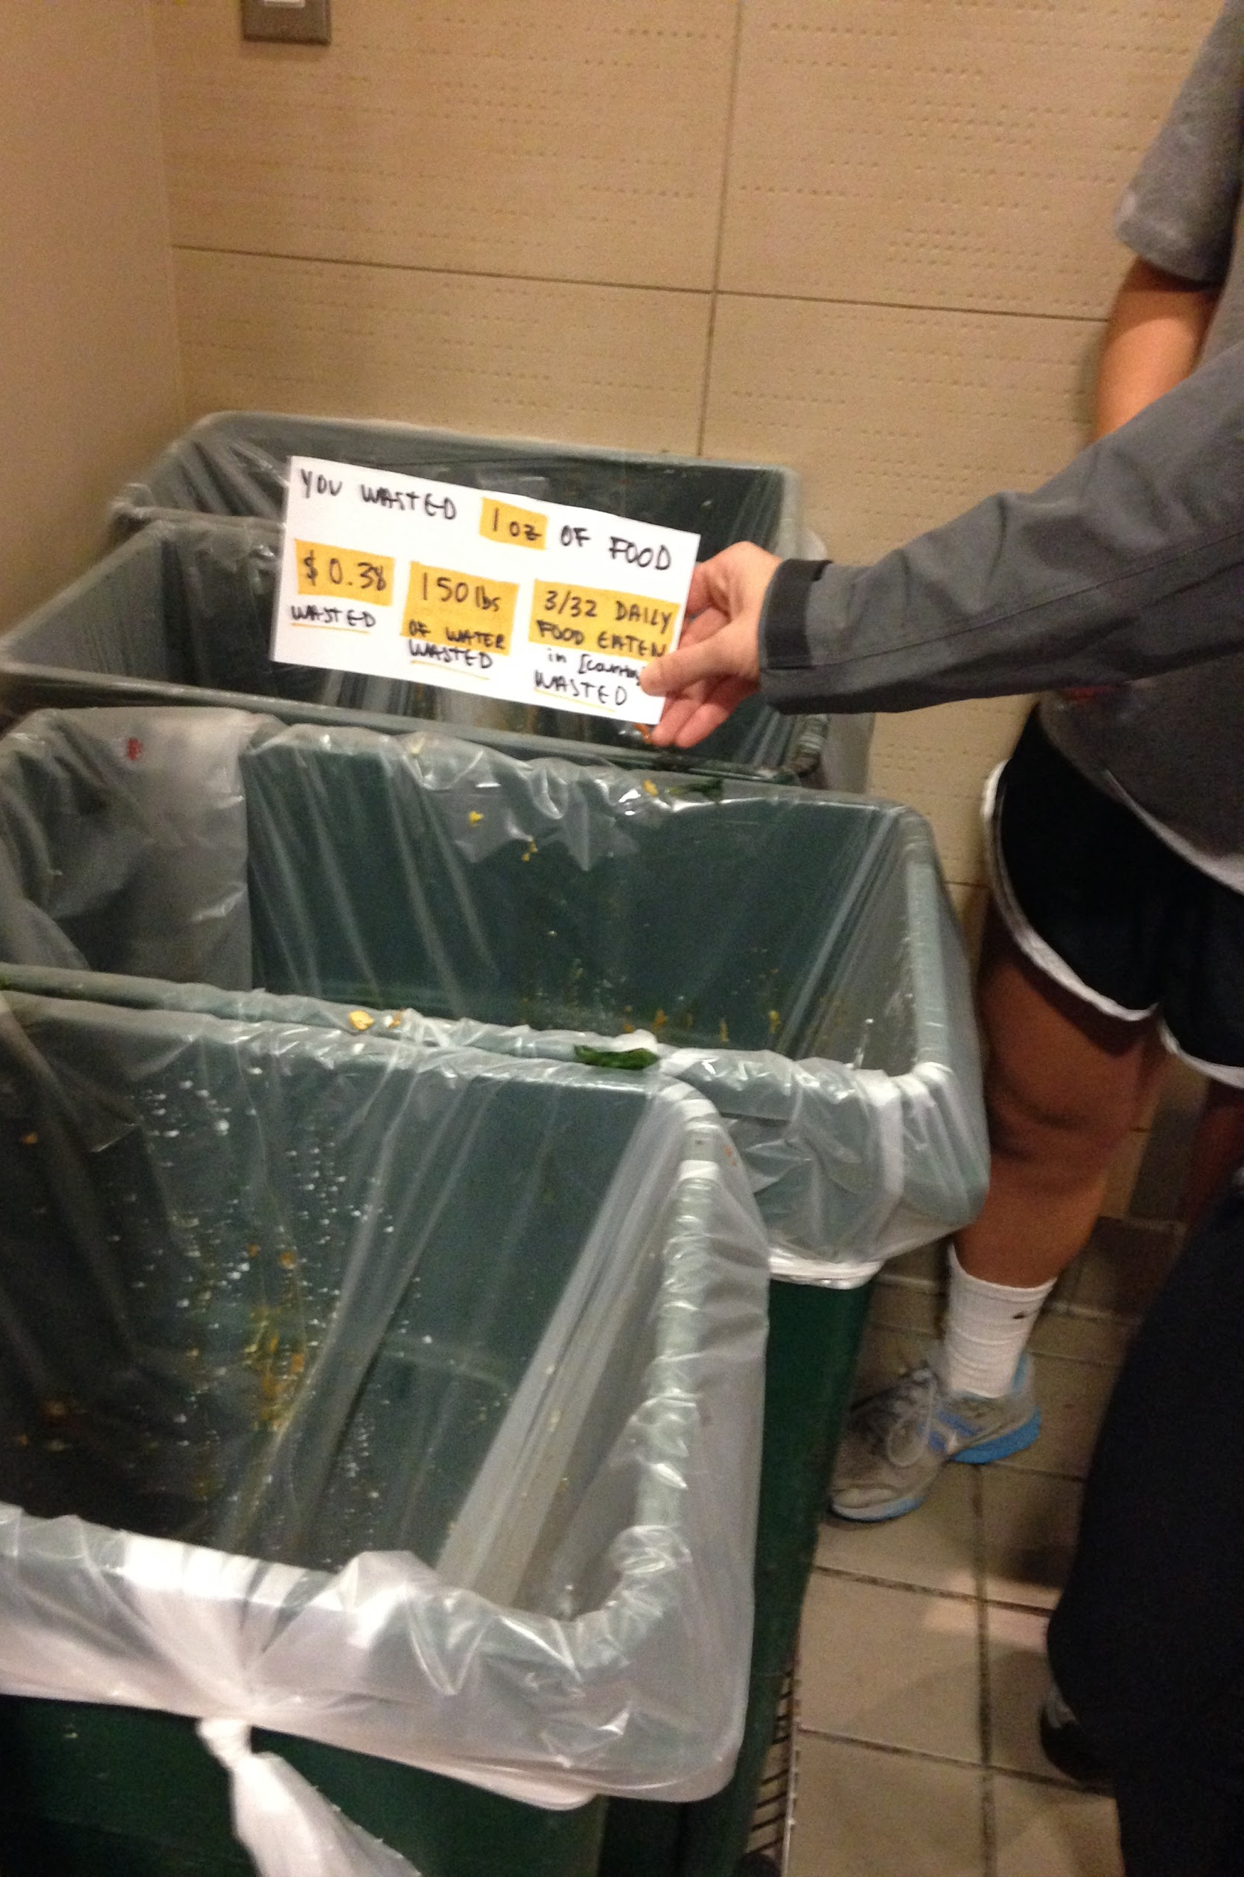
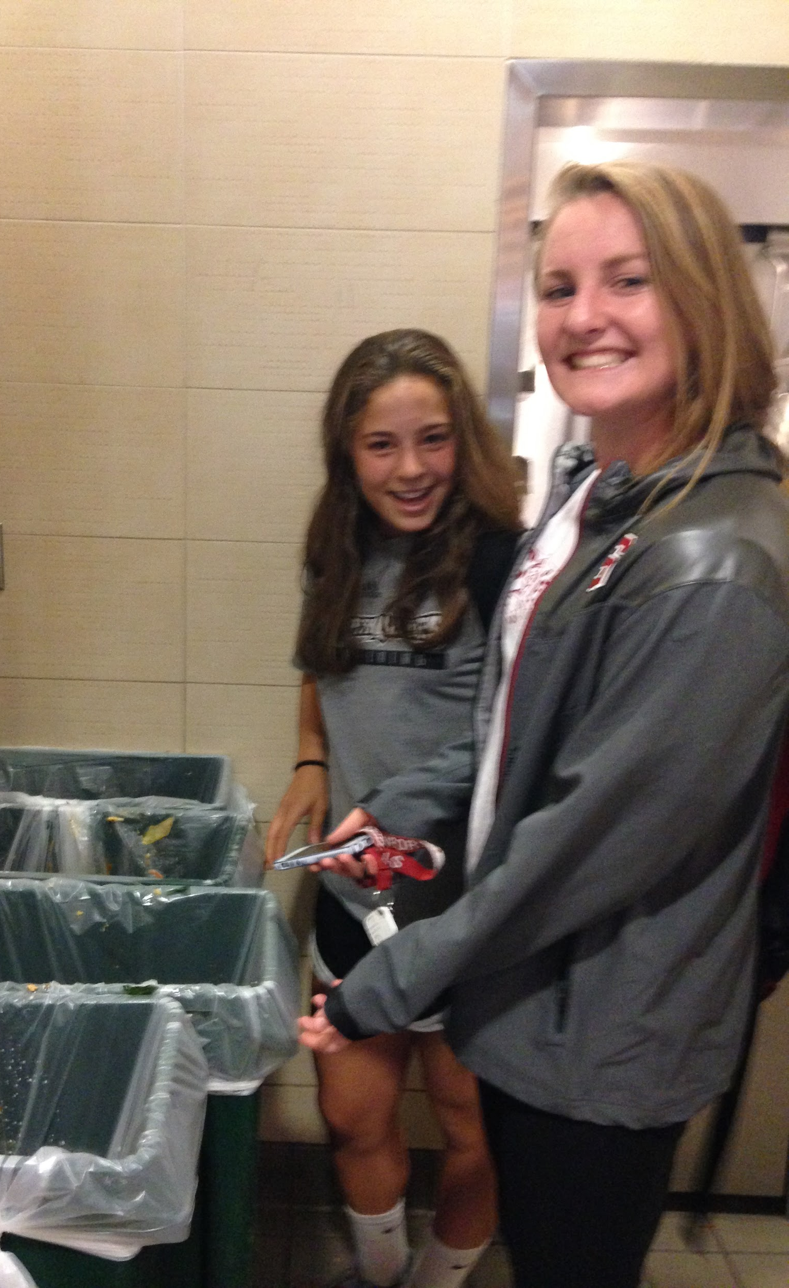
Feedback: too much text!
Notes:
Vivek:
We started rough, with low-fidelity paper prototypes. This initial prototype used colors to indicate whether an individual’s waste level was low, medium, or high.
From our initial testing, people said that these mocks were too busy. Consider the context of the compost station-- people aren’t going to spend several seconds reading lots of text.
Results from testing version 1: Felt some of the messaging was unclear, was unsure what some of the numbers meant; Articulated that there was too much textual information, needed something that “drew [him] in more”
Signs for each “screen” with waste impact held up near compost bins as people used them
Re-iterate wifi enabled scale
emphasize impact - realize composting food is bad, chose to add “impact” statistics

Slide 13
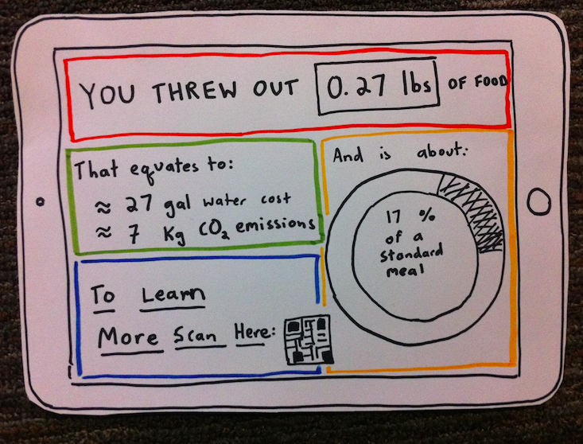
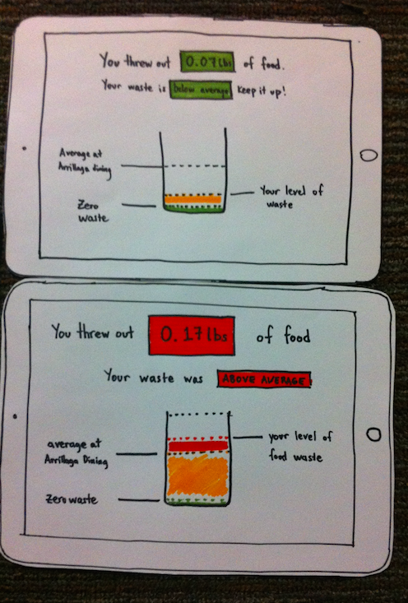
Feedback: still too much text
Notes:
Vivek
In this next iteration, we reduced the amount of text and added graphics for visual appeal. This prototype compares food waste to equivalent amount of water and CO2 emissions involved in producing the food, as well as to a percentage of a standard meal.
In testing, people found all of these comparisons valuable, but still wanted less text. So our task was to reduce text without losing too much of the valuable message.

Slide 14
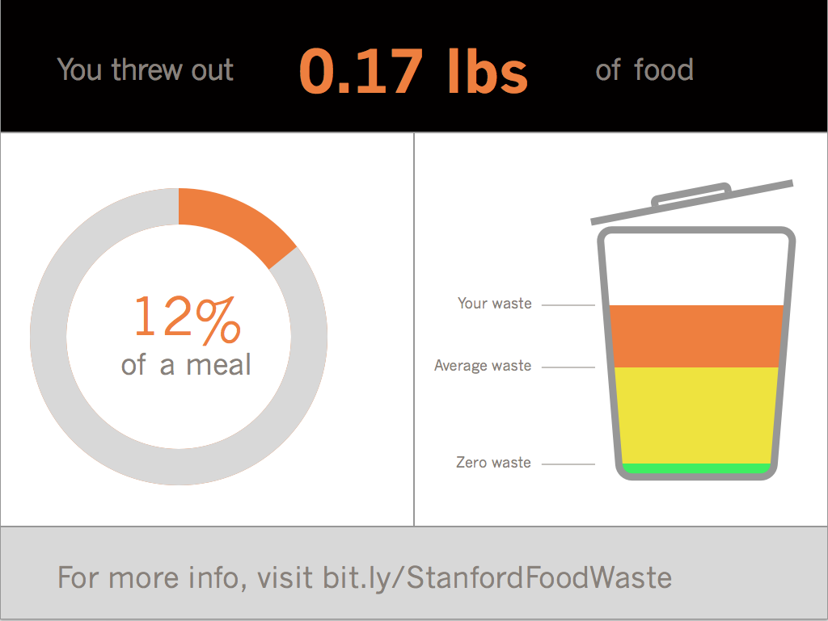
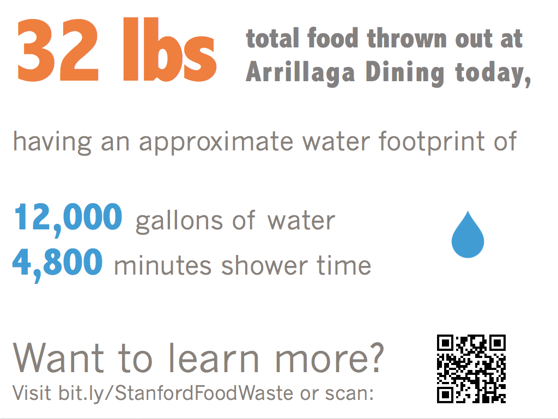
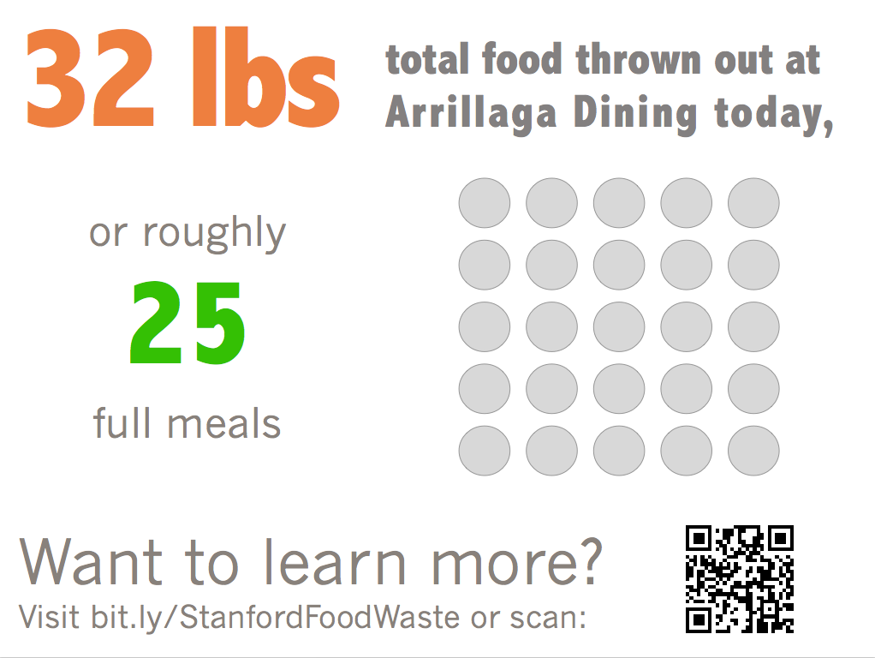
Feedback: needs more visual appeal
Notes:
Vivek
We continued iterating, making the screens simpler and more polished...
Should we cut this slide? Doesn’t add much.

Slide 15
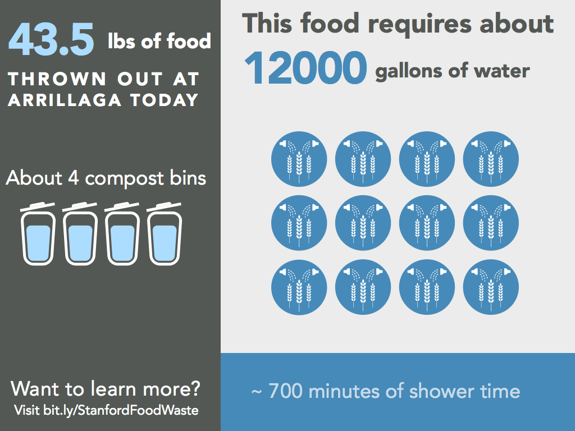
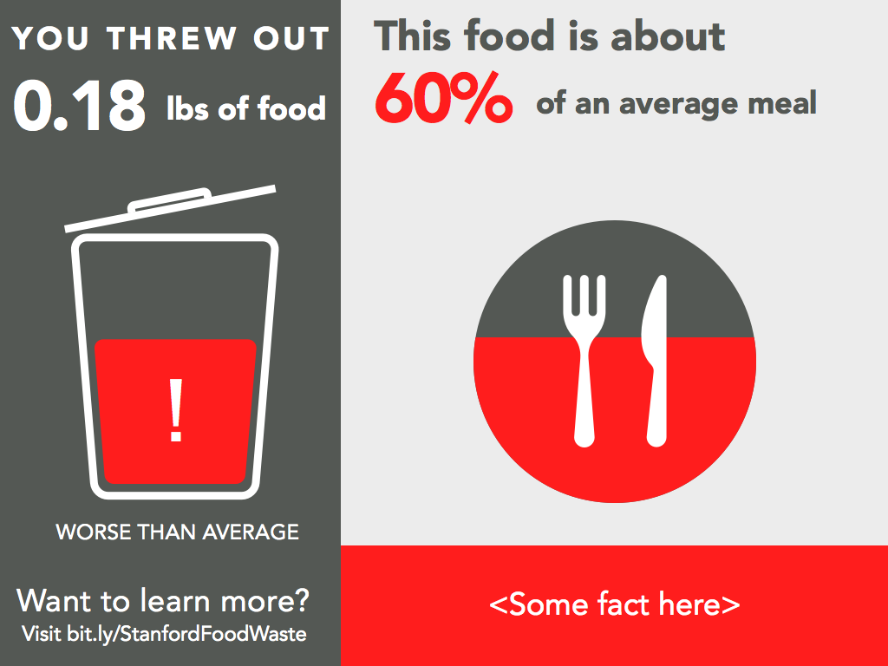
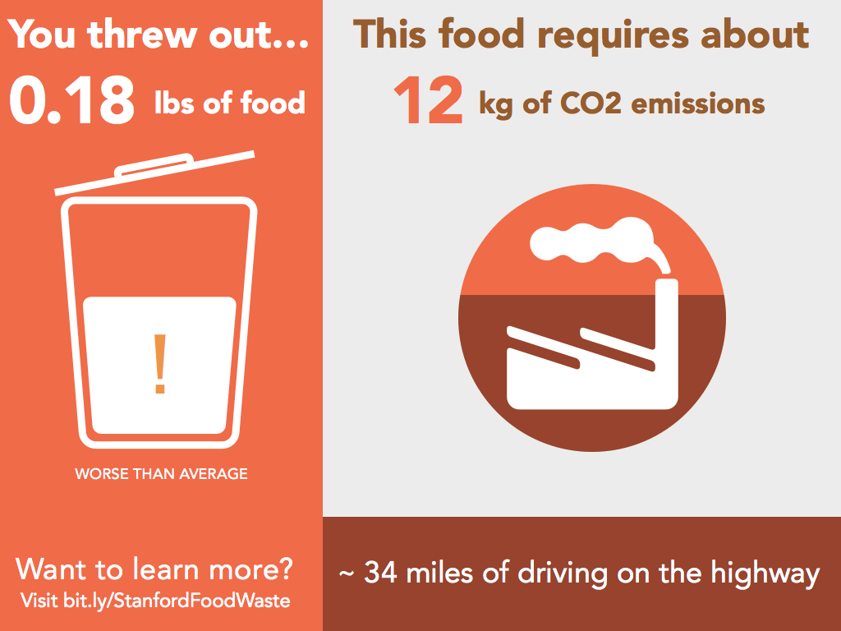
Feedback: needs more visual hierarchy
Notes:
Vivek:
In our next iteration, we solved these problems by creating multiple screens that we could cycle through. This allows us to keep each screen simple, but still display lots of information. We also tried to make the environmental impact of food waste easier to understand by, for example, reframing water quantities in terms of equivalent minutes of shower time.
One piece of feedback we got is that the graphics lack visual hierarchy. It’s not clear where the viewer is supposed to look first.

Slide 16
Final Design

Slide 17
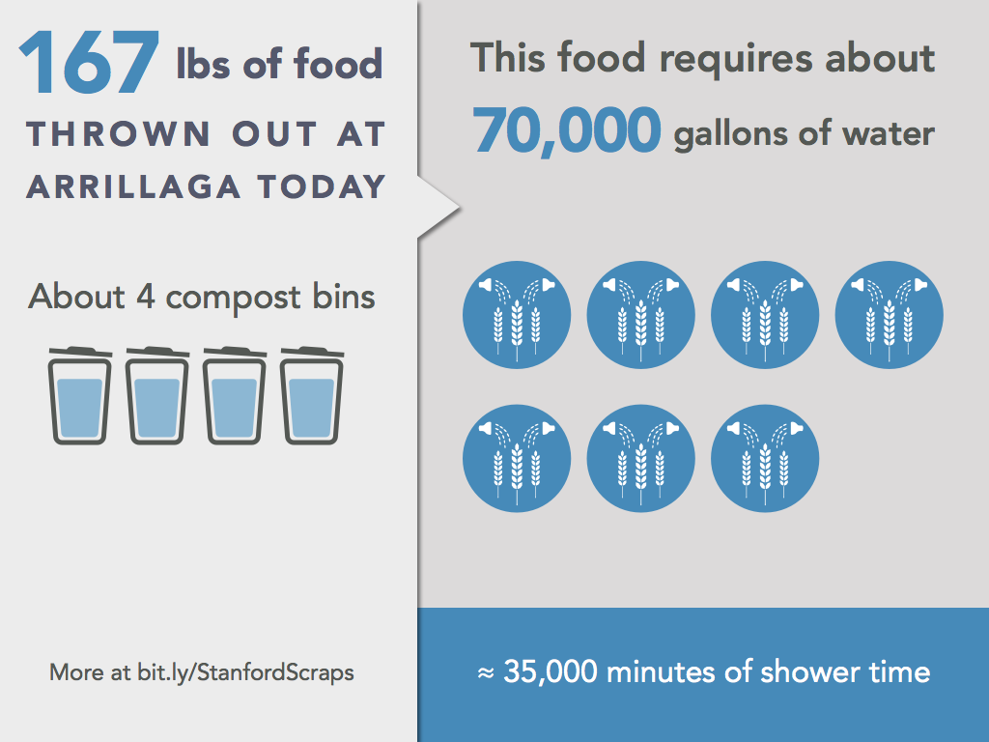
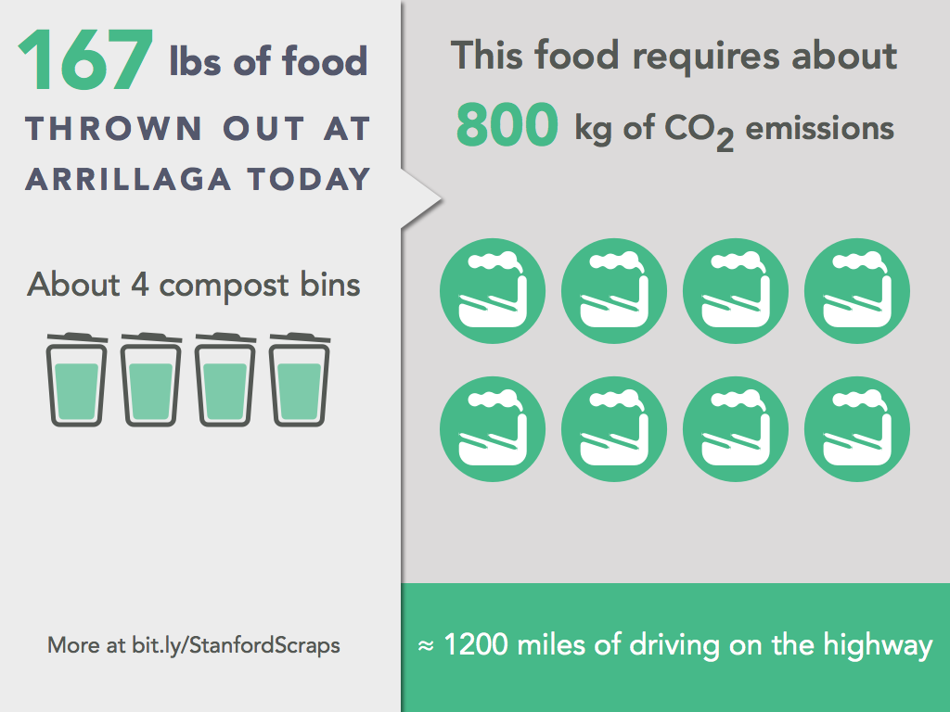
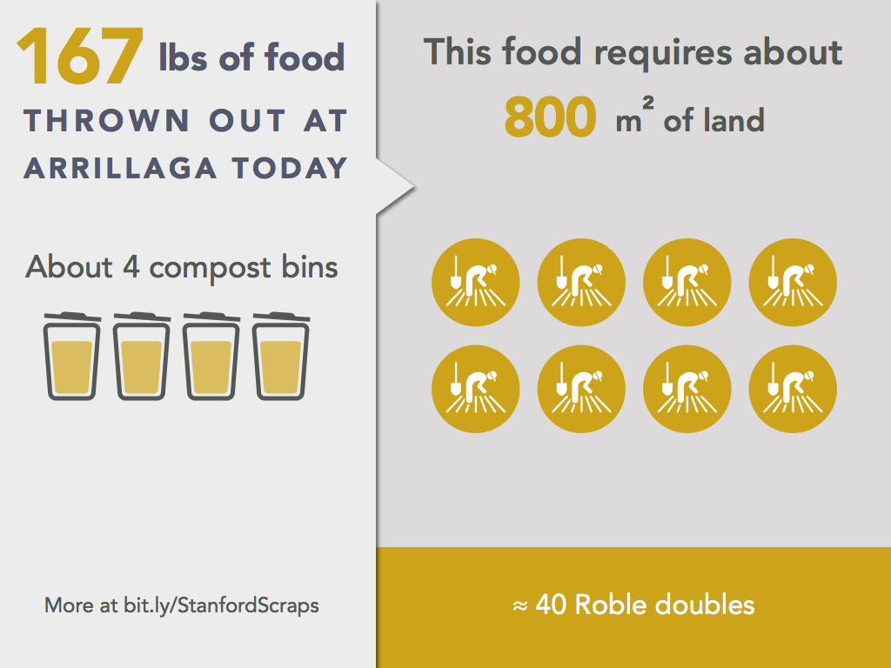
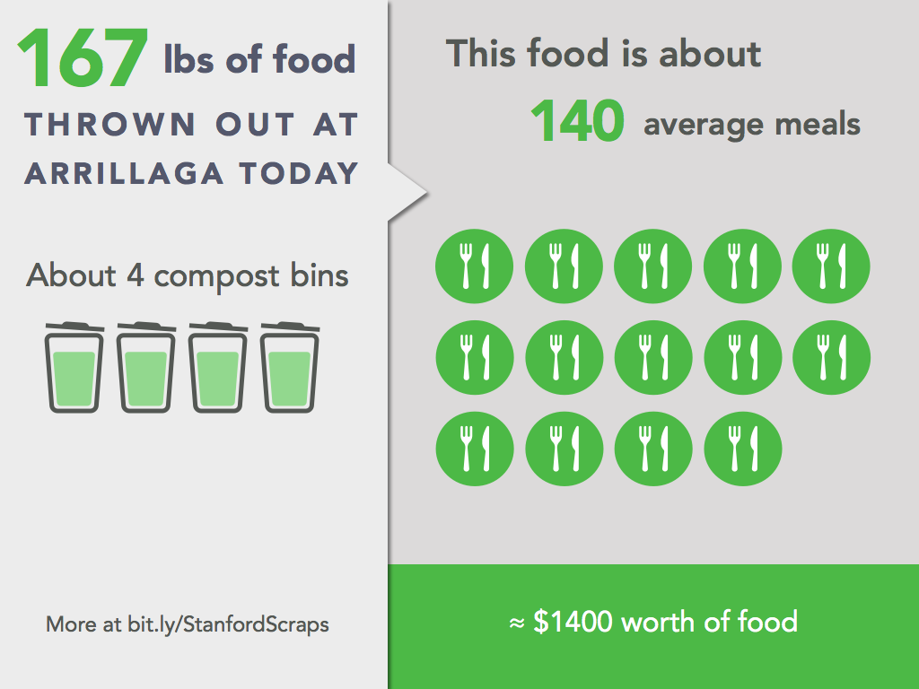
Notes:
Vivek:
In our final design, we played with text sizes, contrast, and shadows to create a better sense of visual hierarchy, cueing the viewer to read the left panel before the right panel.
Again, the app cycles between these multiple screens in order to stay interesting. These displays reframe food waste in terms of water, CO2, and land inputs, as well as the number of meals equivalent of food.
These screens show total waste...

Slide 18
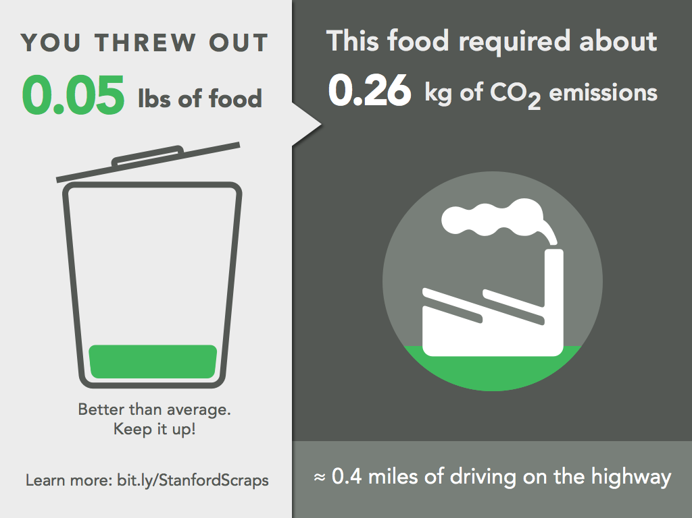
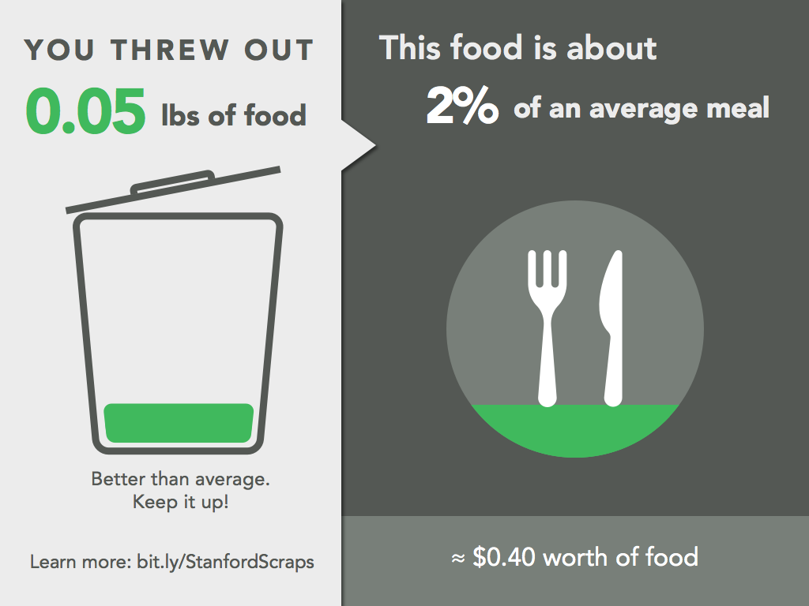
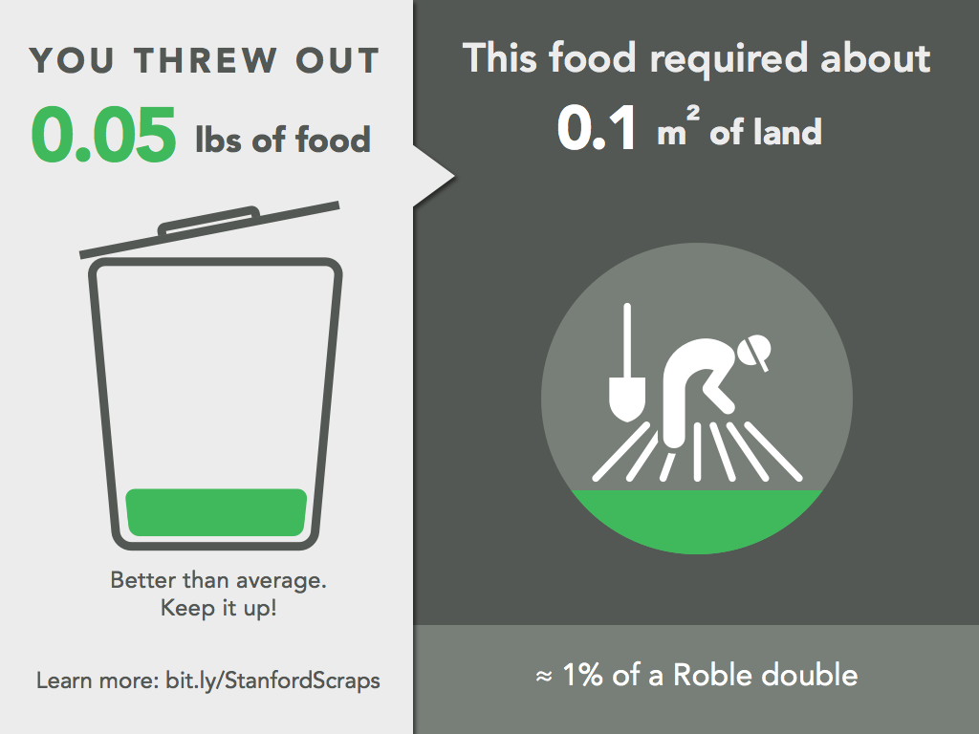
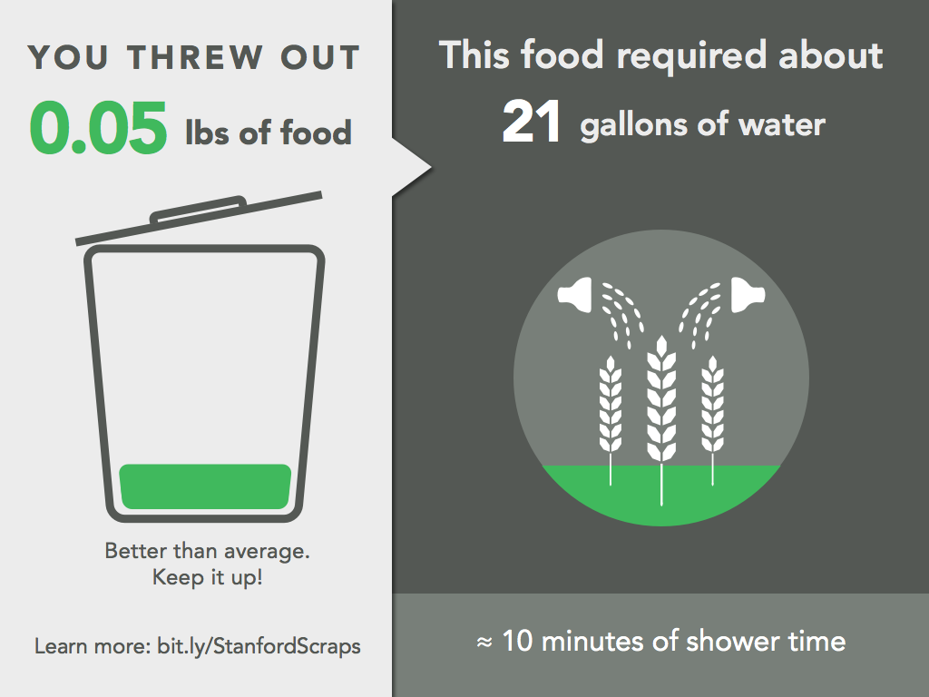
Notes:
Vivek:
And these screens show individual waste. The colors -- green or red -- are glanceable visual cues as to whether your waste was below or above average.

Slide 19
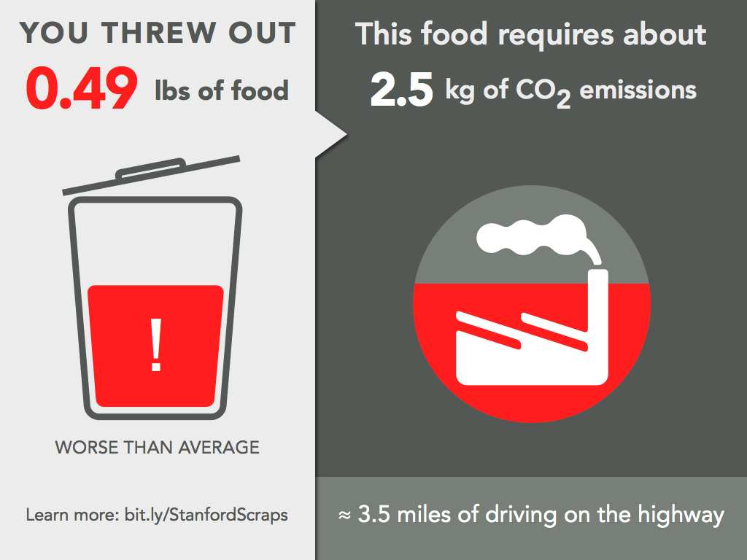
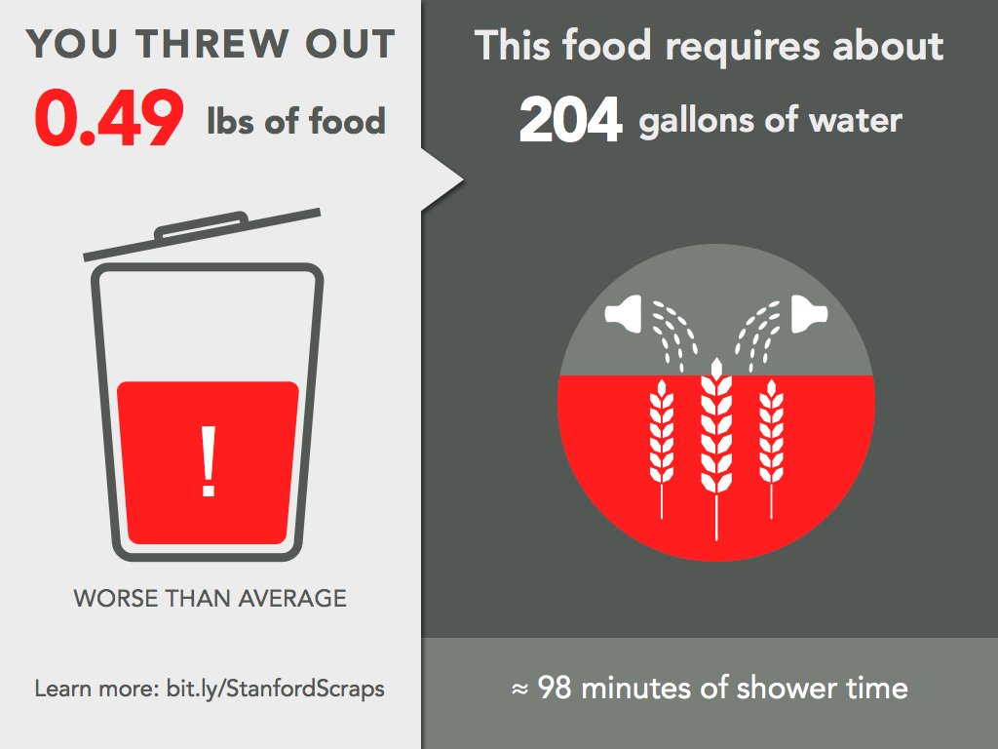
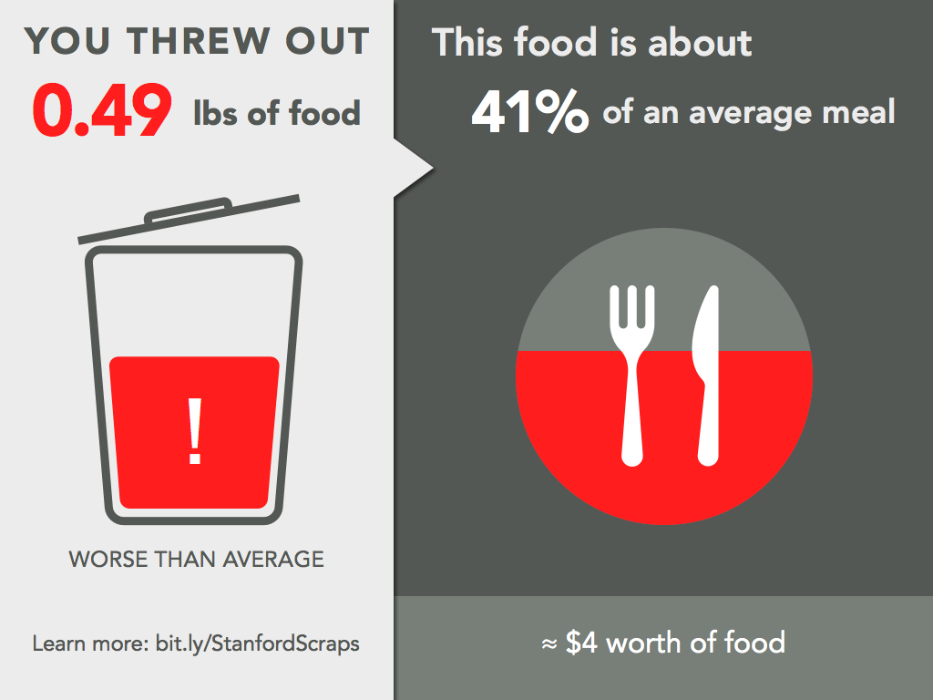
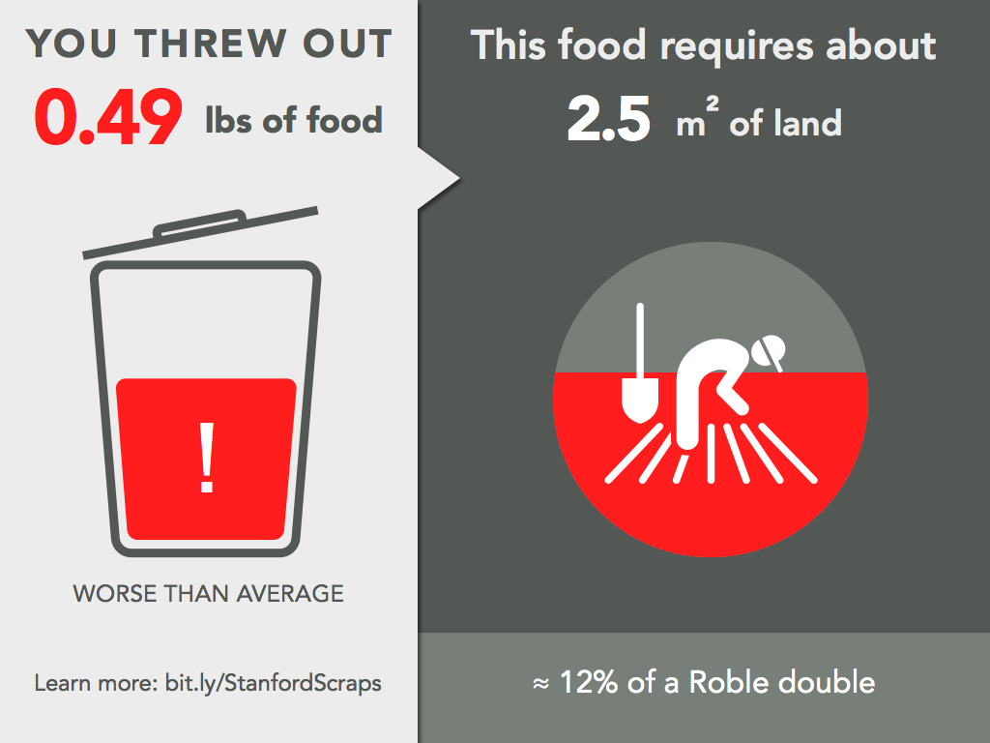

Slide 20
Concept video

Slide 21
Next Steps
Build application
Integrate system with wi-fi enabled scale’s API
Work with dining halls to implement system
Notes:
Tools/infrastructure/services used to build the final prototype
What is missing & what might you add in the future

Slide 22
Summary
Insight: with the right nudge, people would reduce their food waste in cafeterias
Innovation: make food waste tangible
Impact: reduce environmental and economic impact of food waste in cafeterias; inform diners about food waste impact

Slide 23
Attributions
Thanks to The Noun Project for graphic elements
Jane Pellicciotto, Christopher Classens, Ealancheliyan S, Luis Prado, Marek Polakovic
Thanks to Hannah Mensing and Sonia Baltodano for statistics on food waste

