Slide 1

EFFORTLESS
MINDFUL
EATING
Mission Nutrition

Slide 2

Team Mission Nutrition
Robert
Fearon
Sukhi
Gulati
Raymond
Luong
Margaret
Wenzlau

Slide 3
Roadmap
Introduction
The Problem
Needfinding Process
Initial Prototypes
Our Solution
Concept Video
Design Process
Final Design & Implementation

Slide 4
The Problem
1

Slide 5



Unhealthy eating habits lead to obesity.

Slide 6
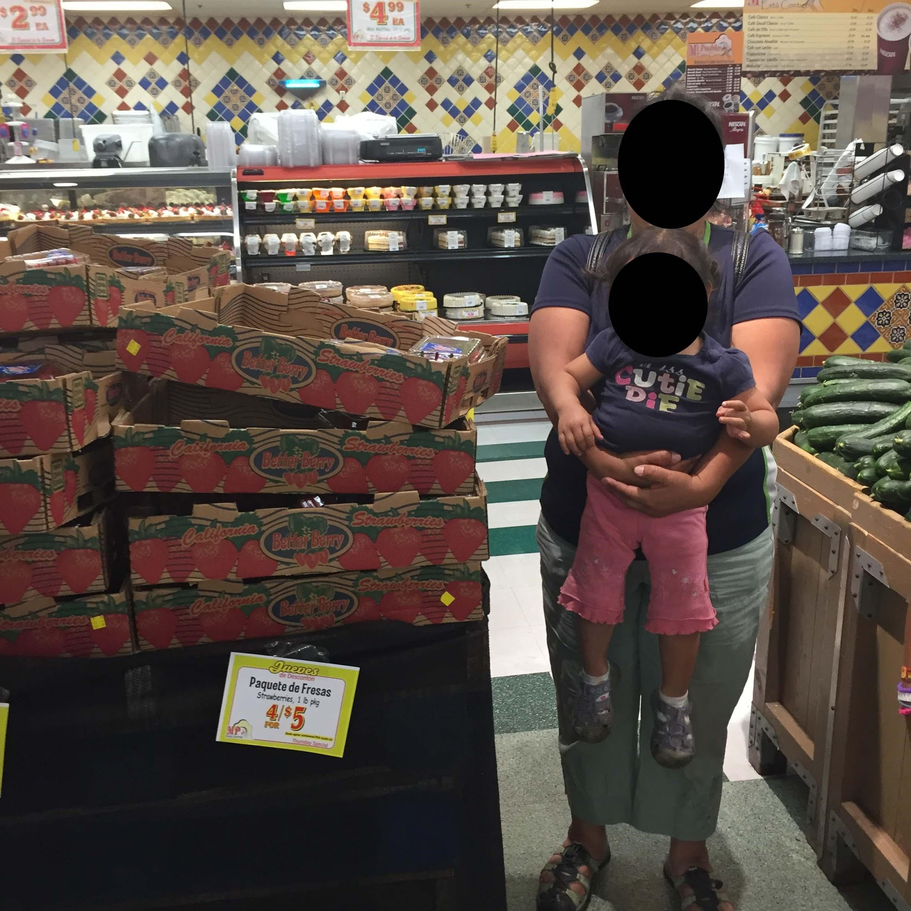
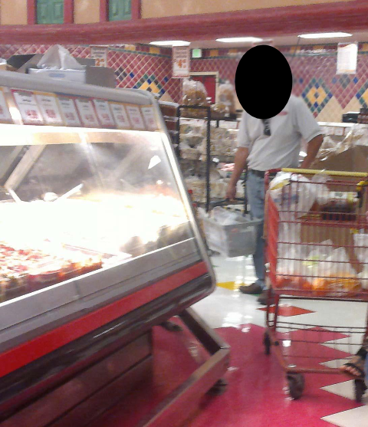
NEEDFINDING AT MI PUEBLO
Parents
Have Nutritional Knowledge
Buying in Bulk
Mismatch Between Actions & Words

Slide 7
Point of View
We met Maria, a working mother of three,
who needs to find a time efficient way to maintain a supply of healthy ingredients in her home,
because her work prevents her from shopping frequently enough to supply her kitchen with the fresh ingredients she knows are important to health.

Slide 8
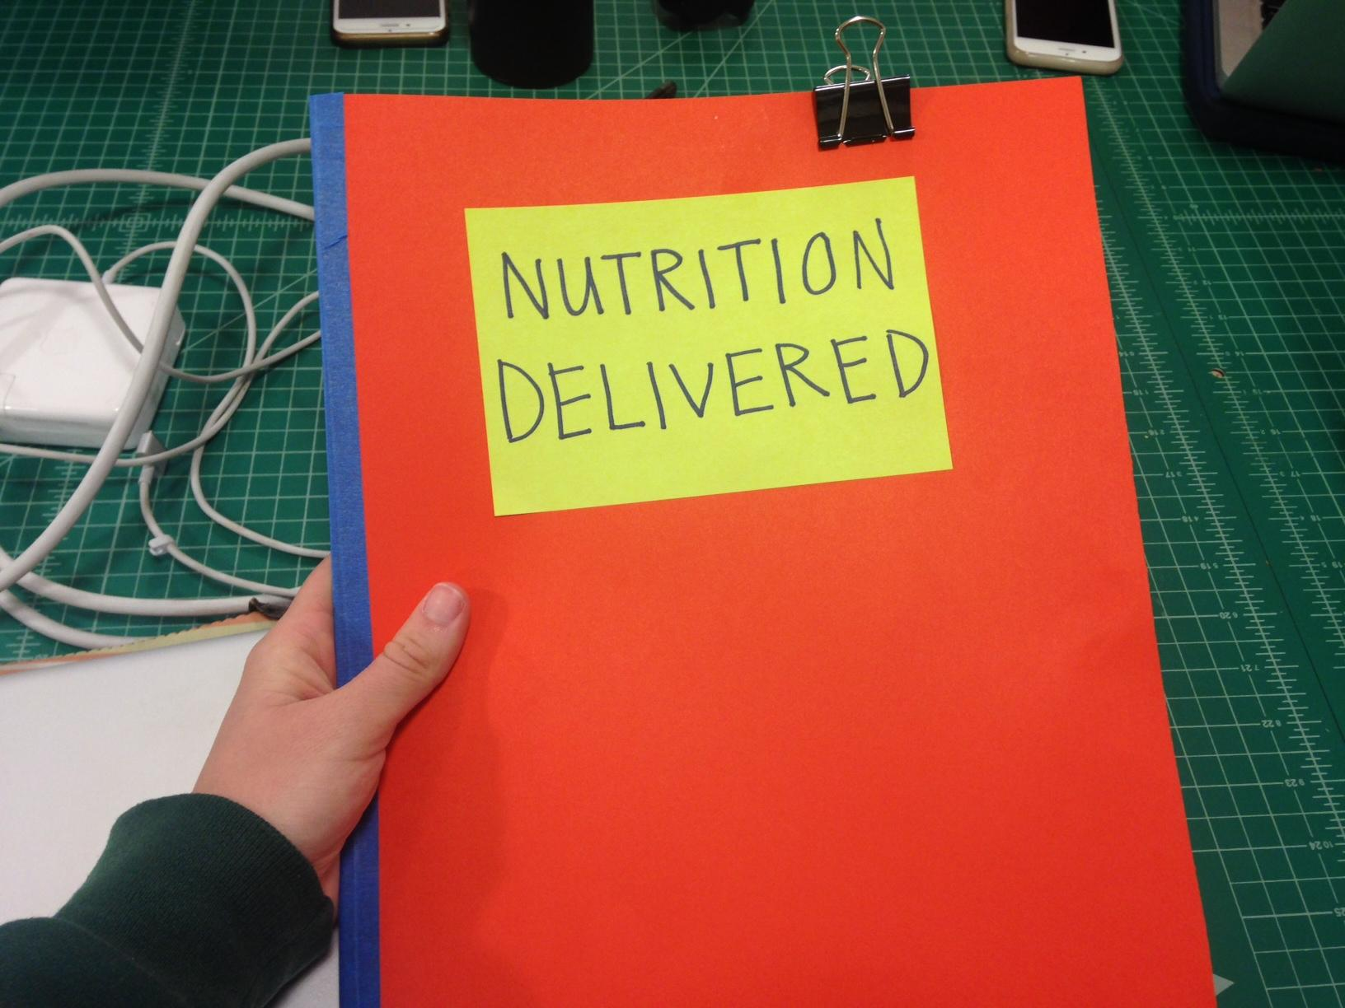
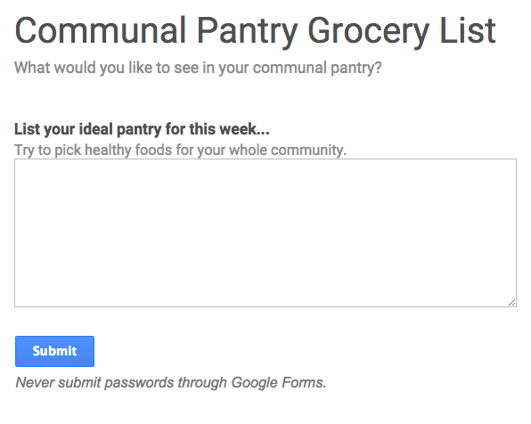
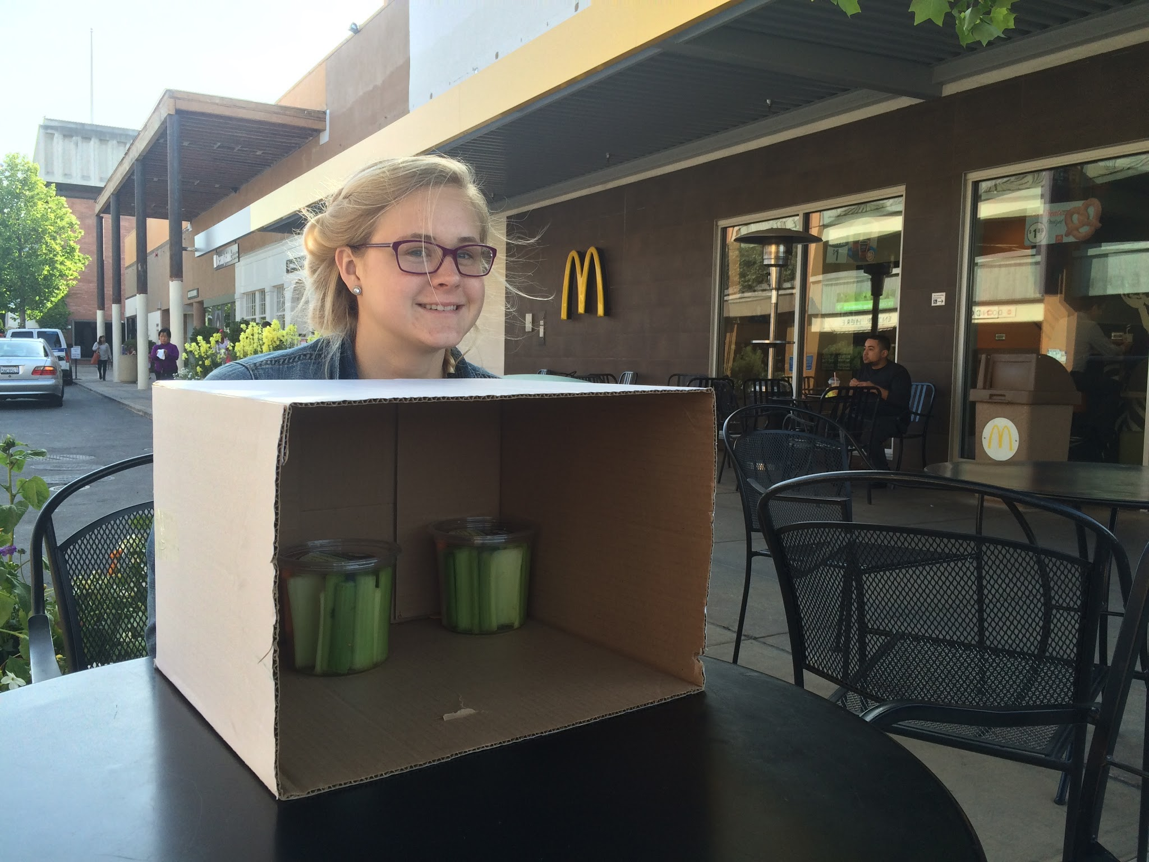
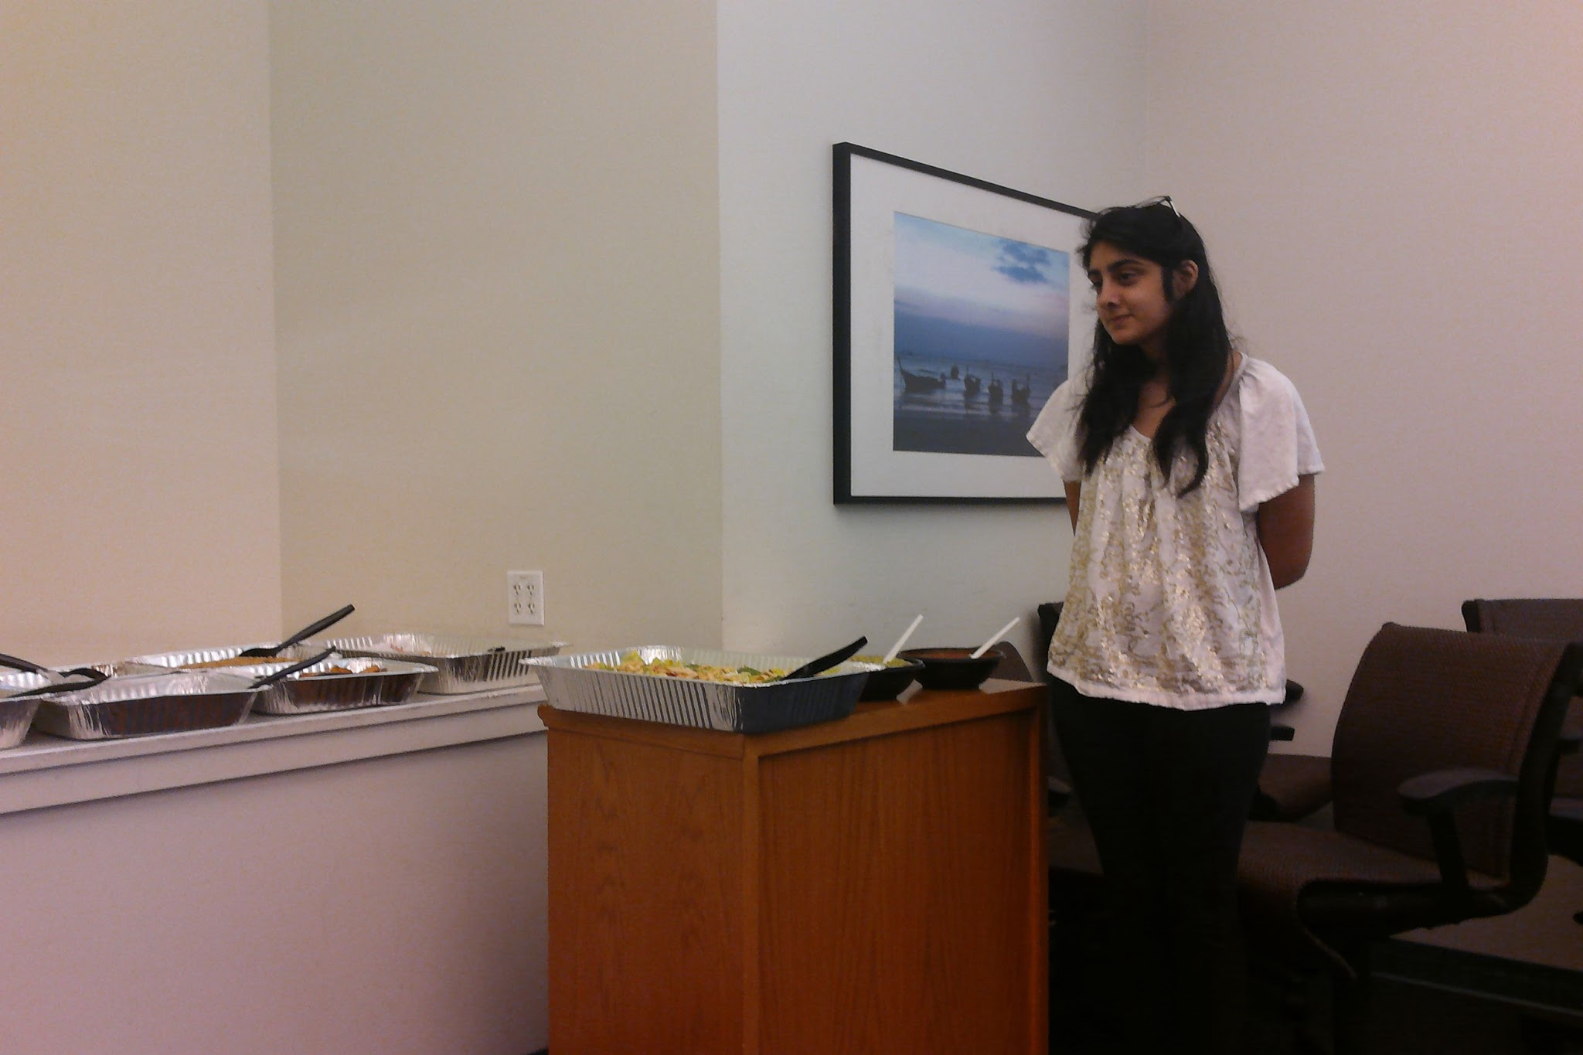
Parallel Prototyping
People are unwilling to surrender control.
Awareness is not the issue.
People act differently when they’re being watched.
Notes:
verbally say didt pick nutrtitous foods

Slide 9
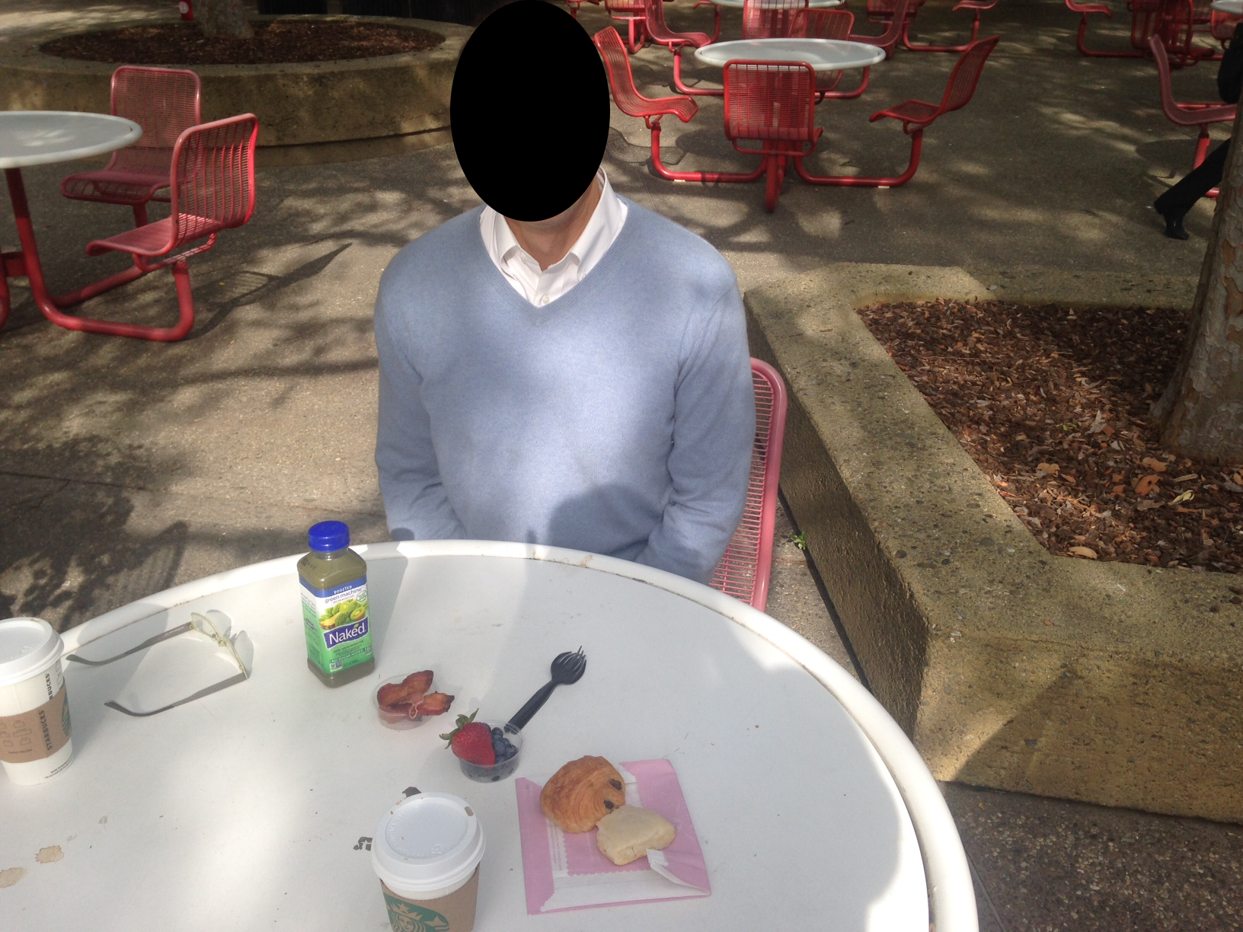
Point of View
We met Martin, a middle aged man with unhealthy eating habits,
who needs to develop personal motivation to eat well instead of relying on external judgement,
because when no one is watching, the mild convenience barriers to healthy food impede him and he falls back on cravings for sugar and unhealthy fat.

Slide 10
People require constant monitoring or other external consequences in order to improve unhealthy eating habits.

Slide 11
The Solution
2

Slide 12
Make mindful eating effortless.

Slide 13
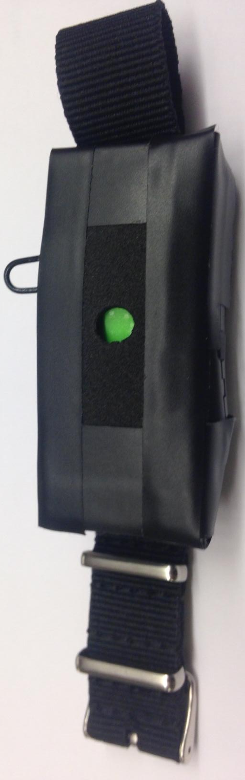
Tracks Health Goals
Gives Gentle Reminders
Social Sharing

Slide 14
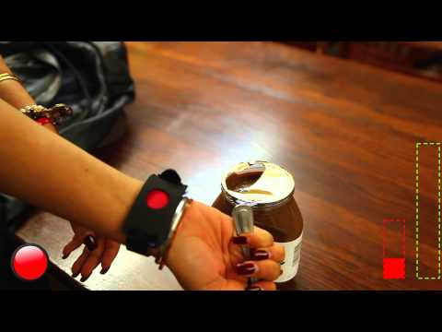

Slide 15
Design Evolution Overview
Tooth Cap Teeth Simulation
Force Based Feedback
Final Design

Slide 16
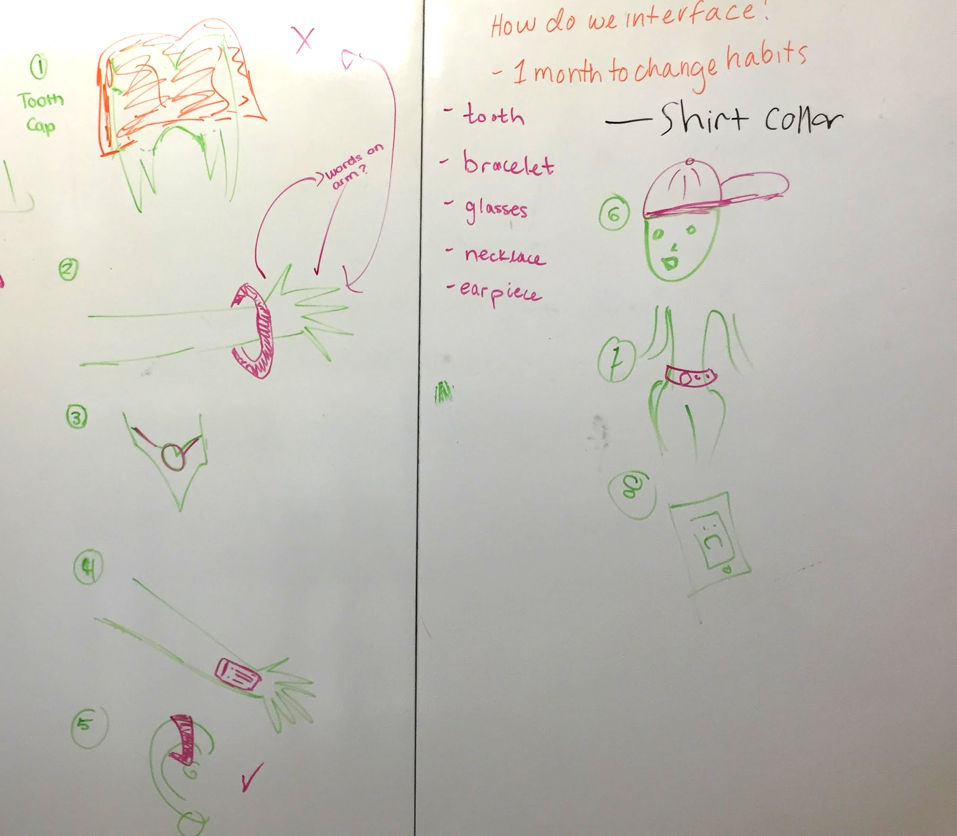
How might we make the consequences of unhealthy food more easily perceived?
Notes:
How might we make the consequences of unhealthy food more easily perceived?
How might we encourage a self-motivated change of habit towards a healthier diet?

Slide 17
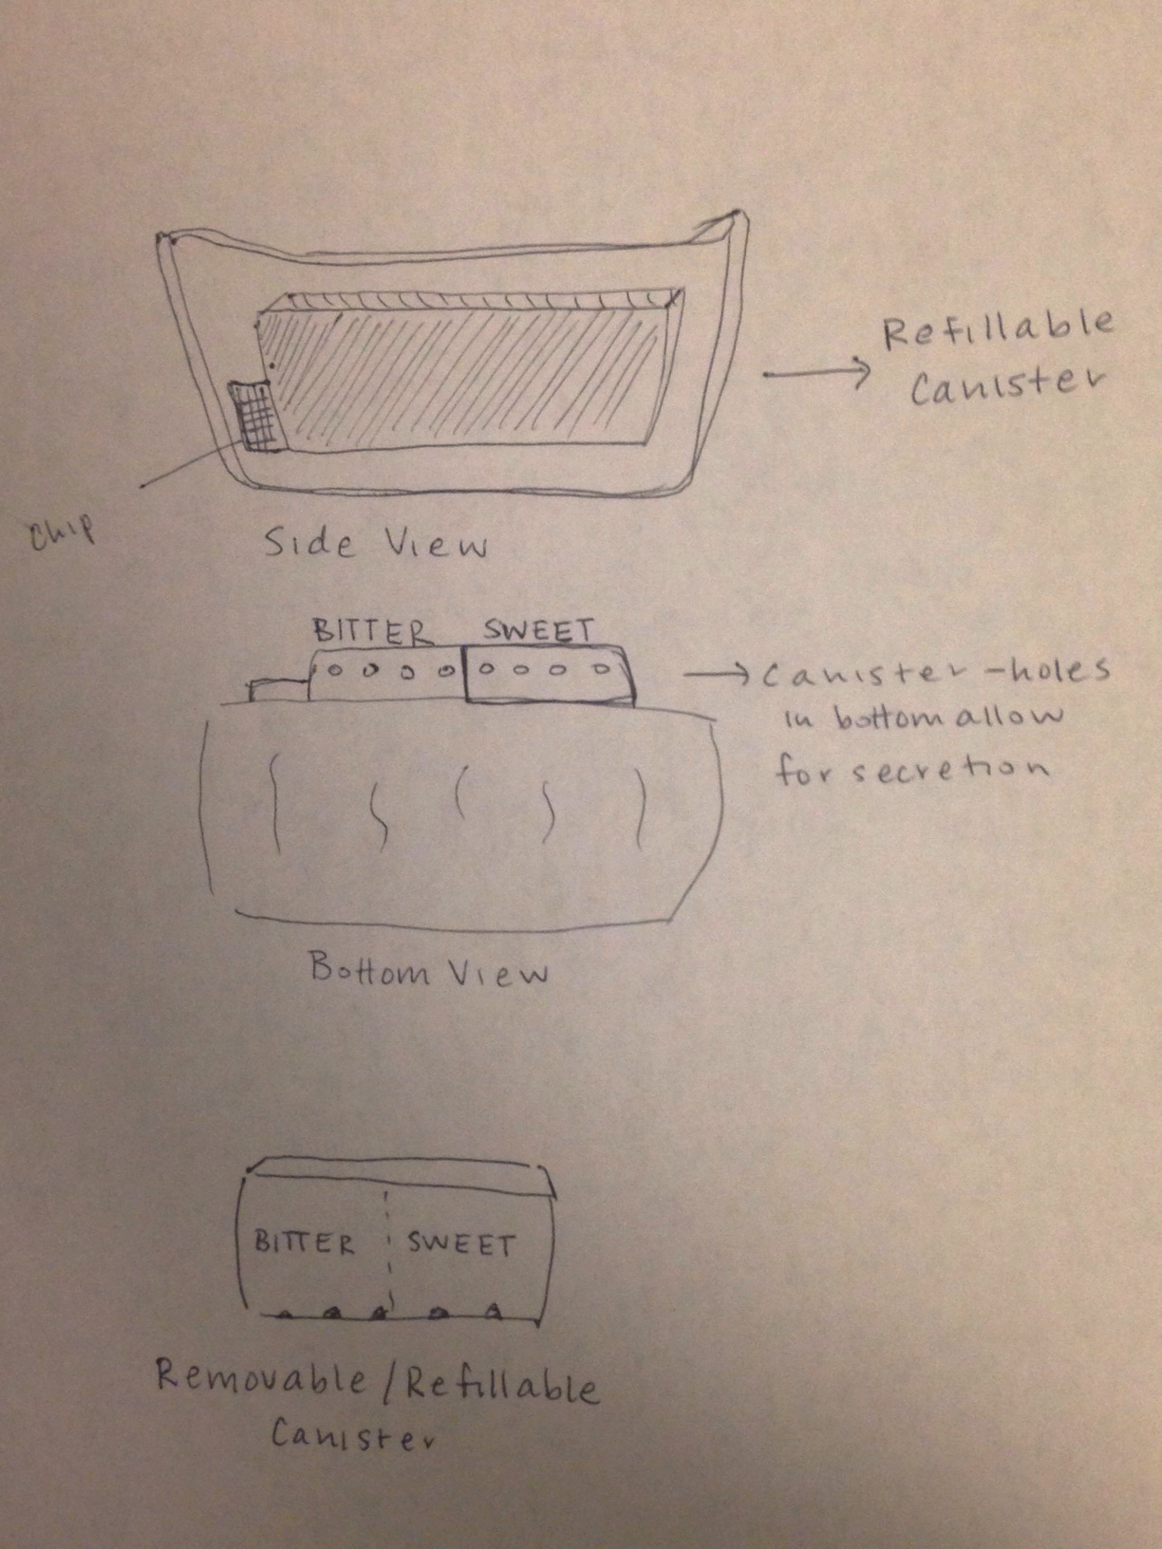
Tooth Cap Decision

Slide 18
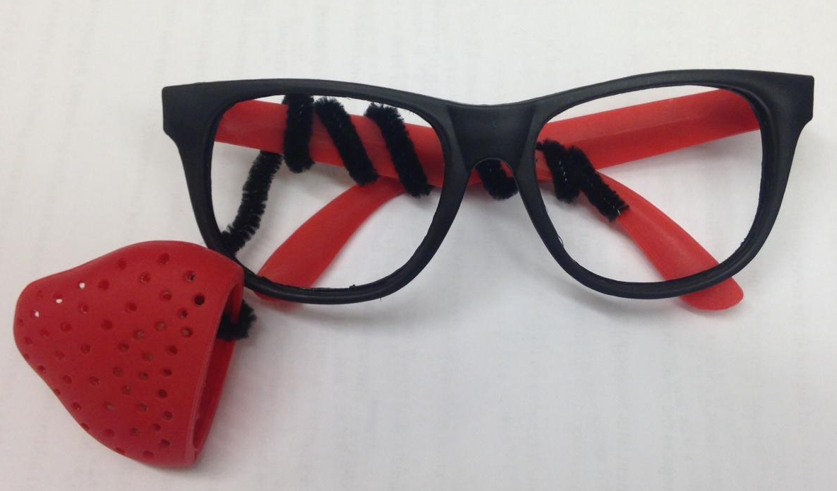
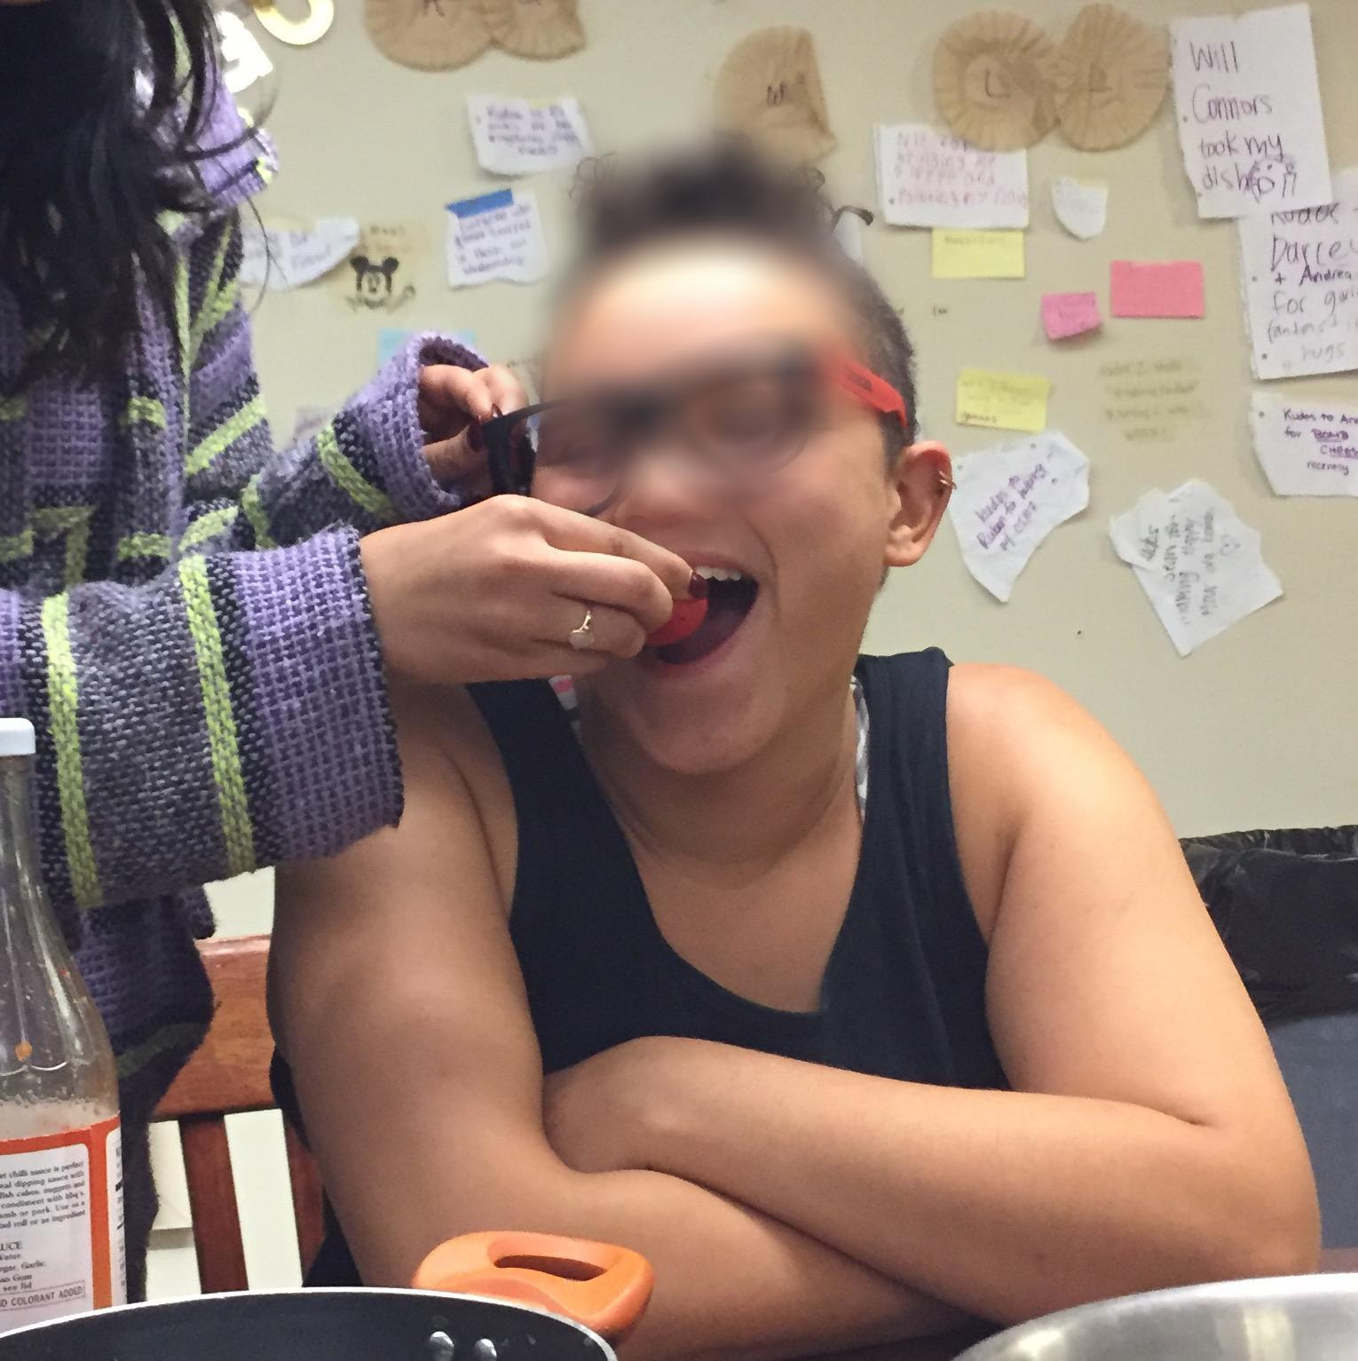
Tooth Cap Prototype
Large Commitment
Invasive
Impractical
Effective

Slide 19
Design Evolution Overview
Tooth Cap Teeth Simulation
Force Based Feedback
Final Design
Updated Form Factor
Eliminate Taste Alteration

Slide 20

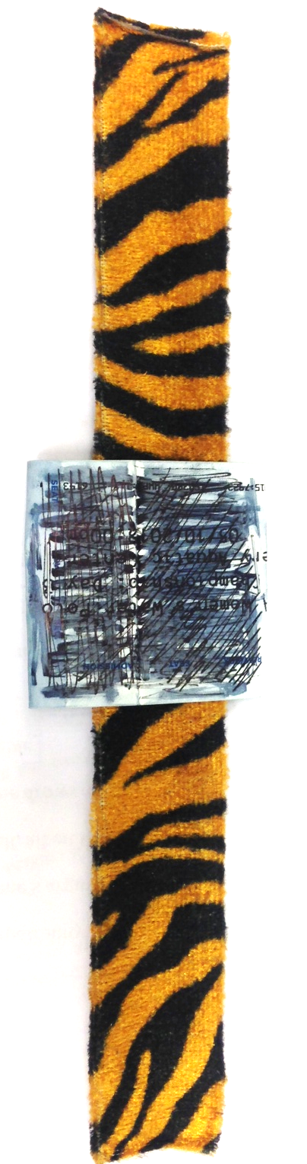

Updated Form Factor

Slide 21
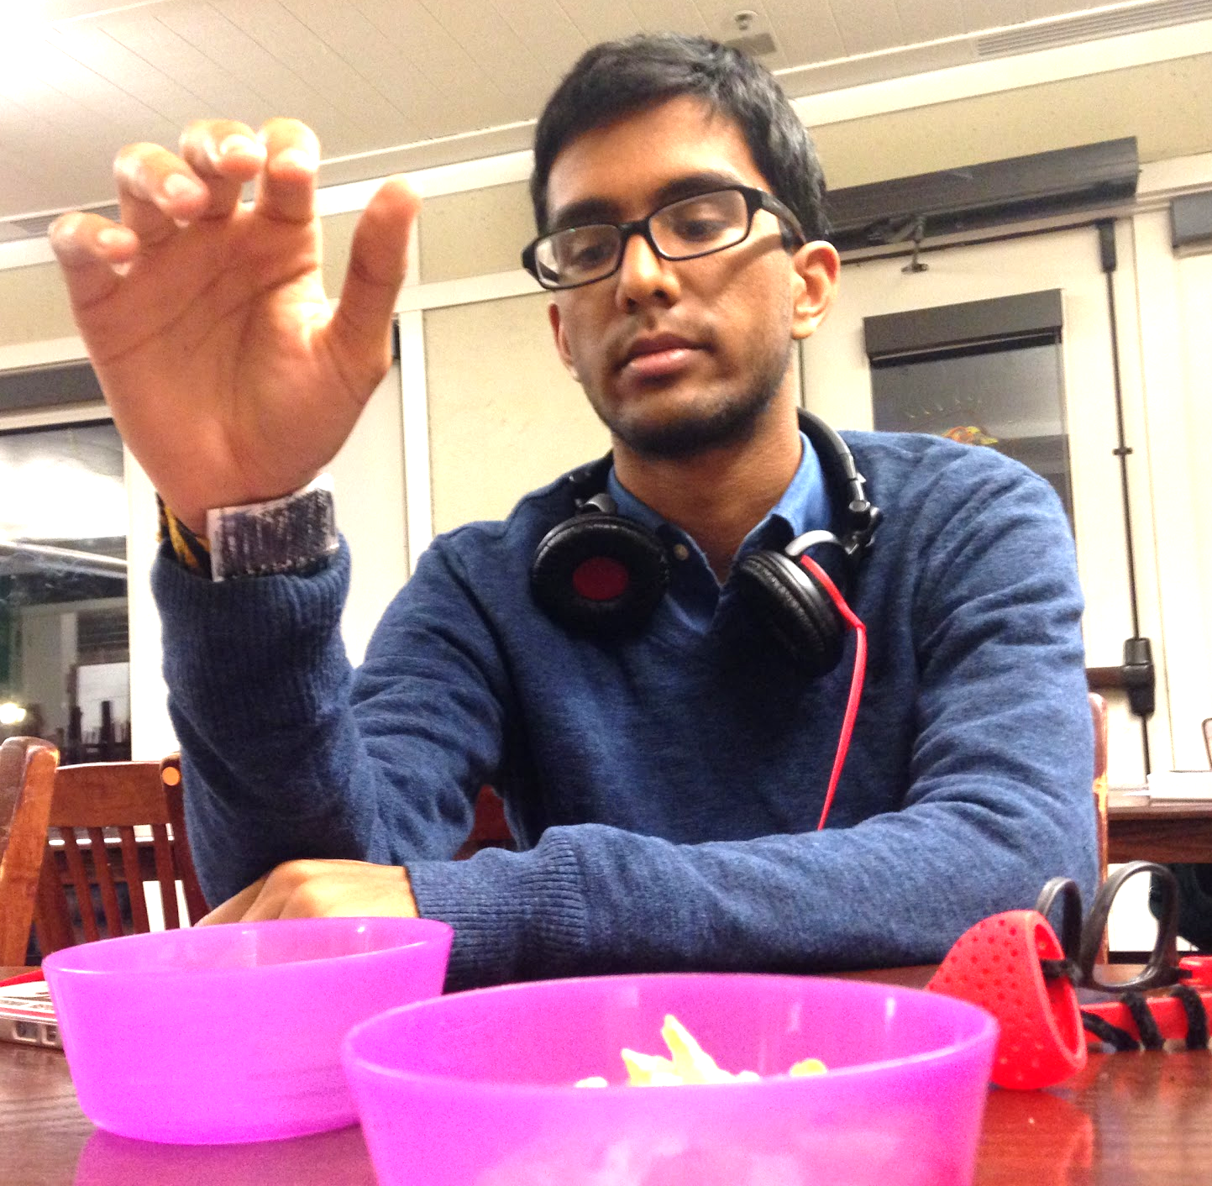
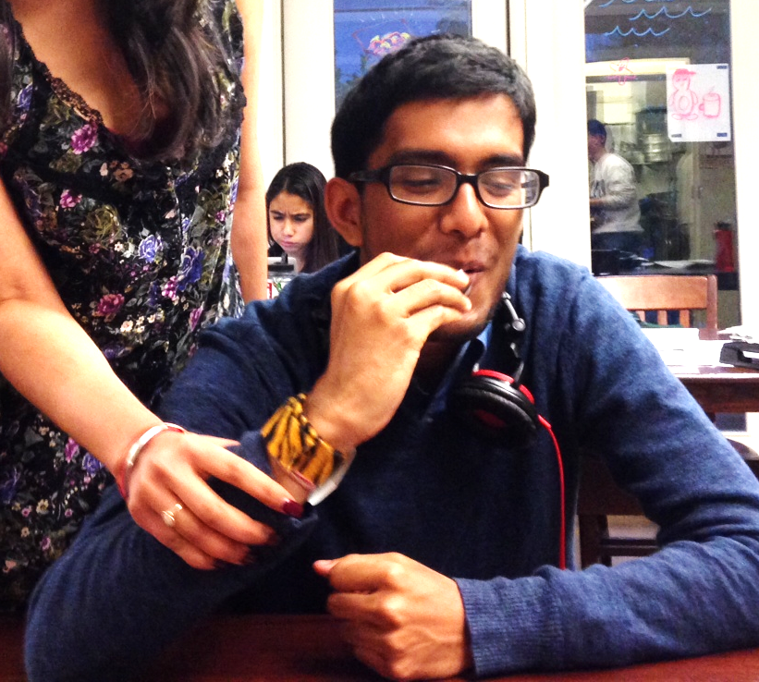
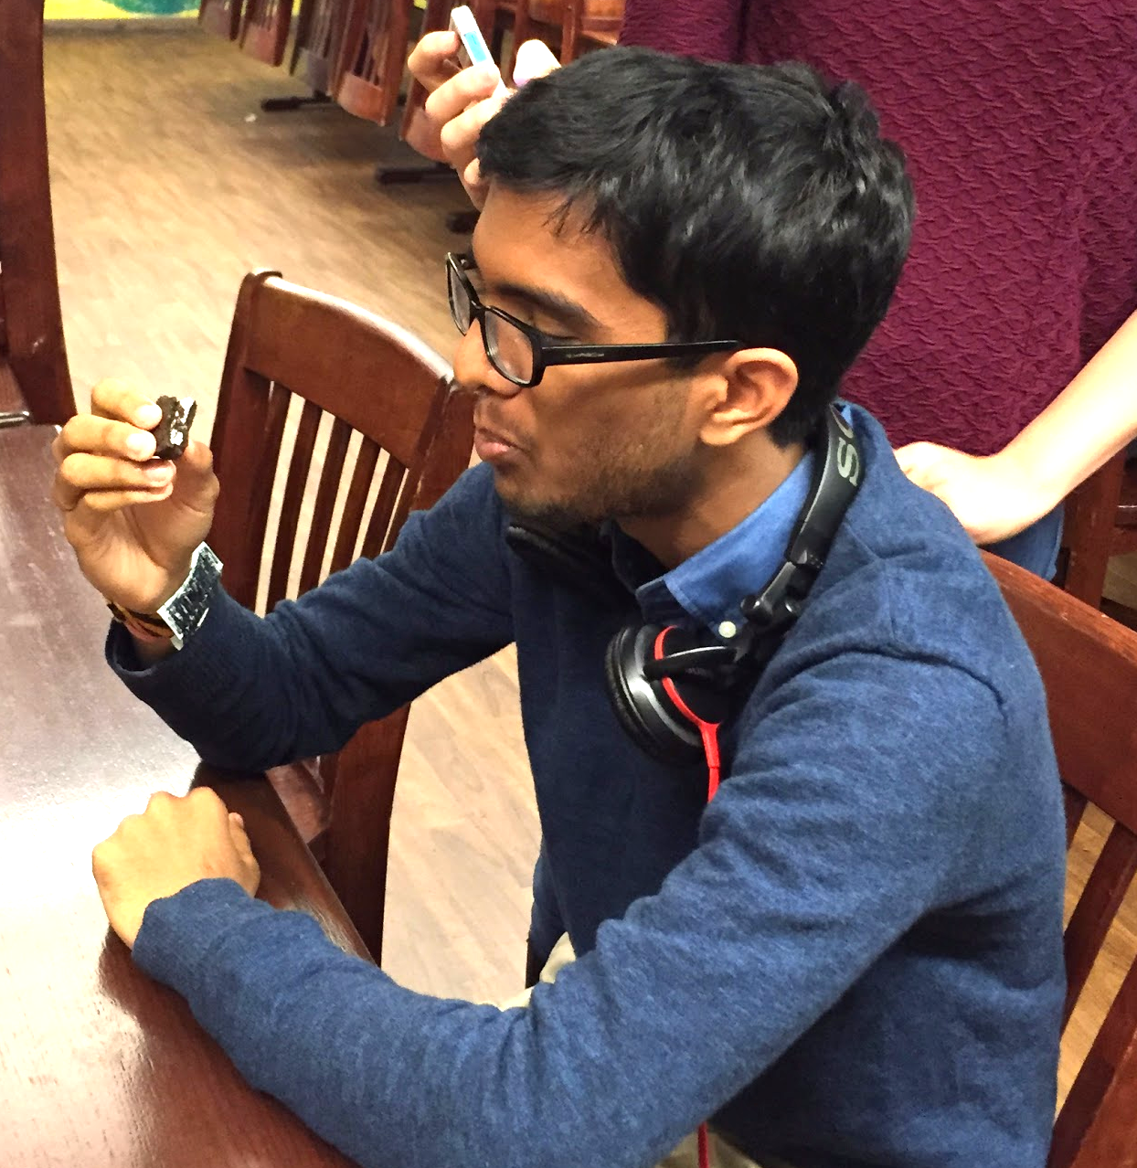

Feedback Prototype
Sound is Ideal
Lack of Transparency
Lack of Compliance
Good Form Factor

Slide 22
Design Evolution Overview
Tooth Cap Teeth Simulation
Force Based Feedback
Final Design
Sound & Status Light
Social Sharing

Slide 23
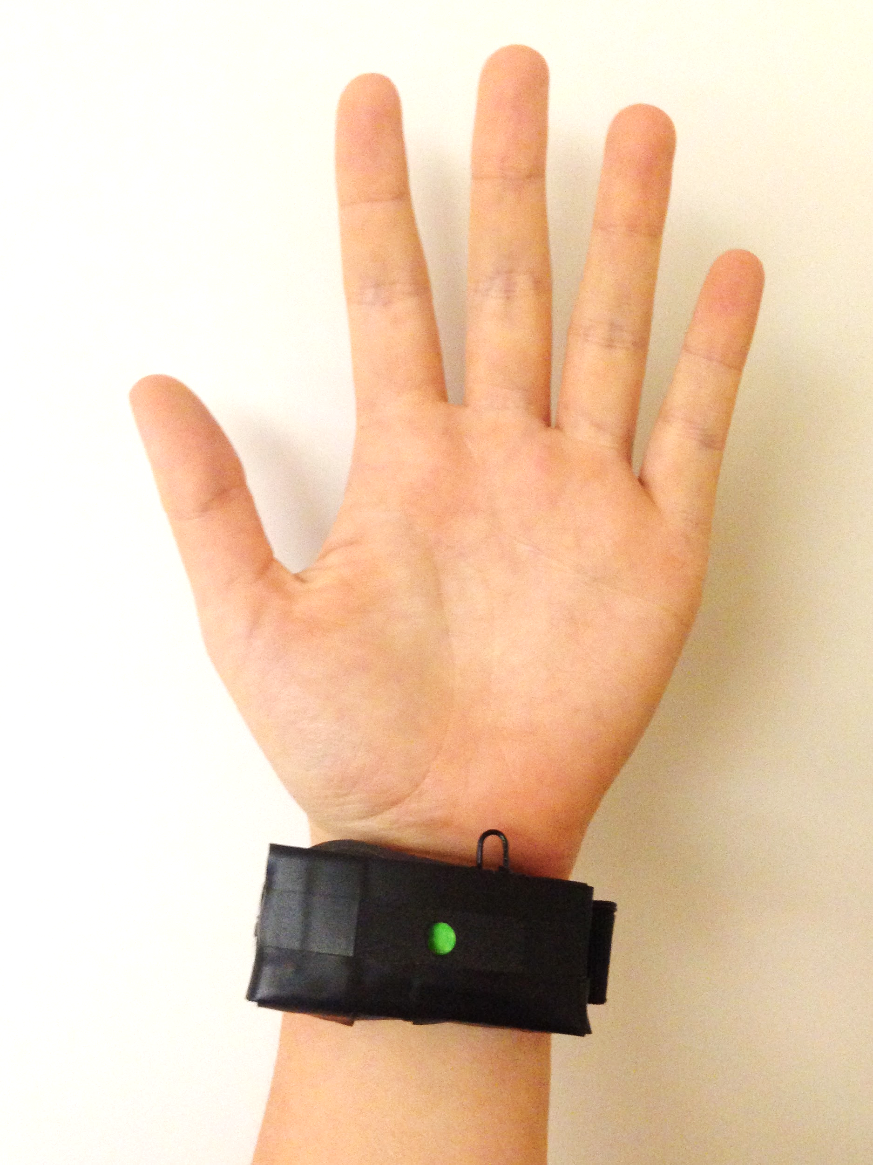
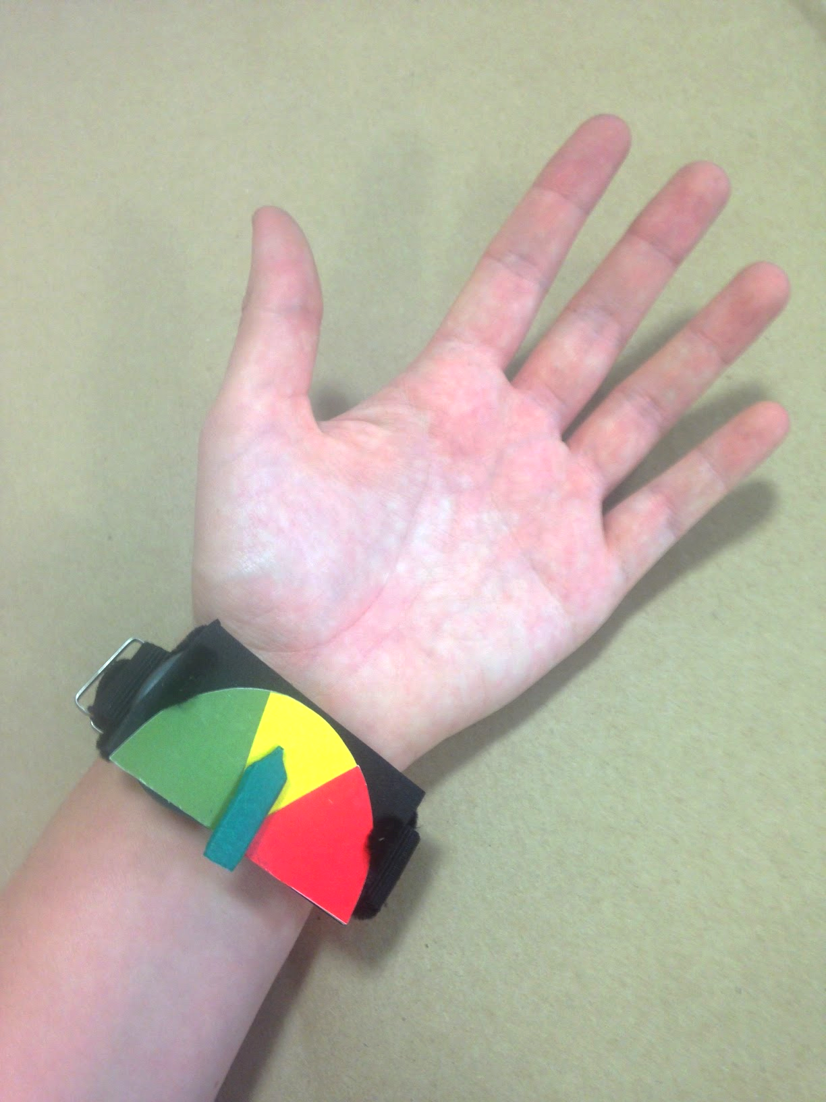
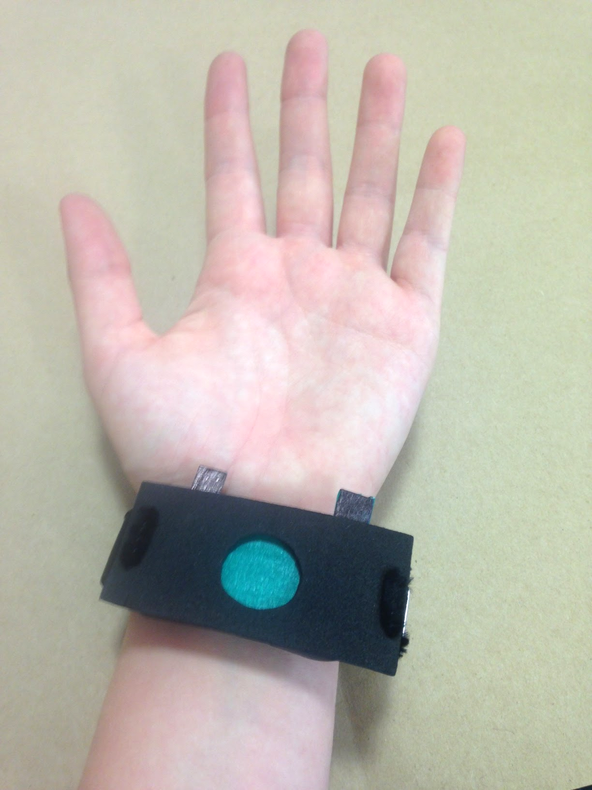
Hardware Design
Obvious
Unwieldy
Sleek & Discreet

Slide 24
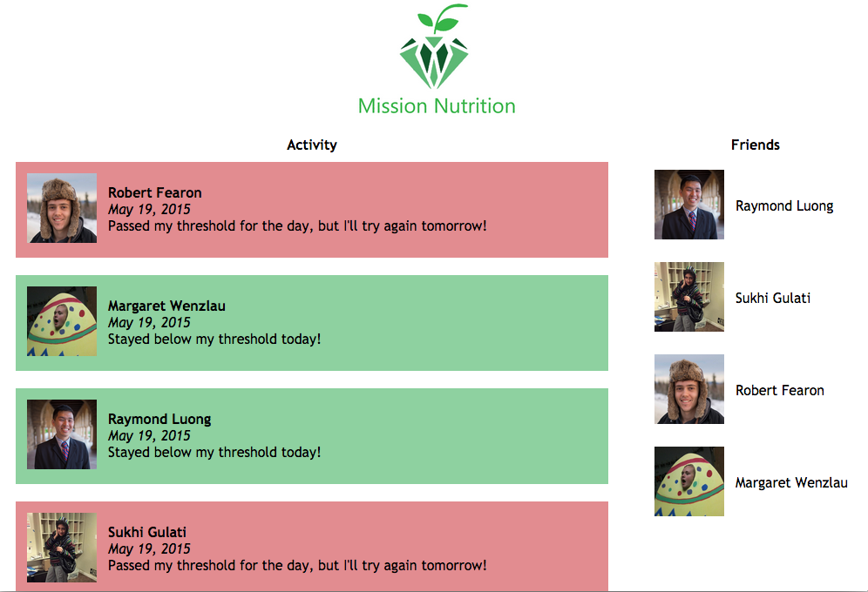
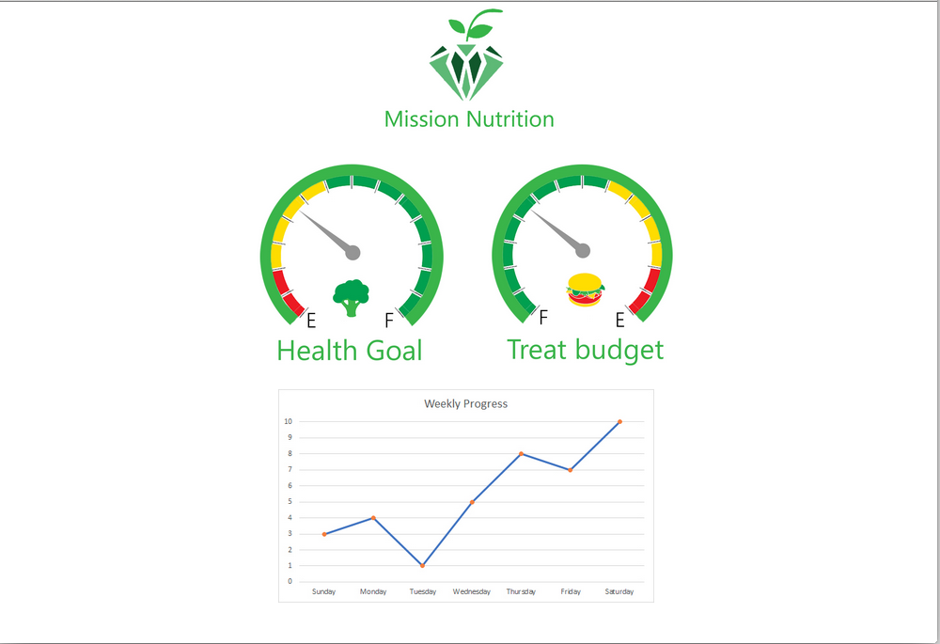
Transparency and Compliance with a Companion App

Slide 25

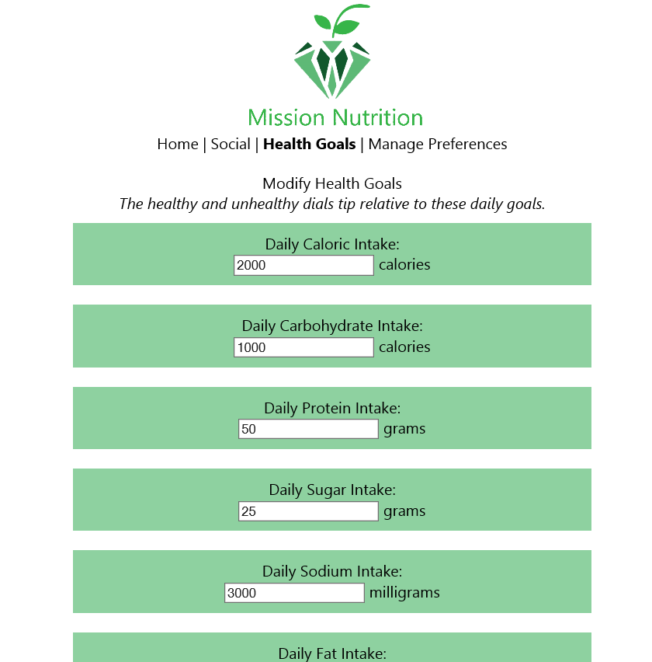
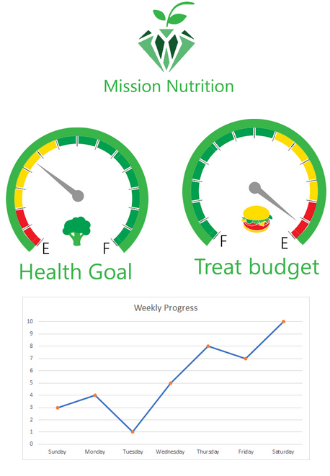
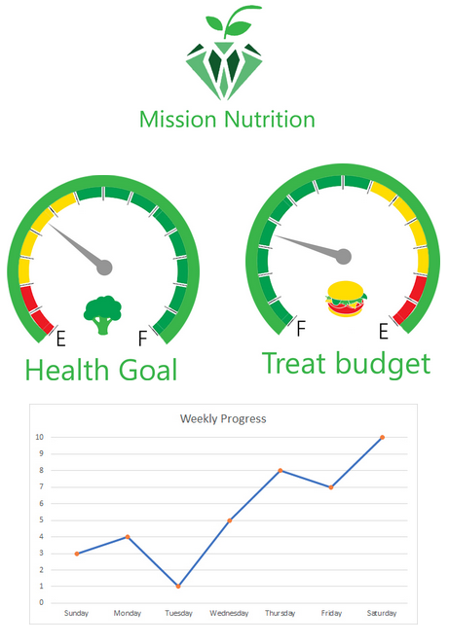

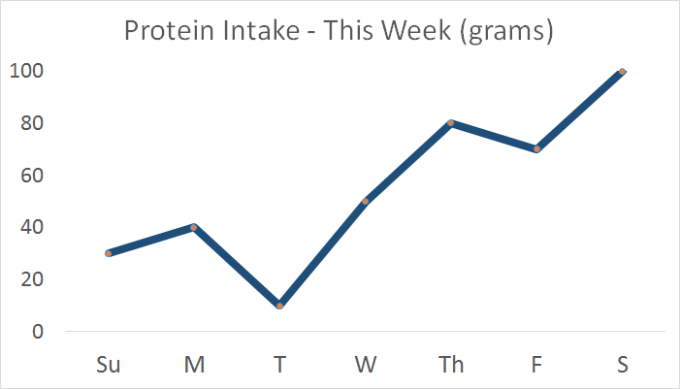
Adding Clarity

Slide 26
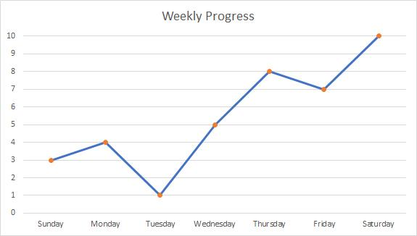
Software Design
Clarity

Slide 27
LIVE DEMO!

Slide 28
Healthy food
1

Slide 30


Slide 31
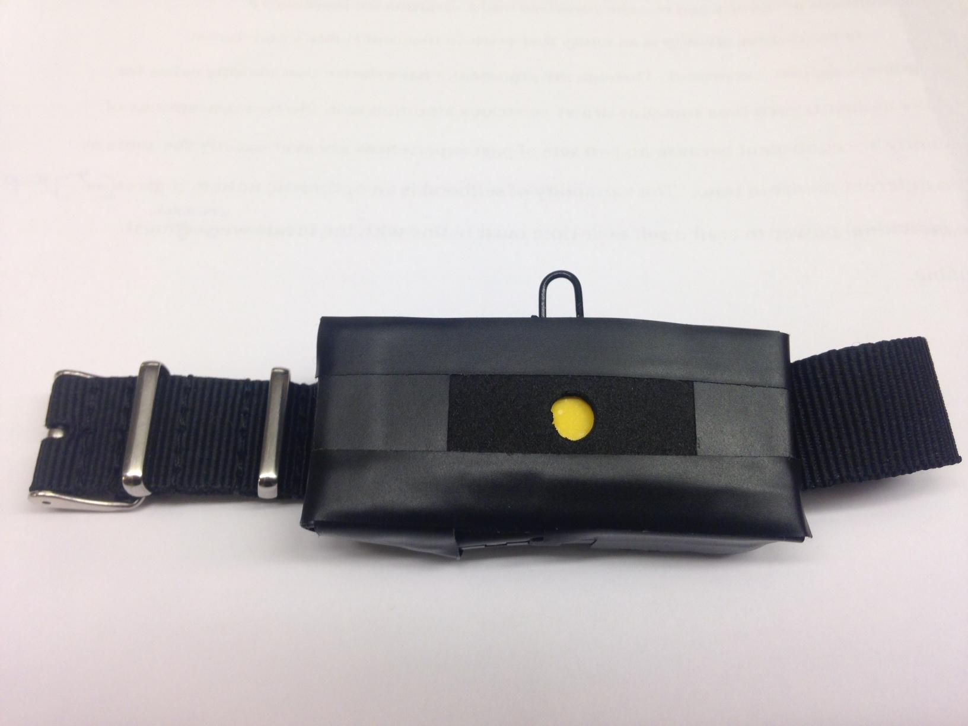
Neutral food
2

Slide 34
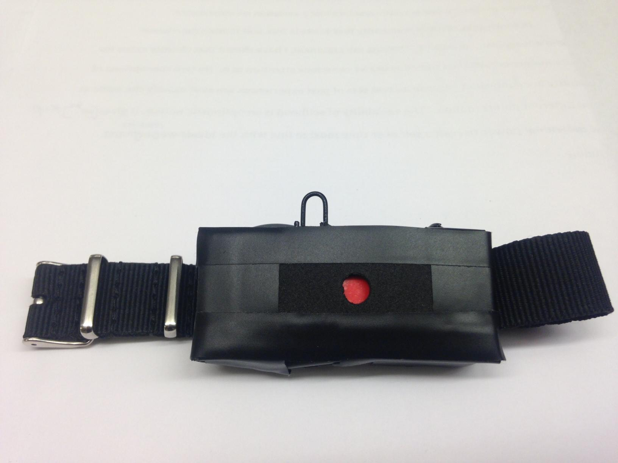
Unhealthy food
3

Slide 37
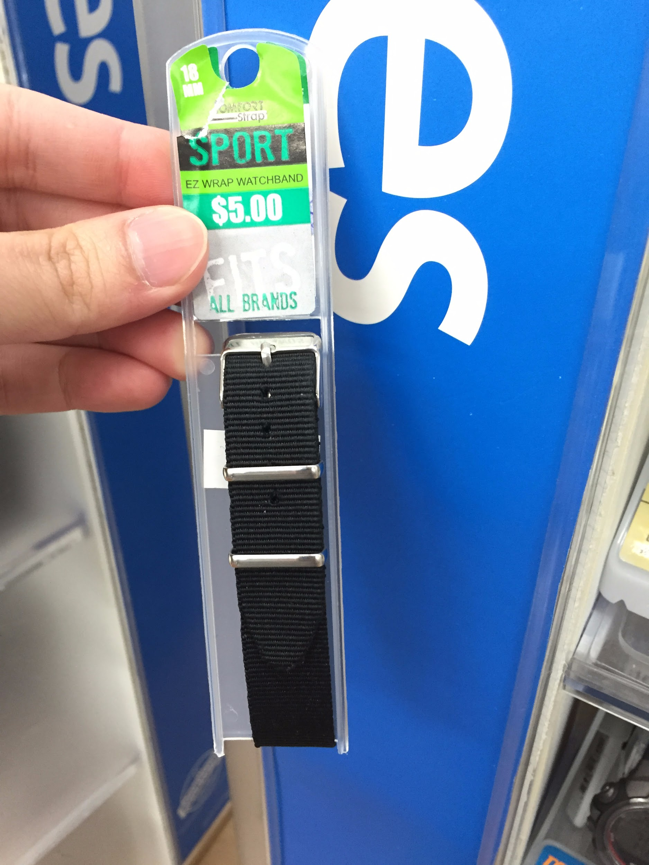
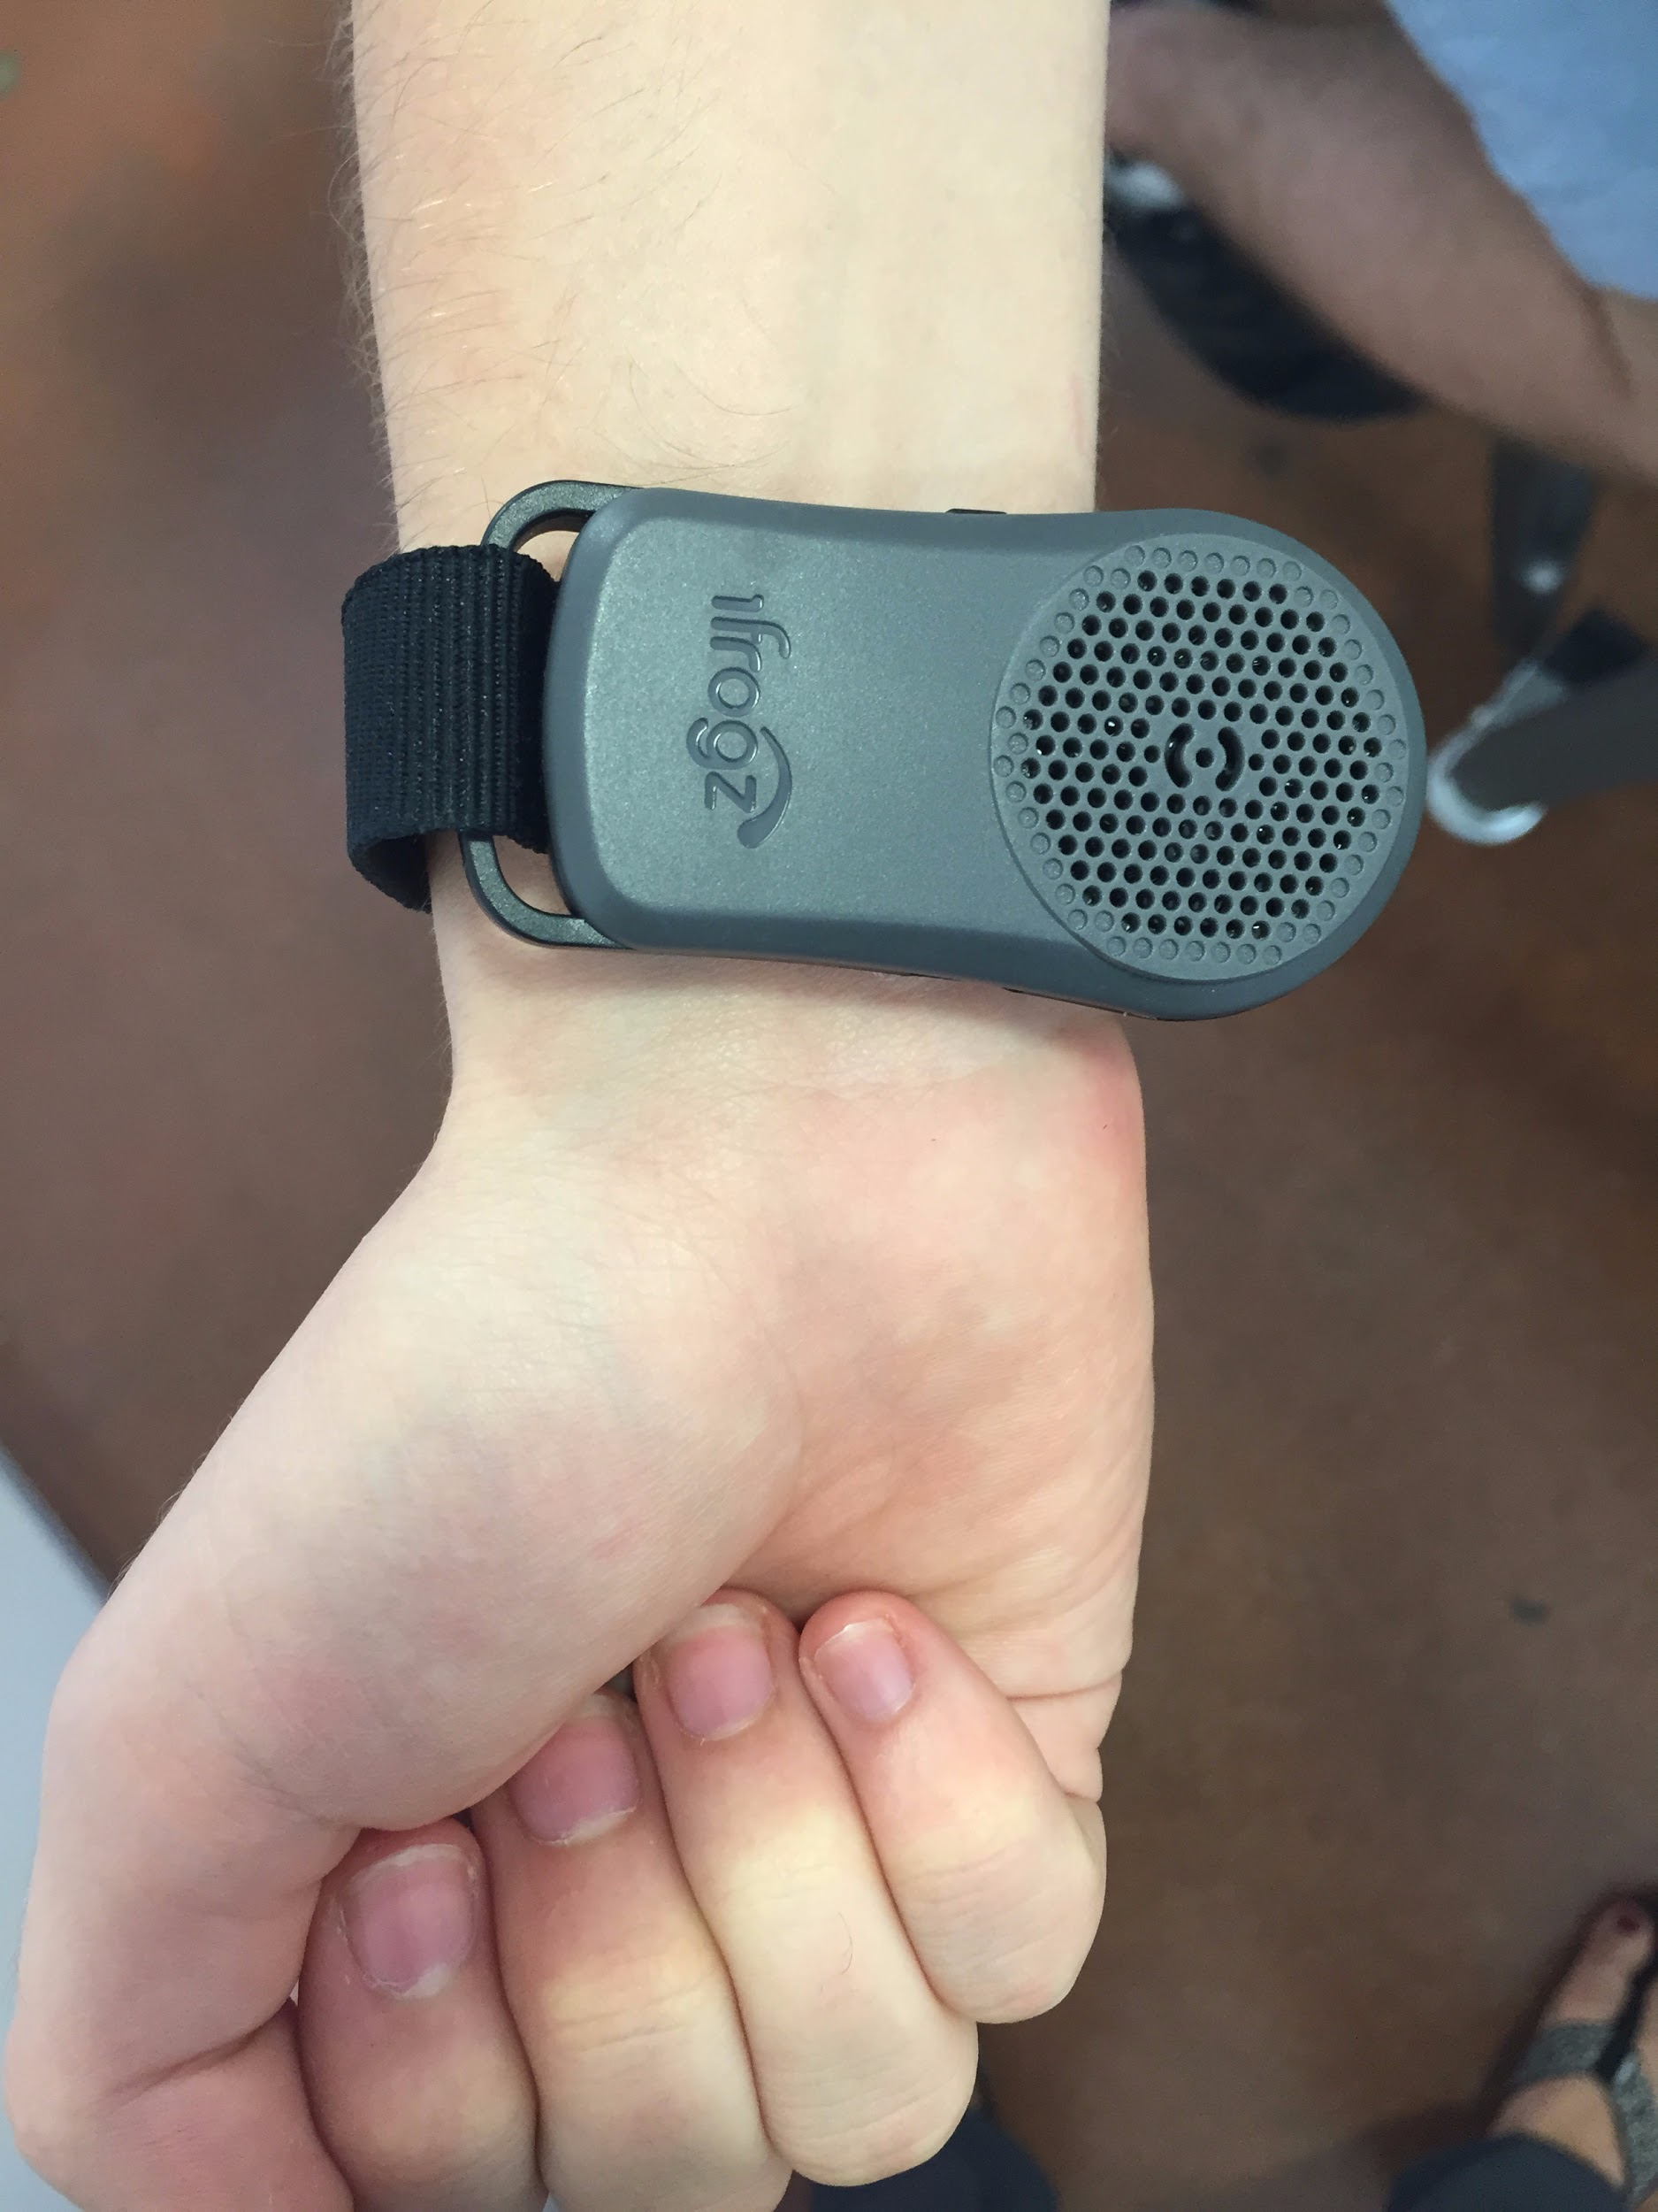

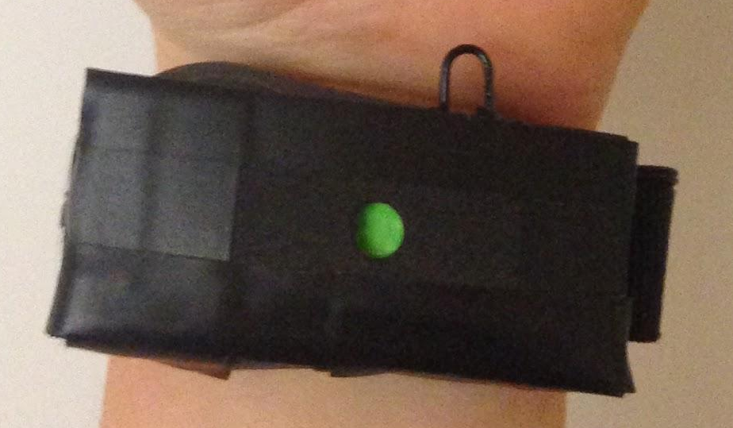
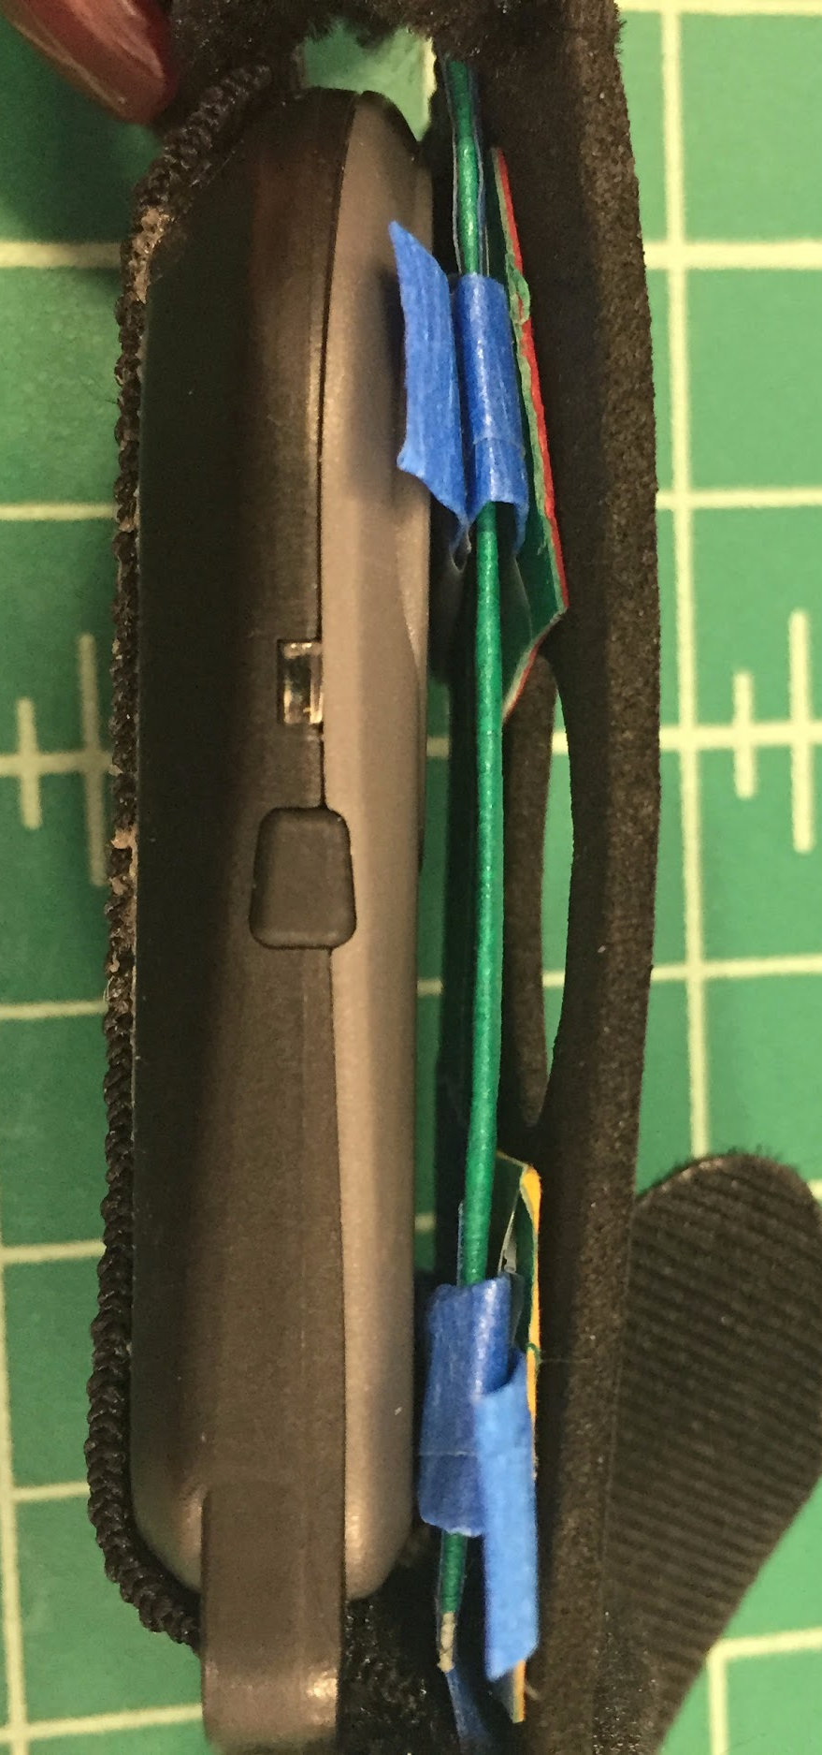
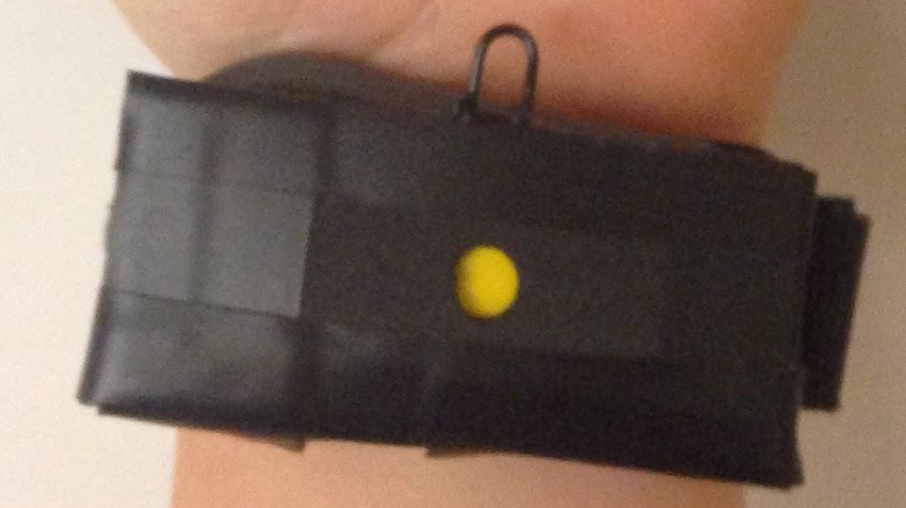
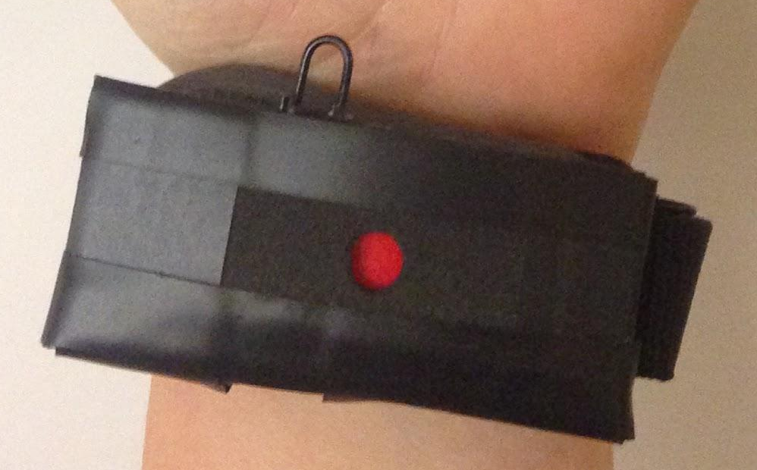
Tools
Watch Strap
Bluetooth Speaker
Paper Status Indicator
Javascript/HTML/CSS

Slide 38
What We’re Missing
Hardware
Spectrometer
LED Light
Software
Hardware Interactivity
Database
Notes:
robert

Slide 39
What We Might Add in the Future
Full functionality (hardware + software)
Compliance methods
More detailed nutrition information
Notes:
robert

Slide 40

Effortless mindful eating.

