Slide 1
formative
Assessment Made Easy
Matan Z, Lavanya J, Laila C
CS377E, Spring 2015
Stanford University

Slide 2
Talk Outline
Initial Scope
Stages of Needfinding
Our Solution & Evolution of Design
Notes:
We’ll talk about our initial broad scope for the project- to improve education at a global scale
How our need-finding interviews helped us narrow down the scope and POVs to identify potential users and important unmet needs in our own Palo Alto
Then we’ll talk about the evolution of our solution design based on feedback from many teachers in PALY- from parallel to low fi to medium fi prototypes.

Slide 3
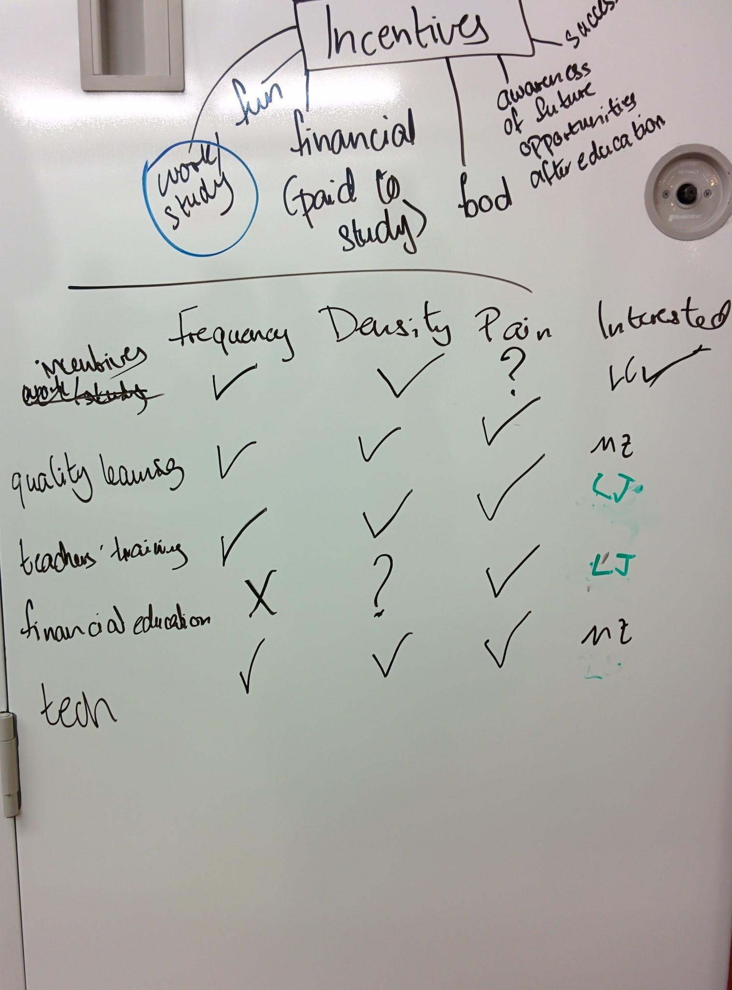
The Problem - Initial Scoping
Technology to improve Education.
Focus on quality of learning.
Lack of access to technology
will be a problem?
Notes:
We wanted to use technology to improve education. We decided to focus on quality of education but kept our options open
about the context- may be we’d end up working with low tech schools in India or may be high tech ones in California.

Slide 4
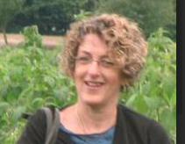
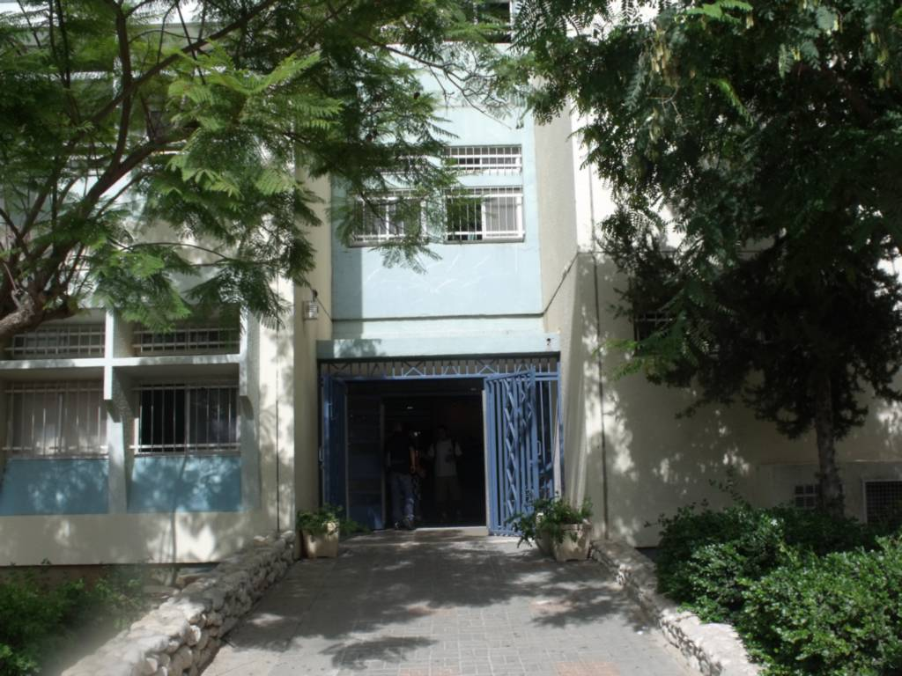
Needfinding - Interviews
Access to tech + Teacher training
Teacher Internet = source of knowledge
Teachers as learning coaches
Notes:
Main Conclusions:
We conducted interviews with education experts as well as teachers from a wide variety of schools.
Access to tech is not enough, methodology and training are required.
With every kind of information available online, teachers are no longer the only sources of knowledge.
This means they cannot just stick to chalk and board methods, they must become learning coaches helping students with with different interests and abilities, chart their own education.

Slide 5
Point of View - Evolution
We met a high-school teacher who teaches a class of students with mixed abilities,
that needs to pay attention to students who are behind, without singling them out,
because they have the skills; thus further attention may help them catch up and do well in class.
Notes:
From our need finding interviews, we came up with our first POV
decided to focus on high school teachers in a public high school like PALY
who teach classes of mixed abilities and interests
A challenge they face is to pay attention to students who are behind without singling them out
Because we believe further attention will help them catch up and do well in class.

Slide 6
Needfinding - Task Analysis
Assessment- formative, summative
Lesson planning
Helping students who are confused
Insight:
Assessment is hard.
focus on many students at once
students don’t always speak up
exams are stressful
Notes:
With this POV, we stepped into our second round of Needfinding. We did contextual inquiries where we sat in on two history classes and analyzed the various tasks that the teachers performed.
We identified three important tasks
We noticed that assessments took up considerable time and effort- whether these were formative or short term like weekly quizzes and worksheets or summative such as exams.
Managing the class- from follow up interviews with teachers, we realized that teachers put a lot of thought into their lesson plan. They have to cover some prescribed syllabus while making sure all their students are engaged and follow along.
Helping students who are confused- some students may fall behind during class or be confused about some topic. Teachers try to identify these kids from assessments and help them catch up by spending time with them inside class or after class.
Our main insight was that assessment is hard. Because
when they grade or review assessment results, teachers have to focus on many students at once.
students may not always speak up in class when they are confused. sometimes they have to wait until an exam to identify topics that were not well-taught.
exams can stress out students.
Insight:
Teachers spend a significant effort, in different ways, to gain information regarding students understanding.

Slide 7
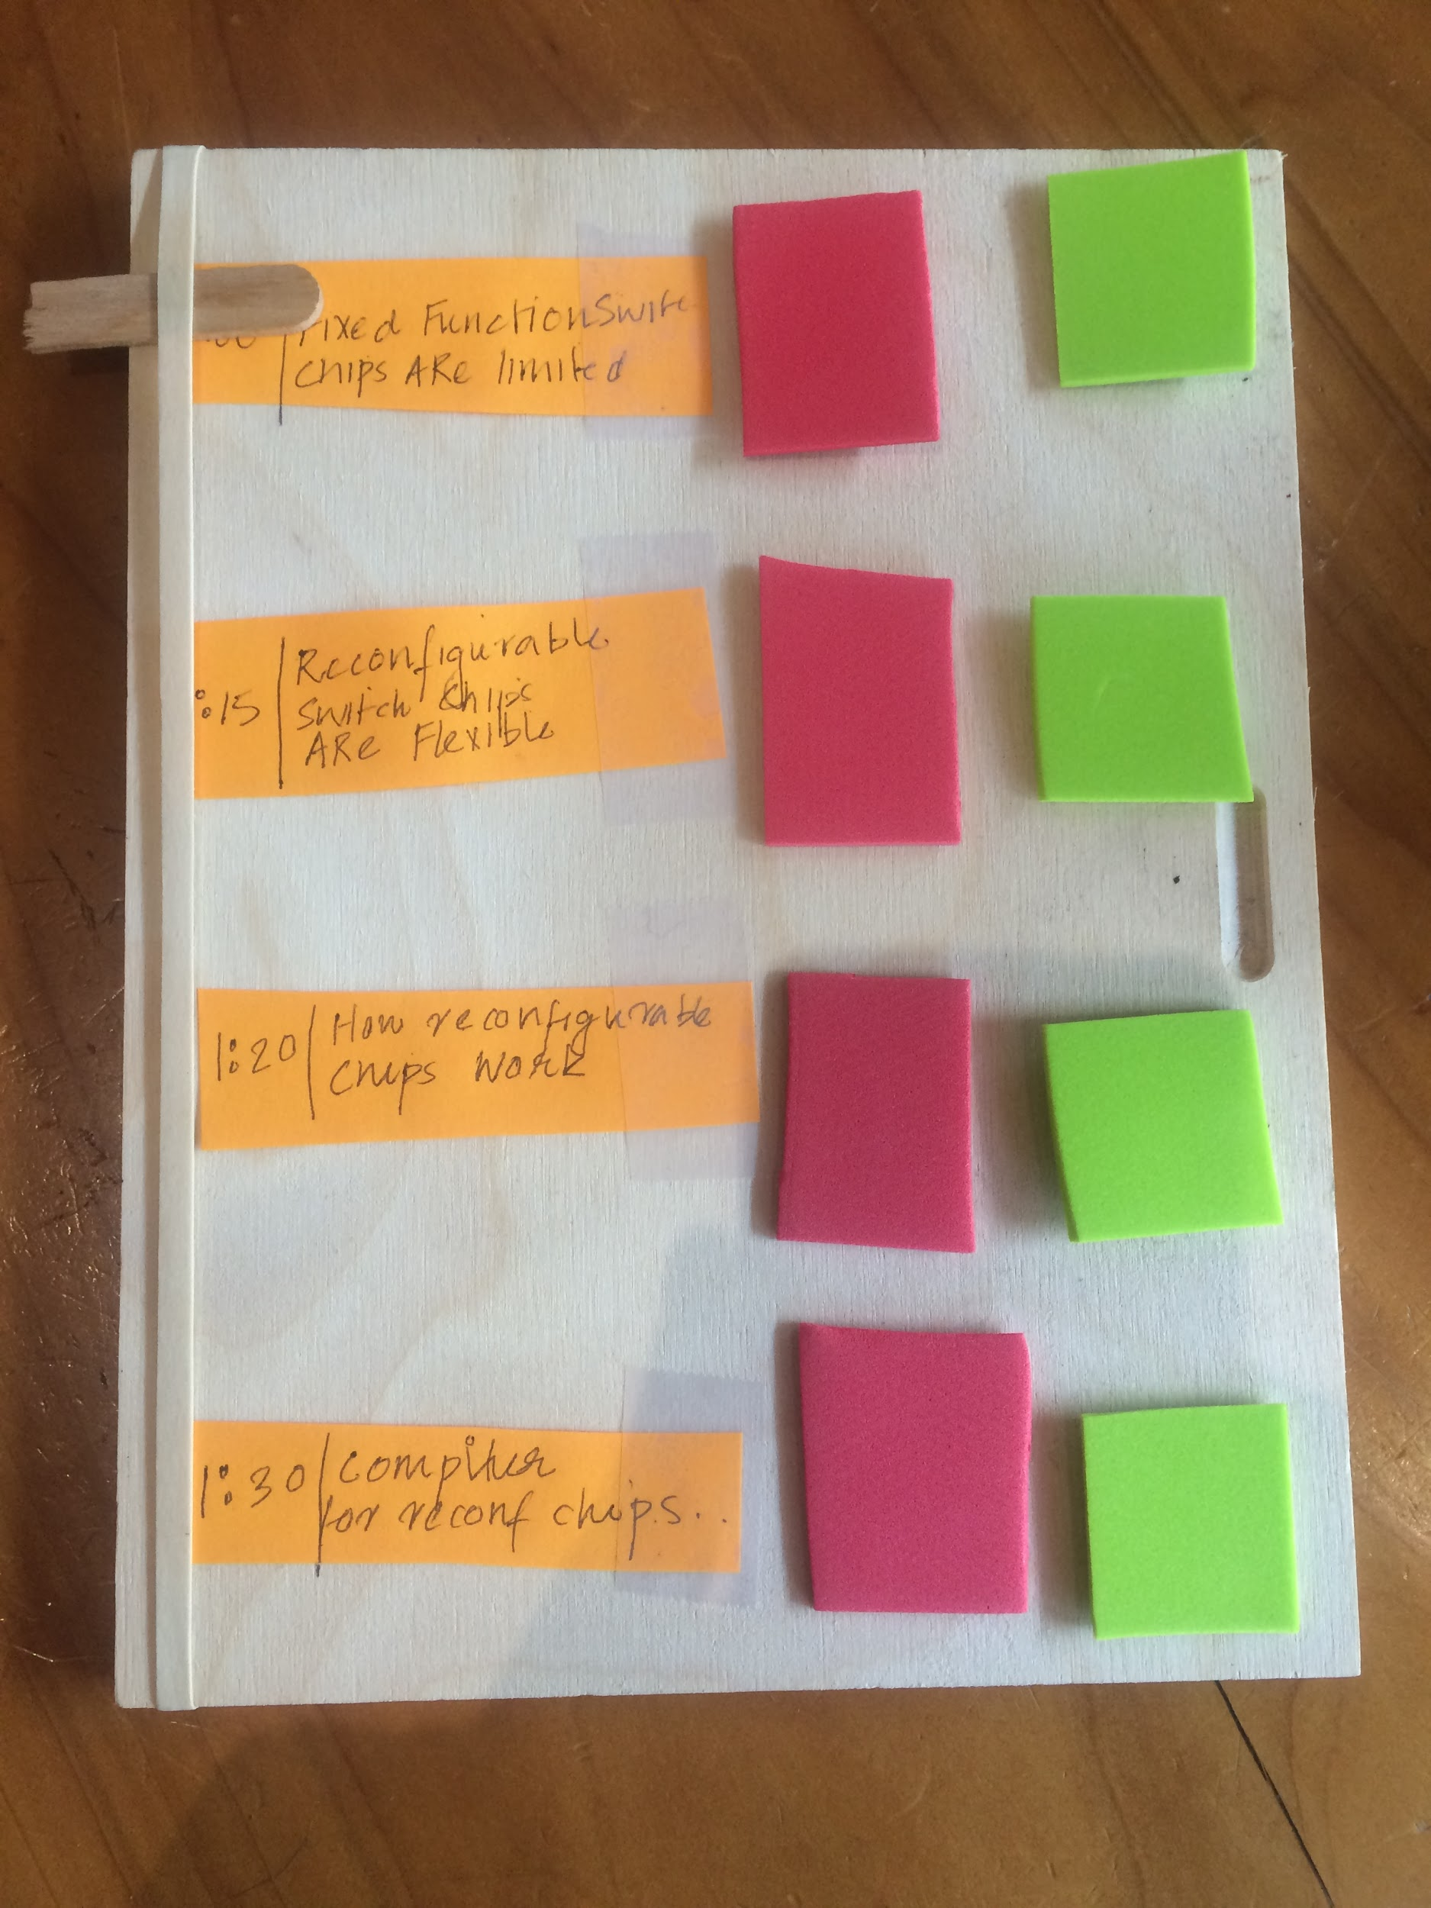
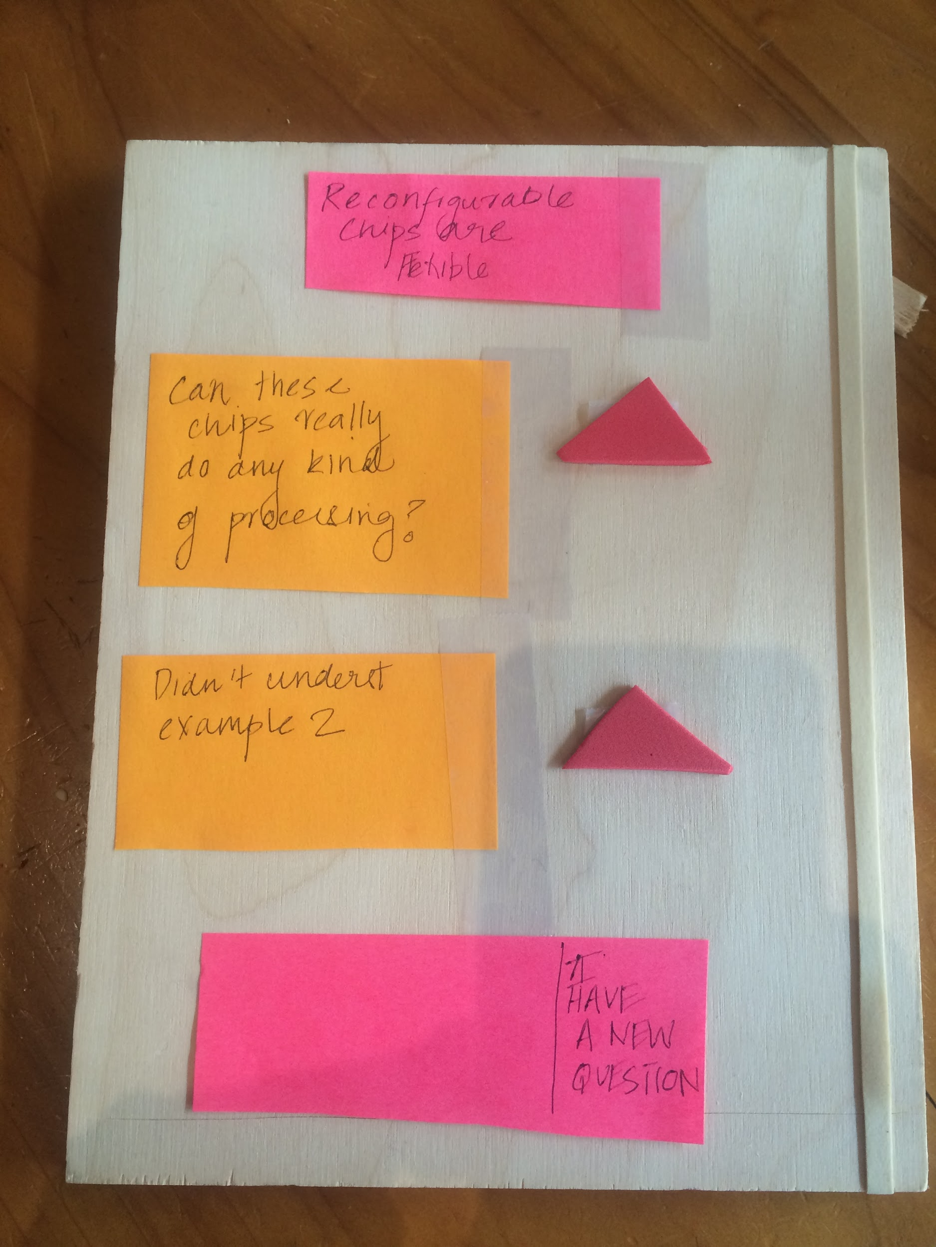
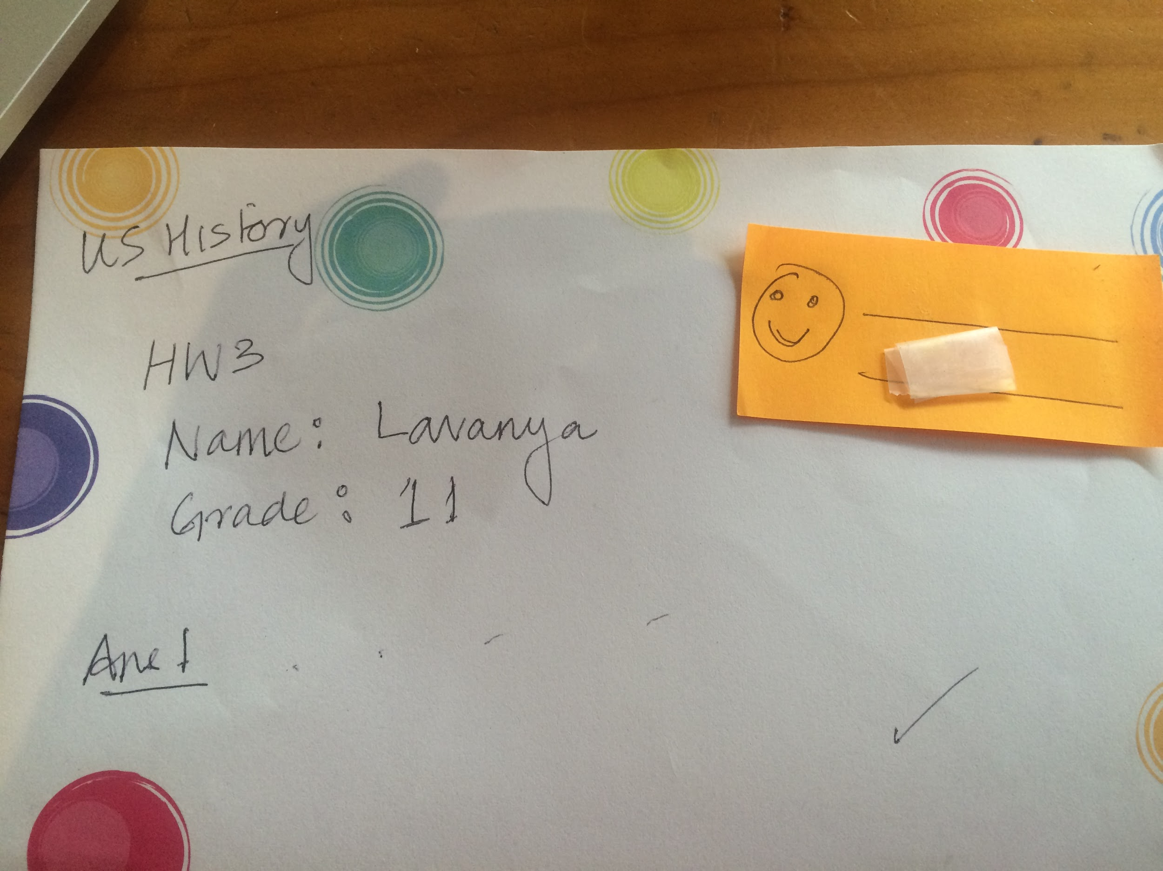
Needfinding-Parallel Prototypes
The lesson planner
Mini-challenges
The positive feedback stamp
Notes:
Since assessments was hard, we came up with two prototypes to make it easy for teachers to assess how students are doing- the lesson planner is for real time assessment while the mini challenges is for weekly assessment.
We also made a prototype called the positive feedback stamp encourages teachers to leave positive feedback for students who show any kind of improvement.
It turned out that Debbie Whitson, one of the teachers was already using something like the positive feedback stamp successfully. We realized we were on the right track and revised our POVs so ..

Slide 8
Point of View - Evolution
We met a high-school teacher who teaches a class of students with mixed abilities,
that needs to pay attention to students who are behind, without singling them out,
because they have the skills; thus further attention may help them catch up and do well in class.
We met Debbie and Eric, ECON teachers in Palo-Alto High School, who teach both AP and a regular class of mixed abilities.
They need to provide special attention and empower students who are behind,
Because these students can do well given encouragement.
Notes:
empowering students who are behind and encouraging them was also an important way to help them do well in class.

Slide 9
Point of View - Evolution
We met a high-school teacher who teaches a class of students with mixed abilities,
that needs to pay attention to students who are behind, without singling them out,
because they have the skills; thus further attention may help them catch up and do well in class.
We met Debbie and Eric, ECON teachers in Palo-Alto High School, who teach both AP and a regular class of mixed abilities.
They need to provide special attention and empower students who are behind,
Because these students can do well given encouragement.
We met Debbie and Eric, who teach both AP and regular ECON high school classes of mixed abilities.
They need to provide students with easy ways to signal when they are confused,
Because customizing the lesson periods would make them much more effective.
Notes:
For our final POV, we took a step back and saw that what we really wanted to do was..

Slide 10
Our Solution
Our Mission: Creating automated ways, both formal and informal, for students to signal teachers when they are confused.
As a result, teachers could focus most of their time and attention on teaching, tailored for their students’ needs.

Slide 11
Evolution of Solution Design

Slide 12
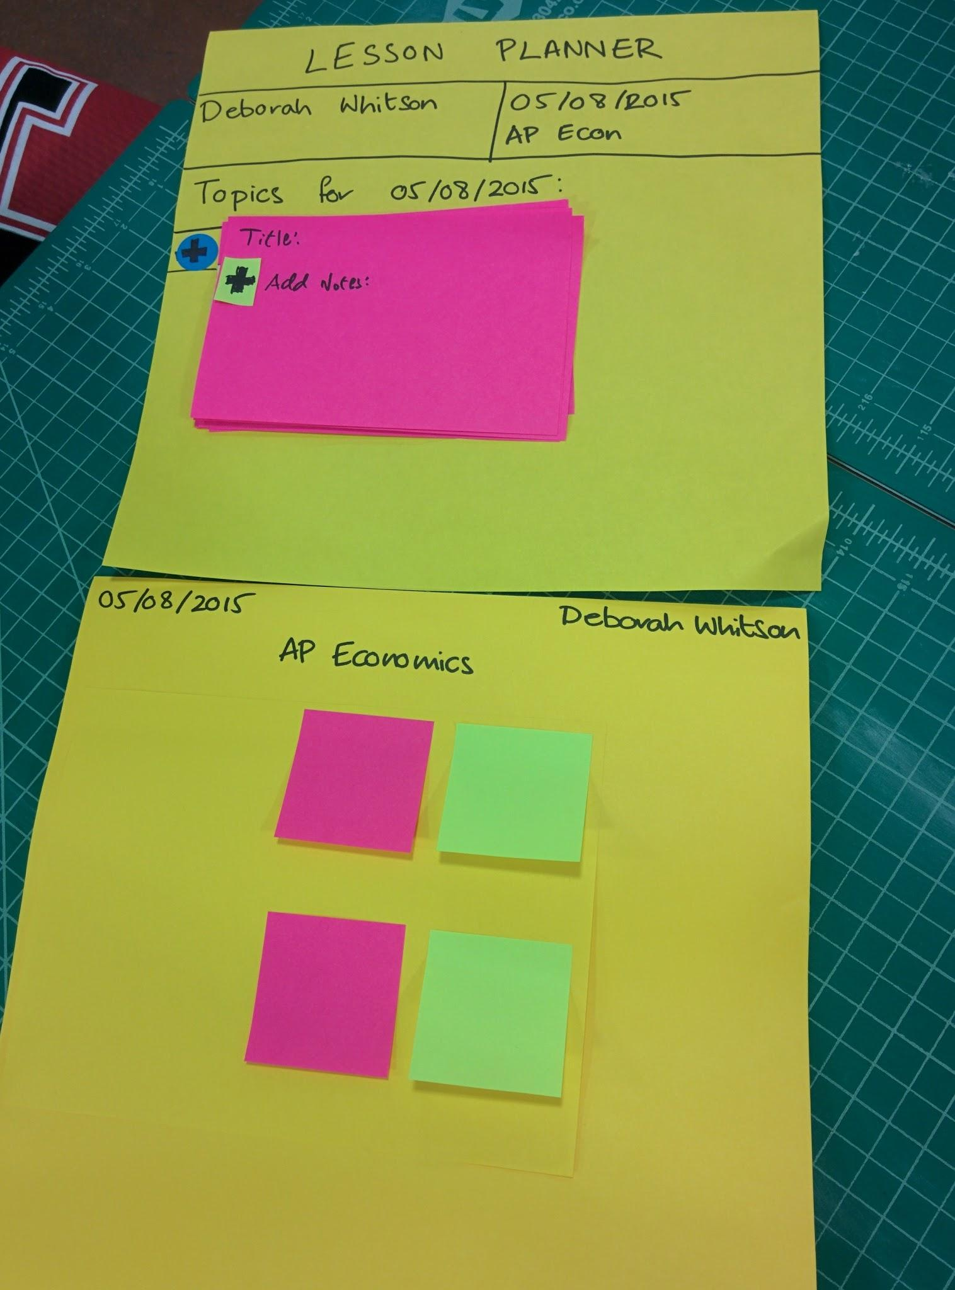
Low-Fi Prototype #1: Lesson Planner
Feedback:
Teachers said it would be useful!
However:
Students might be confused about
a specific term, not a whole topic.
Feels like teachers expect it to
integrate with other existing tools.

Slide 13
Low-Fi Prototype #1: Lesson Planner
Feedback:
Teachers said it would be useful!
However:
Students might be confused about
a specific term, not a whole topic.
Feels like teachers expect it to
integrate with other existing tools.
-> We couldn’t clearly explain
the added value over existing
clickers.

Slide 14
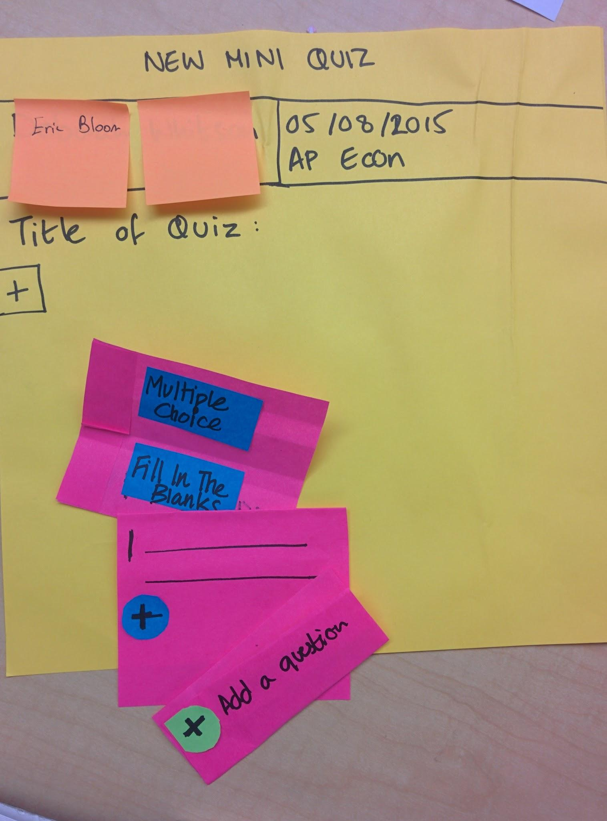
Low-Fi Prototype #2: Quiz Studio
Feedback:
formative assessment, good idea
However:
Different teachers, different approaches:
Paper quizzes, weekly basis.
Hand out paper quizzes, work in groups.
“Tech-savvy”: existing online quiz
platforms…

Slide 15
Low-Fi Prototype #2: Quiz Studio
Feedback:
formative assessment, good idea
However:
Different teachers, different approaches:
Paper quizzes, weekly basis.
Hand out paper quizzes, work in groups.
“Tech-savvy”: use existing online quiz
platforms…
-> Our product might be redundant.

Slide 16
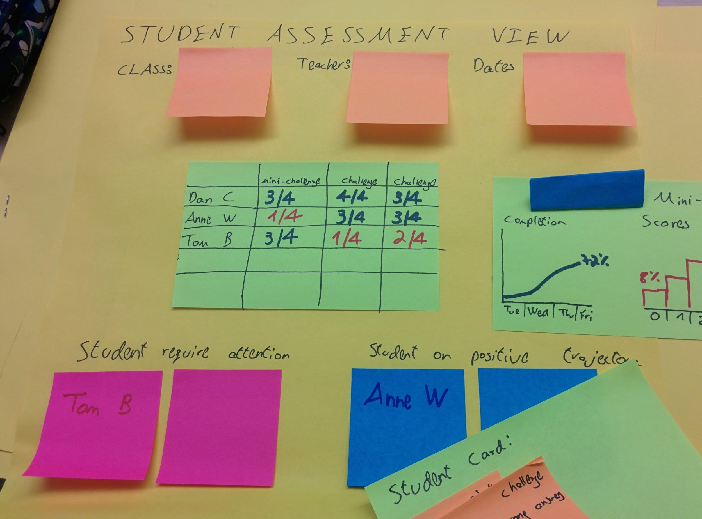
Low-Fi Prototype #3: Assessment Center
Rationale: visualize students and topics that require review, as assessed by the mini challenges
Feedback:
“I really like that”
“Tracking over time is key”

Slide 17
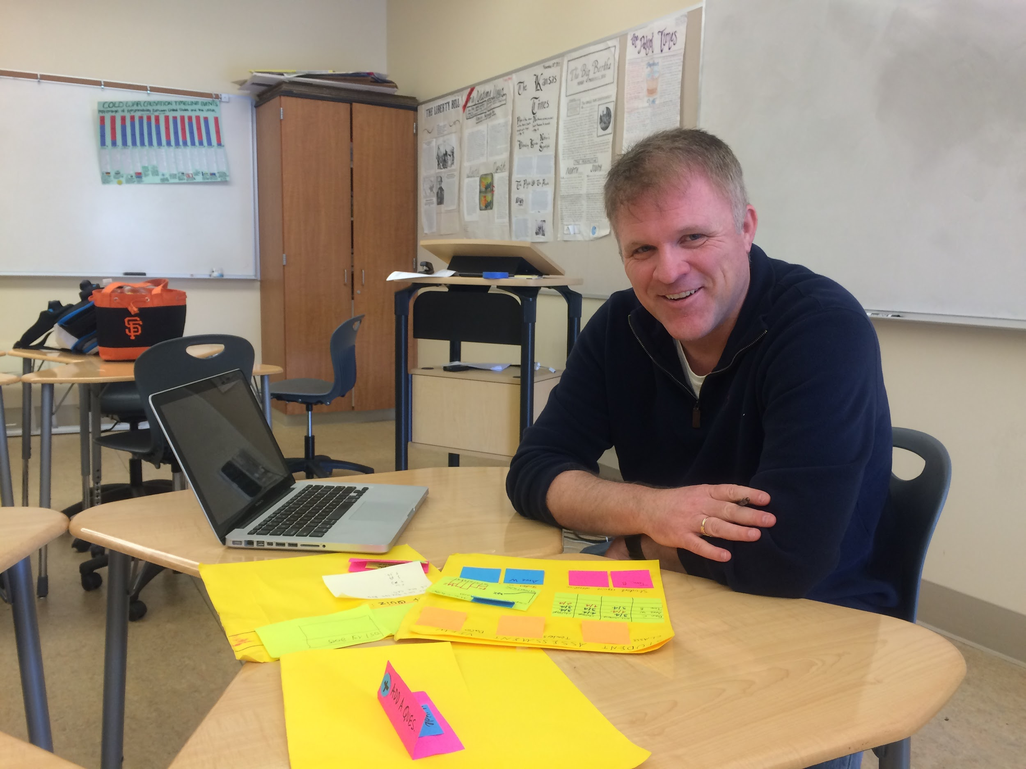
Low-Fi Prototype #3: Assessment Center
Rationale: visualize students and topics that require review, as assessed by the mini challenges
Feedback:
“I really like that”
“Tracking over time is key”
Existing online tools offer one-off quizzes;
we couldn’t find an analytics dashboard….
Potential value for teachers.

Slide 18
Incorporating the feedback...

Slide 19
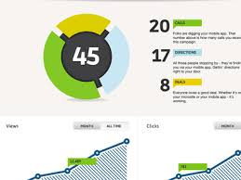
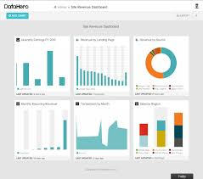
A Refinement to Our Solution
Revised Mission: Providing an analytics tool for teachers to gain insights regarding their students’ understanding.
Teachers keep their current methods for assessment.
Assessment Center

Slide 20
Our Solution: Concept Video

Slide 21
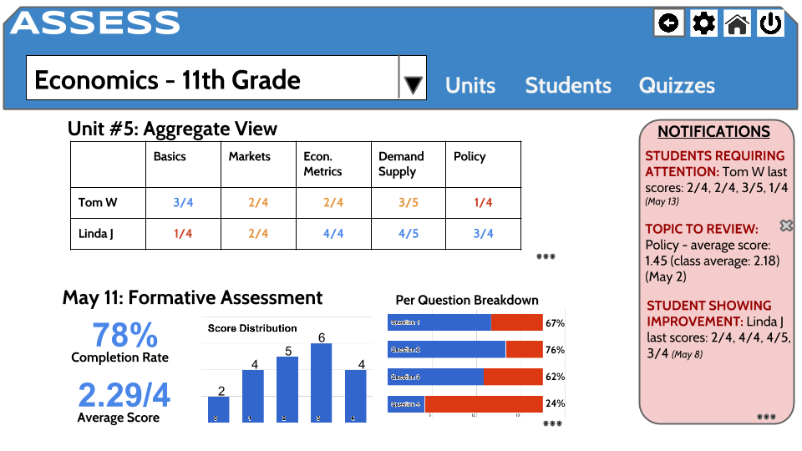
Medium Fidelity Prototype

Slide 22
Medium Fidelity Prototype
Added: Notifications box
Insights from the assessment center.
Each notification links to the relevant report.

Slide 23
Medium Fidelity Prototype
Added:
Question Breakdown
Following feedback from Mr. Gallagher

Slide 24
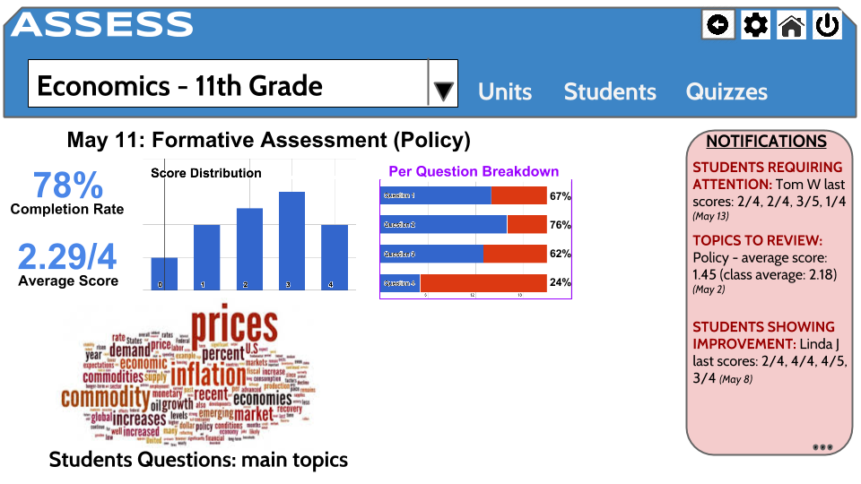
Medium Fidelity Prototype
Added
Students Comments & Questions (free text)
Can’t infer everything from quiz scores
Allowing the students to phrase confusing topics
Surfacing an aggregated word-cloud

Slide 25
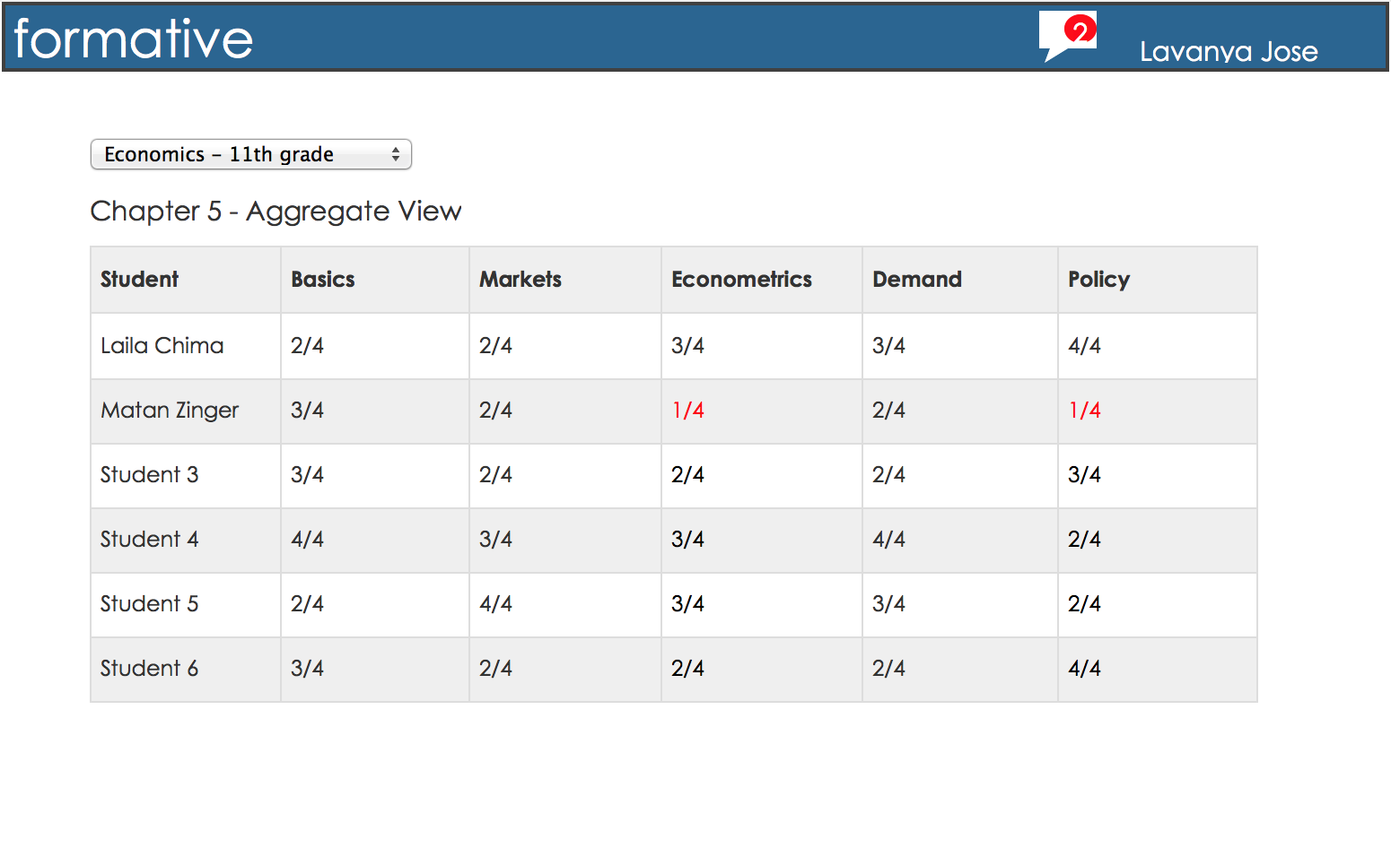
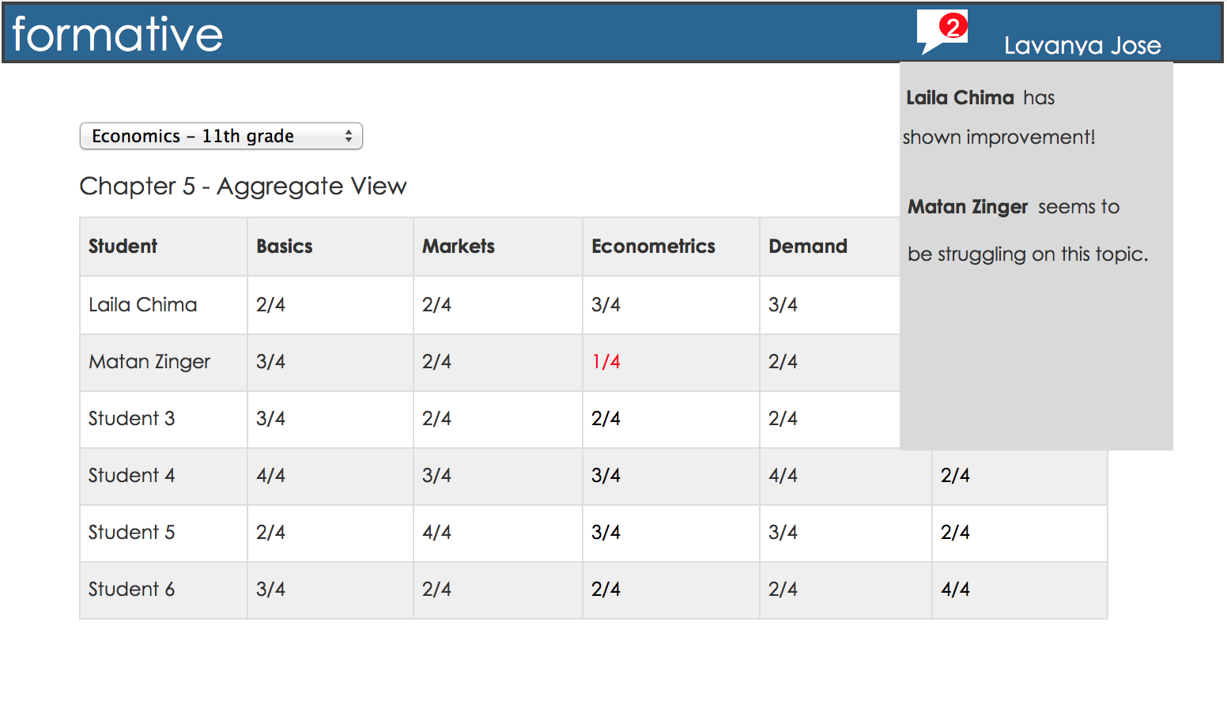
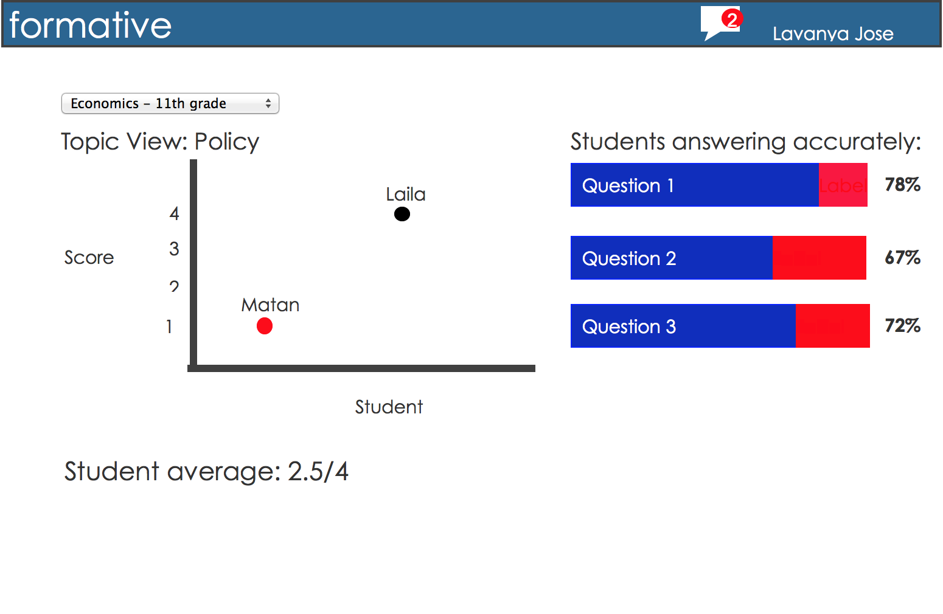
Our Solution: Final Design

Slide 26
Implementation: Tools Used
Post-its, post-its, post-its
Google Slides and InVision: for Medium Fi v1
Illustrator → JustInMind: for Final Design
iMovie: Editing the concept video

Slide 27
Conclusion
Our scope has greatly changed since the first ideation session….
We believe we found an underserved need.
Also believe: key to success would be requiring next-to-zero effort from teachers, while providing useful insights.
“When will you build it? Our math teachers want it for the next school year” (Matan’s Mother...)

Slide 28
Thank you!
Our thanks to Eric Bloom, Debbie Whitson, and teachers of Palo Alto High School, for their time and effort in providing us routine help, insights and feedback throughout this project.

Slide 30
The Problem - Initial Scoping
Objective: Using Technology to Enhance Learning Quality
Focus: Making the most out of
the time students spend in class
Assumption: The problem
is lack of access to technology
(“low-band internationalized coursera?”)
Notes:
Objective: Using Technology to Enhance Learning Quality
Focus: Making the most out of
the time students spend in class
Assumption: The problem
is lack of access to technology
(“low-band internationalized coursera?”)

Slide 31
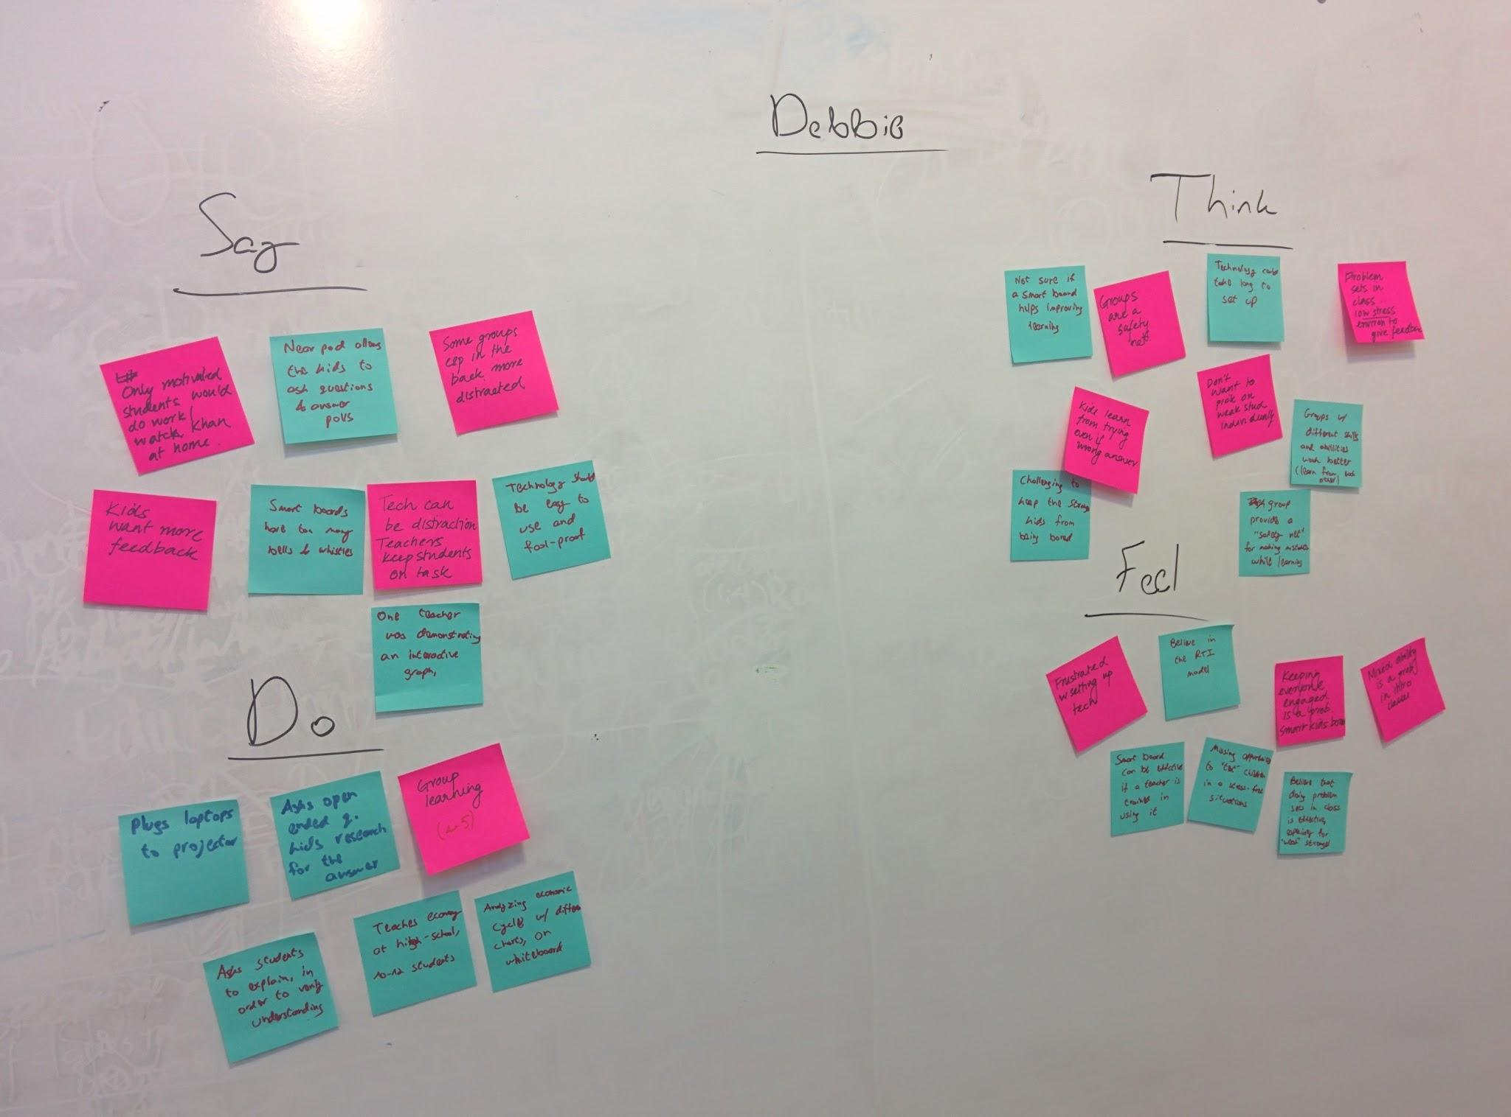
Needfinding - Interviews
Main Conclusions:
Access to tech is not enough,
methodology and training are required.
Chalk-and-board teaching is outdated;
teachers are no longer the gate for knowledge.
With information available online, teachers
become mentors for learning.
Notes:
Main Conclusions:
Access to tech is not enough,
methodology and training are required.
Chalk-and-board teaching is outdated;
teachers are no longer the gate for knowledge.
With information available online, teachers
become mentors for learning.

Slide 32
Needfinding - Task Analysis
Method: Observing classes, identifying tasks.
Follow-up interview: learning how to perform them ourselves.
Tasks Identified:
Formative & Summative Assessment; Informal Assessment
Executing the lesson plan, managing the class.
Providing attention to students who ‘struggle’.
Insight:
Teachers spend a significant effort, in
different ways, to gain information regarding
students understanding.
Notes:
Method: Observing classes, identifying tasks.
Follow-up interview: learning how to perform them ourselves.
Tasks Identified:
Formative & Summative Assessment; Informal Assessment
Executing the lesson plan, managing the class.
Providing attention to students who ‘struggle’.
Insight:
Teachers spend a significant effort, in
different ways, to gain information regarding
students understanding.

Slide 33
Needfinding-Parallel Prototypes
The lesson planner 2. Mini-challenges
3. The positive-feedback stamp

Slide 34
Point of View - Evolution
We met a high-school teacher who teaches a class of students with mixed abilities,
that needs to pay attention to students who are behind, without singling them out,
because they have the skills; thus further attention may help them catch up and do well in class.

Slide 35
Point of View - Evolution
We met a high-school teacher who teaches a class of students with mixed abilities,
that needs to pay attention to students who are behind, without singling them out,
because they have the skills; thus further attention may help them catch up and do well in class.
We met Debbie and Eric, ECON teachers in Palo-Alto High School, who teach both AP and a regular class of mixed abilities.
They need to provide special attention and empower students who are behind,
Because these students can do well given encouragement.

Slide 36
Point of View - Evolution
We met a high-school teacher who teaches a class of students with mixed abilities,
that needs to pay attention to students who are behind, without singling them out,
because they have the skills; thus further attention may help them catch up and do well in class.
We met Debbie and Eric, ECON teachers in Palo-Alto High School, who teach both AP and a regular class of mixed abilities.
They need to provide special attention and empower students who are behind,
Because these students can do well given encouragement.
We met Debbie and Eric, who teach both AP and regular ECON high school classes of mixed abilities.
They need to provide students with easy ways to signal when they are confused,
Because customizing the lesson periods would make them much more effective.

