Slide 1

Helping you save California
one drop at a time
Thursday, June 2nd
CS377E - Spring ’15
Drop
Mizuki Iwakura, Divya Konda, Kelsey Piper
Notes:
I. Introduction
1. Project title & team (introduce yourselves) [1 slide]
a. Title your pitch as the opportunity rather than just the title of the project
b. Anecdote to hook them in (tell a story about yourself or the user you designed your solution for—personal, relevant, impressive)

Slide 2
Outline
Problem
Needfinding
Parallel Prototypes
POV
Our Solution
Overview
Video presentation
Design evolution
Final design
Expansion idea
Summary
Notes:
2. Outline (briefly tell us what you are gonna tell us in the rest of the talk – tell a story)
a. Problem (Problem, needfinding, existing solutions & why inadequate)
b. Our Solution (Solution overview, video, design)

Slide 3

Problem and Need finding

Slide 4
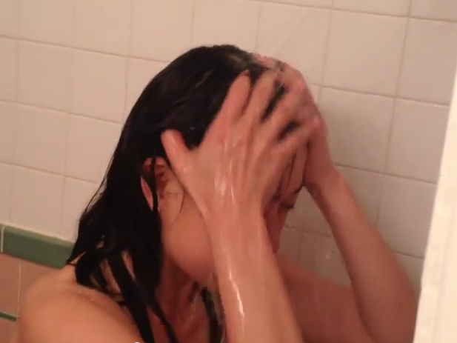
Problem
Students care about the water crisis, but they’re busy and thinking about many things. Saving water doesn’t come to mind when they’re at home and using it.
Notes:
II. Problem
3. Problem
a. Introduction to the overall high-level problem (w/ images) [1 slide]

Slide 5
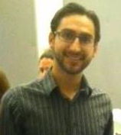
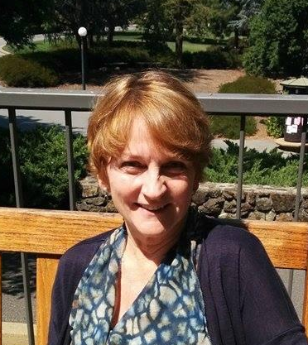
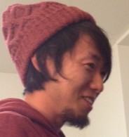
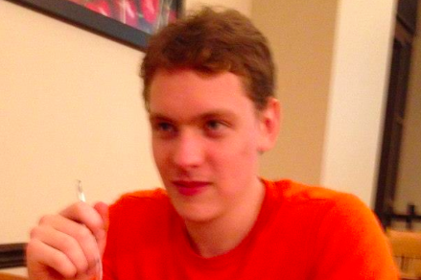
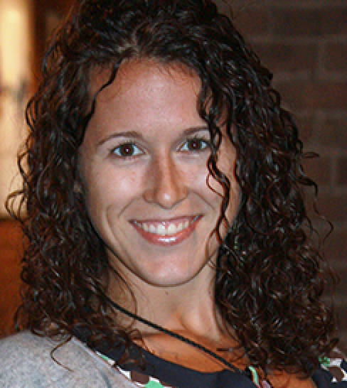
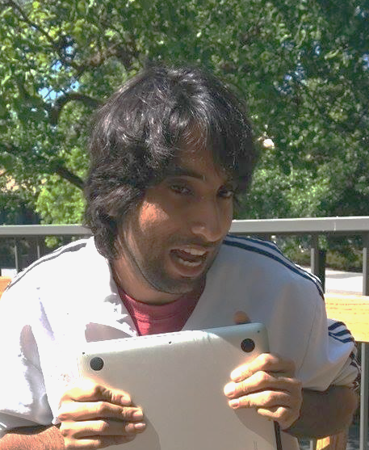
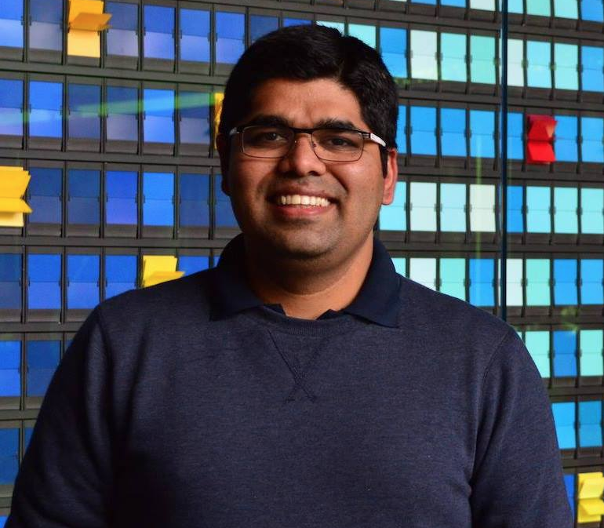
Needfinding
Interview with
People involved with Stanford Sustainability
Stanford students
Surprise
There are people who don’t think about saving water
even if they do, they don’t think of it at the moment of use
Notes:
4. Needfinding / Existing Solutions [3-5 slides]
a. Needfinding (who, where, what you learned, what type of surprises did you encounter, show pictures of the needfinding process)
b. Parallel Prototypes (what you did build & what did you learn when you tested with users?)
c. Evolution of your POV statements (give initial good one and final one if different, and say why it changed)

Slide 6
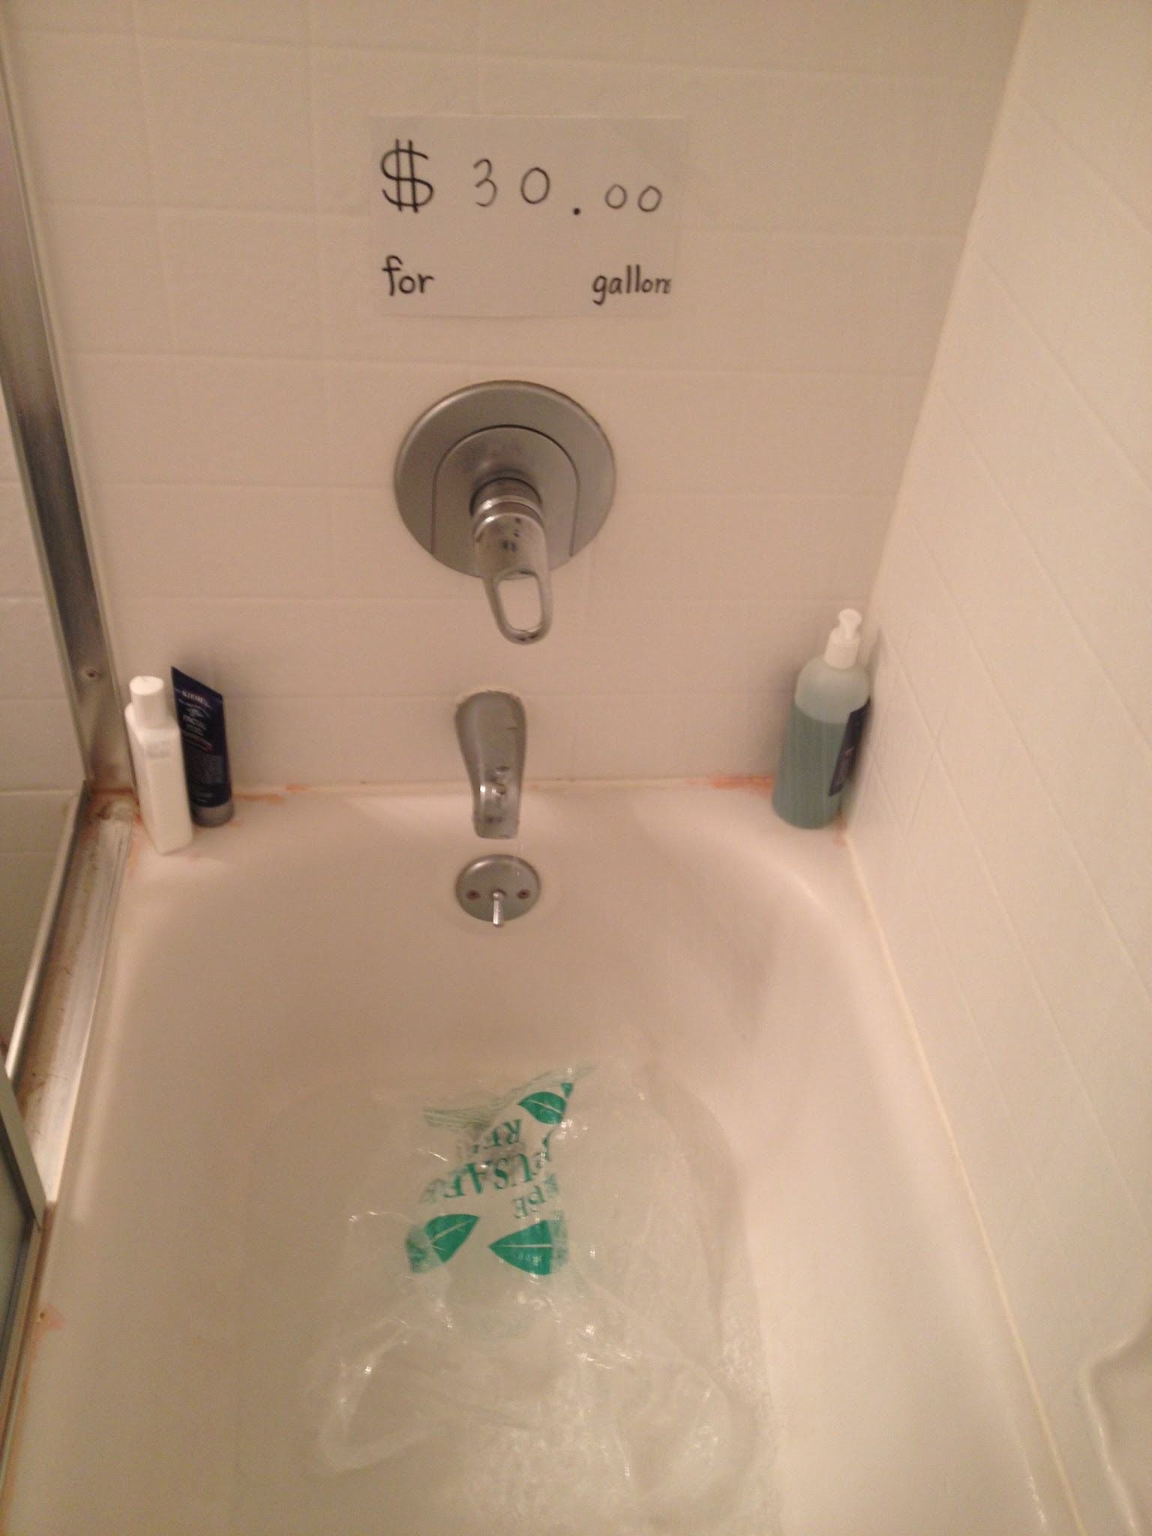
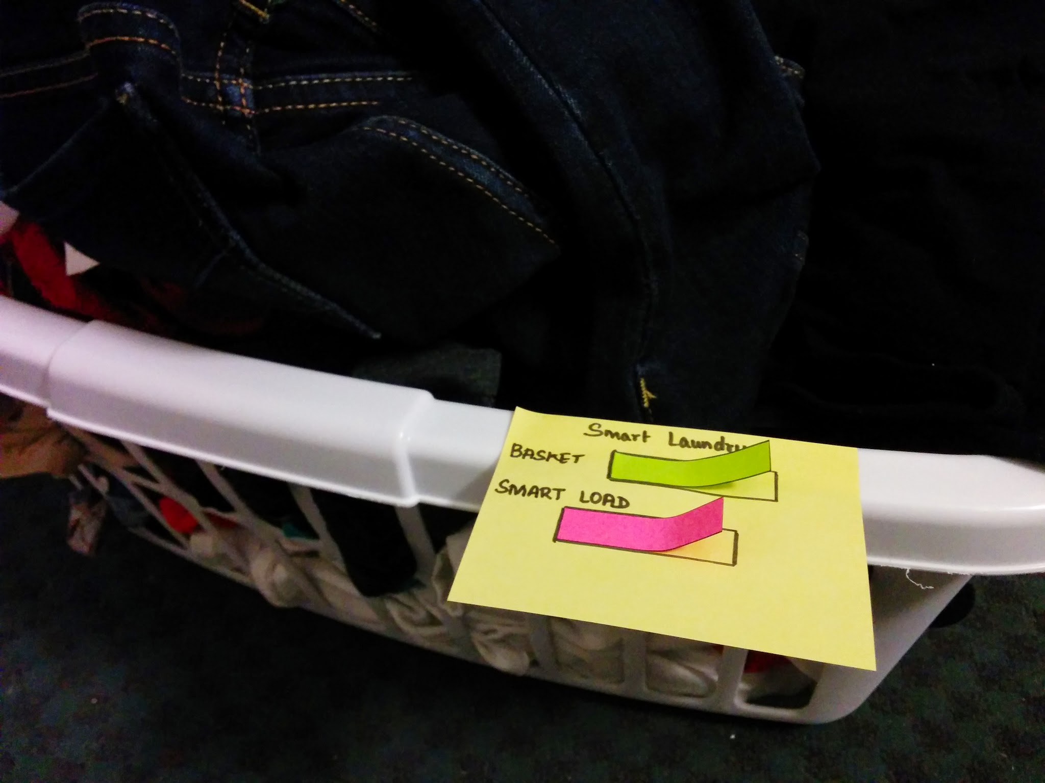
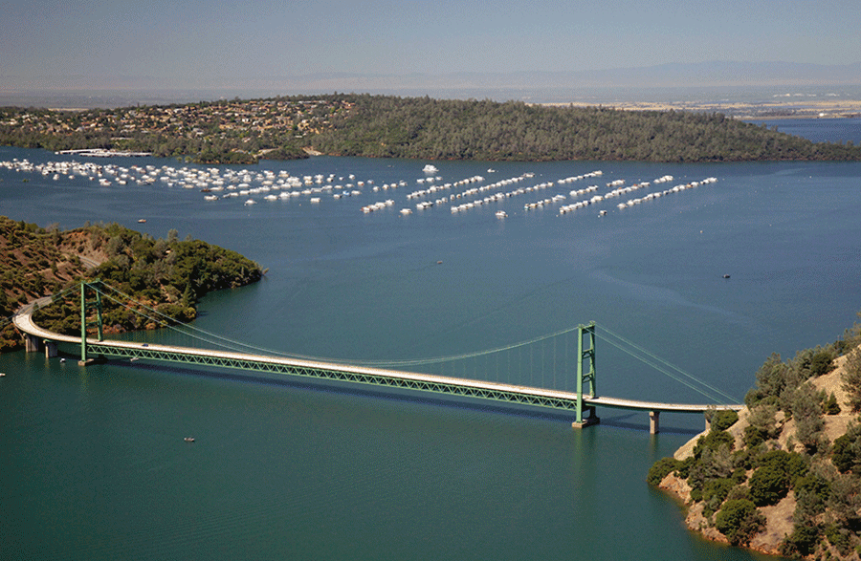
Parallel Prototypes
Smart Laundry
Water collector
Crisis around you
Looking for a solution that doesn’t take much of the user’s time.
Notes:
4. Needfinding / Existing Solutions [3-5 slides]
a. Needfinding (who, where, what you learned, what type of surprises did you encounter, show pictures of the needfinding process)
b. Parallel Prototypes (what you did build & what did you learn when you tested with users?)
c. Evolution of your POV statements (give initial good one and final one if different, and say why it changed)

Slide 7
POV
We met Claire, a busy Stanford student
Who needs to be reminded of the significance of her choices and be prompted to make environmentally friendly decisions at the right moment
Because she is busy and has other priorities and doesn’t think about water when it would actually make a difference

Slide 8

HMW
How might we prompt students to think about their water choices at the moment of making a decision that affects water use, while meeting their need for tools that are unconscious and not distracting?

Slide 9
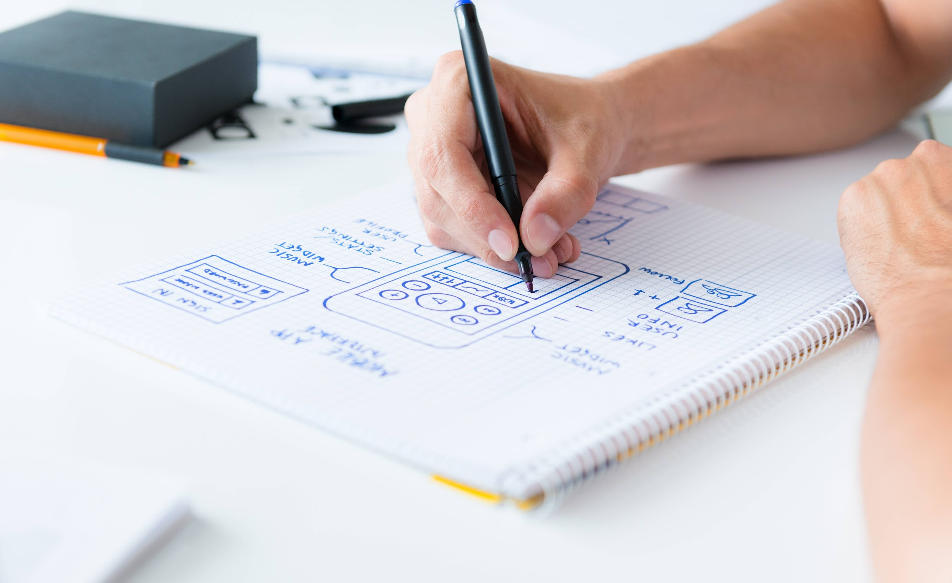
The Solution

Slide 10
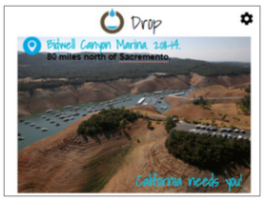
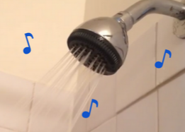
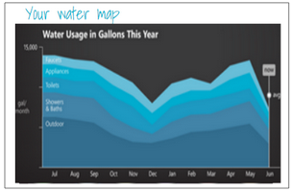
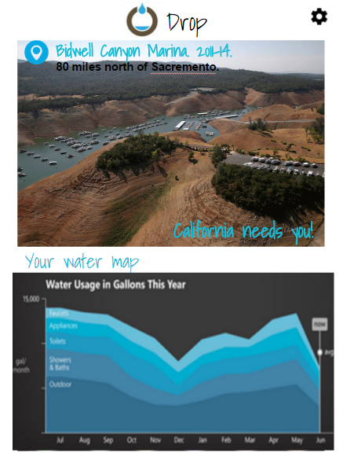
Solution
DROP will help you save California, one drop at a time.
You learn about the water crisis, live water usage and your personal progress every time you use water.
Notes:
5. Solution [1 slide]
a. Brief mission statement or value proposition
b. High level solution description (w/ image of design)

Slide 11
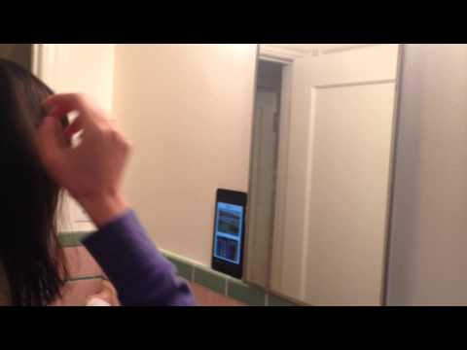
Concept Video

Slide 12
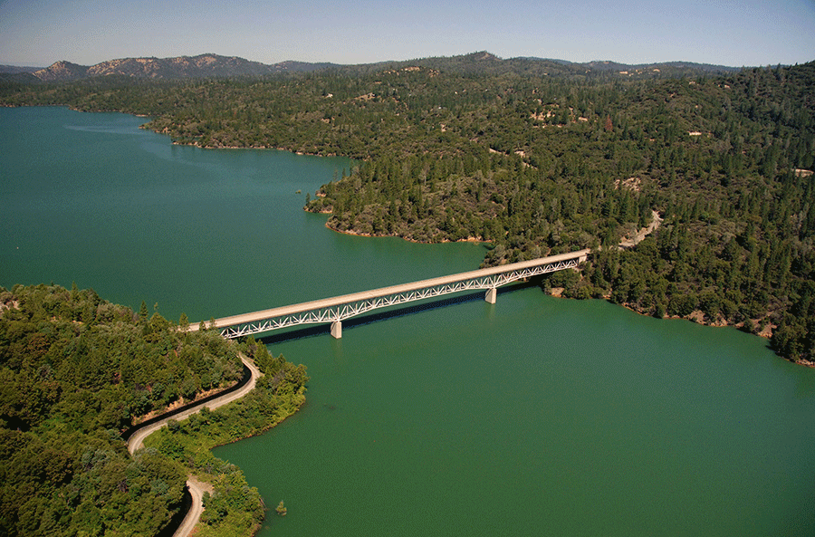
Initial Design - how it all started
People quickly moved on from being shocked/surprised by the images.
The locations chosen were recognized by people.
However, seeing the drought made them care but didn’t give them anything to do.

Slide 13
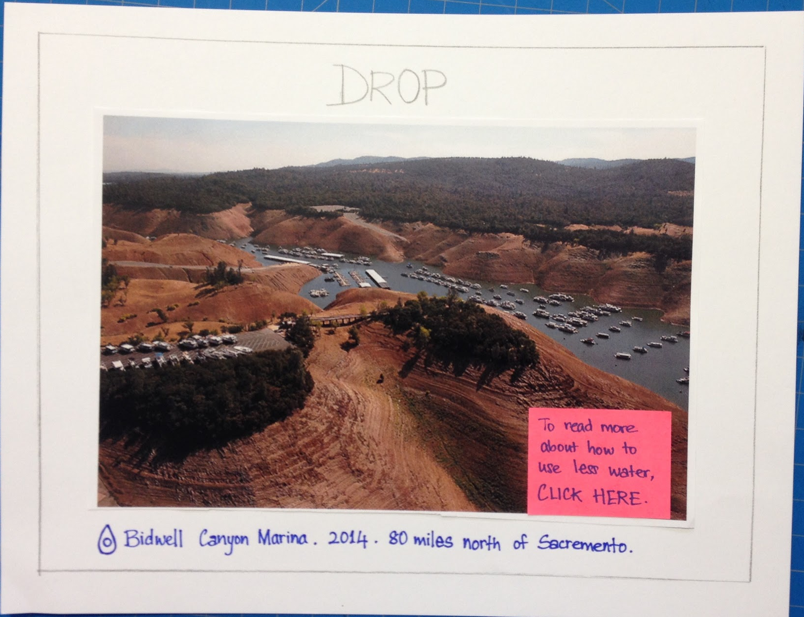
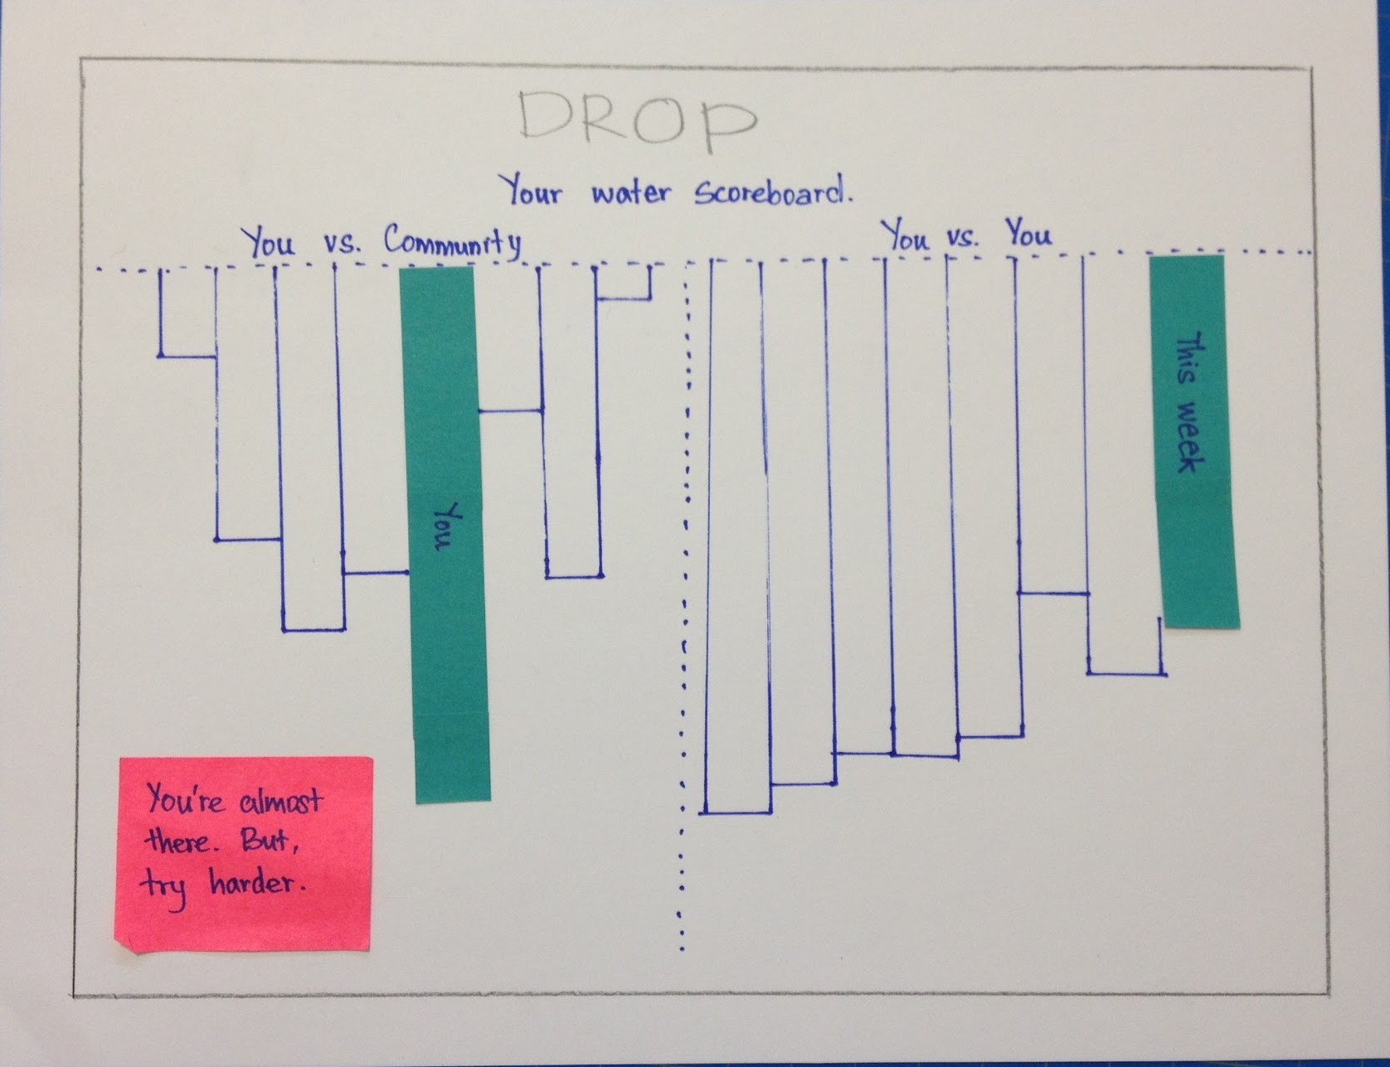
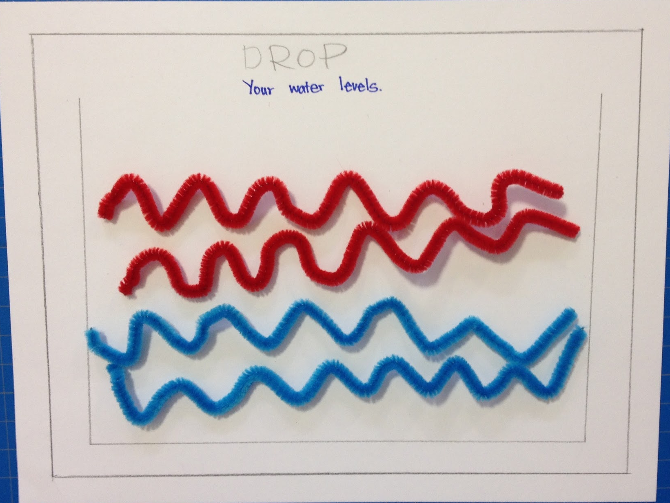
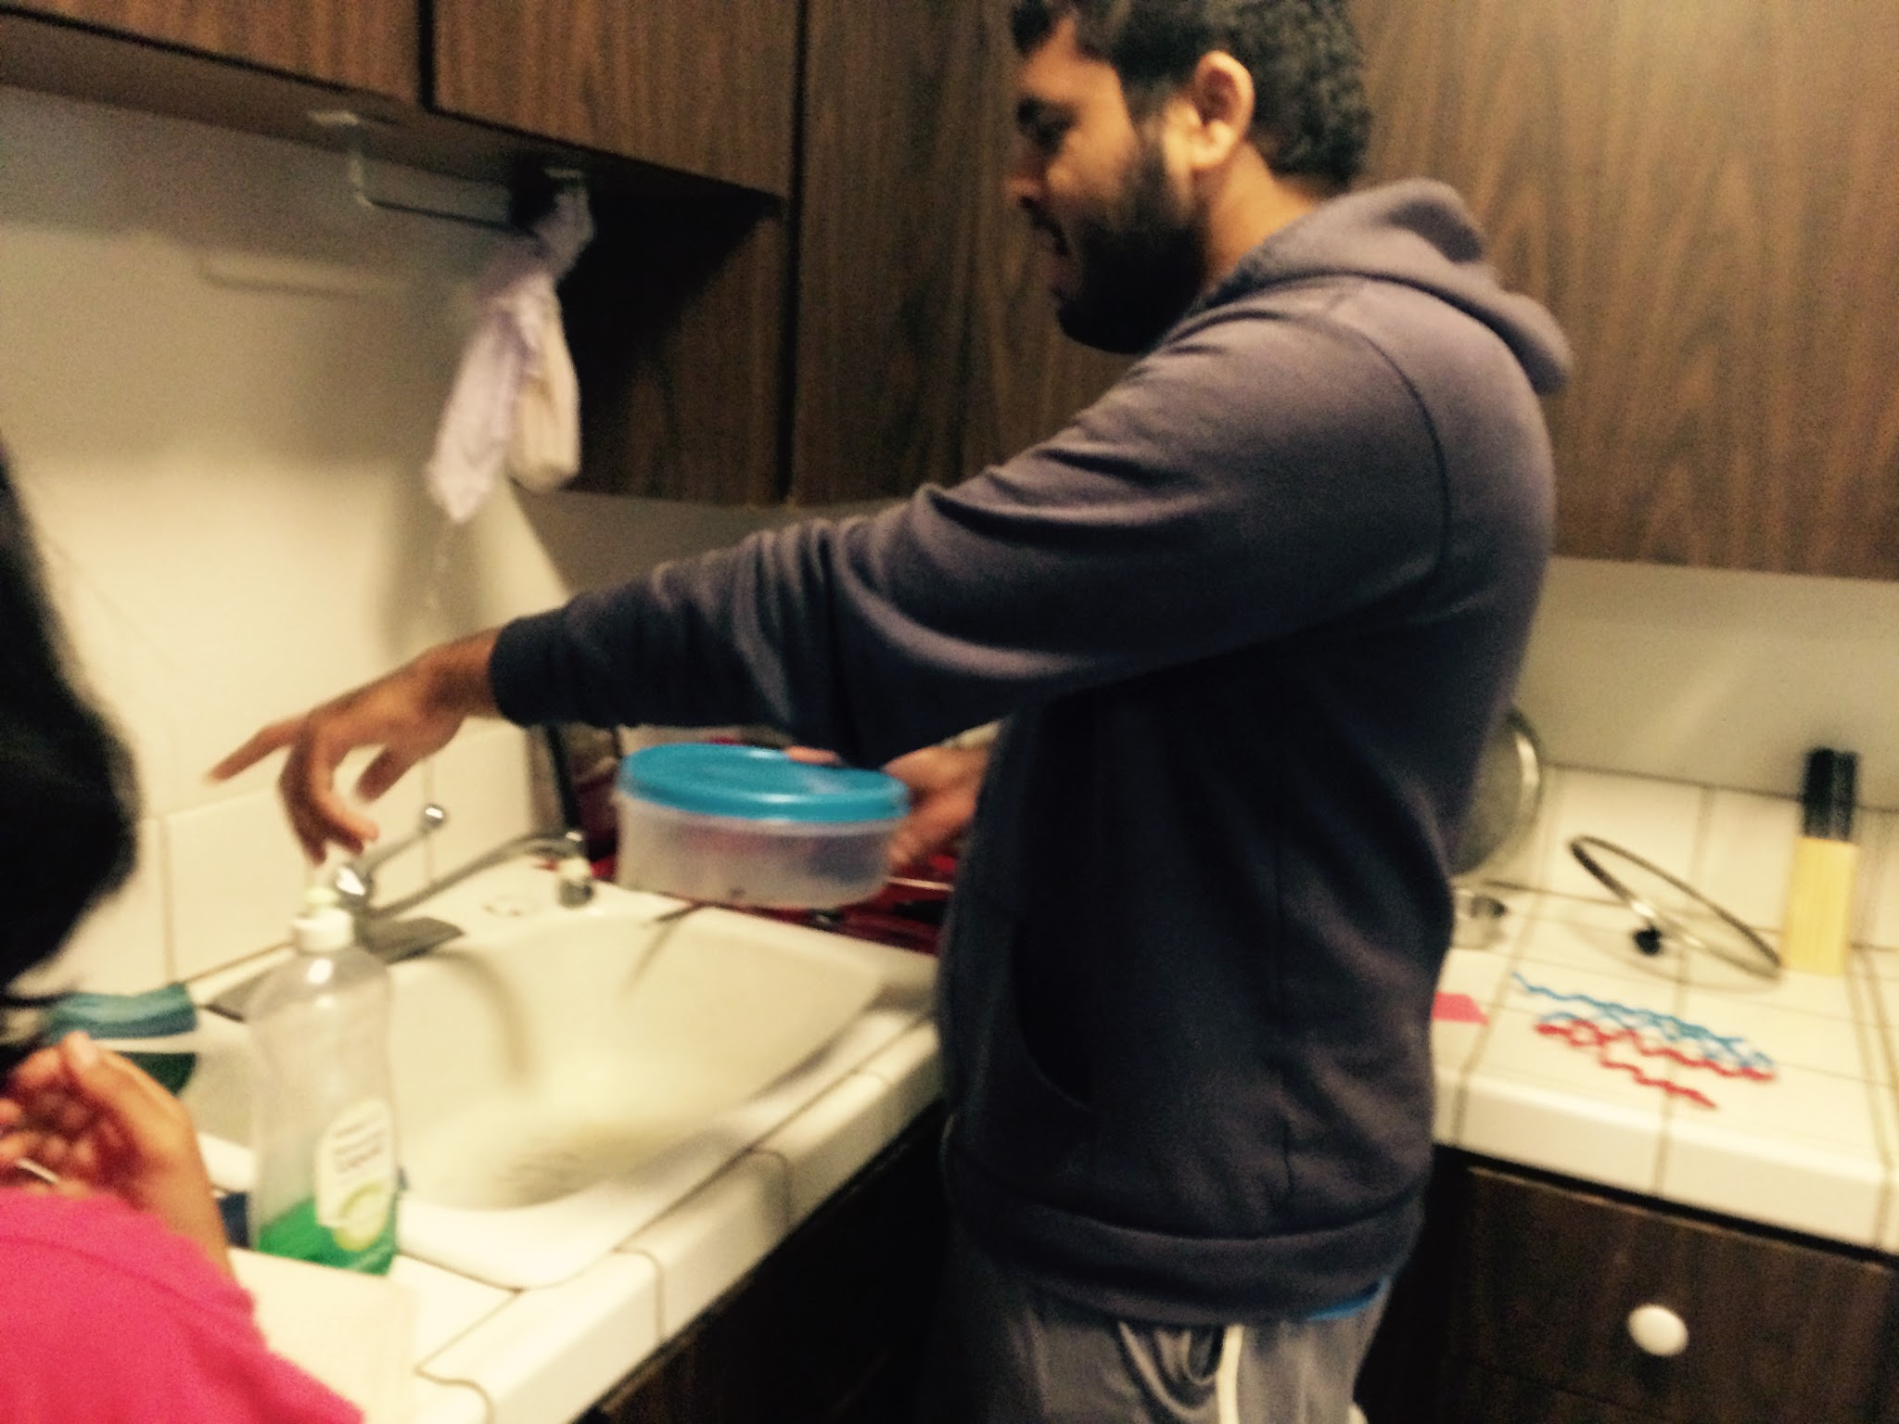
Combining ideas
Show users live water usage so that they make wiser decisions.
Show progress to motivate them
We learned that a screen is not always the best solution/interface.

Slide 14
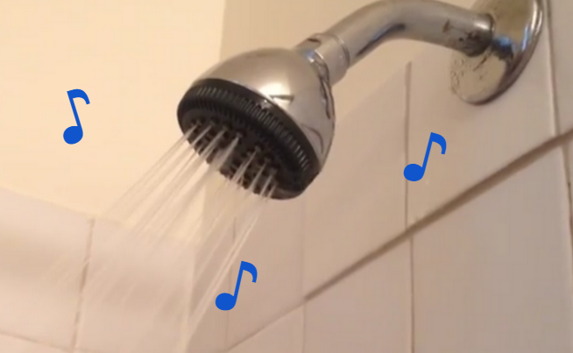
The talking faucet
Introduced the talking faucet.
Wasn’t as creepy as we thought.
What should the faucet should alert about - time? amount of water? crisis alerts?

Slide 15
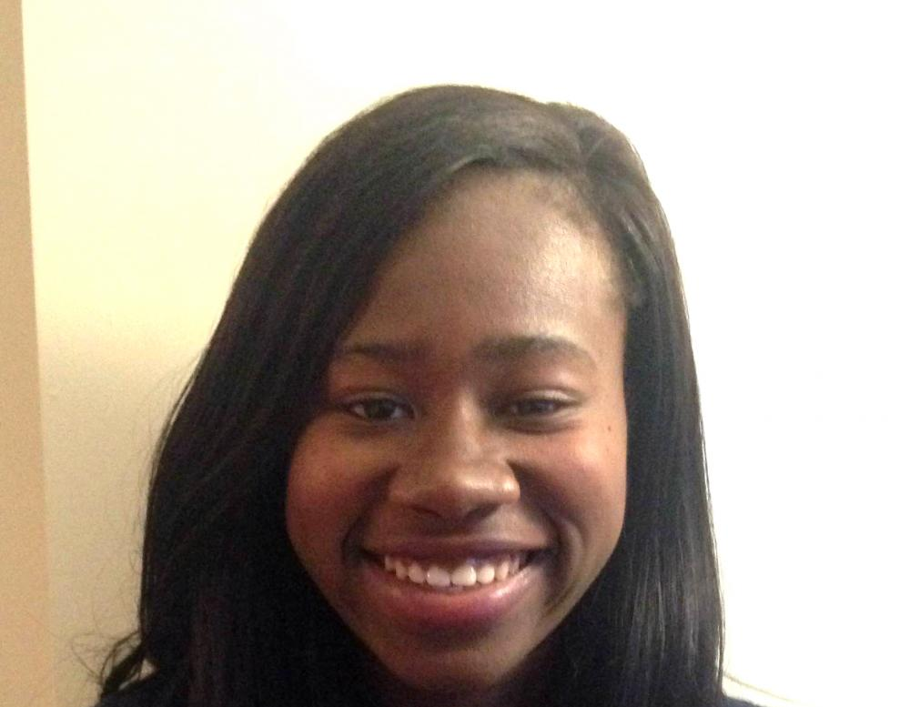
More surprises
“I thought I could finish shower faster by increasing the water flow.”
“I really like my music
while I shower”
Alert about the amount of water used, and comparing to the average.
Introduced music with the alerts.

Slide 16
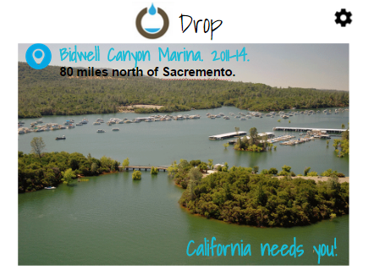
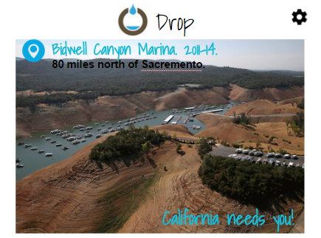
Final Design
Learn about water crisis
Learn about the water crisis
1
1
Learn about the water crisis
1
Learn about the water crisis
1
Learn about the water crisis
1
Learn about the water crisis
1
Notes:
Mizuki
8. Final Design a. Tasks & Interface Description [multiple slides for each task] i. Present walkthrough of each task ii. Explain what it does & how it works b. Should include live demo or video

Slide 17
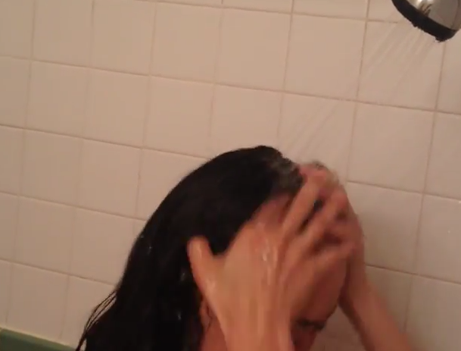
Final Design
2. Learn about live water usage by sound alert
♪
♪
♪
Learn about the water crisis
1
1
Learn about the water crisis
1
Learn about the water crisis
1
Learn about the water crisis
1
Learn about the water crisis
1
Notes:
Mizuki
8. Final Design a. Tasks & Interface Description [multiple slides for each task] i. Present walkthrough of each task ii. Explain what it does & how it works b. Should include live demo or video

Slide 18
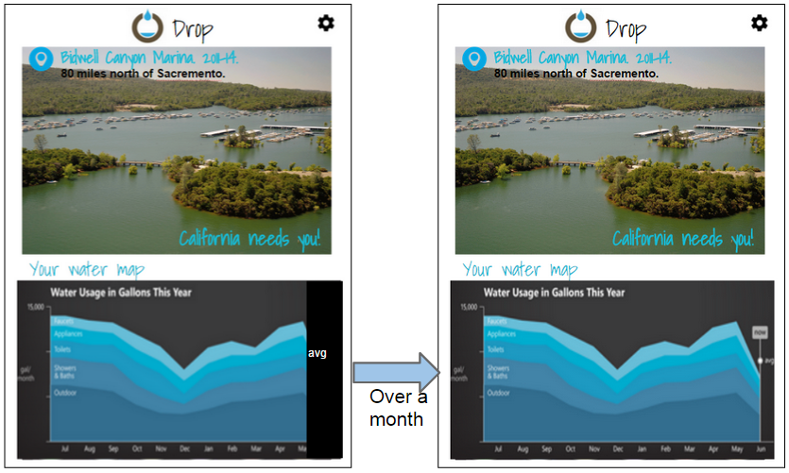
Final Design
3. Learn about personal water usage progress comparing with the past.
Learn about the water crisis
1
1
Learn about the water crisis
1
Learn about the water crisis
1
Learn about the water crisis
1
Learn about the water crisis
1
Notes:
8. Final Design a. Tasks & Interface Description [multiple slides for each task] i. Present walkthrough of each task ii. Explain what it does & how it works b. Should include live demo or video

Slide 19
Tools used
Quicktime Player - easy to record.
iMovie - easy to edit.
Google slides - familiar to prototype, but had no way to import audio.
Wizard of Oz techniques - for the data.

Slide 20
Expansions
Food and sustainable purchases and their effect on water use.
Advice on reducing your water use based on other users who’ve successfully reduced water use (e.g. “your neighbor cut water use by thirty percent by setting their default shower time lower!”)
Notes:
What is missing & what might you add in the future?
10. Summary [15 seconds] a. What is your key innovation b. What will your key impact on the world be

Slide 21
Summary
Our key innovation
The talking faucet ^_^
We focused on the moment people are using water
Our key impact on the world
We expect that people using Drop will reduce their residential water usage substantially and will save California!
Notes:
10. Summary[15 seconds]

Slide 22
Thanks!
Any questions?

