Slide 1
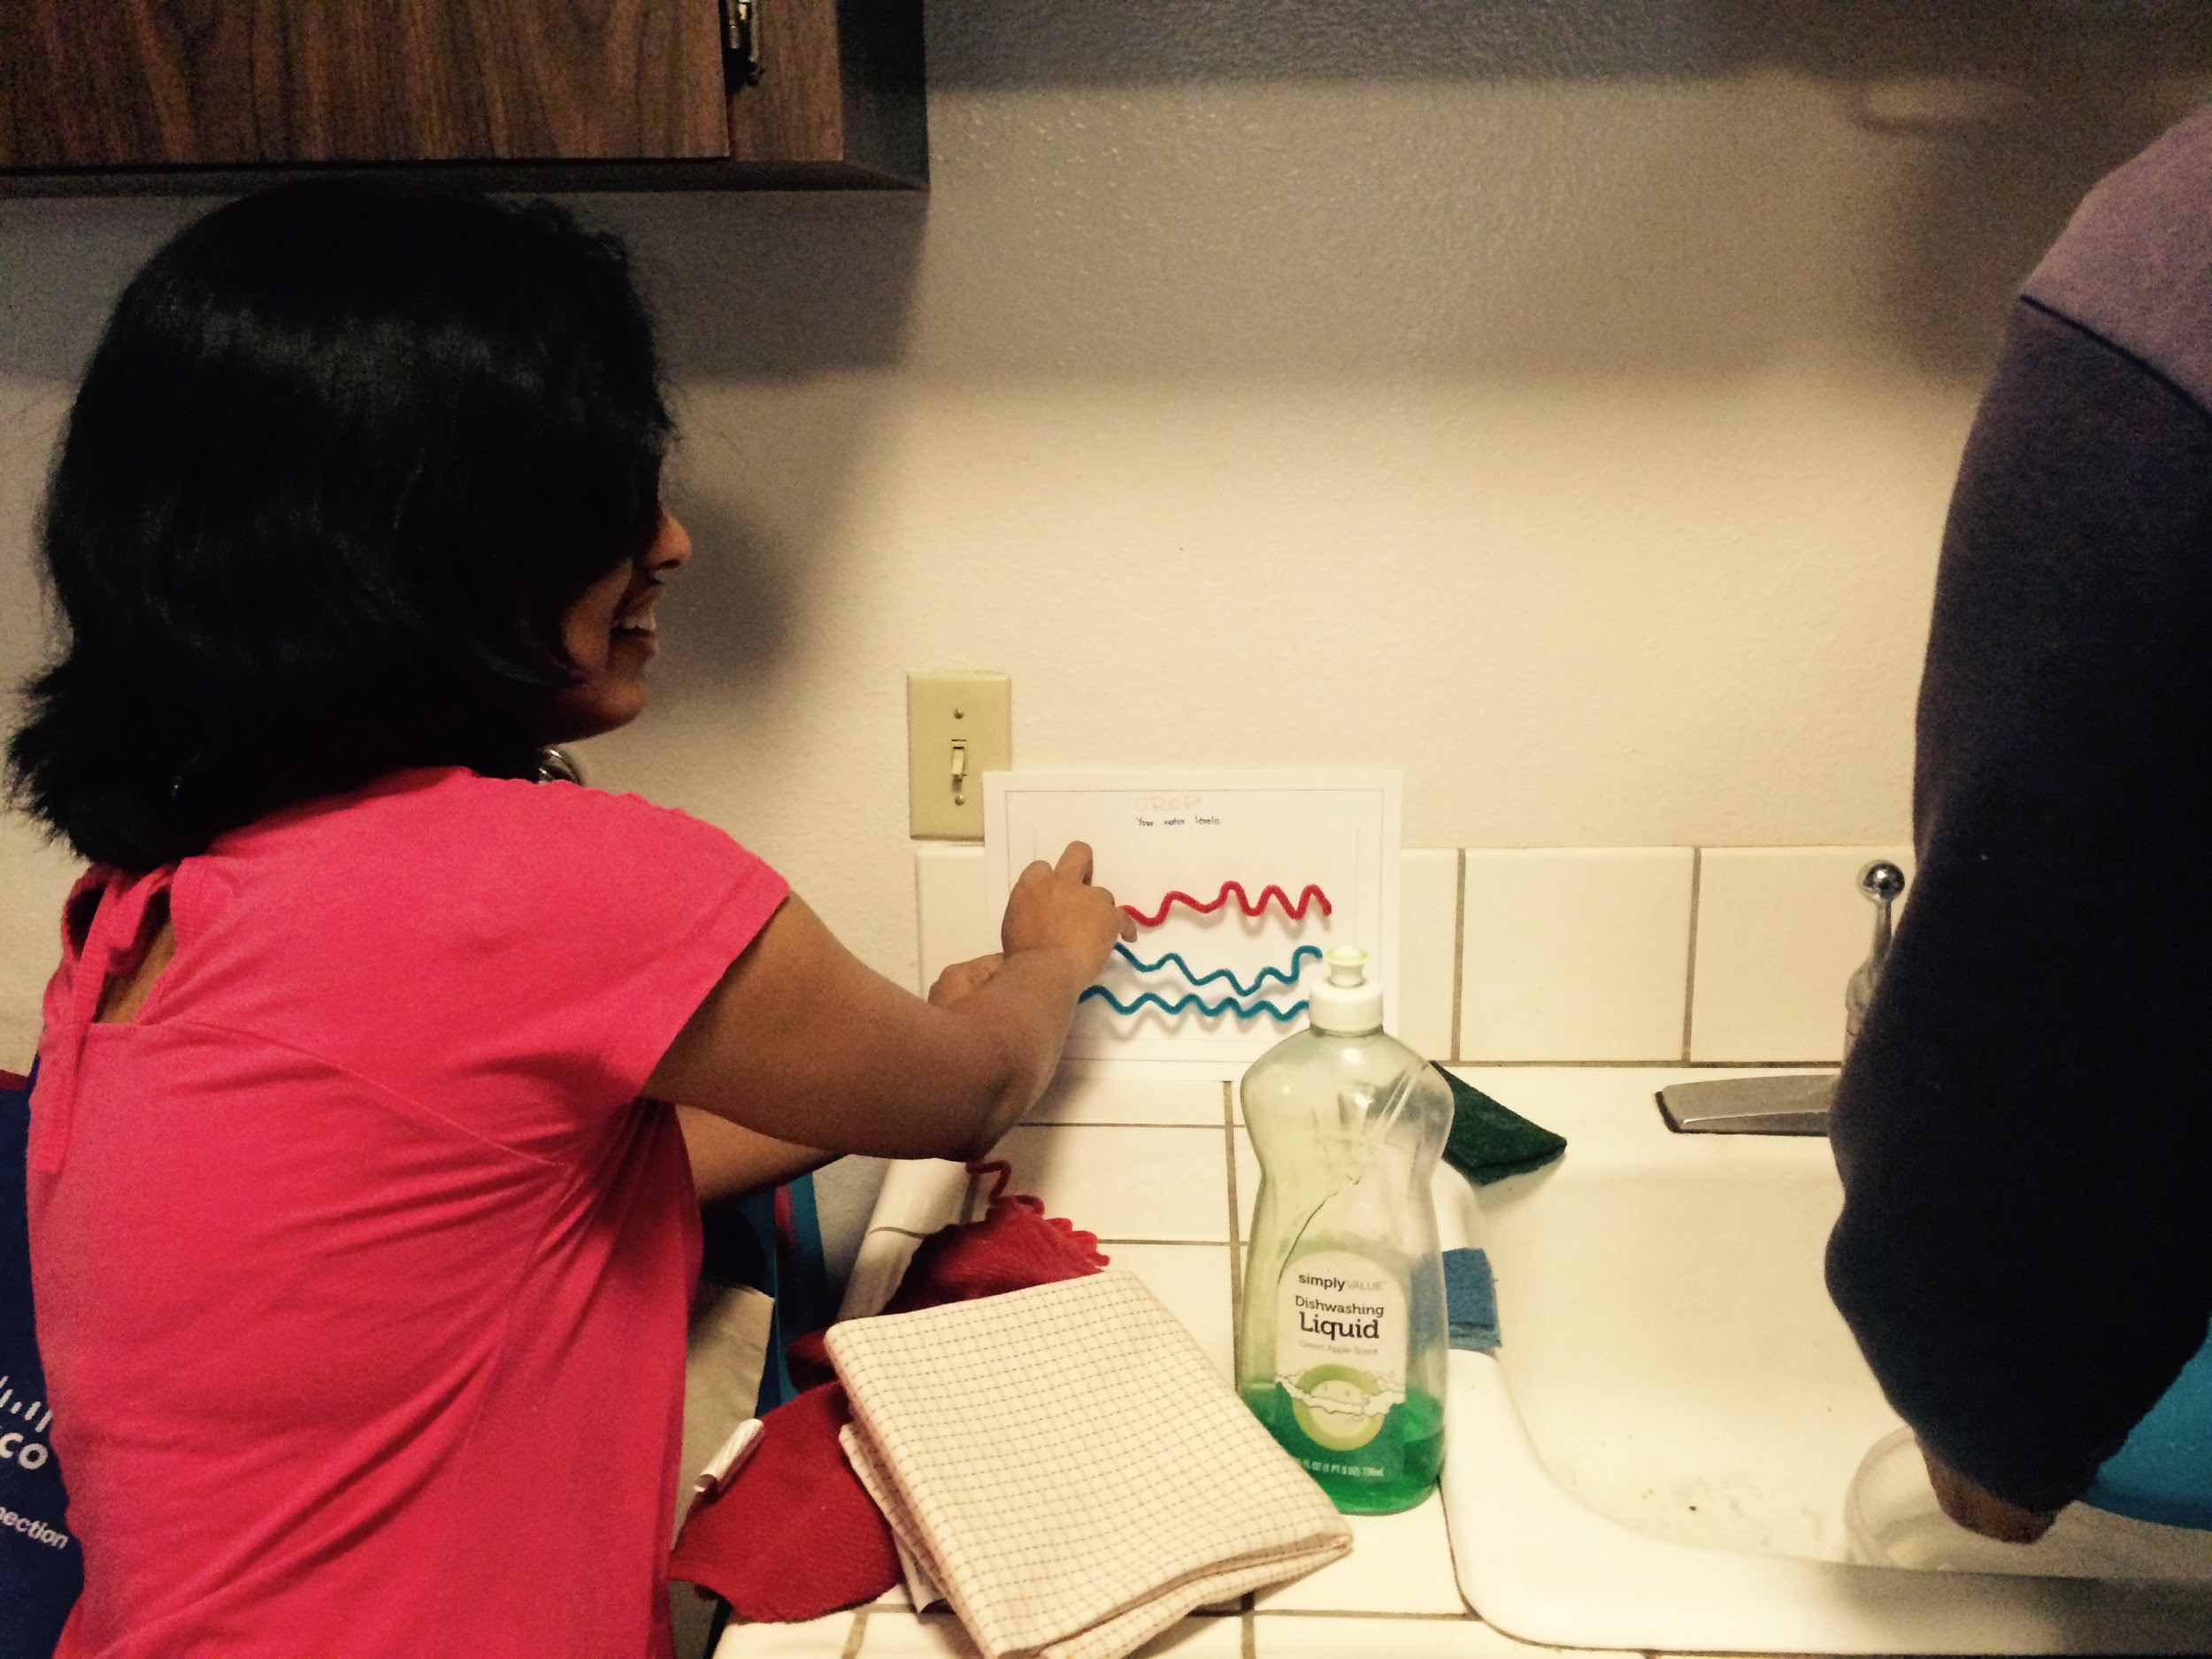
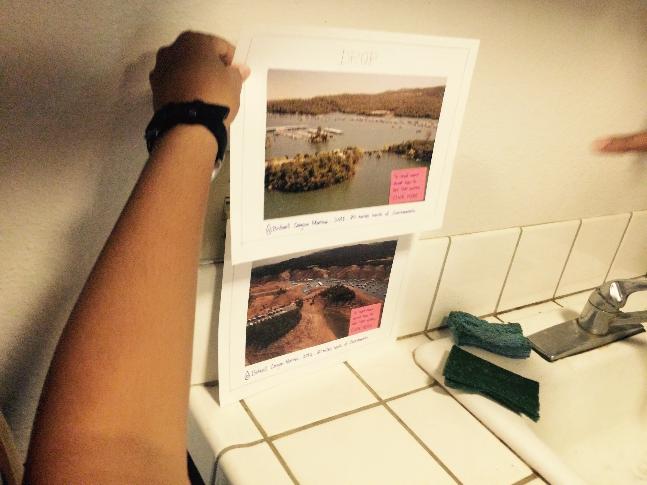
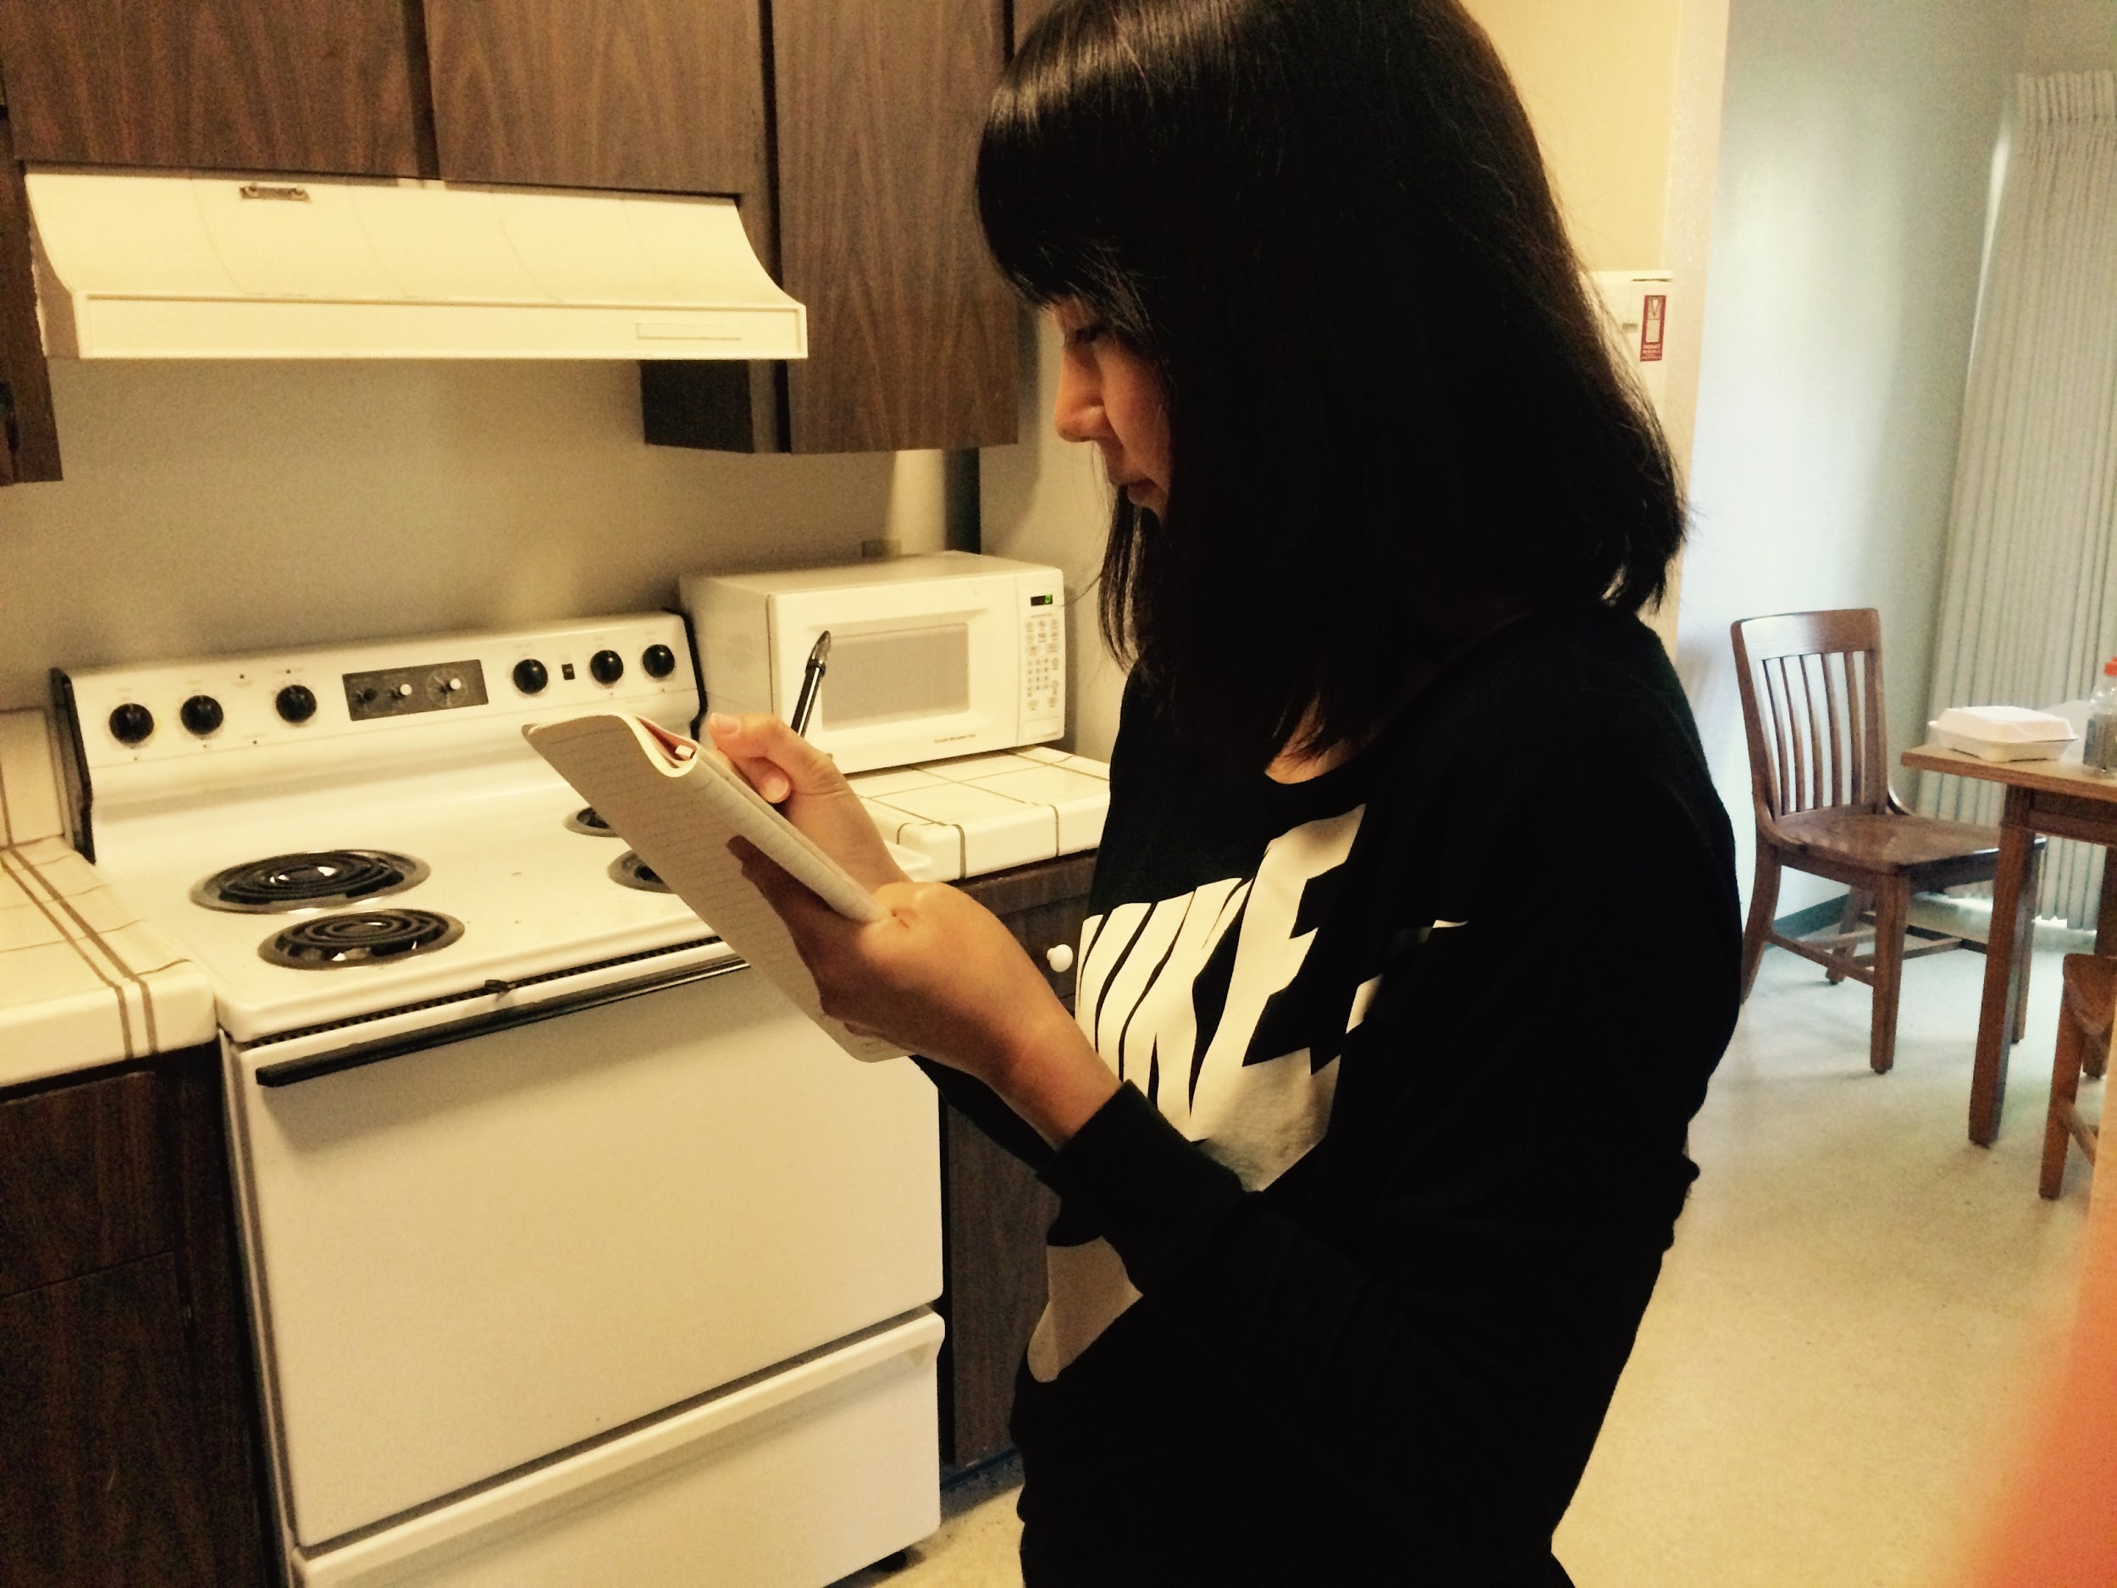
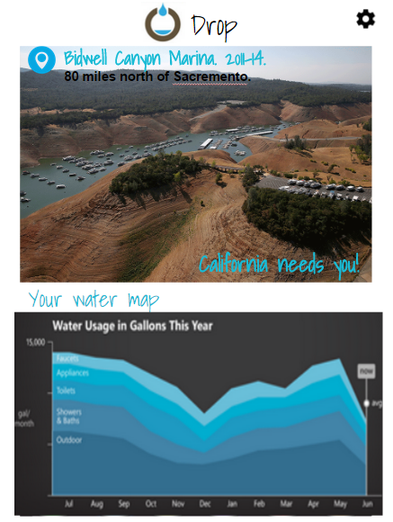
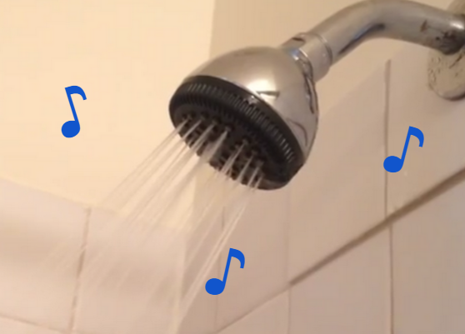
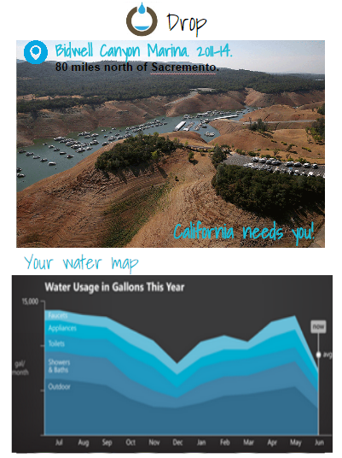
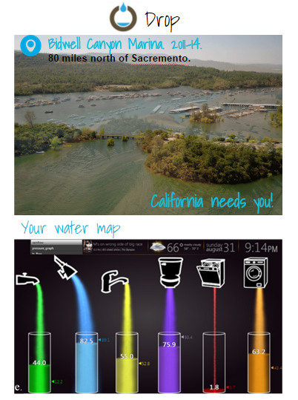
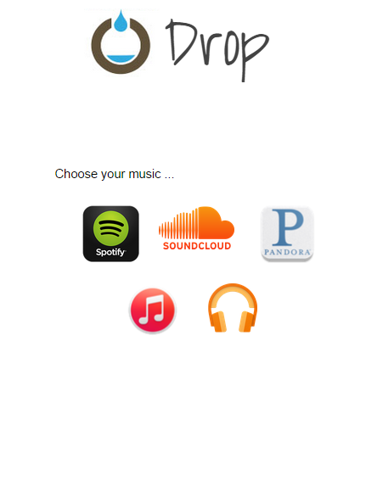
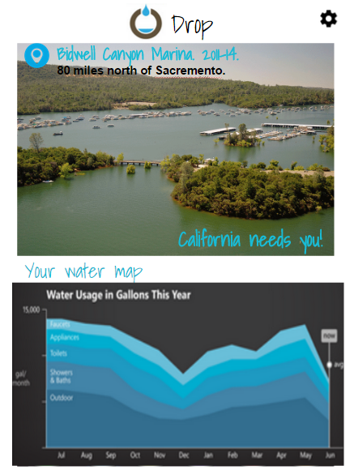
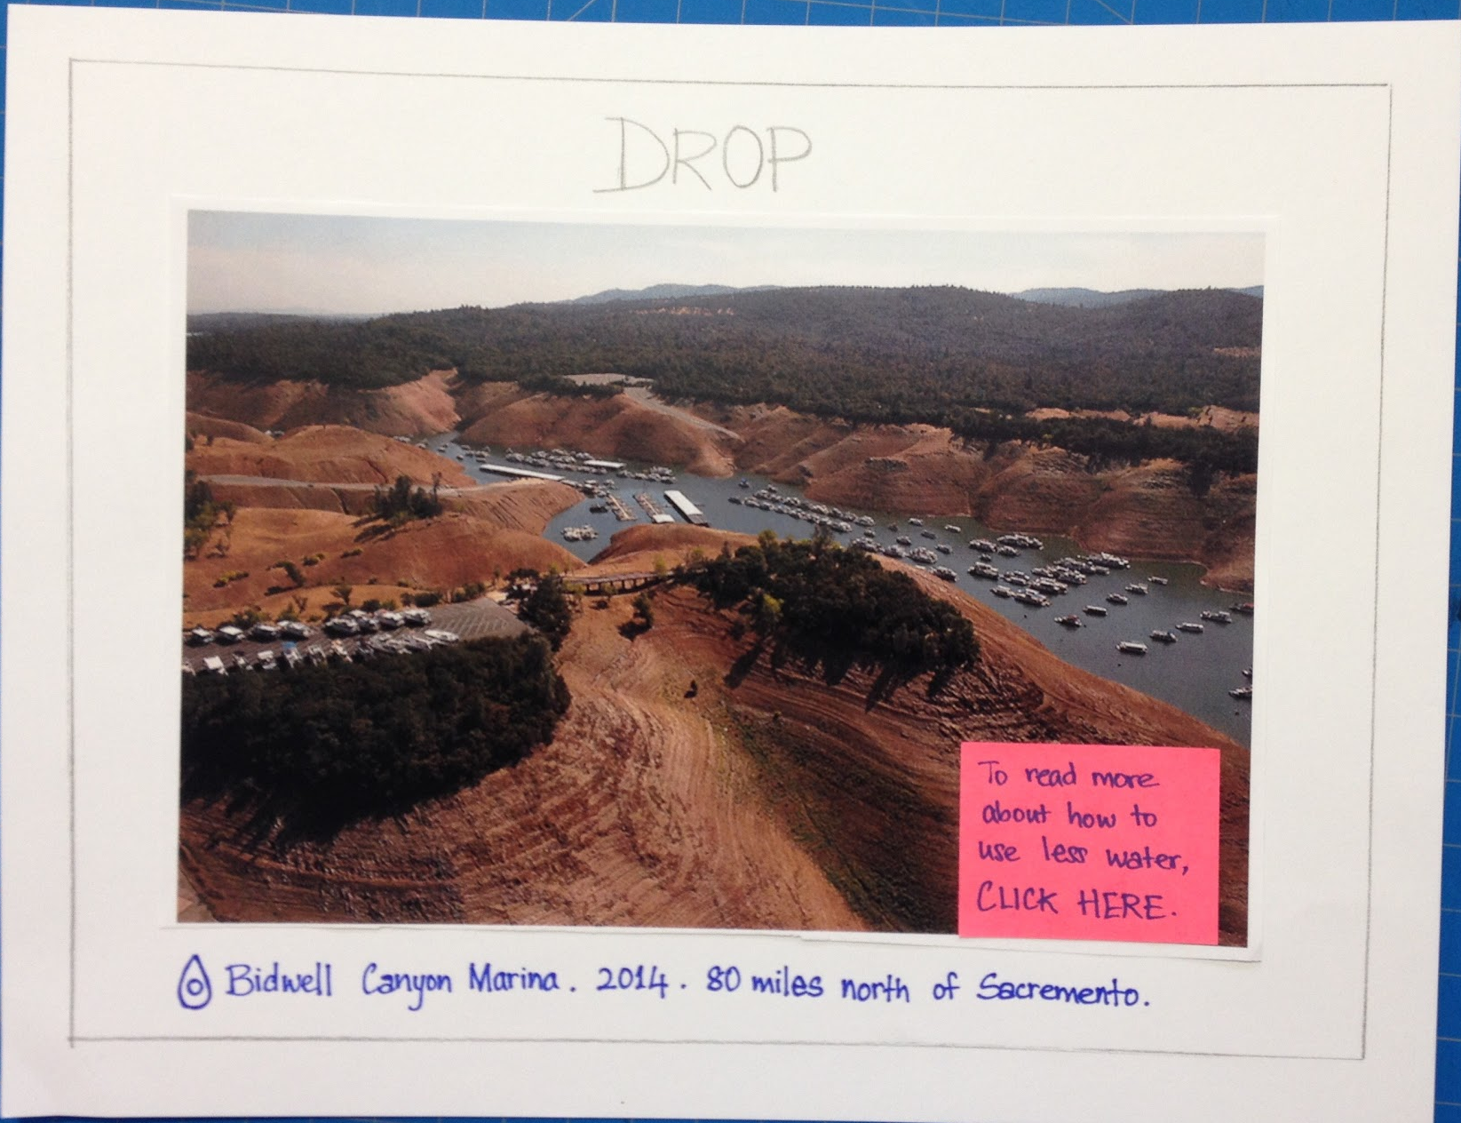
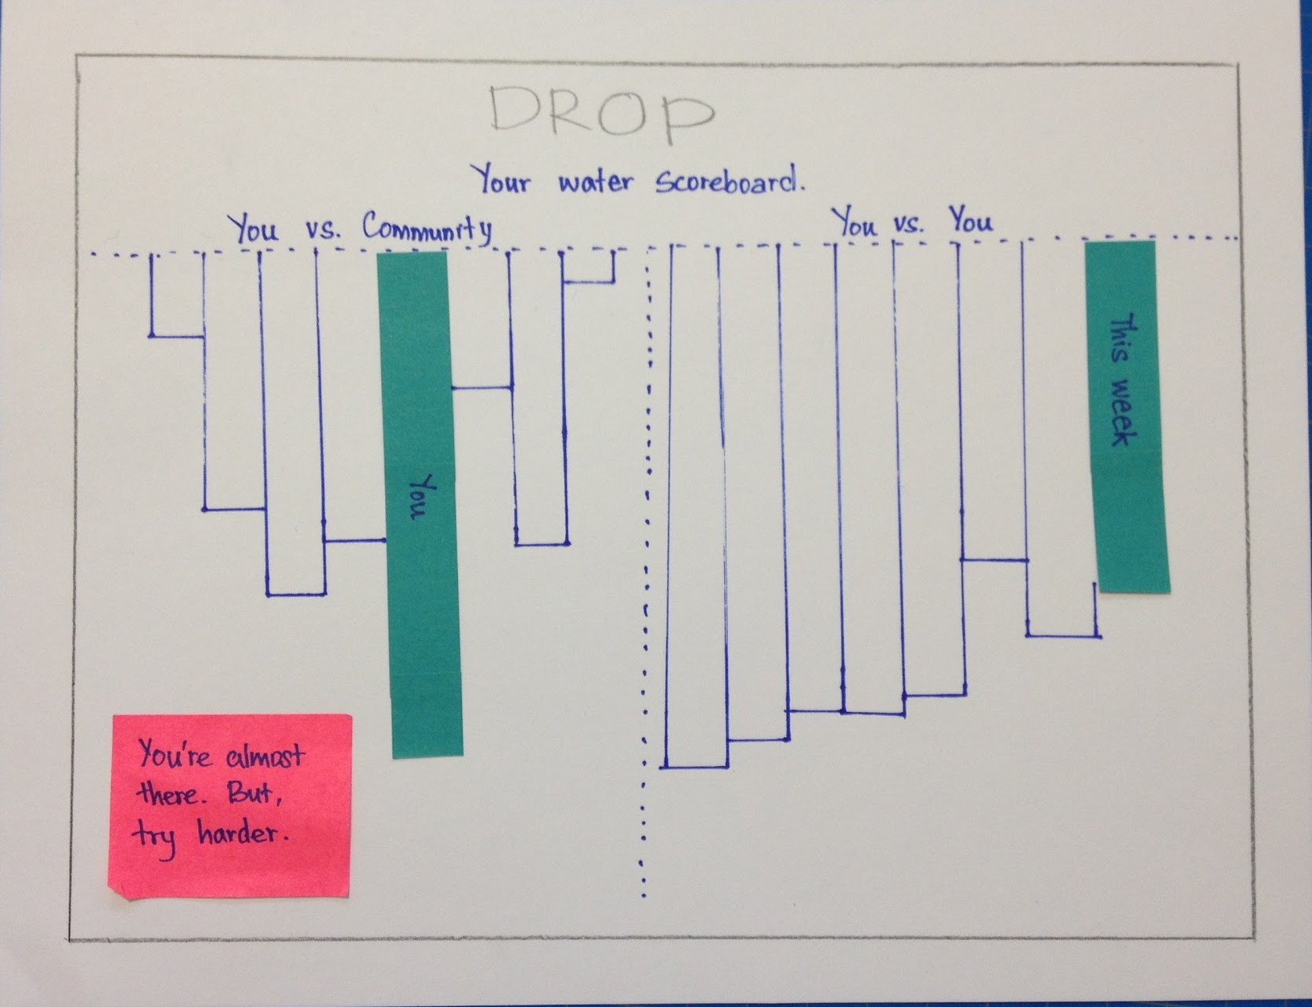
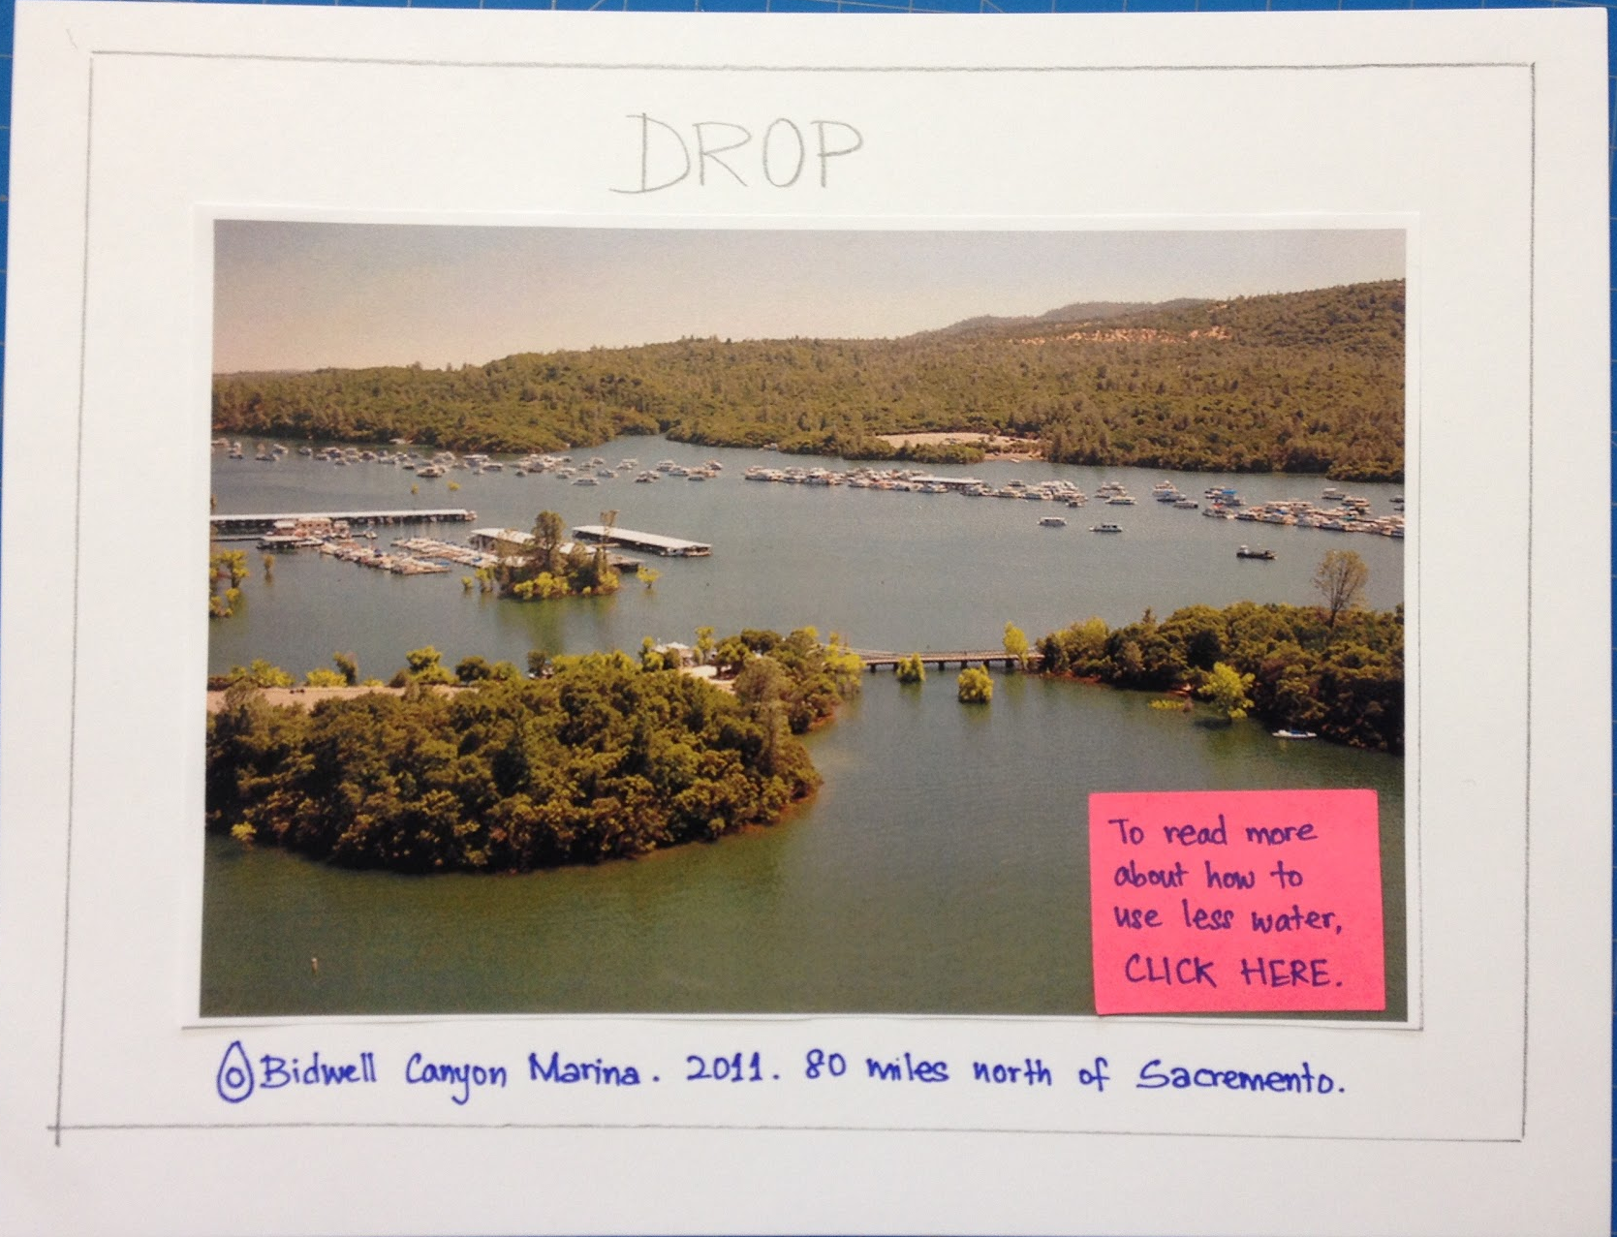
Helping you save California
one drop at a time
We care about the drought, but we’re busy with our lives.
When using water, we think about everything but saving it.
Drop is a personal assistant that helps you use less water.
User Testing
Auditory feedback on live water usage
See personal progress compared to the past.
1
Learn about the water crisis
2
3
Design Evolution
Lo-fi
Medium-fi #1
Medium-fi #2
Divya Konda . Kelsey Piper . Mizuki Iwakura
http://hci.stanford.edu/courses/cs377e/2015/sp/
CS 377E
Spring 2015
Notes:
‹#›

Slide 2
Helping you save California
one drop at a time
We care about the drought, but we’re busy with our lives.
When we use water, we think about everything else but saving it.
Drop is a personal assistant that helps you use less water.
Auditory feedback on live water usage
See personal progress compared to the past.
1
Learn about the water crisis
2
3
Design Evolution
Lo-fi
Medium-fi #1
Medium-fi #2
Divya Konda . Kelsey Piper . Mizuki Iwakura
CS 377E
Spring 2015
Notes:
‹#›

