Slide 1
Introduction & Course Overview
CS 194H – User Experience Design Project
January 8, 2024

Slide 2
Outline
Survey
Who are we?
Course overview & schedule
Introductions
Teams

Slide 3
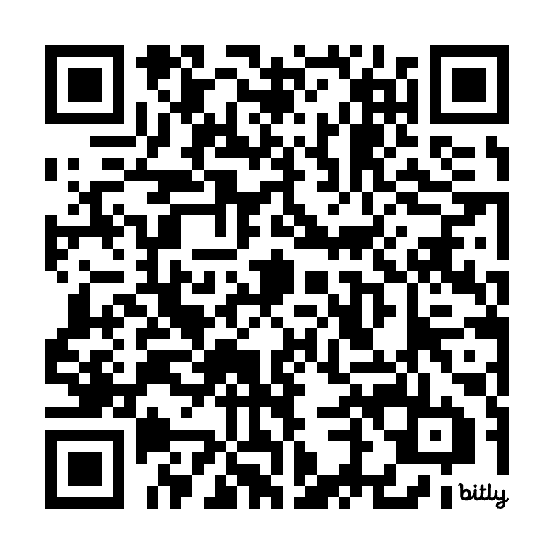
Survey
https://bit.ly/cs194h-2024-initial-survey

Slide 4


Who are We?

Slide 5
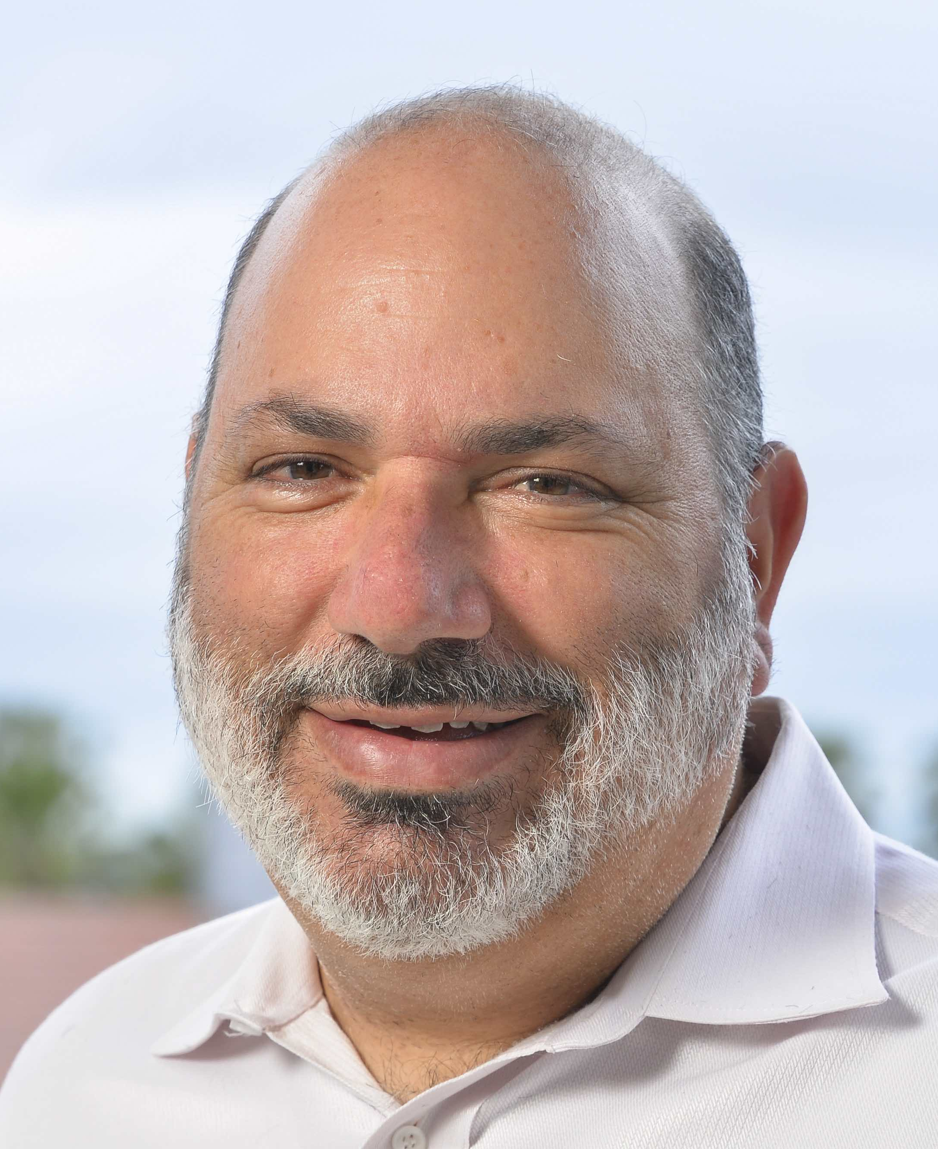
James Landay
he/him
Professor in Computer Science at Stanford
  formerly professor at Cornell Tech, University of Washington, & Berkeley
  spent 3 years as Director of Intel Labs Seattle
PhD in CS from Carnegie Mellon ’96
HCI w/ focus on ubiquitous computing, web design (tools, patterns, etc.), HAI
Founded NetRaker, 1st in web experience management (sold to Keynote)
Co-authored The Design of Sites with Doug van Duyne & Jason Hong
Office Hours: TBD
Email: landay@[insert usual Stanford email domain]

Slide 6
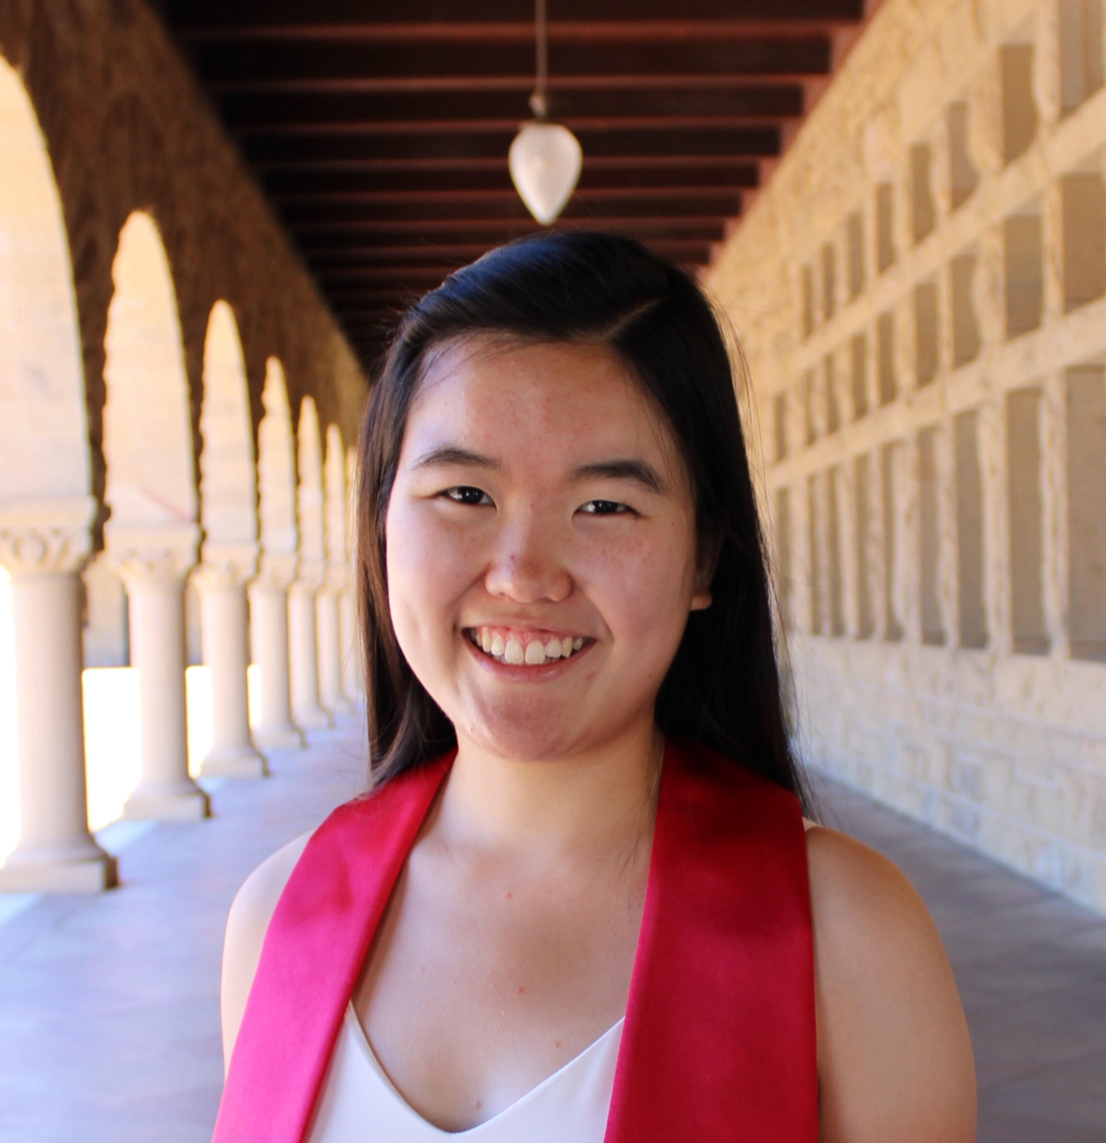
Grace Zhou (CA)
she/her
CS coterm and undergrad (HCI)
Interested in designing for journalism/media, AI, & content creation
Interned in instructional design and growth design in addition to UX
Love watching movies and always working on a script
Office Hours: TBD and by appointment via Calendly

Slide 7
How to Design and Build UIs
UI Development process
Usability goals
User-centered design
Need finding & task analysis
Rapid prototyping
Evaluation
Programming
Notes:
Although we will do a bit of everything, his class focuses much more on the last two steps than CS147

Slide 8
Iteration
At every stage!
Design
Prototype
Evaluate

Slide 9
Goals of the Course
Learn to prototype, evaluate, & build UIs
  the needs & tasks of prospective users
  cognitive/perceptual constraints that affect design
  technology & techniques used to prototype UIs
  techniques for evaluating a user interface design
  importance of iterative design for usability
  how to work together on a team project
  communicate your results to a group
    key to your future success
Understand where technology is going & UIs of the future

Slide 10
Course Format
Quarter long project & individual homework
Interactive lectures (only a few) / Project presentations
Studio design critiques
Readings (very small number & short)
All material will be online
  slides, exercises, readings, schedule
  https://hci.stanford.edu/courses/cs194h/ or cs194h.stanford.edu
Also use the slack channels!
Have fun & participate!

Slide 11
Project Description
We will continue work on projects from CS 147
  existing groups will stay intact
  we will assign “new” students to existing teams
Groups
  4 students to a group → 4-6 groups
  groups meet with teaching staff every week
    often in class, but also sometimes scheduled outside
Cumulative
  apply several HCI methods to a single interface

Slide 12
Project Process Overview
Project Recap (next Wednesday)
Business Model
Web Site (including 147 material)
Lab Usability Study*
Hi-Fi Prototype #2
Field/Remote Usability Test*
Hi-Fi Prototype #3
Hi-Fi Video Prototype
Final posters/presentations & Launch Party w/ industry guests
*user testing funding ~$150/team

Slide 13
Schedule
draft
http://hci.stanford.edu/courses/cs194h/2024/wi/calendar.html

Slide 14
Books
Universal Principles of Design by Lidwell, Holden & Butler
  “hand out” ~8 chapters we will use
We will also hand out other papers, give you web links & refer to slides
Other recommended refs on web page

Slide 15
Assignments
Individual
  5 short studio tasks + one individual talk
Team
  9 team assignments including web site
    5 team presentation/demos + 1 write-up
    video
    poster
  team web site graded
  all work handed in online
    team work on team web site
    individual work shared w/ teaching staff on GDocs

Slide 16
To Be Updated

Slide 17
Grading
No exams
Individual assignments (30%)
Group project (50%)
  demos/presentation (team component)
  project write-up
  team web site
  ratings given by other team members
In class participation (20%)
  beyond simply attending

Slide 18
Tidbits
Late Policy
  no lates on team assignments
  individual assignments lose one letter grade/day
Cheating policy
  Stanford honor code

Slide 19
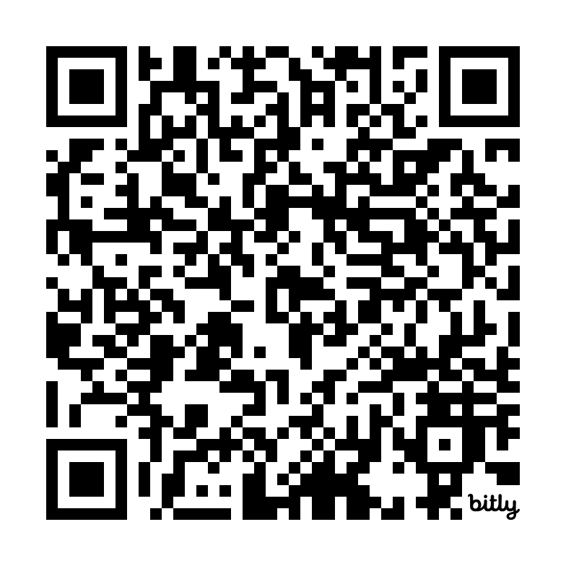
Introductions & Teams
Which 147 teams are represented?
How many team members?
https://bit.ly/cs194h-2024-project-pitches
Mingle & meet potential teammates
Teammate preference form due Wed at 5 PM

Slide 20
Next Time (Wed)
Studio assignment #1 – Hierarchy & Tagging
Read How to Survive a Critique by Karen Cheng
Read Hierarchy from Universal Principles of Design
Share assignment w/ gkzhou@stanford.edu so we can access during class

