Slide 2
Outline: Major UI Changes
Onboarding
Home Screen
Create Flow
Creative CC Flow
Search View
Profile View

Slide 3
PROBLEM
Deaf and hard of hearing people are often left out of key nuanced information that is conveyed through audio in digital spaces
SOLUTION
ALTiO is a social media platform that encourages and provides visual interpretations of audio–providing alternative options for everyone to experience content
ALTiO is a social media platform that encourages and provides drawings as visual supplements for interpreting audio–providing alternative options for everyone to experience content

Slide 4
Interface Changes

Slide 5
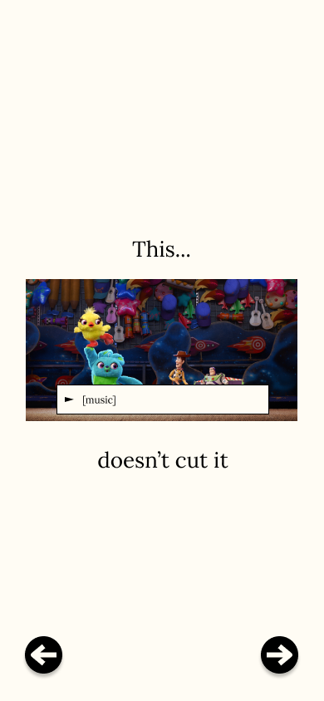
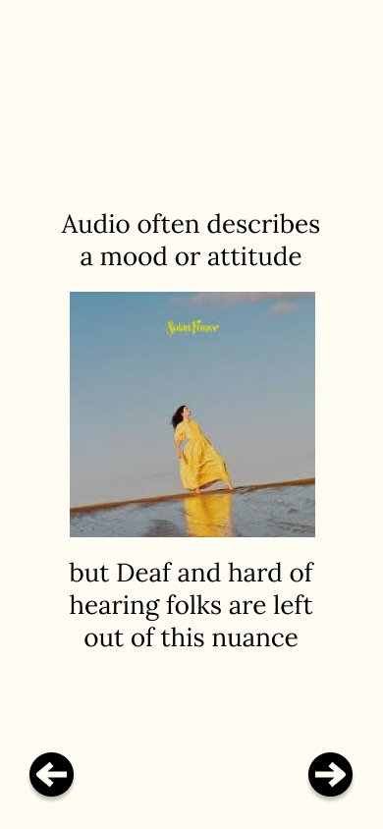
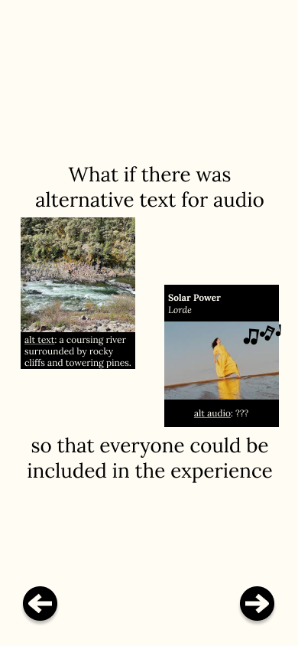
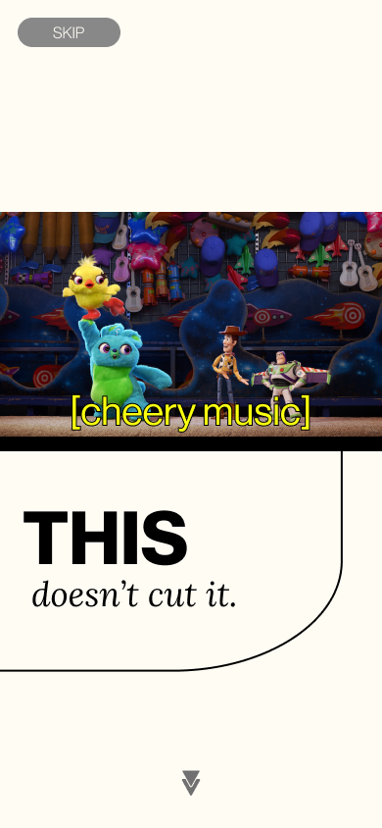
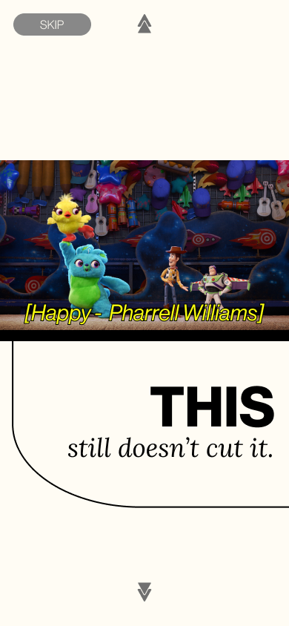
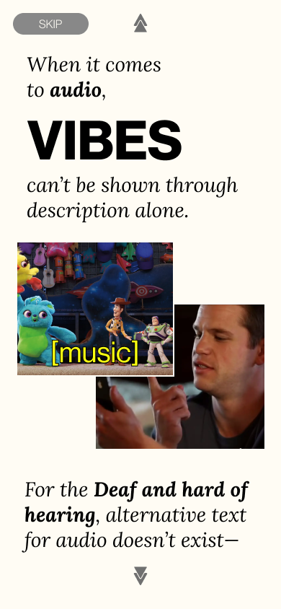
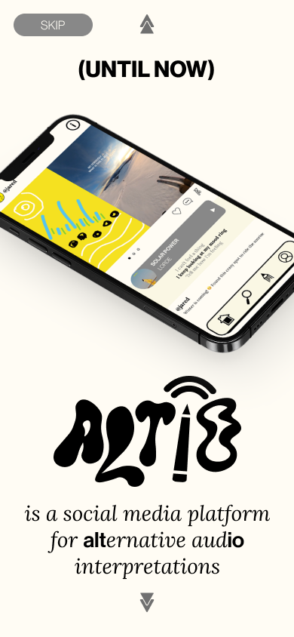
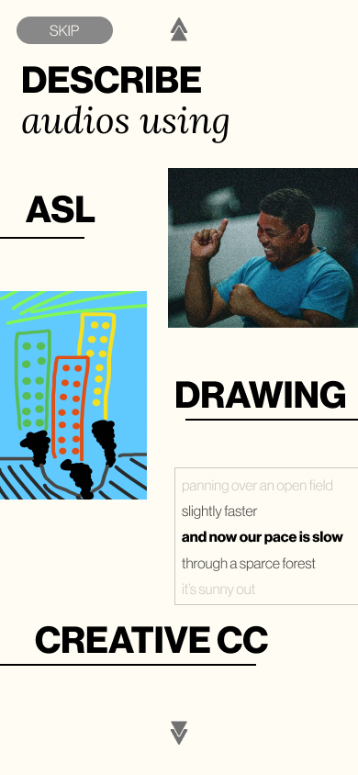
Interface Changes
MAJOR CHANGE 1 -
Onboarding
Old design:
New design:
Notes:
First major change: inherent structure of interpretations of audio
Previously: linear process to create altio
Drawing is main interpretation to toggle between

Slide 6
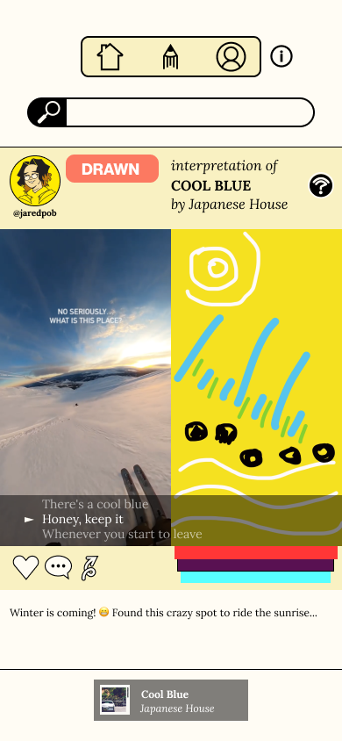
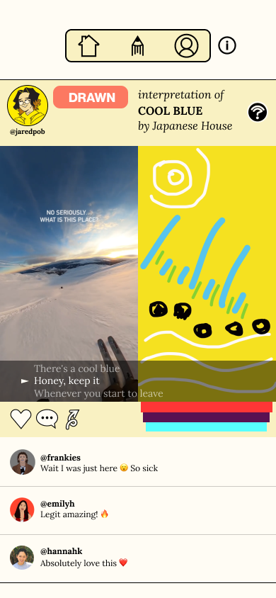
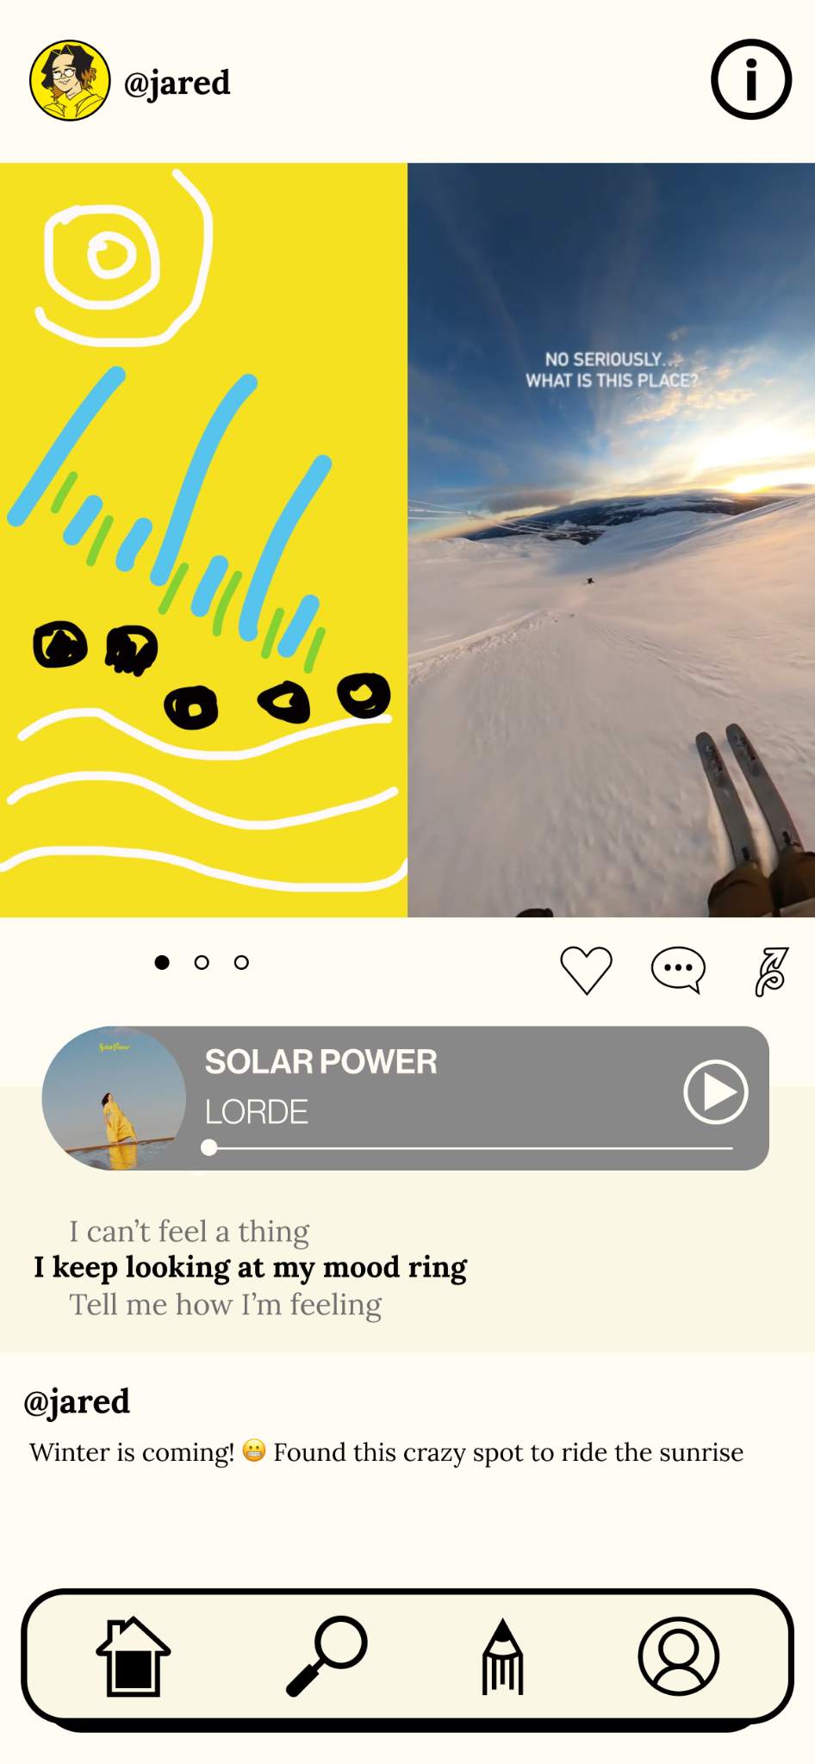
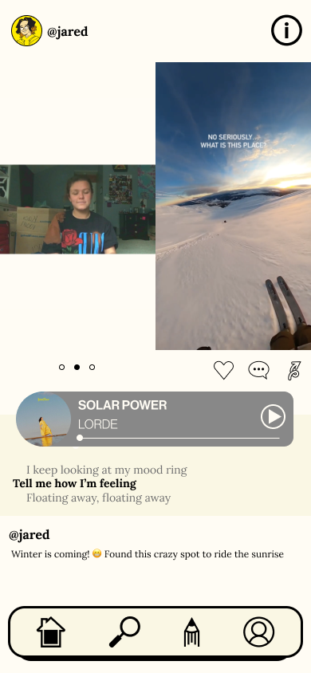
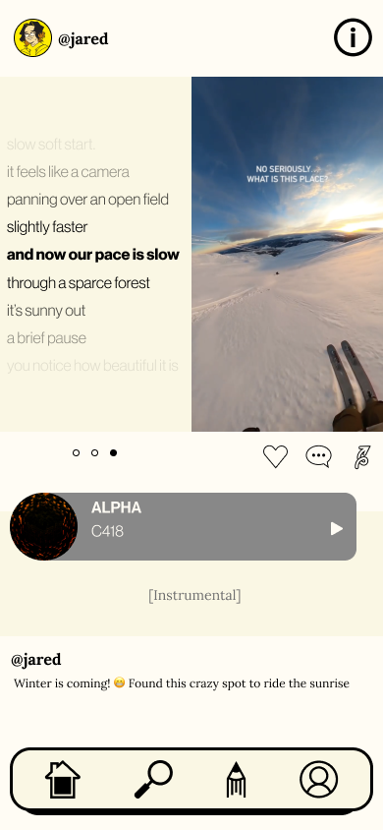
Interface Changes
MAJOR CHANGE 2 -
Home Screen
Old design:
New design:
Notes:
First major change: inherent structure of interpretations of audio
Previously: linear process to create altio
Drawing is main interpretation to toggle between

Slide 7
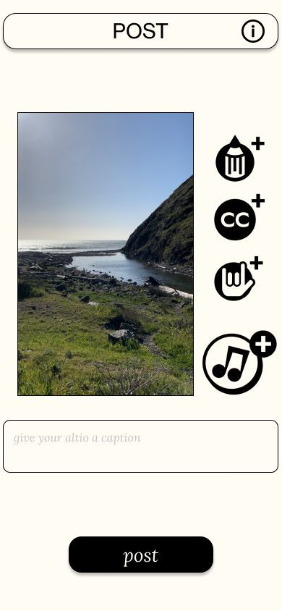
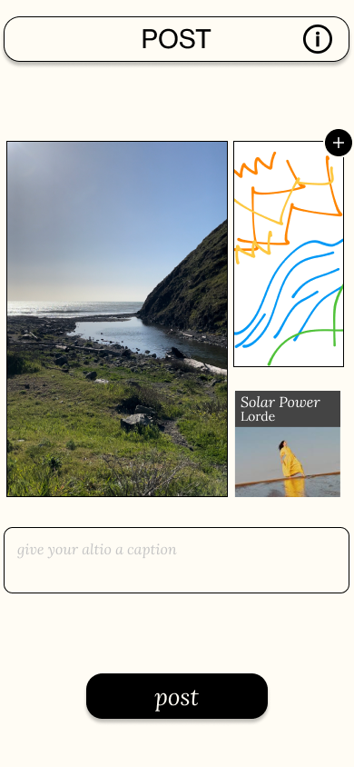
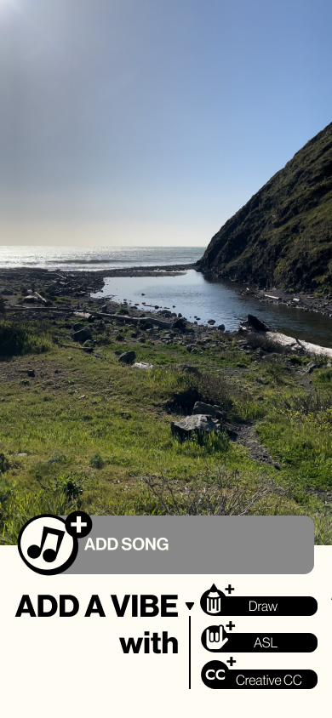
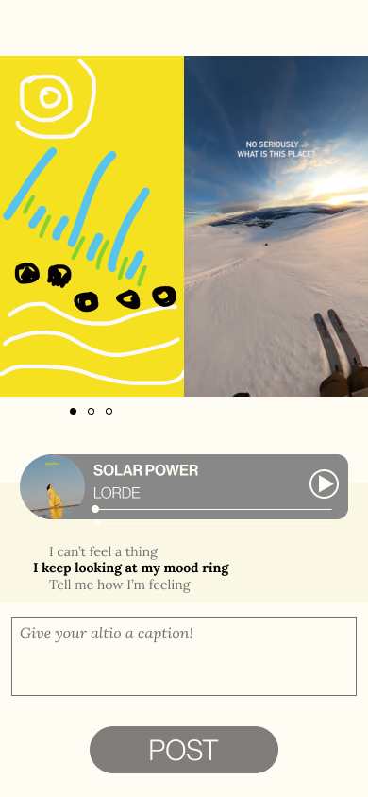
Interface Changes
MAJOR CHANGE 3 -
“Create” Flow
Old design:
New design:

Slide 8
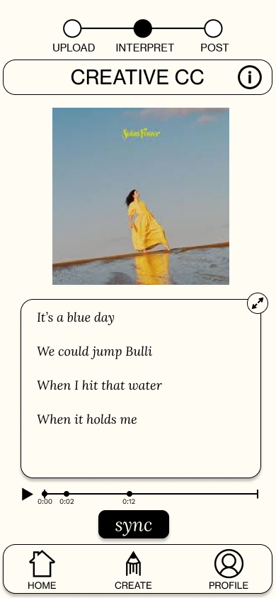
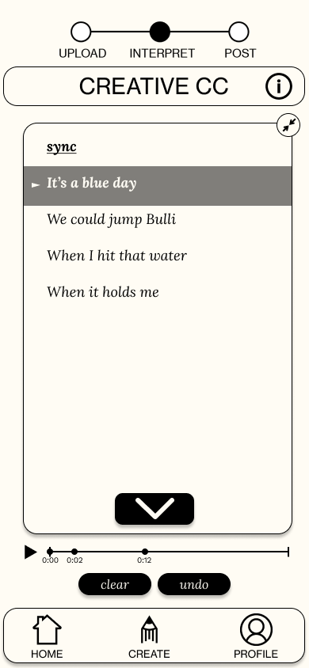
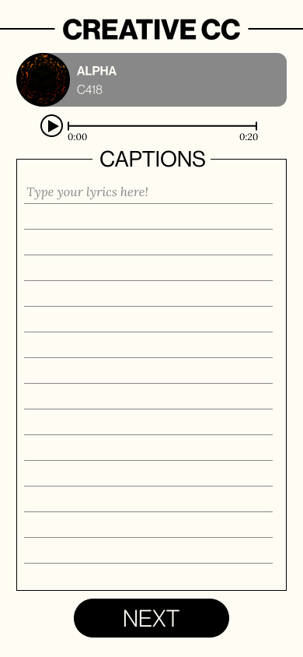
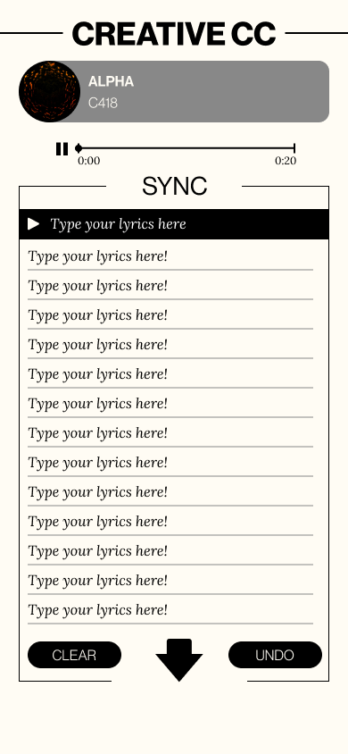
Interface Changes
MAJOR CHANGE 4 -
Creative CC Flow
Old design:
New design:

Slide 9
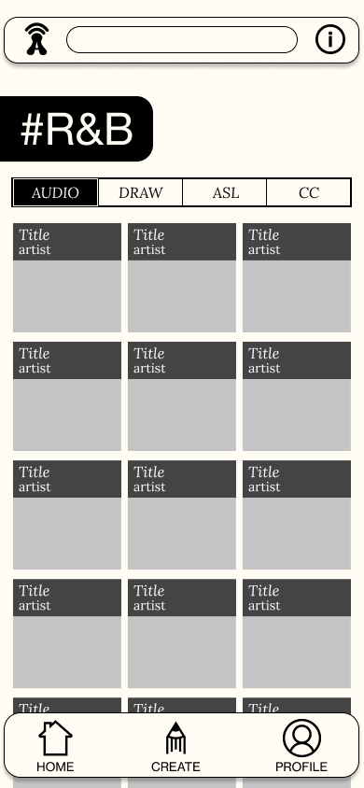
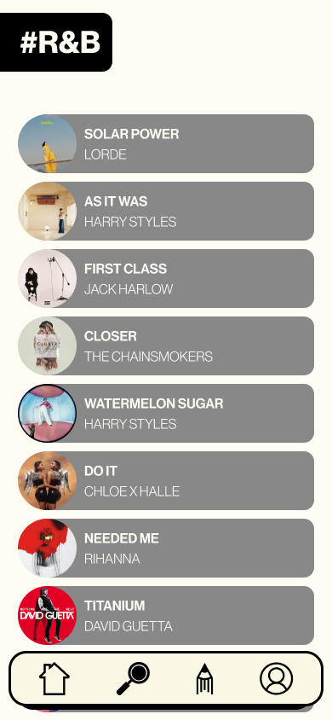
Interface Changes
MAJOR CHANGE 5 -
Search View
Old design:
New design:

Slide 10
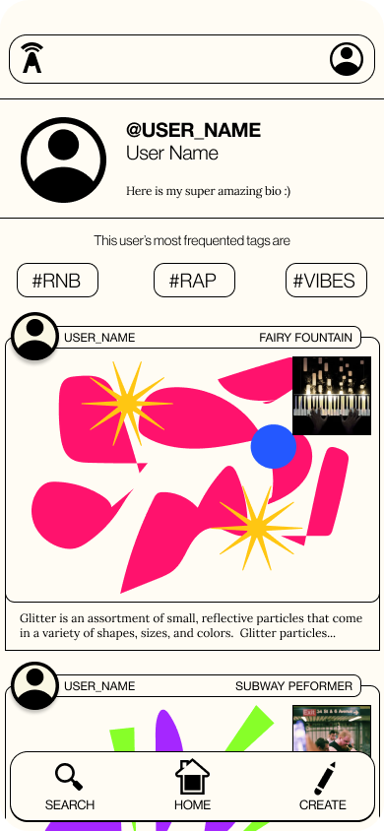
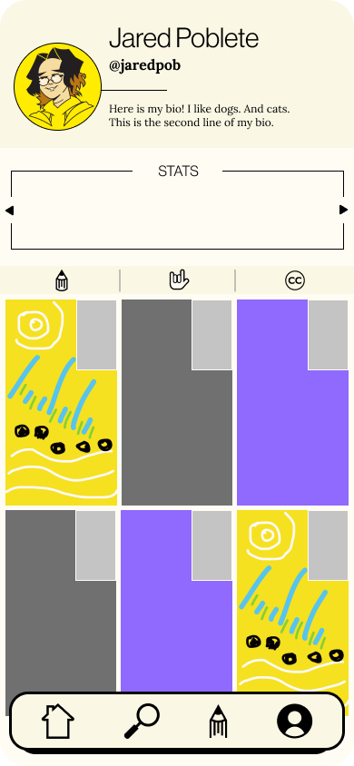
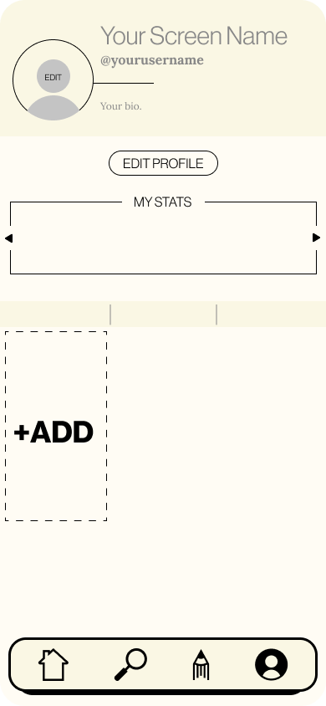
Interface Changes
MAJOR CHANGE 6 -
Profile View
Old design:
New design:

Slide 11
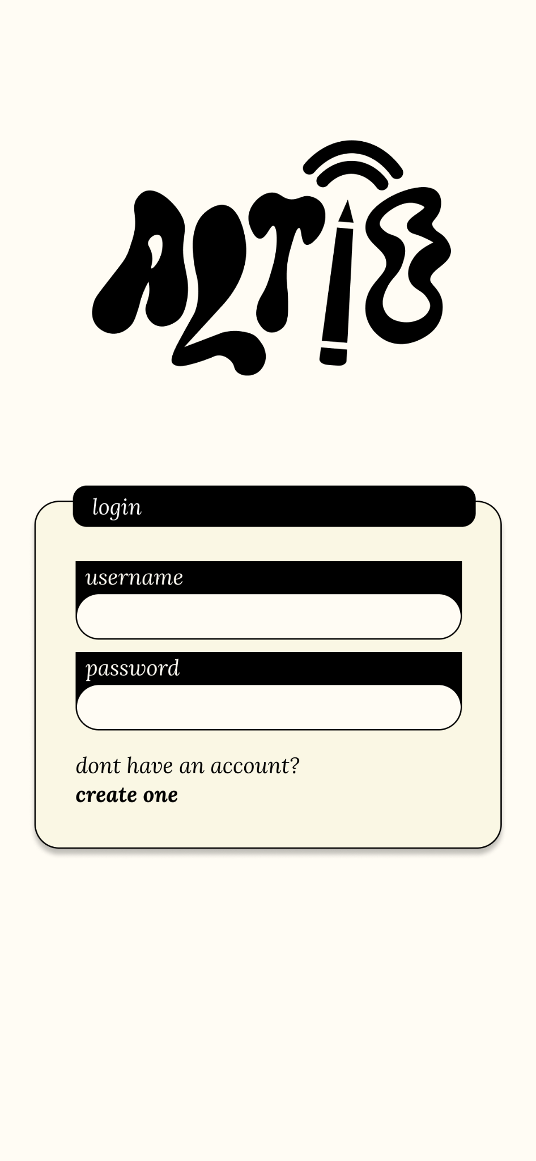
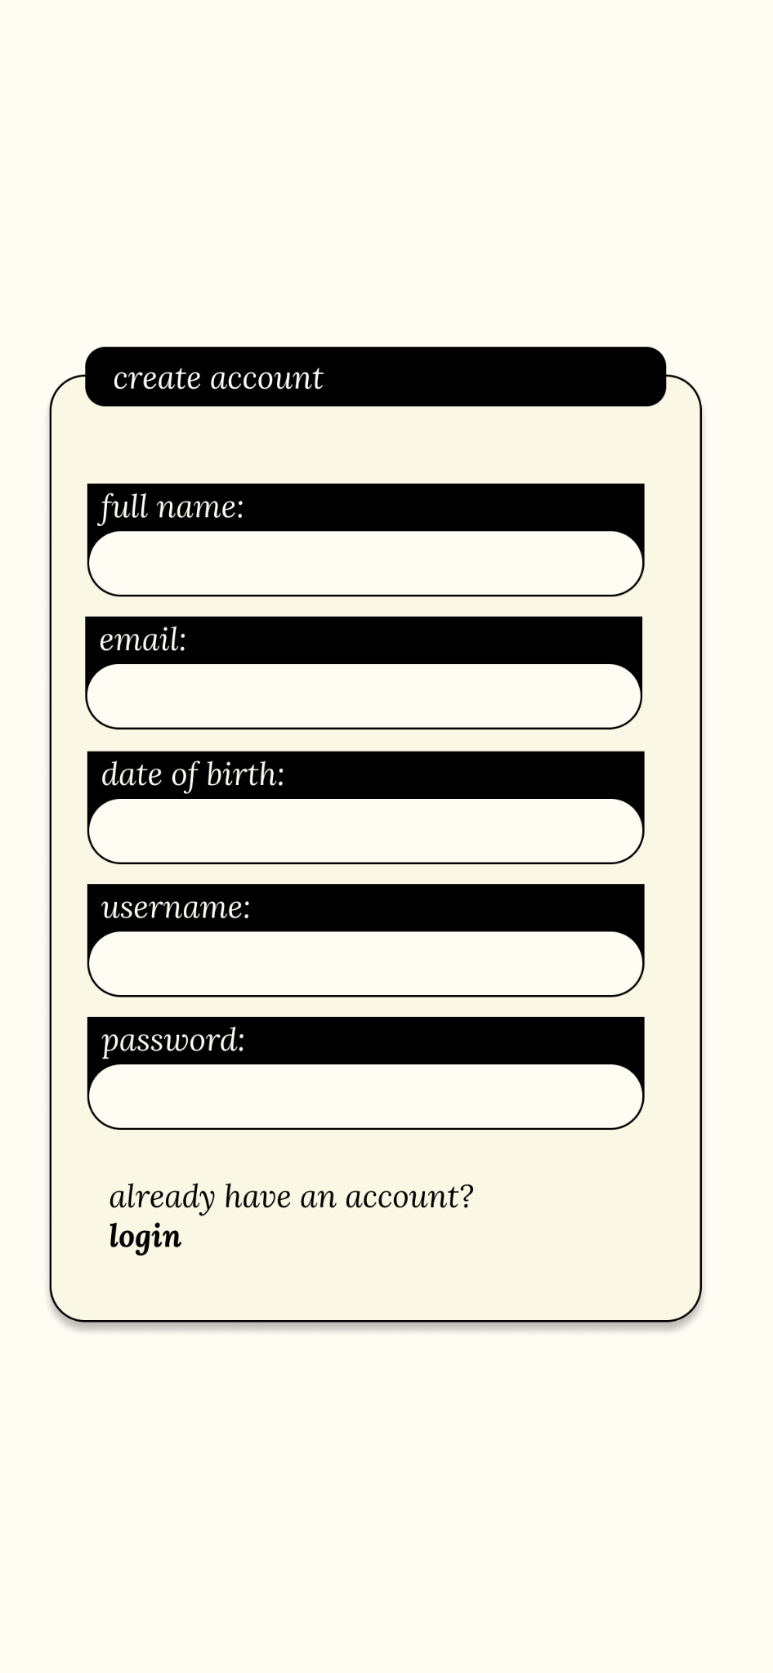
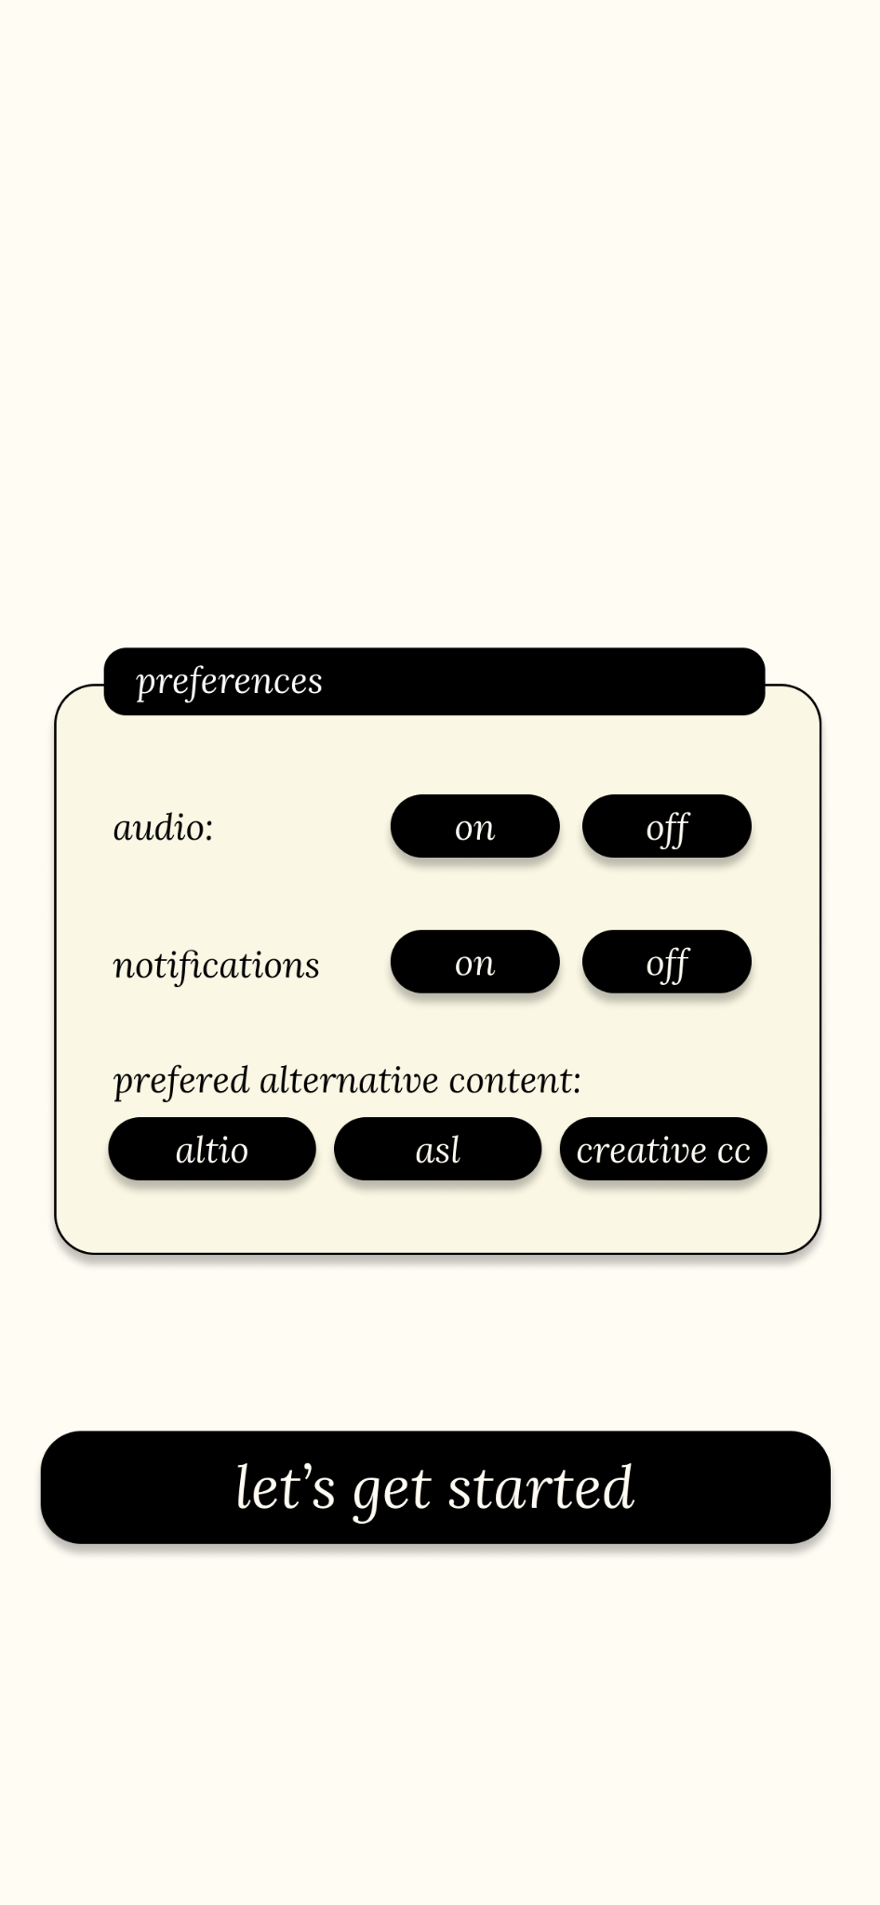
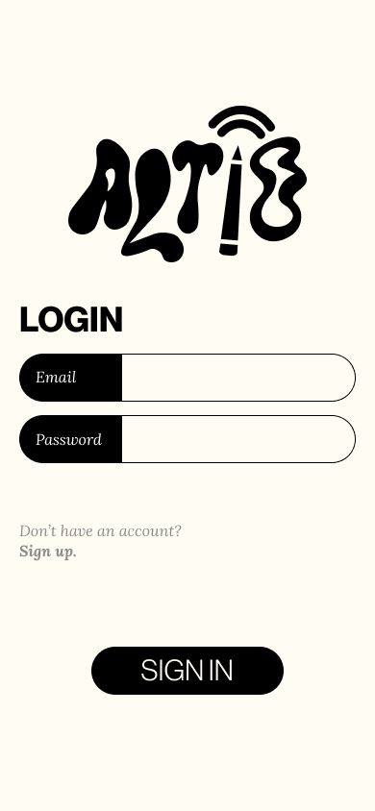
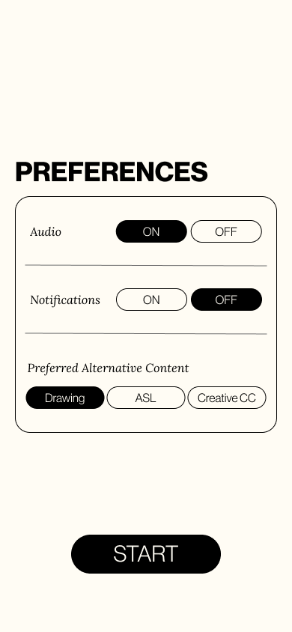
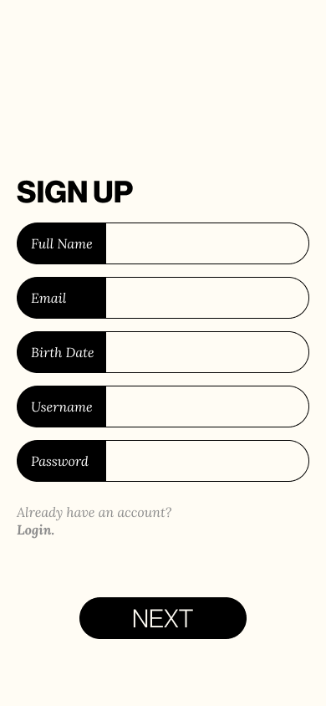
Interface Changes
MAJOR CHANGE 7 -
Create Account
Old design:
New design:

