Slide 2
PROBLEM
Deaf and hard of hearing people are often left out of key nuanced information that is conveyed through audio in digital spaces
SOLUTION
ALTiO is a social media platform that encourages and provides visual interpretations of audio–providing alternative options for everyone to experience content
ALTiO is a social media platform that encourages and provides drawings as visual supplements for interpreting audio–providing alternative options for everyone to experience content

Slide 3
Outline
Prototype Changes
Testing Methodology
Results
Discussion

Slide 4
Prototype Changes

Slide 5
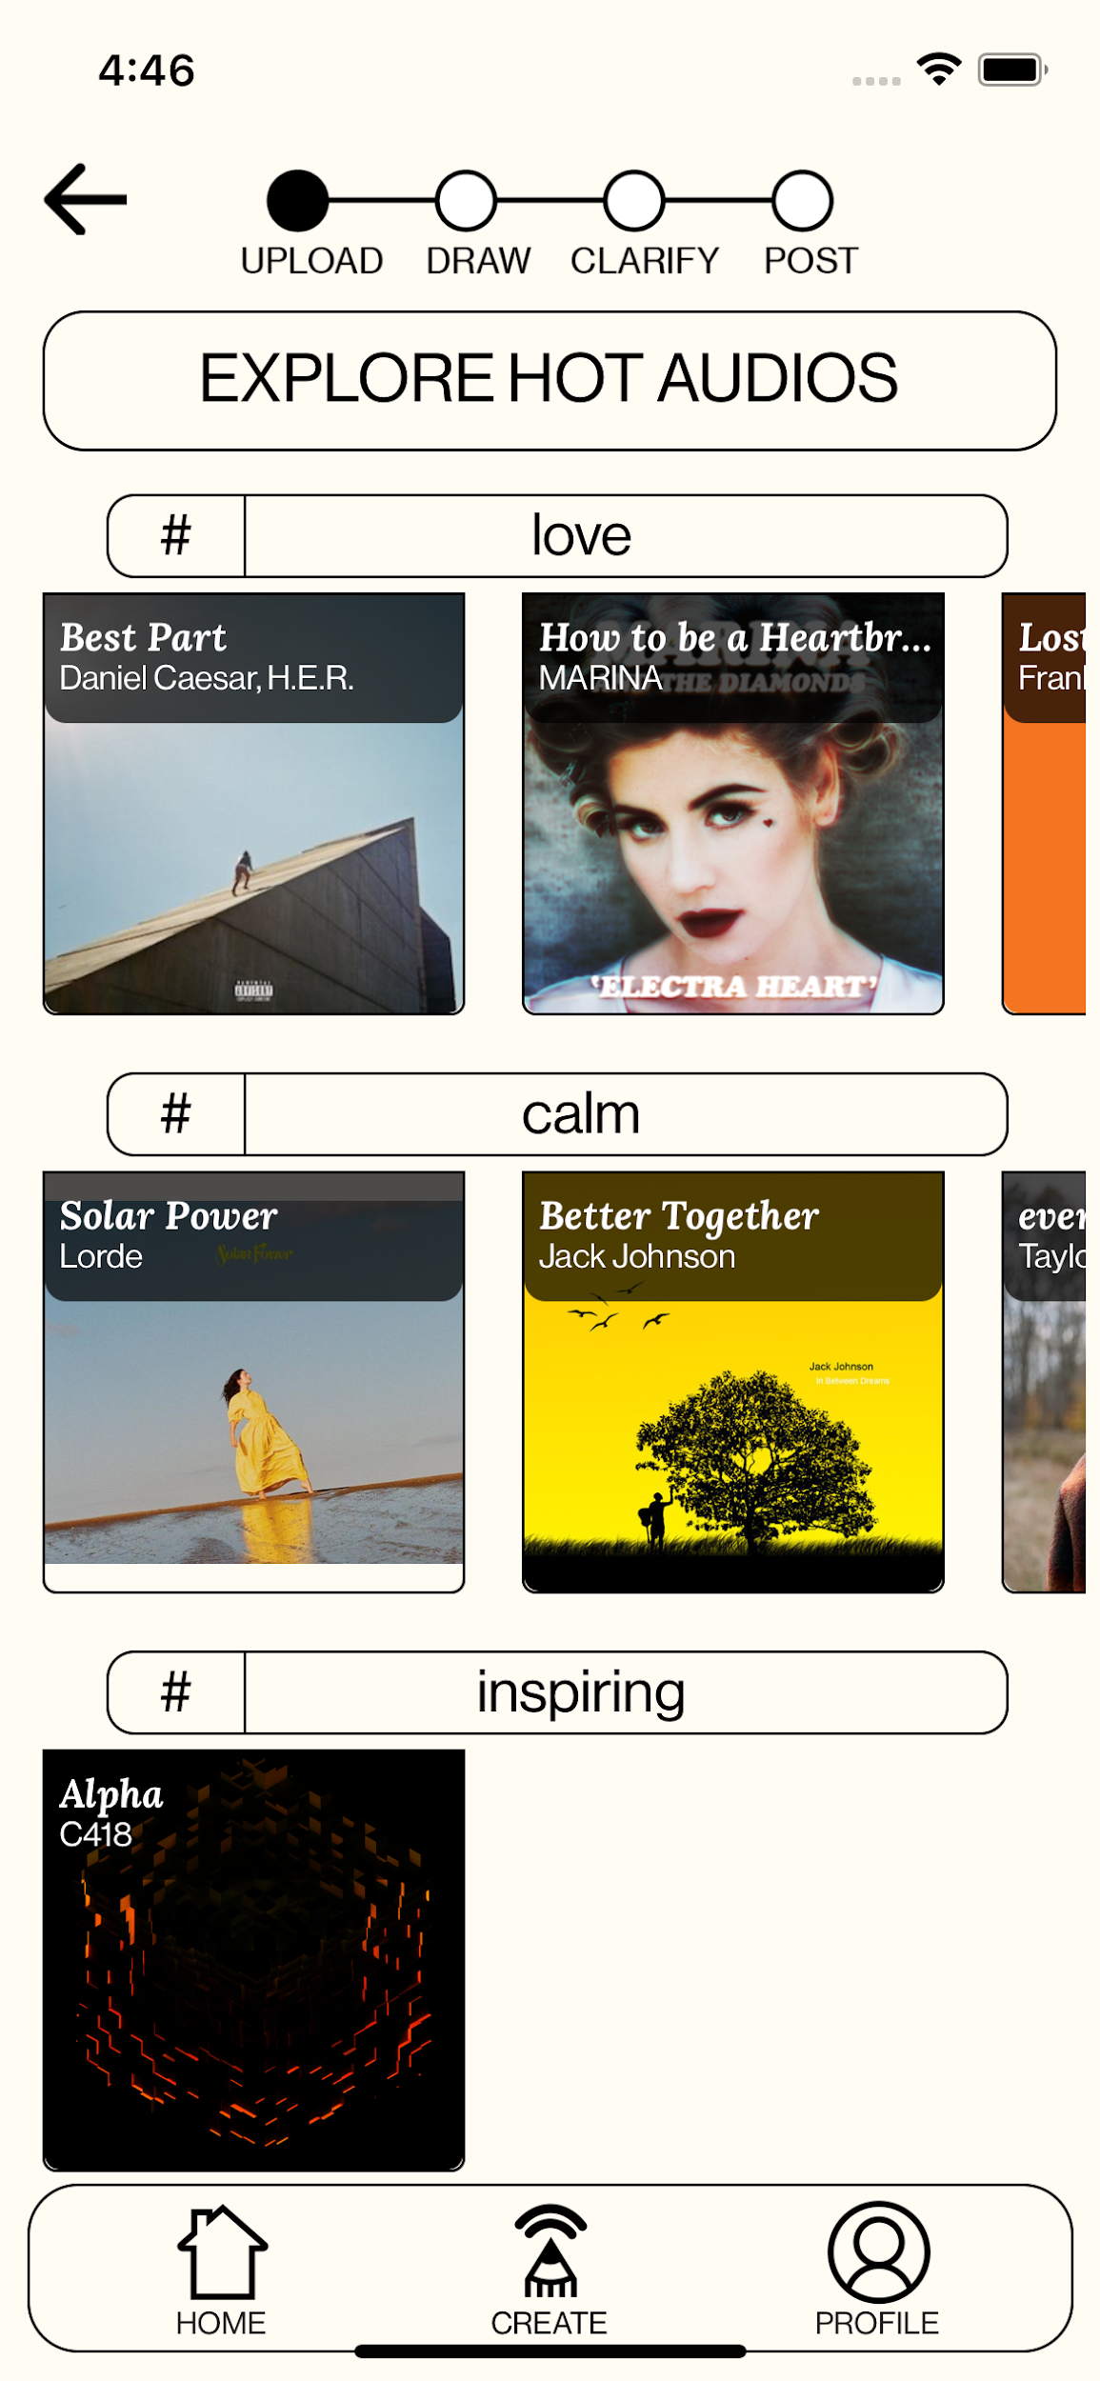
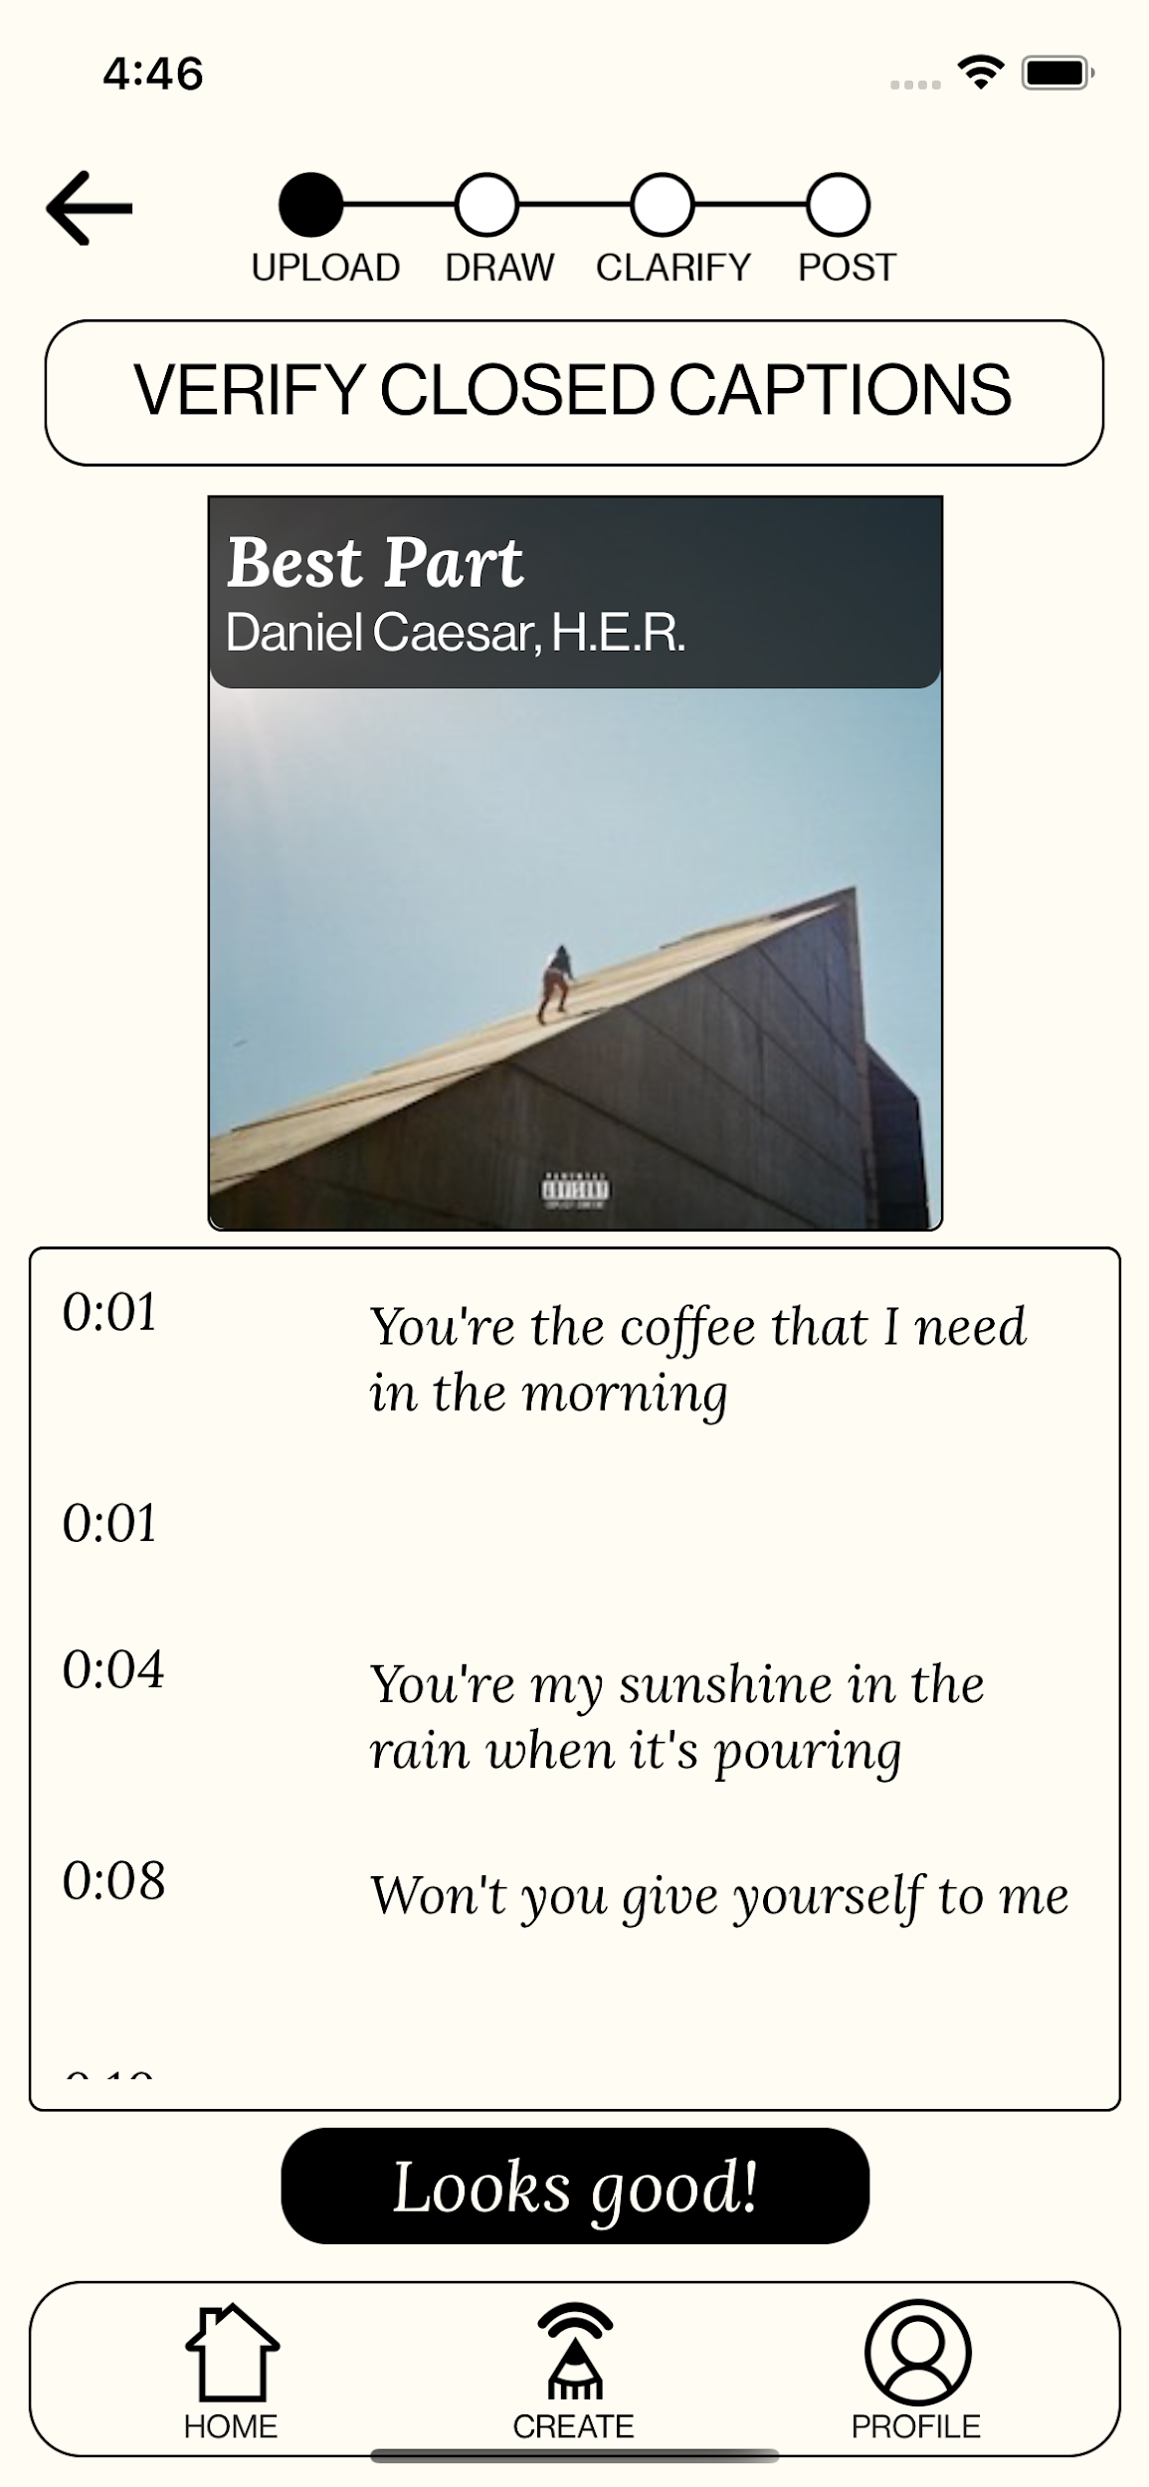
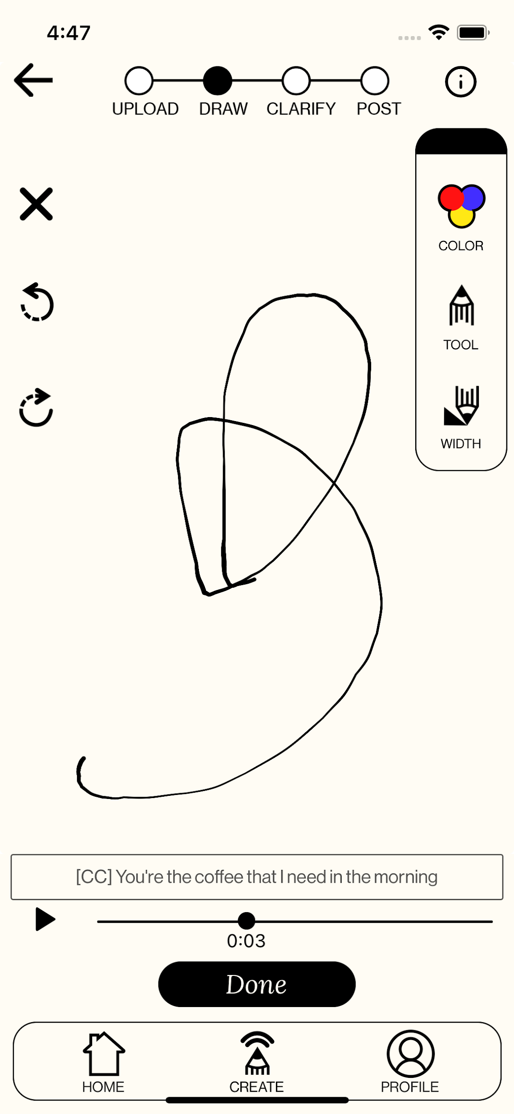
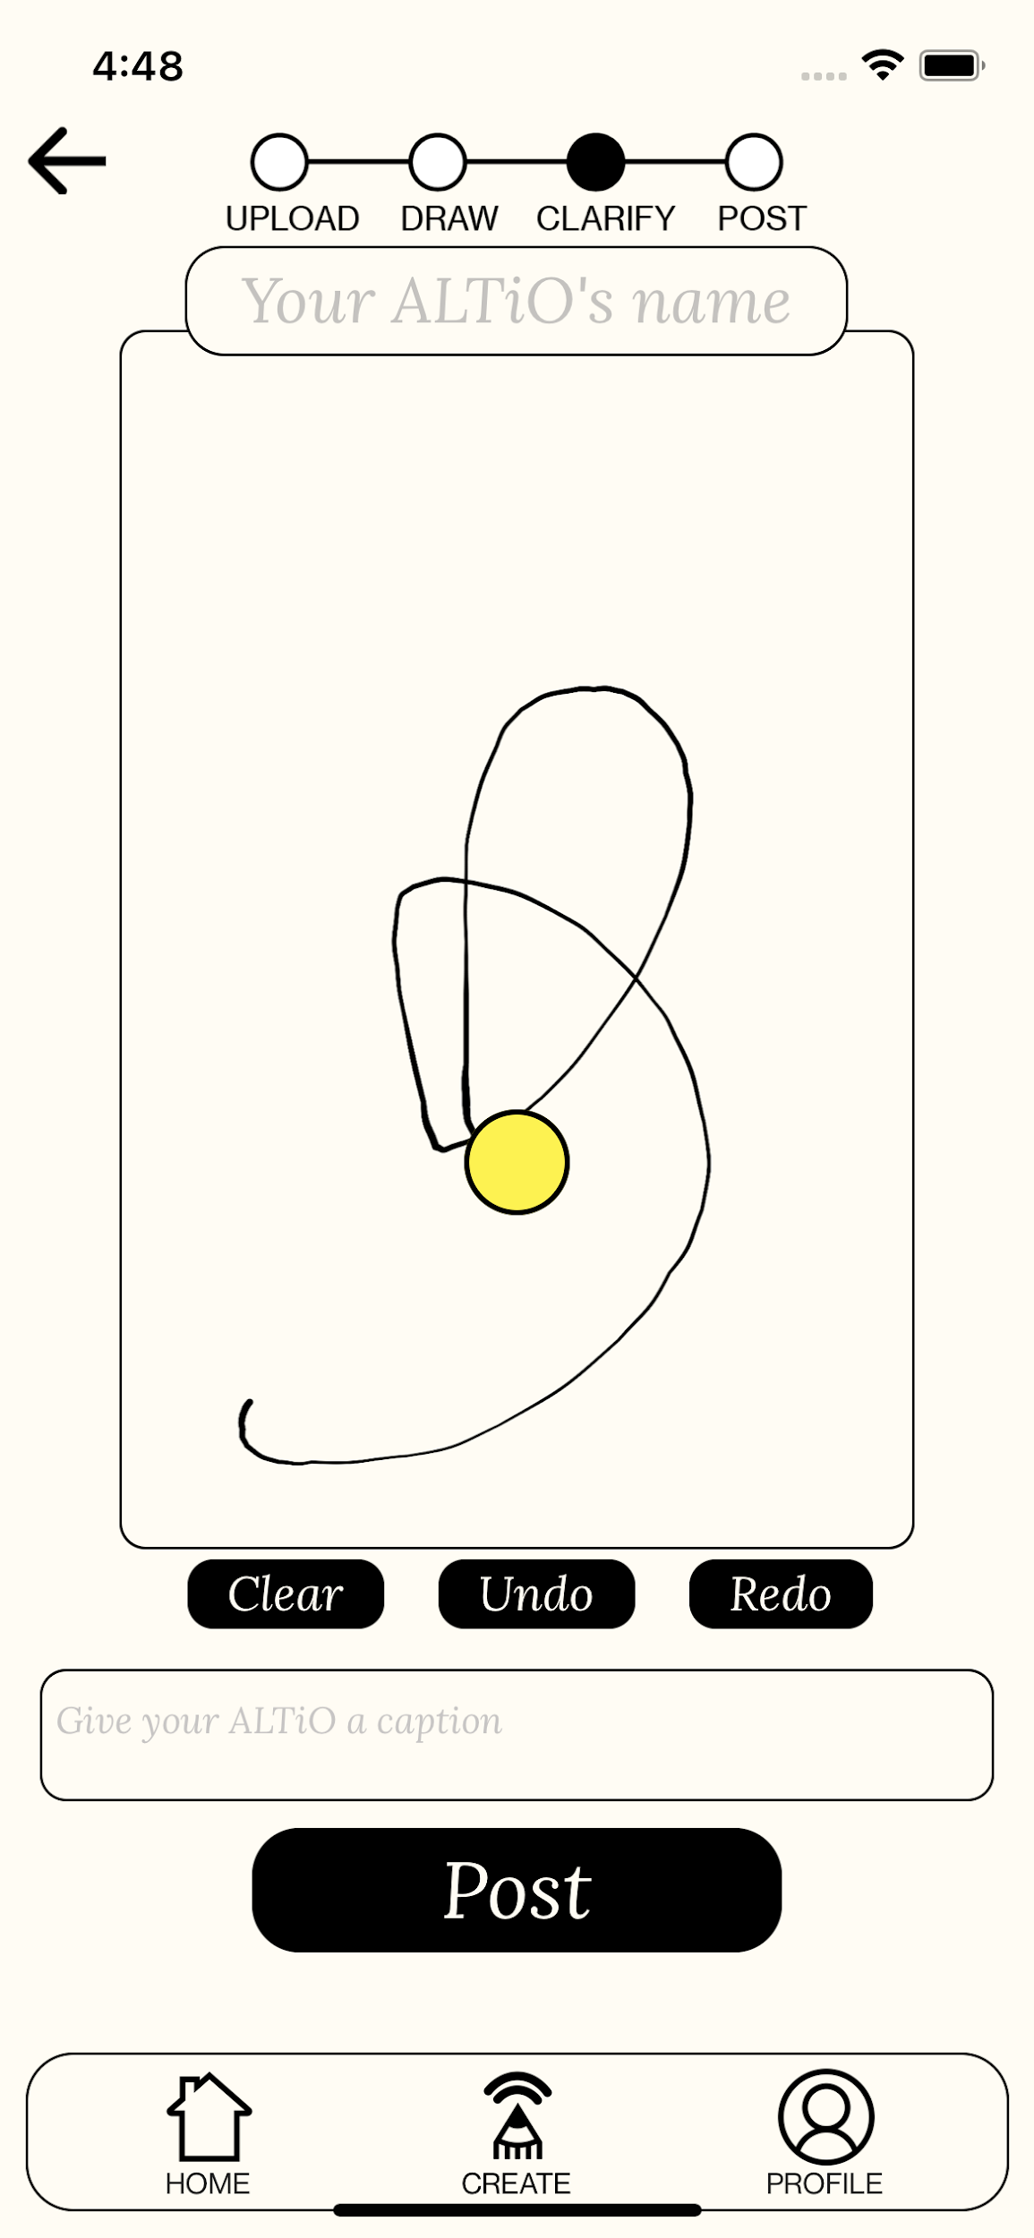
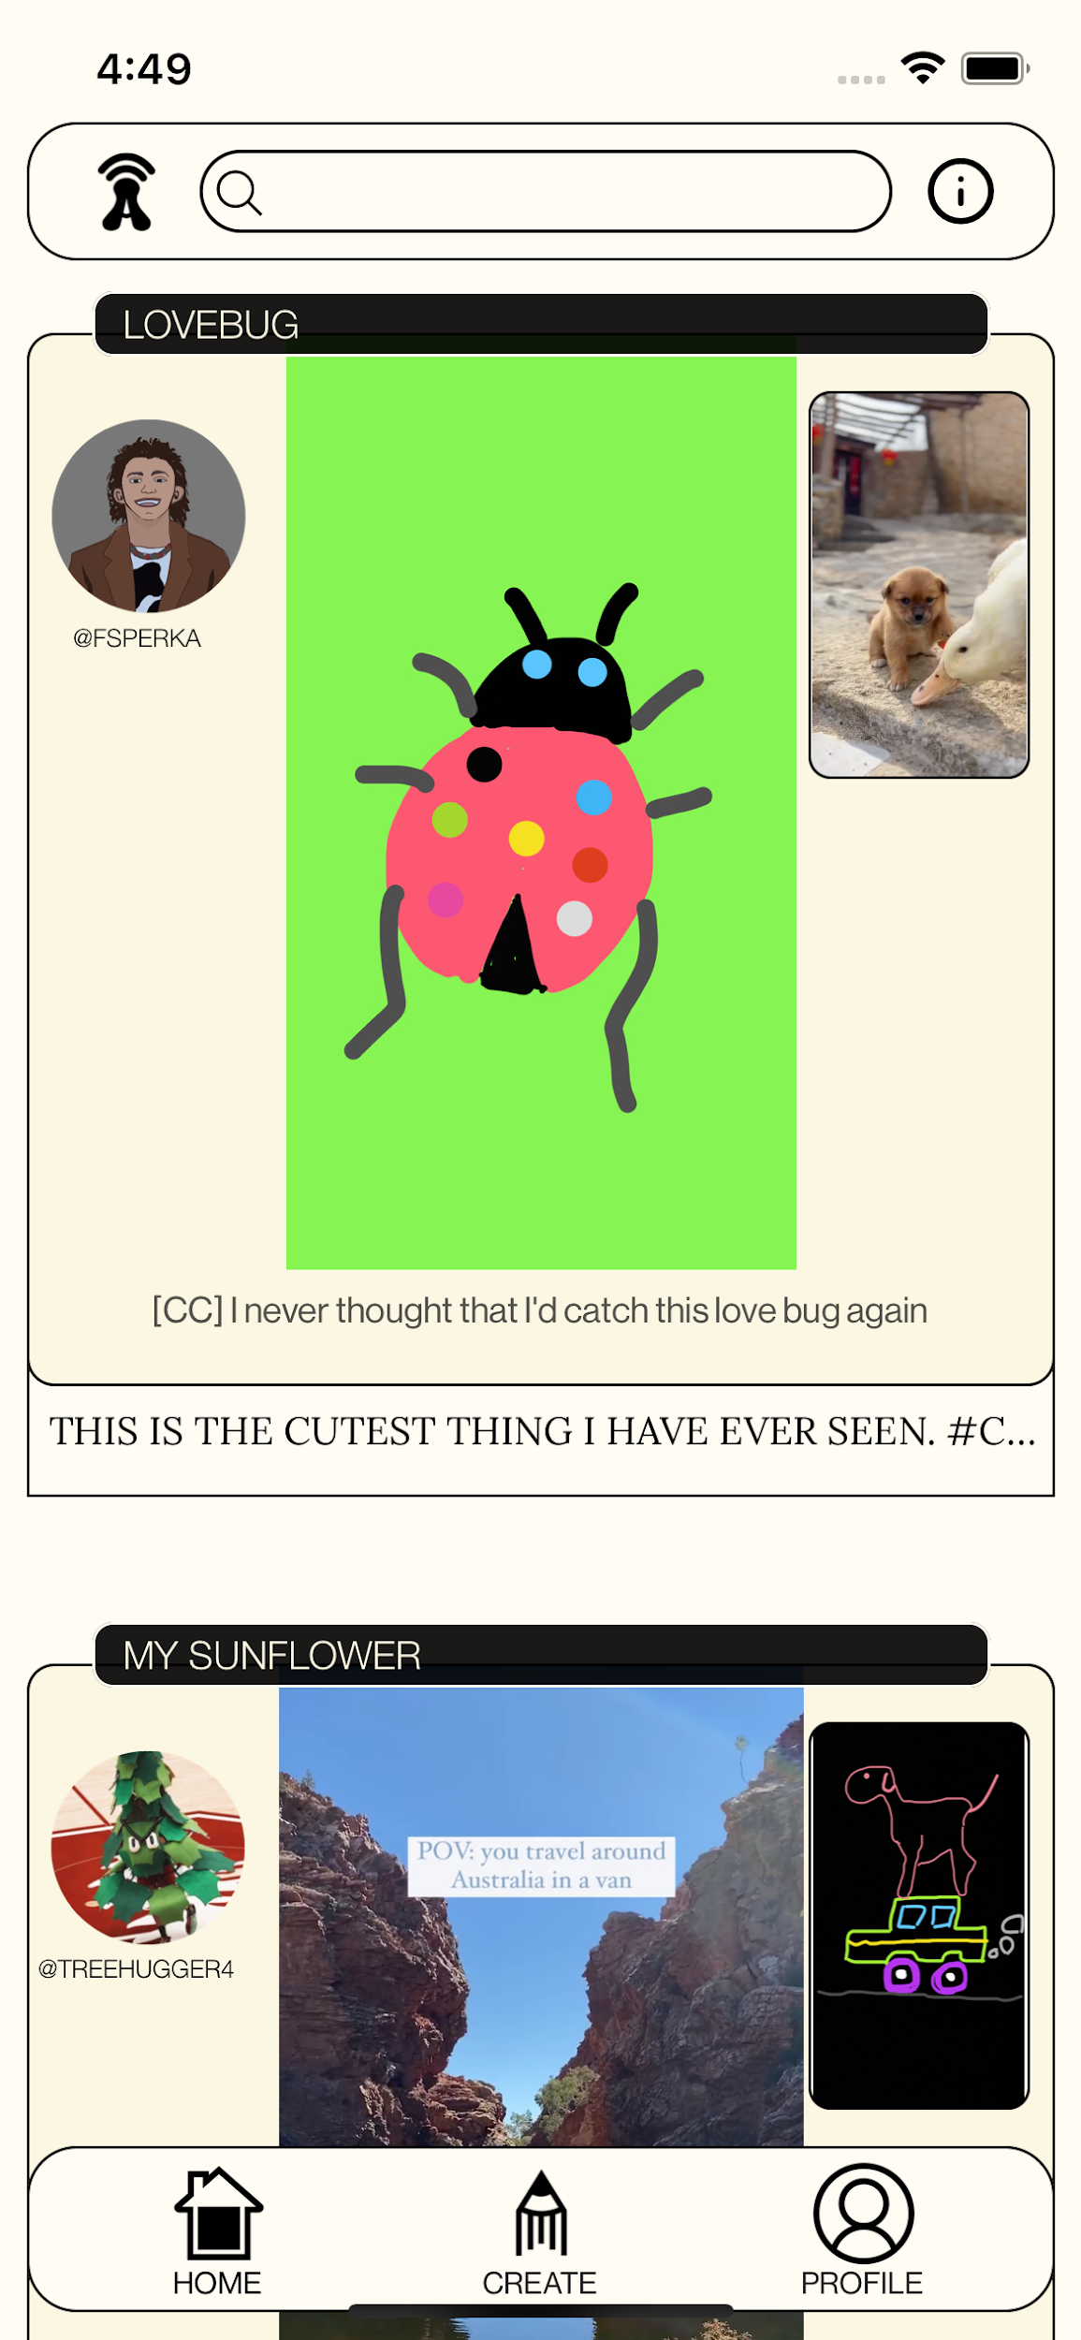
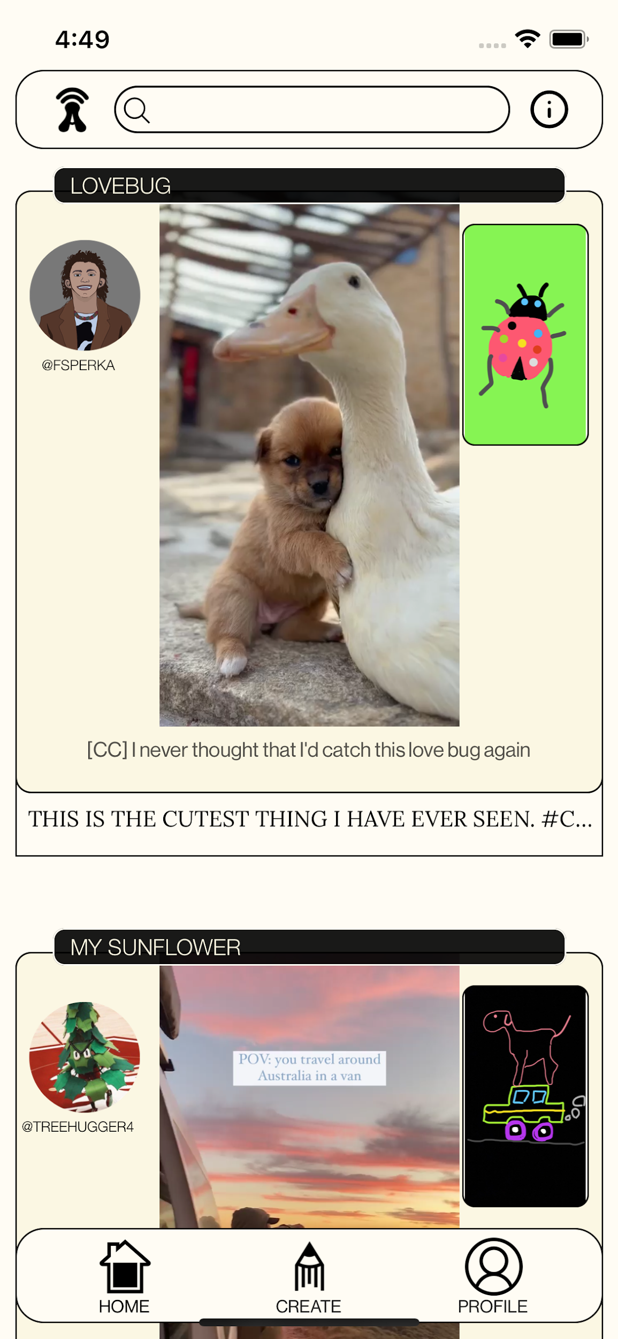
Prototype Changes
MAJOR CHANGE 1 - Interpretation Methods
Previous design:
SOLUTION: Rethink how audio is interpreted and how the posting process can be condensed.
Notes:
First major change: inherent structure of interpretations of audio
Previously: linear process to create altio
Drawing is main interpretation to toggle between

Slide 6
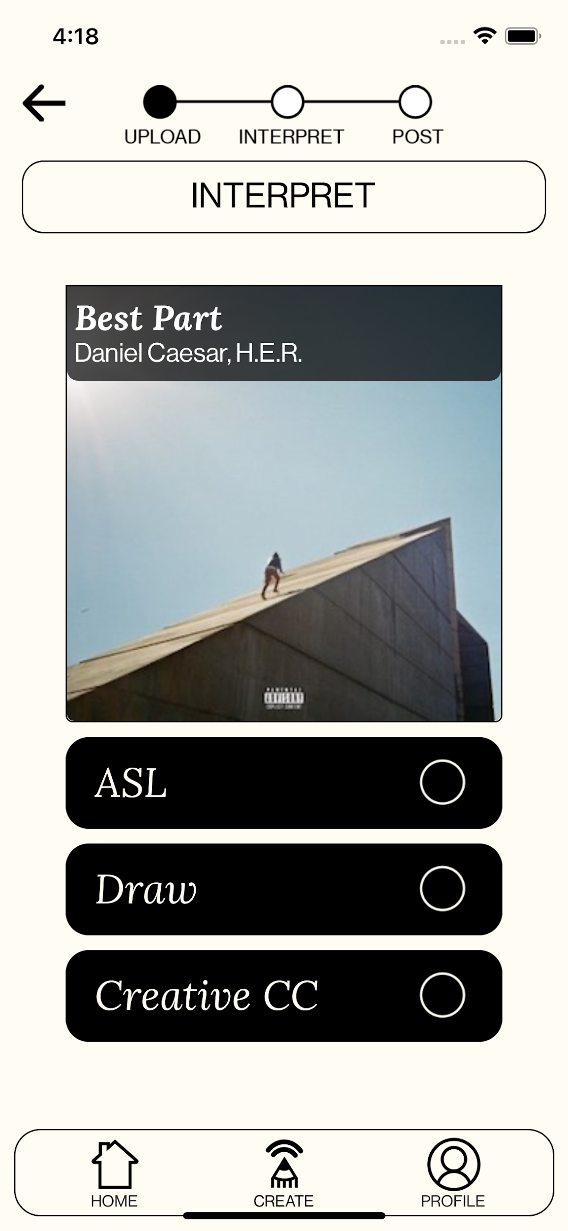
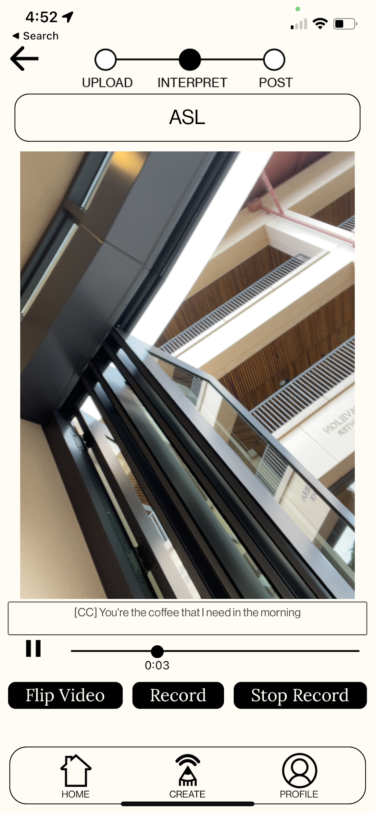
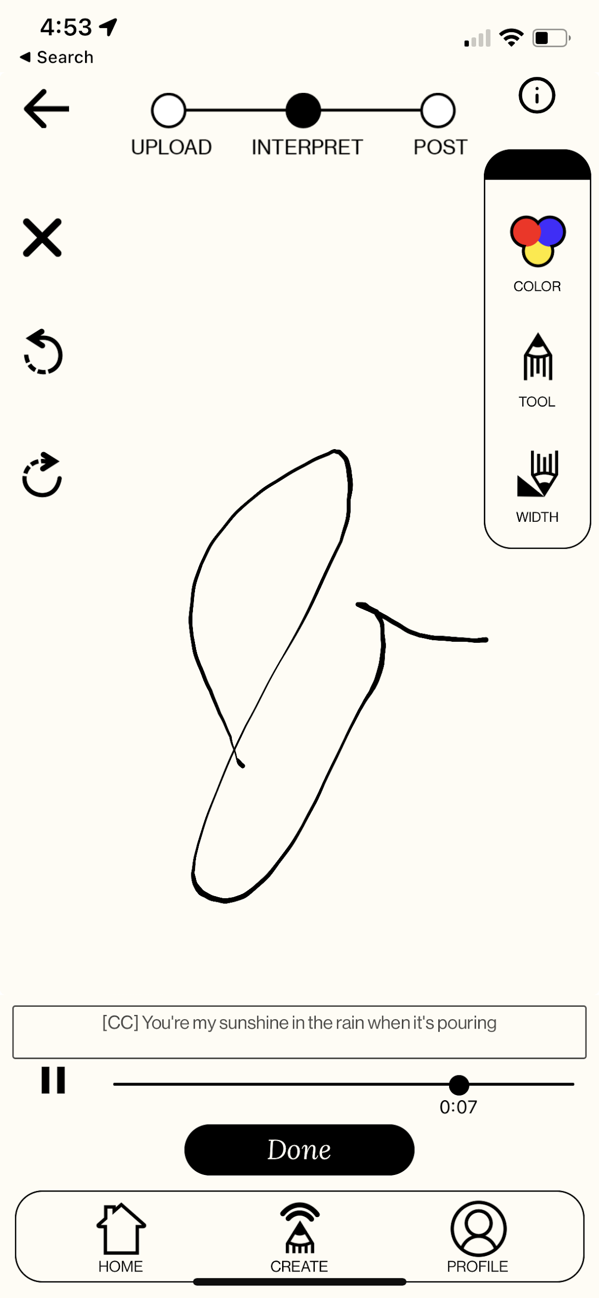
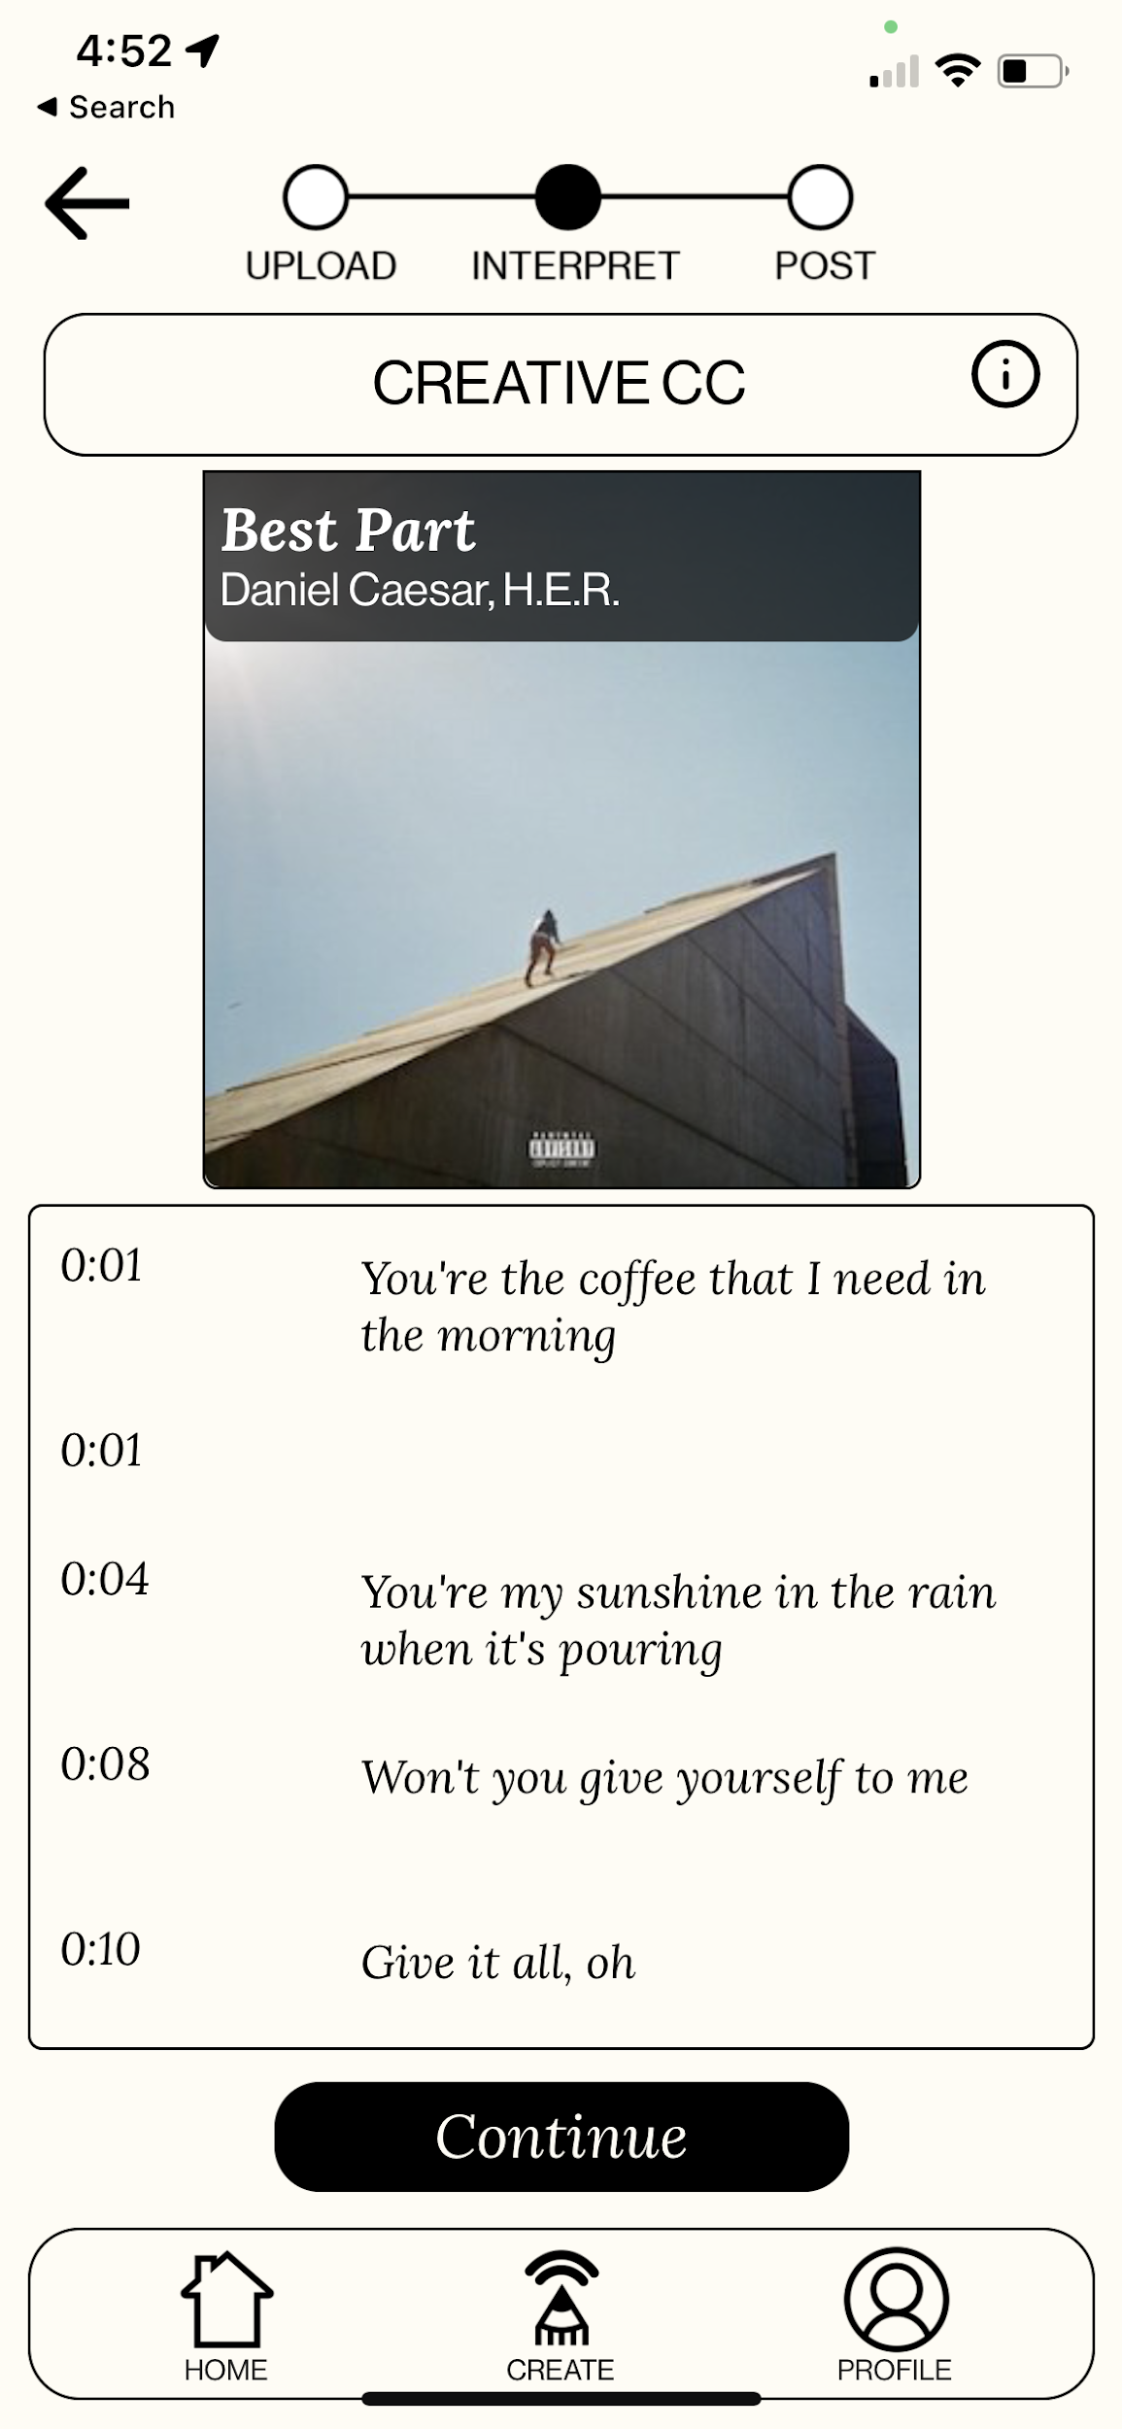
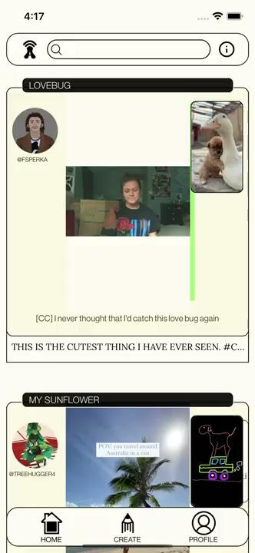
Prototype Changes
MAJOR CHANGE 1 - Interpretation Methods
Updated design:
Notes:
Updated: Wanted to expand interpretations
Condense post flow
Instead of just drawing, there is an interpretation stack

Slide 7
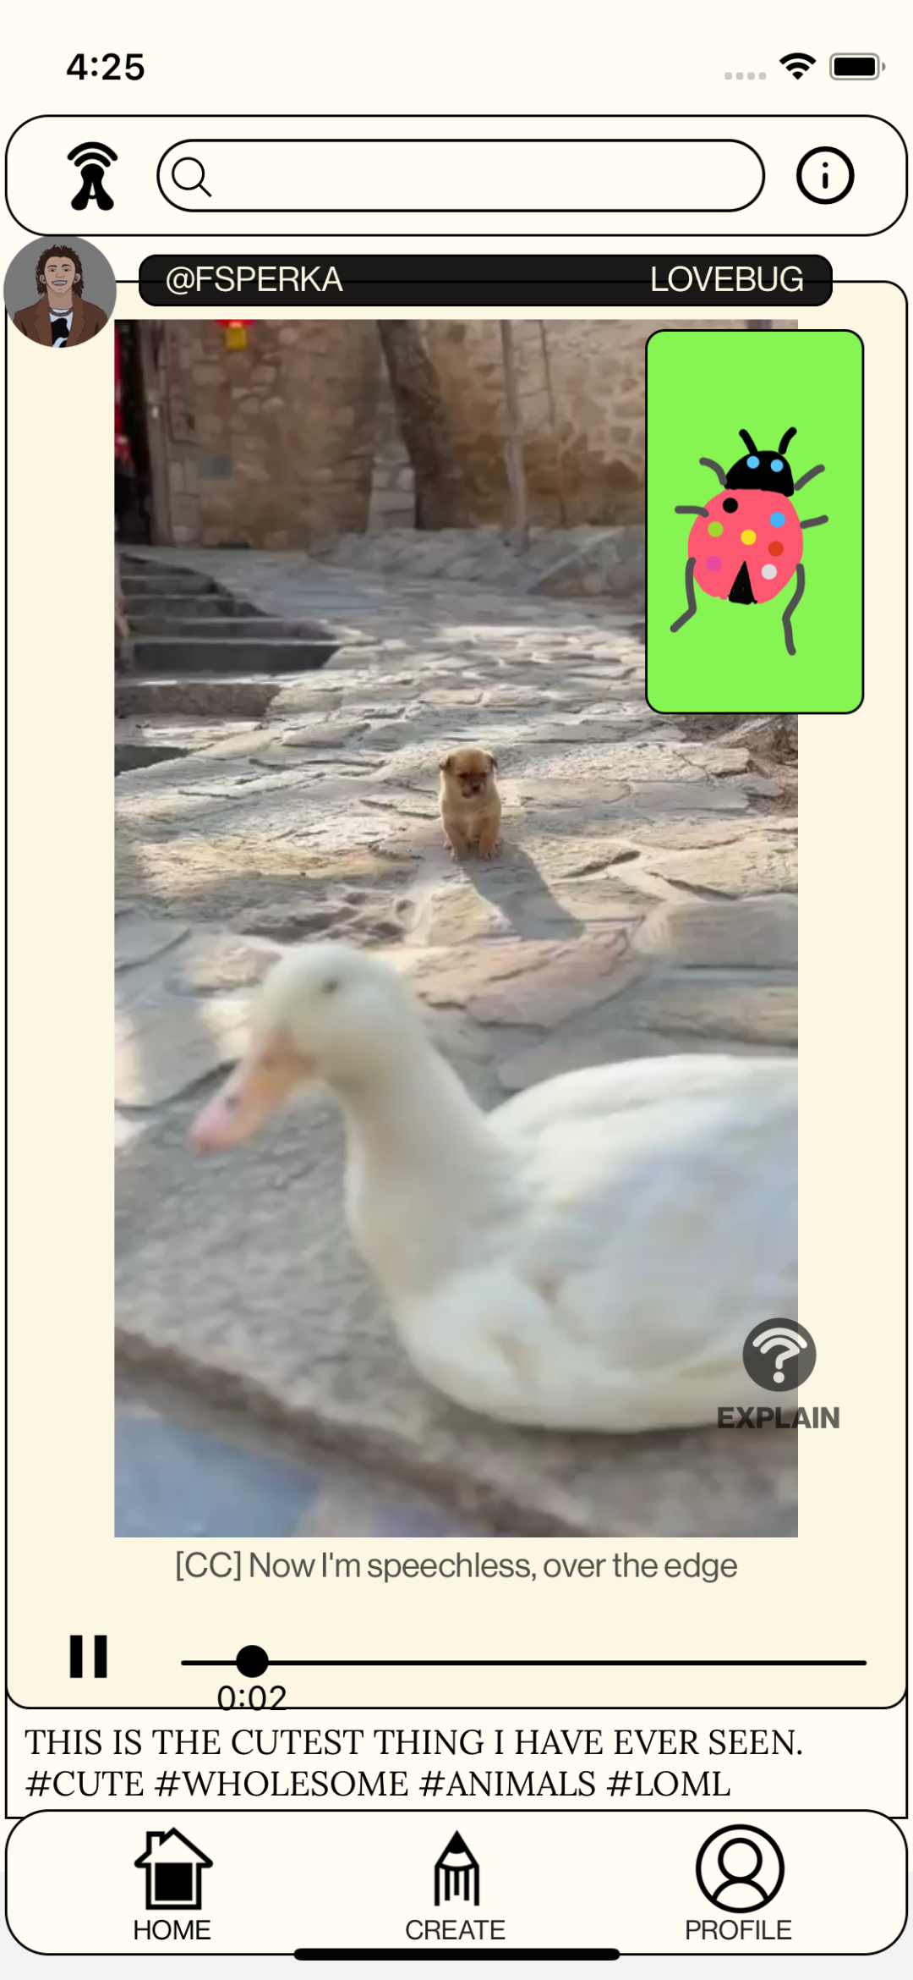
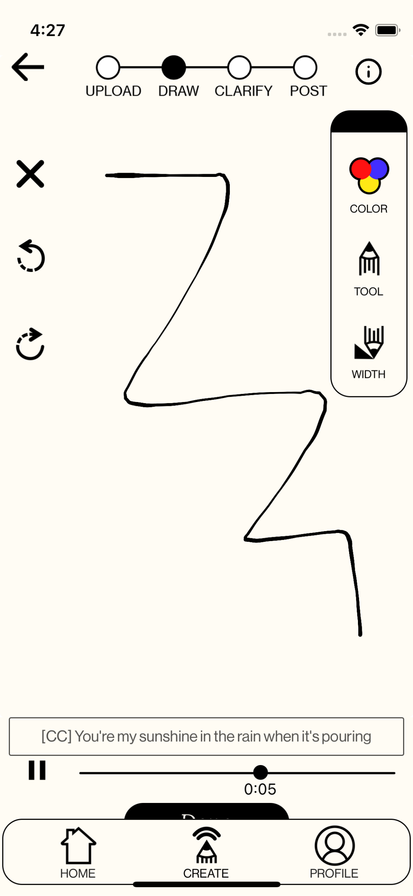
Prototype Changes
MAJOR CHANGE 2 - Resizing for Different Devices
Previous design:
SOLUTION: Scale elements based on screen sizes, rather than constants.
Notes:
Second change: resize app for different screen sizes
Optimized for iphone 12
Some components may overlap, or buttons might not be clickable

Slide 8
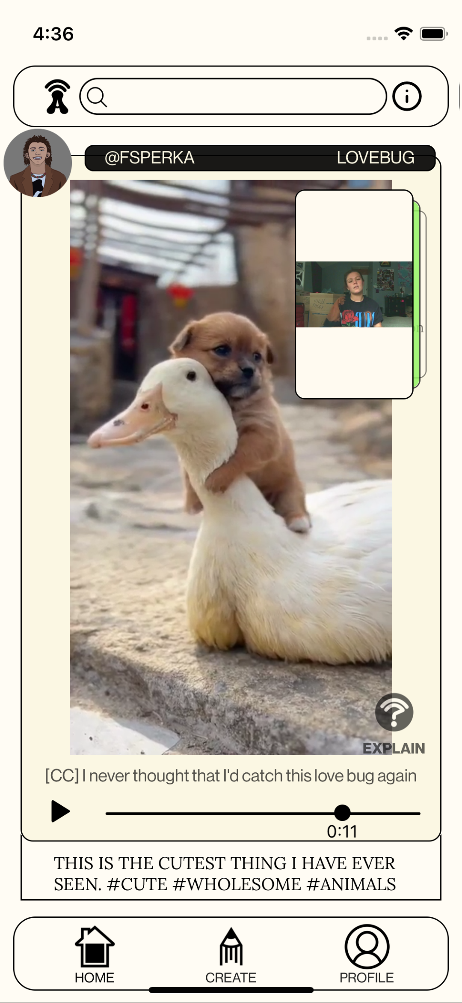
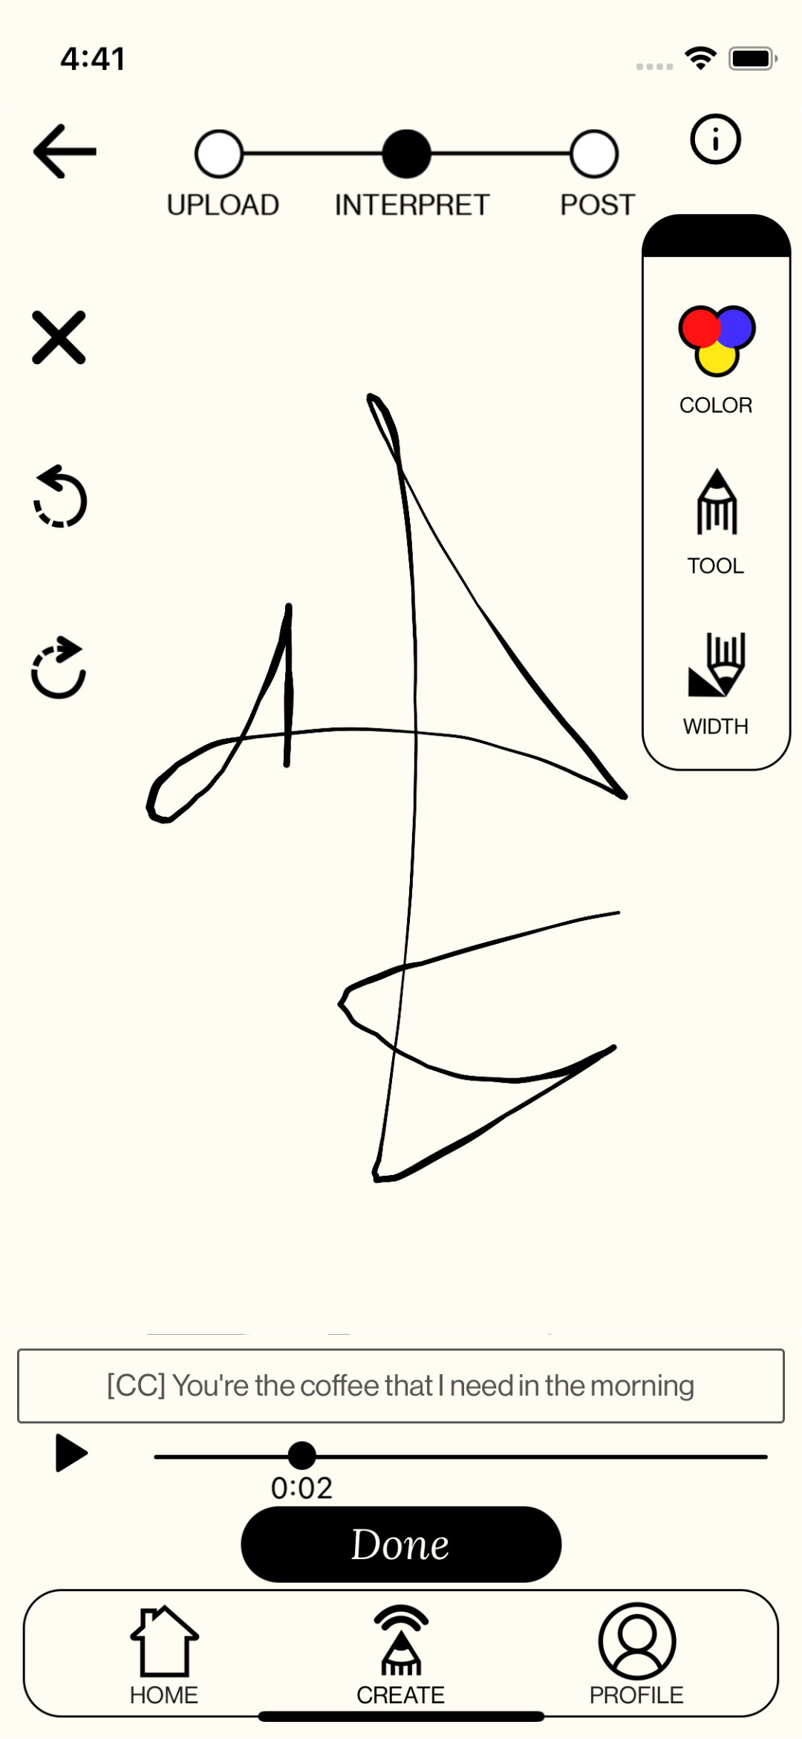
Prototype Changes
MAJOR CHANGE 2 - Resizing for Different Devices
Updated design:
Notes:
Use scaling functions to size components based on screen size
Improve visibility of components and prevent buttons from not bein able to be clicked

Slide 9
Testing Methodology

Slide 10
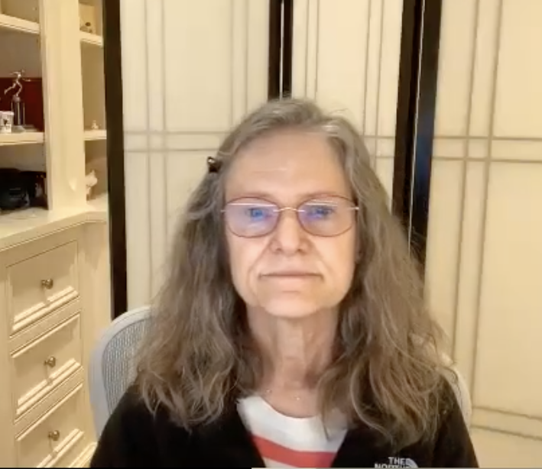
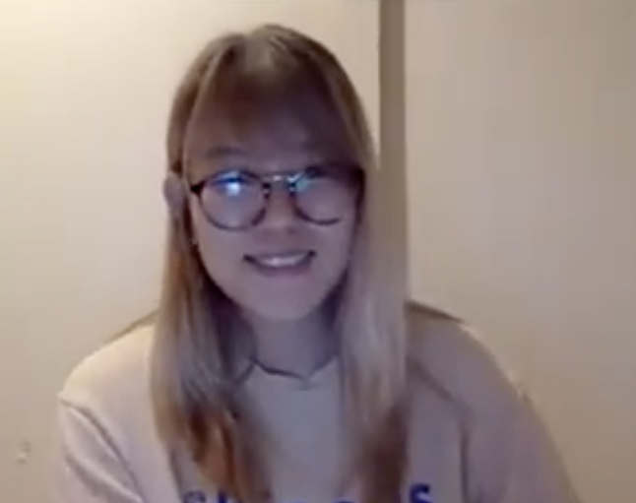
Participants
PARTICIPANT 002
PARTICIPANT 003
PARTICIPANT 004
Hard of hearing woman (>60 years old)
Compensated with $10 coffee shop gift card
Hard of hearing woman in her 30s
Declined compensation
Deaf woman in her mid-20s, fluent in ASL and Korean
Compensated with $10 coffee shop gift card
Notes:
Three participants total
Since weren’t able to test hi fi prototype wanted to get better sense of features w community members

Slide 11
Apparatus
INTERVIEWS CONDUCTED
APP ACCESS
SCREEN
RECORDINGS
Notes:
Testing technology

Slide 12
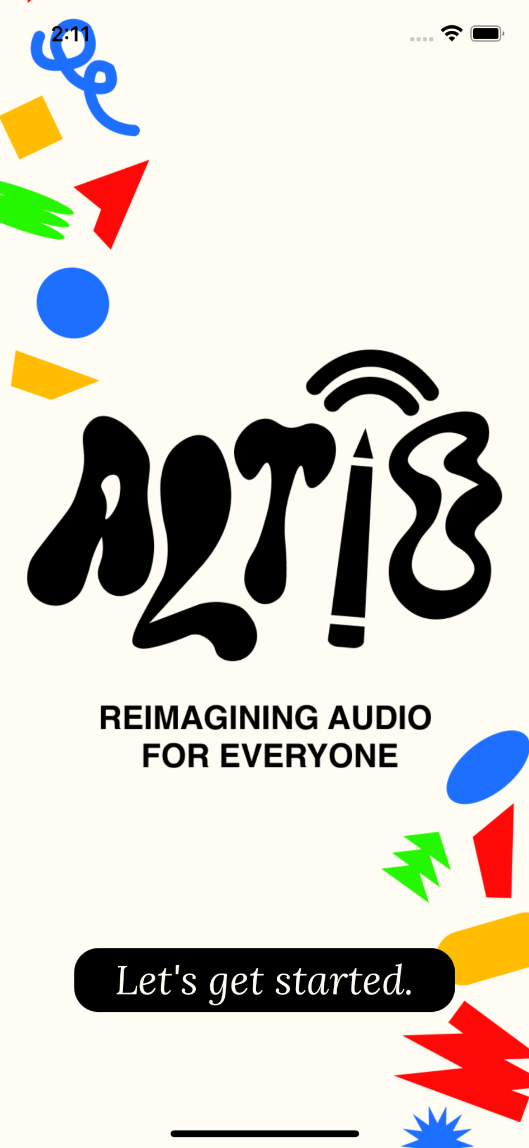
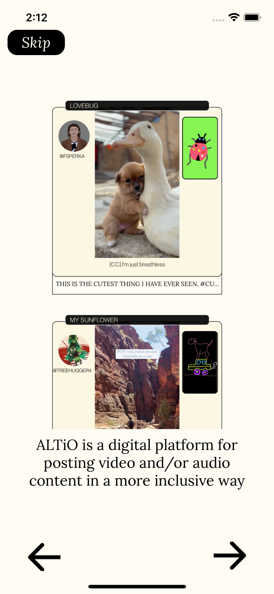
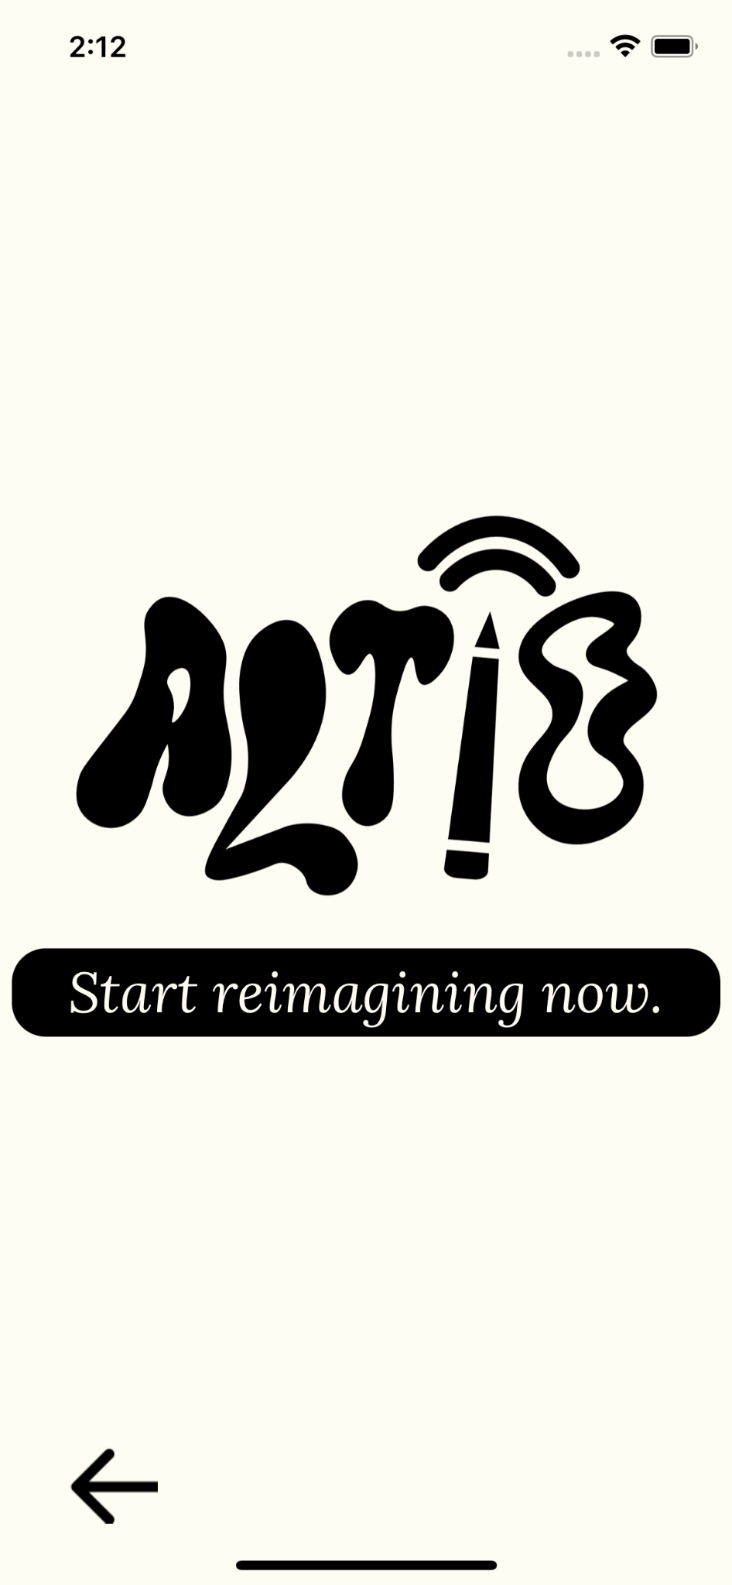
Tasks
TASK 1 - Onboarding
We had the user click through and read through the onboarding flow.
GOAL: For users to be able to understand the purpose of the app and what an “ALTiO” is.

Slide 13
Tasks
TASK 2 - View Content
We had the user navigate to an “ALTiO” interpretation for a post and view its annotations.
GOAL: A user can successfully navigate to an interpretation relatively easily, and that it is an enjoyable process.

Slide 14
Tasks
TASK 3 - Interpret ALTiO
We had the user create a post with an ALTiO interpretation.
GOAL: A user can successfully create a post with ease and enjoyment.

Slide 15
Tasks
TASK 4 - Engage with Community
We had the user navigate to find more interpretations of Funky audio.
GOAL: A user can find other interpretations of audio with ease, and the user is curious about other areas of the app.

Slide 16
Procedure
We interviewed each participant on Zoom, and started off with introductions.
We instructed participants to download Expo Go on their device, then log in with provided credentials to access our app by scanning a QR code.
We vaguely introduced our app and purpose, as well as how the testing procedure would look. At this point we began recording.
We asked users to complete the first task that we introduced. After completion, we asked a few questions about their experience and feelings.
We repeated this with each task, and finally concluded the interview.

Slide 17
Test Measures
ONBOARDING QUIZ SCORE
Does the user understand the basic goals and functions of the app from the onboarding screens?
COMPLETION OF EACH TASK
Can the user achieve the app’s goals?
LENGTH TO COMPLETION FOR EACH TASK
Is it easy for them to do?
INSTANCES OF VISIBLE ENJOYMENT
Do they enjoy using the app?
Notes:
For Onboarding:
number of “correct” answers to questions asked, to ensure clarity of onboarding flow.
For View Content:
success in finding annotations, to make sure it is clear where to find annotations
number of misclicks, to understand what elements may be confusing for users
length to completion, to observe how difficult this process is
instances of visible enjoyment, to observe how much users enjoy this process
For Interpret ALTiO:
Success in interpreting and posting
Instances of visible enjoyment
Number of interpretation methods interacted with
Length of time to add annotations
Length to completion
For Engage with Community:
Number of misclicks
Number of clicks of different elements on pages (discoverability/curiosity)
Length to finding correct screen

Slide 18
Results

Slide 19
Onboarding Quiz Score
Based on what you saw in the onboarding, what can you do in this app?
What is the purpose of this app?
What is an altio?
PARTICIPANT 002
PARTICIPANT 003
PARTICIPANT 004
1.5/3
Unsure about what they are able to do in the app.
Correctly identified “alternative” as a part of “altio”, but not the other part.
“It doesn’t tell me what my audience can expect to see”
3/3
Confused on first read, but after rereading participant understood
Suggested seeing the definition of altio earlier
Problem / solution framework
1.5/3
For the first question: weren’t sure what the altios were for or how to create them
Guessed both that the app’s purpose was to “make sound into art or was some sort of game.”
Notes:
Three questions asked each participant at end of onboarding flow
On avg ⅔ right
Participant with 3 right had to reread, and spent significantly more time on this section
Each had some confusion about purpose of app after first read

Slide 20
Successful Task Completion
PARTICIPANT 002
PARTICIPANT 003
PARTICIPANT 004
Tasks Completed: 2/3
One screen was not formatted correctly on her device, and as a result was unable to complete this task
Tasks Completed: 2/3
Drawing screen was not formatted correctly and prevented drawing screen completion
Tasks Completed: 3/3
Notes:
two of the three participants were unable to complete the posting process due to our errors in formatting screens
if they were formatted correctly, it suggests that the task flows were smooth and somewhat intuitive

Slide 21
Instances of Visible Enjoyment
PARTICIPANT 002
PARTICIPANT 003
PARTICIPANT 004
Instances: 5
“That’s nice! There’s signing in the top right and captions, I like that.”
[in reference to annotations]: “Nice! Like a little more detail!”
Instances: 2
The participant more so approached the demo analytically.
“At first the yellow explainers where just about the picture… but then the explainers were clearly talking about [something] only in the audio.”
Instances: 3
“It’s interesting that you can switch back and forth between images and videos.”
“I like the idea of having different categories of music!"
“This is like a bridge forward for Deaf people.”
Notes:
Participant 2 and 4 made more comments and had more reactions indicating visible enjoyment. Participant 3 approached the demo more analytically, and while she expressed interest, there were fewer immediate reactions.

Slide 22
Length to Completion Across Tasks
PARTICIPANT 002
PARTICIPANT 003
PARTICIPANT 004
AVERAGE
Onboarding
View content
Create Interpretation
Engage with Community
1:15
5:11
8:42*
2:14
4:00
2:36
2:00*
0:55
0:30
1:51
0:40
0:18
1:55
3:12
3:47
1:09
*time to stop, not completion
Notes:
For participants 2 and 3, formatting of the interpretation process prevented them from completion. This was the timepoints when the task was stopped
creation process was not as lengthy as expected, and comparable to making something like a tiktok or instagram post
ages and familiarity with social media seem to be reflected in these times
view content did take a bit longer than anticipated

Slide 23
Critical Incidents
Scale from 0-4, 0 being least severe
PARTICIPANT 002
PARTICIPANT 003
PARTICIPANT 004
Confused about what ALTiO’s were from onboarding screen | 2
Comments it would be nice to see multiple sentences of the captioning at once, so they don’t lose their place | 2
Unable to find explain button due to low contrast | 4
Not used to having to exit out of the expanded view in order to continue scrolling | 3
Stuck on a screen due to improper formatting | 4
Expects audio cards to be clickable | 3
Confused about order for onboarding screen | 4
After seeing first altio, user was unsure about the goal of the app – it was too related to the video | 4
Concerned about having personal videos and photos pulled up on the app | 2
Expected hashtags to be clickable | 3
Unable to complete creation process due to formatting | 4
During the onboarding, wasn’t sure what the image/drawing on the side was, and how it correlates with the video. | 2
Some drawings block part of the video, which is not visually friendly for people who are deaf | 2
Completely overlooked the explain function | 3
Didn’t find it interesting to read text explanations of drawings | 3
Was confused on “no audio, own audio, choose audio” options when creating own altio, and how they would know what music to choose if they cannot hear it. | 3
Wasn’t sure what to do with art itself, or what to draw | 4
Notes:
participants 2 and 4 missed the explain button that would pull up annotations
Participant 3 was confused about the purpose of the app after seeing the first post
Participant 4 also felt excluded in the screen to choose audio, as she doesn’t know what audio she should be choosing as she can’t hear it

Slide 24
Discussion

Slide 25
What we learned
ONBOARDING NEEDS IMPROVEMENT
As shown by our onboarding quiz results and confusions
Users needed guidance to understand the purpose of our app

Slide 26
What we learned
During testing, some users were unable to, or had difficulty completing tasks due to different phone sizes
IMPROVE SCALABILITY THROUGHOUT PHONE SIZES
There is significant sizing differences between phone versions, so not all formatting is consistent.

Slide 27
What we learned
NEED MORE GUIDANCE THROUGHOUT THE APP
Enjoyment and efficiency may be increased by mitigating confusion throughout the app using multiple tours / guides throughout the app
Users took longer than we had hoped to complete certain tasks, and were often confused

Slide 28
What we plan to change
ACCOUNT CREATION / USER PREFERENCES
Avoid feelings of exclusion for Deaf and HoH users by asking for preferences of content type and audio preferences early on
ONBOARDING FLOW
Introduce our app as a solution to an existing problem, also including additional “onboardings” throughout the app (feed, create, etc.)
EXPLAIN FUNCTION
Improve explain button visibility, and make clear what numbers do
IMPROVED ASL / CREATIVE CC SUPPORT
Introduce captions

Slide 29
Next steps
IMPLEMENTING CHANGES FROM LEARNINGS
ALLOW FOR CLICKSTREAM LOGGING
IMPROVE STOCK ALTIOS / ASL / CREATIVE CAPTIONING CONTENT
KEEP WORKING WITH DEAF / HOH COMMUNITY

Slide 30
Thank you!

