Slide 1
Thundr Usability Testing
CS 194H - Winter 2019
Austin Jones
Caroline Willis
Emma Alderton
Daniel Kharitonov

Slide 2
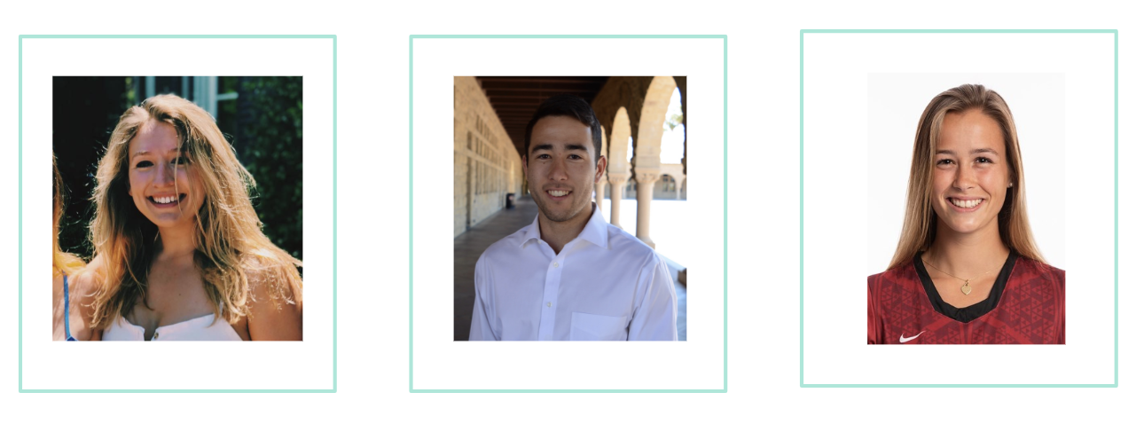
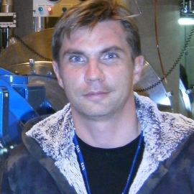
The Team
Caroline Willis
Austin Jones
Emma Alderton
Daniel Kharitonov

Slide 3
Overview of Presentation
Prototype Changes
Experimental Method
Our Tasks
Results of the Study
Discussion/Future Changes
Conclusion

Slide 4
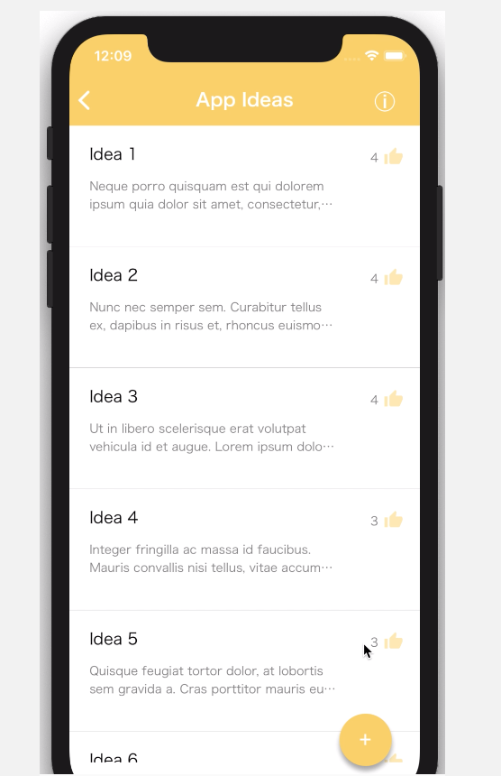
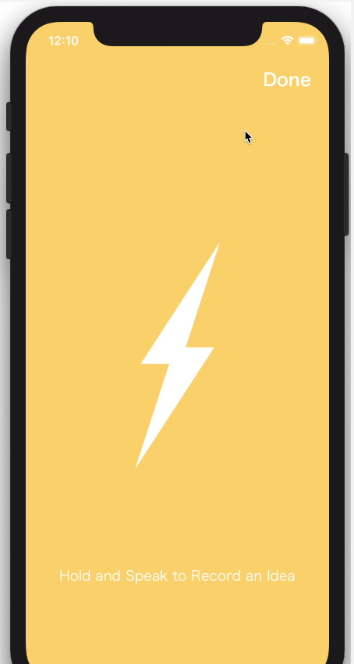
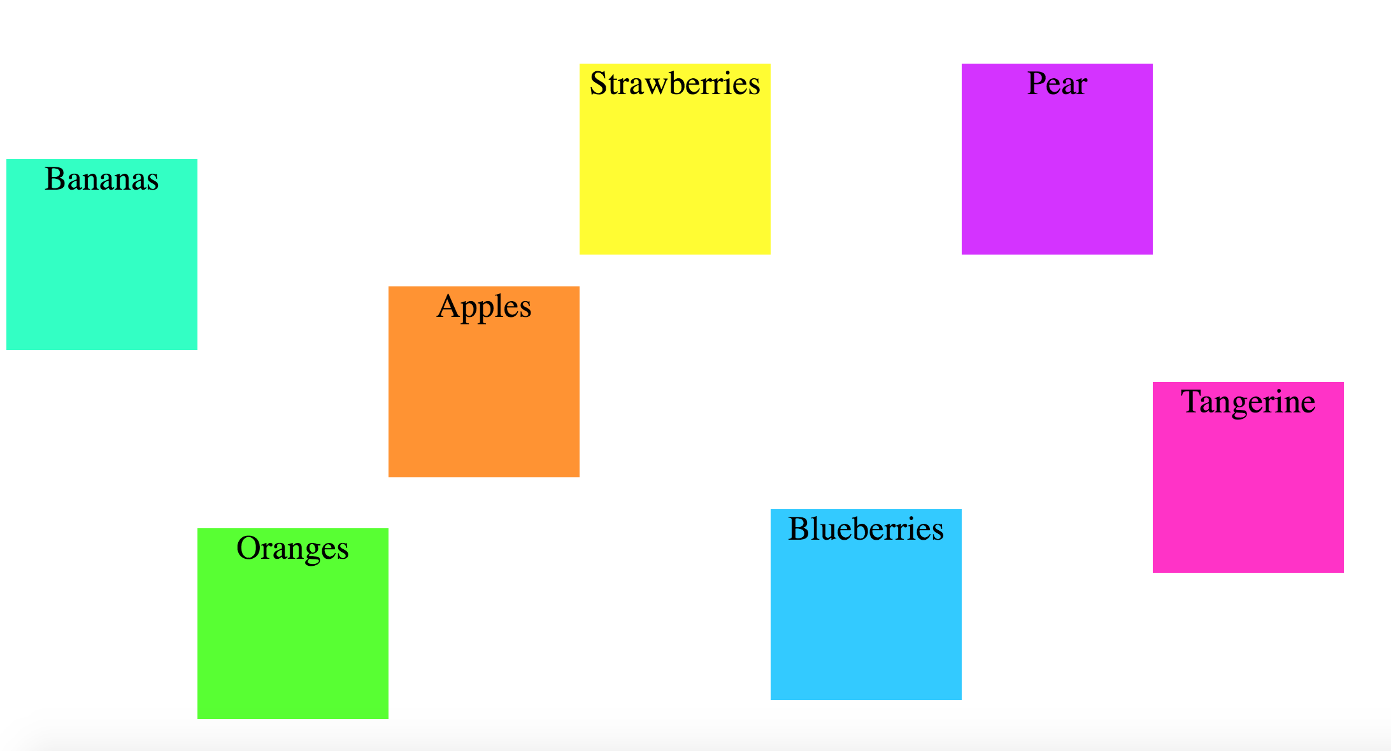
Prototype Changes
No major changes from previous quarter’s Hi-Fi
We wanted to test how users’ interacted with app without much prompting

Slide 5
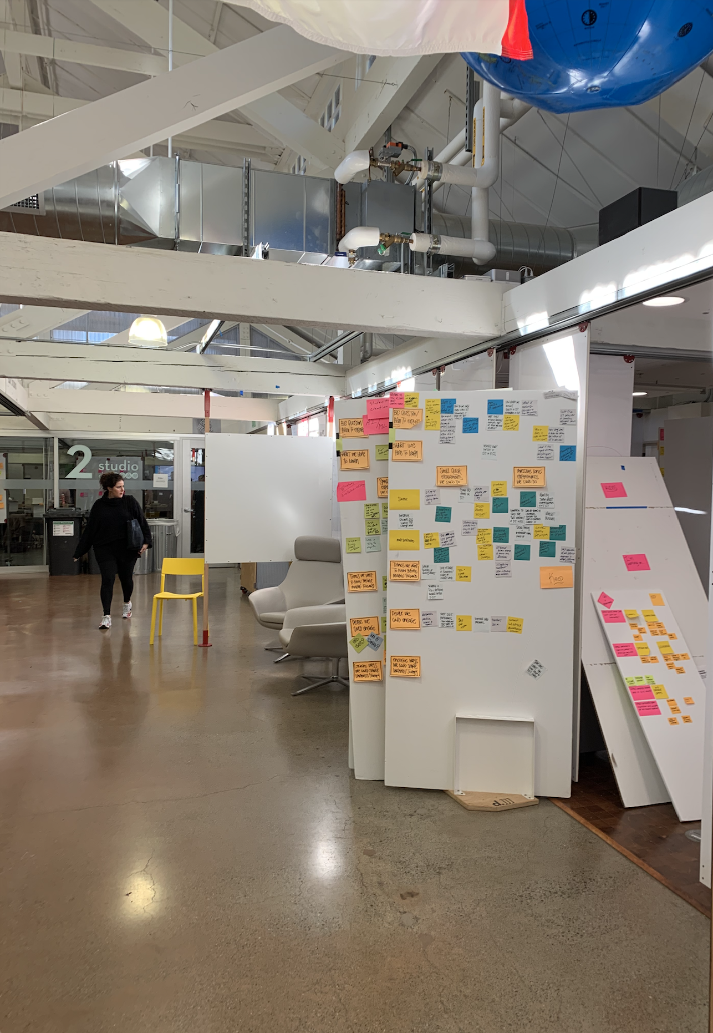
Method - Participants
Variety of ages (21-32)
Highly educated participants
Different backgrounds
Most had experience with brainstorming
Went to the heart of brainstorming - the D.school

Slide 6
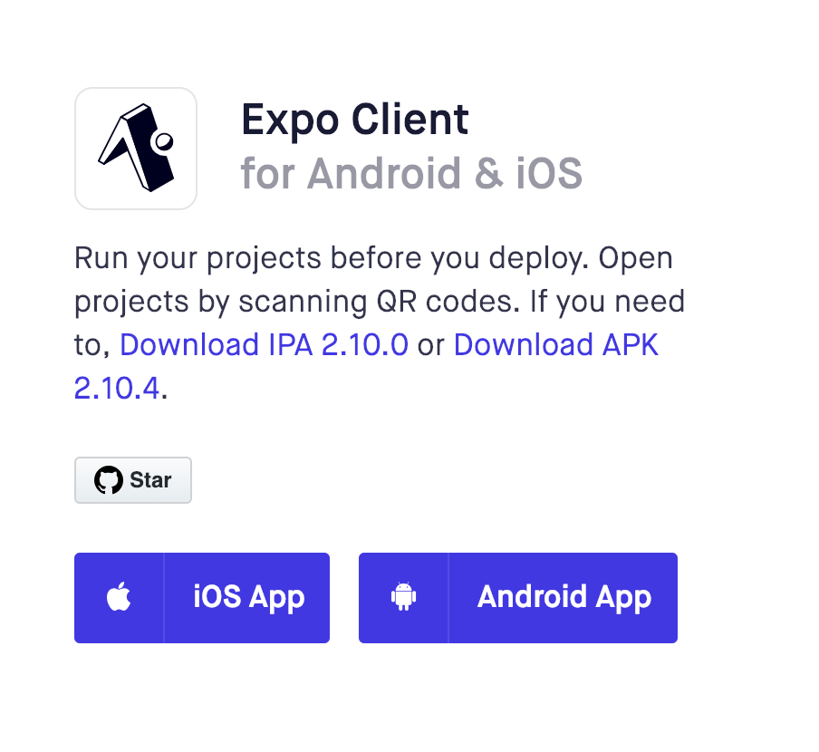
Method - Apparatus
We ran the mobile app using expo
We ran the web app version on a laptop

Slide 7
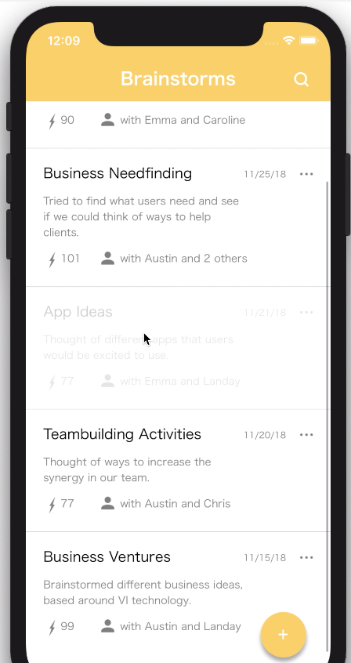
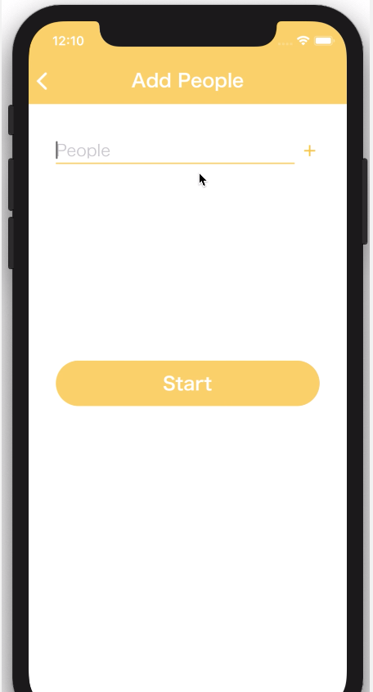
Method - Tasks
Task 1: Create new brainstorm for ‘start up ideas’ with John Smith, and share new idea then end brainstorm.
We want the app to be extremely intuitive, especially for this central task. We want to measure the ease which people can complete this task.

Slide 8
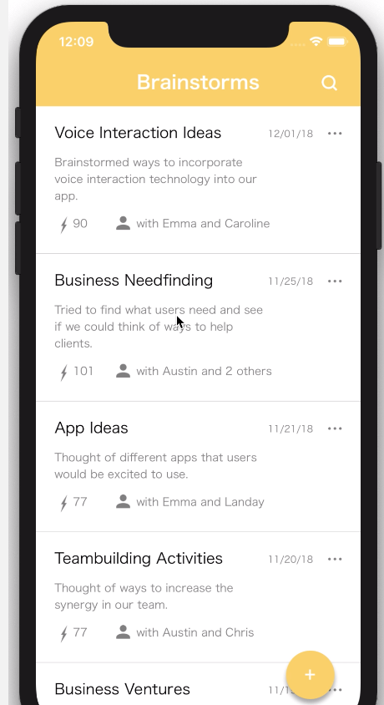
Method - Tasks
Task 2: Access most recent brainstorm and add a new idea.
This task’s purpose was to measure how clear the layout for our app looked. Our current design is to have all the previous brainstorms listed when the app is first opened and we wanted to measure if the user’s picked up on this

Slide 9
Method - Tasks
Task 3: Vote on your favourite ideas
Throughout our design process, we have been interested in how users’ interact with the “Vote” button. We wanted to see if this was intuitive

Slide 10
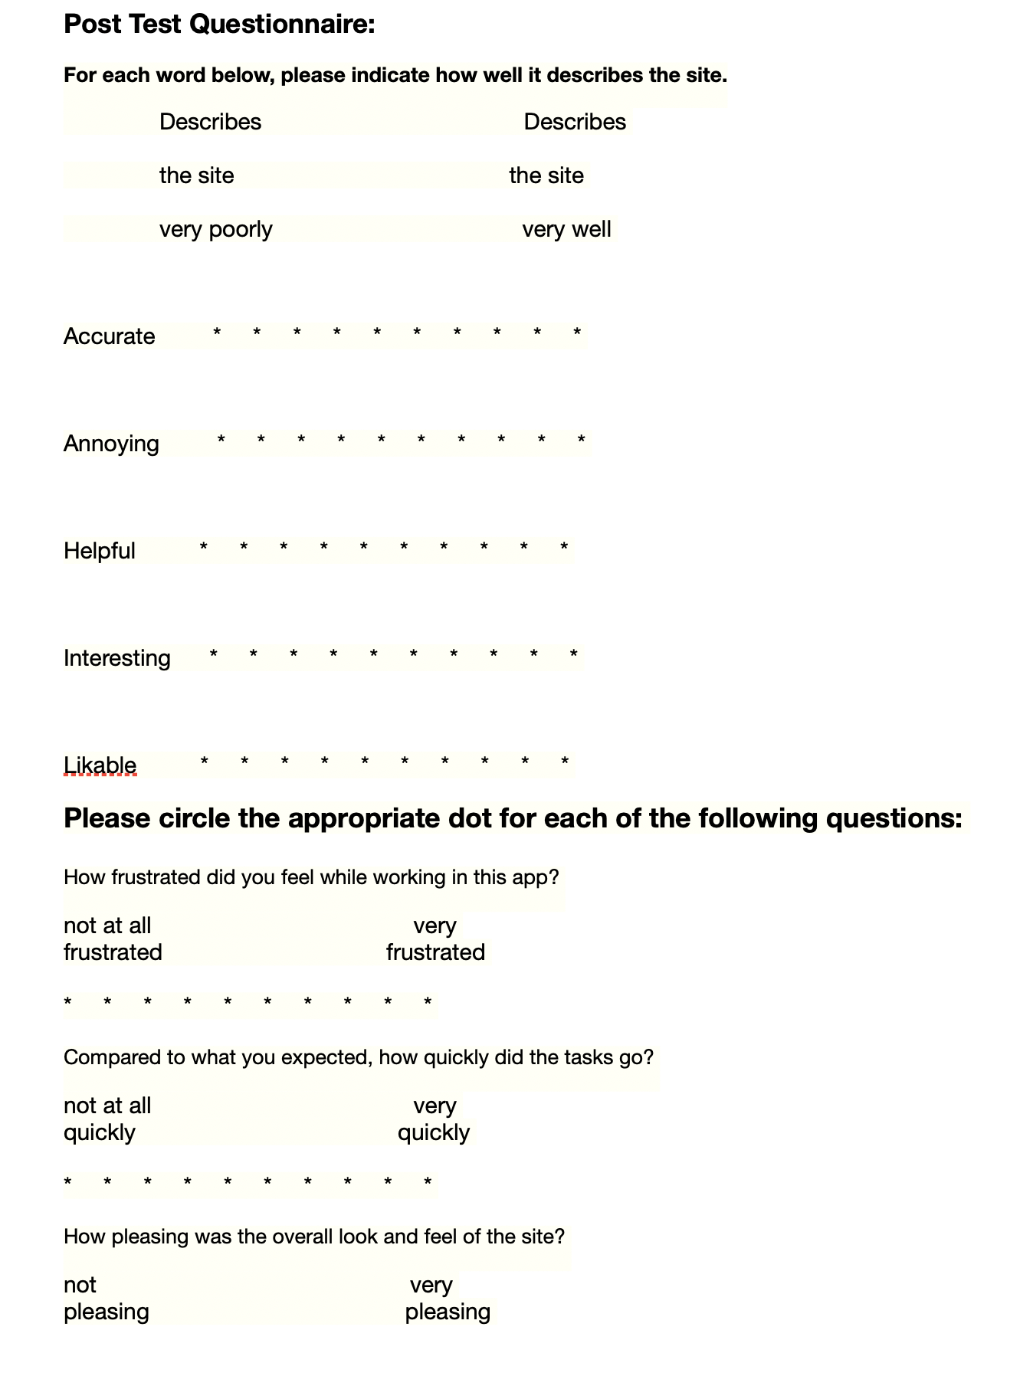
Method - Procedure
Demo/ High level idea of app
Complete 3 tasks
Post Questionnaire

Slide 11
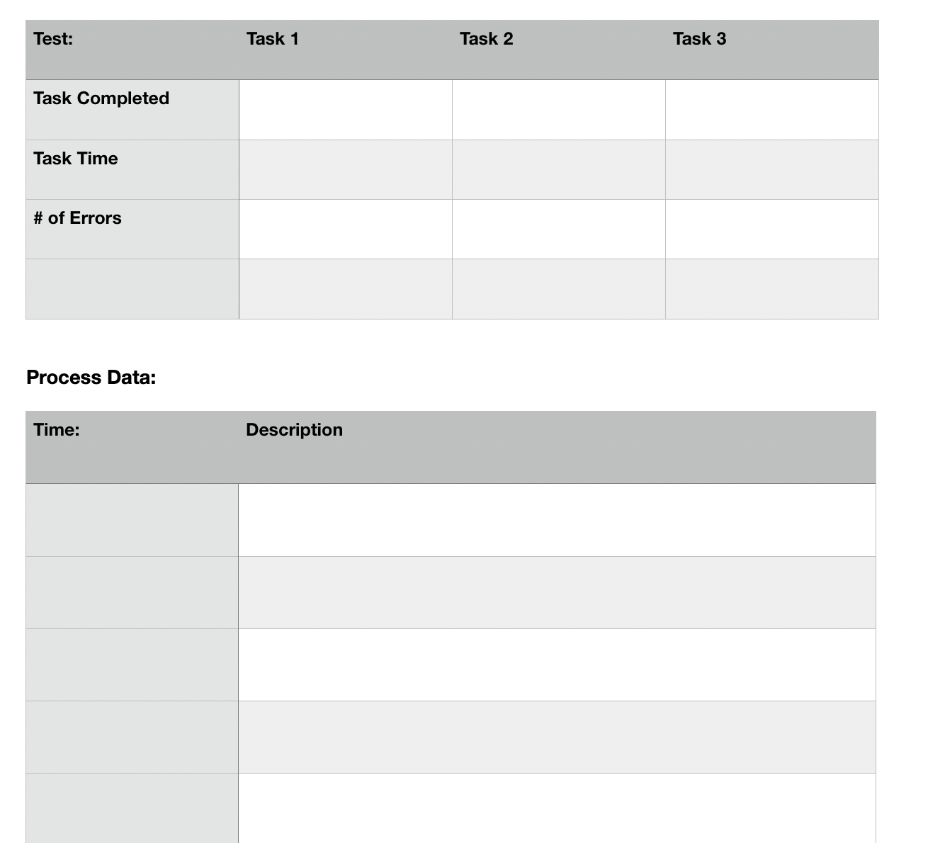
Test Measures
We measured if the user completed a task, the time it took to complete each task, and how many errors they made
We took down observational notes during the experiment as well
We wanted to see if users struggled with any particular task and observe the possible reasons

Slide 12
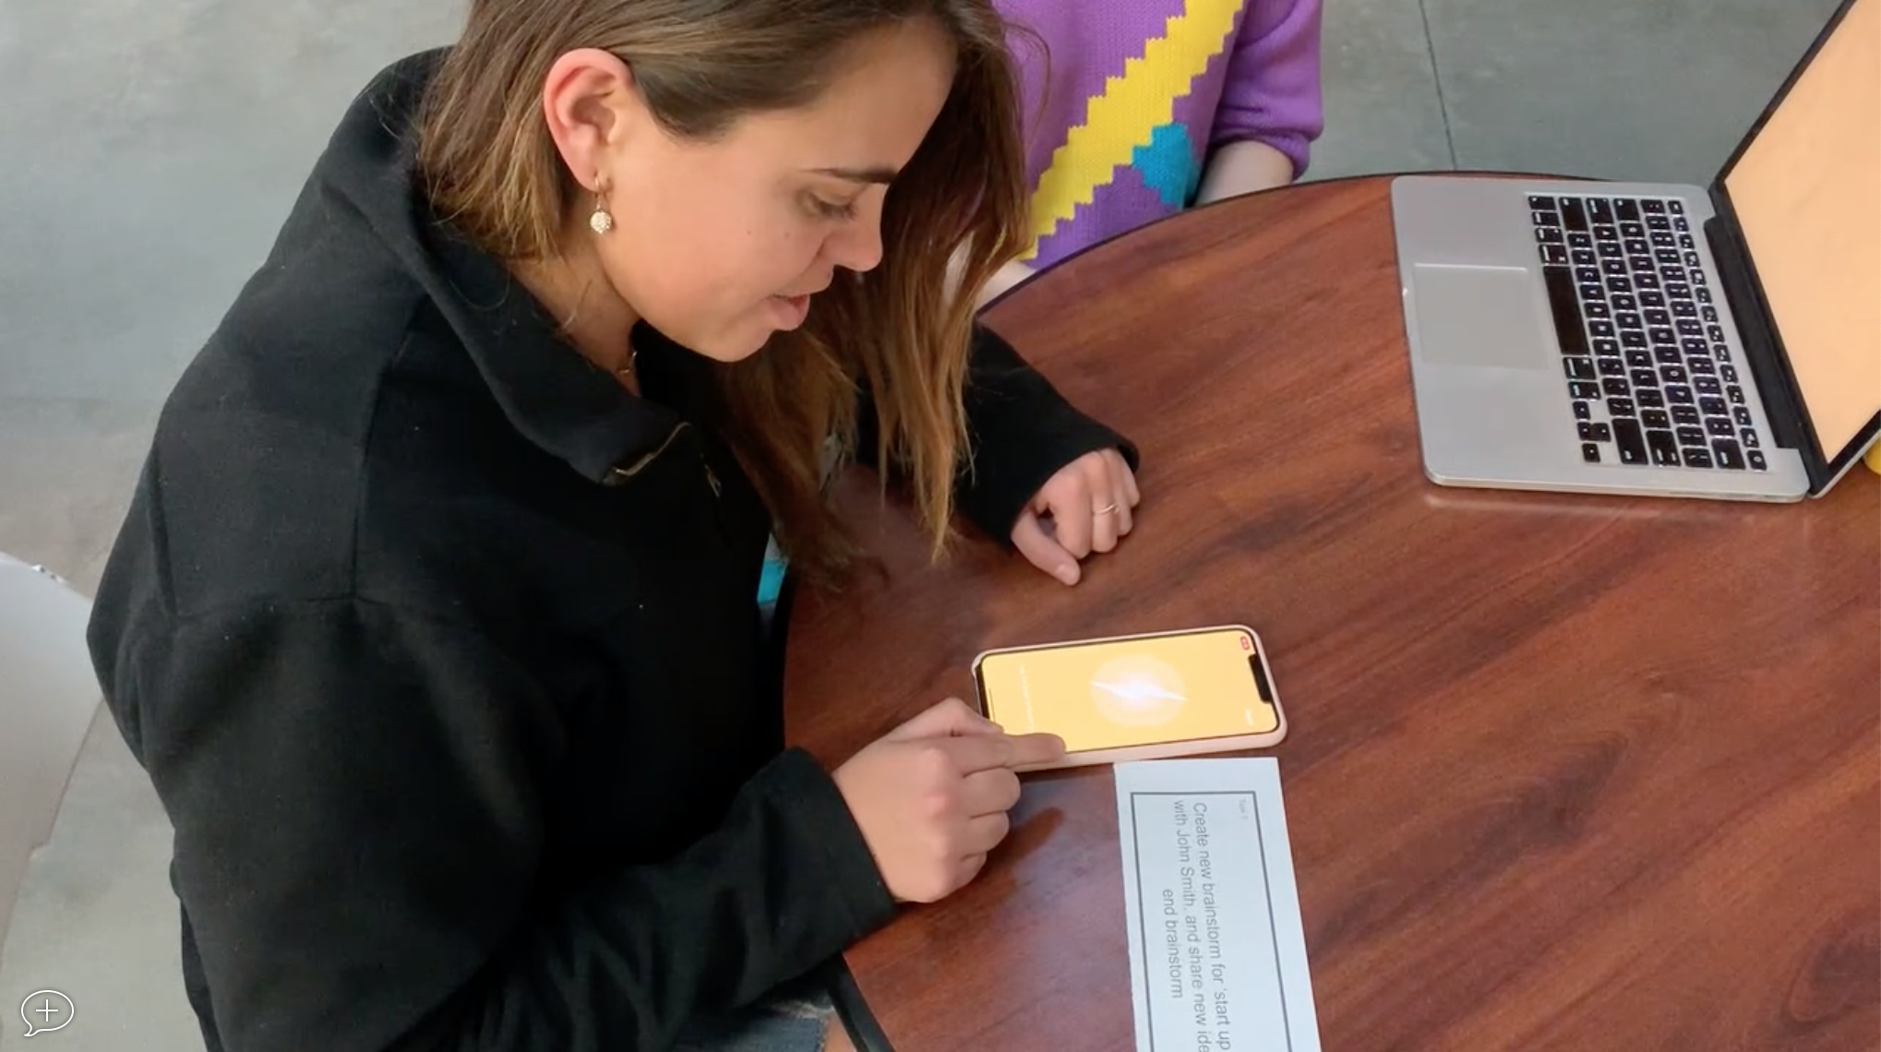
Results
Task 1: Create Brainstorm with John about “Startup Ideas”
60% complete the task
Avg speed for those completed: 50 seconds

Slide 13
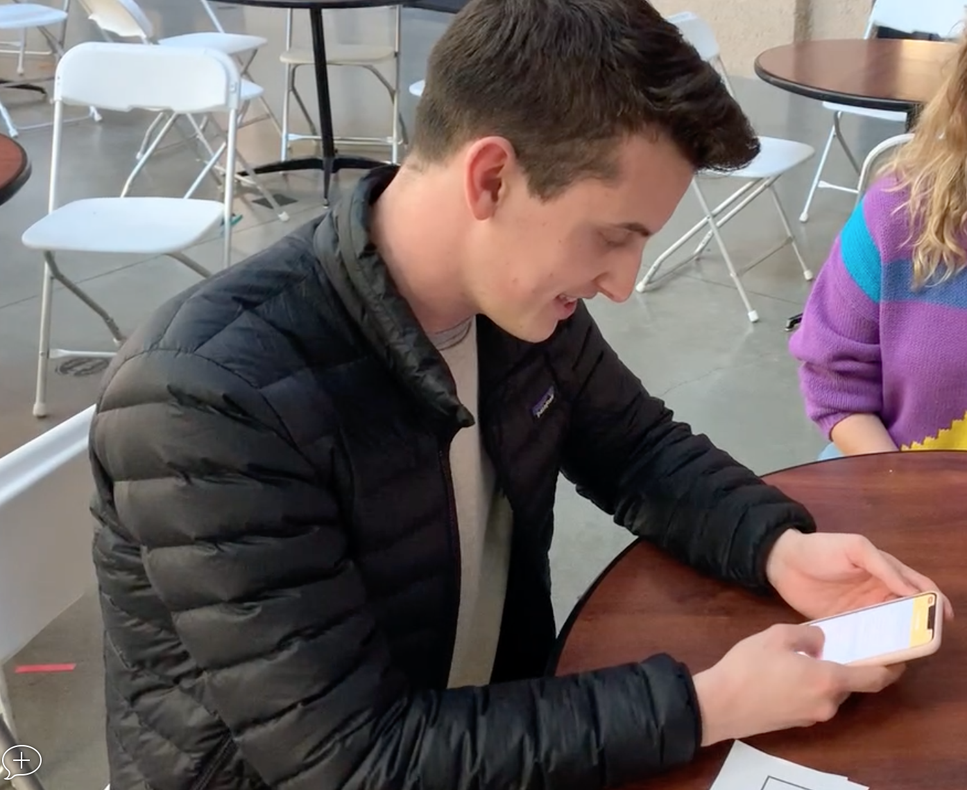
Results
Task 2: Manually add new idea to brainstorm
100% completed the task
Avg speed for those completed: 12.5 seconds

Slide 14
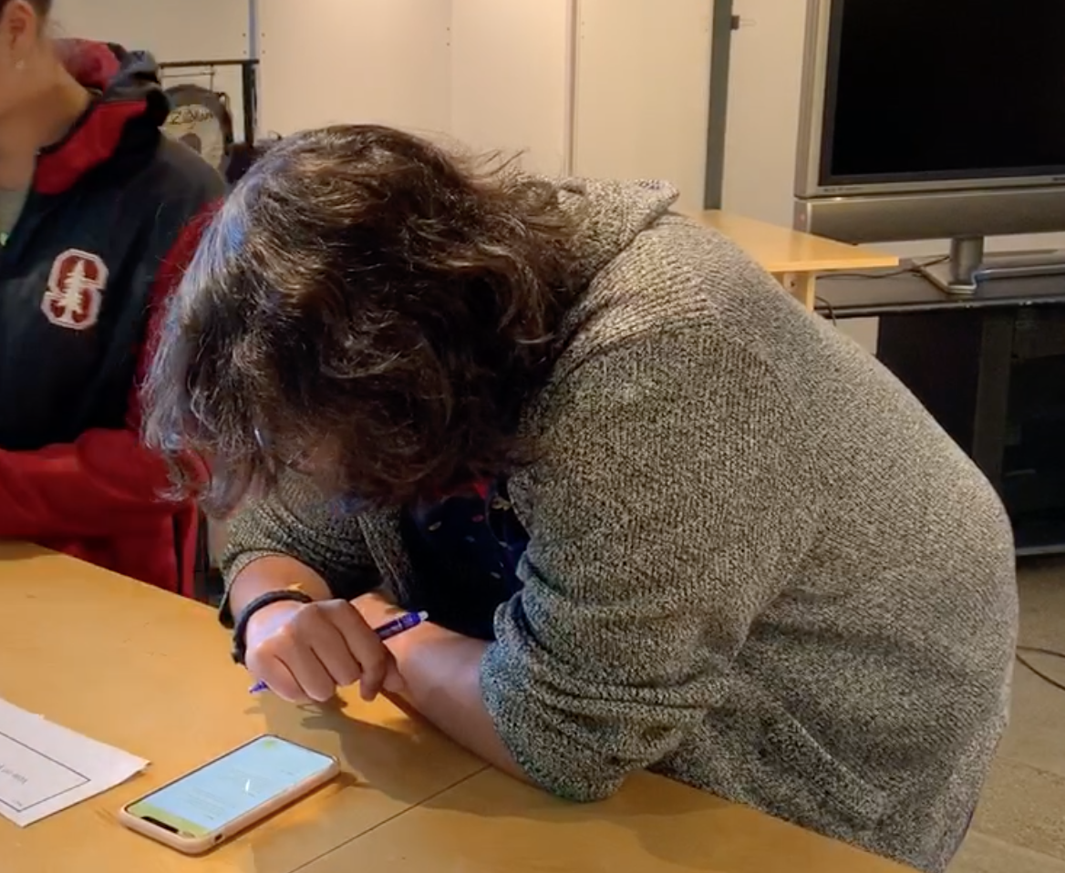
Results
Task 3: Vote on Idea
100% completed the task
Avg speed for those completed: 4.25 seconds

Slide 15
Results
Overall Results:
Most people found the app to be highly accurate
Most people found the app to be only slightly annoying
However, the app was often rated average for likability and usefulness

Slide 16
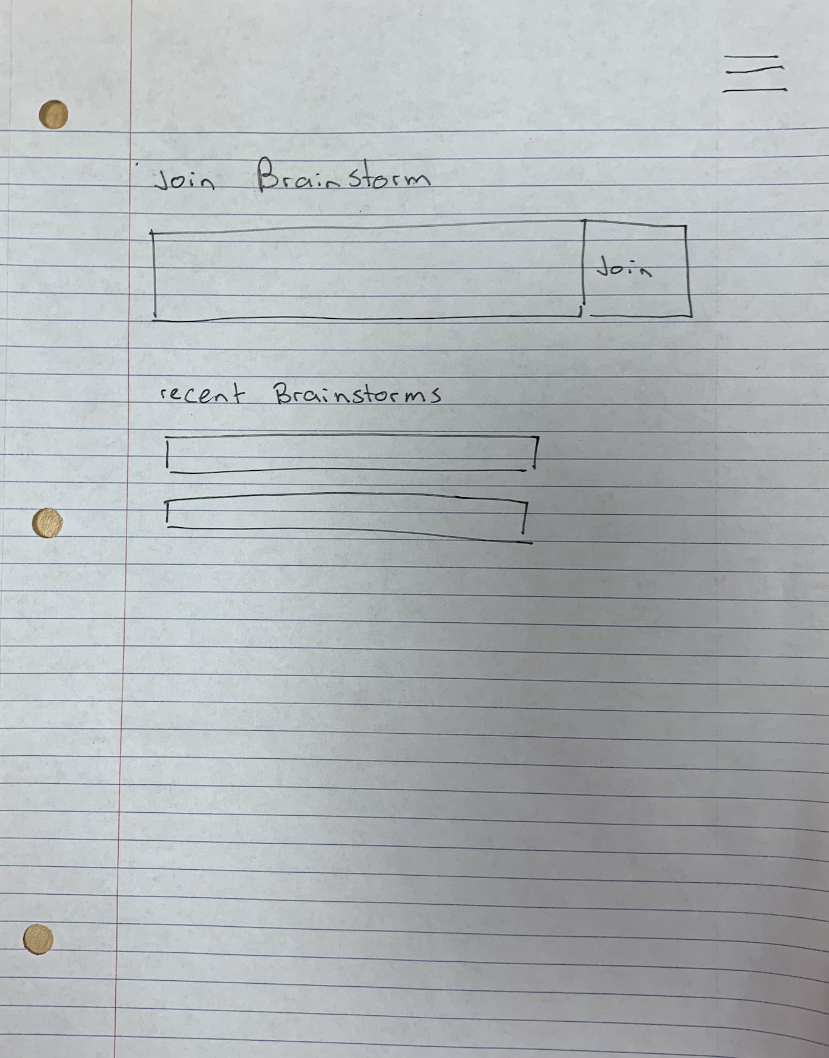
Discussion
Prior to usability testing, we talked about revamping our design to allow for more flexible options while brainstorming
After the testing, we realized we would need to make design changes to make the app more intuitive and easier to use

Slide 17
Discussion
We were surprised to find that many of our participants had a hard time beginning a brainstorm

Slide 18
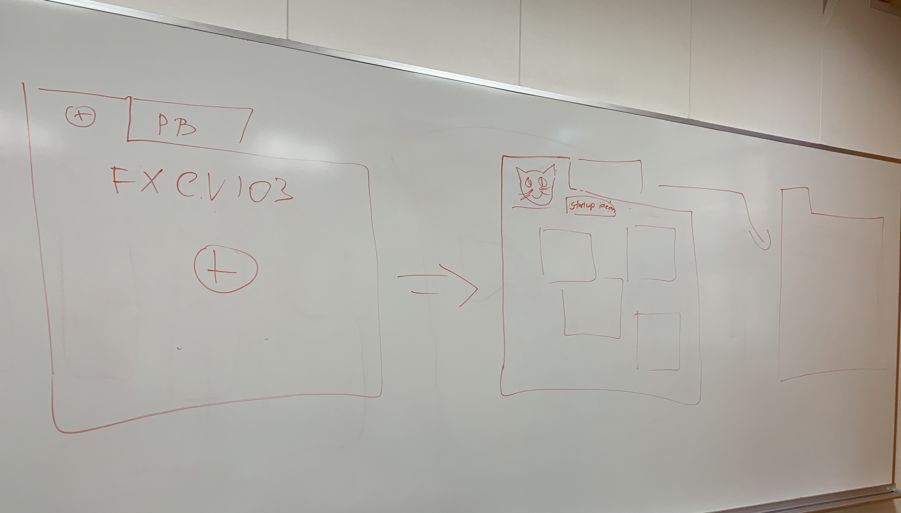
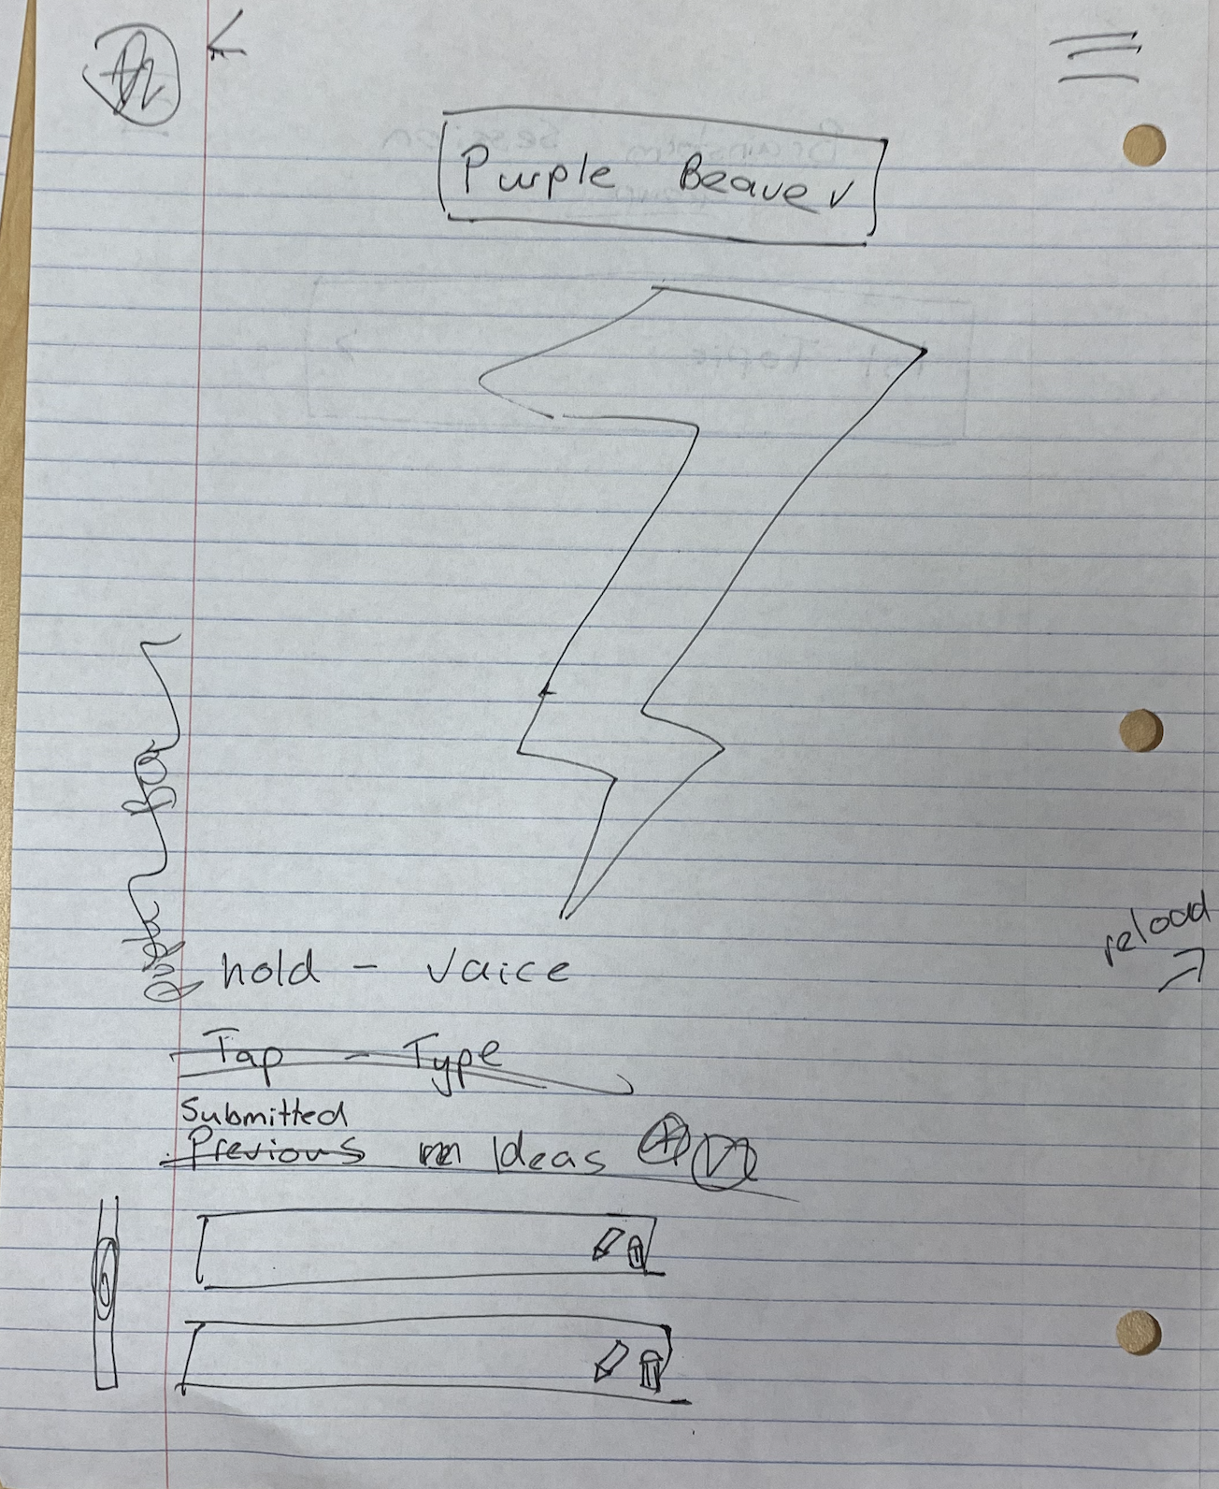
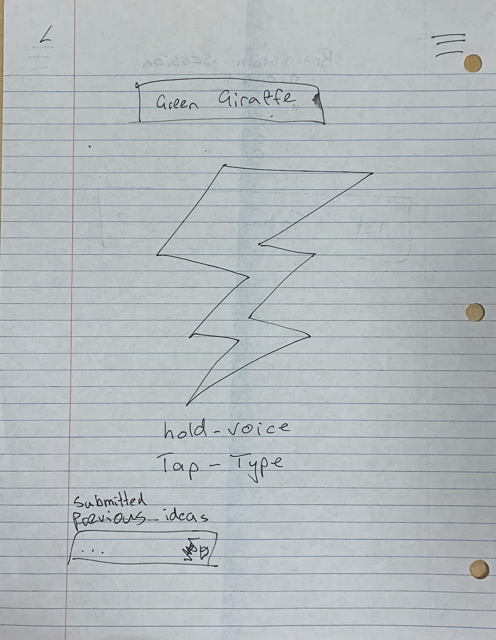
Discussion
We want to redesign our app to allow for multiple brainstorms in a session and allow for easier entry into a brainstorm

Slide 19
Conclusion
While most people were able to complete the tasks, we left the usability study knowing that we wanted to significantly redesign our app
We wanted to make it more “useful” to people and wanted people to find it more “interesting”, as well as speed up many of the errors our users made

