Slide 1
Thundr
CS 194H - Winter 2019
Austin Jones
Caroline Willis
Emma Alderton
Daniel Kharitonov

Slide 2
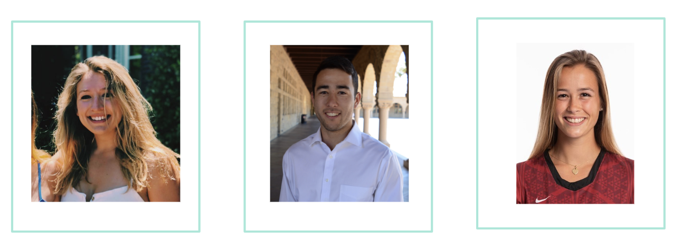
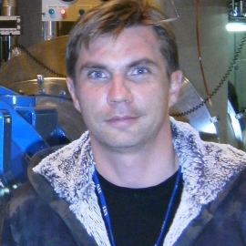
The Team
Caroline Willis
Austin Jones
Emma Alderton
Daniel Kharitonov

Slide 3
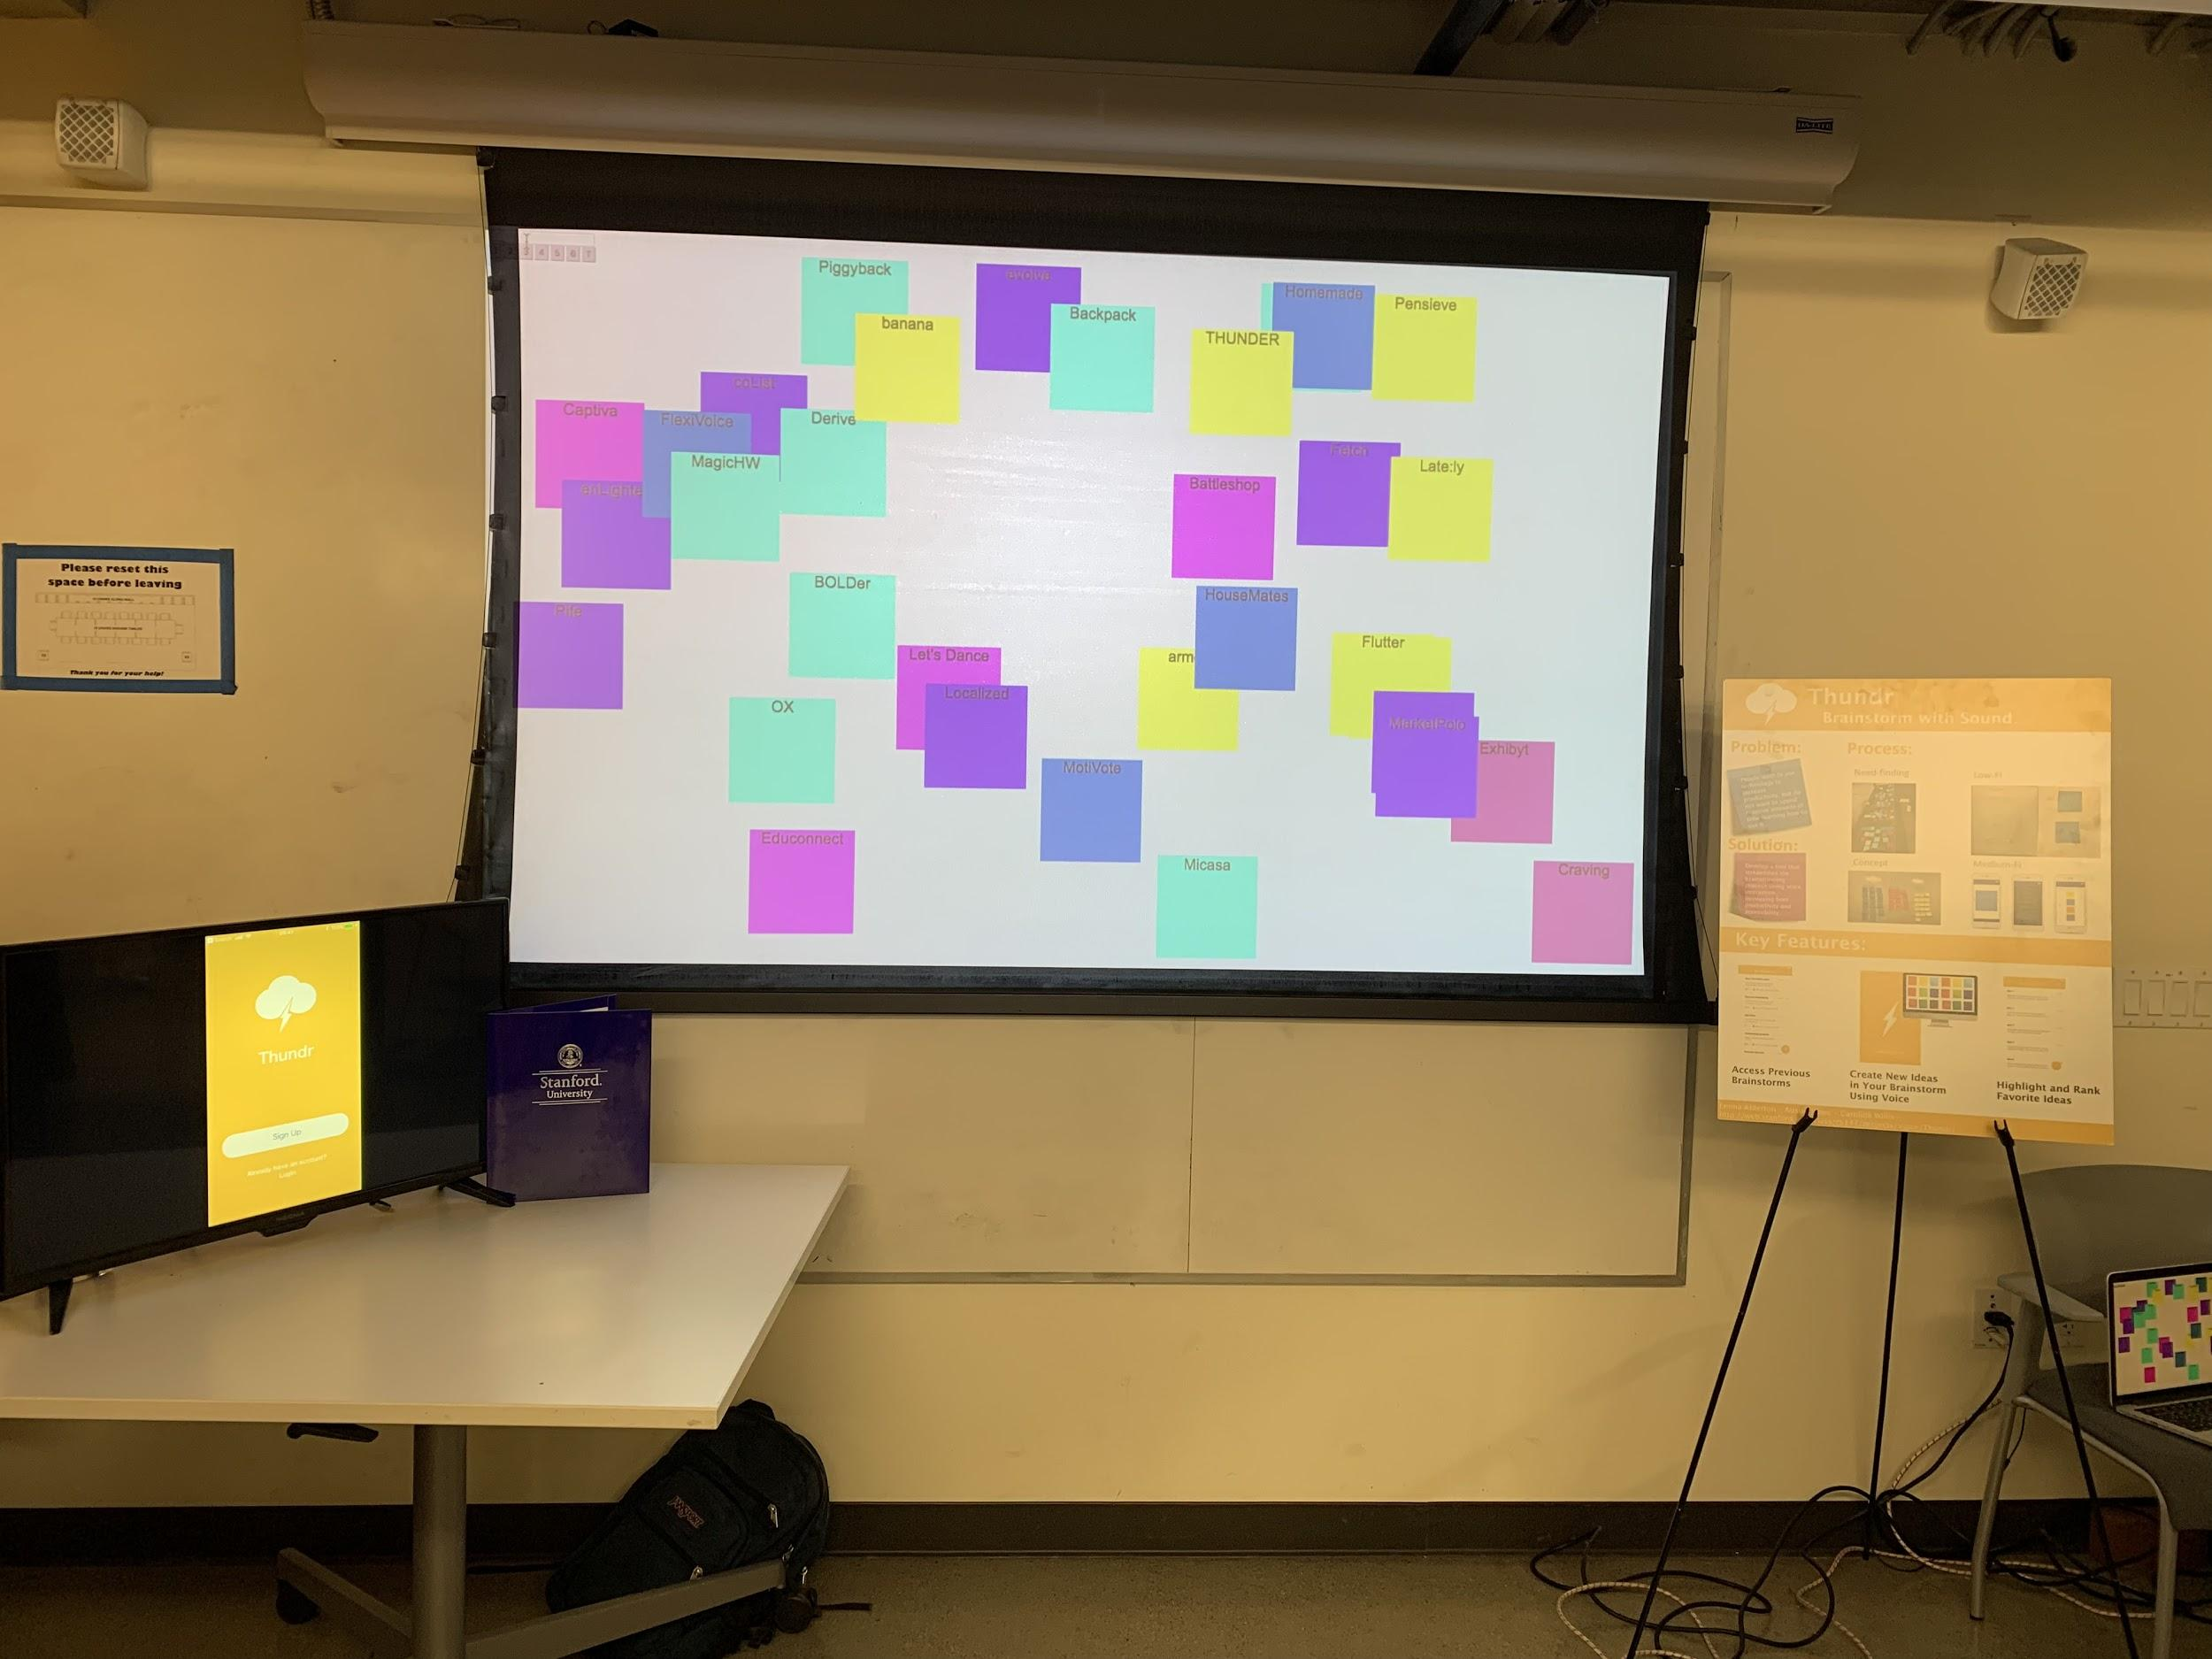
Problem/Solution Overview
Problem:
  We identified a need for a better brainstorming tool that could be used remotely, too.
Solution:
  Taking the writing aspect out of the process and replacing it with voice interaction allows for continuous productivity, engagement, and creativity.

Slide 4
Outline of Talk
Evolution of Our Design (From Low-Fi to Hi-Fi)
Current Design/UI
Ideas for the Future
Summary

Slide 5
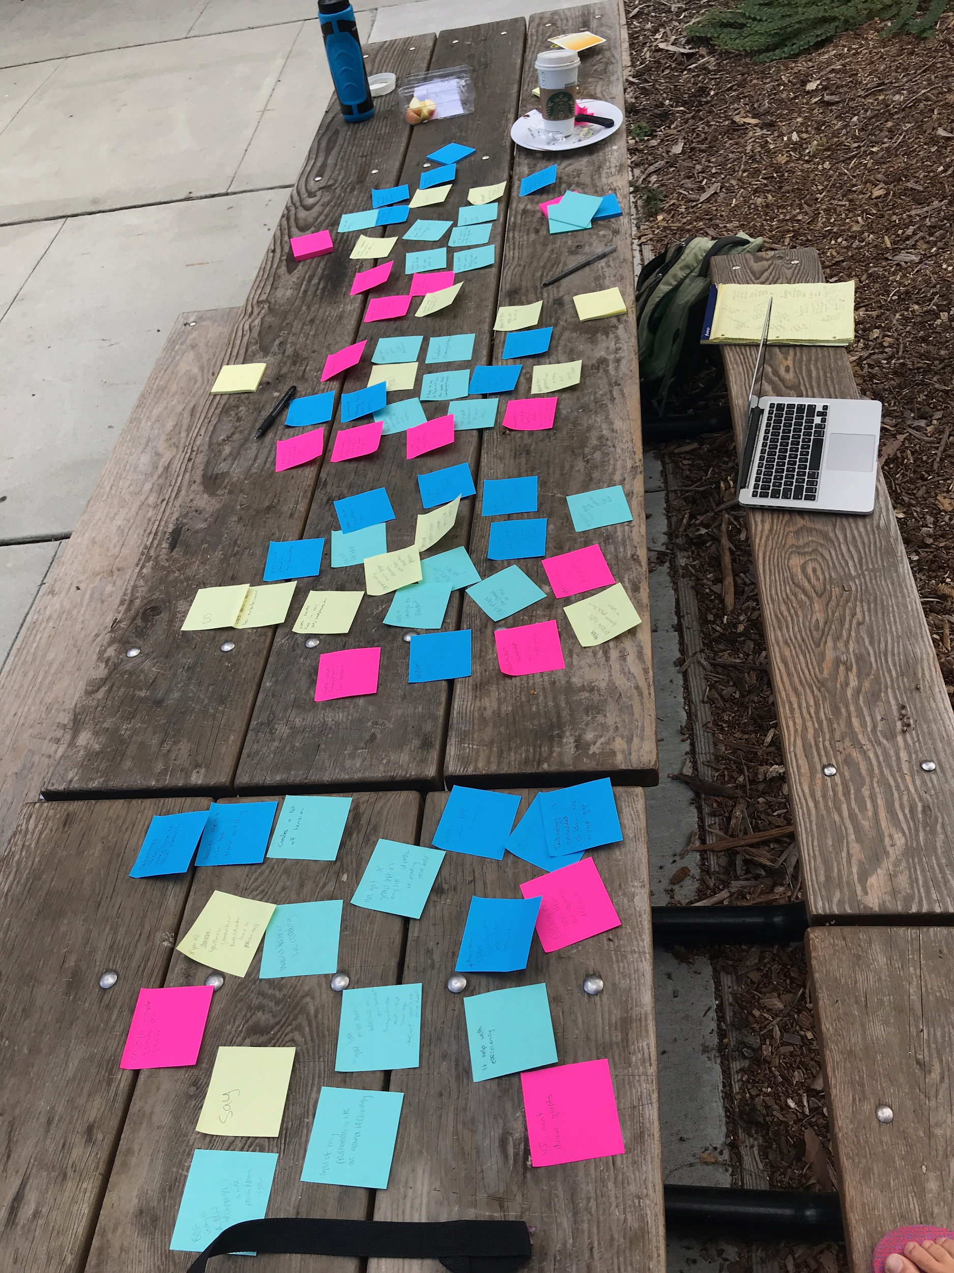
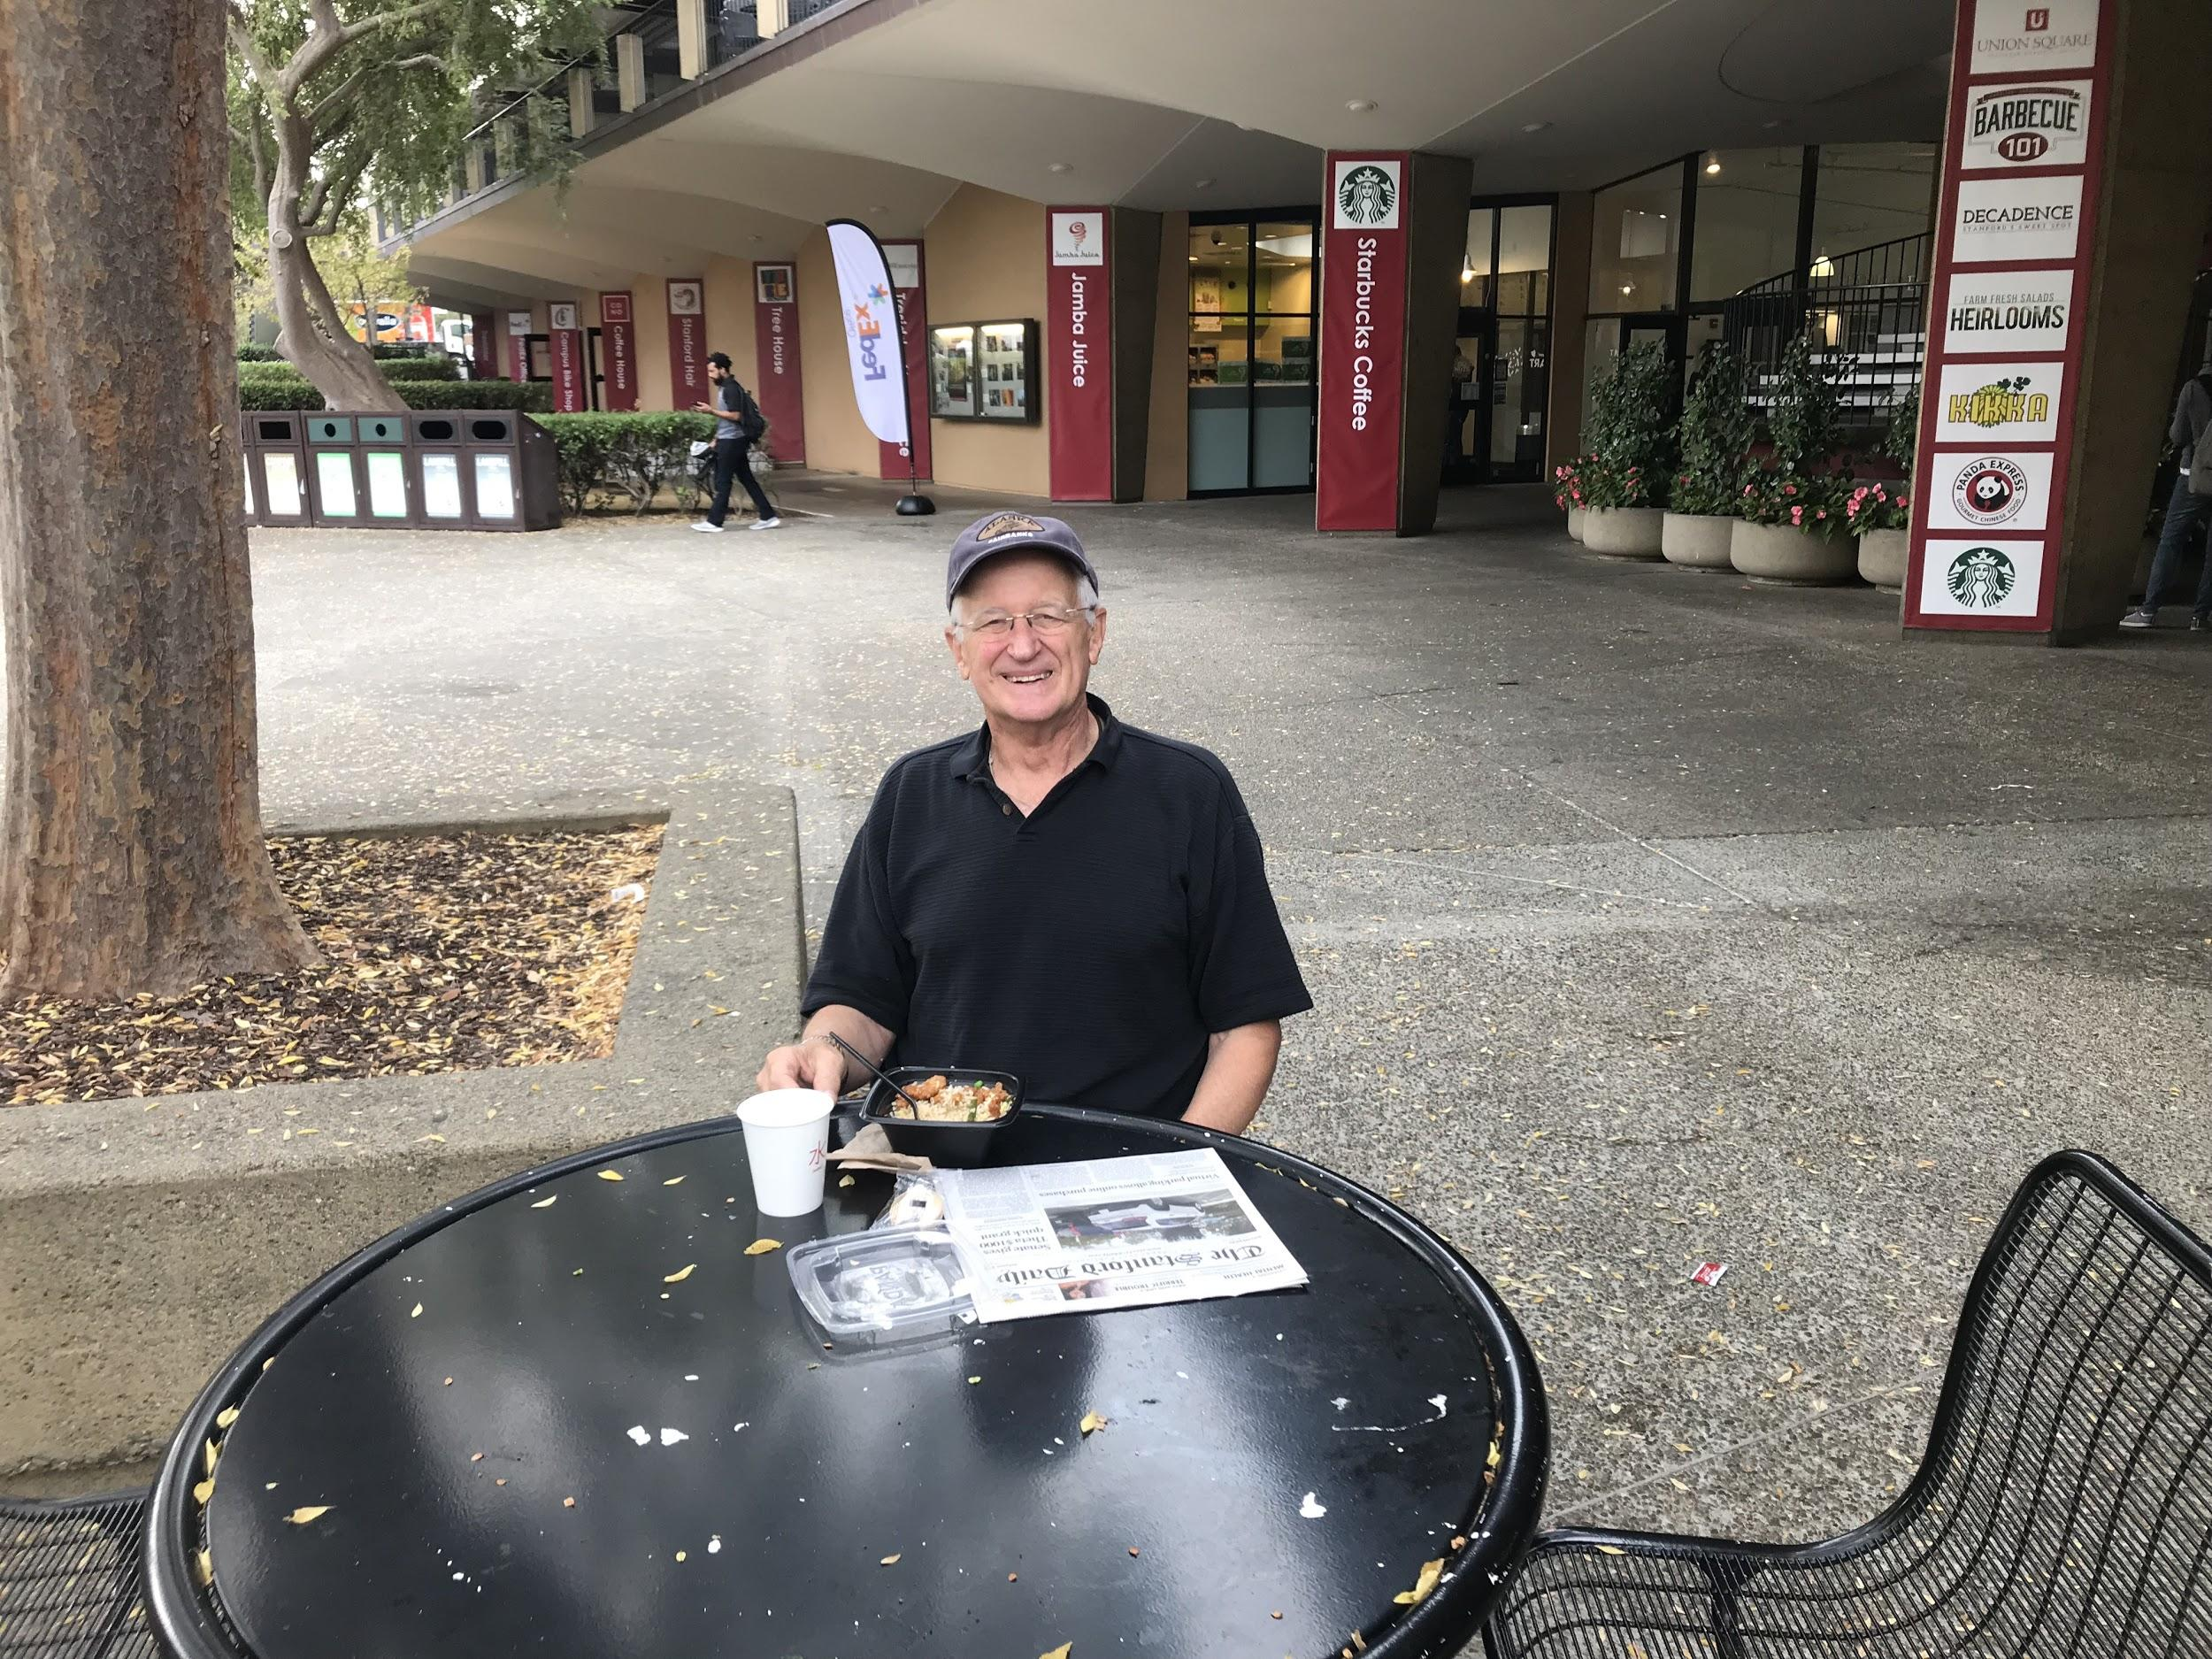
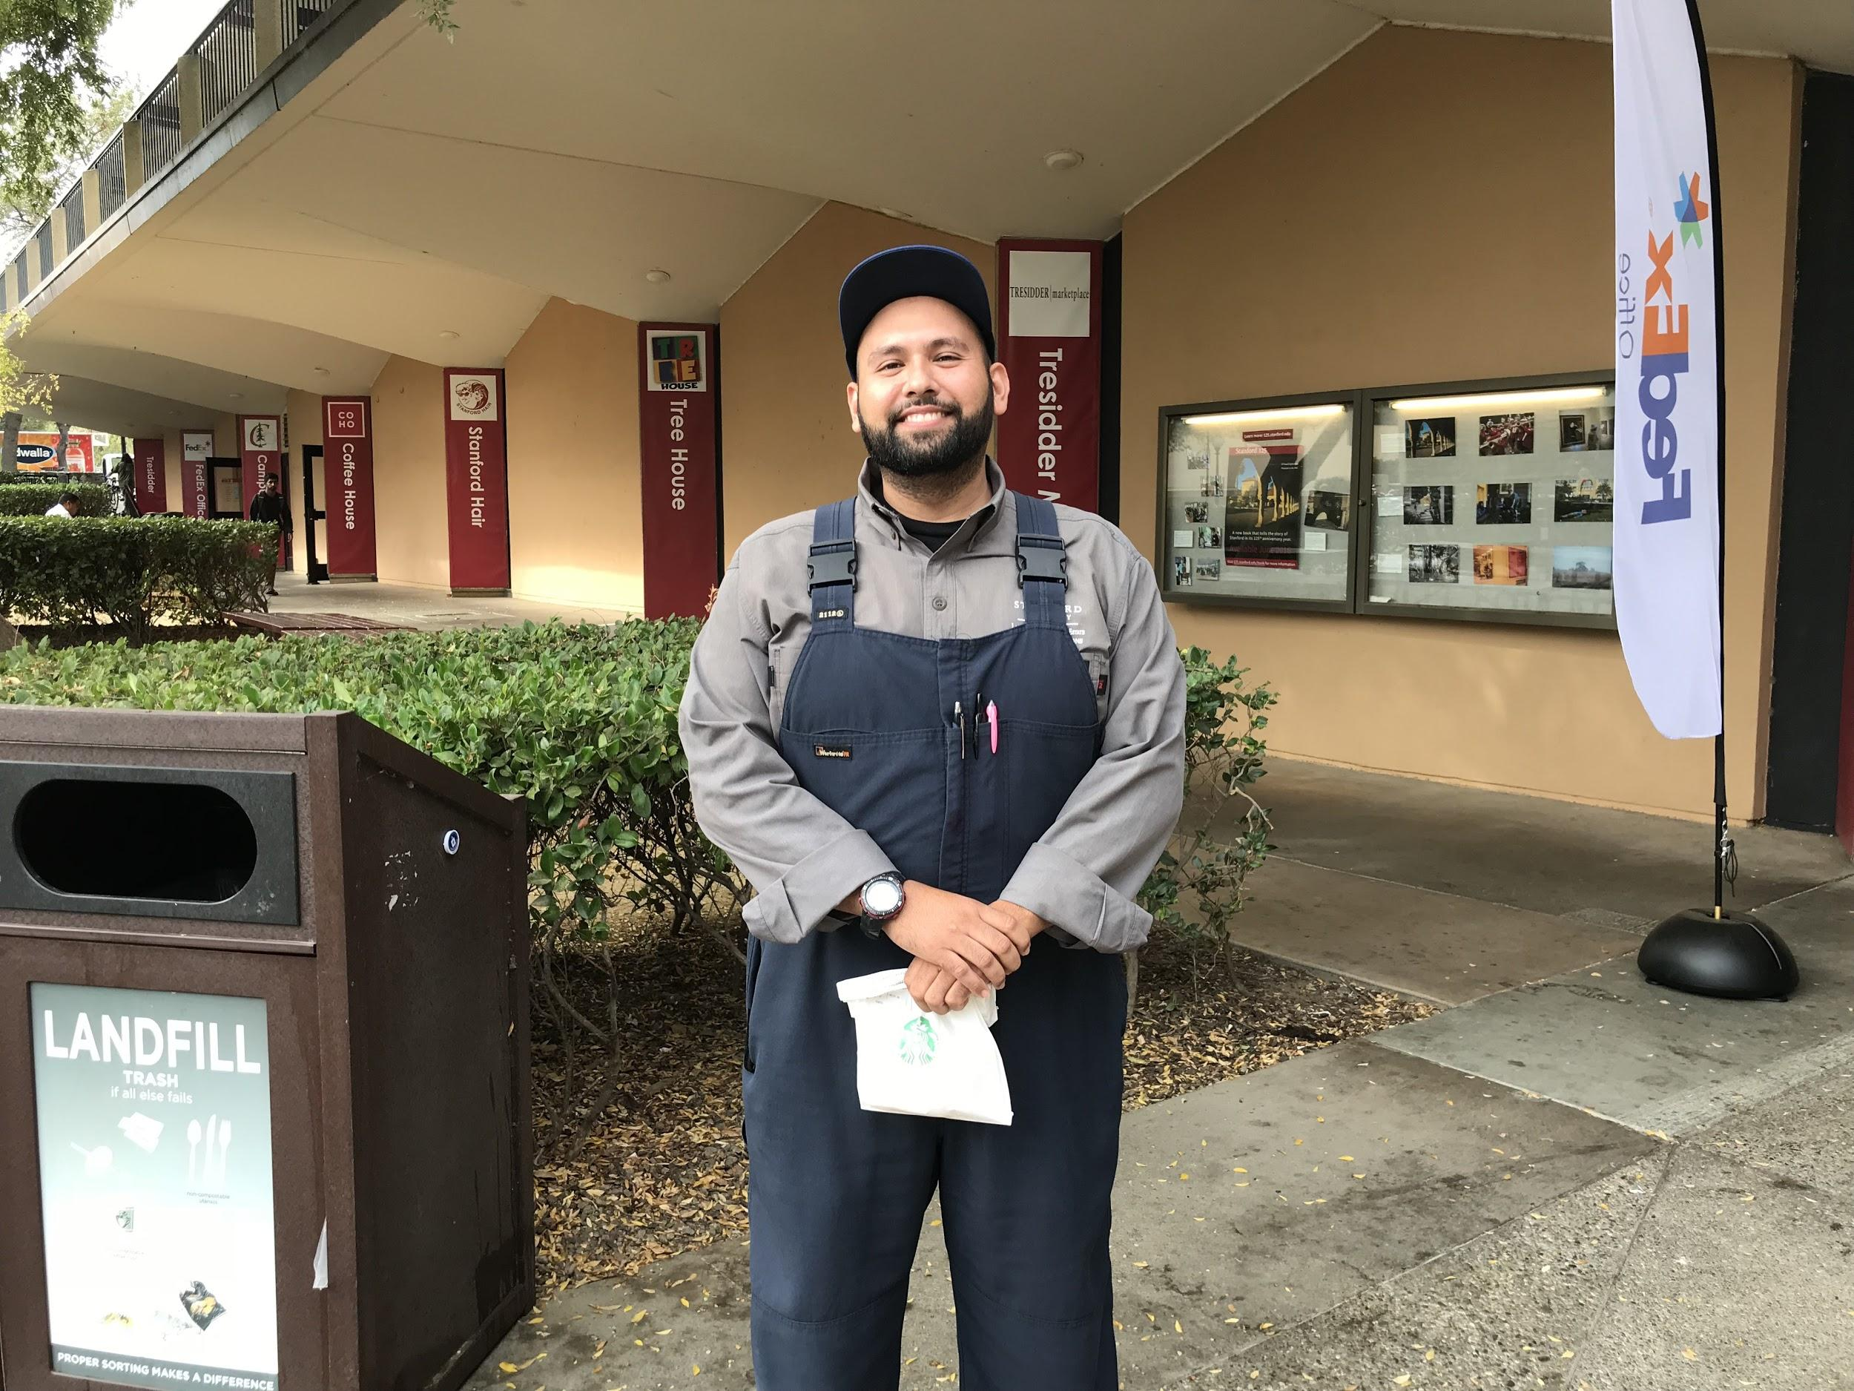
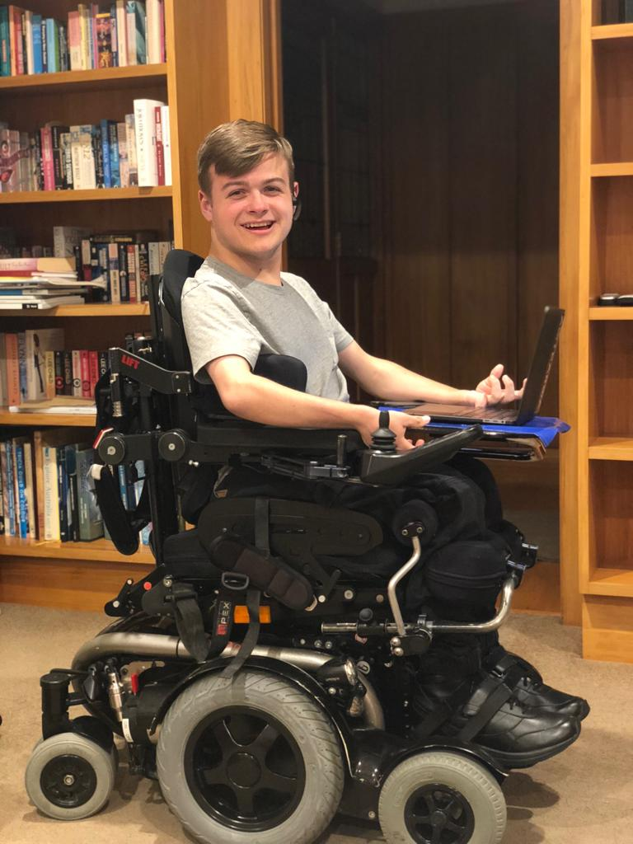
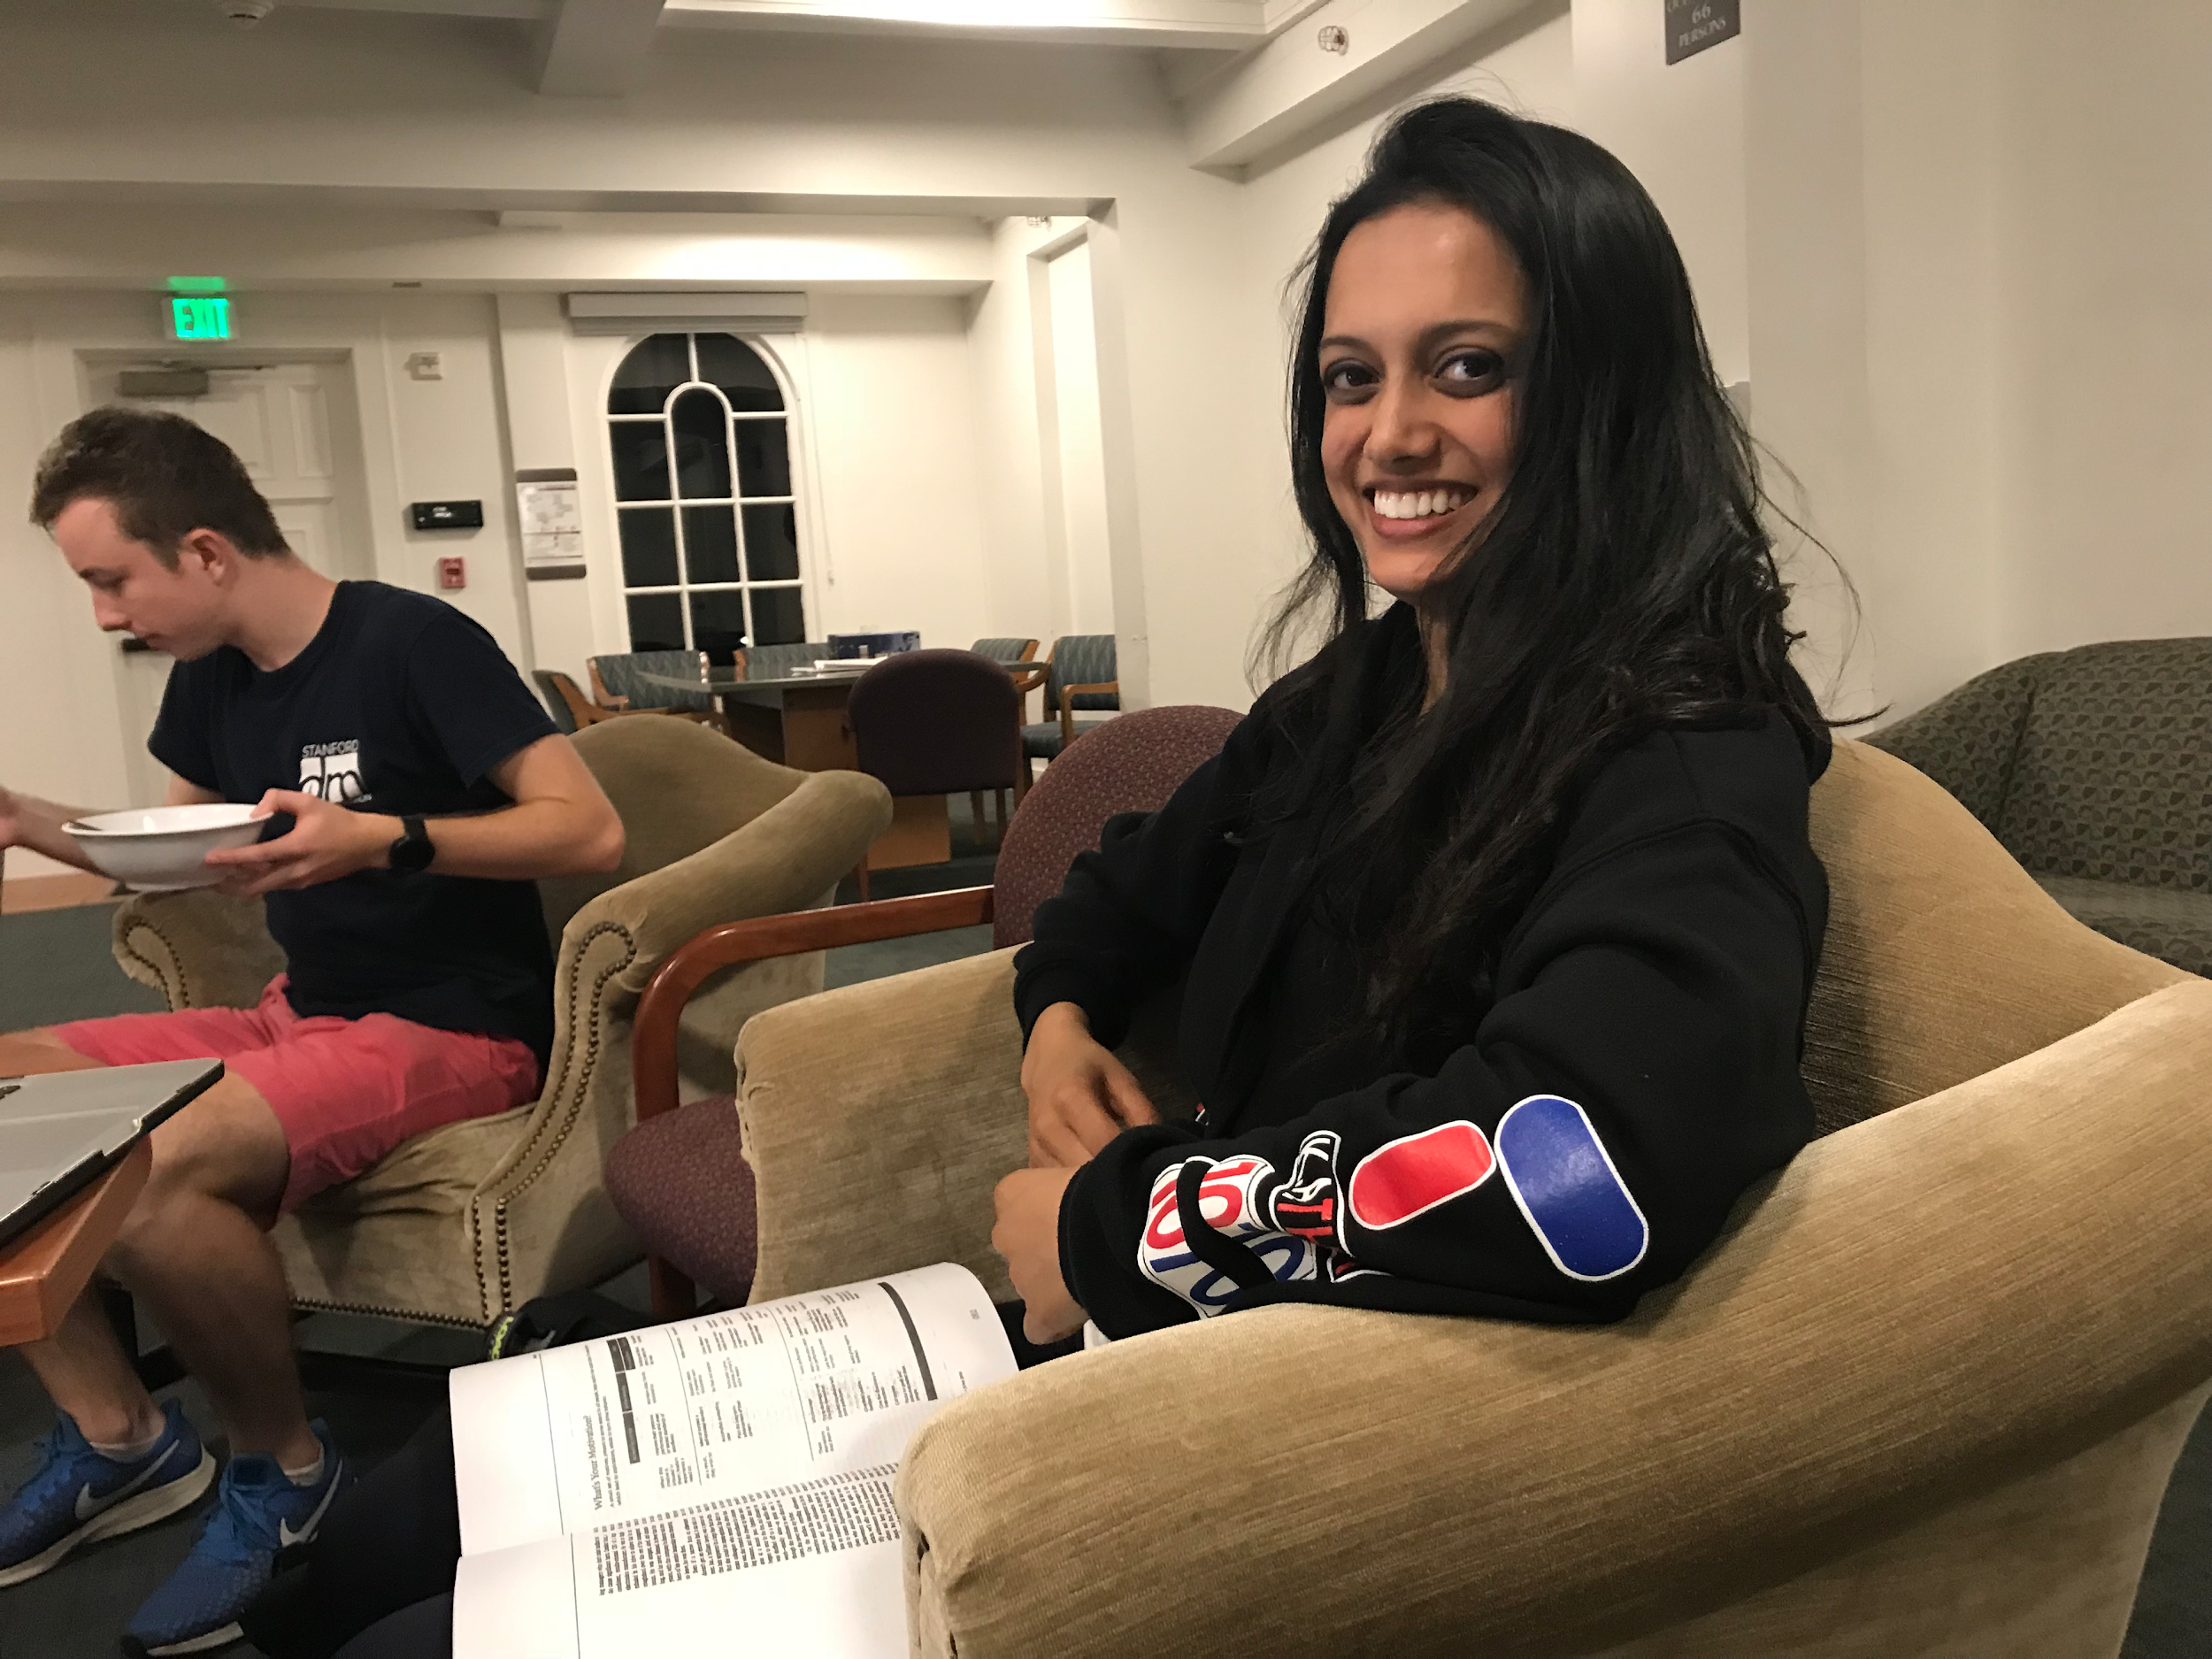
Evolution of Design - Needfinding

Slide 6
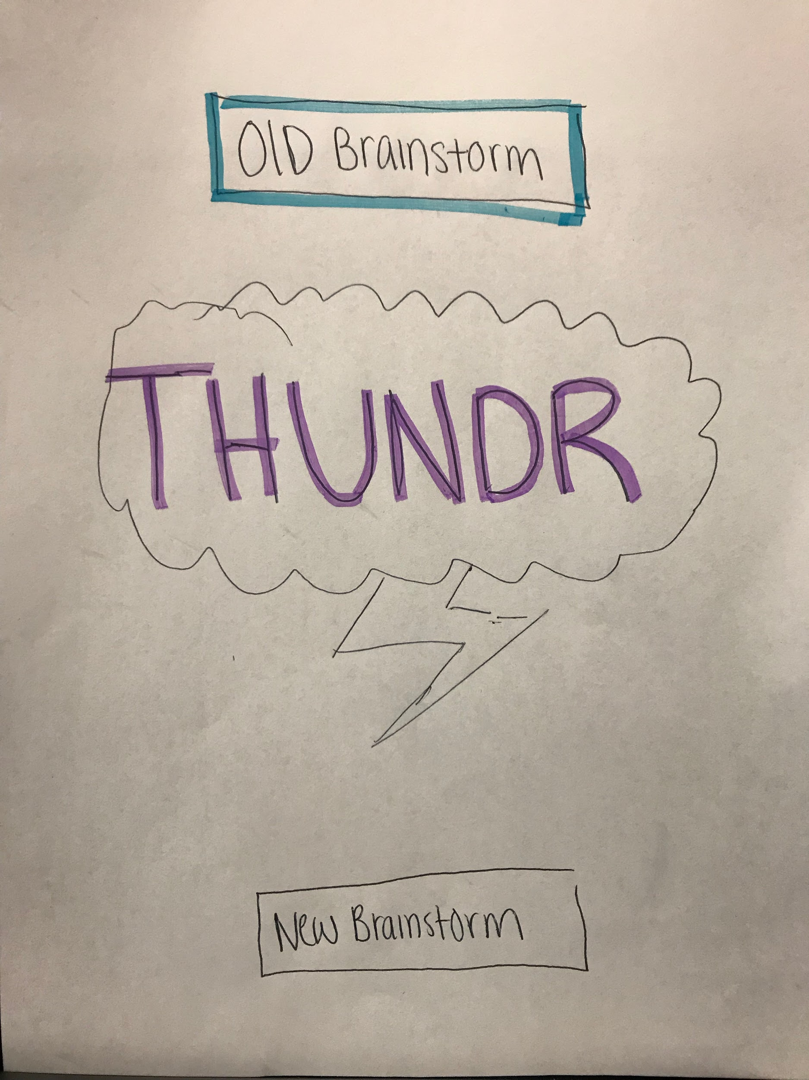
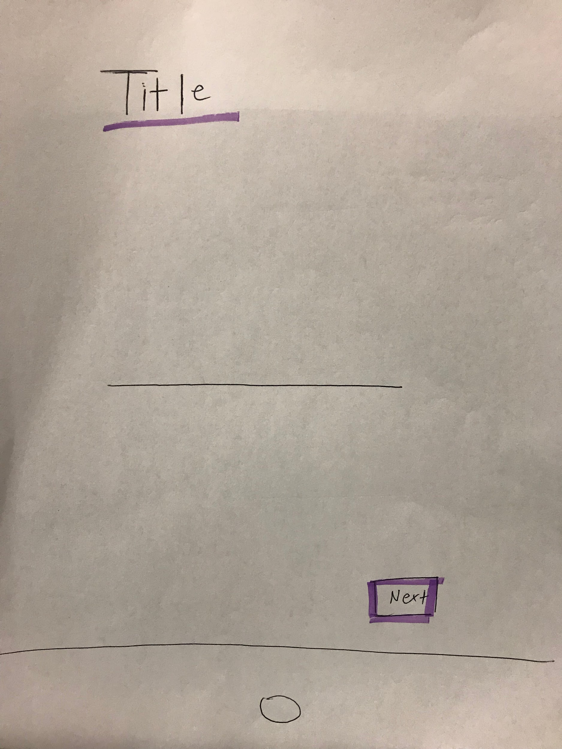
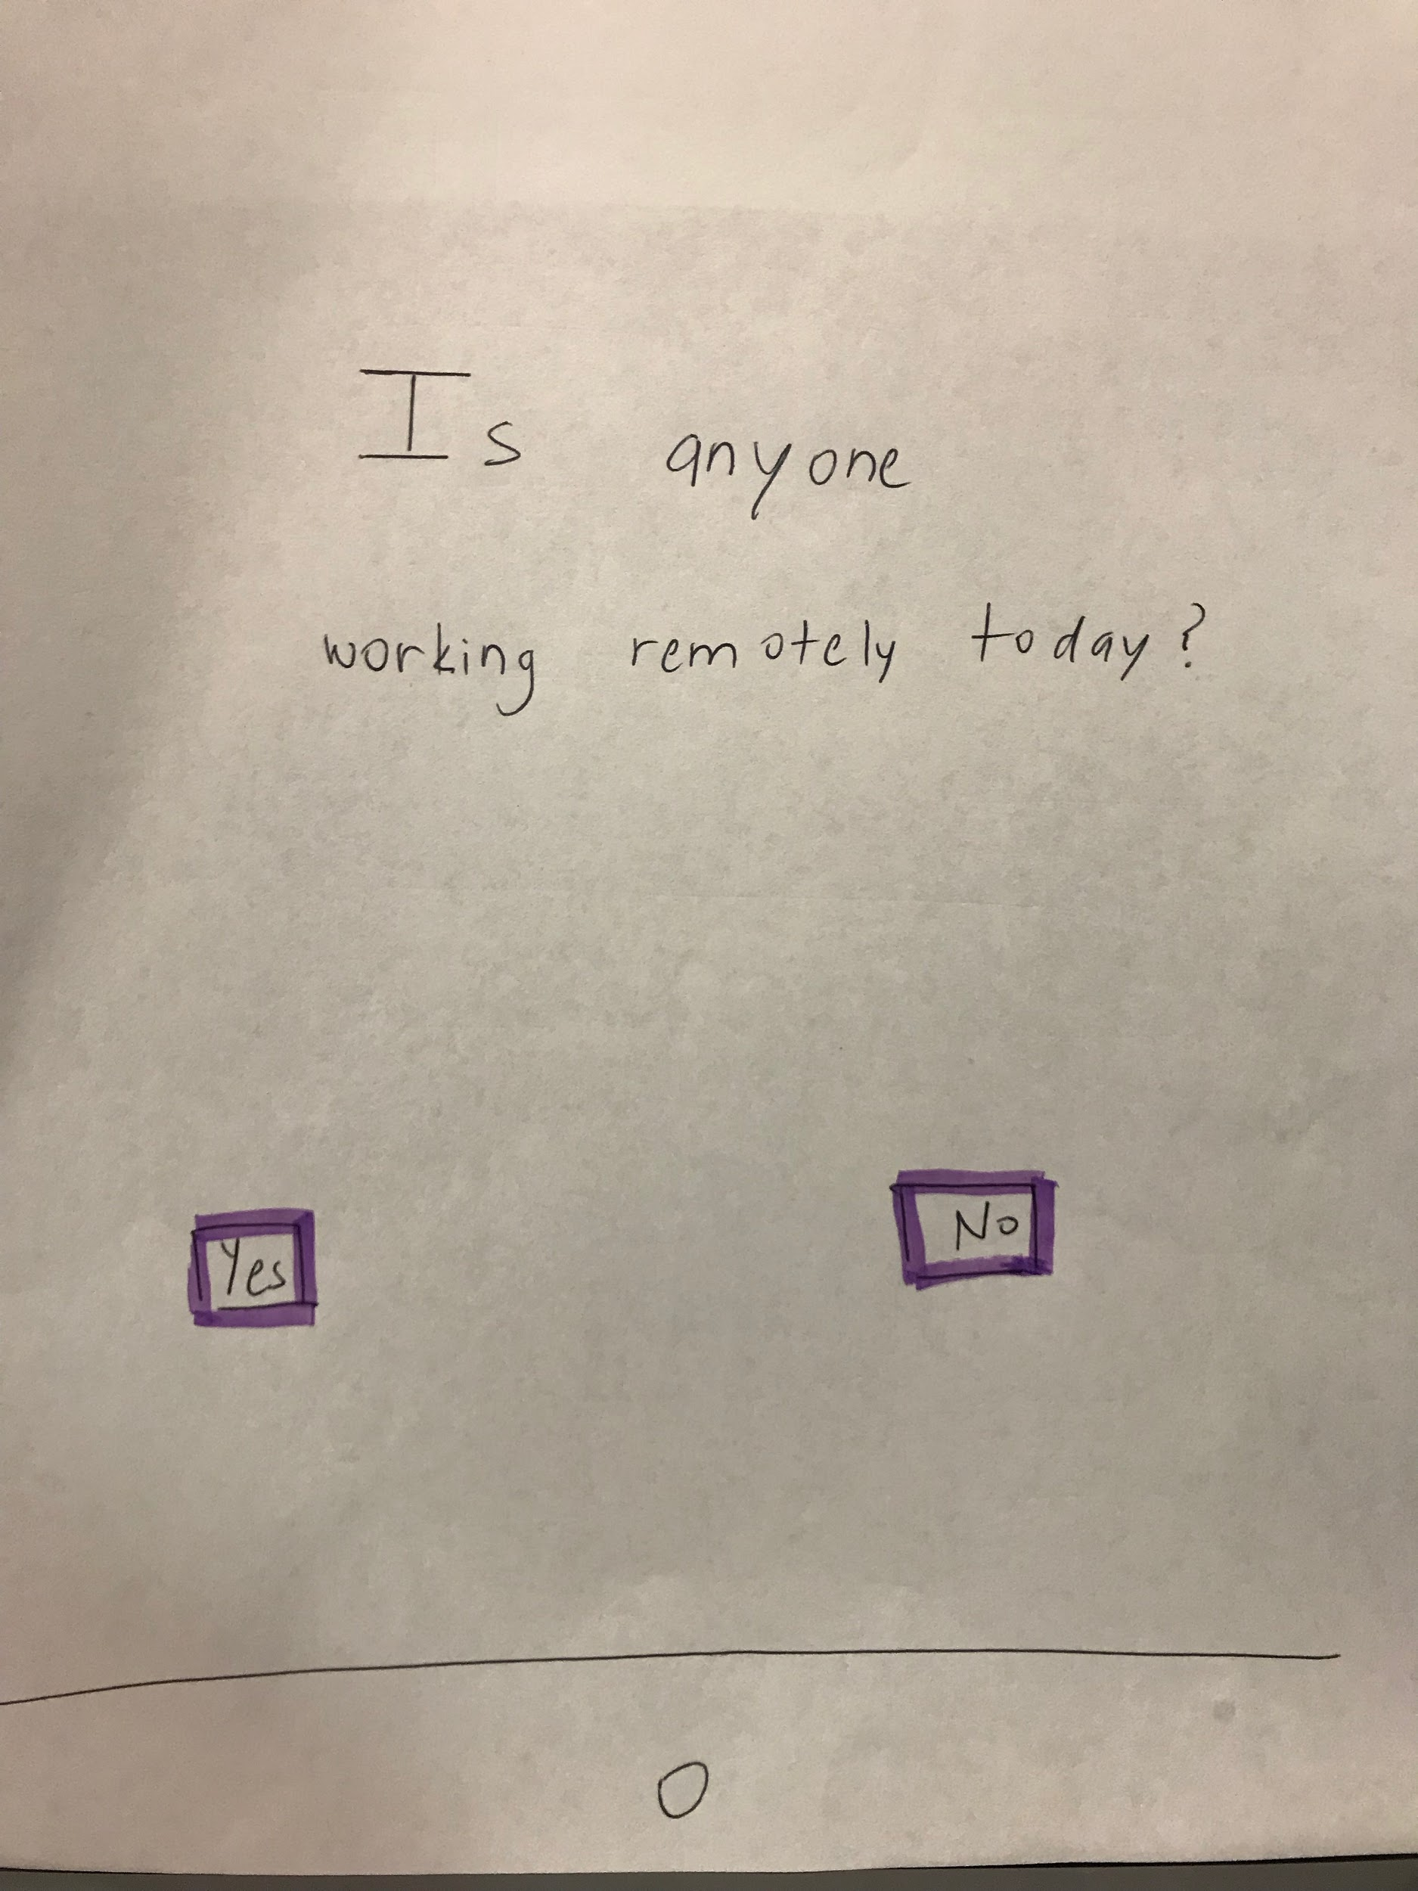
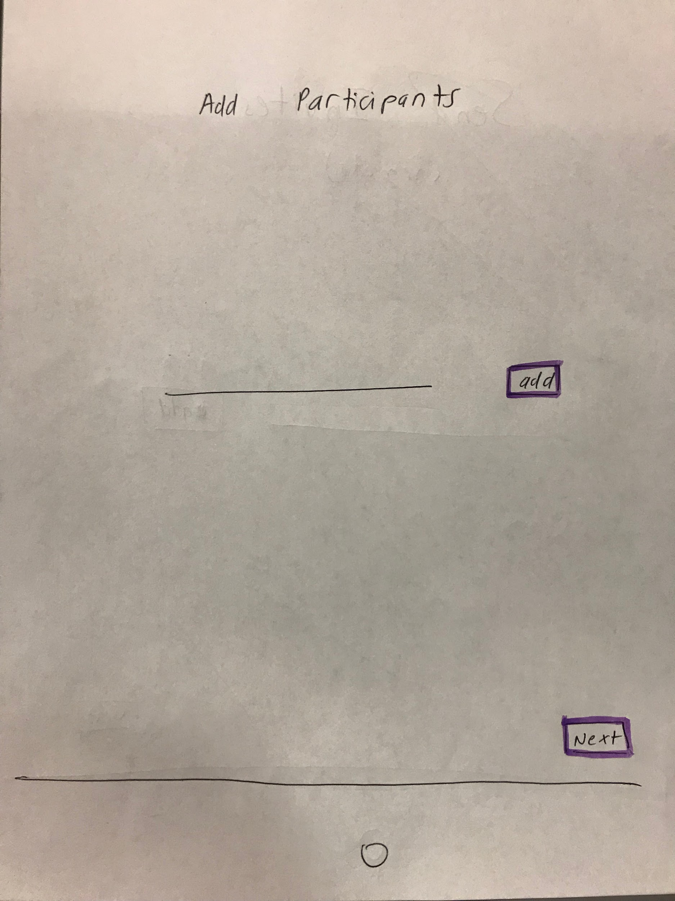
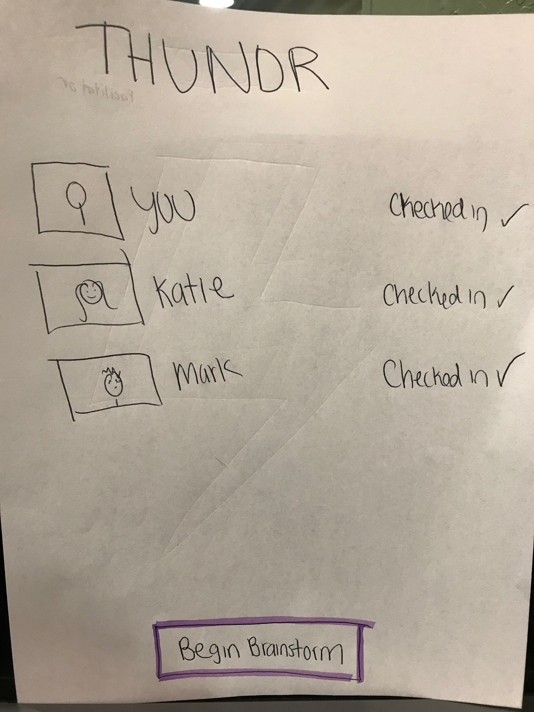
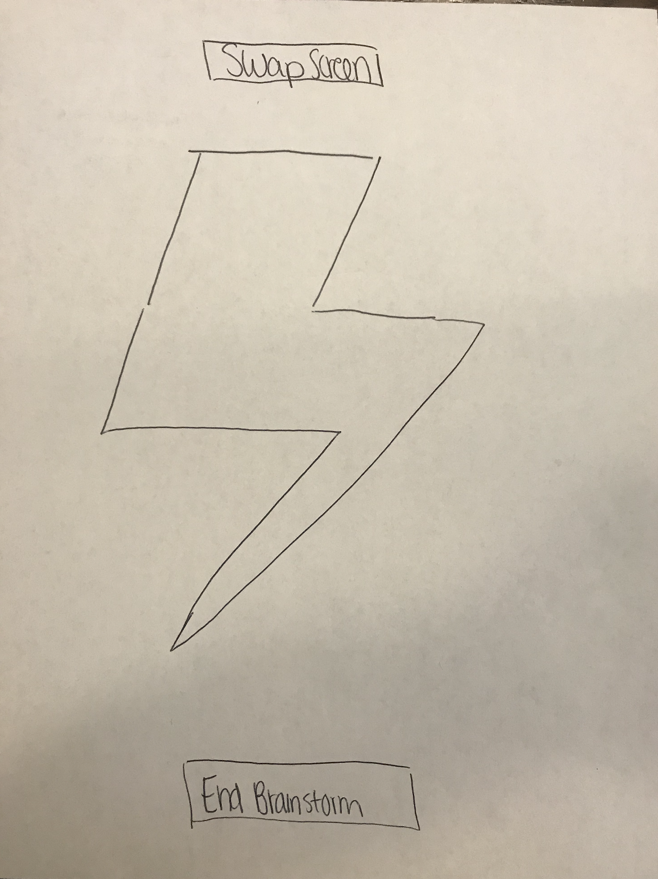
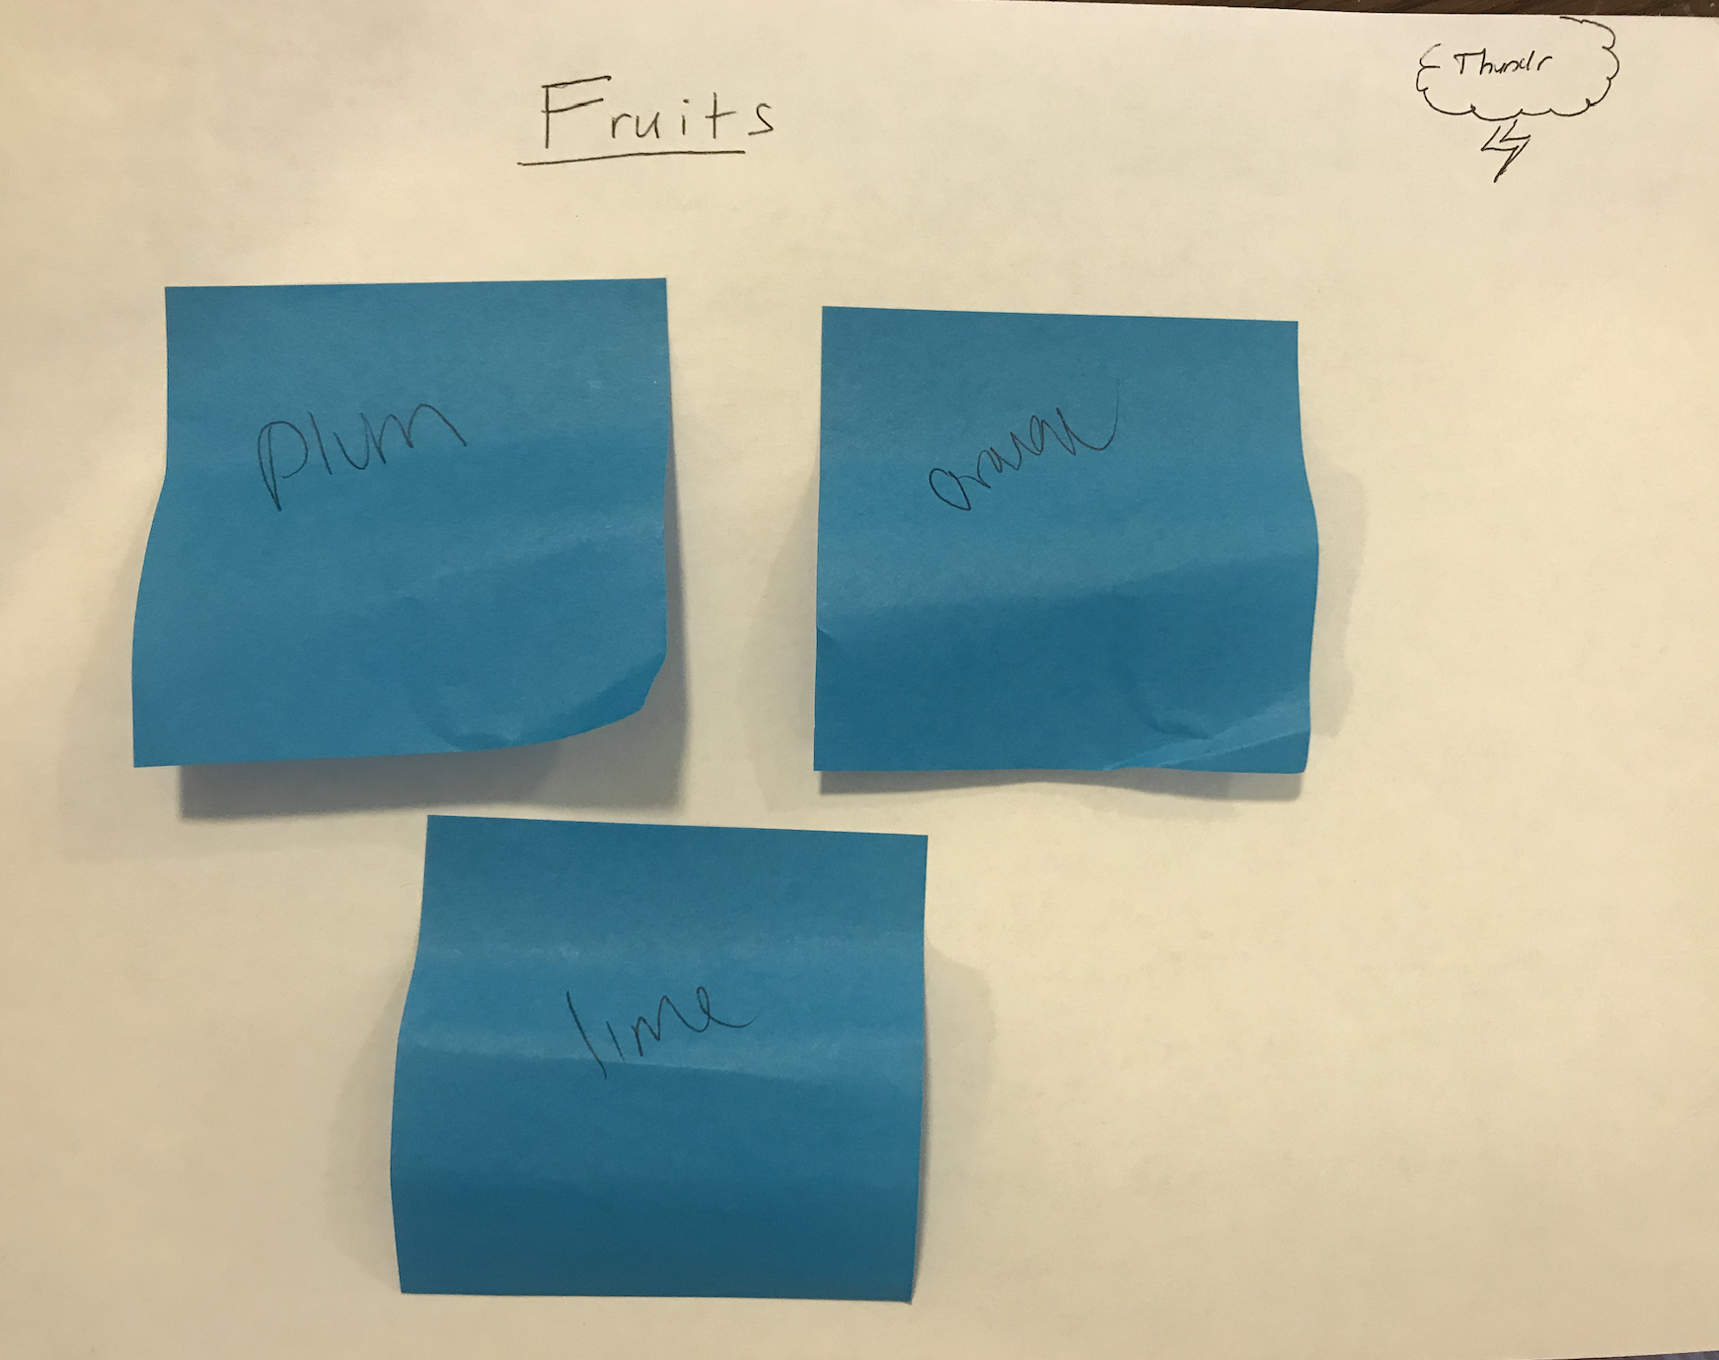
Evolution of Design -Low Fi

Slide 7
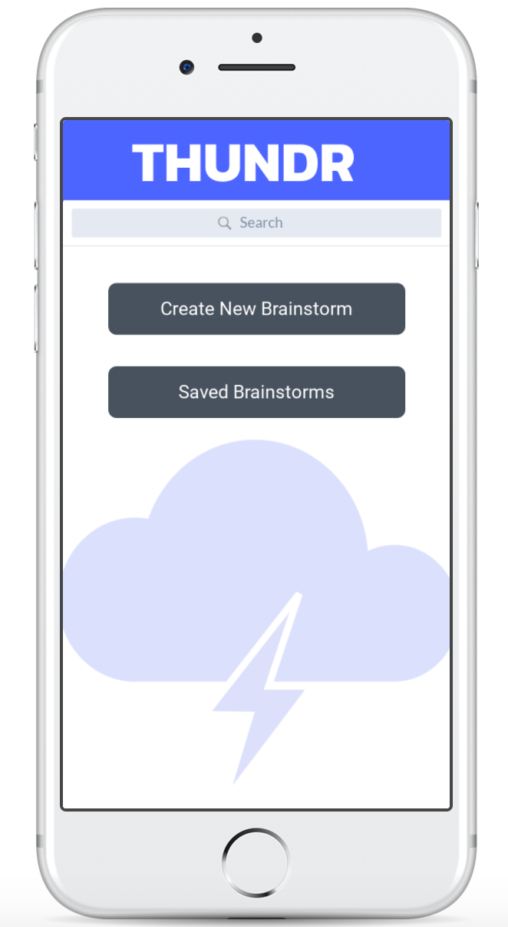
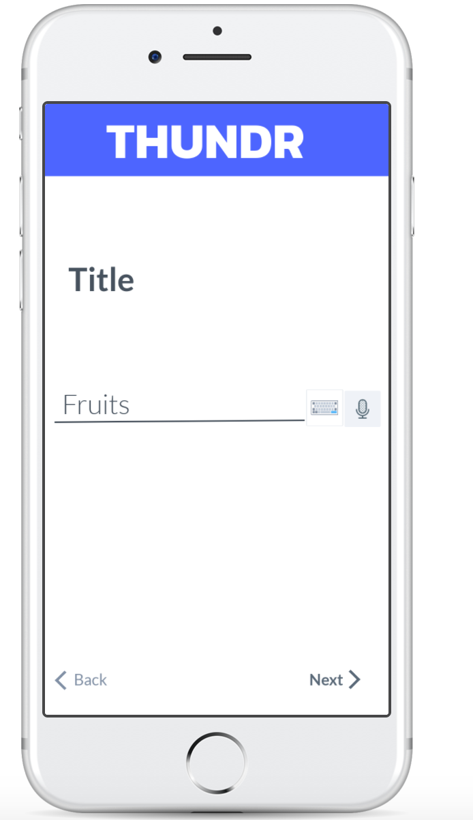
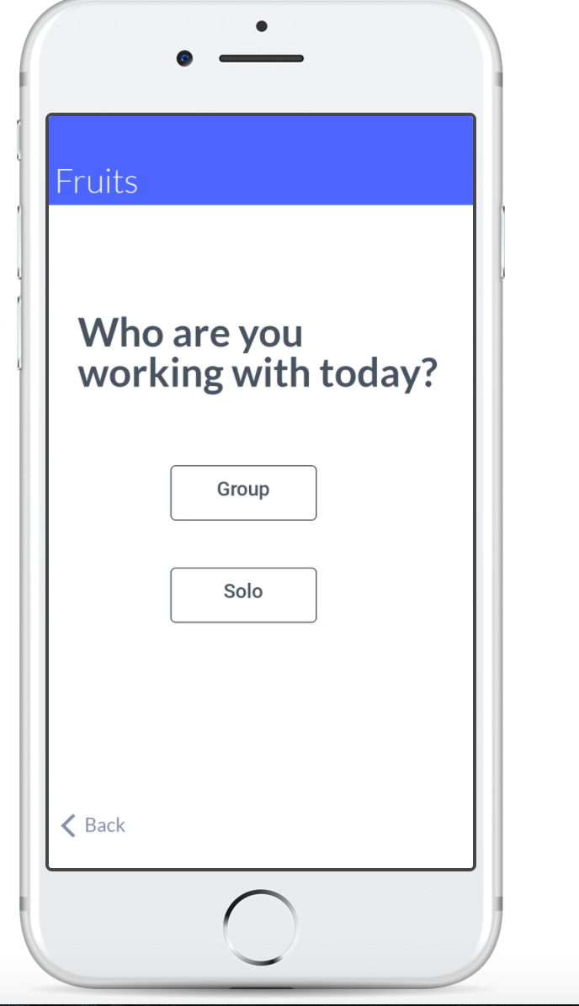
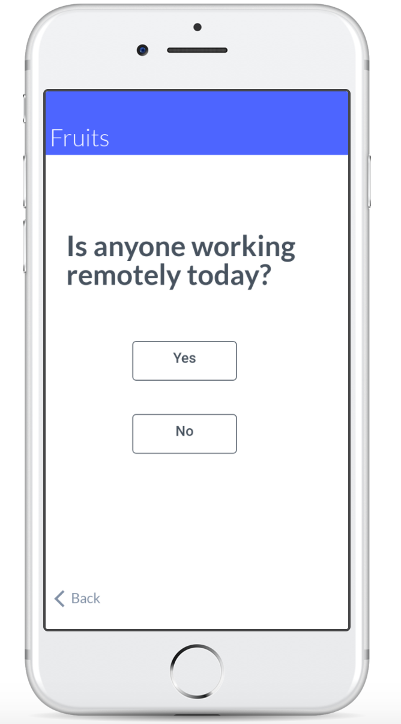
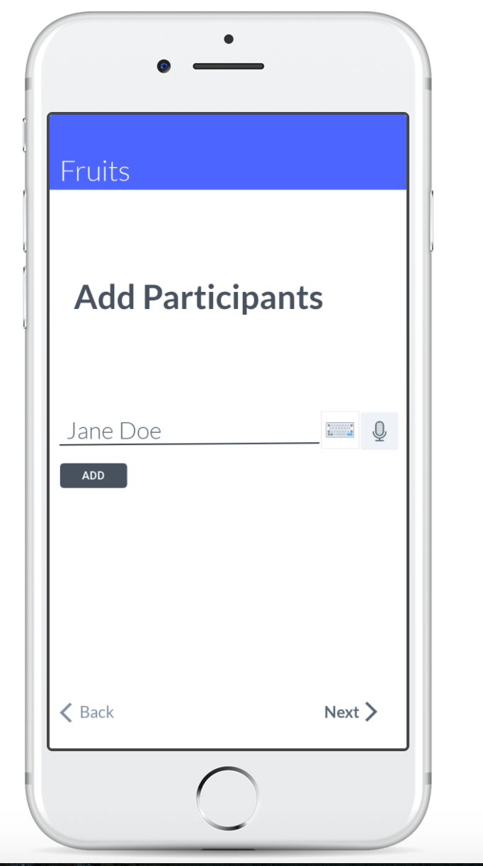
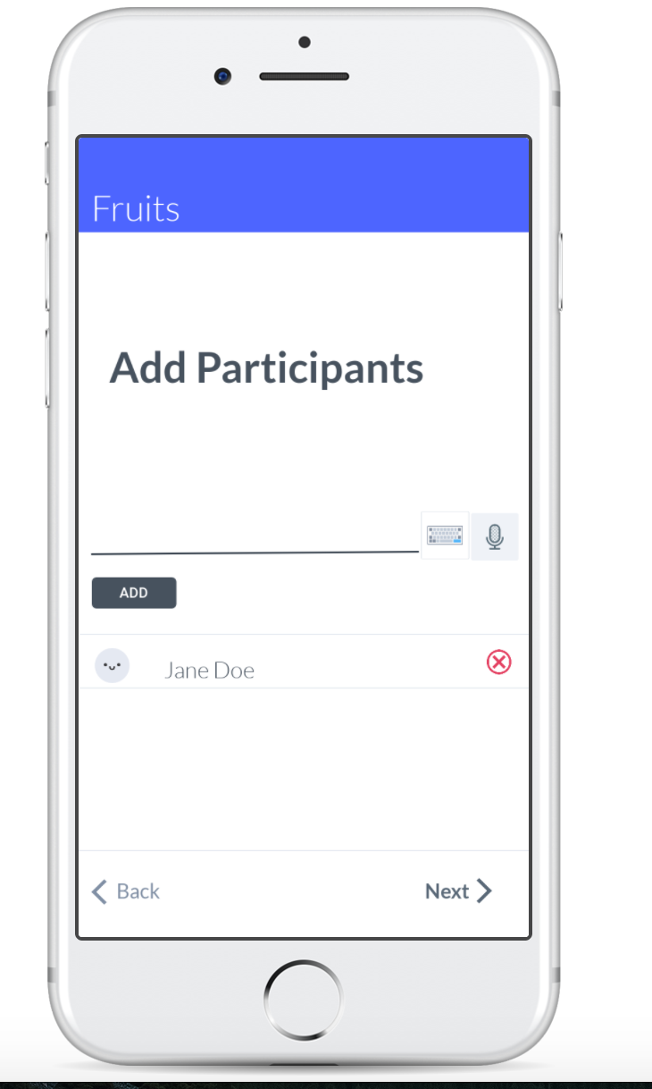
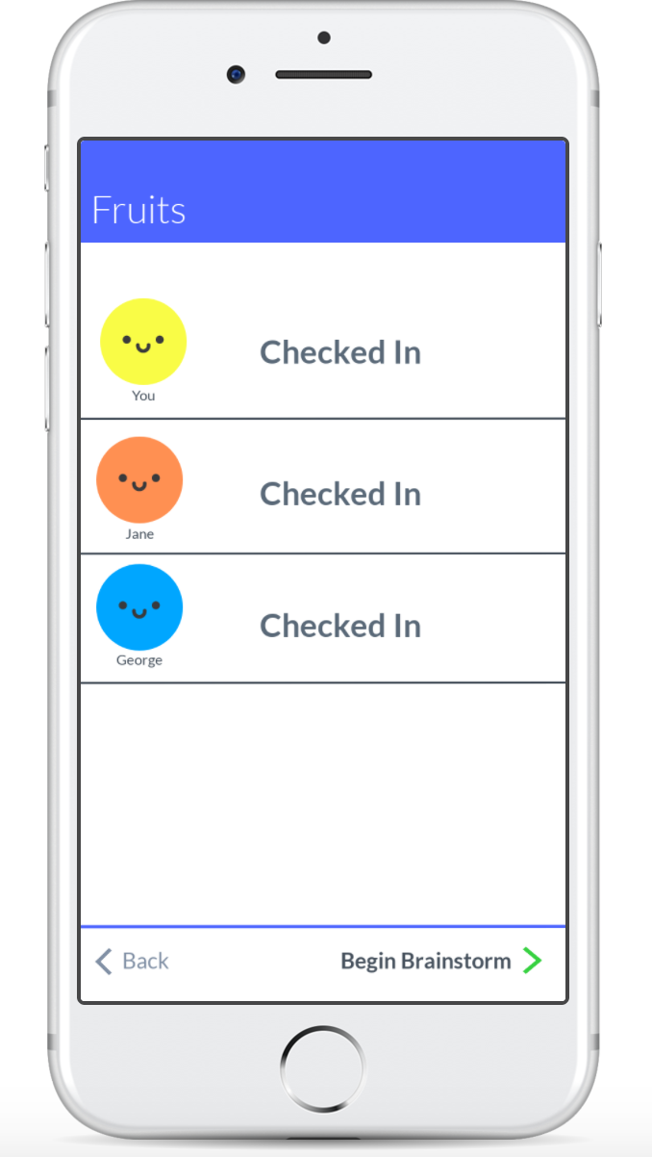
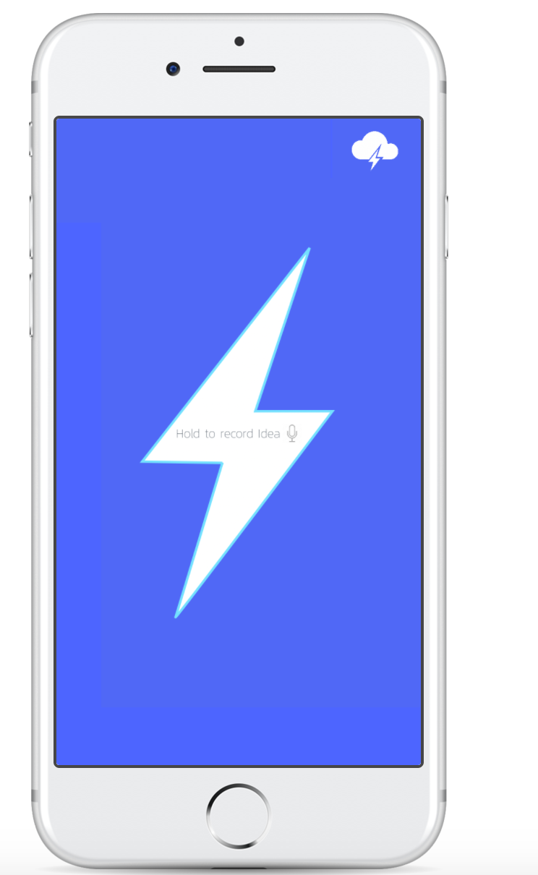
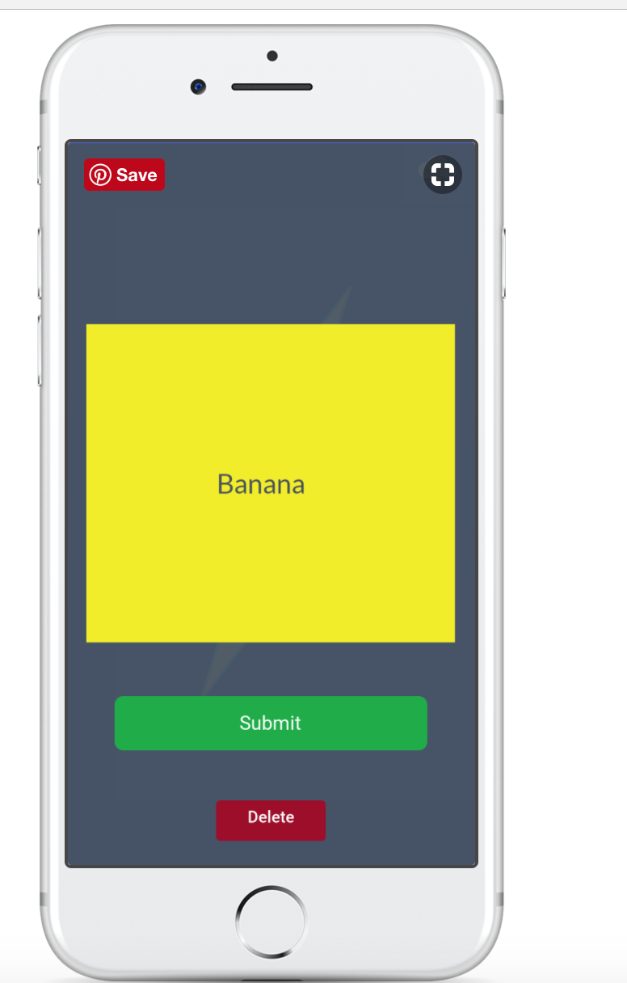
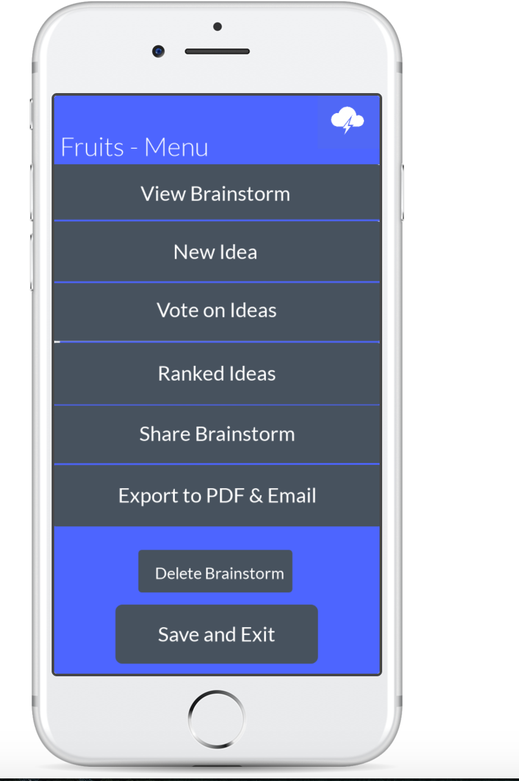
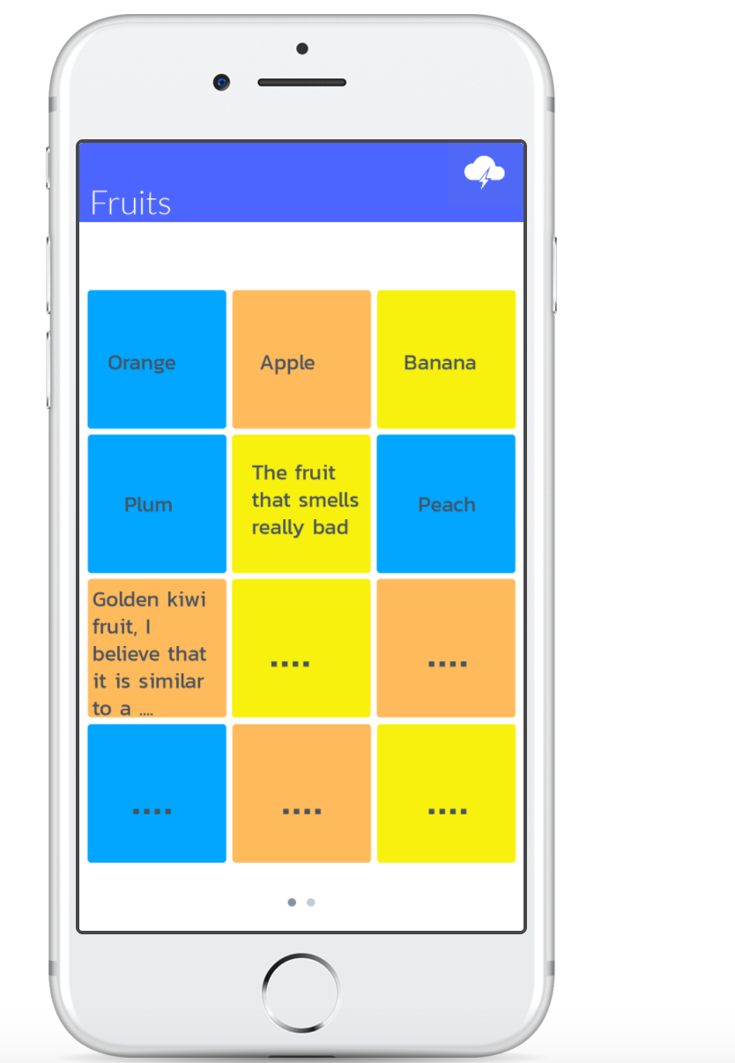
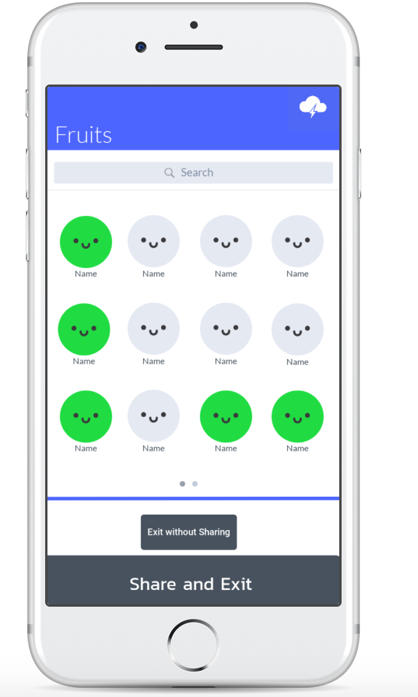
Evolution of Design - Medium Fi

Slide 8
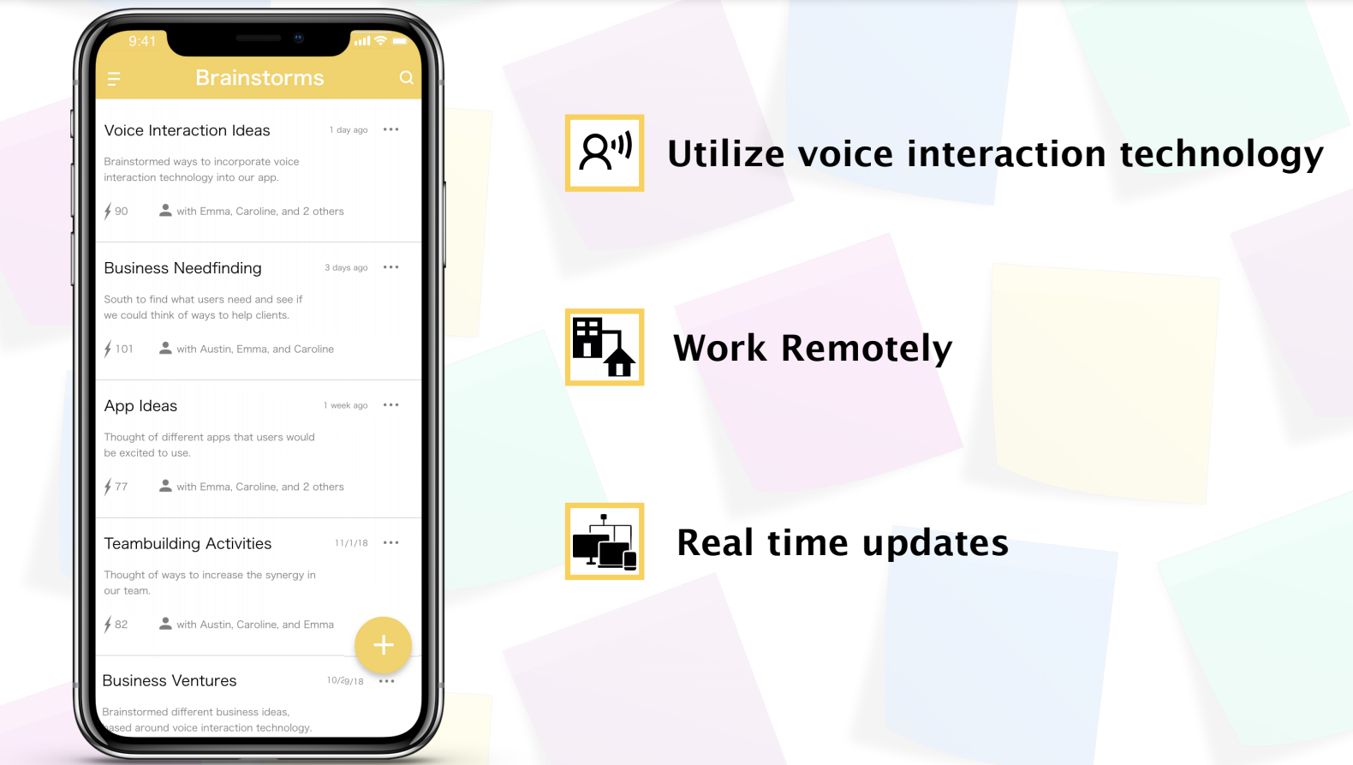
Evolution of Design - Hi-Fi

Slide 9
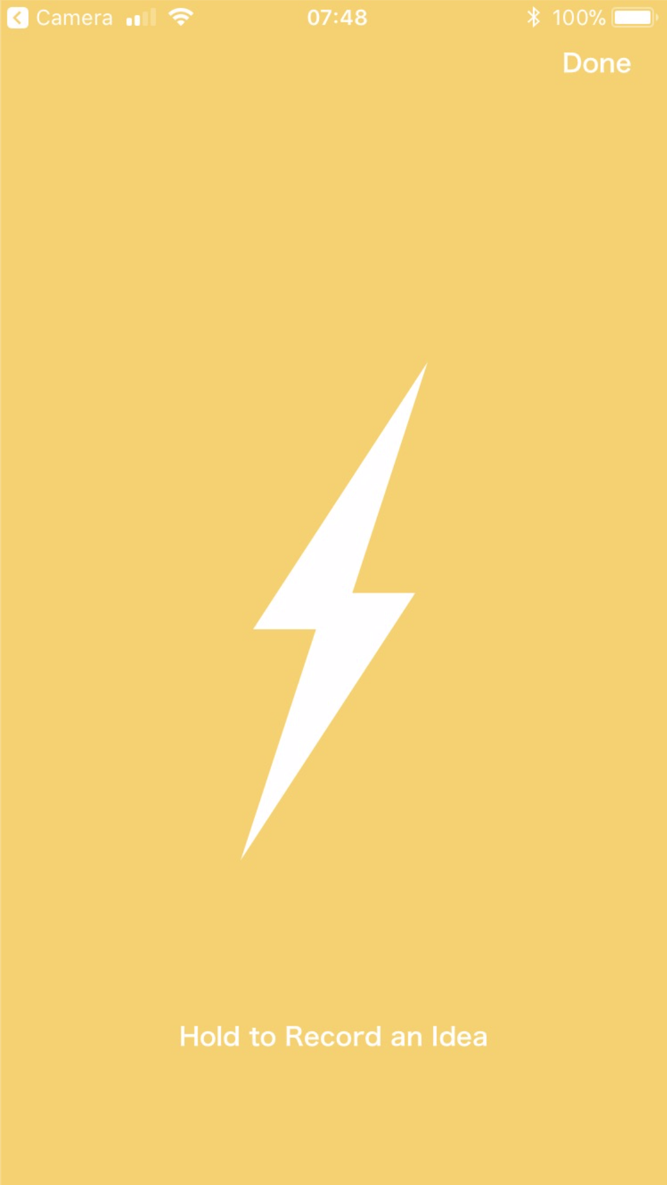
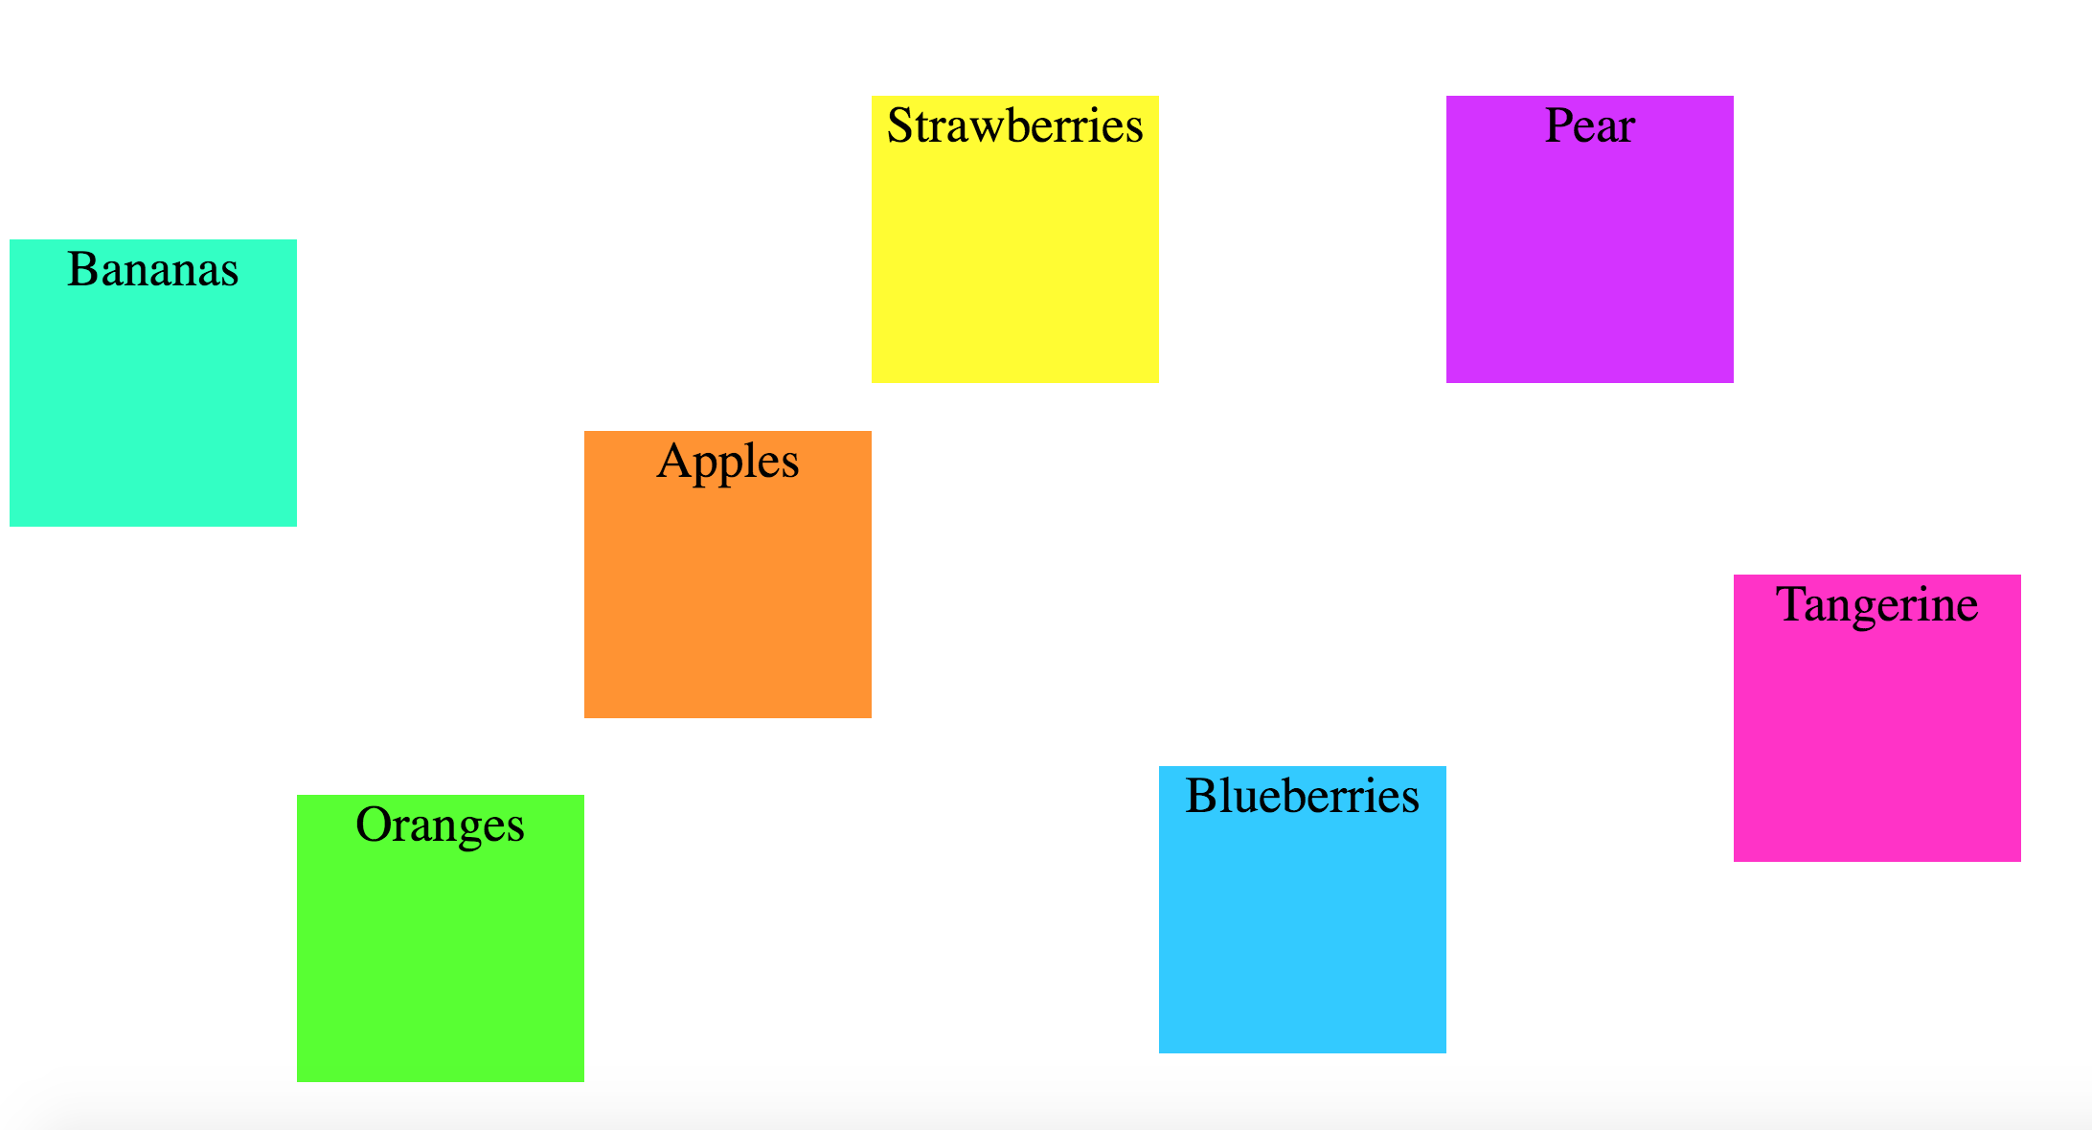
Evolution of Design - Hi-Fi

Slide 10
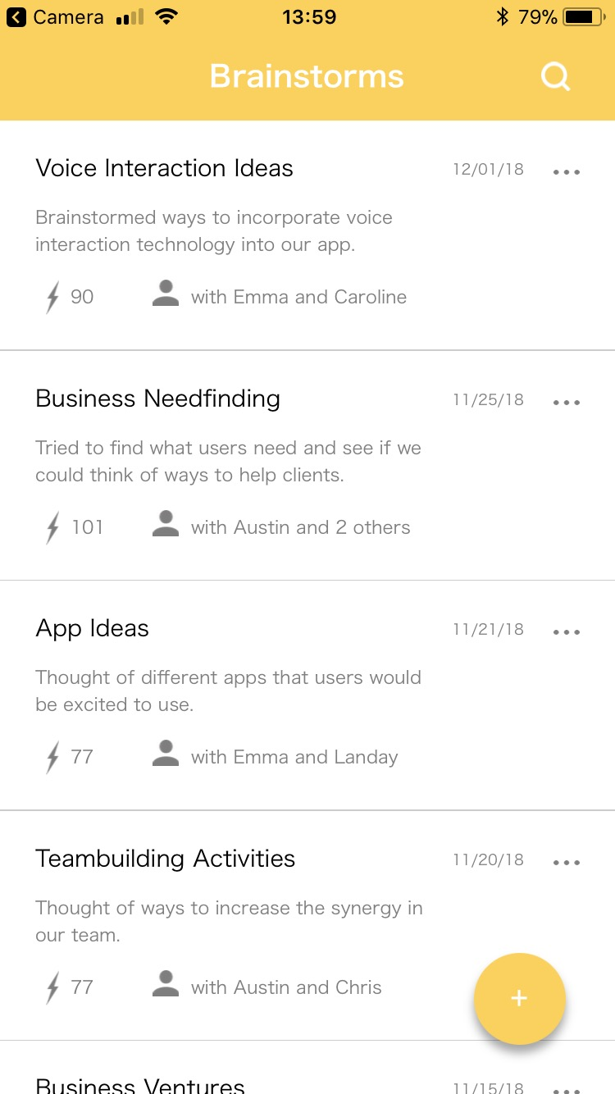
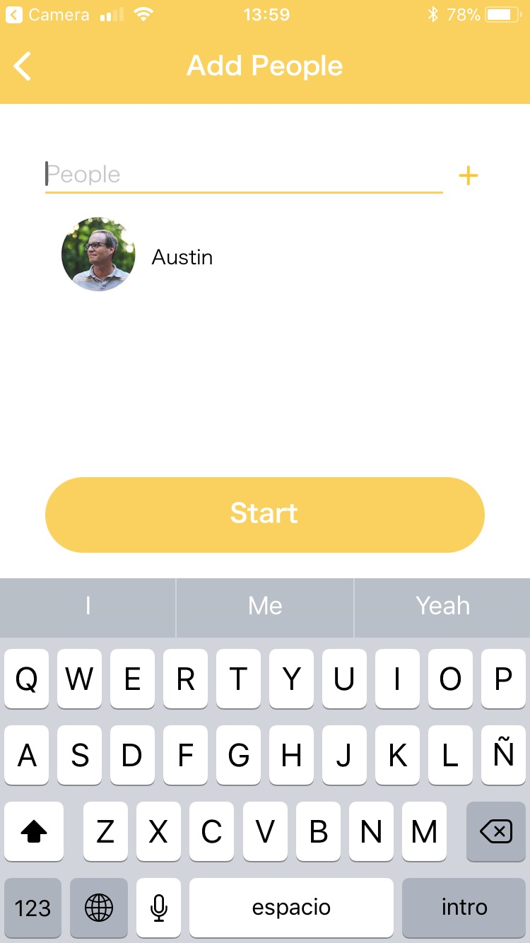
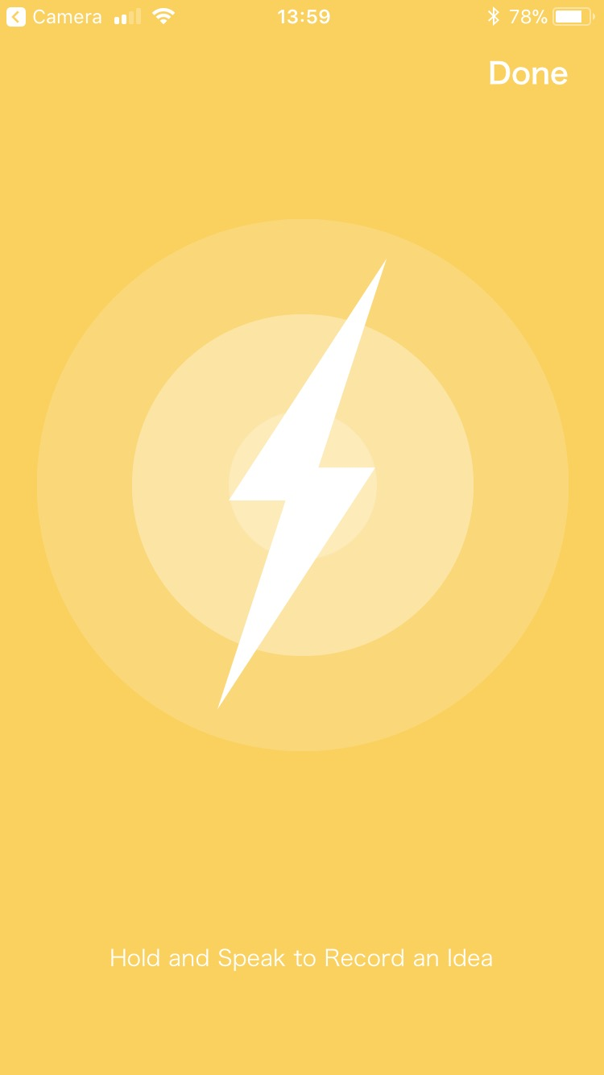
Current UI
Task 1: Create and share new ideas

Slide 11
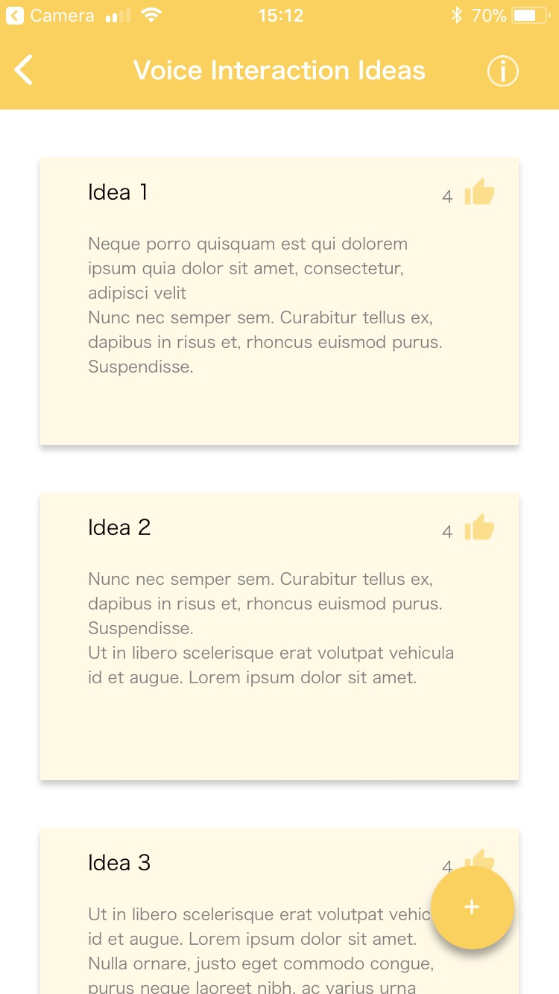
Current UI
Task 2: Access Old Brainstorm
Task 3: Vote on and Rank Ideas

Slide 12
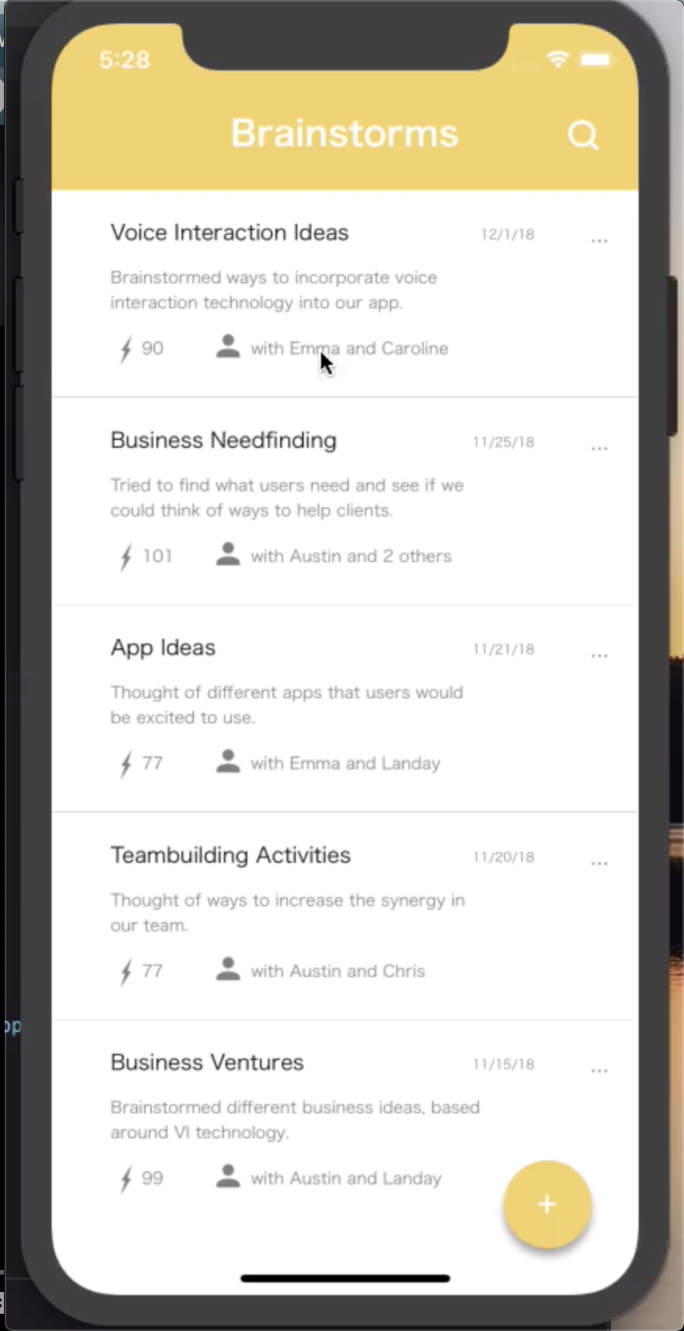
Current UI

Slide 13

Future

Slide 14
Future - Wizard of Oz/Hardcoding
Wizard of Oz:
Used another computer/screen appearing as if the display screen with brainstorm ideas. When brainstorm idea is added on the display, we typed and displayed on computer screen.
Typed in ideas as they were spoken to display on the web app portion.
We also hardcoded a lot of our data such as usernames, past brainstorms and past brainstorm ideas.

Slide 15
Future - Additions
A settings menu to help update info and profile pics.
The UI flow to join add a person to a past brainstorm.
Further implemented voice interaction to assist with app use.
An introductory tutorial explaining the design of the app, particularly how to execute a brainstorm and vote.
Additional personalization as a way to categorize and vote more specifically on brainstormed ideas.

Slide 16
Summary
Evolution of Our Design (From Low-Fi to Hi-Fi)
Current Design/UI
Ideas for the Future

