Slide 1

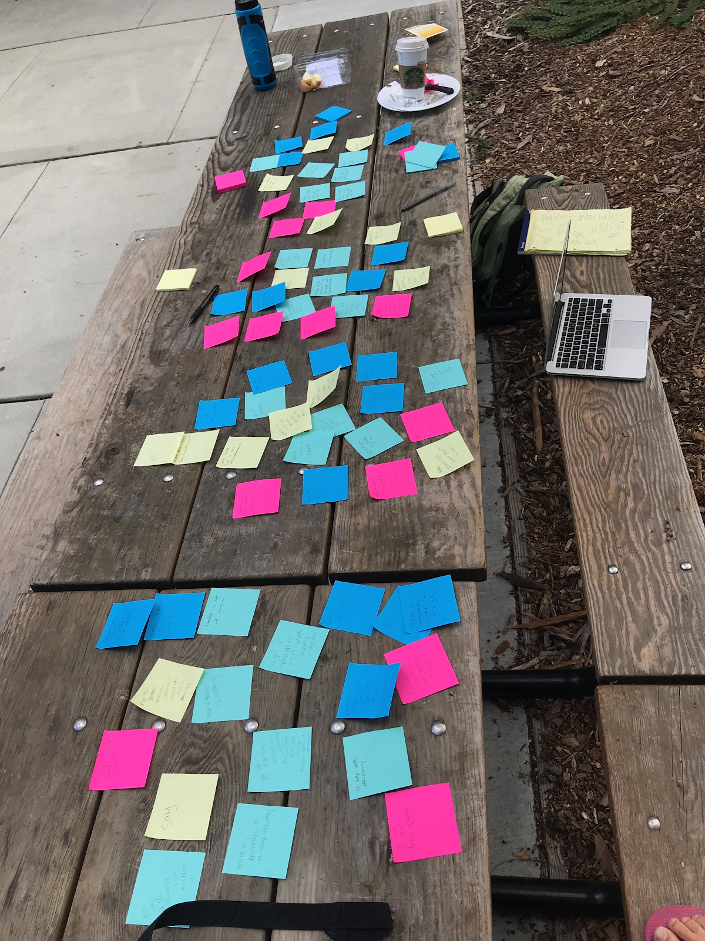
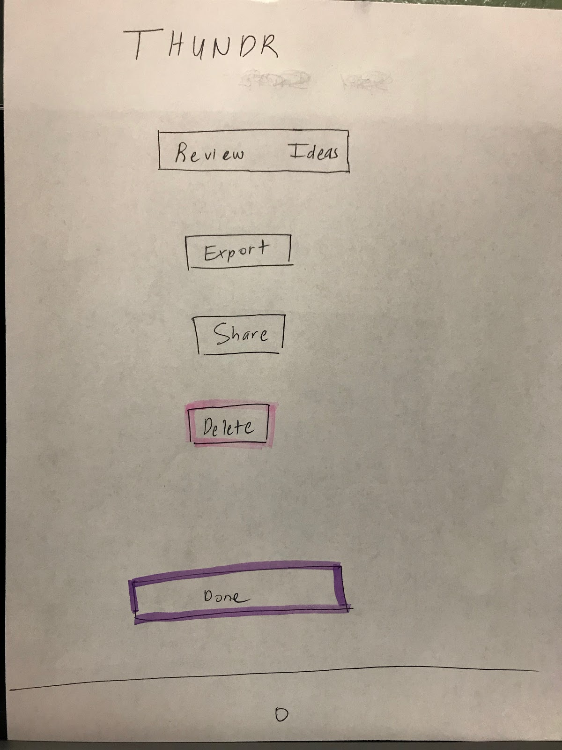
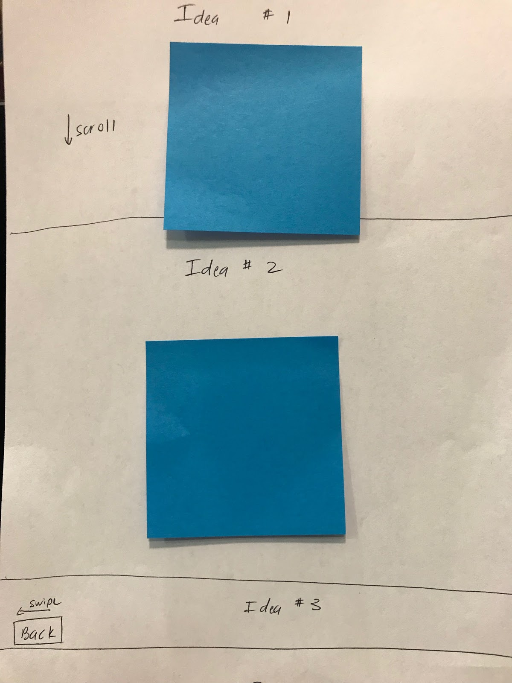
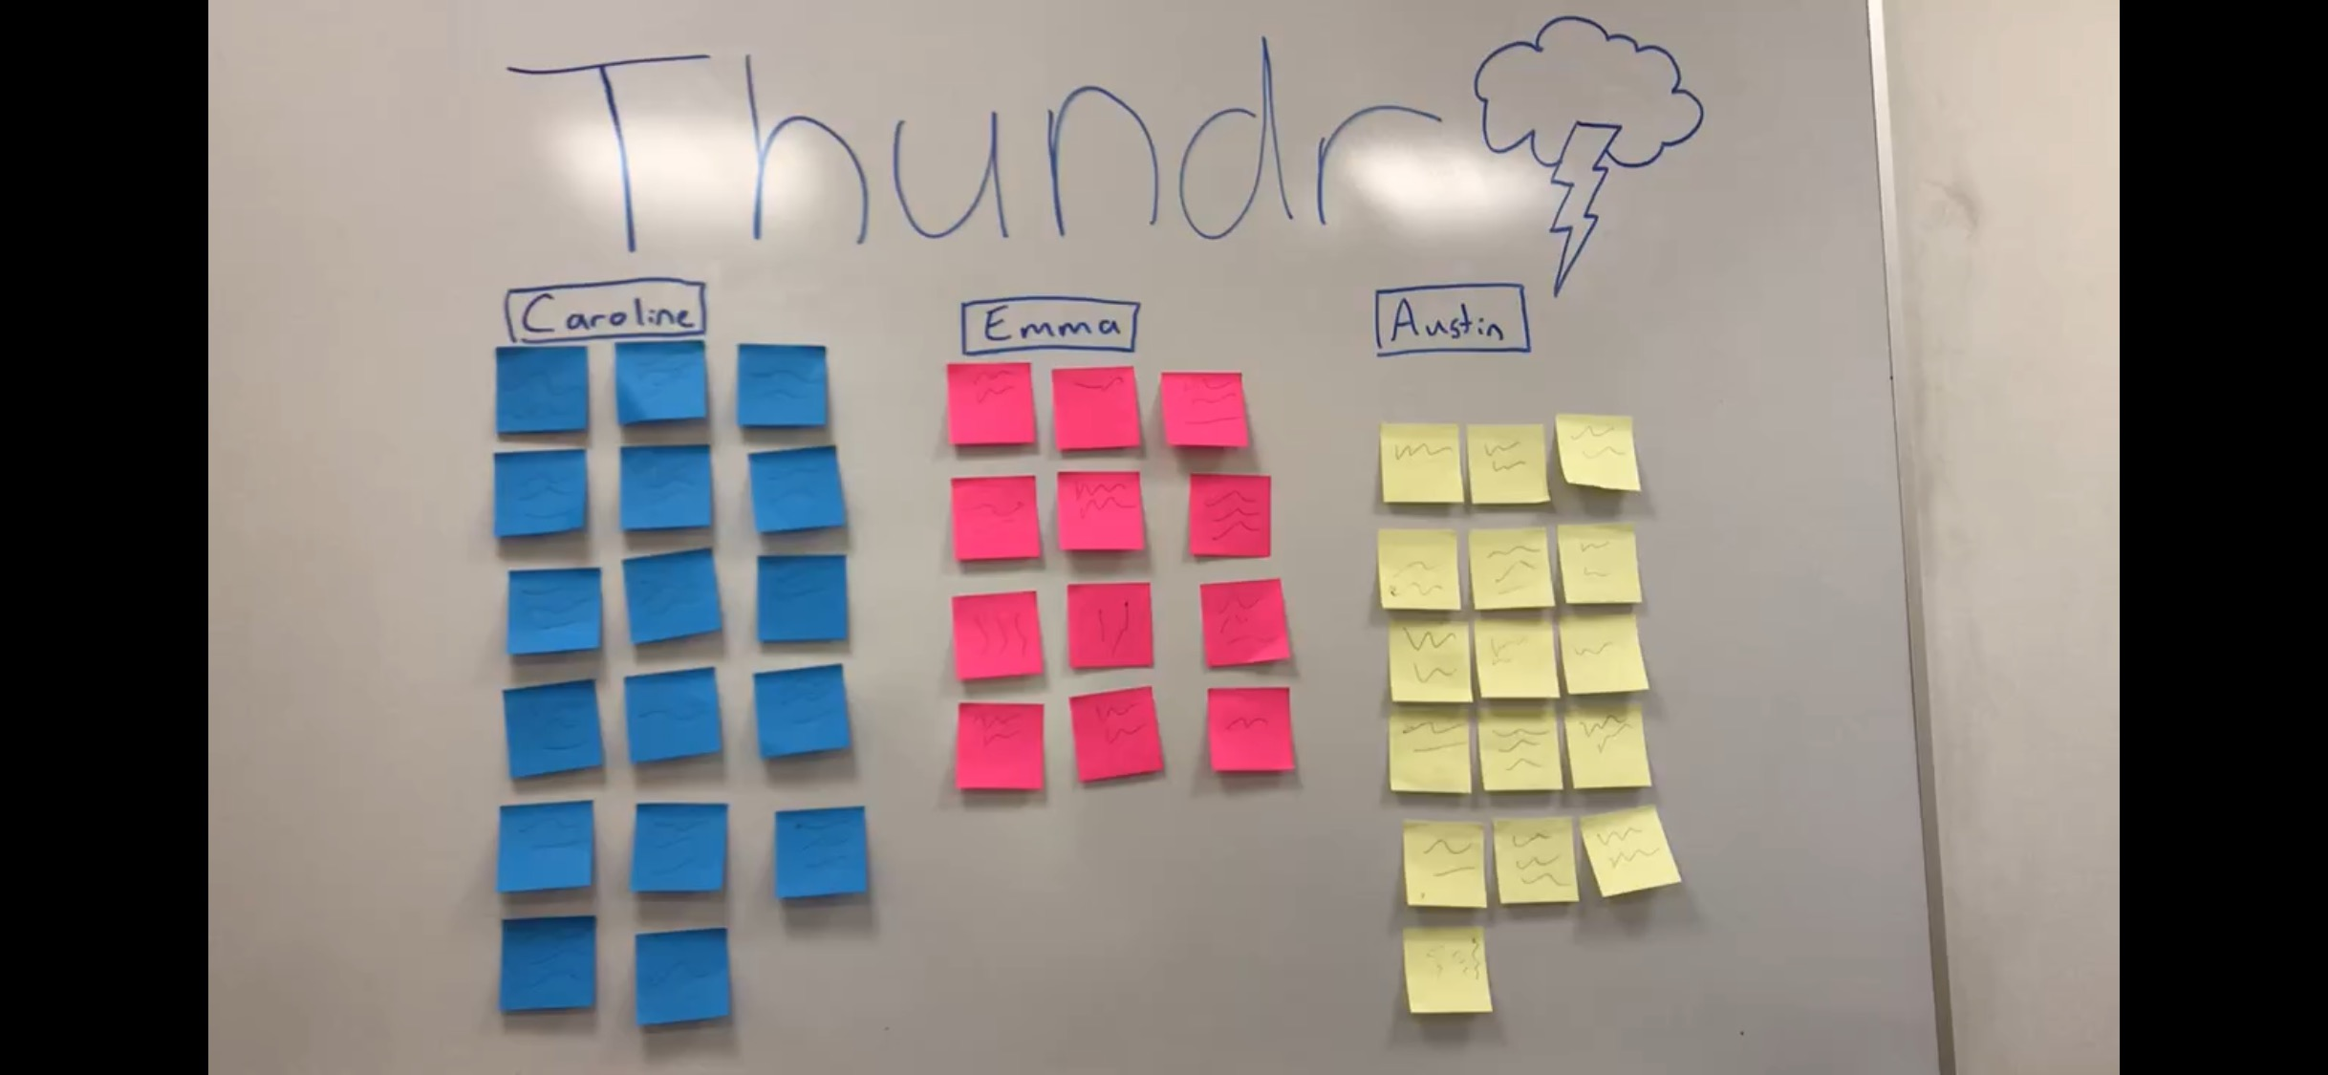
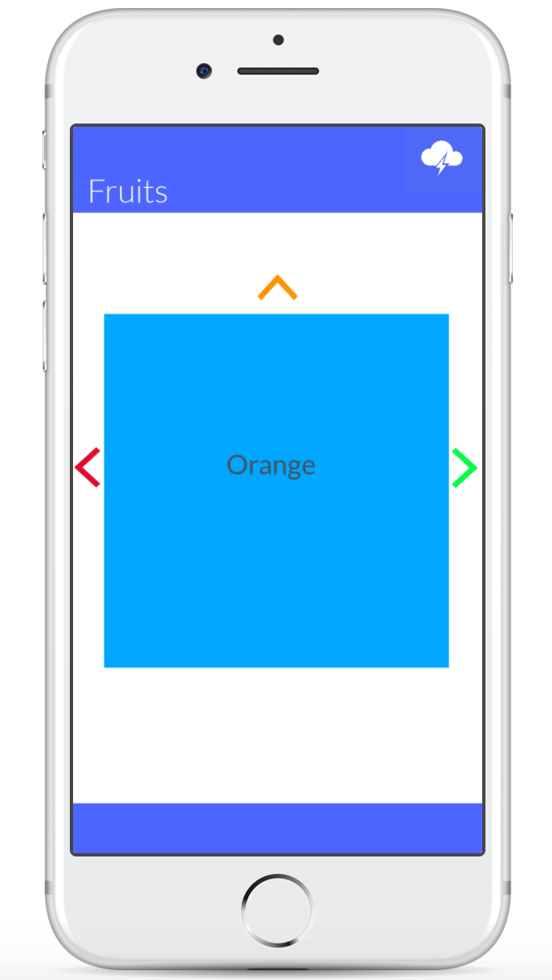
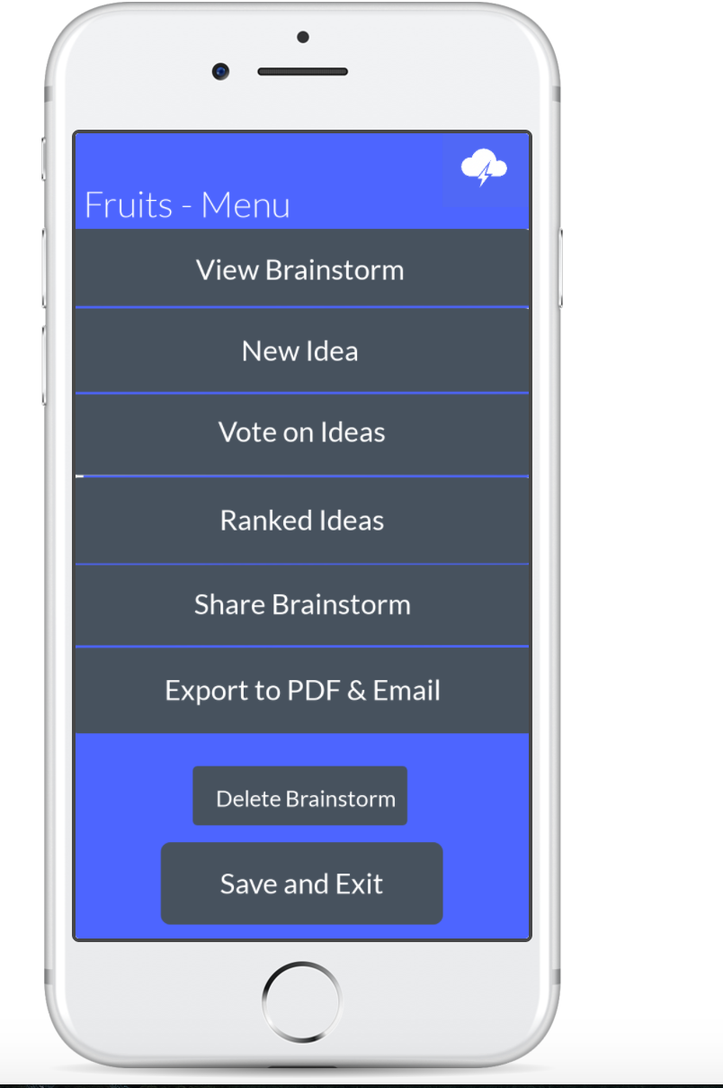
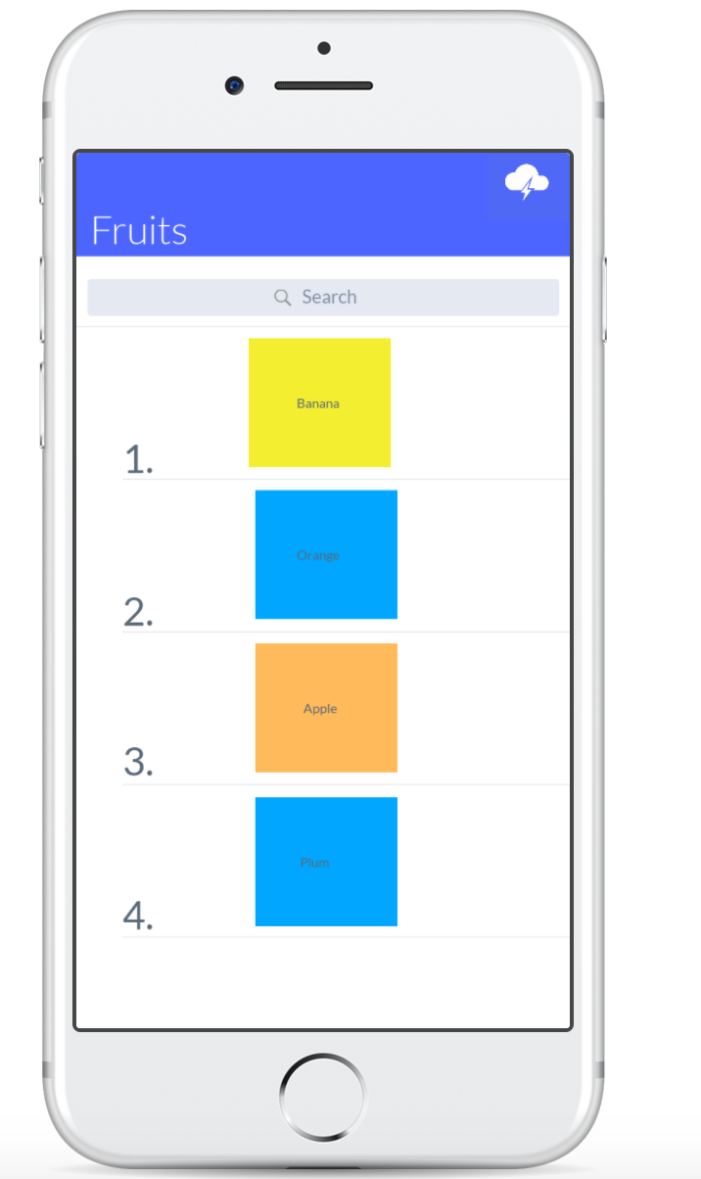
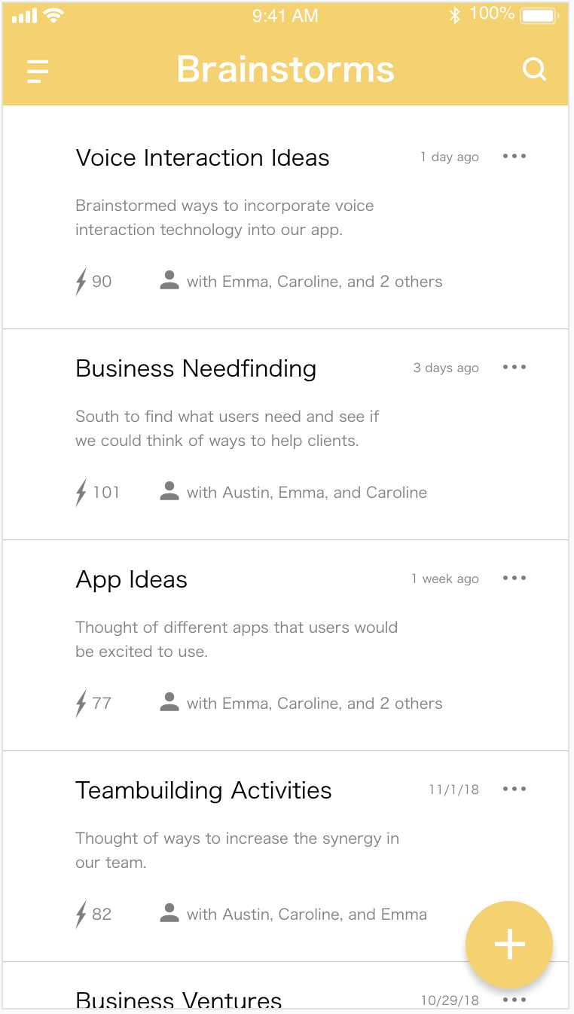


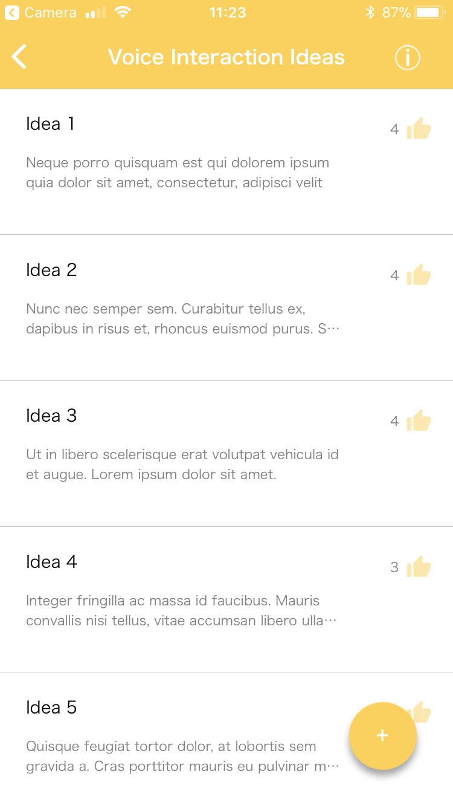
Thundr
Brainstorm with Sound…
Problem:
Process:
People want to use technology to increase productivity, but do not want to spend massive amounts of time learning how to use it.
Need-finding
Low-Fi
Solution:
Concept
Medium-Fi
Develop a tool that streamlines the brainstorming process using voice interaction, increasing both productivity and accessibility.
Key Features:
Access Previous Brainstorms
Create New Ideas in Your Brainstorm Using Voice
Highlight and Rank Favorite Ideas
Emma Alderton – Austin Jones - Caroline Willis - http://hci.stanford.edu/class/cs147/projects/Voice/Thundr/

