Slide 1
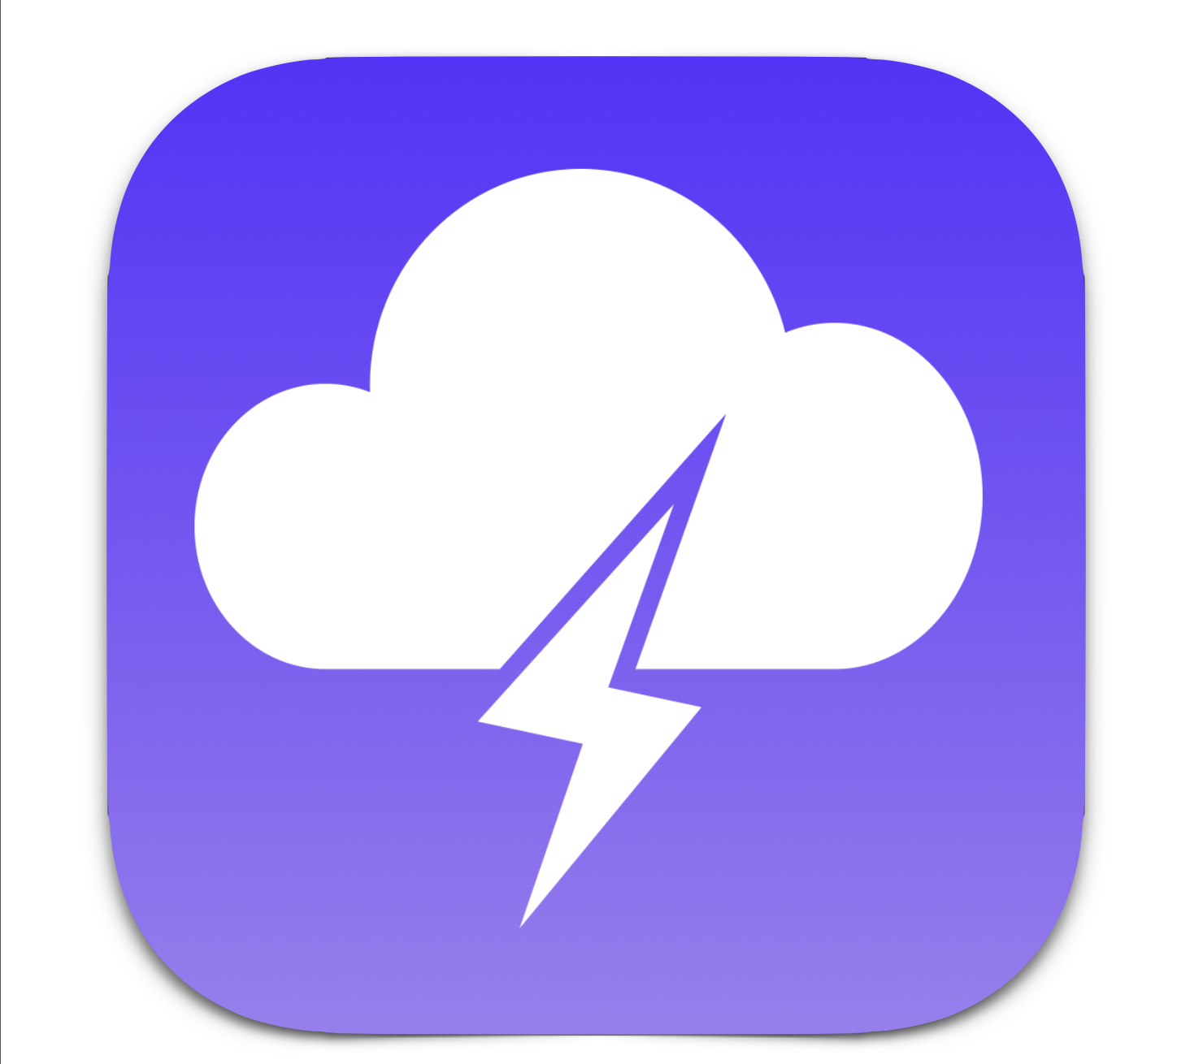
Thundr
High-Fi Prototype
Daniel K., Caroline W., Austin J., Emma A.

Slide 2
Overview Changes Demo Future
Value Proposition
Brainstorm with sound!
Problem
People want to use technology to increase productivity, but do not want to spend massive amounts of time learning how to use it.
Solution
Develop a tool that streamlines the brainstorming process using voice interaction, increasing both productivity and accessibility.

Slide 3
Overview Changes Demo Future
Task 1 (Simple)
Join a Brainstorm
Task 2 (Complex)
Dictate ideas
Task 3 (Medium)
Vote on favorite ideas

Slide 4
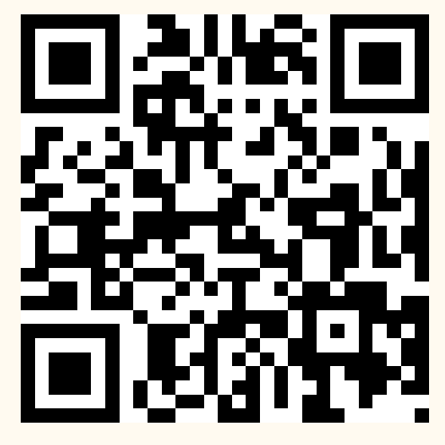
Overview Changes Demo Future
WebApp:
Introduced joining a brainstorm session via QR
Reason – simplification of join process
No typing the session code
Can open the app w/camera

Slide 5
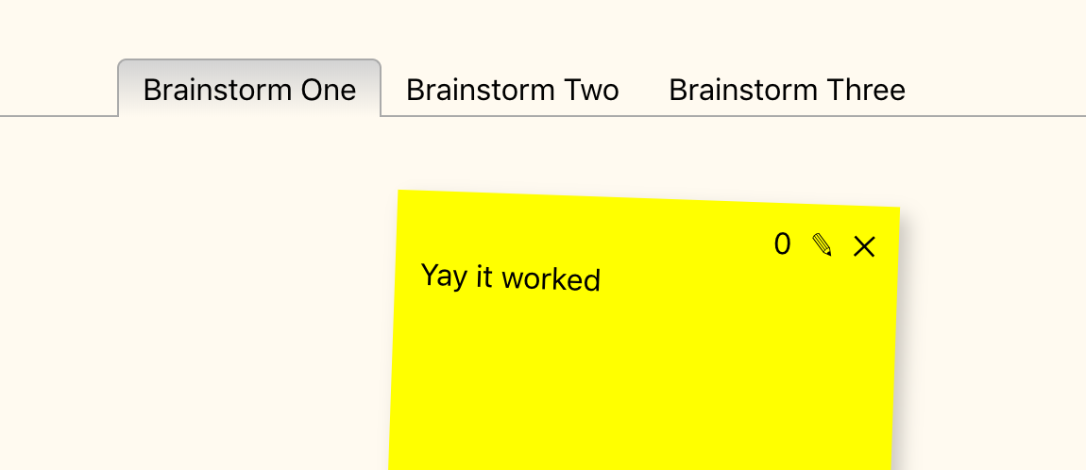
Overview Changes Demo Future
WebApp:
Multiple brainstorm channels
Reason – most teams do several brainstorms in one session

Slide 6
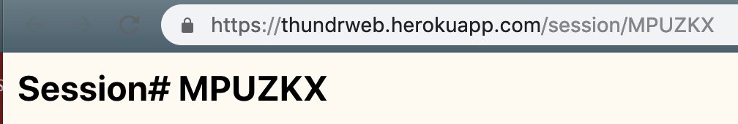
Overview Changes Demo Future
WebApp:
Persistent URL
Reason – teams want to revisit prior brainstorms
Deep linking via URL
Browser bookmark fully restores the session

Slide 7
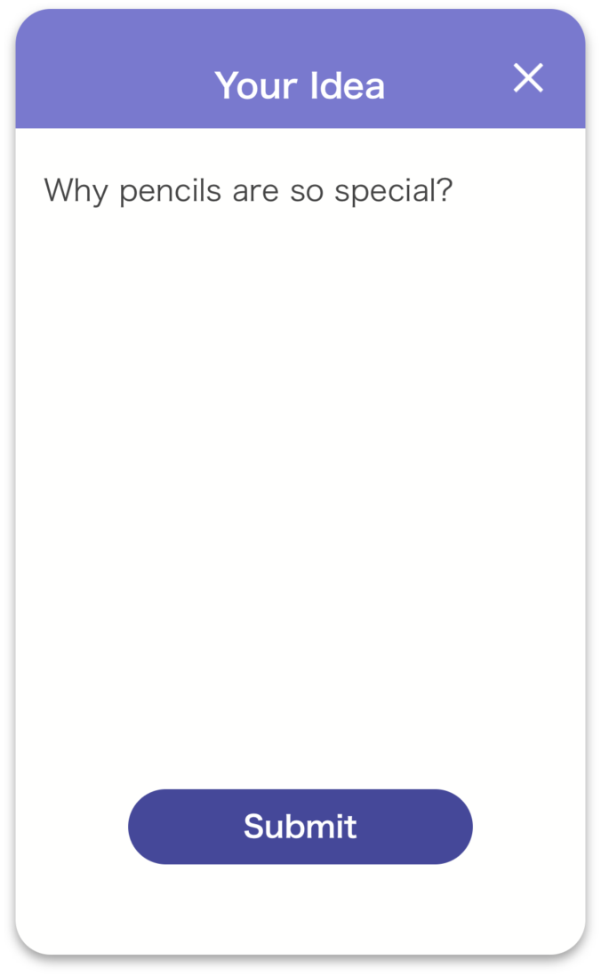
Overview Changes Demo Future
iOS App:
Switched dictation from remote (Watson) to local (IOS)
Reason – remote voice processing was frustrating
and slow

Slide 8
Overview Changes Demo Future
iOS App:
Redesigned dictate idea screen
Reason – More intuitive, less changes of screen. Easier
to use and understand.
– Works better with quicker dictation, can now
view words while dictating.

Slide 9
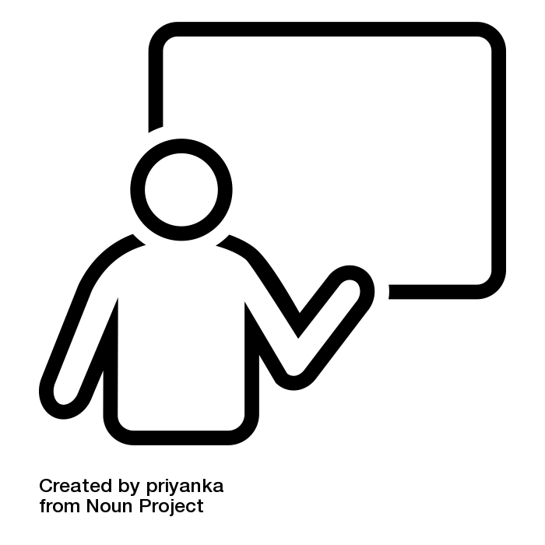
Overview Changes Demo Future
LIVE NOW

Slide 10
Overview Changes Demo Future
By Task (iOS App):
iOS | Task 1 (Join brainstorm) | Task 2 (Dictate 3 ideas) | Task 3 (Vote on ideas)
Revamped Hi-Fi | Complete | Complete | Complete
UI | Complete | Complete | Complete
Database | Complete | Complete | Complete

Slide 11
Overview Changes Demo Future
By Task (WebApp):
WebApp | Task 1 (Join brainstorm) | Task 2 (Dictate 3 ideas) | Task 3 (Vote on ideas)
Revamped Hi-Fi | Complete | Complete | Complete
UI | Complete | Complete | Complete
Database | Complete | Complete | Complete

Slide 12
Overview Changes Demo Future
By Screen (iOS App):
iOS | UI Exists | UI Polished | Database connected
Home Screen | Complete | Complete | Complete
Idea screen | Complete | Complete | Complete
Vote screen | Complete | In progress | Complete

Slide 13
Overview Changes Demo Future
By Task (WebApp):
WebApp | UI Exists | UI Polished | Database connected
Home Screen | Complete | In progress | Complete
Brainstorm session screen | Complete | In progress | Complete

Slide 14
Overview Changes Demo Future
Plan:
4/3 8/3 11/3 15/3
Polish Web UI
-Tabs (color/editable)
-Vote button
-Save & Exit link
-Trash/delete link
Polish iOS vote
-Thumb color change
-Animated flip
Add help tutorial iOS app
Add info links on Web homepage
Bug Fixes

