Slide 1

thundr
brainstorm with sound

Slide 2
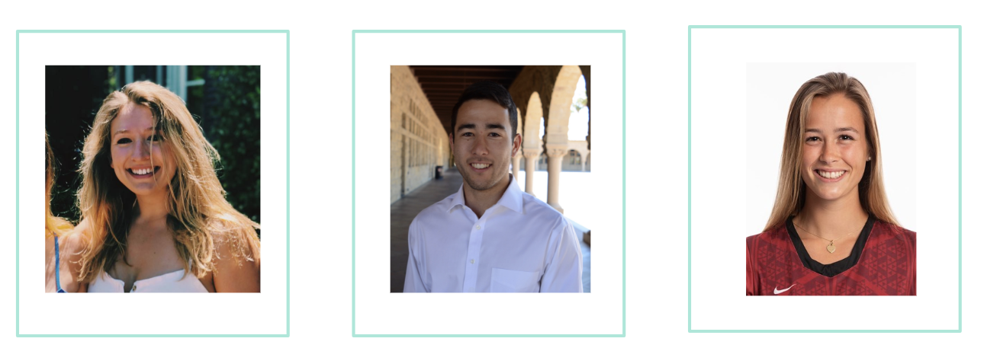
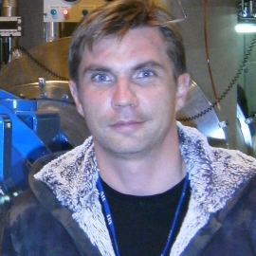
The Team
Caroline Willis
Austin Jones
Emma Alderton
Daniel Kharitonov

Slide 3
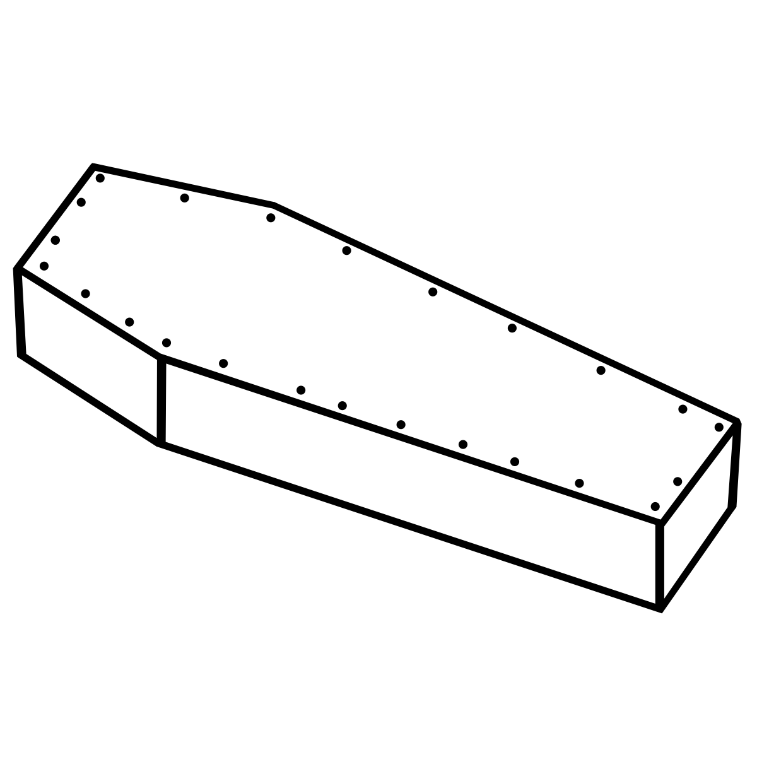
When I die, I want the people I did group projects with to lower me into my grave so they can let me down one last time.
Notes:
Can we all agree on something…. Group projects are hard, getting people free at the same time, in the same place and actually working on the same thing! Its nearly impossible. But you know whats worst…. Group brainstorms… not only do you have the problems of any normal group project… but you have to be creative as well… and lets not forget about actually picking the best idea! You don’t want to offend anyone, you’re literally treading on eggshells… “thats a good idea but….its really not a good idea and its no where neaaarrr as good as mine….buuuut its still a really good idea because i dont want you to throw my grade under the bus with the peer review.

Slide 4
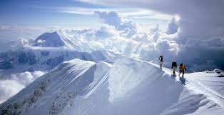
Problem Solution Making it Real

Slide 5
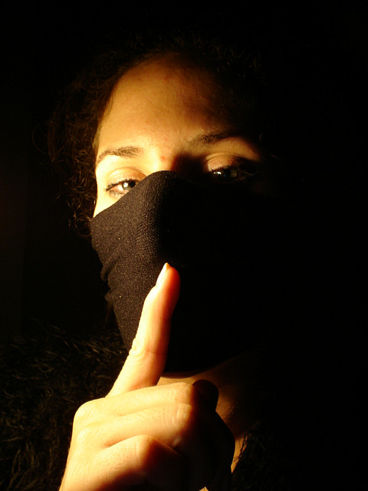
The Problem with Brainstorming
Silent brainstorming is ineffective

Slide 6

The Problem with Brainstorming
Silent brainstorming is ineffective
Difficult to find best ideas

Slide 7
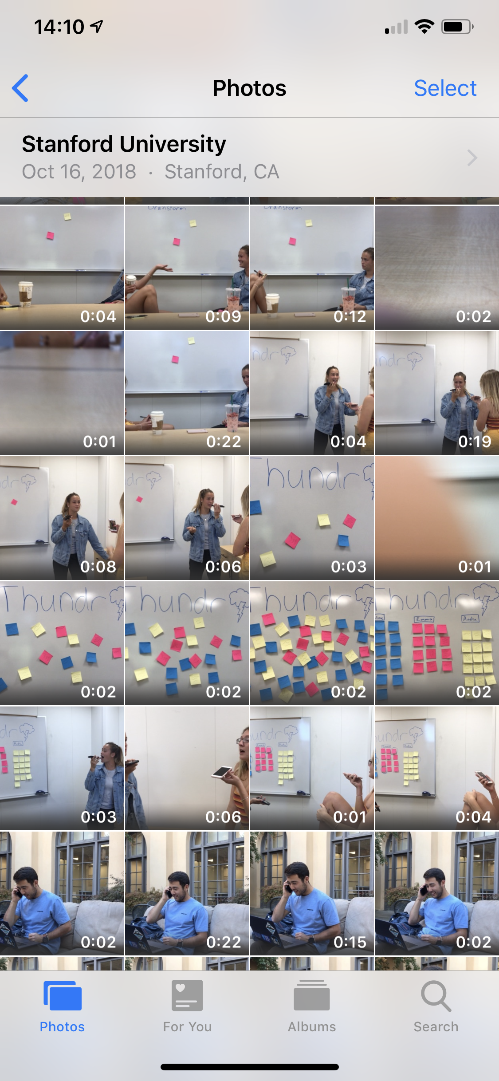
The Problem with Brainstorming
Silent brainstorming is ineffective
Difficult to find best ideas
Hard to save brainstorms

Slide 8
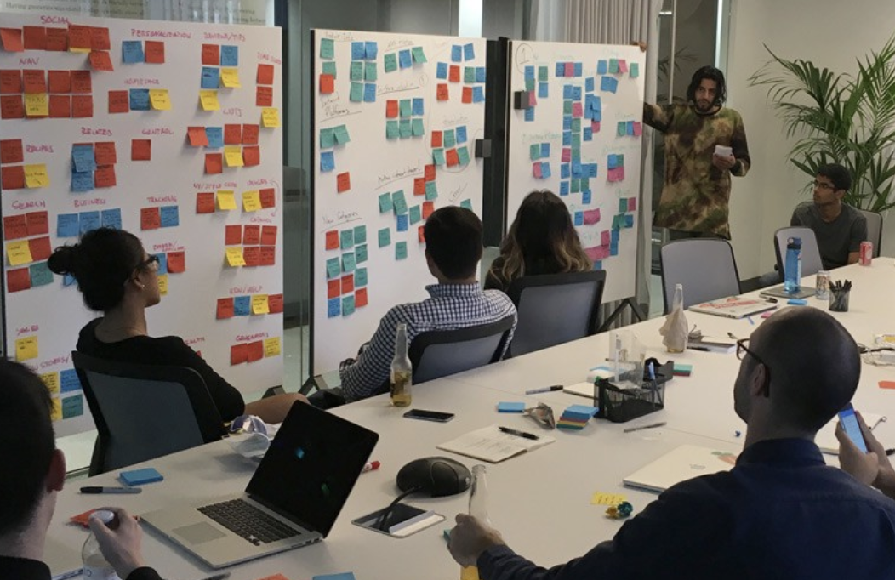
The Problem with Brainstorming
Silent brainstorming is ineffective
Difficult to find best ideas
Hard to save brainstorms
People can’t join remotely

Slide 9


The Problem with Brainstorming
Don’t facilitate effective brainstorming

Slide 10
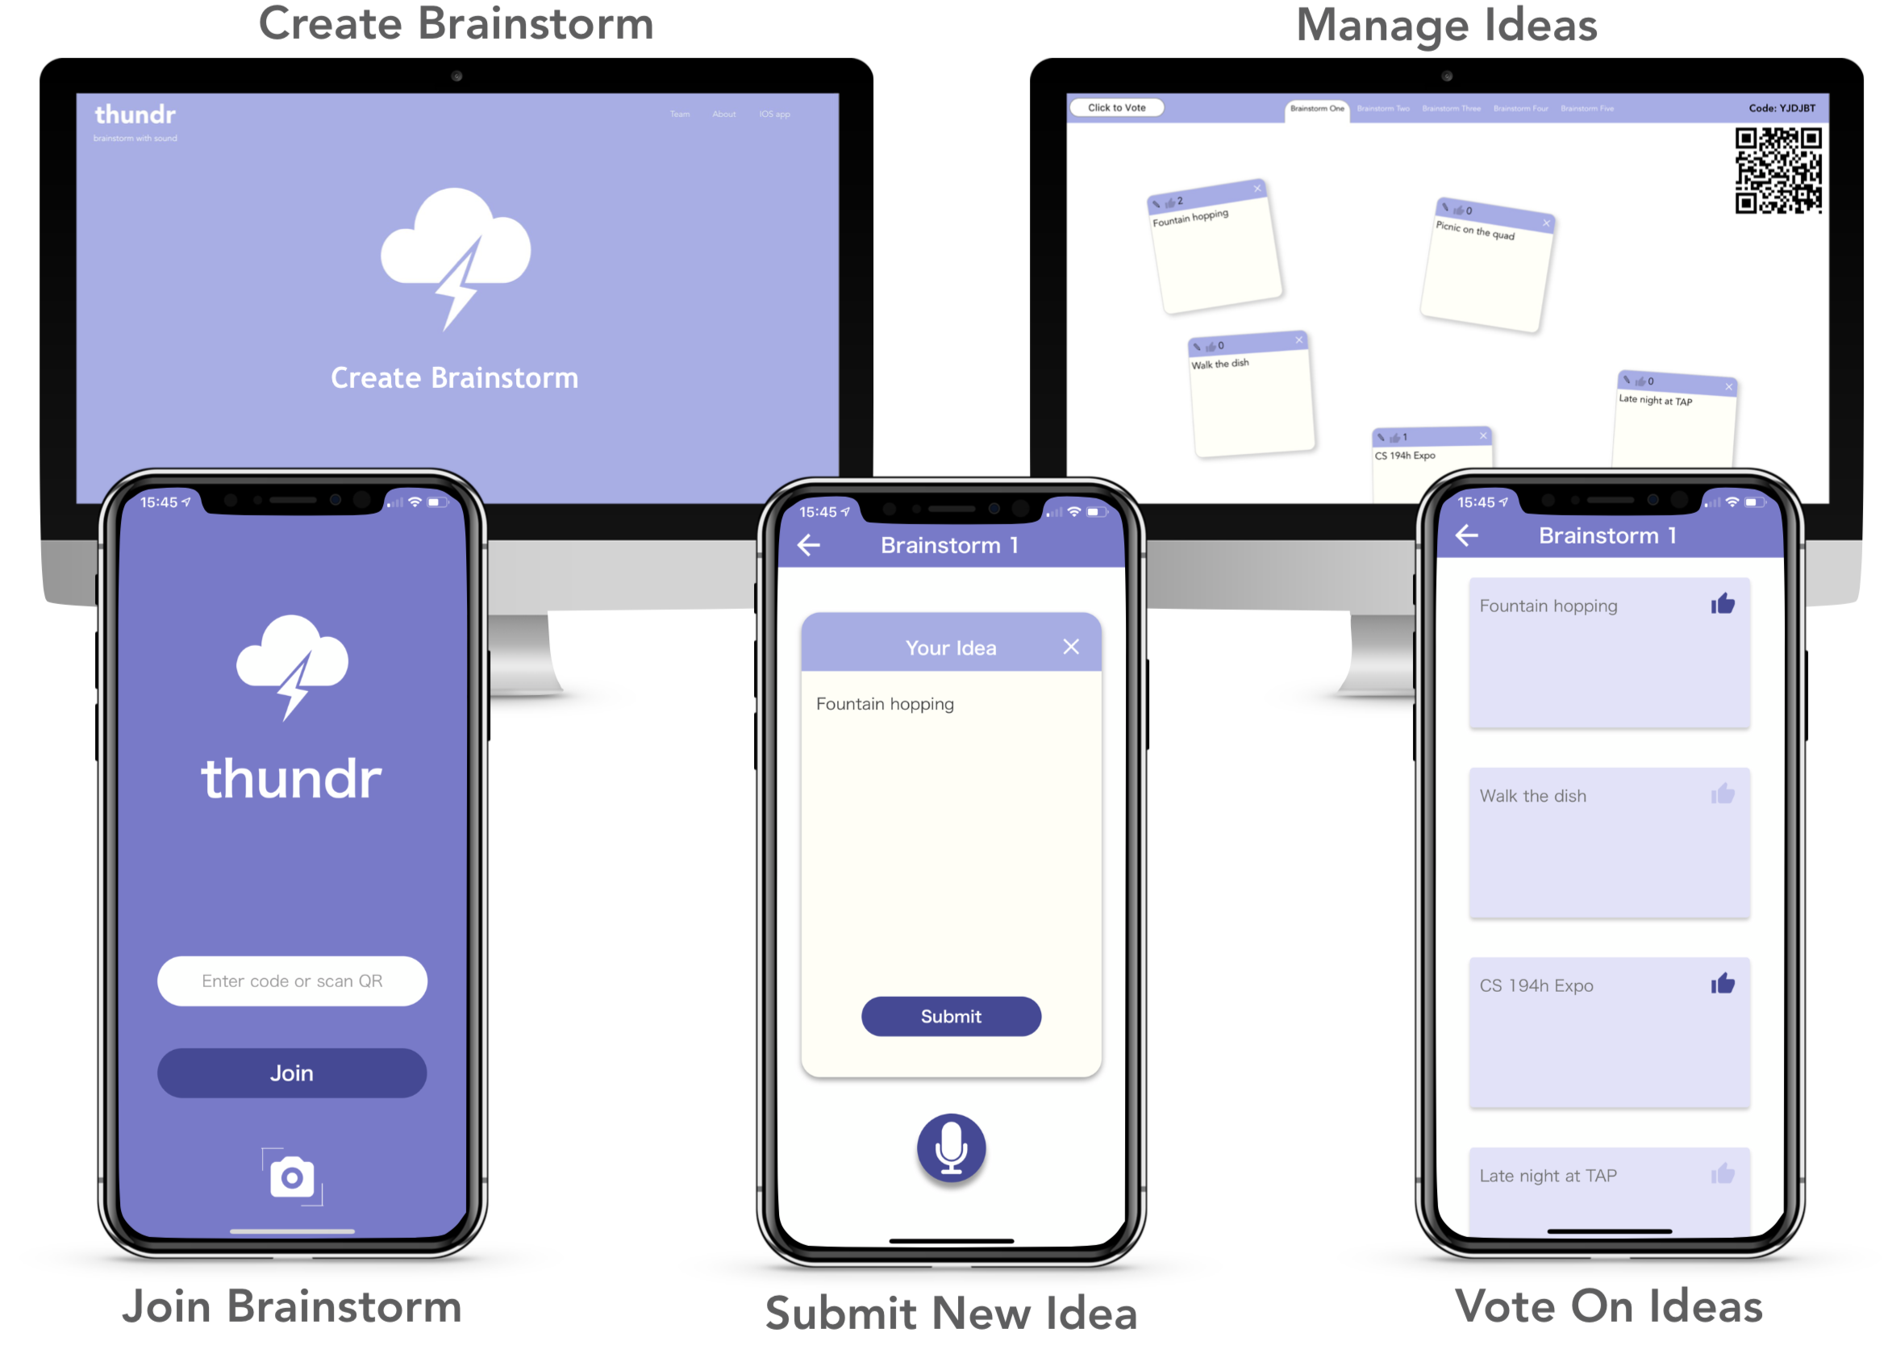
Solution - Thundr
Notes:
Say “brainstorm with sound”, created an environment which establishes effective brainstorming

Slide 11
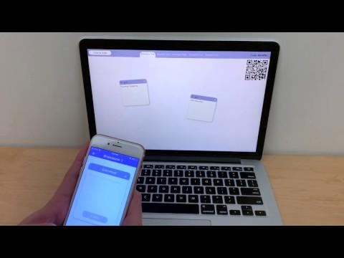

Slide 12
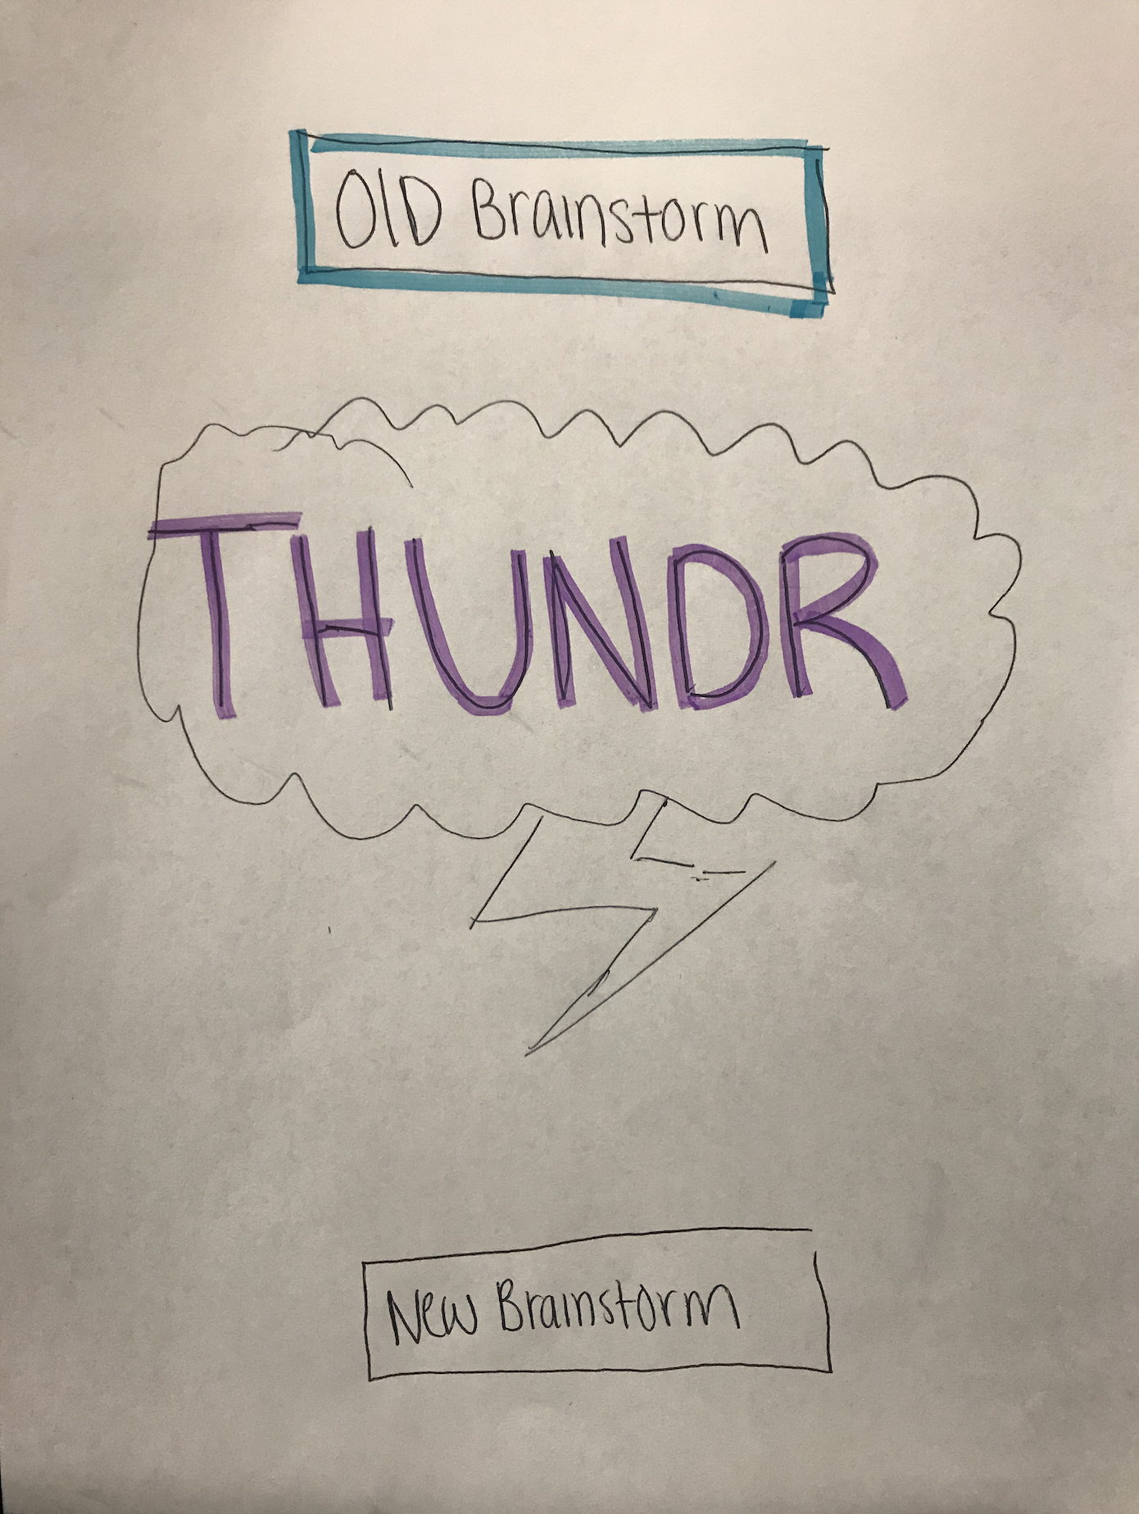
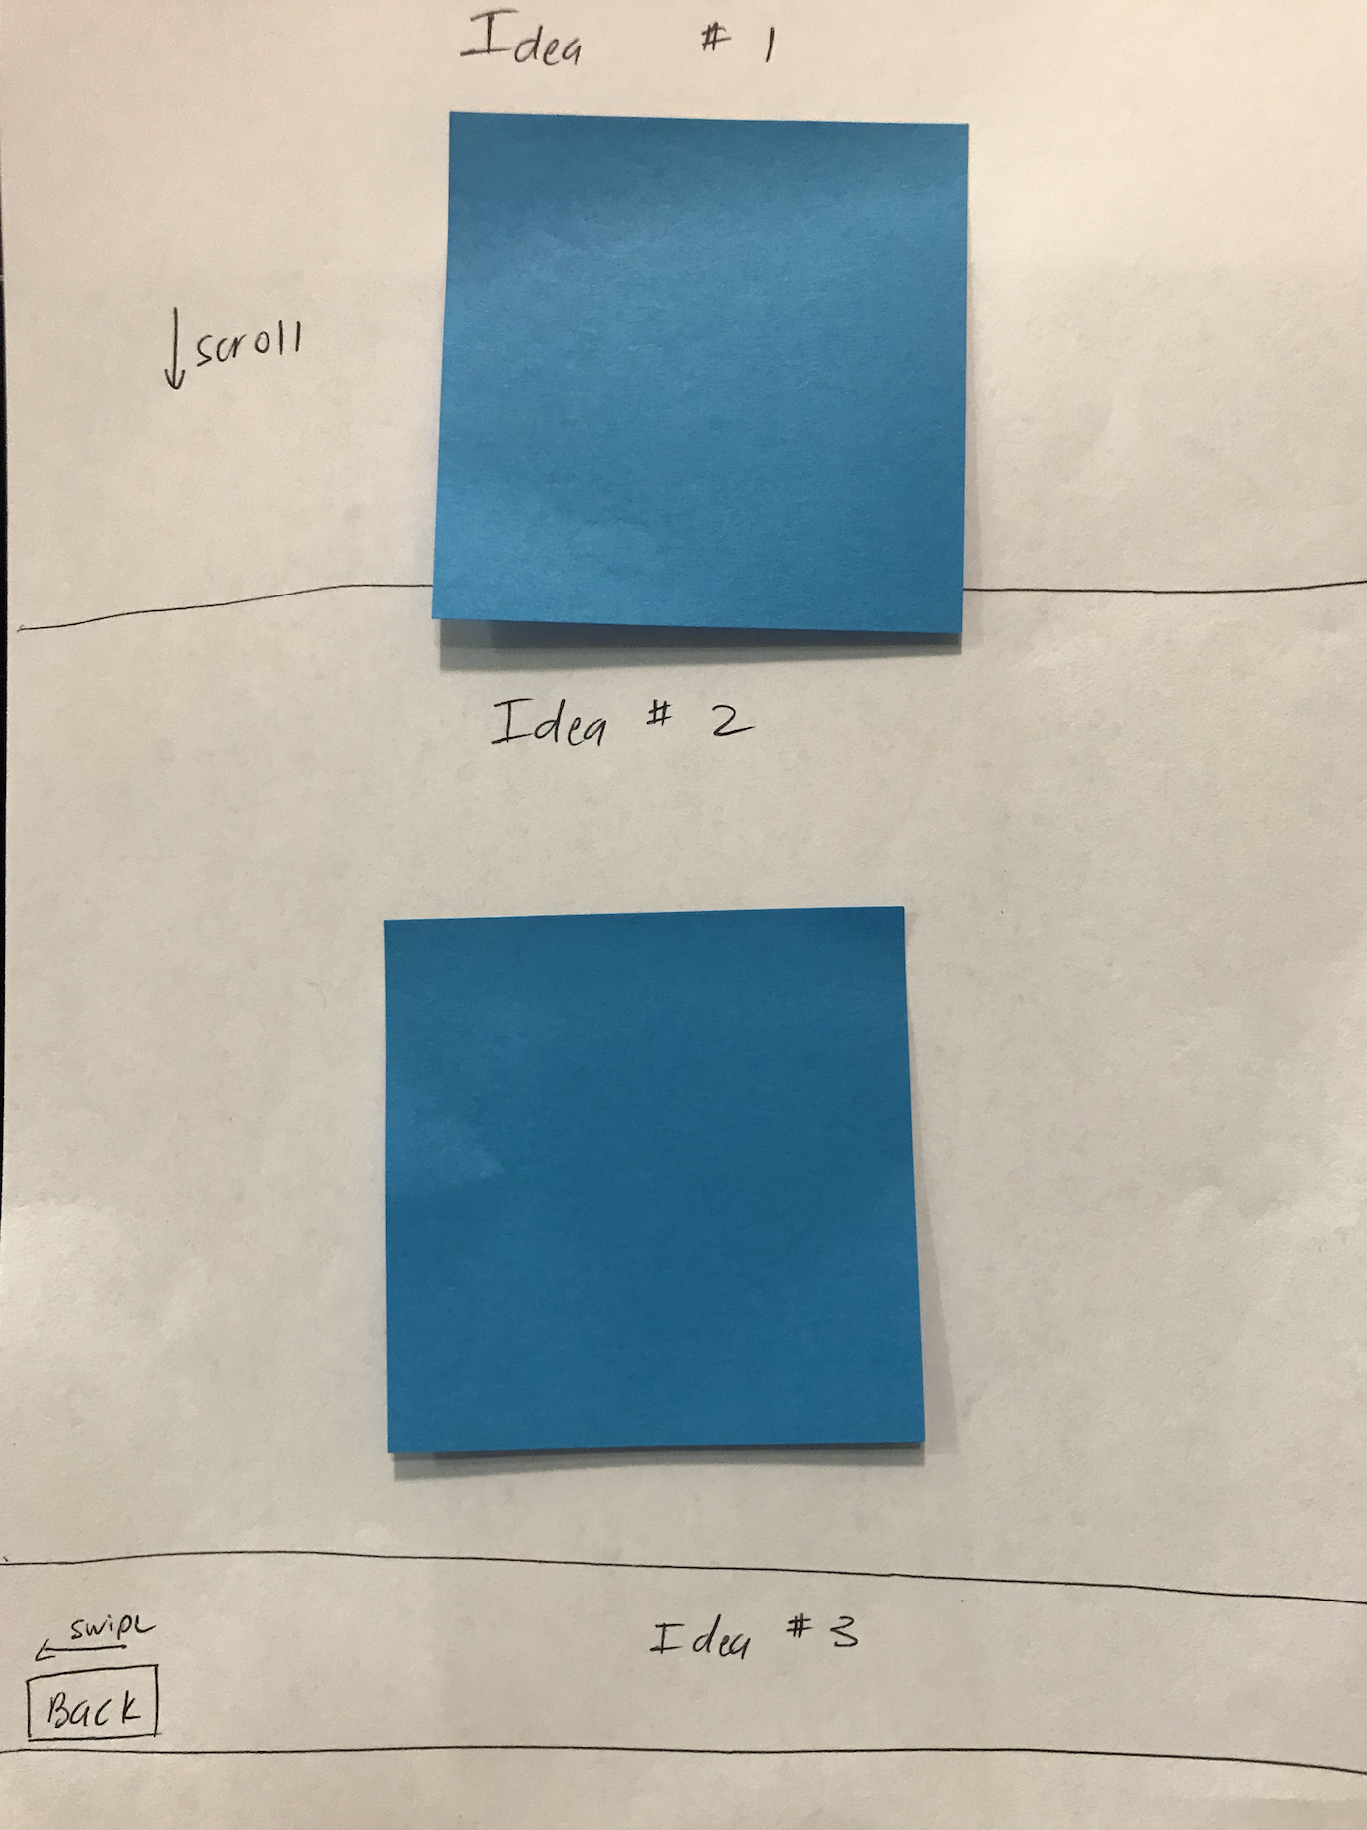
Design Evolution Low-Fi

Slide 13
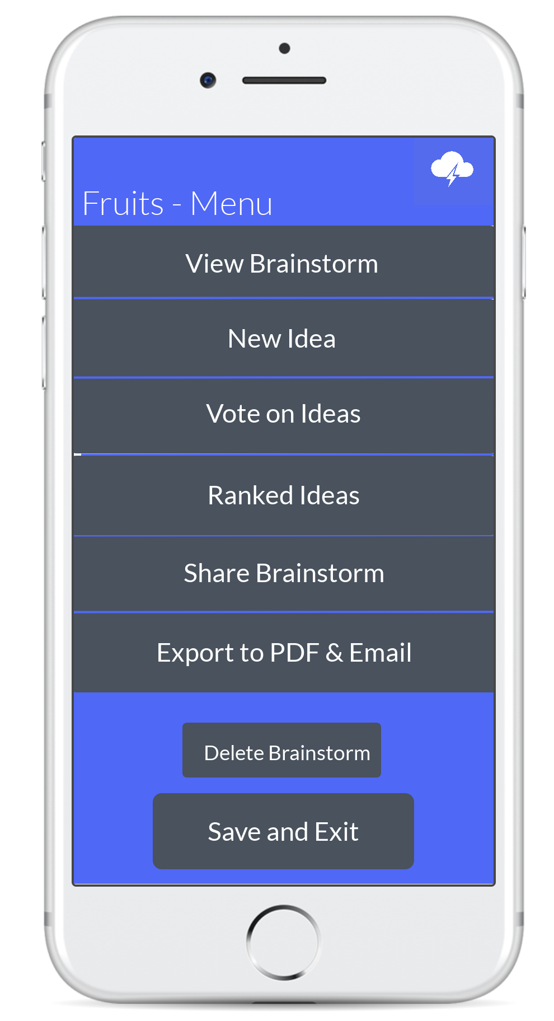
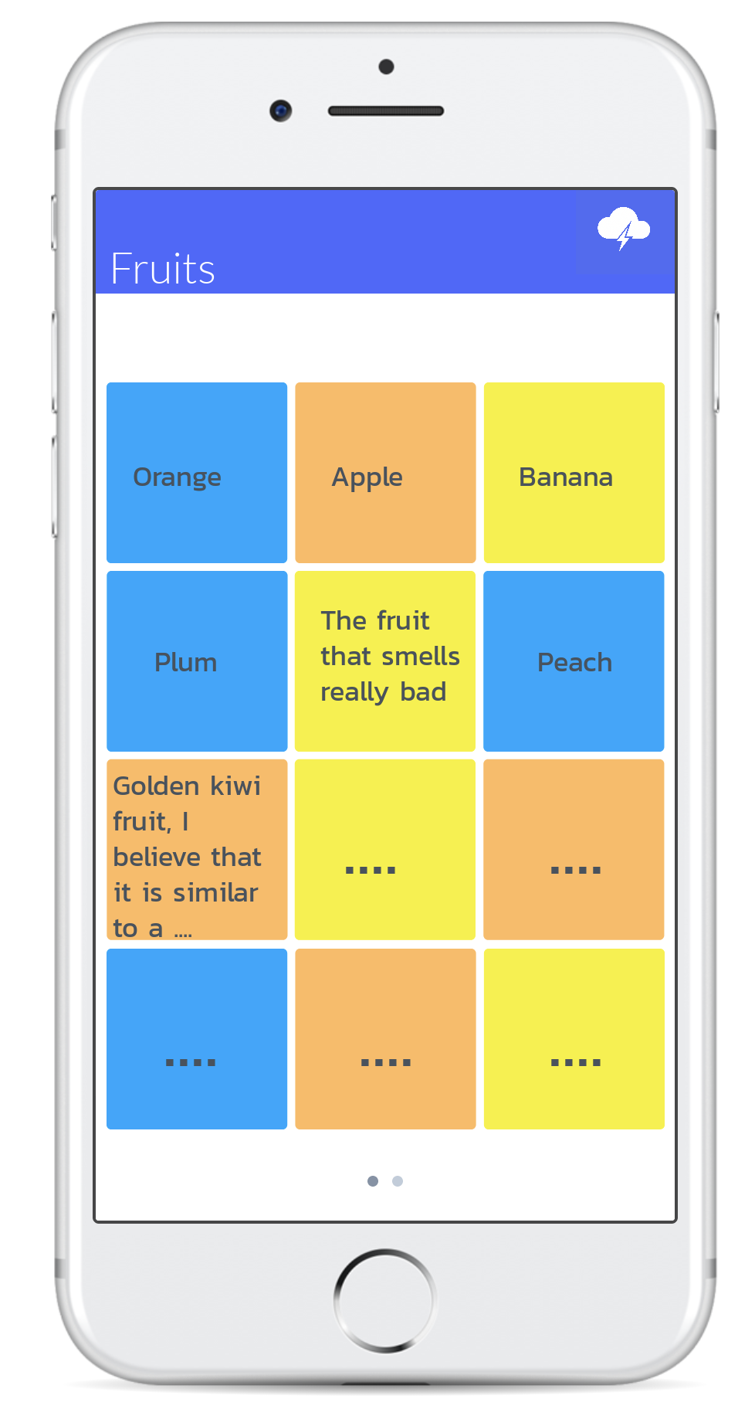
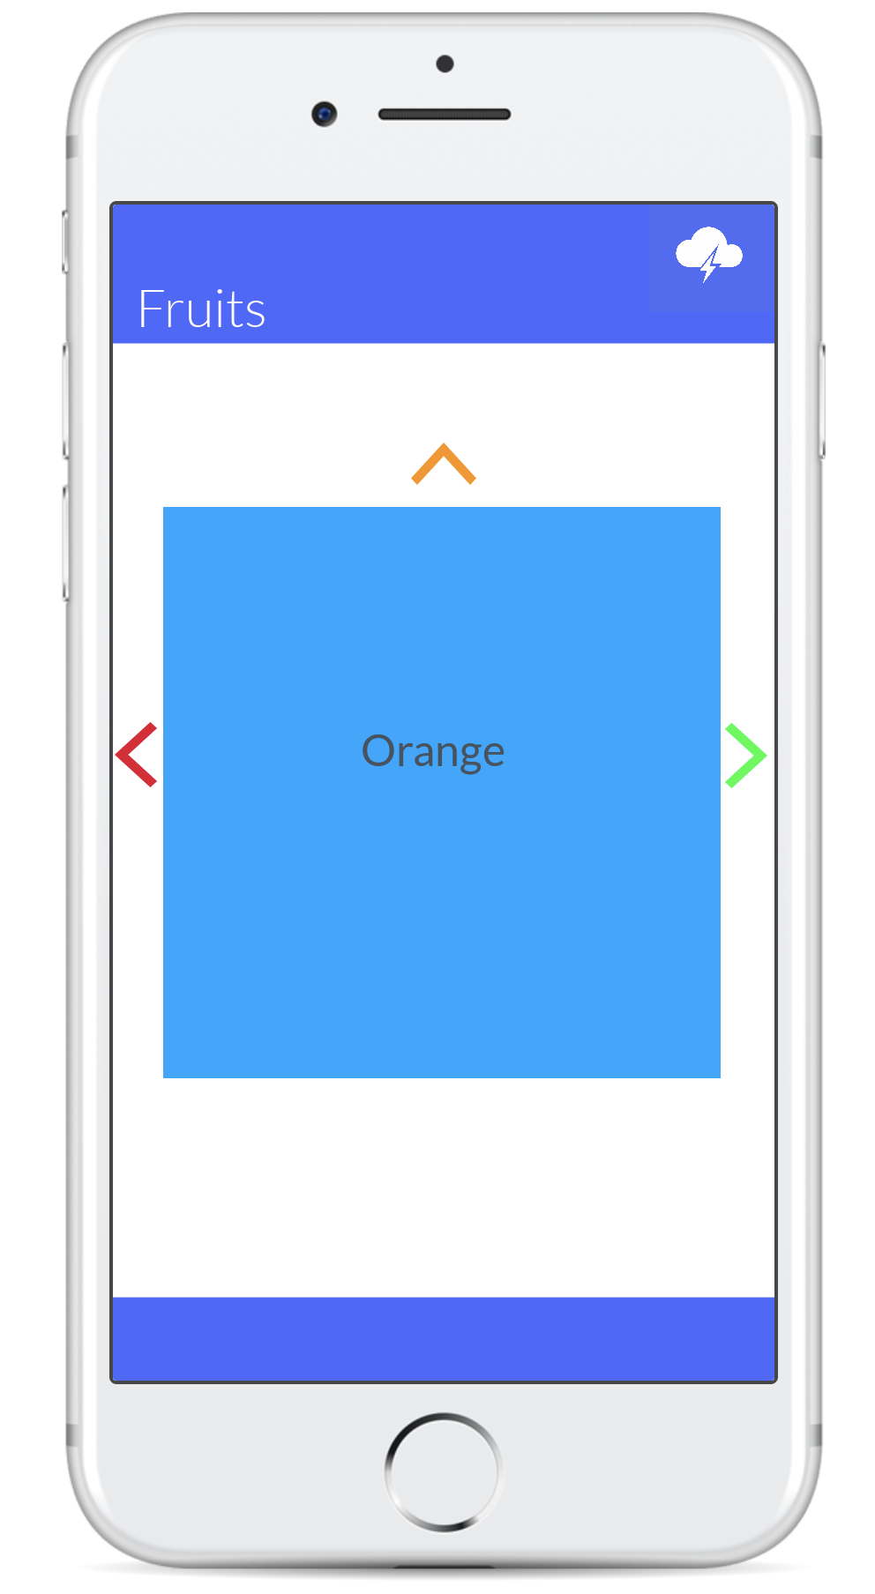
Design Evolution Med-Fi

Slide 14
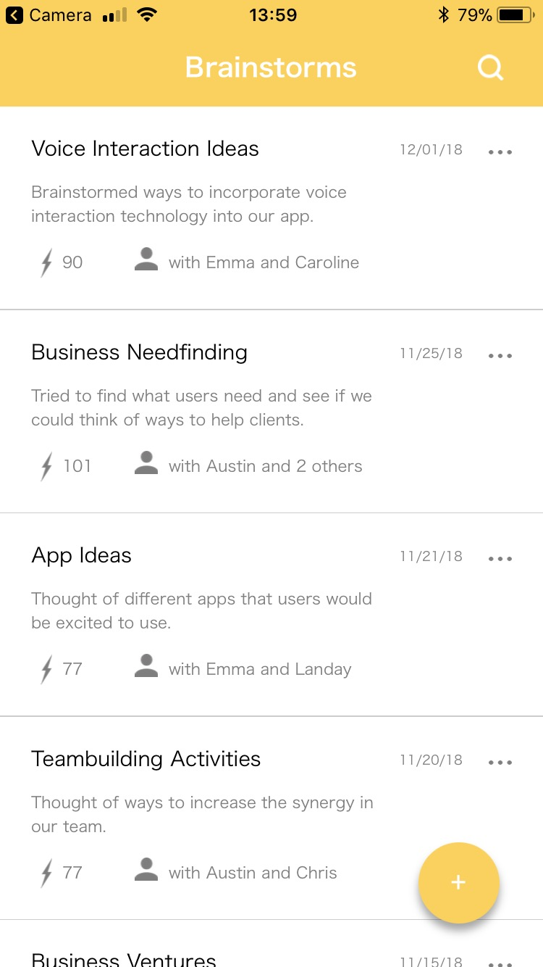
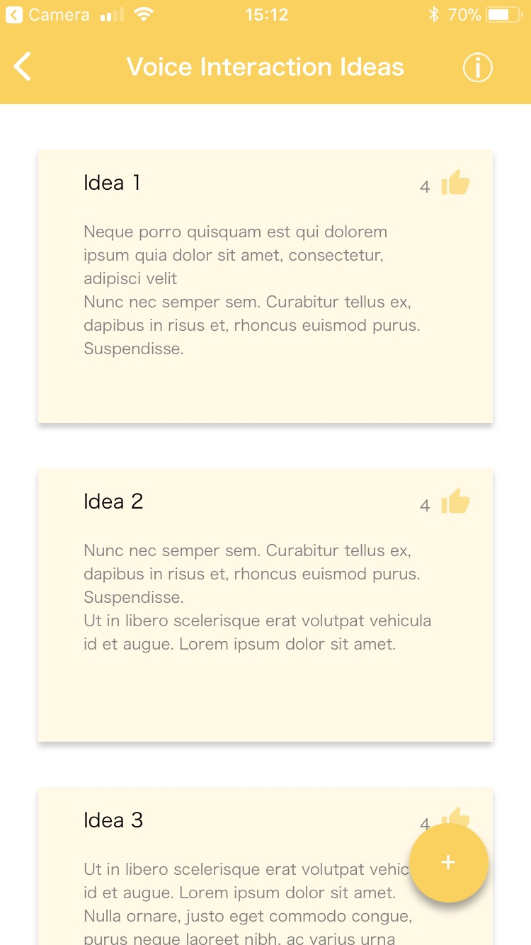
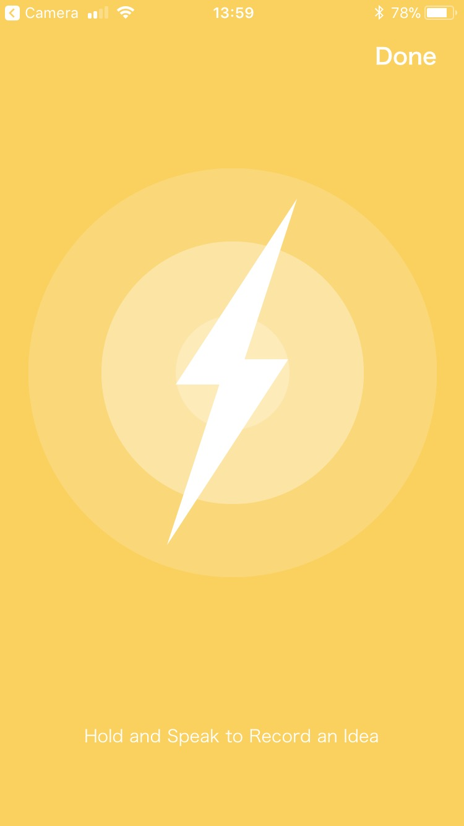
Design Evolution Hi-Fi#1

Slide 15
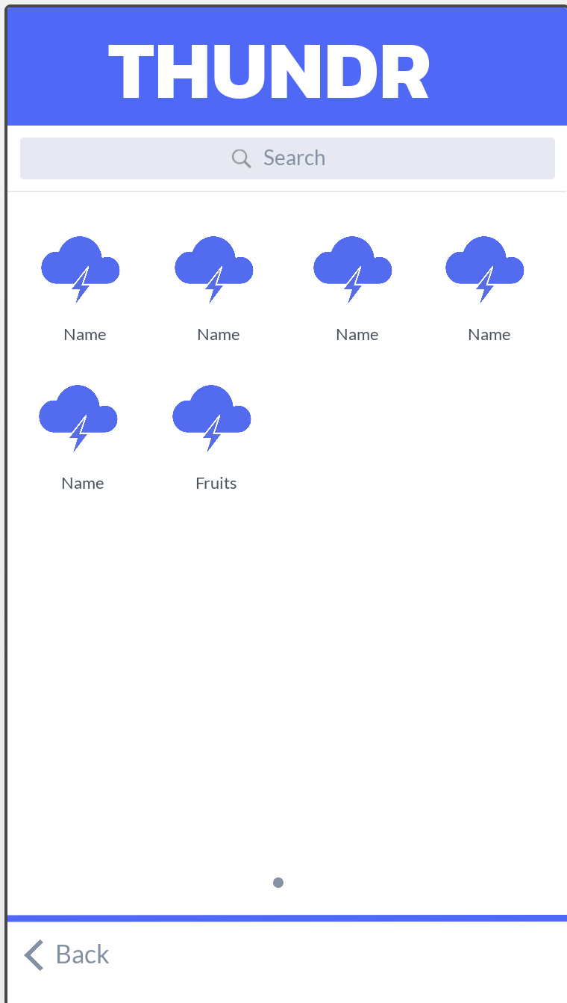
Design Evolution Hi-Fi#1

Slide 16
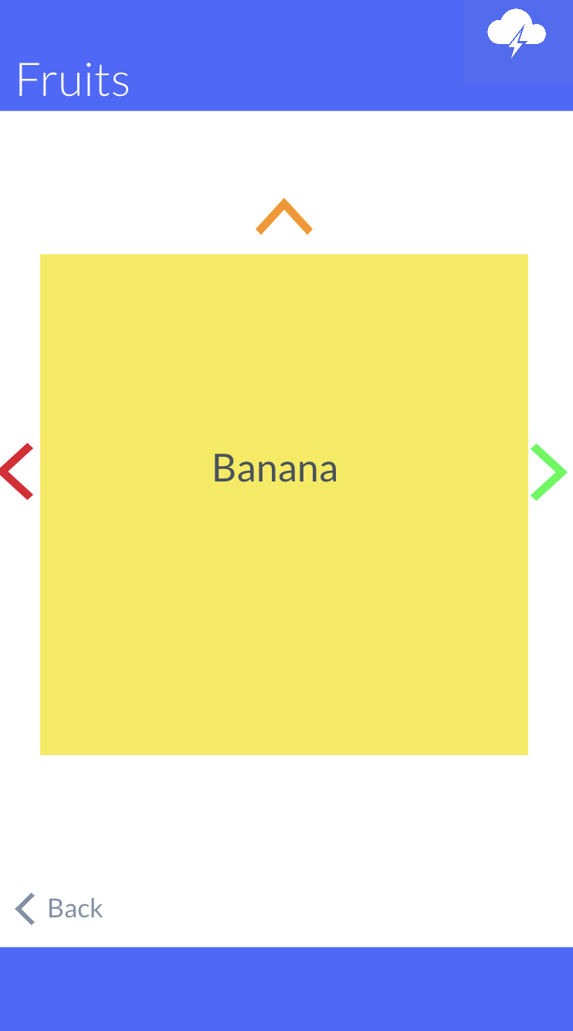
Design Evolution Hi-Fi#1

Slide 17
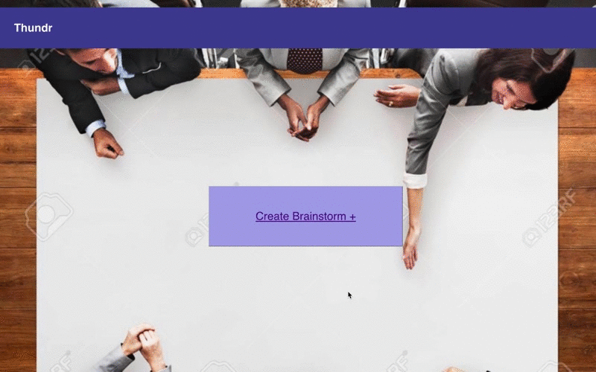
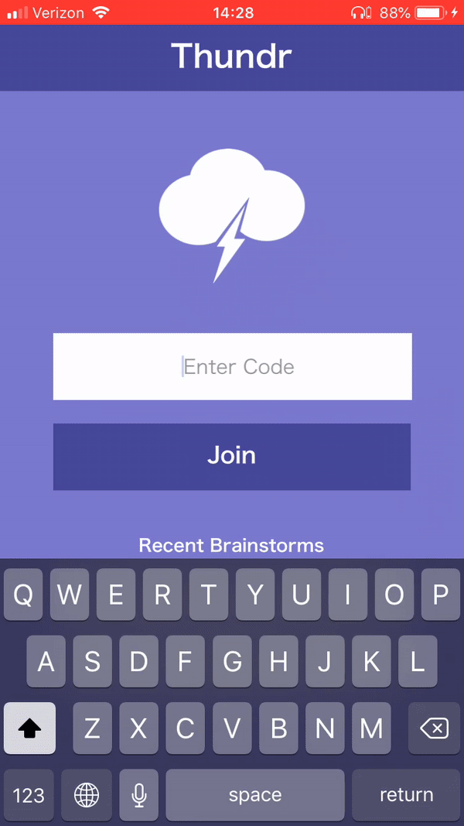
Design Evolution Hi-Fi#2

Slide 18
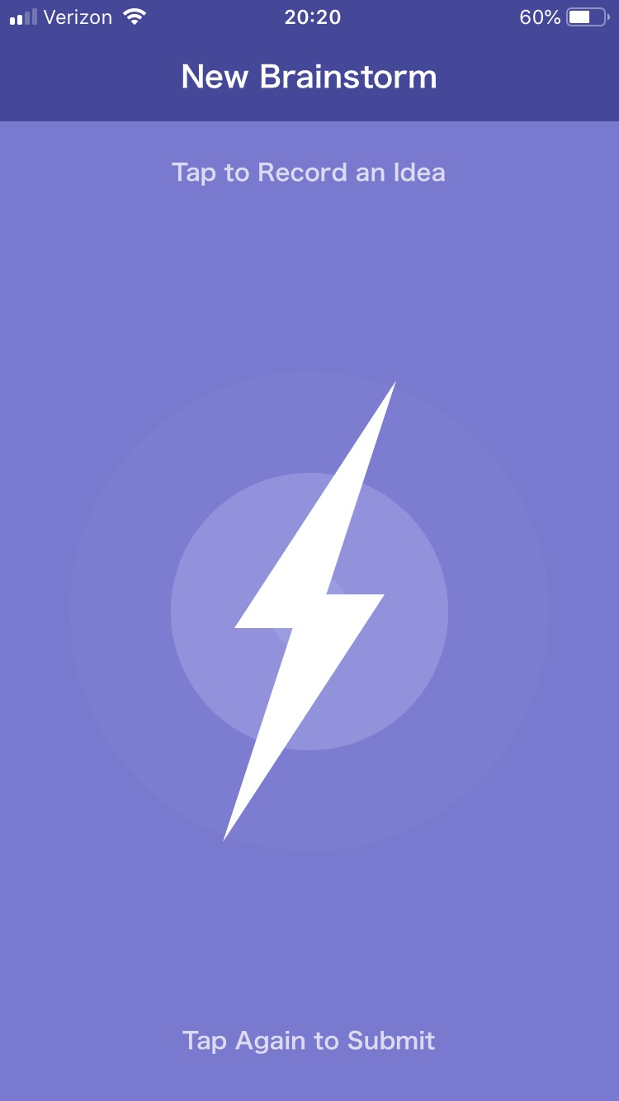
Design Evolution Hi-Fi#2

Slide 19
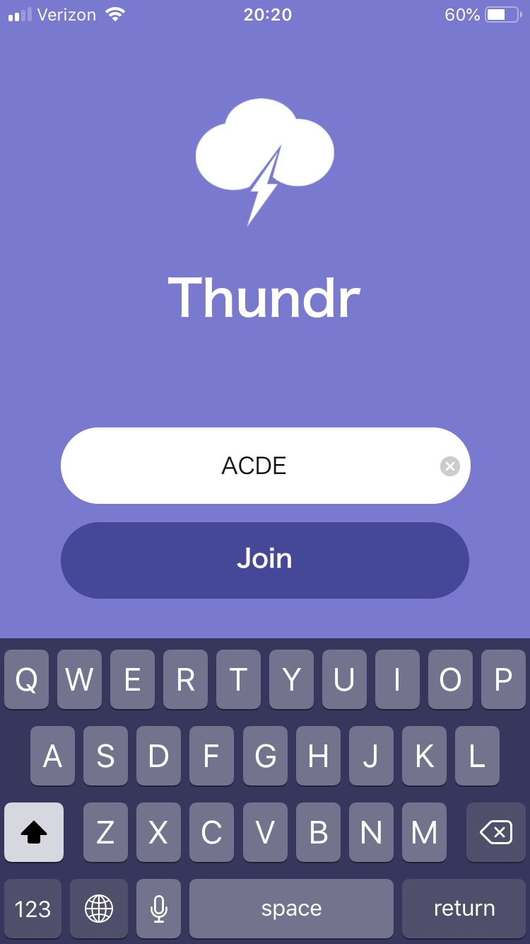
Design Evolution Hi-Fi#2
Notes:
Better align

Slide 20
Final UI
Task 1 (Simple): Join a Brainstorm
Task 2 (Complex): Record ideas
Task 3 (Medium): Vote on favorites

Slide 21
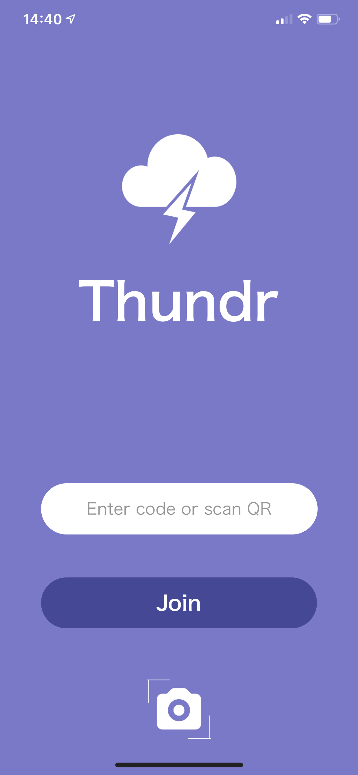

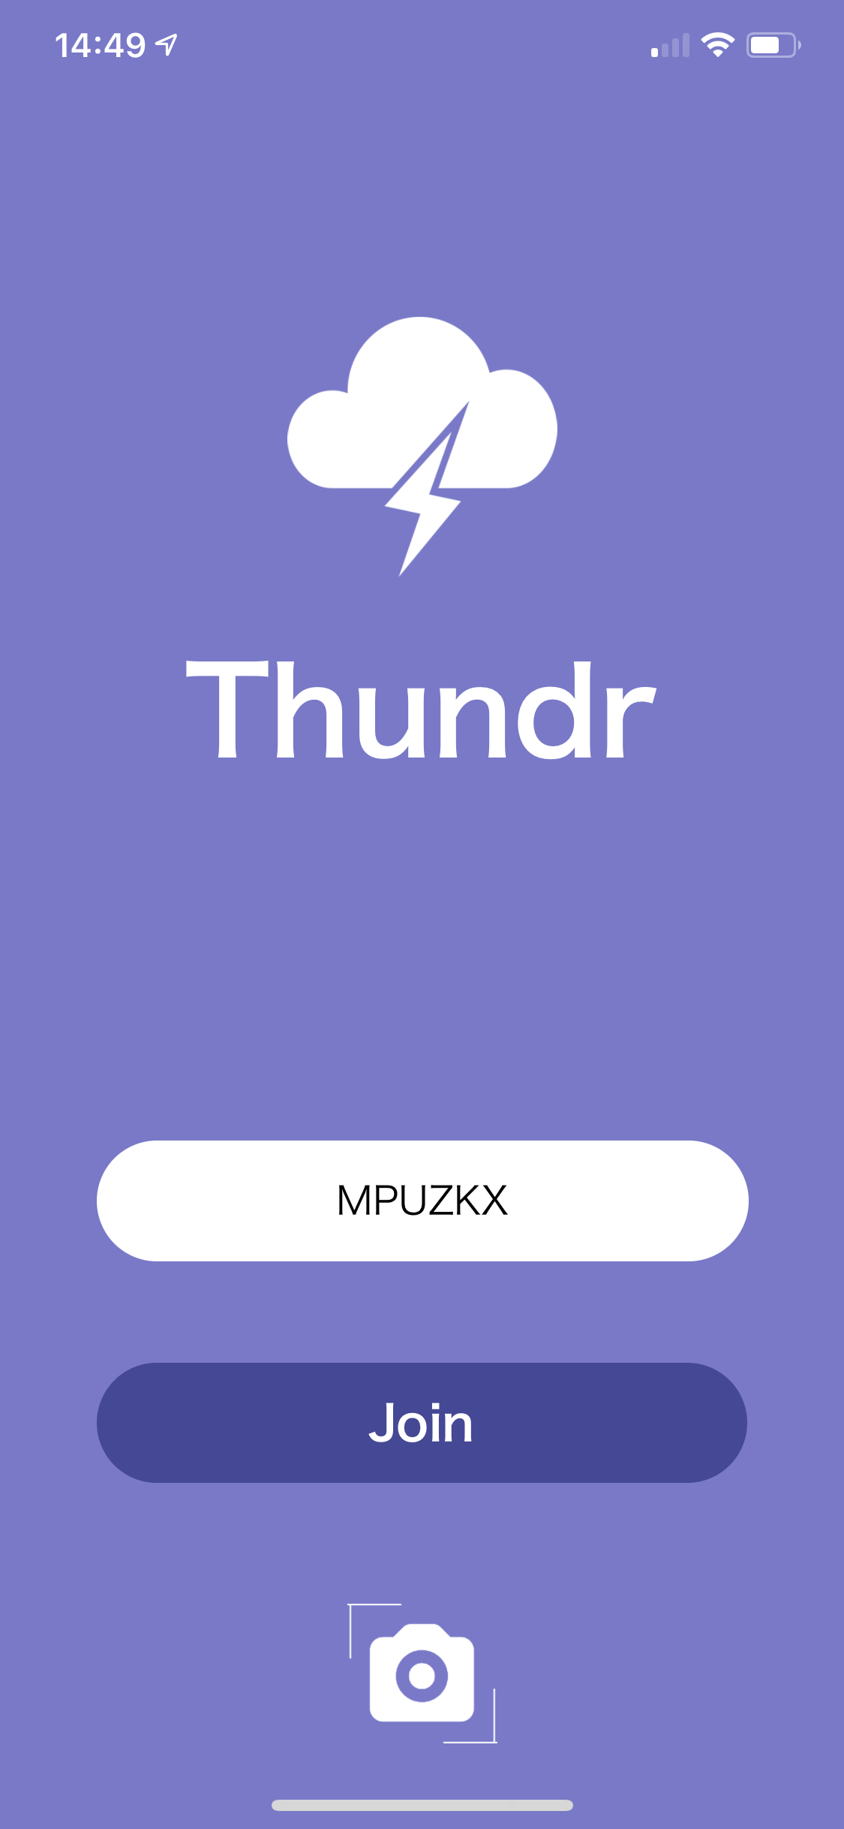
Task 1 (Simple): Join a Brainstorm
Notes:
chage

Slide 22
Task 2 (Complex): Dictate ideas
Notes:
change

Slide 23
Task 3 (Medium): Vote on favorite ideas
Notes:
change

Slide 24




Implementation

Slide 25
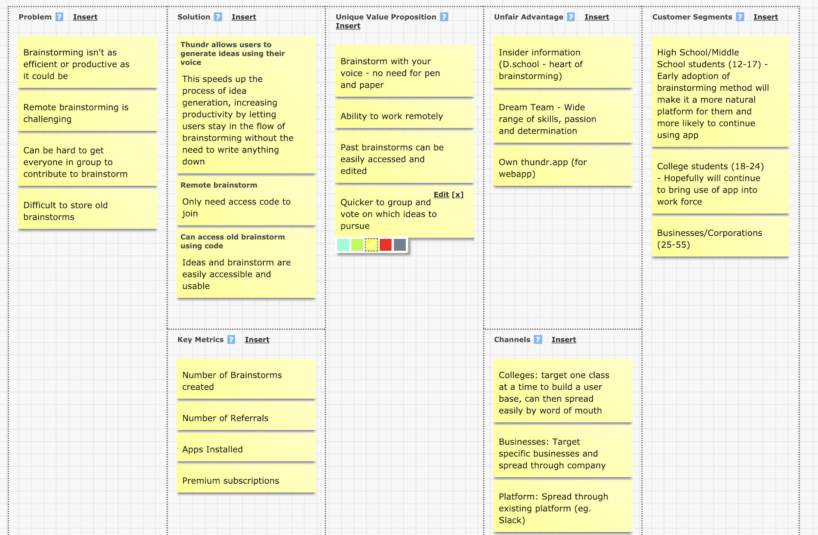
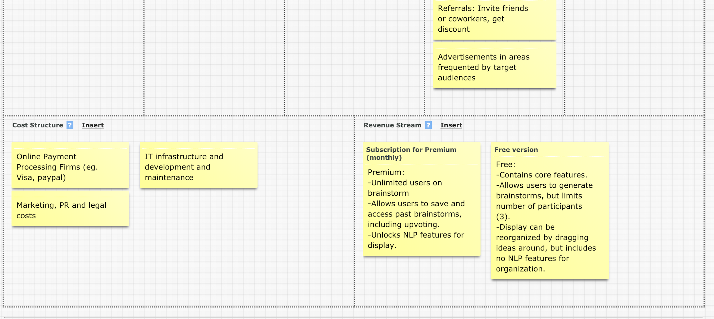
Market fit
Notes:
Change this

Slide 26
Future
Notes:
change

Slide 27
thundr
brainstorm with sound

