Slide 1
Thundr
Assignment 9: Field Usability Study

Slide 2
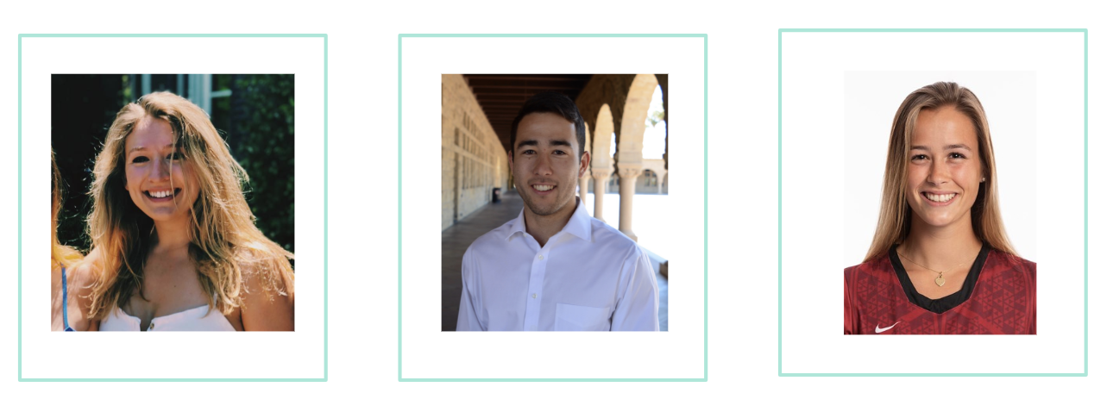
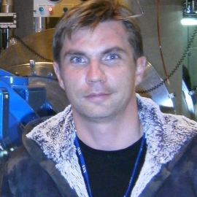
The Team
Caroline Willis
Austin Jones
Emma Alderton
Daniel Kharitonov

Slide 3

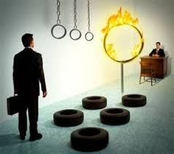
Field Study Purpose
Look for pain points
Identify adoption obstacles

Slide 4

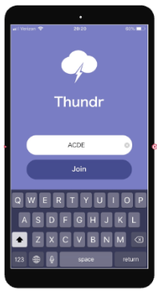
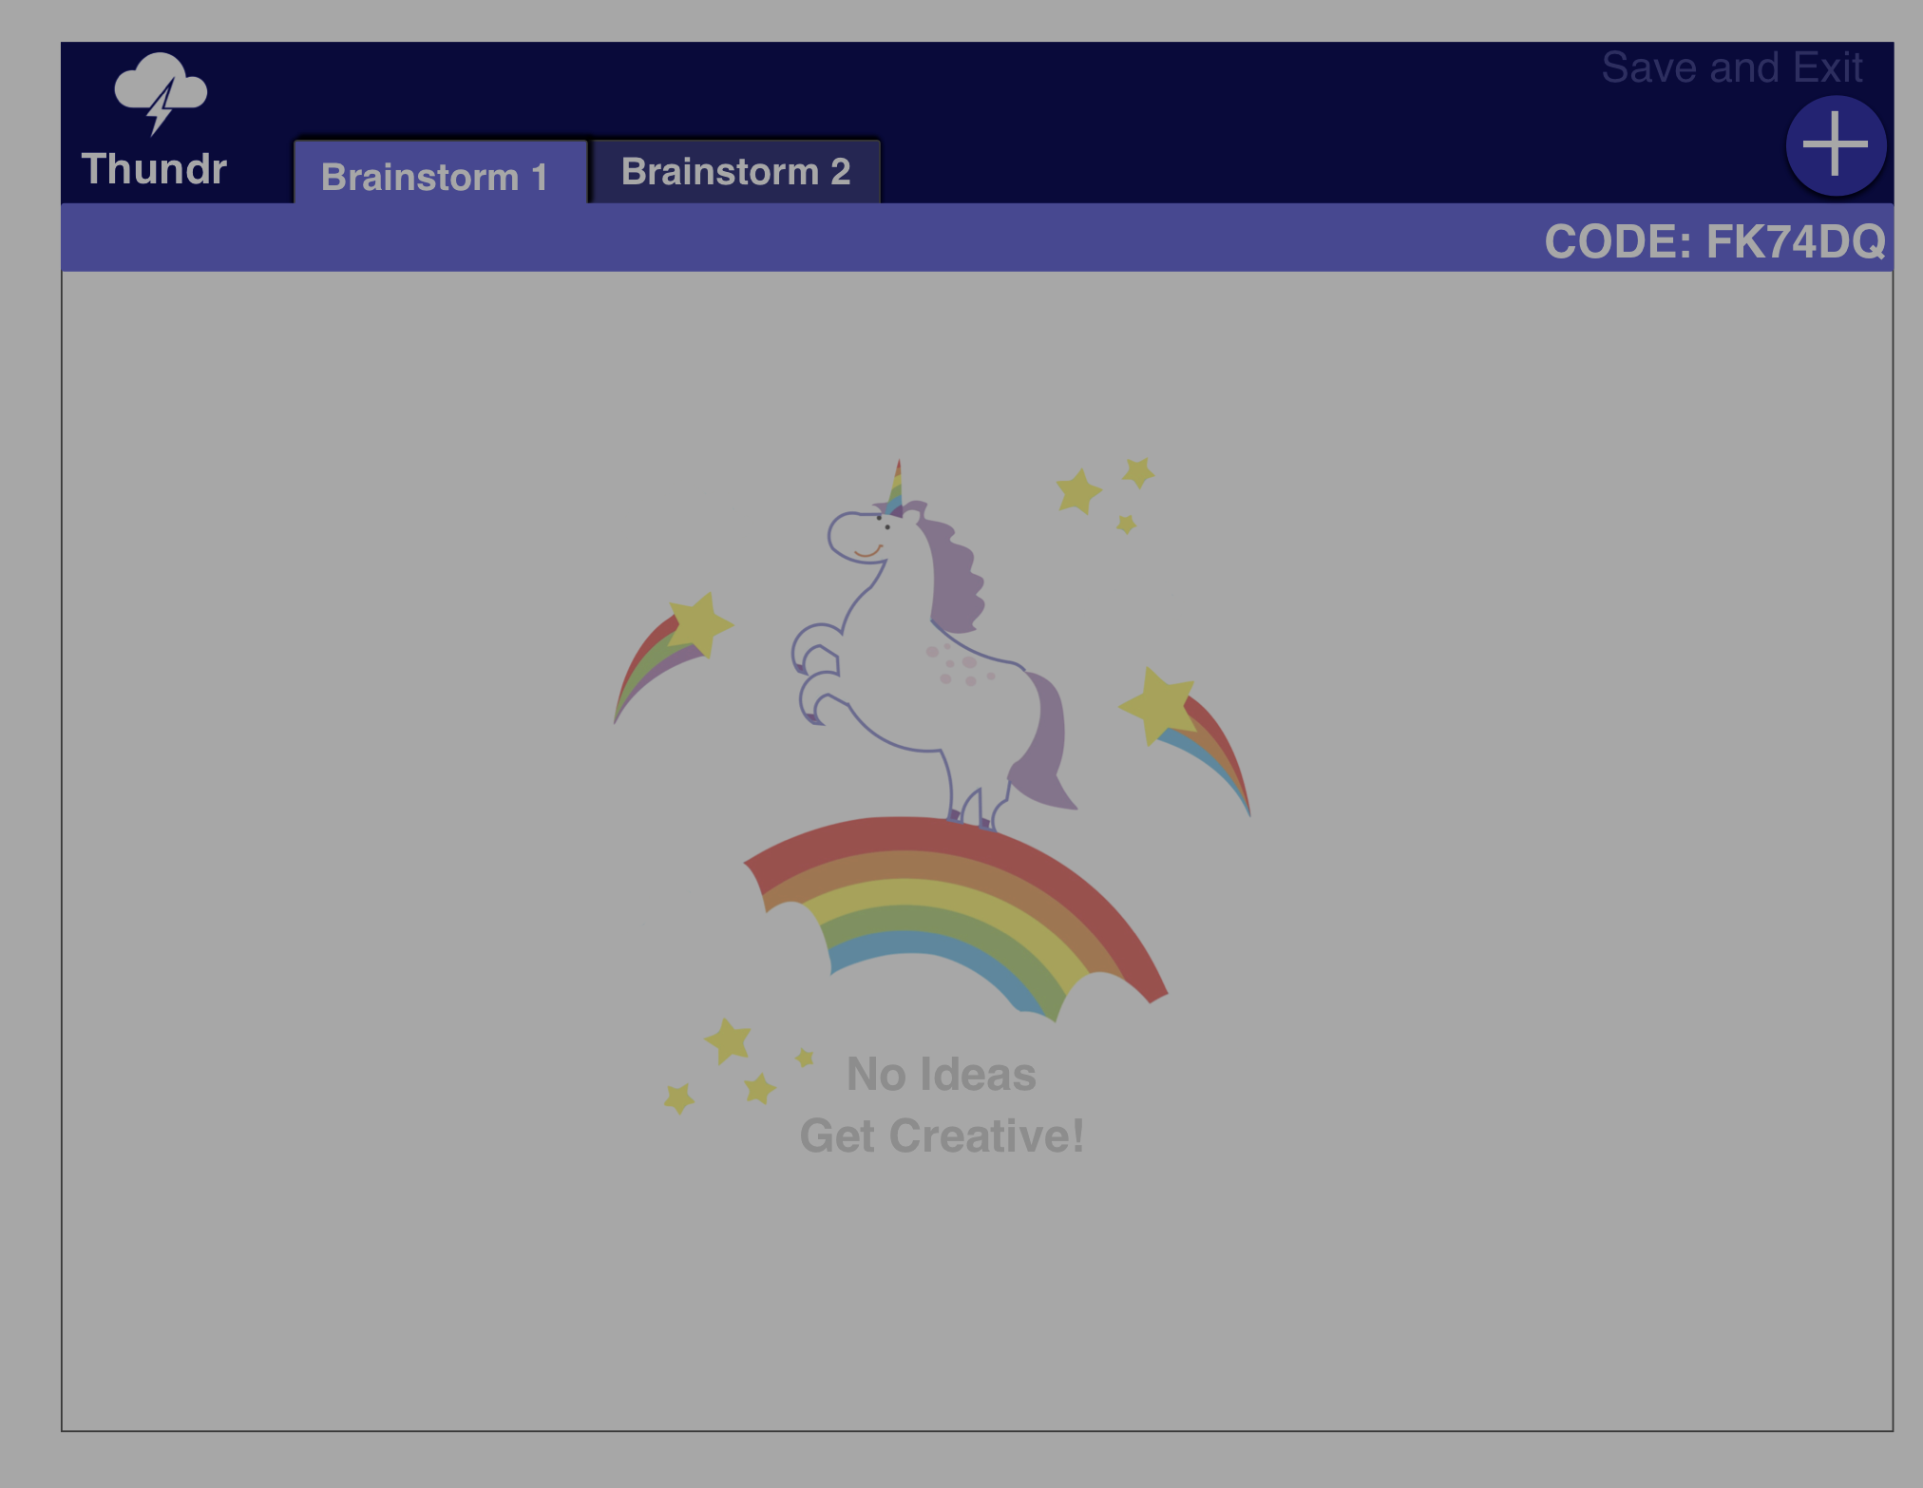
Thundr system
Mobile component
Web component

Slide 5




Study Pipeline
Method
Measures and Observations
Take Away

Slide 6
Method
Method

Slide 7


Participant Profile
Six total (3 individualy, 3 in a group)
Ages 19-26
Variety of genders
Highly educated
Different professional backgrounds
Range of brainstorming experience
Rewards: Starbucks coffee!
Notes:
5 users, range of ages, high levels of education, most were engineering students, compensated starbucks

Slide 8
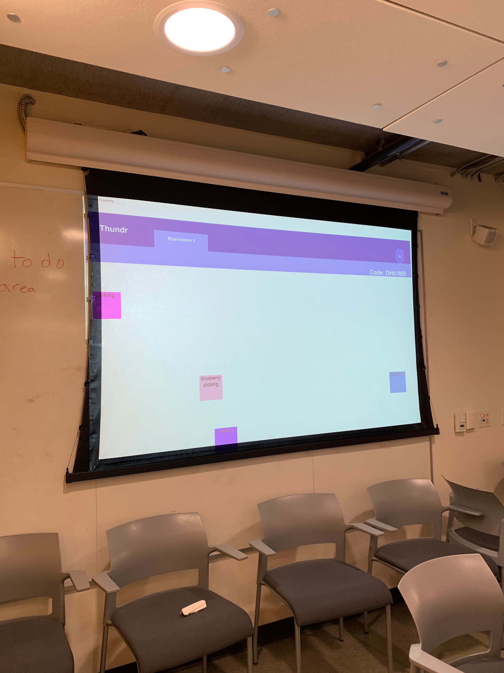
Method - Apparatus
Run the mobile app
Run the web app
Test in a realistic environment (private room with projector)
Use screen recording

Slide 9
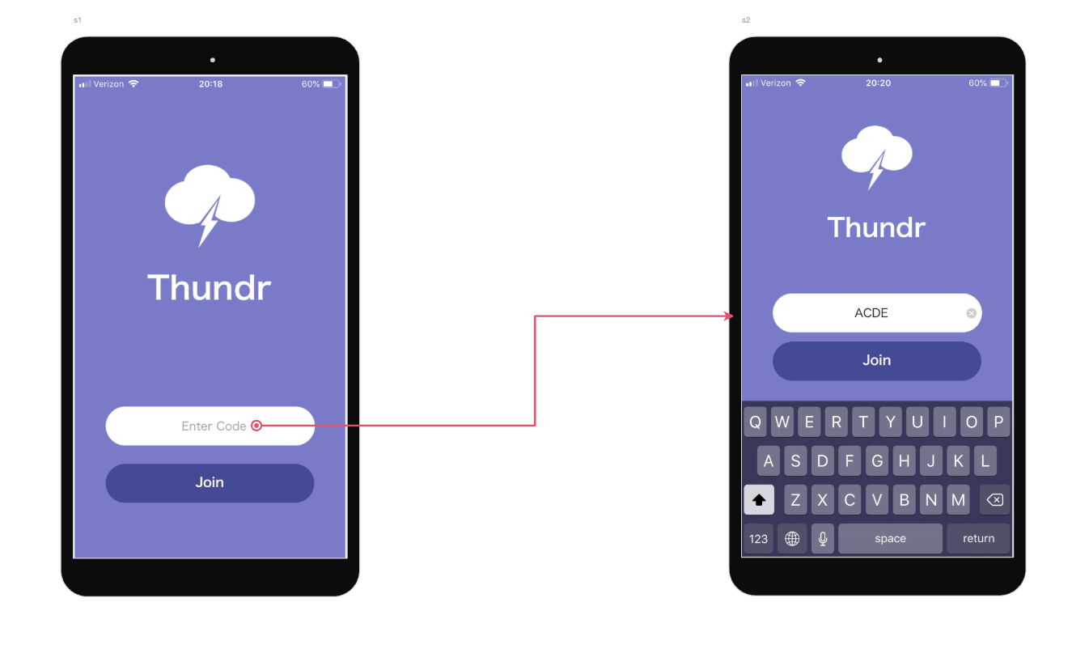
Method - Tasks
Task 1: Join brainstorm.
We want the app to be extremely intuitive, especially for this central task.
We want to measure the ease and speed with which people can complete this task.

Slide 10
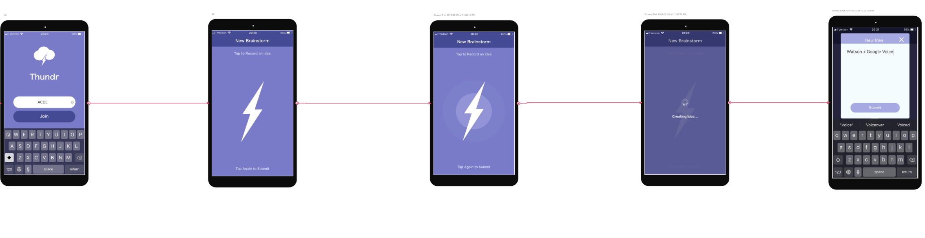
Method - Tasks
Task 2: Dictate three ideas
This task’s purpose was to measure how clear the layout and interaction of the voice dictation screen and task flow.

Slide 11
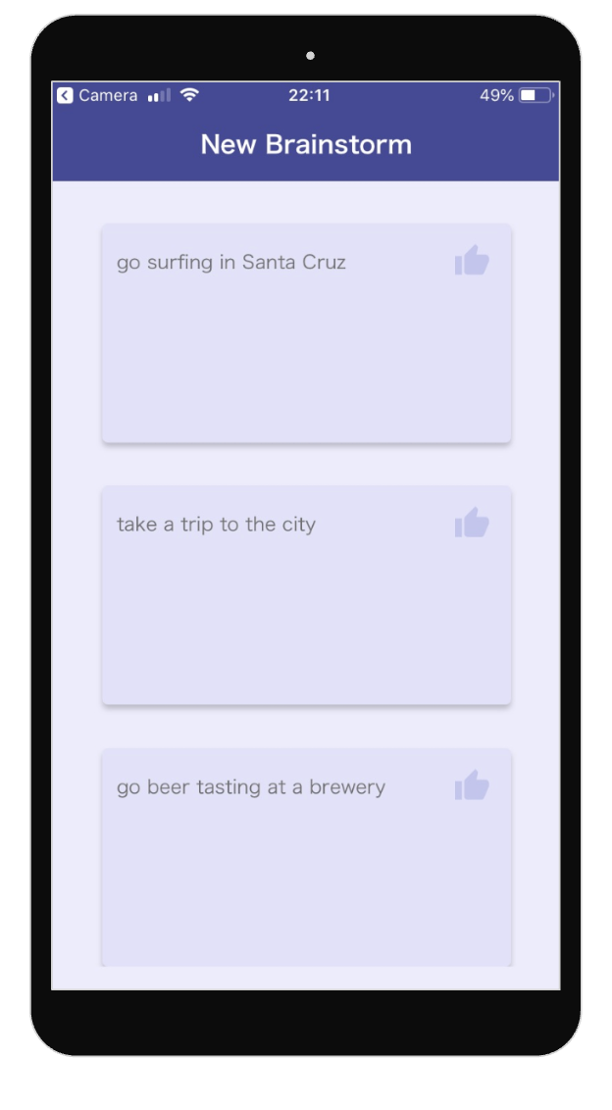
Method - Tasks
Task 3: Vote on your favorite ideas
Throughout our design process, we have been interested in how users’ interact with the “Vote” button. We wanted to see if this was intuitive

Slide 12
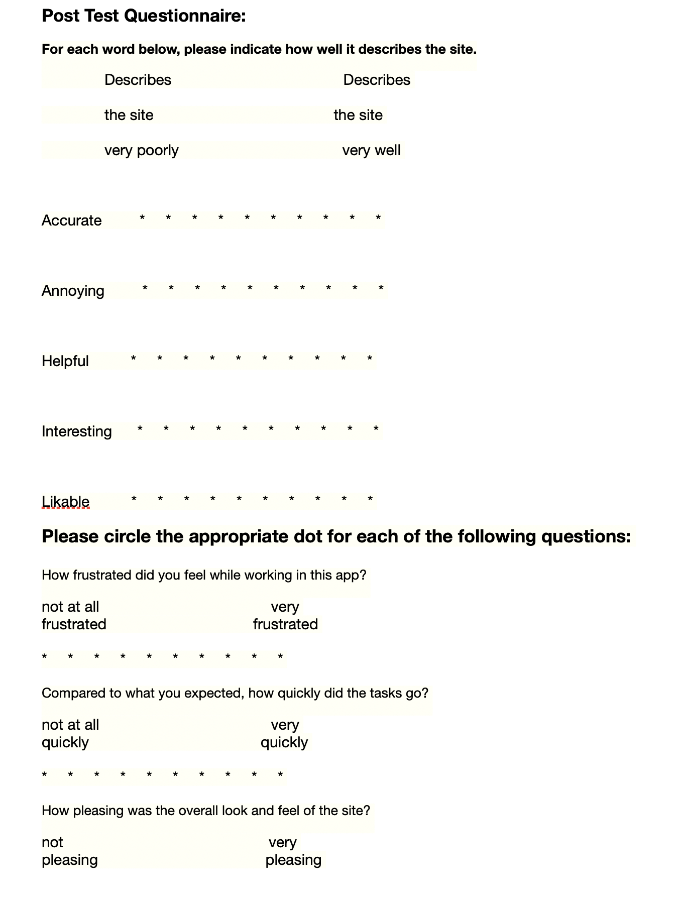
Method - Process
Demo/ High level pitch
Brainstorm and complete tasks
Post-test Questionnaire

Slide 13
Measures and observations
Method
Measures and Observations

Slide 14
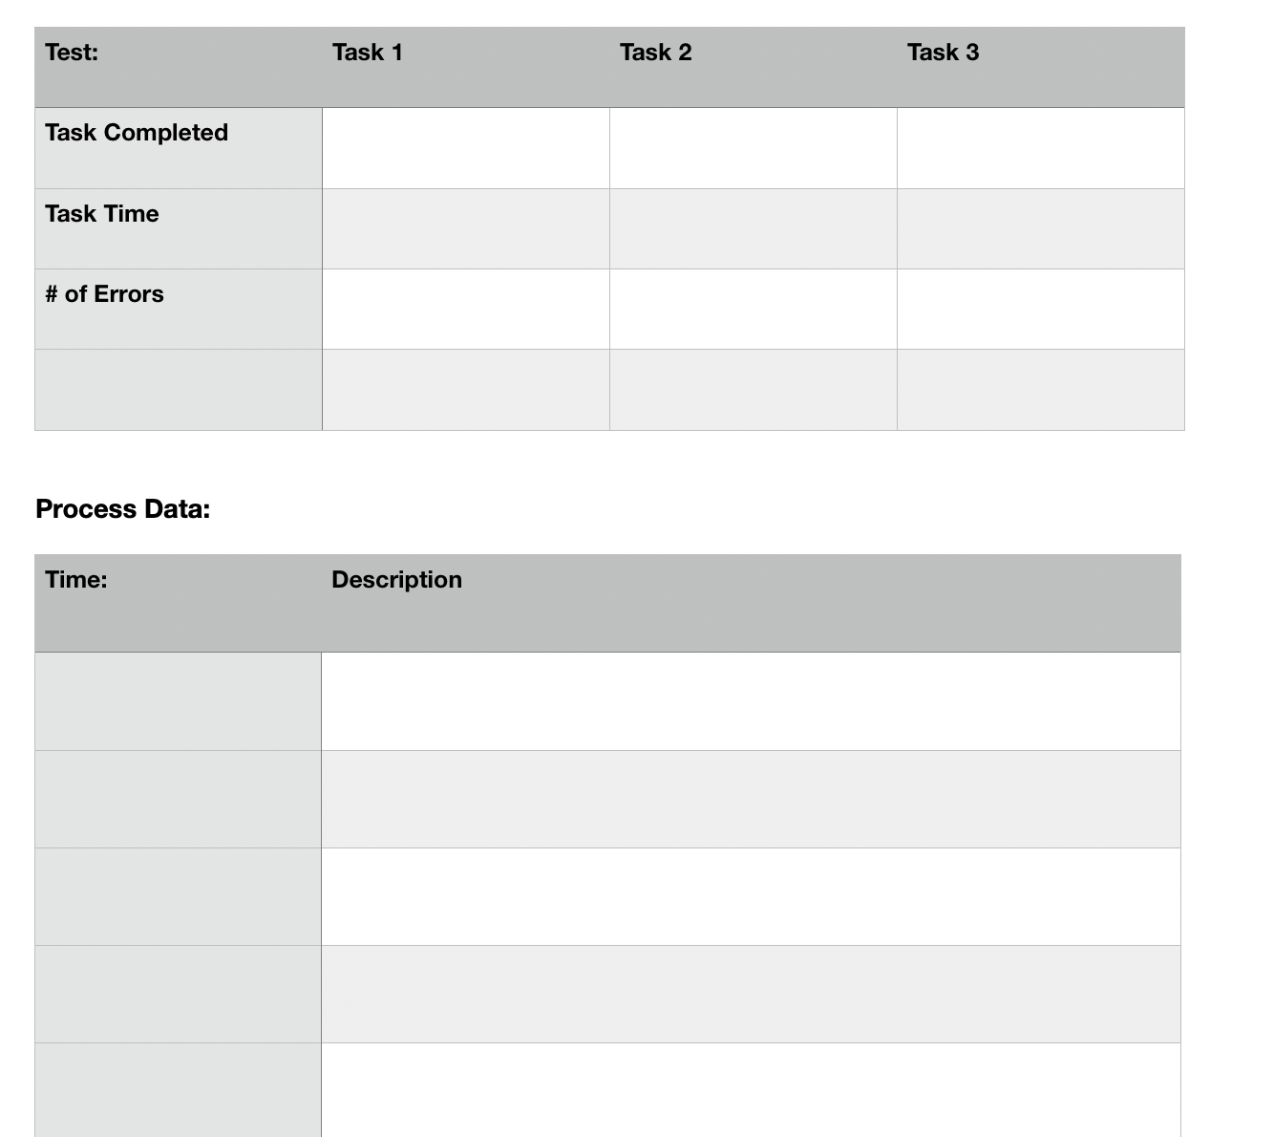
Measures
Measured if the user completed a task, the time it took to complete each task, and how many errors they made
Took down observational notes during the experiment as well
We wanted to see if users struggled with any particular task and observe the reasons
# Critical Errors
Notes:
Goals were to determine the ease of use. We expected all users to be able to complete all tasks, but wanted to see which tasks users struggled with.

Slide 15
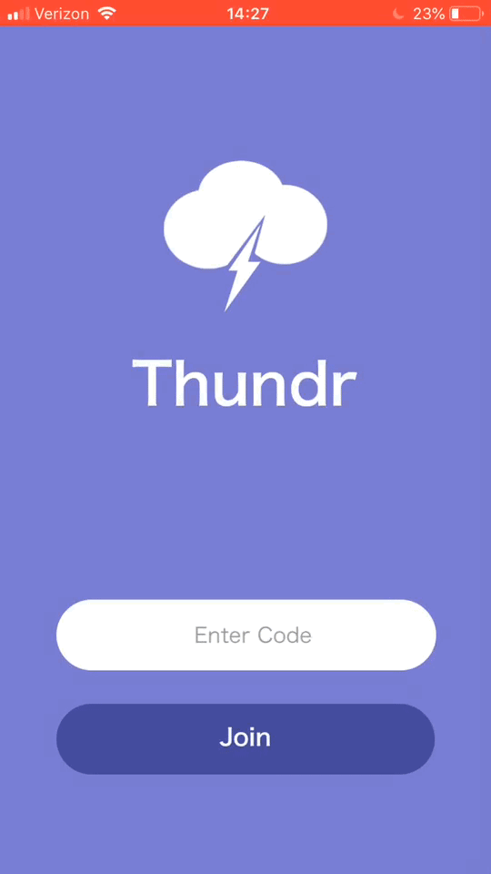
Observations - Quantitative Data
Task 1: Join brainstorm.
83% complete (⅚)
Avg speed for those completed: 3 seconds
1 Critical Error

Slide 16
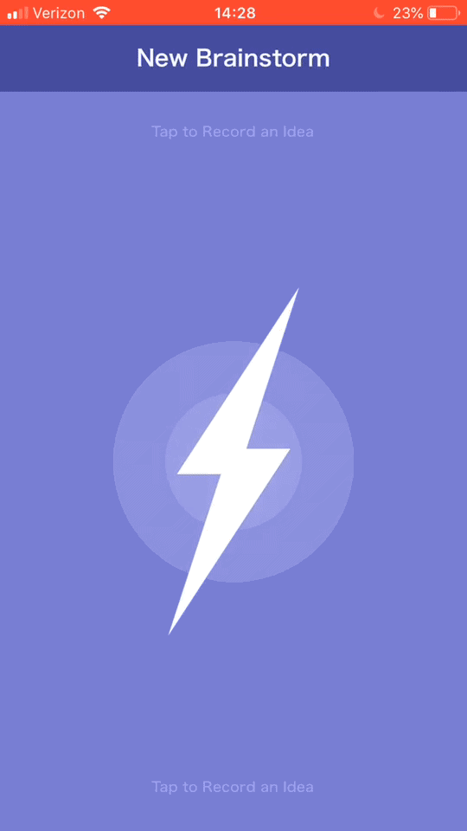
Observations - Quantitative Data
Task 2: Dictate three ideas
60% complete (4/6)
Avg speed for those completed: 21 seconds
1 Error
1 Critical Error

Slide 17
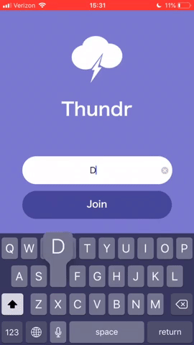
Observations - Quantitative Data
Task 3: Vote on Idea
83% completed the task (⅚)
Avg speed for those completed: 5.25 seconds
0 Errors
1 Critical Error (consequent)

Slide 18
Observations - Qualitative Data
Task 1
Didn’t see code on Web Screen
Tried to join immediately without code
Task 2
Unsure if has to tap for each idea
Didn’t realise they could edit Idea
Task 3
No hesitation in tapping like button

Slide 19

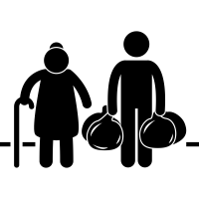

Positive Moments
People found the app to be highly accurate
People found the app to be very helpful
People found the app to be pleasing to look at

Slide 20
Take away
Method
Measures and Observations
Take Away

Slide 21
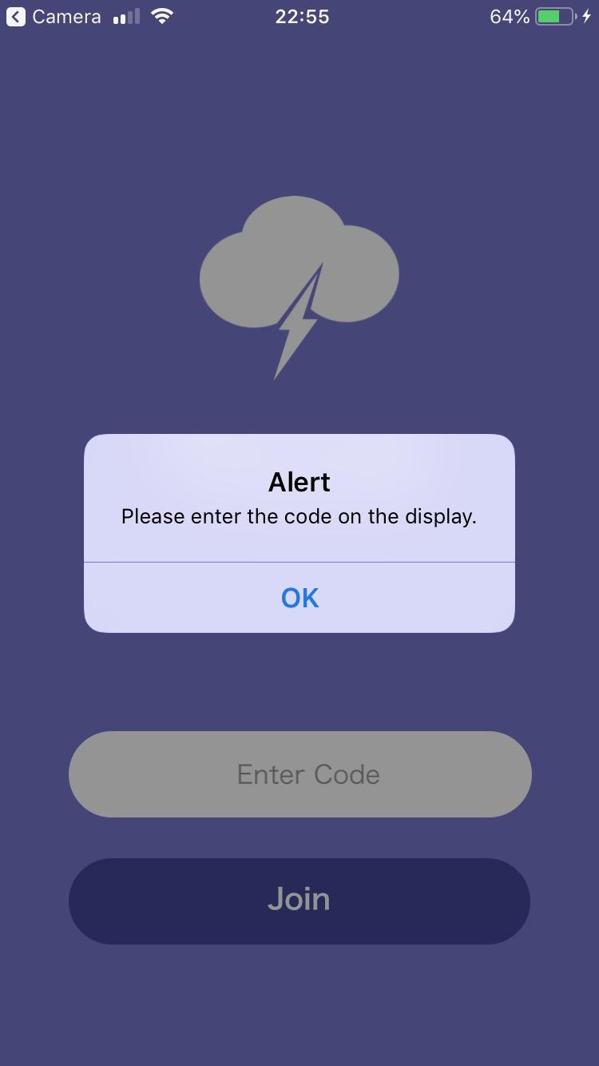
Proposed changes
Add an alert to prevent people from joining without code

Slide 22
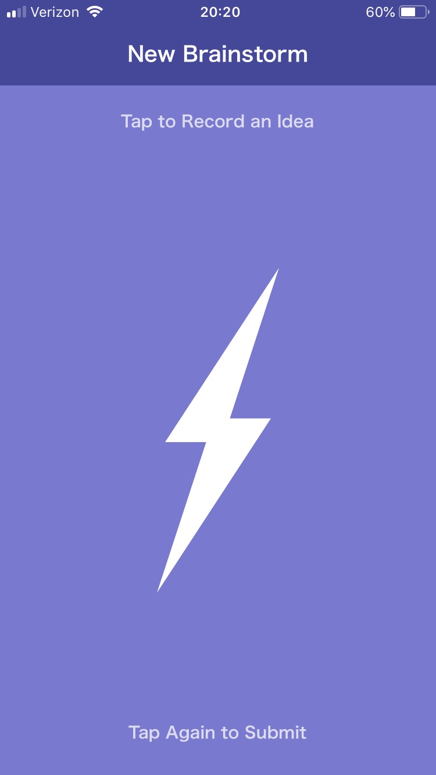

Proposed Changes
Create larger prompts that are animated
RECORDING...

Slide 23
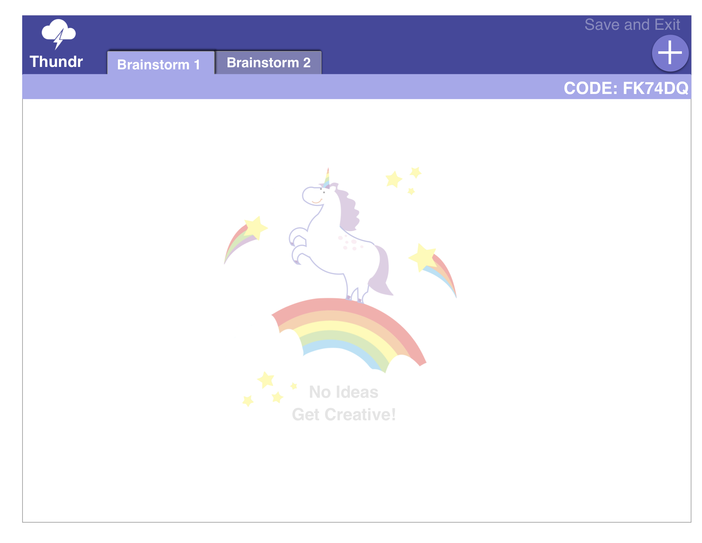
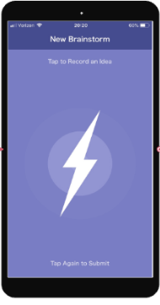
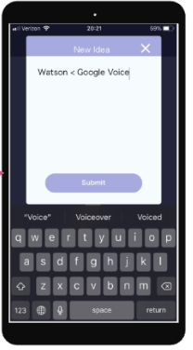
Proposed changes
Watson < Google Voice
Create in-app tutorial

Slide 24

Difficulties
Difficult to simulate the realistic environment.
Difficult to record data for multiple people at once.
People interpret instructions differently

Slide 25
Conclusion
Method
Measures and Observations
Take Away

Slide 26
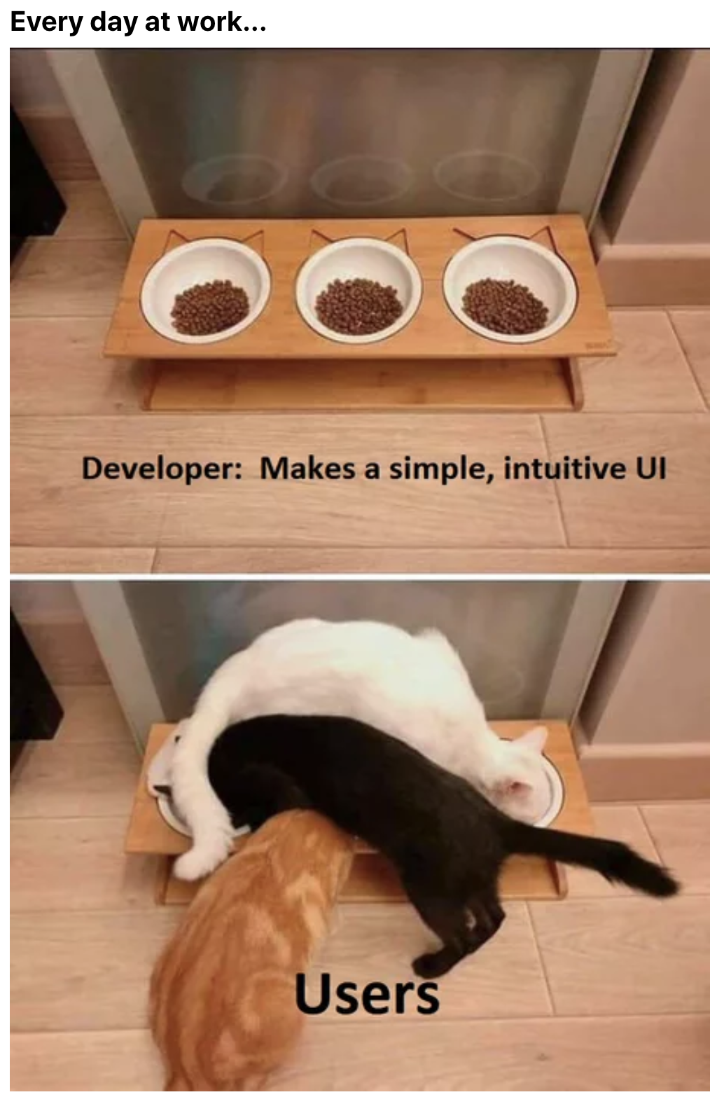
Conclusion
While most people were able to complete the tasks, we need to offer users more help and instruction

