Slide 1
Midway Milestone
CS 147 - Fall 2018
Austin Jones
Caroline Willis
Emma Alderton

Slide 2
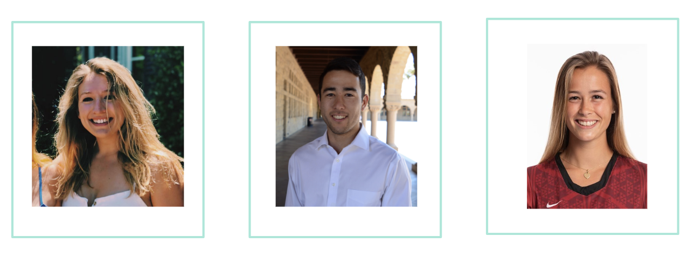
The Team
Caroline Willis
Austin Jones
Emma Alderton

Slide 3
Mission Statement:
Our mission is to create an inclusive and intuitive brainstorming platform that allows users to focus on generating their
best ideas.

Slide 4
Value Proposition:
Brainstorm with Sound

Slide 5
Problem/Solution Overview
Problem:
We identified a need for a better brainstorming tool that could be used remotely, too.
Solution:
Taking the writing aspect out of the process and replacing it with voice interaction allows for continuous productivity, engagement, and creativity.

Slide 6
Heuristic Evaluation Results

Slide 7
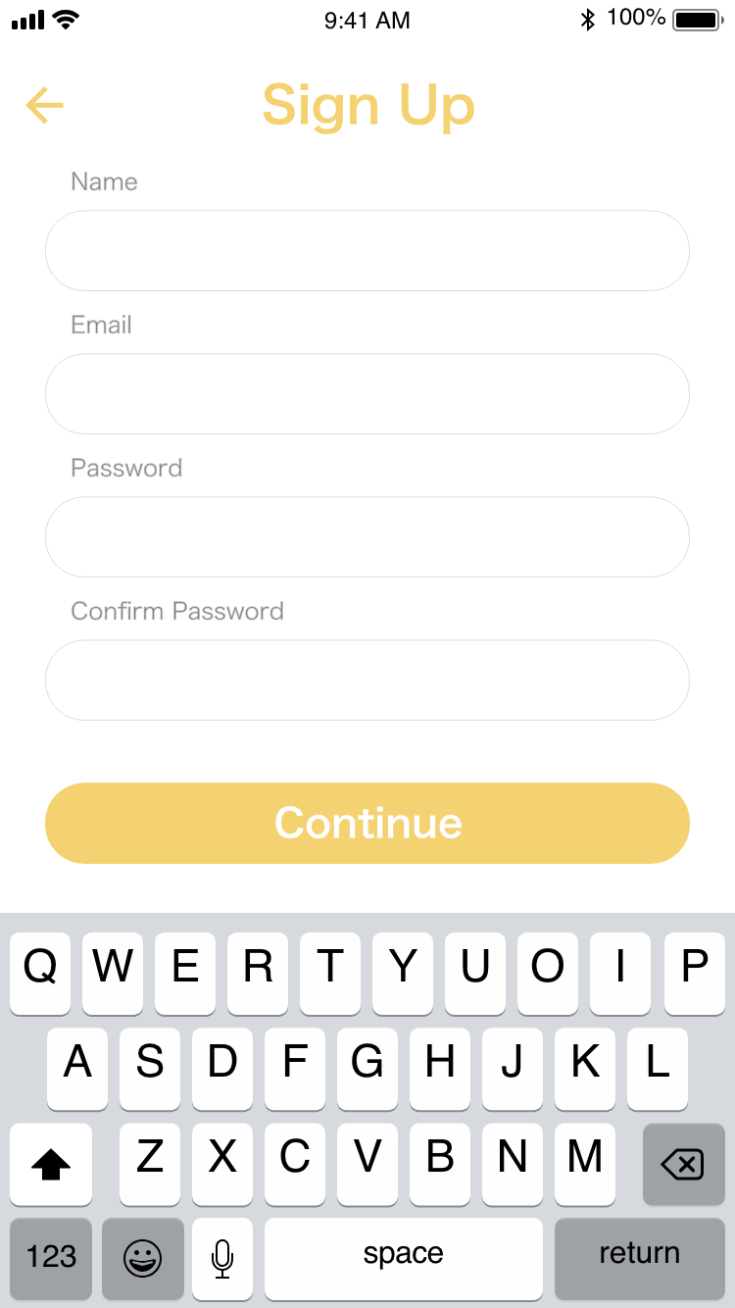
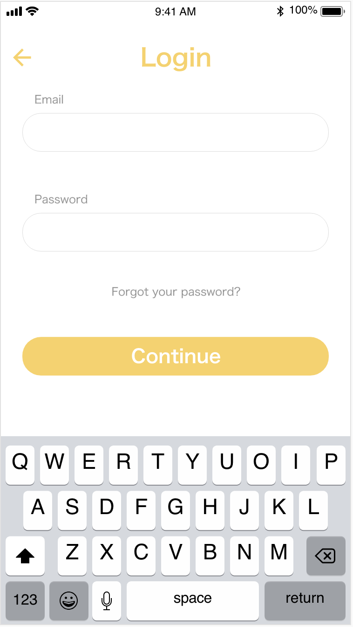
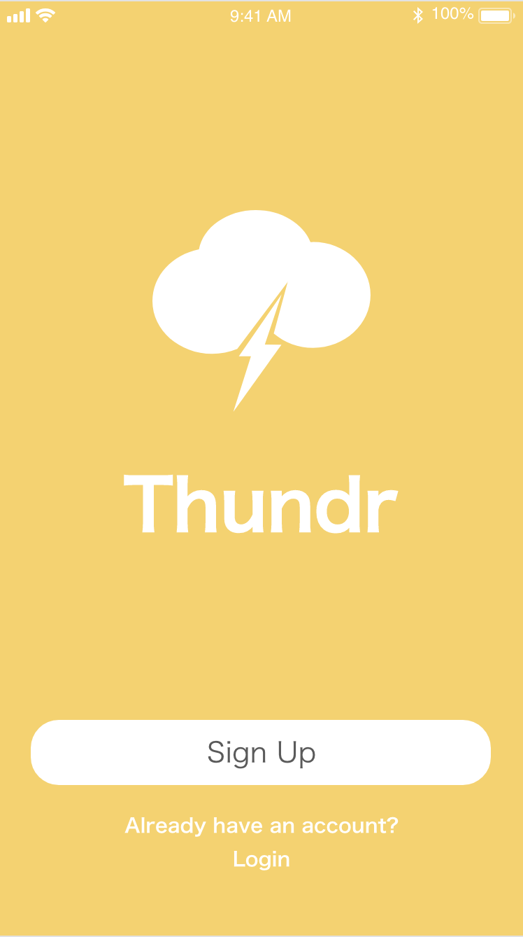
Switching between sign up and sign in
Problem:
User must sign in and
can’t go back to sign up
page
Solution:
Add a link to take them
back to sign up page

Slide 8
Whose color sticky note is who
Problem:
Sticky notes are color coded to represent each participant in the brainstorm.
Depend on the user to recall what color corresponds to what user.
Solution:
At the edge of every sticky note, added a small profile picture to help identify who the contributor is.

Slide 9
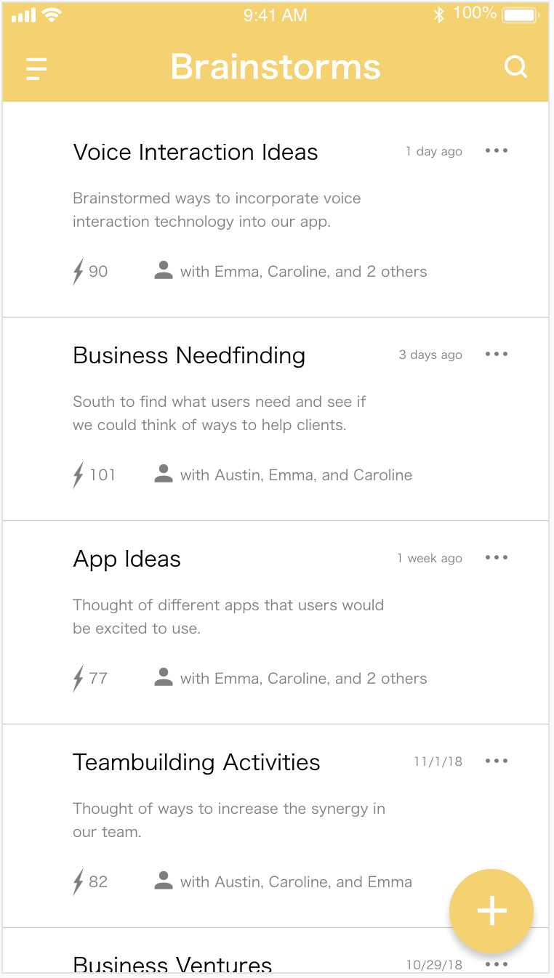
Home menu
Problem:
No general home menu to get back to all brainstorms.
Solution:
Added a home menu through the hamburger menu.

Slide 10
Idea Submission
Problem:
No confirmation to indicate that it was successfully submitted.
Solution:
Add a confirmation through vibration of phone or a notification

Slide 11
Search bar ambiguity
Problem:
The “Homepage” and “Ranked Ideas” pages both have a search bar which seems to be really ambiguous of what it is supposed to search for.
Solution:
Specify the purpose of search bar with an example search

Slide 12
Non-HE Evaluation Changes
Changed the color.
Rearranged the structure of the app, having the past brainstorms be on the home screen.
Added a floating button for creating a new brainstorm.

Slide 13
Overview of Changes
Less clutter, simpler and more streamline
More flexibility
More documentation and help

Slide 14
Prototype Status

Slide 15

Tools Used
React Native

Slide 16

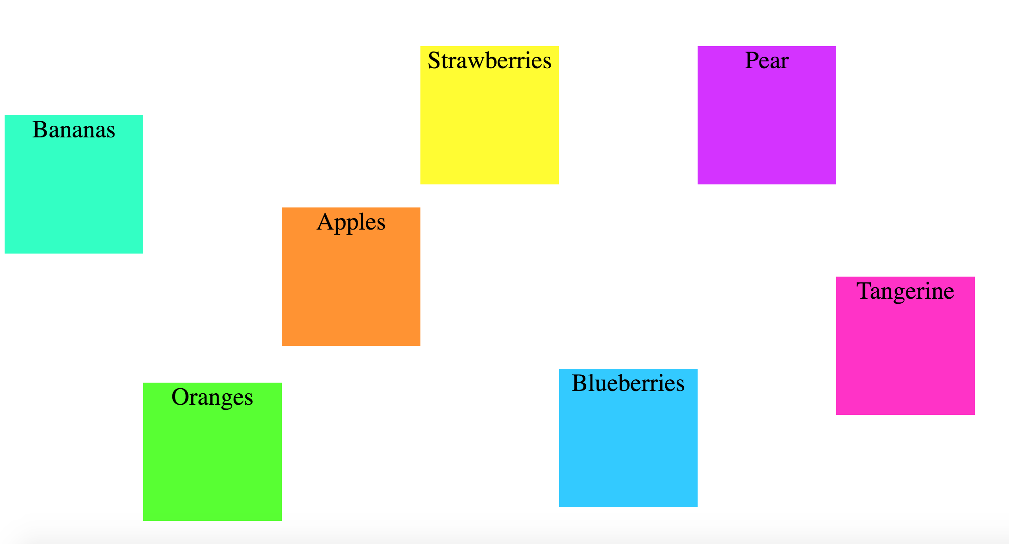
Implemented features
Create and share Ideas(our simple task)

Slide 17
Unimplemented features
Voting system for ideas
Voice functionality of brainstorm
Hamburger Menu
Plan:
Swiping system
Voice input/output
Create a hard-coded user database and history of brainstorms

Slide 18
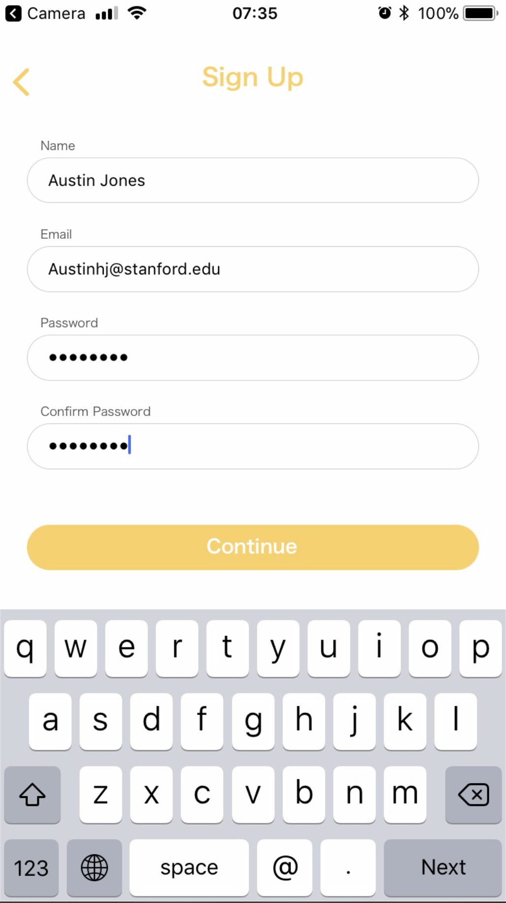
Hard-coded data
User names
Past brainstorms and history

Slide 19
Wizard of Oz Techniques
Plan to use another computer appearing as if the display screen with brainstorm ideas. When brainstorm idea is added on the display, will type and display on computer screen.

Slide 20
Demo☺

Slide 21

Summary
Addressed major points from HE evaluation
Incorporated other changes based on making the app more accessible and easier to use/navigate
On track to finish

Slide 22
Thank you!

