Slide 1

Medium-Fi Prototype
Thundr

Slide 2

Mission Statement
Our mission is to create an inclusive and intuitive brainstorming platform that allows users to focus on generating their best ideas.
Notes:
Thundr will increase productivity by freeing everyone to brainstorm naturally, through speaking, not writing their ideas down, and will display a real time visual the whole time.

Slide 3
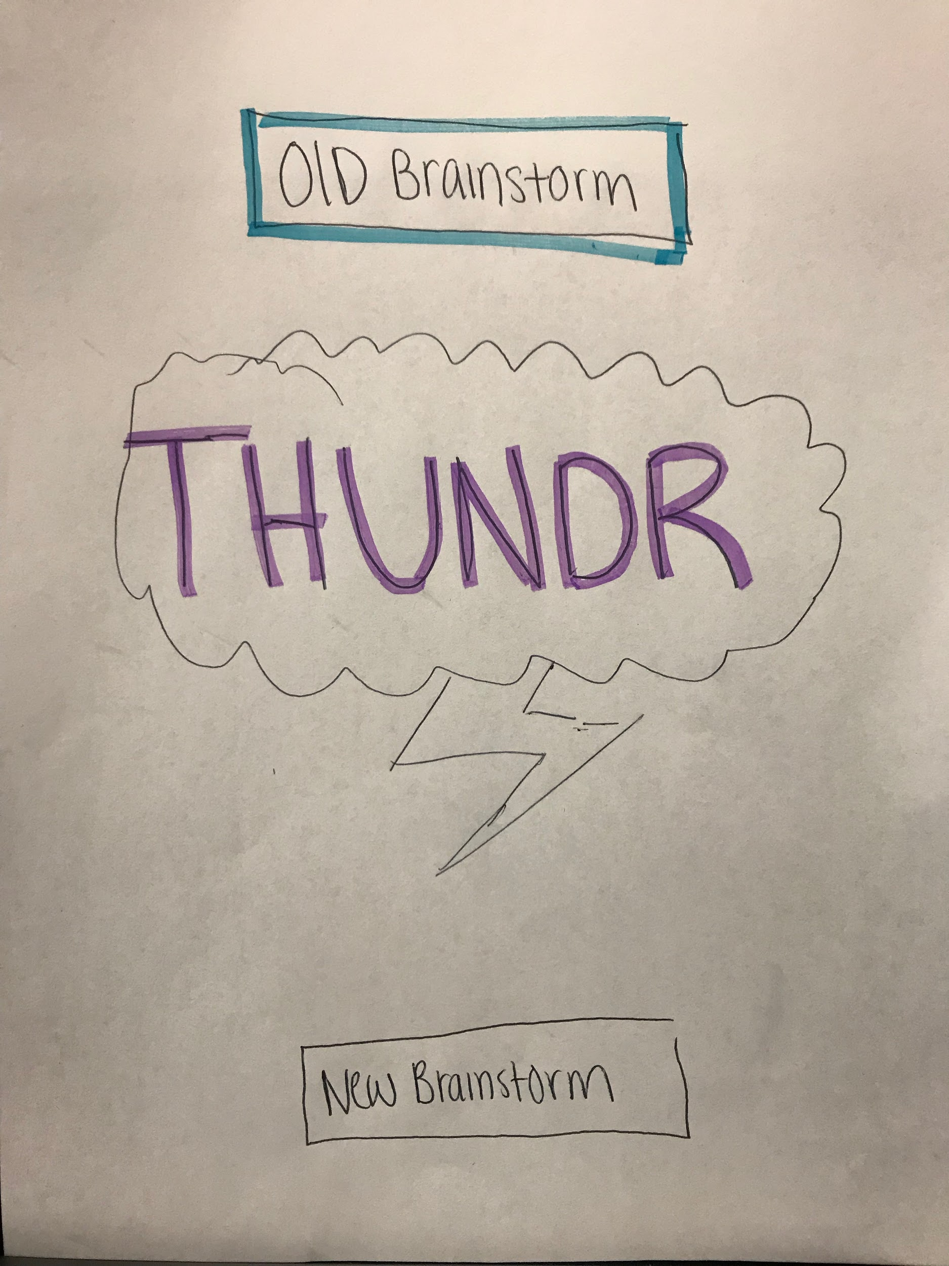
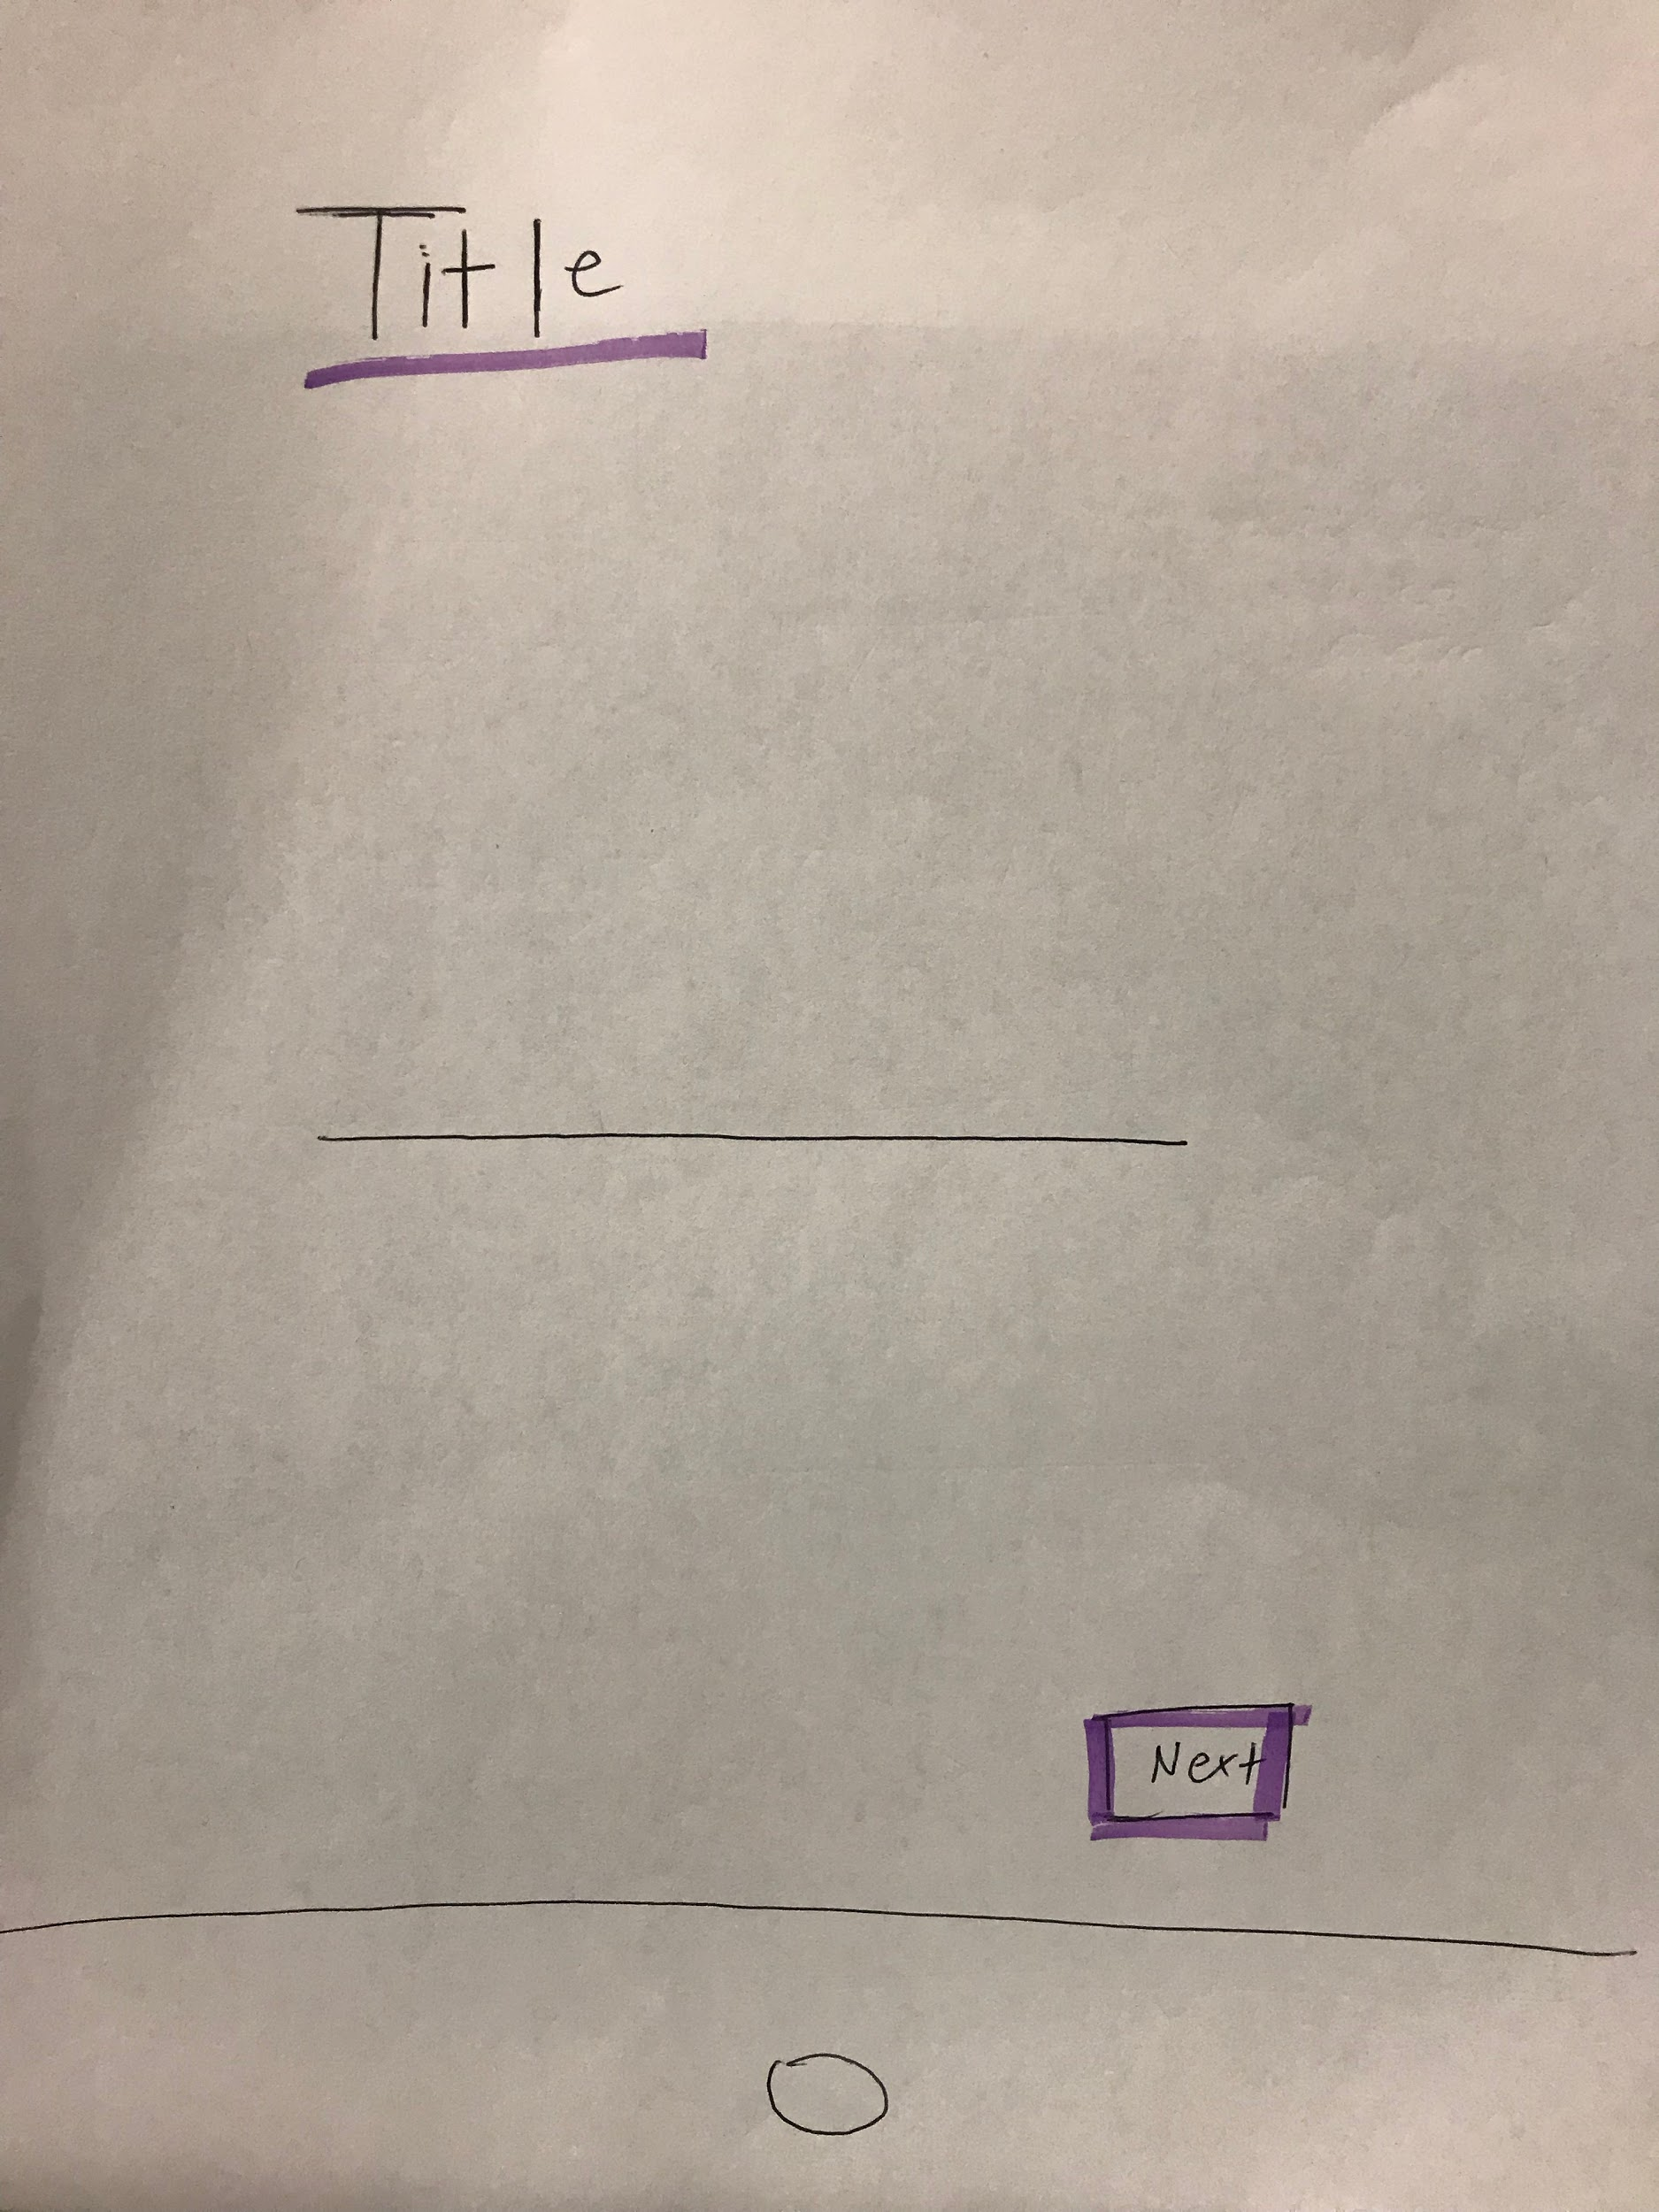
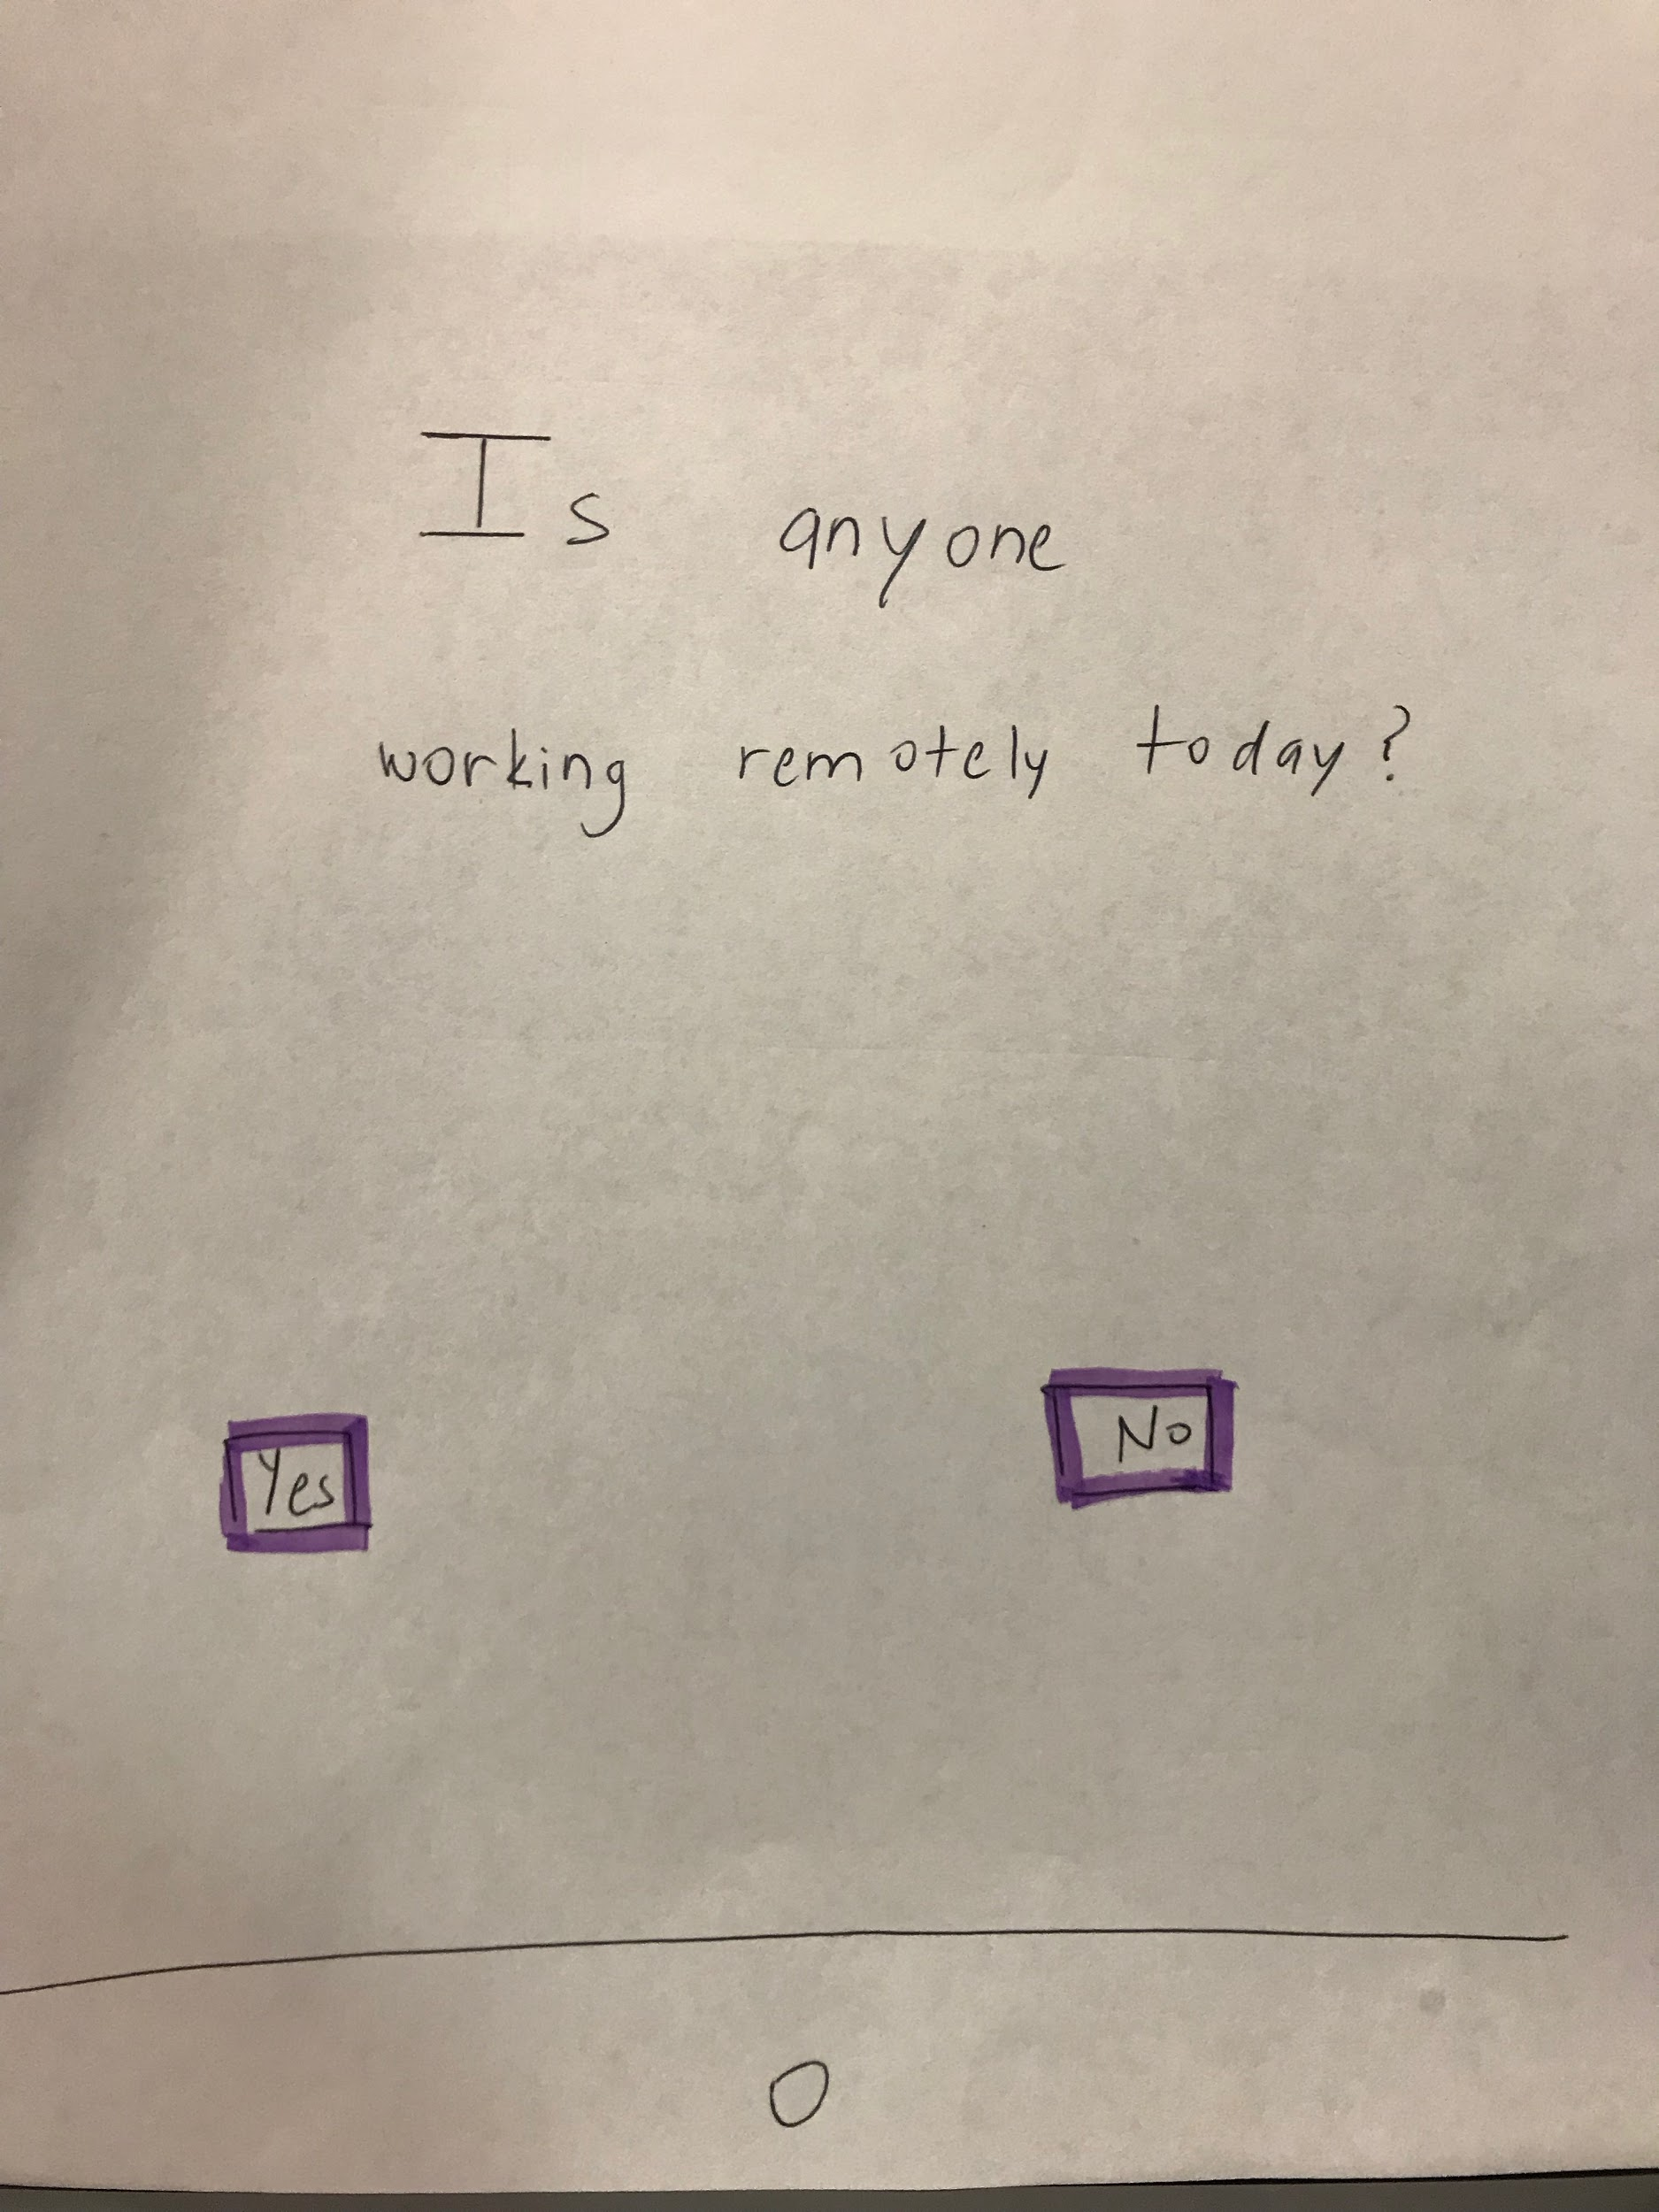
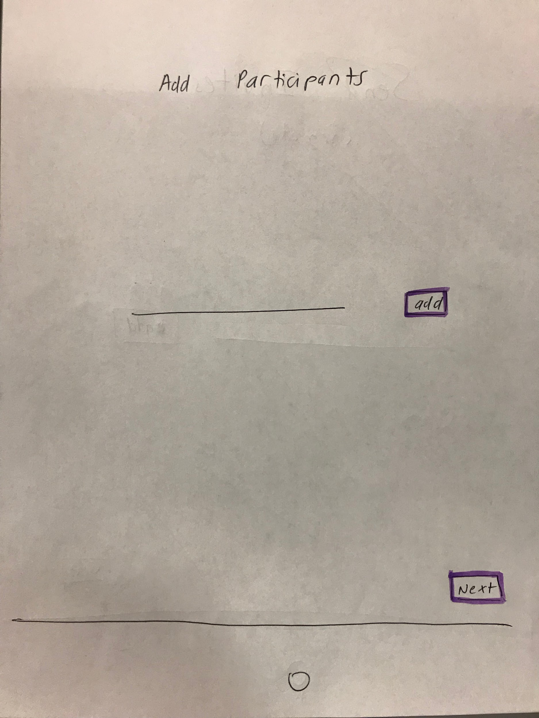
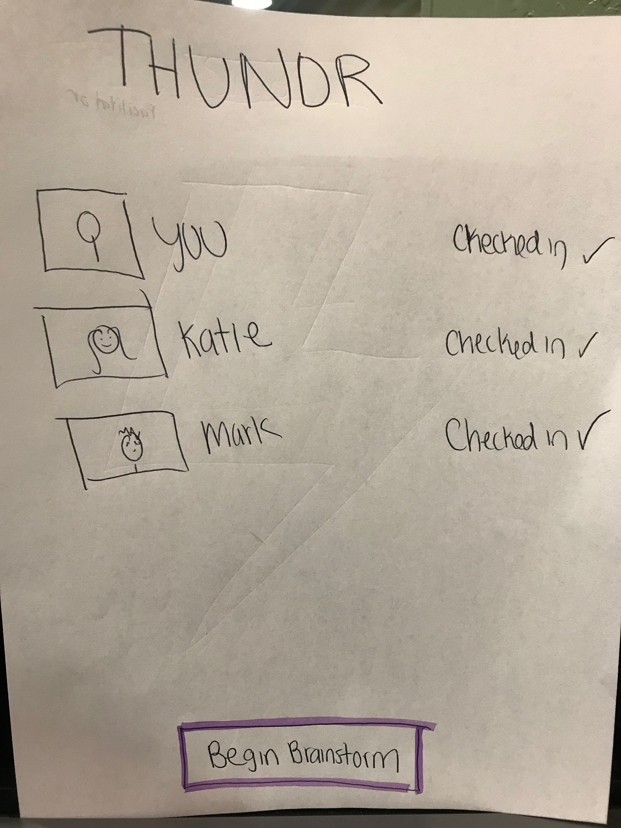
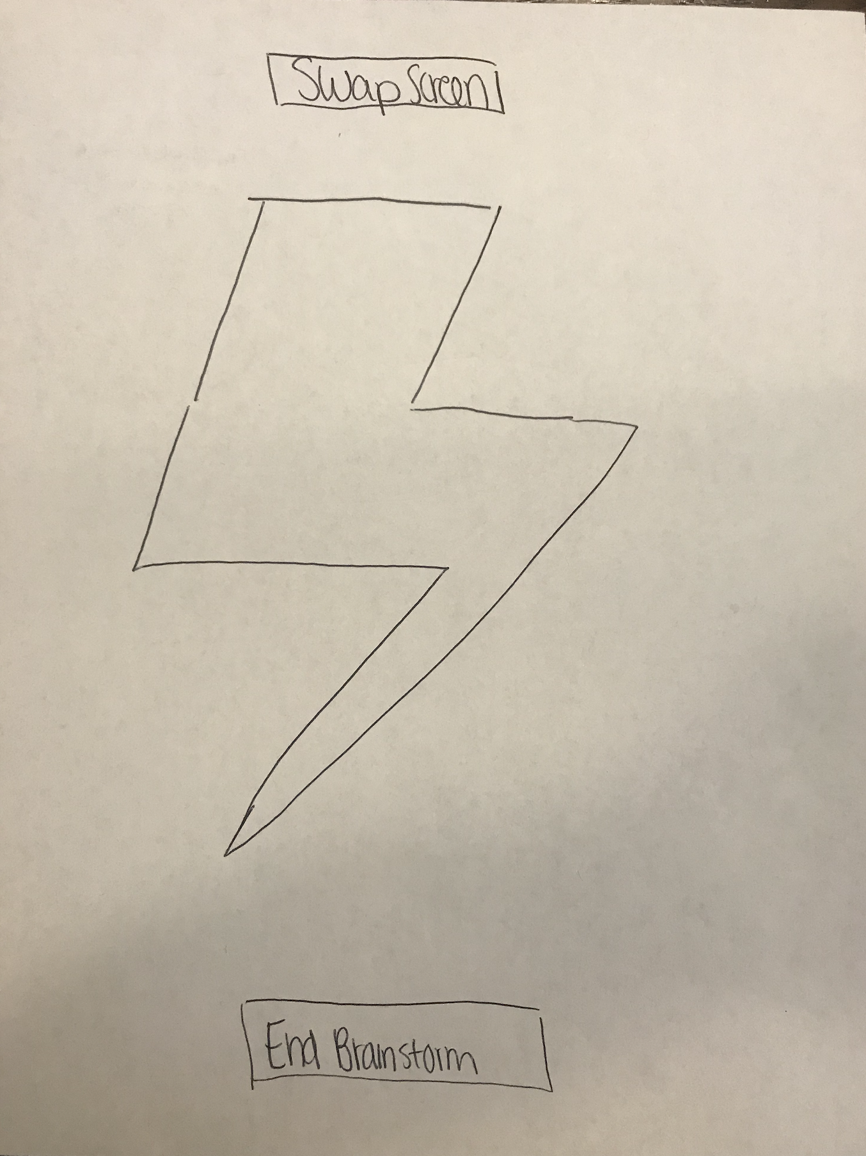
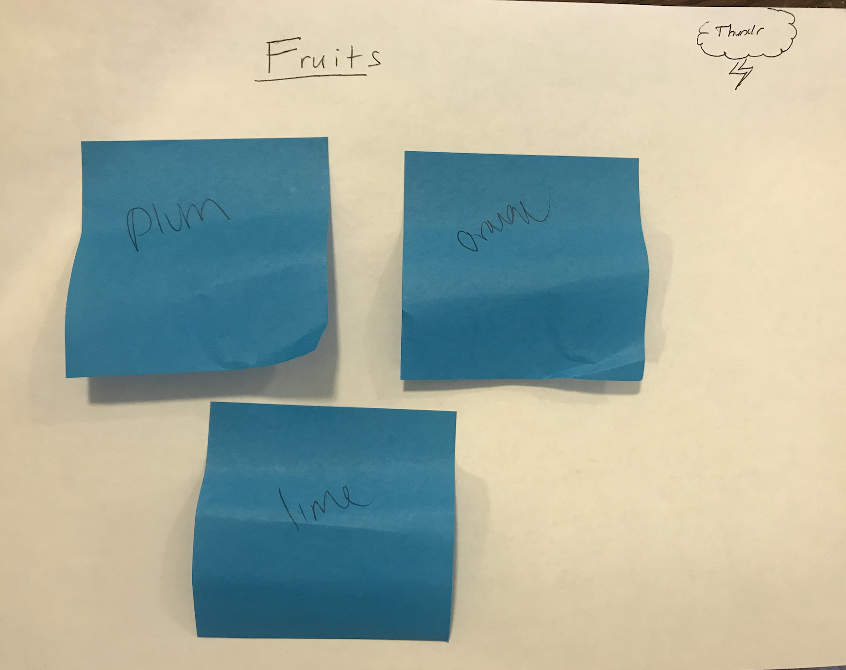
Task 1: Create and Share New Ideas (Simple)
Major Changes: We have changed the “Swap Screen” button. We found this was unintuitive and instead added a hamburger menu, which would allow the user to “View Brainstorm” from that menu.
Notes:
Include any changes we made on the tasks

Slide 4
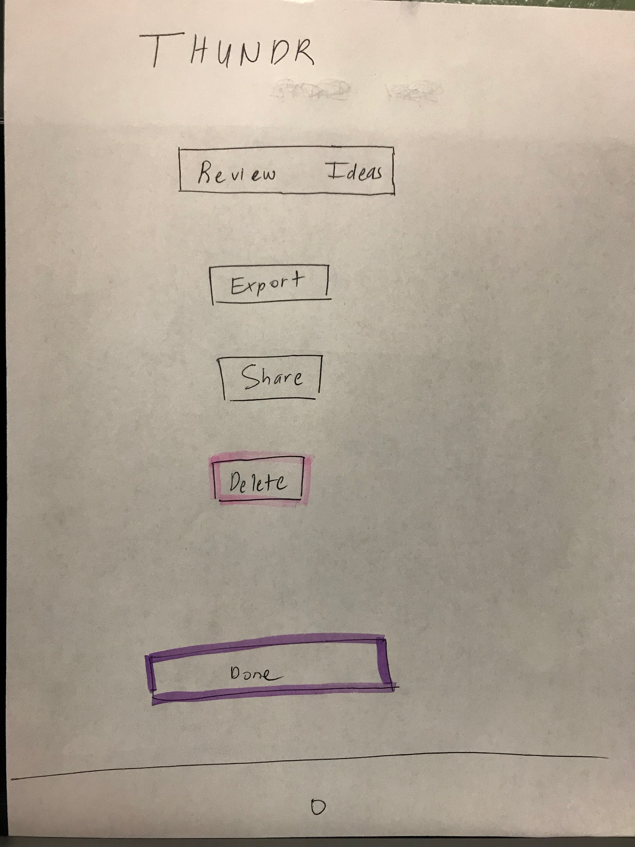
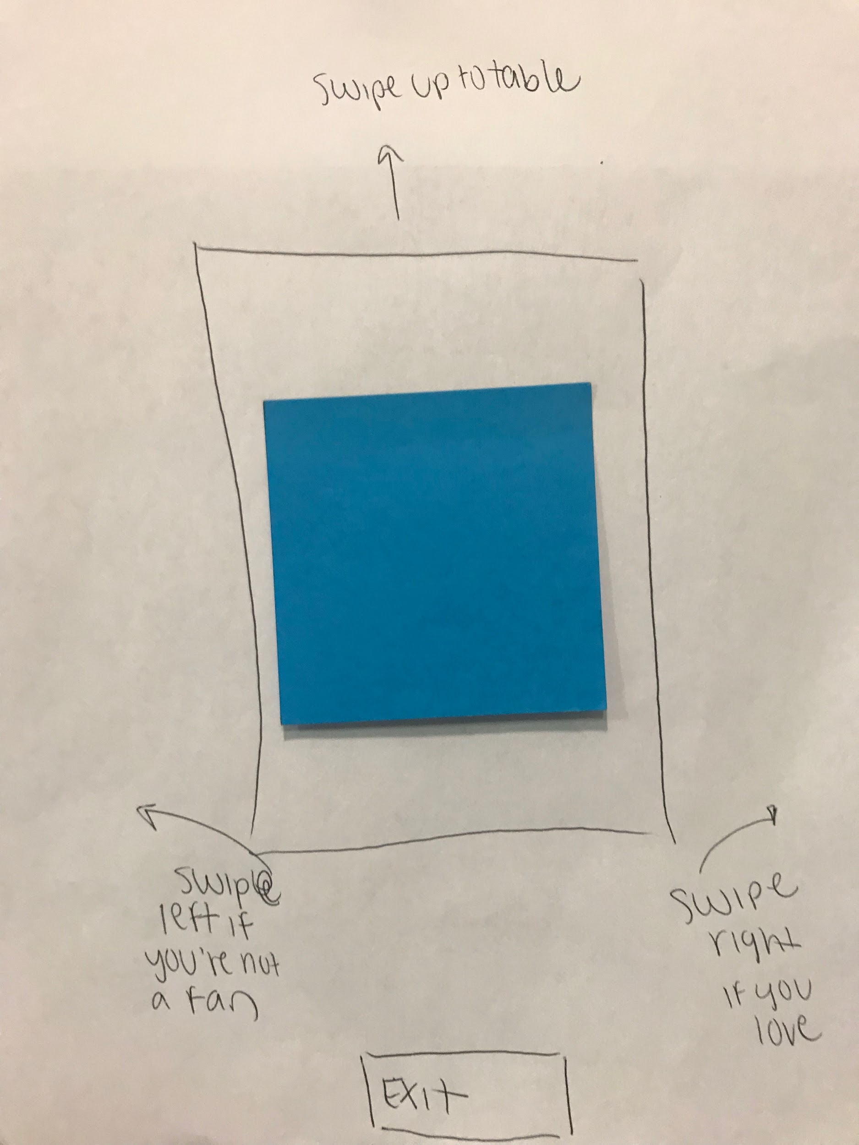
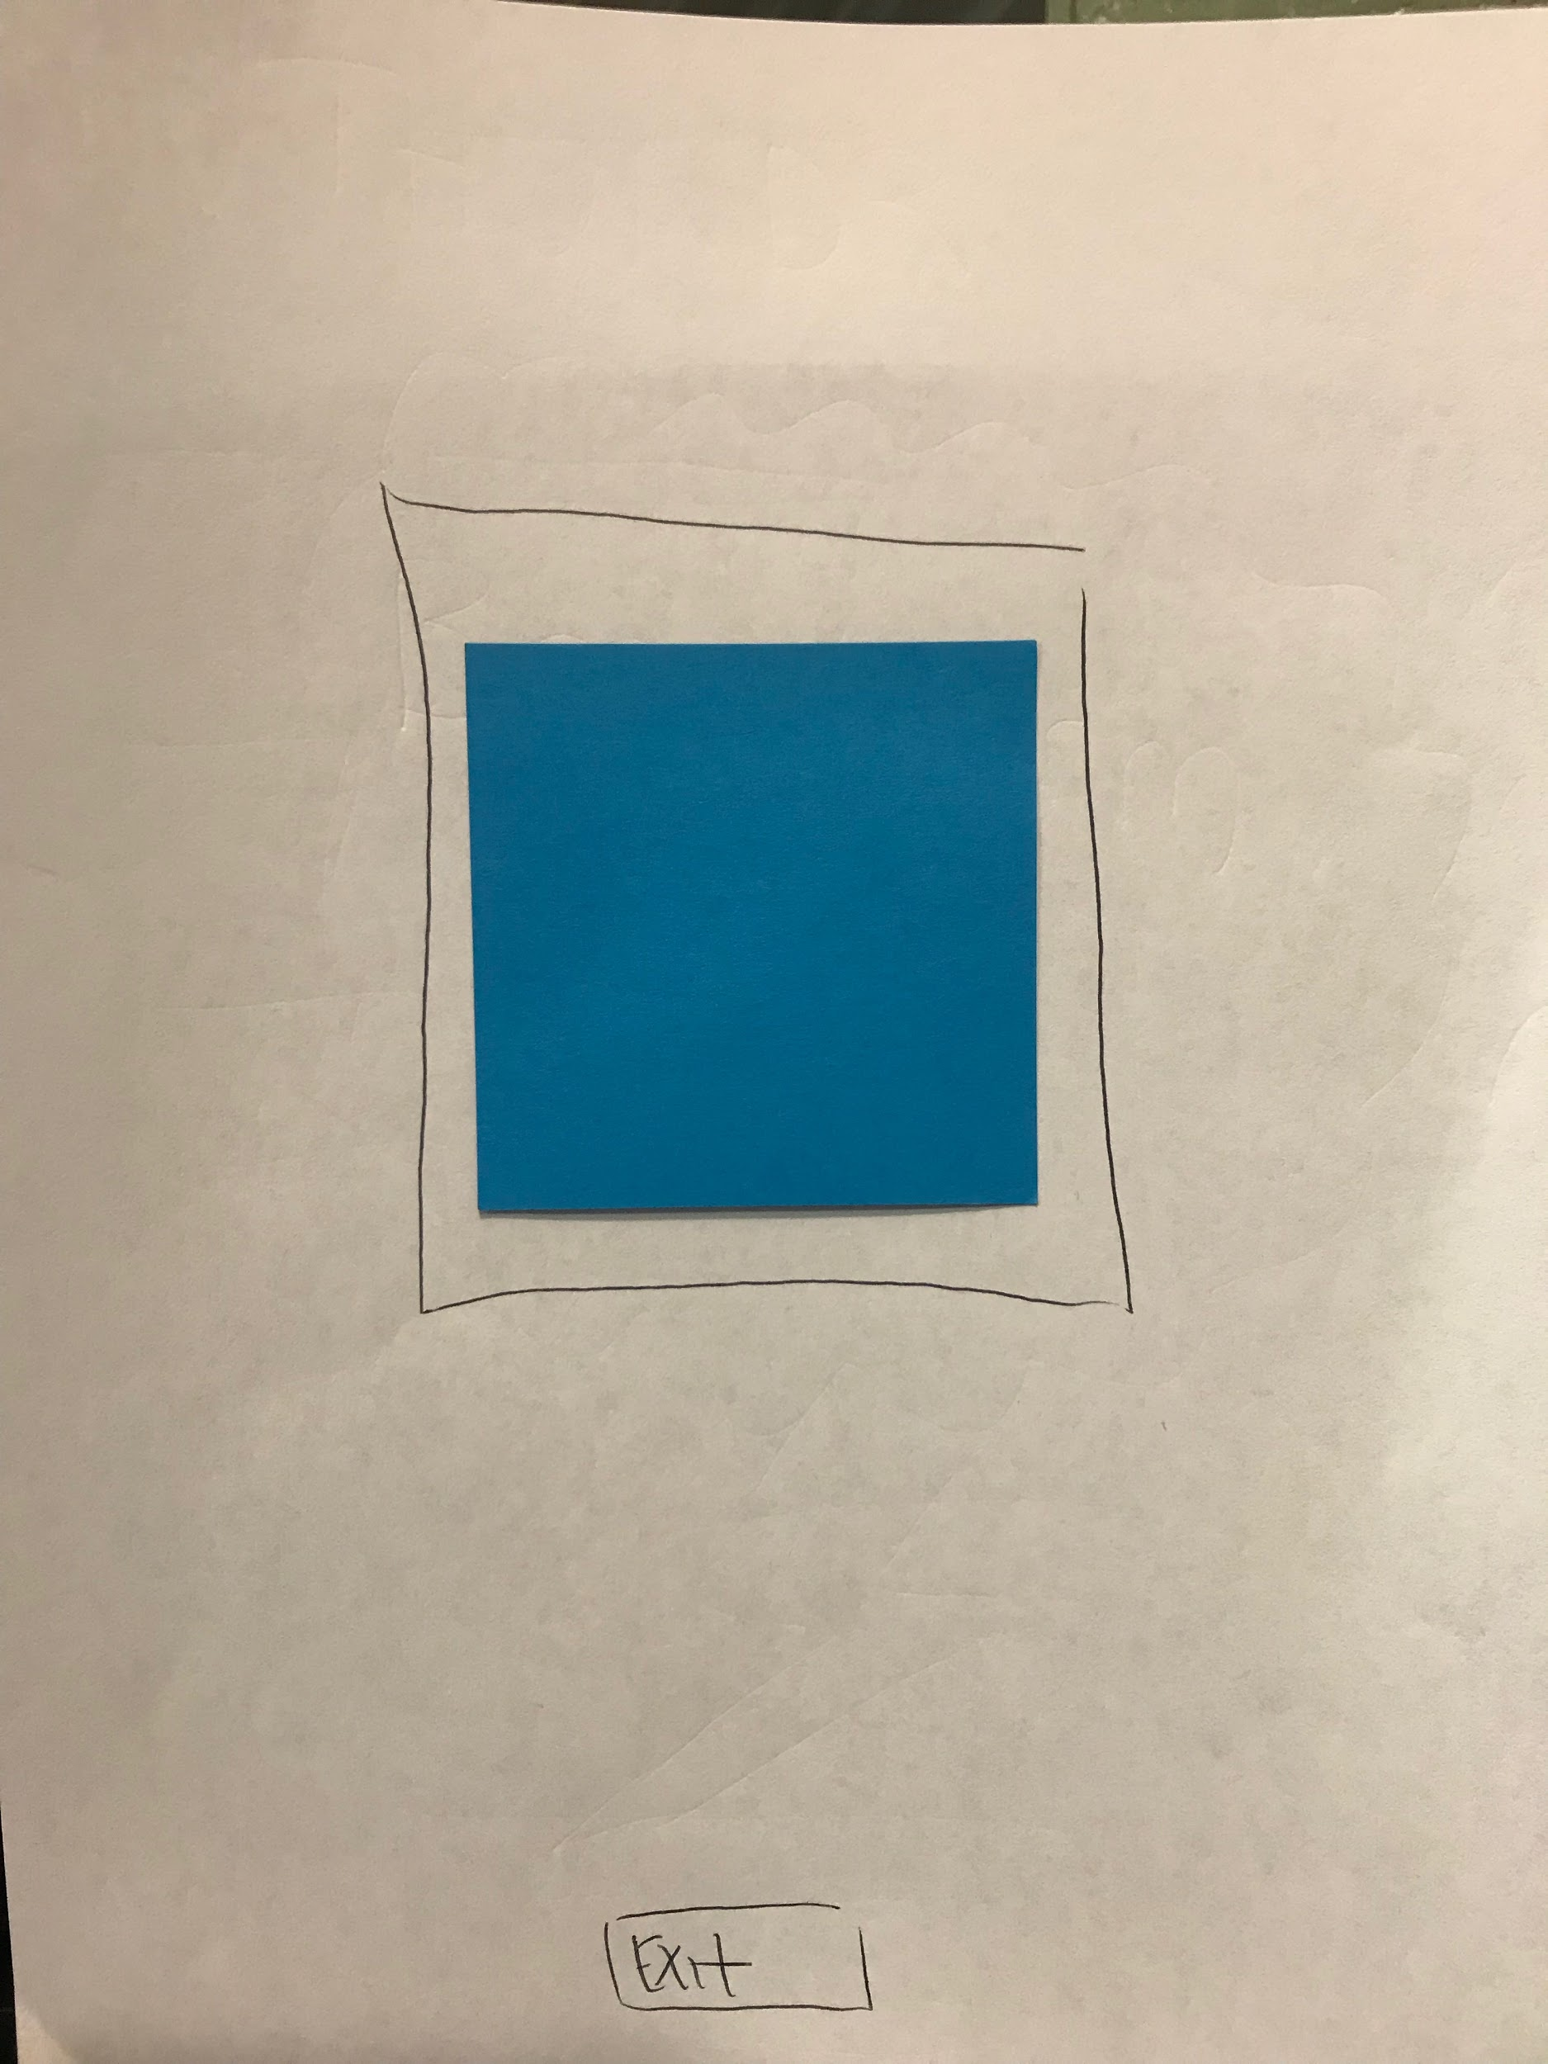
Task 2: Highlight and Present Favorite Ideas (Complex)
Major Changes: We changed the voting system a bit to make it clearer to users what the purpose of voting actually is. This included having “Ranked Ideas” on the Option Screen.

Slide 5
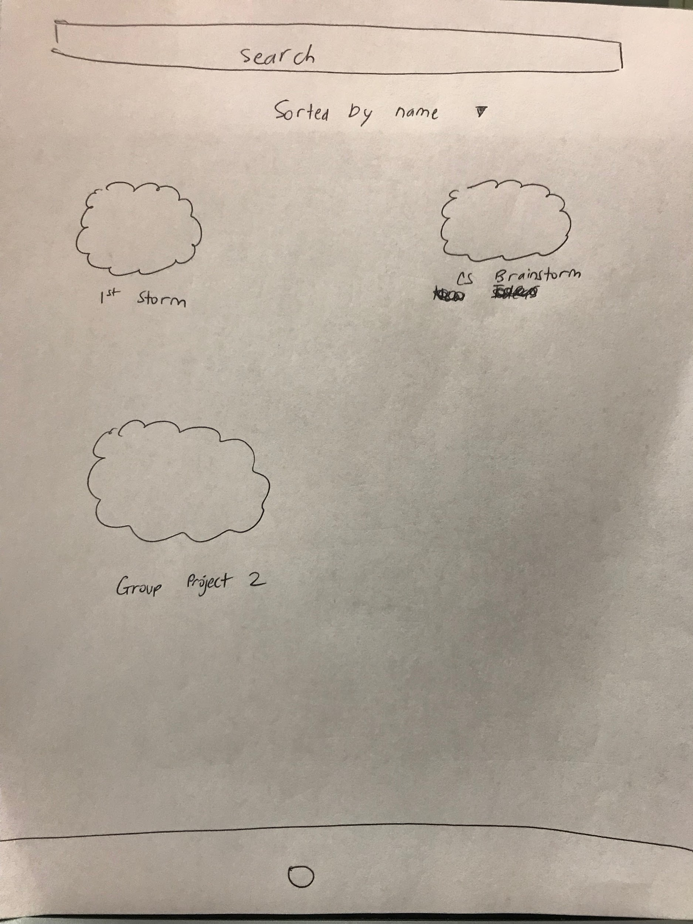
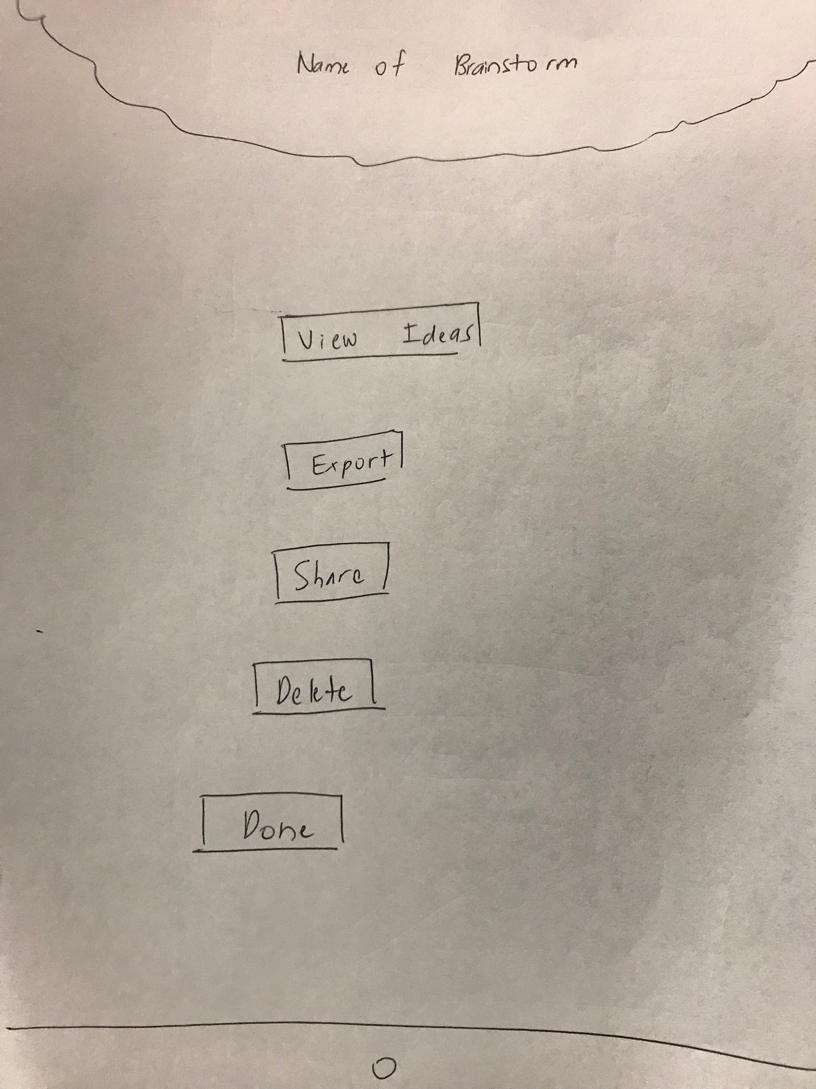
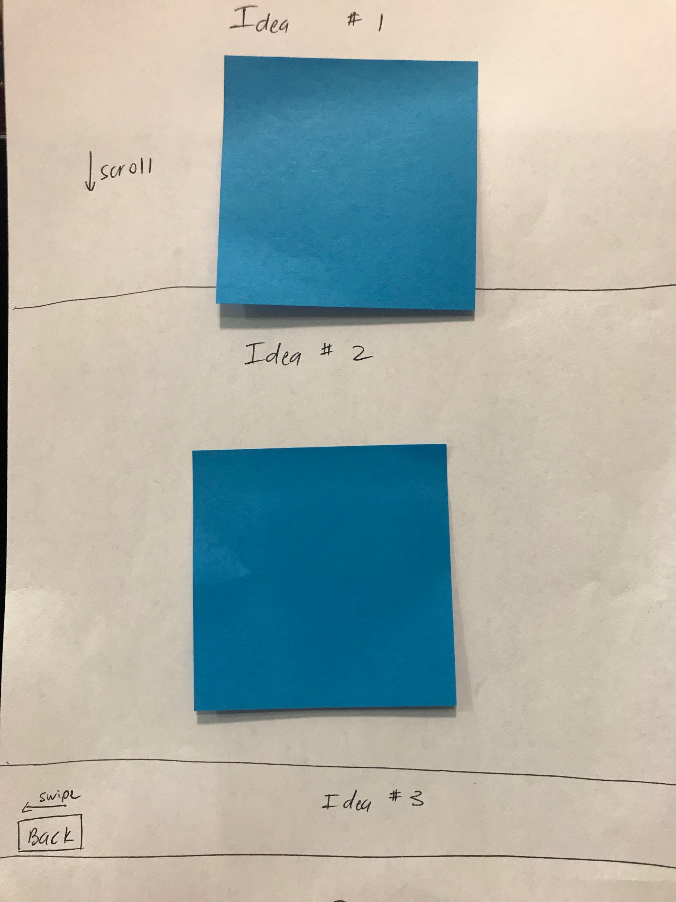
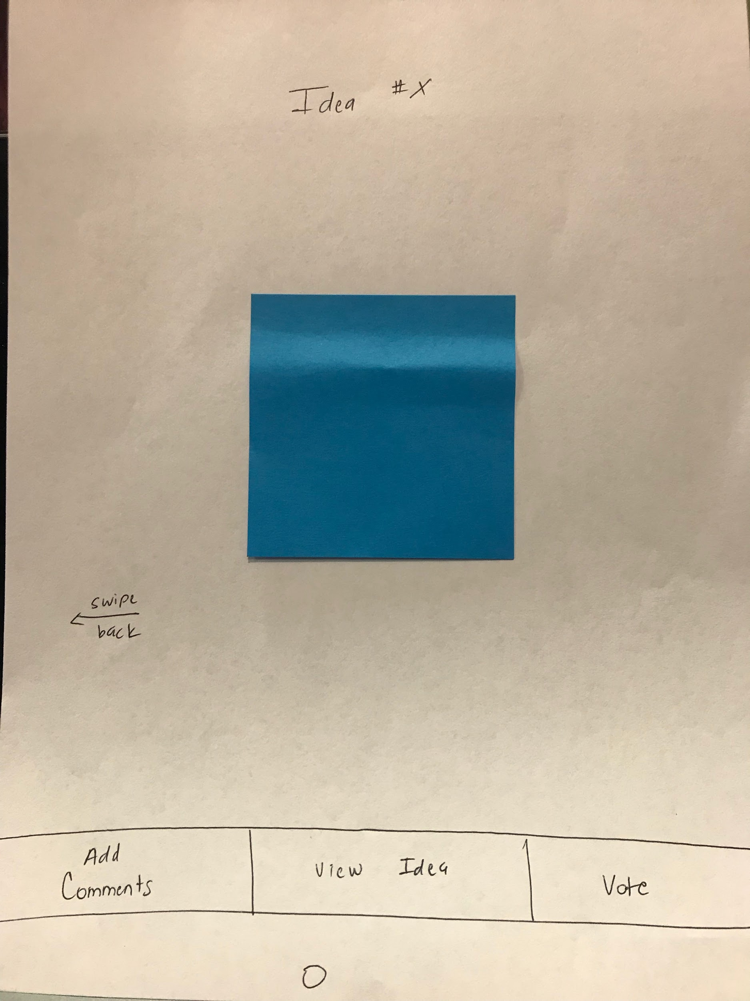
Task 3: Access Old Brainstorm (Medium)
Major Changes: We did not make many major changes to the way we access an old brainstorm. We did add options to the Option Menu which adds ways that users can interact with the brainstorm.

Slide 6
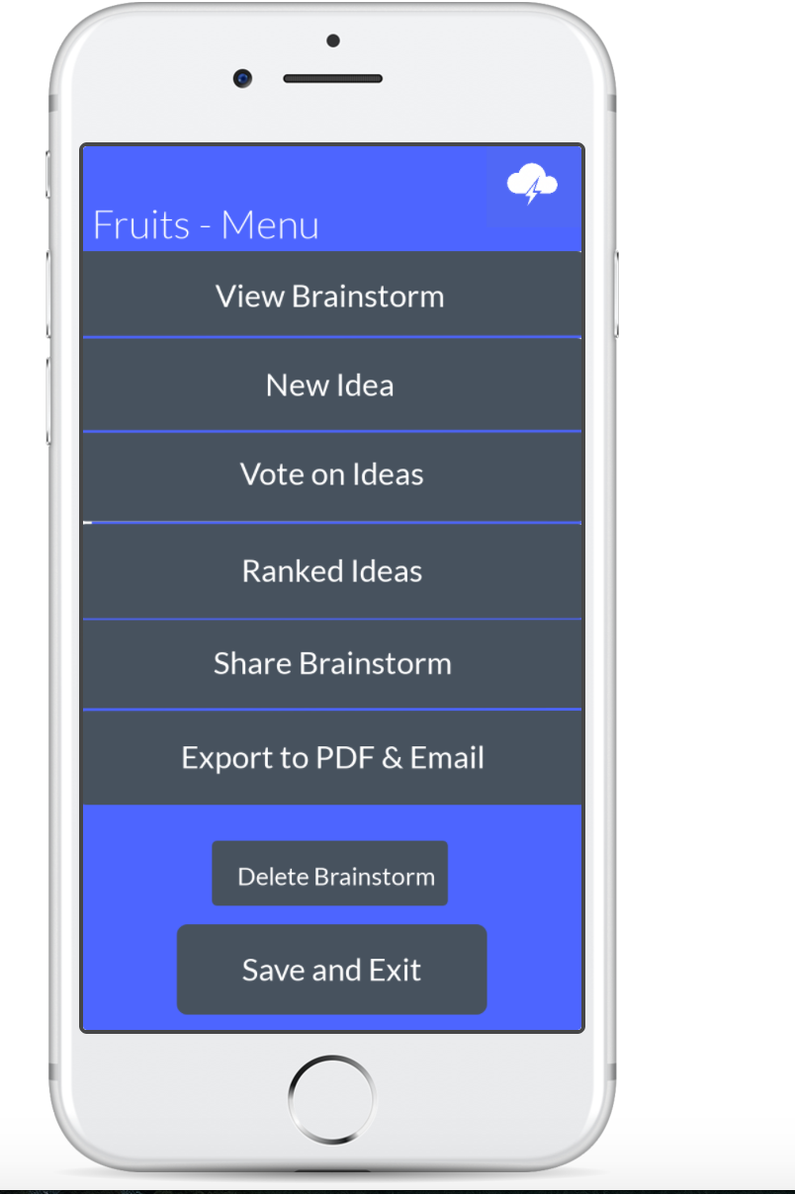
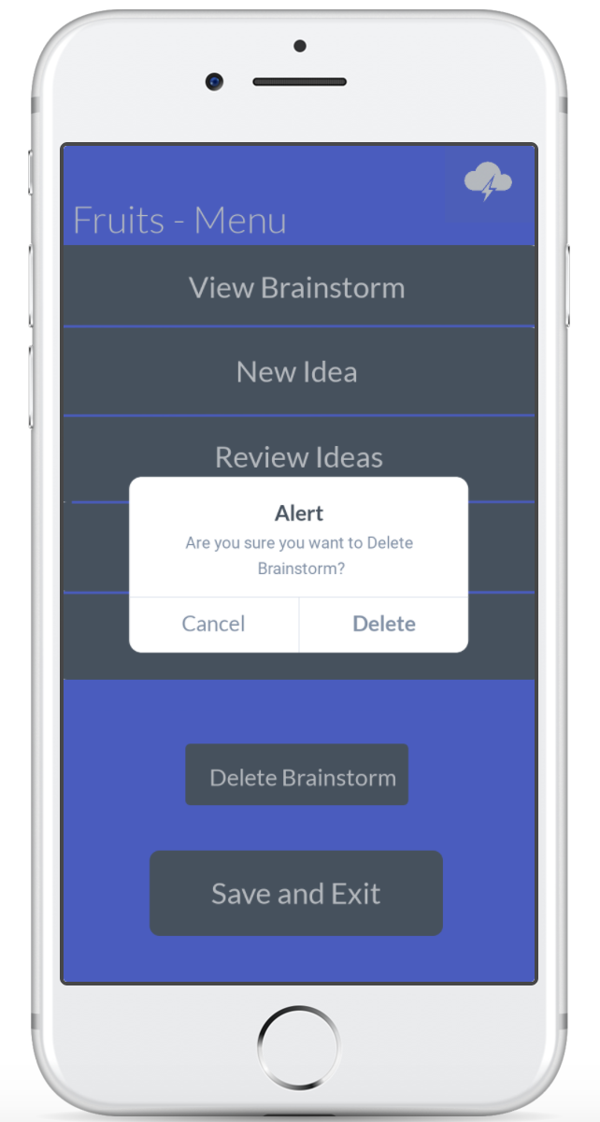
Revised Interface ⟳ Clarified Wording
Rationale: During user-testing, we found that many people were confused when they saw the “Delete” button on our paper prototype. We wanted to clarify the language so users knew that clicking this button would delete the entire brainstorm.

Slide 7
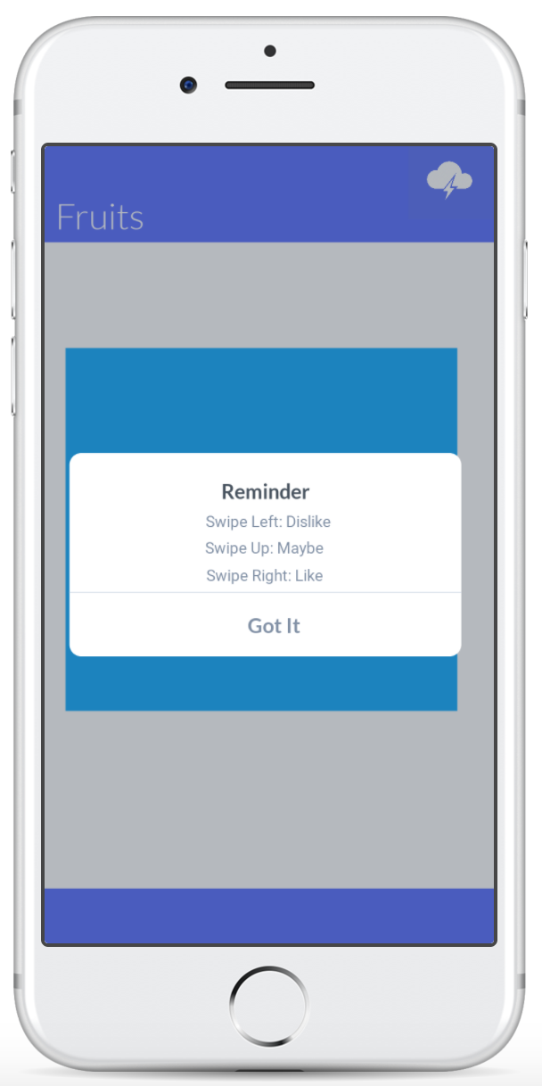
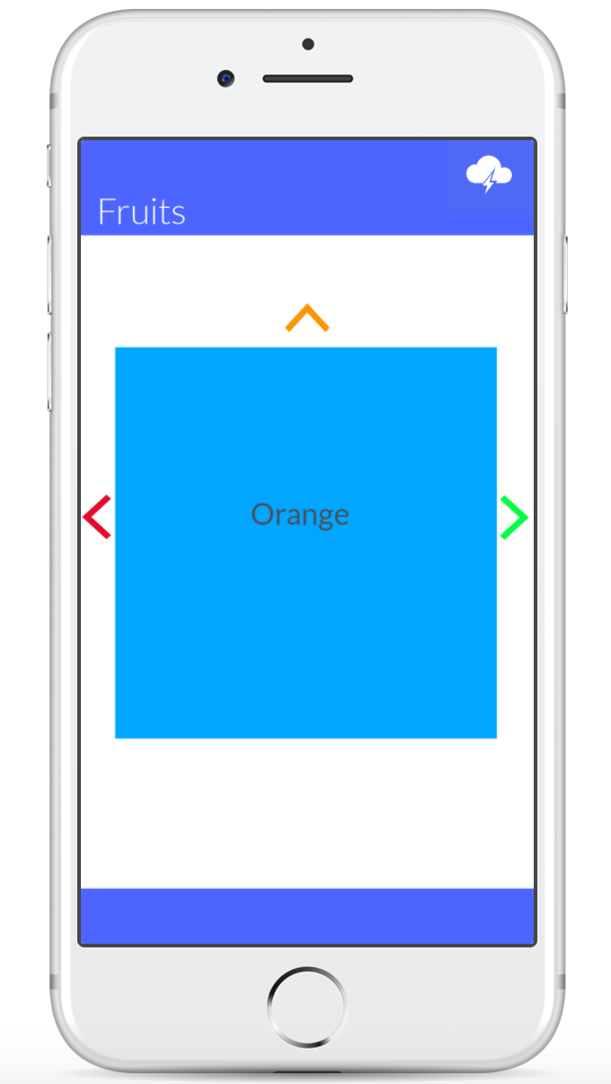
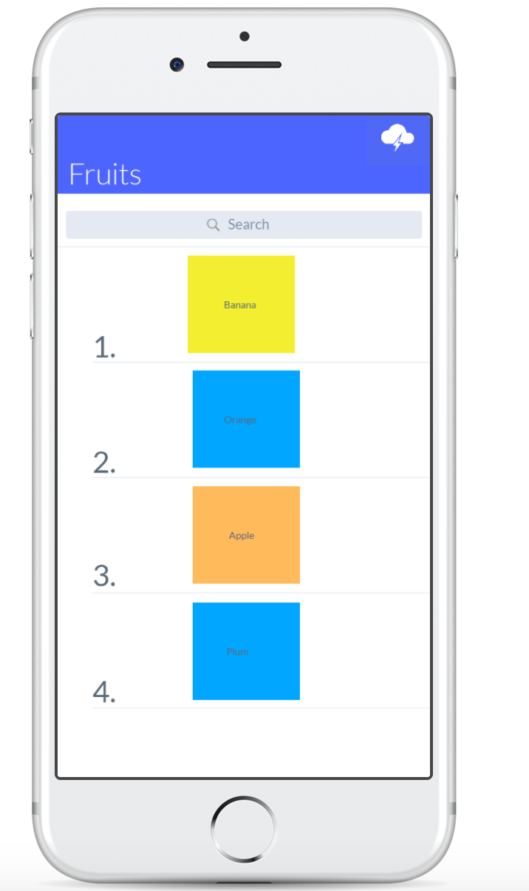
Revised Interface ⟳ Rank of Ideas
Rationale: During user-testing, our participants were often confused by the purpose of our “Vote” button, along with how they were supposed to interact with it. We first wanted to clarify that in order to vote, they needed to swipe. Additionally, we added a “Rank of Ideas” option, so users would see which ideas were ranked the highest after voting.

Slide 8
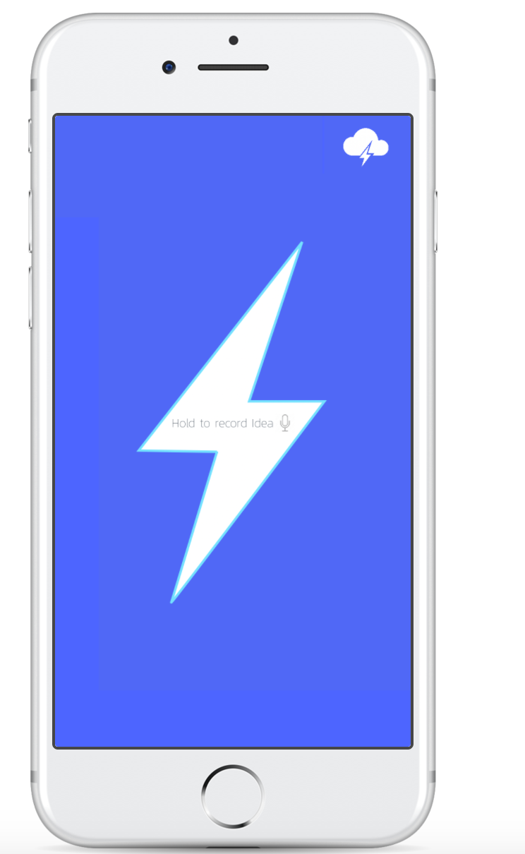
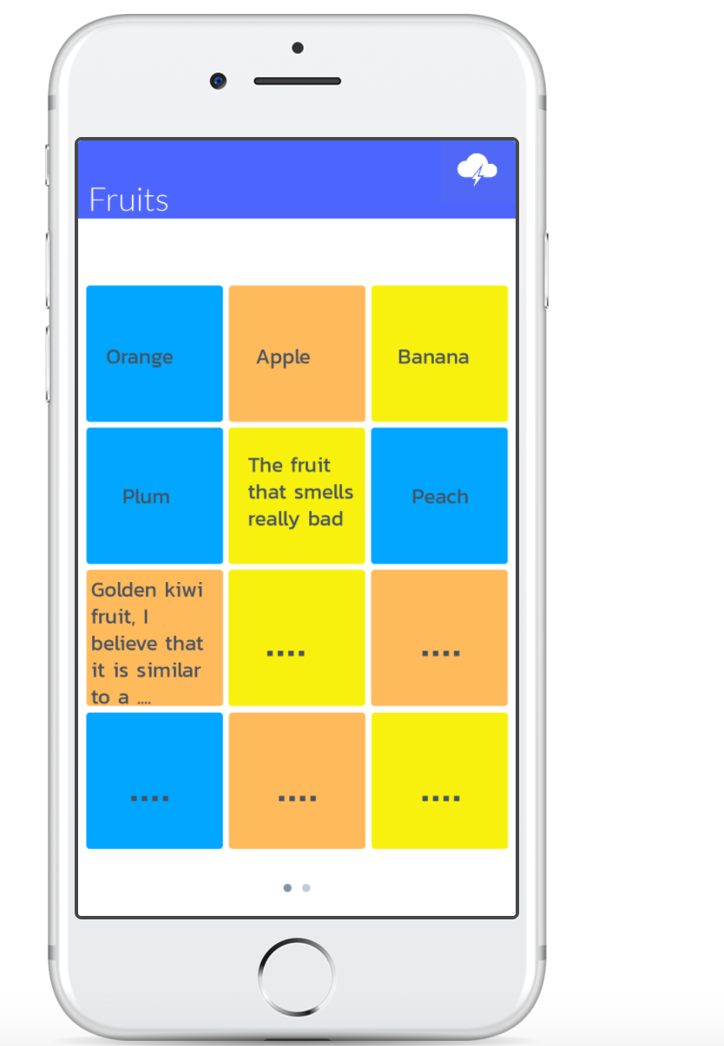
Revised Interface ⟳ “Swap Screen”
Rationale: From feedback from the instructors, we changed the way that a user could access the brainstorm during the session. “Swap Screen” was unintuitive, so we made it part of the hamburger menu to “View Brainstorm” instead.

Slide 9
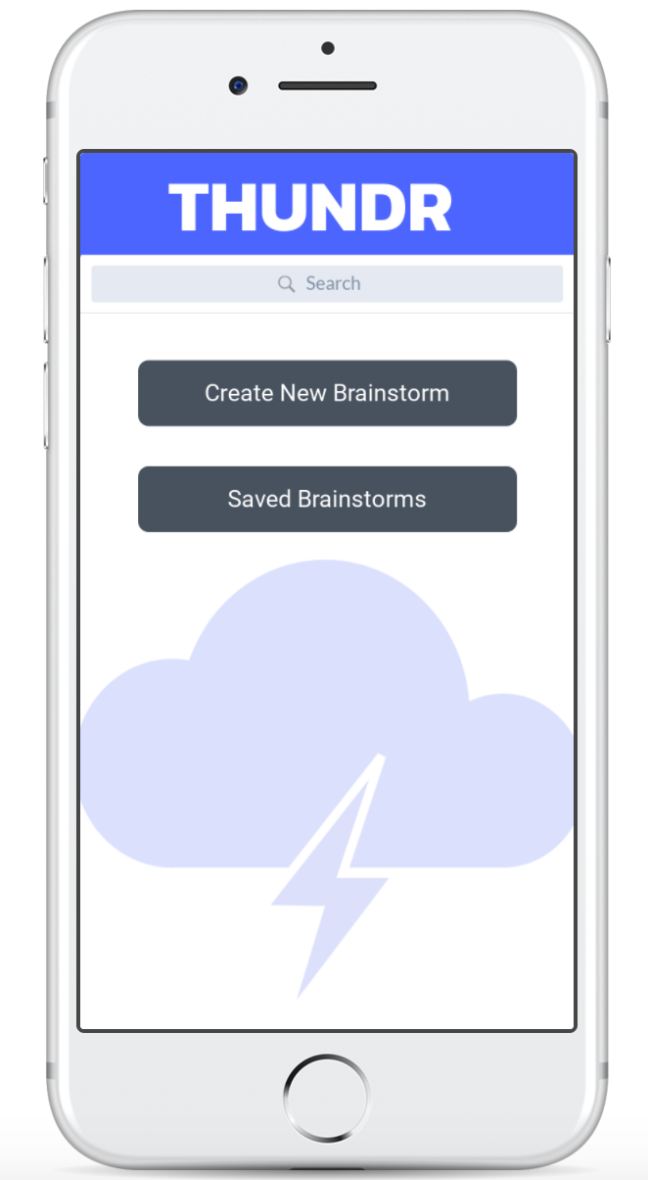
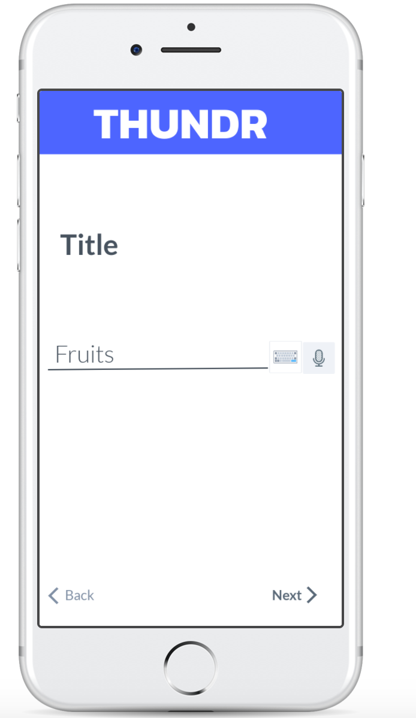
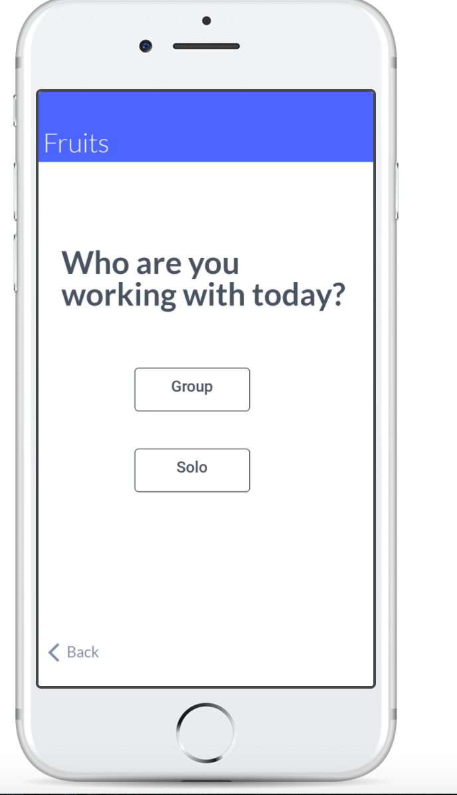
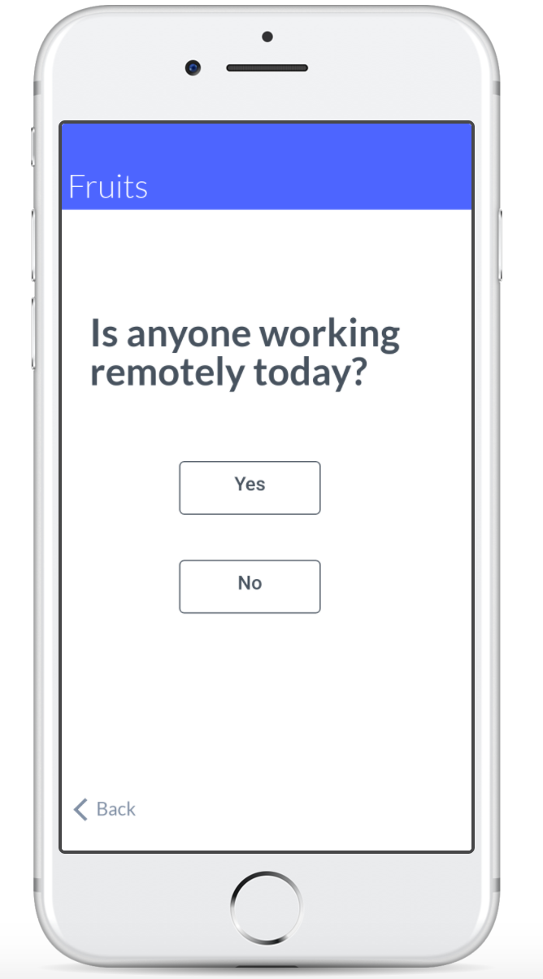
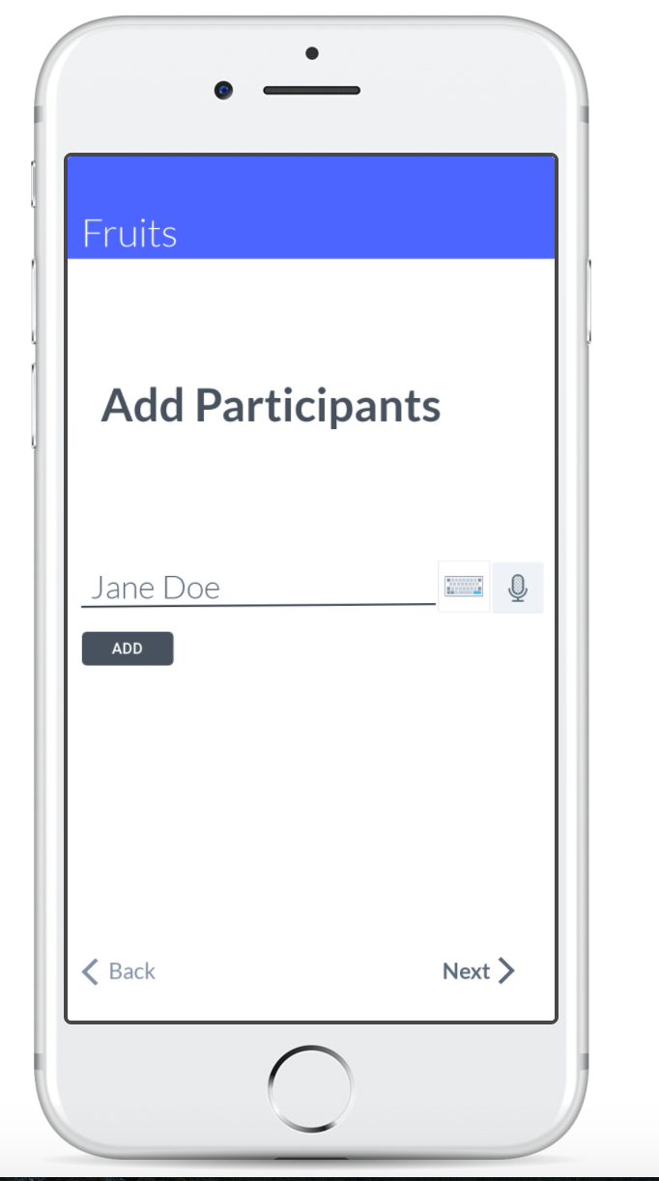
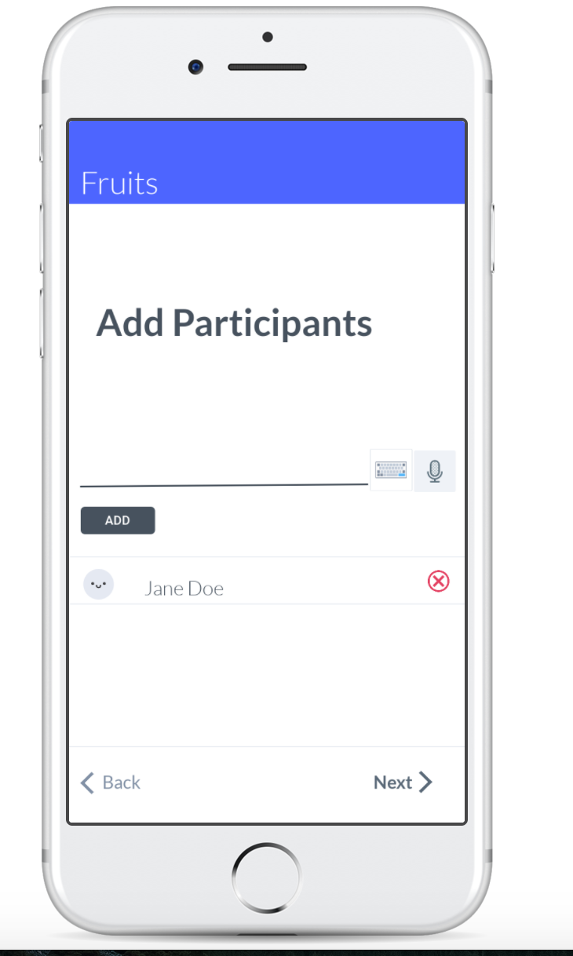
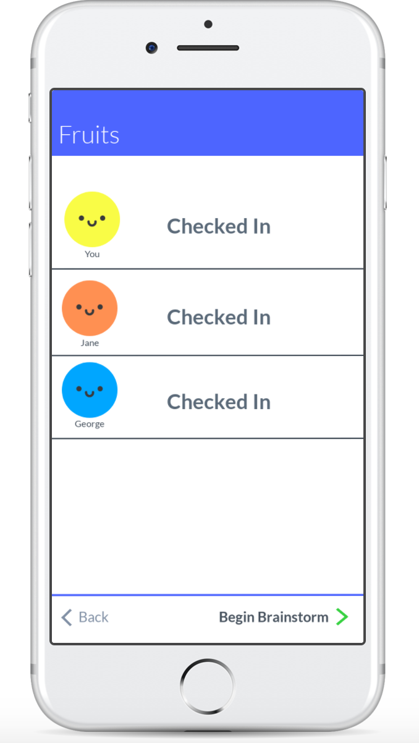
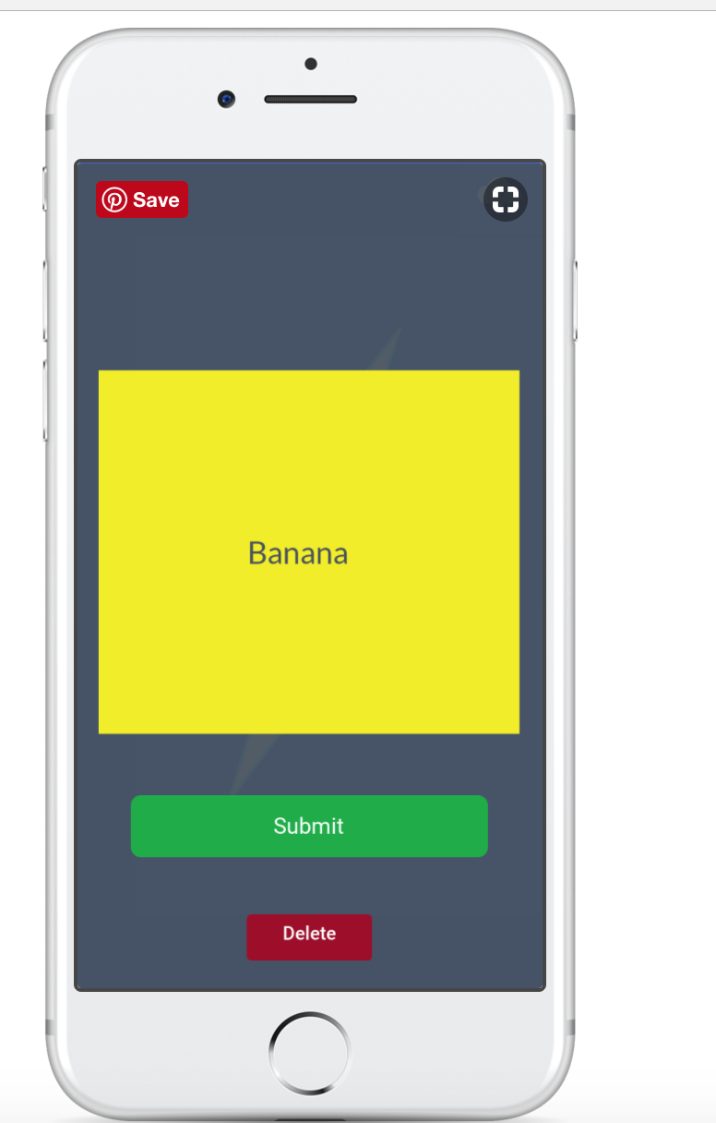
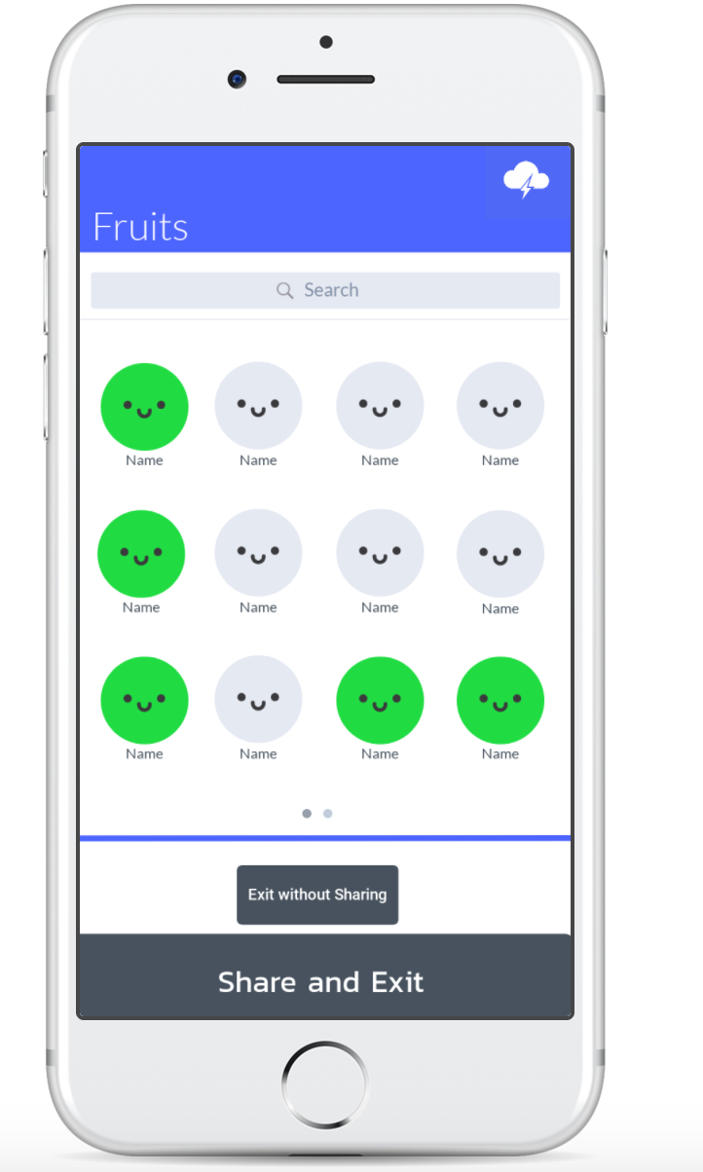
Task 1: Create and Share New Ideas (Simple)
Notes:
Instead of these pics we can use our prototpe ones

Slide 10
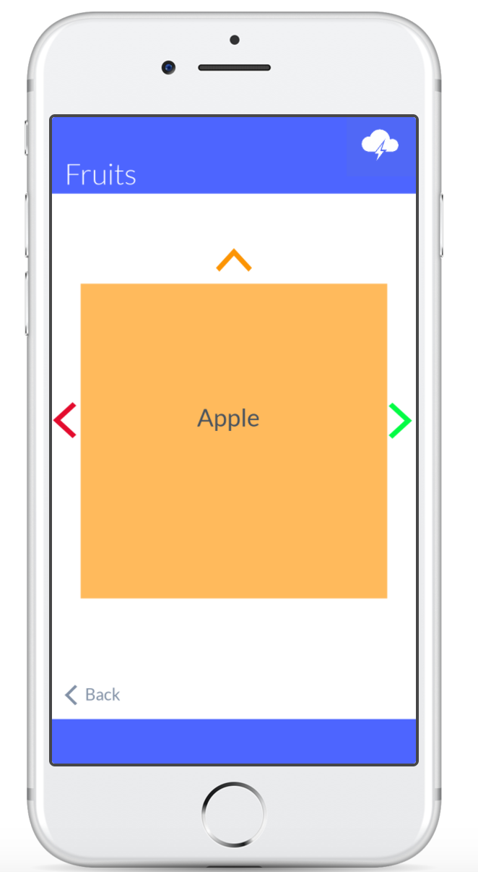
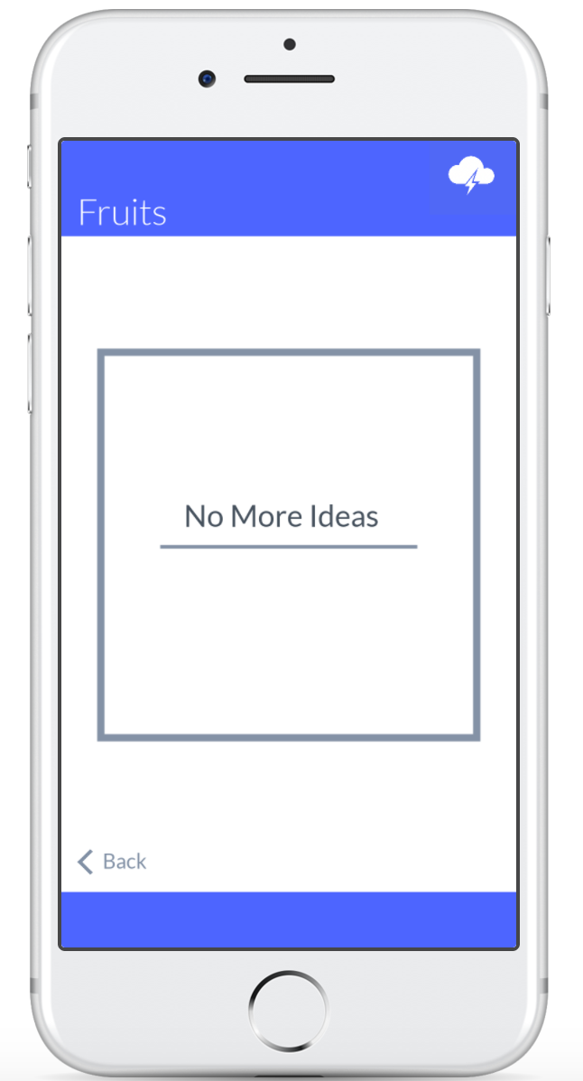
Task 2: Highlight and Present Favorite Ideas (Complex)

Slide 11
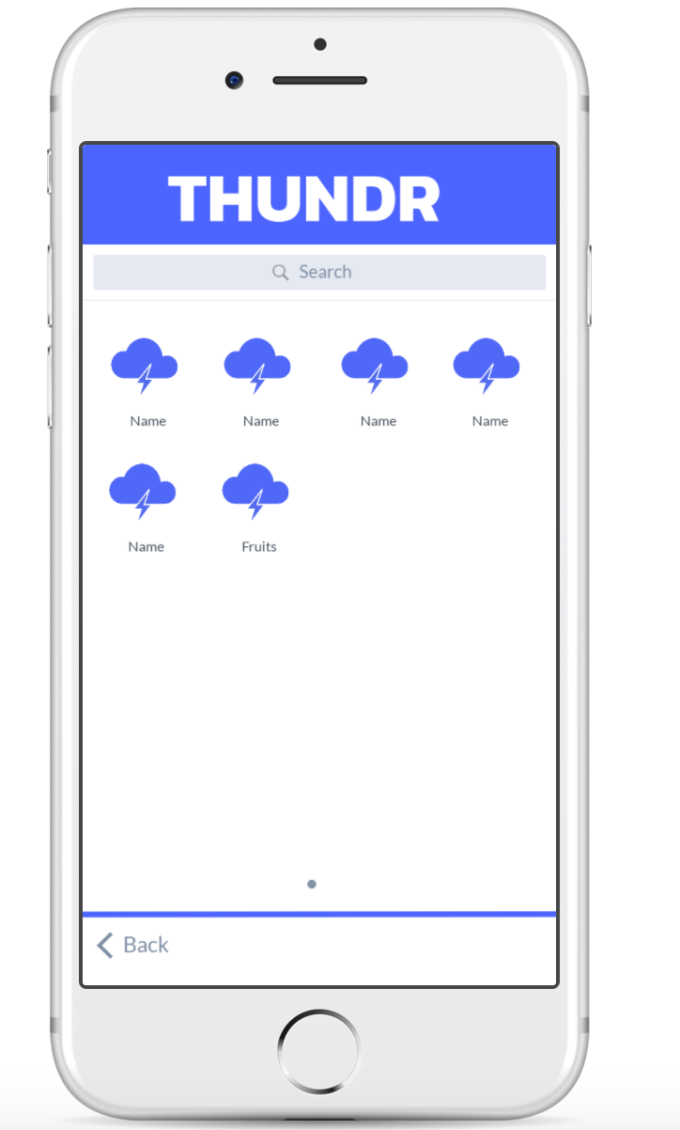
Task 3: Access old brainstorm (Medium)

Slide 12

Medium-Fi Prototype
-Used Marvel to create our new prototype
-Marvel was easy to use and allowed us to create an app we had envisioned
-It did not allow us to create a collaborative project. Only one person could work on the prototype
-It also did not allow us to use voice interaction in our prototype, creating the need for “Wizard of Oz” techniques

Slide 13
Limitations
-We could not add voice interaction to our prototype
-The trade-off to this was that Marvel was incredible intuitive and we were able to build the prototype that we had envisioned

Slide 14
Wizard of Oz Techniques/Hard Coded Features
-Because we could not use voice interaction, we used “Wizard of Oz” techniques on our prototype
-We hard-coded brainstorm ideas onto our prototype so that a user could see that when they perform actions such as “Swap Screen”, it will show them what the interface will look like
-We hard-coded data such as the user’s name, brainstorming partners, and title

