Slide 1
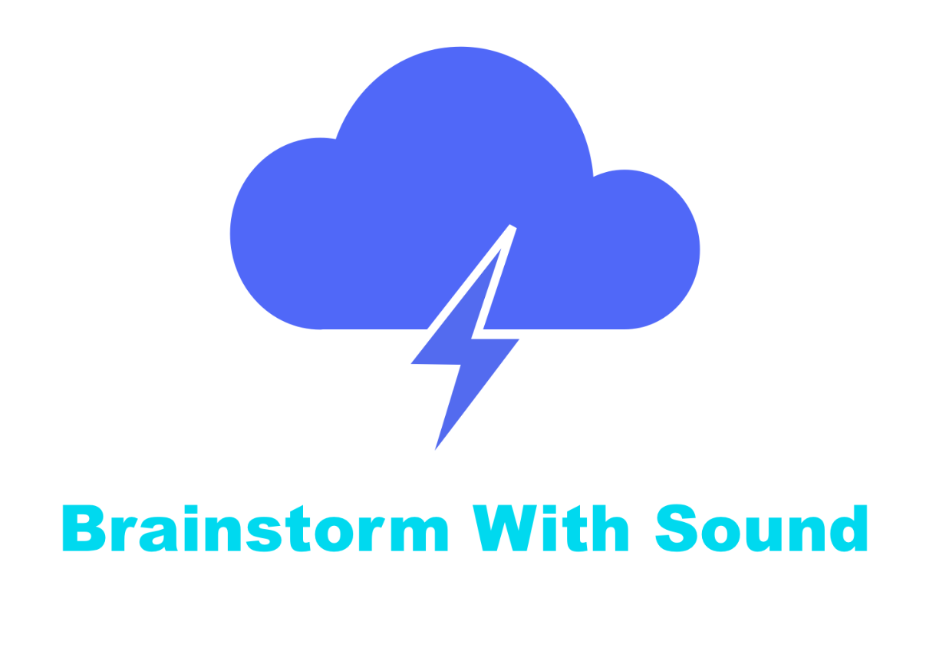
Low-fi Prototyping & Pilot Usability Testing
Thundr

Slide 2
Overview
Mission
&
Interface
Prototype
&
Task
Testing
&
Results

Slide 3

Mission Statement
Brainstorm With Sound
Notes:
Thundr will increase productivity by freeing everyone to brainstorm naturally, through speaking, not writing their ideas down, and will display a real time visual the whole time.

Slide 4
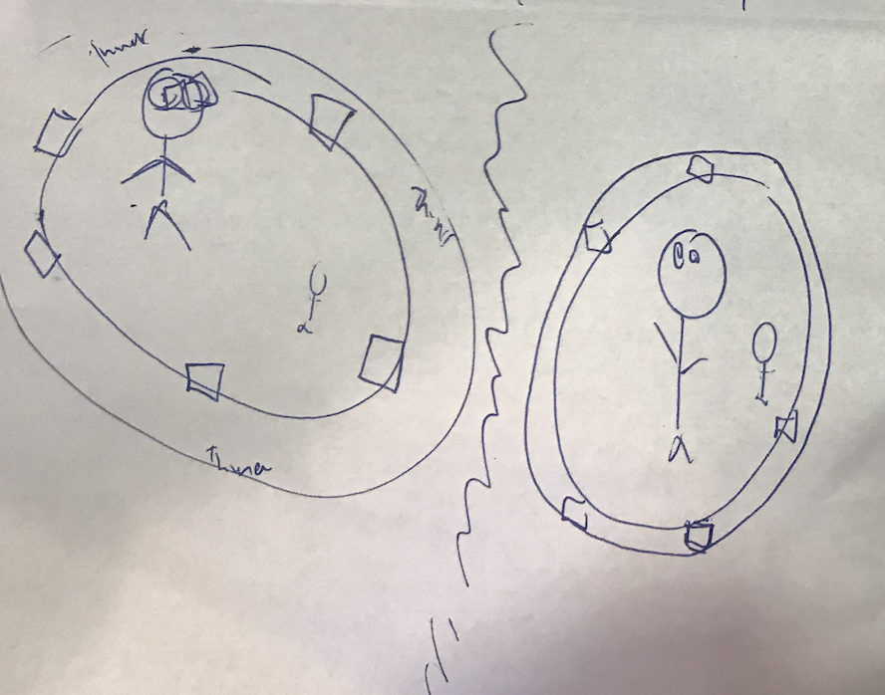
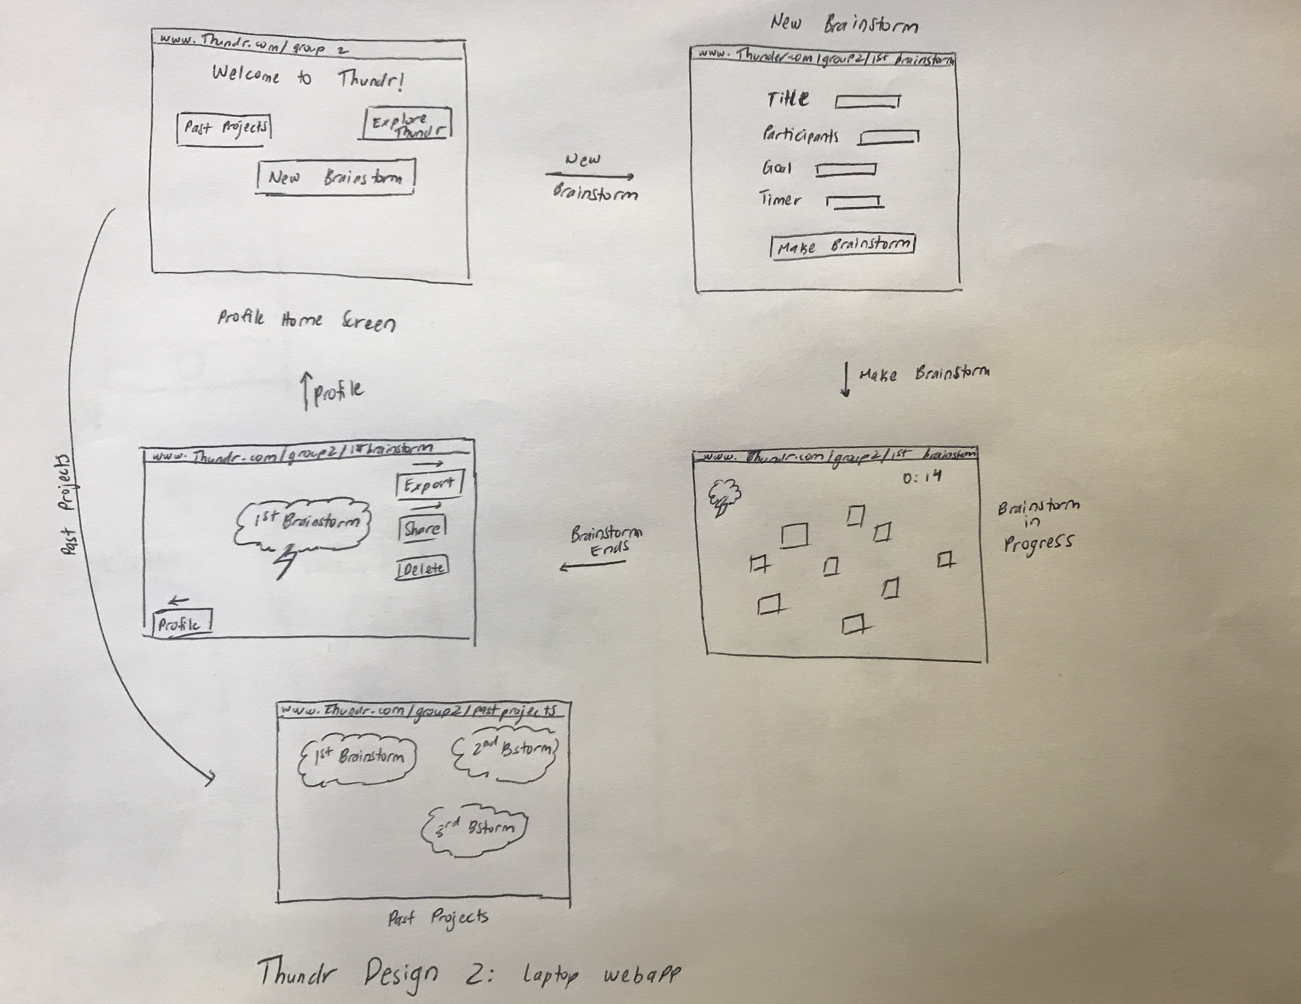
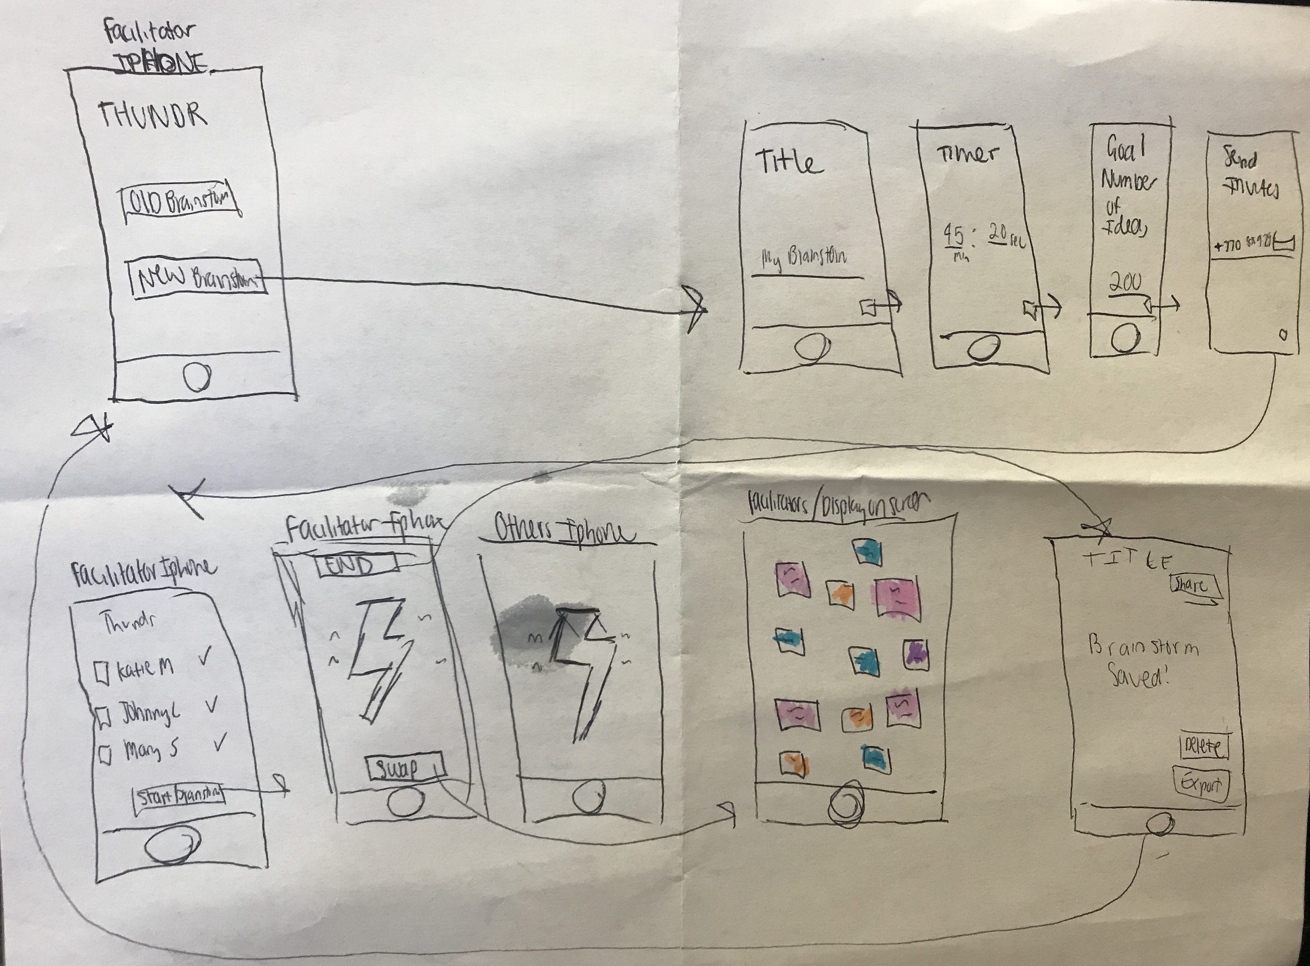
Interface?
IOS Application
Web Application
Virtual Reality

Slide 5
IOS Application!

Slide 6
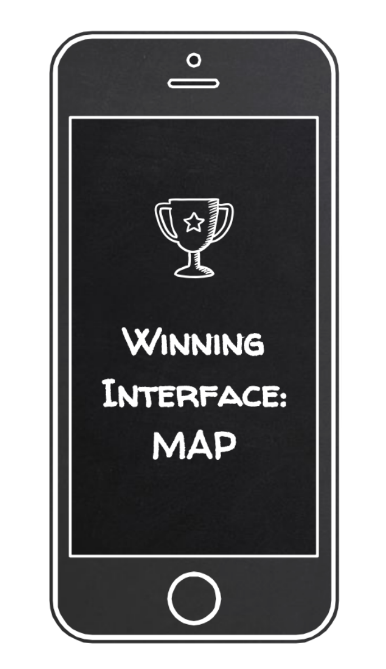
IOS Application
Everyone speaks into phones, allowing them to move around during brainstorm
People can commit full attention to the brainstorming process

Slide 7
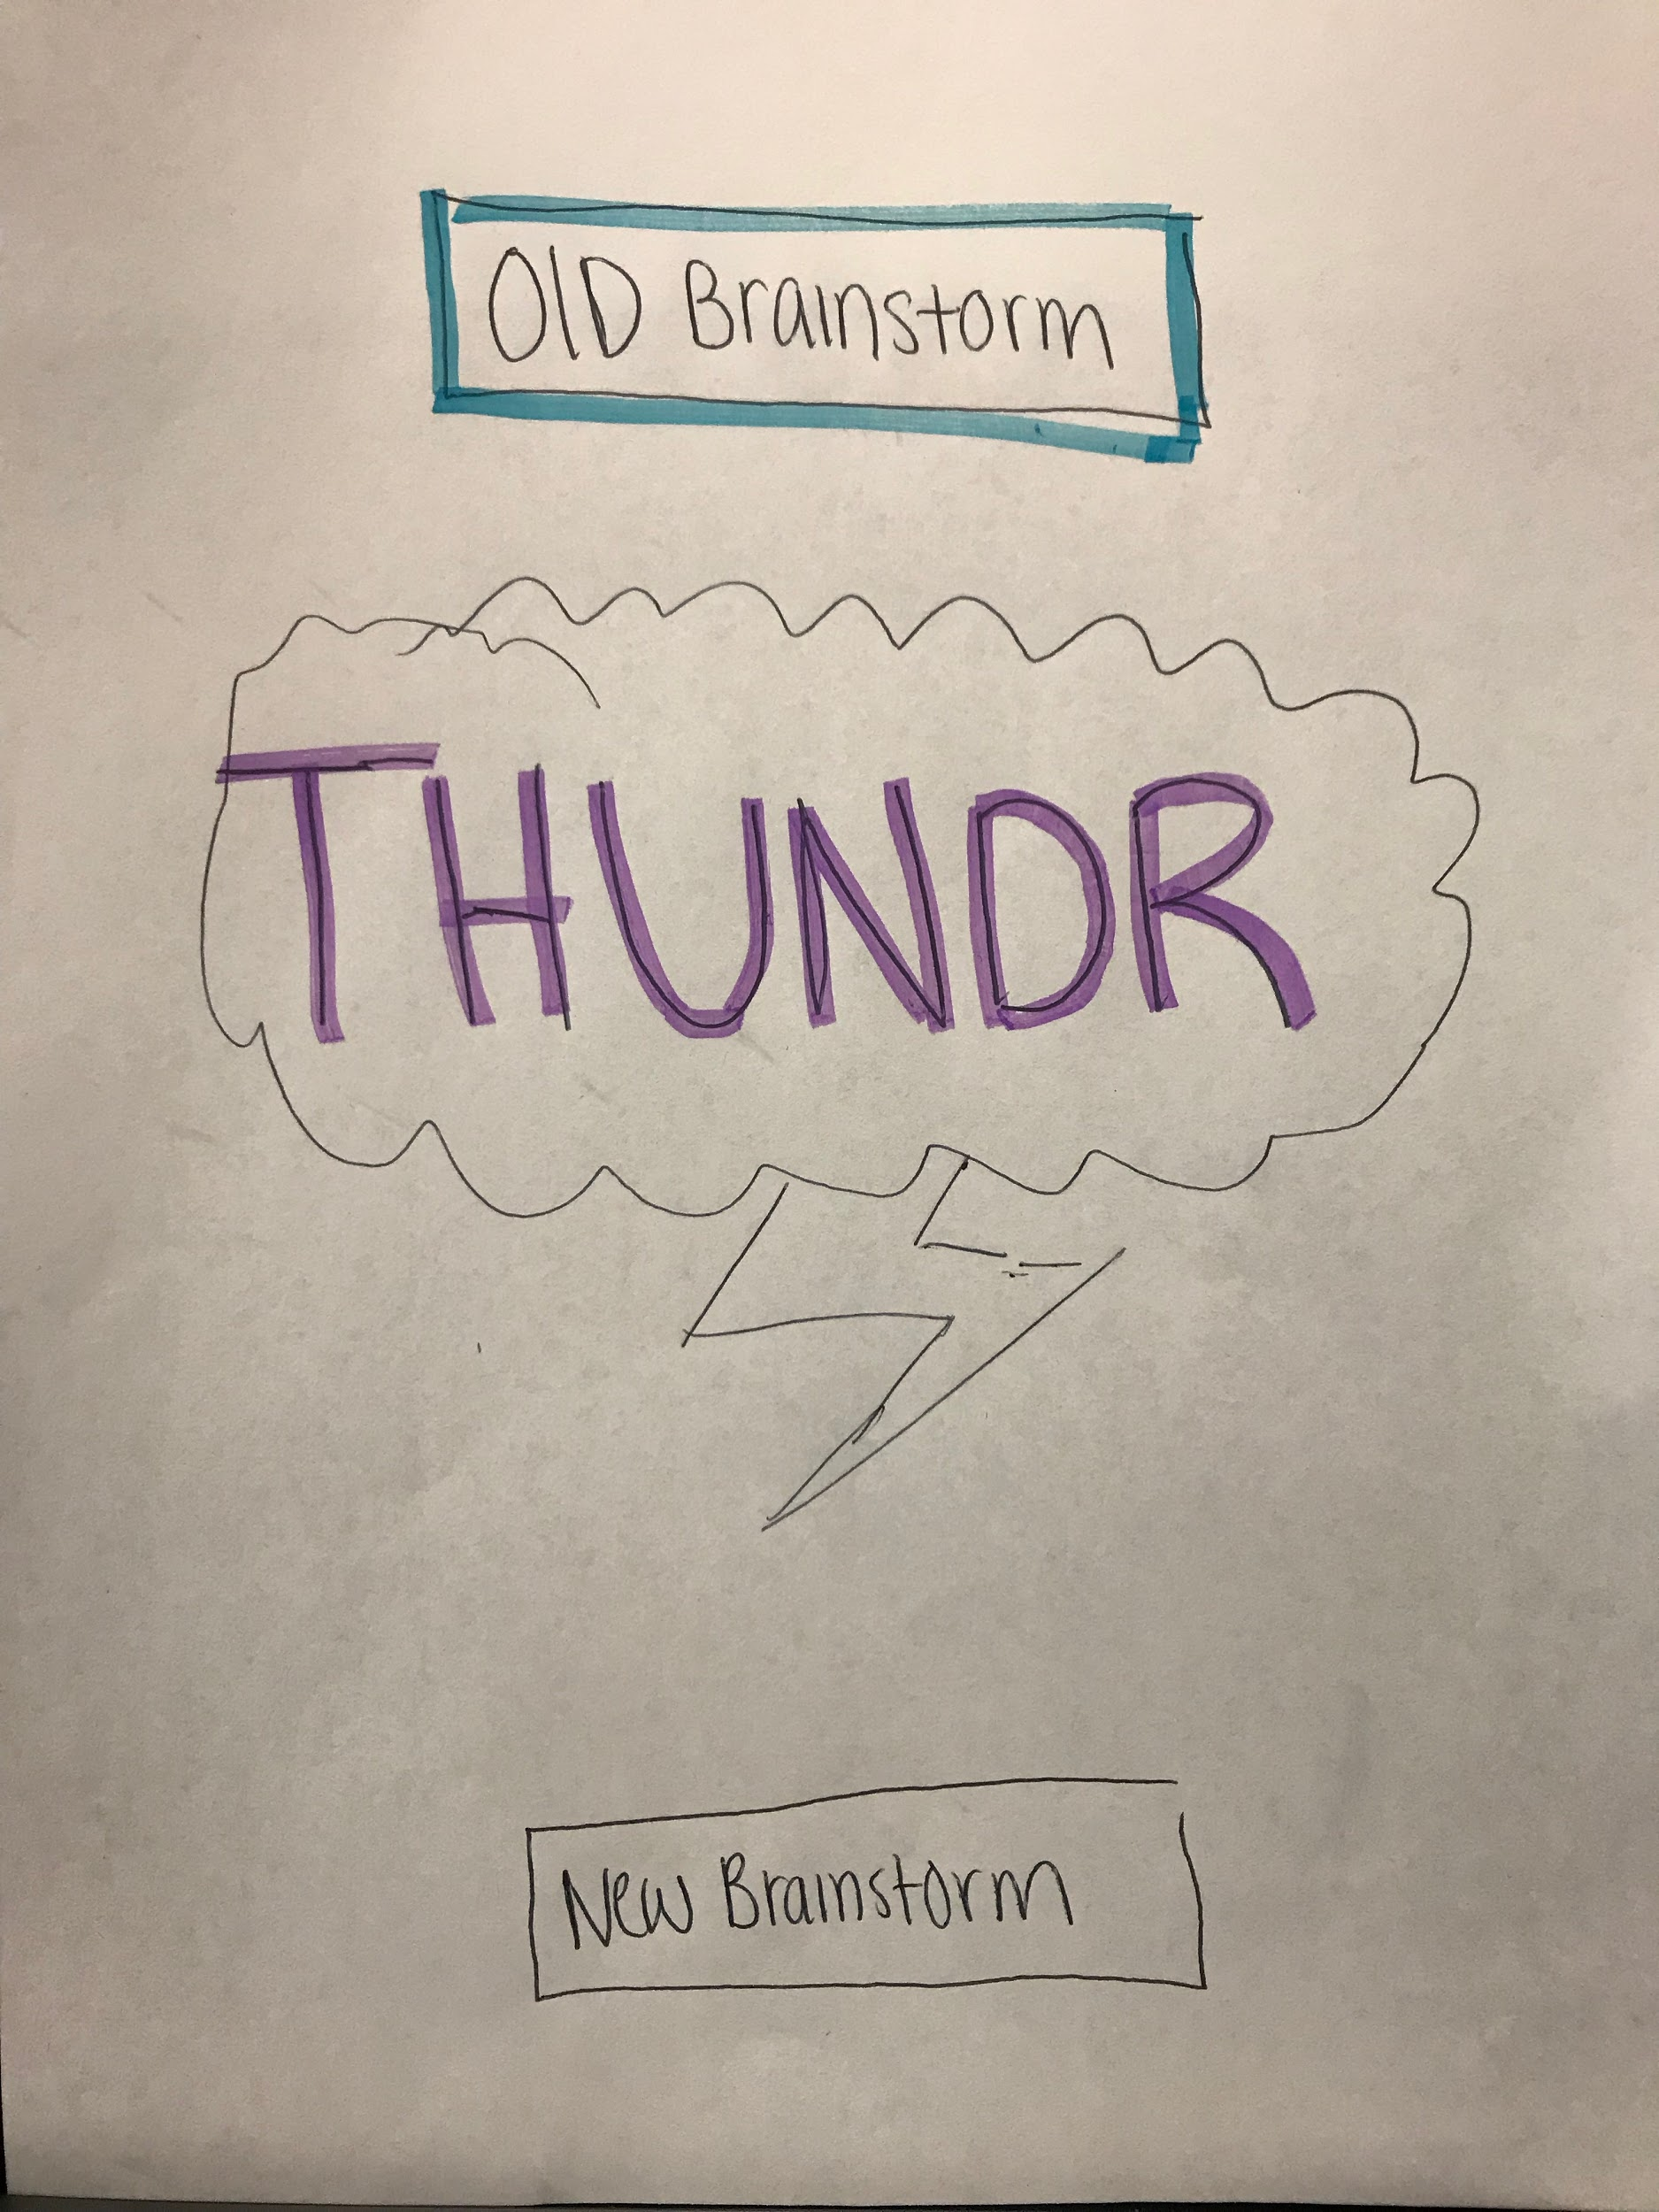
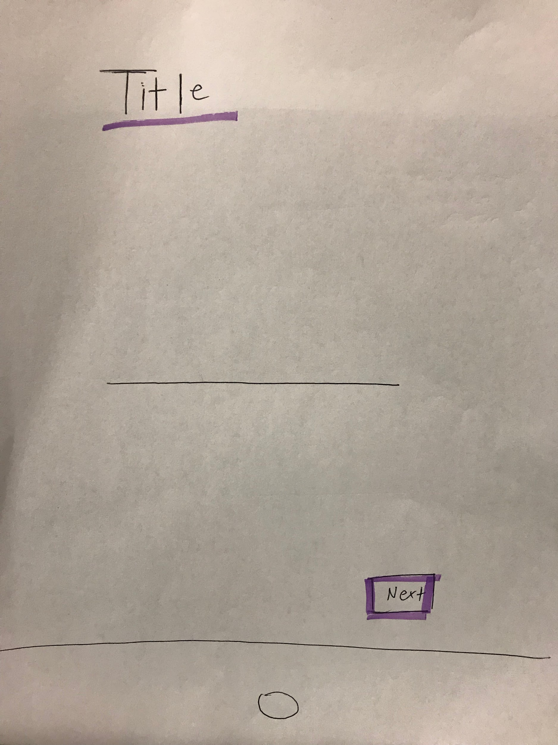
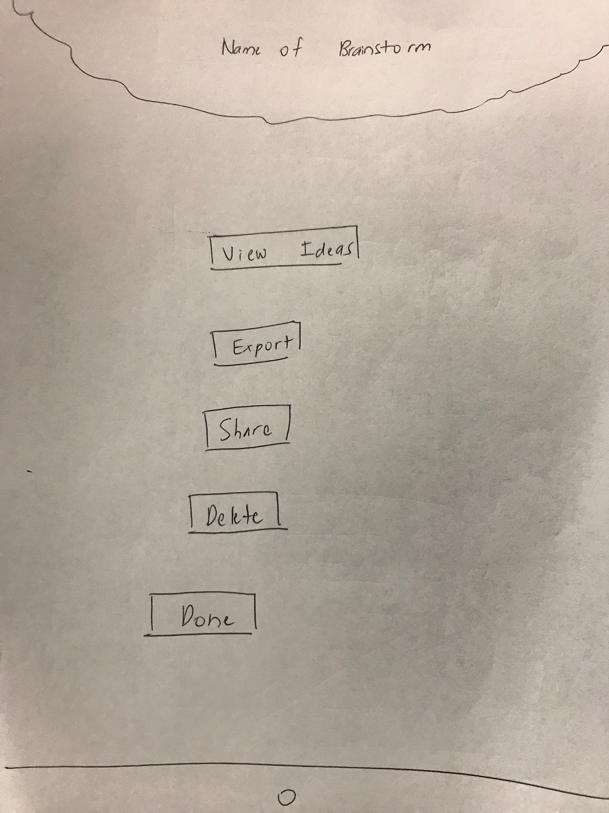
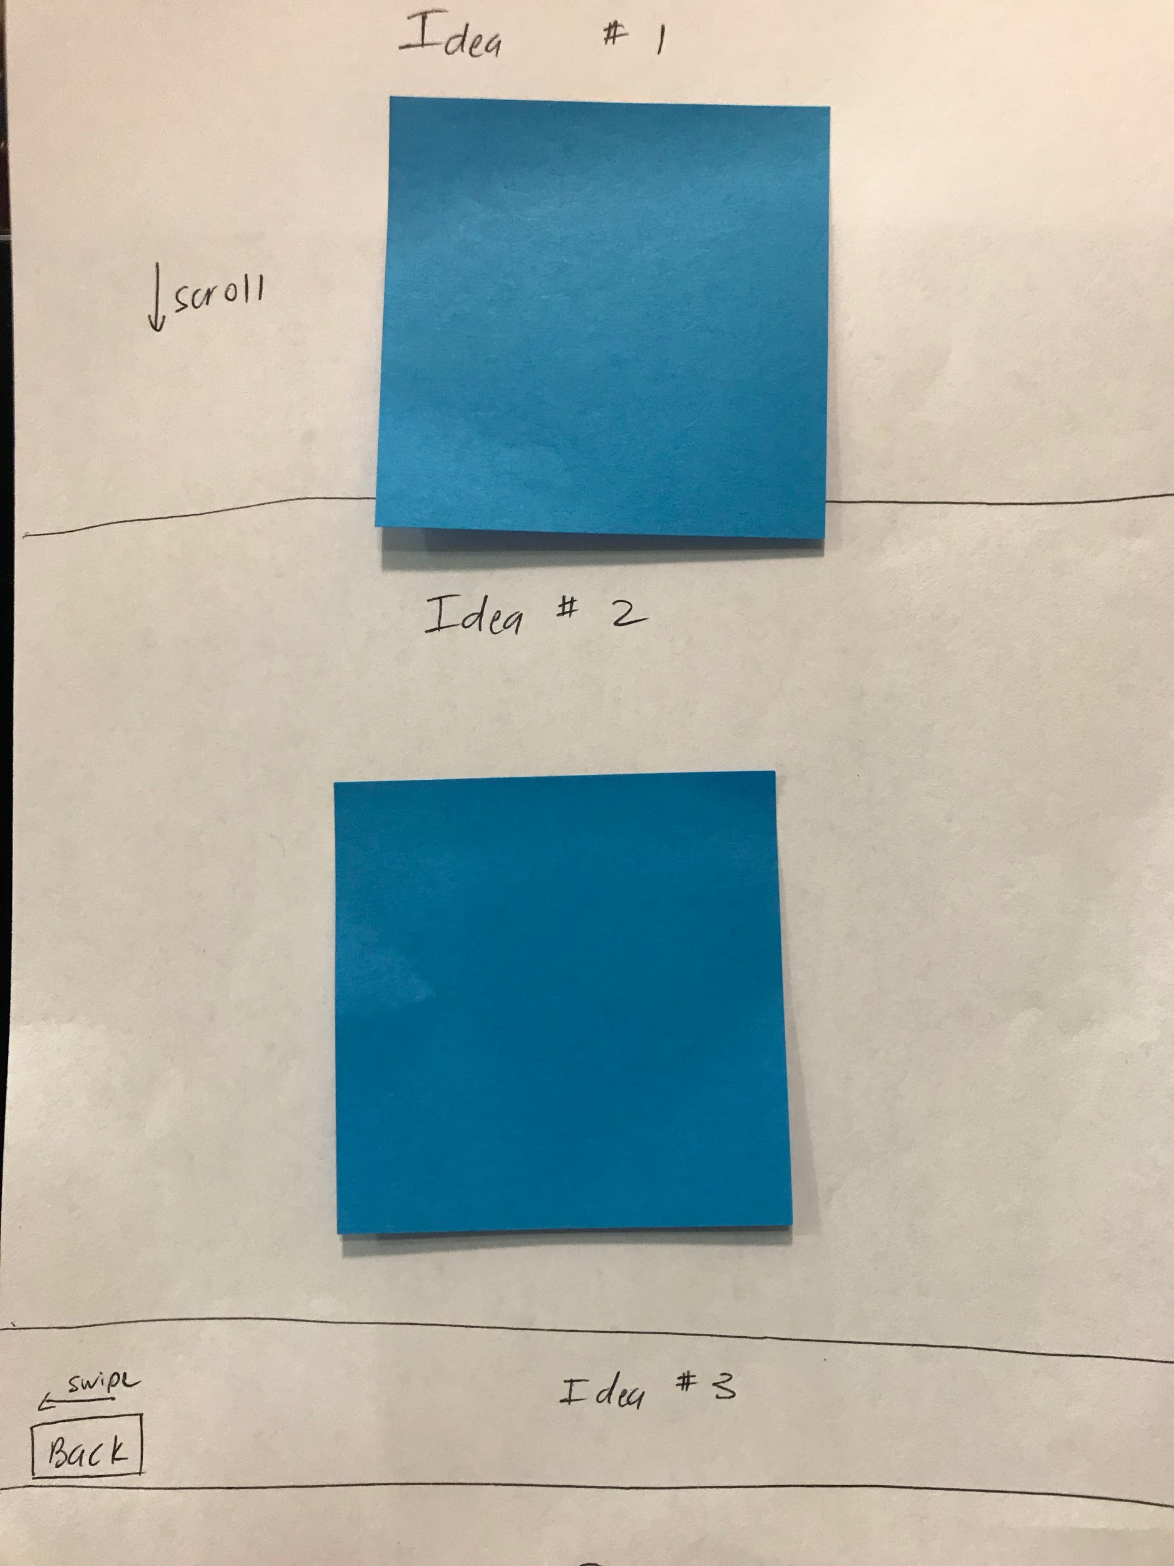
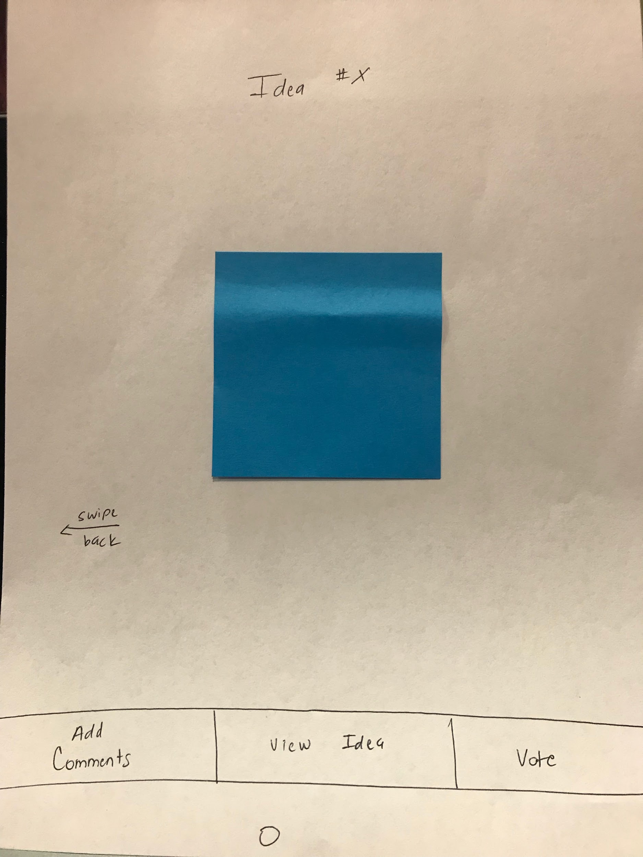
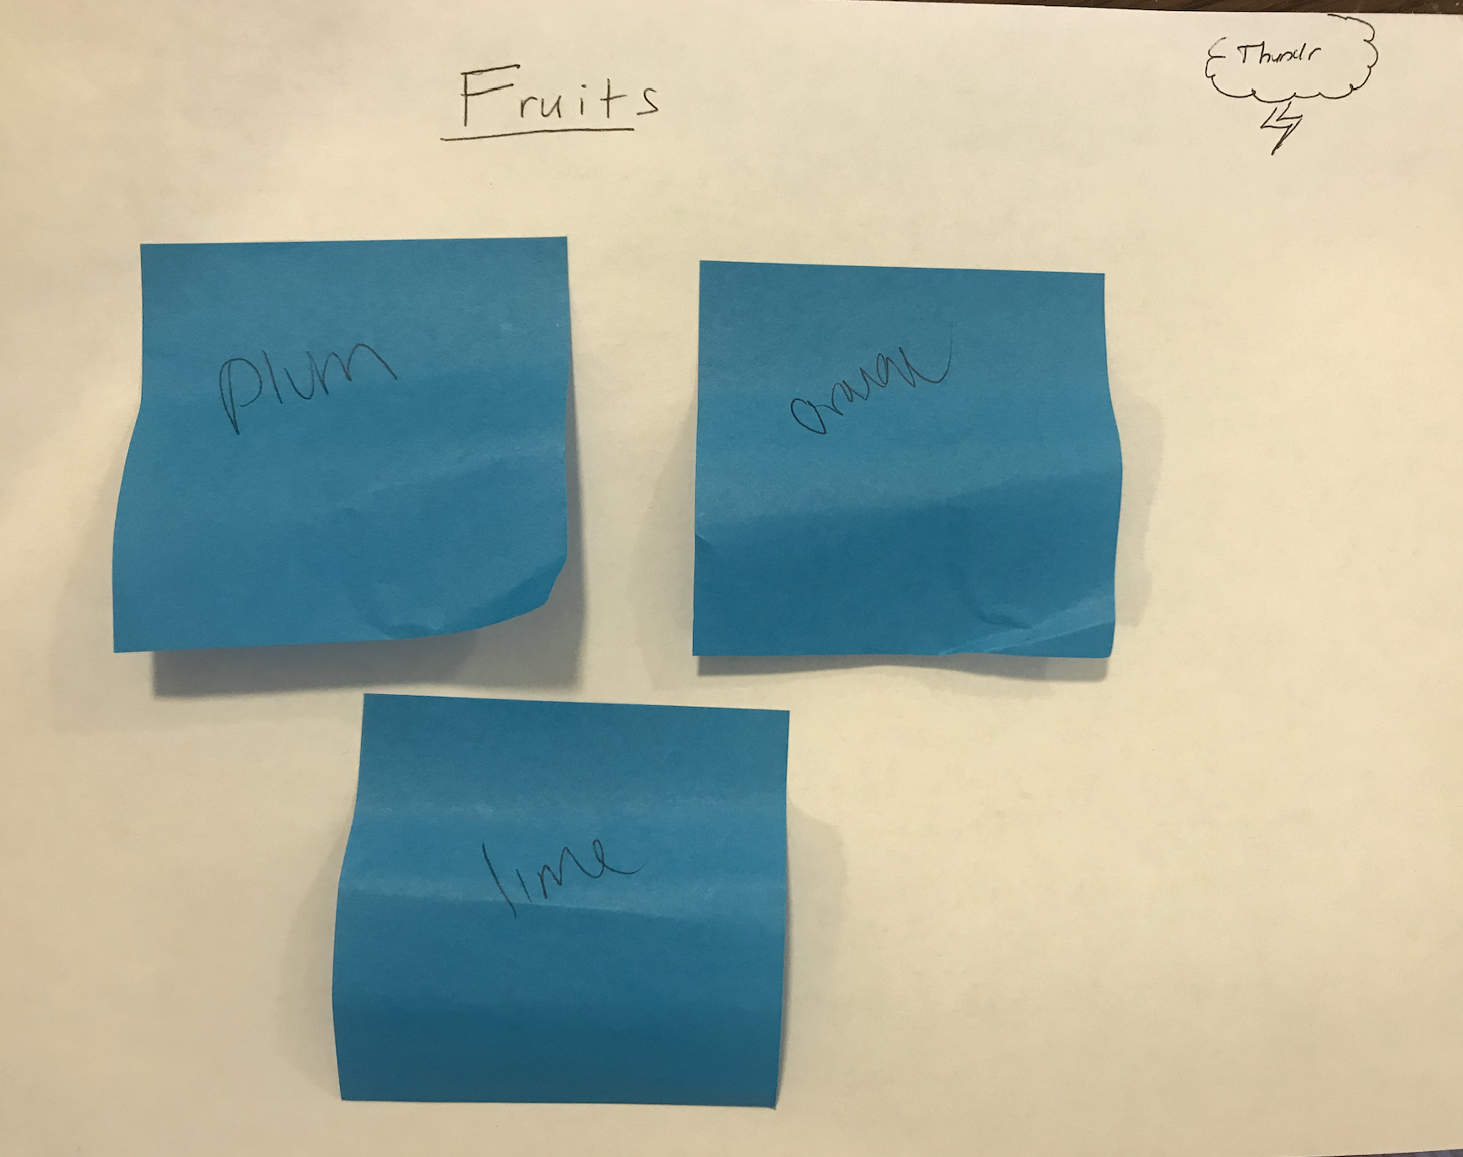
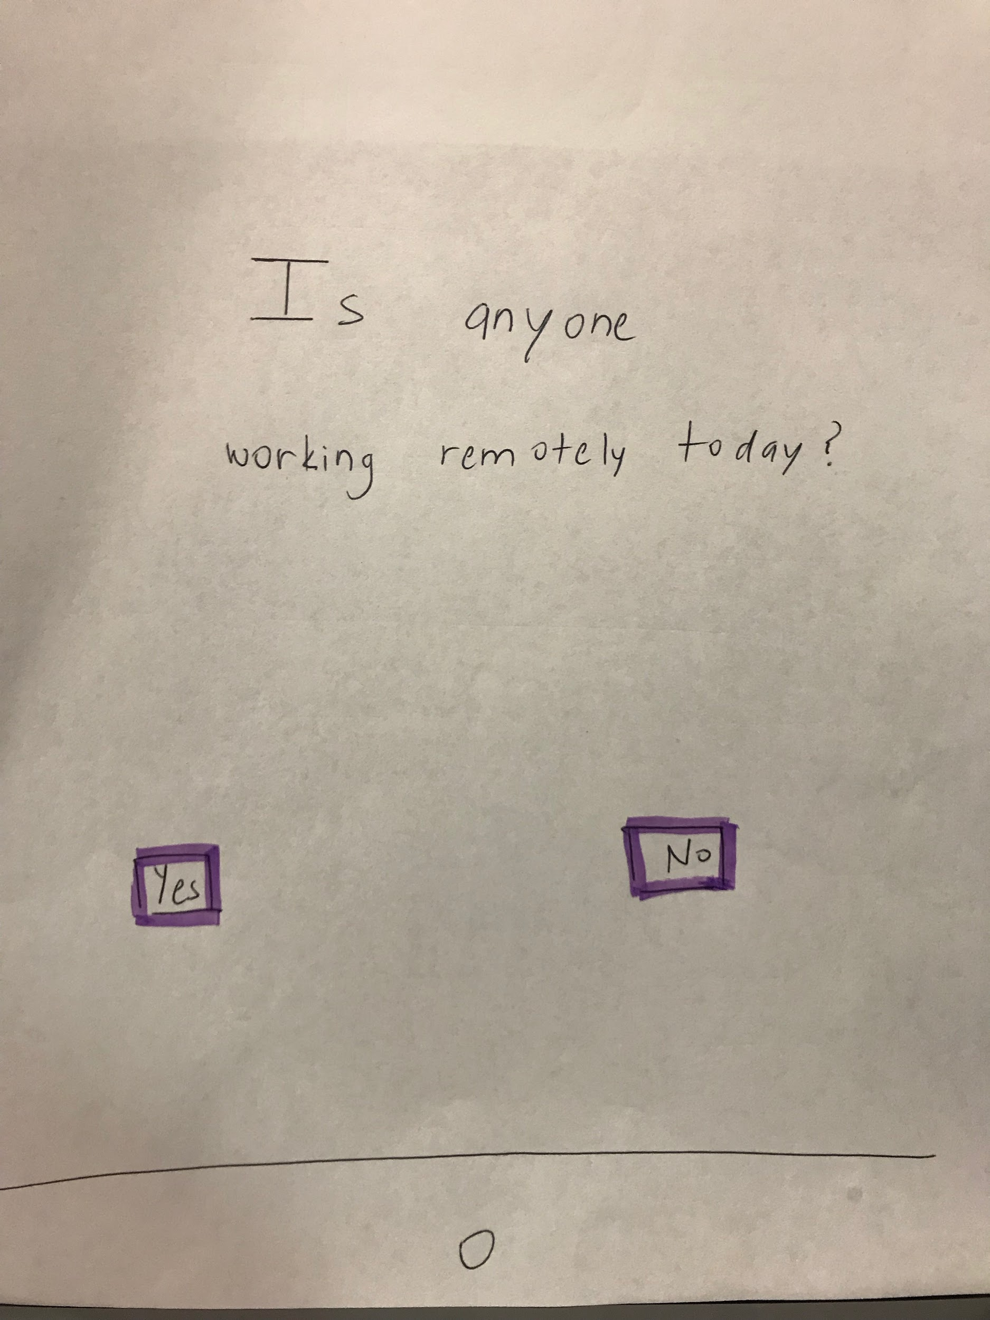
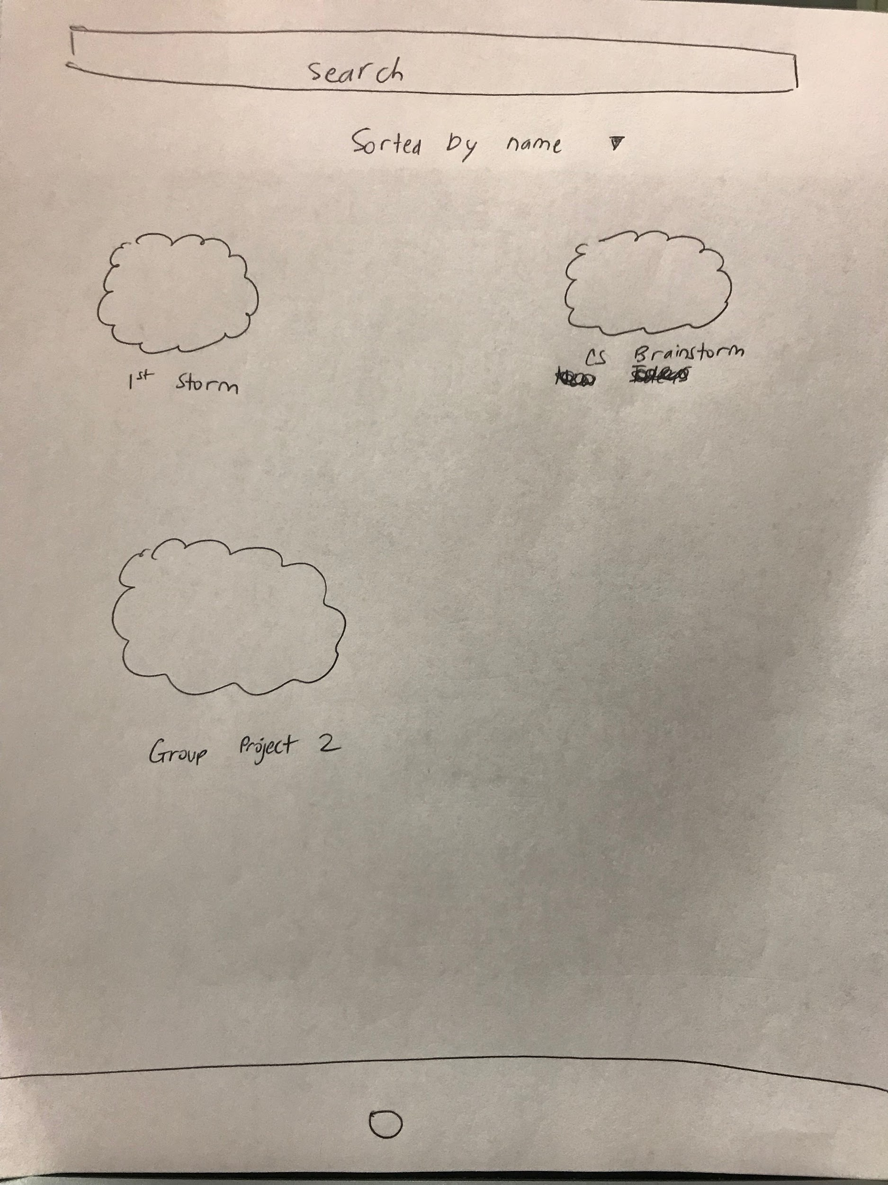
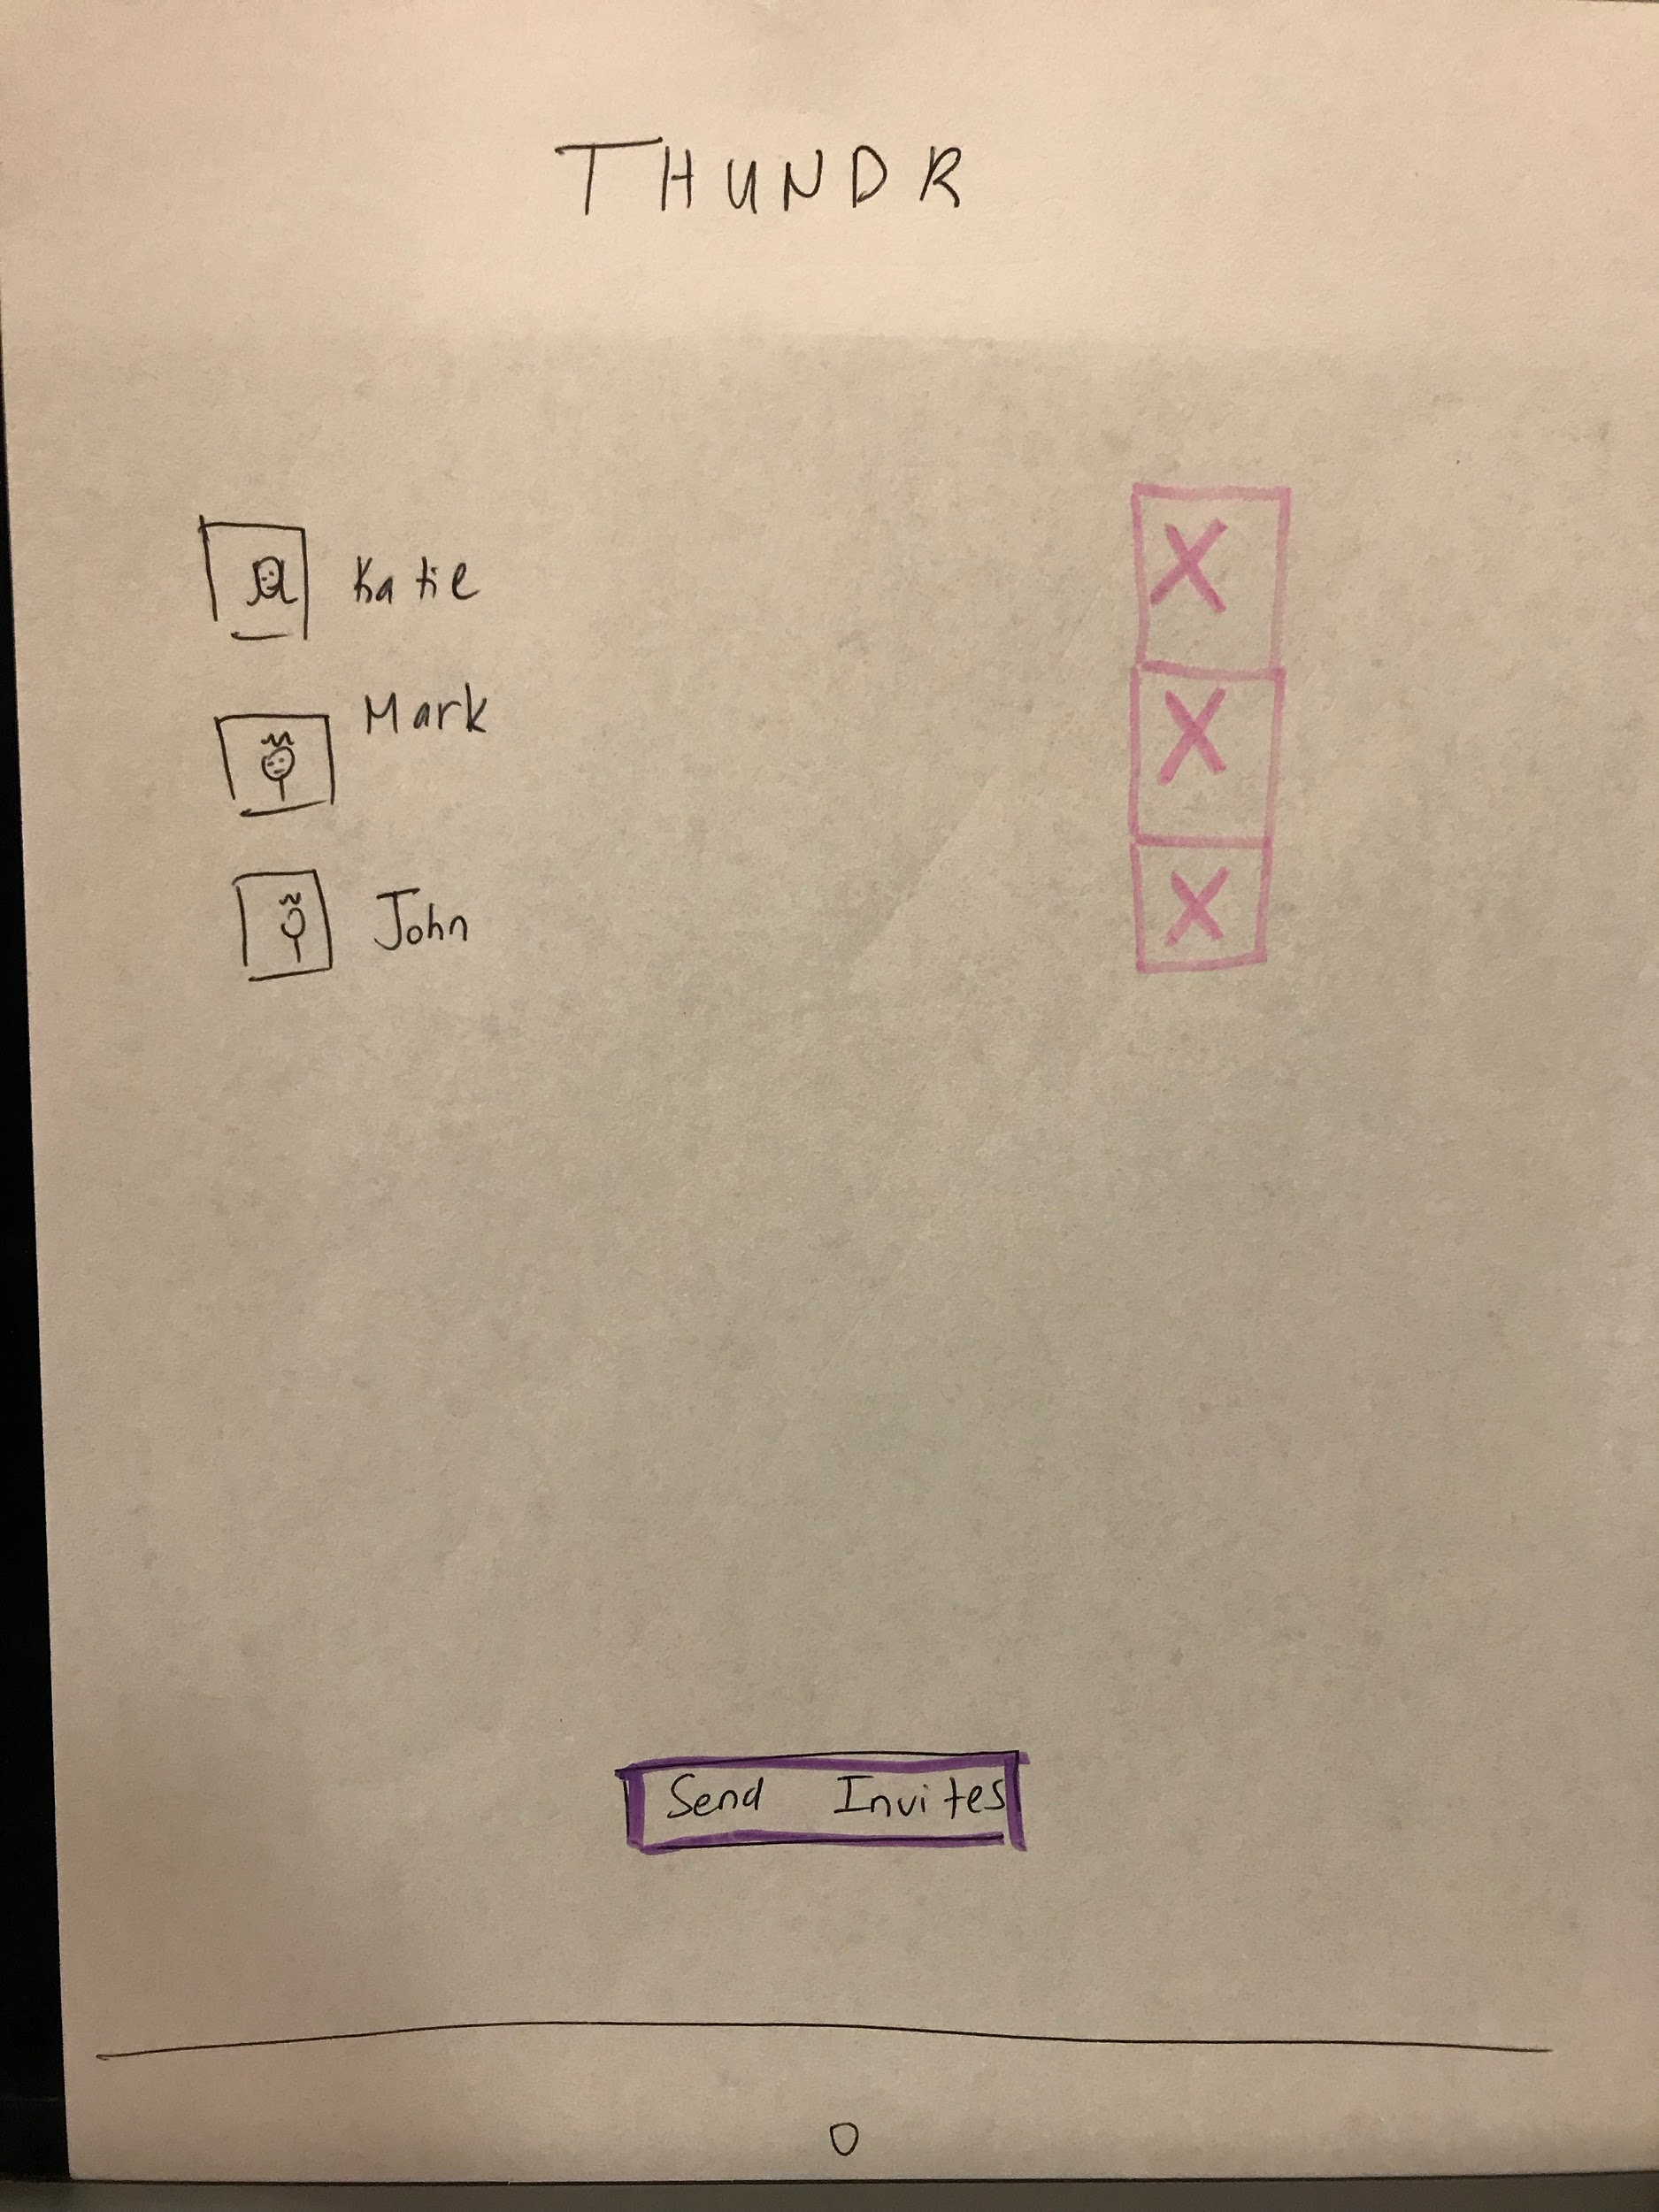
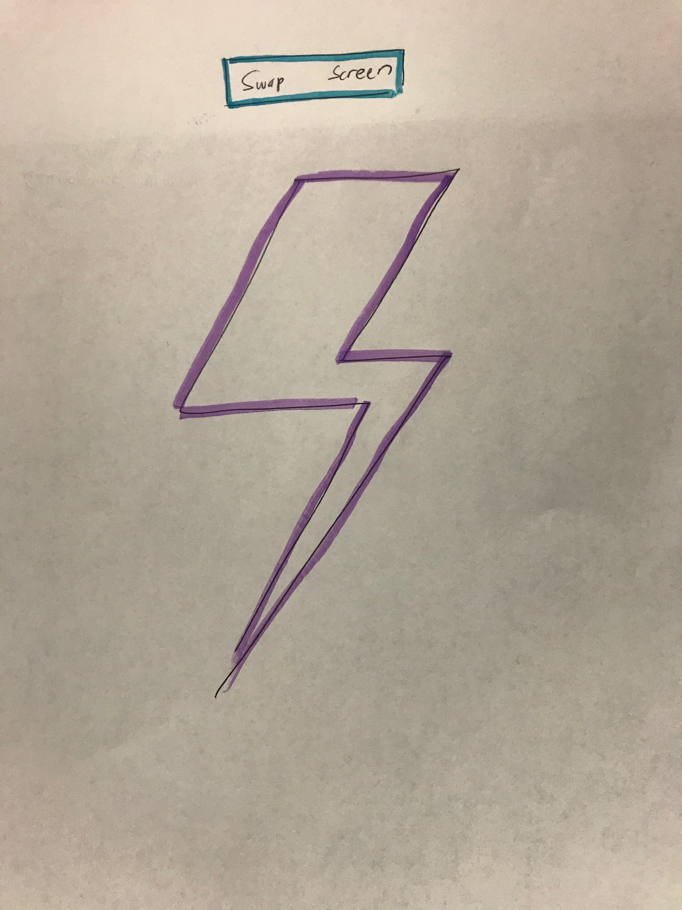
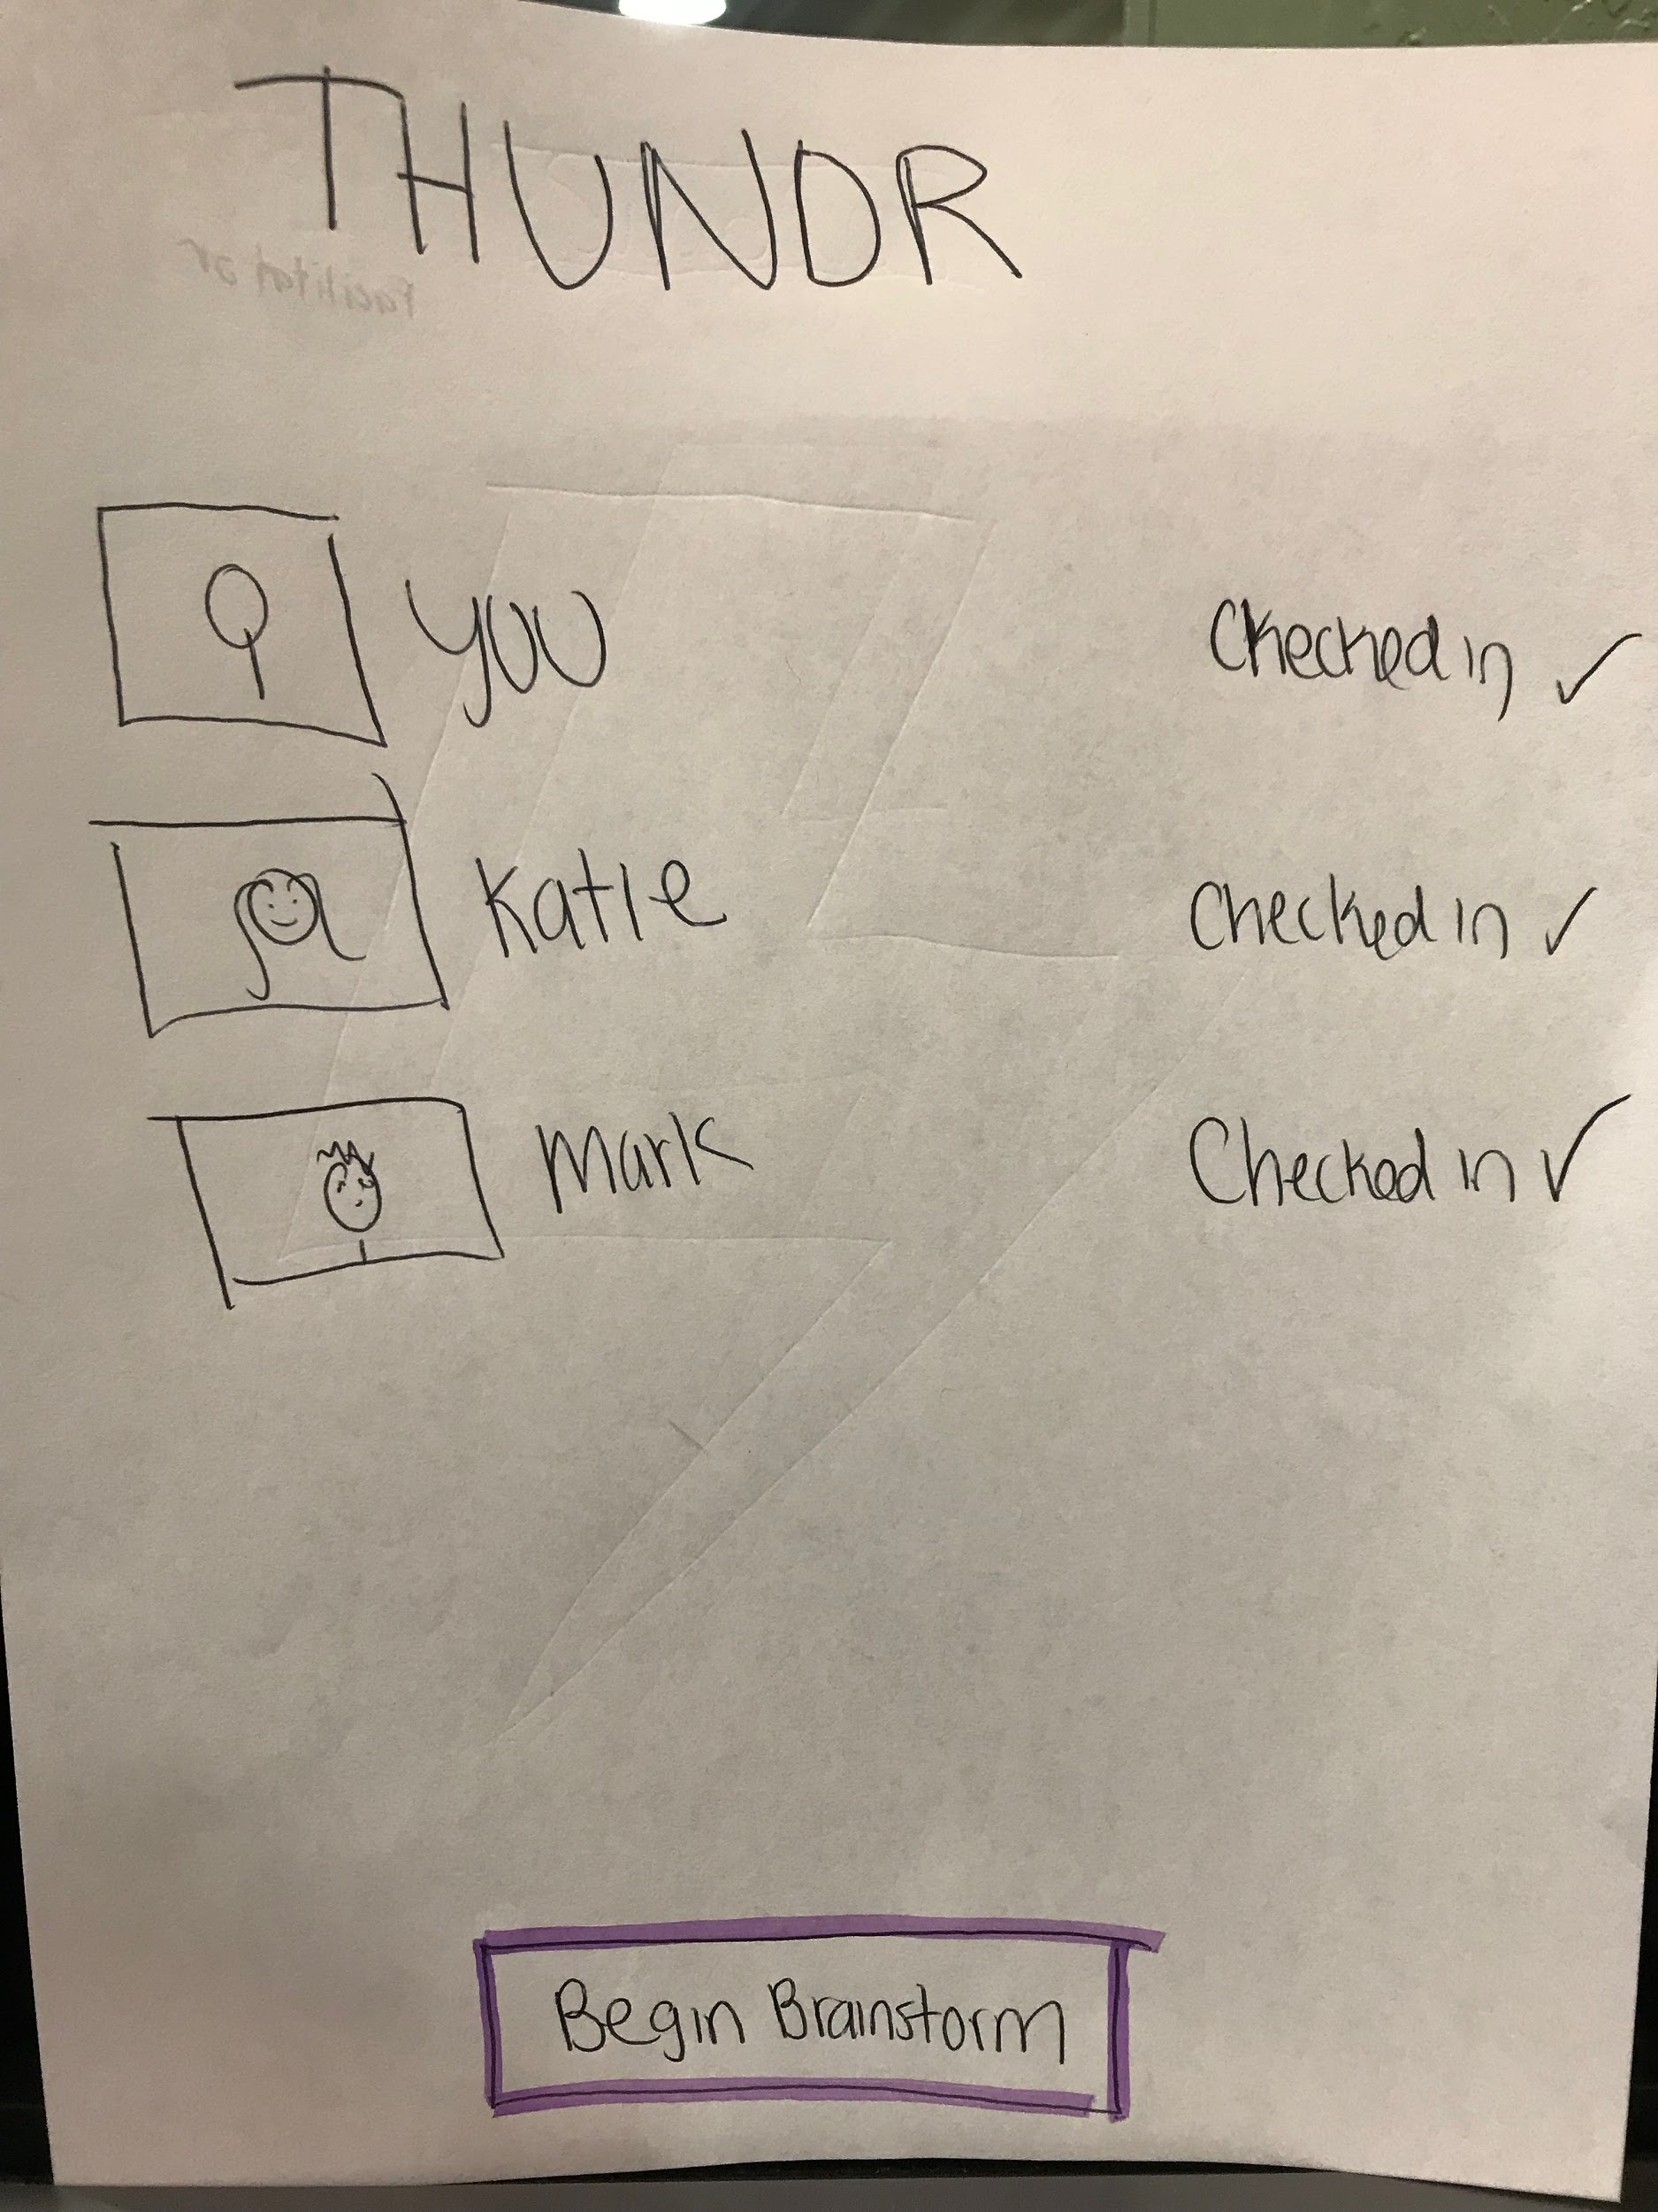
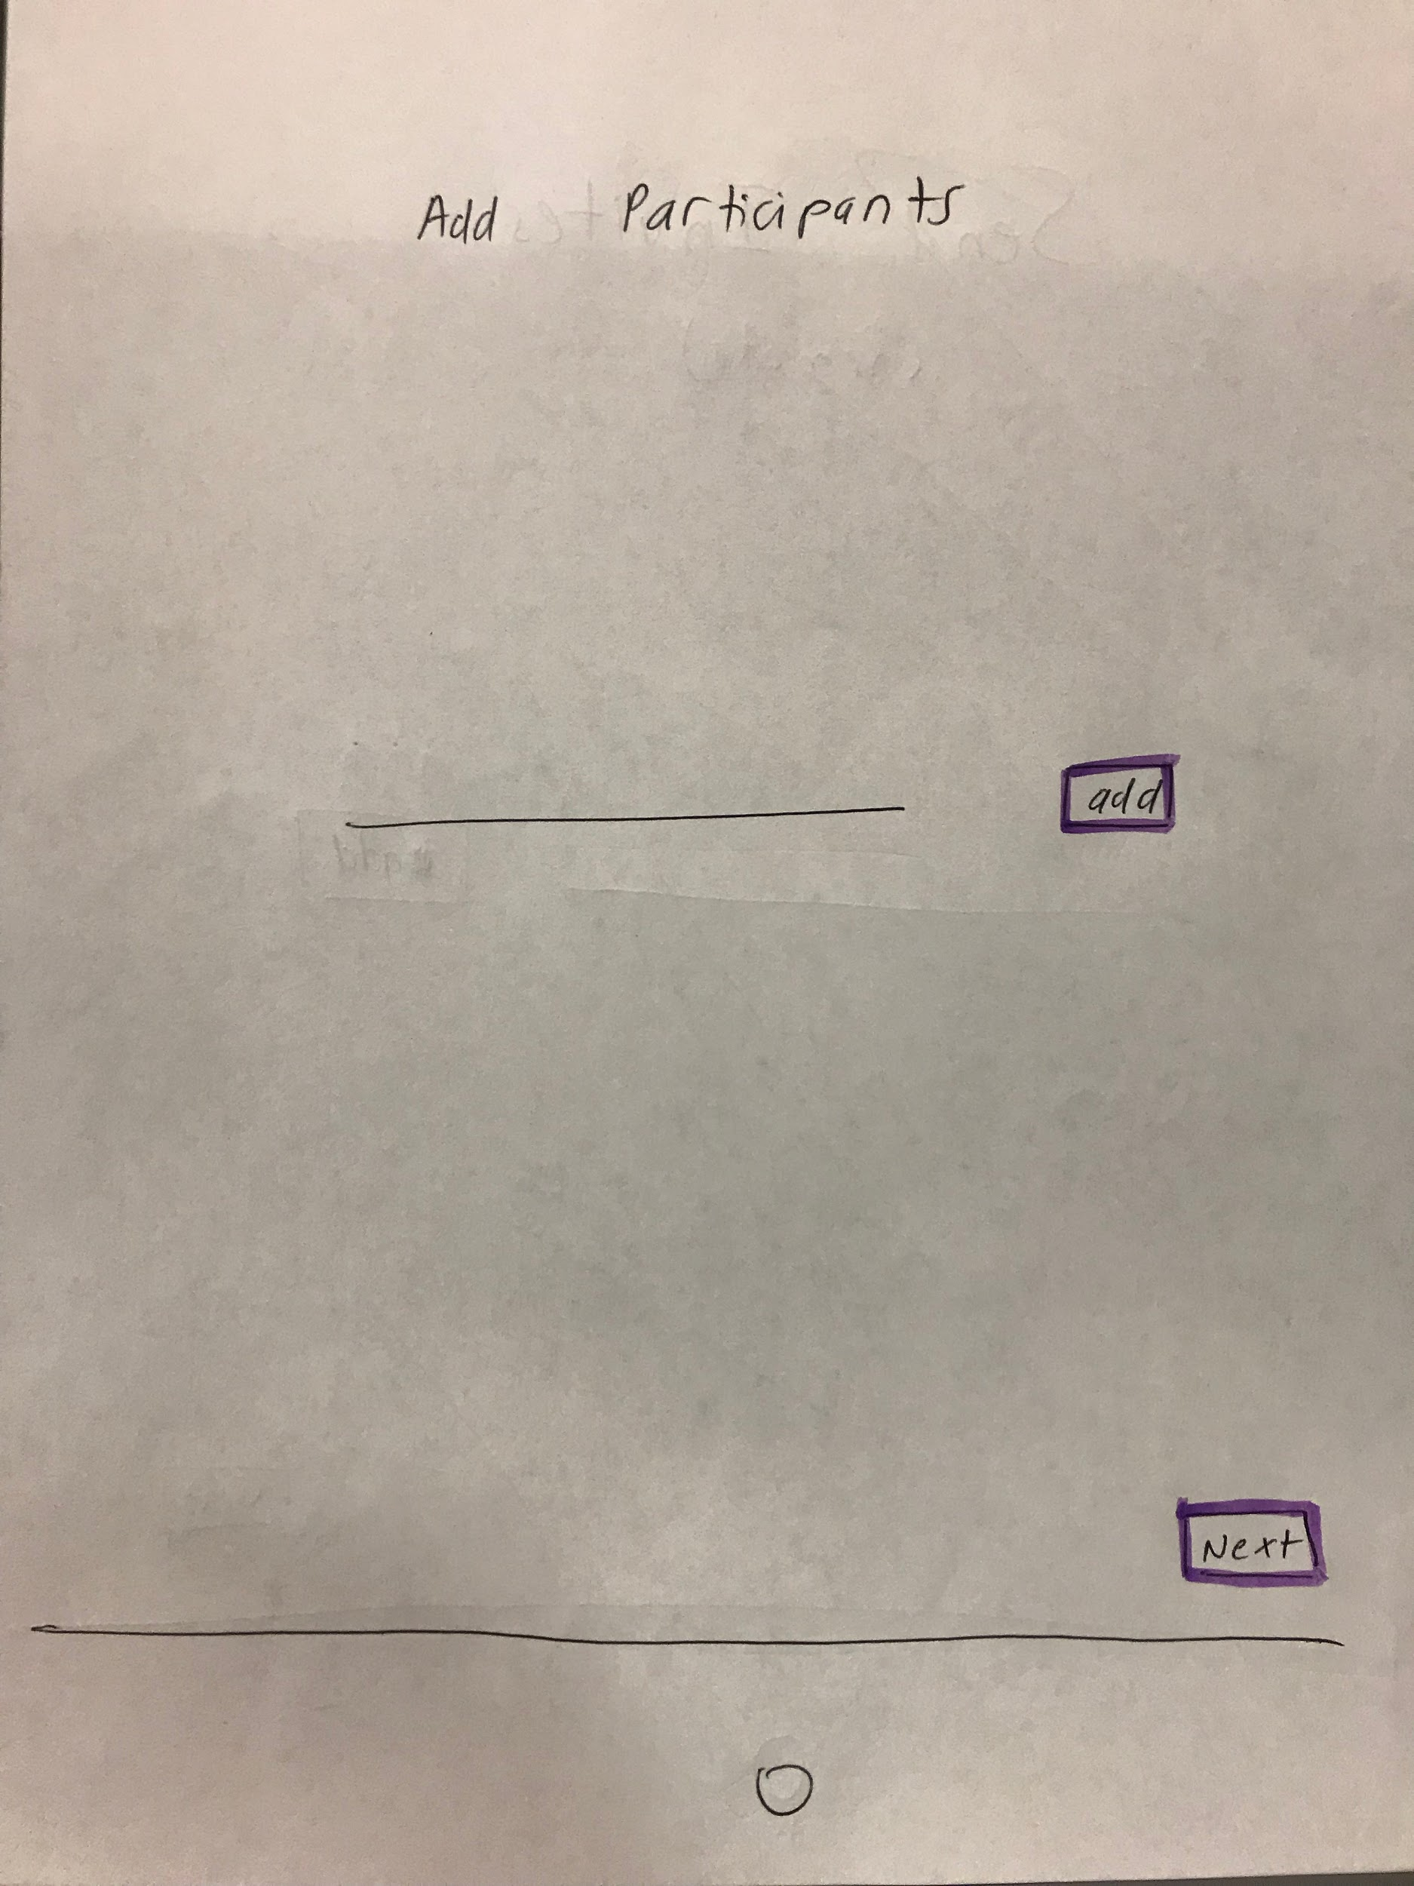
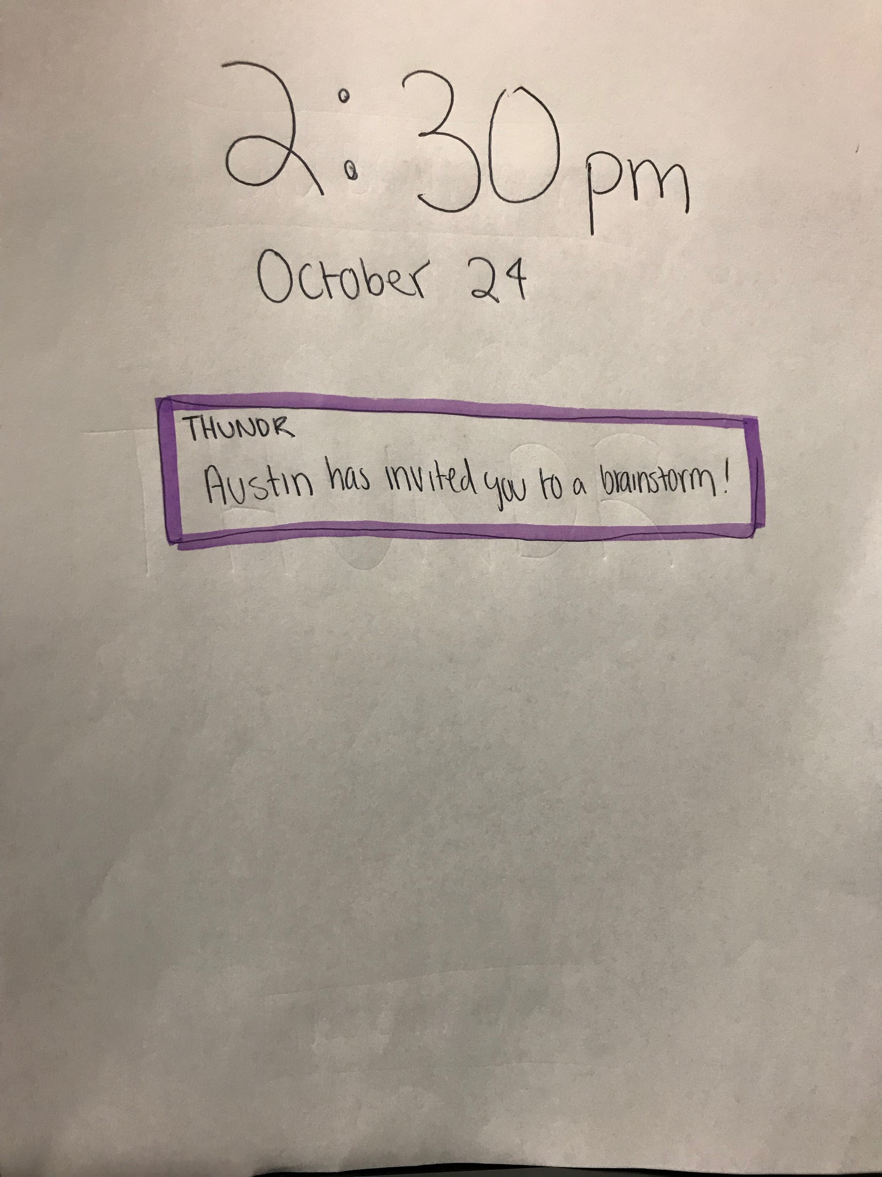
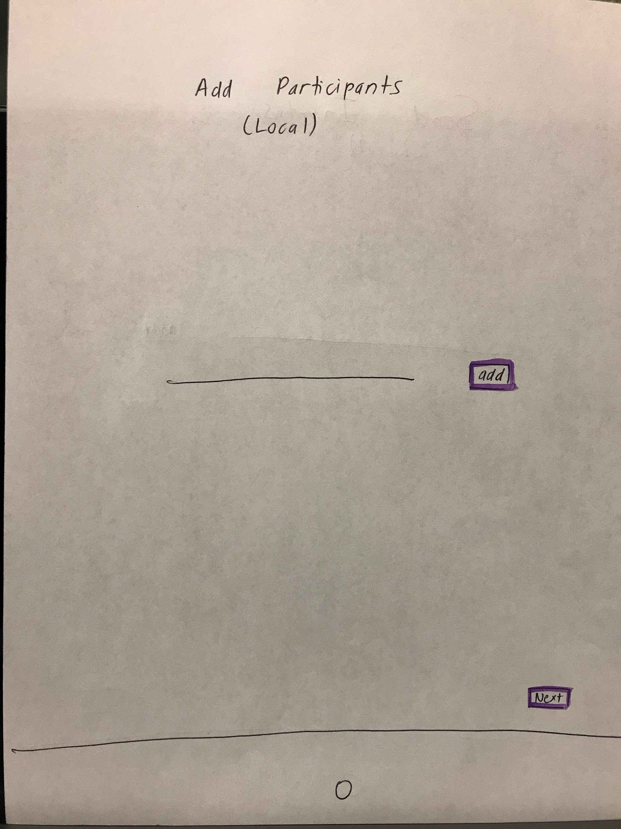
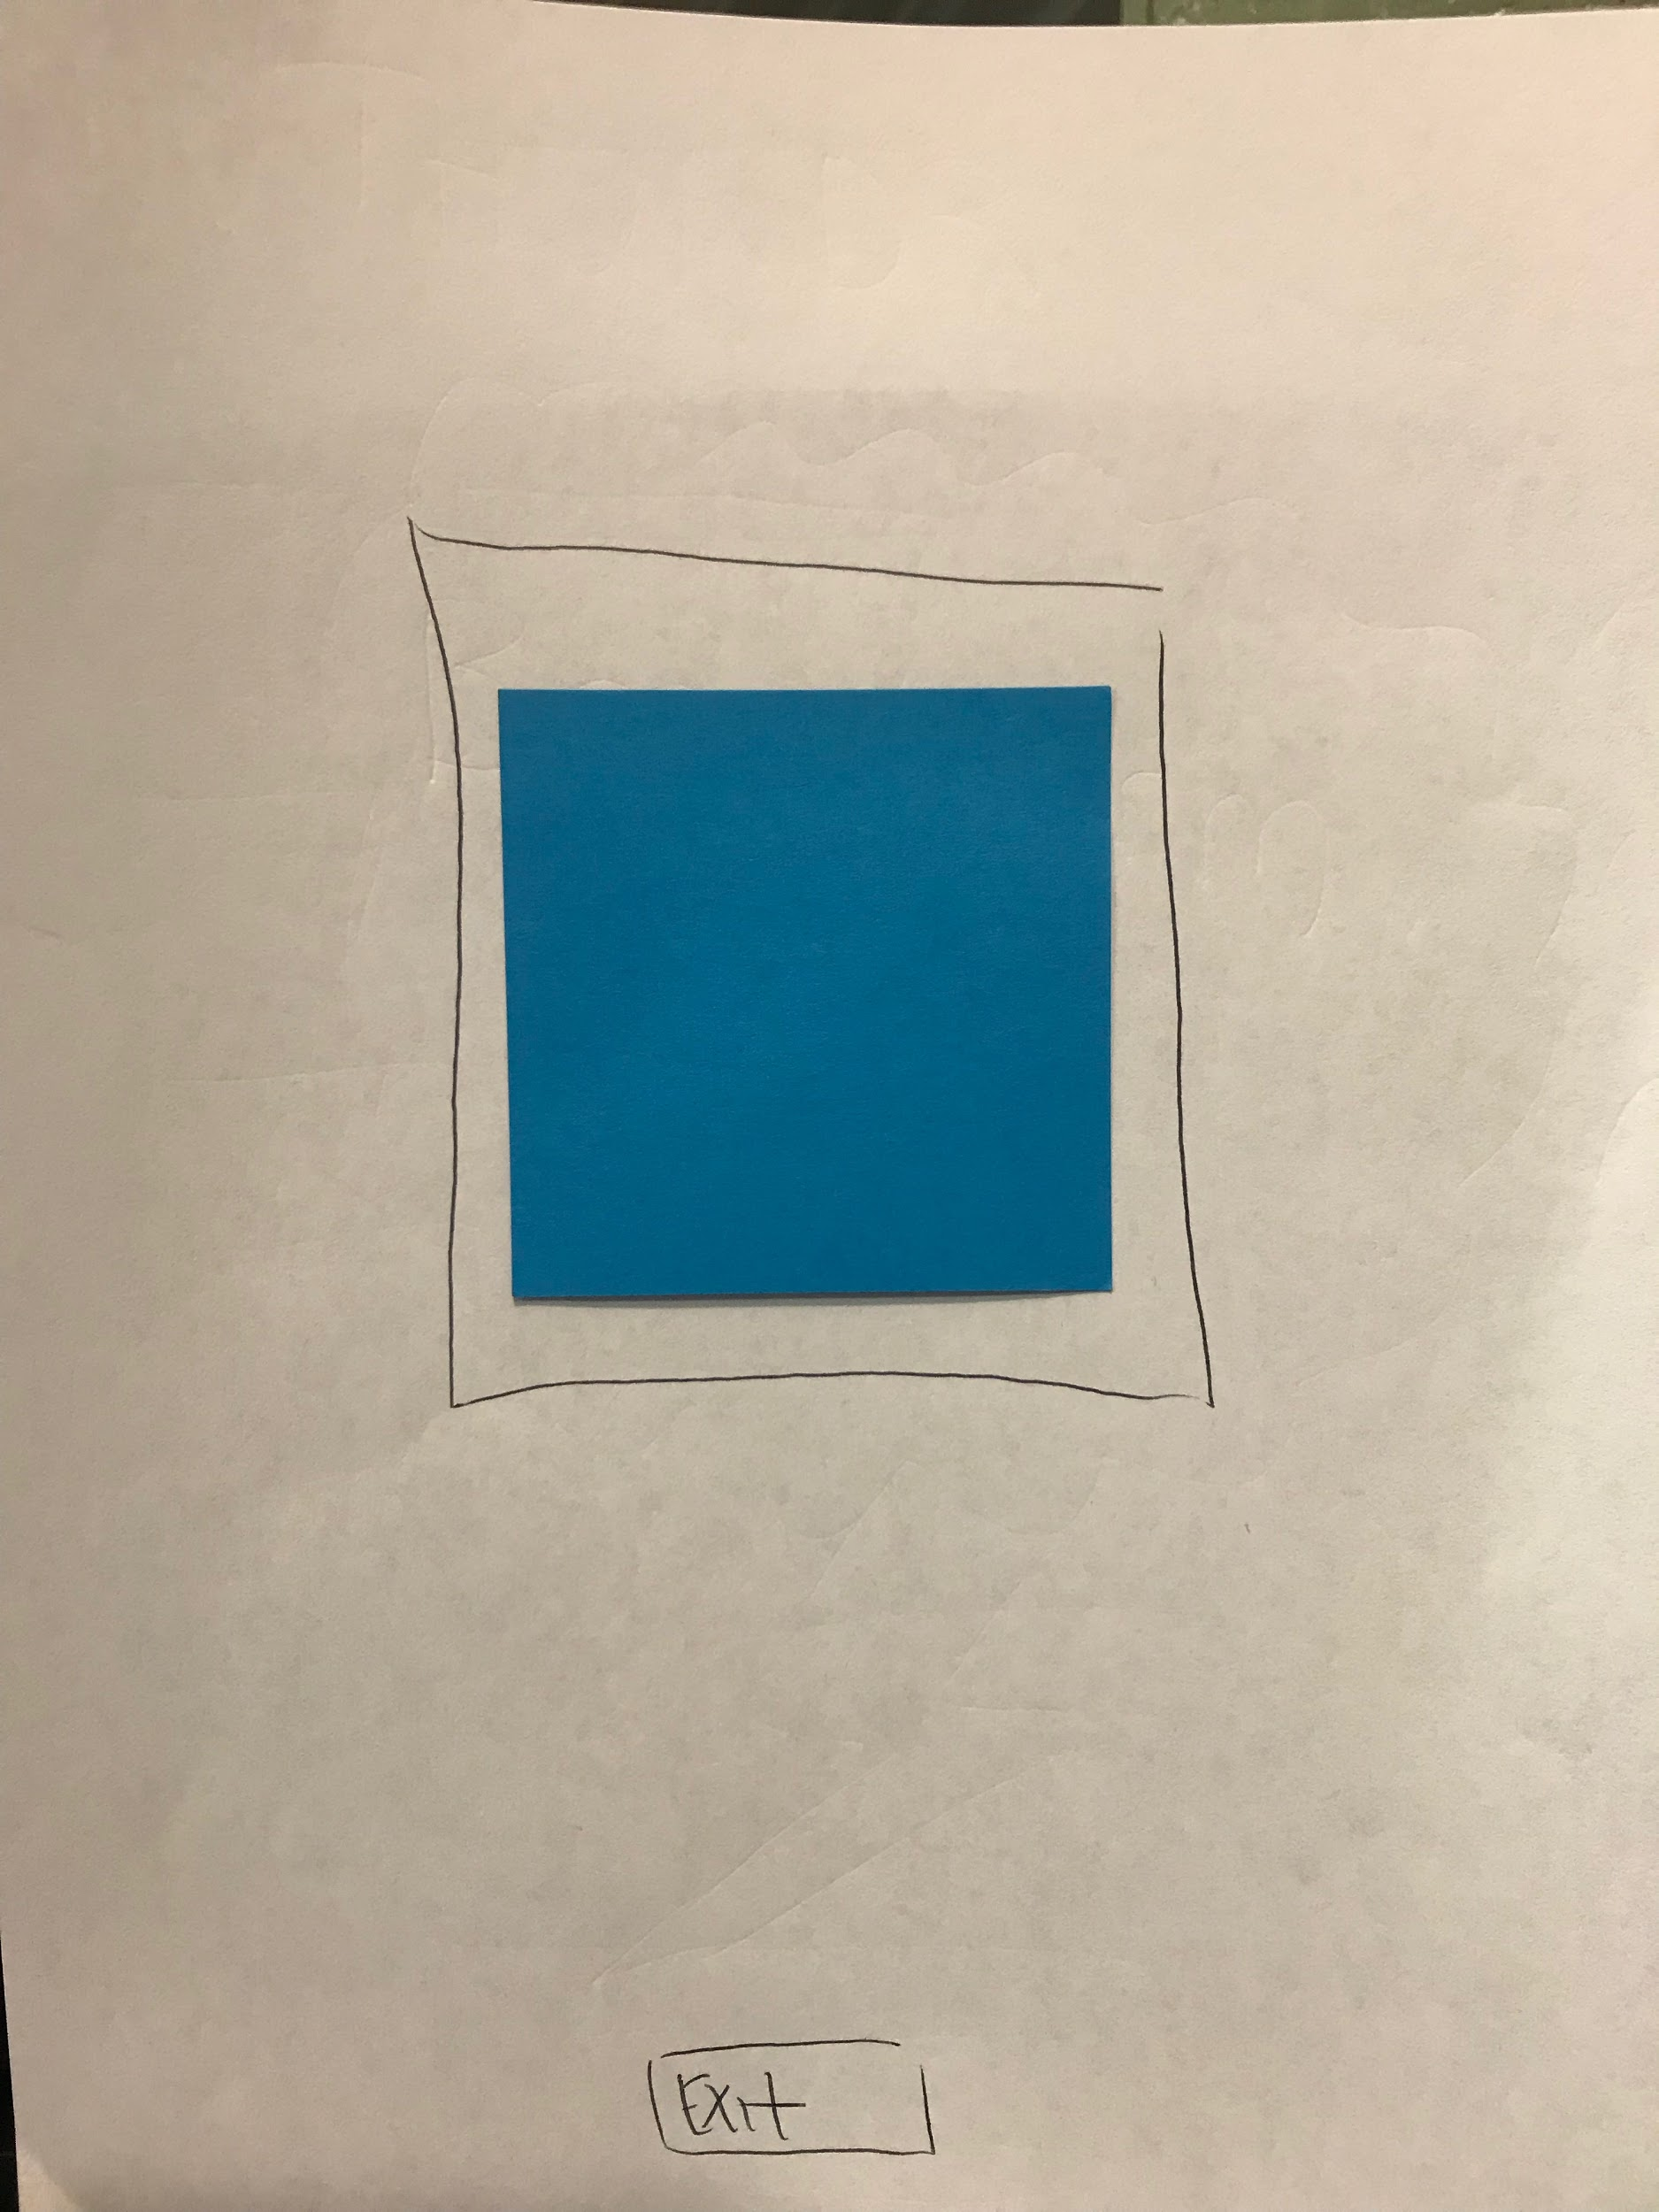
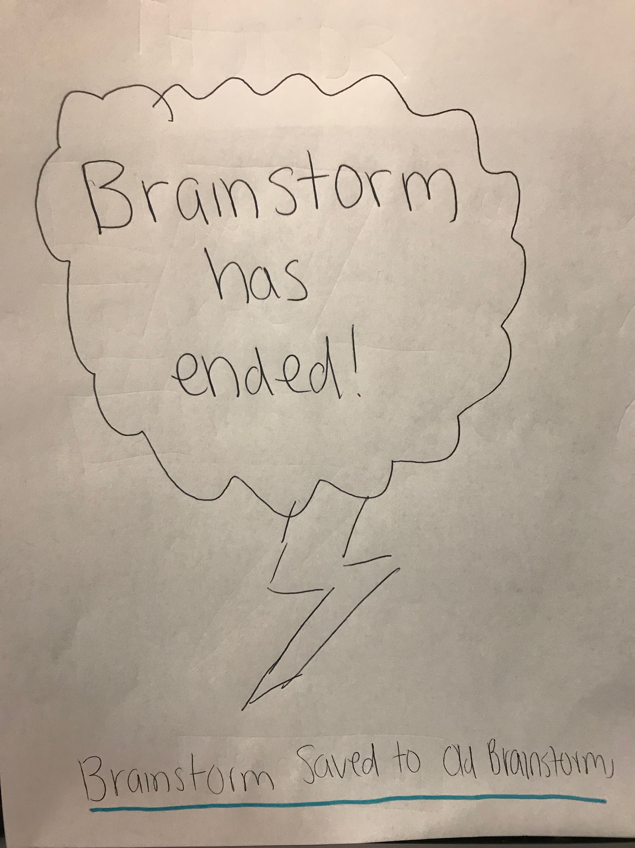
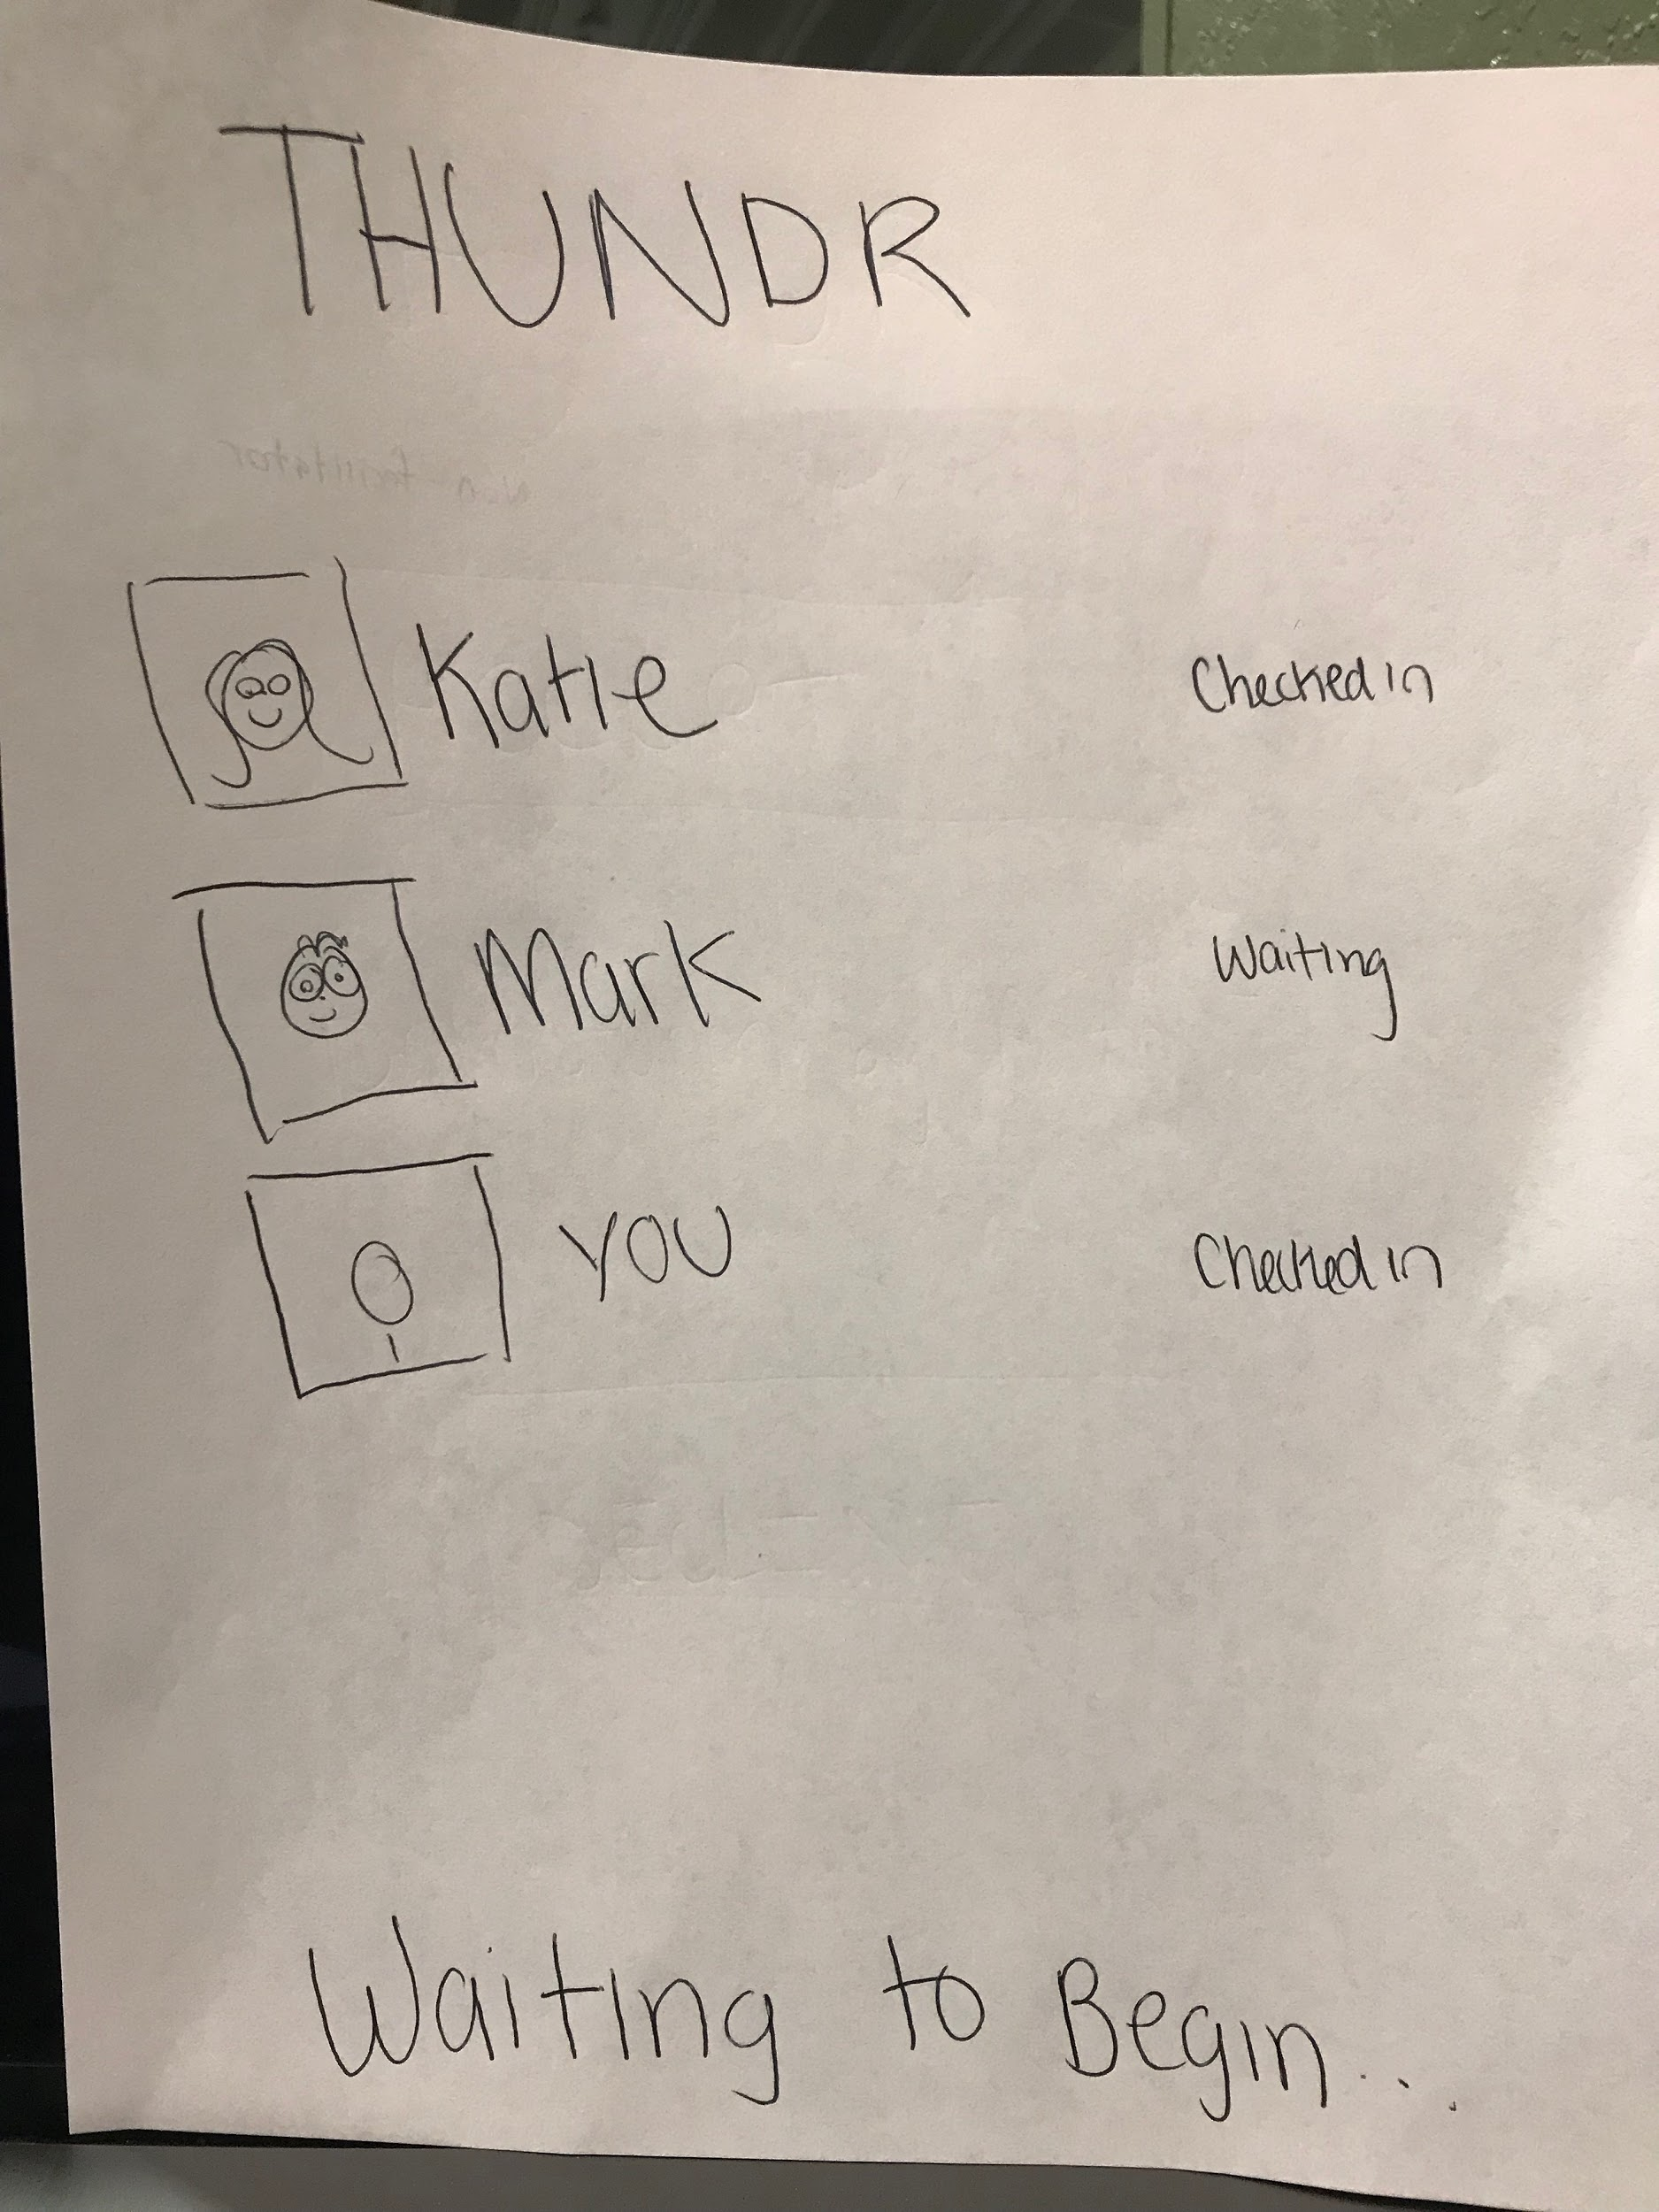
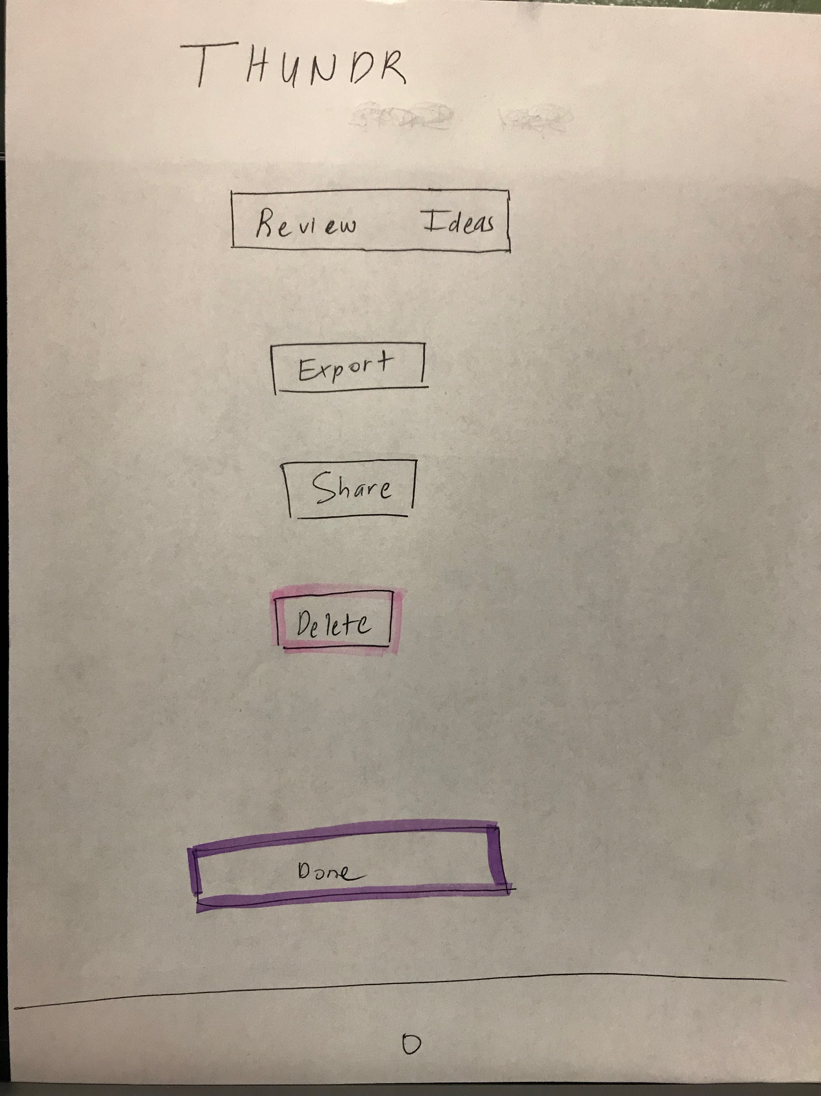
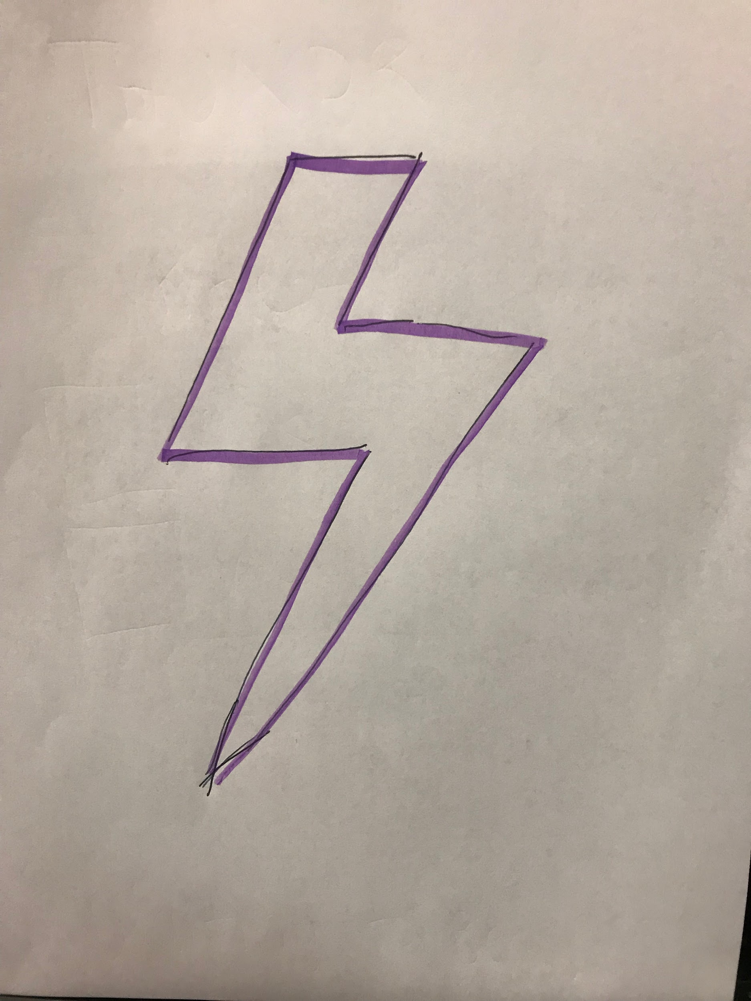
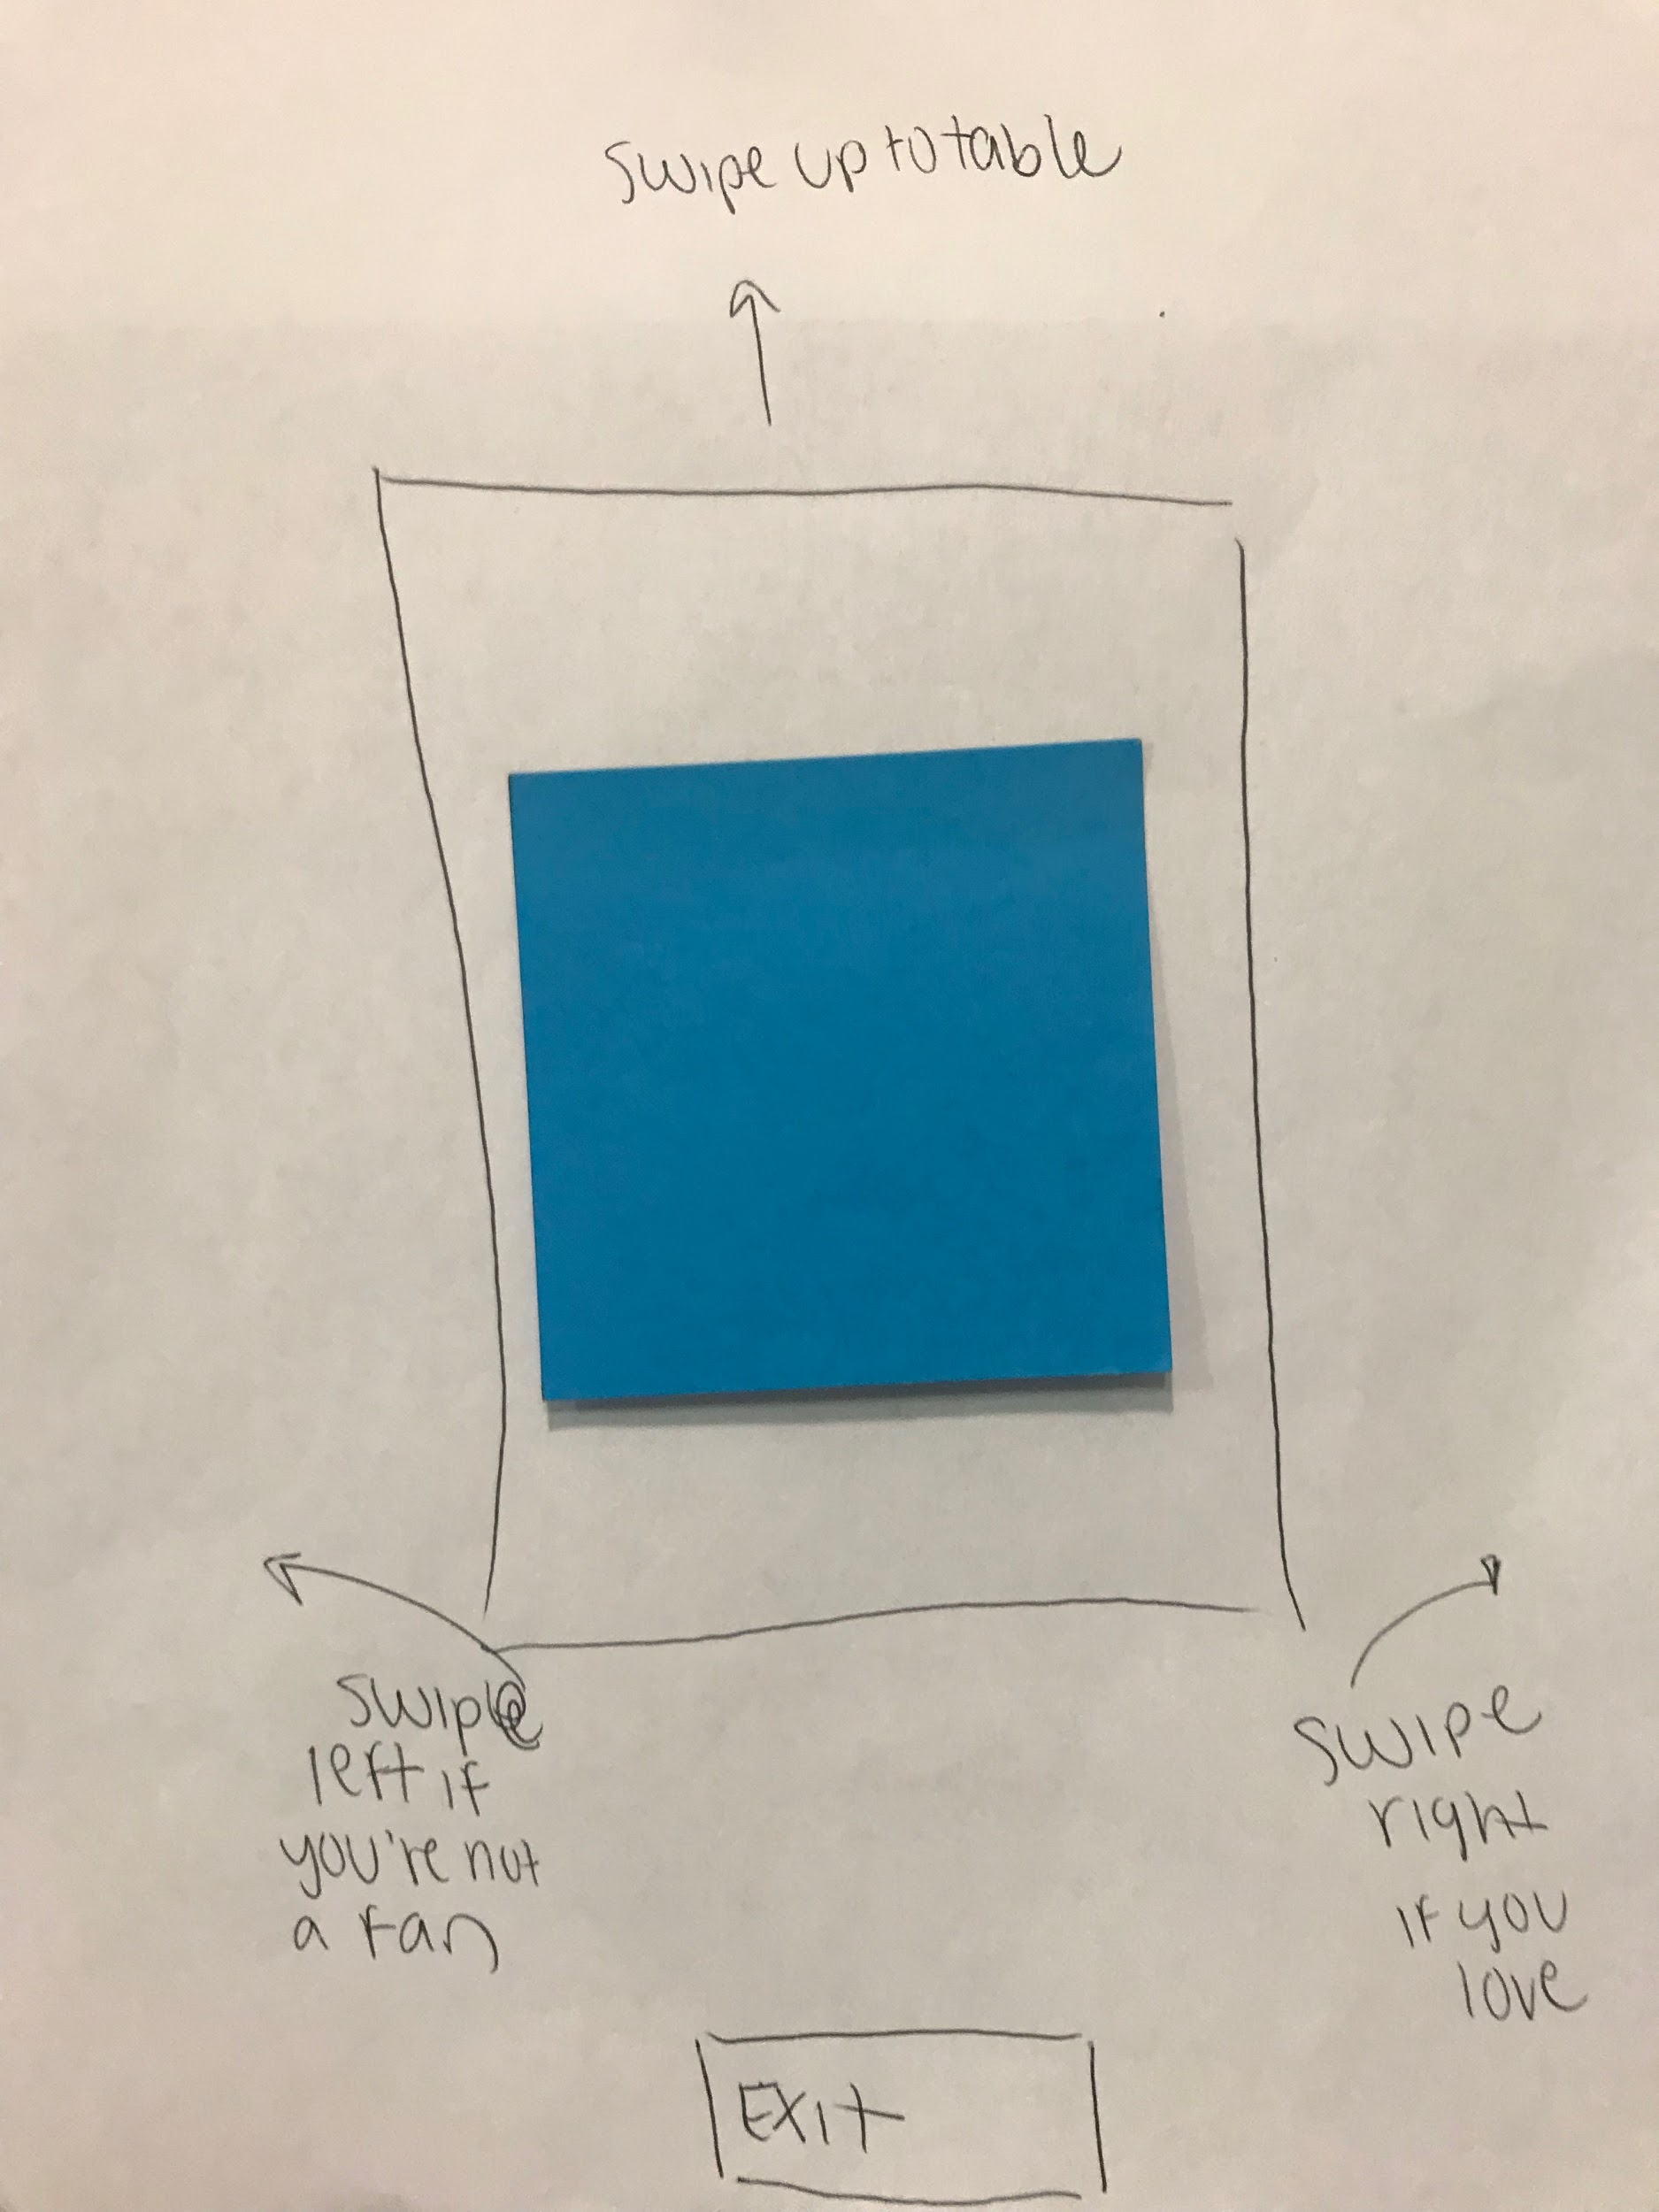
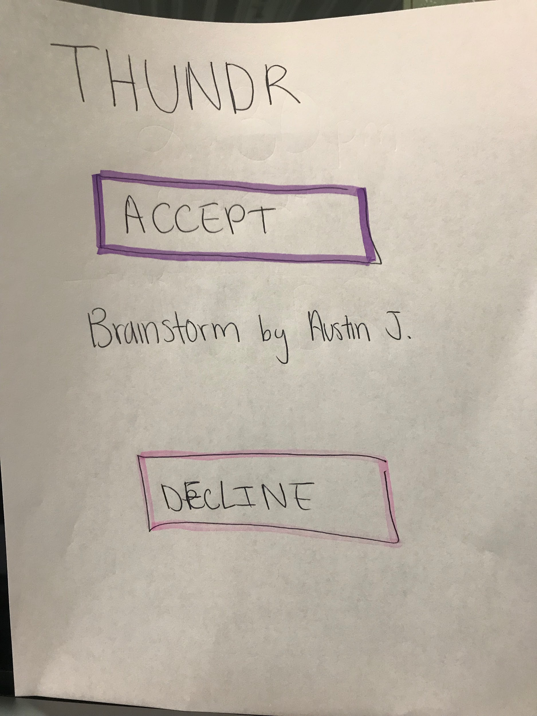
Prototype Structure
Mimics IOS application interaction
Focuses on simplicity and ease of use
Involves touch and voice interaction

Slide 8
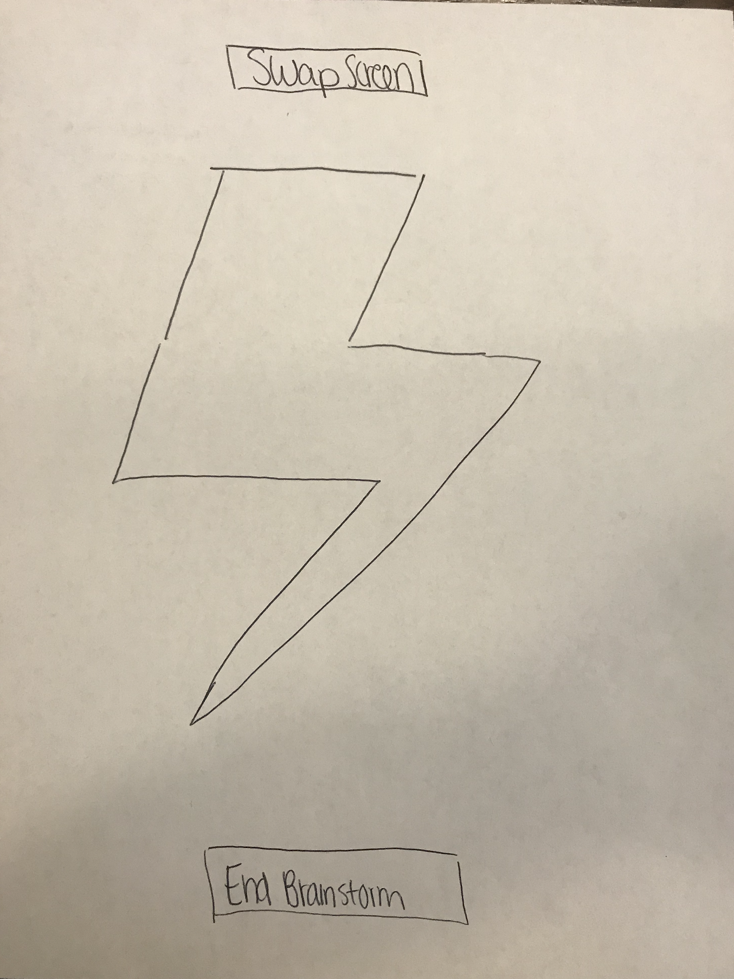
Task 1: Create and Share New Ideas

Slide 9
Task 2: Highlight and Present Favorite Ideas

Slide 10
Task 3: Work Remotely from Team
Facilitator
Remote User

Slide 11
Task 4: Access Old Brainstorm

Slide 12
Testing
Drew: College Student
his 20s
Jeff:
Board Director
his 20s
Experiment Method:
High-level Overview
4 Tasks
Recorded successes and errors
Marc: Medical Director
his 20s
Kristen:
Non-Profit Founder
his 20s

Slide 14
Testing
Drew: College Student
his 20s
Jeff:
Board Director
his 20s
Experiment Method:
High-level Overview
4 Tasks
Recorded successes and errors
Marc: Medical Director
his 20s
Kristen:
Non-Profit Founder
his 20s

Slide 16

Results
Very intuitive
All of the tasks completed successfully
Customizable
Vague delete button
Voting system/buttons confusing

Slide 17
Future
Steps
Identify how people use old brainstorming sessions
Rework how we use the “Vote” button
Clarify language
Create way that allows app to know when someone is saying idea vs. background comments

Slide 18
Questions?

