Slide 1


Concept Video: Thundr
Emma Alderton, Austin Jones, and Caroline Willis

Slide 2
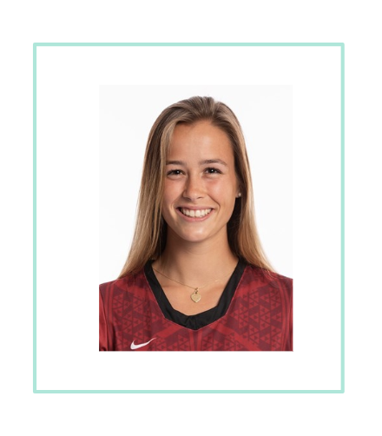
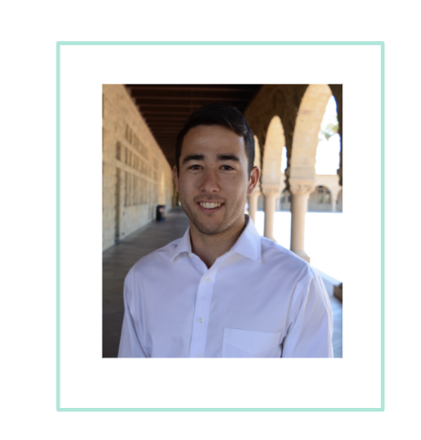
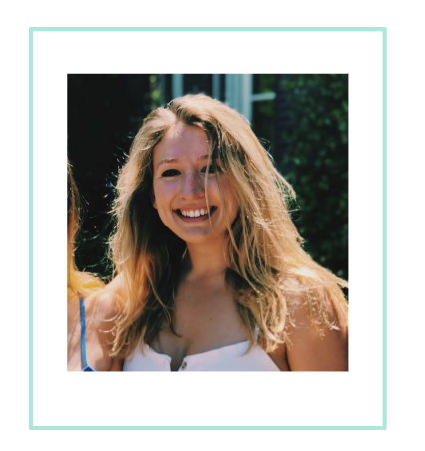
Our Team

Slide 3
Problem/Solution Overview
We identified a need for a better brainstorming tool that could be used remotely, too.
Taking the writing aspect out of the process allows for continuous productivity, engagement, and creativity.
Notes:
We identified a need for a better brainstorming tool that could be used remotely, too. The success of a brainstorm depends heavily on the engagement of the team; taking the writing aspect out of the process allows for continuous productivity, engagement, and creativity.

Slide 4

Introducing… Thundr!
Notes:
Value proposition

Slide 5
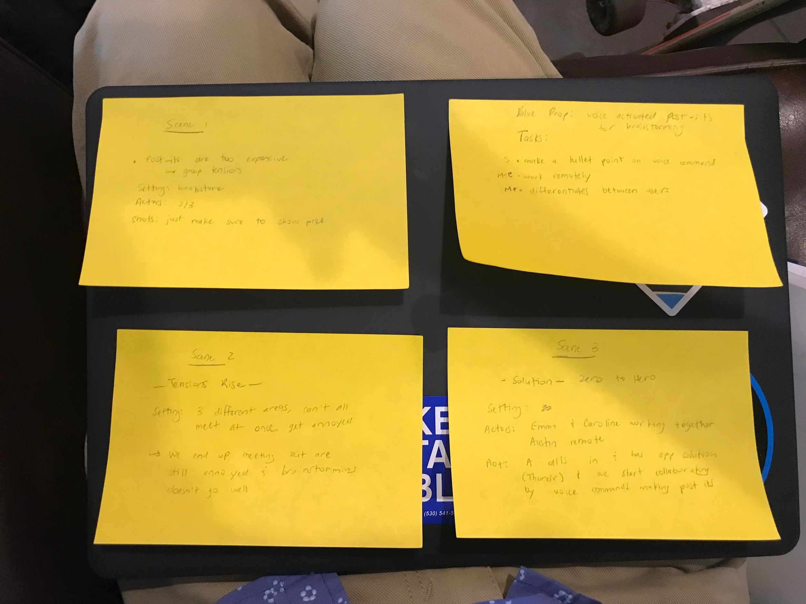
Tasks
Create, organize, and share new ideas
Highlight and present favorite ideas
Draw sketches and diagrams

Slide 6
Scene 1: Intro
Context: Opening (or early) scene
Actors: Emma and Austin
Plot: Emma, Austin, and Caroline are in a group project and are trying to meet up to brainstorm for their project but are having difficulty.

Slide 7
Scene 2: Tensions Rise
Context: brainstorming session
Actors: Emma and Caroline
Plot: Emma and Caroline have been trying to work with Austin, but he’s unable to meet in person. They’re try brainstorming without him, but in their silent brainstorm come up with nothing.

Slide 8
Scene 3: Zero to Hero
Context: brainstorming session, using Thundr
Actors: Emma, Caroline, and Austin
Plot: Austin comes to the rescue with Thundr, and calls in remotely to brainstorm with the team. This scene presents the main features of Thundr, including remote brainstorming, mind mapping using post-it like visuals, and additional functionality including organization, highlighting, and more.

