Slide 1
POVs // Experience Prototypes
Austin Jones, Caroline Willis, Emma Alderton

Slide 2


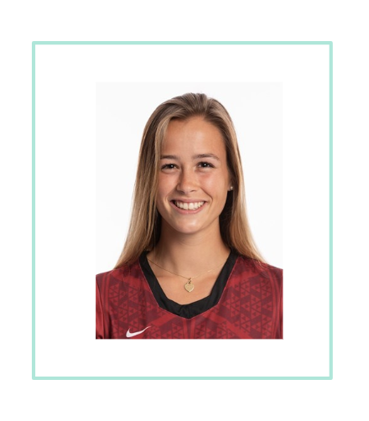
Problem Domain:
Our problem domain is increasing accessibility. People have trouble accessing and using areas of technology because they are limited in other areas of their lives, whether that be knowledge or physically.

Slide 3
Initial POV

Slide 4

Initial POV
We met…
Michael, a former lawyer from Stanford, who struggles with the learning curve of technology.
We were amazed to realize…
that he loves learning but doesn’t want to spend time learning new technology.
It would be game-changing to…
make the process of learning new tech easier.”

Slide 5
Needfinding 2.0

Slide 6

Mike
“Uses technology as a means of communication and reference for his work when inputting patient data and their electronic records.”

Slide 7
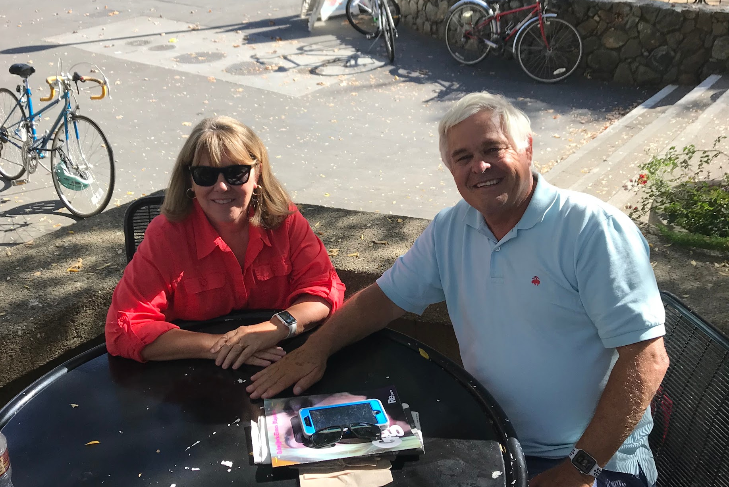
Patty & Steve
Patty - “The easier technology is to use, the more helpful it is.”
Steve - “Technology allows them to be more independent with work and research.”

Slide 8
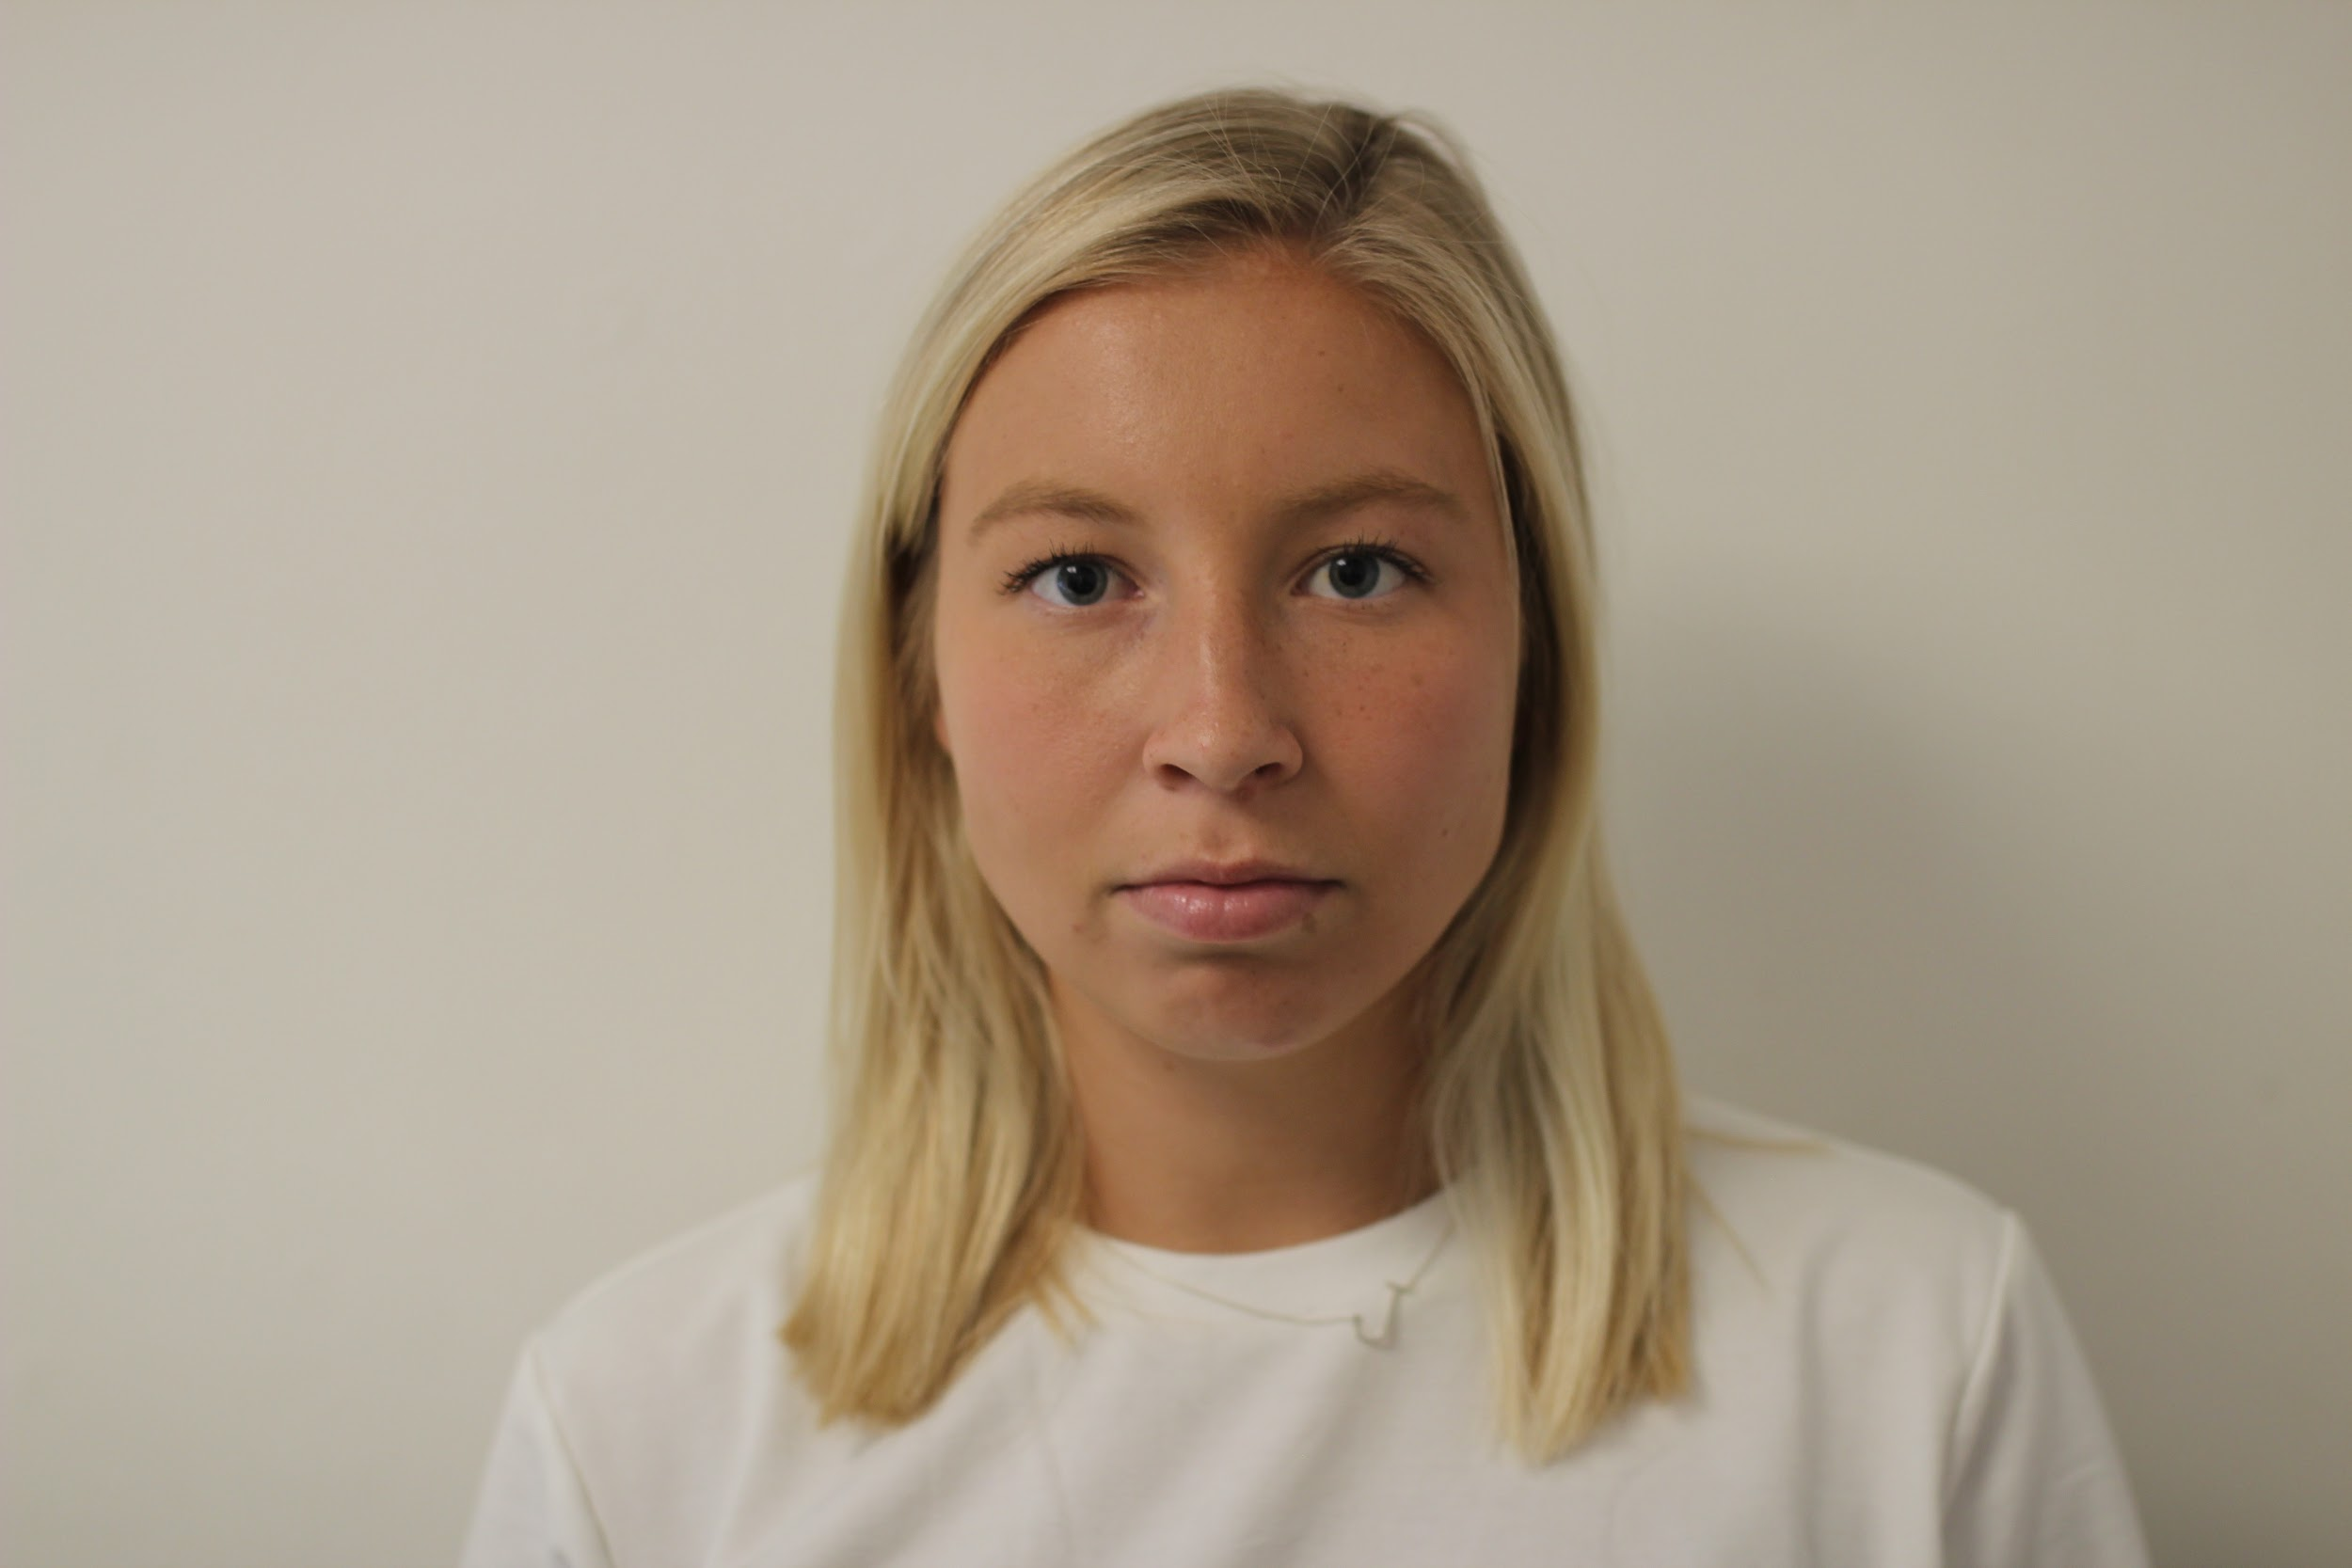
Jordan
“Goes down a distractive and time consuming rabbit hole with the nitty gritty small details in her projects and presentations.”

Slide 9
Revised POVs

Slide 10
POV 1 - Luke
We met:
Luke, a first year university student, who is a quadriplegic and has limited mobility.
We were amazed to realize:
He uses voice interaction a lot for schoolwork but has to ask for help each time he wants to create something that is beyond just written words.
It would be game-changing to:
Allow those with disabilities the ability to work on creative and visual projects independently.

Slide 11
POV 2 - Michael
We met:
Michael, a retired lawyer at Stanford, who has a love of learning and reading.
We were amazed to realize:
That despite Michael’s love of learning, he struggles with the time commitment necessary to pick up new technologies.
It would be game-changing to:
Create easy and accessible ways to learn new technologies.

Slide 12
Top HMWs
How might we use technology to assist in visual tasks?
(POV 1)
How might we decrease the learning curve of technology?
(POV 2)
How might we make learning new tech exciting and not feel like a chore?
(POV 2)

Slide 13
Experience Prototypes

Slide 14
Experience Prototype 1: GraphIt
Use VI to manipulate and create graphs

Slide 15
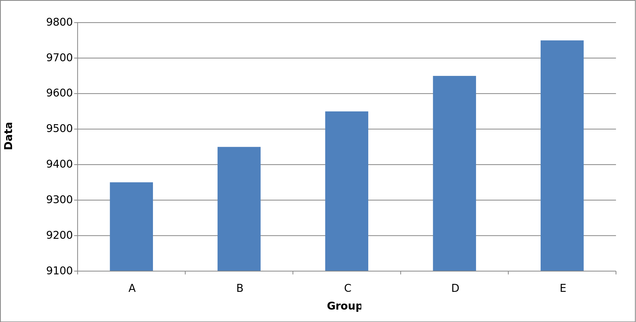
GraphIt
Assumptions:
Easy option

Slide 16
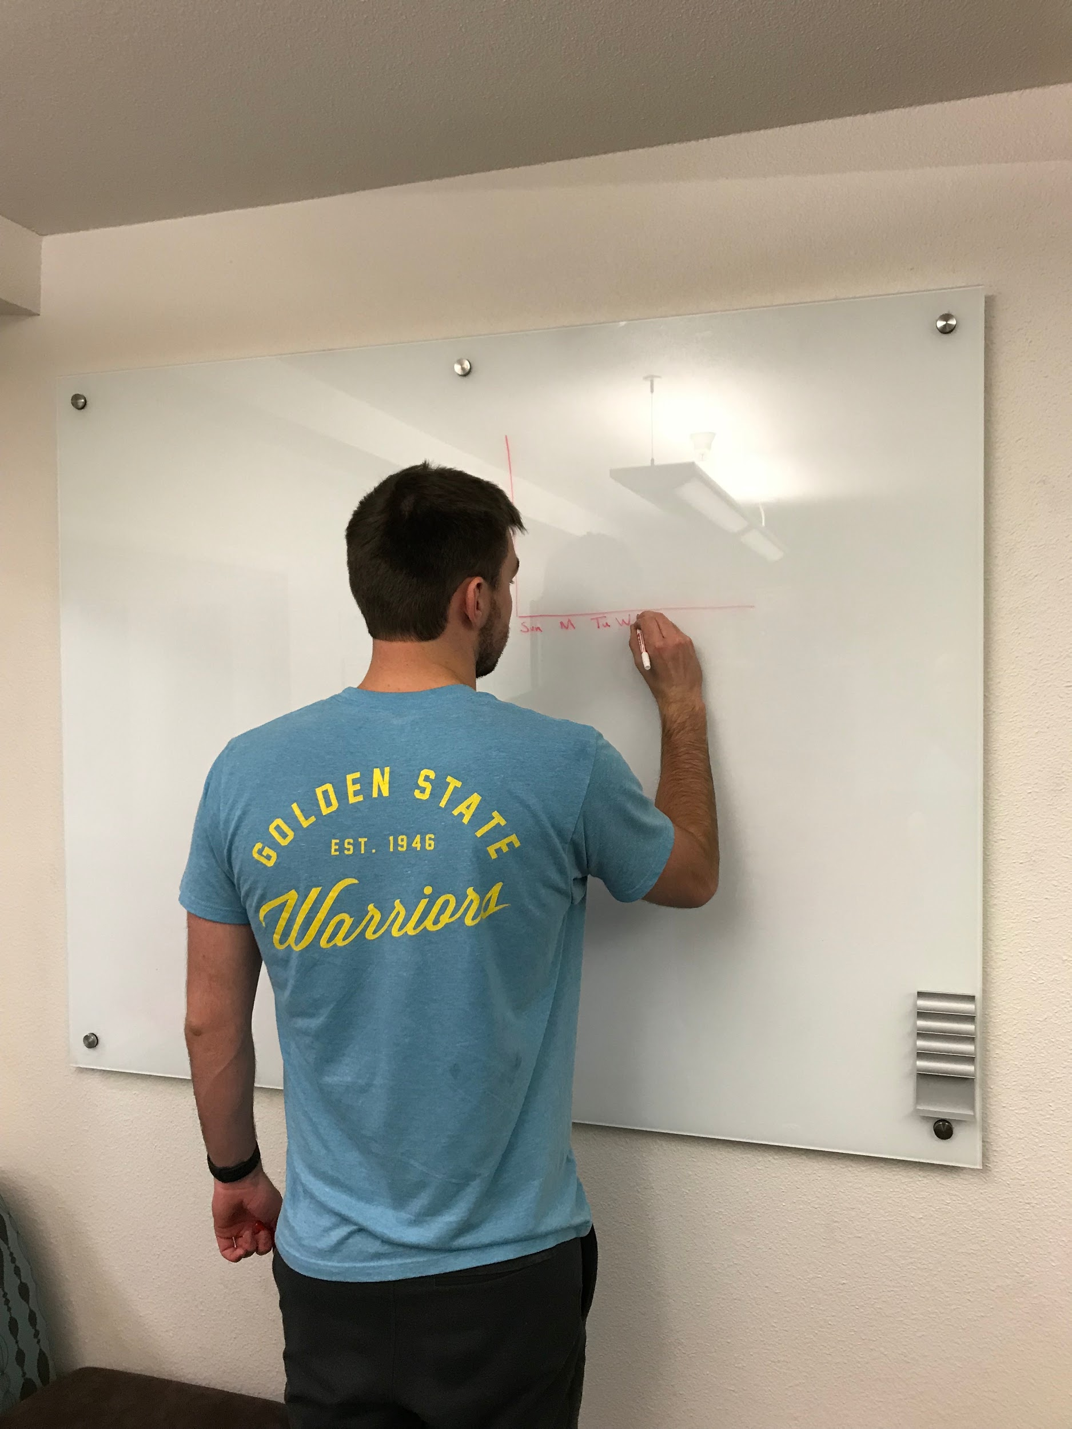
+ Less Cumbersome
+ Simpler to say it
- Confusion in instruction

Slide 17
Surprises
Focus on the big picture
New Learnings
People think differently, clear instructions are vital

Slide 18
Graph
Assumptions:
Easy option, + Simple

Slide 19
Experience Prototype 2: ChatBot
Chatbot for learning new technology

Slide 20
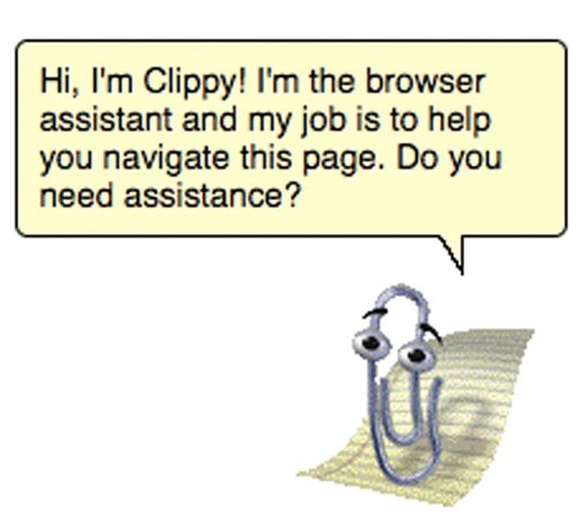
Chatbot
Assumption:
asking questions > reading instructions
Notes:
Assumption: users would rather ask questions when they come up than have to learn by conventional methods (reading instructions, watching video, etc.)

Slide 21
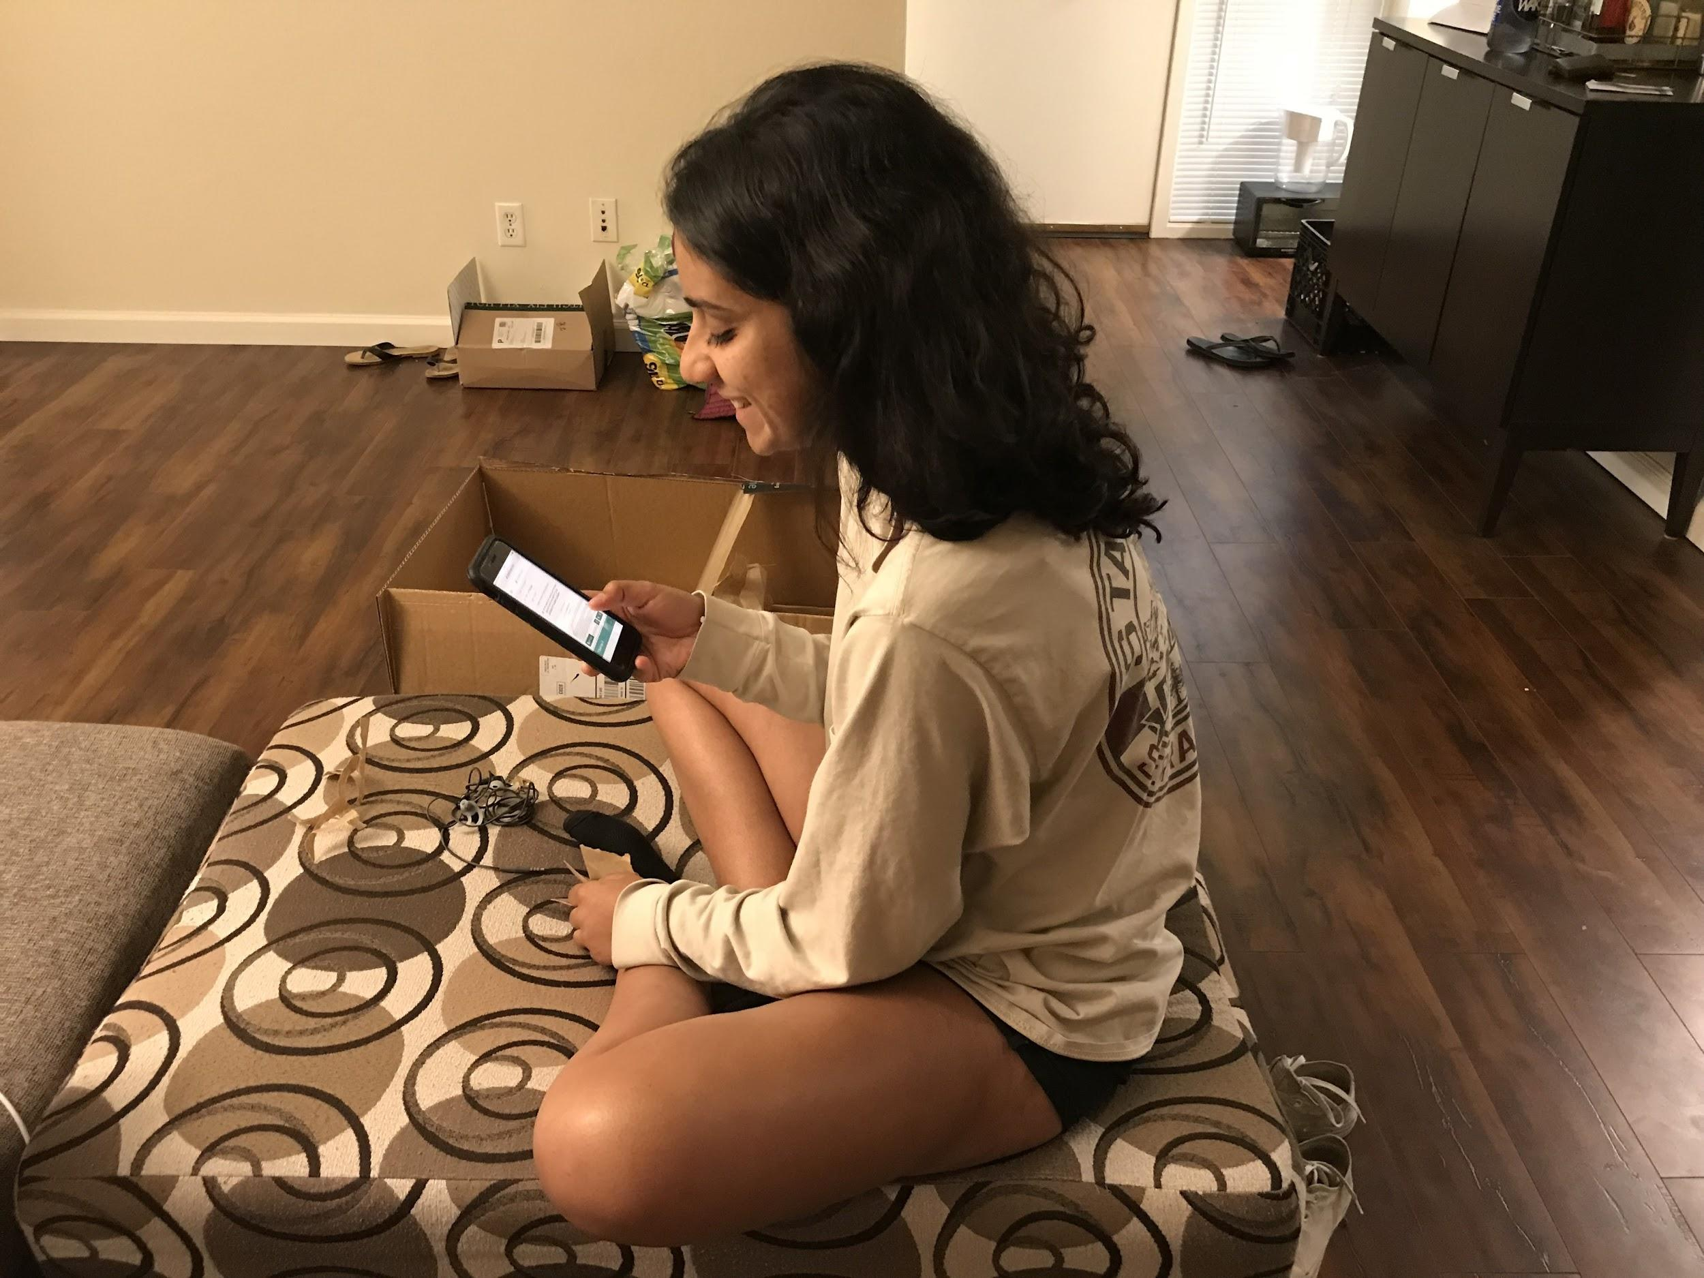
+ Natural, human-like
+ Flexible
- Need may not exist
- Complex
Notes:
* Assumption potentially invalidated *
Natural, human-like: It’s easy to ask the chatbot questions when they come up, feels like you’re asking a friend for help
Flexible: you can ask the chatbot to help with any aspect of the app; not limited to parts the creator decided to give instructions for
Need may not exist: if apps are well designed, we wouldn’t need a specific chatbot designed to answer questions
Time better spent designing intuitive, easy-to-use apps instead of a chatbot to fix poorly designed apps

Slide 22
Surprises
Apps are currently pretty intuitive
New Learnings
When apps are well-designed, people are more patient
Notes:
Apps are currently pretty intuitive: The apps we tested were really easy to pick up, despite having multiple components or focuses that weren’t familiar to the user.
When apps are well-designed, people are more patient: when the instruction is simple, quick, and presented in

Slide 23
Chatbot
Assumption:
asking questions ? reading instructions
Notes:
Assumption: users would rather ask questions when they come up than have to learn by conventional methods (reading instructions, watching video, etc.). It is unclear if our original assumptions hold, especially with intuitive products

Slide 24
Experience Prototype 3:
Learning Options
Give people with different preferences of learning style options

Slide 25
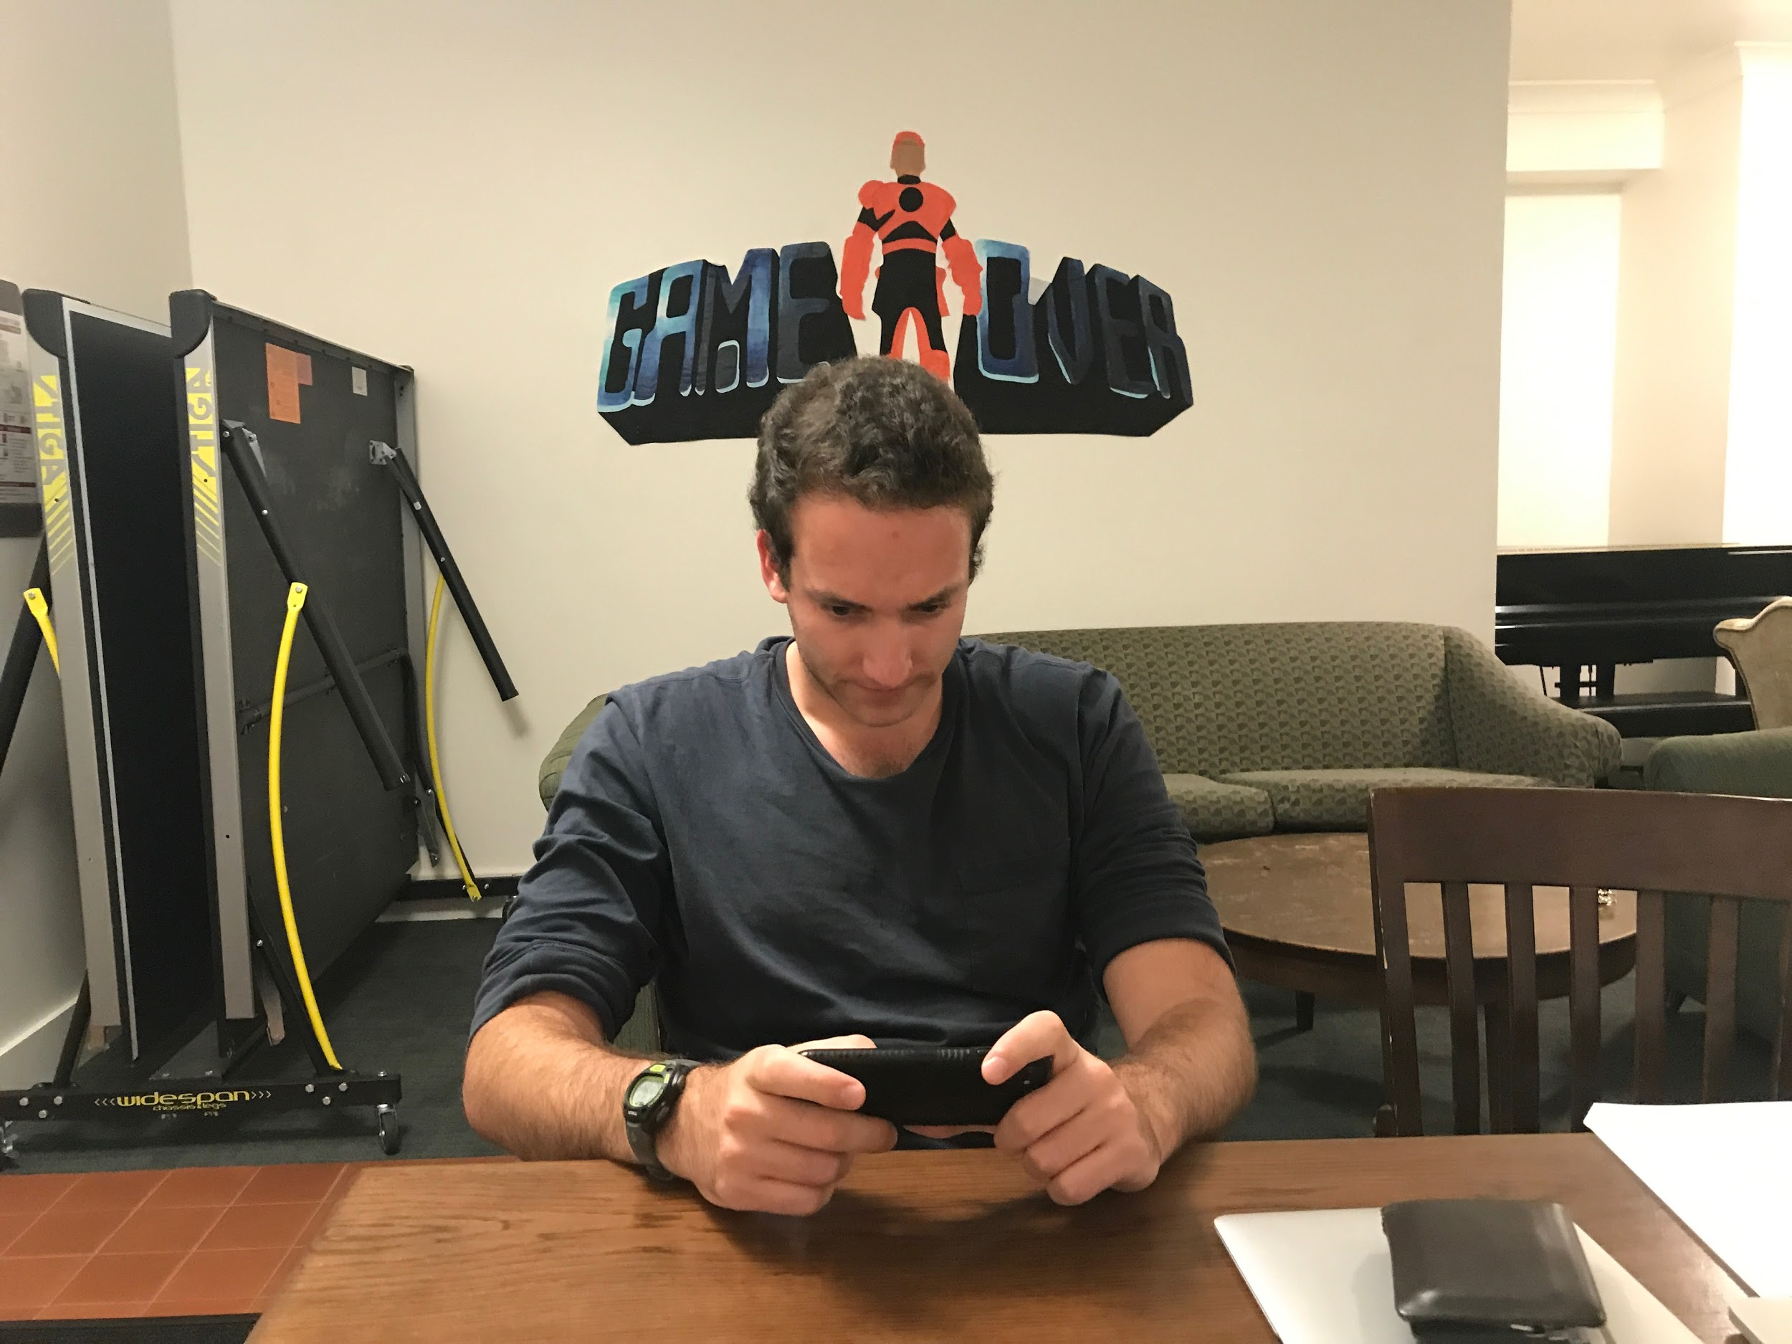
Learning options
Assumptions:
People want to engage in new tech
Notes:
People like to learn, but dislike other methods of learning that what they are comfortable with
People feel that they have “better things to do” than sit down and learn new technology

Slide 26

+ People like to learn
- People still may choose “other” things to do rather than learn
-People do not want to engage in what they do not know
Reading
Games
Video
Podcast

Slide 27
Surprises
Our subject did not pick the option to download the new mobile ordering app, even after many options
New Learnings
It’s less the learning curve, and more so that people feel that learning new tech will not be useful to them that keeps them from learning it

Slide 28
Surprises
New Learnings

Slide 29
Different learning options
Assumptions:
People want to engage in new tech
Notes:
People like to learn, but dislike other methods of learning that what they are comfortable with
People feel that they have “better things to do” than sit down and learn new technology

Slide 30
GraphIt
ChatBot
Learning Options

Slide 31
GraphIt
ChatBot
Learning Options

Slide 32
Questions ?

