Slide 1
Voice Interaction
Austin Jones, Caroline Willis, Emma Alderton
Notes:
-List and identify speakers
-our problem domain, accessability using voice interaction

Slide 2



Our Team

Slide 3
Problem Domain
Accessibility
Notes:
We thought a good problem domain to assess would be accessibility, based on its relation to voice interaction technology.

Slide 4
Needfinding Methodology

Slide 5
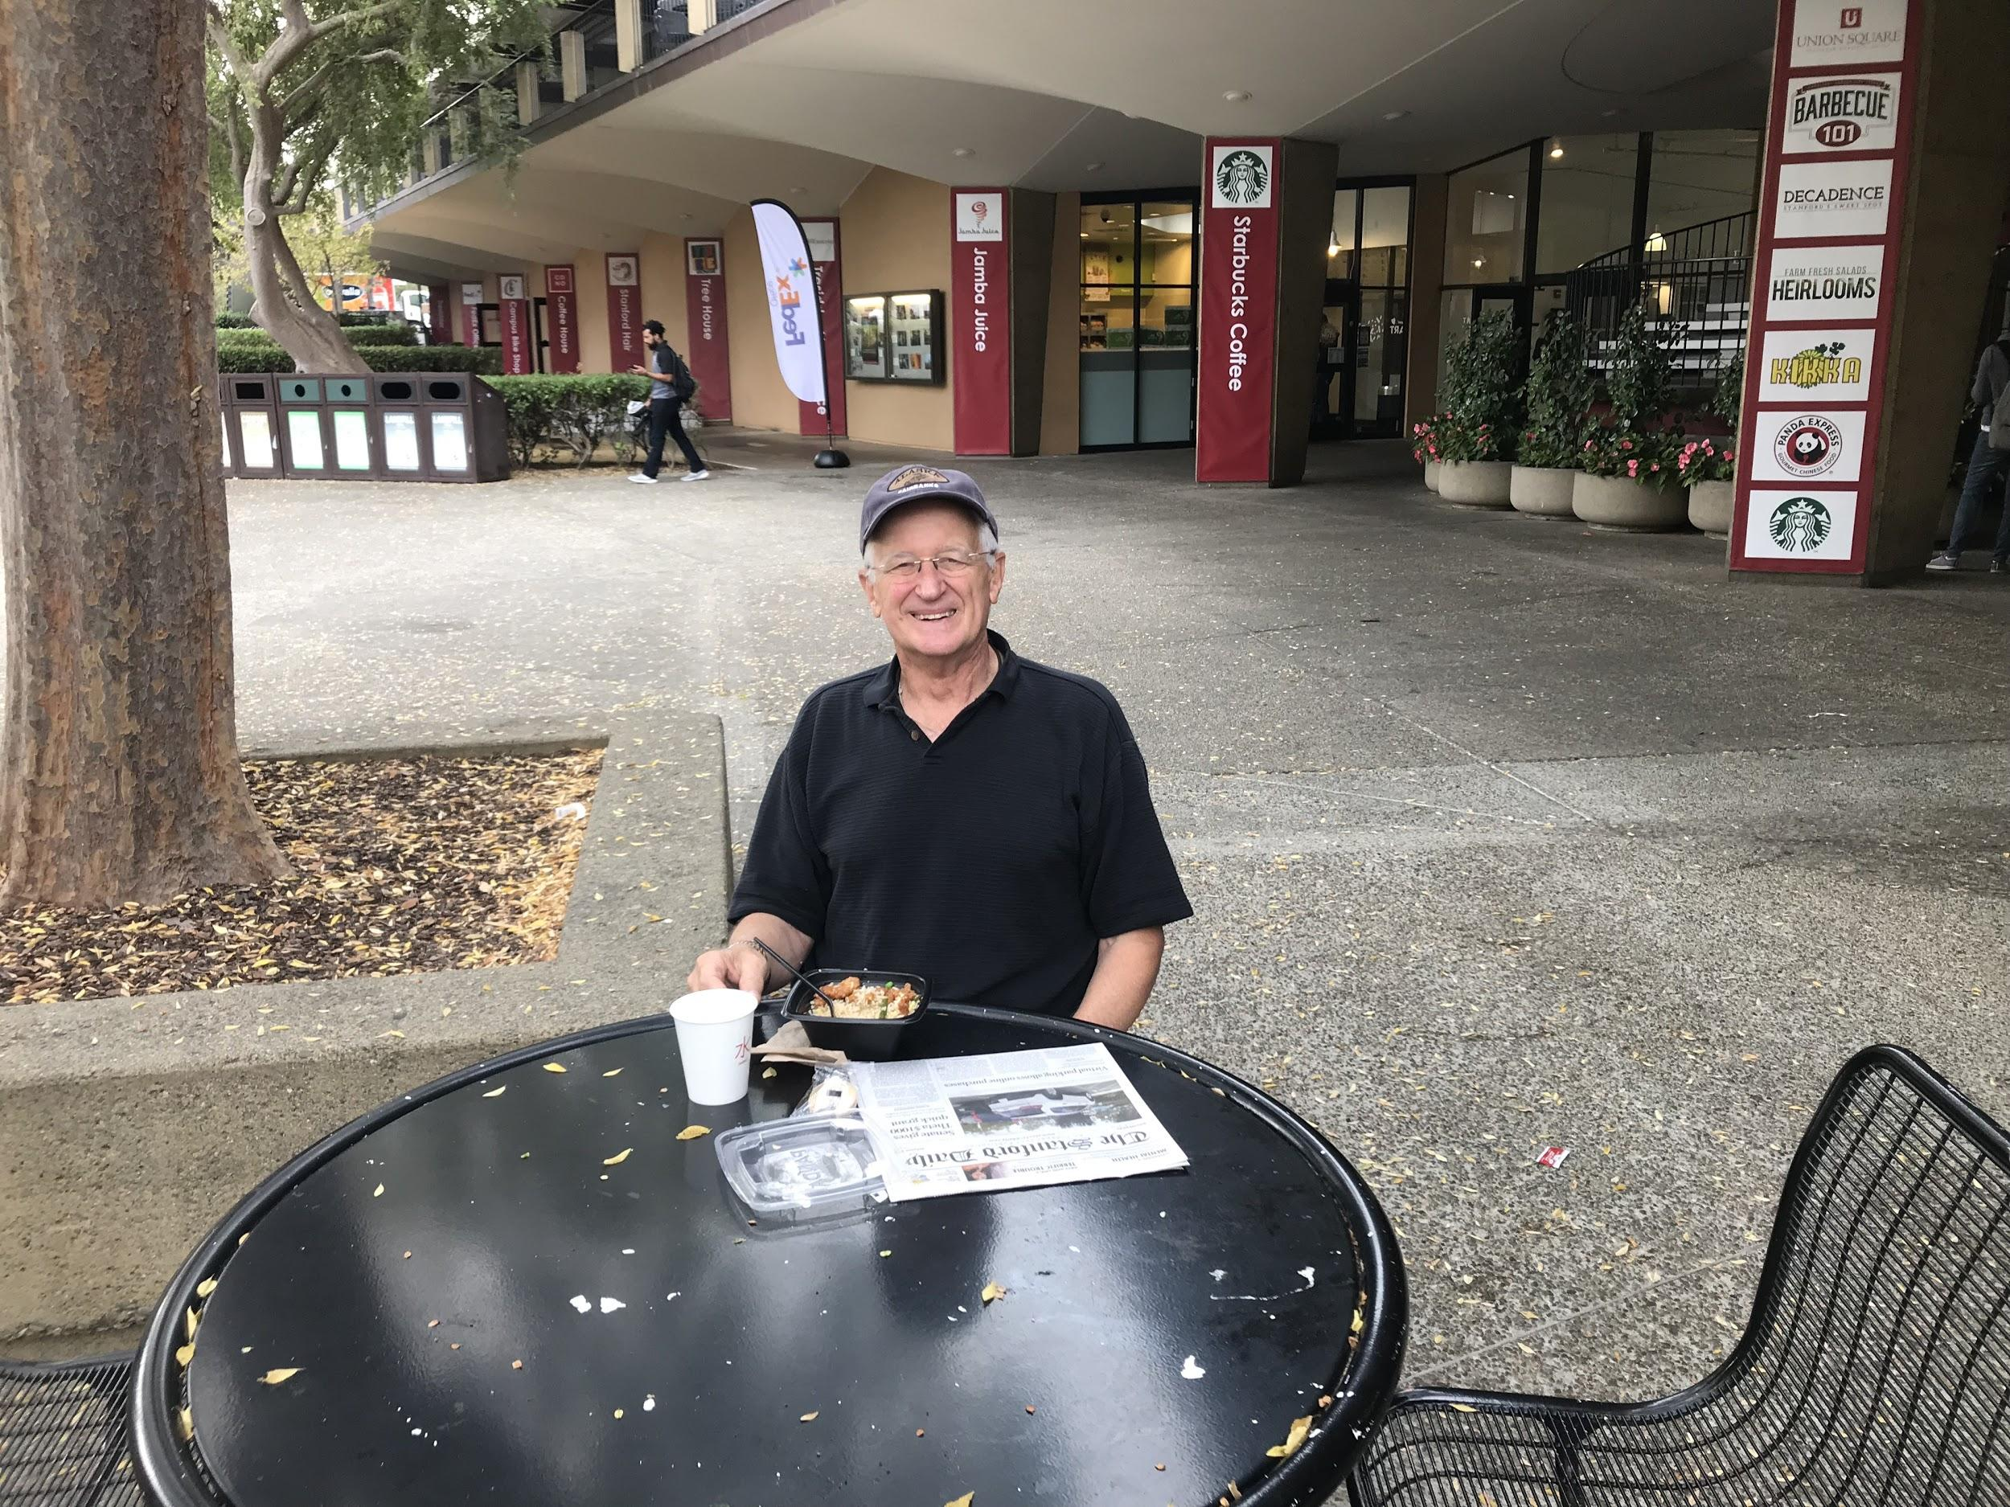
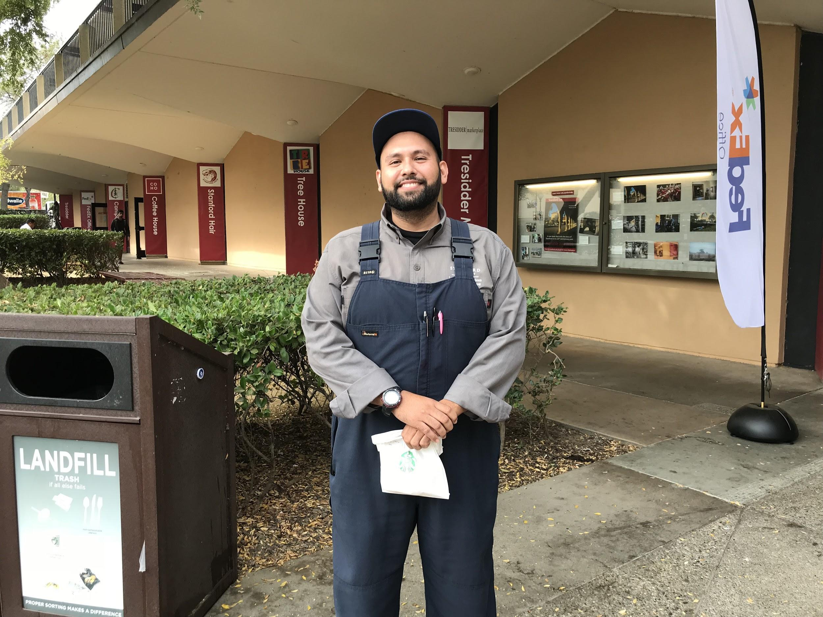
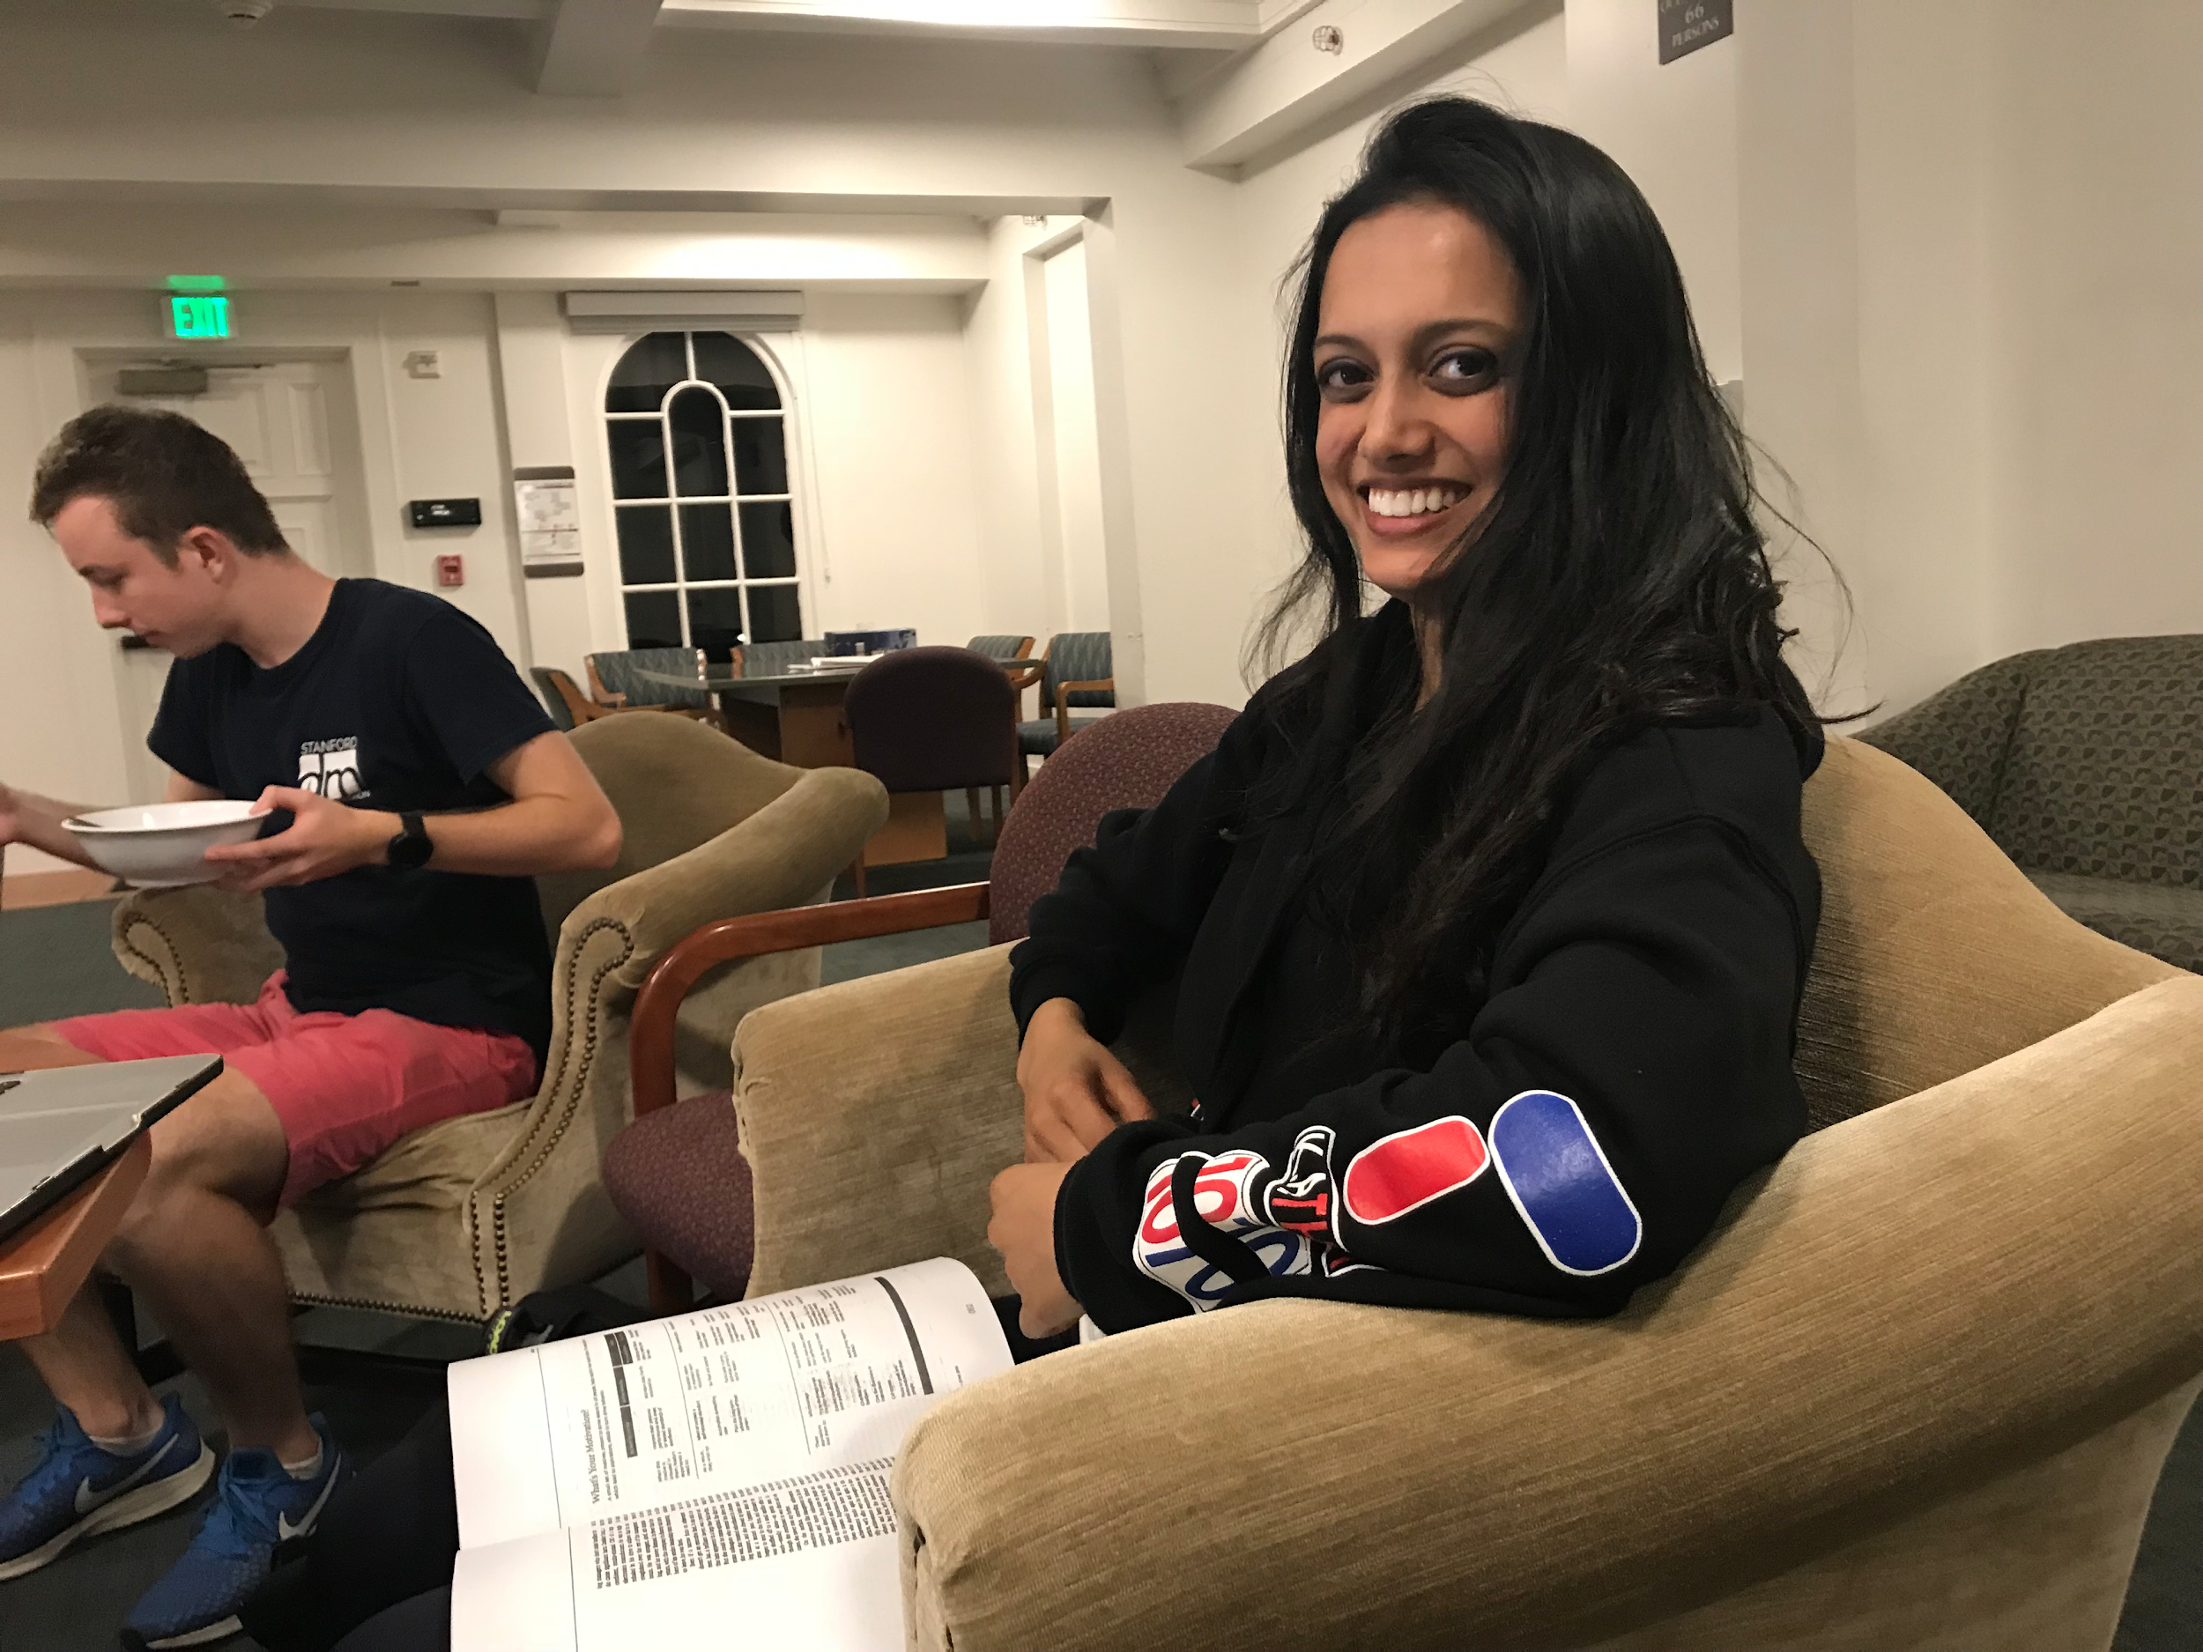
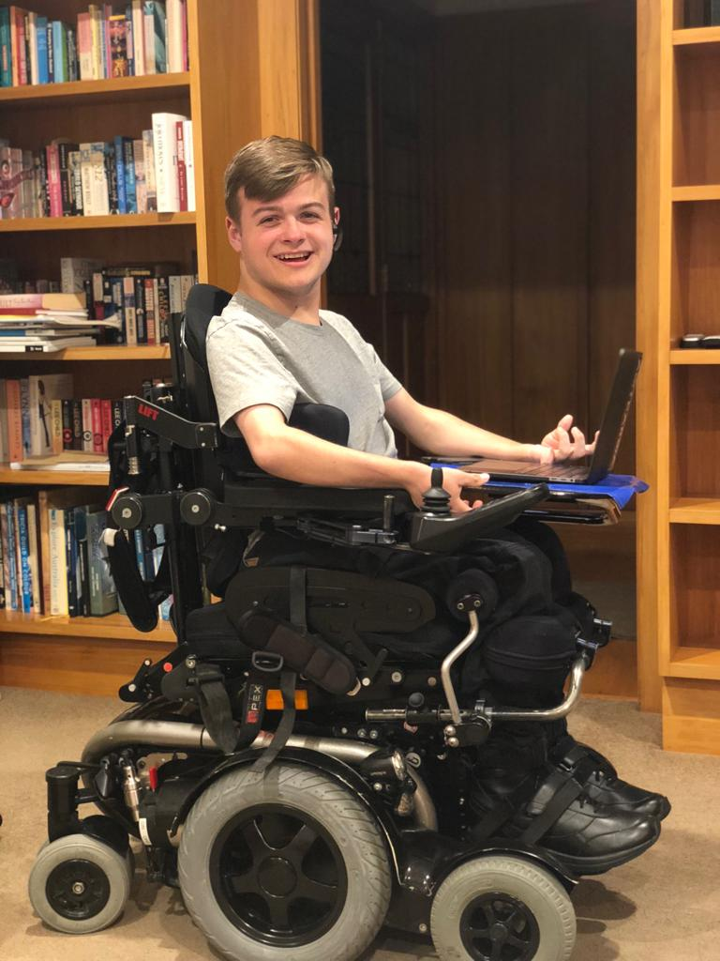
Who?
Notes:
Who we interviewed and why we chose them (broad spectrum, extremes)
Michael, Juan, Lakshmi, Luke

Slide 6
Questions We Asked
How has technology affected the way you communicate?
Tell us a story of when you last used voice interaction technology?
How did it make you feel?
Why did you use voice interaction that way?
?
Notes:
Why we asked these questions

Slide 7
Interview Results

Slide 8
Lakshmi-
“If I’m telling someone that I can’t be somewhere, I’m going to do it with a phone call. It’s less rude.”
Notes:
Main use: finding a way to communicate well without text
Uses VI for entertainment (Alexa) and hands-free use in car
Calls people to make them know it’s more urgent and more personal (as opposed to text)

Slide 9
Michael-
“You look at all those books on your bookshelf that you haven’t read and you’d rather spend your time doing that.”
Notes:
“Most of my stress in life revolves around technology”
“Best way to learn technology is to have an actual human being there with you”
Filled in different age group
Gave us insight into the learning curve required for some tech and what that means
Demonstrated the need for better tutorials or intros to tech products
All a question of time and not wanting to spend it learning

Slide 10
Luke-
“Last week I was taking an exam using dragon dictate (VI software). It doesn’t do graphs or drawing though, so I need someone to write a graph which can be frustrating and time consuming.”
Notes:
Expert in VI; gives him independence and makes him more effective at work
Needs: embarrassed of using VI around other people
What if it doesn’t understand him
Need more accessibility when using his phone since he has trouble using his hands

Slide 11
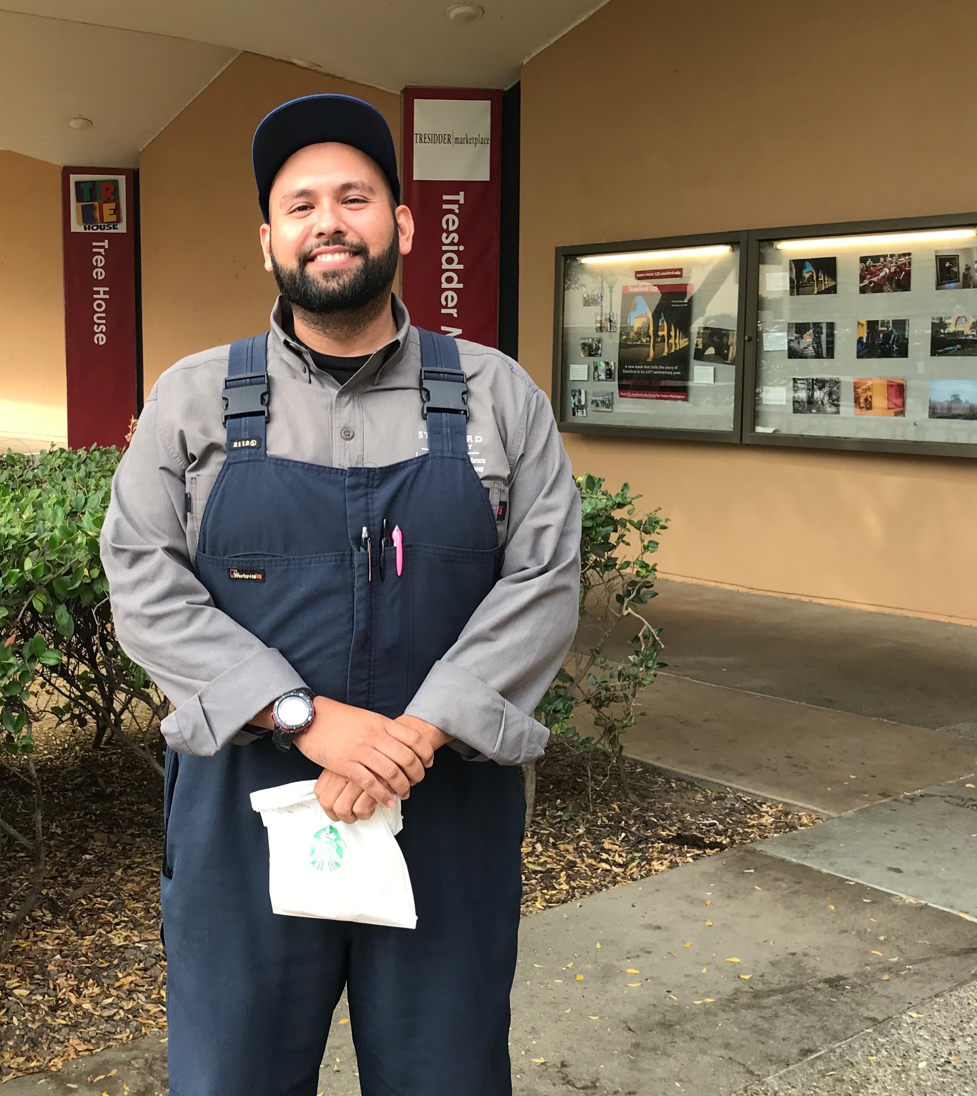
Juan-
“Technology is embedded in children these days, but I’ve missed the gap.”
Notes:
You can’t teach an old dog new tricks
VI super useful for work and communication (used to use radio now uses ft)
Could use voice memos or reminders from others
Negative: tech takes away from face to face interaction

Slide 12
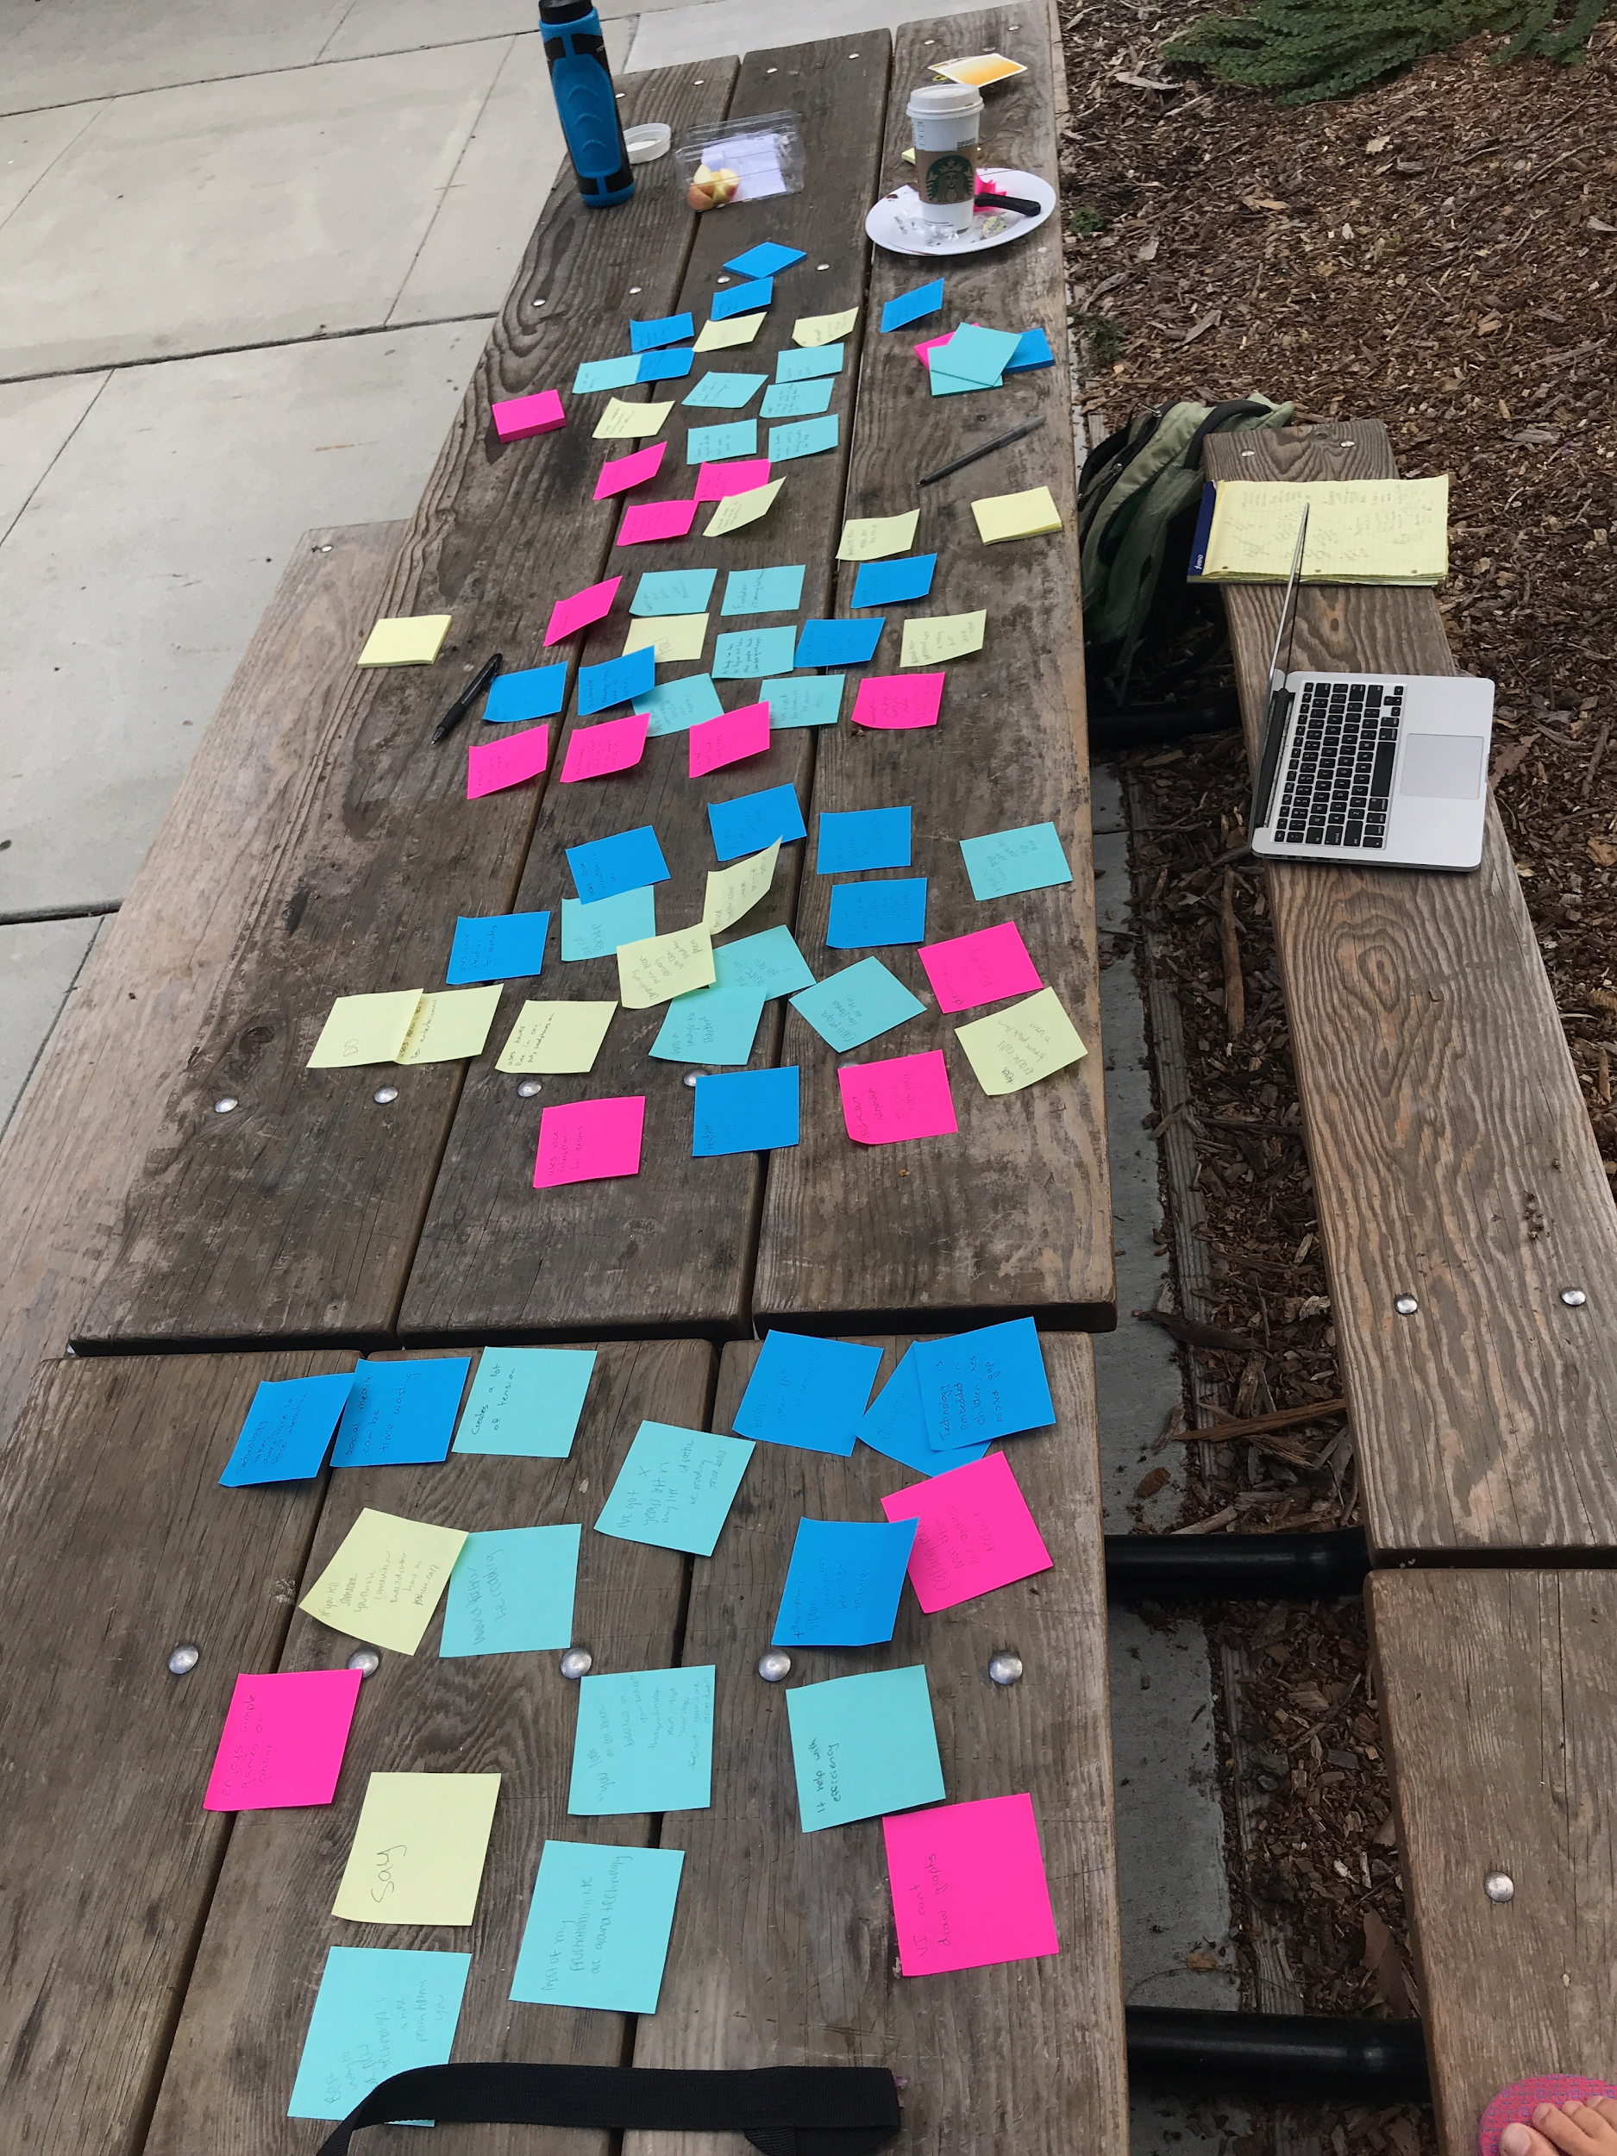
Empathy Map

Slide 13
Empathy Map
Feel:
-Independent, VI gives him independence
-Disconnected, technology does not come as naturally
-Hopeless, feels like a burden, but not overwhelmingly so
Say:
-VI can’t draw graphs
-Technology takes away from face to face interaction
-Technology helps with efficiency
Think:
-Needs more accessibility on phone
-Technology helps with efficiency
-Values his time
Do:
-Uses voice interaction for exams (Dragon Dictate)
-Uses VI for reminders/memos
-Has to figure out how people who make the app think logically so he can use it

Slide 14
Needs, Insight and Analysis

Slide 15
Insight:
VI technology increases accessibility and independence, but still often need other people for help in areas it doesn’t yet cover.
Need:
Method of drawing graphs using VI
Notes:
May initially seem niche, but it would be awesome to have that technology as a teacher too wouldn’t it?

Slide 16
Insight:
Technology is designed to help communication and connectedness, but you have to put in more effort and time to communicate using it
Need:
Hands free access to phone while driving
Notes:
This problem is prevalent; our interviewees pushed the need for better communication methods while driving - sometimes it’s hard to get the phone to work

Slide 17
Insight:
Learning new technology is frustrating even to people who love to learn
Need:
Easier/quick way of figuring out and learning new technologies
Notes:
This isn’t just specific to VI tech, but could use VI to help out
Want to be able to “talk to a person” while figuring out new tech

Slide 18
Summary

Slide 19
Different ages
4 People Interviewed
Different needs
Different occupations
Notes:
Goal was to increase the spread of backgrounds of our interviewees to get more distinct answers and needs

Slide 20
Difficulties with accessibility of technology seems to be a general trend in all interviewees
Notes:
Accessibility and ease of use

Slide 21
Questions?

