Slide 1
Pife:Med-Fi Prototyping

Slide 2
Agenda
Value, Prop, Problem and Solution Overview
Revised Interface Design
Tasks
Prototype Overview

Slide 3
Value Prop, Problem, and Solution Overview

Slide 4
Background
Musicians feel as if they have nothing to practice for and no one to practice with, which leads to a lack of motivation to practice

Slide 5
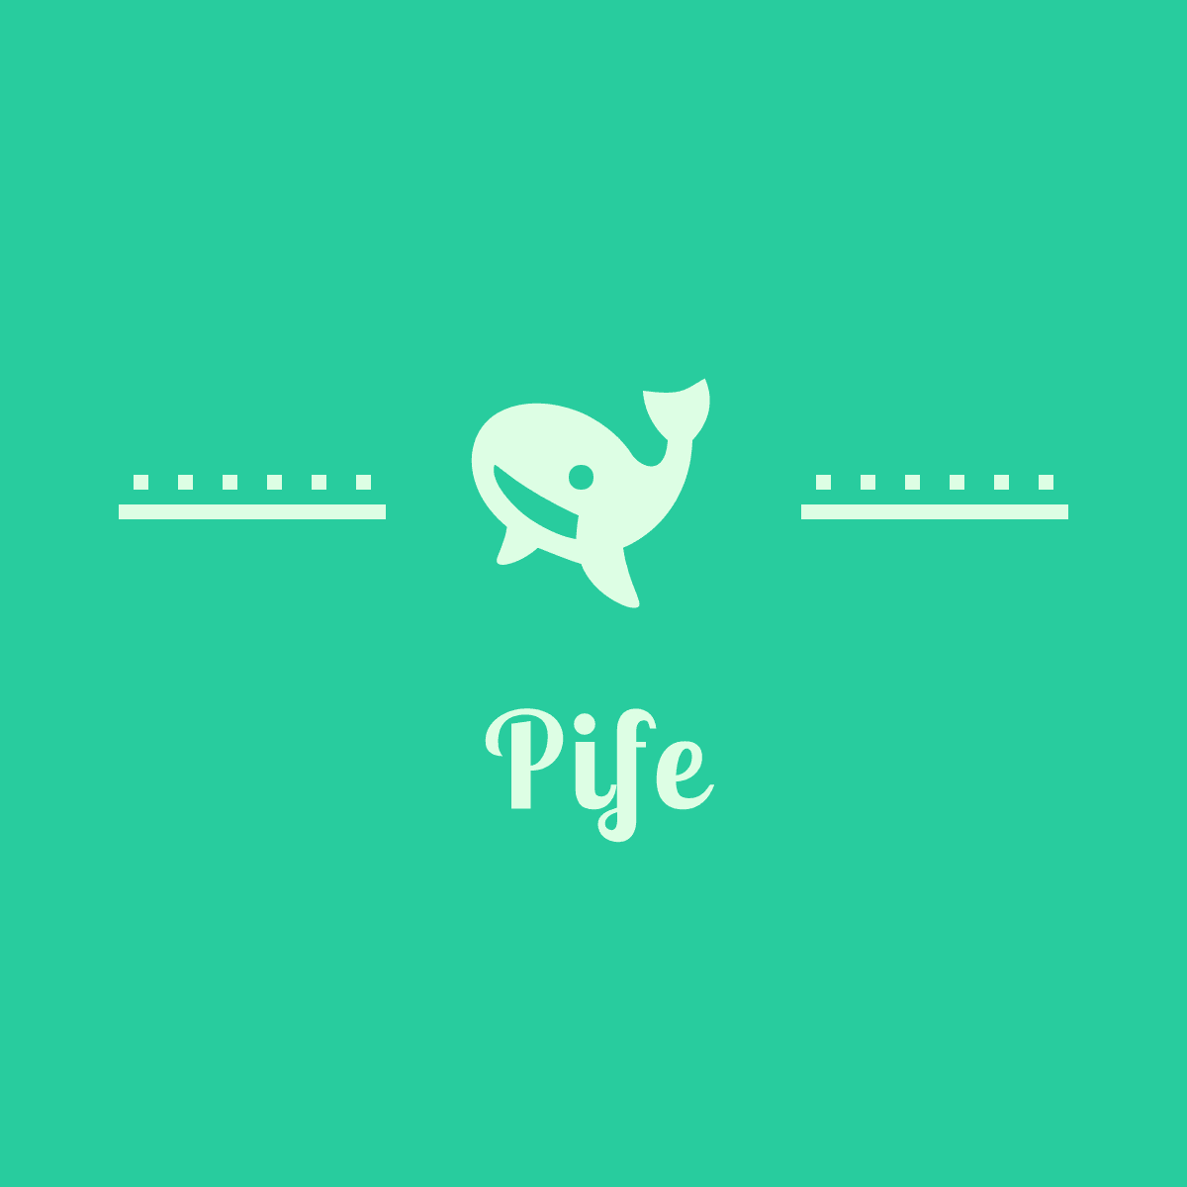
Always Have A Friend to Practice With
Mission Statement

Slide 6
Revised Interface Design

Slide 7
Biggest Interface Changes
Improve user connection with avatar by placing the avatar in a home setting and allowing for avatar evolution
Improved community engagement with ability to respond to feedback and ability to give live reactions + audience profiles during performances
Added clarity to tools through intermediary screens, clearer buttons and prompts

Slide 8
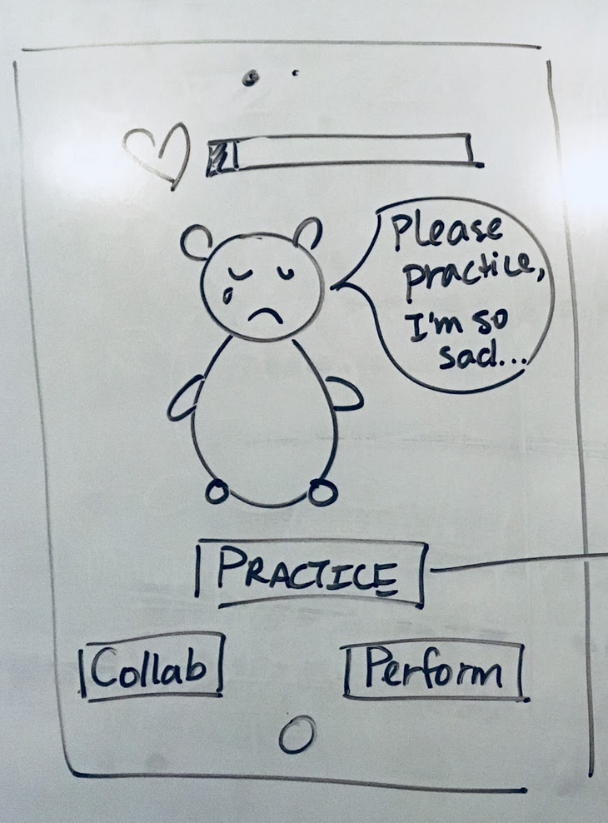
Revised DashBoard
Include Level Up screen at end of app
Include interactive world for Avatar to Play In
Notes:
We also added the name to the Dashboard along with Access control to settings and the My profile, including the store. The store is to dress up your avatar or unlock other items like

Slide 9
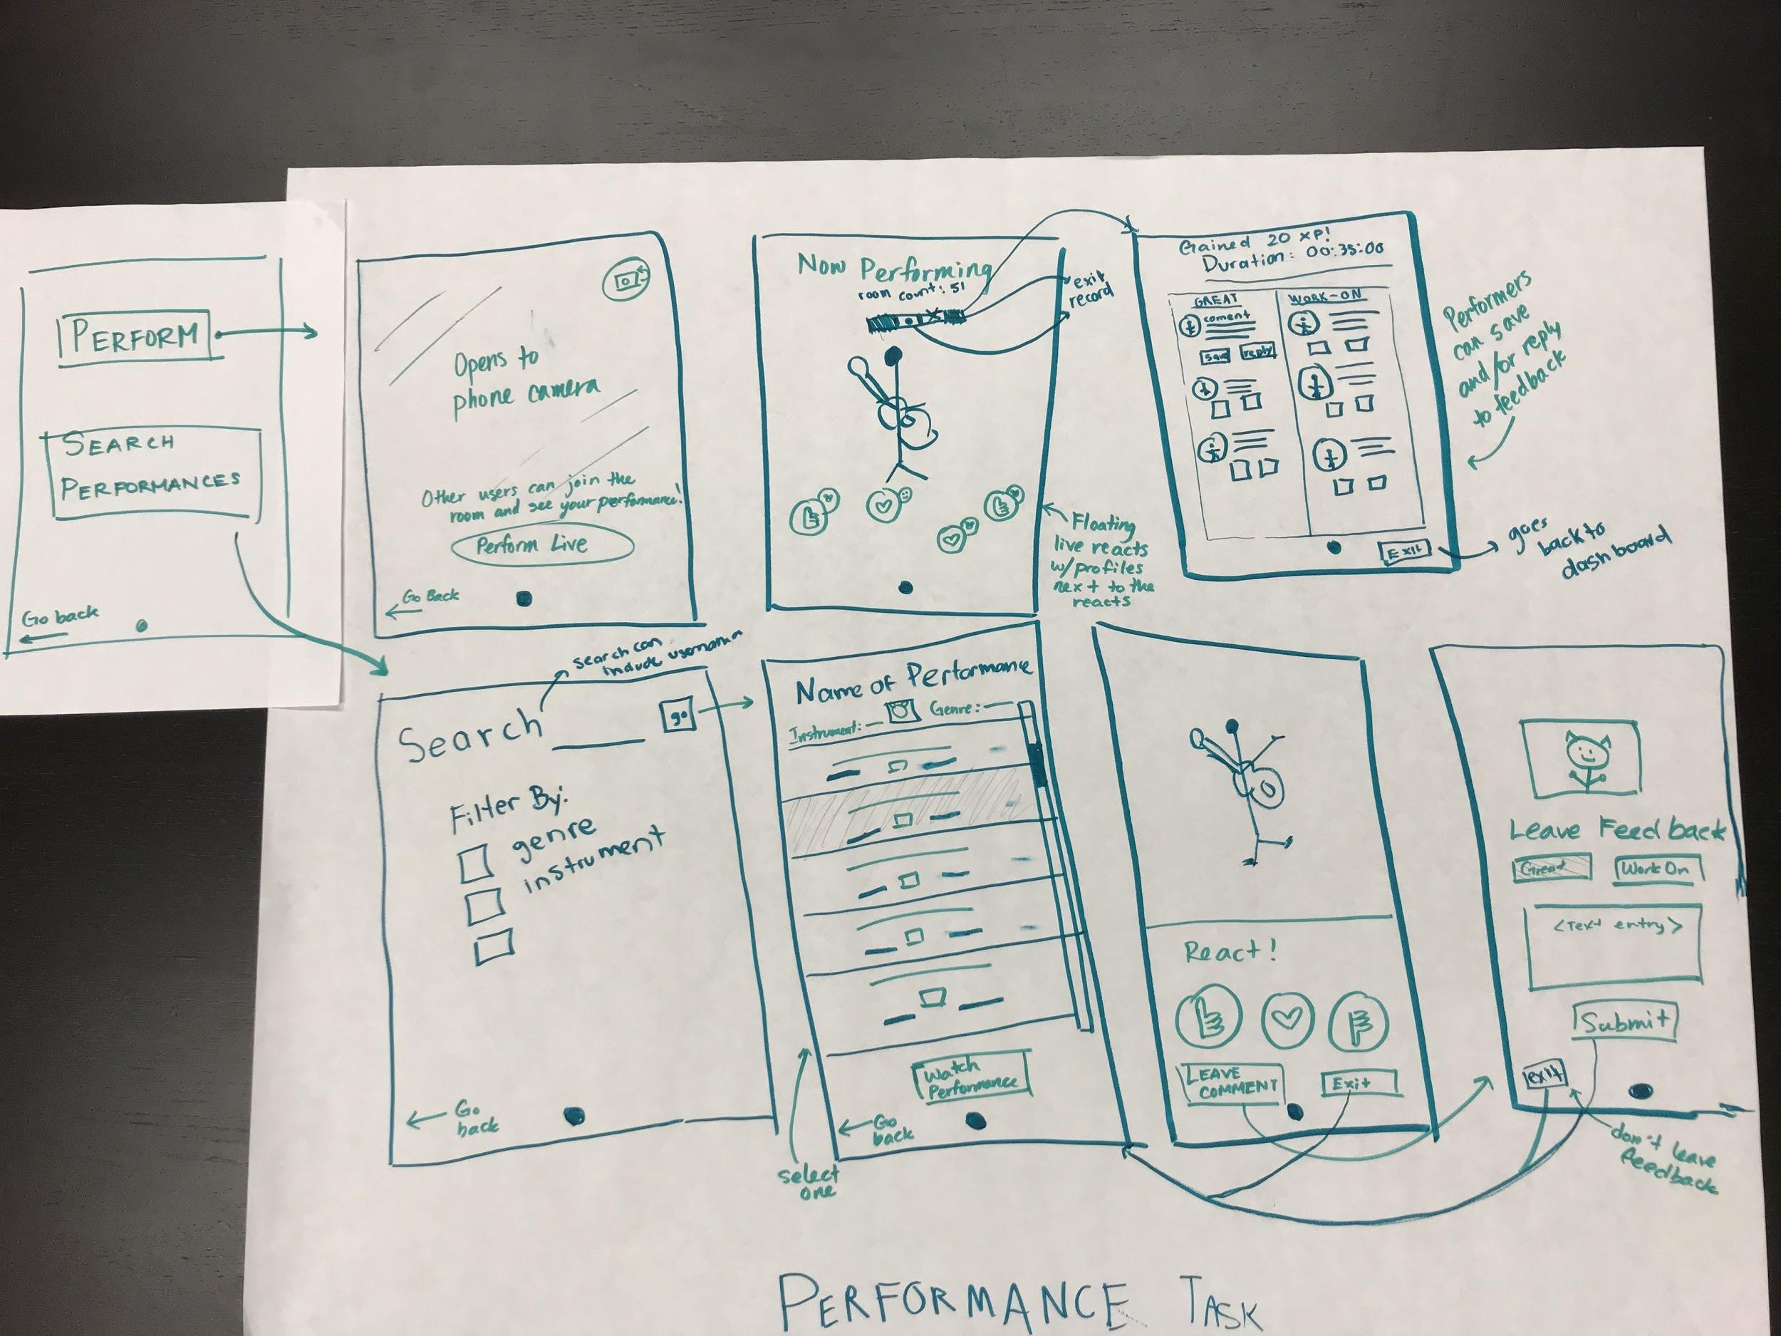
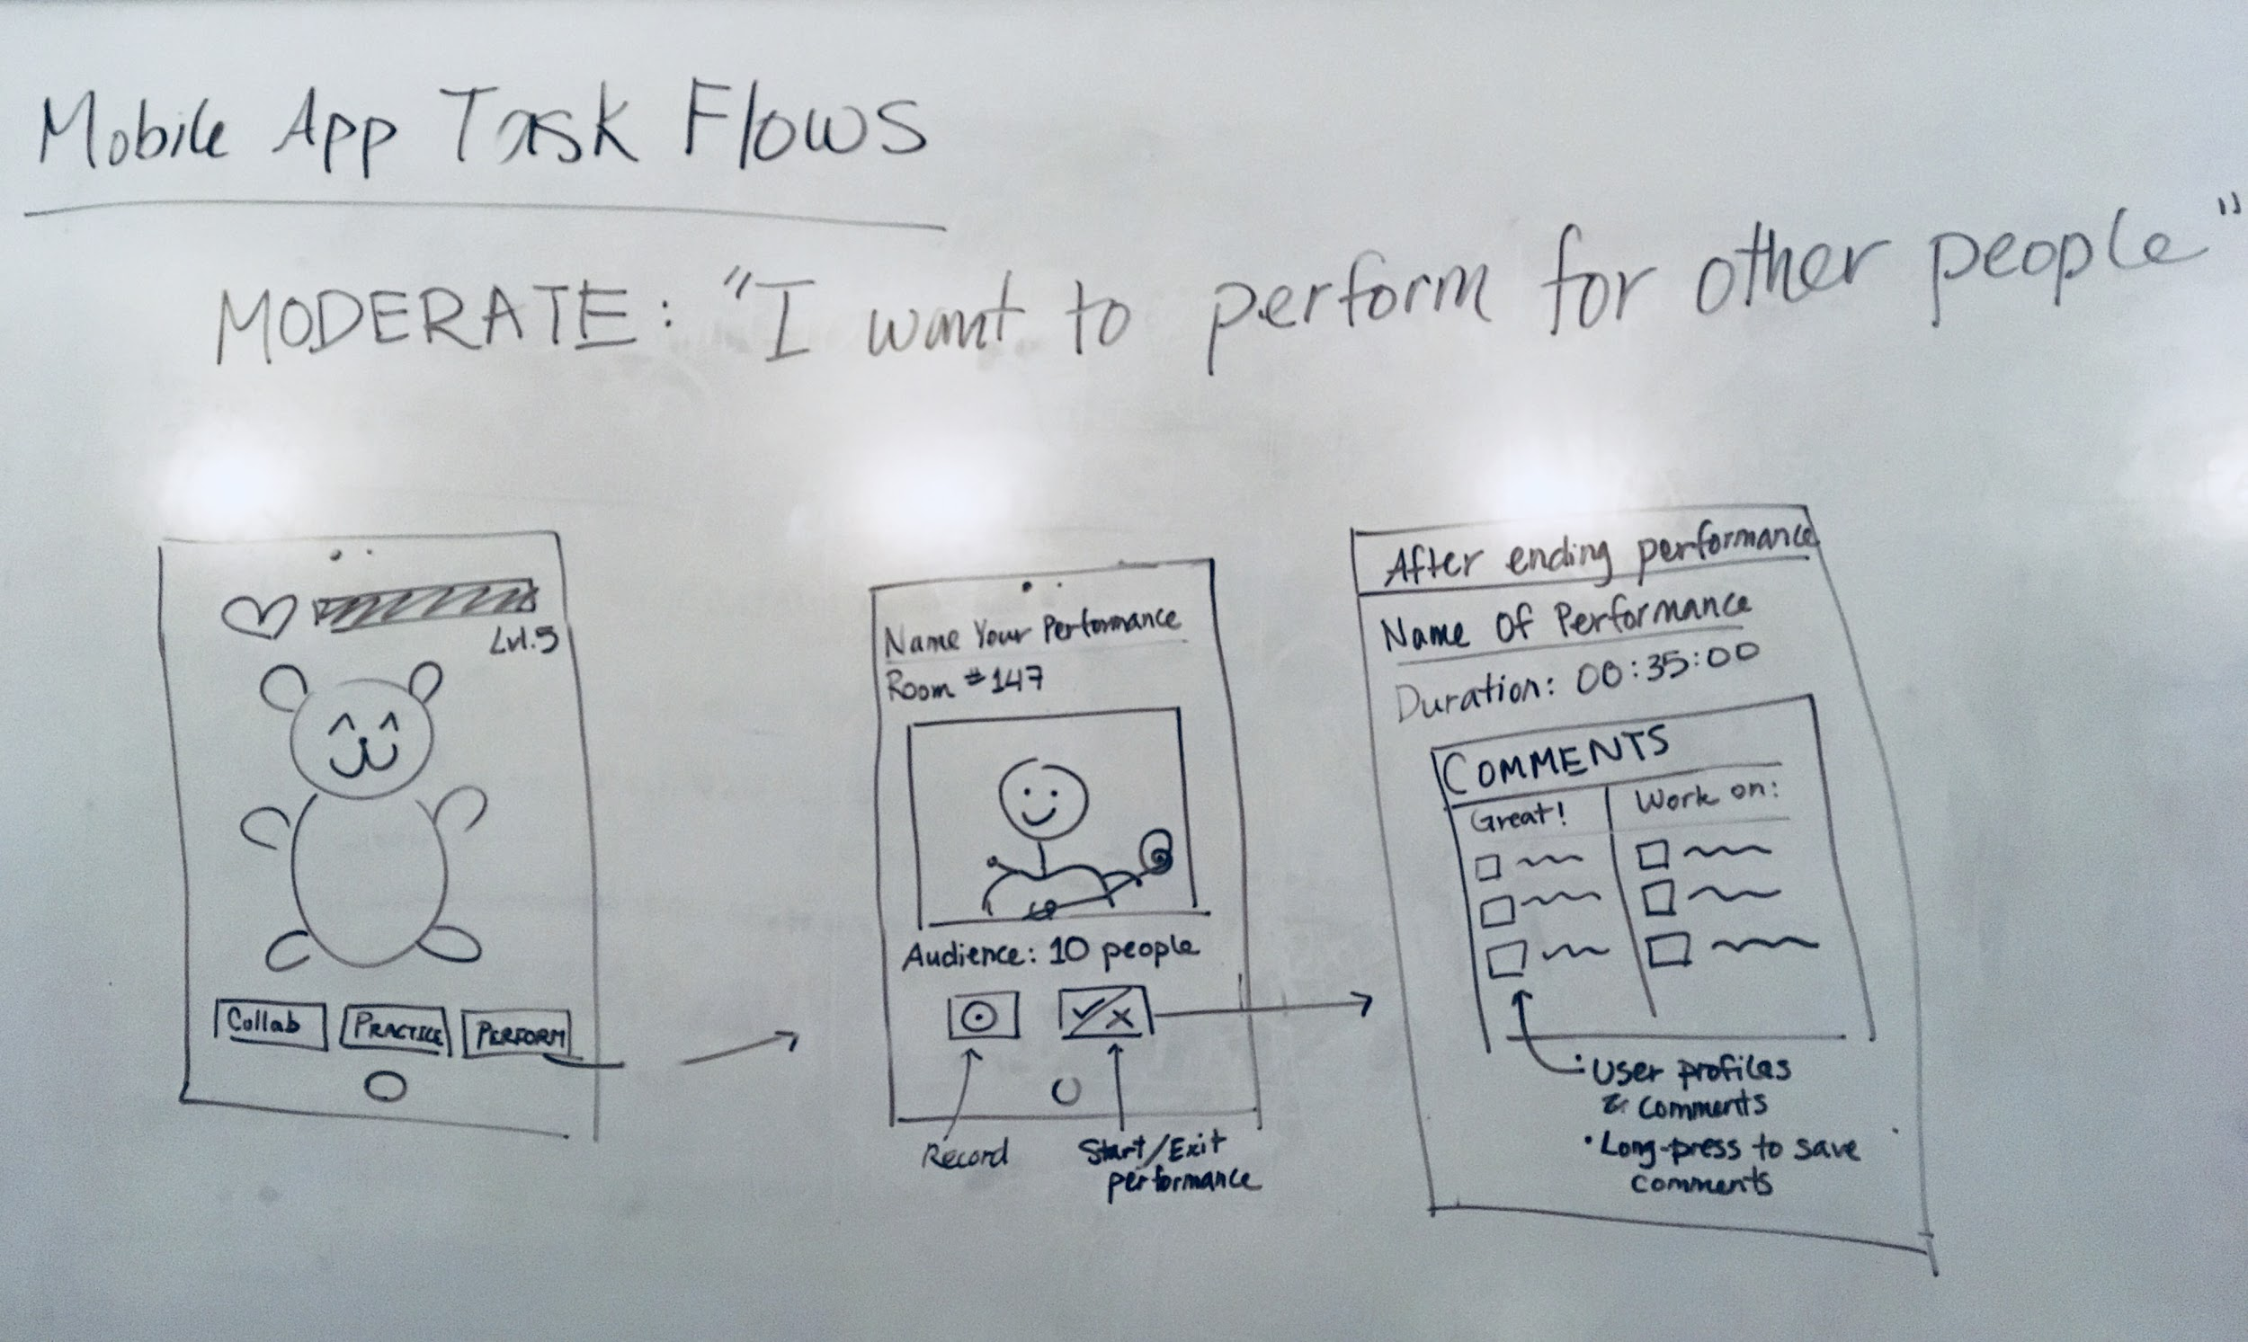
Revised Performance Task
Offer options to perform and search for performances
When performing, you can see the reacts of your viewers
You can react people’s performances
Notes:
Explan rational of

Slide 10
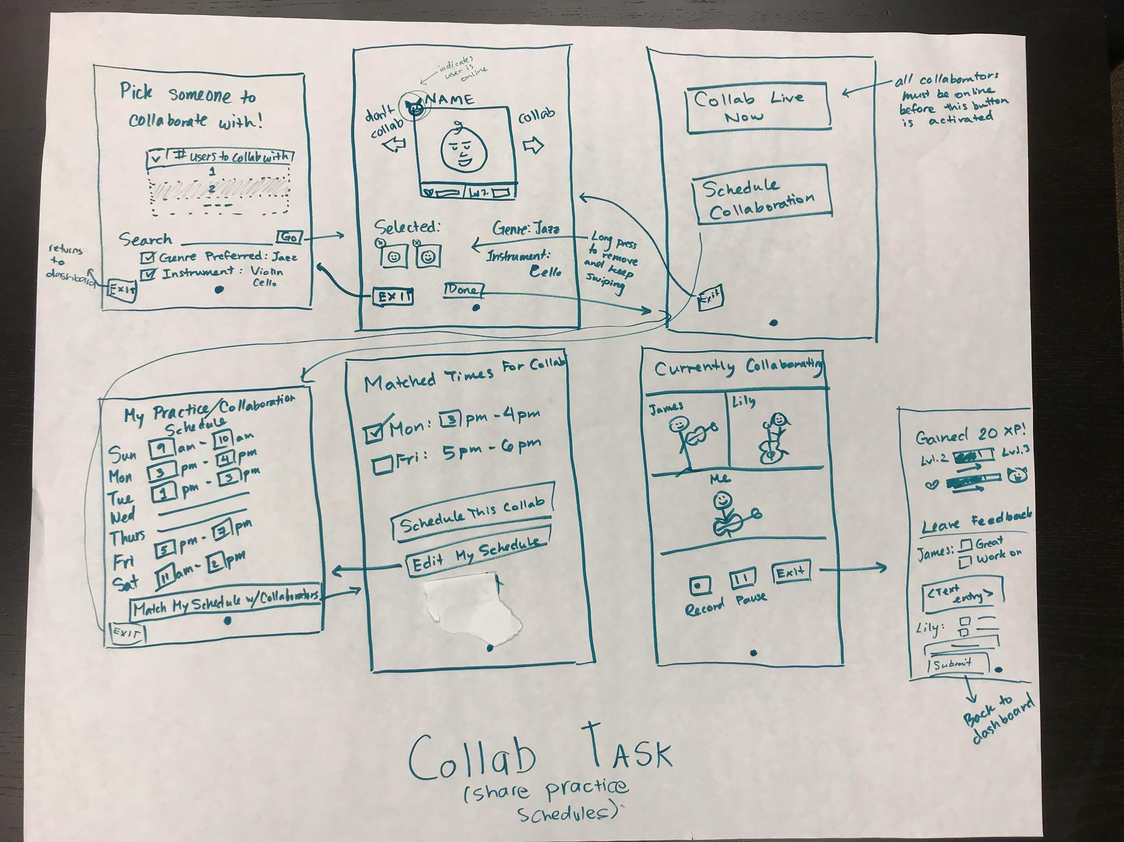
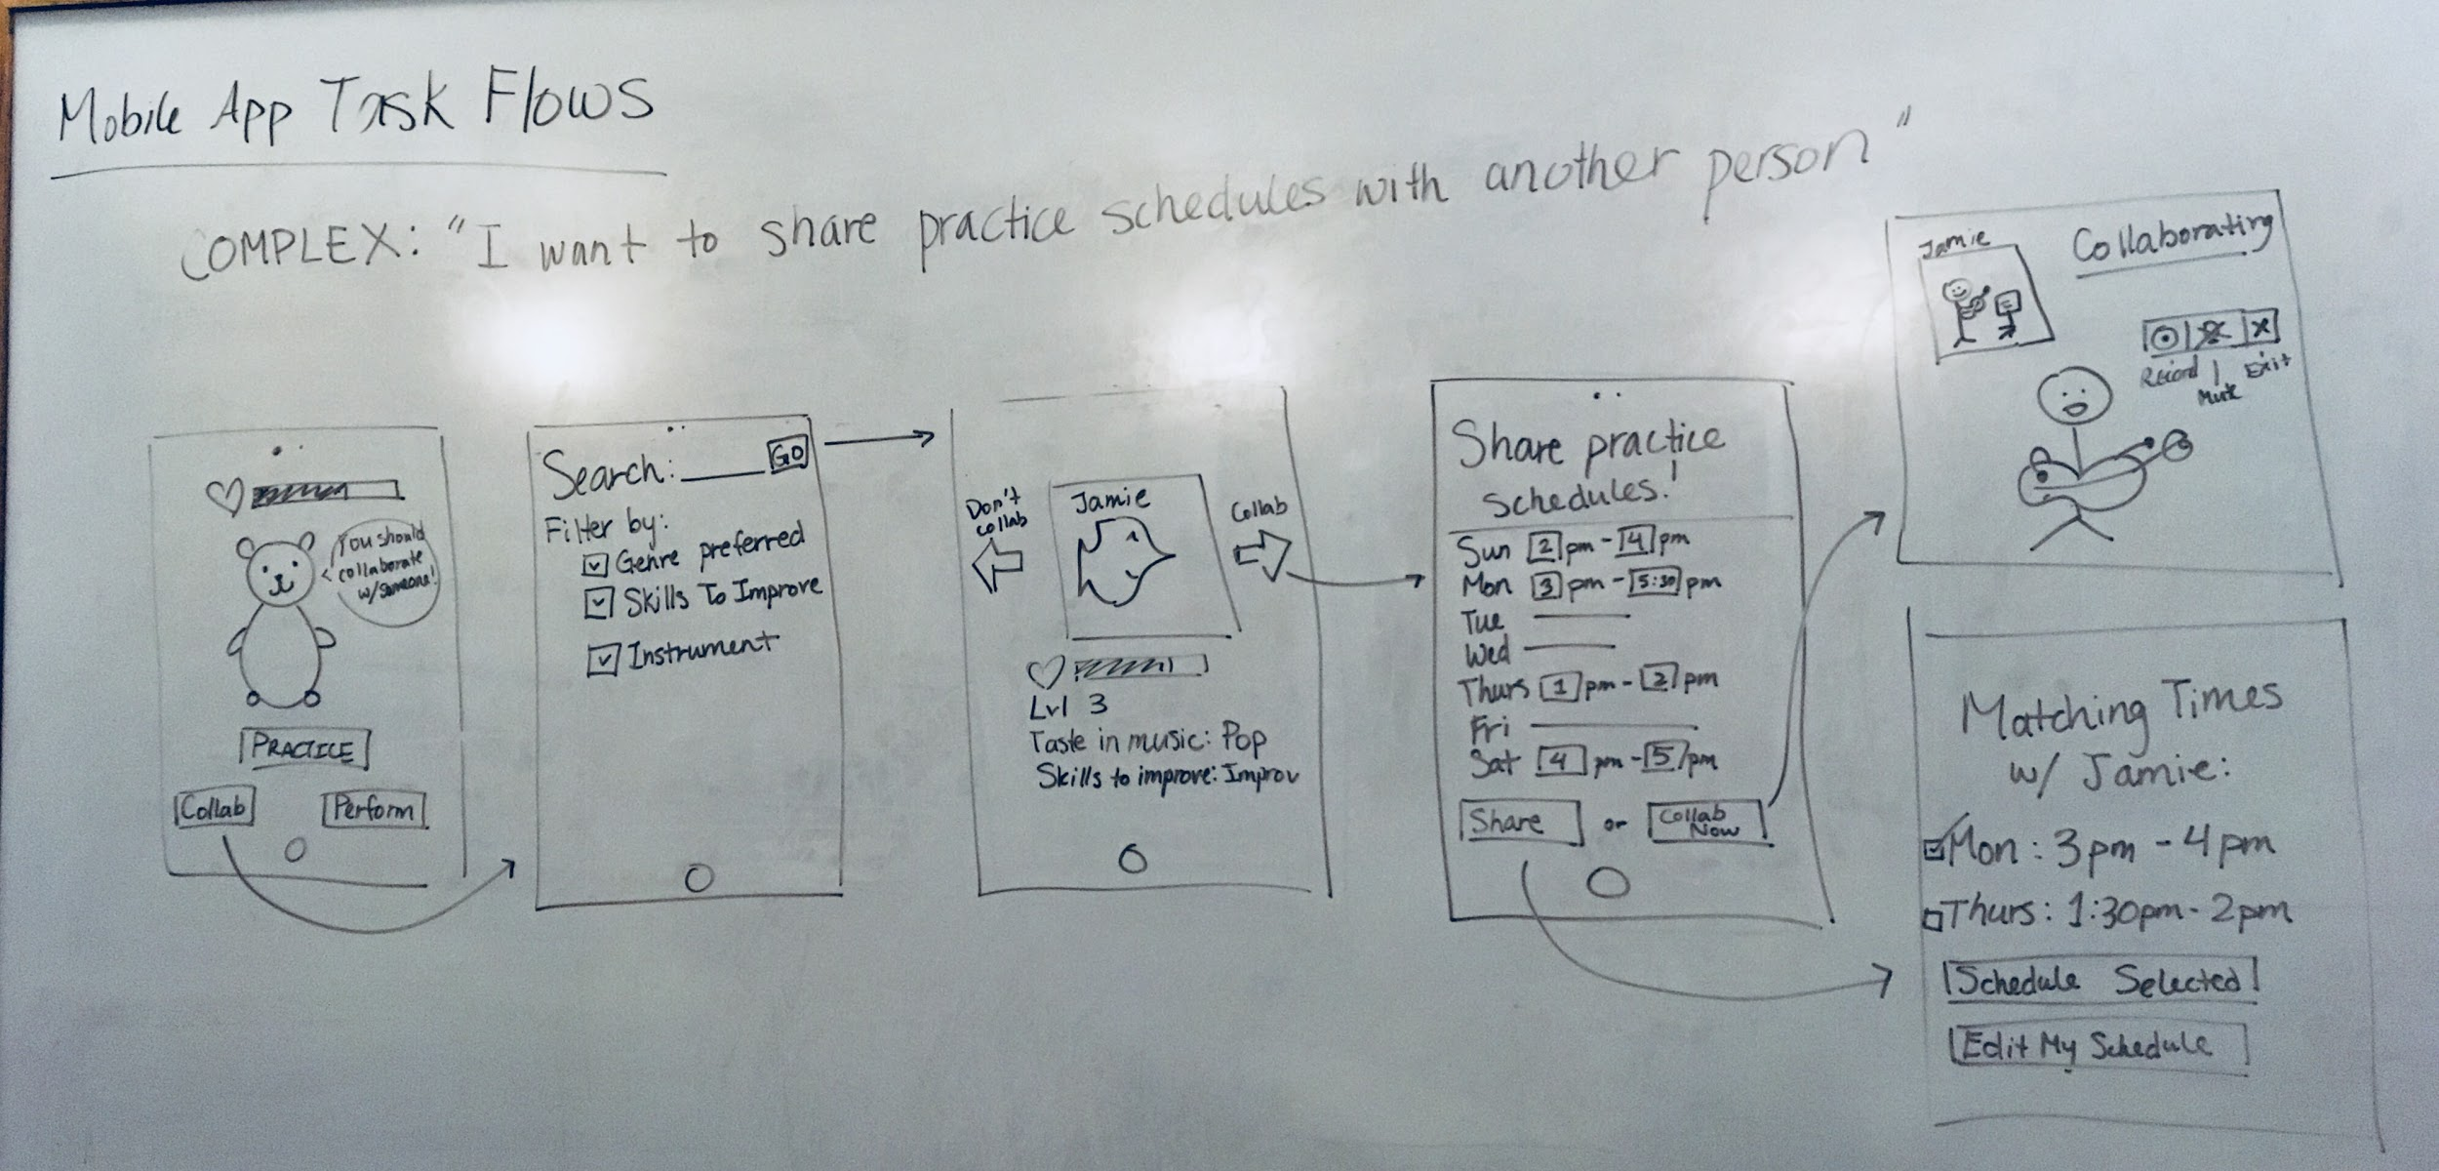
New Collaboration Task
If user online, you and initiate an instant live collab, or schedule on later
You can collaborate with 2+ users

Slide 11
Mid-Fi Prototype Tasks and Task flow

Slide 12
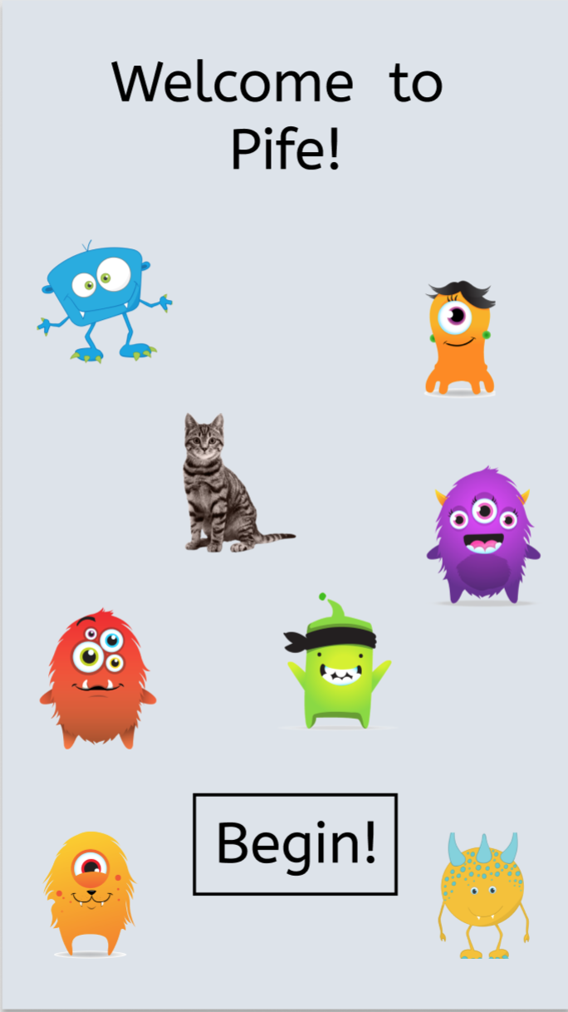
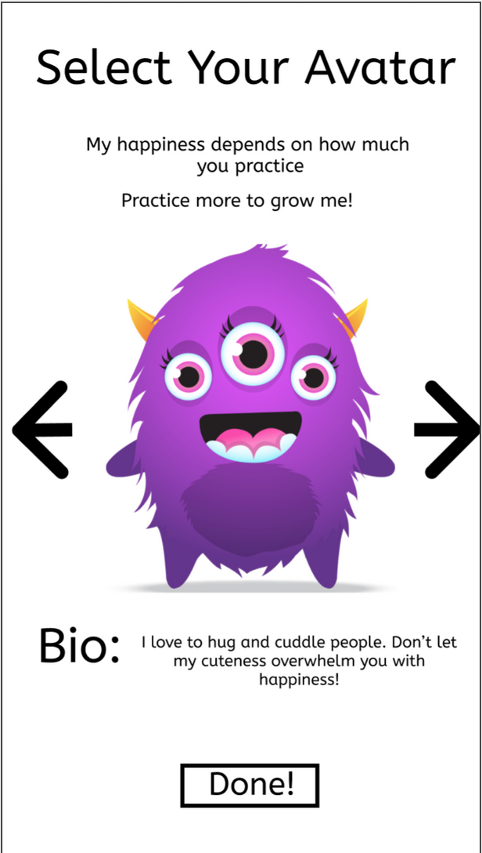
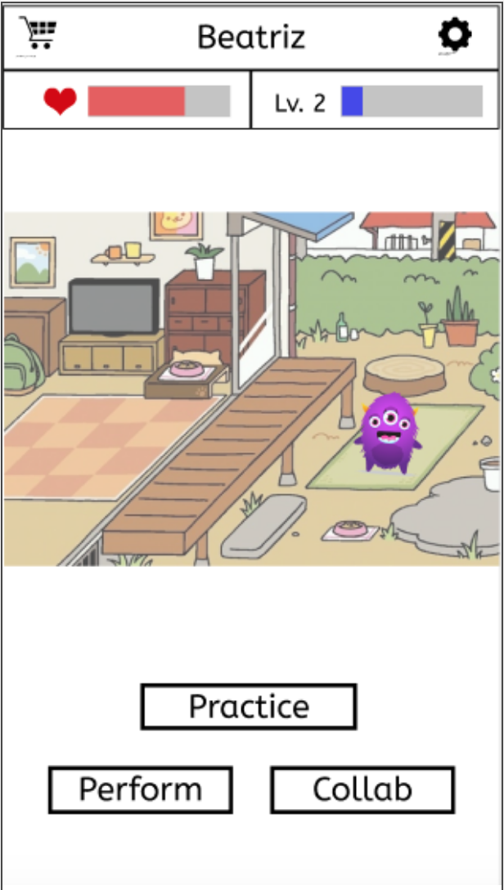
Signing in
Avatar now has personality, level-up growth and ability to roam a digital world, which helps create a connection between user and avatar

Slide 13
Task 1 - Simple
“I want to feel motivated to practice.”

Slide 14
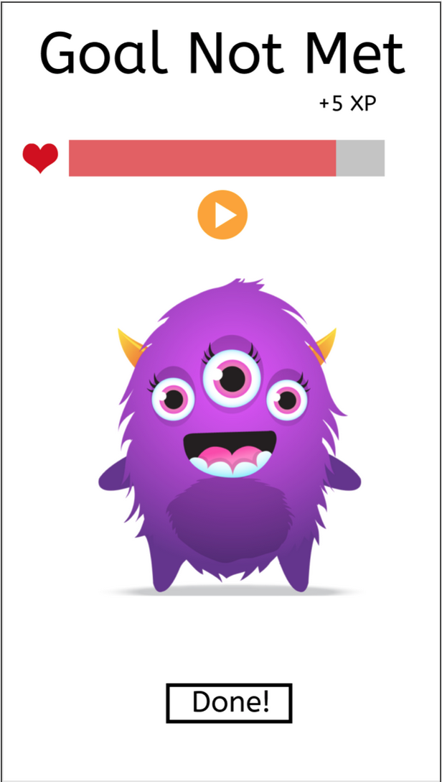
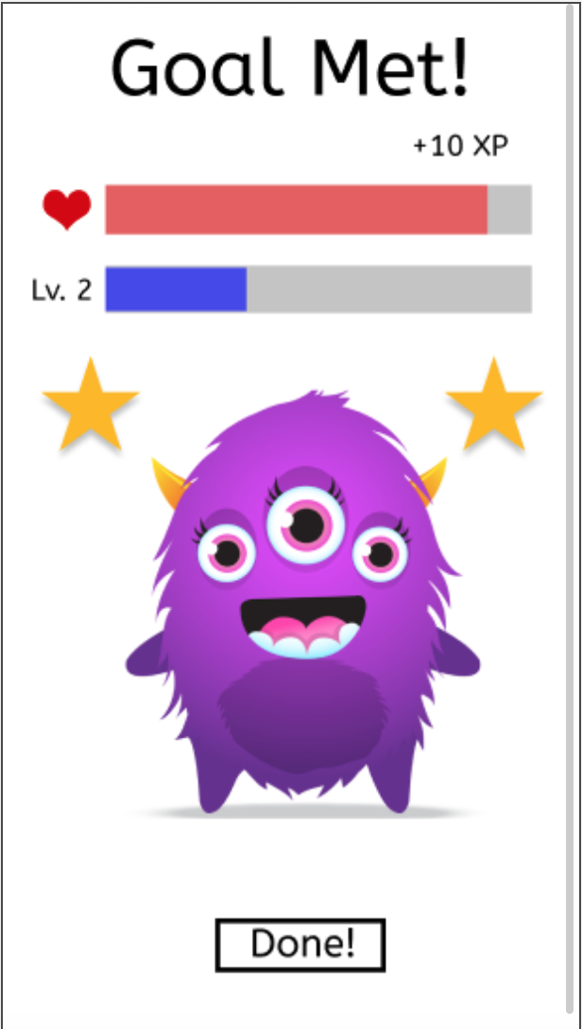
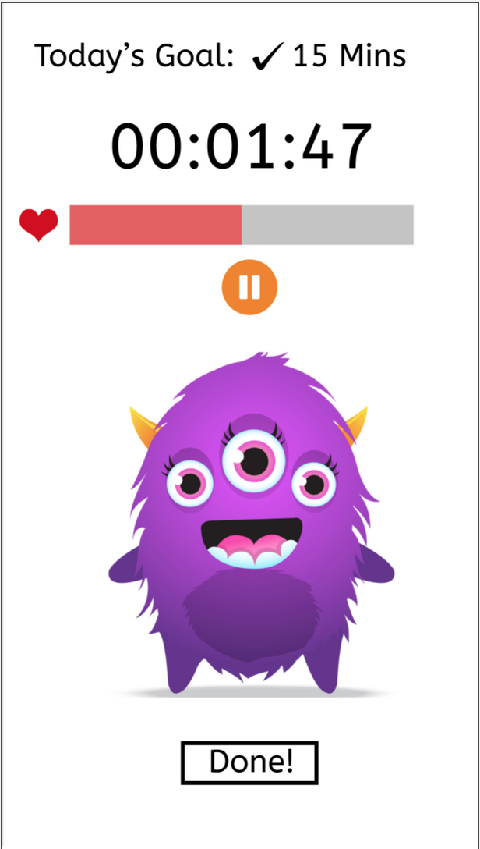
Task 1: “I want to feel motivated to practice.”
Added practice goal selection (see second screen)
Notes:
Taskflow 1`

Slide 15
Task 2 - Moderate
“I want to feel perform in front of others.”

Slide 16
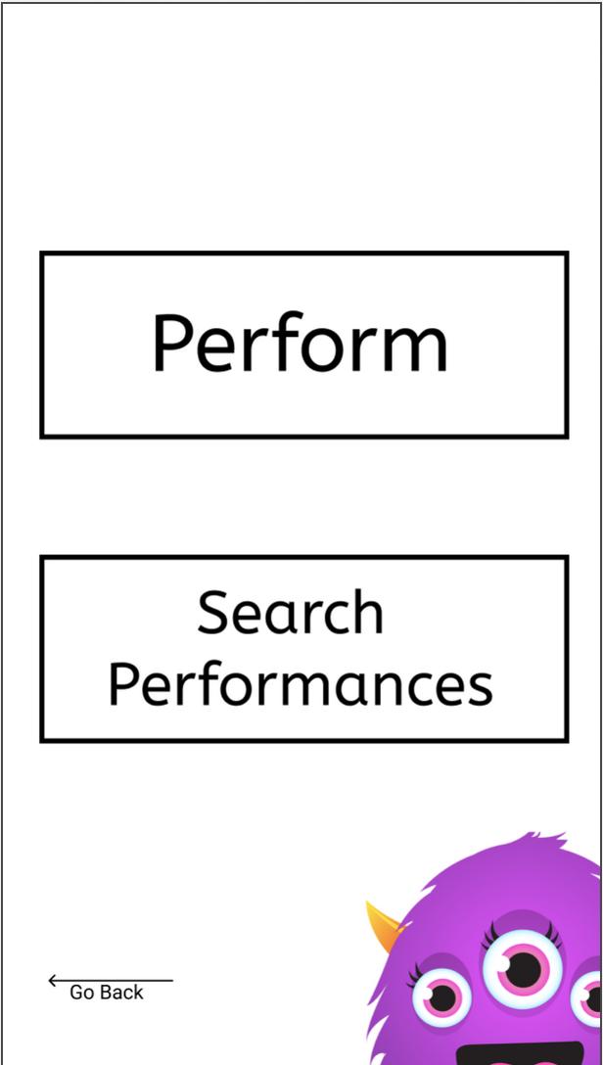
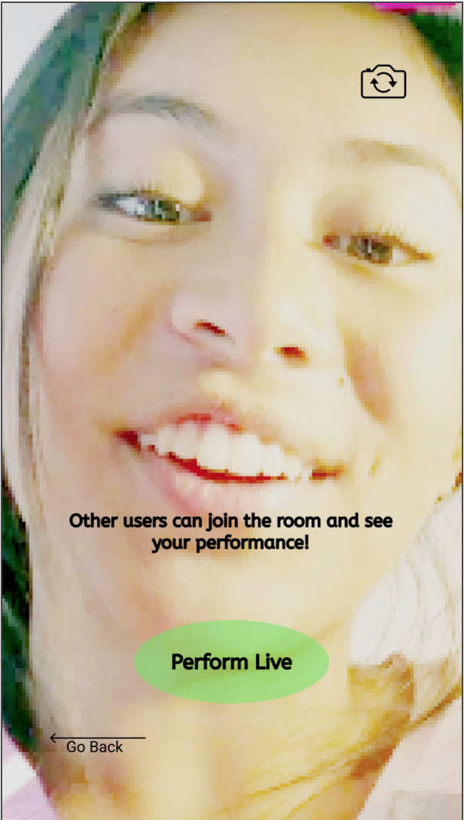
Task 2: “I want to perform in front of others.”
Added ability to search for performances
Added more prompts to guide user through Performance tool and add clarity

Slide 17
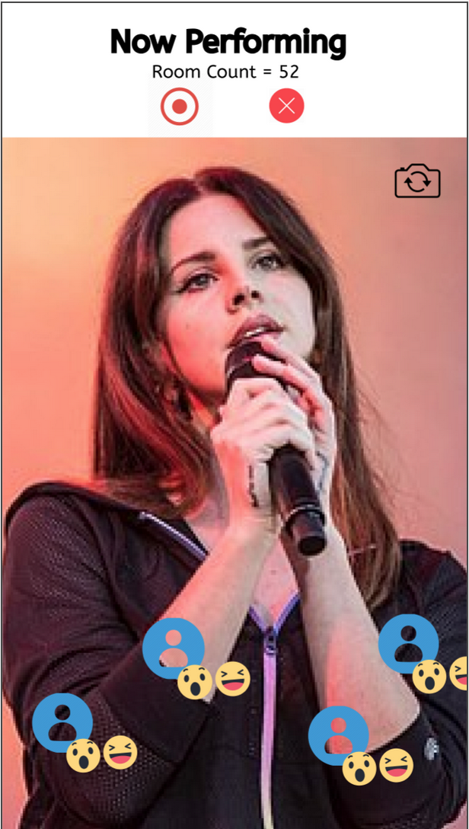
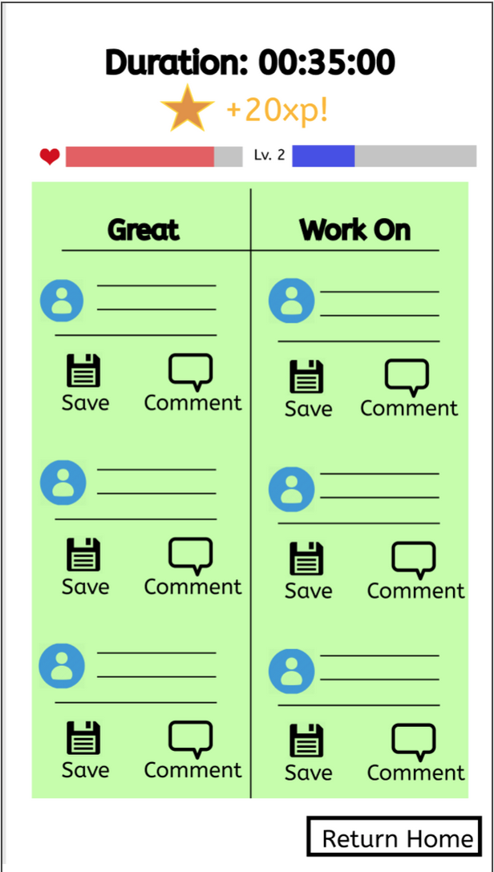
Task 2: “I want to perform in front of others.”
Added live react buttons attached to profile pictures to emphasize audience presence
Added feedback reply feature to encourage community engagement

Slide 18
Task 3 - Complex
“I want to share my practice schedule with others.”

Slide 19
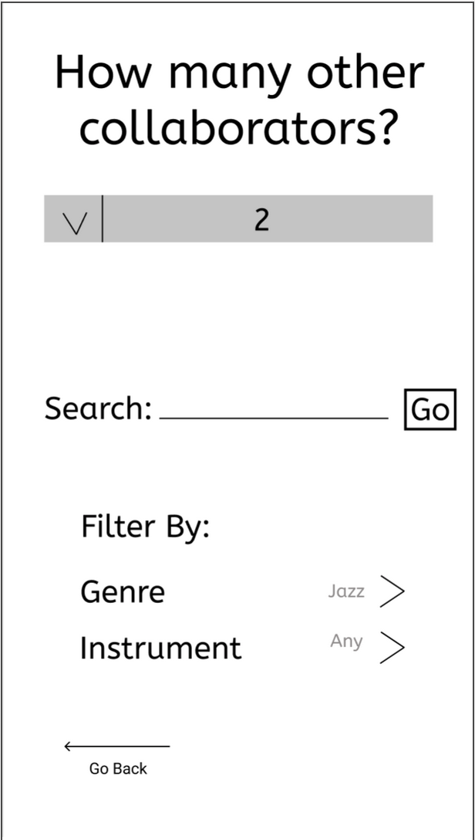
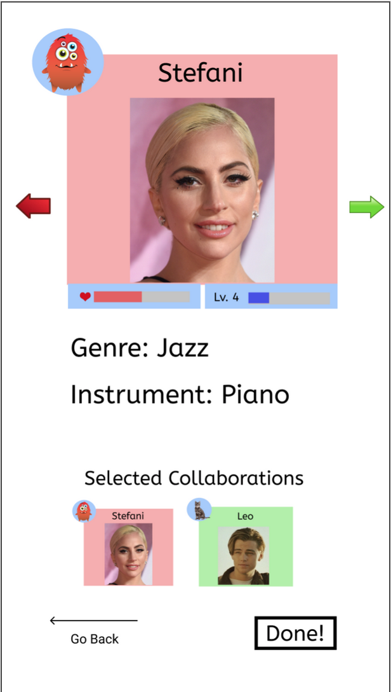
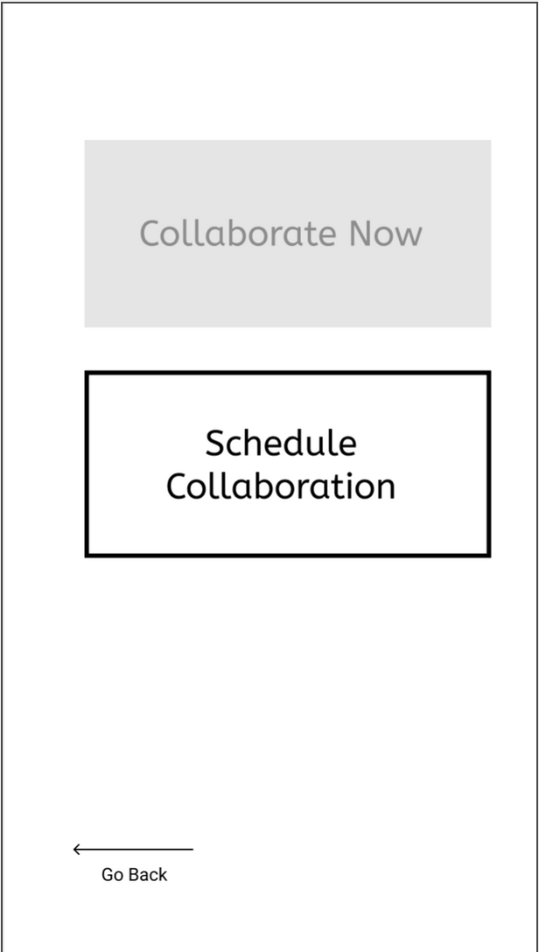
Task 3: “I want to share my practice schedule with others.”
User can now choose number of collaborators; added prompts for clarity and guidance through Collaboration tool

Slide 20
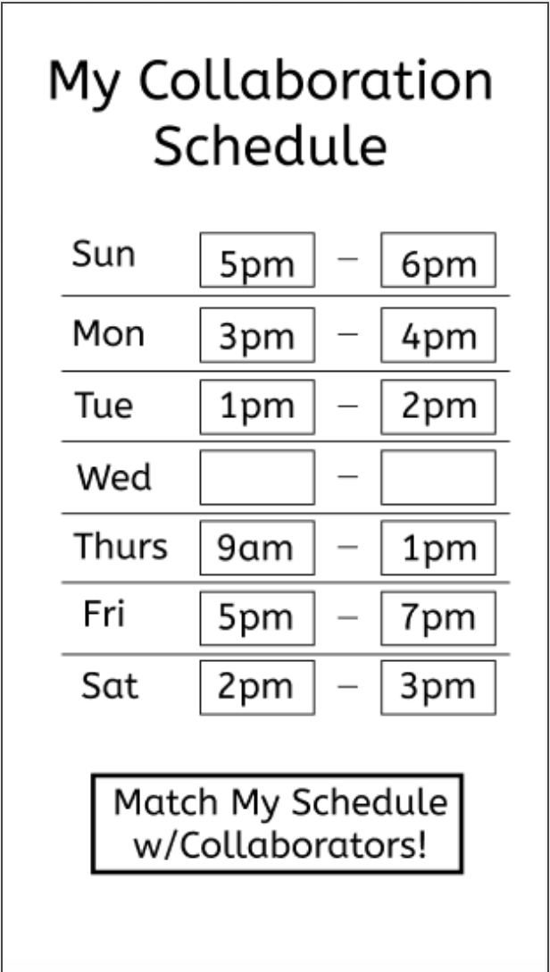
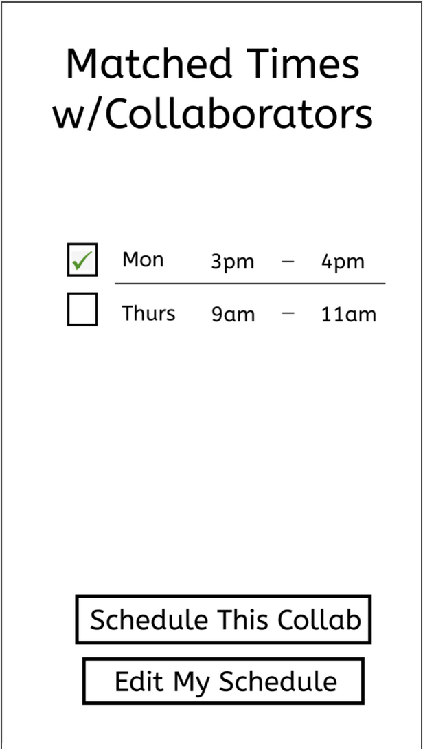
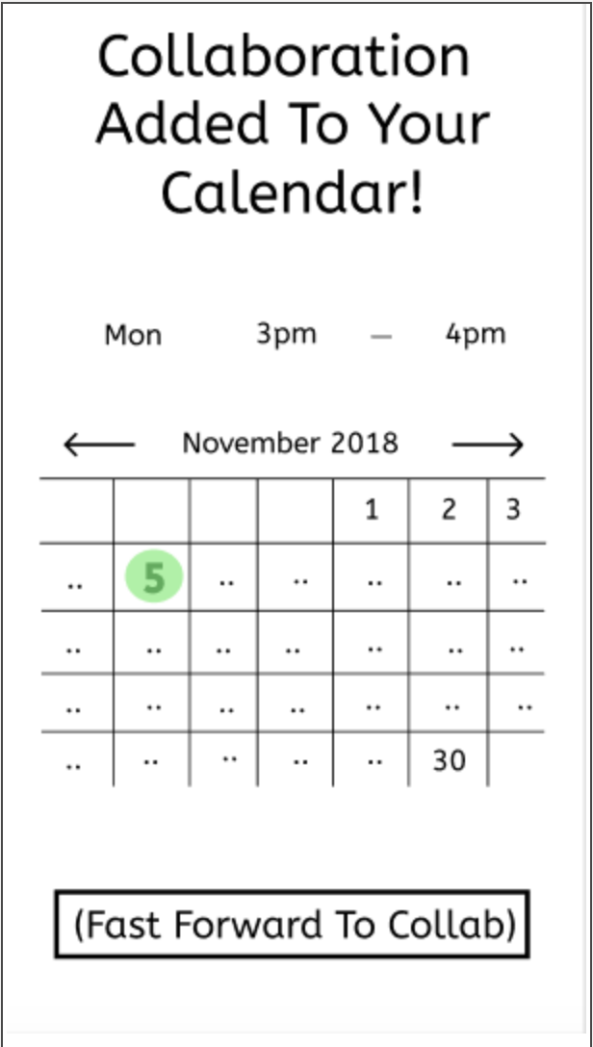
Task 3: “I want to share my practice schedule with others.”
Added clearer buttons to add clarity to scheduling tool

Slide 21
Prototype Overview

Slide 22
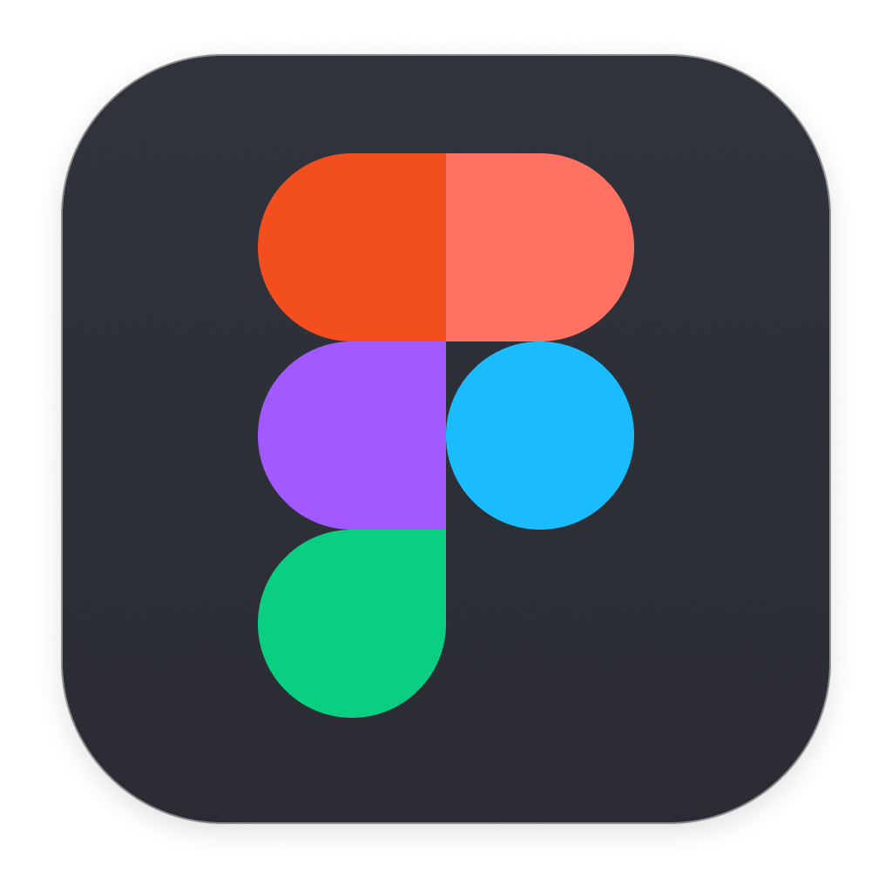
Tools
Figma & Marvel
Figma - Great for screen creation
Marvel - Great for interaction design
Two separate tools made general editing difficult

Slide 23
Limitations/Tradeoffs
Limitations
Hard to hard-code other avatars
Creating tutorials/storyline for gamification aspect
Hard to bring up keyboard to type
Hard-coded Details
Level-Up Feature - we wanted to get across the gamification aspect of our app

Slide 24
UI Changes + Summary

Slide 25
UI Changes and Summary
Added clarity to avatar character
Included live audience feature for performances
Extended collaborations to a 2+ party

Slide 26
Link:
https://marvelapp.com/7deidfd

Slide 27
Appendix

Slide 28
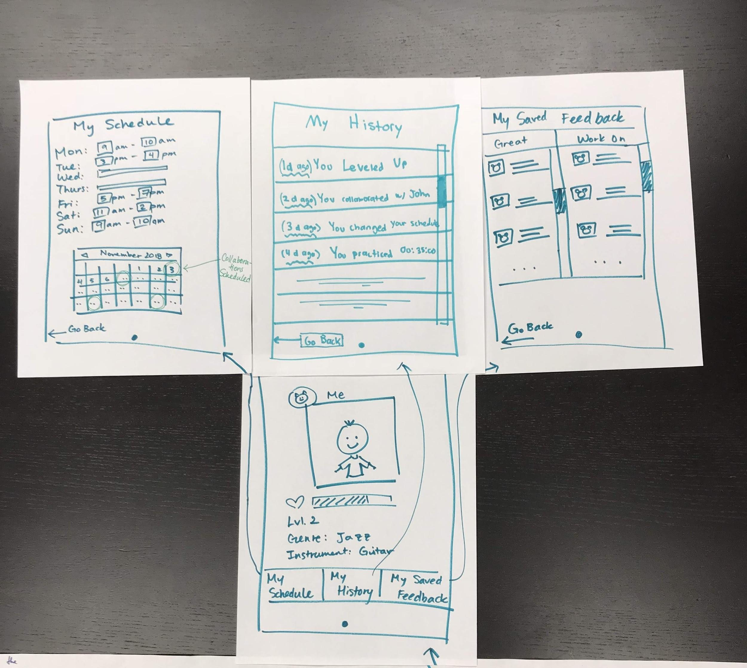
User Profile StoryBoard
Notes:
Added new Settings/Additional Information page to enhance previous features and clarify where “My Schedule” Lives. Keeps Collaboration Task Flow cleaner.

