Slide 1
Arts and Culture Studio
Concept Video

Slide 2
Value Proposition
“Always have a friend to practice with!”

Slide 3
Problem
Solution
Motivate practice with a digital pet whose happiness depends on how much its user practices
Utilize reward systems for practice time - rewards include trophies, accessories and games
Facilitate collaboration & interaction with other musicians and their digital pets
Musicians feel as if they have nothing to practice for and no one to practice with, which leads to a lack of motivation to practice

Slide 4
Three Tasks
Simple:
I want to feel motivated to start practicing today
Moderate:
I want to perform in front of other people
Complex:
I want to align my practice schedule with other collaborators’ schedules

Slide 5
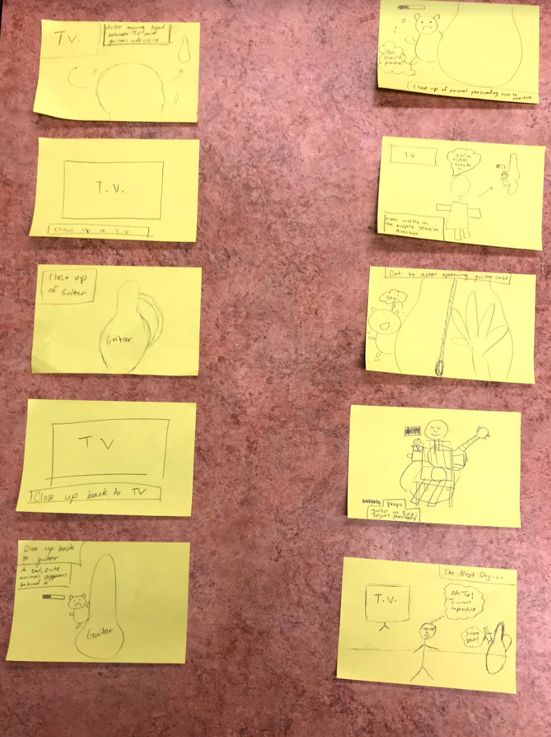
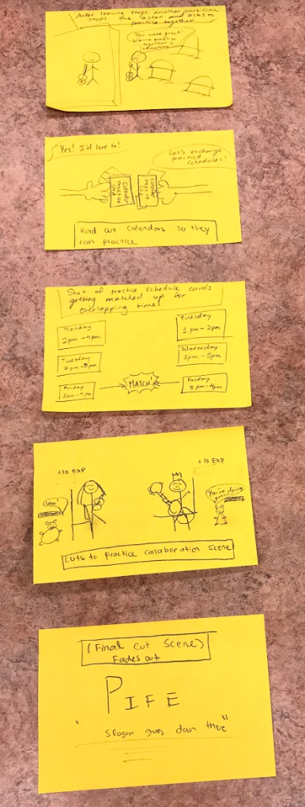
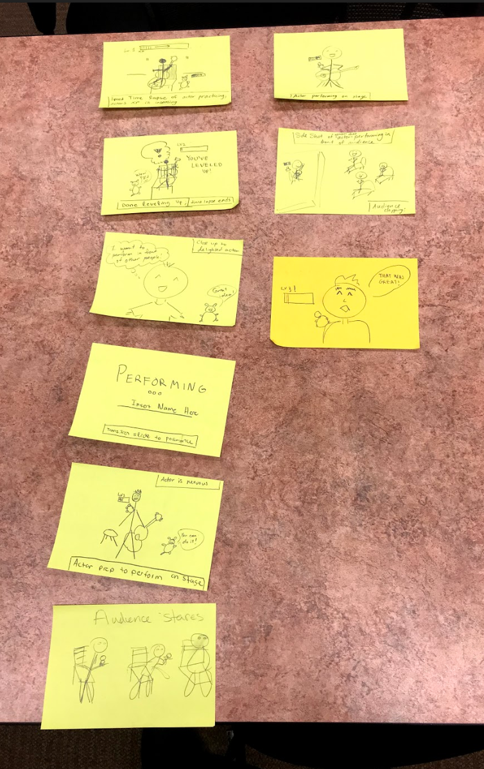
Storyboarding Process...

Slide 6
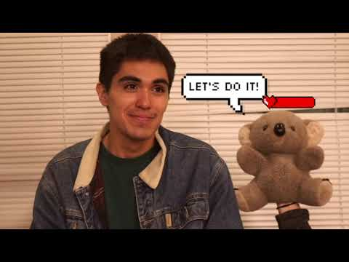
Concept Video

