Slide 1



Student - Teacher Connections in Education
Paulina Reyes Jailene Miranda-Enriquez Sanura N’Jaka Kristina Inouye
Team 4

Slide 2

Problem Domain
Positive student-teacher relationships need to be more accessible and prioritized.
Notes:
To describe further: Last week, we had a recurring theme of "connection" and "relationships" across our slides. When choosing this domain, we defined positive student-teacher relationships as bonds where both parties felt comfortable expressing their thoughts, ideas, and personal aspects. For example, teachers who have positive relationships with their students might periodically make time to check in on them at a personal level, go to their students' basketball games or performances. This connection between students and teachers is not always accessible. Teachers who do those things I just listed are "ideal" teachers, the ones who would be "your favorite." How can we help teachers achieve this level of connection, and make these ideal teachers the norm? What barriers in the education system will we have to overcome for this to occur?

Slide 3
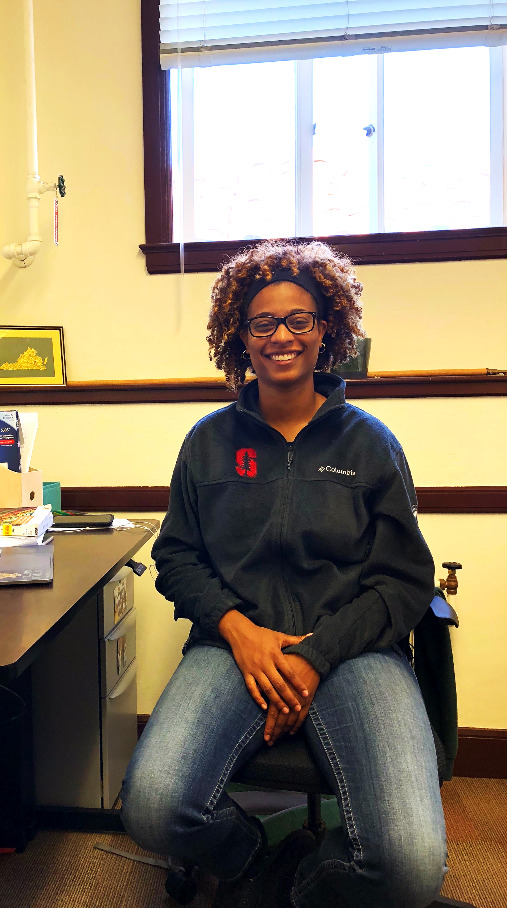
We met...
Initial POV
We were amazed to realize...
It would be game changing to...
Danielle Greene
Former middle/high school social studies teacher for 5 years, current PhD student
that she put so much time and effort in order to get to know her students, which was sometimes tiring.
make it easy for all teachers to spend extra time with their students.

Slide 4


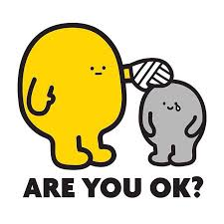

Additional Needfinding Results
Who did we interview?
Focused on student experiences with the types of relationships they have with their teachers
Interviewees: Daysy, Brighid, Karsten
What did we learn?
1.
Vulnerability and willingness to share should be mutual
Students’ best interactions with teachers were when teachers showed they care
2.
Overstepping boundaries leads to a negative relationship
3.
Notes:
Why High School? From the extremely wide range of interviews we conducted last week, we found that relationship-building became less prioritized as students progressed through grade school.
Insights:
When a teacher opened up to Brighid, she felt more comfortable opening up to them
Positive memories: AP U.S. History teacher approached Daysy and checked up on her since she looked stressed
Overall, we found that positive student-teacher relationships were a lot more nuanced than just spending time with the students.

Slide 5
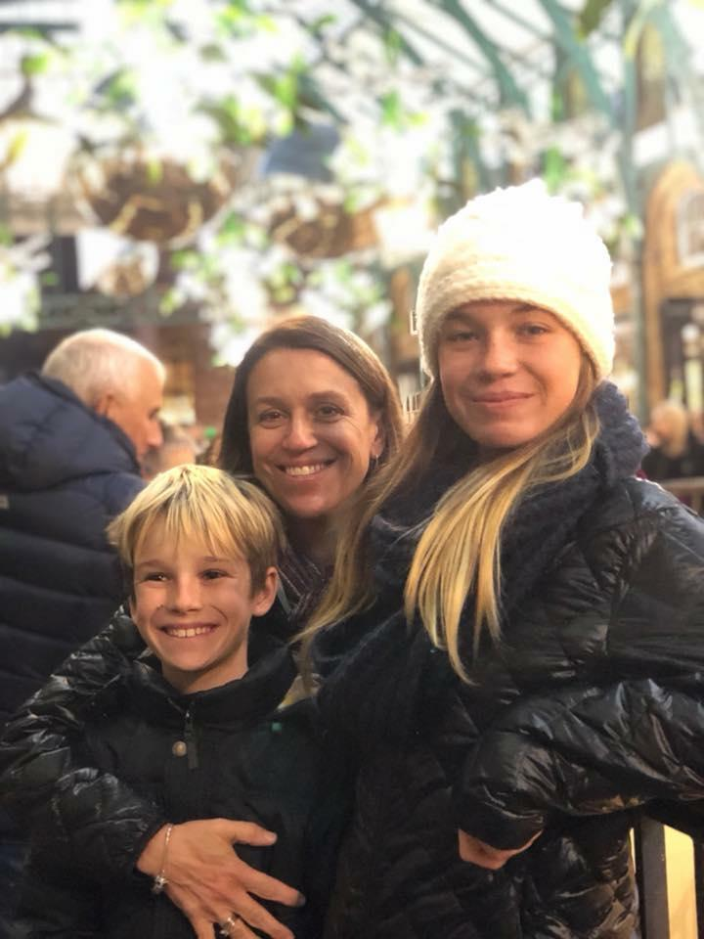
We met...
We were amazed to realize...
It would be game changing to...
Brighid
High school freshman
that even though she isn’t shy, she’s too scared to ask her teacher for help since she is intimidated by her strictness.
provide a way for teachers to understand when their classroom environment is restricting a student’s education.

Slide 6
How might we...
Solution:
help teachers create a class atmosphere that encourages both a dedication to learning & class engagement?
Interactive daily check in

Slide 7
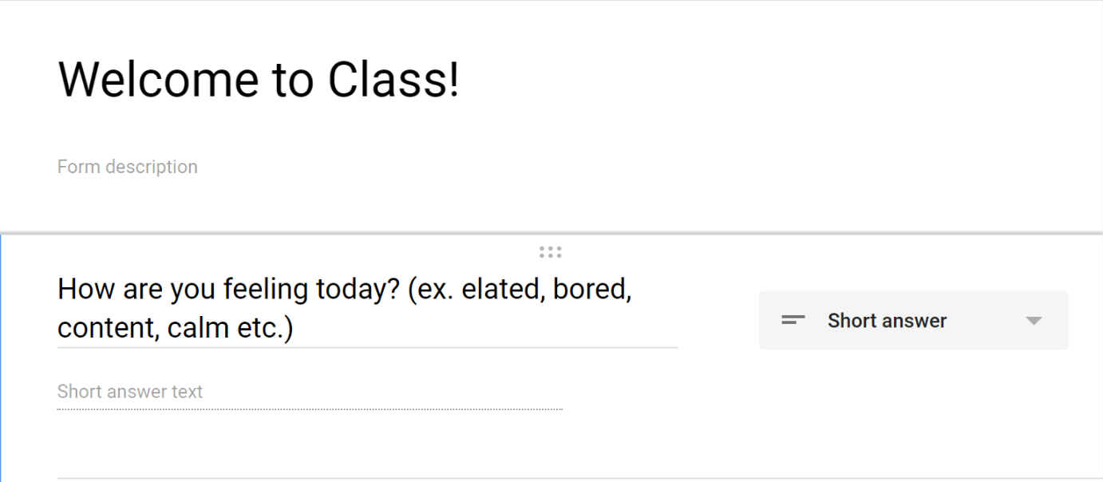
Experience Prototype
#1.
Assumption: Student feedback helps the teacher gauge the environment of the classroom
Teacher: “It was a really straightforward and easy way to get to know how students are feeling”
Student: “I like talking about myself. Also no one ever asks me this so it was nice.”
Teacher: “Feels a little forced”
Notes:
Google Form: Asking students how they’re feeling at the beginning of class
a. Short description of the prototype and how it was tested (with pictures for both) b. Results: 1-2 bullets on each of: Things that worked: It was straightforward, the question allowed students to be thoughtful
Things that didn’t work: The question was too generic, boring to students, not anonymous = bias
Surprises: Surprised that teachers don’t just generally ask this
New learnings: Students find it easier to express emotions through tech vs in-person
c. Validity: Was the assumption valid? Why or Why Not? Any new assumptions that emerged?
Not always. We found that some students would submit false info.

Slide 8
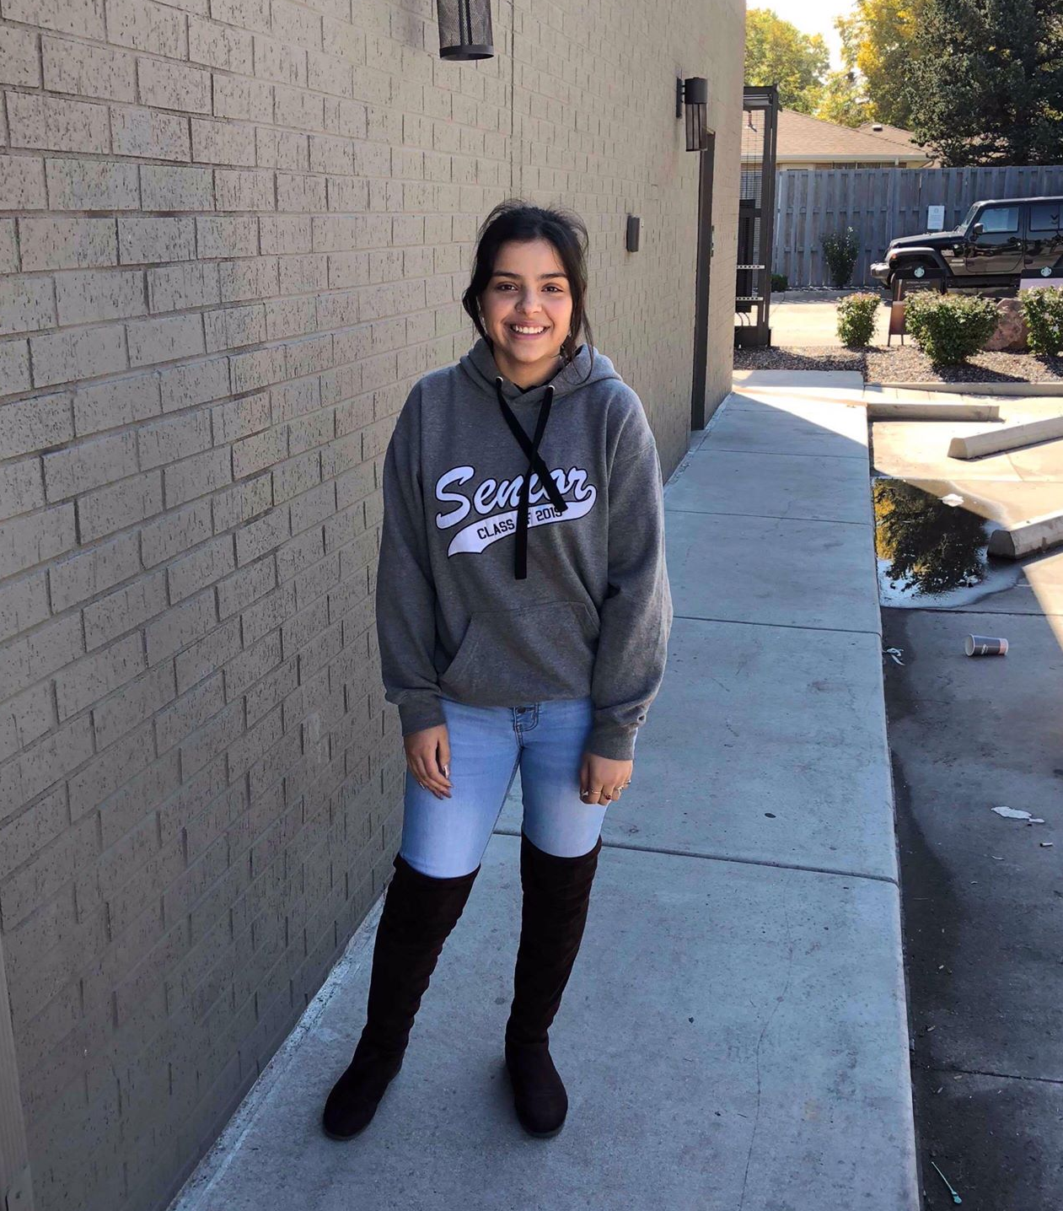
We met...
We were amazed to realize...
It would be game changing to...
Daysy
High school senior
for a class that many students wanted to drop, the administration of her school stepped in to ask for suggestions, then implemented these changes (with positive results).
create safe spaces where students and teachers can express feelings and ideas to improve the classroom experience for everyone.
Notes:
Clarification: For the “we were amazed to realize” section, this was surprising to us since generally all of our student interviewees have stated that administration tends to be stand-offish. More details: her AP Chemistry teacher became more open to her and her classmates after the administration of her school created a “ discussion circle” with students taking AP Chemistry and her AP Chemistry teacher to discuss what could be changed in the classroom since many wanted to drop her class.

Slide 9
How might we...
Solution:
make learning more collaborative between teachers & students?
Help teachers break their subjects into different interesting aspects (ie geometry → geometric art) , students will sign up for aspects they like, teachers will have small discussions based on this to help shape the curriculum and inspire lesson plans.

Slide 10
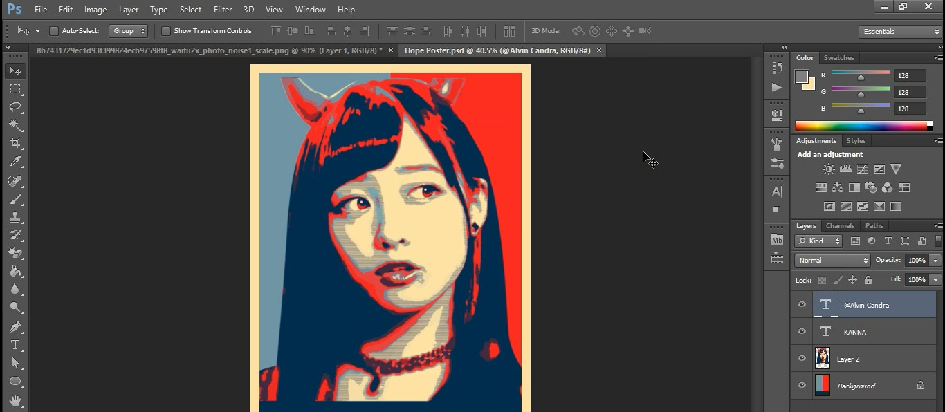
Experience Prototype
#2.
Assumption: Students will be more engaged when teachers make an effort to make classes interesting
Teacher: “I liked the suggestion of different interesting areas, it made it easy.”
Student: “This was so cool! I feel like it made learning Photoshop more manageable”
Teacher: “Eventually the students will need to learn all areas of the curriculum, not just the ones they want. Make sure to incorporate that.”
Notes:
a. Short description of the prototype and how it was tested (with pictures for both) b. Results: 1-2 bullets on each of:
Things that worked: splitting into groups while the other worked was effective, students were excited
Things that didn’t work: for this particular demo, only students with photoshop could follow along
Surprises: Students were very responsive to groups
New learnings: Students get excited when they get to shape their learning
c. Validity: Was the assumption valid? Why or Why Not? Any new assumptions that emerged?
Yes because we could visibly see the raised level of engagement from the students.

Slide 11
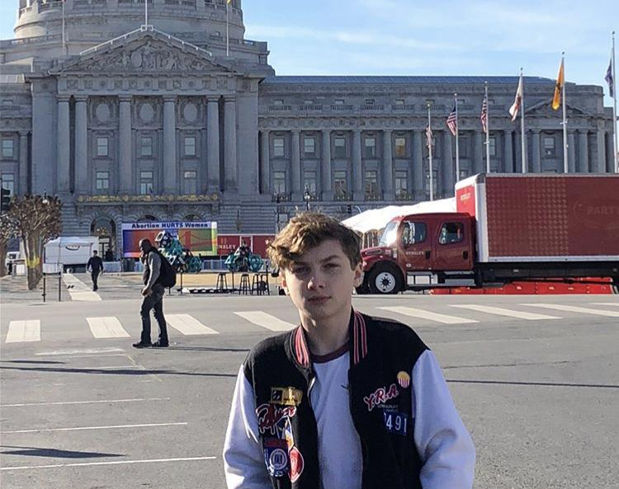
We met...
We were amazed to realize...
It would be game changing to...
Karsten
High school senior
that he has had experiences where teachers tried to have too deep or too forced connections with students, causing negative feelings towards that teacher.
teach teachers to respect students and engage them strategically without overstepping boundaries.

Slide 12
How might we...
Solution:
consider boundaries when building relationships between teachers and students?
Focus on empowerment over pressure, so have teachers host “enrichments” that students proactively sign up for.

Slide 13
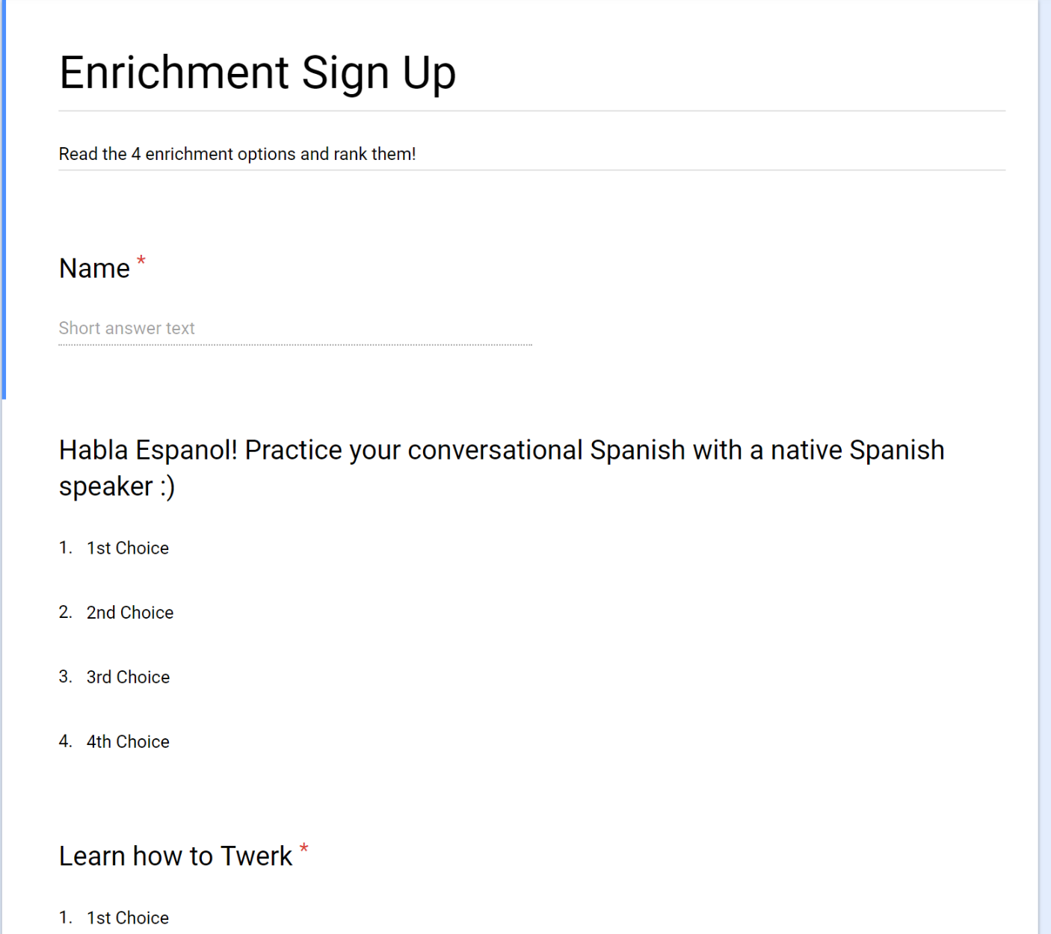
Experience Prototype
#3.
Assumption: Students will be responsive to an invitation system
Teacher: “I was able to showcase something that interests me and it was very enriching.”
Student: “It was fun to do something other than work.” “The teachers were really passionate about their respective subjects… it was like seeing a whole new side to them!”
Teacher: “This isn’t part of the curriculum.” “Preparing this would take time out of my day.”
Notes:
a. Short description of the prototype and how it was tested (with pictures for both) b. Results: 1-2 bullets on each of:
Things that worked: Teachers liked showcasing interests
Things that didn’t work: Took some time to plan the lessons
Surprises: Some teachers felt it wasted learning time
New learnings: Students like being distracted by other events and workshops
c. Validity: Was the assumption valid? Why or Why Not? Any new assumptions that emerged?
Yes, but the teachers got more work from it

Slide 14
We chose to expand on...
#2.
Lots of room for this idea to expand and develop
Still related to the subject
Customizable
Need to figure out the scope of this idea: would we assist with the discussions themselves in addition to suggesting?

Slide 15
Summary
Problem Domain
Working on making positive student-teacher relationships more accessible and prioritized
3 Interviews/Revised POVs
Teachers need to care
Openness should be mutual
Boundaries need to be considered
3 Prototypes
Chose to expand on the small group discussions prototype

Slide 16
Thank you!
Questions?
Team 4

