Slide 1
POV’s -> Experience Prototypes

Slide 2
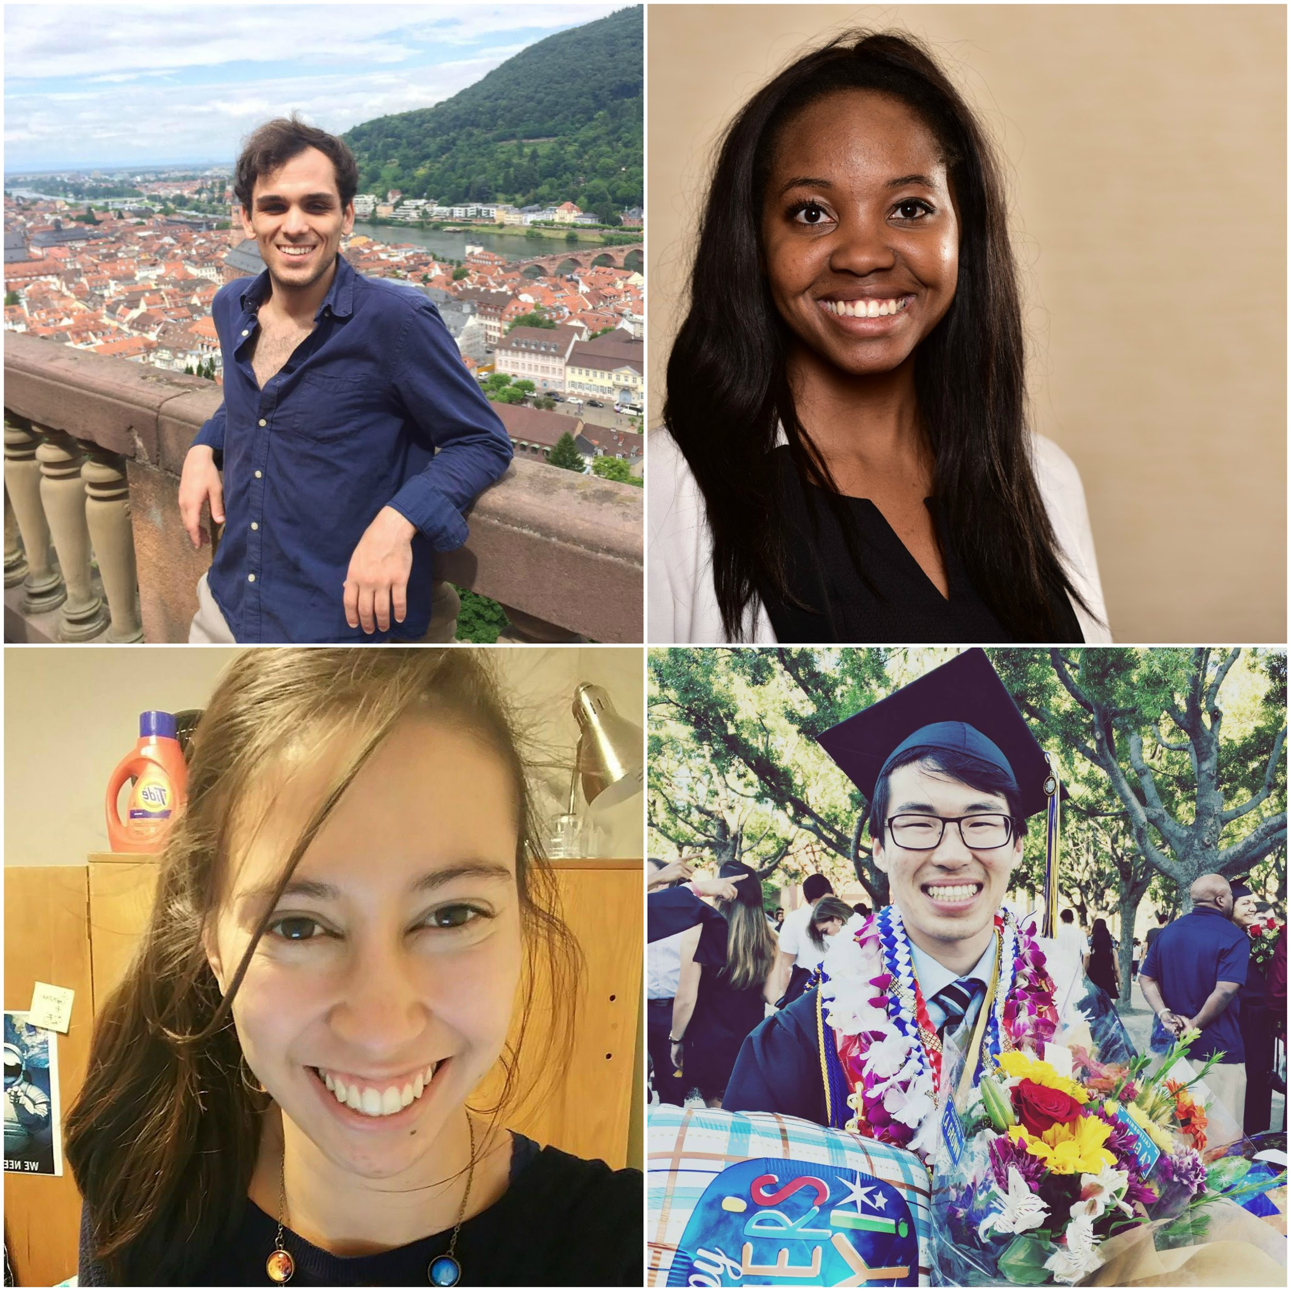
Fitlit 🔥🔥
Olivia Gregory
Christina Ramsey
Denis Russu
Bryce Tham

Slide 3
Exercise

Slide 4
1.
Original POV
Our initial perspective going into research was...

Slide 5
WE MET… a self-identifying non-fitness-oriented college student.
WE WERE AMAZED TO REALIZE…that she was interested in strenuous fitness challenges for incentives and medals (which she proudly displayed) but was uninterested in training or lead-up work.
IT WOULD BE GAME-CHANGING IF…she could receive tangible incentives for exercising more regularly
Notes:
In our original POV, we talked with a student who described herself as not into fitness. We were amazed to realize that, even though she was very disinterested in the everyday process of running up, she would compete in the challenges, like Spartan Run and Color Run, and she even proudly put up her medals from these events, which she was obviously very proud of. We thought it’d be game changing to give her some proverbial “medals” for more regular exercise.

Slide 6
2.
More Needfinding!
The more, the merrier
Notes:
We did more needfinding interviews to see what held back other people from working out

Slide 7
“I don’t actually like going to the gym, but I’ll do group fitness classes and befriend the other people in the class, and then I’m motivated to actually show up.”
jenny
Notes:
40-something year old woman, works as a lawyer

Slide 8
“Even though I consider health to be really important, it’s hard to find time to work out, especially when you’re working”
dan
Notes:
40-something year old man, works as a lawyer
Similar response from someone who wasn’t even a full-time employee

Slide 9
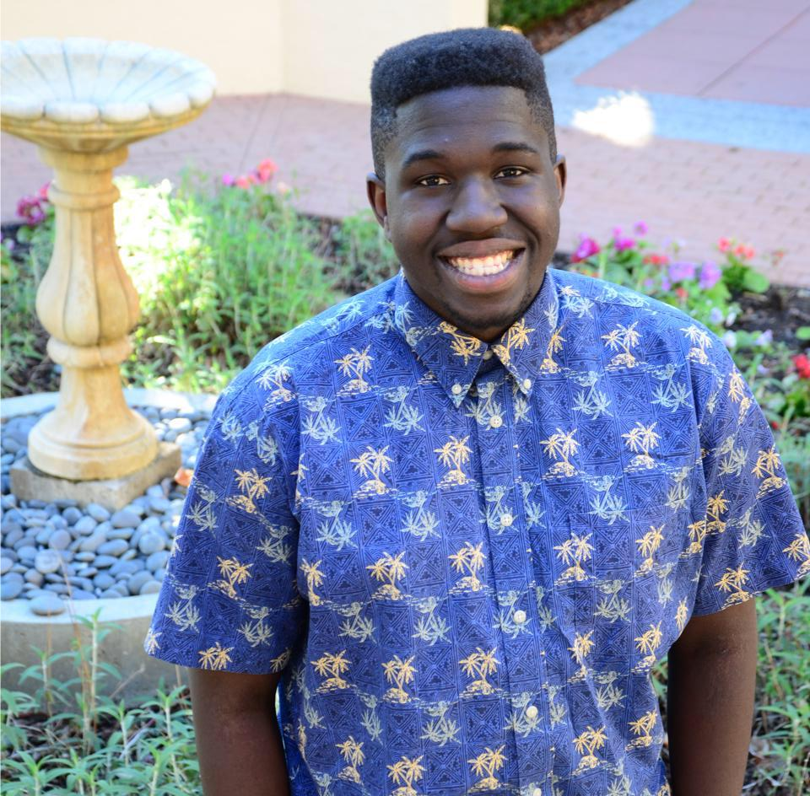
“There’s a lot of things I know I could do, but I don’t know how to find the time when I’m at Stanford.”
REmi
Notes:
College age student who isn’t too passionate about exercise

Slide 10
3.
POV’s
Point of View statements
Notes:
After our interviews, we started creating revised POV statements.

Slide 11
POV 1
WE MET... a 40-something year old woman who works as a lawyer.
WE WERE AMAZED TO REALIZE... that she dislikes working out, but motivates herself to do it by taking group classes and befriending her classmates.
IT WOULD BE GAME-CHANGING IF...she could find social connection in other types of exercise and health practices.
Notes:
Met
Rezlie
...since it seemed like it was this social connection that motivated her to actually go to the gym, even though she dislikes it.

Slide 12
POV 2
WE MET... a college-aged fitness enthusiast.
WE WERE AMAZED TO REALIZE... he was very dedicated to fitness and hiking but he found himself with no time to pursue his goals.
IT WOULD BE GAME-CHANGING IF...there was a way to help him integrate his goals into his daily schedule.

Slide 13
POV 3
WE MET... middle-aged civil engineer who spends most of his day sitting in an office
WE WERE AMAZED TO REALIZE... even though he felt strongly about the importance of staying healthy and living longer, he rarely went out of his way to exercise.
IT WOULD BE GAME-CHANGING IF...there was a way to incentivize exercising while reminding him of his goal of staying healthy and living longer.

Slide 14
4.
HMW’s
How Might We help these needs?
Notes:
After thinking about these different points of view, we tried to think about ways we could help these needs.

Slide 15
WE MET… a self-identifying non-fitness-oriented college student.
WE WERE AMAZED TO REALIZE…that she was interested in strenuous fitness challenges for incentives and medals (which she proudly displayed) but was uninterested in training or lead-up work.
IT WOULD BE GAME-CHANGING IF…she saw daily exercise as adventurous and exciting as completing these challenges.
HMW
#1
Notes:
Our first was the student who didn’t consider herself a “fitness” person, but loved strenuous challenges. We noticed that she spoke about these challenges as if they were adventurous and exciting. We started wondering if...

Slide 16
WE MET… a self-identifying non-fitness-oriented college student.
WE WERE AMAZED TO REALIZE…that she was interested in strenuous fitness challenges for incentives and medals (which she proudly displayed) but was uninterested in training or lead-up work.
IT WOULD BE GAME-CHANGING IF…she saw daily exercise as adventurous and exciting as completing these challenges.
HMW
#1

Slide 17
WE MET… a self-identifying non-fitness-oriented college student.
WE WERE AMAZED TO REALIZE…that she was interested in strenuous fitness challenges for incentives and medals (which she proudly displayed) but was uninterested in training or lead-up work.
IT WOULD BE GAME-CHANGING IF…she saw daily exercise as adventurous and exciting as completing these challenges.
How might we get people more excited about the idea of exercising?
HMW
#1

Slide 18
WE MET... a college-aged fitness enthusiast. WE WERE AMAZED TO REALIZE... he was very dedicated to fitness and hiking but he found himself with no time to pursue his goals. IT WOULD BE GAME-CHANGING IF...there was a way to help him integrate his goals into his daily schedule.
HMW
#2
Notes:
The next hmw was about the more “fit” student who didn’t have time to achieve his goals.

Slide 19
WE MET... a college-aged fitness enthusiast. WE WERE AMAZED TO REALIZE... he was very dedicated to fitness and hiking but he found himself with no time to pursue his goals. IT WOULD BE GAME-CHANGING IF...there was a way to help him integrate his goals into his daily schedule.
HMW
#2

Slide 20
WE MET... a college-aged fitness enthusiast. WE WERE AMAZED TO REALIZE... he was very dedicated to fitness and hiking but he found himself with no time to pursue his goals. IT WOULD BE GAME-CHANGING IF...there was a way to help him integrate his goals into his daily schedule.
How might we structure exercise around the lifestyle of busy people?
HMW
#2
Notes:
Also relates to the new college student and the lawyer man.

Slide 21
WE MET… a self-identifying non-fitness-oriented college student.
WE WERE AMAZED TO REALIZE…that she was was able to motivate herself to do fitness-related activities if she was doing it with others, as she saw them more as social activities than fitness activities.
IT WOULD BE GAME-CHANGING IF…there was a way for her to feel social connection while getting regular exercise.
HMW
#3
Notes:
We thought about making active more social, but went more interesting route.

Slide 22
WE MET… a self-identifying non-fitness-oriented college student.
WE WERE AMAZED TO REALIZE…that she was was able to motivate herself to do fitness-related activities if she was doing it with others, as she saw them more as social activities than fitness activities.
IT WOULD BE GAME-CHANGING IF…there was a way for her to feel social connection while getting regular exercise.
HMW
#3

Slide 23
WE MET… a self-identifying non-fitness-oriented college student.
WE WERE AMAZED TO REALIZE…that she was was able to motivate herself to do fitness-related activities if she was doing it with others, as she saw them more as social activities than fitness activities.
IT WOULD BE GAME-CHANGING IF…there was a way for her to feel social connection while getting regular exercise.
How might we make social activities more active?
HMW
#3

Slide 24
How might we get people more excited about the idea of exercising?
How might we make social activities more active?
How might we structure exercise around the lifestyle of busy people?
Notes:
These are the HMW’s we ended up with, and these were mainly what was used when we started brainstorming.

Slide 25
5.
Experience Prototypes
Notes:
From our brainstorming, came experience prototypes.

Slide 27
Prototype 1: Personal Trainer
Idea: a virtual personal trainer that helps users achieve small, simple fitness-related goals and increase their “fitness level” throughout their day
tailored to the personal schedule of the user
based on the assumption that people feel as though they do not have enough time to do any significant physical activity
Having a personal trainer to motivate the user and help them perform small lifestyle changes throughout their day will have a significant impact on their overall health.

Slide 28
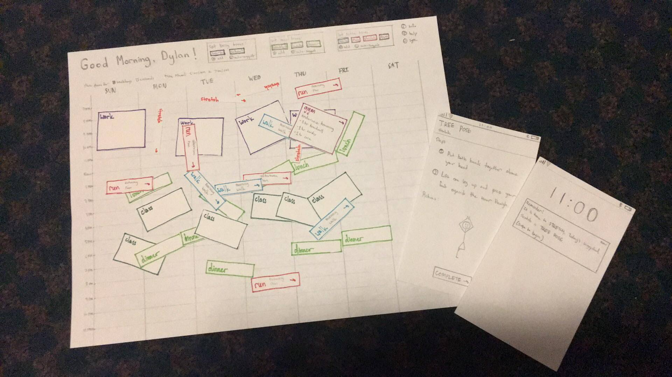
5.
Experience Prototypes
Notes:
The experience prototype was made out of paper to represent web dashboard interface and ab accompanying mobile application interface. First, the test user was asked to fill out a calendar on the web interface with his schedule using paper “blocks” to represent when he has work or class. We then (acting as the application) filled in the gaps with various fitness-related activities and asked the test user to rearrange them to his liking.

Slide 29
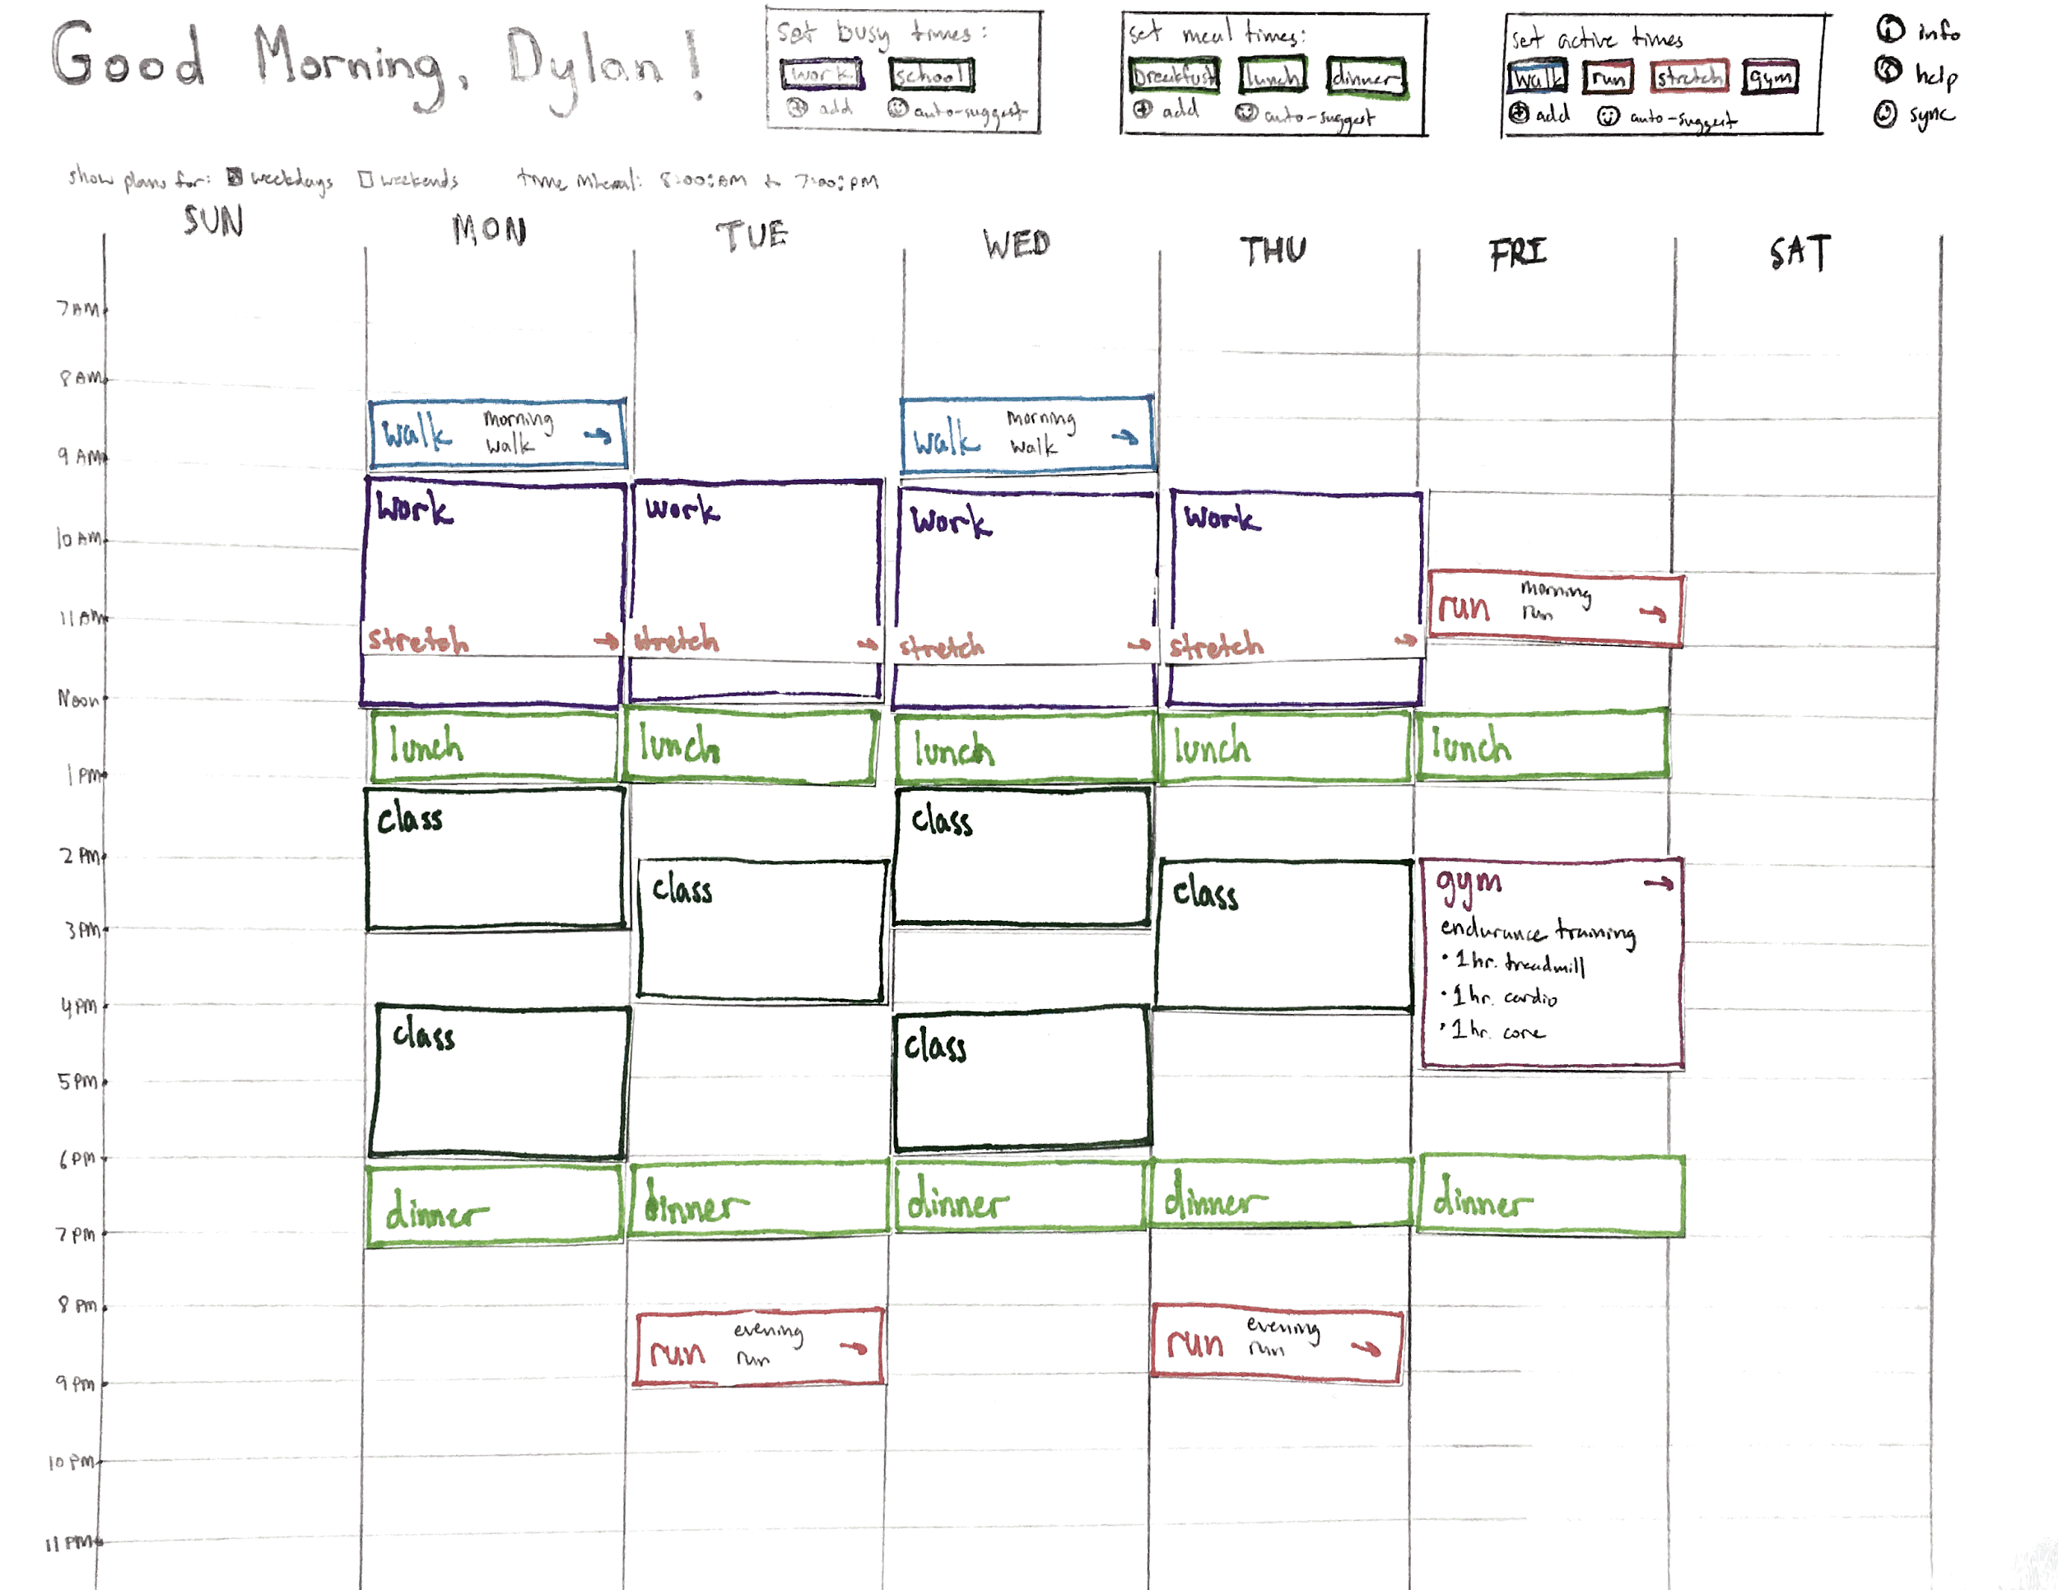
5.
Experience Prototypes
Notes:
The final schedule is illustrated in the paper prototype here, showing both large and small fitness activities to be done throughout the test user’s day.

Slide 30
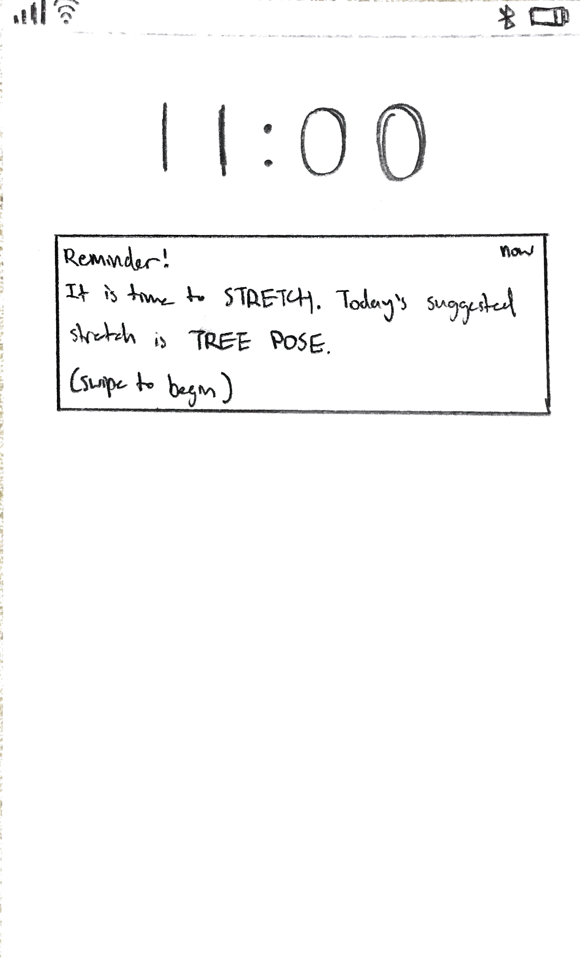
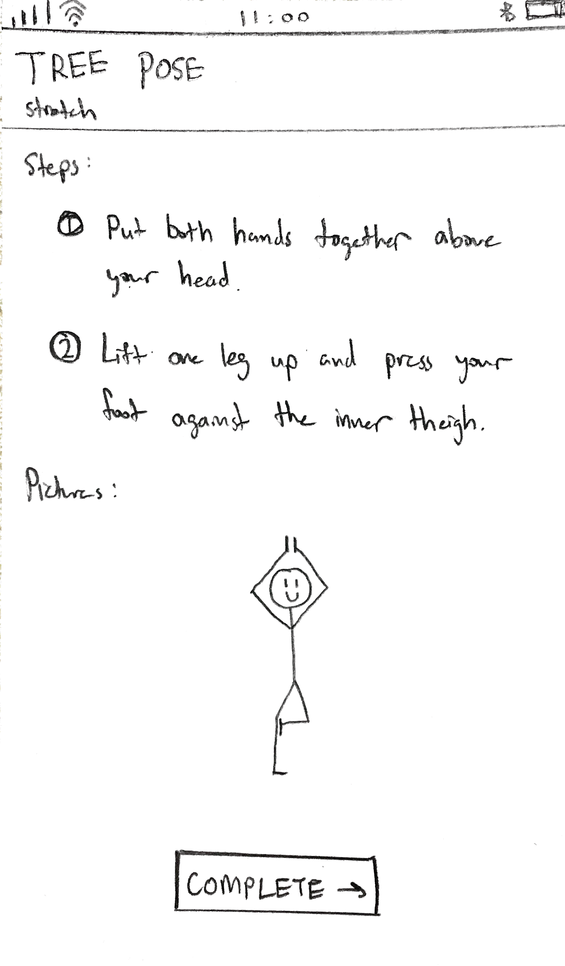
Notes:
After that, we would sync these reminders to the mobile interface. We showed the test user an example of what the “stretch” activity would look like as a mobile notification and then what the activity would like in the mobile application itself.

Slide 31
Prototype 1: Personal Trainer
User liked: how he was able to rearrange the events in the calendar to his liking -> feeling of maximum flexibility
Enjoyed how simple the “tree pose” instructions were and was interested to see what other simple activities might be possible
Notes:
The test user liked how he was able to rearrange the events in the calendar to his liking because he felt like it gave him maximum flexibility to achieve only what he was willing to do. He also enjoyed how simple the “tree pose” instructions were in the mobile application and was interested to see what other simple activities might be possible.

Slide 32
Prototype 1: Personal Trainer
User wished: there were more “active times” outside of walking, running, stretching, and gymming (Felt even those simple actions were too time-consuming)
Felt the paper prototype of calendar was “messy” because of too many moving parts with the paper “blocks”
Notes:
The test user wished there were more “active times” outside of walking, running, stretching, and gymming. He felt that even simple actions such as walking, running, and gymming were too time-consuming. He also lamented how messy the calendar felt as a paper prototype because there were too many moving parts with the paper “blocks”.

Slide 33
Prototype 1: Personal Trainer
Assumption of whether people felt they didn’t have time for significant physical activity was validated
Test user wished for even simpler activities
Still hard to determine if assumption that a virtual personal trainer would help motivate these people to become more active
User seemed happy with the simpler of the preliminary activities
Notes:
The assumption of whether people felt they didn’t have time for significant physical activity was validated with the prototype. In fact, the test user wished for even simpler activities than the ones suggested in the prototype. The assumption that a virtual personal trainer would help motivate these people become more active remains to be seen, but the test user seemed happy with how simple the preliminary “tree pose” activity was.

Slide 35
Prototype 2: Fitness Competition
Idea: an application/website that virtually rewards users for accomplishing fitness goals set by themselves or by others (friends or physicians).
Based on assumption that people are unwilling to exercise because they are unable to conceptualize the concrete, long term goals associated with it.
We wanted to test whether people would prioritize their fitness if we gamified it and gave them tangible, short-term rewards when they achieved their goals or won competitions. .
Notes:
assumption that people are unwilling to exercise because they are unable to conceptualize the concrete, long term goals associated with it. Through building this prototype, we wanted to test whether people would be more motivated to exercise and prioritize their fitness if we gamified it - making it into more of a competition - and gave them tangible, short-term rewards when they achieved their goals or won these competitions.

Slide 36
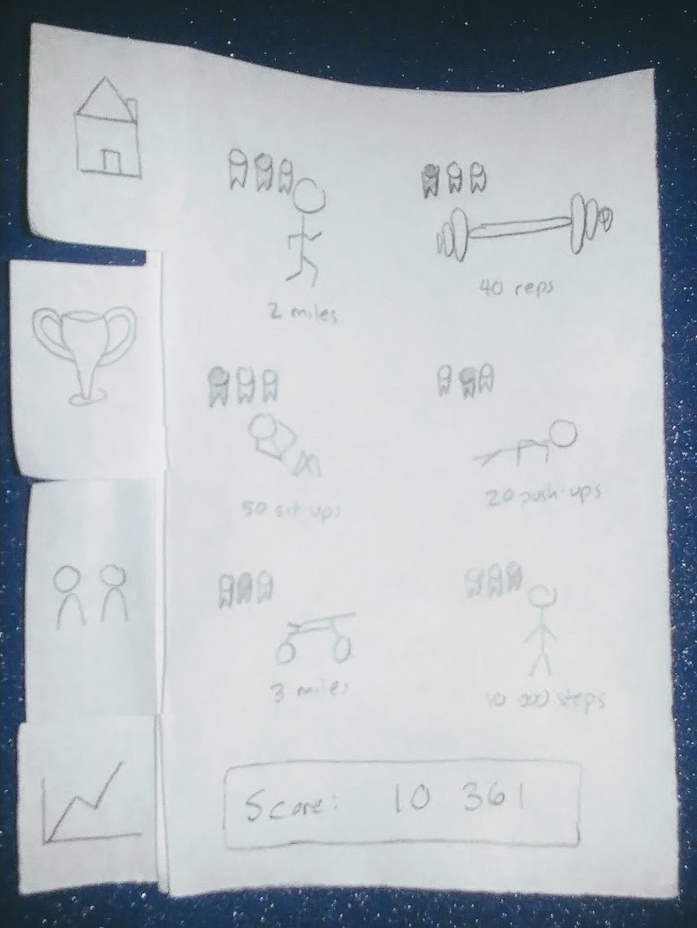
5.
Experience Prototypes
Notes:
The home page gave an overview of specific fitness tasks. It tracks how much a user has completed each task, as well as quantifying this with a score below.

Slide 37
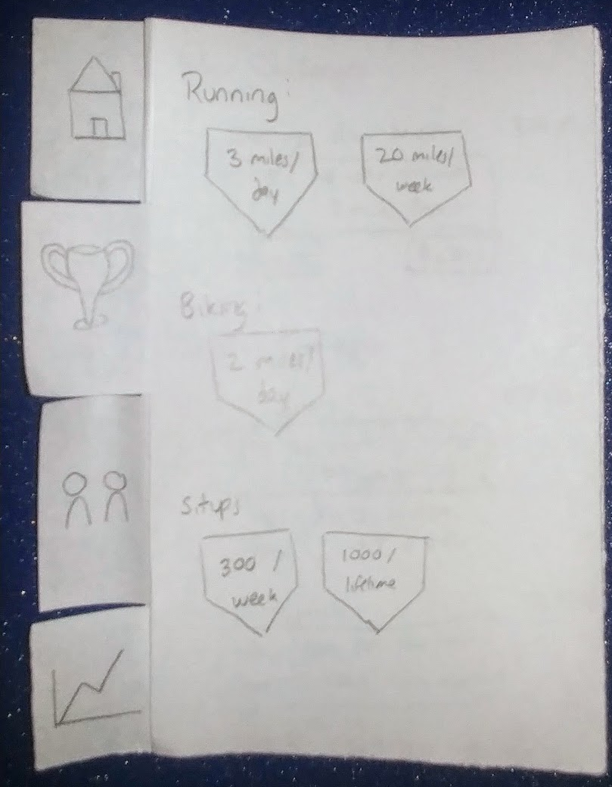
5.
Experience Prototypes
Notes:
The next screen highlighted each of the “trophies” or “badges” that a user could earn, either through competitions or by completing exercise-specific goals.

Slide 38
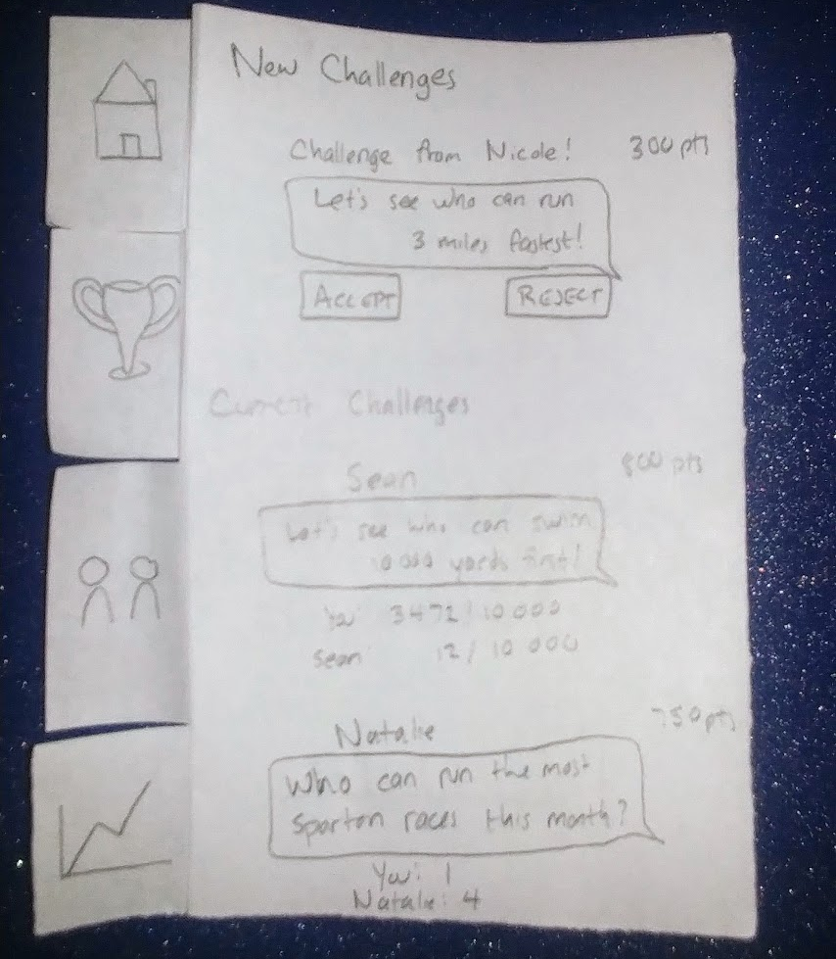
5.
Experience Prototypes
Notes:
The social page listed different competitions to which the user had been challenged. These challenges could be challenged either by friends or physicians with whom he had connected, and this screen tracks the user’s progress in these challenges and comparing it to the other parties involved. The idea here is that direct competition would be more of a concrete motivating factor than helpful messages or notifications.

Slide 39
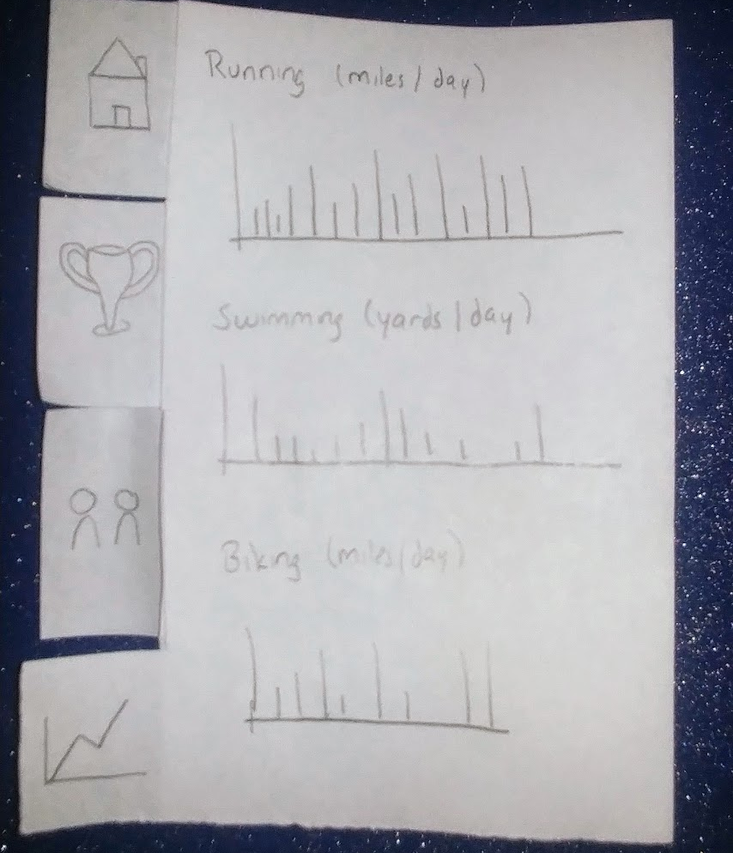
5.
Experience Prototypes
Notes:
The last screen tracks the user’s personal progress across a variety of sports and fitness activities, so that he can see how he has worked and developed over time. The idea behind this page is that if the user sees himself in a lull of activity, he will be reminded to pick up that activity again instead of letting it fade out of his routine.

Slide 40
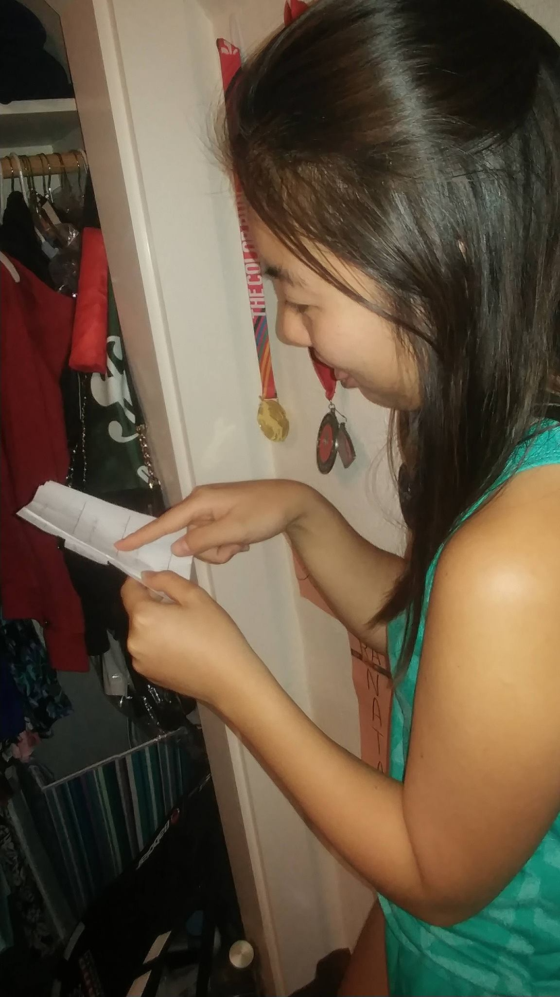
Notes:
We tested the prototype by giving it to various subjects, setting up a scenario in which they were people who were willing to exercise and improve their fitness, but did not currently exercise or work out (either because of lack of time, lack of inspiration or motivation, or any other reason). The test subjects said that this scenario seemed very similar to their everyday lives.

Slide 41
Prototype 2: Fitness Competition
Do you think being confronted by your statistics every time you open this app be more likely to motivate you or de-motivate you from exercising? Why?
What do you think of the features that are included? What do you like or think is lacking? Why?
Do you think that this app would affect the way you would work out/motivate yourself to work out?
What features would you be looking for that this currently doesn’t include?
.
Notes:
After setting up the scenario, we asked questions per each screen. The main questions we asked are included, although we asked additional questions based off of their specific answers.

Slide 42
Prototype 2: Fitness Competition
Users liked the app in general!
people (surprisingly) didn’t like having a score, but were very motivated by the idea of challenging their friends and trying to beat them in various competitions
liked the idea of tracking their own personal fitness history, but thought that the current format was confusing
Overall, people preferred simplicity instead of complicated, even if a complicated version included more features. .
Notes:
Overall, people preferred simplicity instead of complicated, even if a complicated version included more features. They liked that it looked easy to use and add workouts, and thought adding extra features would clutter the simple UI.

Slide 43
Prototype 2: Fitness Competition
From our discussions, it seemed like our assumption was valid; people seemed to be more motivated to work out if they had a way to gamify and reward their motivation.
new assumption: in general, people want to exercise and improve their fitness, even if they don’t currently prioritize it in their life
.

Slide 45
Prototype 3: Fitness VR
Idea: a vr headset that would allow you to select a location/mode and track you as you run in treadmill or any other fitness activity
Based on assumption that people can find exercise uninteresting.
.

Slide 46
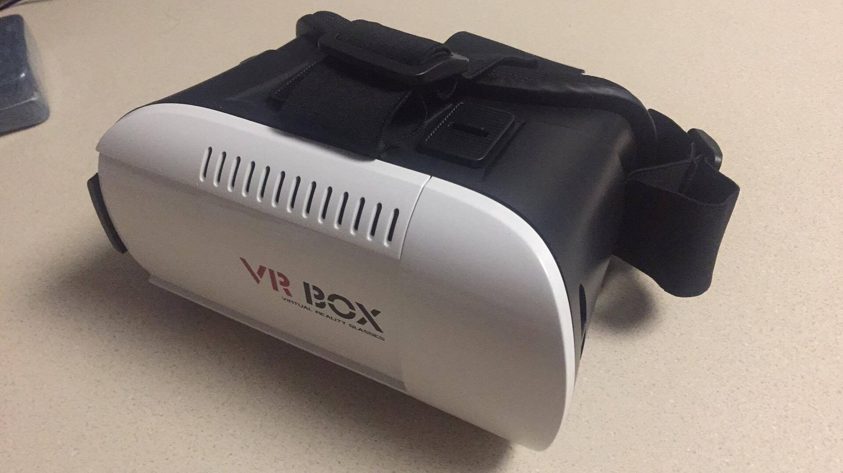

Slide 47
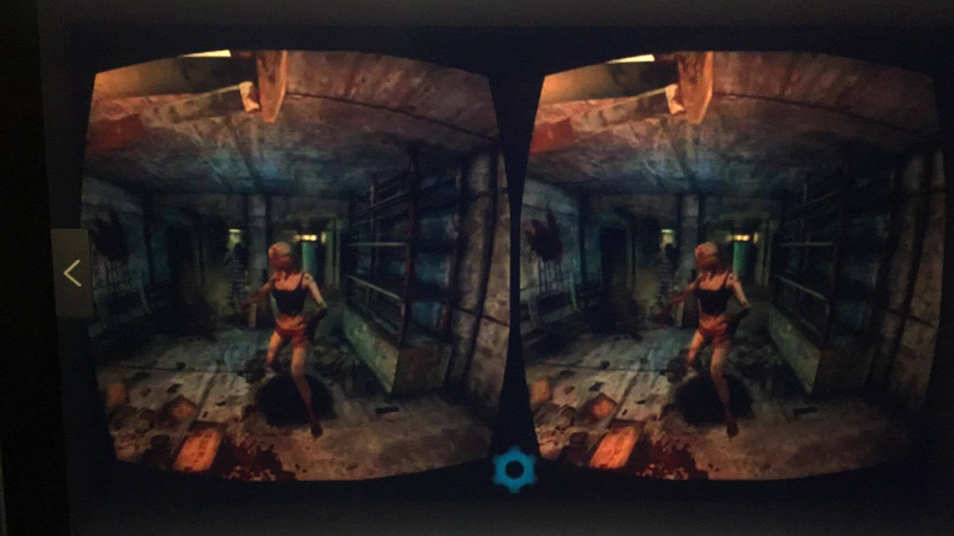
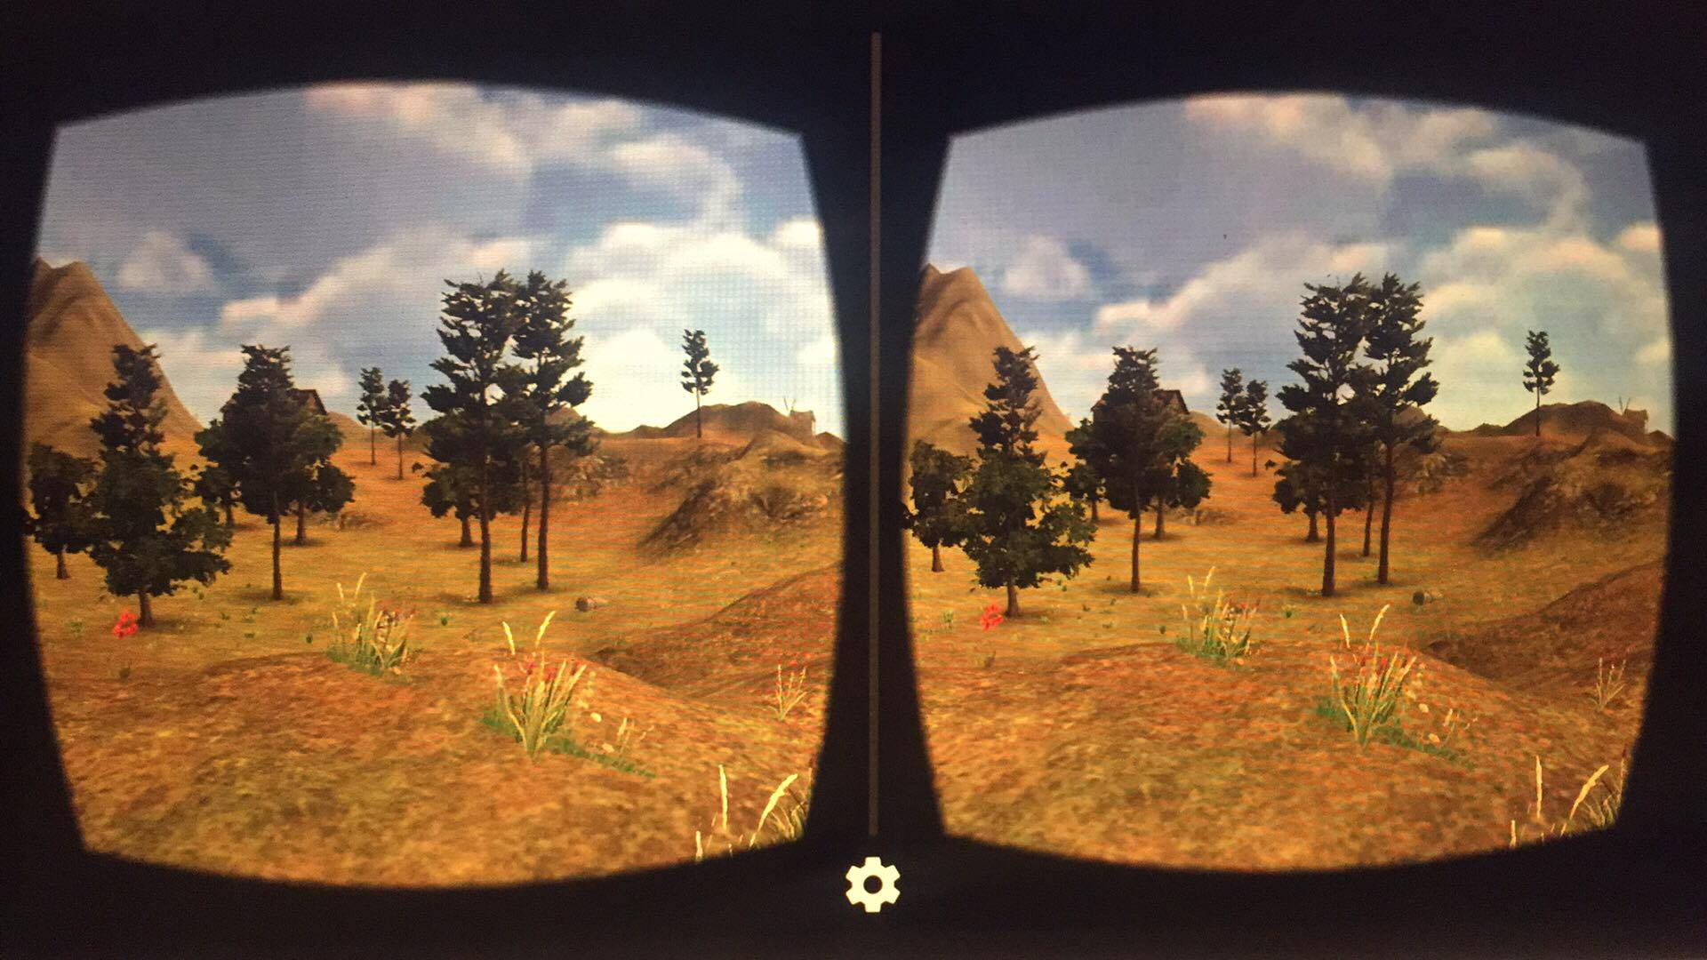

Slide 48
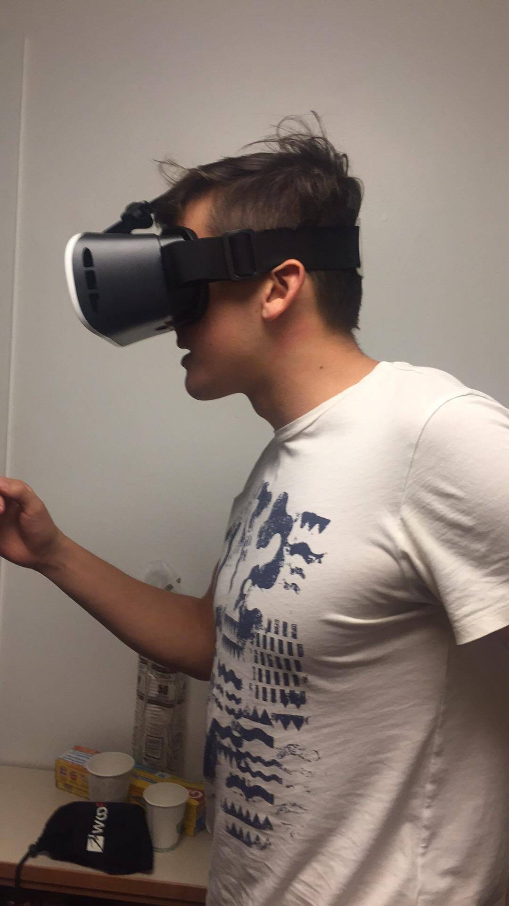

Slide 49
Prototype 3: Fitness VR
Assumption validated: Users felt VR approach does lead to being more motivated
Prototype was difficult to test
Our users informed us that our descriptions sounded wonderful, however, our experience prototype is too rough to invoke the emotions we believe a functioning product would
Technical limitations of VR headset
.

Slide 50
AND THE
WINNER
IS...

Slide 51
Best Prototype: Fitness games
Most successful in achieving desired solution and most positive feedback
has elements of the other two: adding some incentives, making exercise more exciting, and the personalized challenges effectively act as a virtual personal trainer.
most technically feasible and most widely accessible to our users.
.
Notes:
Overall, we believe that our experience prototype in gamifying health was the most successful in achieving a desired solution. This prototype has elements of the other two: adding some insensitive, making exercise more exciting, and the personalized challenges effectively act as a virtual personal trainer. This experience prototype was the most successful with our testers, and received the most positive feedback. In addition, this potential solution is the most technically feasible and most widely accessible to our users.

Slide 52
Thanks!
Questions?

