Slide 1
goFIT: Lab Usability Study
CS 194H: User Experience Design Project

Slide 2
Team FITLIT
Olivia Gregory
Bryce Tham
Christian Valadez
CJ Keller

Slide 3
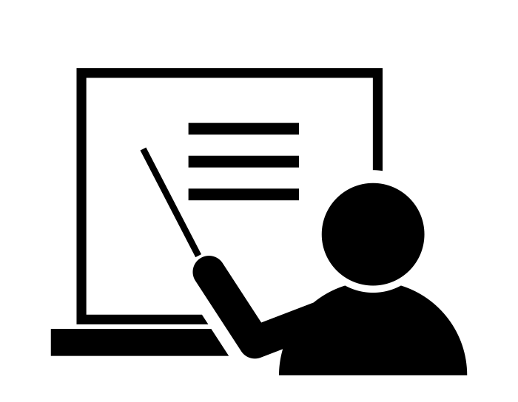
Outline of Talk
Prototype Changes
Method
Test Measures
Results
Discussion
Summary

Slide 4
Prototype Changes

Slide 5
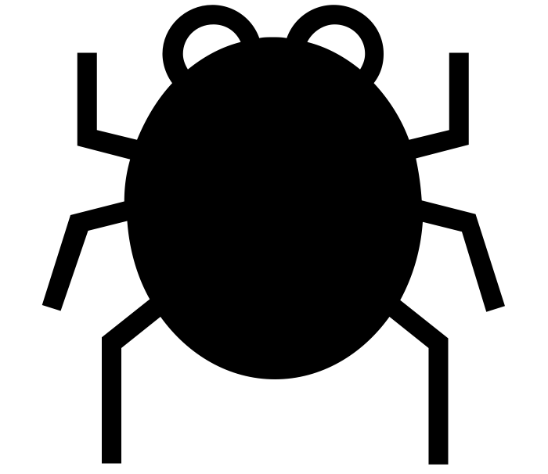
Prototype Changes
Fixed existing bugs in the interface
Updated images with higher quality ones
Cleaned up fake user data to make demo more realistic
Notes:
Major changes you made to your prototype in preparation for the test (1-3 slides w/ images)

Slide 6
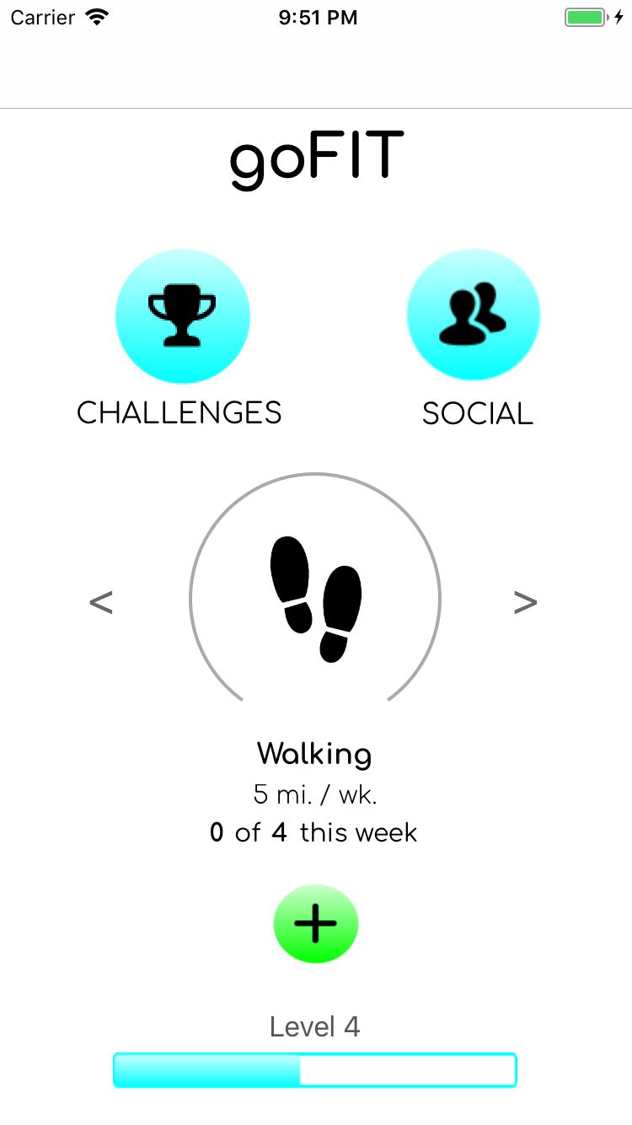
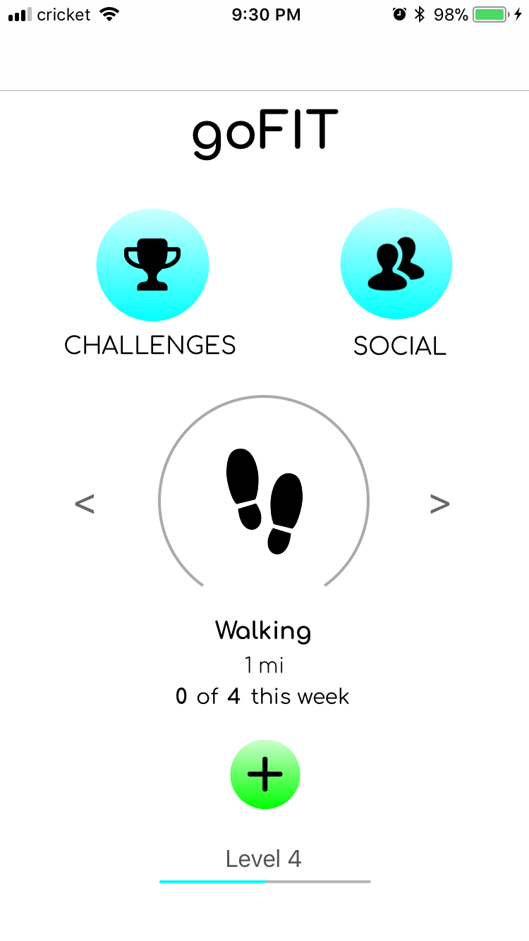
Prototype Changes
Changes were mostly minor but resulted in a polished interface for testing.
Notes:
Major changes you made to your prototype in preparation for the test (1-3 slides w/ images)

Slide 7
Method

Slide 8
Participant Demographics
Recruiting: We wanted a spectrum of power users and casual users
Compensation: Candy bar 🍫
Alex
Competitive powerlifter
Goes to the gym ~5x a week
Uses pen + paper to lock specific workouts
A 20 year old male
“Power-User” (needs the app to complete his goals)
Cherry
Self-identified “couch potato”
Used to work out pretty regularly, still watches what she eats
A 19-year-old female
“Novice user”
Chris
Engineering graduate student
Exercises 1-2 hours per day
A 22-year-old male
Describes himself as “moderately active”
Looking into mass-gaining/bulking
Jamie
Casual gym-goer
Goes to the gym ~2x per week
Uses Apple Health, Apple Watch, and FitBit to track challenges and calories burned
A 21-year-old female
“Proficient User” (tracking health is important to her, and she’s already invested in doing so)
Notes:
Participants (who -- demographics -- and how were they selected & compensated) (1 slide)

Slide 9
Apparatus
Ran the app on Xcode simulator or on iPhone.
Used timers to time tasks.
Made screen recording to go back on later.
Took notes on laptop and in notebooks.
Tested in quiet locations around campus.
Notes:
• Apparatus (describe the equipment/software you used and where tests run) (1 slide)

Slide 10
Tasks
Set a personal goal
Medium task, should be easy for users to do.
Challenge a friend
Complex task, should also be easy, requires connecting with friends.
Log progress on a challenge
Easy task, should be incredibly simple or people won’t do it.
Notes:
Tasks (1 slide each) - describe each task & what you looked for during each task

Slide 11
Procedure
1. Introduction
Brief explanation of goFIT.
Short interface demo.
2. Pre-Survey
Obtain demographic information.
Age, sex, occupation, etc.
Understand participant’s current fitness level.
Novice? Expert? Power-user?
Notes:
Procedure (1 slide) - describe what you did and how

Slide 12
Procedure
3. Usability Test
Tell participant to think aloud.
Ask participant to complete 3 tasks.
Create a challenge.
Log progress.
Challenge friends.
5 minutes to let them play around with the app on their own.
4. Post-Survey
General feedback on interface.
“I wish” and “I like”
How valuable was each task?
How often do they see themselves using the app?
Thank you and compensation.
Notes:
Procedure (1 slide) - describe what you did and how

Slide 13
Test Measures

Slide 14
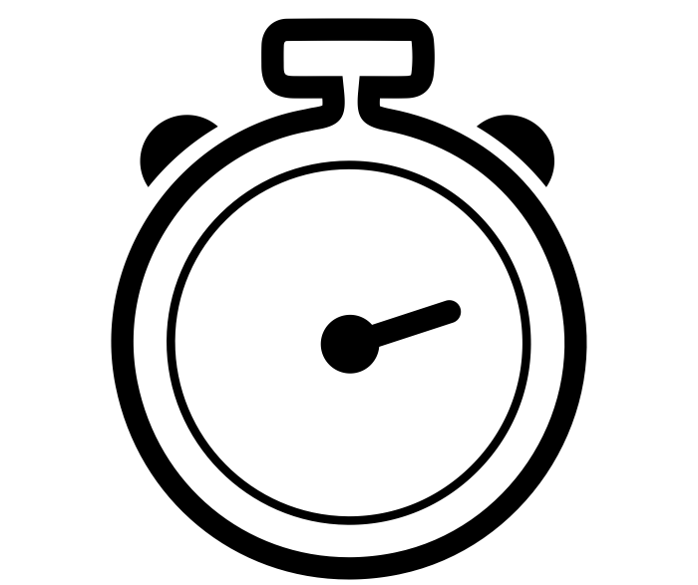
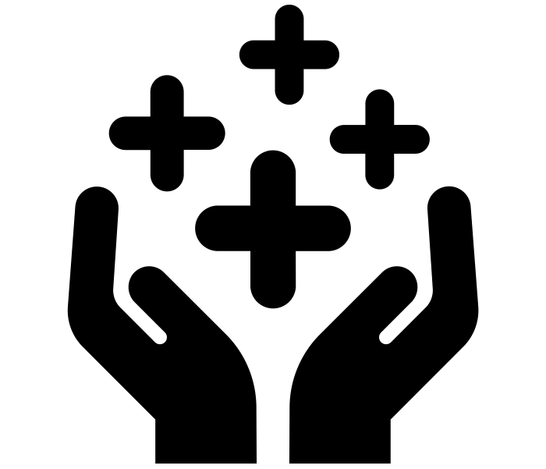
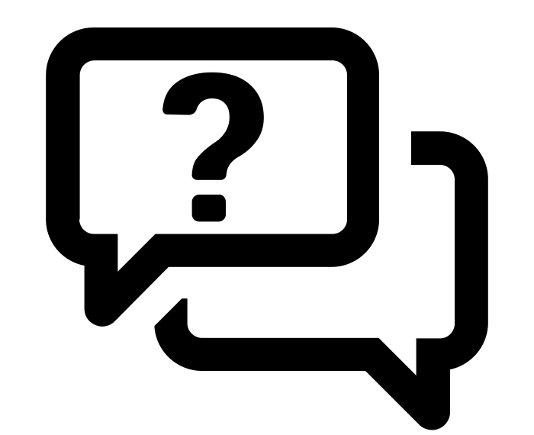
Test Measures
Ability to complete tasks easily (time it took, number of presses)
Value Proposition: how useful is our app in providing real value to the user?
How many questions did the user have to ask when they got confused?
Notes:
describe what you measured and why

Slide 15
Test Insights
App needs to be easy to use so completion time should be low.
App needs to provide significant value so people use it over other methods.
App needs to be straightforward or else people will not use it at all.
Notes:
describe what you measured and why

Slide 16
Results

Slide 17
Major Results
Overall, all 4 participants succeeded in accomplishing their tasks.
Create a challenge (14 sec. avg.)
Log progress (20 sec. avg.)
Challenge friend (15 sec. avg.)
However, we were more interested in whether the app generated real value for them, and how often they would consider using the app on a weekly basis.
(right: trimmed video recording of usability test)
Notes:
describe what you measured and why

Slide 18
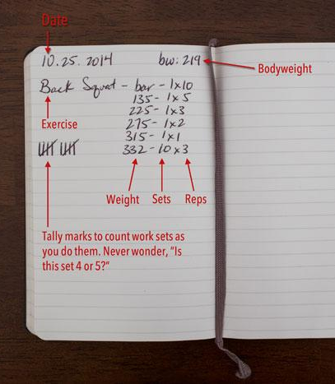
Results & Insights
“When I lift, I keep an exercise journal and log workouts using pen and paper.”
“Or, I use a Google Sheet to progress over time.”
Insight: Although apps for exercise logging exist, the UI is cumbersome, convoluted and takes too much time away from the gym.
“Get in and out of the gym.”
Notes:
Primary creating-a-new-challenge flow seems pretty intuitive
Creating a new challenge from the social screen seems to be unintuitive
Easy to see friends’ progress on social screen, harder on challenge screen
Home screen seems pretty intuitive as is
Has very friendly, game-y vibe
Shouldn’t have to select yourself for personal goals
The social connection and the gamification are huge draws

Slide 19
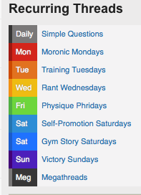
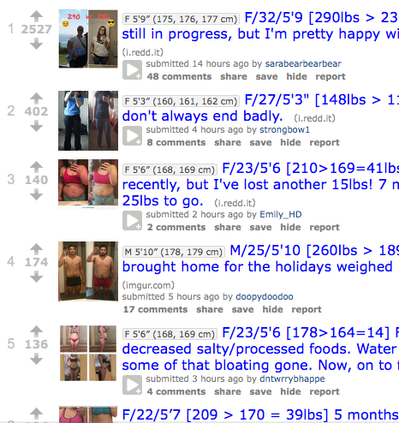
Results & Insights
“I go to Reddit for the social aspect of staying motivated and encouraging other to meet their goals.”
Insight: People love the social aspect of fitness, because it incentivizes them to achieve their goals.
Notes:
Primary creating-a-new-challenge flow seems pretty intuitive
Creating a new challenge from the social screen seems to be unintuitive
Easy to see friends’ progress on social screen, harder on challenge screen
Home screen seems pretty intuitive as is
Has very friendly, game-y vibe
Shouldn’t have to select yourself for personal goals
The social connection and the gamification are huge draws

Slide 20
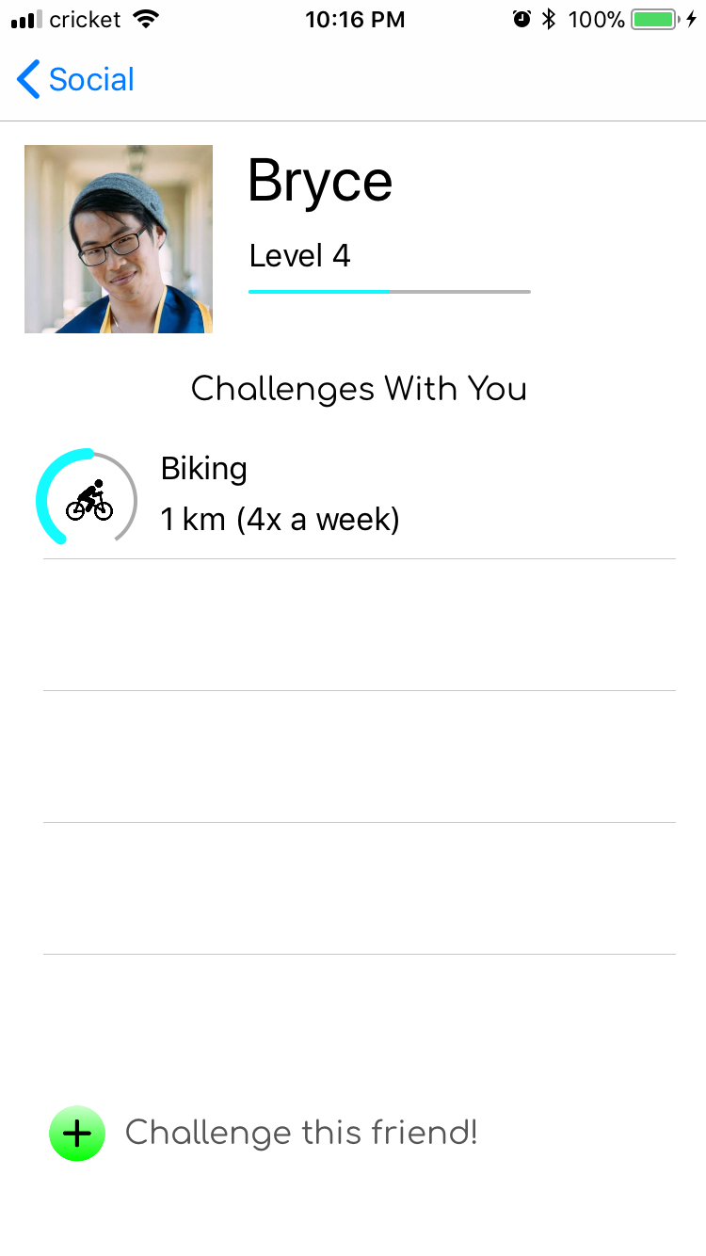
Results & Insights
Although creating a challenge from the challenge screen was intuitive, our second flow of challenging a friend directly from their profile was unintuitive
Insight: Make this button more clear, and more clearly clickable

Slide 21
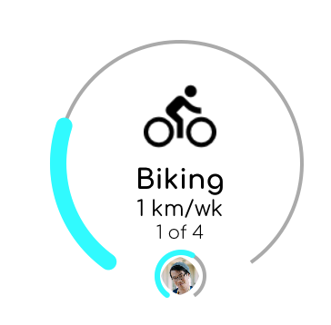
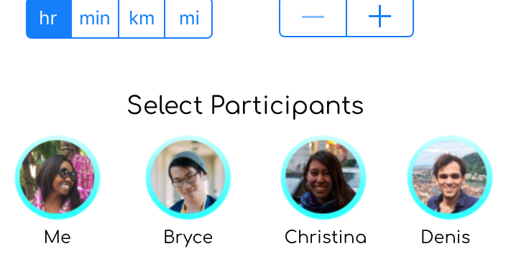
Results & Insights
Difficult to see friends’ progress on challenges from the challenges screen
Insight: Make this image bigger? Or find another way to display progress
It feels unintuitive to have to select yourself to set a personal goal -- “a challenge being against yourself should be the default”
Insight: Different flows for personal goals and social challenges

Slide 22
Other Results
Participants liked the visual design of current prototype.
Participants wanted more flexibility in creating challenges.
Some lingering bugs hindered testing, but overall went smoothly.
Overall, participants seemed to be interested in using the app in the future.

Slide 23
Discussion

Slide 24
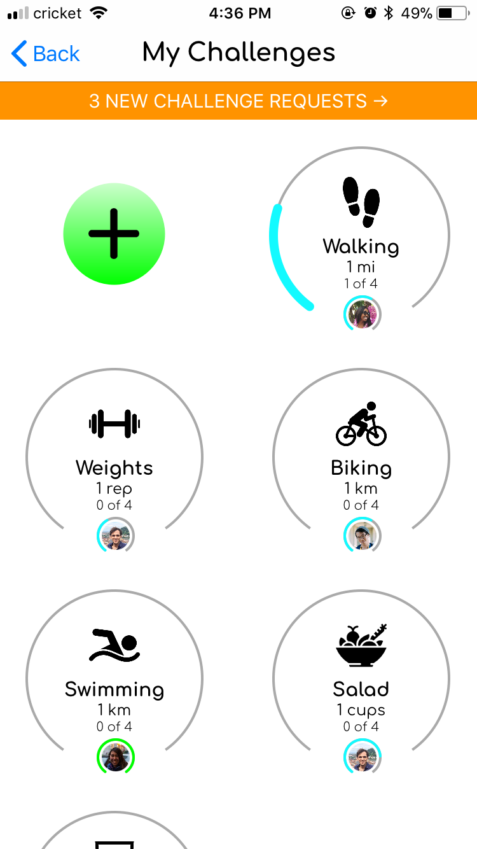
Separate logging food / water from activities
Insights
From a user standpoint, logging “Salad” and “Water” are much different than logging an activity
Insights
MyFitnessPal already exists for this purpose
Notes:
Results of the tests (process data, quantitative data, and logged data)

Slide 25
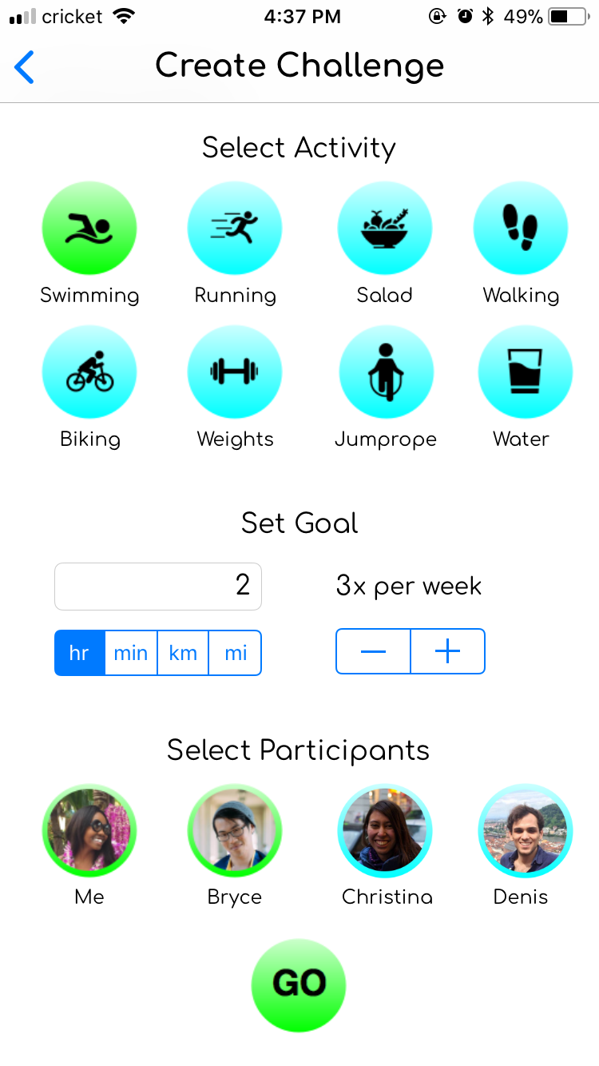
Hone in on what requires manual logging
Tracked automatically by Apple Health / Google Fit
“(Features) are too general to be useful”
“My iPhone already tracks all of this”
Tracked automatically by Apple Watch / FitBit
Some apps do this, but not well
Opportunity for us to implement logging for specific workouts
Notes:
Results of the tests (process data, quantitative data, and logged data)

Slide 26
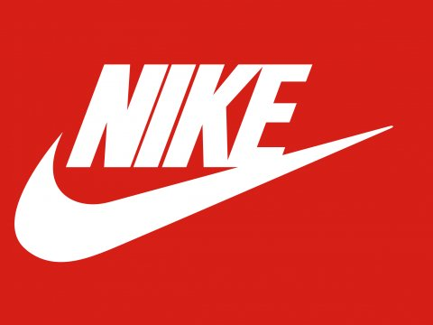
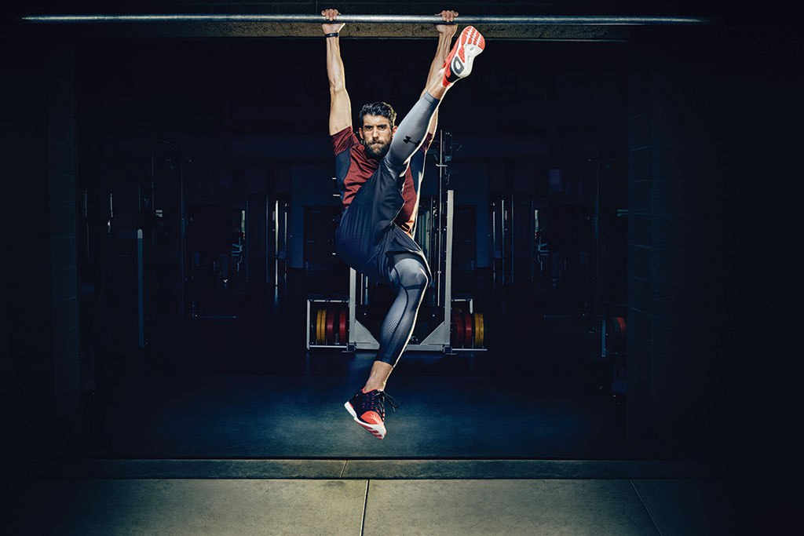
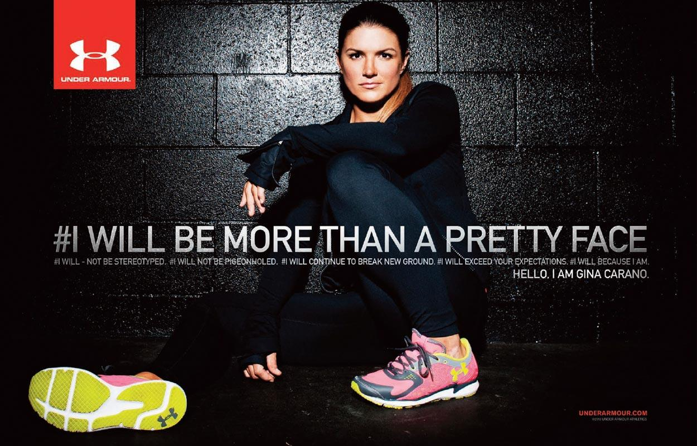
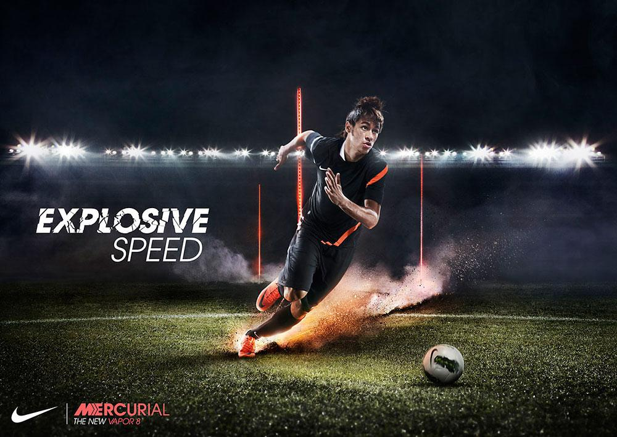
Design Revamp
Sleek
Powerful
Evocative
Aspirational
Ads, colors, design implore you to achieve something
Notes:
Results of the tests (process data, quantitative data, and logged data)

Slide 27
UI Fixes
Introduce Tabs because current layout is confusing to navigate
Swipe left and right on activities instead of using arrows to click through
Make progress more dynamic with animations so users can feel more excitement
Show breaks in progress circle to make it easier to see how much more is left to complete a goal
Use bold fonts to differentiate between app sections
Notes:
Results of the tests (process data, quantitative data, and logged data)

Slide 28
Recommendations for Future Testing
Current test had relatively small sample size (4 people).
Test with more people to gain additional insights and different perspectives.
Current test environment was indoors, but app is likely to be used outdoors.
Test app in multiple contexts (e.g. outside, gym, etc.)
Potential for longitudinal study to explore long-term behavior.

Slide 29
Important Questions
How can we improve the logging capabilities for more general users?
How can we change the logging/point system/accountability to be less of a binary?

Slide 30
Summary
Recruited 4 participants from a variety of different backgrounds
Performed usability tests focusing on how useful our app is in accomplishing our goals/tasks.
Key insights: UI needs to be simple and the social aspect must be incentivizing.
Next step: redesign some interface elements to improve the look and feel of the app while adding new, useful features.

