Slide 1
goFIT Field Usability Study

Slide 2
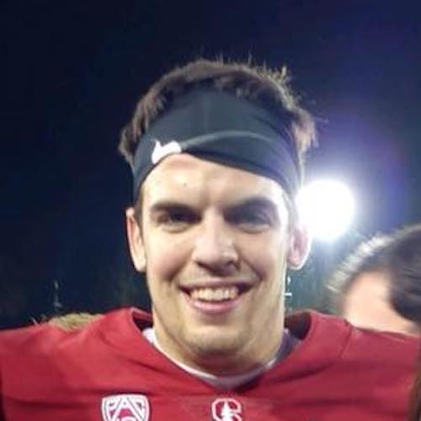
Team FITLIT
Bryce Tham
Olivia Gregory
Chris Valadez
CJ Keller

Slide 3
About goFIT
PROBLEM
Although many people want to stay healthy, they rarely prioritize their health.
SOLUTION
goFIT combines fitness tracking and social interaction, offering meaningful social connection to make exercise more rewarding.

Slide 4
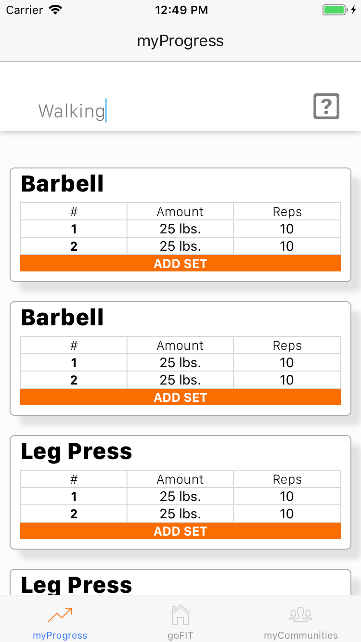
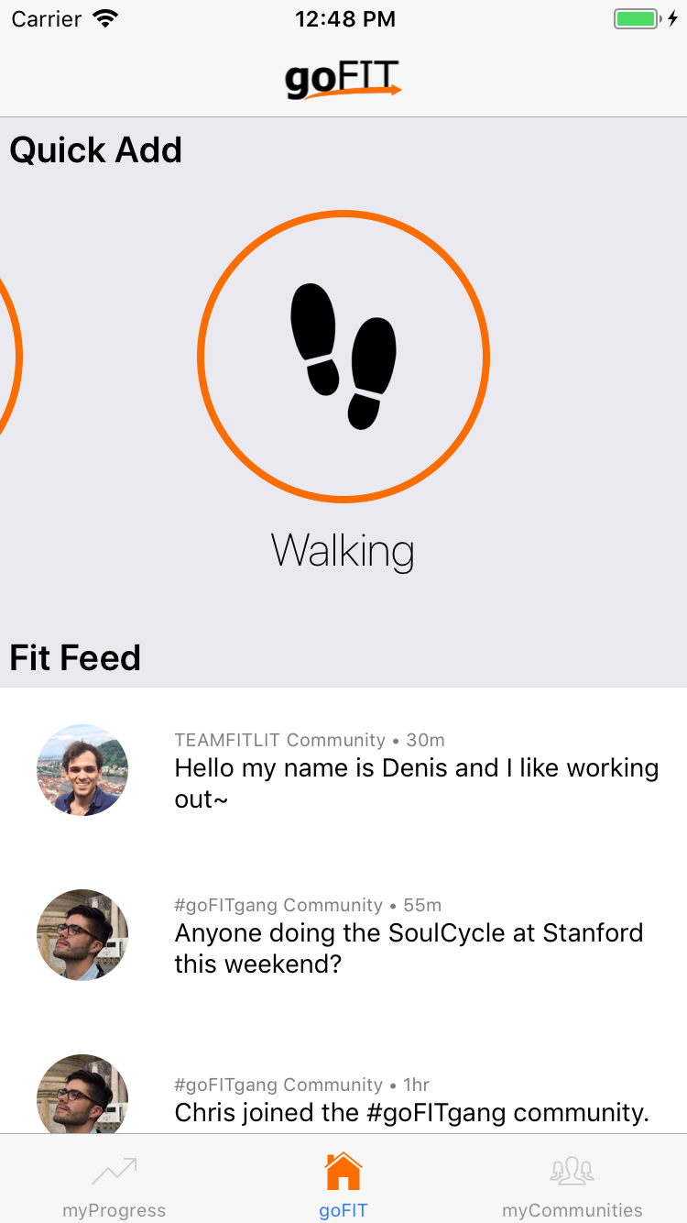
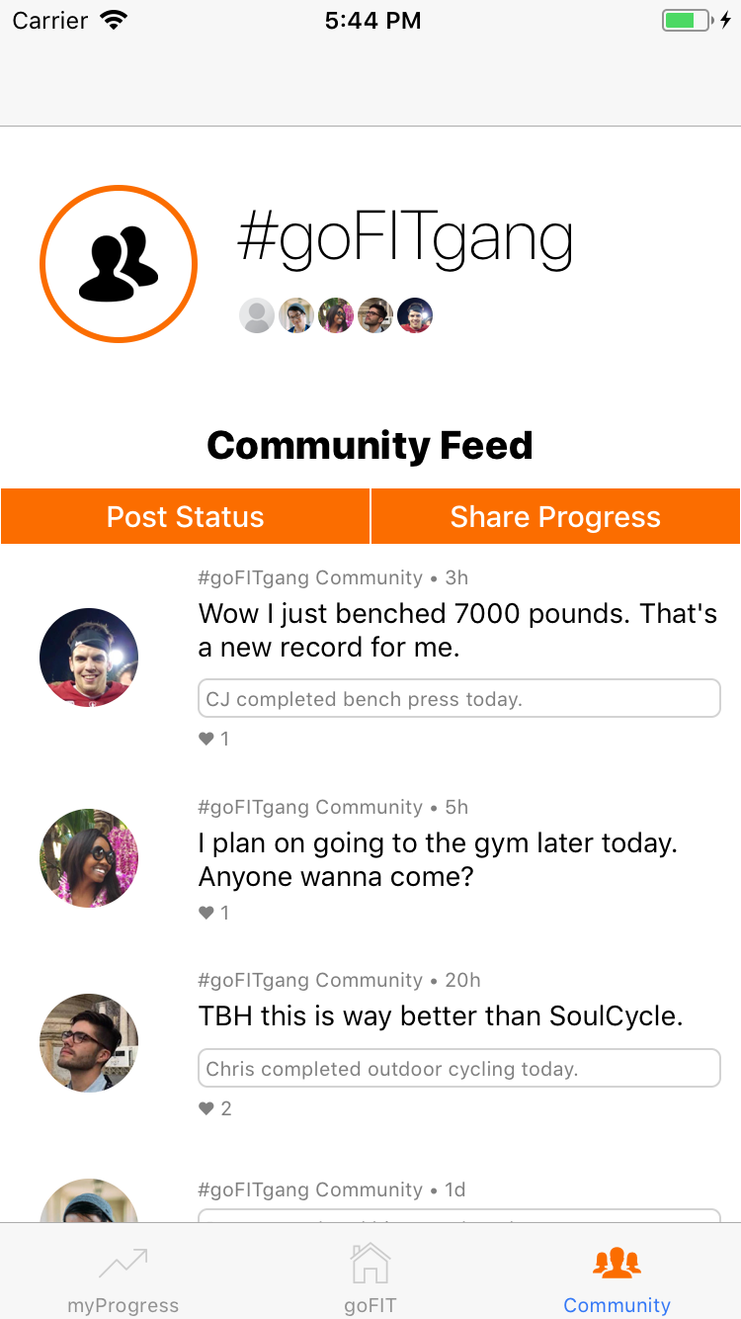
Notes:
The system being evaluated is the Quick Add Screen, the charts in myProgress Screen and the Community Screen.

Slide 5
About the Field Study
The purpose of the field study is to understand 2 things in context:
Does the virtual progress log effectively replicate the traditional pen-and-paper model at the gym?
Does the community aspect offer any significant social meaning to exercise at the gym or at home?
Notes:
Introduce the system being evaluated (1 slide) & the purpose of the experiment (1 slide)

Slide 6
Outline
Method
Test Measures
Results
Discussion
Notes:
Outline of Talk (tell a story, do not read bullets)

Slide 7
Method

Slide 8
1 App, 2 Tests
We wanted to perform 2 different field tests, 1 focused on dedicated users and 1 focused on more casual users.
Gym Test: focused on all tasks to be done at the gym.
Home Test: focused on casual community-related tasks to be done at home.

Slide 9
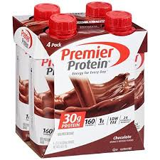
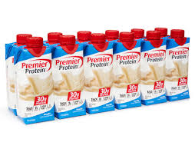
Participant Recruitment
Caught people as they were off to the gym (gym test).
Asked friends to take a look at the app in a more casual setting (home test).
Compensation was having protein shakes available for them after their workout was completed
Premier Protein (Vanilla or Chocolate flavors offered)

Slide 10
Participants (Gym Test)
Keller
College Student, Male, Age 22
Goes to the Gym 6 days a week
Describes himself as active
Max
College Student, Male, Age 22
Goes to the Gym 3 days a week
Describes himself as moderately active for a non-athlete
Curtis
College Student, Male, Age 22
Goes to the Gym 3 days a week and swims 5 days a week
Describes himself as active
Maggie
College Student, Female, Age 22
Goes to the Gym 4 days a week
Describes herself as active
Karina
College Student, Female, Age 21
Goes to the Gym 3 days a week
Describes herself as active for non-athlete
Emma
College Student, Female, Age 20
Goes to the Gym 4 days a week
Describes herself as active
Notes:
Participants (who -- demographics -- and how were they selected & compensated) (1 slide)

Slide 11
Participants (Home Test)
Jackie
College Student, Female, Age 22
Does not go to the gym regularly, but performs dancing 2x per week.
Describes herself as moderately active.
Roberto
Full-Time Employee, Male, Age 25
Rarely exercises at all, but goes on walks during lunch break 3-4x per week.
Describes himself as lightly active.
Notes:
Participants (who -- demographics -- and how were they selected & compensated) (1 slide)

Slide 12
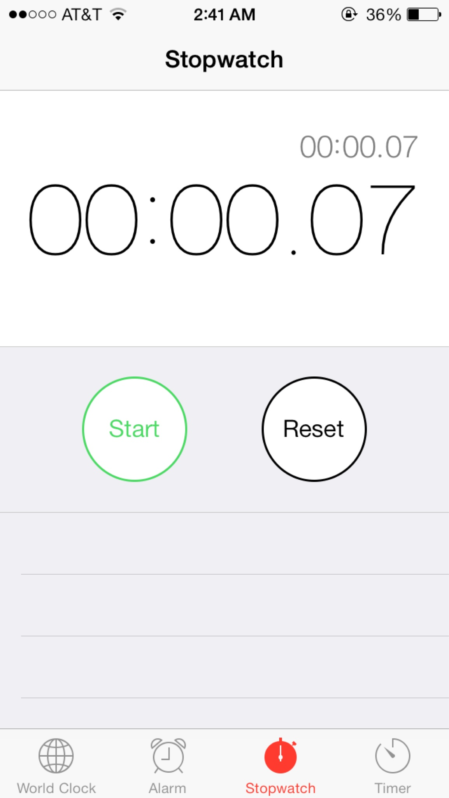
Equipment/Software
Tests were run using mobile devices (iOS device) running on Expo.
Recordings were done using built-in screen recording software.
Stopwatches and timers were used to time tasks.
Notes were taken on notebooks and laptop computers.
Notes:
Apparatus (the equipment/software you used and the environment where tested) (1 slide)

Slide 13
Location
Gym tests were done at Arrillaga Recreation Center.
Home tests were done in a casual setting (on a bed or on the couch) in the participant’s home.
Notes:
Apparatus (the equipment/software you used and the environment where tested) (1 slide)

Slide 14
Tasks
① Add Activity
Medium Task
Do people prefer searching for an activity or using quick add?
② Log Progress
Easy Task
Needs to be completed quickly due to high frequency.
How quickly can the user complete this task?
Does this task offer maximum flexibility for the user to log what they want?
Notes:
Tasks (1 slide each) - describe each task & what you looked for during each task

Slide 15
Tasks
③ Create Community
Difficult Task
Doesn’t need to be quick, but needs to be engaging.
Extend task to community interactions including posting status and sharing progress.
Is the community creation process intuitive?
Does the user get confused when posting a status update or sharing progress?
Is sharing with the community enjoyable to the user?
Does the user share or post often?
Notes:
Tasks (1 slide each) - describe each task & what you looked for during each task

Slide 16
Procedure (Gym Test)
Collect background/demographic information.
Complete Task ① and then get feedback.
Complete Task ② and then get feedback.
Complete Task ③ and then get feedback.
Let user play with the app for 5 minutes to get further feel for app.
Post-survey, compensation, and thank you.
Notes:
Procedure (1 slide) - describe what you did and how

Slide 17
Procedure (Home Test)
Collect background/demographic information.
Complete Task ③ only.
Let user play with the app for 5 minutes.
Post-survey, compensation, and thank you.
Notes:
Procedure (1 slide) - describe what you did and how

Slide 18
Test Measures

Slide 19
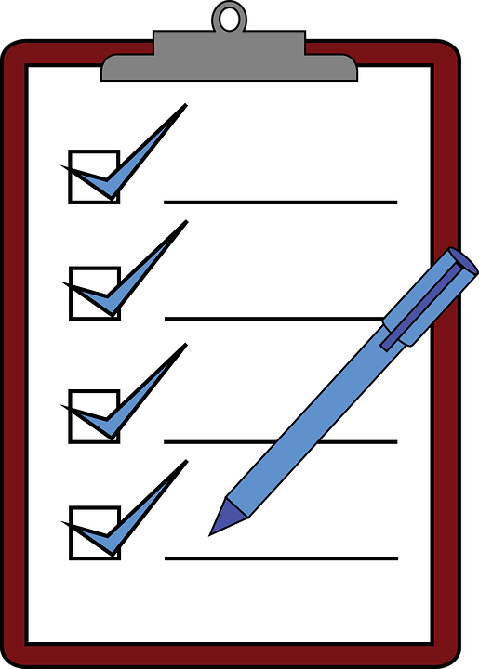
Test Measures
① Time to Add Activity
Time it takes to add 1 activity.
Time it takes to add multiple activities.
② Log Progress
Time it to log information into the weights chart.

Slide 20
Test Measures
③ Create Community
Time it takes to create a community.
Time it takes to post a status.
Time it takes to share progress.

Slide 21
Test Measures
Other Measures
Were users comfortable navigating the interface?
Were users confused about how to accomplish any of the tasks?
Did users feel like features were missing?
Did users see themselves using the app in the future?

Slide 22
Results

Slide 23
Results (Gym Test)
Users were able to complete the tasks relatively quickly
Task ① : ~ 7 seconds
Task ②: ~ 15 seconds
Task ③: ~ 30 seconds
Critical Error found in Task ②, users after inputting their information could not find the way to get out of the keyboard
Critical Error found in Task ③, users tried to back out to see other group options after completion and could not find way

Slide 24
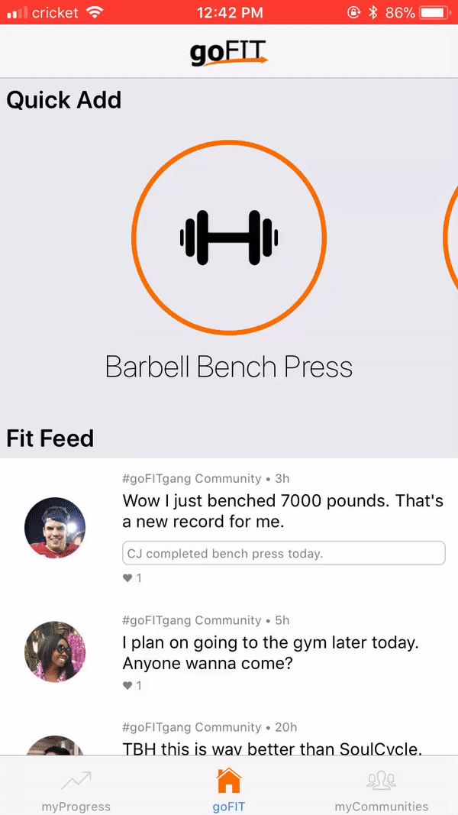
Results (Home Test)
Casual users were able to complete task ③ easily.
Create Community: ~10s avg.
Post Status: ~6s avg.
Share Progress: ~16s avg.
They really enjoyed the UI and layout.
They stressed the importance of the community feature being made up of people they know.
Opinion on color was mixed.

Slide 25
Summary

Slide 26
Summary (Cont)
“Loved Clean and Clear UI which allowed for the app to not draw from workout” - Curtis
“Loved Big buttons for easy and efficient use” - Maggie
“When using a workout app I want it to be quick and easy” - Max
“Liked Immediate access to feed to see what my friends have done upon opening” - Maggie
“Community aspect was something that would inspire me to work out more” - Emma
“Did not really understand the use of the quick add feature” - Keller

Slide 27
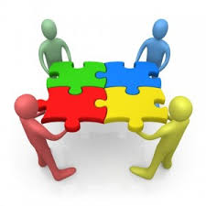
Summary
The users gave great reviews on the app and really enjoyed the experience
The biggest drawbacks seemed to be small quirks within the navigation of the app

Slide 28
Discussion

Slide 29
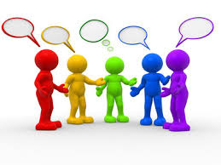
Discussion
Larger Study
Should be done to get a wider breathe of people such as different age groups and non active individuals
Changes
Cleaner movement around app
Quick Add Clarification
Change Color Scheme
Potential Additions (Came from Participants)
Individual Body Weight Tracking
Notifications
More efficient method of information input
Suggested Workouts
Can post more to community other than just weight cards

