Slide 1

SkillSwap
A Community of Learners and Teachers
All too often people have difficulty finding ways to learn new interesting things. We believe that these same people already have teachable skills. With SkillSwap, users can trade knowledge so that they can learn new skills and topics while also teaching others what they know; in this way, every user is both a learner and a teacher.

Slide 2
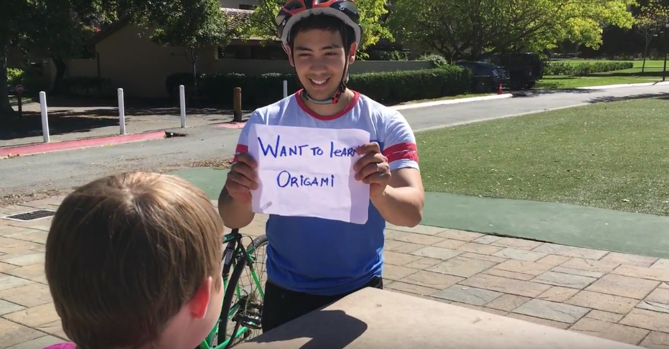
Tasks
Simple
Learn a new skill/topic from someone

Slide 3
Tasks
Simple
Learn a new skill/topic from someone
Moderate
Teach a familiar skill/topic to someone else

Slide 4
Tasks
Simple
Learn a new skill/topic from someone
Moderate
Teach a familiar skill/topic to someone else
Complex
Pass on a newfound skill/topic by teaching it to someone else

Slide 5
Storyboards

Slide 6
