Slide 1
Assignment 2:
POVs and Prototypes
Team Banana Cat Judo

Slide 2
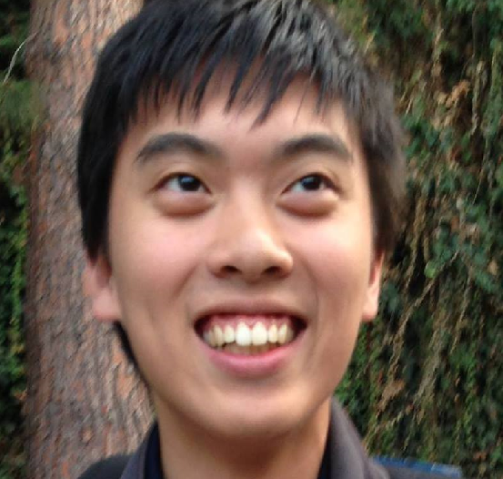
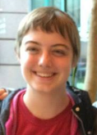
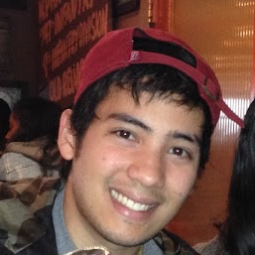
POVs and Prototypes
Presented by: Dana Murphy
Team: Jacob, Dana, Tuan
Team focus: barriers in exchange of information

Slide 3
Initial POVs
It would be game changing to...
Mary Esther: instill the belief that you can be a learner and a teacher
Bonnie: create a way to implement stress-free structure in learning/teaching
Kate: add (desirable?) pressure to learning.

Slide 4
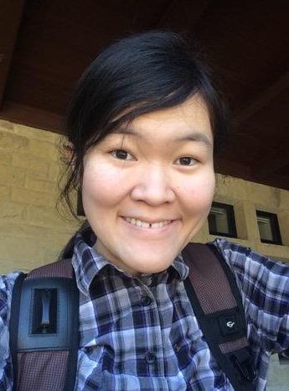
Additional interviewees
Mashbayar Tu
Senior at Stanford University,
Chemistry Tutor
Grace Ching
Community College Student, Grad School Applicant

Slide 5
Digging deeper
“If you’ve never struggled with the material, you’re not going to be a very good tutor... I can tutor chemistry because I struggled with it.”
“I watched one [Japanese drama] episode without subtitles and it was really hard. It took so much energy so I kinda stopped… it’s hard to see what I’m going to use it for.”

Slide 6
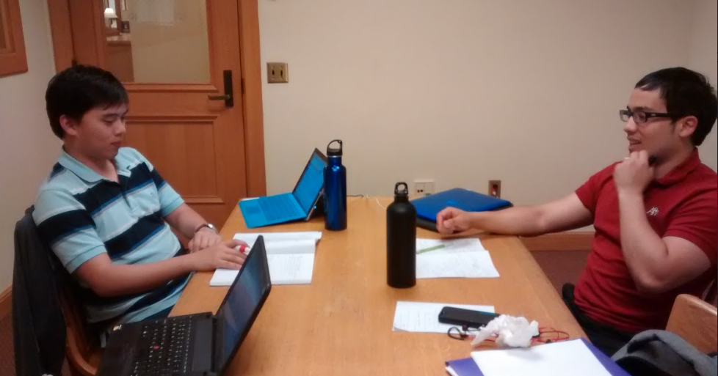
POVs

Slide 7
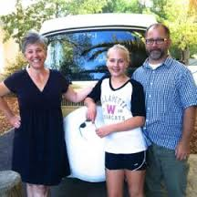
POVs
We met with Mary Esther, a former professor in philosophy

Slide 8
POVs
We met with Mary Esther, a former professor in philosophy
We were amazed to realize that she didn’t identify as a learner – to her, being a teacher and a learner was somewhat mutually exclusive.

Slide 9
POVs
We met with Mary Esther, a former professor in philosophy
We were amazed to realize that she didn’t identify as a learner – to her, being a teacher and a learner was somewhat mutually exclusive
It would be game changing to close the perceived gap between learner and teacher

Slide 10
POVs
We met with Mashbayar Tu, a student and chemistry tutor.

Slide 11
POVs
We met with Mashbayar Tu, a student and chemistry tutor.
We were amazed to realize that she emphasized empathy over raw knowledge in being a good teacher.

Slide 12
POVs
We met with Mashbayar Tu, a student and chemistry tutor.
We were amazed to realize that she emphasized empathy over raw knowledge in being a good teacher.
It would be game changing to help teachers develop that sense of empathy.

Slide 13
POVs
We met Grace Ching, a community college student preparing for grad school.

Slide 14
POVs
We met Grace Ching, a community college student preparing for grad school.
We were amazed to find that her approach to learning was severely hindered when she thought that the subject wasn’t applicable/interesting.

Slide 15
POVs
We met Grace Ching, a community college student preparing for grad school.
We were amazed to find that her approach to learning was severely hindered when she thought that the subject wasn’t applicable/interesting.
It would be game-changing to create that sense of both applicability and interest to any given topic.

Slide 16
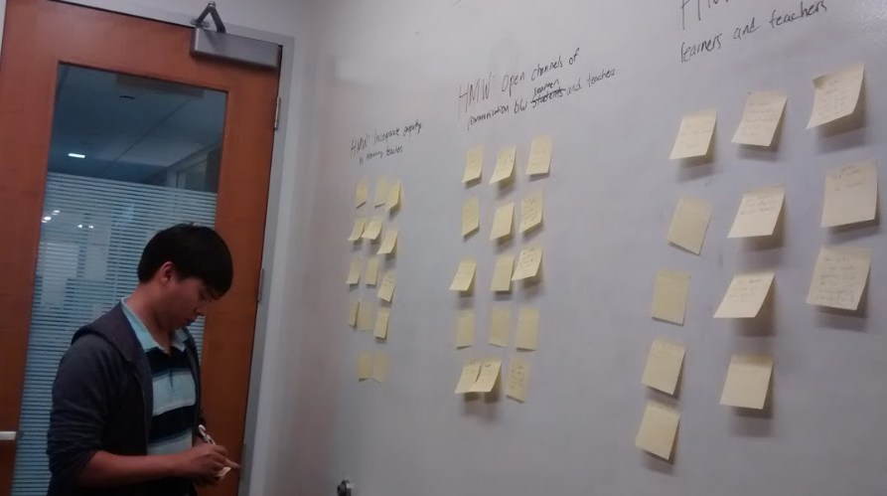
HMWs

Slide 17
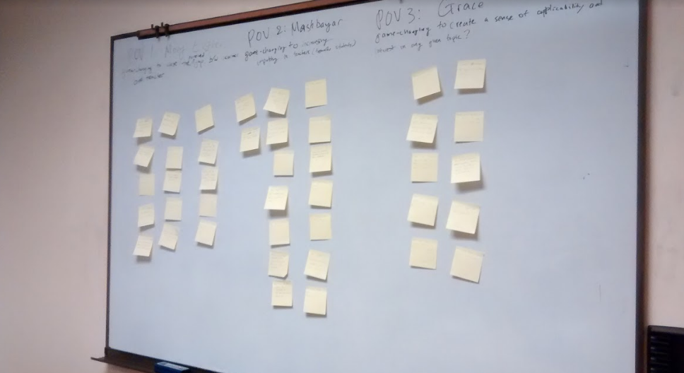
HMW
From the game-changer: “help teachers develop a sense of empathy.”
...HMW incorporate empathy in the training of teachers?

Slide 18
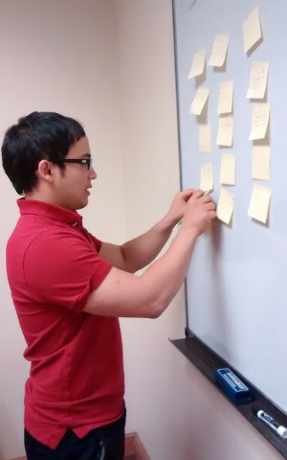
HMW
From the game-changer: “help teachers develop a sense of empathy.”
...HMW opening channels of communication between students and teachers?

Slide 19
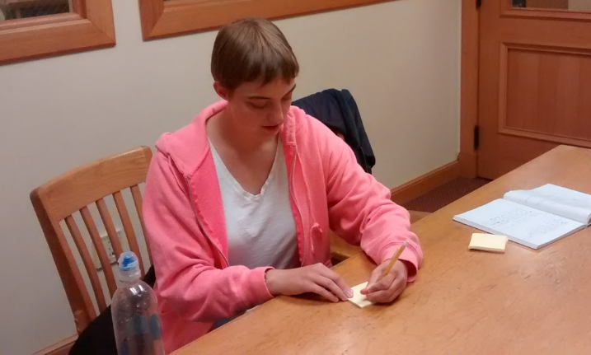
HMW
From the game-changer: “close the perceived gap between learner and teacher”
...HMW reverse the roles of students & teachers?

Slide 20
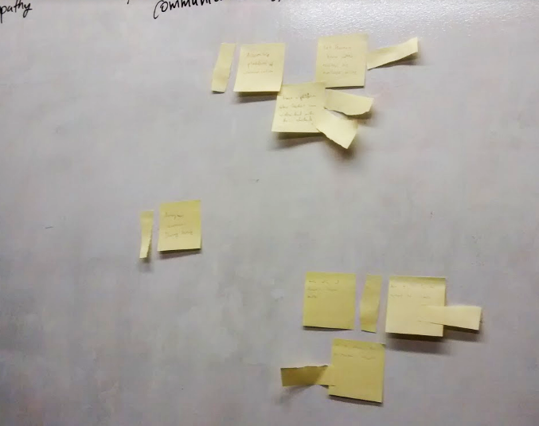
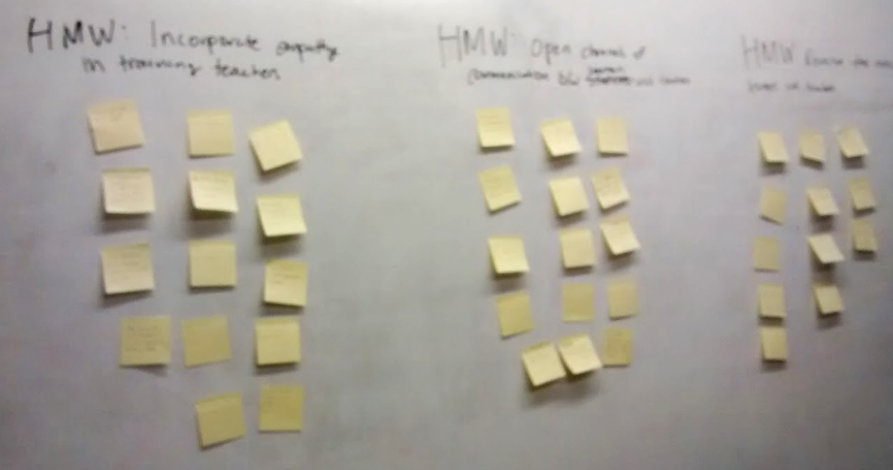
Brainstorming

Slide 21
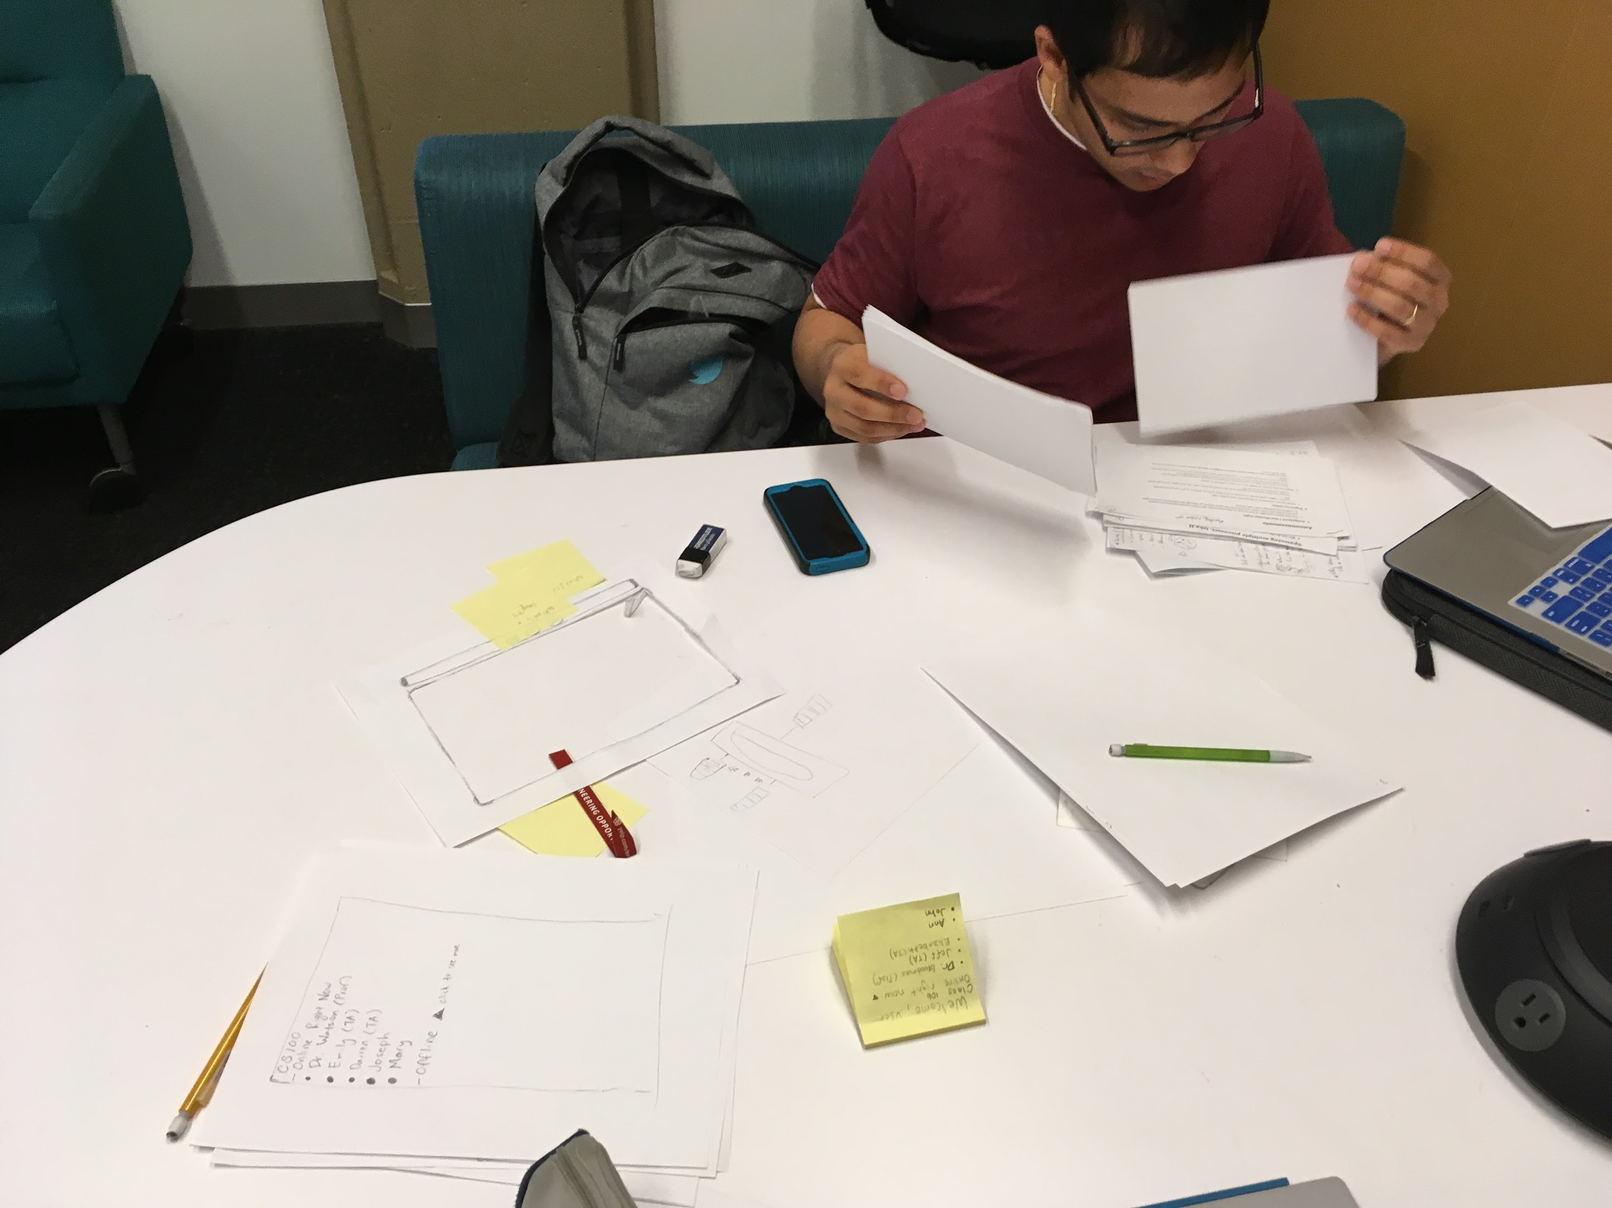
Prototypes

Slide 22
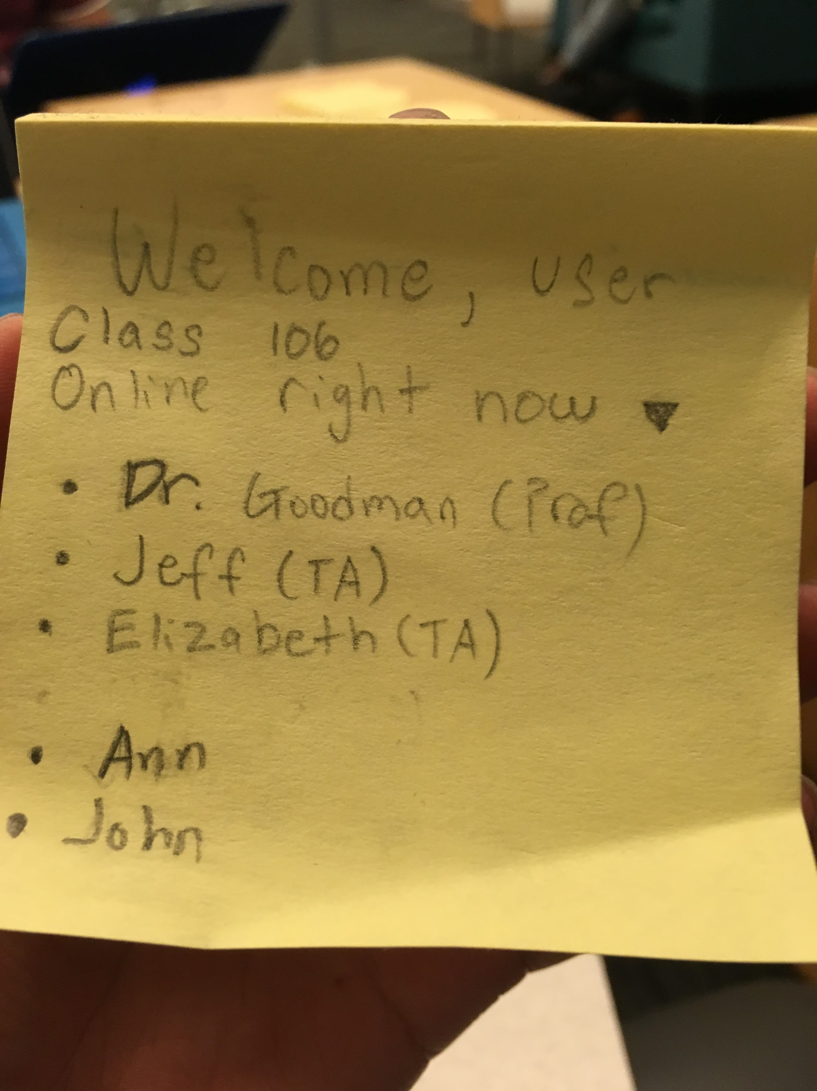
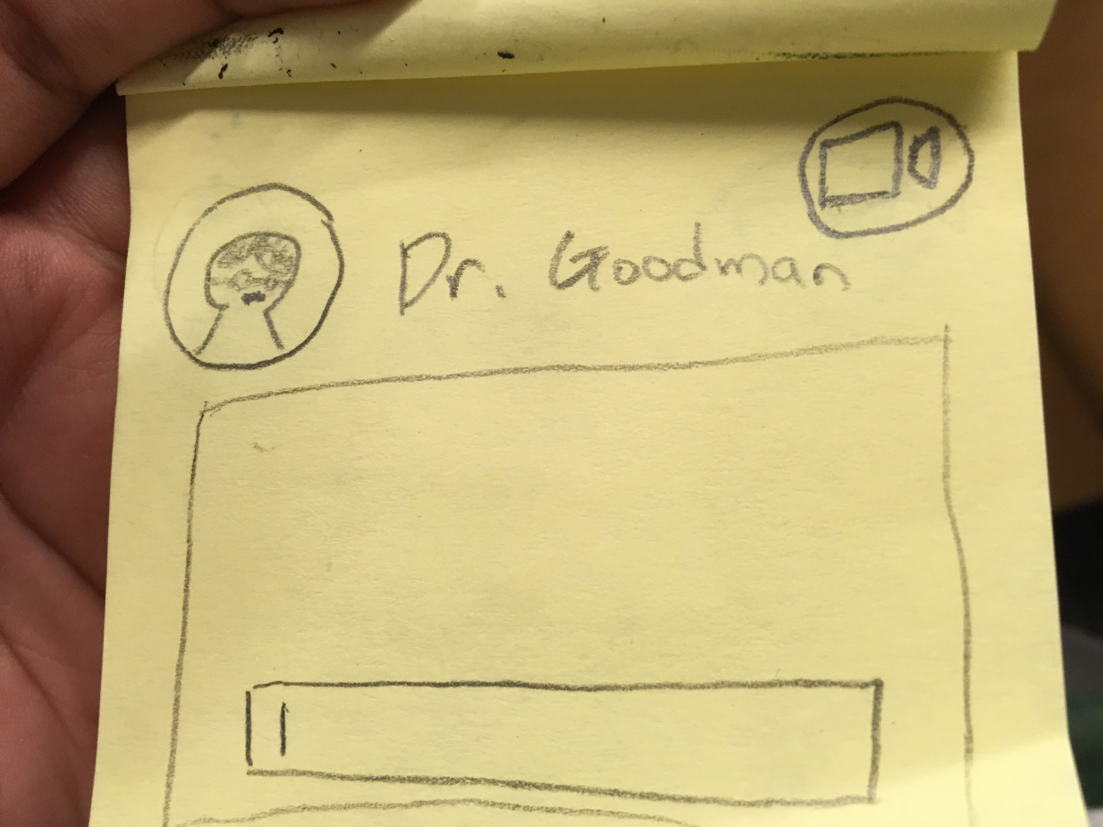
Solution 1
“Accessible platform of online communication between learners and teachers”

Slide 23
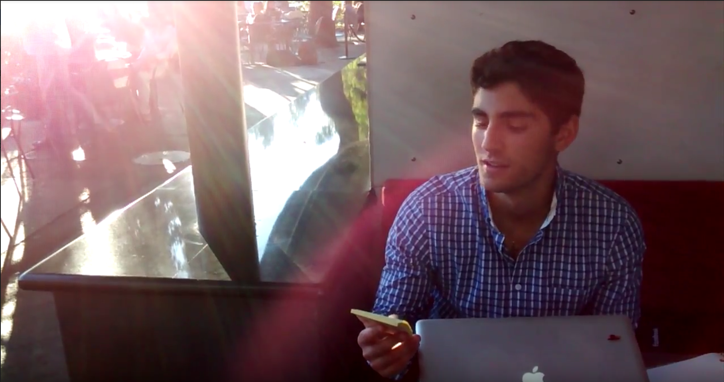
Process

Slide 24
Assumptions:
The learners/teacher would prefer to speak in real time

Slide 25
Assumptions:
The learners/teacher would prefer to speak in real time
Teachers would be willing and able to talk to students online

Slide 26
Assumptions:
The learners/teacher would prefer to speak in real time
Teachers would be willing and able to talk to students online
New: Teachers prefer direct conversation more than students

Slide 27
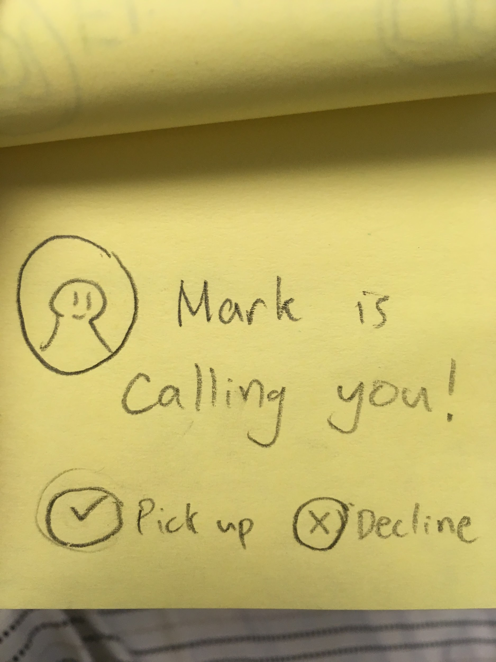
Results:
What worked
  Straightforward, Useful
What didn’t work
  Unexciting, a “feature”
Surprises
  Preference for TA
New Learnings
  Prefer “on-hold” option

Slide 28
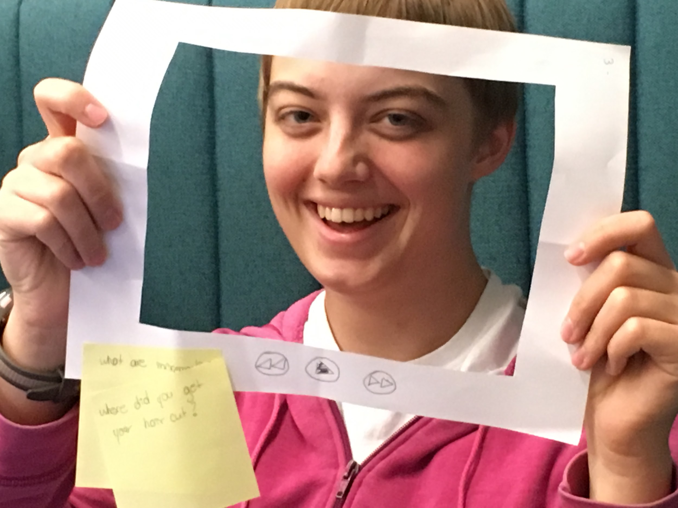
Solution 2
“Recordings of lectures that may be annotated with comments and questions”

Slide 29
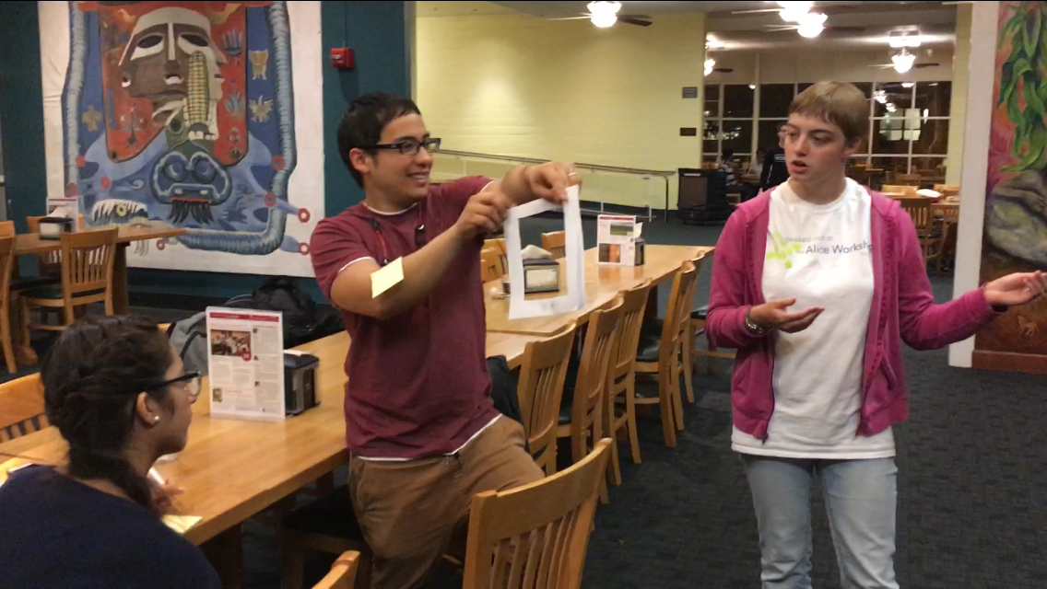
Process

Slide 30
Assumptions:
Students would provide annotations if given the chance

Slide 31
Assumptions:
Students would provide annotations if given the chance
Students wouldn’t abuse anonymity

Slide 32
Assumptions:
Students would provide annotations if given the chance
Students wouldn’t abuse anonymity
New: Annotations aren’t a suitable substitute for coming in person

Slide 33
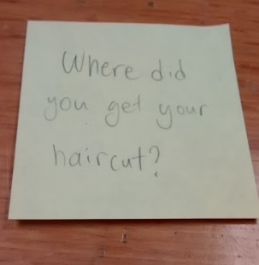
Results:
What worked
  Engaging, Fun
What didn’t work
  Selectively useful
Surprises
  Response from extreme user
New Learnings
  Vetting process for posts

Slide 34
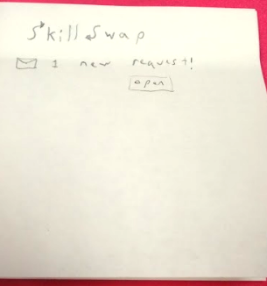
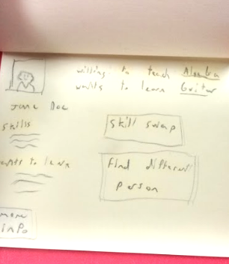
Solution 3
“Switch whether the user is learning or teaching a subject”

Slide 35
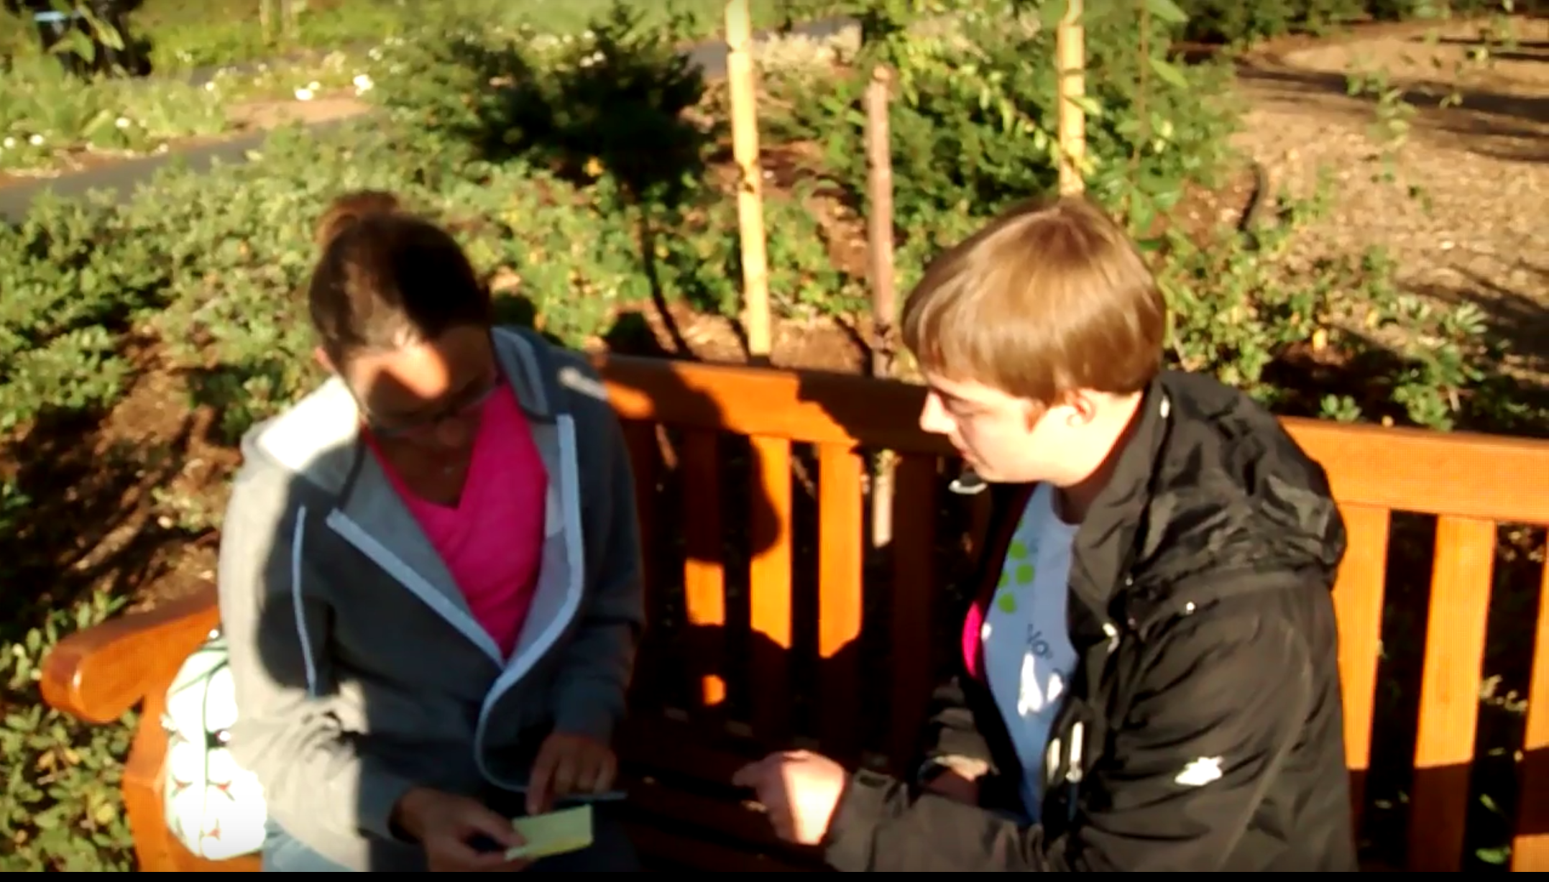
Assumptions and feedback

Slide 36
Assumptions:
User is willing to be a learner and teacher

Slide 37
Assumptions:
User is willing to be a learner and teacher
User is willing to meet with a stranger

Slide 38
Assumptions:
User is willing to be a learner and teacher
User is willing to meet with a stranger
New: Two users may never have matching skills

Slide 39
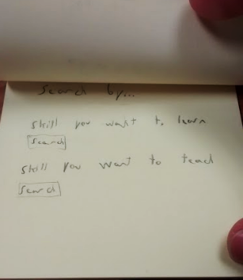
Results:
What worked
  Interested, engaged
What didn’t work
  Skeptical of two-person network
Surprises
  Use of video chat
New Learnings
  Larger network of learning/teaching

Slide 40
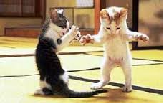
Thank you
Any questions?

