Slide 1
Assignment 1: Needfinding

Slide 2
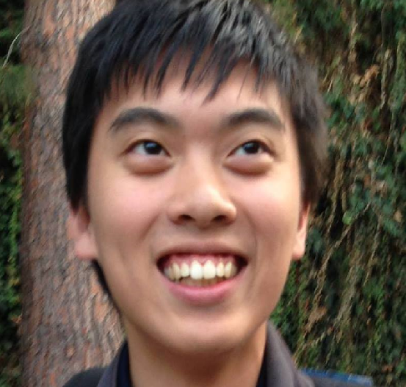
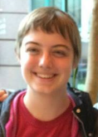
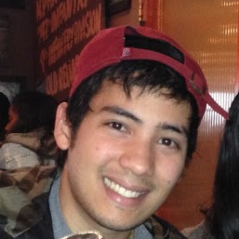
Needfinding
Presented by: Tuan Anh Tran Carballo
Studio: Learning
Team: Jacob, Dana, Tuan

Slide 3

Problem domain:
Barriers between knowledge
and exchange.

Slide 4
Needfinding Methodology

Slide 5
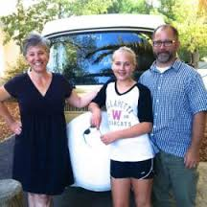

Interviewees
Mary Esther Schnaubelt
  Residential Fellow in Branner Dorm
Bonnie Tam
  Toxicologist working at Chevron
Kate Milani
  Administrative assistant
Notes:
Former Professor, extreme user in age and teaching experience
Recruited via email, interviewed in Branner Library
Typical user: young adult, frequent user of mobile technology
Recruited in person, interviewed at her office
Highly educated, though currently not involved in academia
Recruited in person, interviewed over phone

Slide 6
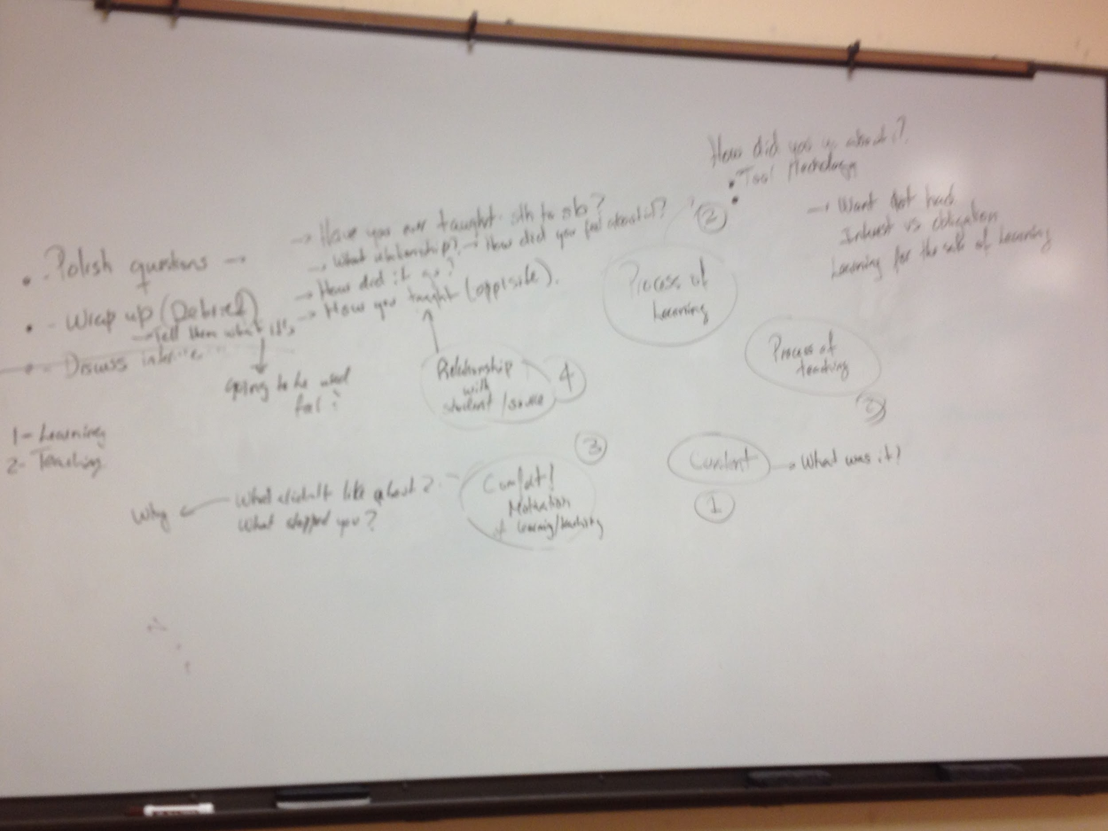
Question
Design
Thinking
Process

Slide 7
Question Focus
Content
Content
Teaching
Learning
Motivation
Teaching
Teaching
Process

Slide 8
We asked interviewees...
About a time they learned a new skill or topic
  What motivated them to learn it?
  How did they learn it?
  What part of learning it worked/ didn’t work?
About a time they taught a new skill or topic
  What motivated them to teach it?
  How did they teach it?
  What part of teaching it worked/ didn’t work?

Slide 9
Interview Results

Slide 10
Tension
“For me... if my own personal balance gets out-of-wack when I’m trying to go through the learning process, then I don’t learn things properly. Stress creates blinders.” -Mary Esther
“He (professor) is an older man who doesn’t know how to engage young people … young teachers know better how to do this ...” -Kate
“[To teach] I want to be a supervisor, but I don’t have that opportunity just yet.” - Bonnie

Slide 11
Contradictions
“[Teaching] definitely relies on the teacher being the authority… [as a teacher] I would try to flatten the hierarchy in the class.” -Mary Esther
“[Class] was pretty structured, and I felt pretty stressed out about that.” - Bonnie
“[Structure] helps with the process of learning. There’s a clear outcome. You know when you’ve achieved or failed to achieved the desired outcome.” -Mary Esther
“I don’t feel comfortable learning from strangers … you feel more pressured to perform well and learn when you are overseen by somebody you don’t know” -Kate

Slide 12
Surprises
“[when talking with peer groups] you’re also getting a sense of how people are thinking about it... values come out, and how people are valuing the process, and levels of anxiety around it... As a learner, I think ‘who’s making the most sense? Where do I fit in on the spectrum?’ Then I take the steps that align with my beliefs.” -Mary Esther
“My coworkers understood that what I had learned was good, but they didn’t really try to improve themselves and learn the same thing.” - Bonnie
“People don’t like change.” - Kate

Slide 13
Analysis

Slide 14
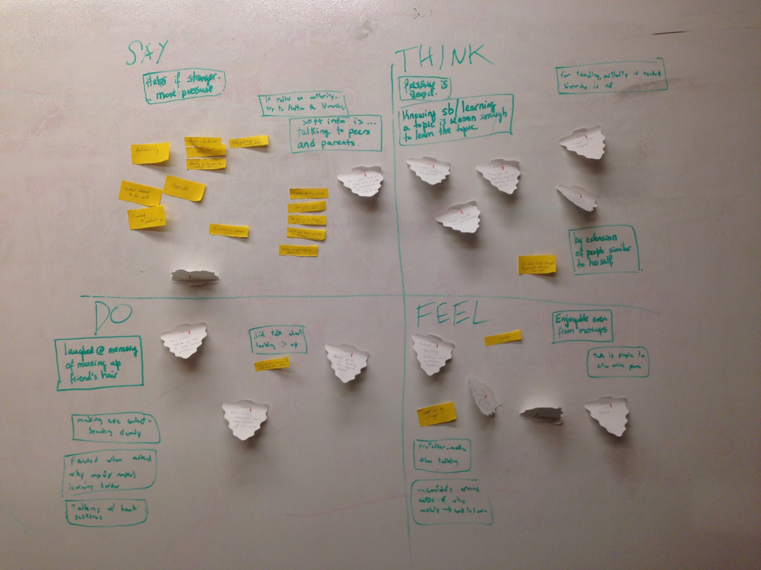
Empathy
Map

Slide 15
Say
Think
When have I learned something? Me personally? As an adult learner?” - Mary Esther
“I think it’s a great, unique skill for a scientist to have. It’s really empowering.” - Bonnie
“I teach people the way that I was taught.” - Bonnie
“I took the accounting because because my dad majored in accounting and I thought if he could do it, I could also do it.” - Kate
I identify more as a teacher than a learner now
More than anything else, a teacher’s authority comes from their knowledge of a subject.
I want to inspire and empower others
My dad and friends inspire me
Do
Feel
Mary Esther paused when asked why asked why anxiety makes learning harder
Mary Esther got out her phone when she wanted to know how to record audio
Bonnie would pause when thinking about negative answers
Kate laughed at memory of messing up friend’s hair
Proud Overwhelmed
Bored Secure in role of teacher
Anxious Nostalgic despite mess-ups
Uncertain Confident learning simple skills

Slide 16
Needs
Practical applications for subjects being learned
Some form of pressure (but not stress)
relatable teacher
Feeling empowered through learning/teaching
Insights
Teachers and learners can have incongruent preferences
People want to inspire and be inspired
People have an ingrained belief that being a teacher/student is mutually exclusive

Slide 17

Thanks for Listening!

