Slide 1
SkillSwap: Med-Fi Prototype
Jacob Yu Villa, Dana Murphy, Tuan Tran

Slide 2
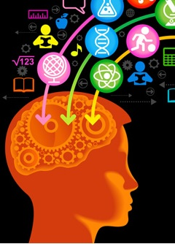

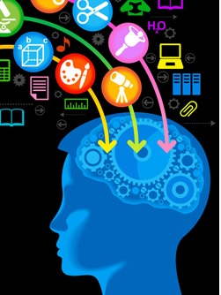
Team mission statement/value proposition

Slide 3
Outline:
1- TASKS
2- DESIGN CHANGES
3- STORYBOARD FLOW
4- PROTOTYPING TOOLS
5- LIMITATIONS AND TRADEOFFS

Slide 4
Tasks

Slide 5

Task # 1: (easy)
Show others what you want to learn

Slide 6

Task # 2: (medium)
Find a partner to swap skills with

Slide 7

Task # 3: (complex)
Teach a skill you have learned through the app

Slide 8
Design changes

Slide 9
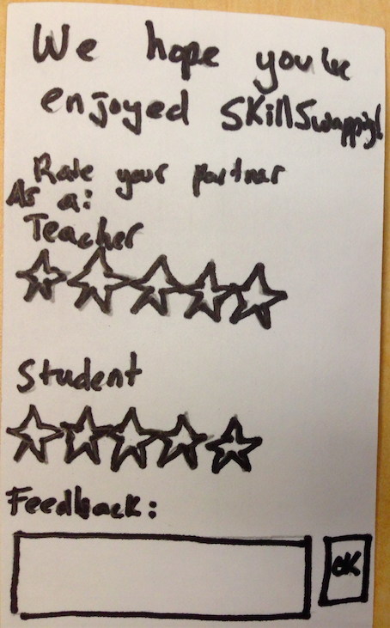
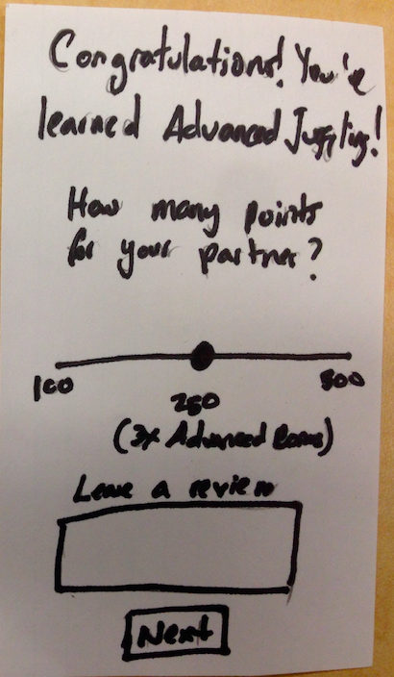
Design Change #1
Before After
Notes:
Users feel bad giving people they spent alot of time with low stars. So a point system would be better.

Slide 10
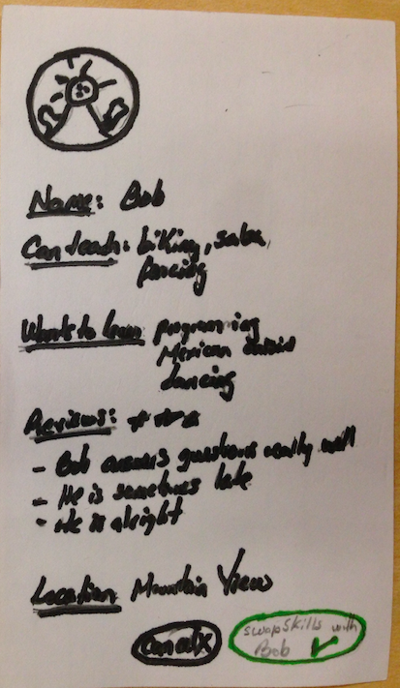
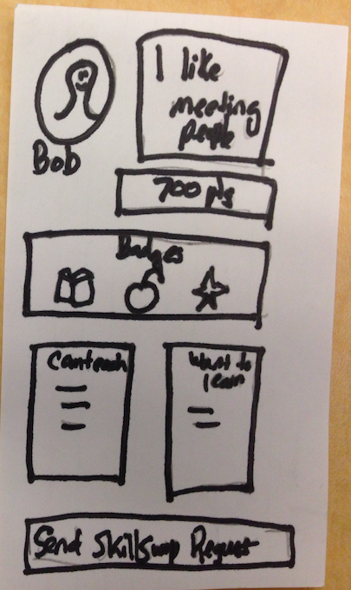
Design Change #2
Before After
Notes:
We changed this to reduce text clutter and to make users less confused at the profiles.

Slide 11
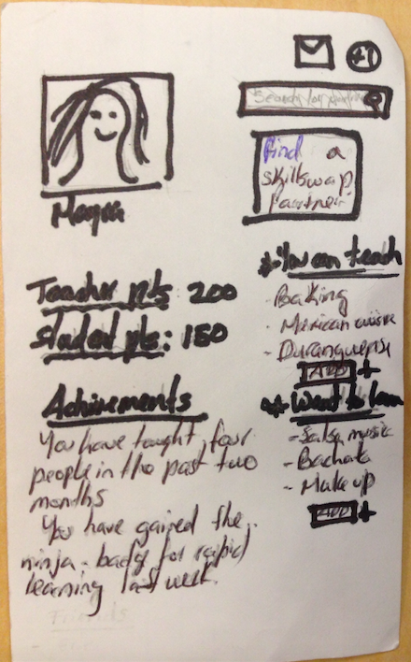
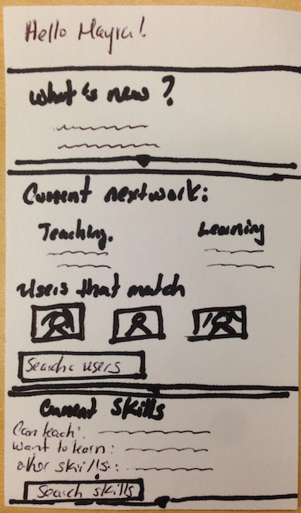
Design Change #3
Before After
Notes:
We changed this because our original front page had too much information. We broke it down into two new screens this time: a profile and a home screen to separate the information.

Slide 12
Storyboard flow

Slide 13
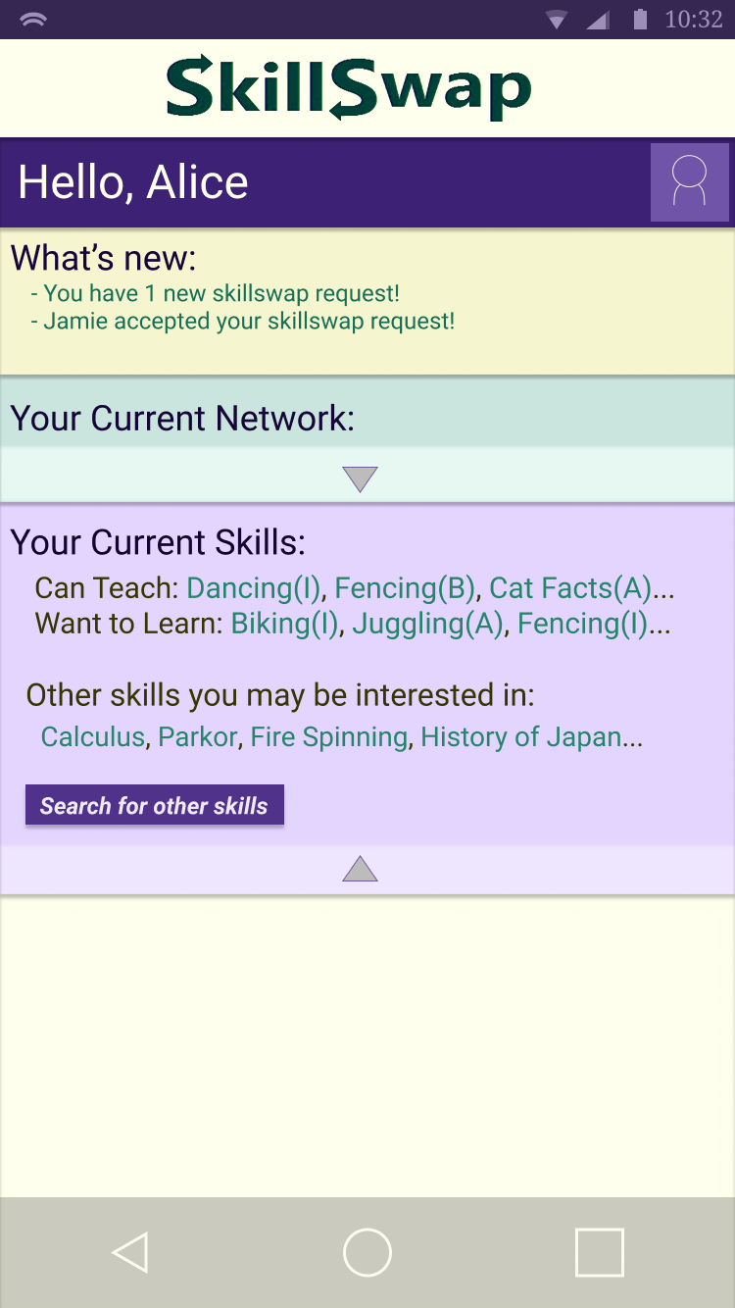
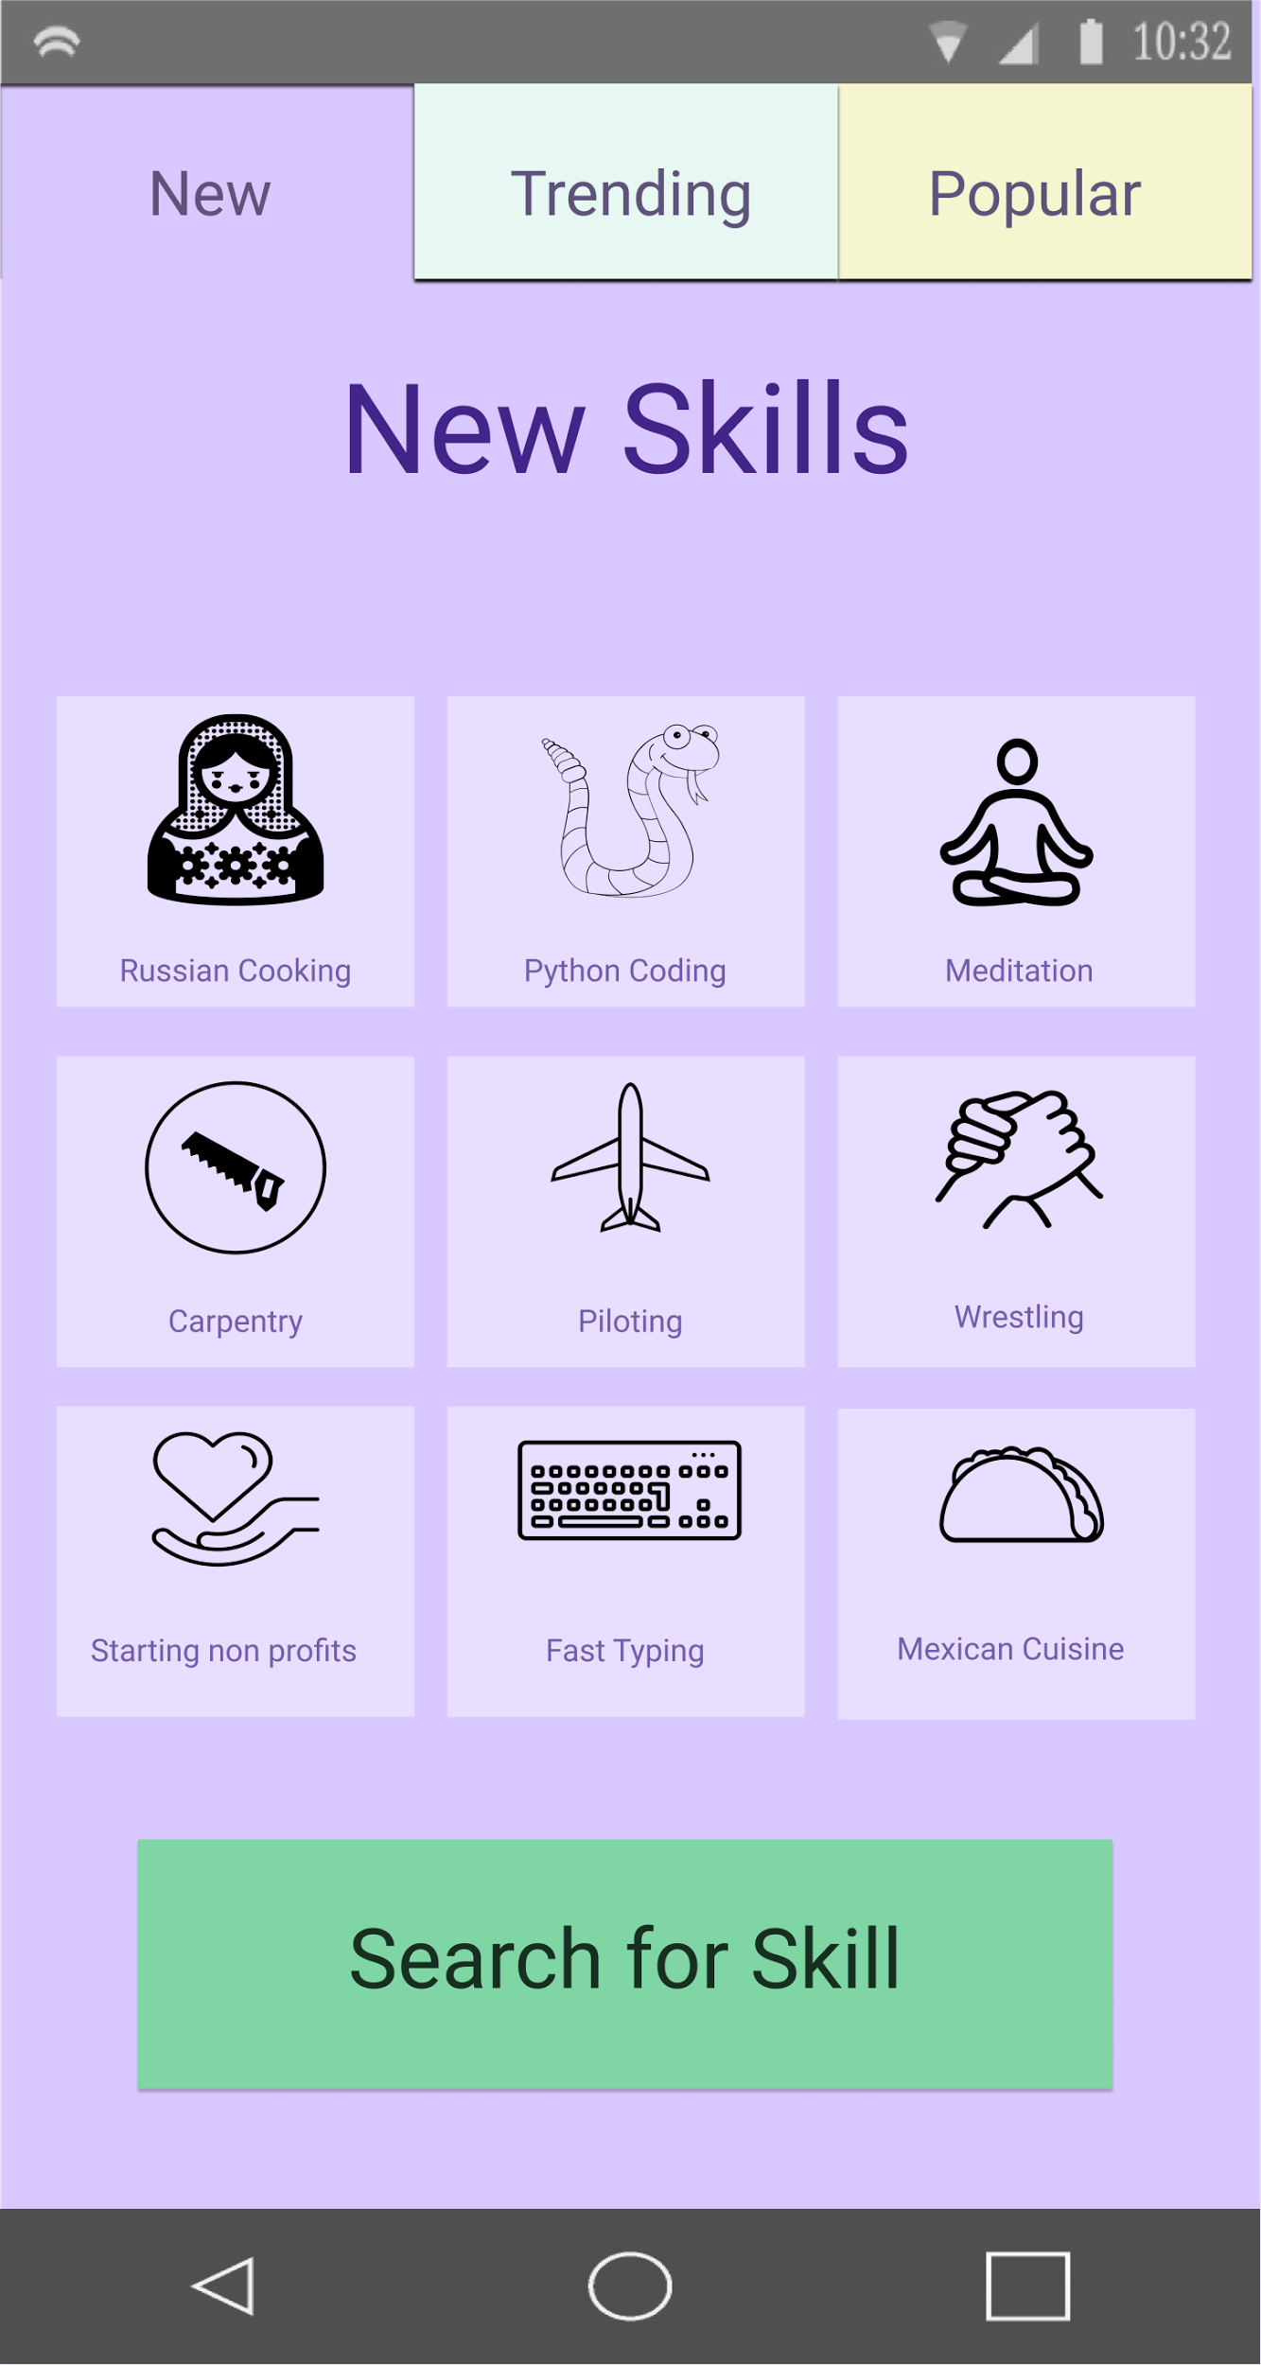
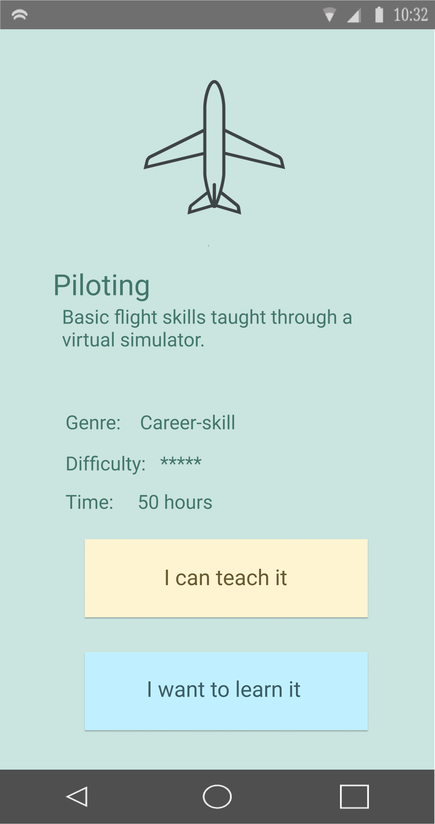
Task Flow Storyboard #1:
Notes:
Brings user back to home page after updating profile at the end

Slide 14
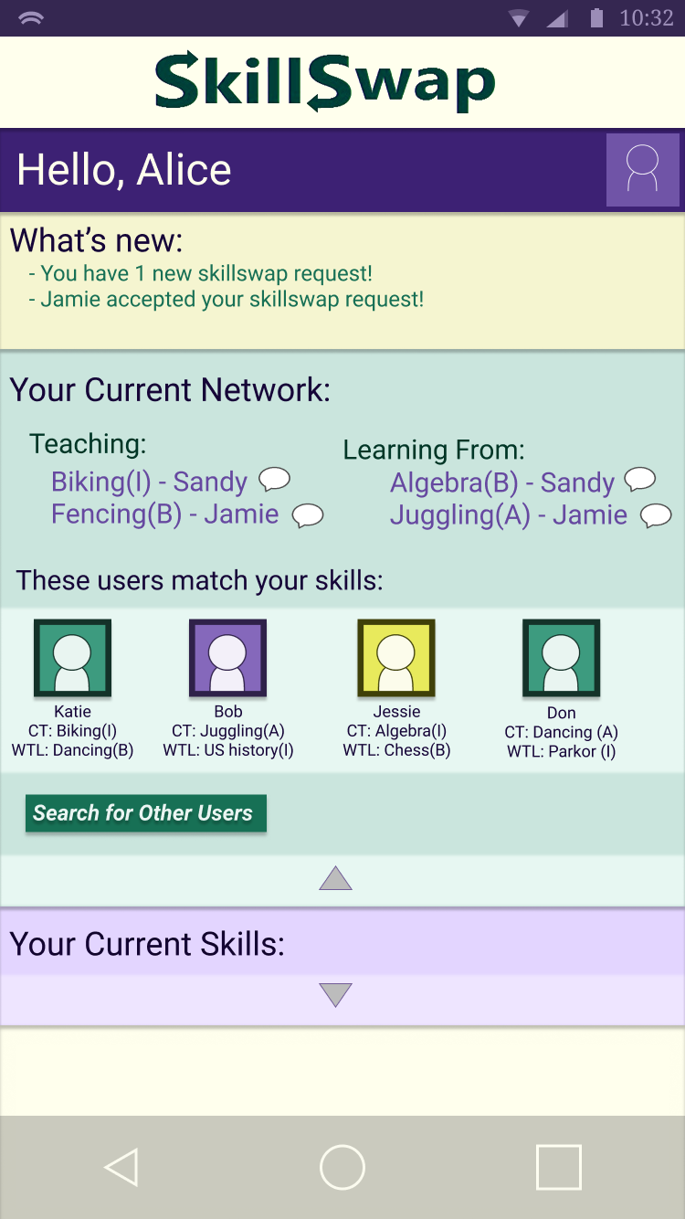
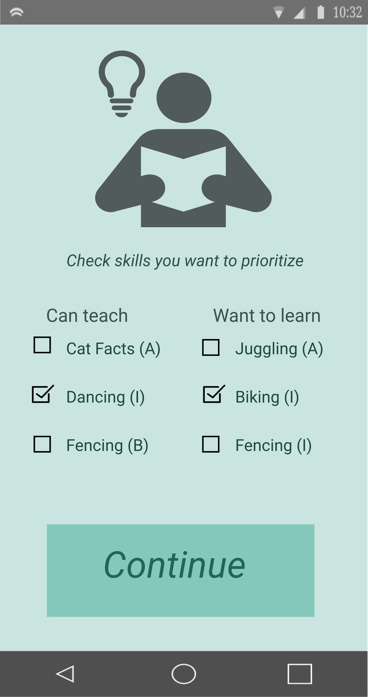
Task Flow Storyboard #2:

Slide 15
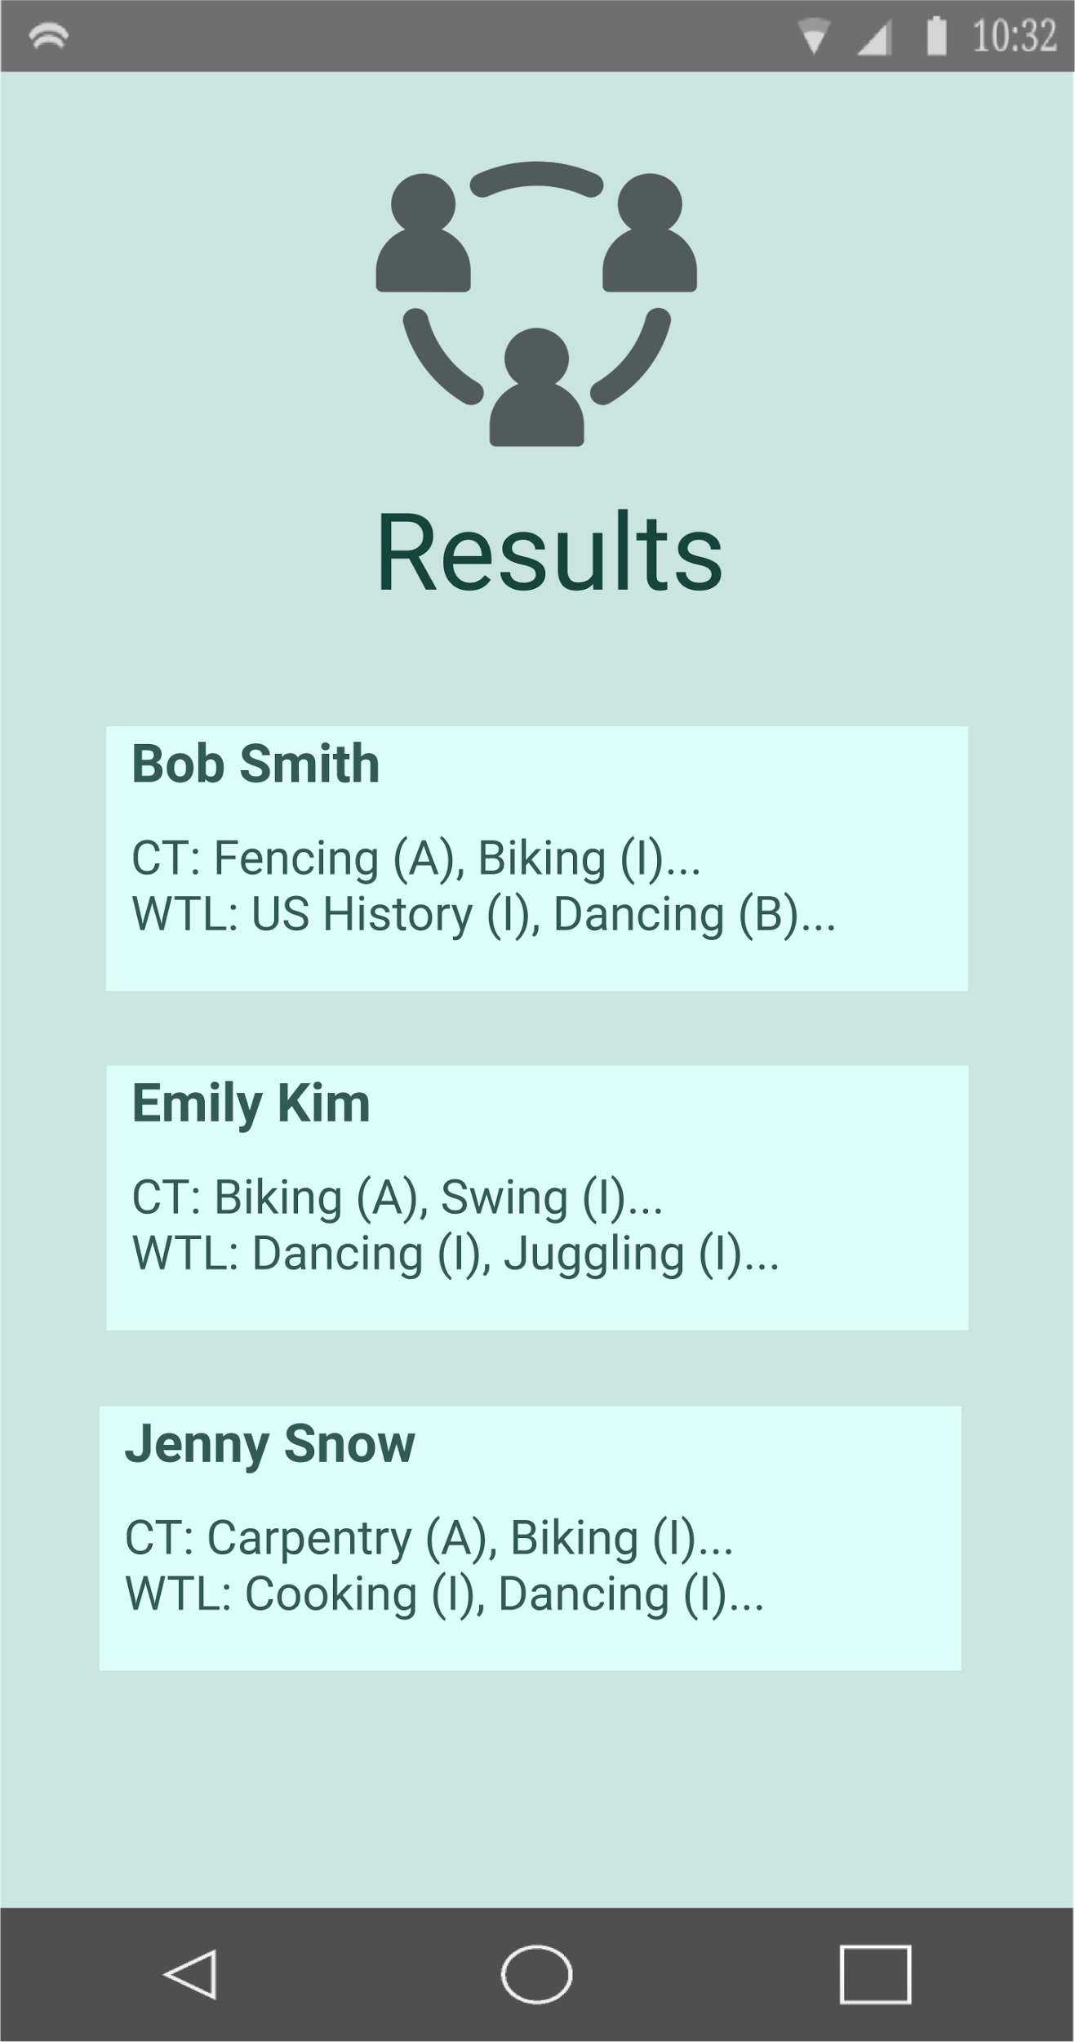
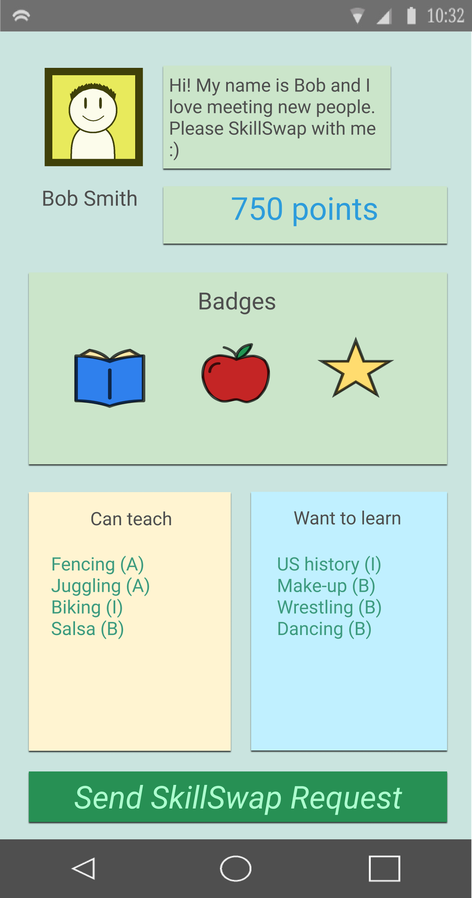
Task Flow Storyboard #2:

Slide 16
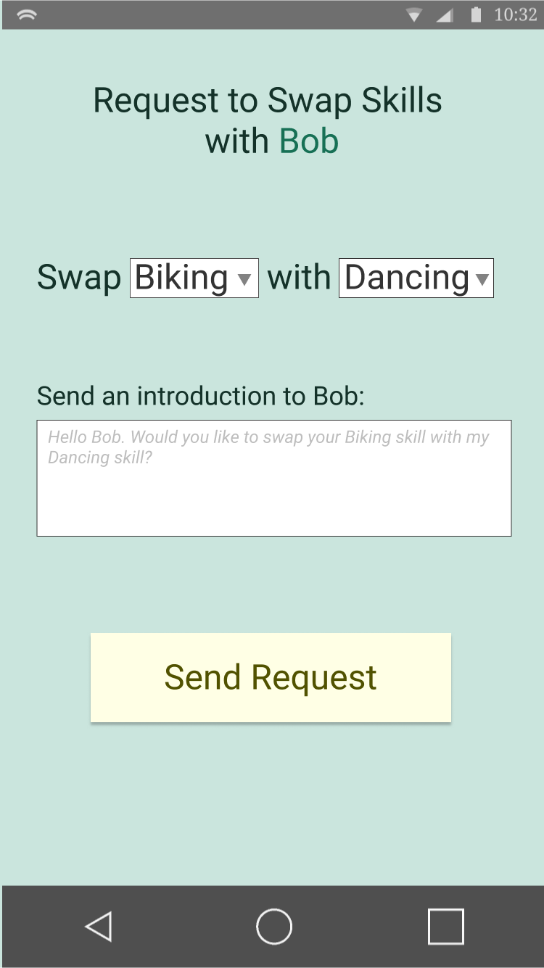
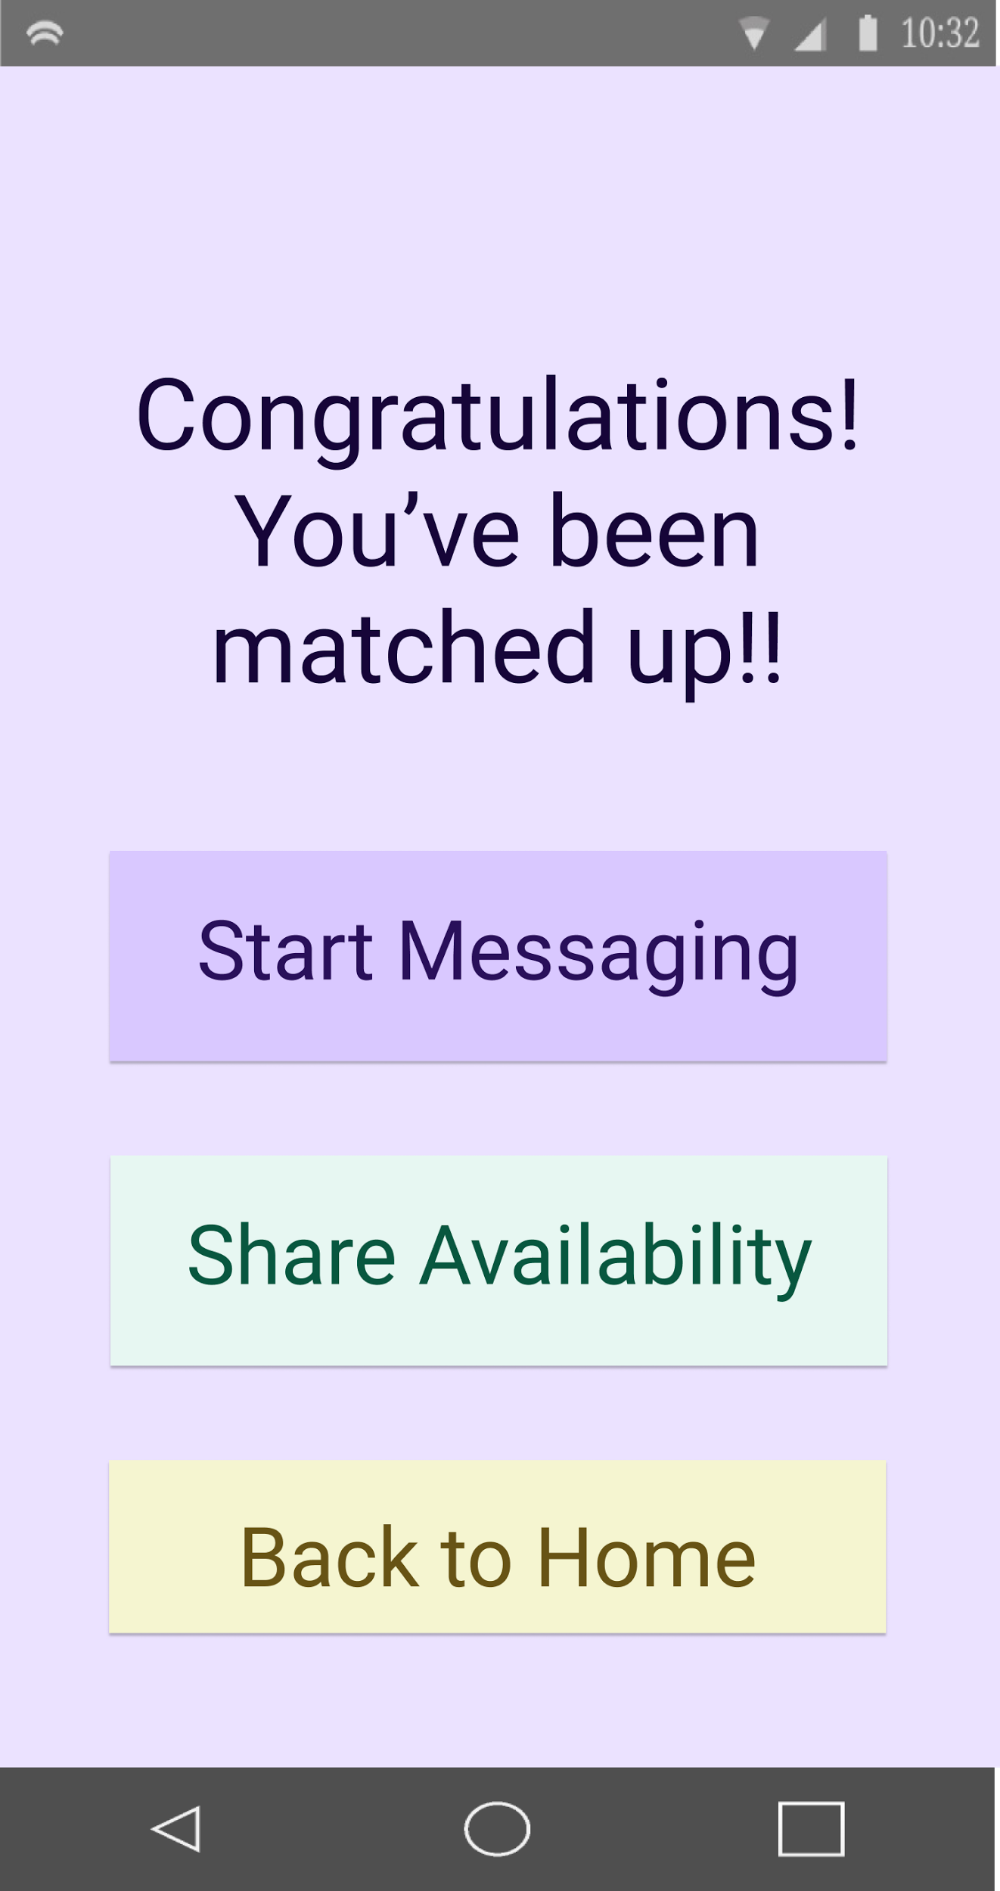
Task Flow Storyboard #2:

Slide 17
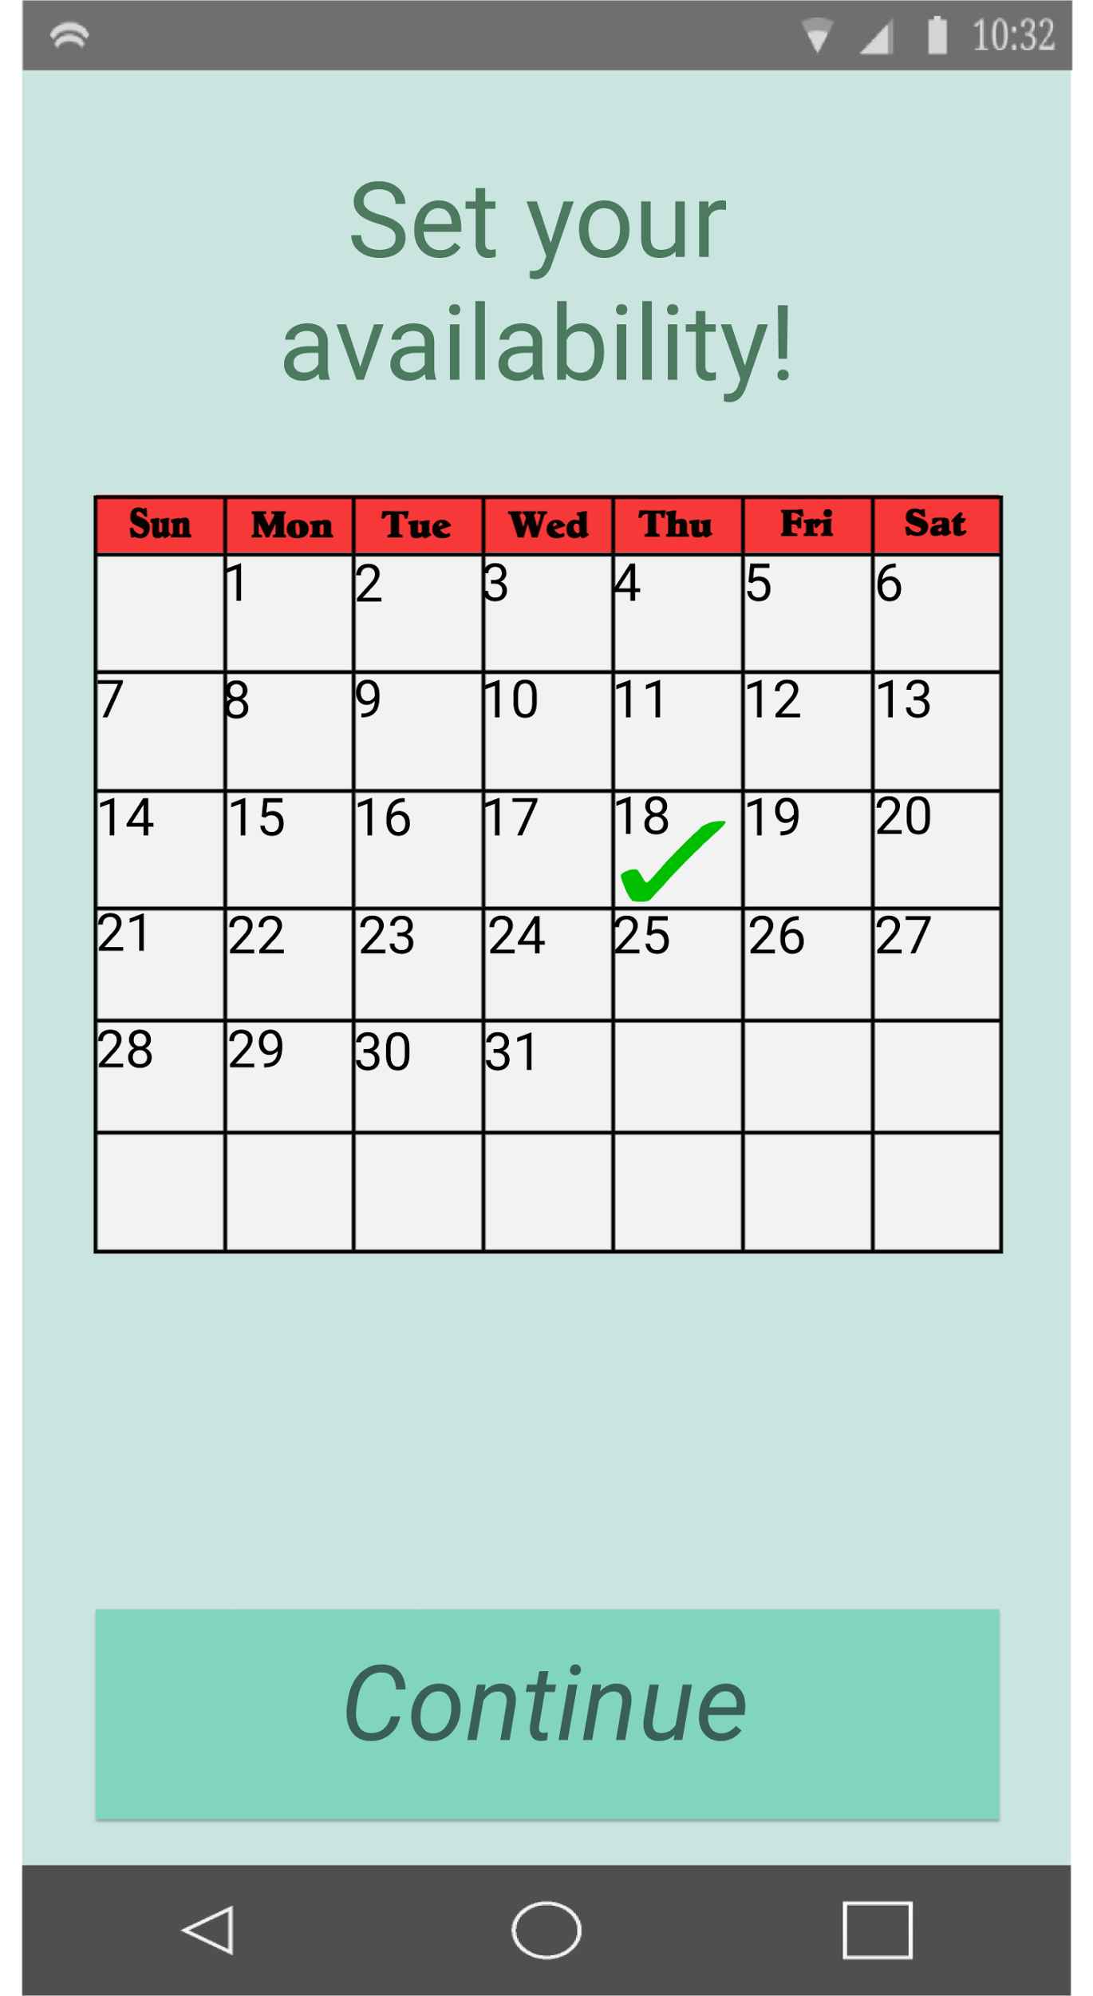
Task Flow Storyboard #2:
Notes:
SkillSwap occurs after availability

Slide 18
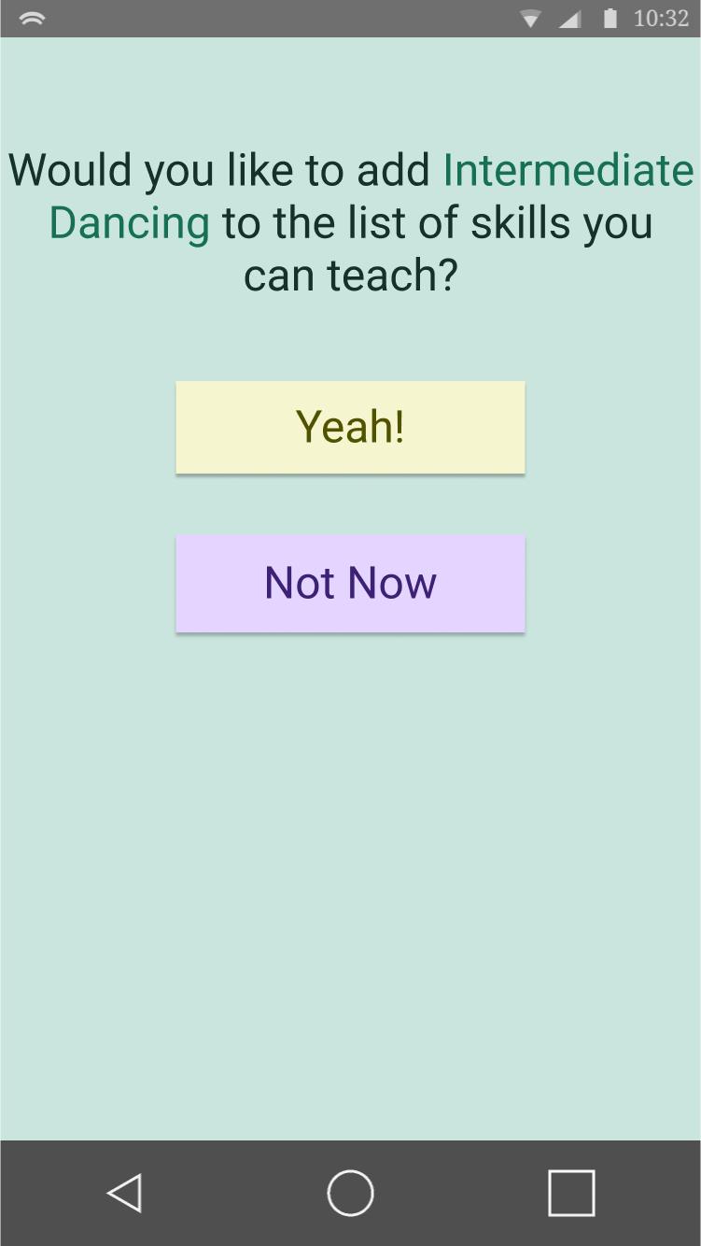
Task Flow Storyboard #3: Part 1
Notes:
After a SkillSwap, users can choose to add skills they learned to skills they can now teach!

Slide 19
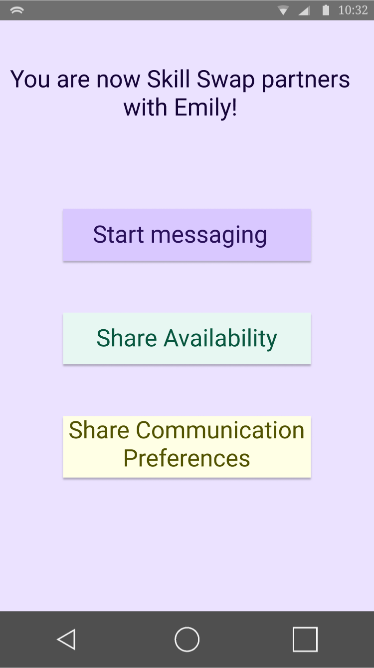
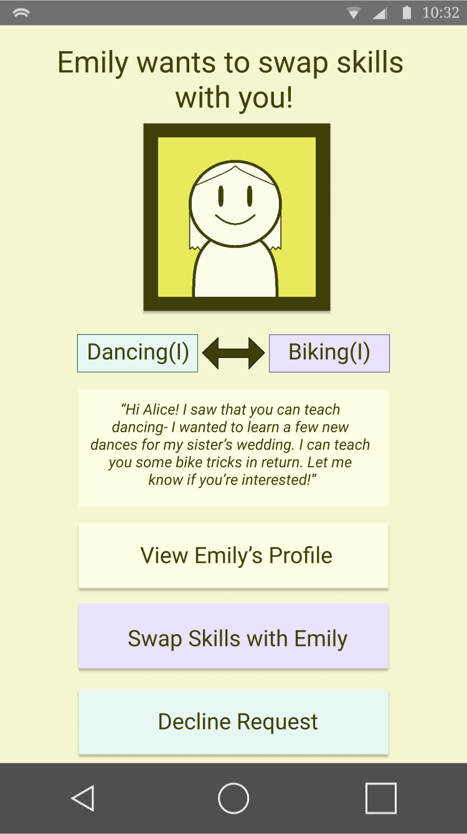
Task Flow Storyboard #3: Part 2

Slide 20
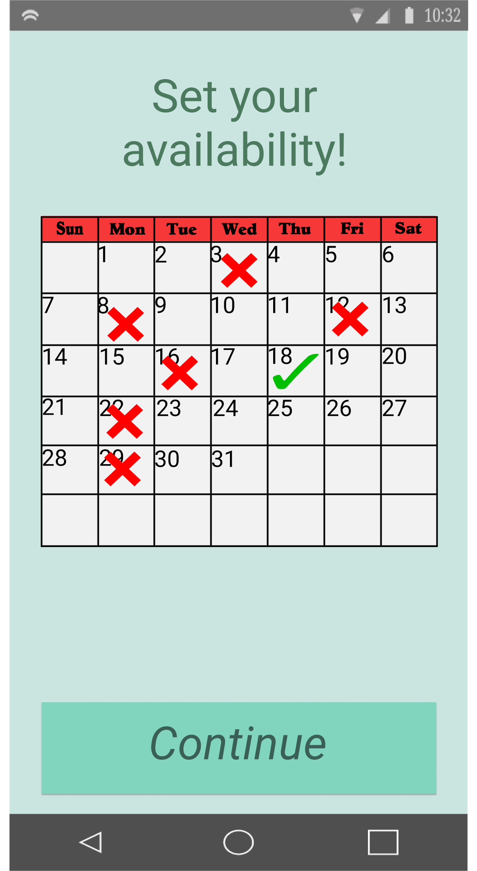
Task Flow Storyboard #3: Part 2
Notes:
SkillSwap occurs after

Slide 21
Prototyping Tools:

Slide 22
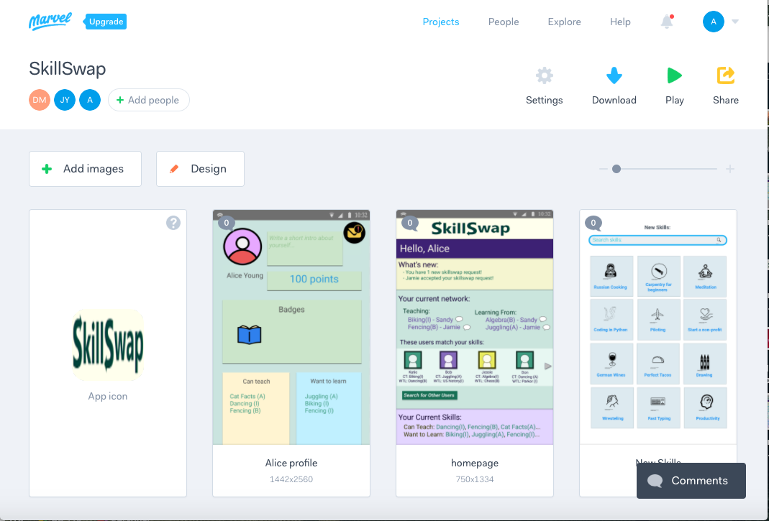
Marvel

Slide 23
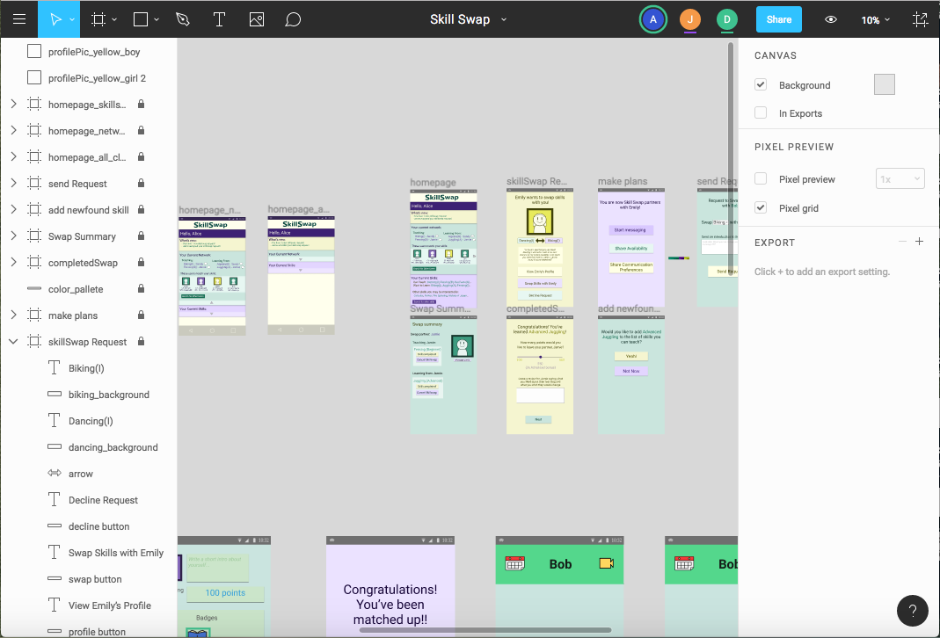
Figma

Slide 24
Limitations and Tradeoffs
Users unable to set their availabilities
Unable to update information
Currently unable to set their availabilities
Notes:
User can do whatever he wants, no constraints in terms of search
currently this prototype does not update profiles
Users unable to set their availabilities
Potential partners hard coded
Many buttons are not clickable.
We have no Wizard-of-Oz elements but we do have hard coded stuff
The slider which decide how many points a user gives to their partner currently cannot be adjusted
→ All this because Marvel doesn’t allow database, or provide other more complex functionalities

Slide 25
Limitations and Tradeoffs
Users unable to set their availabilities
Unable to update information
Currently unable to set their availabilities
Notes:
User can do whatever he wants, no constraints in terms of search
currently this prototype does not update profiles
Users unable to set their availabilities
Potential partners hard coded
Many buttons are not clickable.
We have no Wizard-of-Oz elements but we do have hard coded stuff
The slider which decide how many points a user gives to their partner currently cannot be adjusted
→ All this because Marvel doesn’t allow database, or provide other more complex functionalities

Slide 26
Limitations and Tradeoffs
Users unable to set their availabilities
Unable to update information
Currently unable to set their availabilities
Notes:
User can do whatever he wants, no constraints in terms of search
currently this prototype does not update profiles
Users unable to set their availabilities
Potential partners hard coded
Many buttons are not clickable.
We have no Wizard-of-Oz elements but we do have hard coded stuff
The slider which decide how many points a user gives to their partner currently cannot be adjusted
→ All this because Marvel doesn’t allow database, or provide other more complex functionalities

Slide 27
Thank you

