Slide 1
SkillSwap: Low-fi Prototyping & Pilot Usability Testing
Jacob Yu Villa, Dana Murphy, Tuan Tran
Notes:
Talk about overview

Slide 2



Team mission statement/value proposition
Notes:
Breaking the barriers in learning

Slide 3

Team mission statement/value proposition
Notes:
Breaking the barriers in learning

Slide 4

Team mission statement/value proposition
Notes:
Breaking the barriers in learning

Slide 5
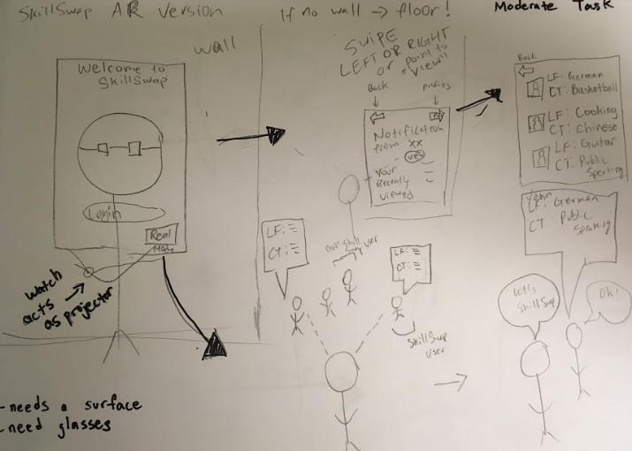
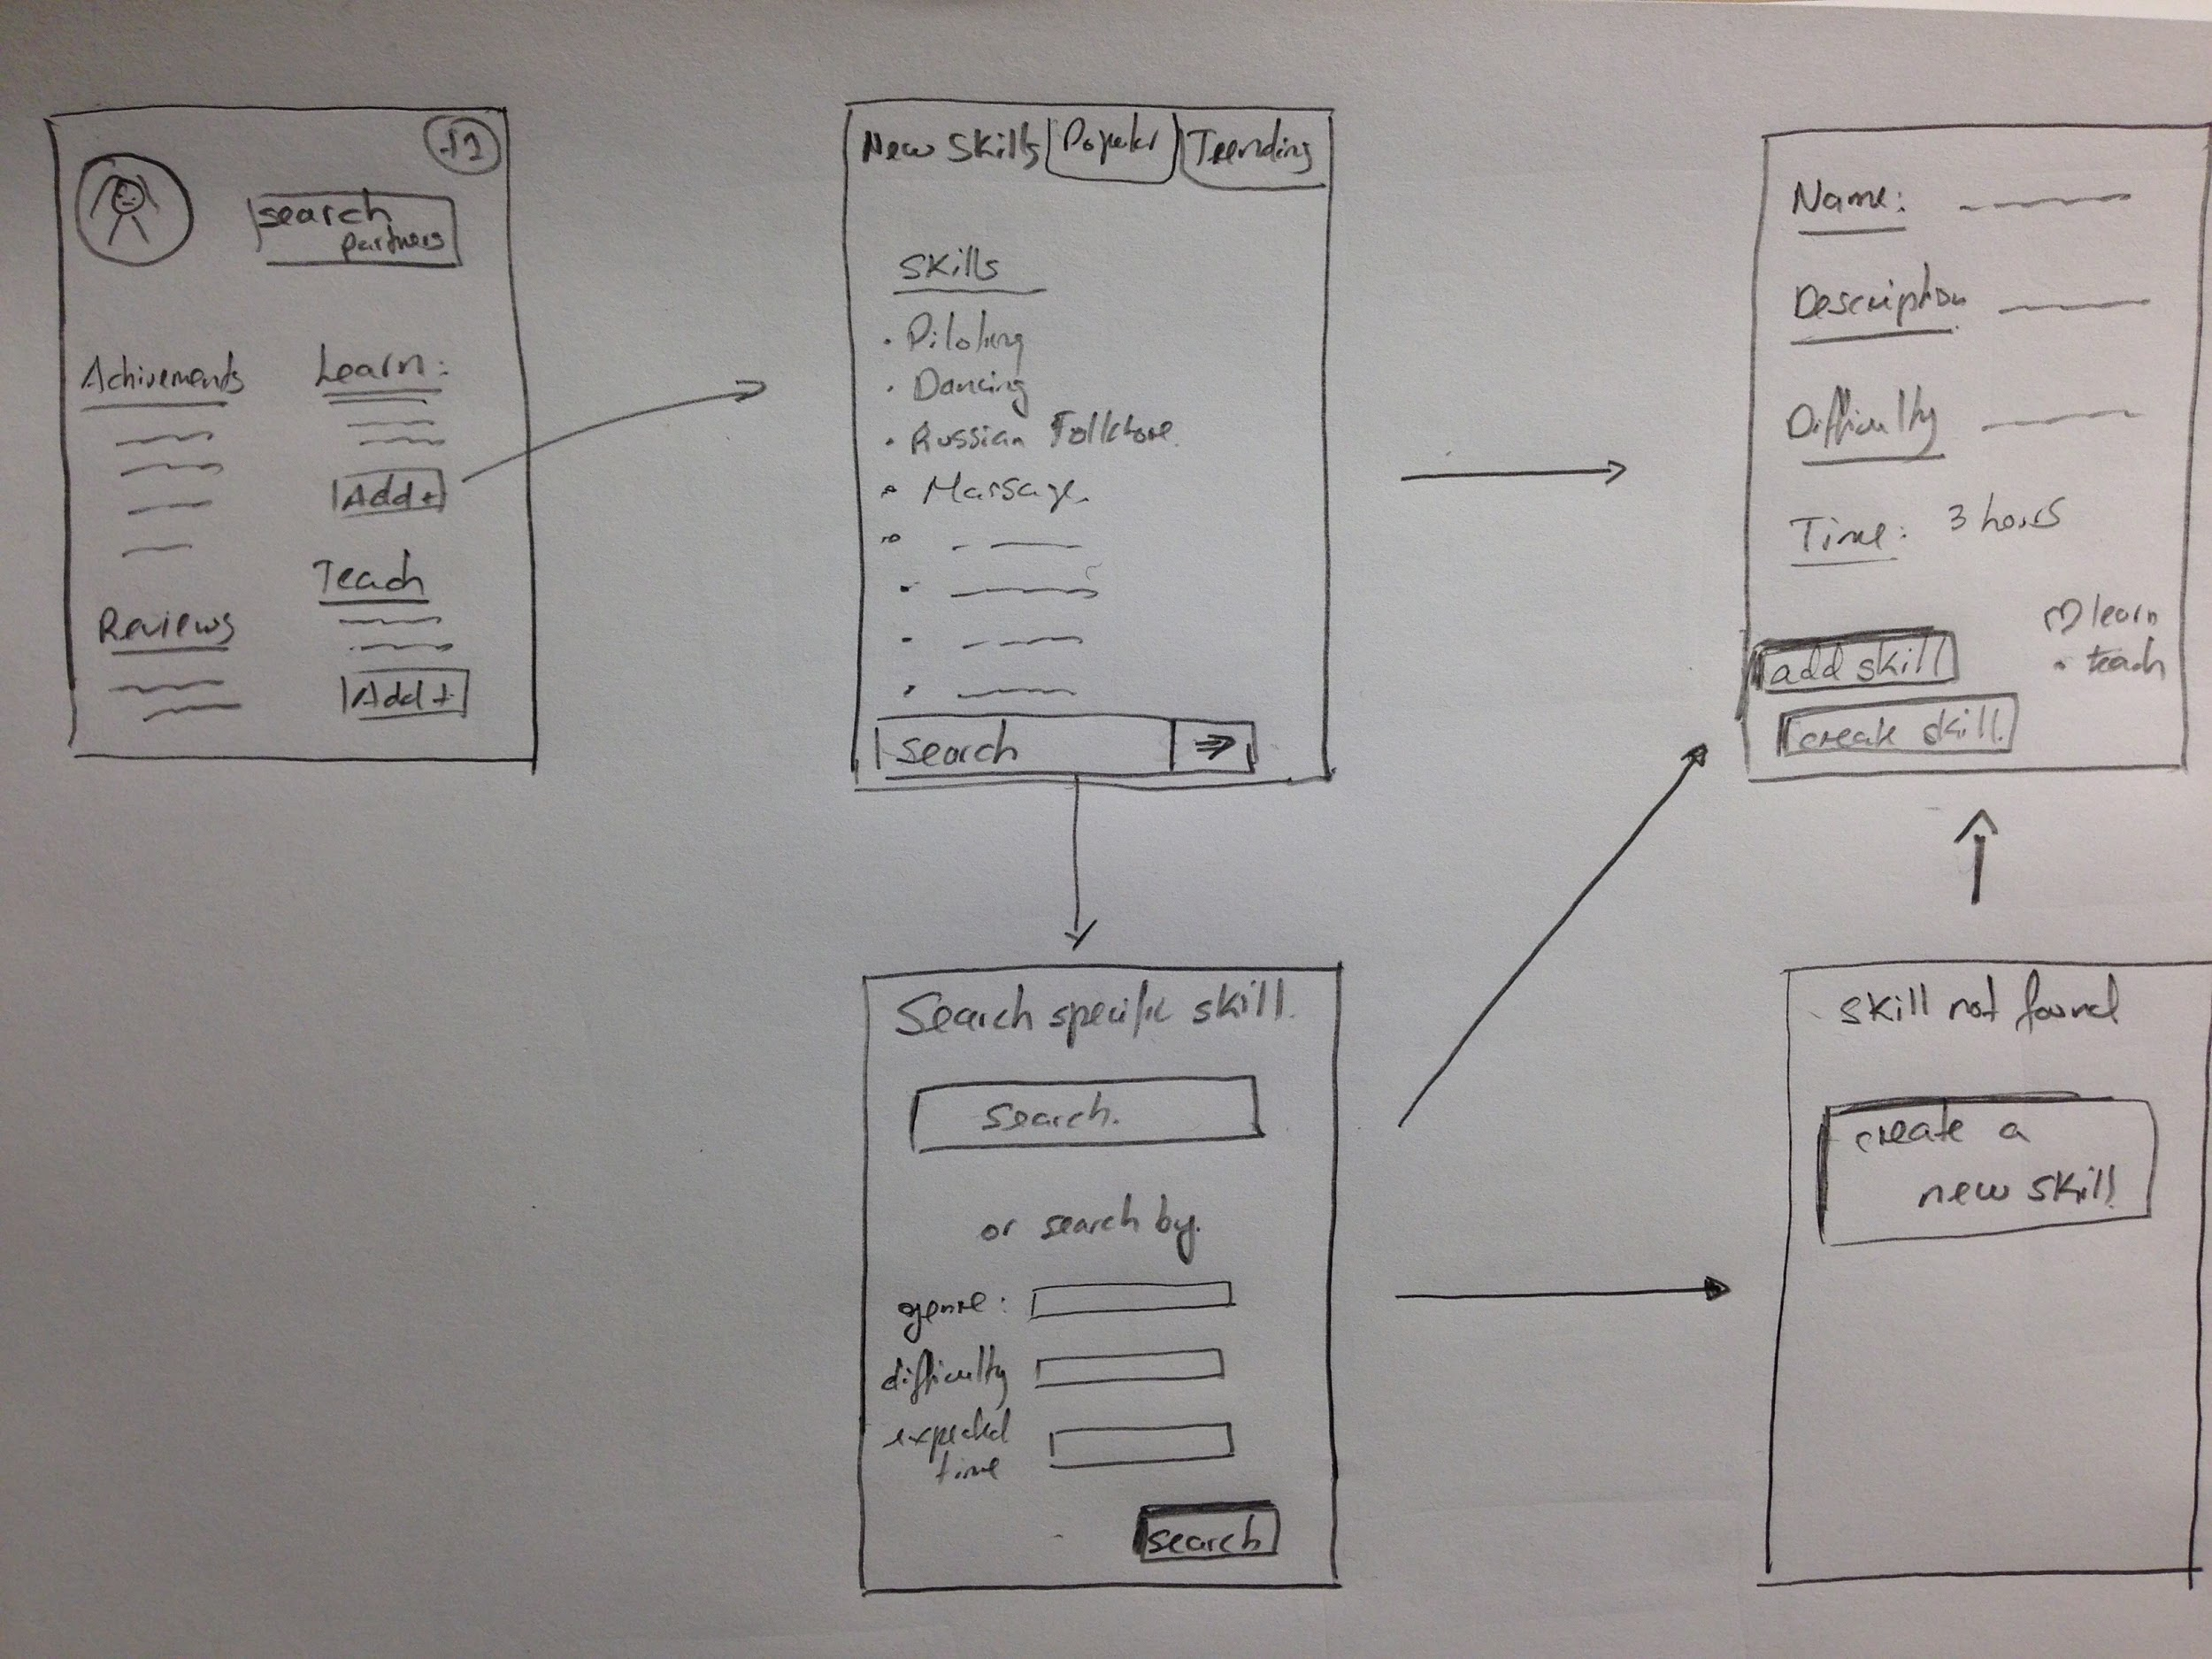
Selected interface/rationale
AR vs Mobile
Chose mobile platform
Phone most accessible

Slide 6
Low-fi Prototype Structure

Slide 7
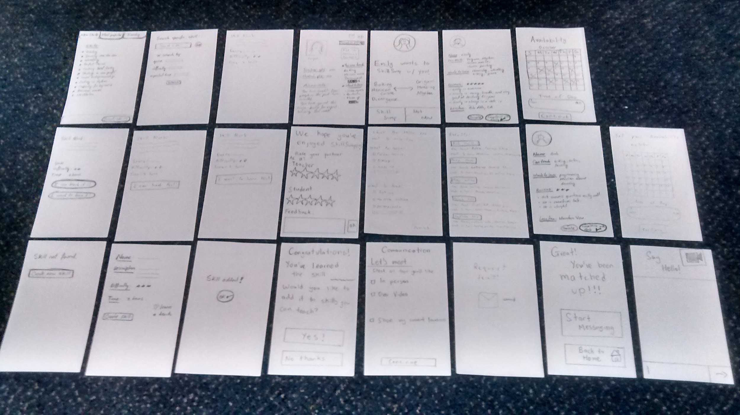

Slide 8
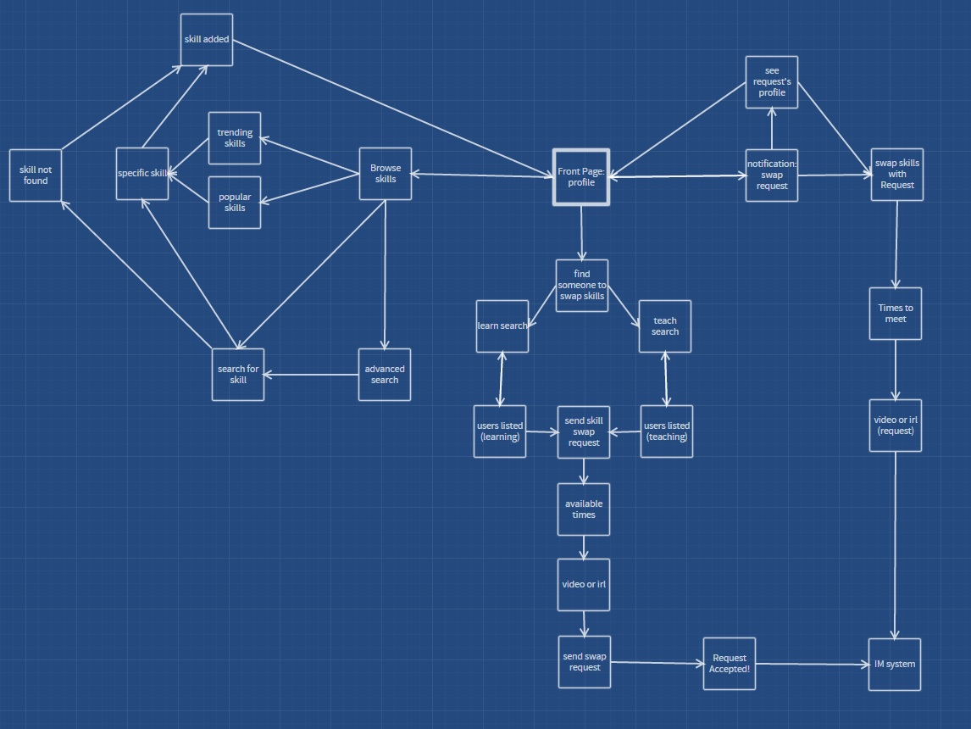

Slide 9
Task 1

Slide 10
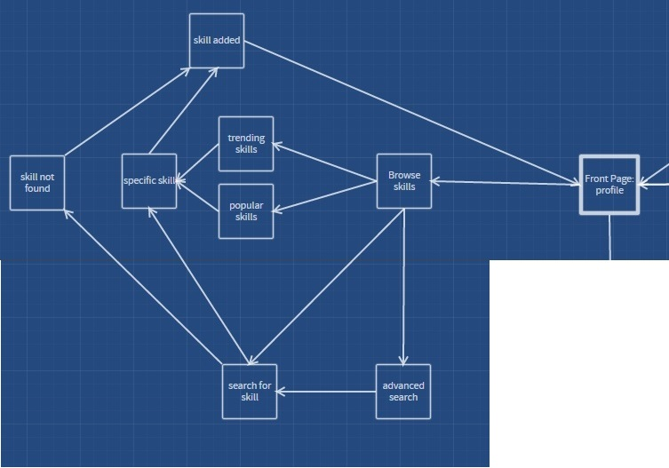
Let others know you want to learn something
Notes:
Talk about how originally we had different simple task

Slide 11
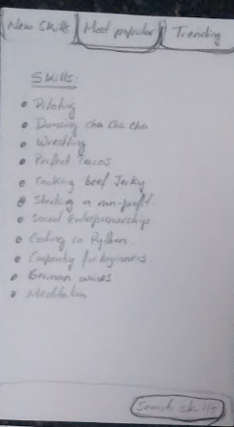
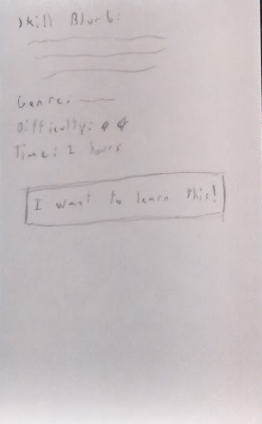
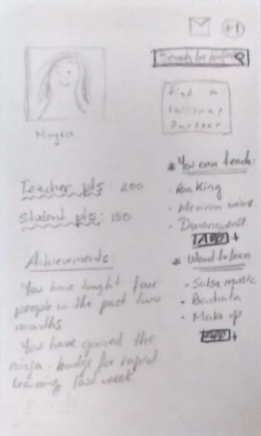
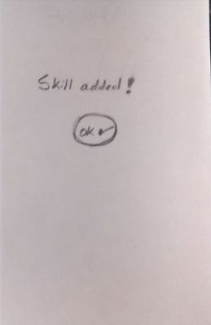
Let others know you want to learn something

Slide 12
Task 2

Slide 13
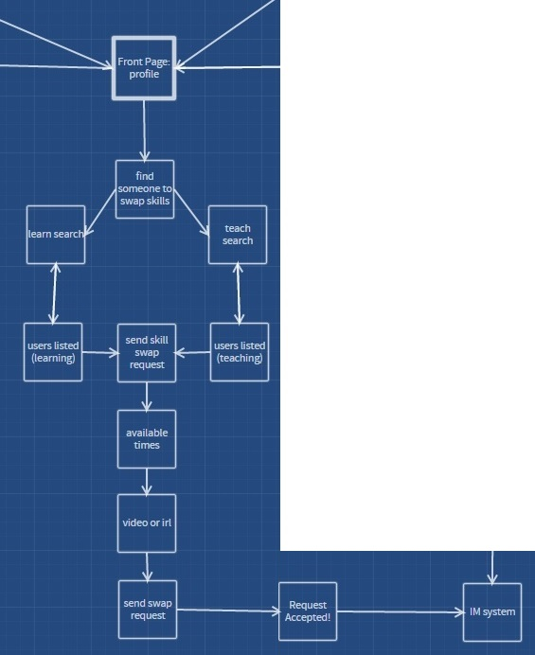
Find a partner to teach and learn from

Slide 14
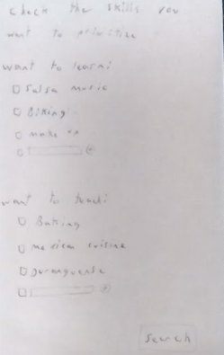
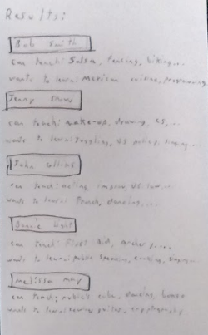
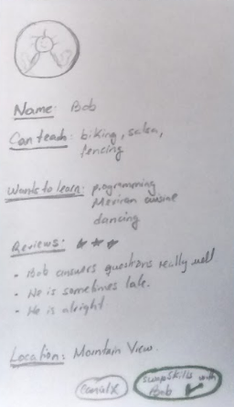
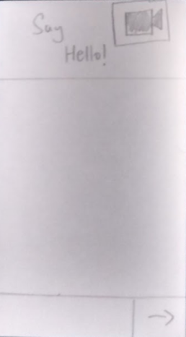
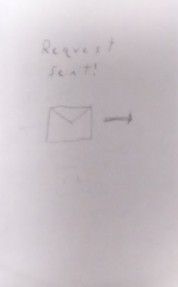
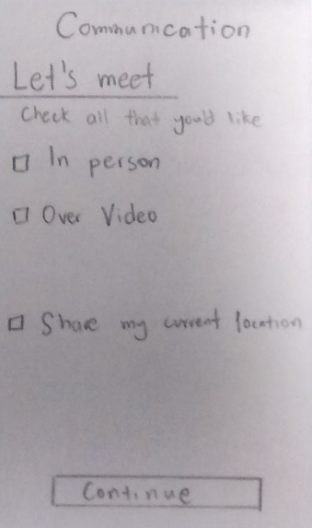
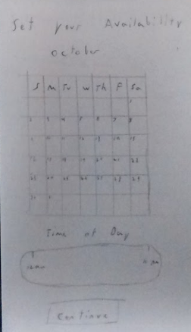
Find a partner to teach and learn from

Slide 15
Task 3

Slide 16
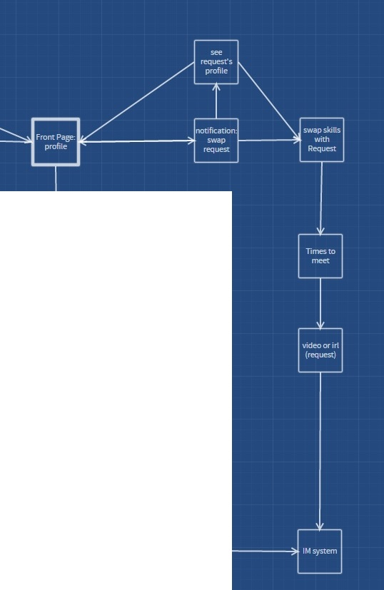
Teach a skill you’ve learned to someone new

Slide 17
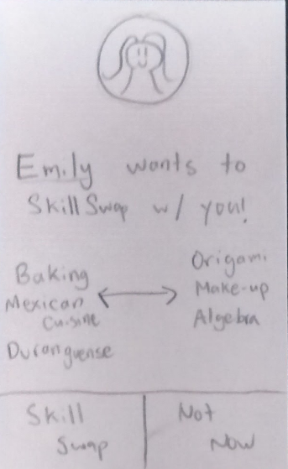
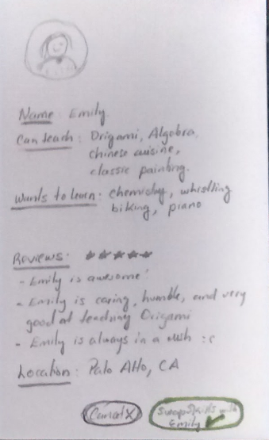
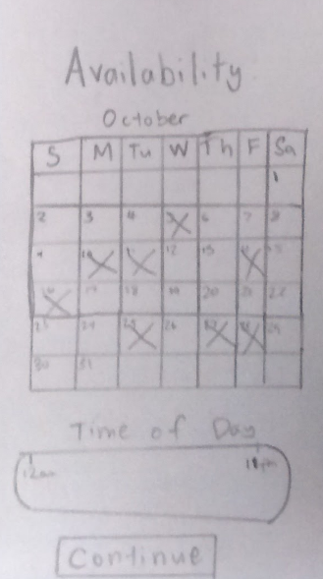
Teach a skill you’ve learned to someone new

Slide 18
Experimental method
Secured an environment with a desk
Consent form
Task 1
Task 2
Task 3
Took notes on testing measures
Debrief

Slide 19
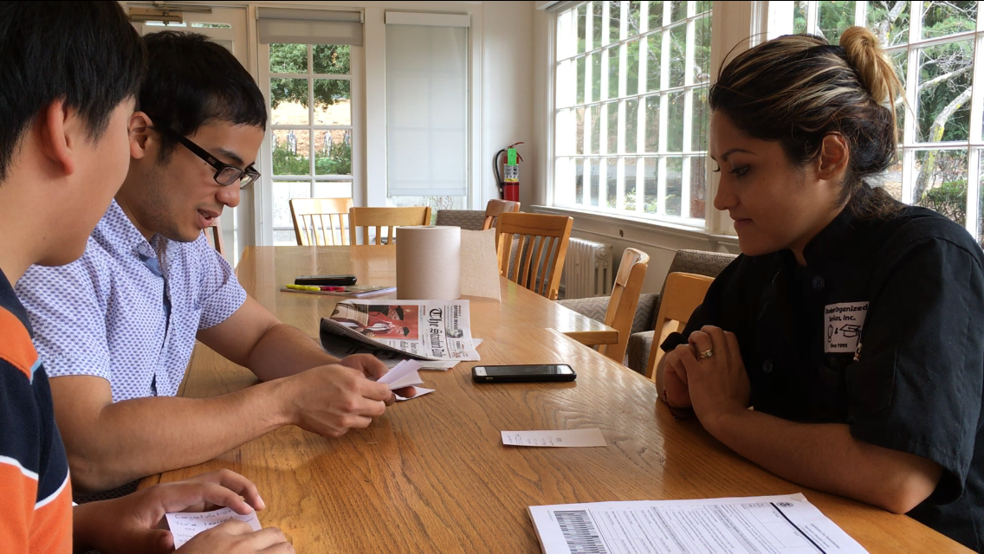
Experimental results
Confused about search bar
Tried clicking on unclickable items
Profile selection not obvious
Safety concerns
Notes:
Took about 18 minutes

Slide 20
Experimental results
Confused about search bar
Tried clicking on unclickable items
Profile selection not obvious
Safety concerns
Notes:
Took about 18 minutes

Slide 21
Experimental results
Confused about search bar
Tried clicking on unclickable items
Profile selection not obvious
Safety concerns
Notes:
Took about 18 minutes

Slide 22
Experimental results
Confused about search bar
Tried clicking on unclickable items
Profile selection not obvious
Safety concerns
Notes:
Took about 18 minutes

Slide 23
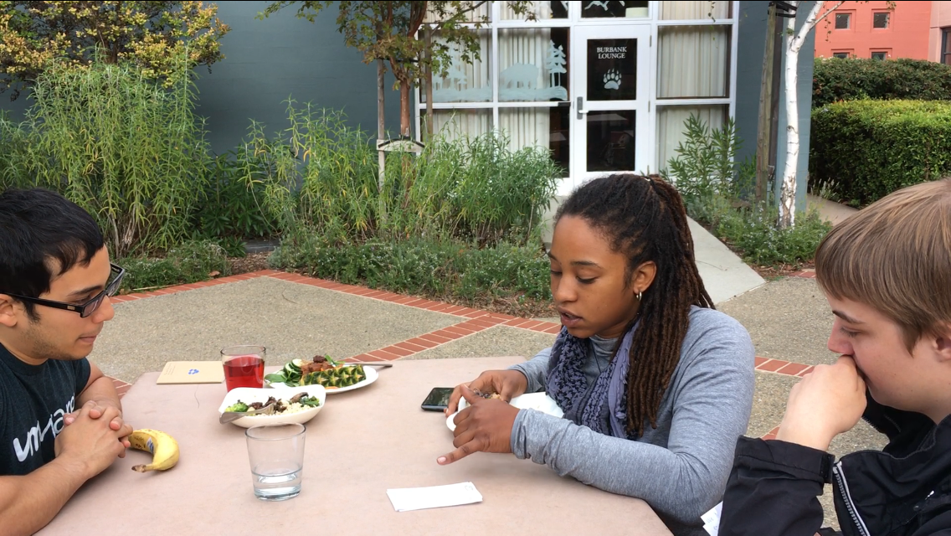
Experimental results
Confused about search function
Comments about expertise level
Took too many steps to SkillSwap
Safety concerns
Notes:
Took about 13 minutes

Slide 24
Experimental results
Confused about search function
Comments about expertise level
Took too many steps to SkillSwap
Safety concerns
Notes:
Took about 13 minutes

Slide 25
Experimental results
Confused about search function
Comments about expertise level
Took too many steps to SkillSwap
Safety concerns
Notes:
Took about 13 minutes

Slide 26
Experimental results
Confused about search function
Comments about expertise level
Took too many steps to SkillSwap
Safety concerns
Notes:
Took about 13 minutes

Slide 27
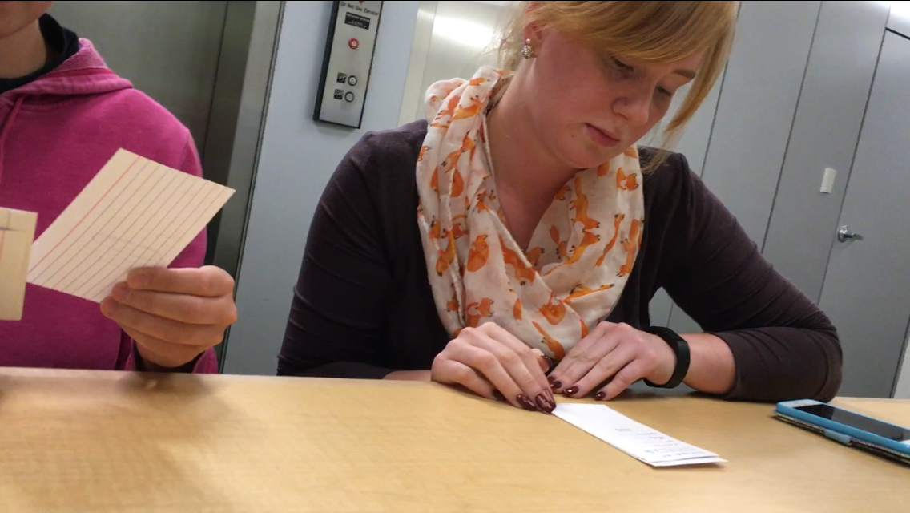
Experimental results
Navigation intuitive
Profile selection not obvious
Felt anxious at the idea of meeting others
Wondered if there was a way to just learn
Notes:
Took about 7 minutes

Slide 28
Experimental results
Navigation intuitive
Profile selection not obvious
Felt anxious at the idea of meeting others
Wondered if there was a way to just learn
Notes:
Took about 7 minutes

Slide 29
Experimental results
Navigation intuitive
Profile selection not obvious
Felt anxious at the idea of meeting others
Wondered if there was a way to just learn
Notes:
Took about 7 minutes

Slide 30
Experimental results
Navigation intuitive
Profile selection not obvious
Felt anxious at the idea of meeting others
Wondered if there was a way to just learn
Notes:
Took about 7 minutes

Slide 31
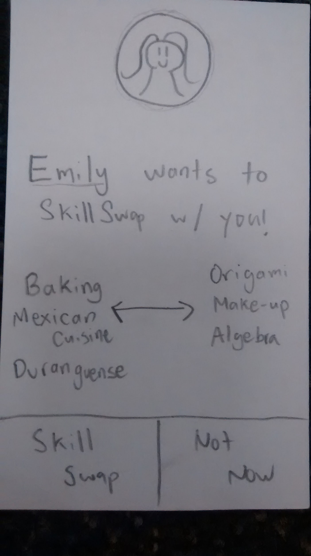
Suggested UI edits
More obvious profile link
Integrated search function
Easier messaging

Slide 32
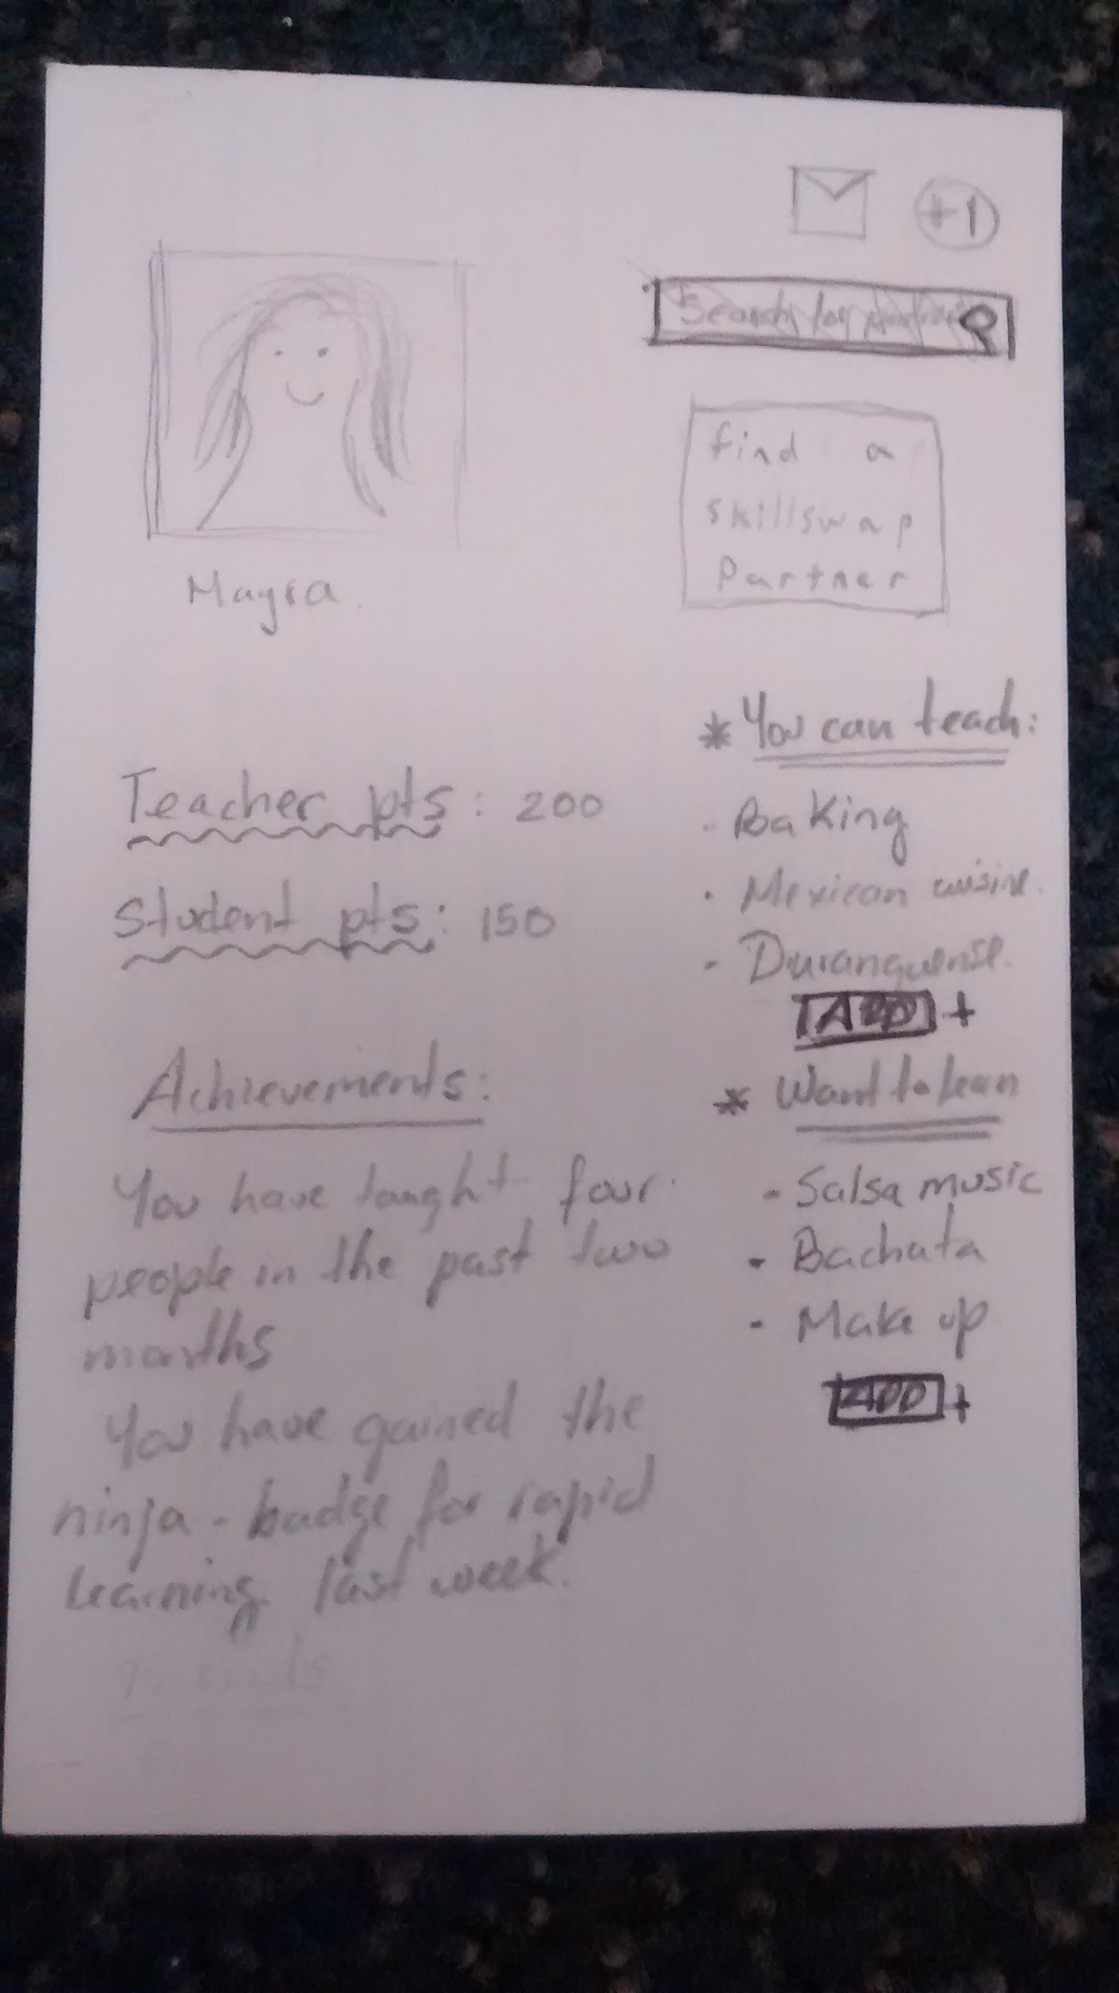
Suggested UI edits
More obvious profile link
Integrated search function
Easier messaging

Slide 33
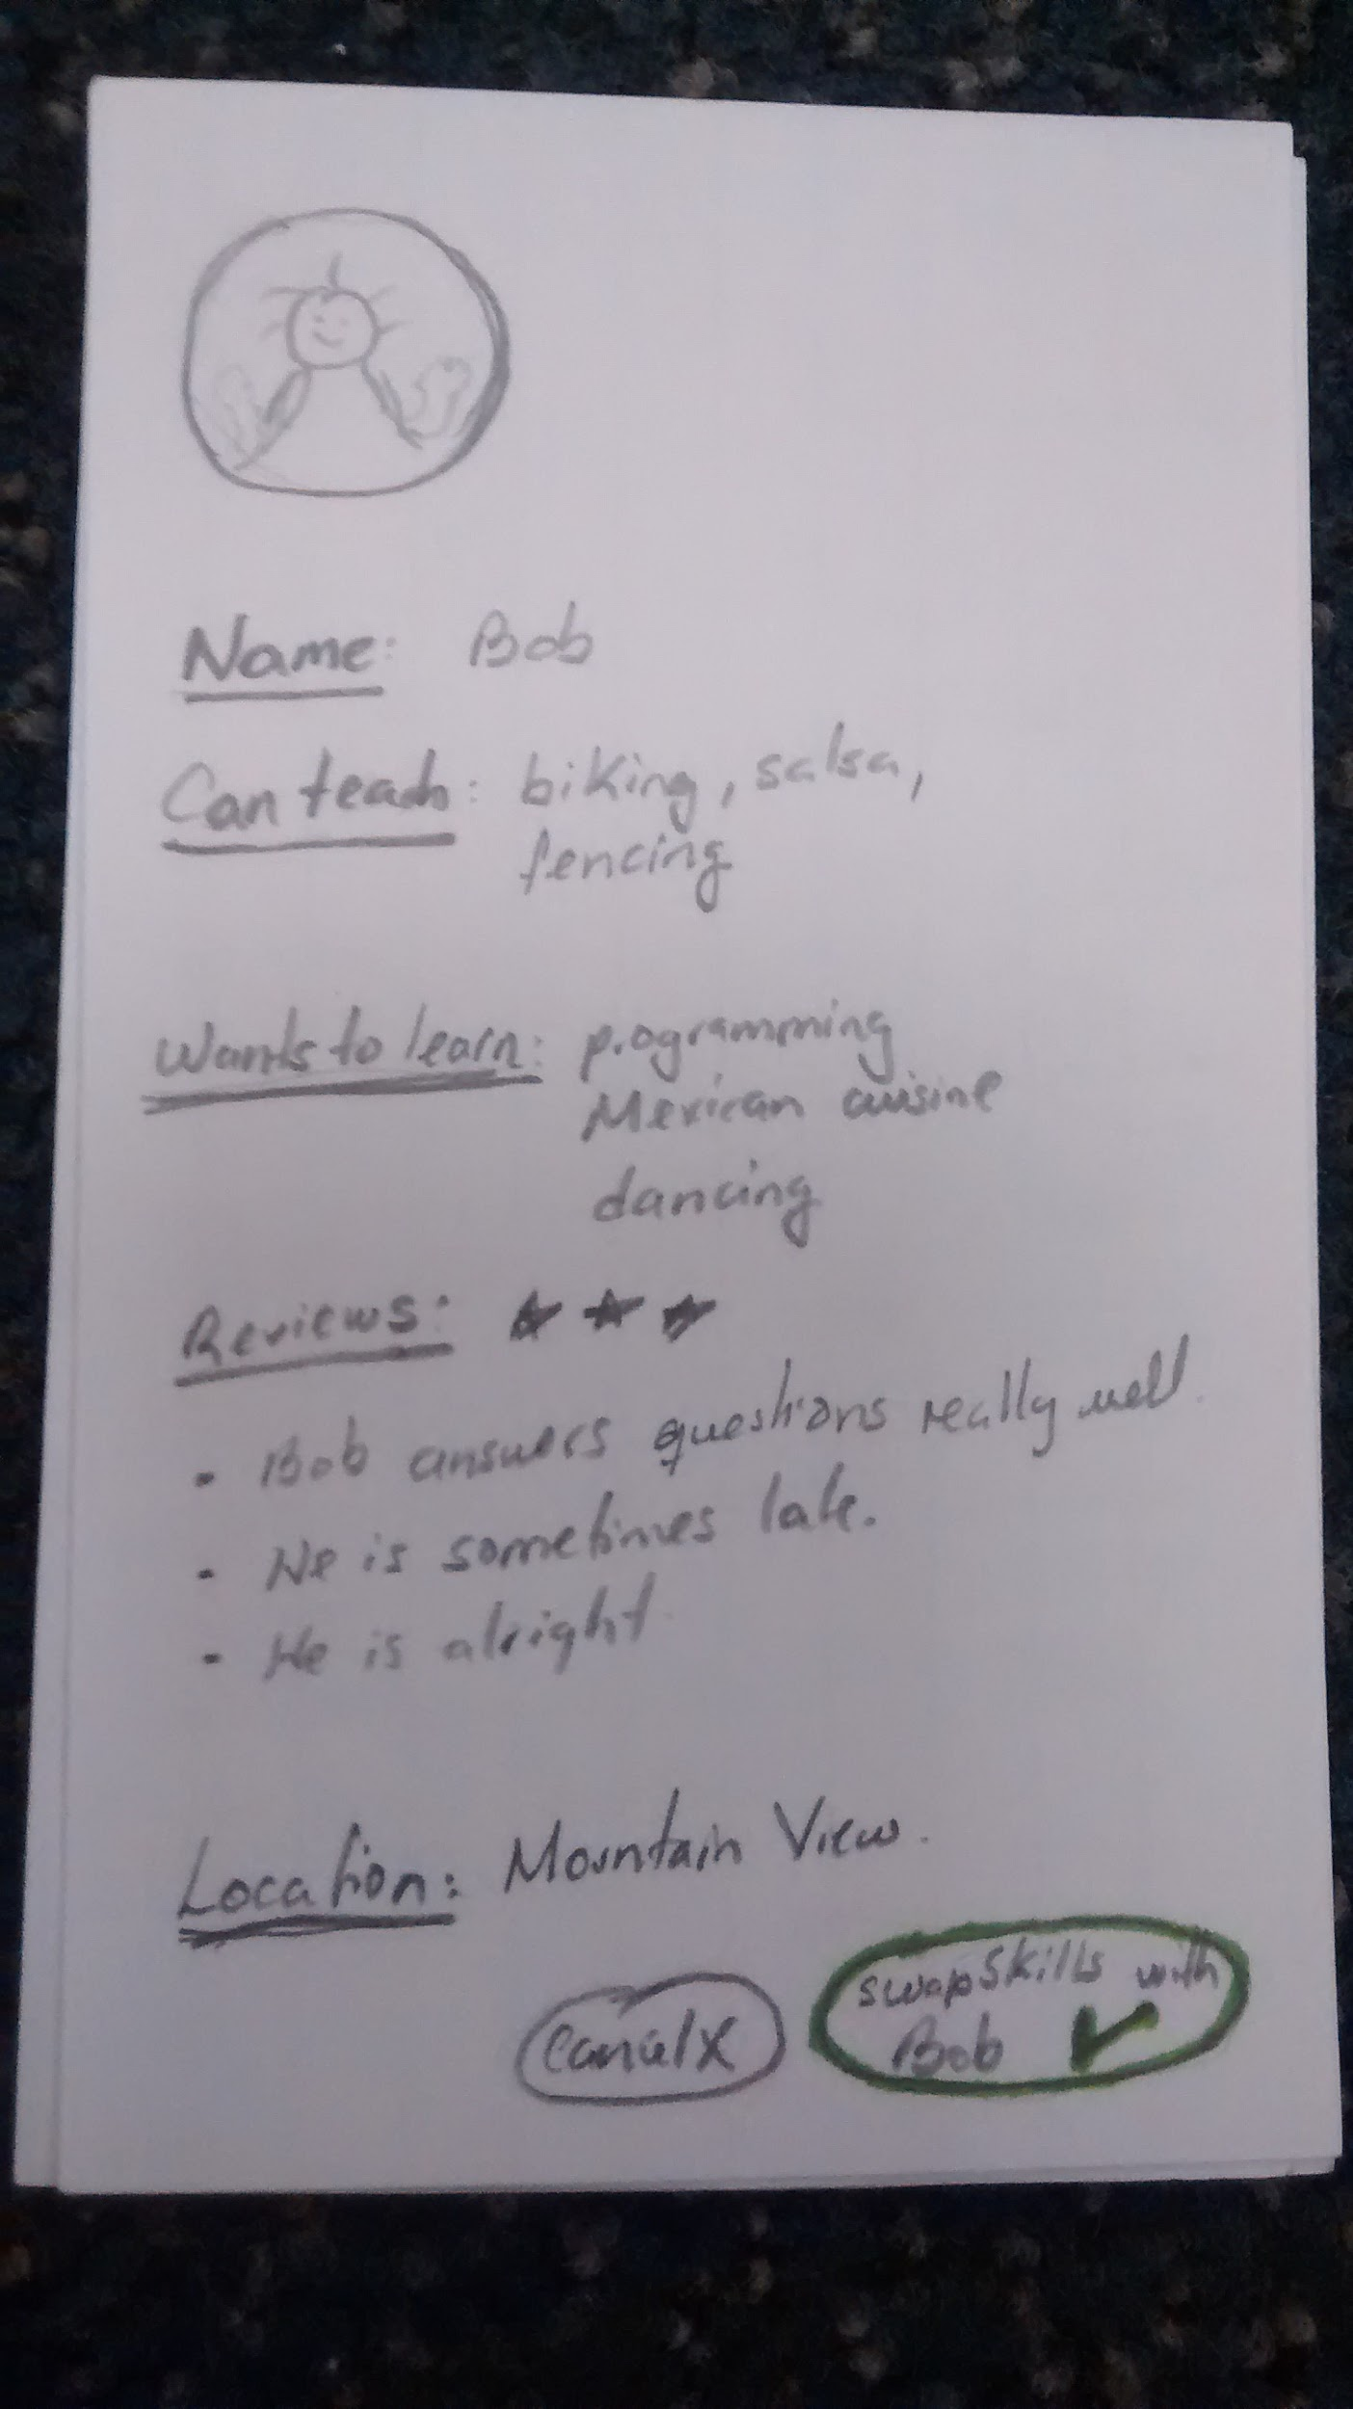
Suggested UI edits
More obvious profile link
Integrated search function
Easier messaging

Slide 34
Summary

Slide 35
Thanks! Questions?

