Slide 1
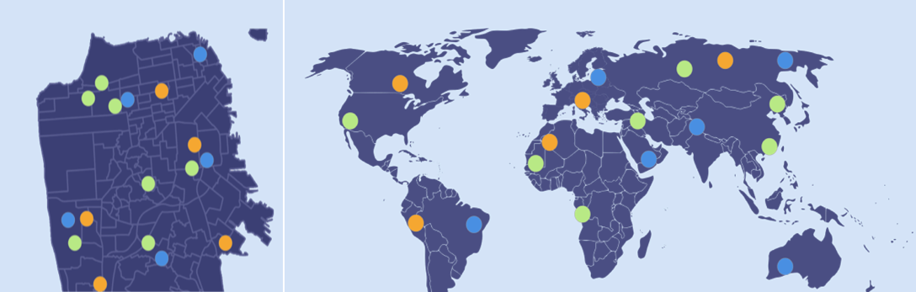
U R B A N S P I R E
BRING WHAT YOU KNOW AND LOVE TO YOUR COMMUNITY
Lab Usability Study
Notes:
Hi everyone! We are team Urbanspire

Slide 2
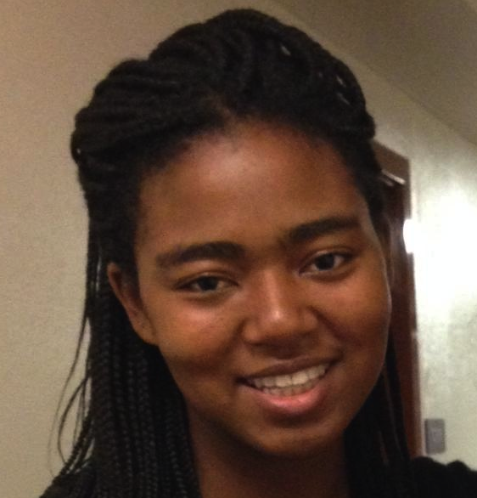

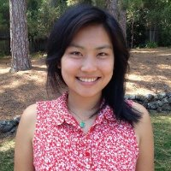
Our Team
Adrienne
Christina
Haley
Nikhita
Notes:
And my name is Christina. We are all studying CS with a focus in HCI.

Slide 3
Prototype Changes

Slide 4
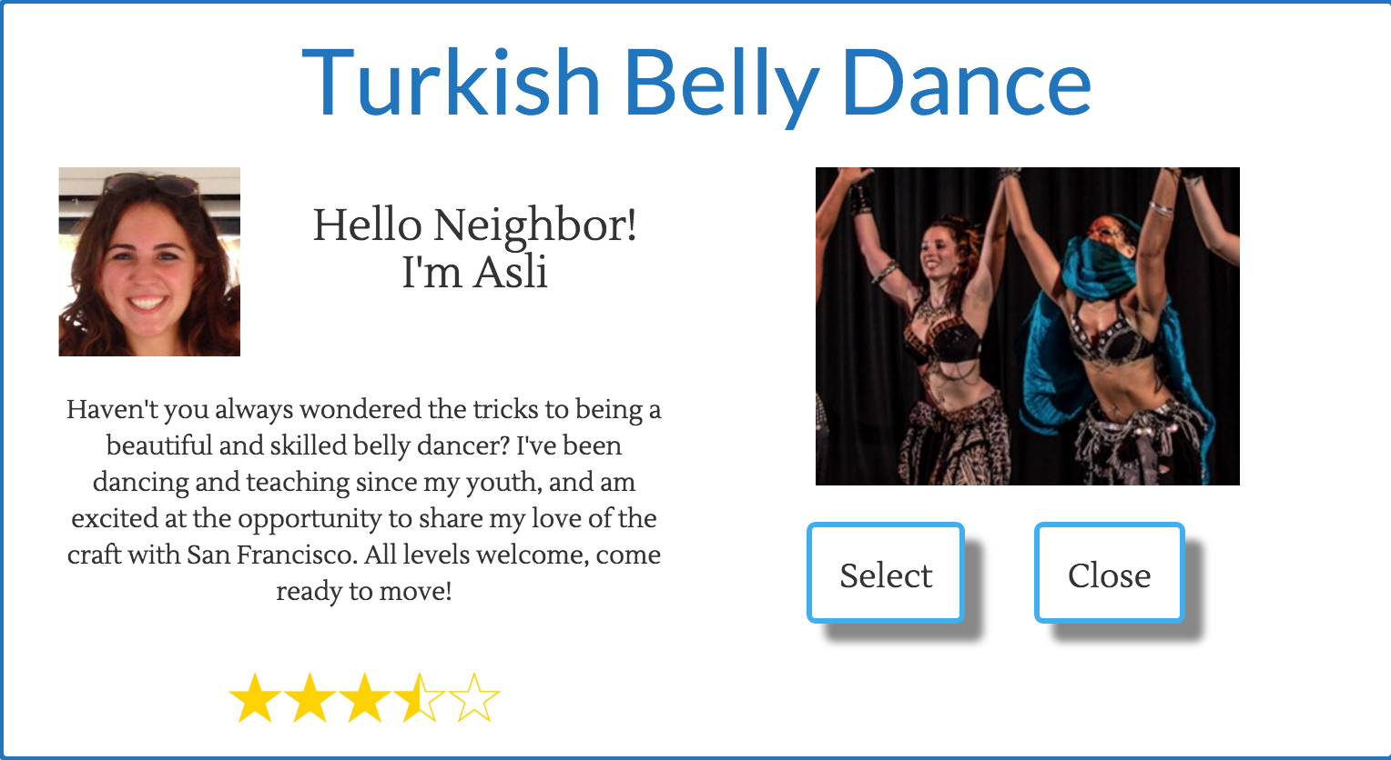
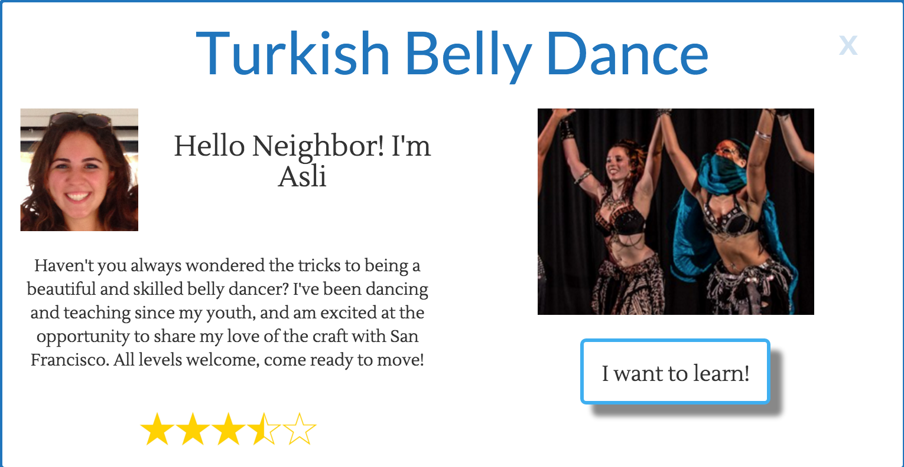
Prototype Changes
Before
After
Increased usability for class pages
Notes:
Increased usability for our class description page, by changing the Select button to a I want to learn! button, and turning Close into an x and moving it to the top right.

Slide 5
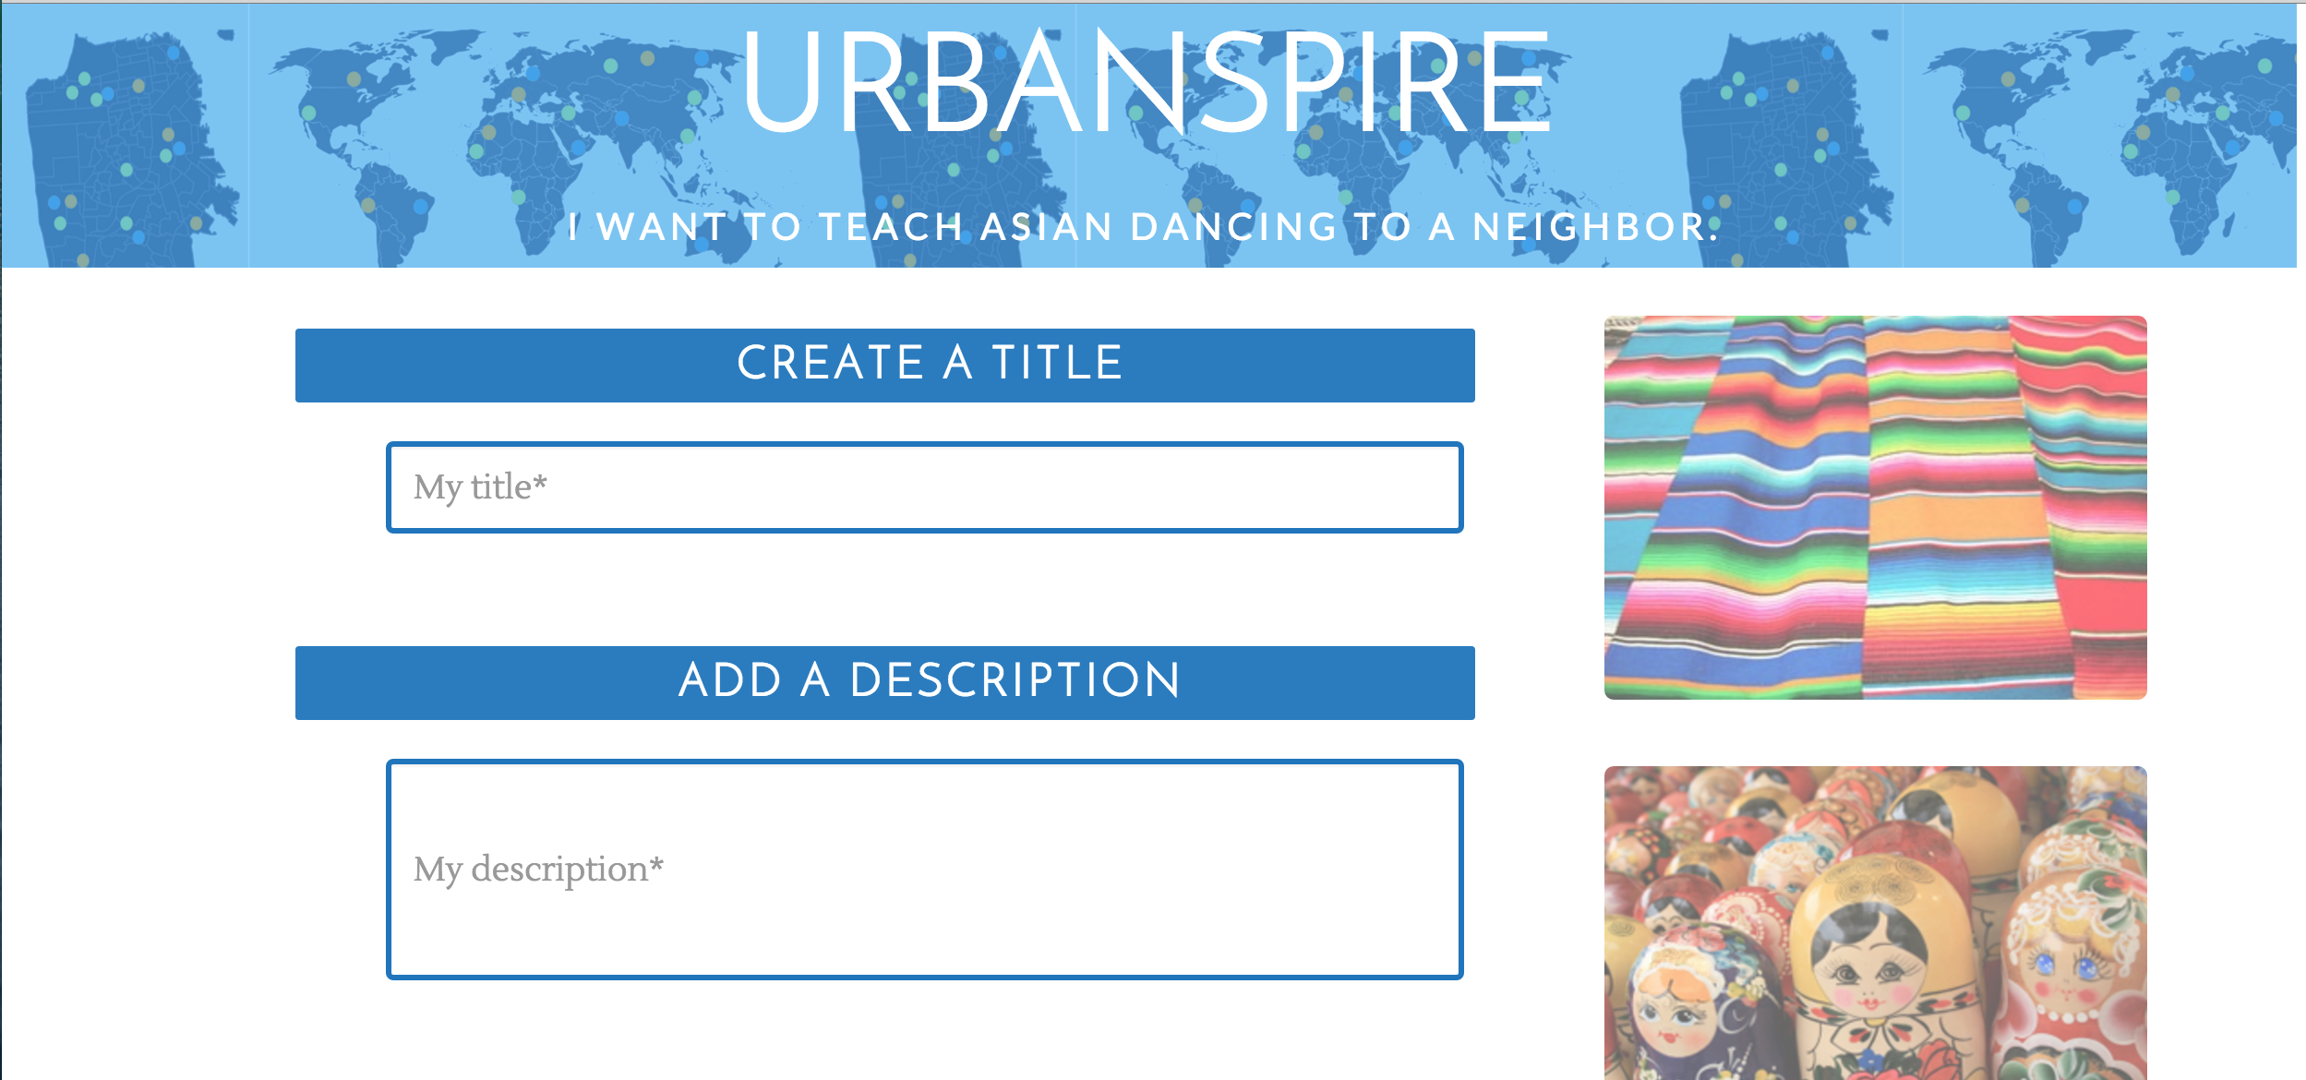
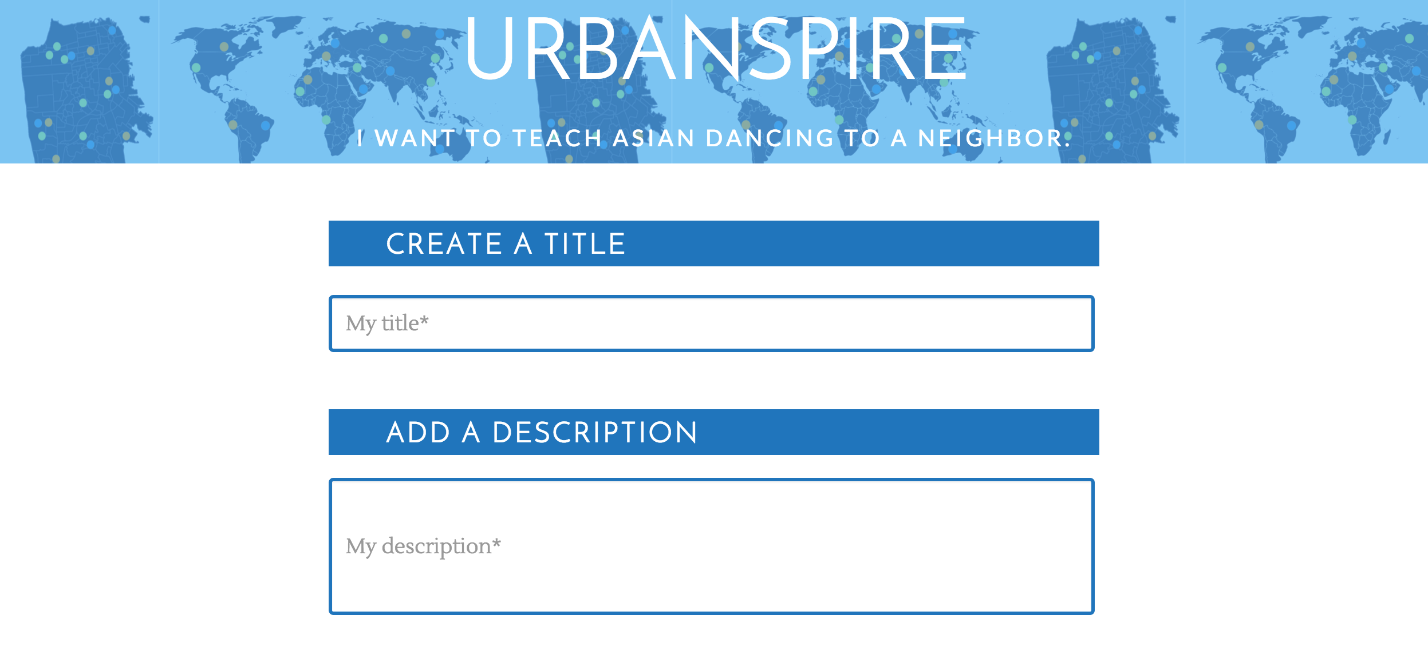
Prototype Changes
Before
After
Decreased clutter to reduce cognitive load
Notes:
Second, we decreased clutter by removing pictures on our create a class page

Slide 6
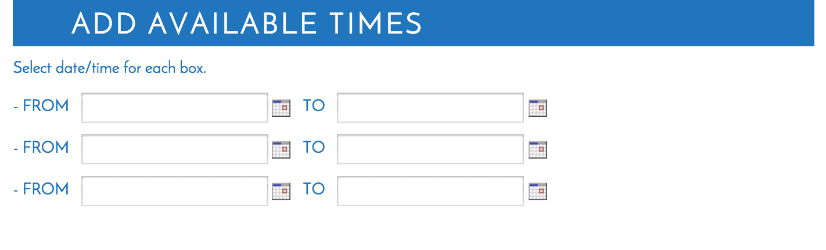
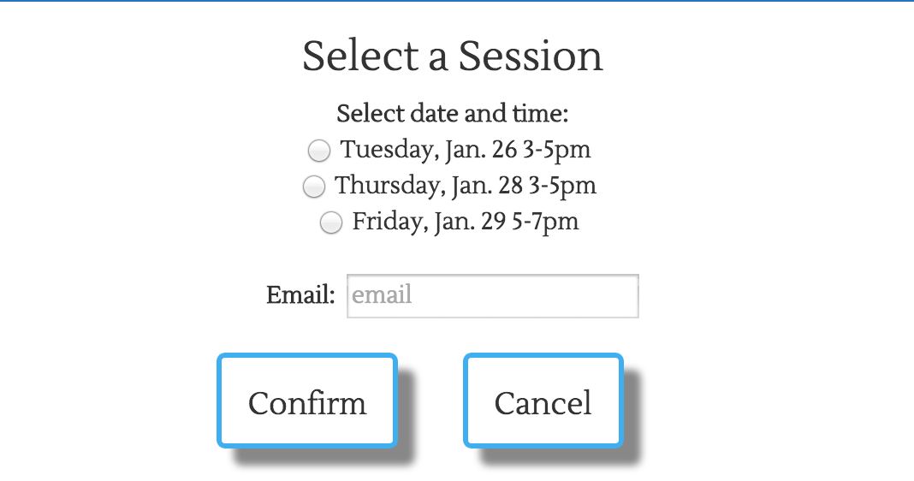
Prototype Changes
For teachers
For learners
Added scheduling for classes
Notes:
Lastly, we added features to allow scheduling of classes to be completely directly through the site.

Slide 7
Method

Slide 8
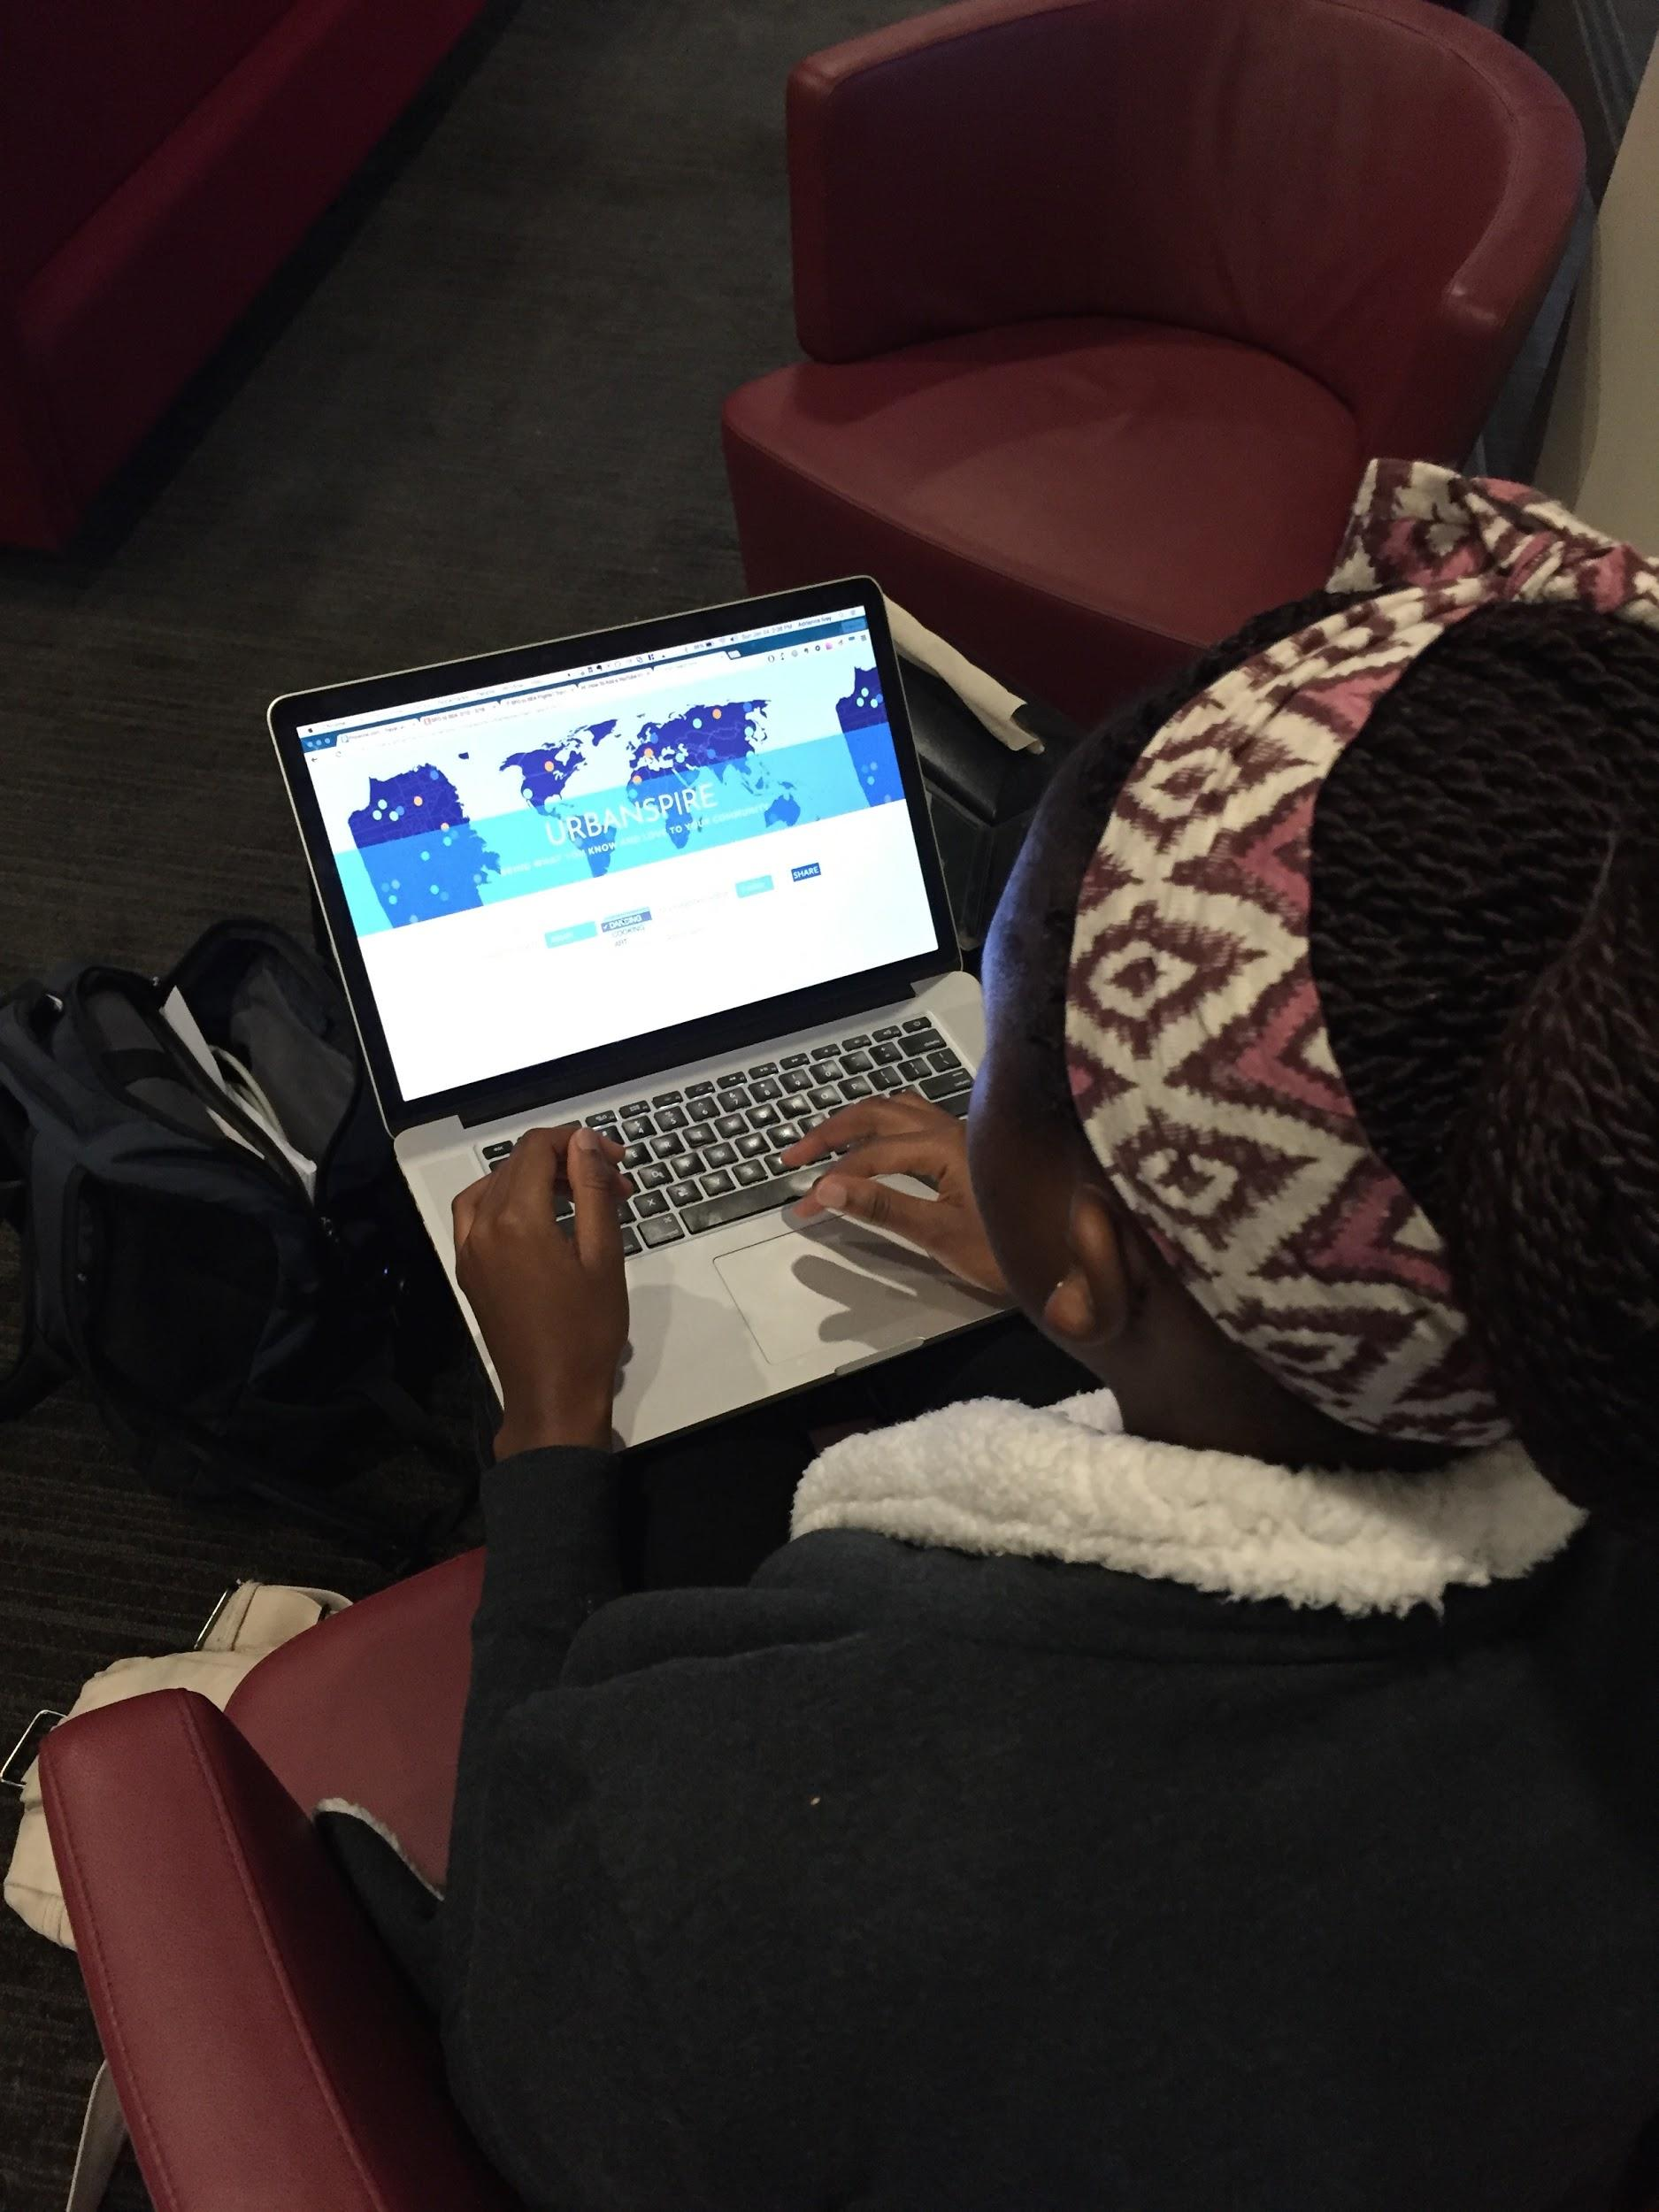
Method - Participants
Pre-screening
3 users in total
  User 1: Doctor from Taiwan who’s on a two year government sponsored fellowship and has been in the States for about a year. [F, 32, Taiwanese]
  User 2: Sophomore, studying Civil Engineering, from Zimbabwe who has been in the us for ~52 weeks total. [F, 19, Zimbabwean]
  User 3: Senior, studying History, who travelled to Nepal for an extended period of time. [F, 21, ethnically Burmese]
Compensation
  Thank-you card
  $5 Jamba Juice Gift Card
Notes:
Pre-screening questions:
How long have you been in the US?
Do you consider yourself as a newcomer?
On a scale from 1 to 5 (1 being Nepalese and 5 being a foreigner), how American do you feel?
What have you done to integrate yourself into the American culture?

Slide 9


Method - Apparatus
Equipment
  The users performed the tests on laptops
Software
  Quicktime for logging and voice recording
Test Locations
  Relatively quiet spots in public spaces or conference room / dorm room

Slide 10
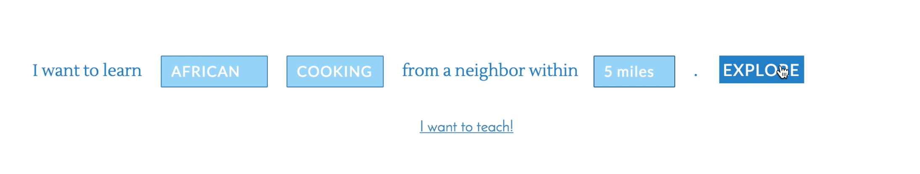
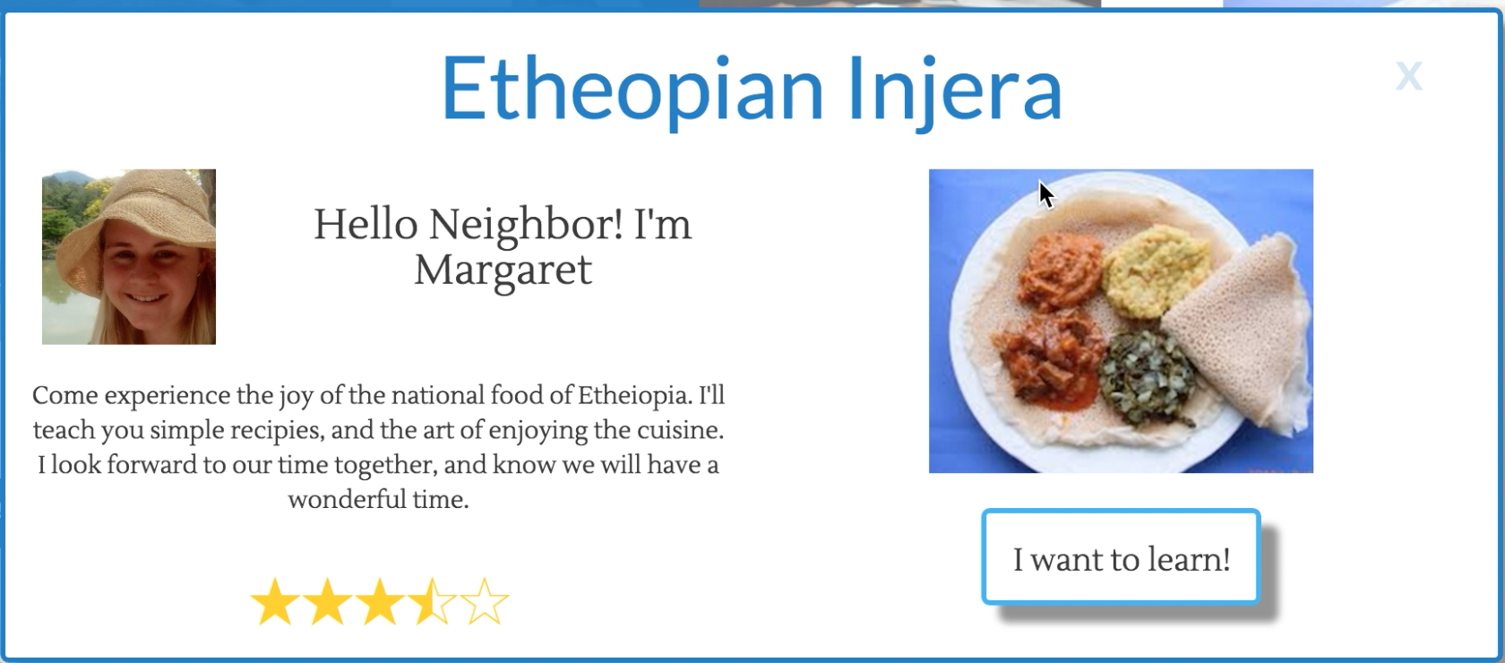

Method - Simple Task
Task Description:
Find African cooking classes and sign up for one
What we looked for:
User is able to perform the basic search functionality on our site to find classes and, upon determining the class they want, sign up for it

Slide 11
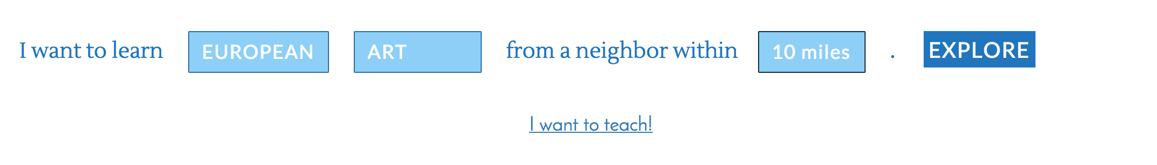

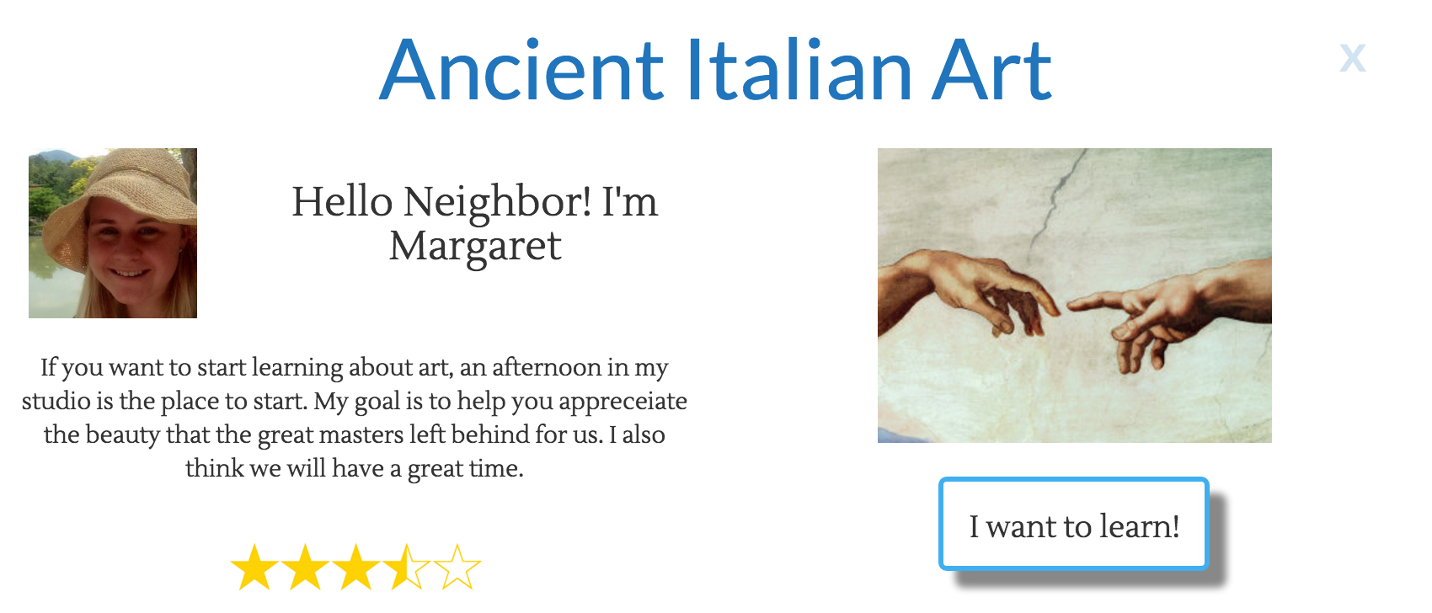
Method - Moderate Task
Task Description:
Find a European art class within 15 miles and sign up for the Tuesday 3-5pm class
What we looked for:
User is able to explore all the functionalities for both finding and signing up for a class.

Slide 12
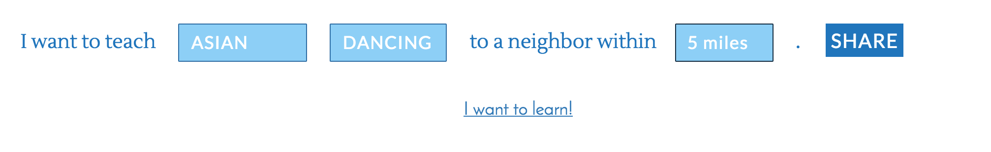
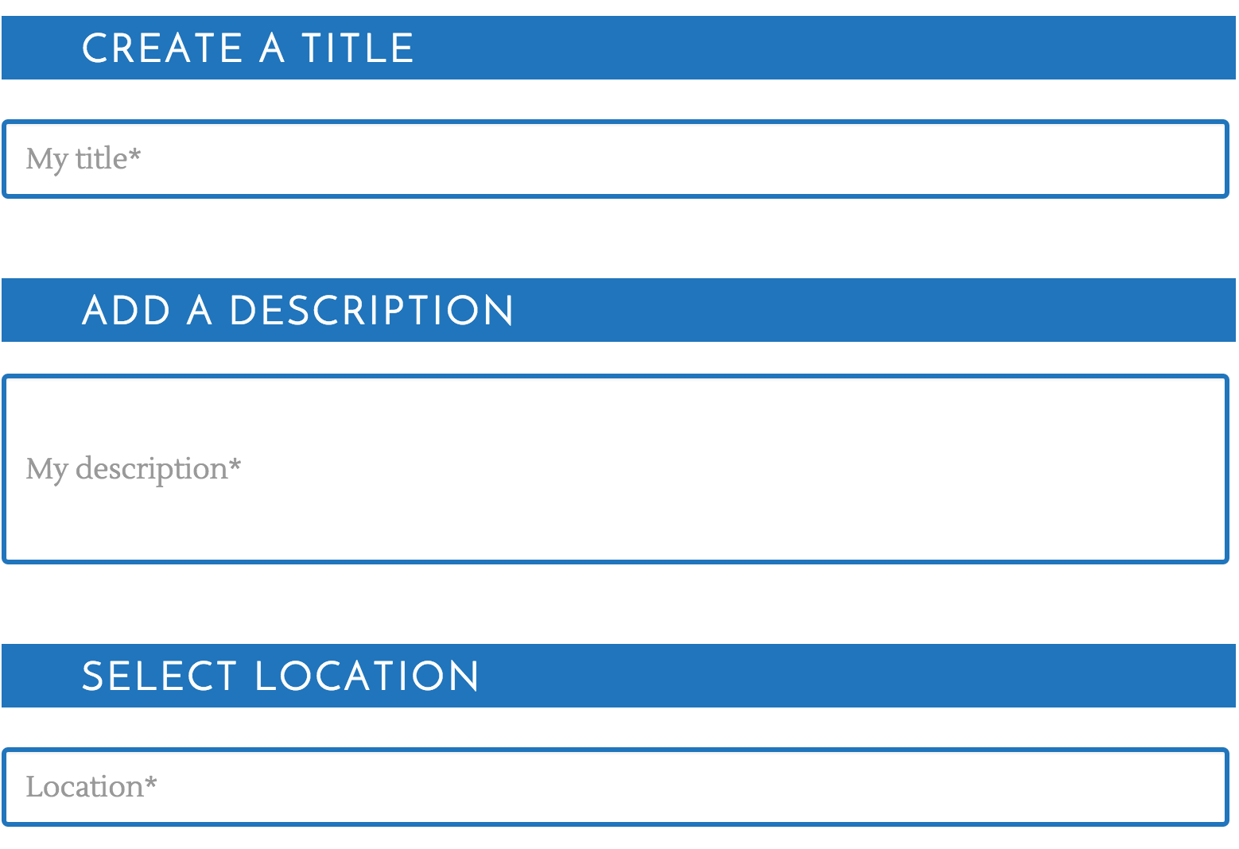
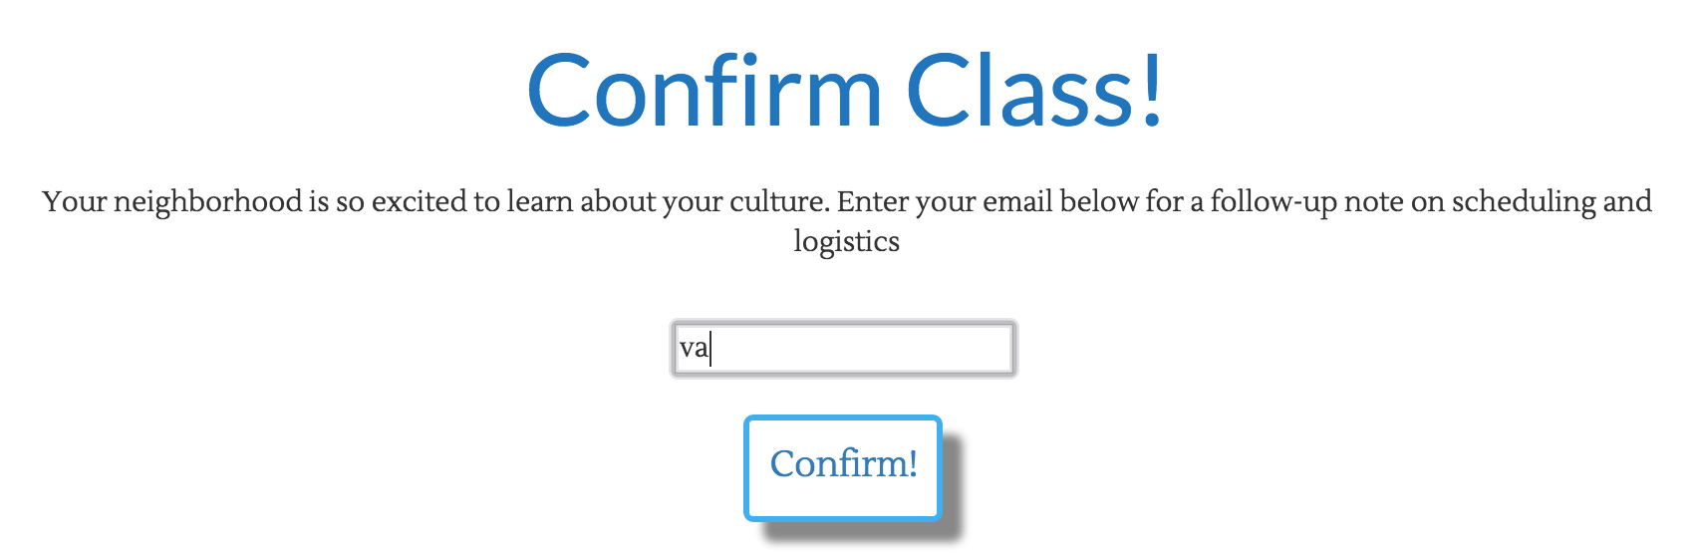
Method - Complex Task
Task Description:
Create a class to teach about a topic from your home culture
What we looked for:
User is able to correctly create a class to teach, the other major functionality on our site other than learning.

Slide 13
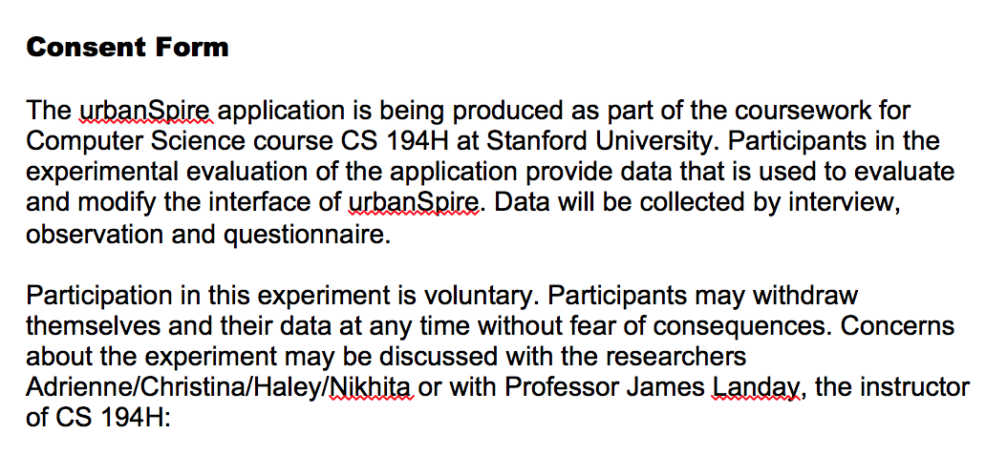
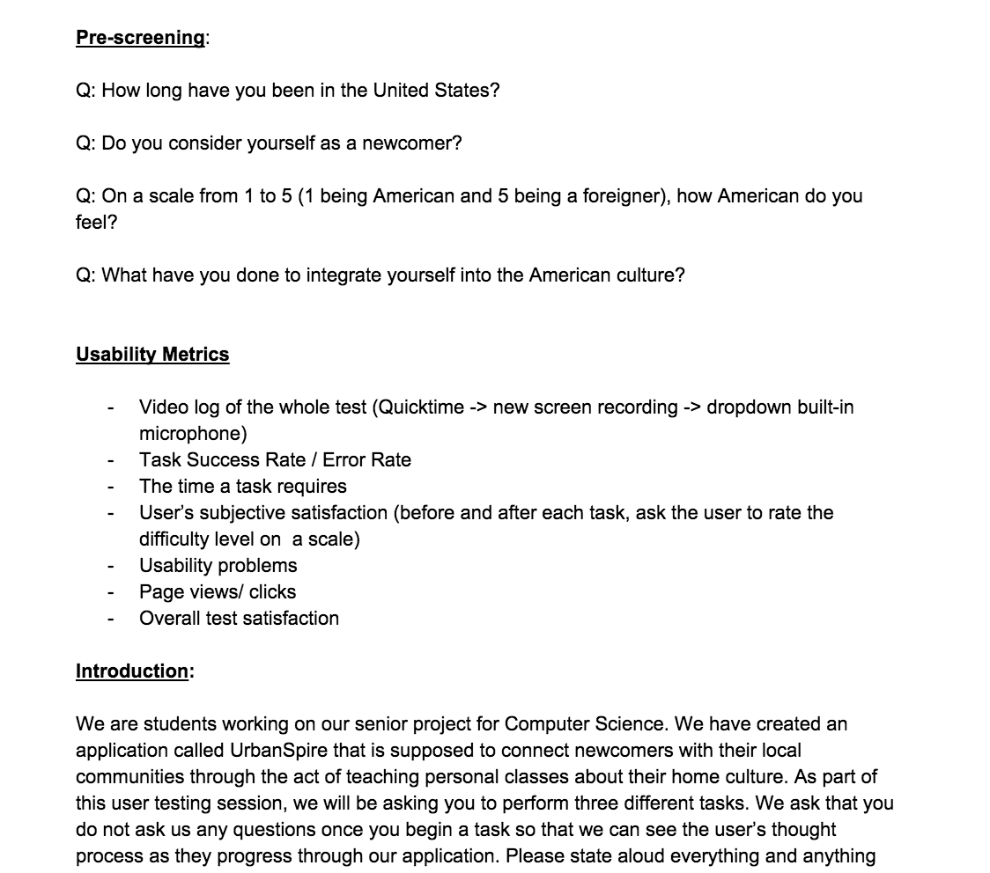
Method - Procedure
Pre-screening
Project Introduction
Sign Consent Form
Ask user to perform each of the 3 tasks
Post-test interview
Thank you and wrap-up
Notes:
No demos - simple application, only two main functionalities: signing up for classes to learn or creating a class to teach

Slide 14
Test Measures

Slide 15
Test Measures
Quantitative
  Task Success Rate
  Time required to complete a task
  Clicks
Qualitative
  User’s perspective on how difficult a task is before and after the task (on a scale of 1-5, 1 being very easy, and 5 being very hard)
  Usability problems (observation + post-test interview)
  User’s perspective on how difficult the whole test was (on a scale of 1-5, 1 being very easy, and 5 being very hard)
Notes:
Why: we chose this combination, so that we could verify if our quantitative results are aligned with our users perceptions and vice versa

Slide 16
Results

Slide 17
Results - Quantitative
Task Success Rate
User | Success Rate
001 | 3/3
002 | 2/3
003 | 3/3
TIme required to complete each task / clicks
User | Task 1 | Task 2 | Task 3
001 | 41 secs / 10 clicks | 35 secs / 10 clicks | 2 mins 33 secs / 33 clicks
002 | 1 min 15 secs / 15 clicks | 46 secs / 13 clicks | 5 min 19 secs / 24 clicks
003 | 2 mins 25 secs / 19 clicks | 54 secs / 13 clicks | 3 min 19 secs / 72 clicks

Slide 18
Results - Qualitative
Test / Task Difficulty
 | Task 1 |  | Task 2 |  | Task 3 |  | Entire Test
User | Pre-task | Post-task | Pre-task | Post-task | Pre-task | Post-task
001 | 2 | 1 | 1 | 1 | 2 | 3 | 1.5 - 2
002 | 3 | 2 | 2 | 2 | 3 | 2 | 3
003 | 1 | 3 | 4 | 5 | 5 | 5 | 4
Usability Problems
  Calendar selection
  “I want to learn”, “I want to teach”
  Search results hierarchy

Slide 19
Discussion

Slide 20
Discussion - Changes for the “real experiment”
Test a wider spectrum of people
  Local
  Gender-balanced
  Community center
Setting the scene better
  Right now, they are focused on their current situation
Notes:
Setting the scene better, give them more scenario information so they aren’t too focused on their current situation

Slide 21
Discussion - Interface changes to be made
Location
  Google map and address to show the exact location of the class
Avenue for interaction
  Allow user to contact / interact with the teacher before meeting in person
Group setting
  Also allow small-group classes to address user’s safety concerns
“I want to learn”, “I want to teach”
  Make “Learn / Teach” a drop-down selection as well

Slide 22
Summary
Notes:
After our lab usability study, we discovered that although our users can connect with our mission, and they like the simplicity of our application (two main actions involved, learn and teach); the user experience process can be made clearer and smoother by changing some designs and adding more information. We look forward to improving our product, and also seeing what further insights we could gain from a larger scale user test.

