Slide 1
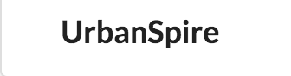

Hi-Fi Prototype #2
Notes:
Hi everyone! We are team Urbanspire

Slide 2
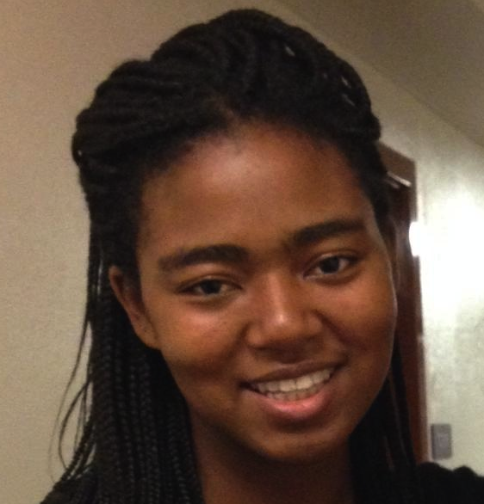

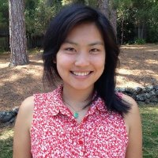
Our Team
Adrienne
Christina
Haley
Nikhita
Notes:
And my name is Adrienne.

Slide 3
Overview

Slide 4
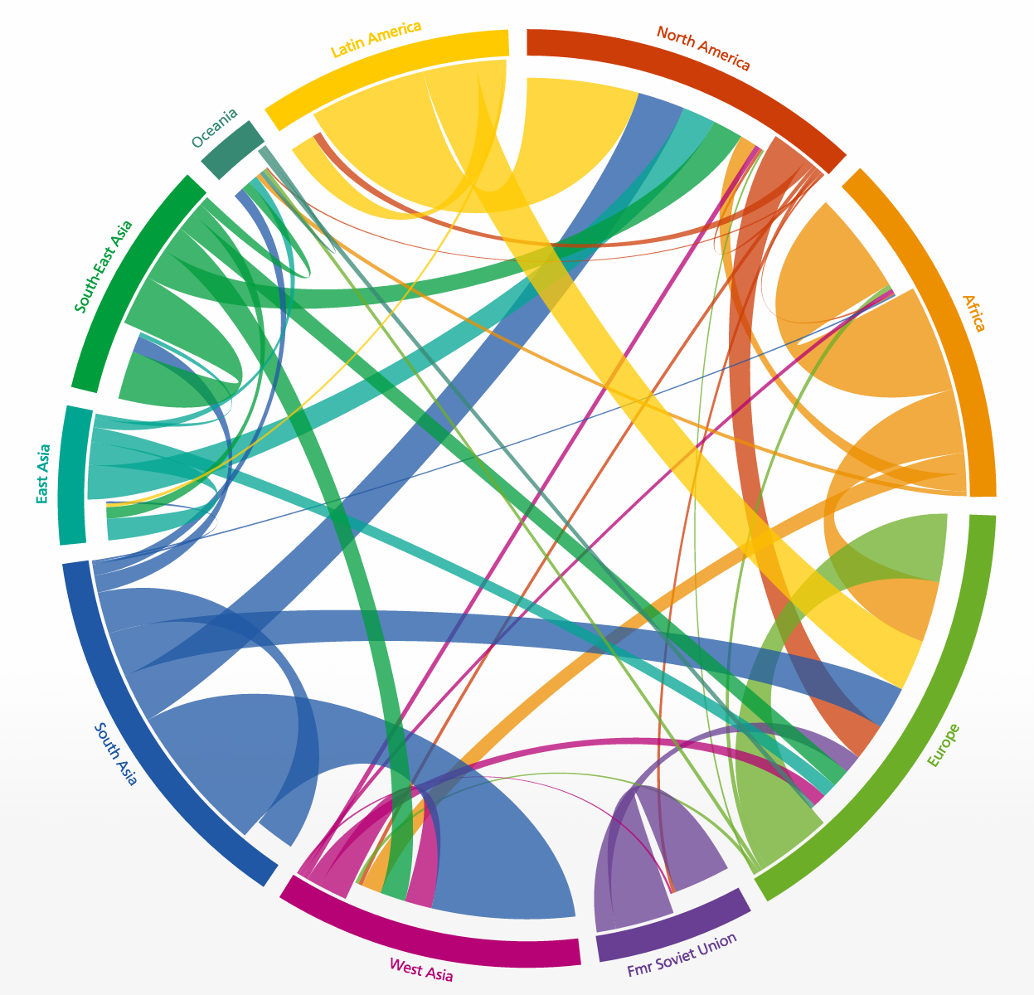
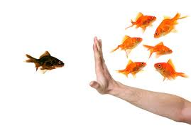
What’s the Problem?
We live in a world increasingly shaped by global migration and diaspora
Newcomers often have a hard time integrating into existing communities
This results in feelings of alienation, confusion and anxiety on a daily basis
Notes:
The application we are building is aimed at mitigating the problems that exist due to global migration and diaspora.
The main pain point is that of newcomers who often feel alienated, confused, and anxious when integrating into existing communities

Slide 5

What’s our Solution?
Urbanspire is a cultural bridge that gives newcomers the opportunity to flourish in their community by teaching what they know and love from their home in a neighbor-to-neighbor context.
Notes:
Our solution, through Urbanspire, is to create a cultural bridge by empowers newcomers to flourish in their new communities by teaching classes on topics from their home culture and building connections with their neighbors in that context.

Slide 6
Interface Changes

Slide 7
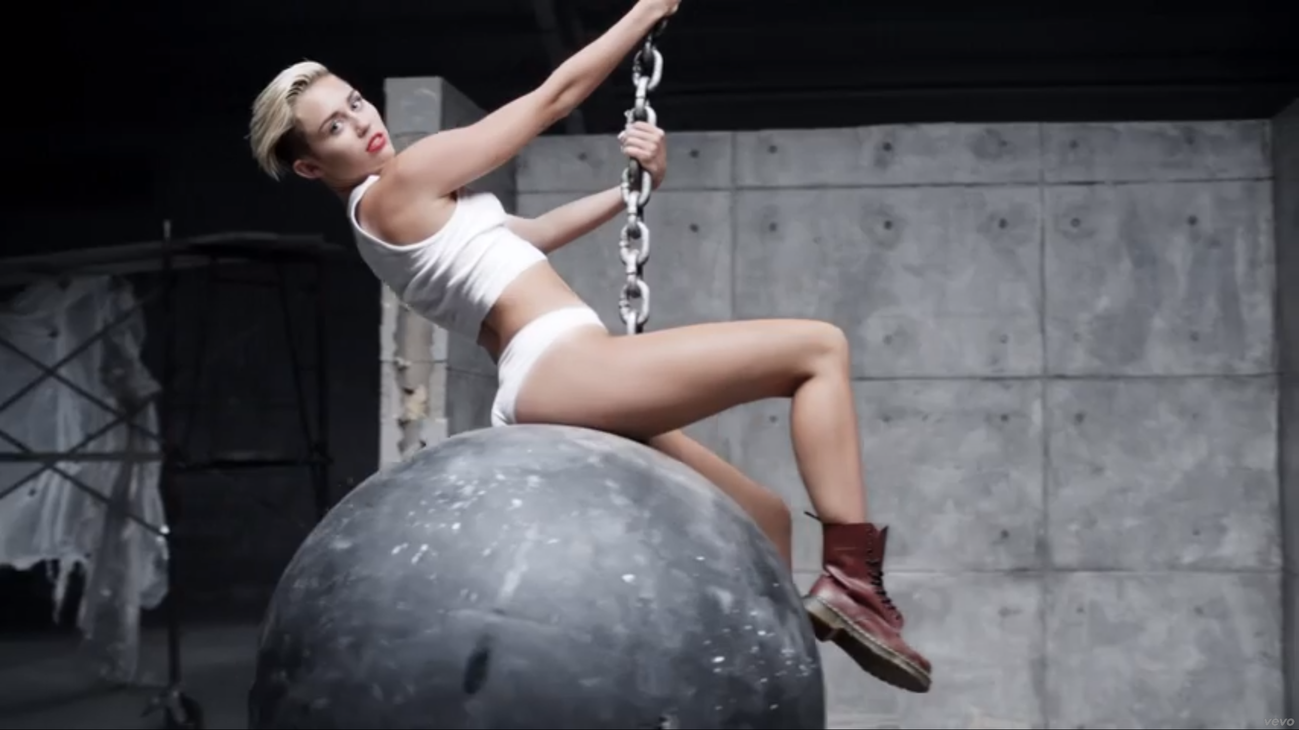
Complete Reconstruction (InterFACELIFT)
Notes:
Photo: Global flows of people from 2005 - 2010

Slide 8
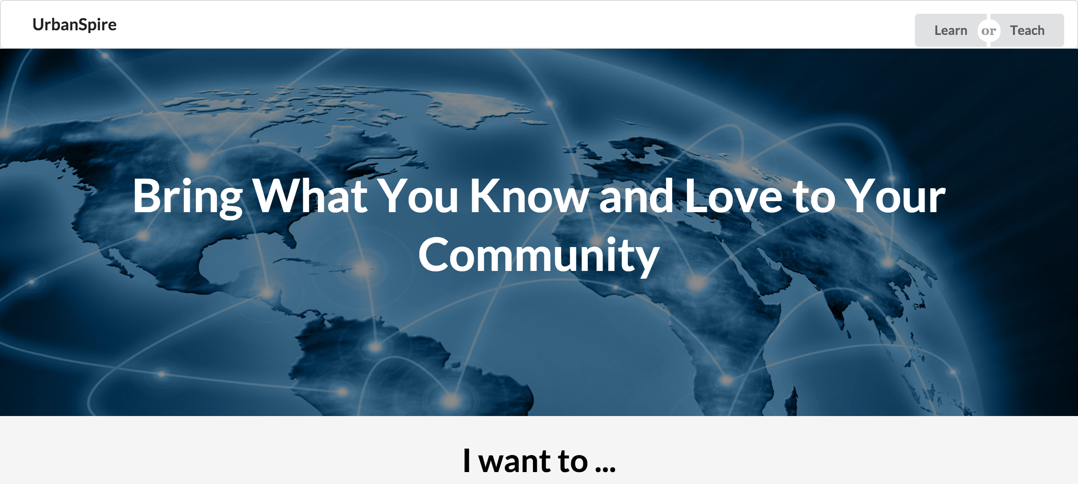
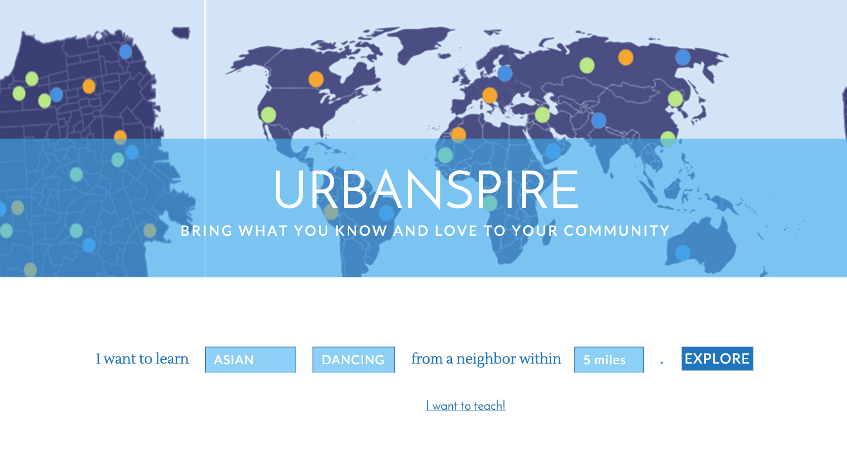
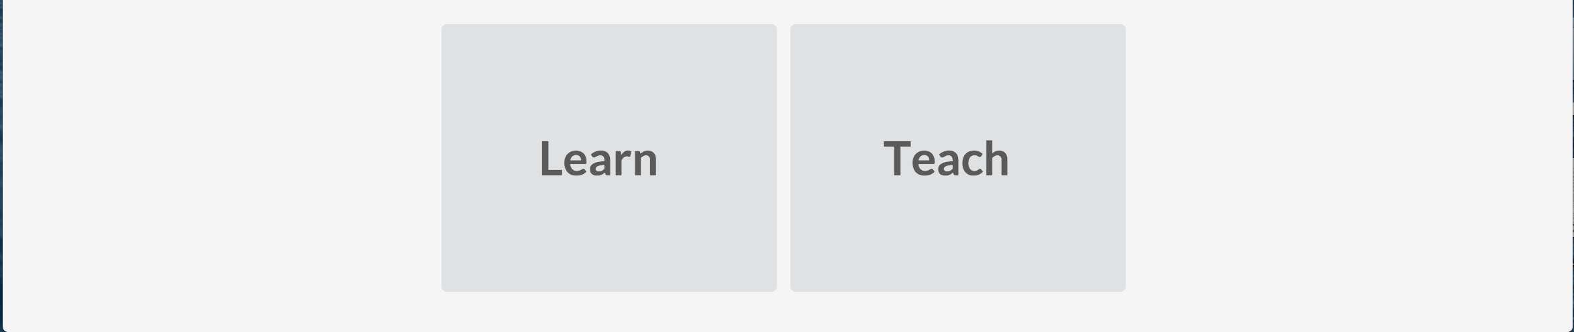
Home Page
Before
After
Notes:
why change:
Our test participants were confused with how the interaction worked between switching between the teaching and learnings modes.
All three of our participants either failed this task or took around 3-5 minutes trying to figure out how to do it.

Slide 9
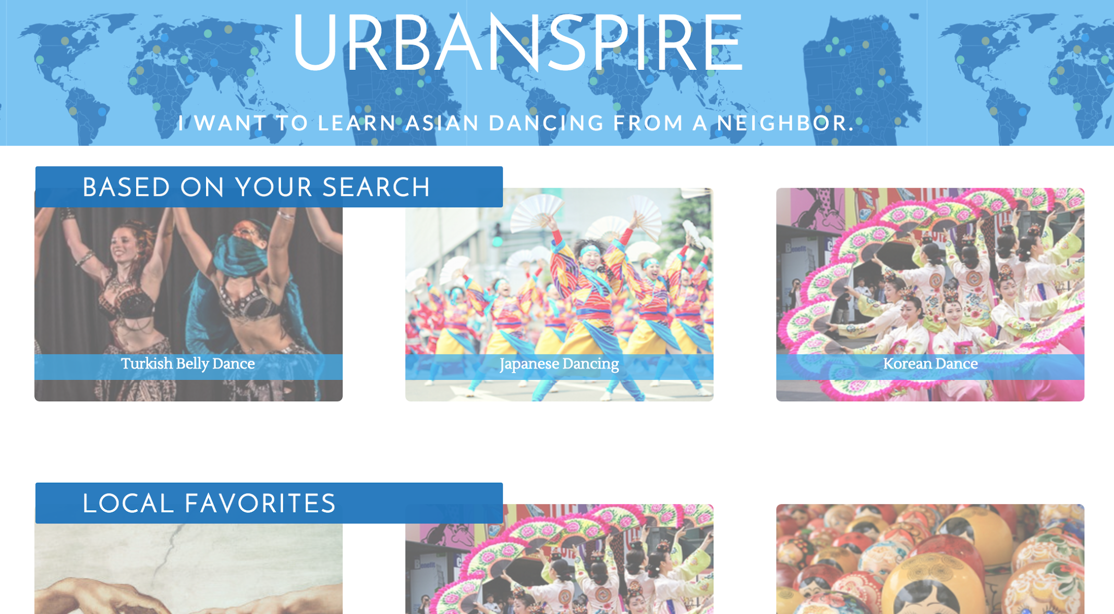
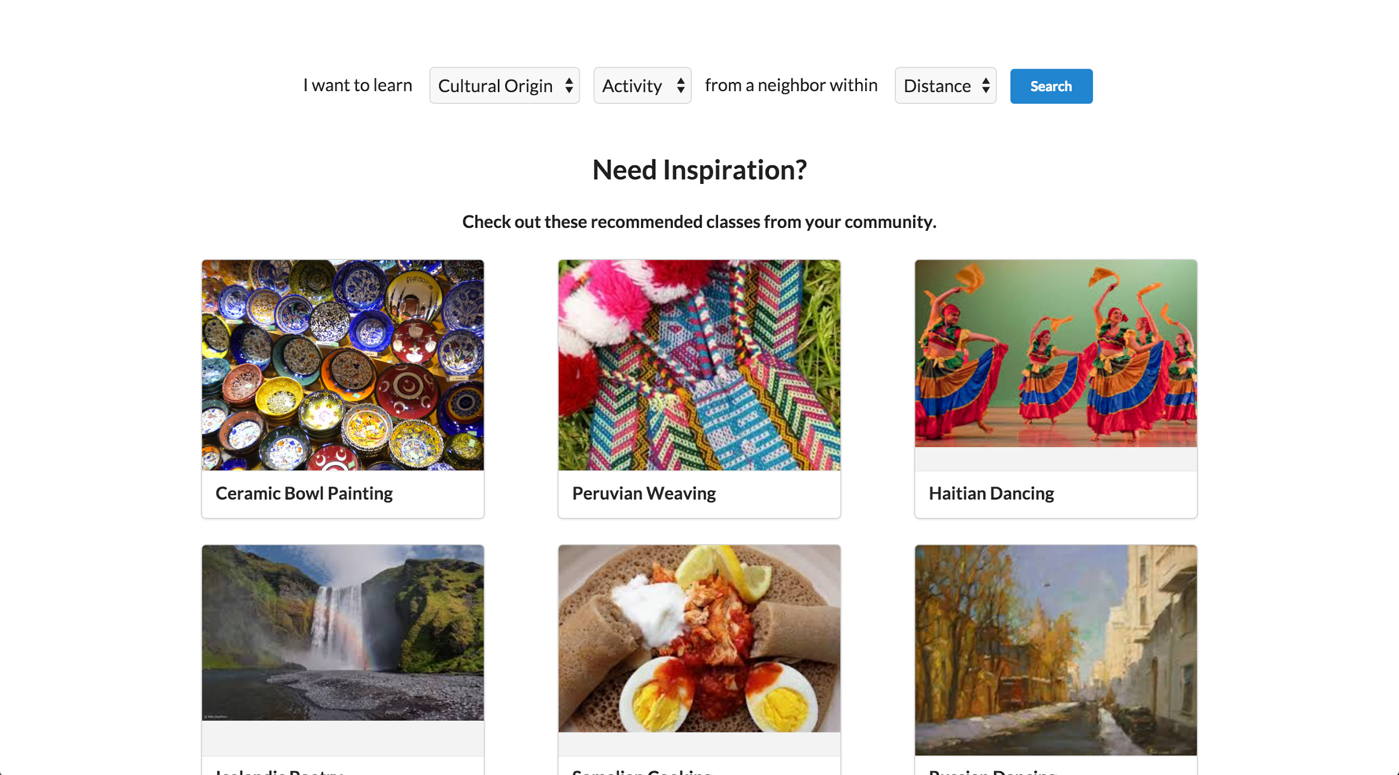
Learn Page
Before
After
Notes:
why change:
Some participants confused by the results page, because the second tier is actually recommendations so the results were unrelated
Change: We moved the search selectors to this page, and have the results dynamically update below. We first show recommendations, and once they search, its only their search results.
Another Idea we are playing with is having a panel on the right with trending classes.

Slide 10
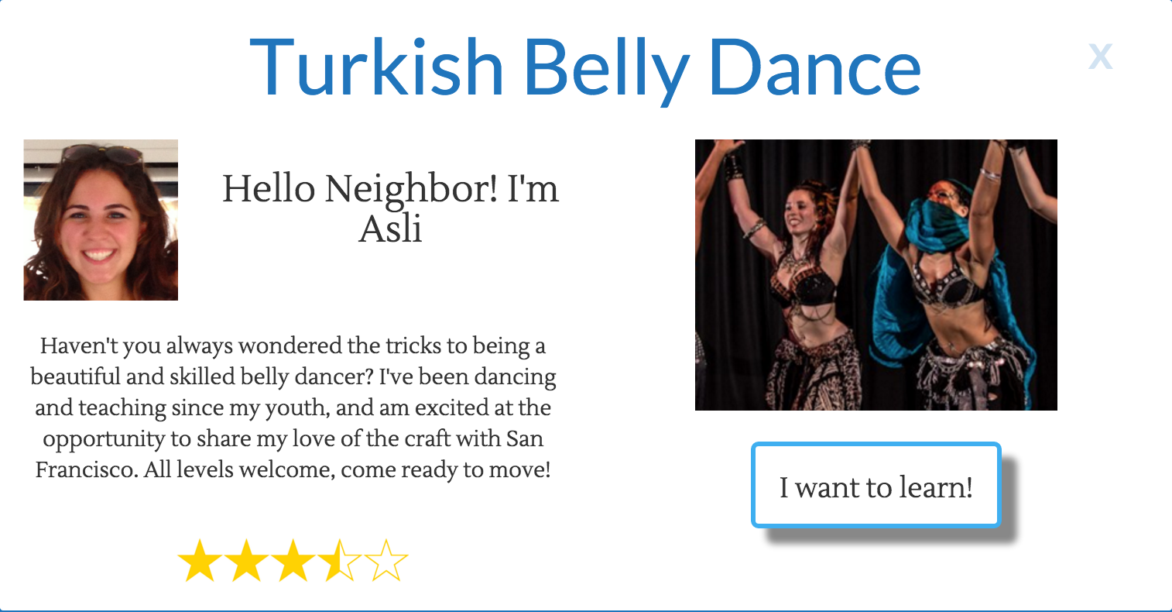
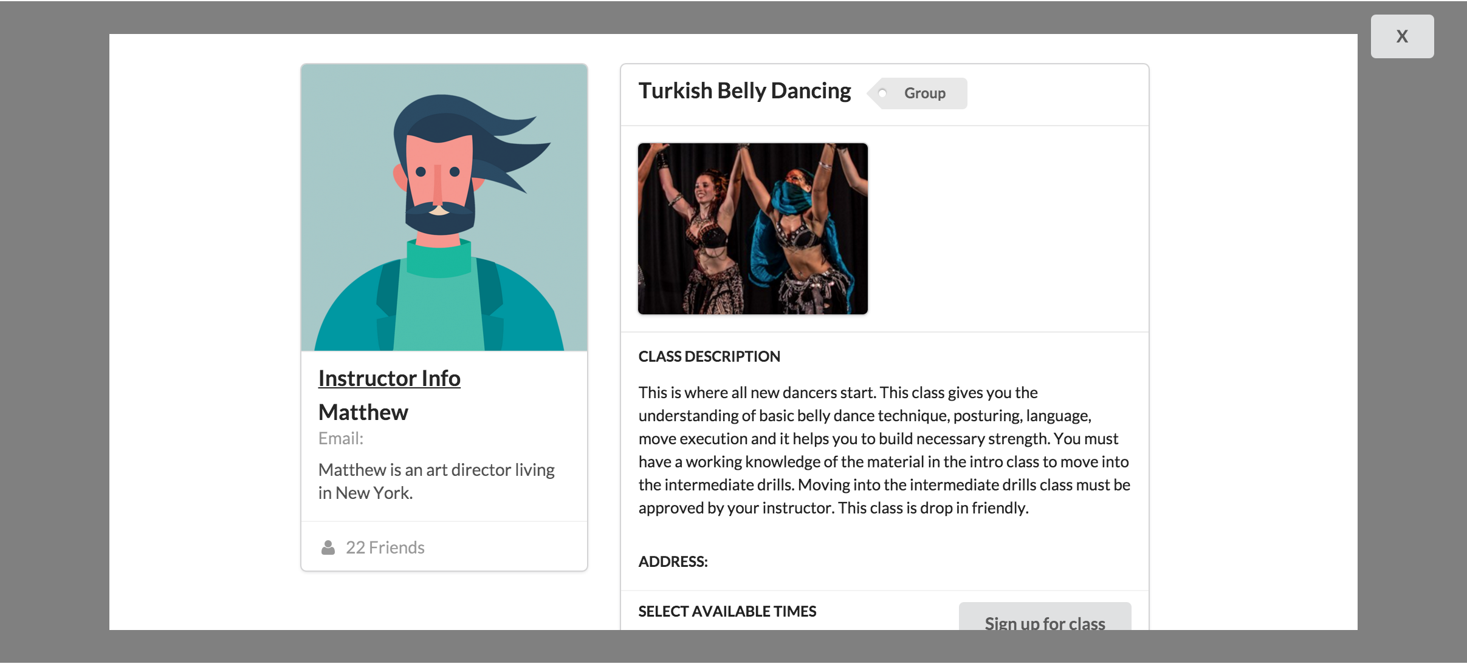
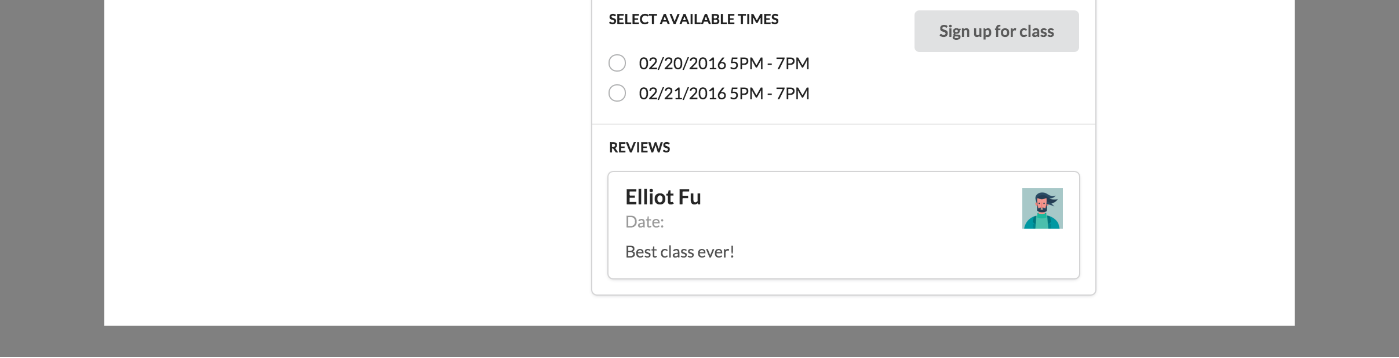
Class Page
Before
After
Notes:
why change:
wasn’t much confusion, only on whether the stars were for the class or teacher. also wanted the user to be able to see all the class info as they went through the sign up process.

Slide 11
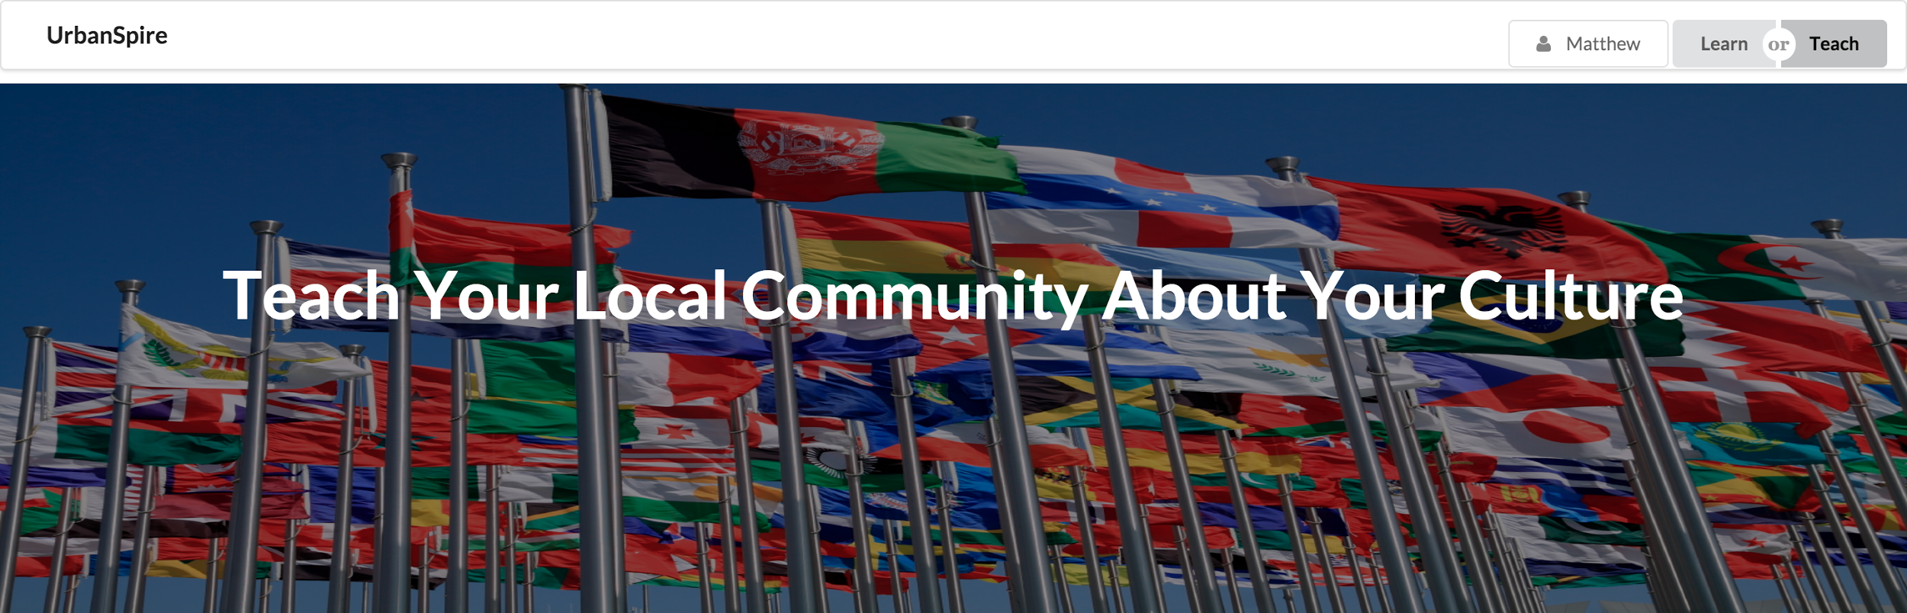
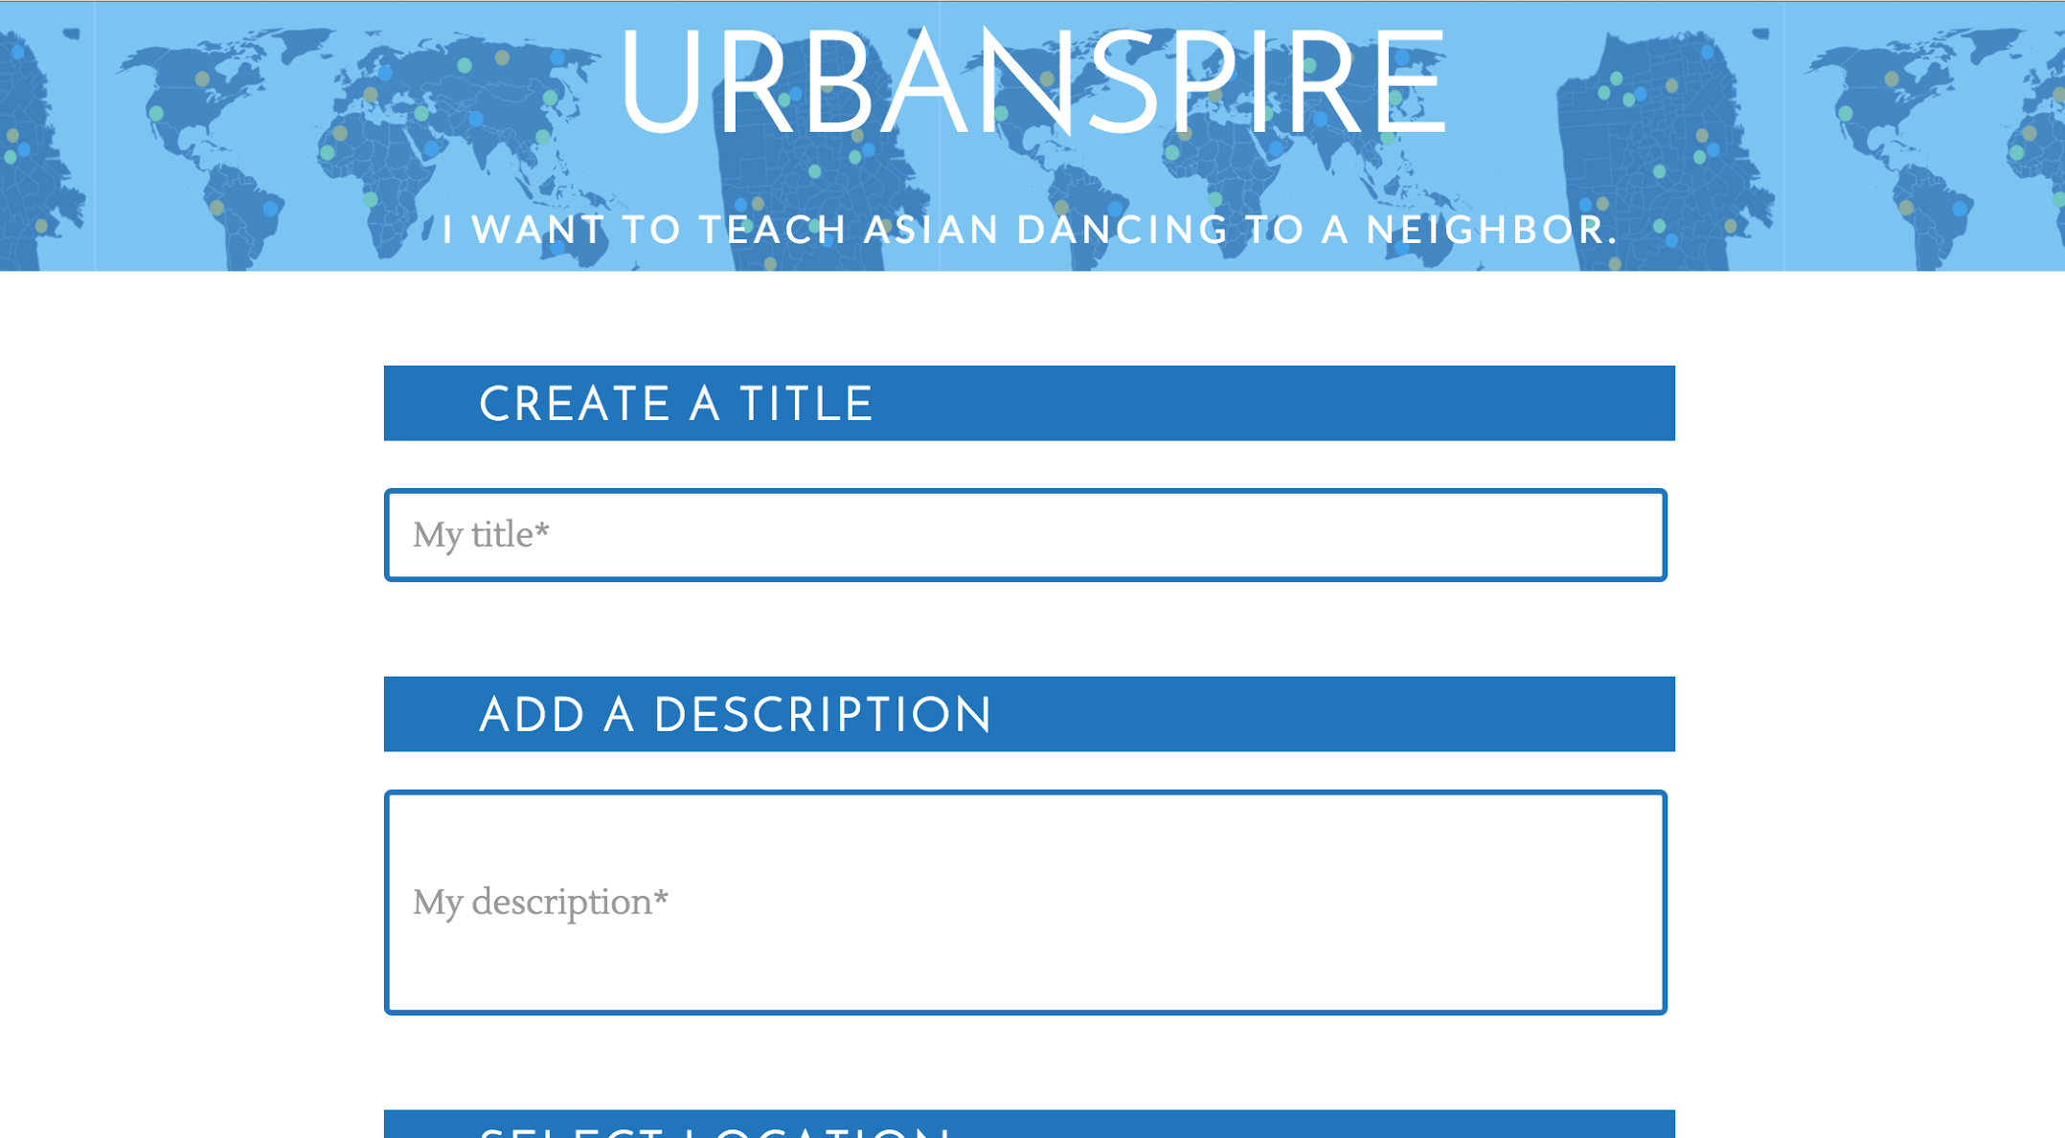
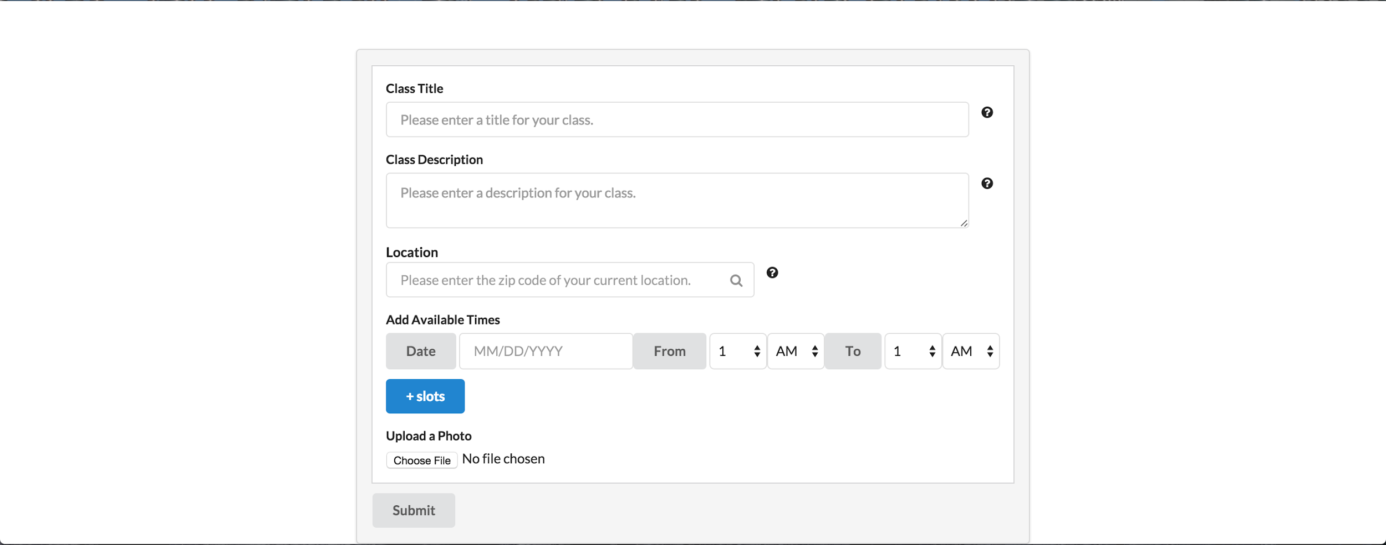
Teach Page
Before
After
Notes:
facelift

Slide 12
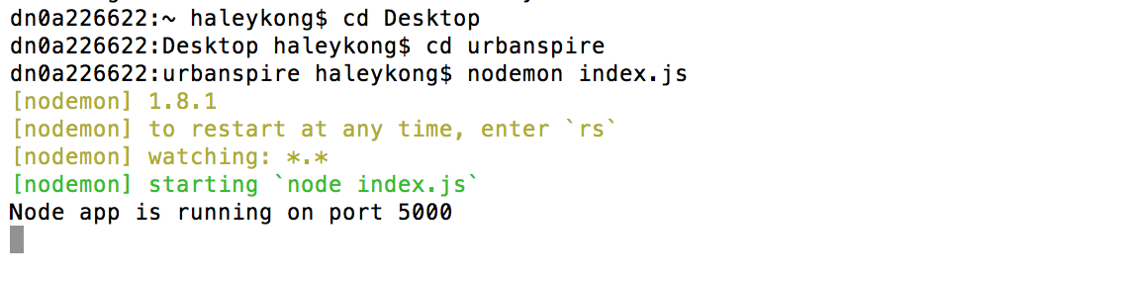

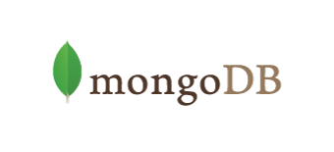
Backend
Node.js server
MongoDB database
Notes:
perpetuating data once its connected

Slide 13
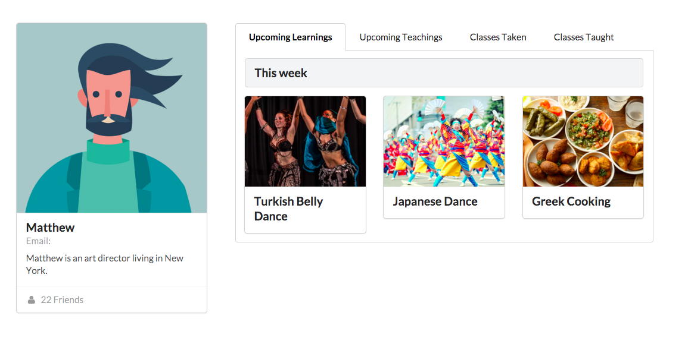
Added Functionality
Profile page
Notes:
why:
want to enable class facilitation through the website,
viewing info on teachers,
seeing classes you’ve taken.
opens us up to having a lot more features to facilitate making connections

Slide 14
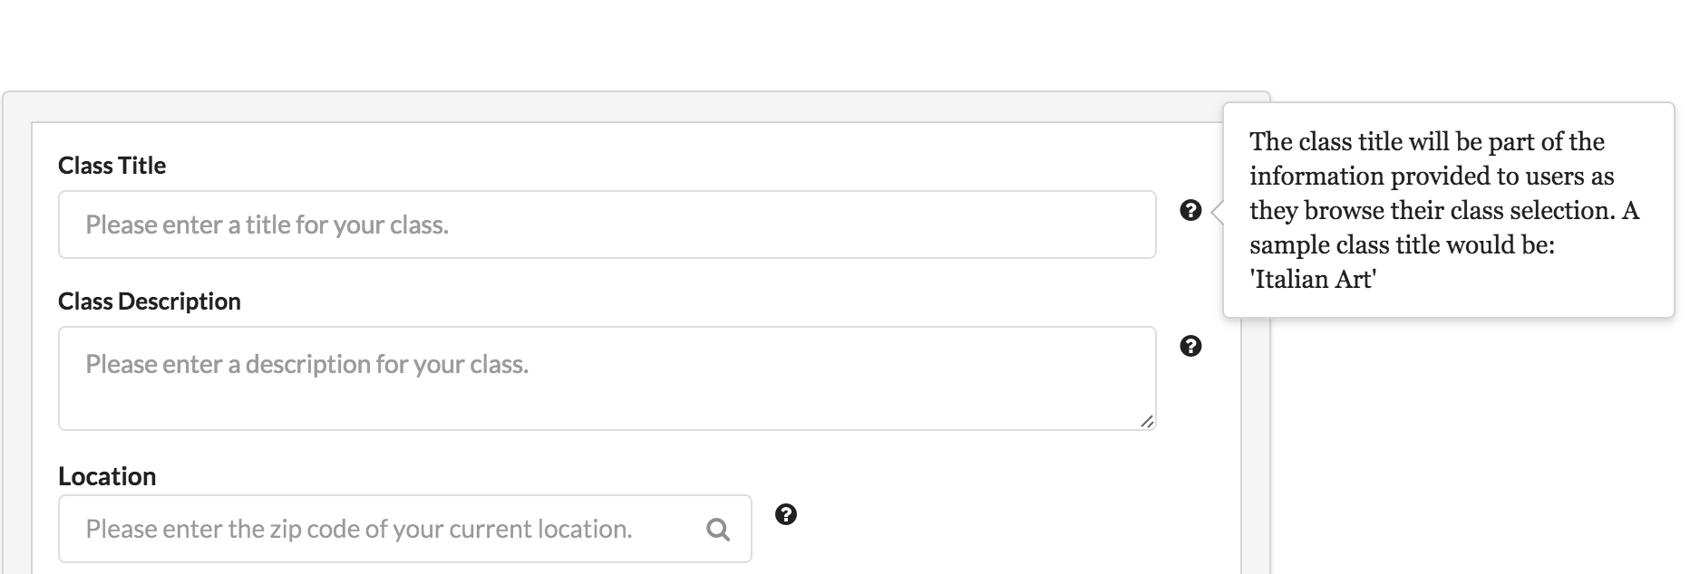
User Assistance
Addresses user questions on Teach page
Notes:
why:
participants wanted more guidance as to what to put in the class description to make it attractive to more people

Slide 15
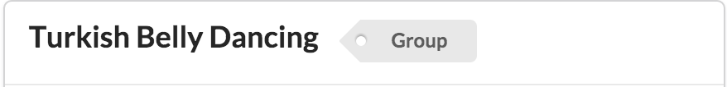
Added Functionality
Basic organization with tags
Notes:
why:
relaying more info about a class through tags
searching through tags,

Slide 16
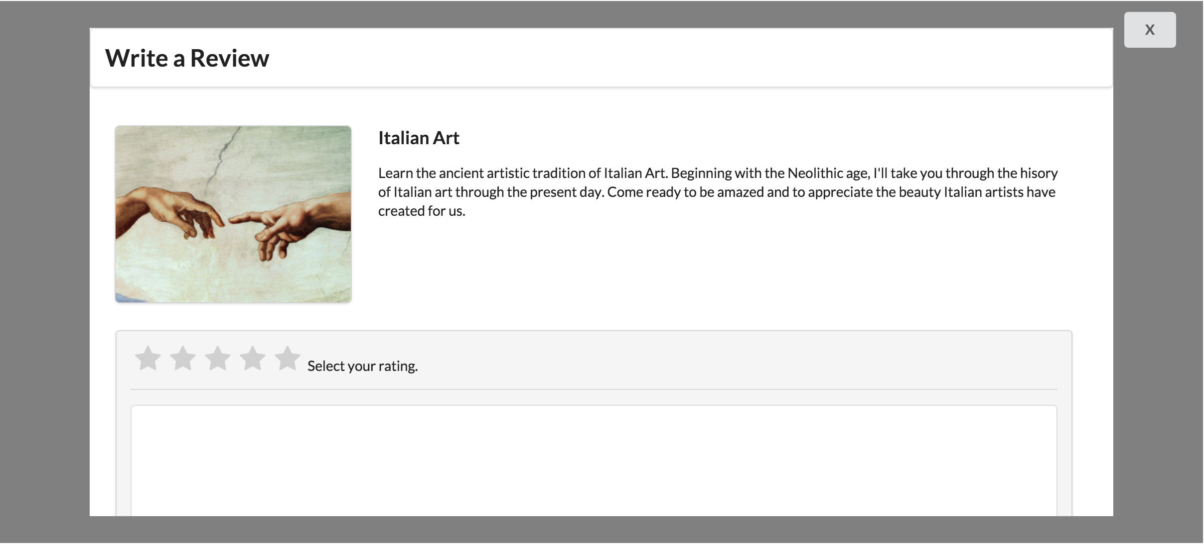
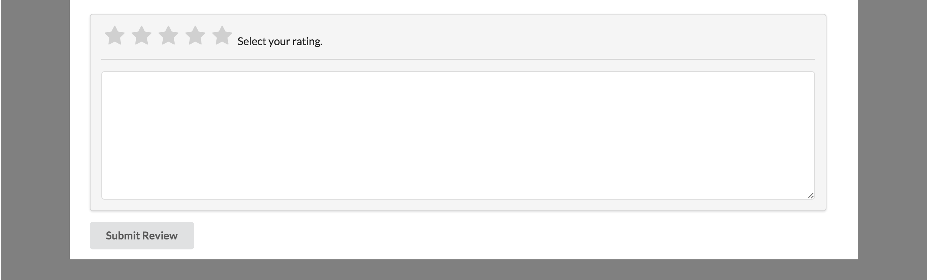
Added Functionality
Review system
Notes:
why:
users wanted to know more about a teacher before taking a class with them.
now: reviews allow them to see all the teachers previous reviews before taking a class (if they’ve had a class before)

Slide 17
Task Flow

Slide 18
3 Tasks
Simple: Find African cooking classes and sign up for one
Moderate: Find a European art class within 15 miles and sign up for the Tuesday 5-7pm class
Complex: Create a class to teach about a topic from your home culture
Video: https://drive.google.com/a/stanford.edu/file/d/0B0fRS05FLPT1dE5ad21id1dvTU0/view

Slide 19
Future Work

Slide 20
To-Dos
Button implementation
Add pop-up boxes
Login
Customizing site for users who are logged in
Filtering/search
Confirmations for creating and signing up for a class
Map interfaces to show community centers/seeing connections made
UI for teachers managing classes and viewing participants
Backend Completion and Connection to Front End
Color Scheme / Branding
Adjust Value Prop

Slide 21
Summary

