Slide 1
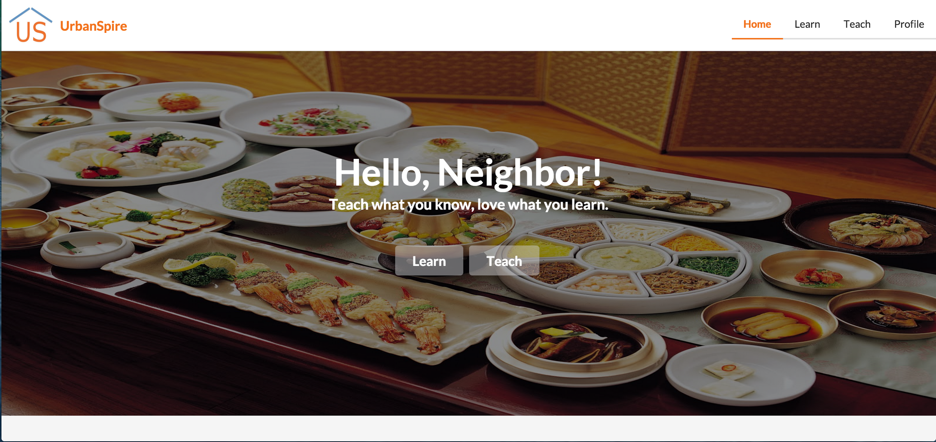
Field Usability Study
Notes:
Hi everyone! We are team Urbanspire

Slide 2
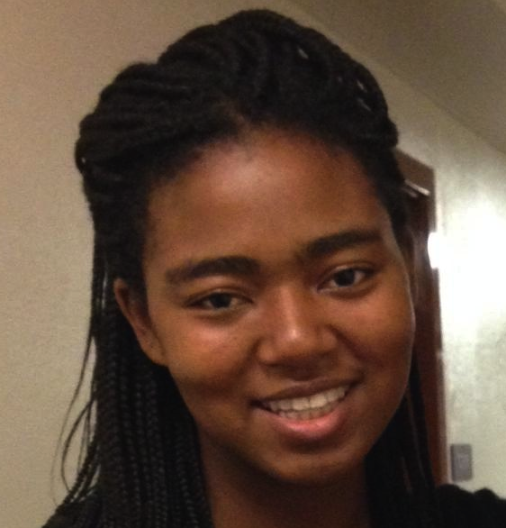

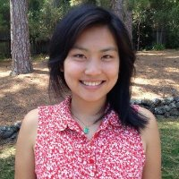
Our Team
Adrienne
Christina
Haley
Nikhita
Notes:
And my name is Christina. We are all studying CS with a focus in HCI.

Slide 3
Introduction
Urbanspire is a cultural bridge that gives newcomers the opportunity to flourish in their community by teaching what they know and love from their home in a neighbor-to-neighbor context.

Slide 4
Our Field Test
Test the flow of our new UI
Gauge the usability of our new features (i.e. creating reviews, profiles)
Gain insight into incentives for users

Slide 5
Talk Outline
Prototype Changes
Methods
Test Measures/Results
Discussion

Slide 6
Prototype Changes

Slide 7

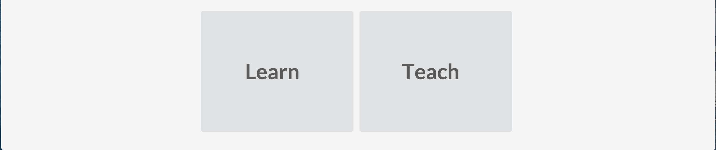
Home Page
Before
After

Slide 8
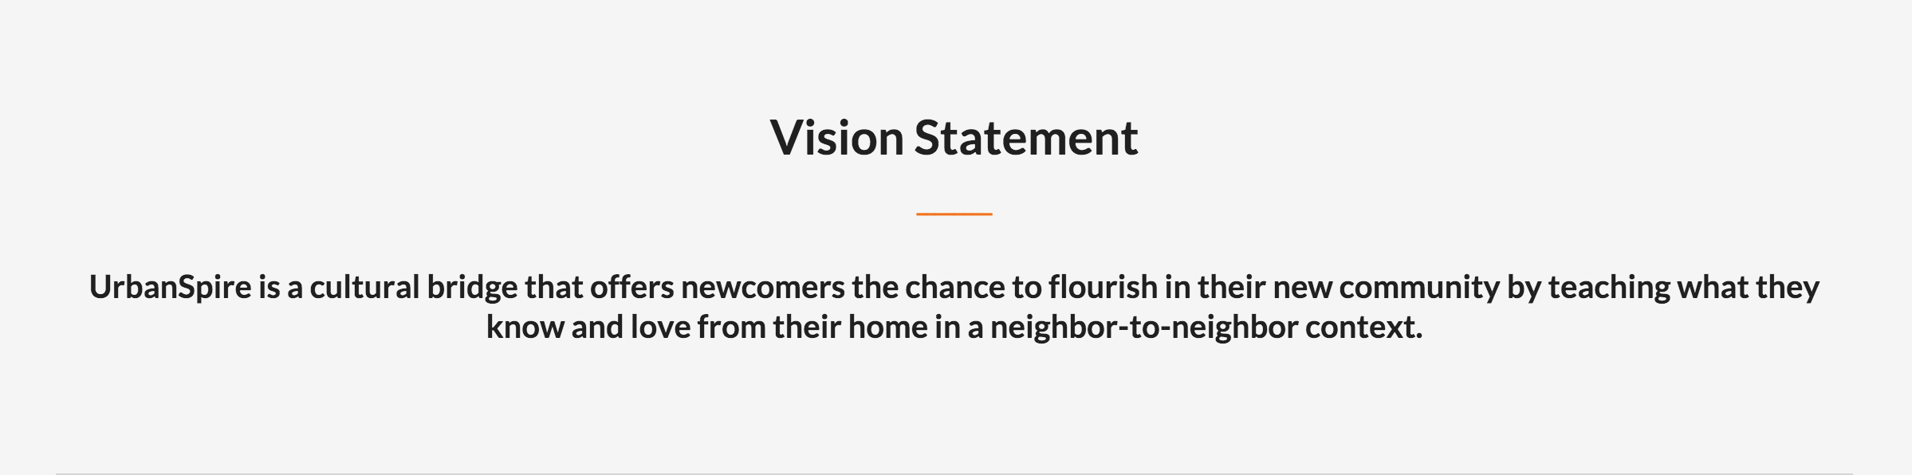
Vision Statement

Slide 9
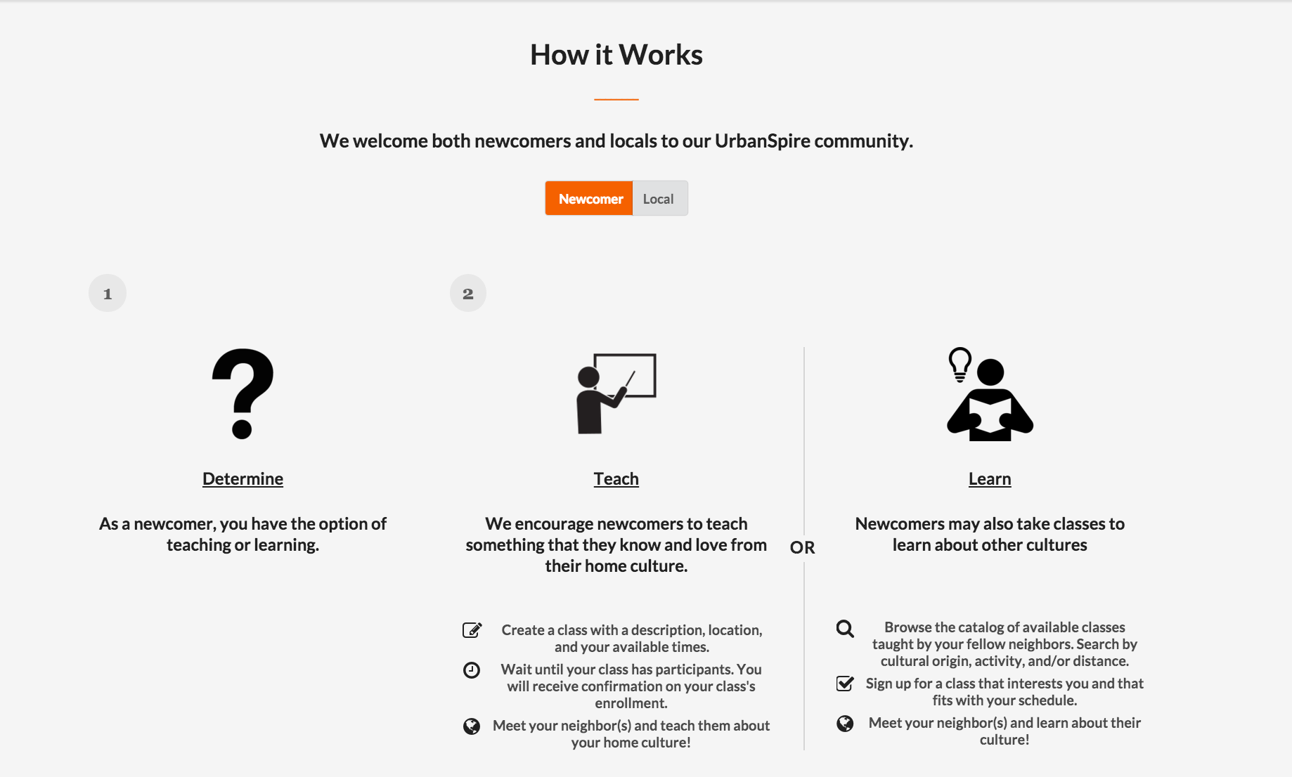
How It Works - Newcomer

Slide 10
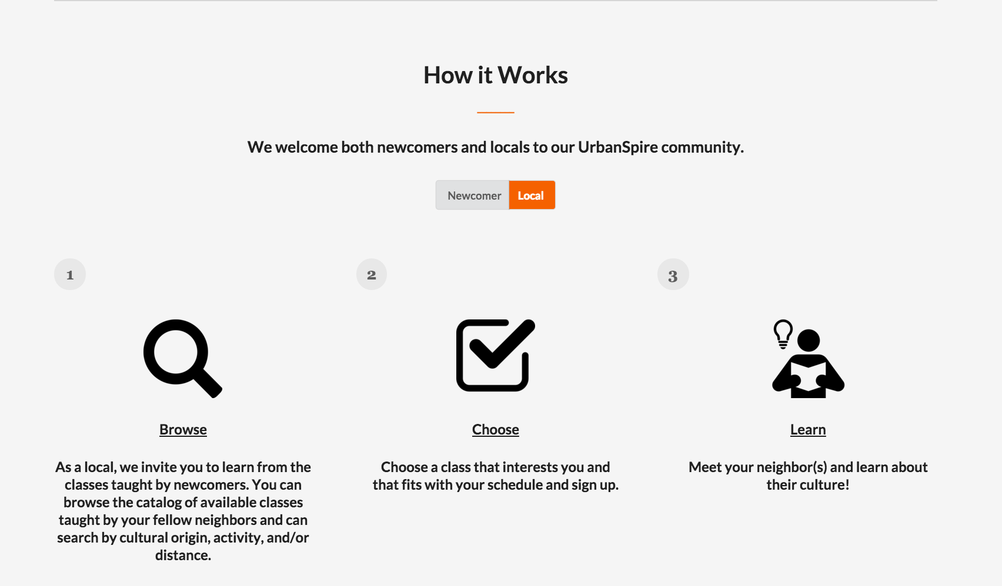
How It Works - Local

Slide 11
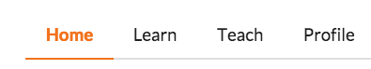

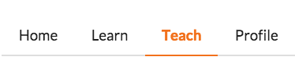

Navigation

Slide 12
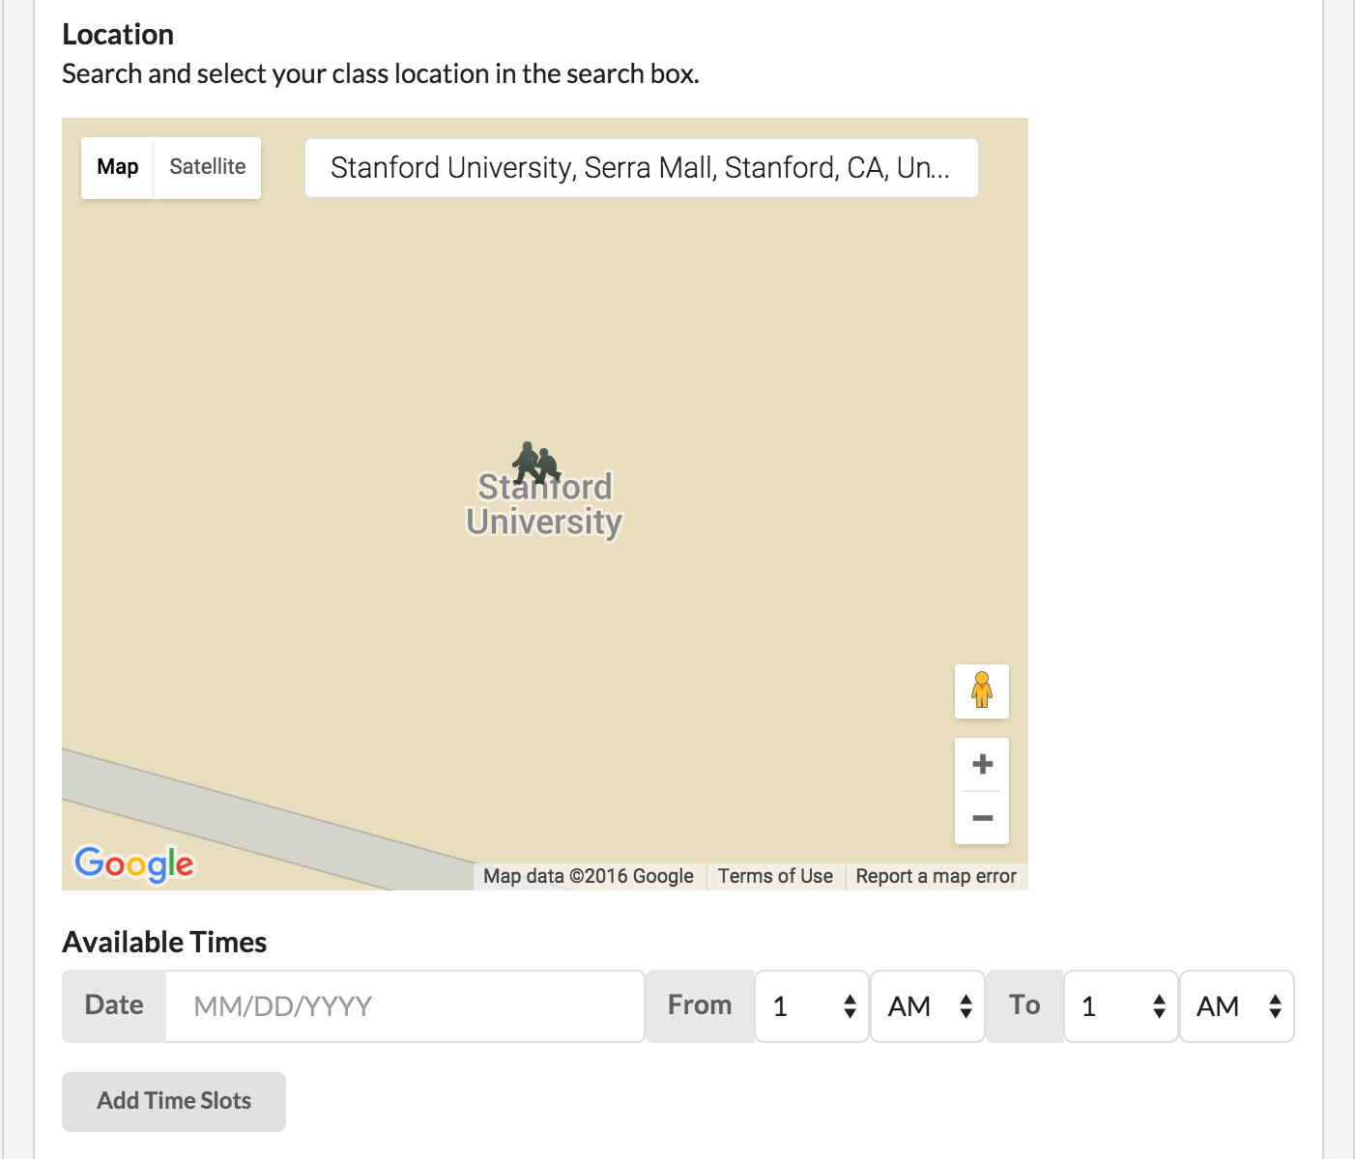
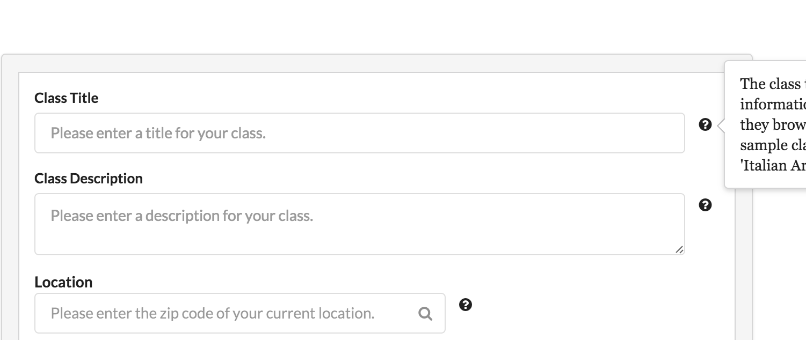
Teach Page
Before
After

Slide 13
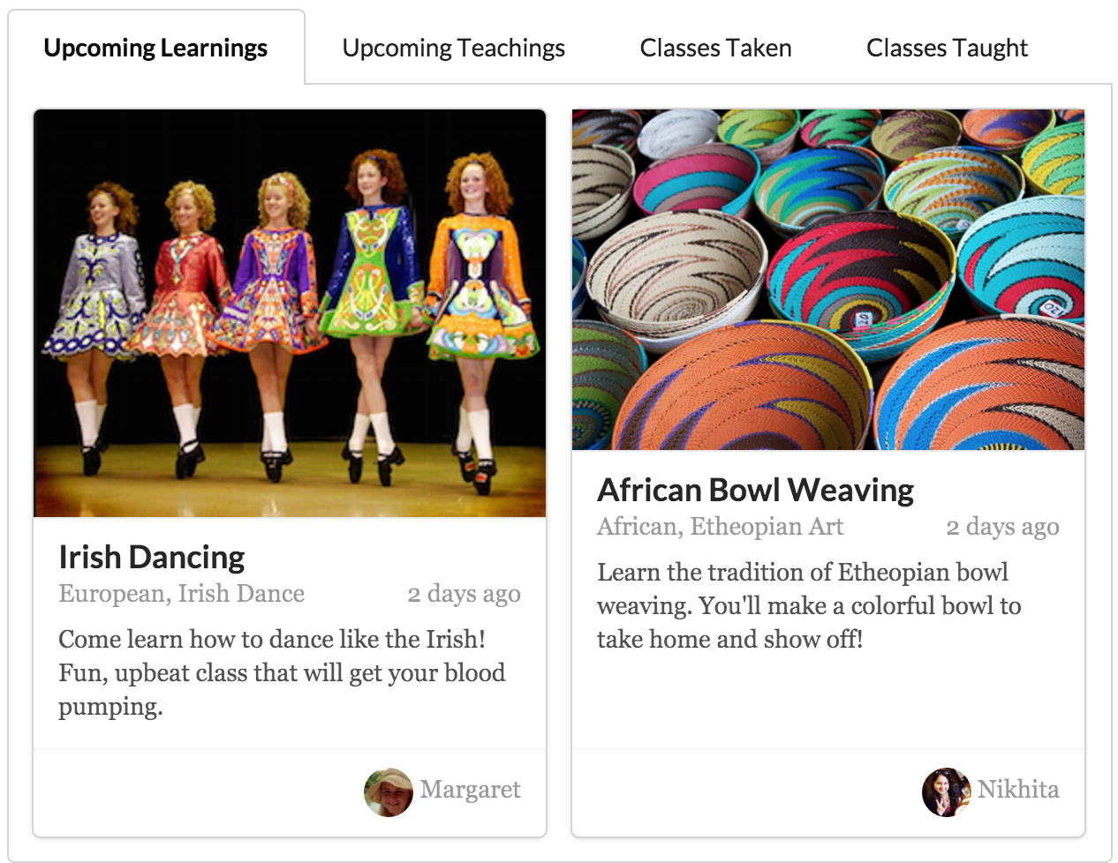
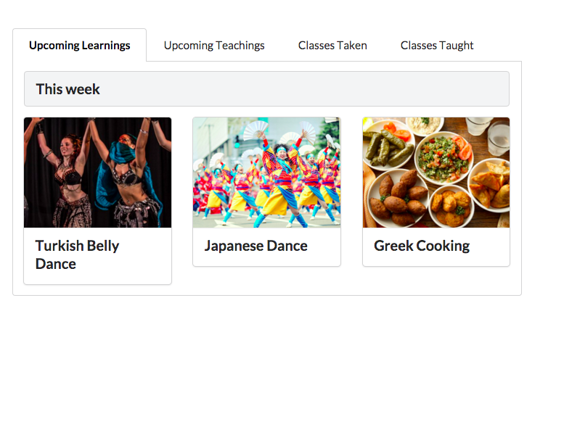
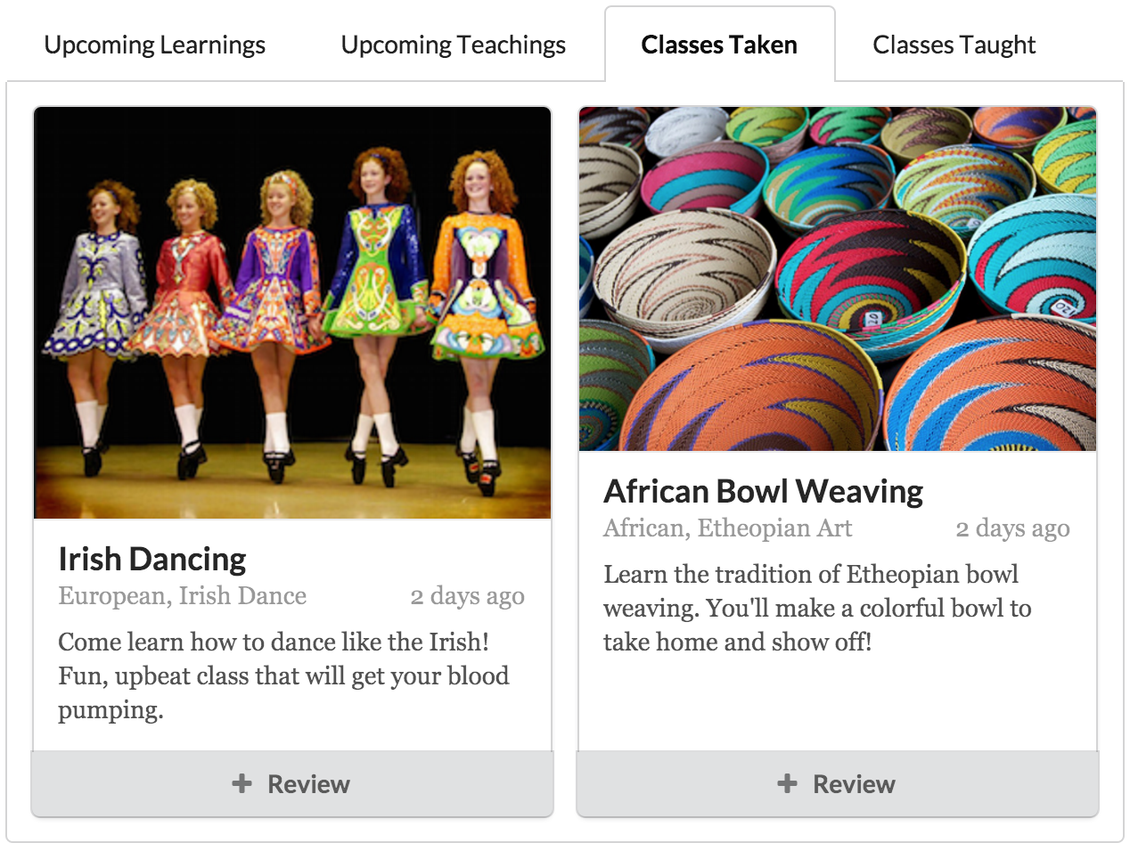
Profile Page
After
Before

Slide 14
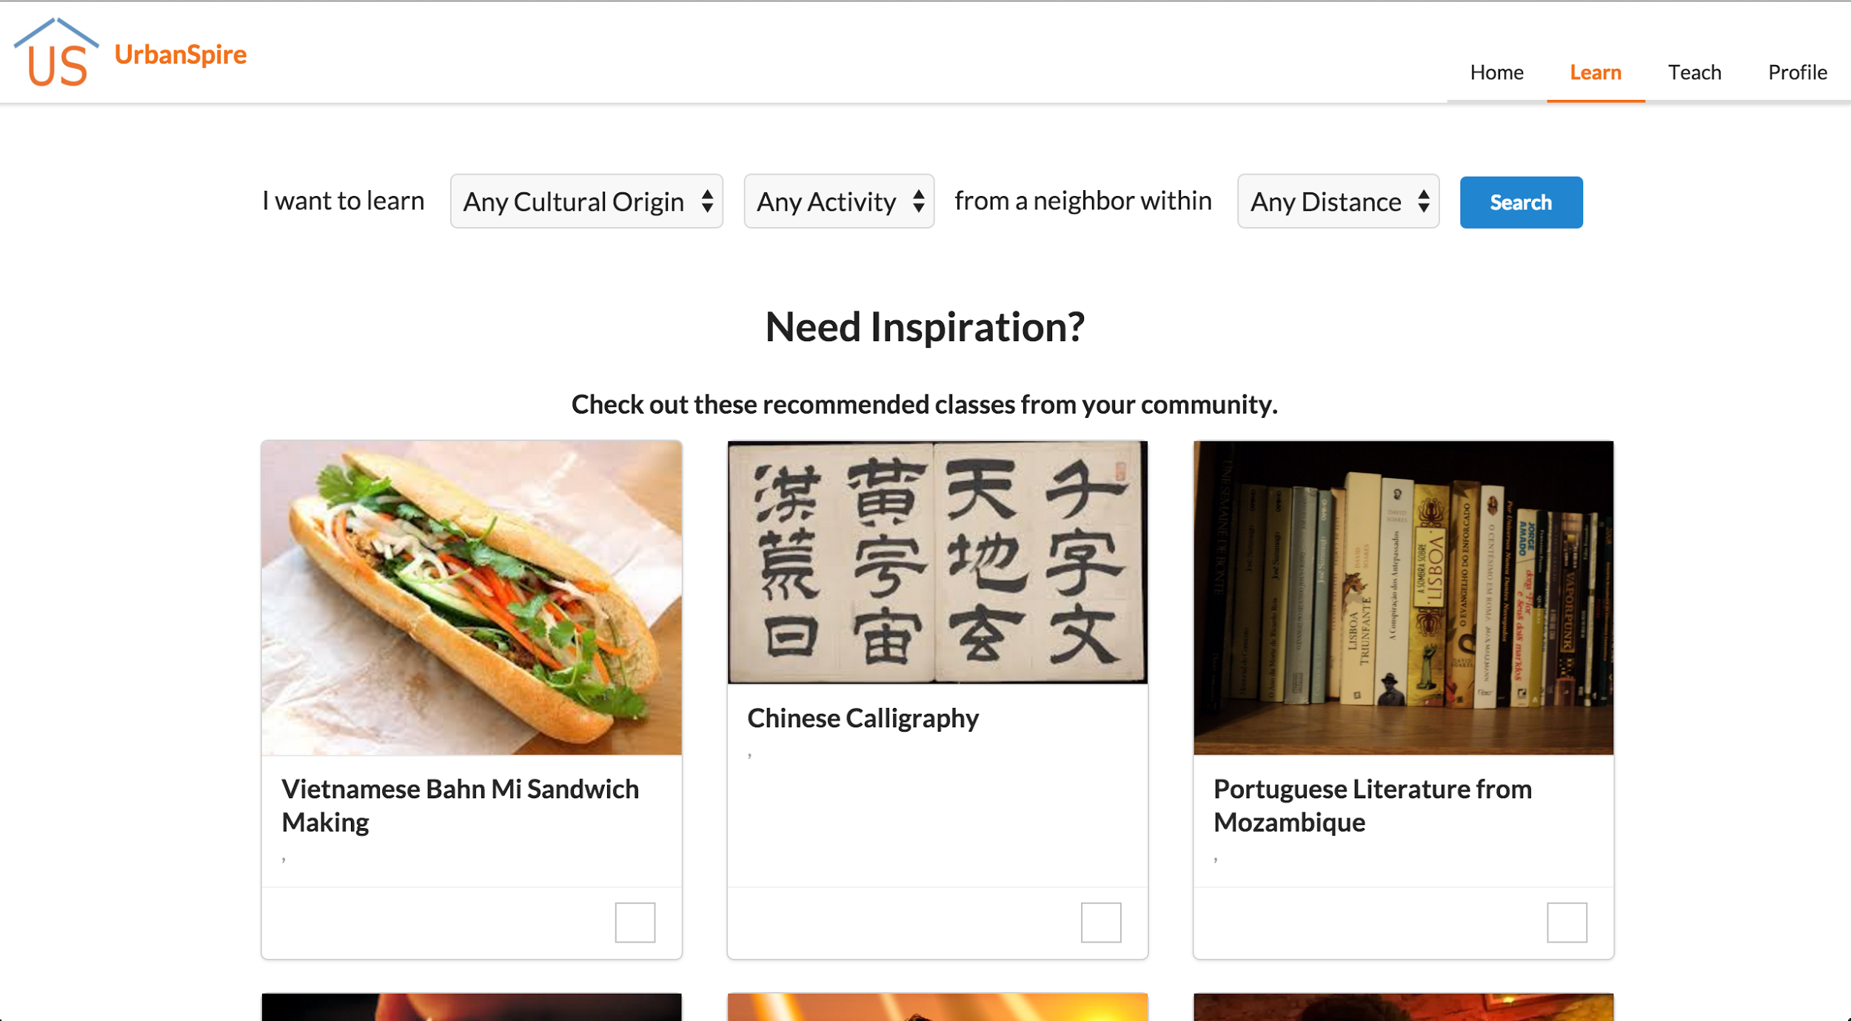
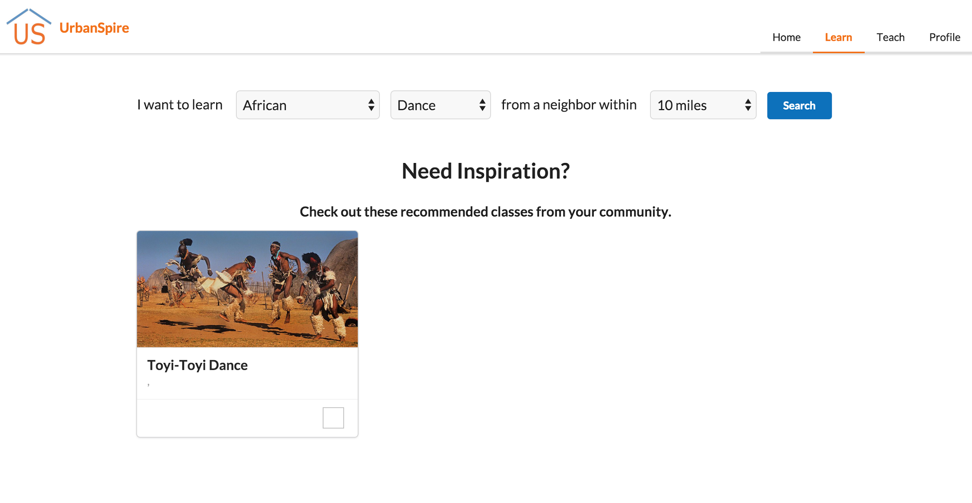
Search Functionality
Without Search
With Search

Slide 15
Method

Slide 16
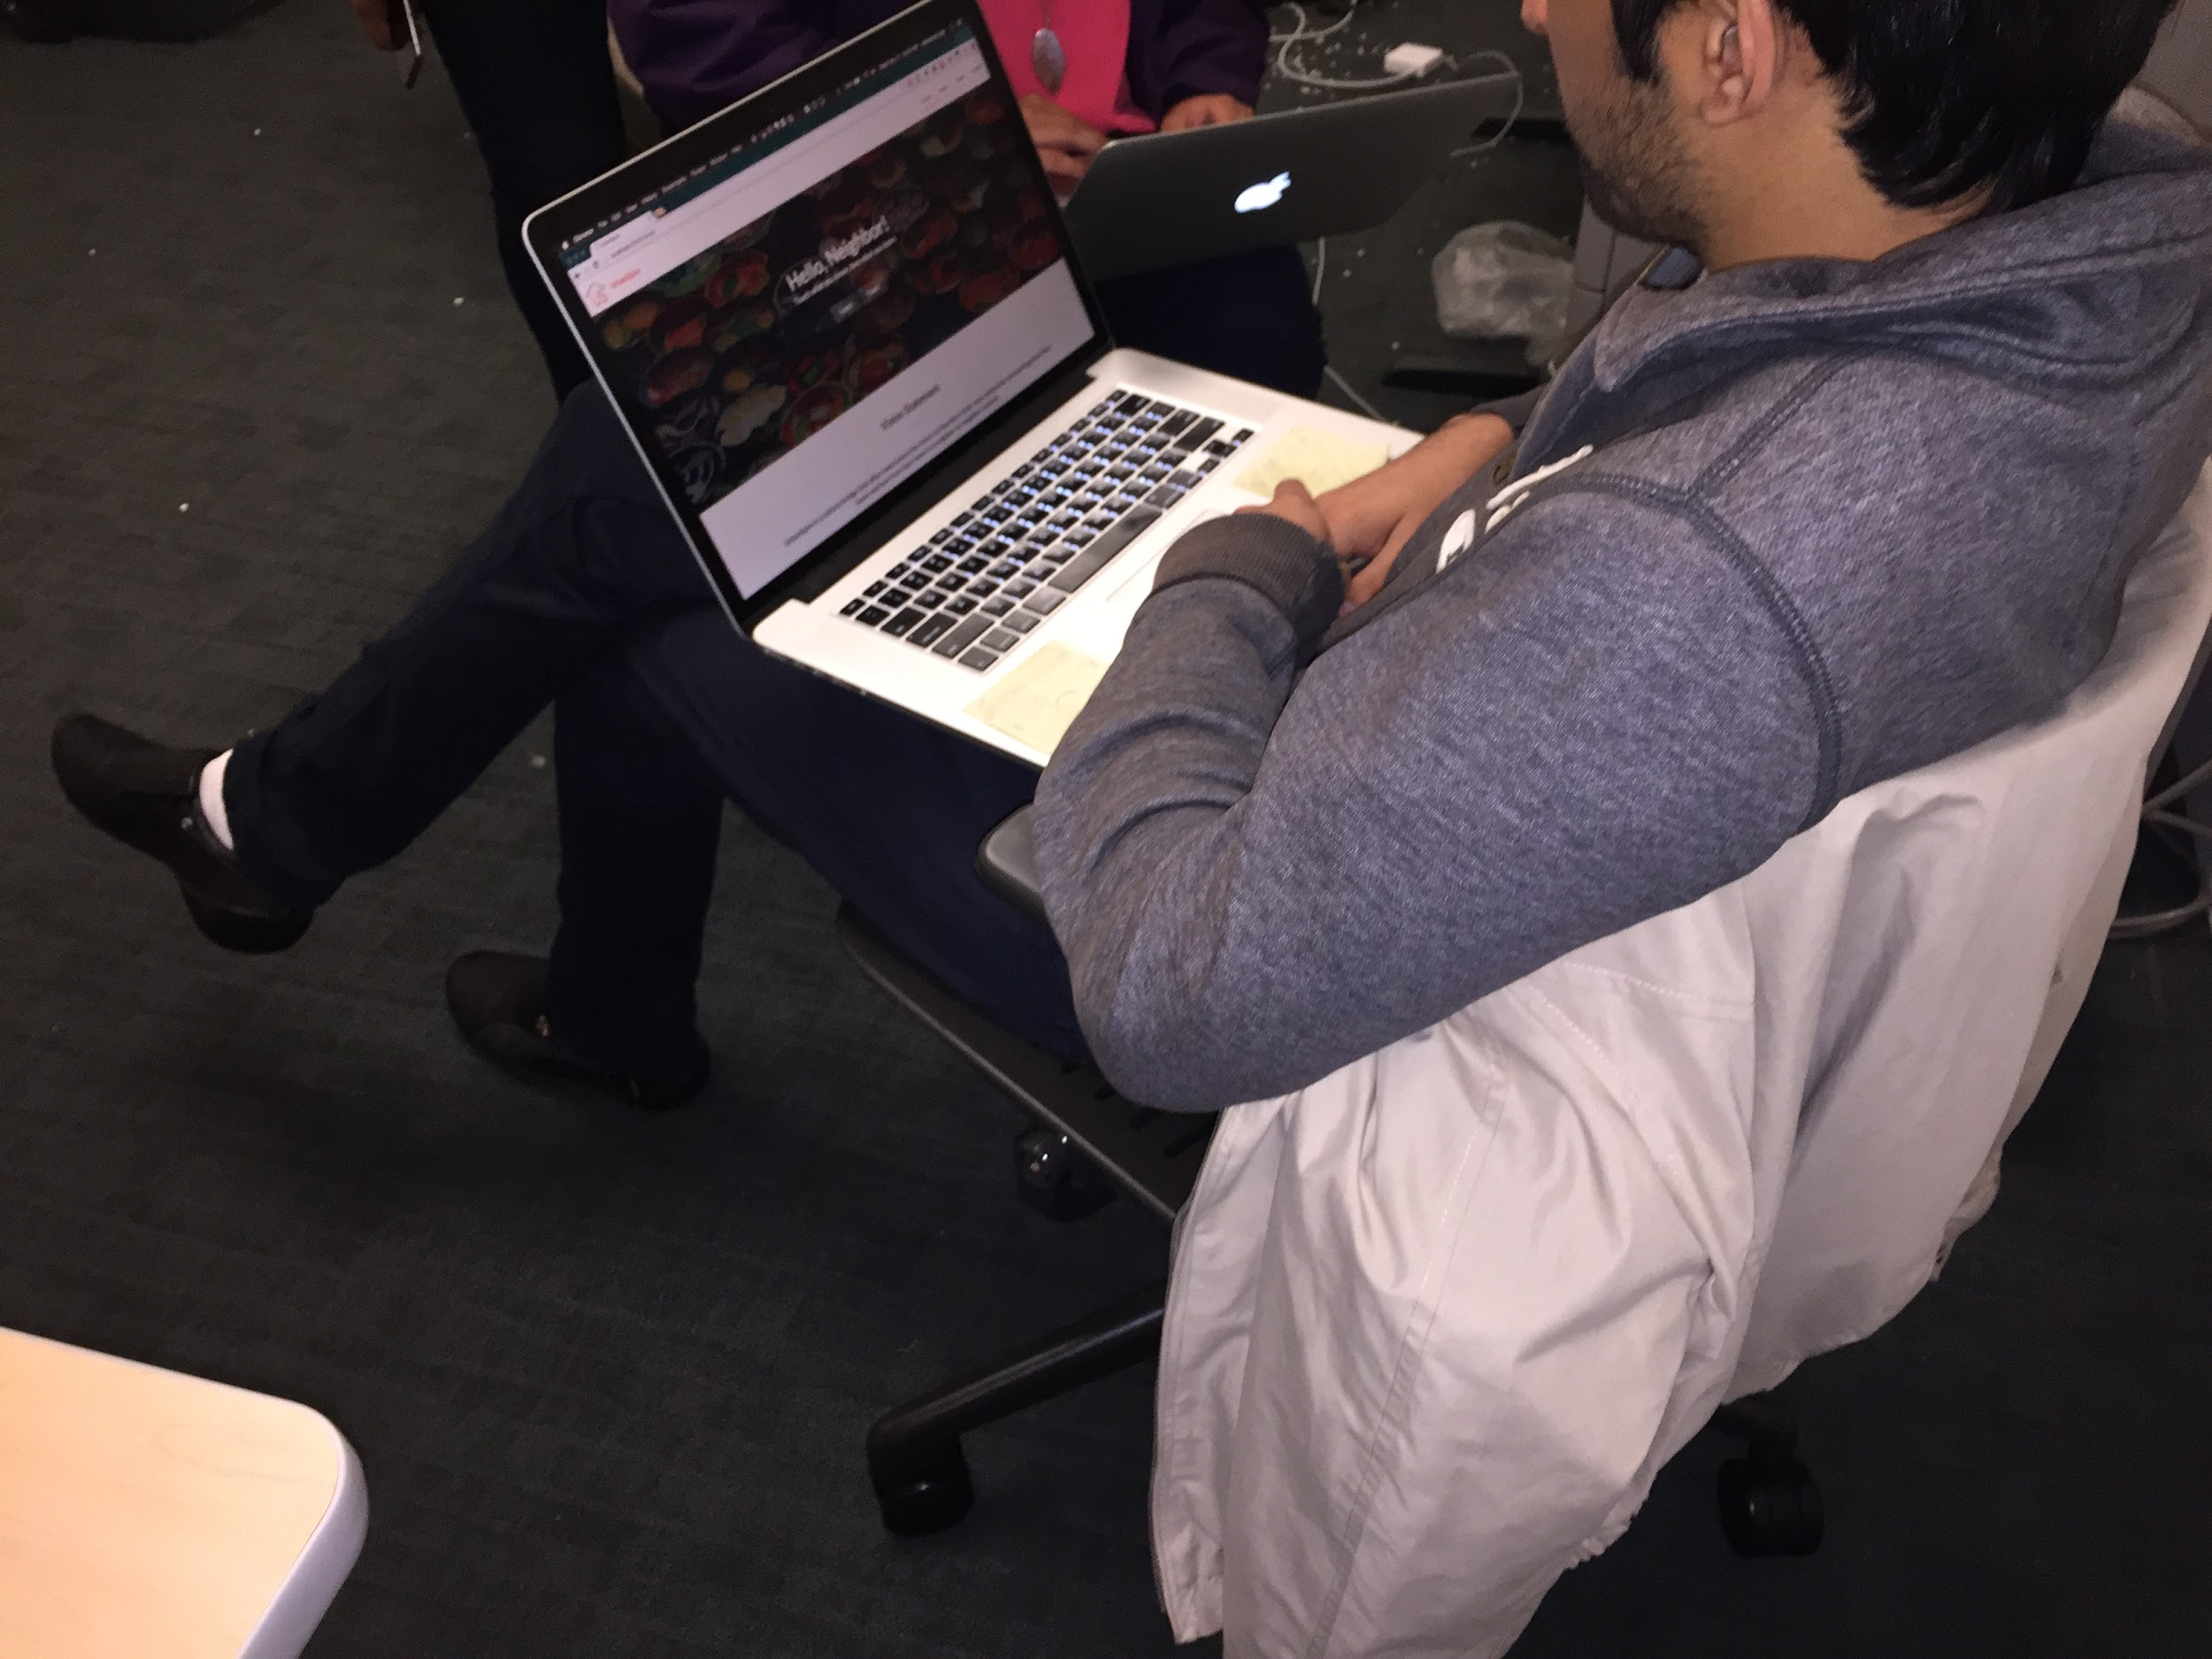
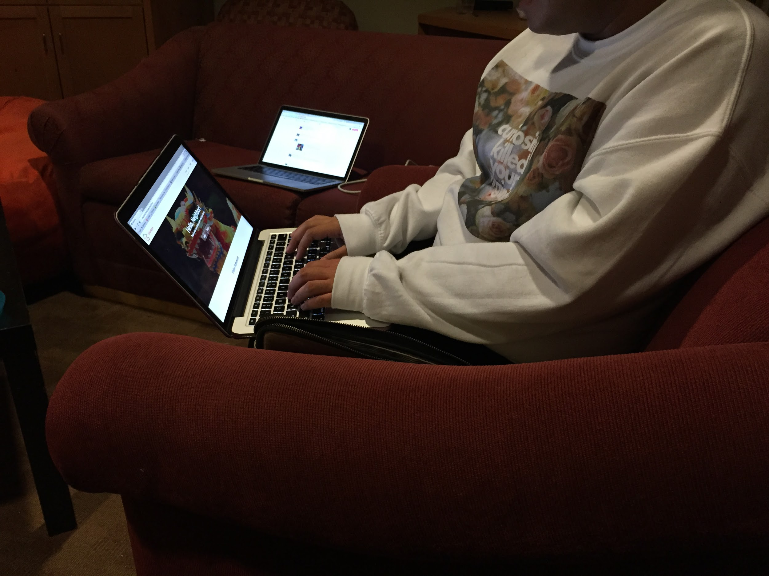
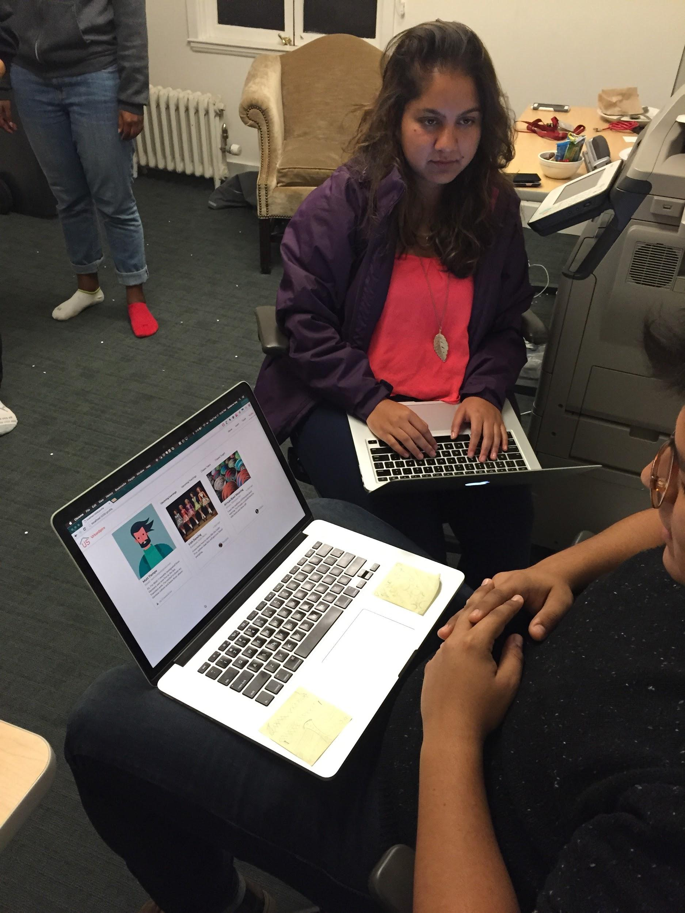
Participants
Pre-screening
6 users in total
  Newcomer 1: Senior, studying Computer Science, from India who has been in the U.S. for 3.5 years. [M, 22, Indian]
  Newcomer 2: Coterm, studying Computer Science, who was born in Peru and moved to the U.S. during high school. [M, 23, Peruvian]
  Newcomer 3: Marketing manager for semiconductor company in China. Has traveled to the U.S. multiple times for business. [F, 52, Chinese]
  Local 1: Masters student. Has been in the U.S. for 8 years and considers herself a local.. [F, 23, Chinese]
  Local 2: Senior, has lived in the U.S. for all her life. [F, 21, American]
  Local 3: Sophomore, studying Music, has lived in the U.S. for all his life. [M, 19, American]
Compensation: Heartfelt gratitude + Candy
Notes:
how they were selected and compensated

Slide 17


Apparatus
Equipment
  The users performed the tests on laptops
Software
  Quicktime for logging and voice recording
“Field” Locations
  Dorm rooms, Homes
  Relatively quiet spots in public spaces where one might use their computer
  Public spaces (public transport, dining halls, lounges) on mobile devices
    not tested due to lack of site responsiveness
Notes:
Test location notes: Our app would most likely be used by people at work or at home who are browsing on their computers in their free or break time

Slide 18
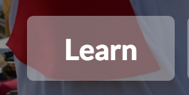

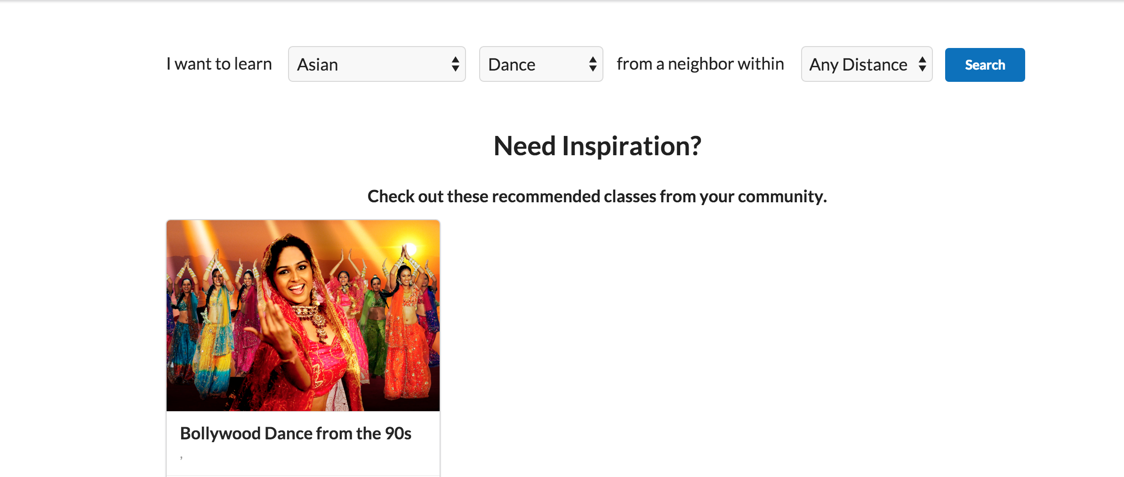
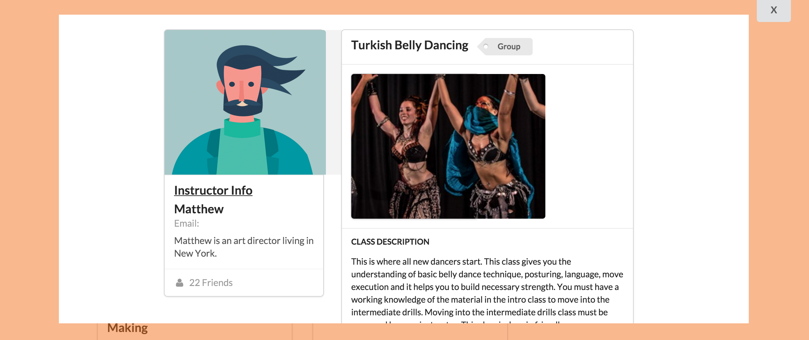
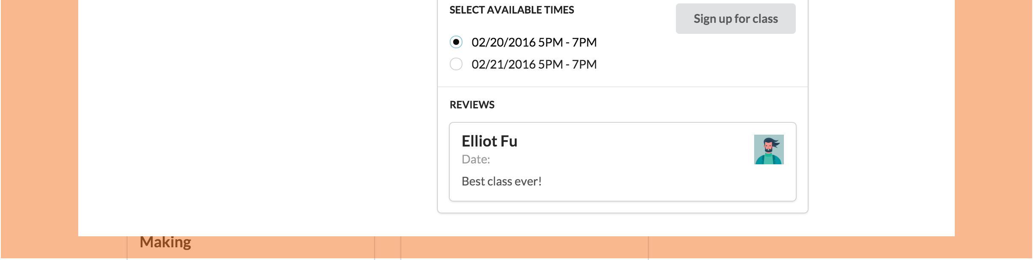
Simple Task - Learn
Task Description:
Find a class that interests you and sign up for one.
What we looked for:
User is able to perform the basic search functionality on our site, choose a class, select a time and click sign up.

Slide 19

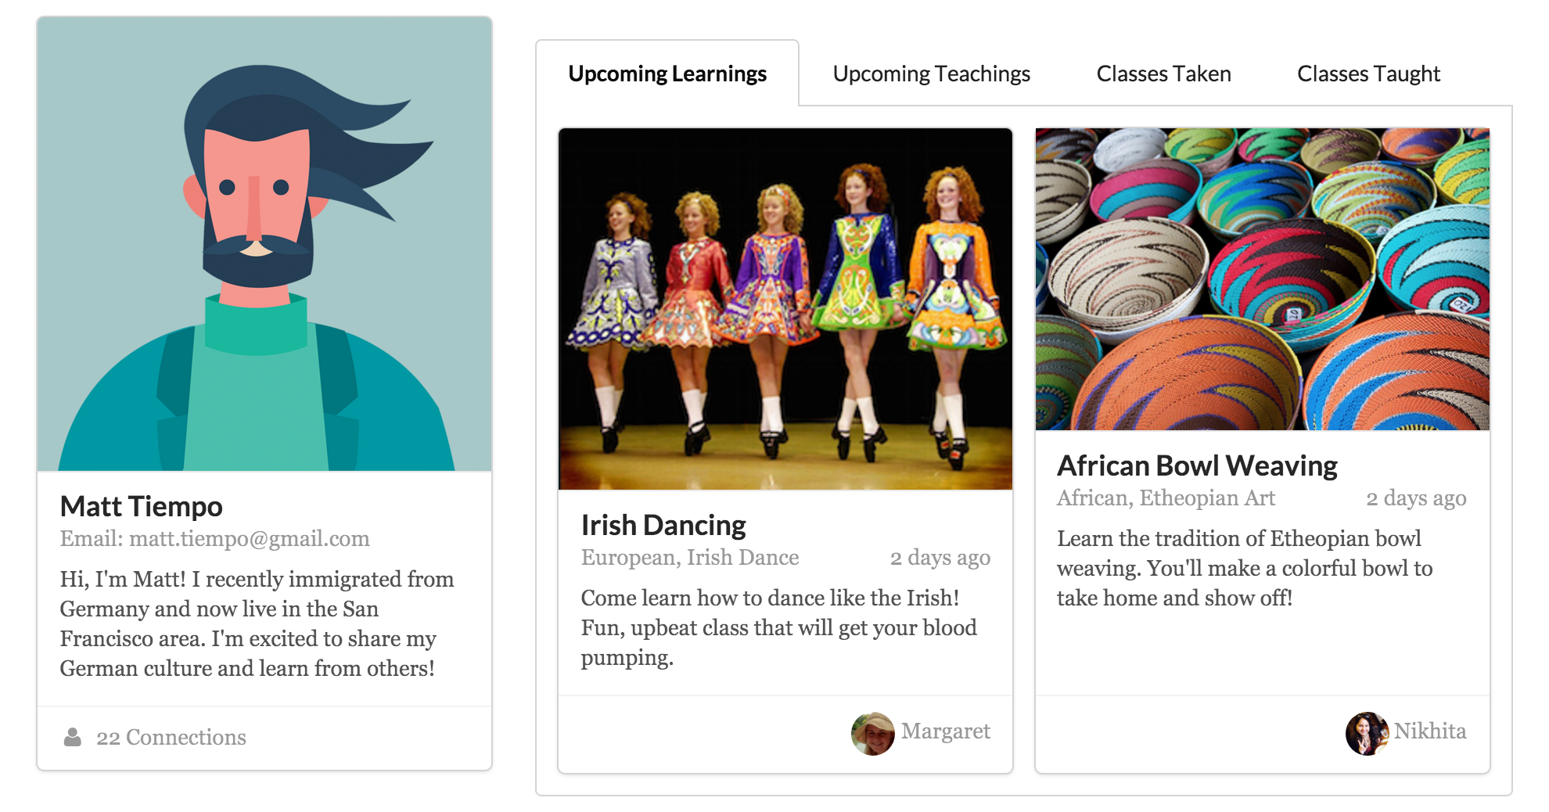
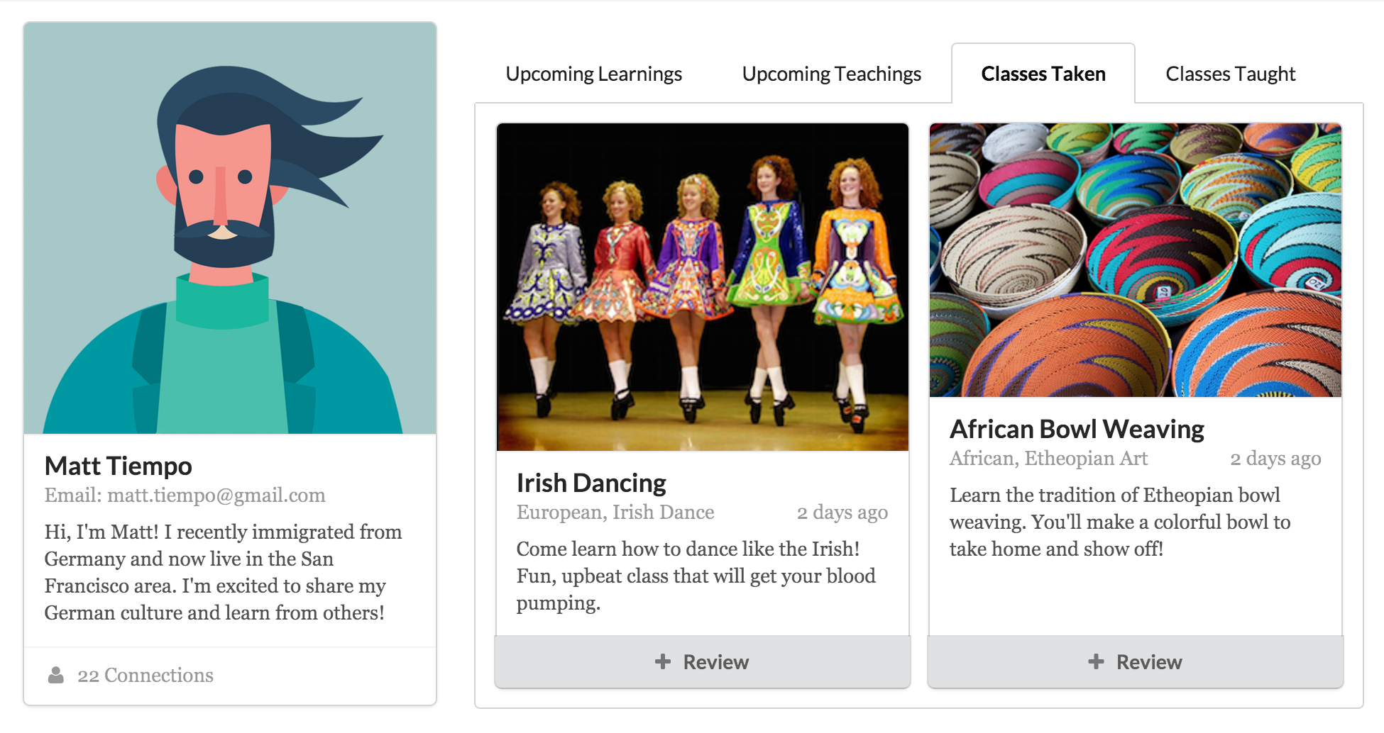
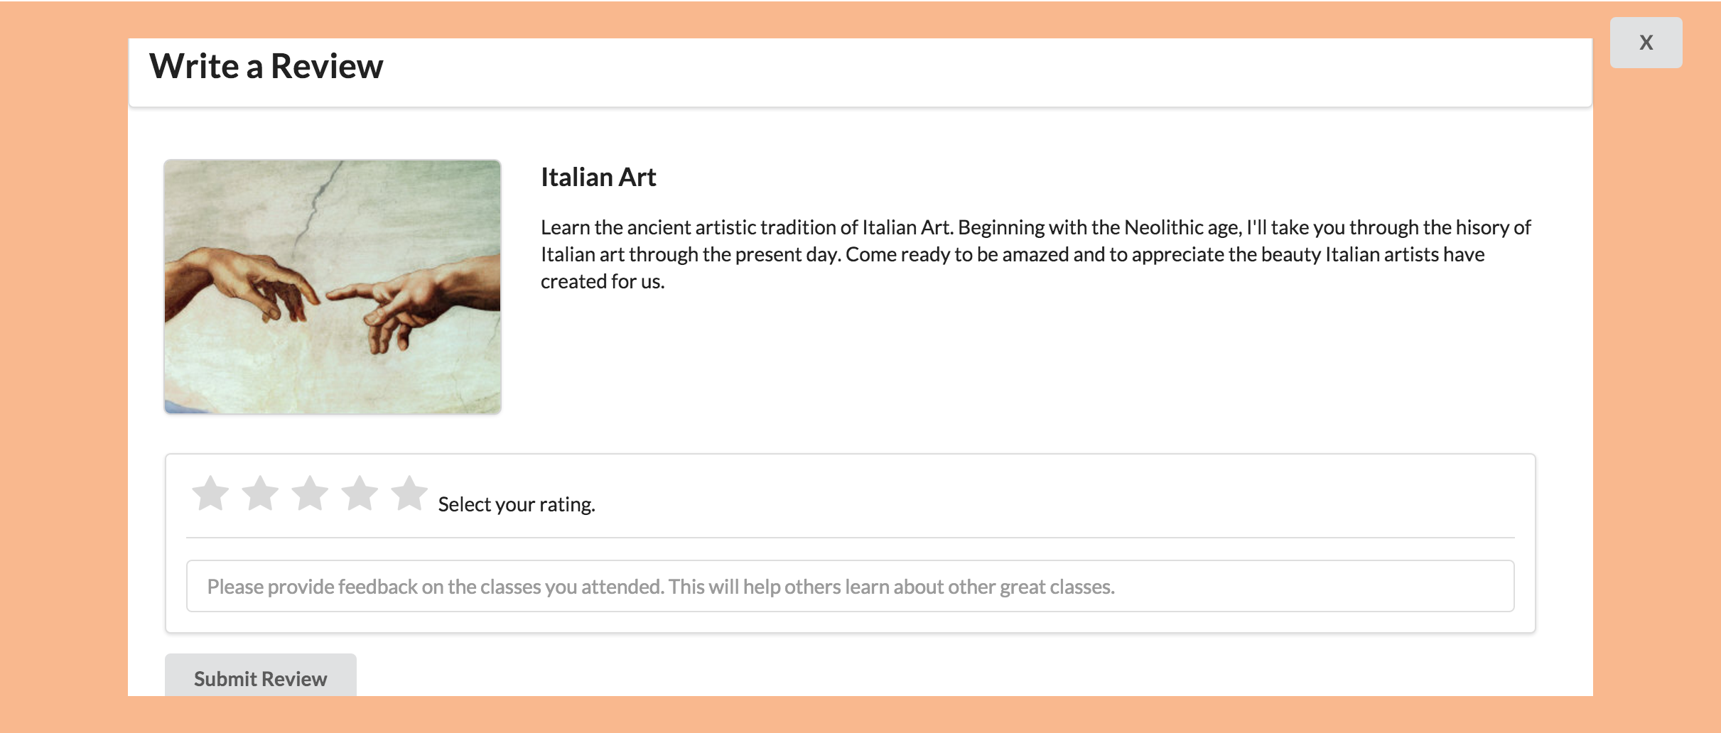
Moderate Task - Review
Task Description:
Check out the class you signed up for and write a review for a class you’ve taken
What we looked for:
User is able to navigate their profile page and then the classes taken tab and then the review system

Slide 20


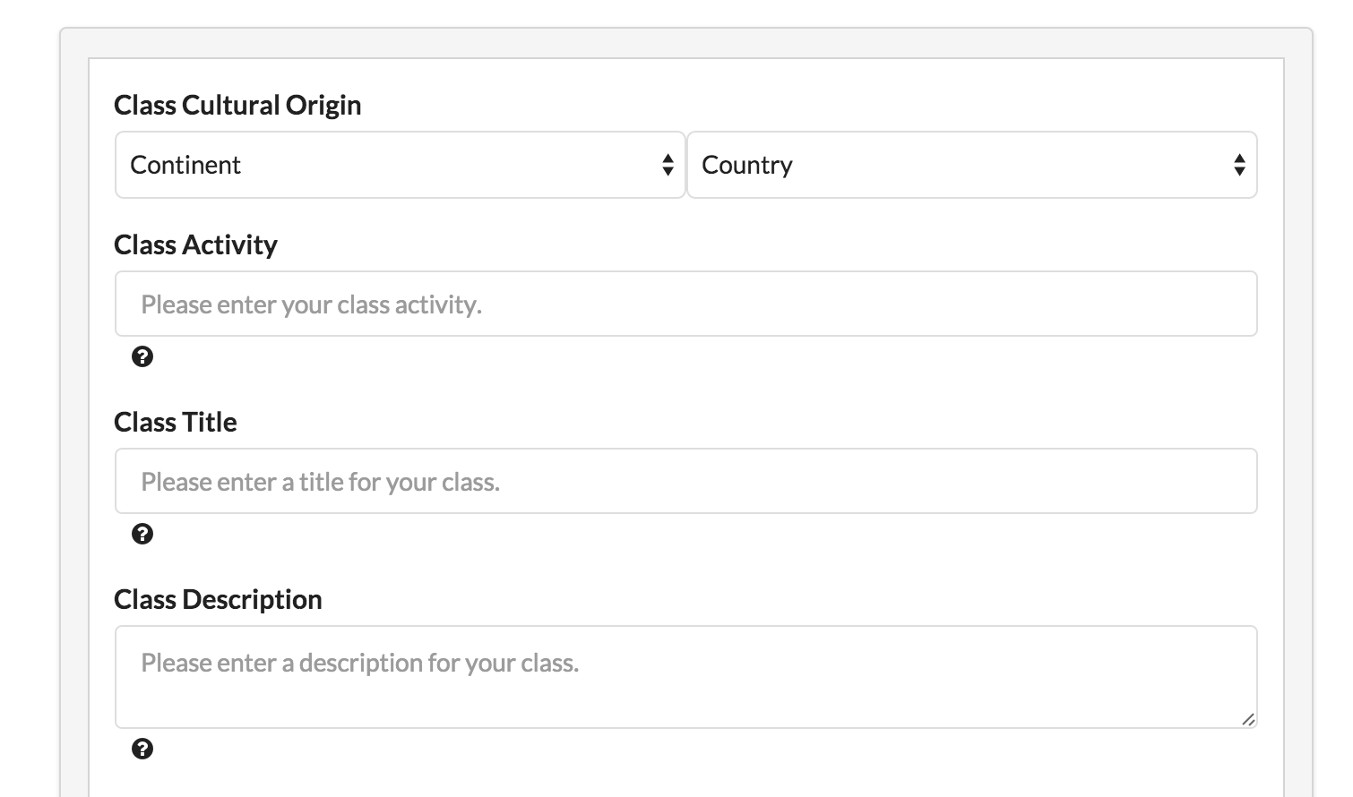
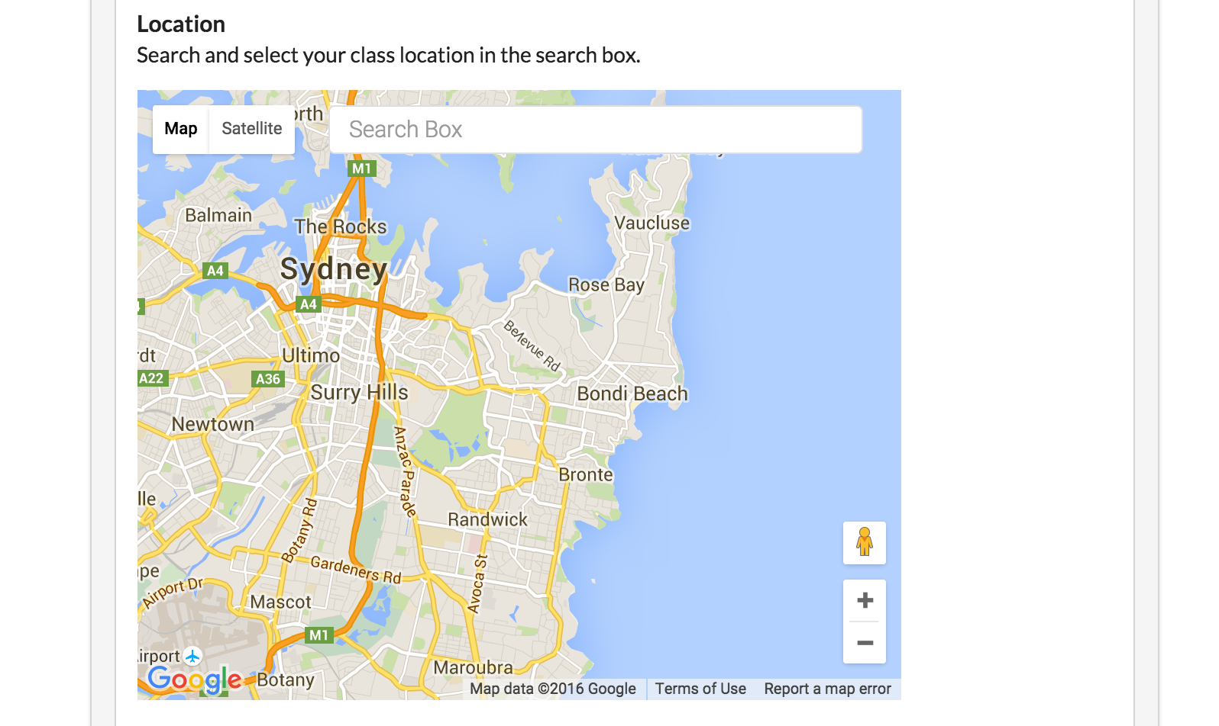
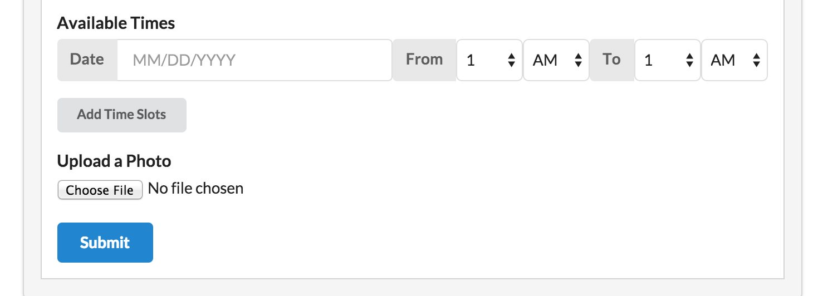
Complex Task - Teach
Task Description:
Create a class to teach about a topic from your home culture.
What we looked for:
User is able to correctly create a class to teach - fill in all information, select a location, and add times.
Notes:
other major site functionality

Slide 21
Procedure
Pre-screening
Project Introduction
Sign Consent Form
Ask user to perform each of the 3 tasks
Post-test interview
Thank you and wrap-up

Slide 22
Test Measures

Slide 23
Test Measures
Quantitative
  Task Success Rate
  Time required to complete a task
  Clicks
Qualitative
  User’s perspective on how difficult a task is before and after the task (on a scale of 1-5, 1 being very easy, and 5 being very hard)
  Usability problems (observation + post-test interview)
  User’s perspective on the warmth/professionalism of our website.
  User’s feedback on the UI/feel of the website - 3 adjectives

Slide 24
Results

Slide 25
Quantitative Results
Task Success Rate
Lab Usability Study
User | Success Rate
001 | 3/3
002 | 2/3
003 | 3/3
Field Usability Study
User | Success Rate
001 | 3/3
002 | 3/3
003 | 3/3
004 | 3/3
005 | 3/3
006 | 3/3

Slide 26
Quantitative Results
Task Completion Time / Clicks
Field Usability Study
User | Task 1 (5 - 11 clicks needed) | Task 2 (5-6 clicks needed) | Task 3 (21 - 22 clicks needed)
001 | 1 min 48 secs / 26 clicks | 45 secs / 11 clicks | 2 mins 35 secs / 30 clicks
002 | 32 secs / 6 clicks | 2 mins 06 secs / 32 clicks | 1 min 21 secs / 25 clicks
003 | 1 min 30 secs / 23 clicks | 1 min 18 secs / 6 clicks | 3 min 20 secs / 34 clicks
004 | 2 mins 55 secs / 9 clicks | 1 min 9 secs / 10 clicks | 5 mins 16 secs / 36 clicks
005 | 1 min 56 secs / 27 clicks | 1 min 33 secs / 6 clicks | 1 min 44 secs / 27 clicks
006 | 1 min 14 secs / 15 clicks | 42 secs/ 5 clicks | 1 min 53 secs / 21 clicks
Notes:
added clicks needed for reference -
for task 1 - 5 clicks if you pick from recommendations, 11 if you use all the search parameters)
for task 2 - 5 if you just star, 6 if you actually write a review
for task 3 - 21 if you don’t add a picture and only do one time slot (can get even lower if you do am classes), 22 if you add a picture

Slide 27
Qualitative Results
Test / Task Difficulty
Field Usability Study
 | Task 1 |  | Task 2 |  | Task 3
User | Pre-task | Post-task | Pre-task | Post-task | Pre-task | Post-task
001 | 1.5 | 3 | 1 | 1 | 2 | 3
002 | 2 | 1 | 2 | 5 | 2.5 | 1
003 | 1 | 1 | 2 | 1 | 3 | 2
004 | 1 | 2.5 | 2 | 3 | 4.5 | 2.5
005 | 2 | 2 | 3 | 2 | 4 | 2
006 | 1 | 1 | 2 | 1 | 3 | 2
Notes:
Many more tasks were easier than expected

Slide 28
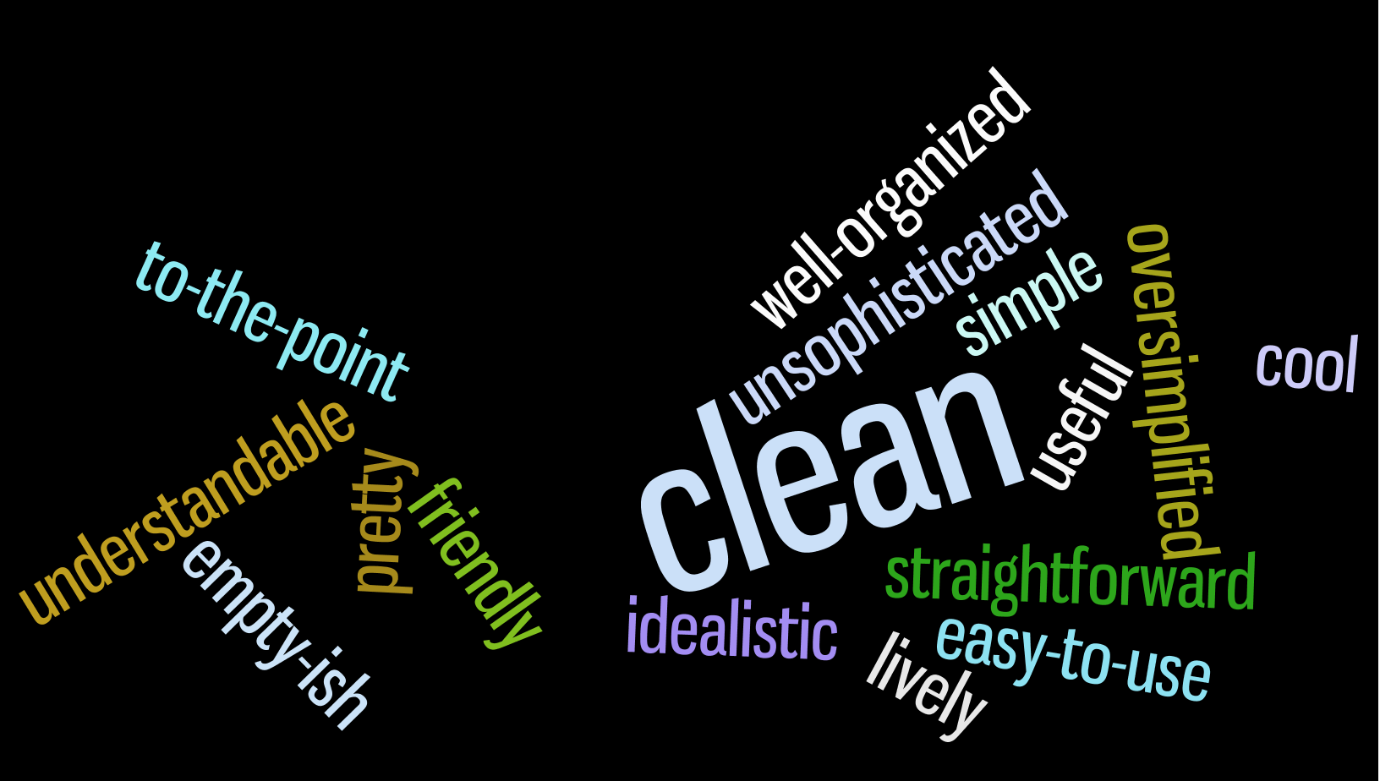
Qualitative Results
Usability Problems
  Wasn’t clear what the photo was of when creating a class
  Confused by “class activity” field when creating a class
  Doesn’t know which fields in the create class form are required
  Missing parameters and displays: class size, fee, ratings
  Class “sign up” button hard to find
  Confusion with Google Maps usage
Professionalism: Professional
Warmth: Neutral - Very Warm
Notes:
some said really like it, clean and airbnb ish
others wanted more color and said too much white space

Slide 29
Discussion

Slide 30
Changes for the “real experiment”
Allow the user to click around on their own before the test - similar to how upon downloading a new app, we might “take a tour” ourselves to explore features
Construct a test to see if users realize the fullness of the searching functionality - all of them used all three parameters to search
Test more non-central functionality such as setting up your profile page, viewing other people’s profiles, and as a teacher, managing your classes and communicating over the site
Test on mobile devices (once the site is responsive)
More specific and targeted questions to address uniformity/aesthetics
Notes:
reasoning:
you feel more in tune when the site when you explore yourself rather than someone showing you
unclear now if users understand the full functionality
there could also be usability issues here that we aren’t seeing because they aren’t in our core functionality
many people in general and also newcomers will do a lot on their mobile devices

Slide 31
Interface Changes
Result: sign up button hard to find on class description page
Change: Make our call to action (“sign up”, “submit” buttons) different colors and put them in more visible locations
Result: “Empty-ish”, “a lot of white space”, “could have more eye catching elements” Change: Add more pictures from previous classes on the teach page, home page and possibly profile page. Also consider adding another highlight color
Result: General confusion on teach page
Change: Make class type field a dropdown. More descriptive text for photo. Add a visual cue when a location is selected

Slide 32
Running the Experiment In Situ
Advantages
  User felt comfortable since our setting was on their home turf where they are used to browsing on their computers
Disadvantages
  Does not recreate the actual need/incentive to use the website

Slide 33
Summary

