Slide 1
POVs and Experience Prototypes
Team Members:
Bronson Duran, Melissa Du,
David Albán Hidalgo, Kevin Khieu

Slide 2

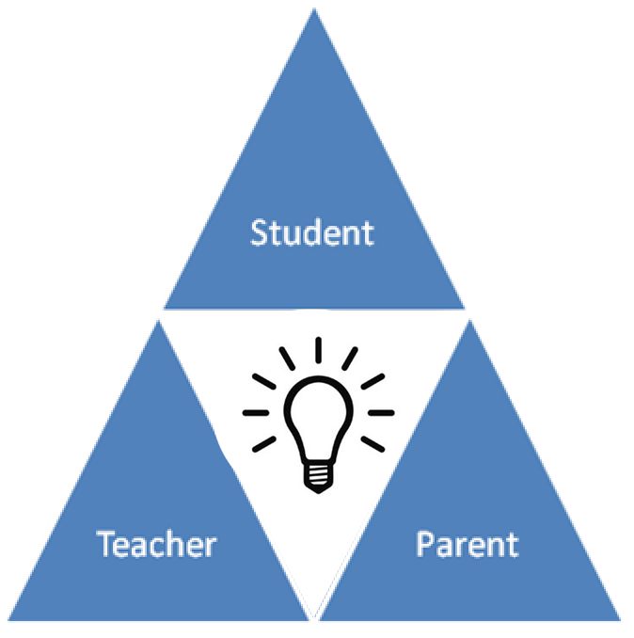


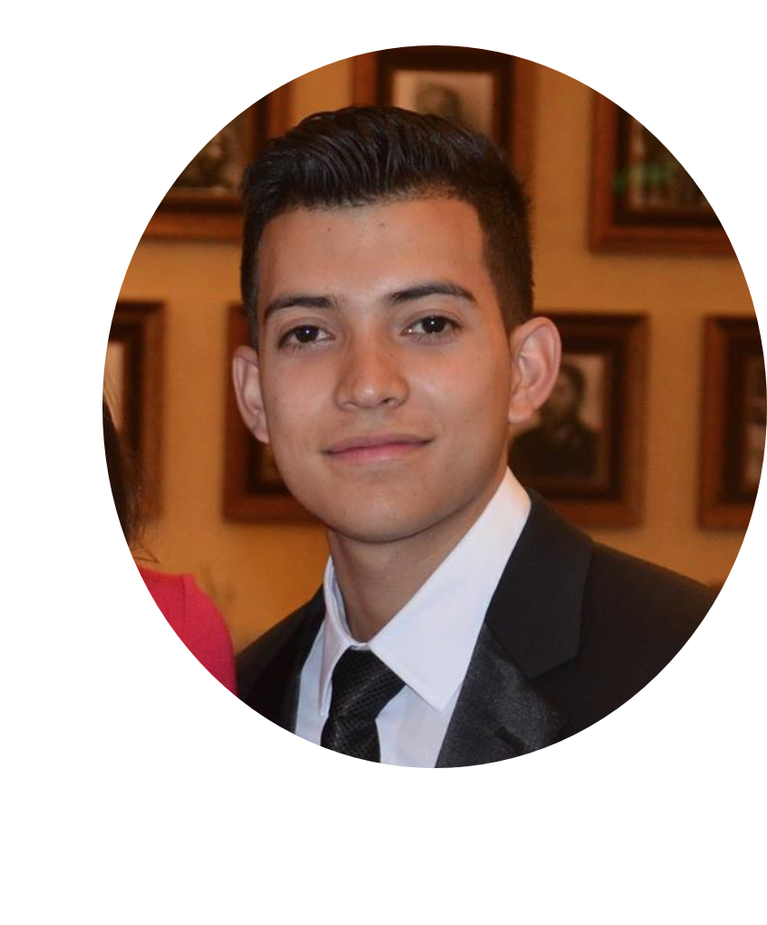
Our Team
Kevin
David
Melissa
Bronson
Notes:
Introduce Team Members
Explain our goal and the problem we are trying to target.
“We are targeting student engagement during the early years of education, specifically relating to the circle of communication between Student, Parents, and Educators

Slide 3


Initial Point of View
“We met… Kyle, a senior year student in Stanford’s STEP Program.
We were amazed to realize… that there were very little incentives for people to become teachers
It would be game-changing… if we could provide a stronger support framework for teachers.”

Slide 4

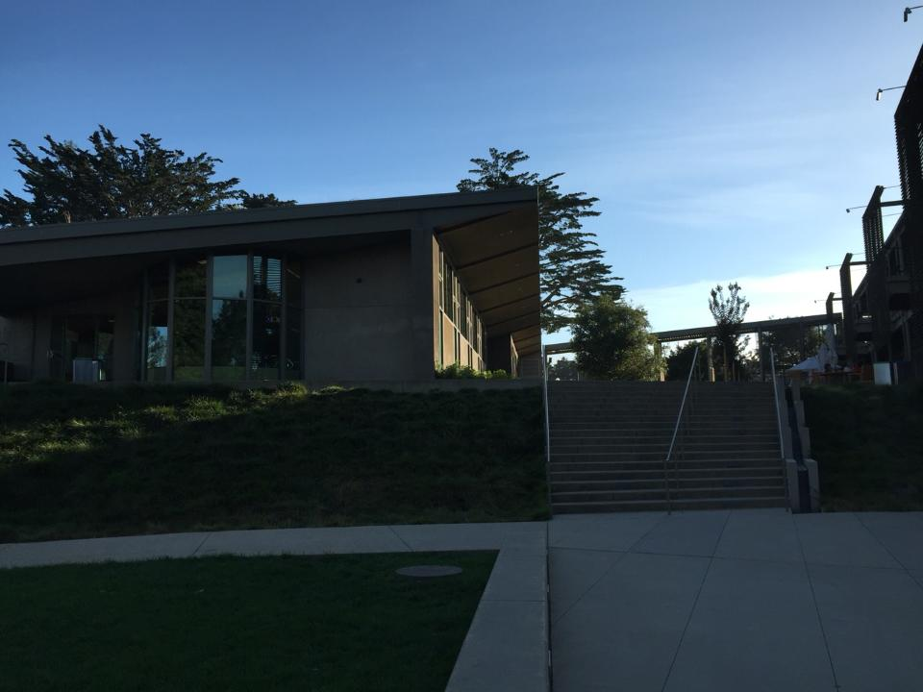
Needfinding - Interviews
Feedback:
More from parents/educators
Focus on specific age ranges
Additional Interviews:
Bing Nursery Teacher/Parent
PTA Pres. of Nueva School
Retired Teacher (35+ years)
Kindergarten Teacher (20+ years)

Slide 5
Needfinding - Results
”A big issue may come up with one of the kids...That information needs to be shared between teachers immediately and effectively”
“..how do I [parent] approach this teacher?”
“He never used to get bored, and now he was asking me: “tell me what to do”.
Teacher to Teacher Communication
Parent-Teacher Communication
Student Creativity

Slide 6

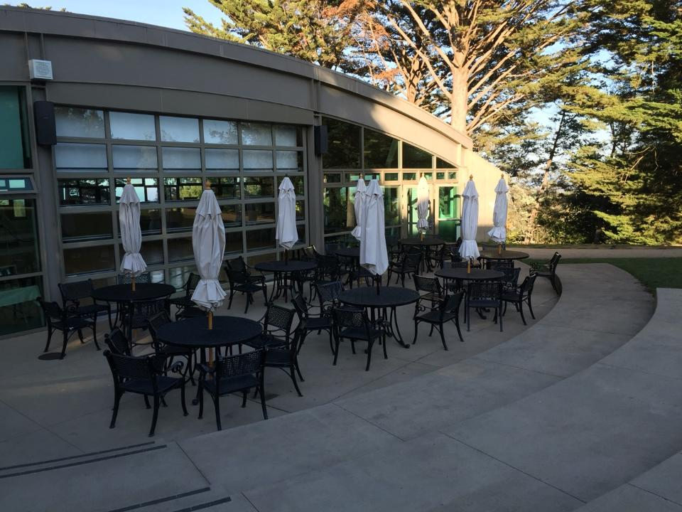
Revised POVs - Parent Involvement
“We met… Sun, the President of Nueva School District’s PTA
We were amazed to realize… that there is a severe communication gap between parents and teachers
It would be game-changing… to give parents and teachers a way in which they can communicate effectively and without added stress”

Slide 7
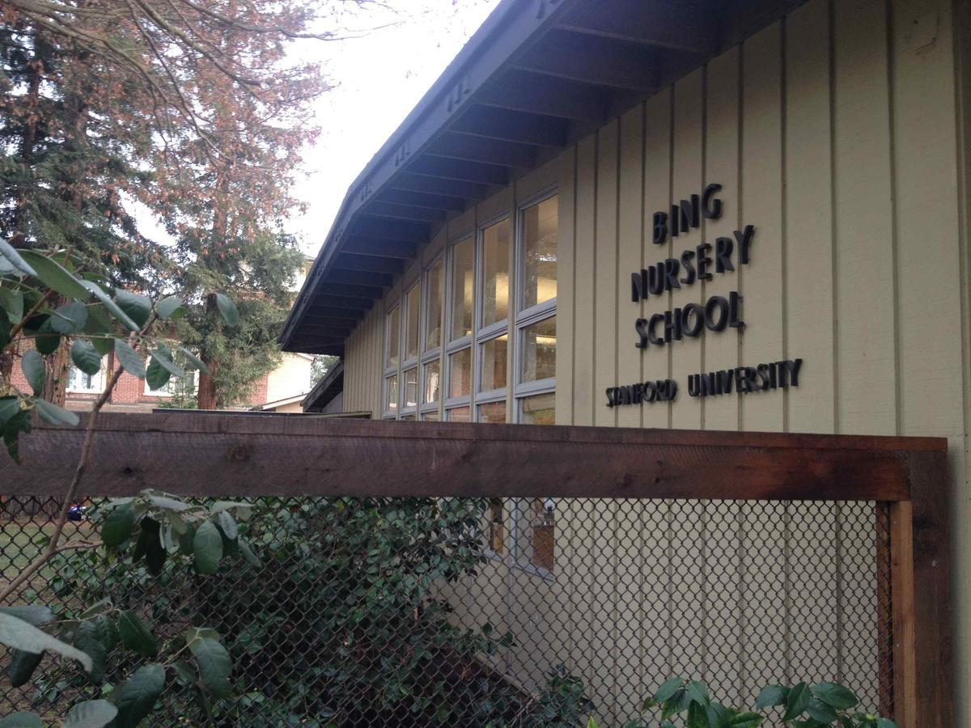
Revised POVs - Teacher Support
We met… Adrienne, a Bing Nursery School Teacher
We were amazed to realize… how much information about child development currently is lost
It would be game-changing… to give teachers a way to rapidly document and share information between themselves in order to ease and better the process of creating parent reports.

Slide 8
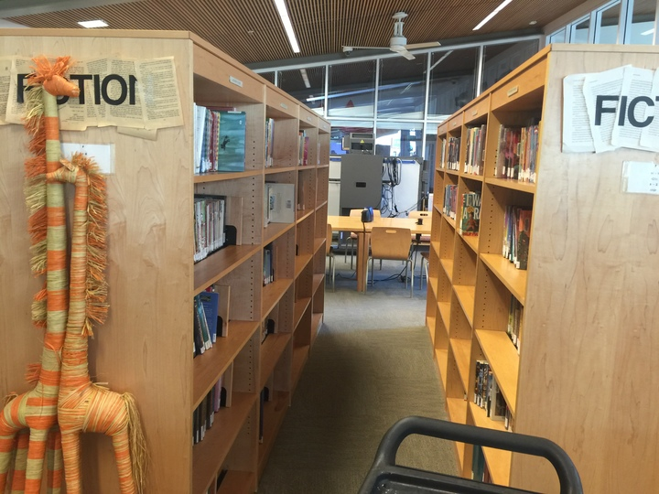
Revised POV - Student Creativity
We met… Adrienne, a parent to one 6-year-old son
We were amazed to realize… that focusing on the process of learning allows students to empower themselves and be more creative
It would be game-changing… to devise a solution that helps kids learn and encourages creativity

Slide 9
Parental Involvement → HMW?
How might we cultivate the mindset that the educational experience is everywhere, not just in the classroom?

Slide 10
Teacher Support → HMW?
How might we centralize all information gathered to make student growth data recollection easier?

Slide 11
Student Creativity → HMW?
How might we give students the power to choose how they learn the set curriculum?

Slide 12
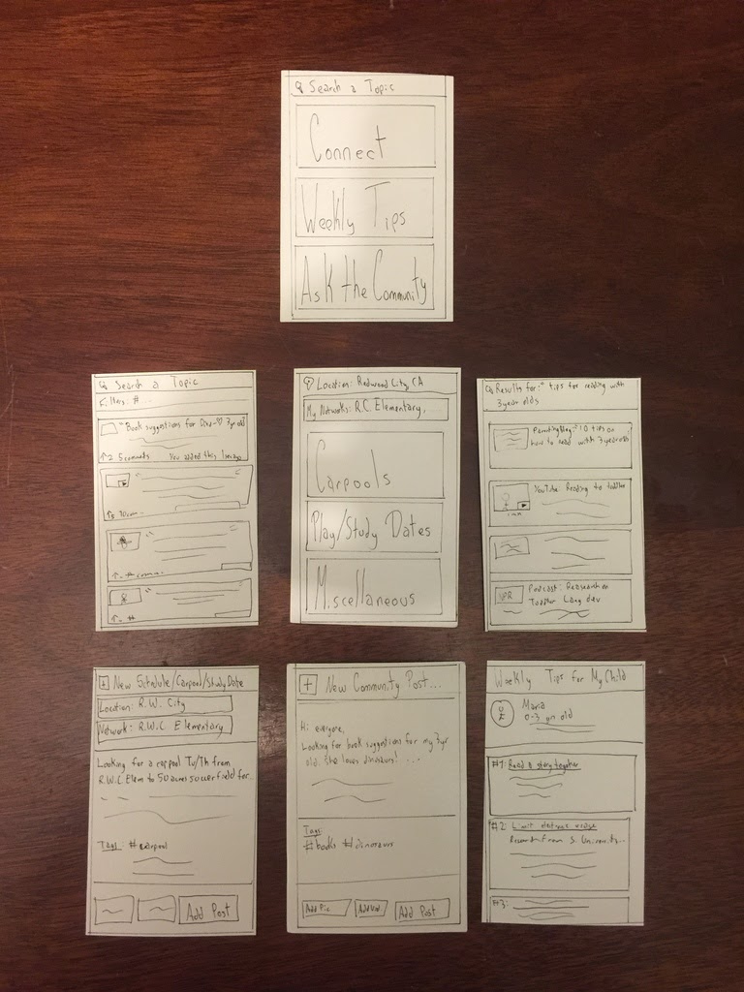
Exp. Prototype - Parent Involvement
Prototype → Hardstock mockups
Worked → Idea!
Parents identified with the need of resources this attempted to fill
!(Worked) → Implementation?
Crowdsource vs. privacy
Surprises → Privacy Issues
New Ideas → Curated content vs. Crowd

Slide 13
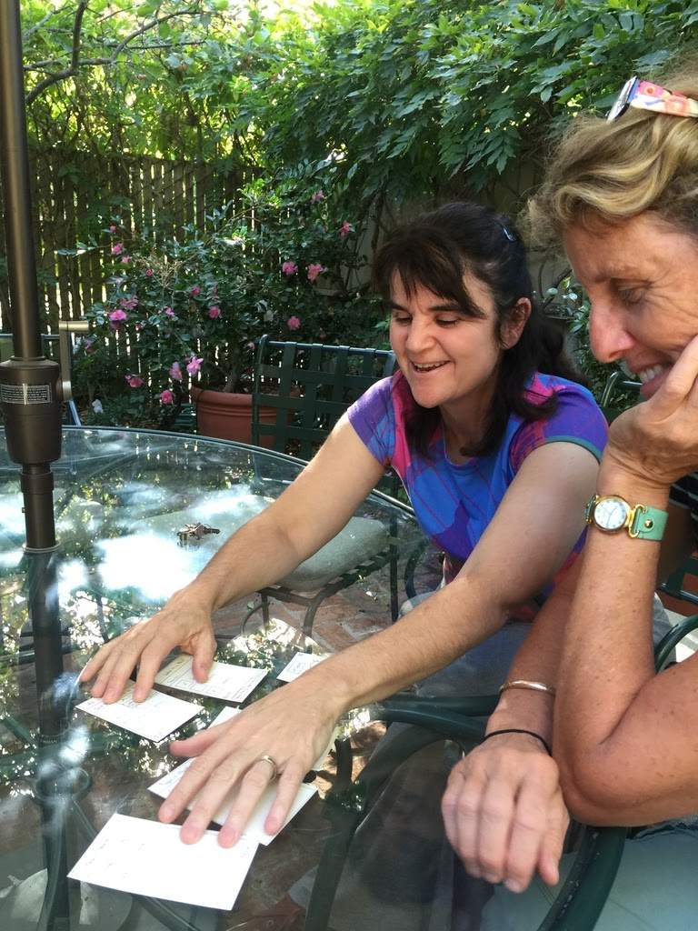
Exp. Prototype - Teacher Support
Prototype → Hardstock mockups
Worked → Intuitive and useful
Teachers found value in being able to attach snapshots to individual kids
!(Worked)→ Storage/Display?
Organization of snapshots
Surprises → Teachers know they sometimes pay more attention to some
New Ideas → Way to track quantity/student

Slide 14
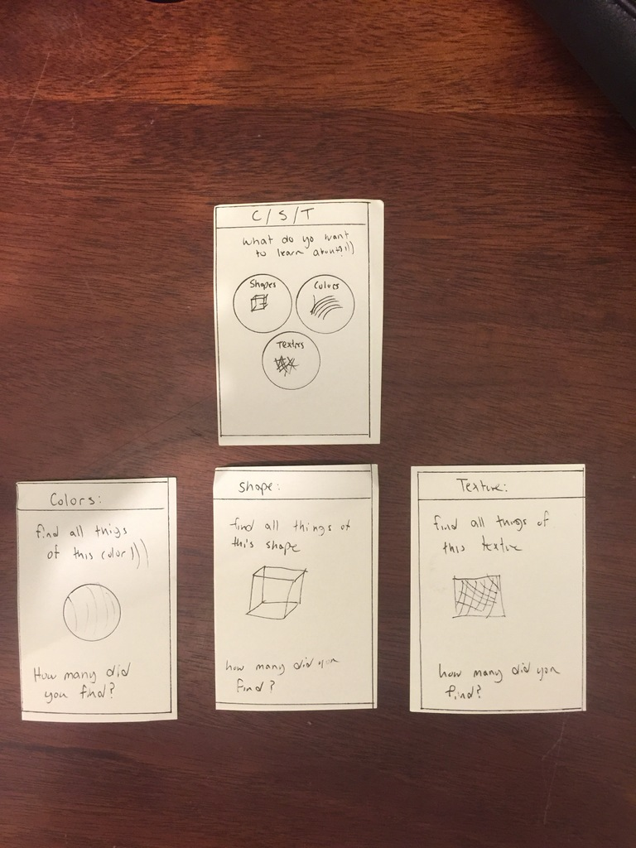
Exp. Prototype - Student Creativity
Prototype → Hardstock mockups
Worked → ”Process” idea
Experiential learning provides an engaging curriculum
!(Worked)→ Constraints
Young kids and set curriculum
Surprises → Designing for kids is hard
New Ideas → Kids take pics of process for classroom

Slide 15
Summary
Prototypes
Mixed Reception of Ideas
New Ideas/Problem Areas
Consolidate into 1?
Further Testing
Craft a storyboard for
whatever path we end up
choosing

