Slide 1
Needfinding: Education Studio
Team Members: Bronson Duran, Melissa Du, David Albán Hidalgo, Kevin Khieu

Slide 2

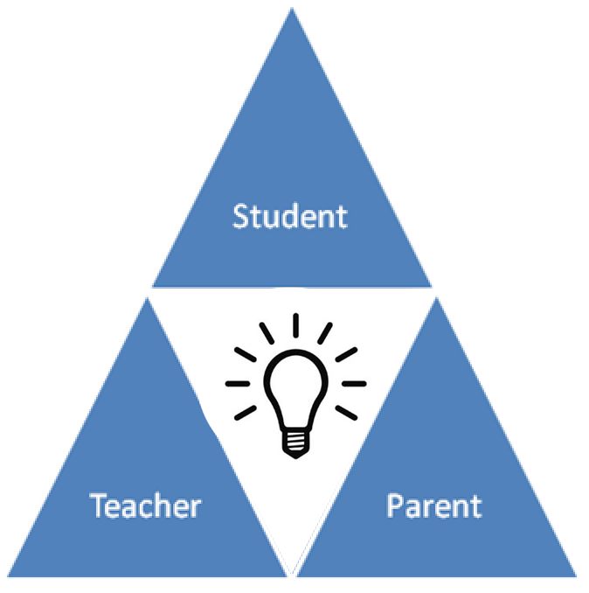



Our Team
Kevin
Davíd
Melissa
Bronson
Notes:
Introduce Team Members
Explain our goal and the problem we are trying to target.
“We are targeting student engagement during the early years of education, specifically relating to the circle of communication between Student, Parents, and Educators

Slide 3




Needfinding Methodologies - Participants
2 Students
3 Educators
2 Parents
Notes:
Participants
2 Students
3 Educators
2 Parents
Recruited our participants based on how representative they were of the different aspects of the problem we are trying to solve (the Student-Teacher-Parent relation)

Slide 4

Needfinding Methodologies - Parents
Who:
Two Parents - Late Thirties - Working full time - Have kids ages 3 and 6
Why:
Very representative of users in target domain.
How:
They are my cousins. :)
Where:
Their house in Union City
What’s their Involvement in kids’ education?
What’s their relationship with the teacher like?
What are the Difficulties involved in raising two young kids?
What do you like/dislike about the current system?
Notes:
Who:
Two Parents - Late Thirties - Working full time - Have kids ages 3 and 6
Why:
Very representative of users in target domain.
How:
They are my cousins. :)
Where:
Their house in Union City
What’s their Involvement in kids’ education?
What’s their relationship with the teacher like?
What are the Difficulties involved in raising two young kids?
What do you like/dislike about the current system?

Slide 5

Needfinding Methodologies - Students
Who:
11th grade HS student A Stanford Senior Econ Major
Why:
Needed Student perspective on teacher/parent influences
How:
Kevin’s cousin, Melissa’s friend
Where:
On Campus
What role did Technology play in learning?
How did your parents affect your schooling?
What was your relationship like with your teachers?
Notes:
Who:
11th grade HS student A Stanford Senior Econ Major
Why:
Needed Student perspective on teacher/parent influences
How:
Kevin’s cousin, Melissa’s friend
Where:
On Campus
What role did Technology play in learning?
How did your parents affect your schooling?
What was your relationship like with your teachers?

Slide 6

Needfinding Methodologies - Educators
Who:
Learning specialist - PhD Candidate - STEP program member
Why:
Insight into current education system. How students learn.
How:
Advisors/Friends
Where:
The Stanford OAE - School of Education
What difficult about fostering kids’ curiosity?
What are some strategies to keep kids engaged in class?
How is parent-teacher communication currently handled?
What are some problems with the education system?
Notes:
Who:
Learning specialist - PhD Candidate - STEP program member
Why:
Insight into current education system. How students learn.
How:
Advisors/Friends
Where:
The Stanford OAE - School of Education
What difficult about fostering kids’ curiosity?
What are some strategies to keep kids engaged in class?
How is parent-teacher communication currently handled?
What are some problems with the education system?

Slide 7
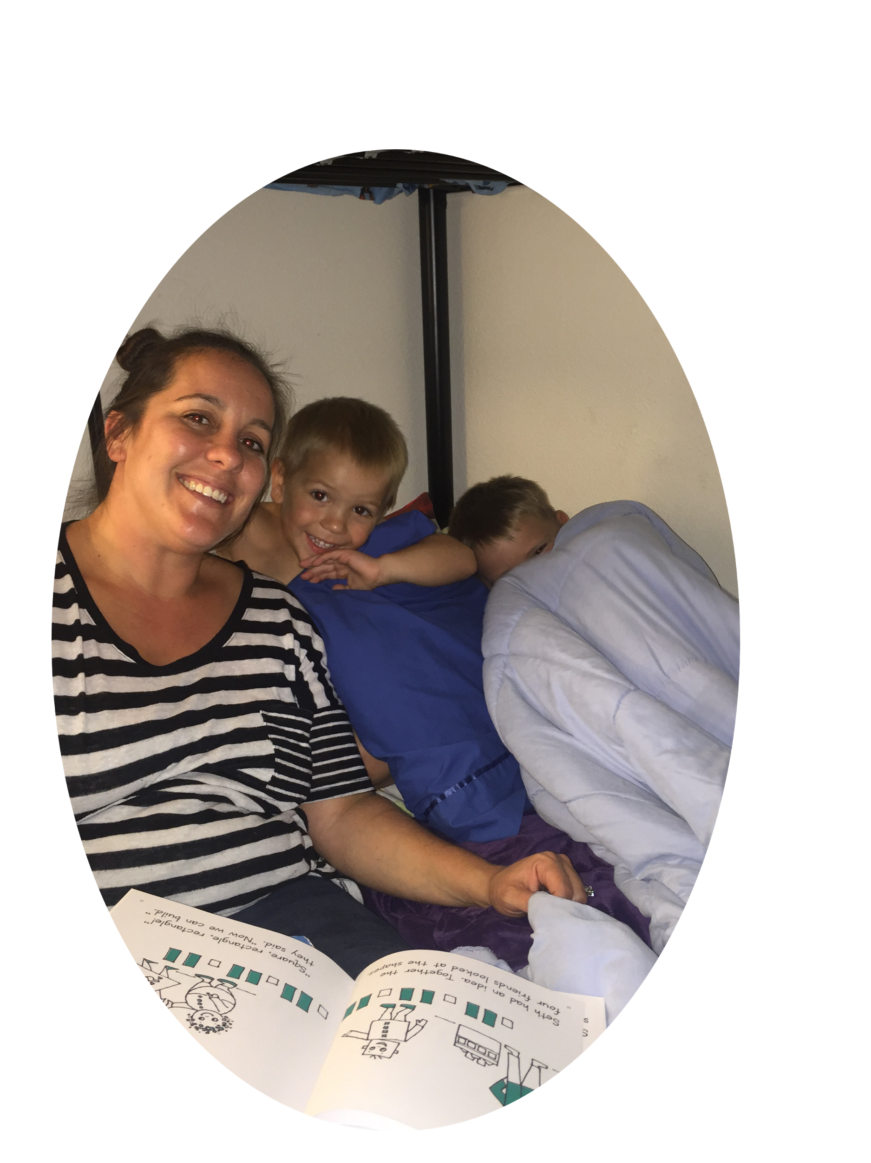
Interview - Parents
“We would love to be more involved with our child’s education”
“Time is a major issue for us”
“You can have a really great teacher, but if the families aren’t doing anything on their end, it doesn’t mean anything”
Parents want involvement, but lack the time and means.
Not all parents are aware of the huge role they play.
Notes:
“We would love to be more involved with our child’s education”
“Time is a major issue for us”
“You can have a really great teacher, but if the families aren’t doing anything on their end, it doesn’t mean anything”
Parents want involvement, but lack the time and means.
Not all parents are aware of the huge role they play.

Slide 8
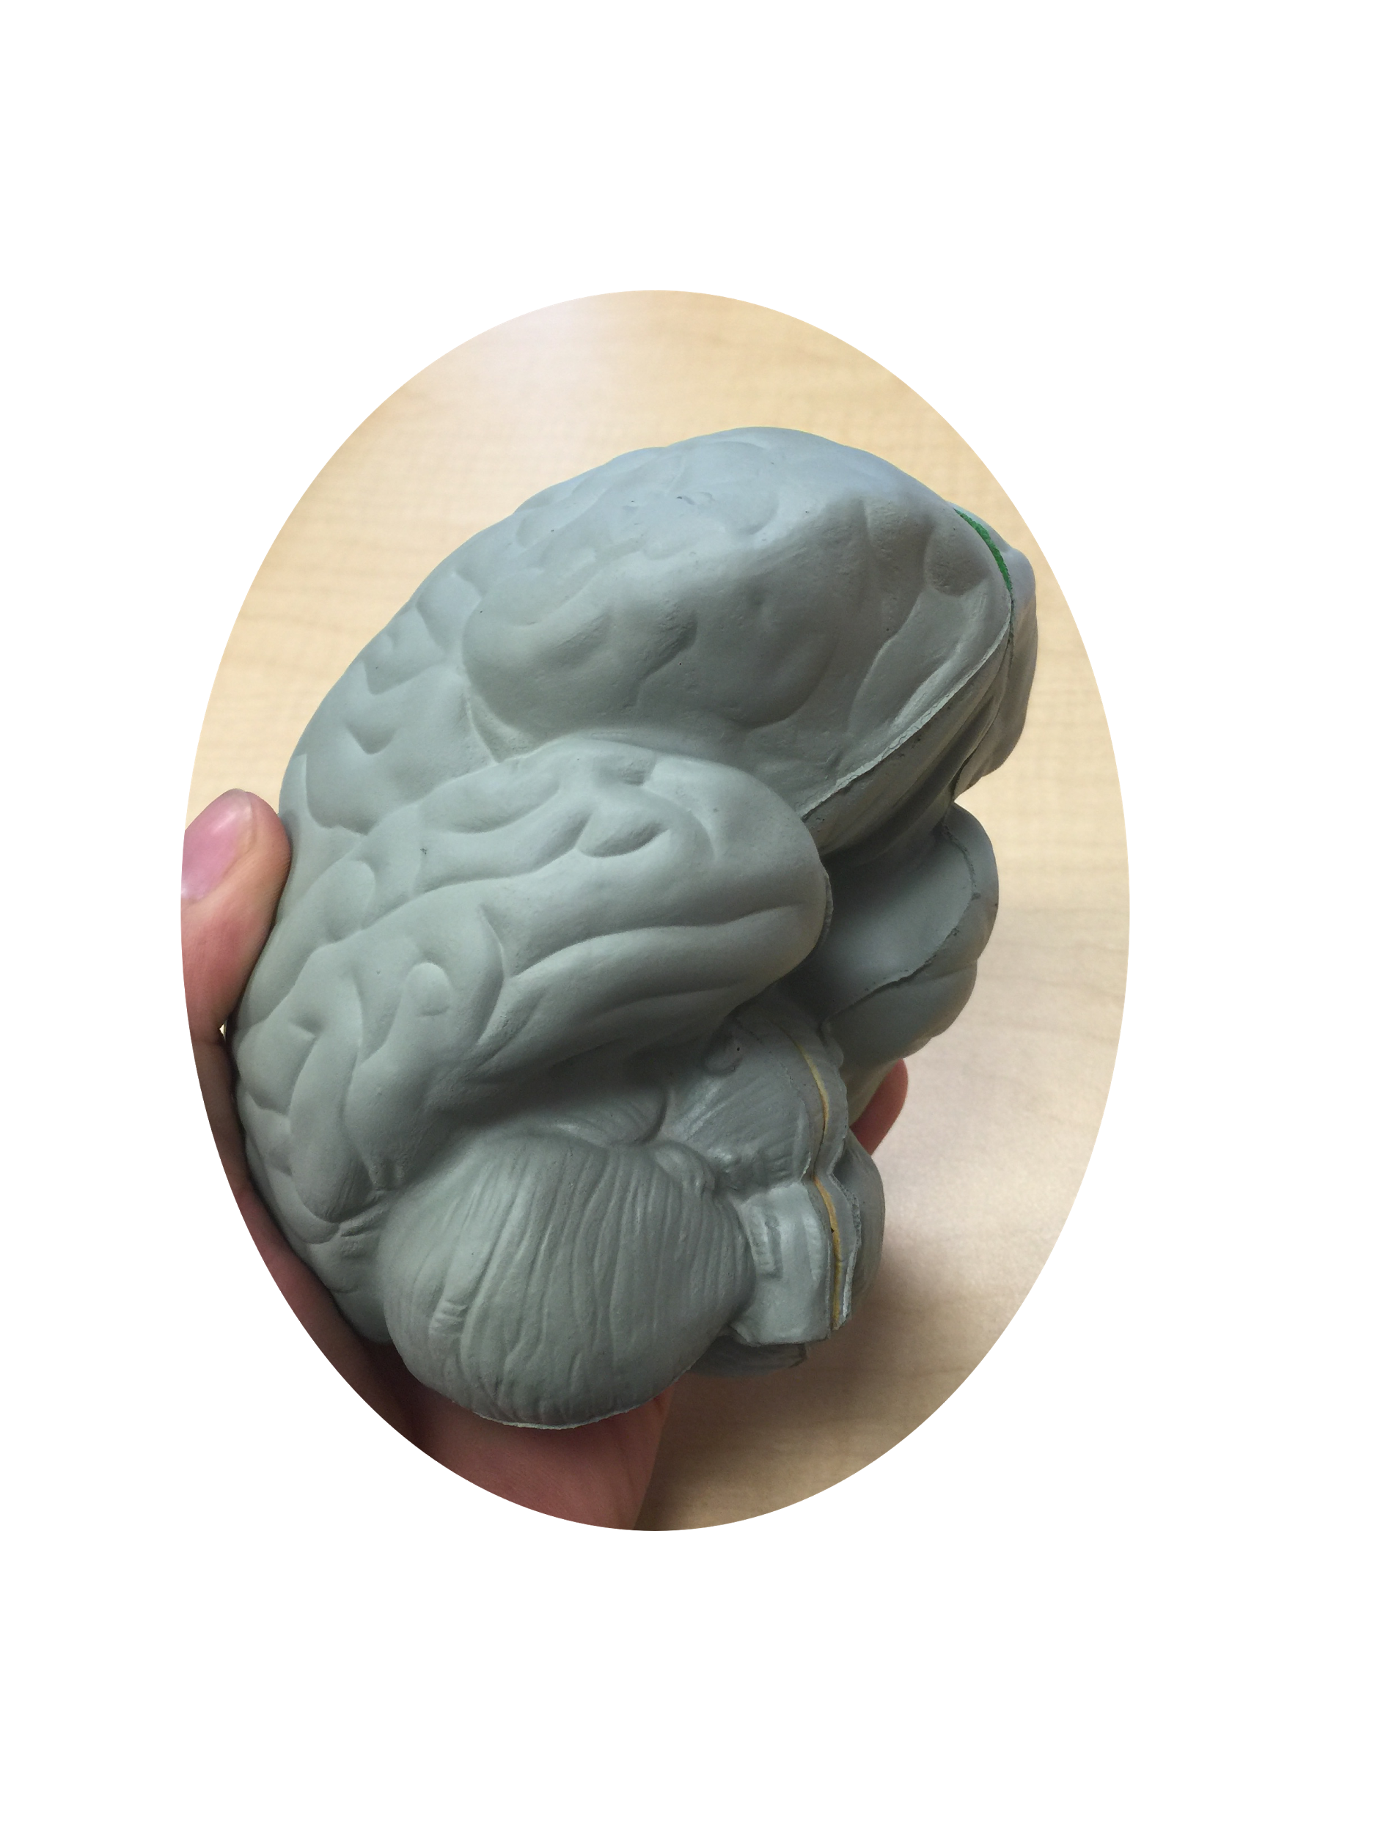
Interview - Students
Parents are crucial in pushing kids to become engaged in education early in their lives.
“My parents were an integral supplemental aid towards my education.”
“I wish all of my classes were online so that I could review the information outside of class.”
There’s a lack of accessibility to both the teacher and material
Notes:
“My parents were an integral supplemental aid towards my education.”
“I wish all of my classes were online so that I could review the information outside of class.”
Parents are crucial in pushing kids to become engaged in education early in their lives.
There’s a lack of accessibility to both the teacher and material

Slide 9
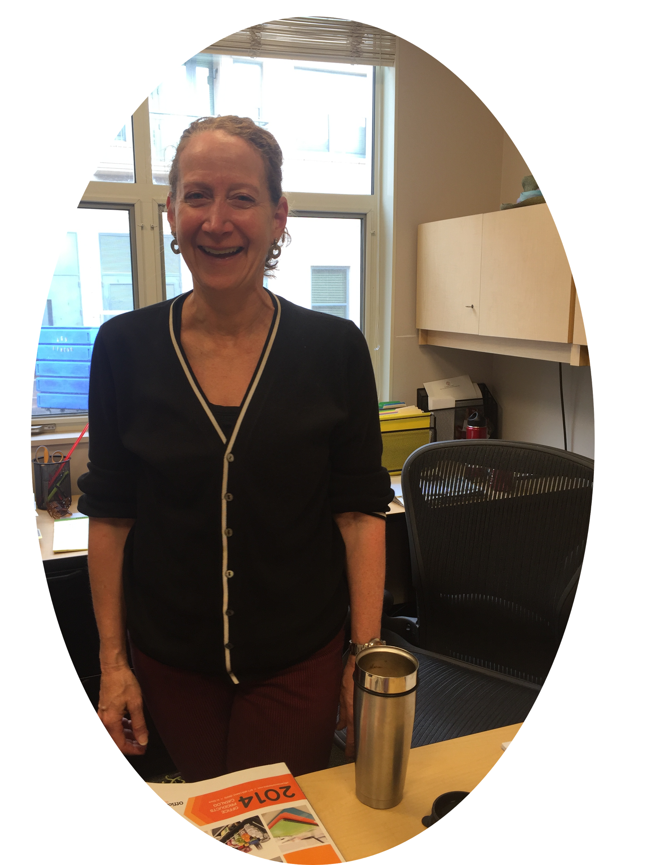
Interview - Educators
”The real way to engage kids from a really young age is experiential learning, not sitting, but doing”
“As a teacher, it’s basically sink or swim”
”Education is not about leveling the playing field because we value certain skills above others”
Empower students to be invested in their own education.
Teachers don’t have many avenues of support.
Ironically, a fixed intelligence mindset is promoted by current system
Notes:
The three quotes in the slide map to these 3 ideas: Empower students: -”Give students an aspect of control over their learning” ..“If you managed to kill a child’s curiosity by the time they reached high school, you really [messed] up”
Give support to teachers/educators: “sink or swim” as teachers. Teachers receive little to no support “...if you have an unprepared teacher, you have….catastrophic but less quantifiable consequences”
What values do we have culturally over what students need in school: “I want to help people become better fucking human beings”
”The real way to engage kids from a really young age is experiential learning, not sitting, but doing”
“As a teacher, it’s basically sink or swim”
”Education is not about leveling the playing field because we value certain skills above others”
Empower students to be invested in their own education.
Teachers don’t have many avenues of support..
Ironically, a fixed intelligence mindset is promoted by current system

Slide 10
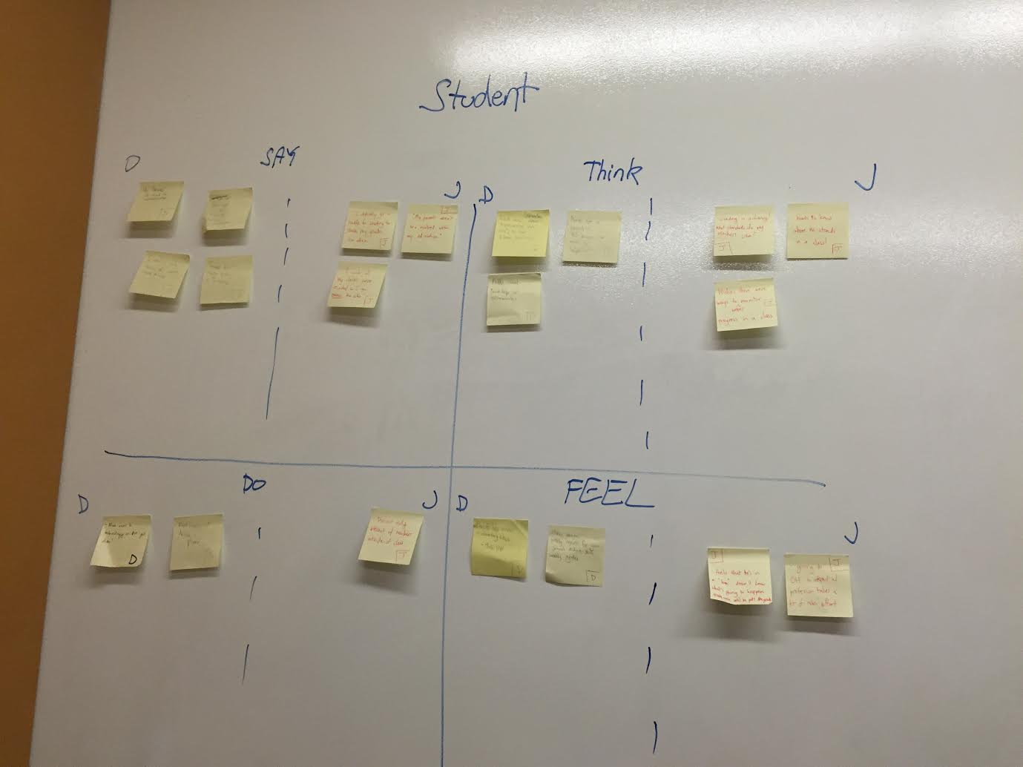
Empathy Map - Students
“My parents weren’t that involved”
“I wish I had a way to track my grades“
“Teachers are slow to reply to emails”
Wishes there was a way to be more involved
Wants to know where he stands
School doesn’t provide extra help
Smiled
Speaks nicely about parents and teachers
Laughs when asked if teachers are accessible
Feels empowered when involvement is allowed
unhappy about current student teacher relations
Dissatisfied with lack of extra resources
Notes:
Younger students benefit from parental involvement.
Parents can only help less as kids get older/more independent.
Technology is only beneficial to an educational experience if it is useful and helpful (it either helps or it doesn’t - no middle ground).
Fostering engagement in education early is important in maintaining it later in life.

Slide 11
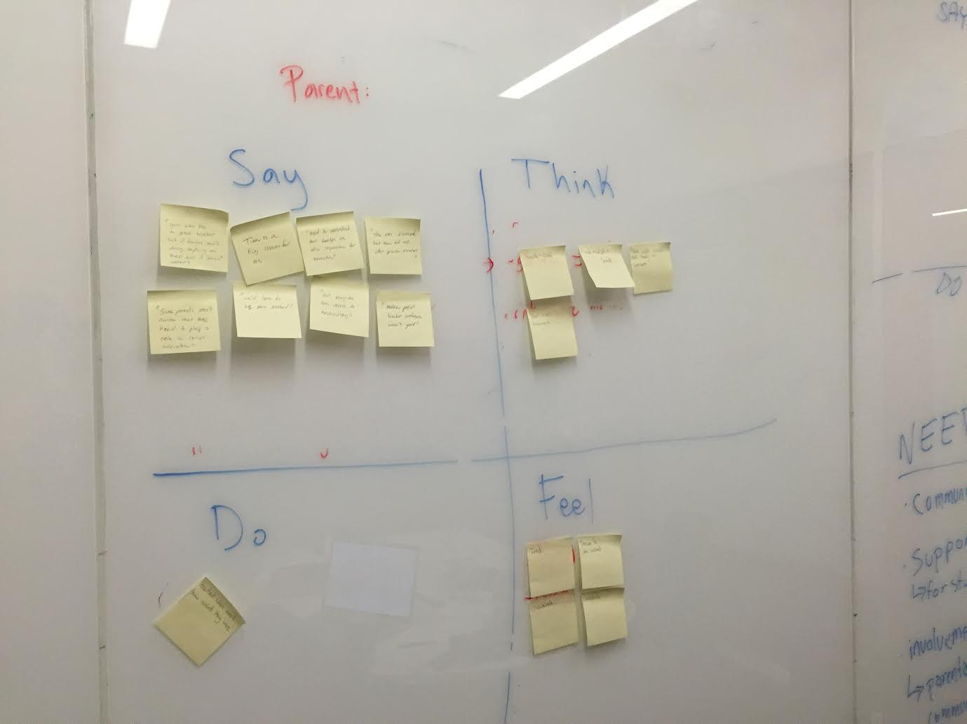
Empathy Map - Parents
“Time is a major issue for us”
“If I had more control or information, I’d be more likely to want be involved“
“A good family understands that they are also responsible for their child’s education”
I should be more involved.
I wish we had more time to be involved.
The current system has probelems.
*Yawn*
Shifted in seats when asked how involved they were
Seemed genuinely concerned about their Kids’ education
Guilty about not having enough time to be involved
unhappy about current parent teacher relations
Stressed about having to deal with work and kids

Slide 12
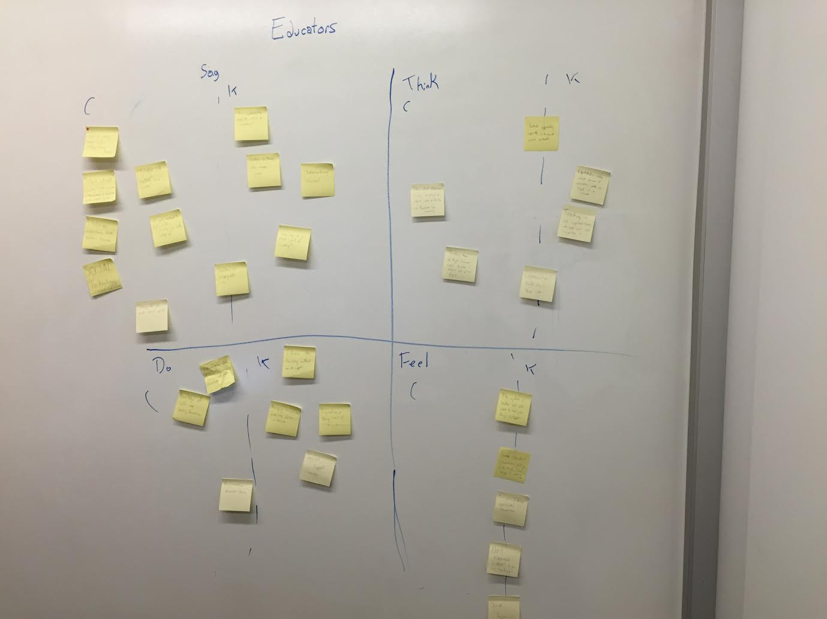
Empathy Map - Educators
“We receive little to no support”
“Education is not about leveling the playing field because we value some skill above others “
“The real way to engage kids is experiential learning,not sitting,
but doing”
Teachers don’t have enough resources
Teaching isn’t prestigious
It’s hard to keep track of kids
Shakes head when asked about current system
Enthusiastic about new teaching methods
Seemed to like their work.
Frustrated with current system
Enthusiastic about new teaching methods
Stressed about low pay and long hours

Slide 13
Empathy Map Analysis
Needs:
Communication
Support
Involvement
Empowerment/Confidence
Curiosity/Engagement
Insights:
Lack of Parent Awareness
School, Ironically, Kills Curiosity
Placing high value on certain skills leads to marginalization of kids.
Major Lack of awareness between Groups
Notes:
Needs:
Communication
Support
Involvement
Empowerment/Confidence
Curiosity/Engagement
Insights:
Lack of Parent Awareness
School, Ironically, Kills Curiosity
Placing high value on certain skills leads to marginalization of kids.
Major Lack of awareness between Groups

Slide 14
Summary
Main Focus
How Data Was obtained
Main needs/Insights: Lack of Awareness, Time, Communication
Further Questions: Would like to speak to more teachers.

