Slide 1
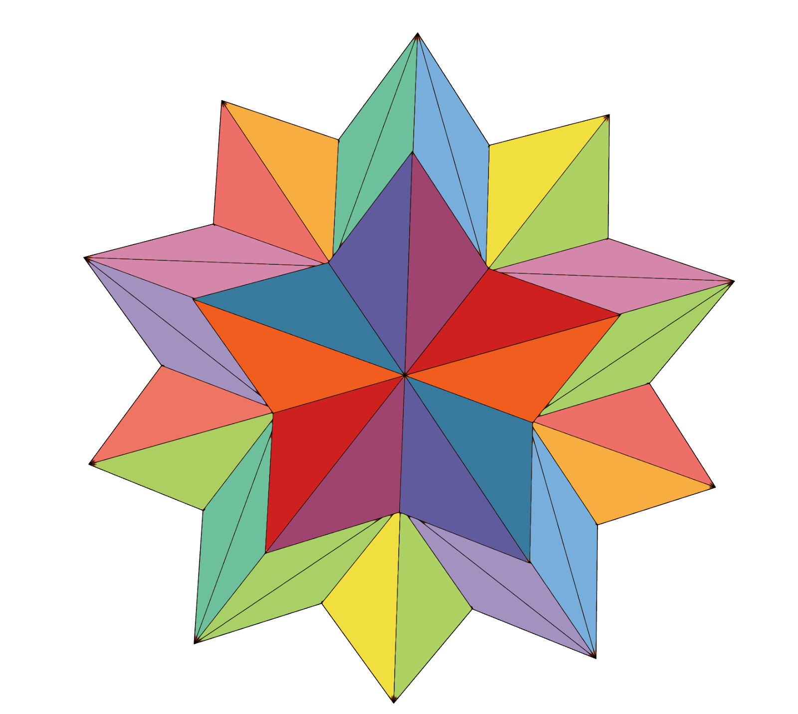
spark: helping teachers help students

Slide 2

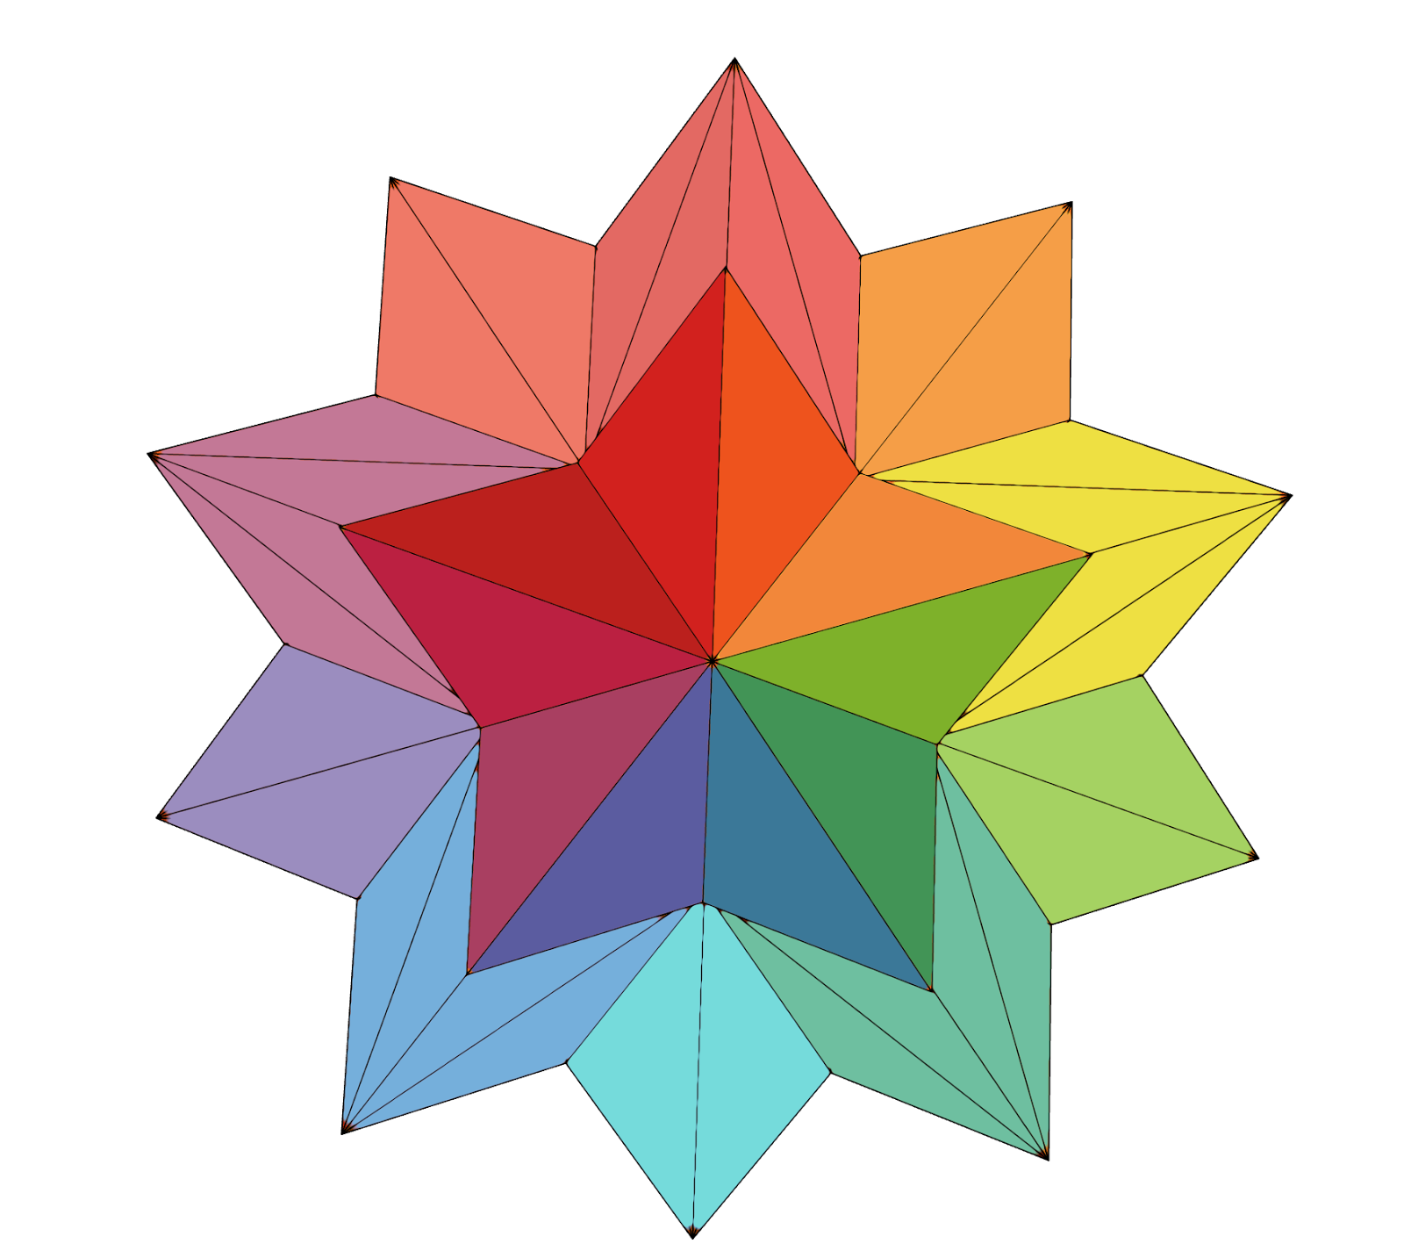

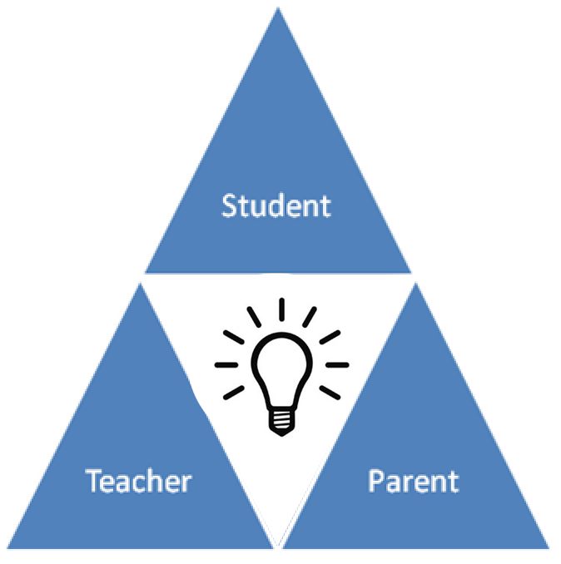

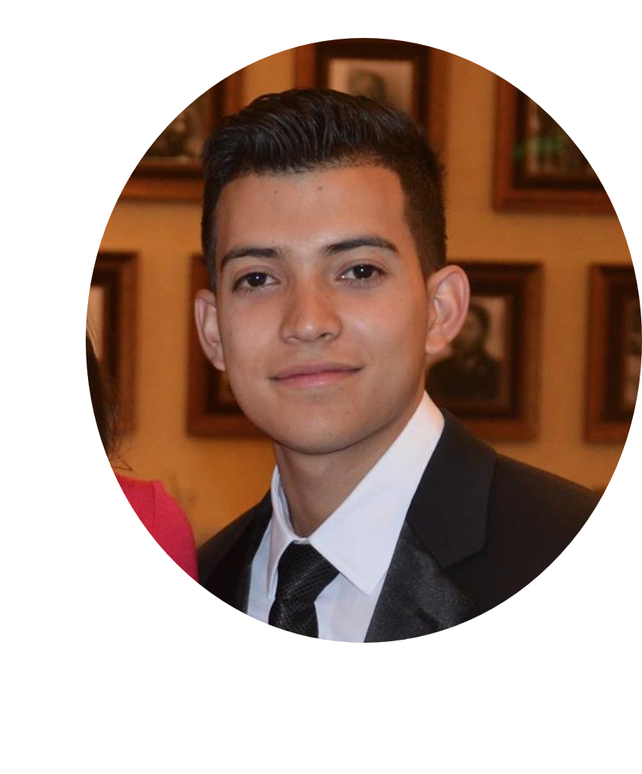
Kevin
David
Melissa
Bronson

Slide 3
Scheduling and resource constraints prevent many parents and teachers from actively working together to support students in their educational development. With communication limited to just quarterly conferences, if even that often, both parents and teachers crave ways to collaboratively and effectively track a child’s development. Spark allows teachers and parents to capture the learning progress of each individual student, and the versatility of Spark allows teachers to easily view their child’s progress across a variety of platforms.
Problem
Solution
Spark helping teachers help students

Slide 4
Overview
Heuristic Evaluation Results
Overview of Revised Design
Prototype Implementation Status
Demo!

Slide 5
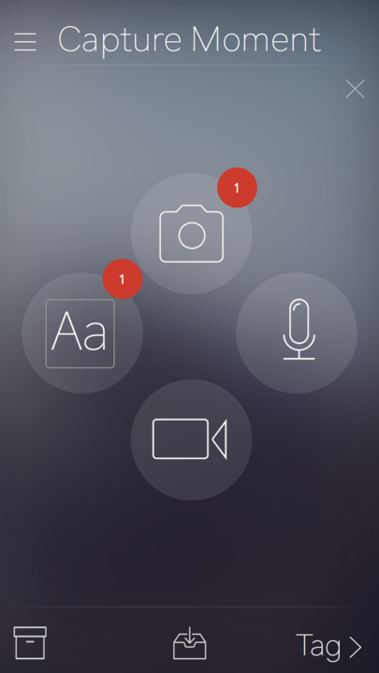
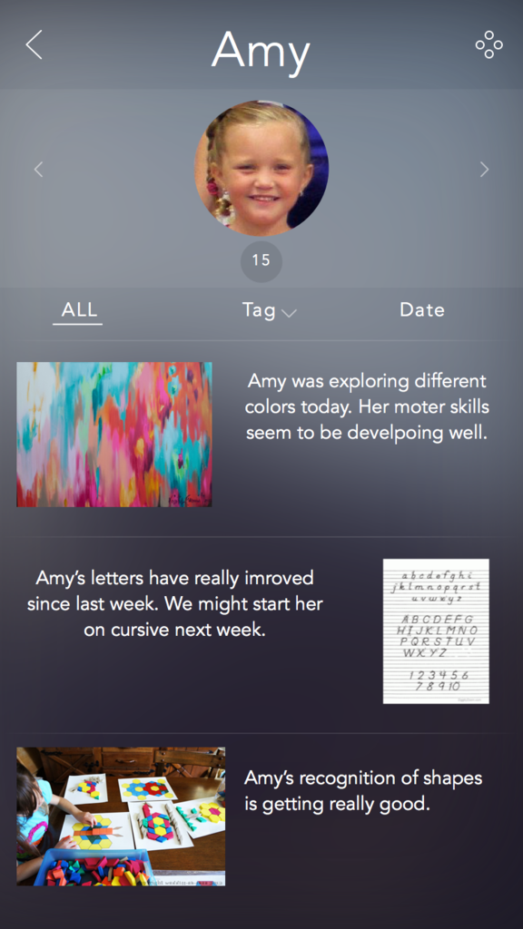

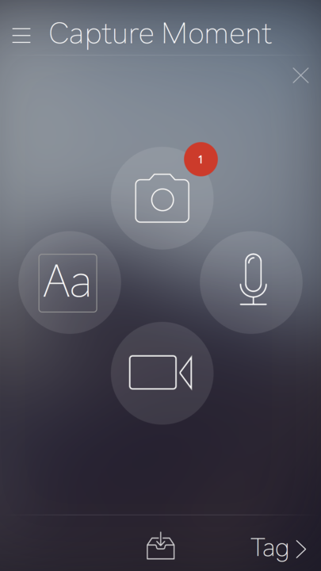
Heuristic Evaluation Results
10 Severity 3 or 4 Violations:
Easy Fixes (2)
[H2-5] [Severity 4] → Archive Button while creating moment
Removed to avoid confusion
[H2-2] [Severity 3] → “Tag” confusing terminology
Changed the action word to “Filter”
Notes:
These were pretty easy fixes; the archive button was confusing so we fixed it. The word Tag seemed more like an action to do instead of sorting by tag, so we changed that. Both of these fixes took no time at all.

Slide 6
Heuristic Evaluation Results (continued)
10 Severity 3 or 4 Violations:
To be implemented/resolved (4)
[​H2-5] [Severity 3] Untagged Moments
Needfinding → add Reminder functionality
[H2-7] [Severity 4] Parent Communication
Needfinding → Less focus on parents
[H2-7] [Severity 3] Multiple student tagging
Needfinding → privacy concerns
[H2-10] [Severity 3] Concept of a “Moment”
Solution → Tutorial!
Notes:
One concern addressed untagged moments and suggested making this not a possibility. Something however, that we had touched on a lot during our needfinding, or perhaps that we did not make explicit enough in our last presentation, was that we found people liked the ability to quickly capture a moment. In order to really keep up the usefulness of our solution however, things need to be tagged, so we decided on implementing a reminder functionality after 5 untagged moments are reached, and this reminder would keep coming back until they were tagged.
Another concern was that people did not find it easy to send things to parents. Perhaps we did not emphasize this enough in our last presentation too, but we were thinking of shifting more towards focusing on helping teachers help students. In narrowing our focus, we can enhance our impact and avoid spreading ourselves too thin/avoid feature bloat
Tagging multiple students was also a concern we raised during needfinding and we encountered a lot of resistance to that due to the large administrative overhead/privacy concerns that arise with this issues (you cant send a picture of another child to parents) but this is definitely something we have been looking to implement as we continue forward since our focus has shifted away from sending moments to parents. Logistically, it is a bit more difficult to deal with replicating moments and all that, but it’s definitely something we are working on
Also something that came up in needfinding a lot, but we are working on making a first time tutorial

Slide 7
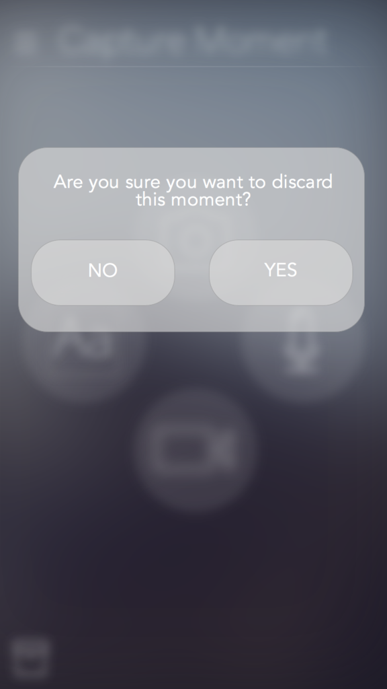
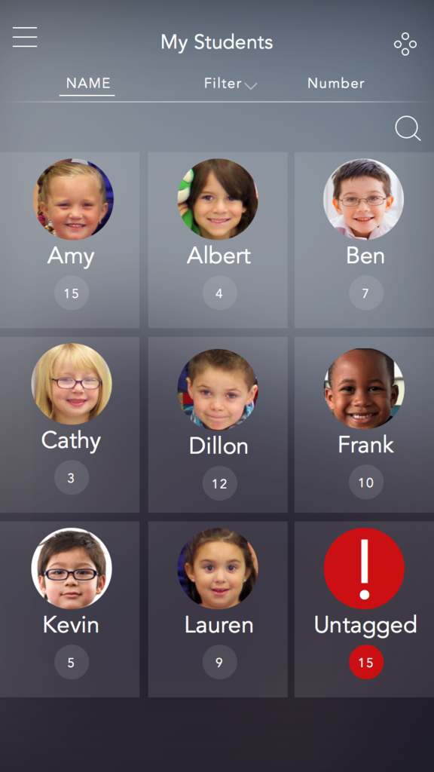
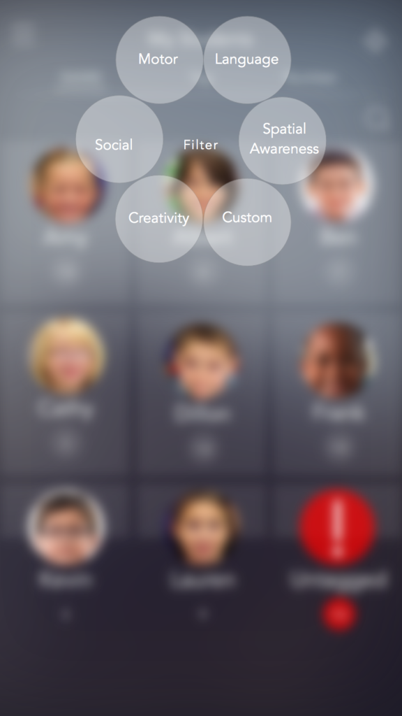
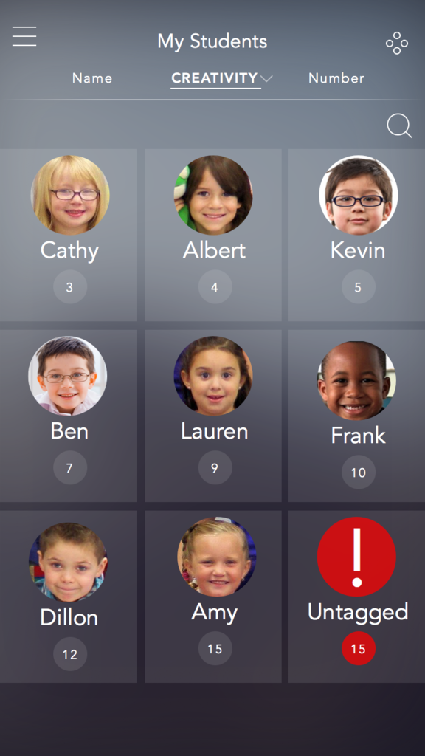
H.E. Results (continued)/Overview of Design
10 Severity 3 or 4 Violations:
Remaining Violations (4):
​​[H2-5] [Severity 4] Confirm deleting/submitting a moment
Working to ensure all cases are met
[​H2-3] [Severity 4] Editing Content
Media can be retaken on-the-fly (More edits later)
[H2-7] [Severity 3] Filtering all Students Page
Numbers under students change accordingly
Notes:
As per the standard, we will be implementing confirmation windows deleting or adding something, i.e. moments, whenever necessary.
As for editing content, the violation found was that a moment’s content couldn’t be edited. We figured people would delete and retake a picture if they didnt like it on the camera view directly, etc, so decided to only work towards editing/adding of content to a moment after it is in the archive
We were most confused as to how to address this violation, it seemed really valid and worthy and decided it both made more sense to rename the page All Students and have a filter category, like the one in the individual student page, on this page, and have the list of students reflect this appropriately

Slide 8



Prototype Implementation - Tools + Current Implementation
Swift /XCode
Git Repository
Focus → Archive and “Outline”
Navigation
Layout and Organization
Notes:
we’re all noobs at swift/xcode
Some dont have a mac/splititing up work
developing a workflow with git
Great learning experience!
Until now, we’ve been working on an “outline” of the app, to be filled in more and more as we progress
This bare-bones structure approach allows us to know what to work towards

Slide 9

Prototype Implementation - Unimplemented Features
Media Capturing
4 Different media types
Plan
Thanksgiving Hackathon
Implement bulk of media capturing
Finish up archive /structure
Poster / Finishing touches week after
Notes:
Media Capturing
Most daunting part of it
4 different media types
But...have all been done before. There is no need to reinvent the wheel
Google is our friend [with proper citations of course]
Plan
Thanksgiving? More like Hacksgiving
Bronson, Melissa, and Kevin will all have a mini hackathon sesh
David will work remotely on logistics /project management issues (poster and pitch slide/ workflow)

Slide 10
Prototype Implementation - Wizard of Oz Techniques
Hard-coding
Archive
No data structure for storing user-captured moments
Concerns
Data structures (see above)
Notes:
Large media capturing and storing → feasible long term
Less feasible given our constraints

Slide 11
Conclusion
Notes:
Do we need to put anything on this slide? Or can we just summarize it? Maybe put some screenshots of our app so far?

