Slide 1
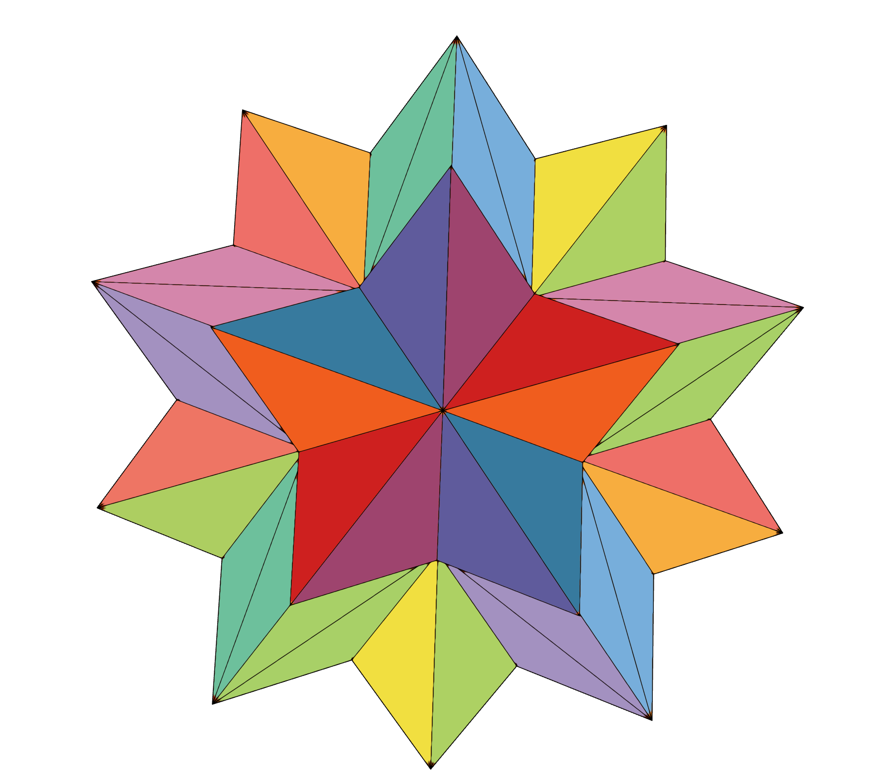
spark: never miss a moment

Slide 2
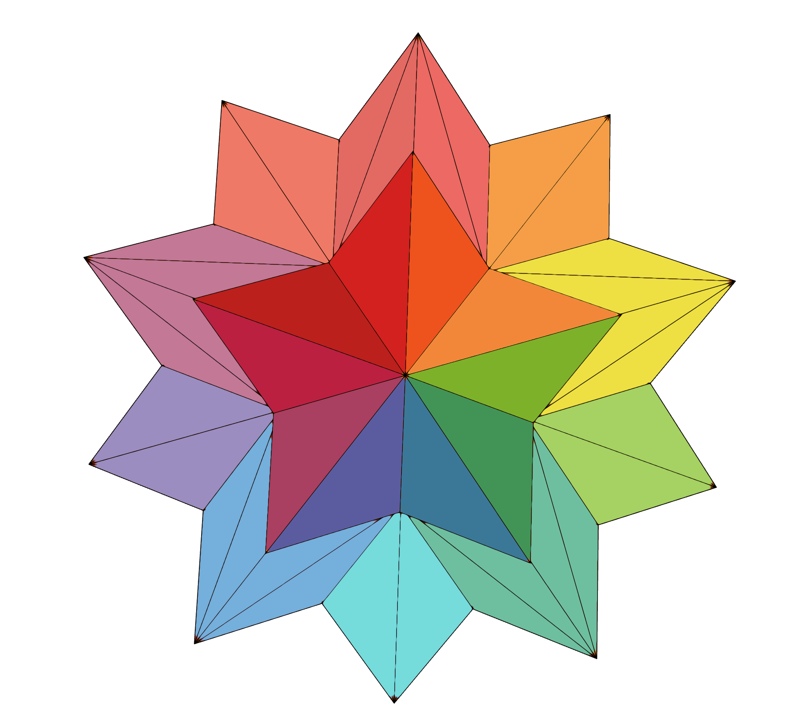

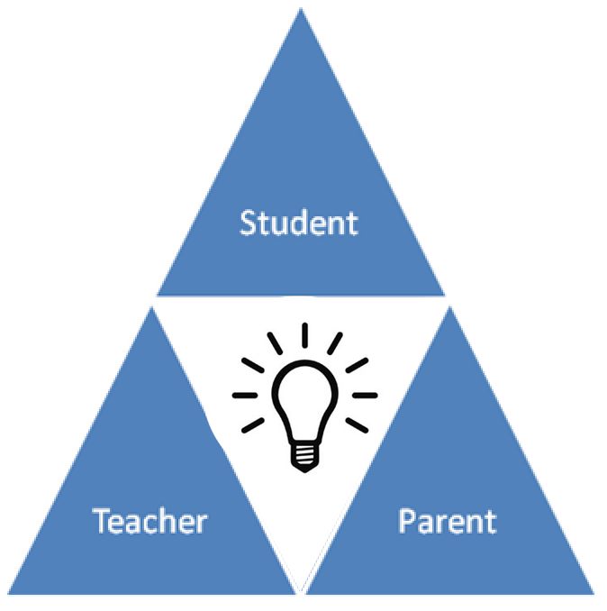


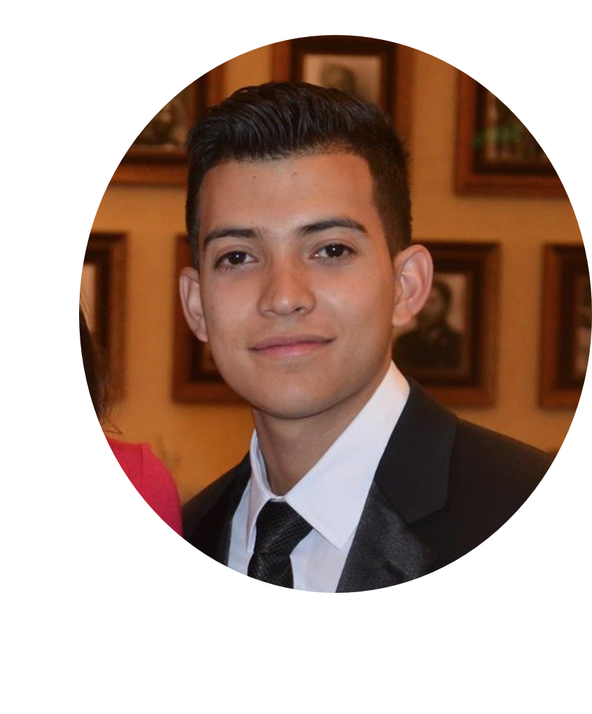
Kevin
David
Melissa
Bronson

Slide 3
Problem/Solution: Scheduling and resource constraints prevent many parents and teachers from actively working together to support students in their educational development. With communication limited to just quarterly conferences, if even that often, both parents and teachers crave ways to collaboratively and effectively track a child’s development. Spark allows teachers and parents to capture the learning progress of each individual student, and the versatility of Spark allows parents to easily view their child’s progress across a variety of platforms.
Value Proposition: Streamlining student growth tracking for teachers.

Slide 4



Tasks
Simple: easily sort & recollect a child’s developmental history
Medium: capture a moment in a child’s education
Complex: share a moment in a child’s education with his/her parents.

Slide 5
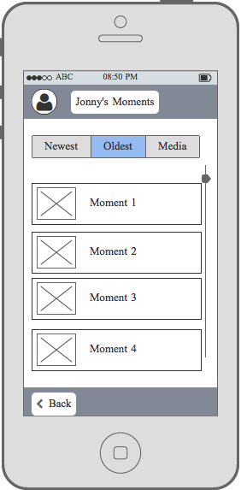
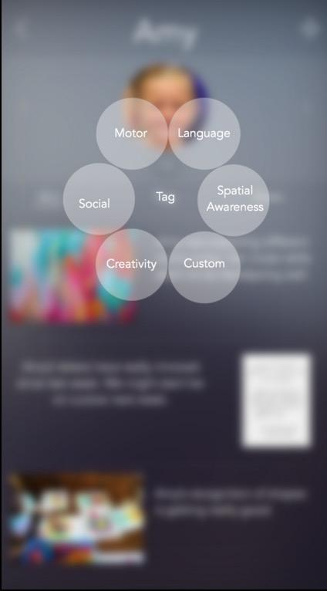
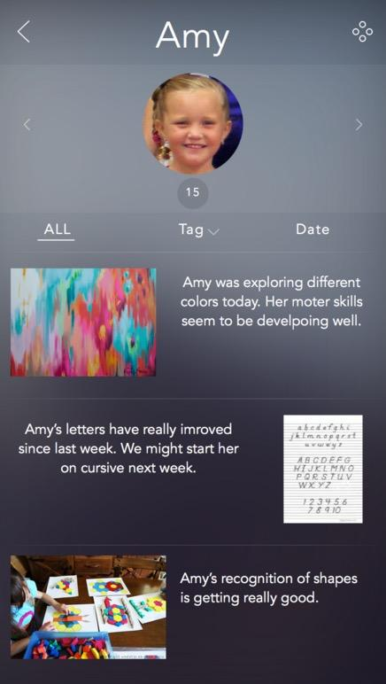
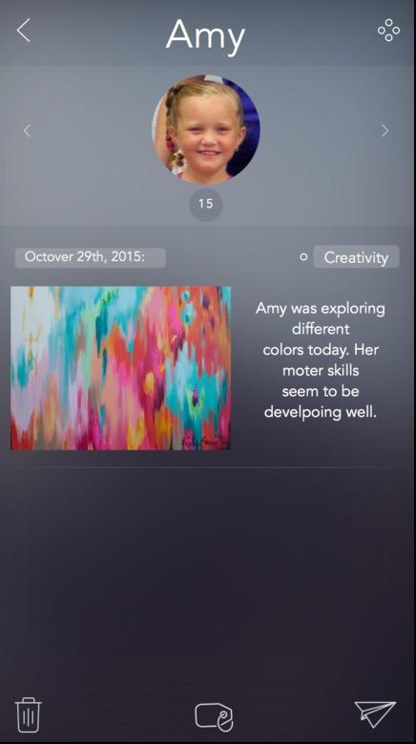
major design change #1: individual student views
Notes:
OPTION TO SORT BY TAGS. OPTION TO CATEGORIZE CHILD’S MOMENTS BY TAGS. HAVE GENERAL ARCHIVE + TAGGED ONES (YOU CAN ALWAYS TAG LATER). SEE # OF MOMENTS. HAVE OPTION TO SEND, DELETE, OR TAG EACH MOMENT @ THE BOTTOM.

Slide 6
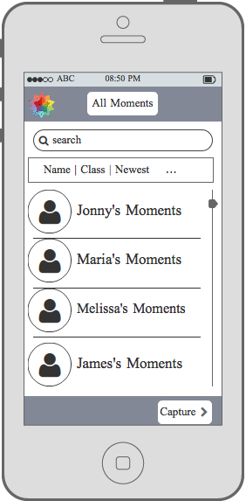
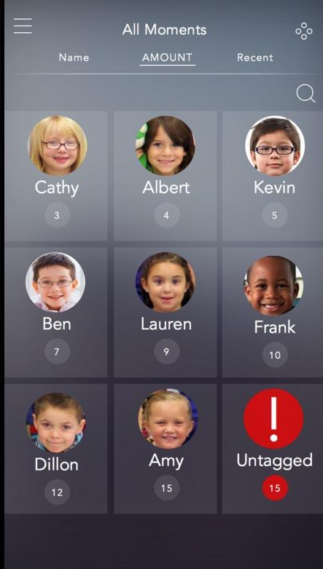
major design change #2: grid view
Notes:
GRID VIEW - FITS MORE, SEE # OF MOMENTS (PAY ATTENTION TO IGNORED STUDENTS), HAVE UNTAGGED MOMENTS (EASE OF USE)

Slide 7
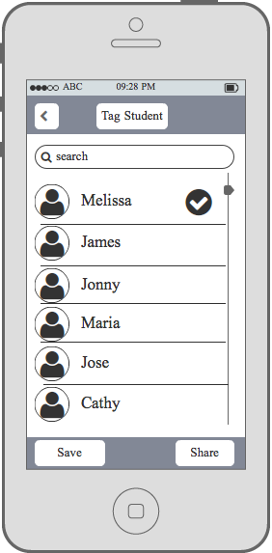
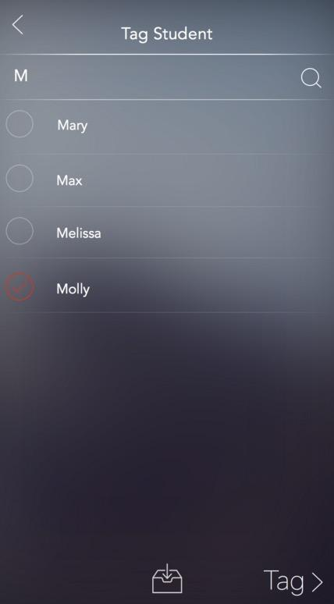
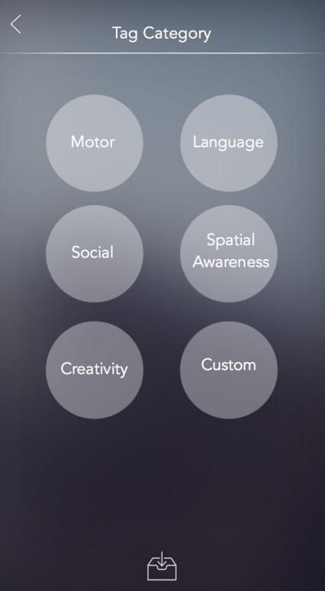
major design change #3: tagging
Notes:
TOOK AWAY THE ‘SHARE IMMEDIATELY’ FUNCTION BASED ON THIS WEEK’S INTERVIEWS @ BING. OPTION TO TAG AFTER YOU CAPTURE OR ARCHIVE IMMEDIATELY.

Slide 8
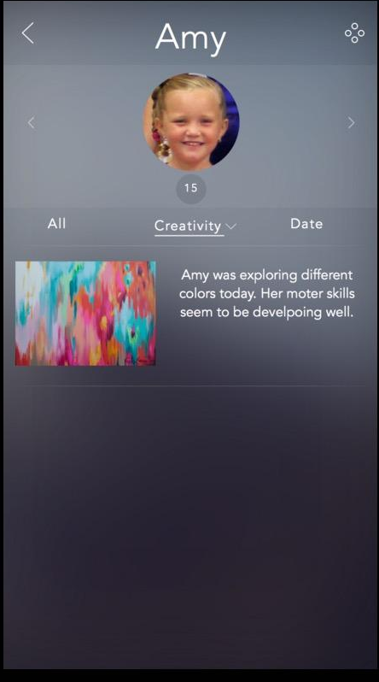
task flow, simple: easily sort & recollect a child’s developmental history.
Notes:
changes from lo-fi:
removal of home screen
grid-view layout
ability to sort by different views for individual children

Slide 9
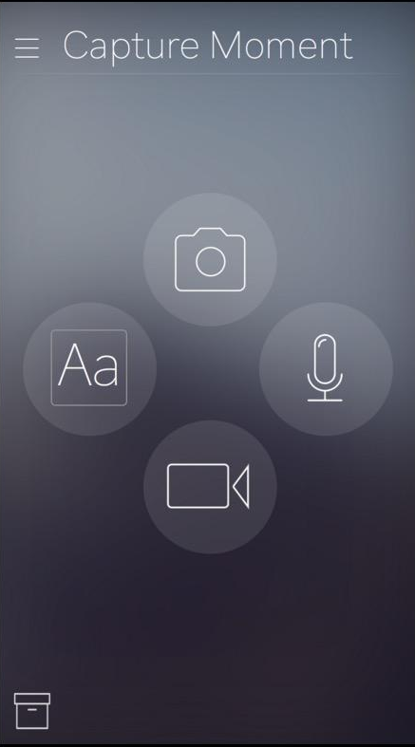
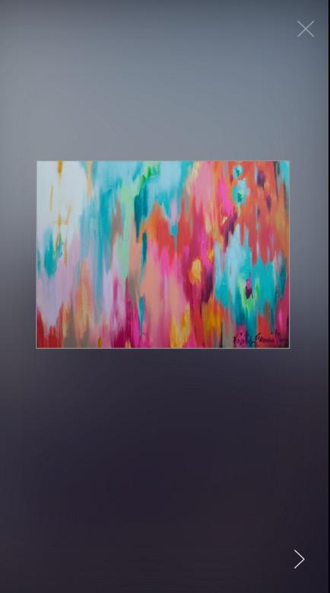
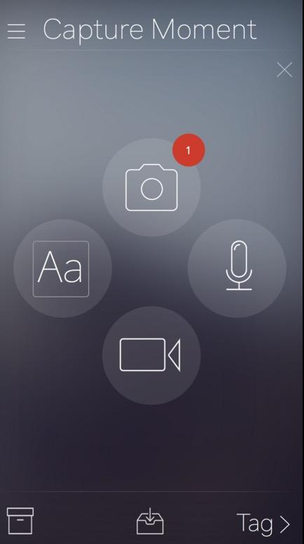
task flow, moderate: capture a moment in a child’s education.
Notes:
changes from lo-fi: option/ability to tag student by name & category after capturing moment

Slide 10
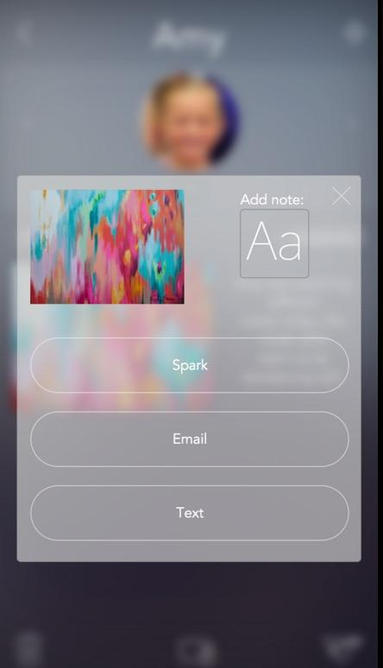
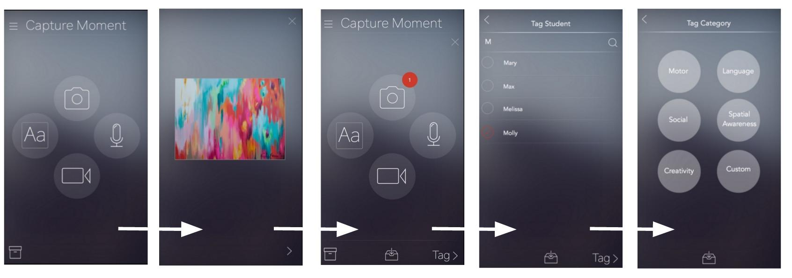
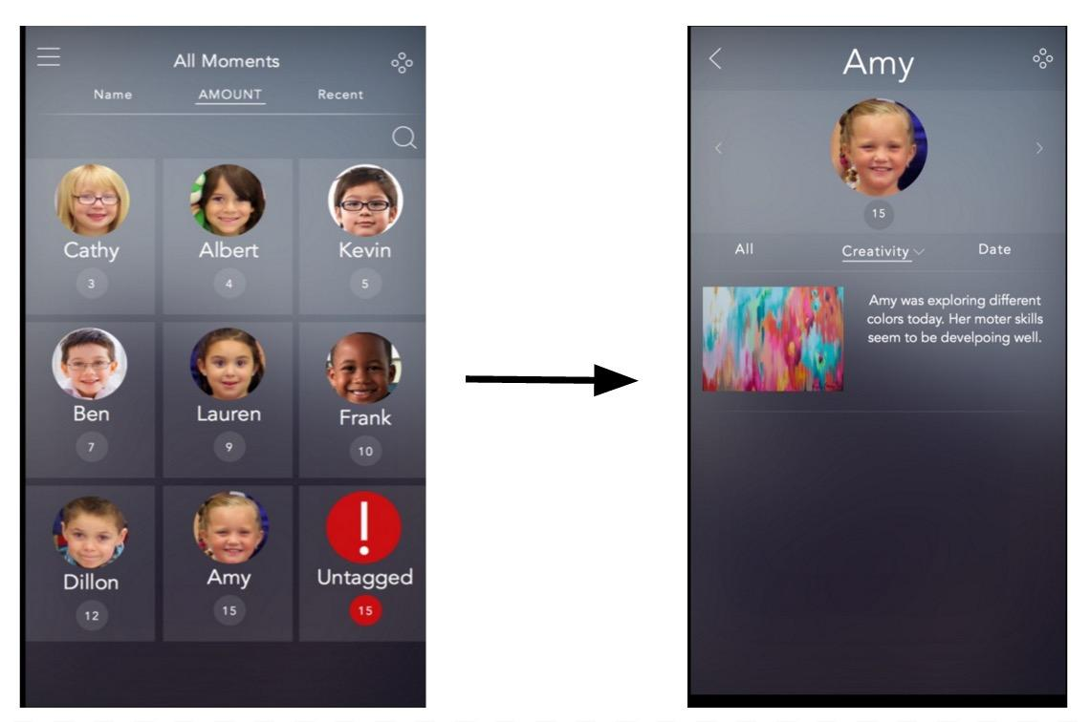
task flow, complex: share a moment in a child’s education with his/her parents.
moderate task flow
+
simple task flow
Notes:
changes from lo-fi: removed ability to send directly to parents after capturing moment

Slide 11

Prototyping Overview: Tools
Used Marvel + Sketch
Helped:
  A lot of great resources
  Don’t have to make everything yourself
  (icons are provided, templates are provided,
  easy drag interface. Snap-to-grid system is great,
  alignment is automatic).
  Suitable for design prototyping needs.
Did not help:
  Not interactive
    Could not capture pictures/video/voice with prototype.
    Had to pay in order to add collaborative function
  Downloading screens requires you to upgrade to Premium plan

Slide 12
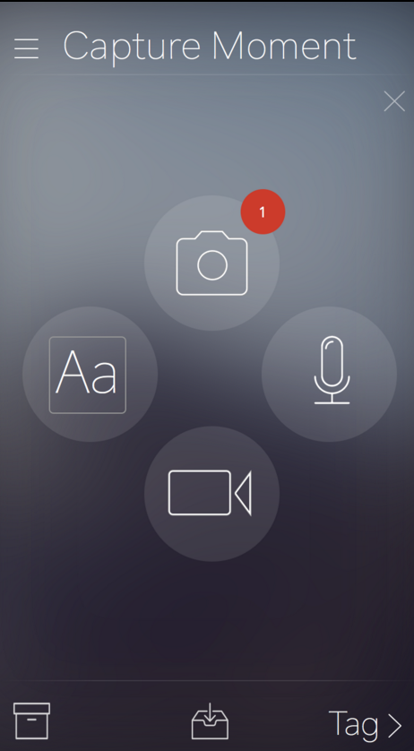
Prototyping Overview: Limitations/Trade-offs
To give a realistic feel, there are many different
screens/permutations of different functions.
Non-interactive (no ways to actually capture
media to simulate the experience)
More detailed prototype meant fleshing out
more details/adding more screens
  Increases learning curve for prototype

Slide 13
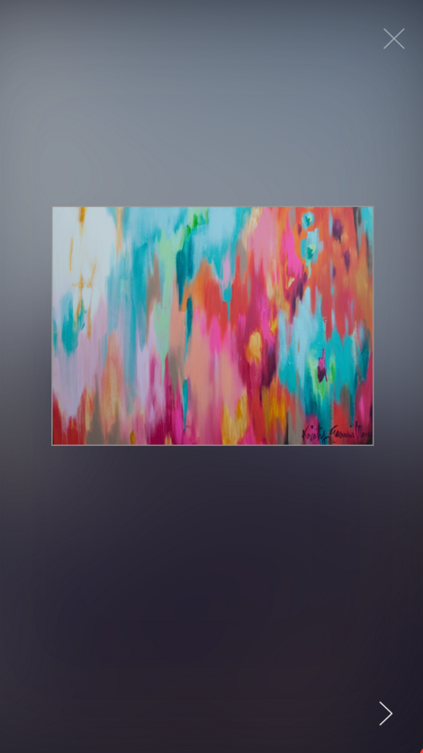
Prototyping Overview:
Wizard of Oz:
  Media capture/upload
  Sharing
Hand-coded features:
  Pre-populated with data to make it look realistic (screens with images of children, sample text upload, sample picture upload, etc.)

Slide 14
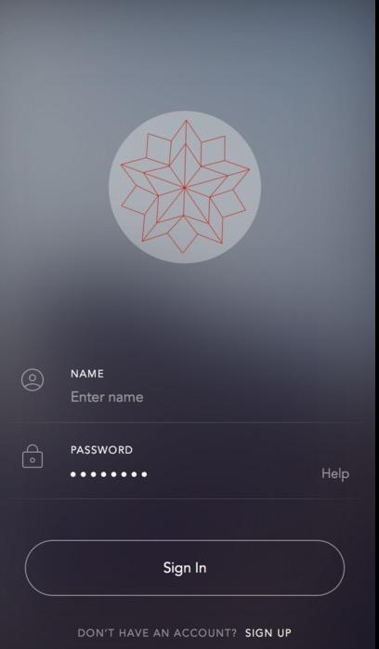
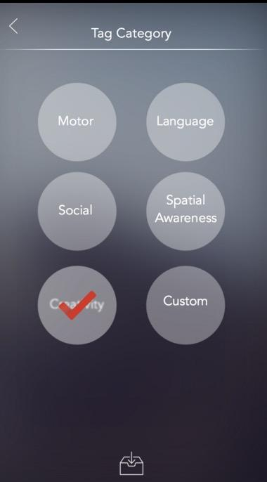
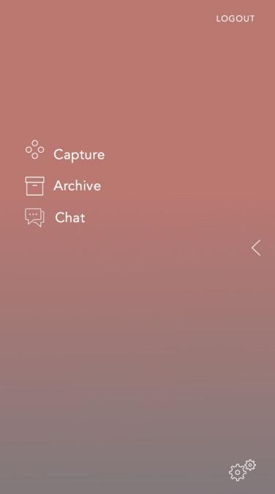
Log In
Tagging
Menu

Slide 15
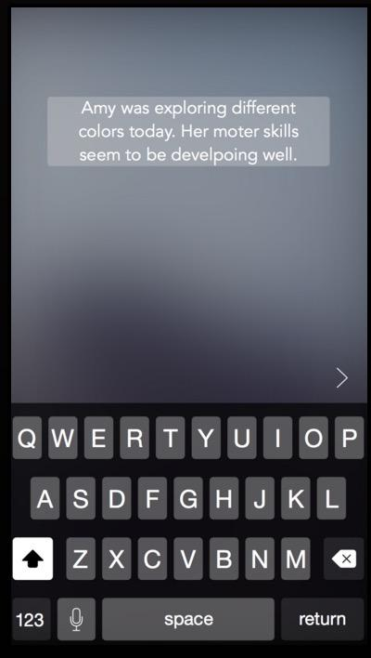
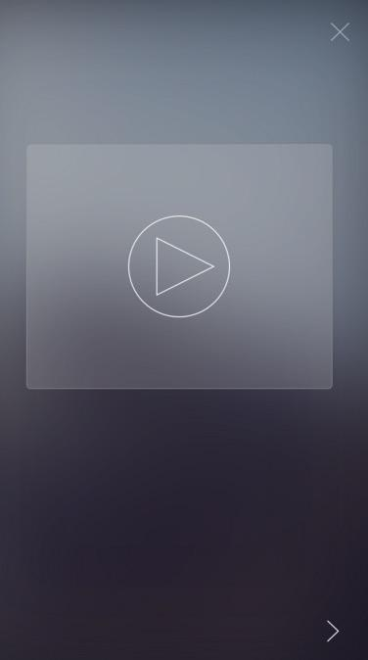

Text Capture
Video Capture
Voice Capture

