Slide 1
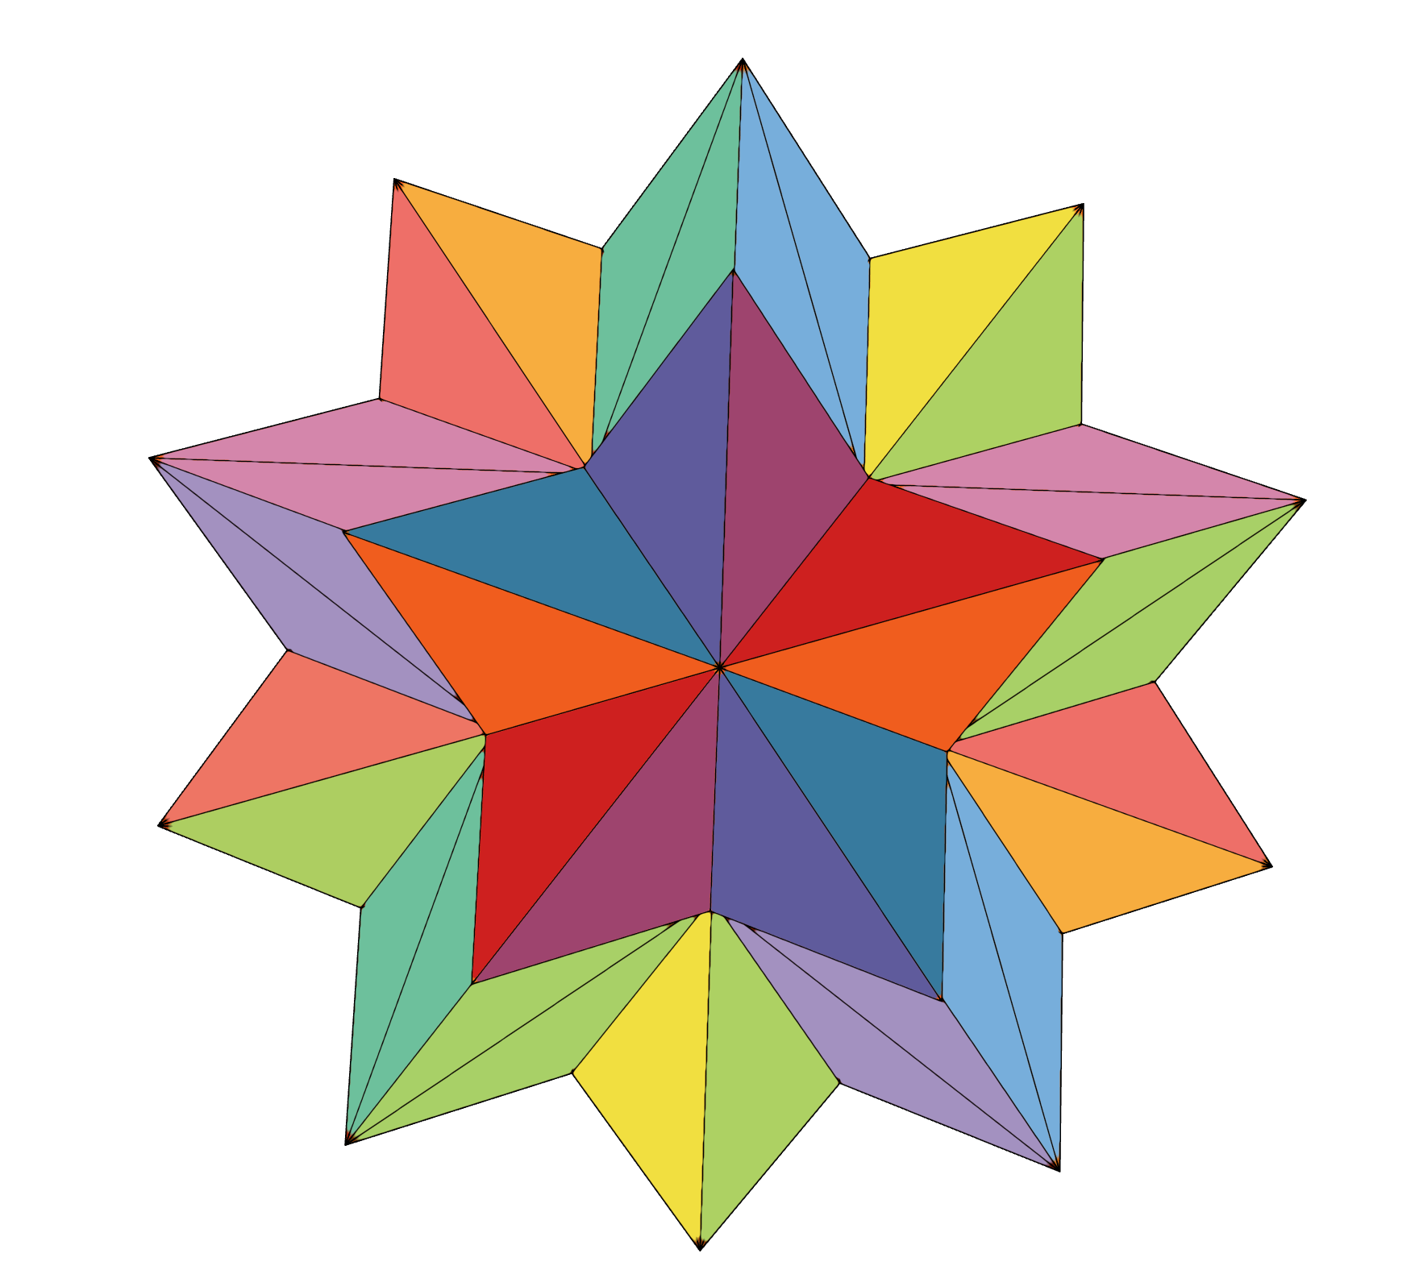
spark: never miss a moment

Slide 2

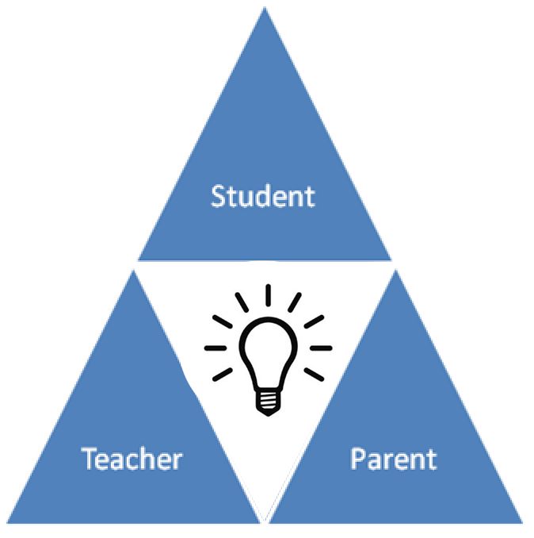



Our Team
Kevin
David
Melissa
Bronson

Slide 3


2 Problems

Slide 4
Mission

Slide 5
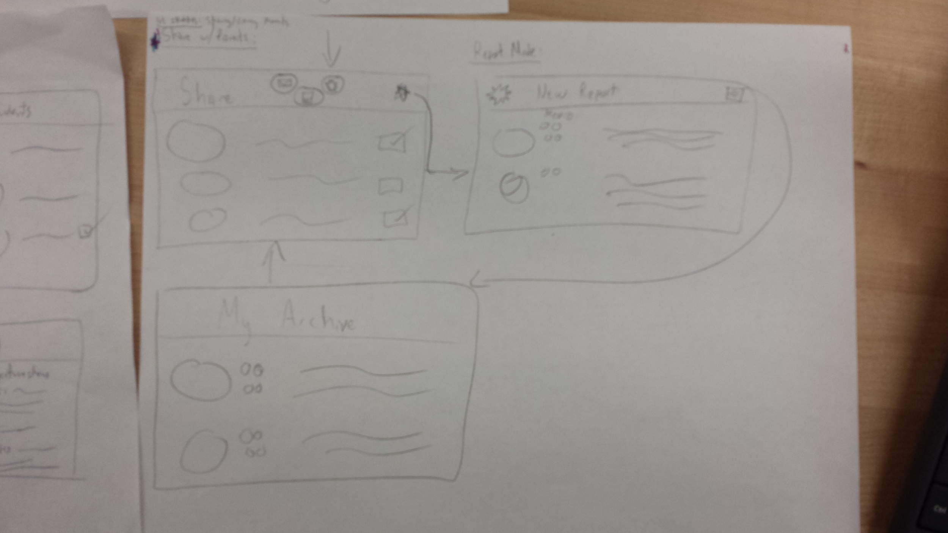
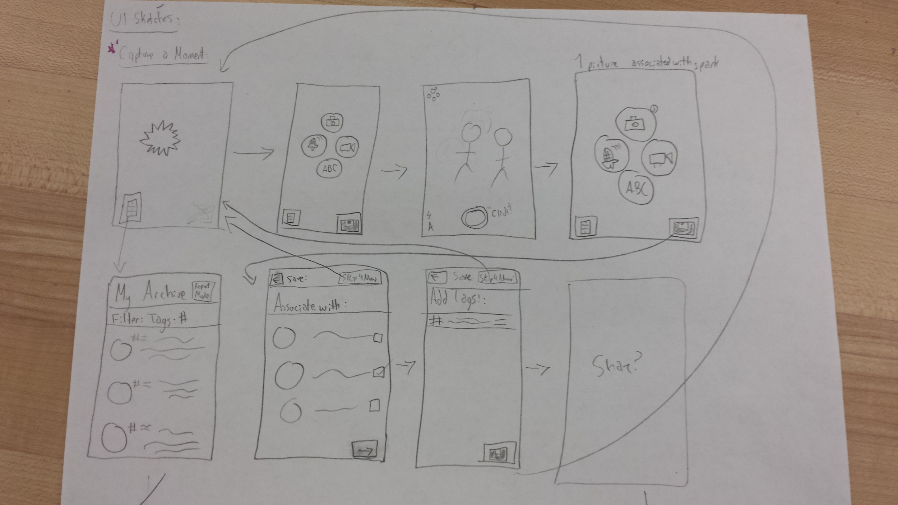
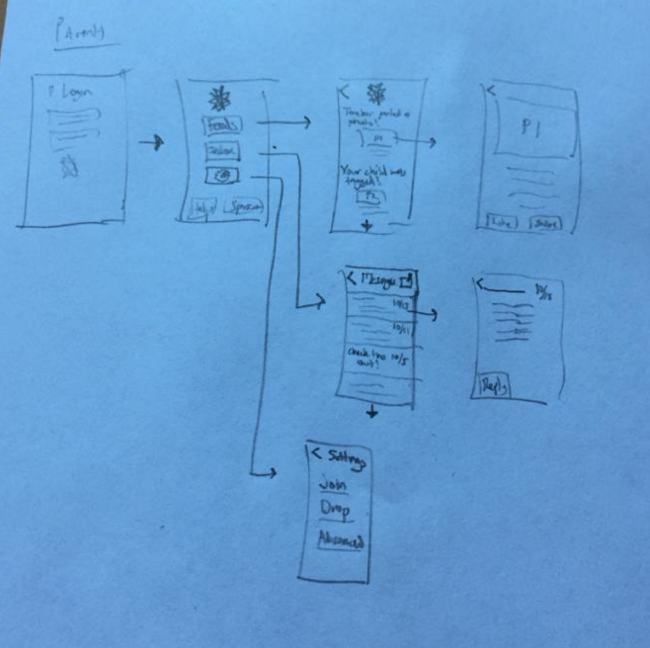
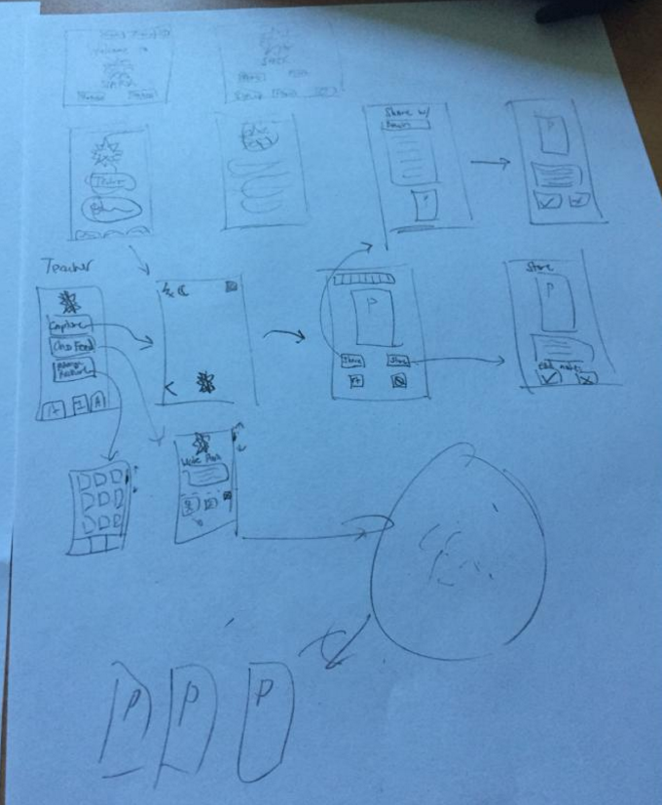
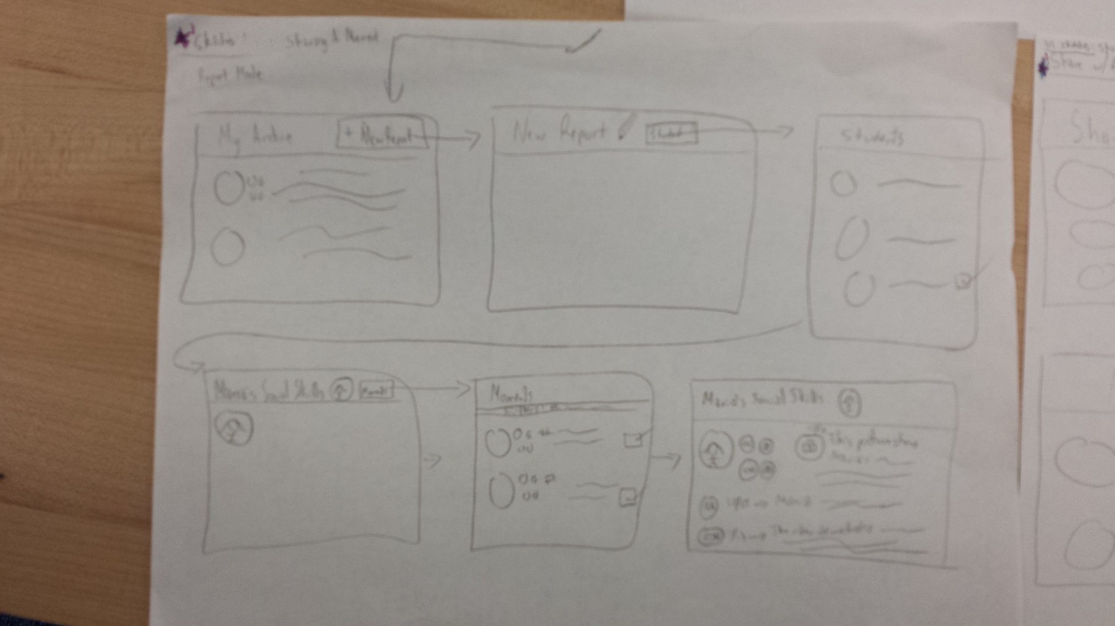
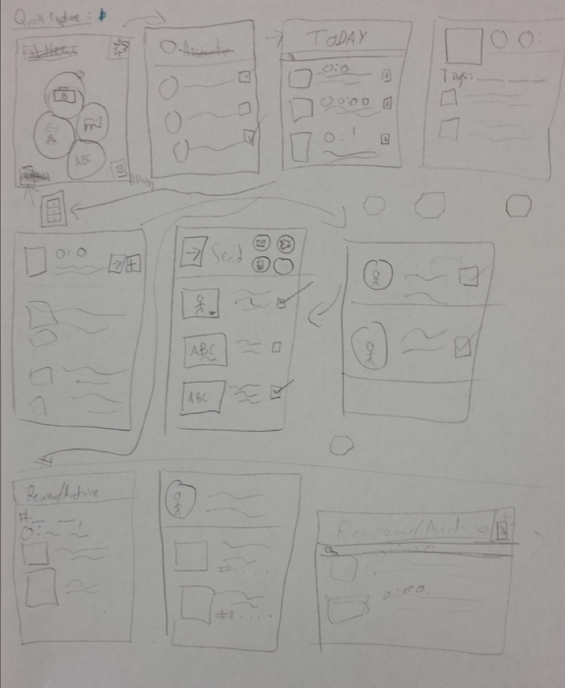
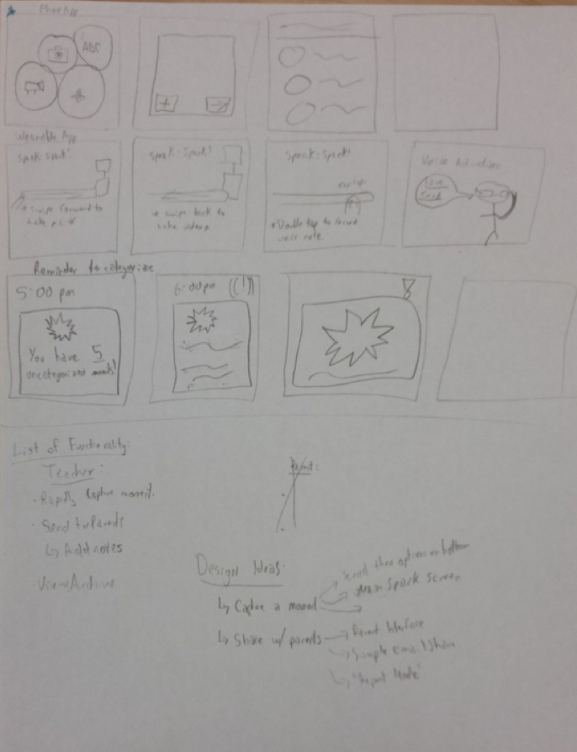
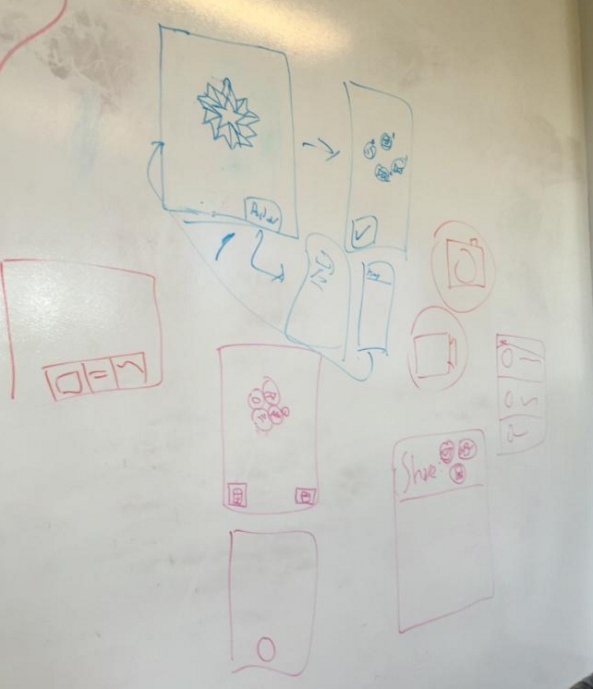
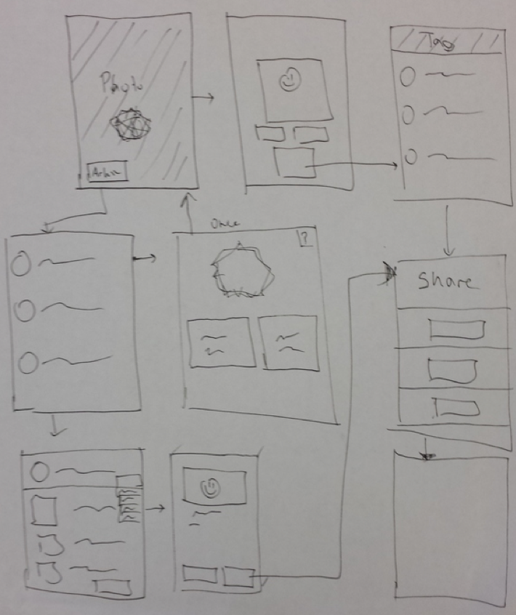
Concept/UI Sketches

Slide 6
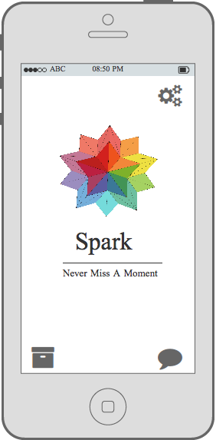
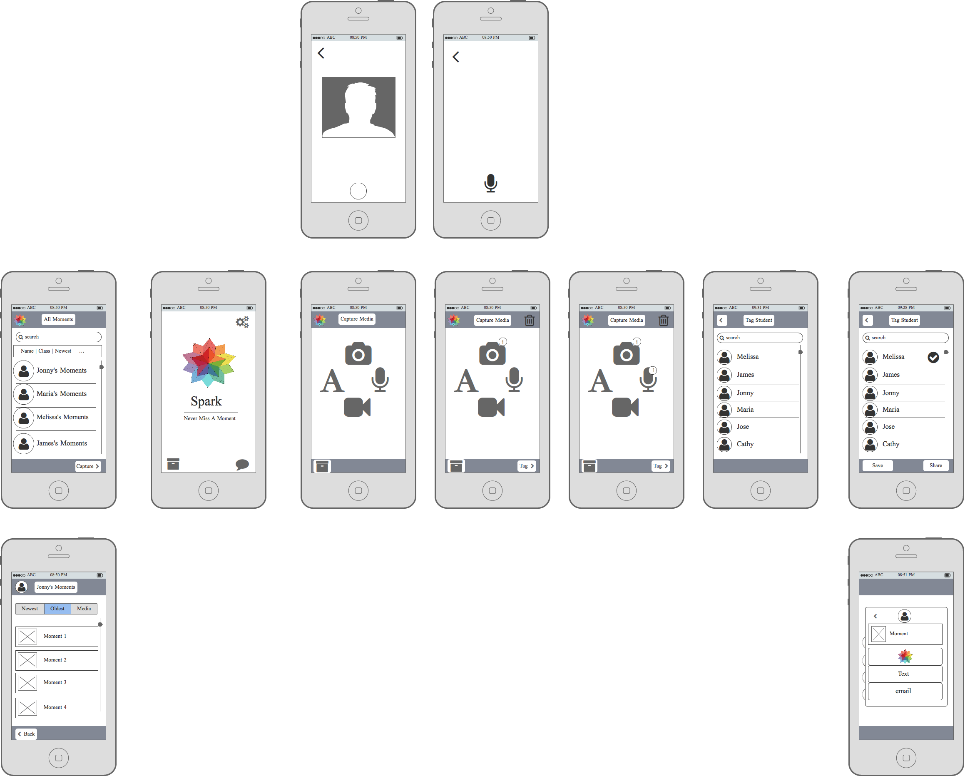
Final Lo-Fi Prototype

Slide 7
Task Flows

Slide 8
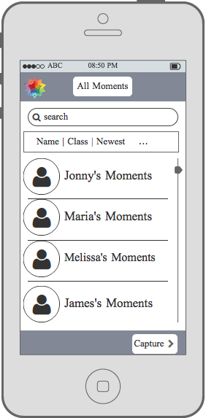
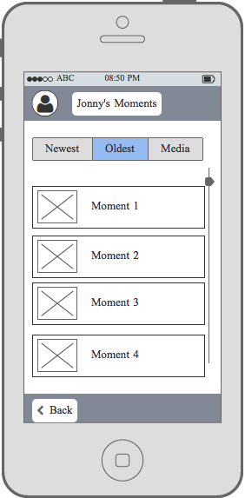
Task Flow: Simple
“To easily sort & recollect a child’s developmental history.”

Slide 9
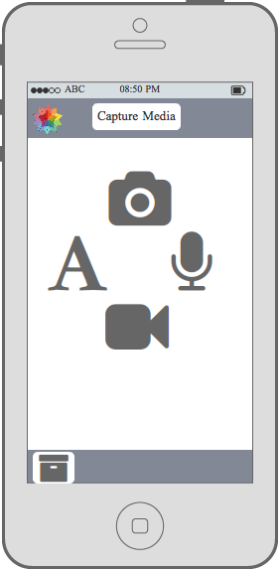
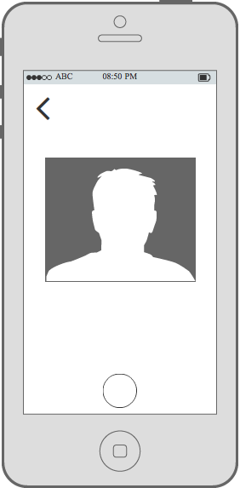
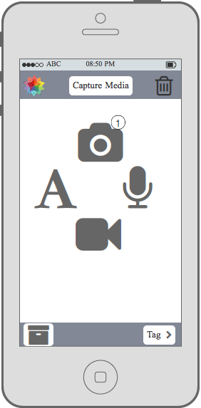
Task Flow: Moderate
“To capture a moment in a child’s education.”

Slide 10
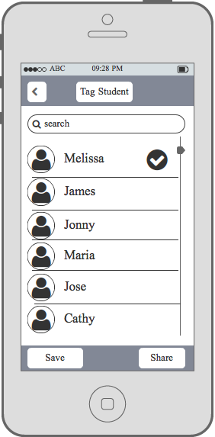
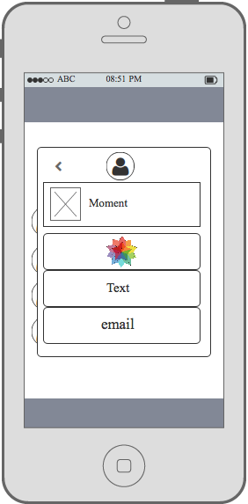
Task Flow: Complex
“To share a moment in a child’s education w/ parents.”
+
Moderate Task Flow

Slide 11
Experiment

Slide 12
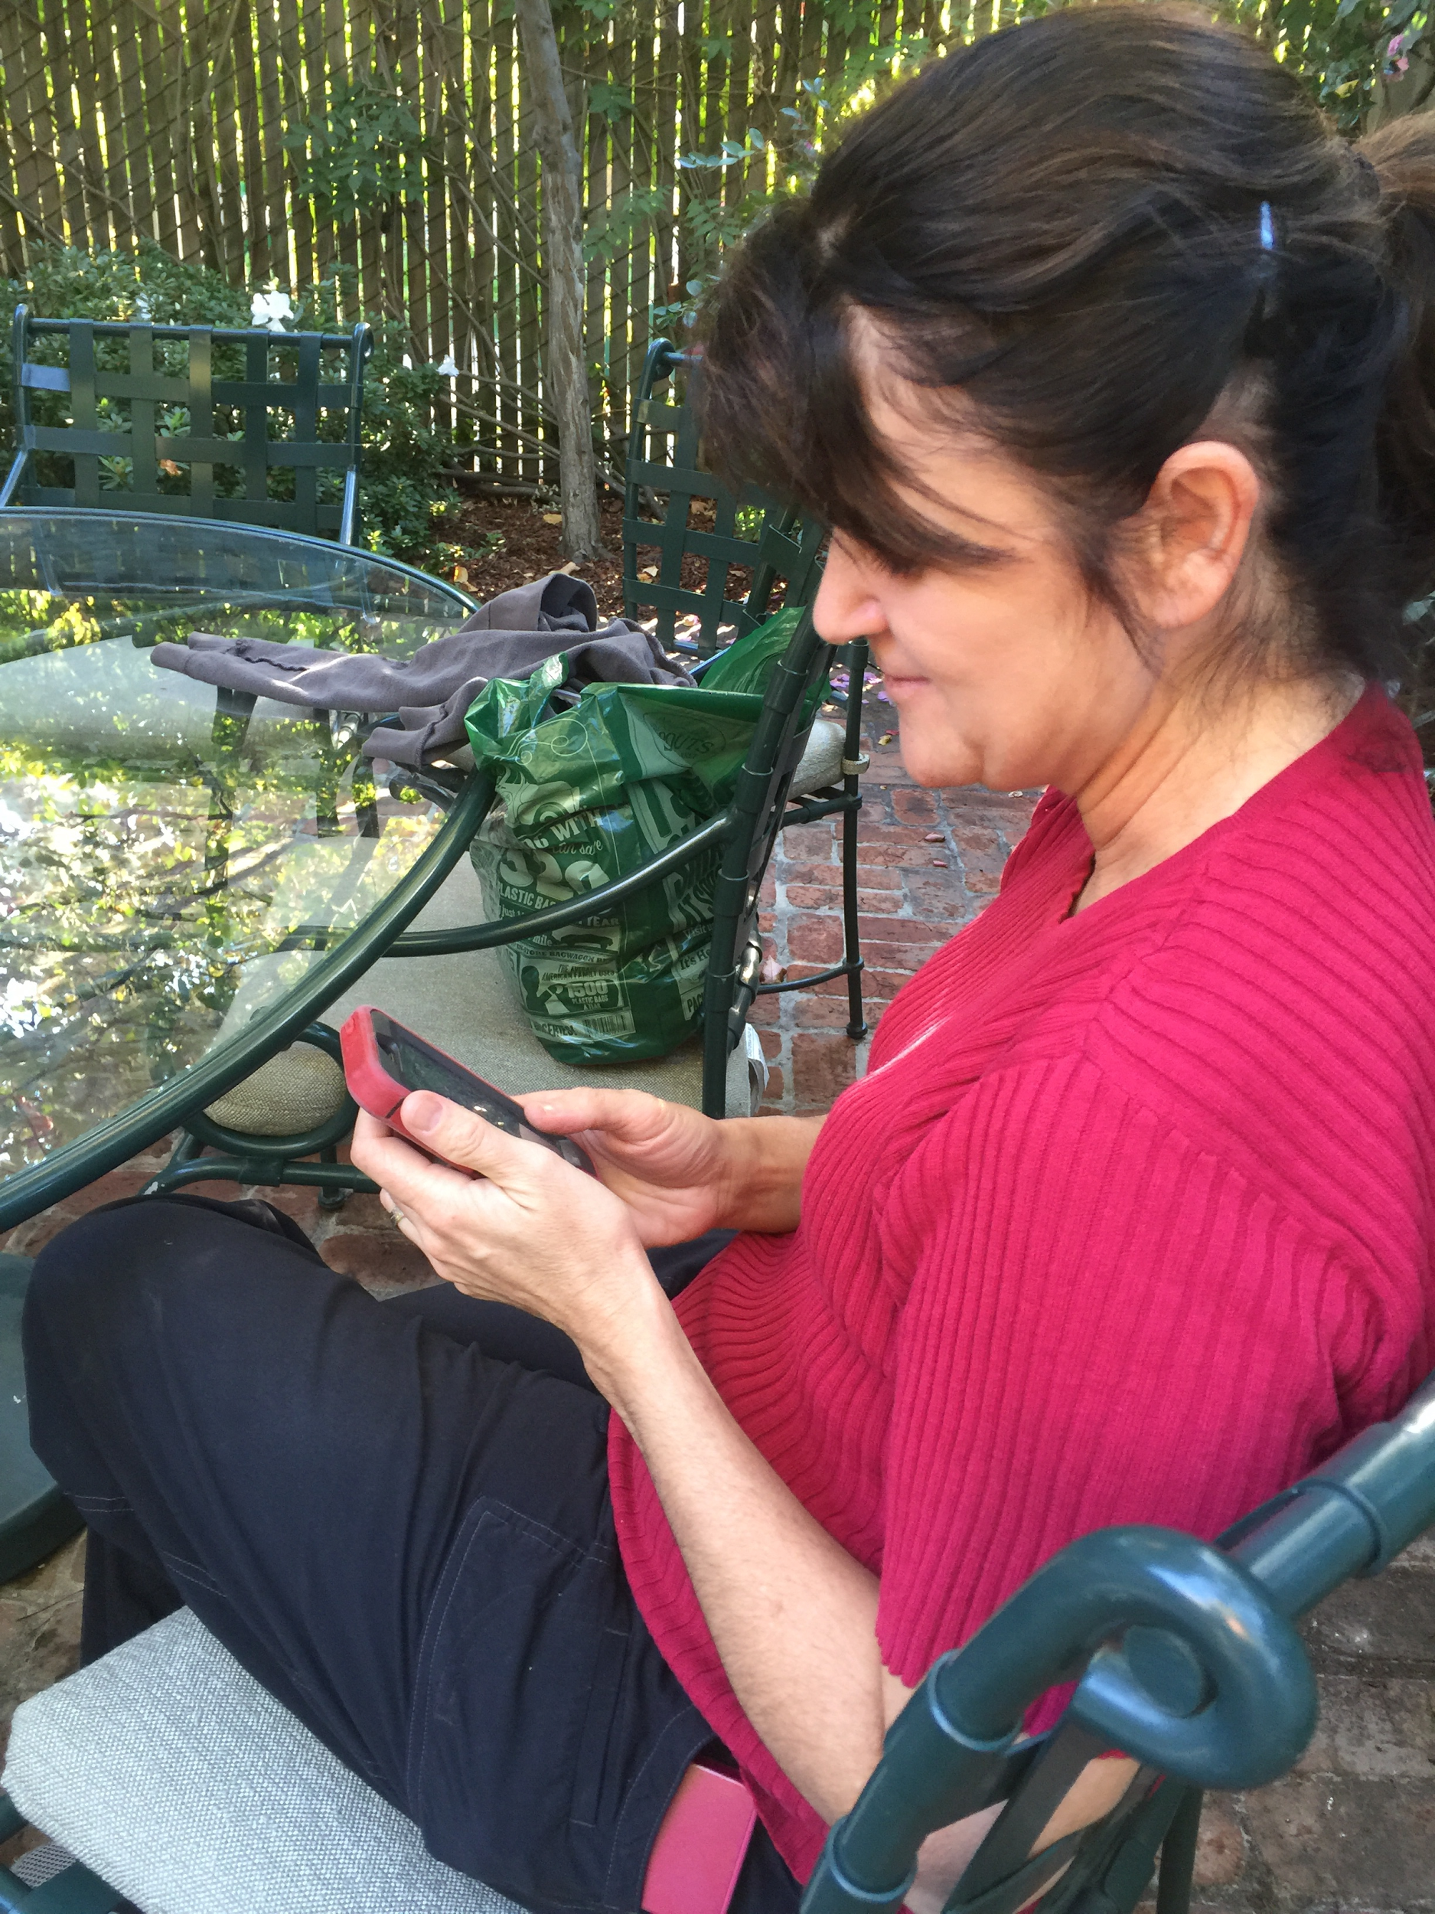
Method
Participants
2 Pre-K Teachers from Bing
1 Pre-K Teacher from New Haven Unified School District
Asked to complete three tasks and rate issues.

Slide 13
Participant #1
Cosmetic | Minor | Major | Catastrophic
X | X

Slide 14
Participant #2
Cosmetic | Minor | Major | Catastrophic
X

Slide 15
Participant #3
Cosmetic | Minor | Major | Catastrophic
X | X | X

Slide 16
UI Improvements

Slide 17
UI Changes - Visual
# of Moments for each Child
Reduce Information Overload
1
3
3
0
9

Slide 18
UI Changes - Conceptual
Implement Efficient Sort
Remove Archive Button in Capture Screen

Slide 19
Conclusion

